Slide 1
Notes:
Let’s have a look at Power Supplies.

Slide 2
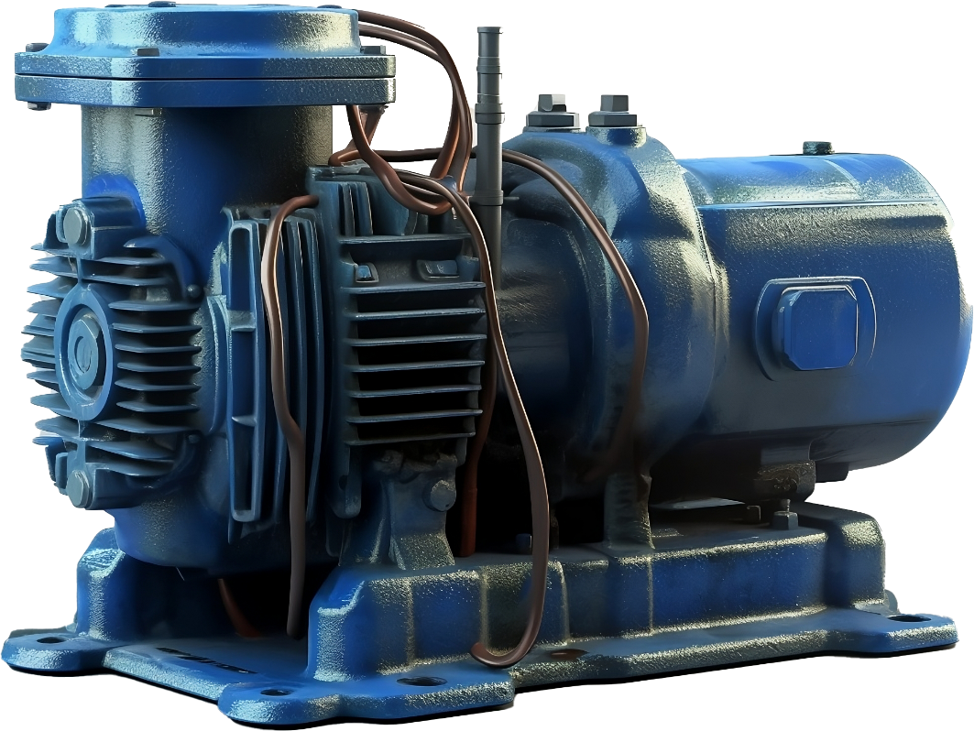
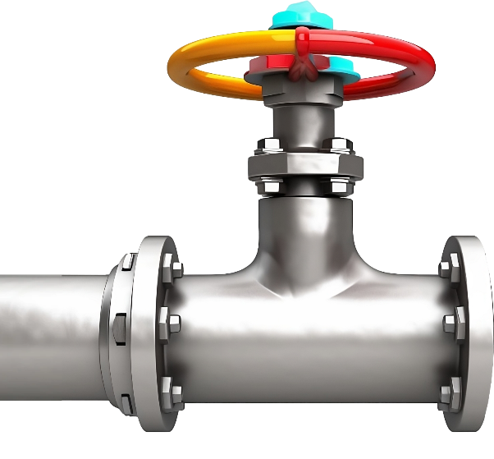
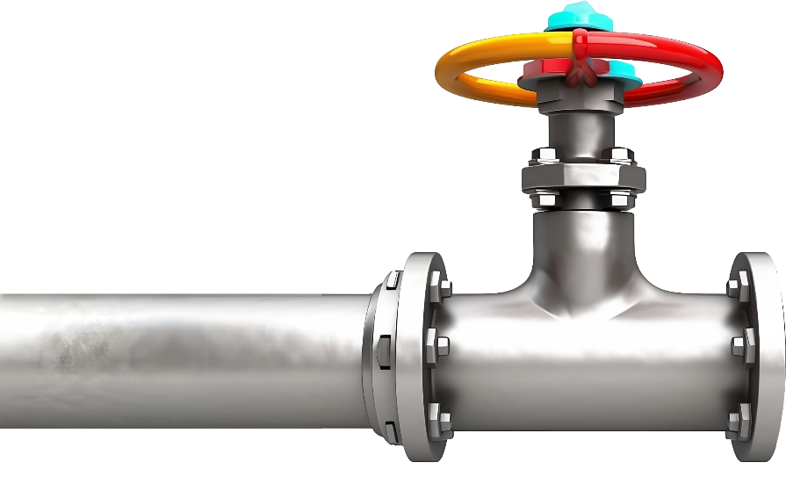
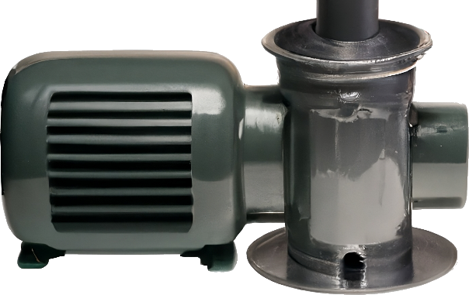
What is Electricity?
Flow of electrically charged particles
Easy to think about electronic flow like water traveling through pipes
The pressure applied to the electronics is called voltage
High
voltage
Low
voltage
ITFreeTraining.com
© Copyright 2024
Notes:
00:02 To start with, I will have a look at what electricity is. You don’t need to understand this for the exam, but it does help to have a basic understanding for troubleshooting and also to keep yourself safe when working with electronic devices.
Electricity is the flow of electrically charged particles. When thinking about electricity, I like to compare it with water flowing through pipes. Electricity often behaves in a similar manner to how water flows.
You will hear the term voltage used a lot when talking about electricity. Voltage is the pressure applied to the electronics. To gain a deeper understanding, let's examine an example using water. Let’s consider that we have a large pump that is connected to a pipe. This pump is capable of pumping a lot of water quickly, thus providing a lot of water pressure.
Contrast this with a scenario where we use a smaller pump. The smaller pump cannot generate as much water pressure as the larger pump. When water is pumped through the pipes, the output from the larger pump will travel further compared to the smaller pump. In this analogy, the larger pump represents high voltage, while the smaller pump symbolizes low voltage. The large pump pushes the water further because it can generate more power than the smaller pump.
Voltage, in its simplest form, represents the pressure with which electricity flows through wires. This water analogy explains why high voltage can damage electronics designed for low voltage. It is like forcing high-pressure water through a weak hose; the hose will inevitably rupture under the strain. Similarly, low voltage electronics subjected to high voltage will generate excessive heat, causing components to burn out.

Slide 3
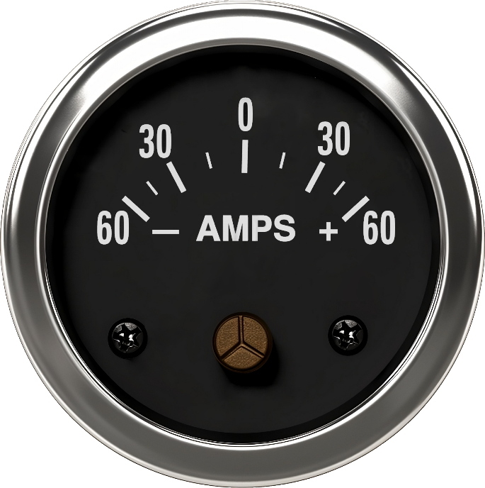
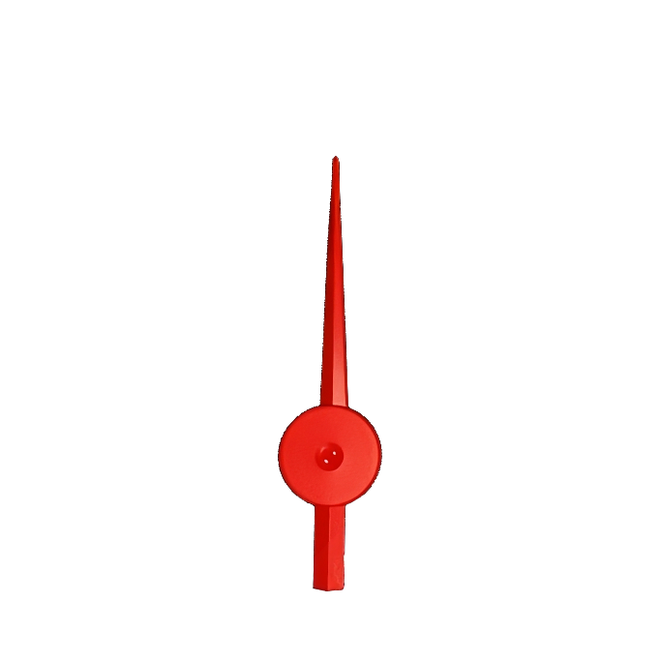
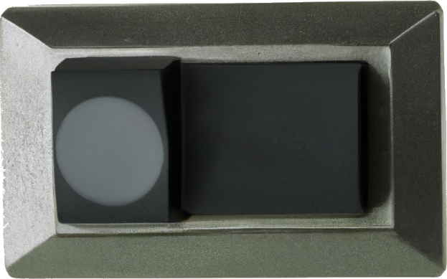
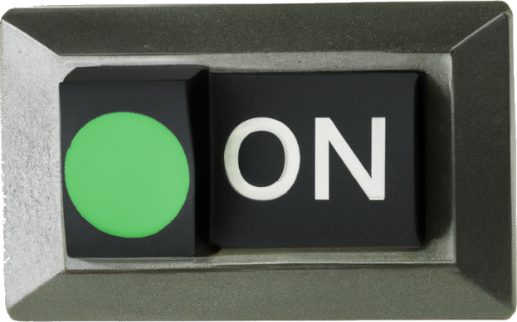
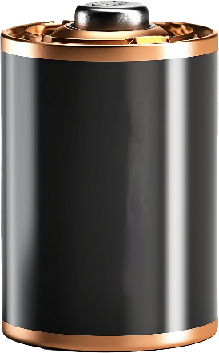
What are Amps?
Amount of electric charge moving past a certain point (Current)
Device only uses what it needs. Power supply needs to supply this amount or more
ITFreeTraining.com
© Copyright 2024
Notes:
01:40 The next crucial aspect of electricity to consider is the amount of electric charge flowing through a circuit, known as Amperes, or Amps for short. While voltage represents the pressure applied to move the electric charge, Amps measures the volume of electric charge that moves past a specific point in the circuit.
Amps differs from voltage in that a device only uses what it needs. A power supply needs to supply this amount or more in order to power the device. Let’s consider that we have a circuit. Attached to this circuit is a light that is not currently on. A device is attached that measures the Amps. Since no current is going through the wire the Amps are zero.
When the circuit is activated by turning on the switch, the light illuminates. This occurs because the light draws an electrical charge, also known as current, prompting the movement of electrical charge through the circuit.
The main takeaway from this is that you need to have a power supply that will supply enough Amps for your electronics. Having more Amps is not a problem, but you can’t have too little. Things get a little complicated because, when designing electronics, if you raise the voltage, you can reduce the Amps. Thus, to determine how much power you need, you need to consider both the voltage and Amps. So, what we really need is a measurement that takes this into account.
The key takeaway is that you need a power supply that can deliver sufficient amperage for your electronic devices. While excessive amperage is not an issue, insufficient amperage can lead to your electronics not working as expected or not at all.
While voltage and Amps are useful measurements for electronic devices, their relationship can become complex, as the same power output can be achieved by adjusting both parameters. For instance, increasing voltage while decreasing Amps can maintain a constant power level. Additionally, different regions of the world utilize varying voltage standards. To address these challenges, a measurement specifically focused on power consumption was devised.

Slide 4
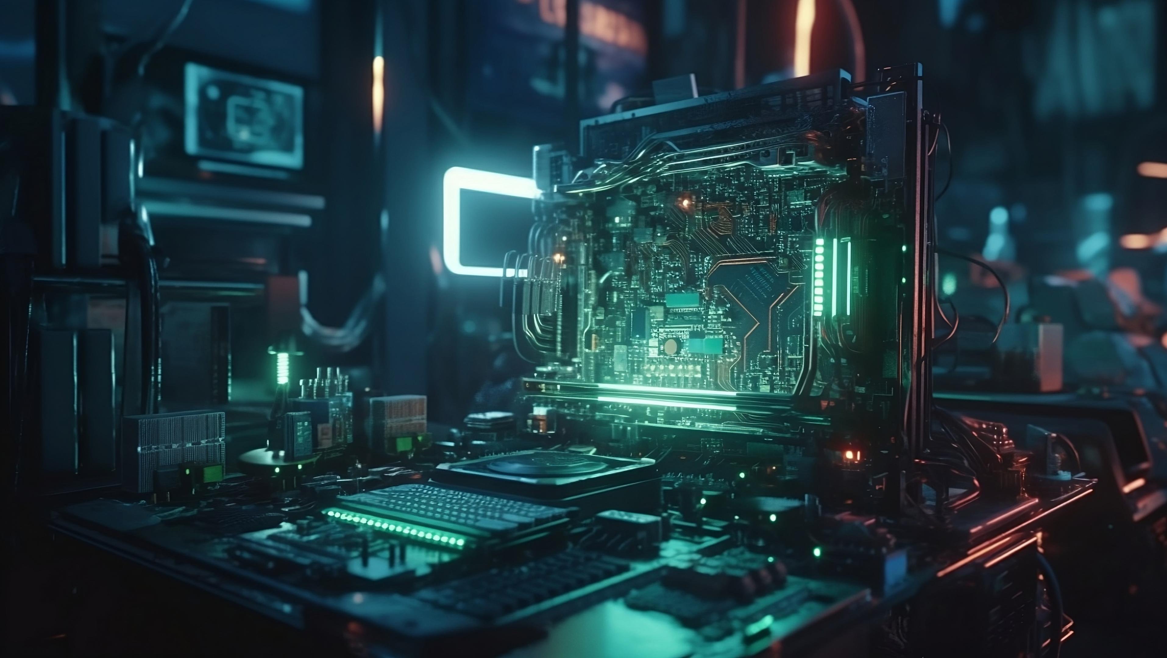
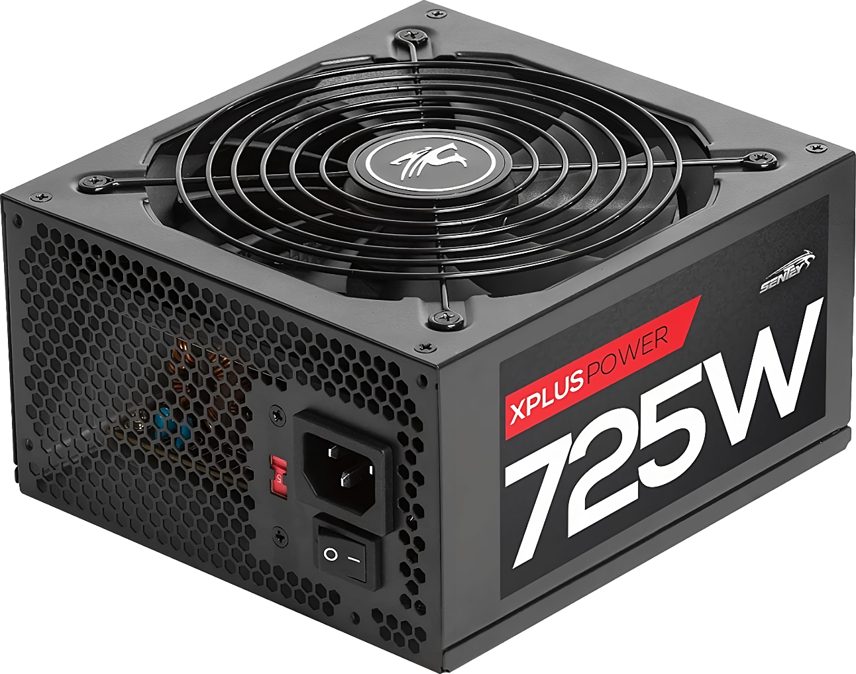
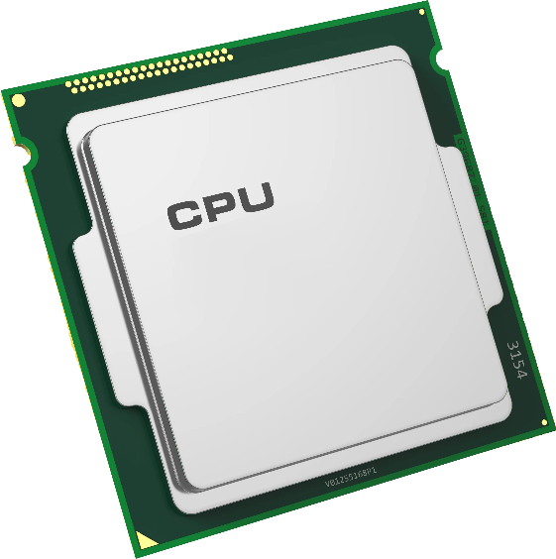
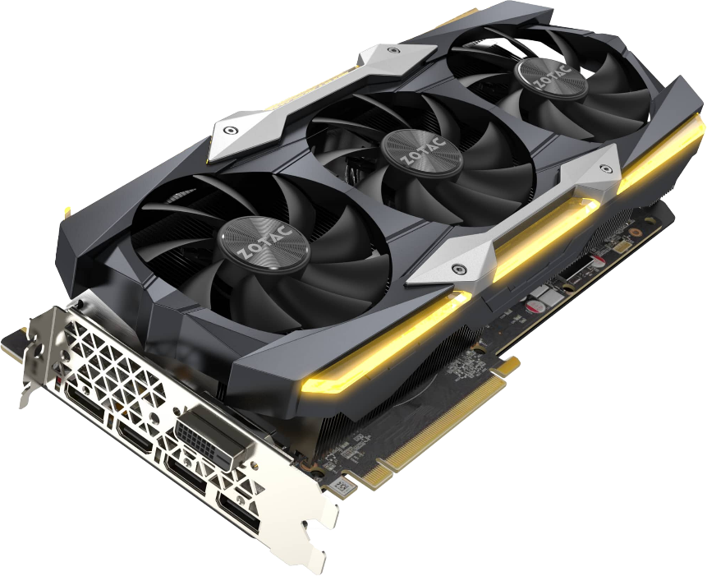
Watts
Measure of rate of electrical work done
Watts = Voltage * Amps
Gives a way of measuring power needs without worrying about voltage and amps
= 300W
ITFreeTraining.com
© Copyright 2024
Notes:
03:38 To better understand how much power is being used, the wattage measurement can be used. Wattage otherwise known as Watts represents the rate at which electrical work is performed. Watts are calculated by multiplying Voltage by Amps. While the underlying math isn't essential to remember, the key point is that Watts provides a convenient means to assess power needs without the complexity of separately considering voltage and Amps.
When you purchase a power supply, it will have a rating in Watts. To ensure the power supply can provide enough power to your computer, you need to add up the power needs of the components in the computer. Later in the video, I will look at how to work out the number of Watts you require for your power supply.
Let’s have a closer look at a power supply.

Slide 5
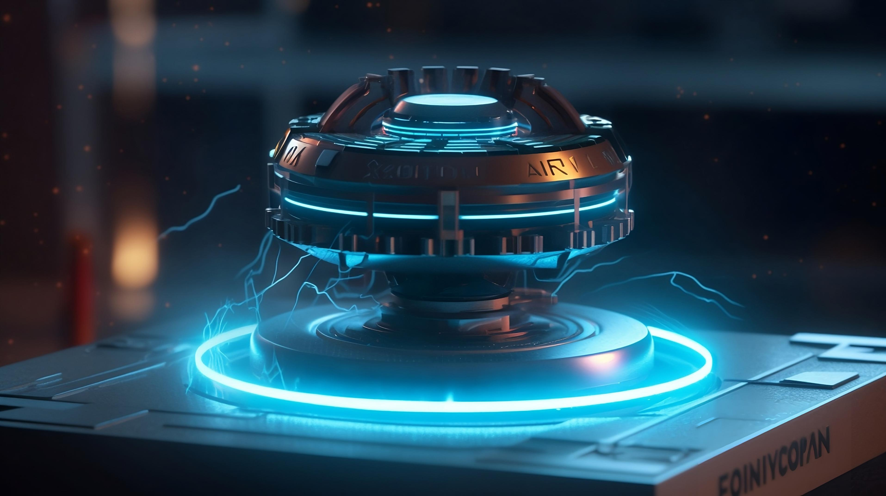
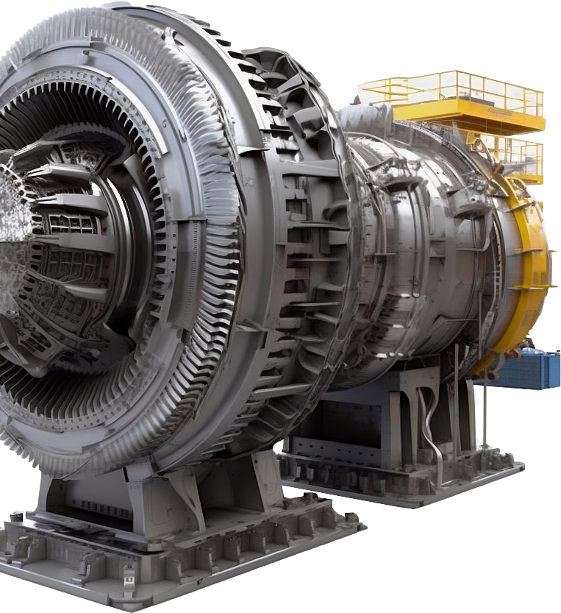
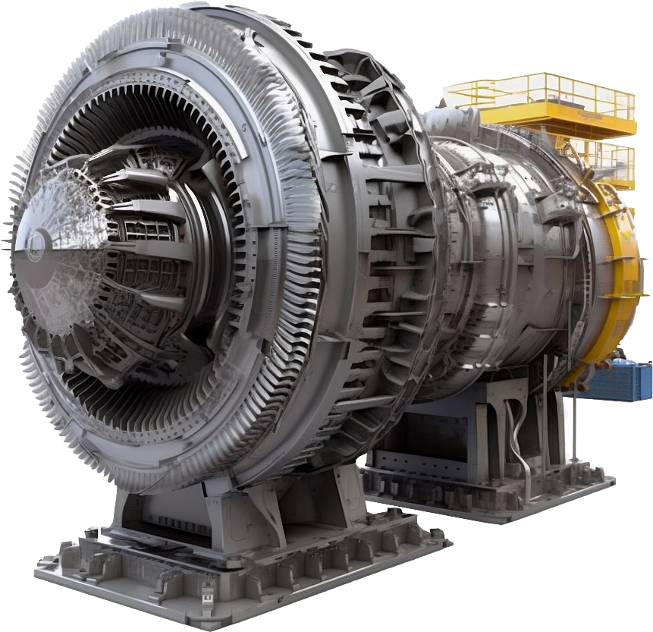
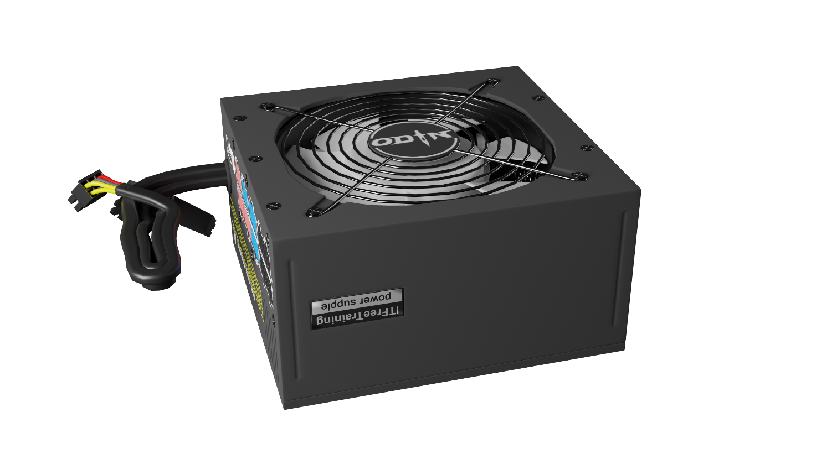
Power Supply
Converts AC power to DC power
Outputs multiple DC currents of different voltages
Alternating current (AC)
Direct current (DC)
AC flips direction of charge
Charge remains constant
+
-
+
-
ITFreeTraining.com
© Copyright 2024
Notes:
04:22 A computer’s power supply converts AC power to DC power. A single power supply will convert one AC power input and output multiple DC voltages. To understand the process a bit better, I will have a look at what AC and DC power is.
Alternating current or AC is when the current flips the direction of the charge. That is, it periodically goes from positive to negative and back, looking like a Sine wave. To understand why it is done this way, consider that you have a power generator.
On the other end is our computer’s power supply. So, what happens is, the generator creates AC current. This is the most efficient way to generate electricity. It is also the most efficient way to transmit electricity over long distances. The problem is electronics such as microchips can’t use alternating current. Microchips have gates that require constant power to keep them open or closed. This can’t be achieved using alternating current.
To run our electronics, we need to instead use direct current or DC. With DC, unlike AC, the charge remains at the same voltage. In this example positive. However, the power supply will output multiple voltages. Some of these are positive and others negative. The main point is that the voltage output is a fixed voltage and remains constant. This is what is required in order for our electronics to run.
Now let’s break it down and have a closer look.

Slide 6
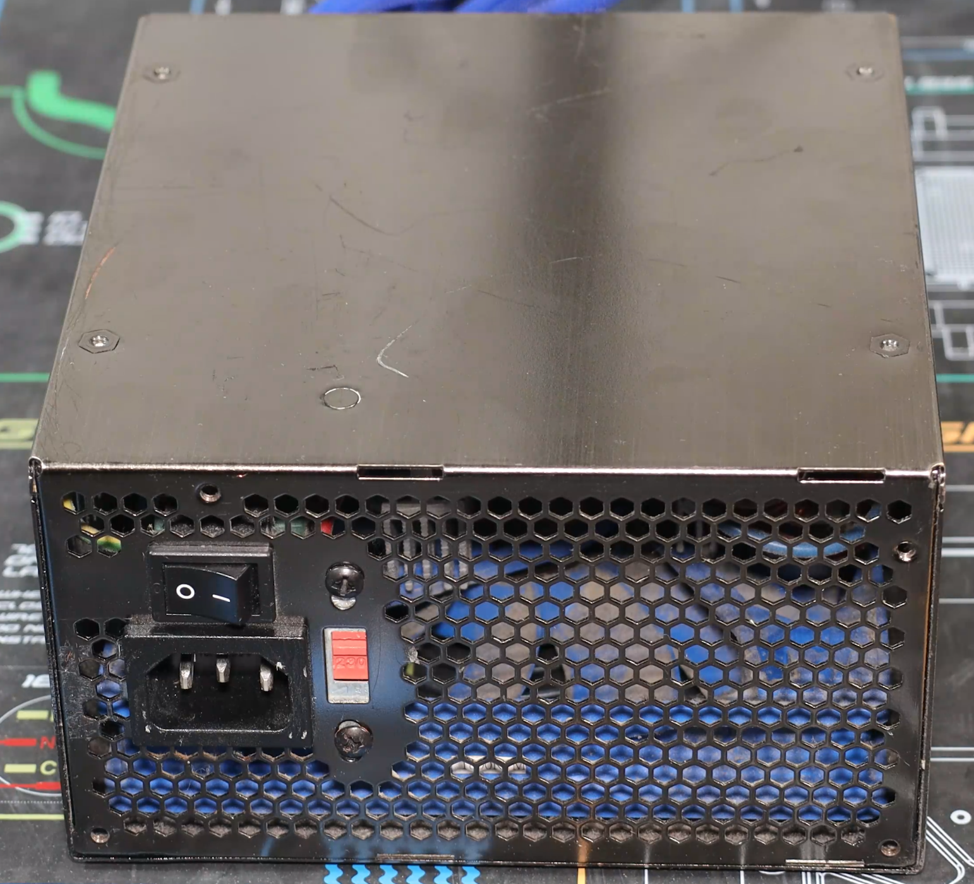
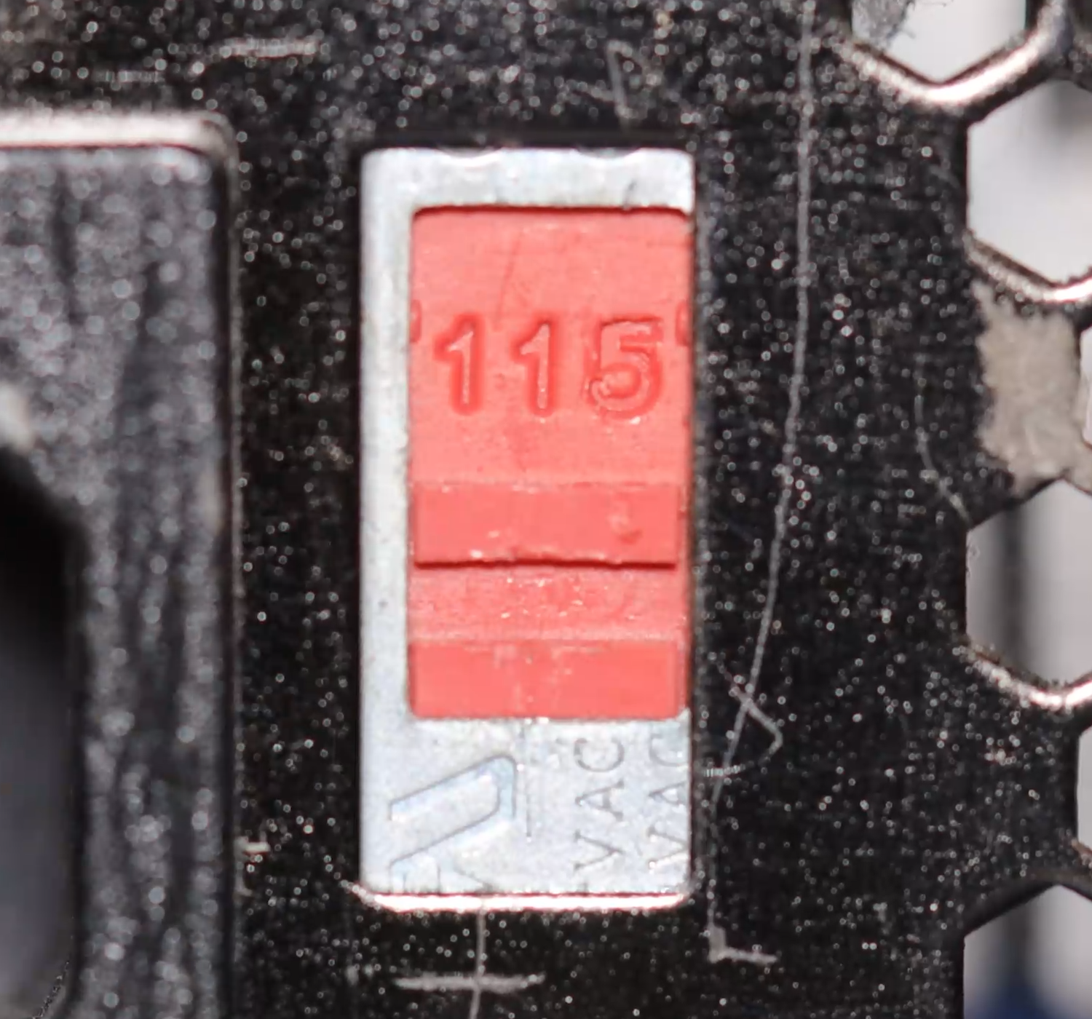
Power Supply Voltage
Needs to be a close match to your country's voltage
ITFreeTraining.com
© Copyright 2024
Notes:
05:49 Your computer’s power supply is designed to work with a particular input voltage or range of voltages. The input voltage needs to be a close match to your country’s main voltage. On your power supply there may be a power supply switch. This is not on all power supplies, as modern power supplies will auto sense the input voltage and adjust accordingly. If your power supply has this switch and it is not set correctly when you switch on the power supply, it will most likely blow the internal components and you will need to buy a new power supply.
The voltage needs to be a near match. In this example the power supply is currently set to 230 volts, otherwise known as “high-line”. If your country uses 240 volts this is a close enough match. You will notice that I can switch the power supply to 115 volts otherwise known as “low-line”. In countries that use around this voltage, for example a country that uses 120 volts for its power, you would use this setting. Close enough is good enough in this case, but a big difference in voltage will most likely damage the power supply.
If you are in a country that uses 120-volt power supplies, you will find that data centers will often use 240 volts or even higher voltages because higher voltages are more efficient. Whatever voltage is used, make sure it matches. The power supply should be clearly marked which voltages it can be used with and using the wrong voltage will cause damage.
There are some other things that you may want to consider when purchasing a power supply.

Slide 7
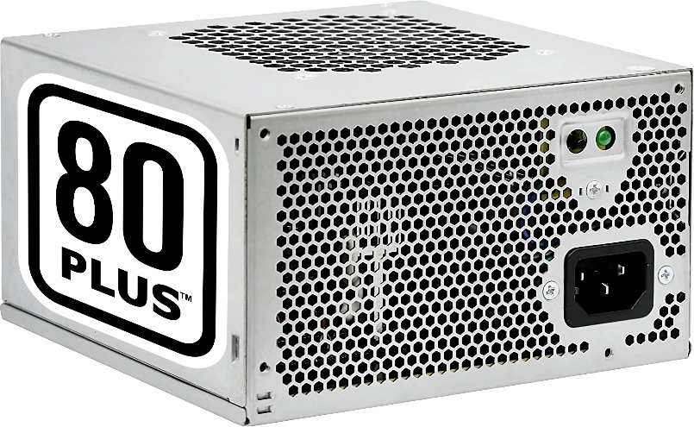
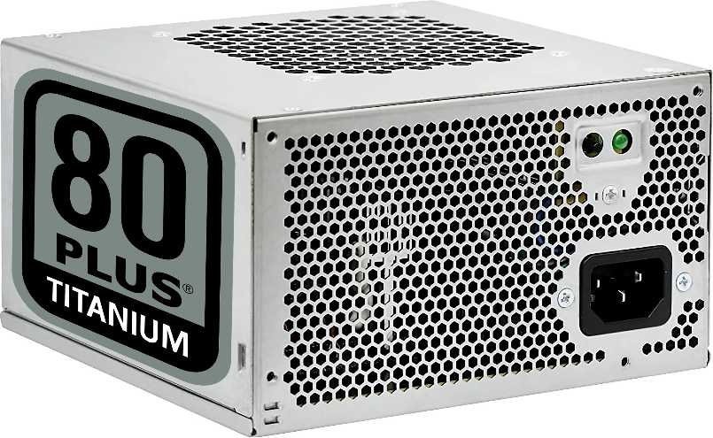
Power Efficiency
Power draw is higher than the output
Extra power mainly lost as heat
375W
300W
80% efficient
333W
300W
90% efficient
ITFreeTraining.com
© Copyright 2024
Notes:
07:16 Nowadays, particularly with energy becoming more expensive and climate concerns, you may want to consider how efficient your power supply is. The power draw for a power supply will be higher than the amount the power supply outputs. This difference in power is mostly power being lost as heat.
To understand the process a bit better, consider an example power supply. This power supply is marked as 80 Plus. 80 Plus is a voluntary certification program intended to promote efficient energy use. The lowest option is just 80 Plus. Higher certifications are marked as bronze, silver, gold, etc. As the rating goes up, the power efficiency goes up. In this example, the power efficiency is 80%. If your power supply does not have this rating on it, you will need to check the specifications of the power supply to determine what its power efficiency is.
This means that in order to output 300 Watts, the power supply needs to draw 375 Watts. Now let’s consider that we have a second power supply. This power supply is 80 Plus Titanium and thus has a 90% efficiency.
This means to have 300 Watts of output the power draw needs to be 333 Watts. This means the second power supply uses 12% less power than the first one. This may not seem a lot, but let’s consider this over a year or if you are running a lot of computers in a server room or data center. This does make a difference to your electricity costs. I will let you do the math to see if it is worth your money purchasing a more power efficient power supply.
In most cases you will consider the Watts the power supply outputs in order to determine if it will meet your needs, however, in some cases you may need to look at some other specifications to ensure the power supply outputs the power that you require.

Slide 8
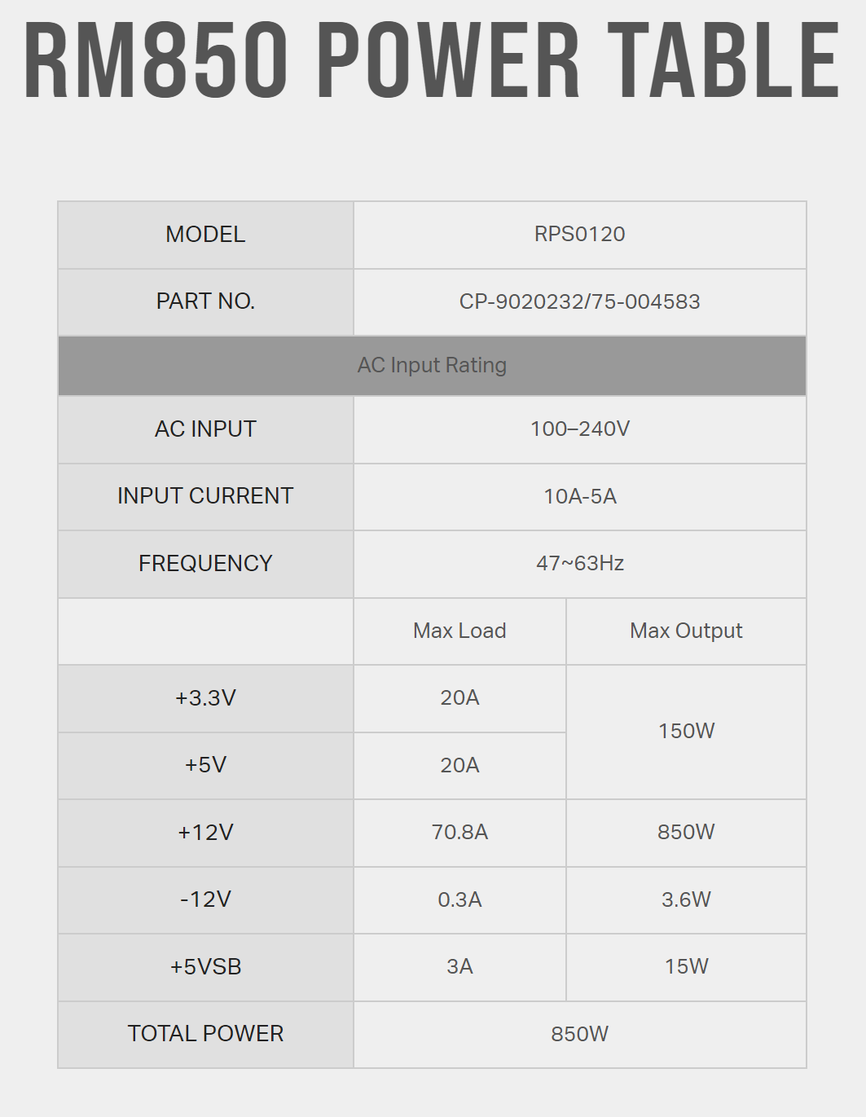
Rails
A rail provides a particular voltage
3.3 and 5 Volts often have combined maximum output
ITFreeTraining.com
© Copyright 2024
Notes:
09:01 In some cases, you may need to consider how much each rail in your power supply outputs. A rail provides a particular voltage to the computer. Let’s consider an example power supply. The power supply needs to provide a number of different voltages in order for the computer to operate. The power supply is rated to deliver a maximum number of Watts for that power voltage, or over that rail.
Many power supplies share a maximum output wattage between the 3.3V and 5V rails. In this instance, the combined maximum output for both voltages is 150 Watts.
12 Volts is the biggest power draw on a computer, thus it will generally have the highest maximum output. In the real world, you don’t really need to worry too much about the maximum rail output. Devices that draw a lot of power such as graphics cards will draw the majority of their power from the 12 Volt rail. Devices such as storage devices will often use 12 Volts and 5 Volts, sometimes even 3.3 Volts. The point is, they share the load between the different rails. Thus, you could have a lot of storage devices before you reach the 150-Watt limit in this example. Even a low-end power supply could easily run six or more hard disks, even more if you are using Solid-State-Drives since they use less power.
In the real world, focusing on the maximum output of Watts should be enough. Unless you have a specialized system that puts more load on one of the rails, for example one that uses 20 hard disks, you should not have to worry about looking at the output of the rails.

Slide 9
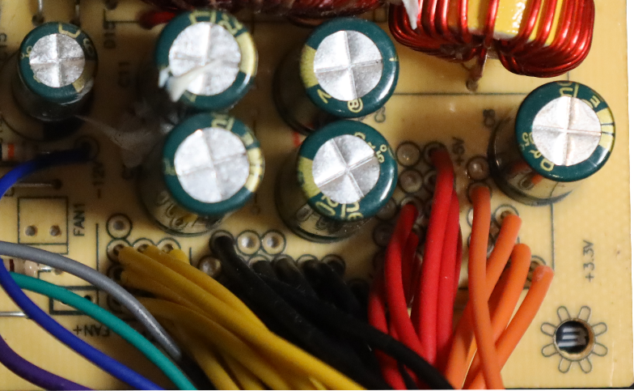
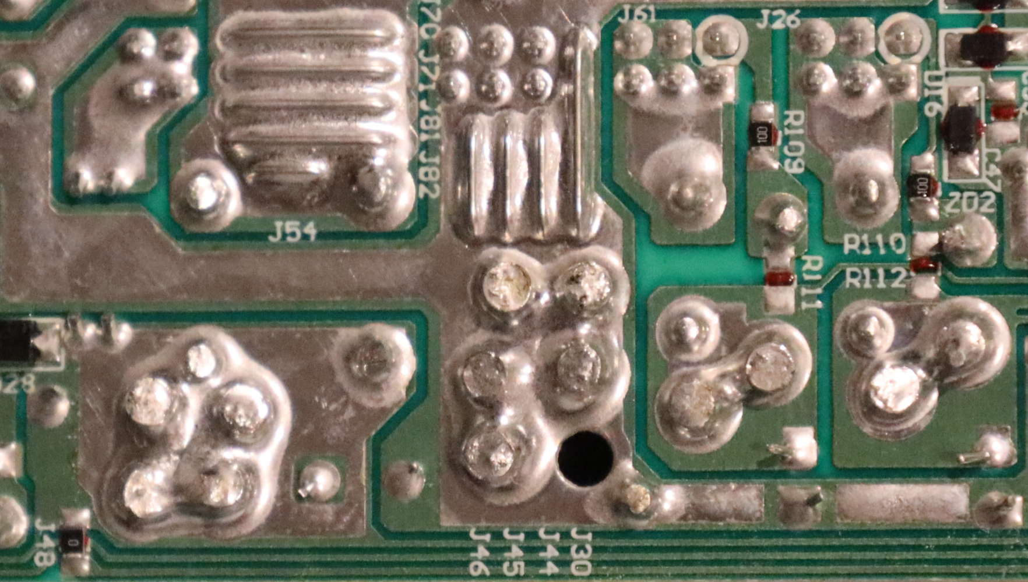
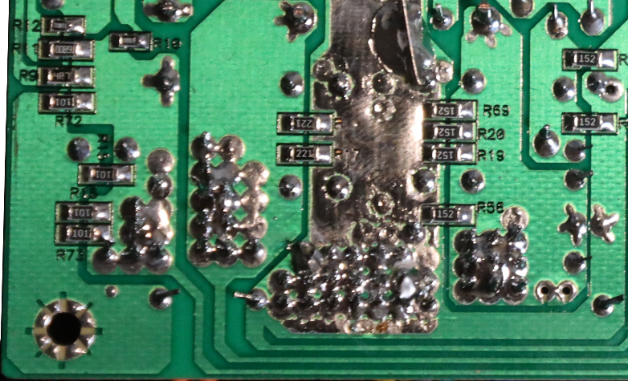
Single Vs Multiple Rails
Don’t worry about it
Was a problem back 20 years ago (For a short time)
Single Rail
Multiple Rail
+12V1
+12V2
+12V3
+12V4
30A
30A
30A
30A
360W
360W
360W
360W
Combined Power:
600W
ITFreeTraining.com
© Copyright 2024
Notes:
10:33 Some power supplies use a single rail and others multiple rails. My advice on this is, don’t worry about it. In fact, feel free to skip this part if you are happy with that answer, otherwise I will explain why you should not be concerned if the power supply is single or multiple rail.
Single vs multiple rail power supplies were problematic for a short time some 20 years ago or so. What happened around that time was, video cards started using a lot more power. This unexpected increase in power requirements caught power supply manufacturers off guard, resulting in some power supplies, despite having sufficient overall wattage, being unable to provide the necessary power to the graphics card.
To understand why, consider that with a single rail power supply, all the voltages are combined together. You can see in this power supply that the voltage wires are soldered together on the circuit board.
Multiple rail is when the same voltage rate is divided up into separate rails. Each of these individual rails will generally have a lower maximum current. The total power supplied by all the rails will still be the same.
With single rail power supplies, the graphics card was attempting to pull too much power which resulted in possible safety problems due to overheating. With multiple rail power supplies, when the power was split up, some could not provide enough power.
This was a short-lived problem, since power supply manufacturers made changes to better support higher power draws from graphic cards regardless of whether it was single or multiple rail.
In the real world, in modern power supplies there is a protection in them which will shut the power supply down if there is a short or there is too much draw of current through the power supply. Thus, I will say it again, nowadays, I would not worry about it. Whether the power supply is single or multiple rails I would not even be concerned. I would be more concerned about the overall safety protection in the power supply rather than how many rails it has.

Slide 10
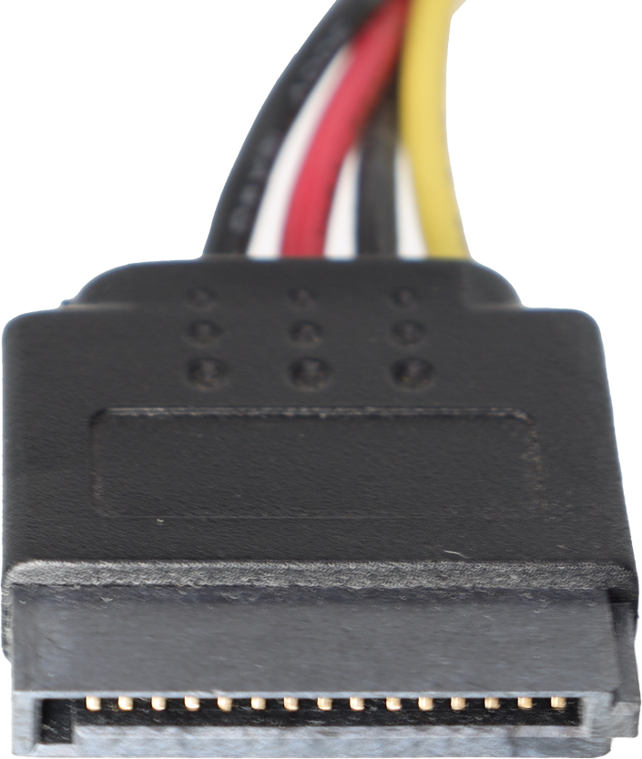
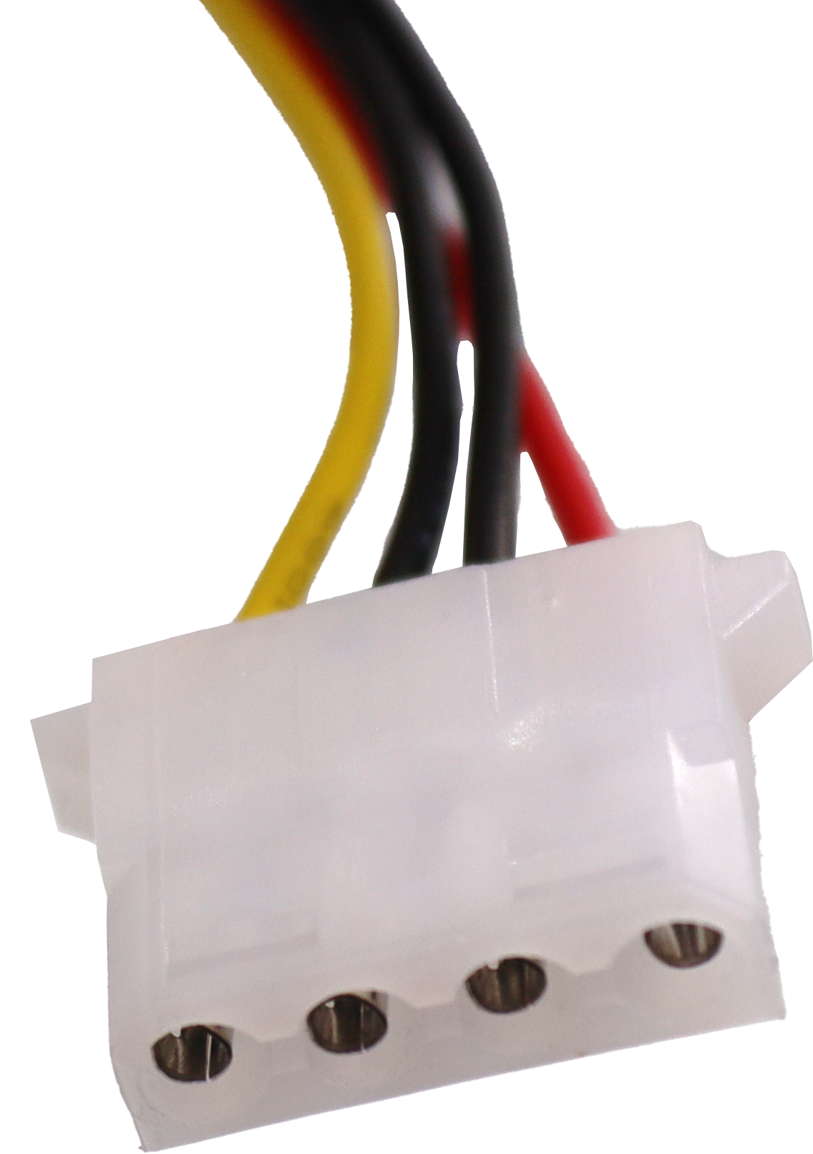
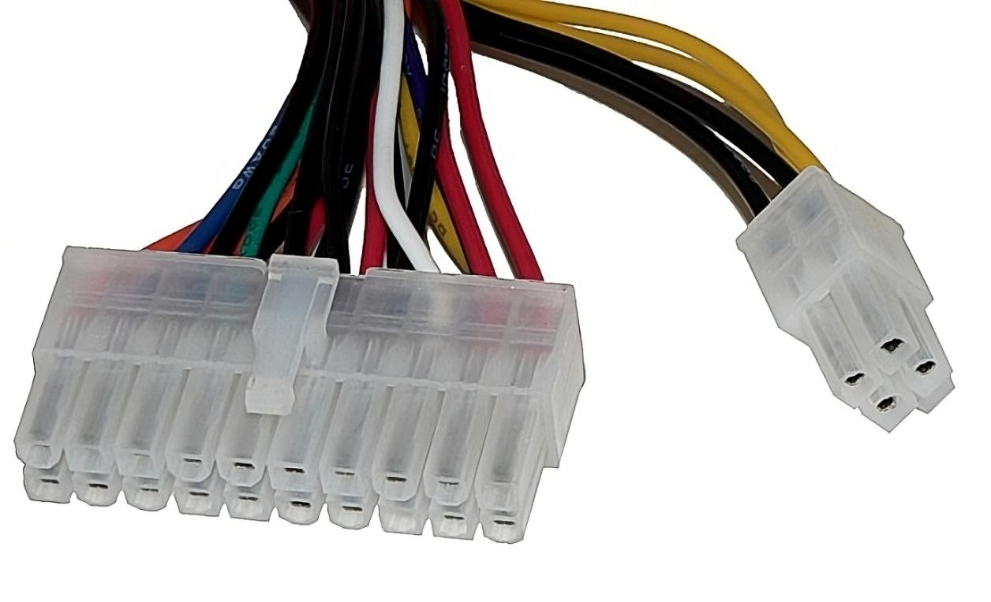
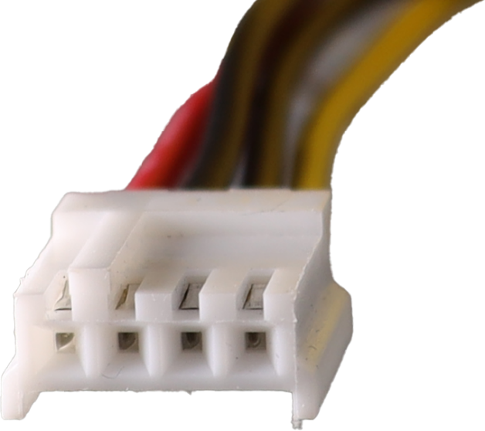
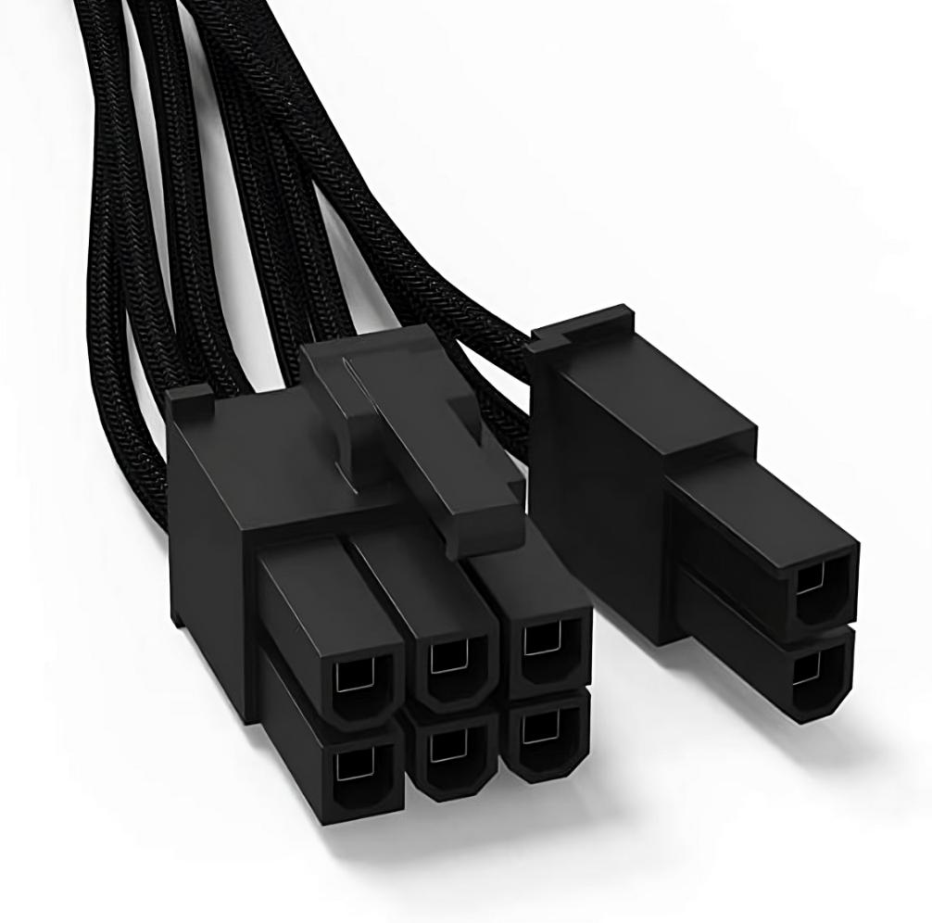
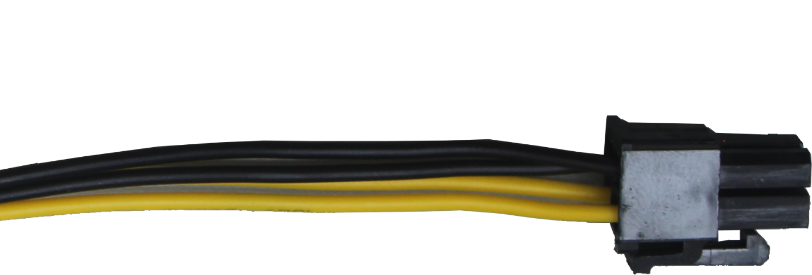
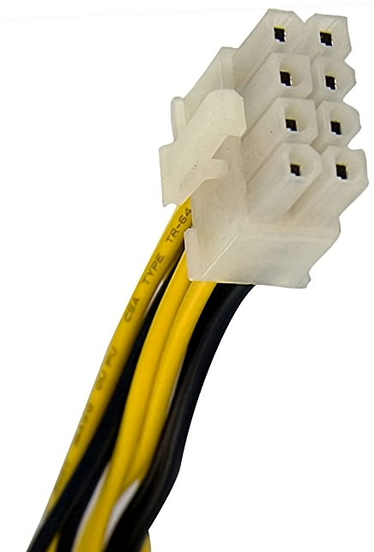
ATX Standard
Defines the size of the power supply and cables
Mini Molex
P1
SATA
Molex
EPS/ATX 12V
8-pin (4+4)
P4
PCI Express
6-8 pin
ITFreeTraining.com
© Copyright 2024
Notes:
12:23 The manufacturer of the motherboard will determine which power supply the computer will require. A lot of computers will use the ATX standard. This standard defines the size of the power supply and also the cables that are used.
Modern power supplies have three or four power cables, the main being a 24-pin power connector called the P1 connector. This connector, in most cases, can be split into a 20-pin and a 4-pin connector to allow compatibility with older motherboards.
The next connector is a 4-pin connector called the P4 connector. As motherboards started using more power the P1 connector was not able to supply enough. Thus, the P4 connector was added to provide additional power to the motherboard.
As time went on, the P4 connector was not able to provide enough power. To provide even more power, the EPS connector, also called the ATX 12V connector, was added. This connector is an 8-pin connector which is essentially two P4 connectors. This connector can be used as an 8-pin or split into two 4-pin connectors. Some motherboards will use one of the connectors or both of them and in other cases two 8-pin connectors. Different power supplies will have a different number of connectors. Generally, newer power supplies will have two 8-pin connectors whereas old ones may only have had the P4 connector.
As time went on, graphic cards also needed additional power just like the motherboard. To provide this additional power, the PCI Express power cable was added. This is an 8-pin connector that can be split into a 6-pin connector. Some very high-end graphics cards may require two 8-pin connectors. Your power supply may have one or two of these connectors. Some power supplies may have a 6-pin connector rather than an 8-pin connector. When you purchase a power supply, it is important that it includes all the connectors that you require. In some cases, you may be able to get a convertor connector which can add an additional power connector, usually by converting an existing connector to the required type.
The most common case of this is converting a SATA power cable to a PCI Express connector. The SATA connectors are flat connectors used to connect SATA based storage devices.
Your power supply may also have Molex connectors. Molex connectors are used for older hard disks before SATA drives came along. They are also used for other devices such as case fans, although they don’t tend to get used that much nowadays. They may also be used to convert into a power connector like a PCI Express connector.
Since Molex connectors are used for older storage devices, your power supply may not have them. Usually, most modern power supplies will include at least one cable with Molex connectors. If your power supply does not have them, you can also use a convertor to convert a SATA connector to a Molex connector.
The last connector is the mini-Molex. This is used for floppy disk drives and some other devices. These are very rare nowadays as floppy disk drives have been obsolete for a long time.

Slide 11
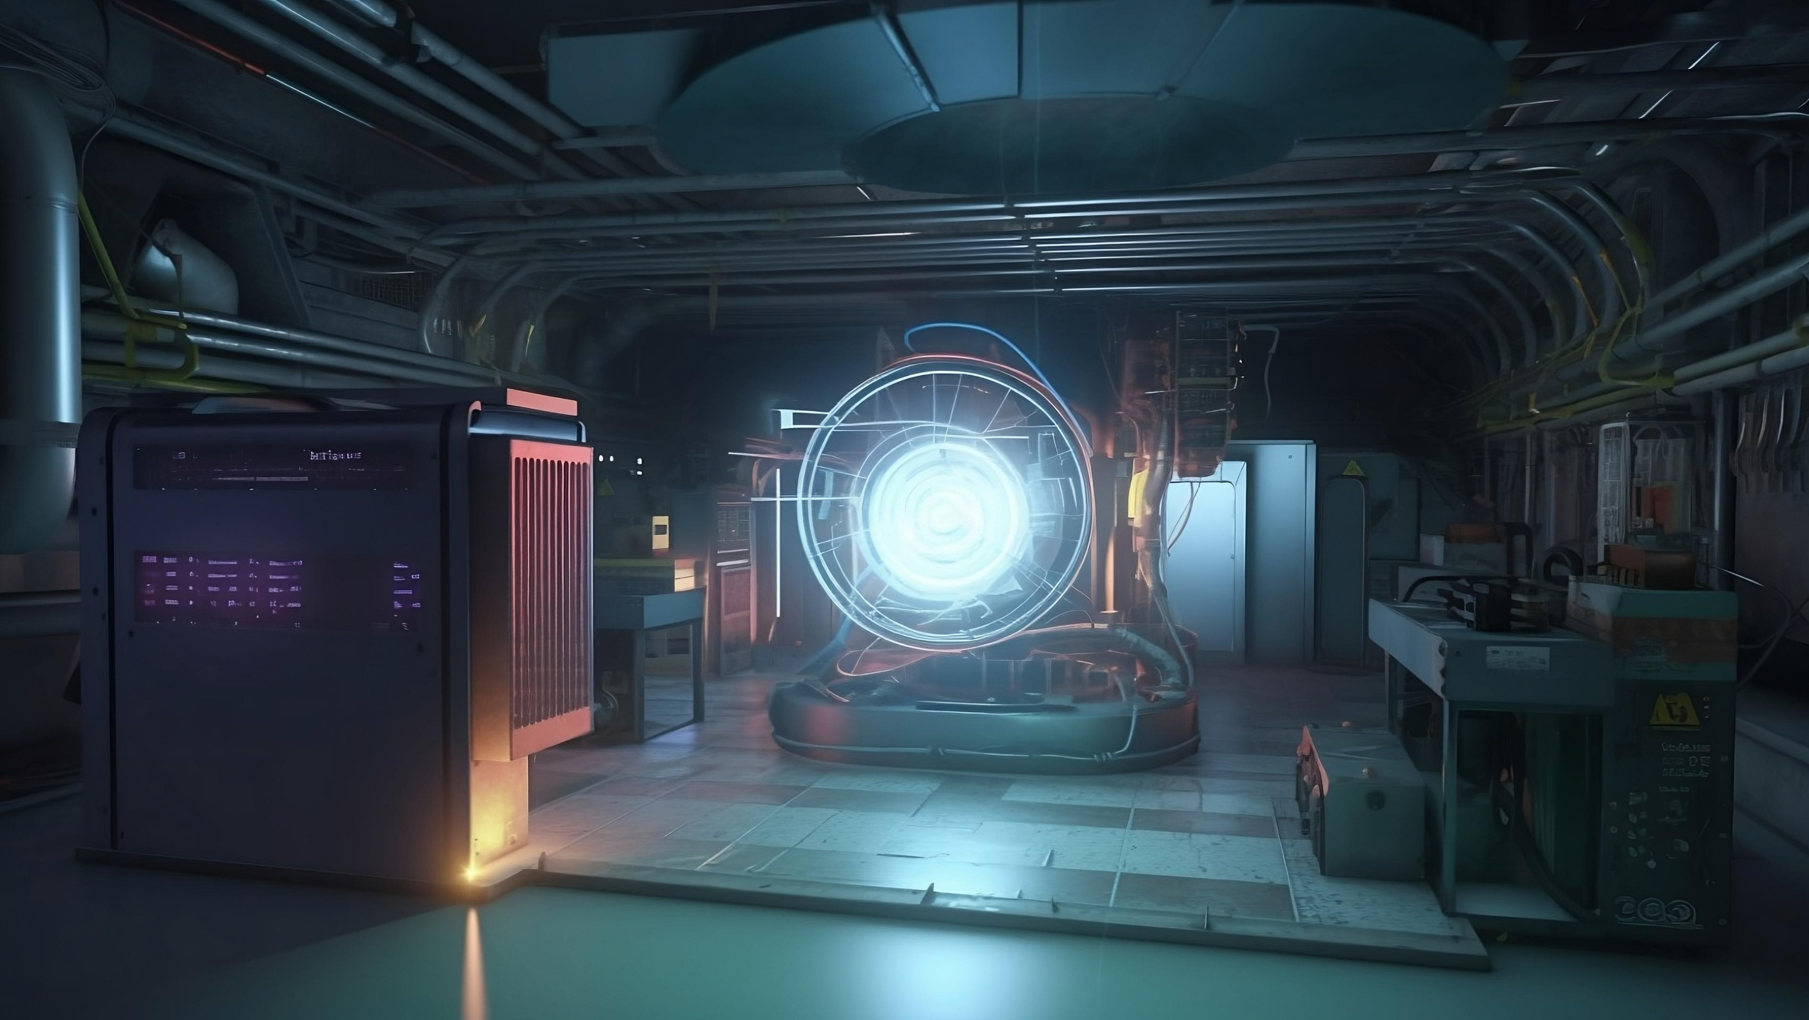
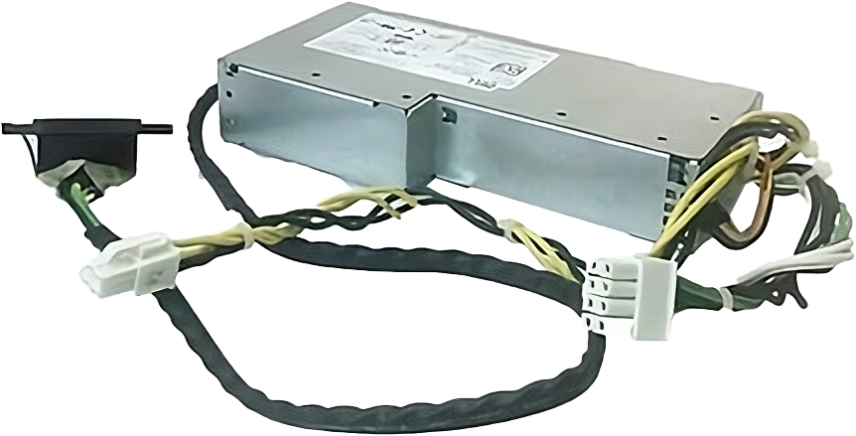
Non-Standard Power Supplies
Proprietary power supply made by the manufacturer
May use different connectors and be a different size
ITFreeTraining.com
© Copyright 2024
Notes:
15:18 In some cases, you may come across a power supply that does not follow the ATX standard. These are referred to as proprietary power supplies. They are made by the manufacturer of the computer. These power supplies may use different connectors and may be of a different size.
When you come across these, it is best to get a replacement power supply from the manufacturer of the computer.
Let’s have a look at an example computer. This computer has a non-standard power supply. You will notice the power supply looks pretty normal. However, when I put a standard ATX power supply next to it, you will notice that it is larger than the standard ATX one. Power supplies will vary in length, but in this case the height is different. Thus, the power supply in this computer won’t fit into another computer as it is too large.
Depending on the computer, it may have the same connectors as the ATX standard. In this example, the P1 connector is the same as the ATX standard. In some cases, the motherboard’s main power connector may be different. When this occurs, sometimes you can get a converter cable to convert an ATX power supply to the proprietary connector, however, these cables are rare.
We have had a good look at power supplies, now let’s have a look at how to work out how much power you will need.

Slide 12
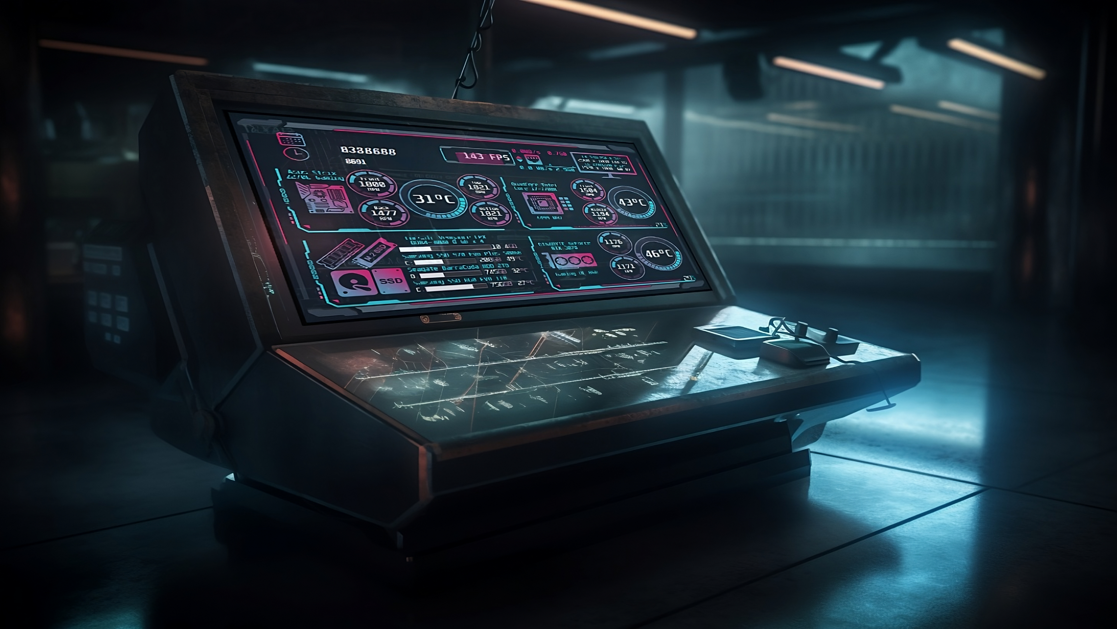
Power Supply Calculator
Simple way to estimate power use
Estimate only. Best to always allows a little bit extra
http://enermax.outervision.com
http://pcpartpicker.com
ITFreeTraining.com
© Copyright 2024
Notes:
16:31 You can do the calculations manually, but there are a lot of power supply calculators available nowadays. These calculators make it simple to estimate how many Watts your power supply may need. It is an estimate, so better to allow a little bit extra.
I will look at two different calculators. The first is more general and does not require you to know all the parts you are going to use. The second requires you to know all the components you want to use. Different components will use different amounts of power. You can take a general guess for some components, for example, different hard disks will have similar power needs, however, components like graphics cards will vary in power use considerably.
Let’s now have a closer look. I have already put in values for some components. At the top, I can enter some details about the CPU. CPUs vary in power usage. Low-powered CPUs don’t use too many Watts, for example 20. The very high-powered CPUs may use upward of 300 Watts. So, you can see there is a big range of possible CPU power needs. High-end consumer CPUs are generally under 200 Watts. If you are not sure, have a think about what CPU you may use, for example a high- or low-range CPU.
The largest user of power is the graphics card. Graphics cards can range in power usage from 15 Watts to 600 Watts. Thus, you can see the CPU and graphics card can vary enormously in power usage. Thus, it is important to work out which ones you are using or which types you are likely to use.
You can see at the bottom, the estimated power use is 746 Watts. So, an 800 Watts or 850 Watts power supply should be enough. Personally, I would go a little larger just in case.
The question is, how much higher would you want to go with a power supply. To understand how much, let’s change some figures. To start with, I will change the number of memory modules from one to two and press the calculate button. The number of estimated Watts required has increased by one. Thus, you can see that increasing the number of memory modules has little effect on the power usage. Some components will have a greater effect than others, so it is important you have a basic idea of what you may add later, so you can future proof yourself.
I have already added some storage devices. I will now increase the number of Solid-State-Drives from one to two and press the calculate button. The number of estimated Watts increases by four.
I will next increase the number of SATA hard disks from one to two and press the calculate button. The estimated Watts increases by 11. So, you can see hard disks use a lot more power than Solid-State-Drives.
I will next increase the optical drives from one to two and press the calculate button. Notice the Watts increases by 32. Thus, you can start to see that the type of storage device that you are using can have an effect on how many Watts you require.
I will next increase the number of fans from one to two and press the calculate button. The Watts increases by two. The main takeaway from this is that, generally speaking, you need to estimate the power you need for the biggest power users, which will be the graphics card followed by the CPU. Next, I would consider the number of storage devices that you are likely to add. Although putting everything in the estimate will help give you a better estimate, getting the CPU and graphics card correct are generally the most important.
You will notice there is an option for computer utilization. I will change this from 24 hours to 1 hour per day and press the calculate button. You will notice that the estimated power usage has dropped by 42 Watts.
Some of these power supply calculators will have some interesting options. You never really know how these calculators get their results and different calculators will give you different results. I personally don’t think this is a good option, as the time using the computer does not give you a true indication of power use. You could use it for less than an hour under heavy load which would maximize the draw on the power supply. You could use it for 24 hours and hardly draw any power from the power supply. Therefore, for this setting I would set it to what gives you the highest estimate. When usings tools like this one, have a good look at the settings and see how they affect the results.
I will next have a look at the website PCPartPicker. PCPartPicker allows you to select the components that you want to use to build your computer. I have already picked a few components. You will notice the estimated wattage at the top right. Sites like PCPartPicker will use the power ratings provided by the manufacturer. This may give you a more accurate estimate, assuming the values are correct.
If you use this site to estimate wattage, I would also consider adding some components that you think you may install later. This will give you a better estimate of Watts you need to future proof yourself.
Now that we know how to estimate how many Watts we may need, let’s have a look at what sort of power supply you may consider buying.

Slide 13
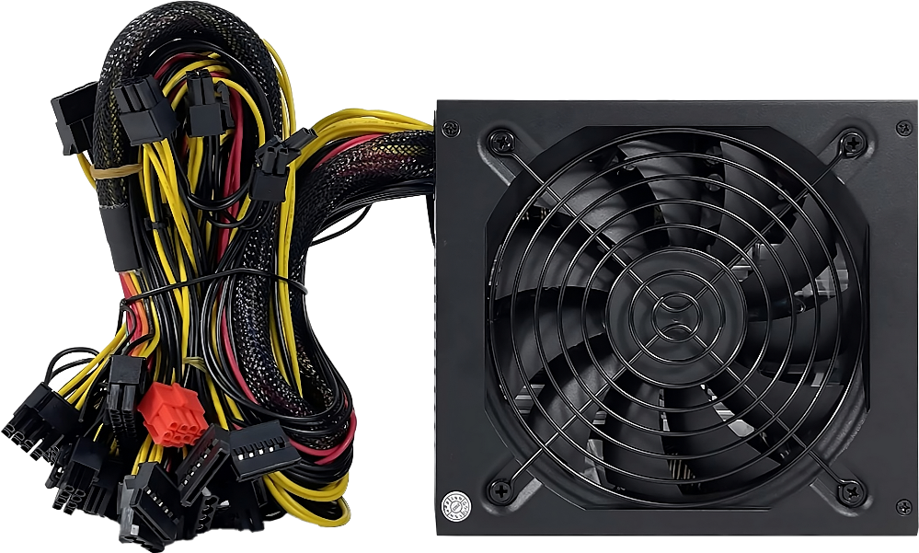
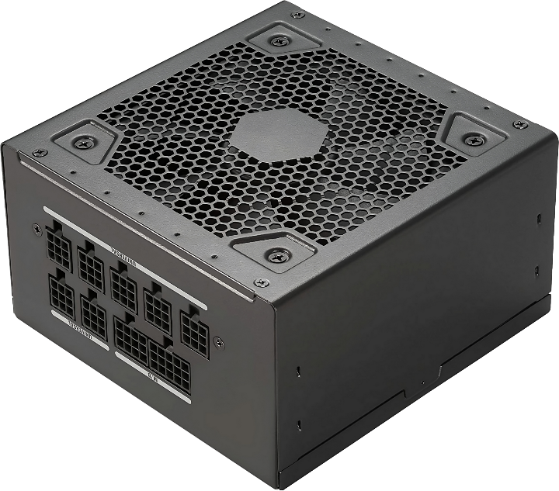
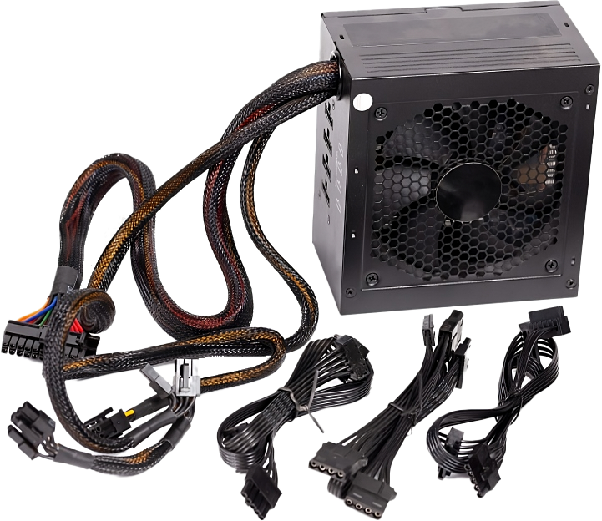
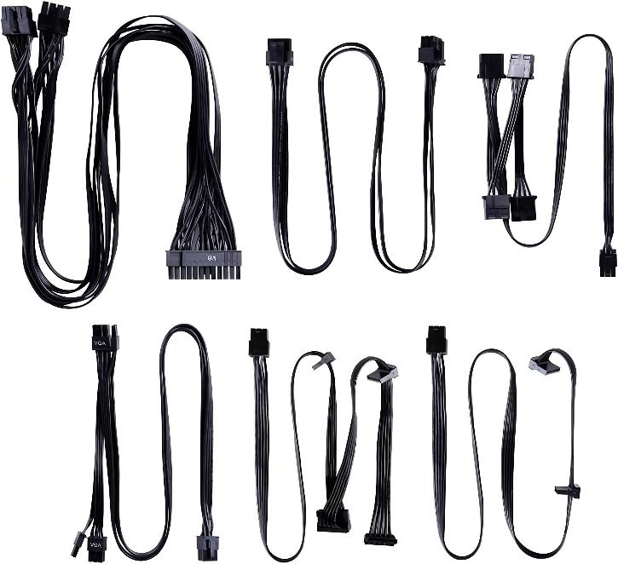
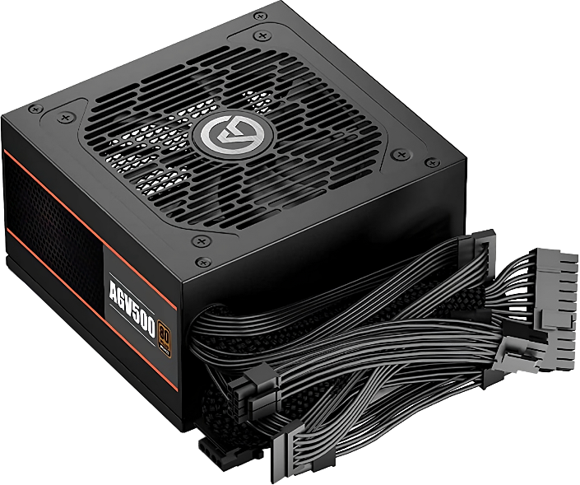
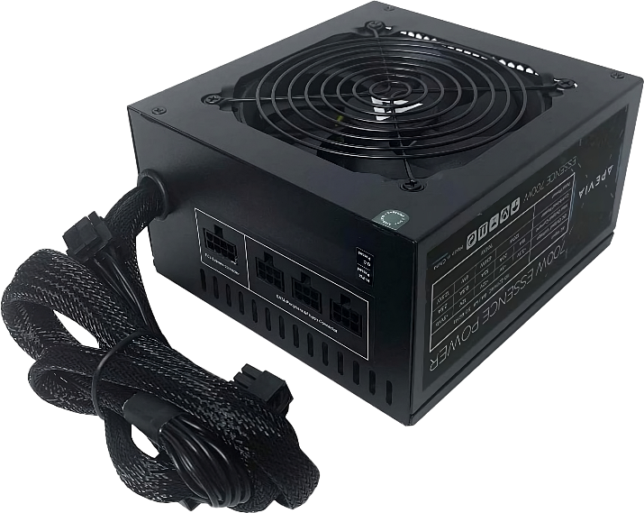
Power Supply Types
Non-Modular
Semi-Modular
Fully Modular
All cables fixed
Some fixed/Some detachable
All detachable
ITFreeTraining.com
© Copyright 2024
Notes:
21:15 One of the features you may want to look at in a power supply is how modular it is. A non-modular power supply is one in which all the cables are fixed into the power supply. You can see in both these examples, the cables go directly into the power supply and can’t be removed. This means that if you don’t use some of the cables they can’t be removed. More cables means more cables that you need to manage.
The advantage of these powers supplies is that they are generally the cheapest of the power supplies. Although the power supplies need to be a certain size to meet the ATX standard, the manufacturer is free to vary the depth of the power supply. Generally, non-modular power supplies may be a little shorter in depth for the reasons I will explain in a moment.
The next type is semi-modular. These power supplies have some fixed cables and also some detachable cables. Since the cables can be plugged in and unplugged from the power supply, the power supply may be a little deeper to allow room for the plugs. Having detachable cables allows you to remove cables that you don’t plan on using, making cable management easier.
Be careful that you use compatible cables with the power supply. The power supply does not make use of any standard for the keying of the cables. Thus, different cables from different power supplies may plug into your power supply; however, the wires in the cable may be different. Be careful, if the cables are wired differently, this can cause the wrong voltages to go through the wires and damage components. Even power supplies from the same manufacturer may be wired differently.
With semi-modular power supplies, the main cables are fixed. That is, generally the motherboard power cables. These you are almost always going to use, so I personally don’t find it a concern that they are not detachable. However, if you need them to be detachable, you can get a fully modular power supply.
With a fully modular power supply, all the cables are detachable. The downside of semi-modular and fully modular power supplies is that they tend to be a little more expensive than the non-modular ones.
A modular power supply gives you the advantage that you can use different cables. For example, you can purchase shorter cables or replacement cables. If you are planning on doing this, I would check to see what replacement cables the manufacturer offers. For some powers supplies, the manufacturer may not sell any cables for that power supply and you are stuck with the ones that came with it.

Slide 14
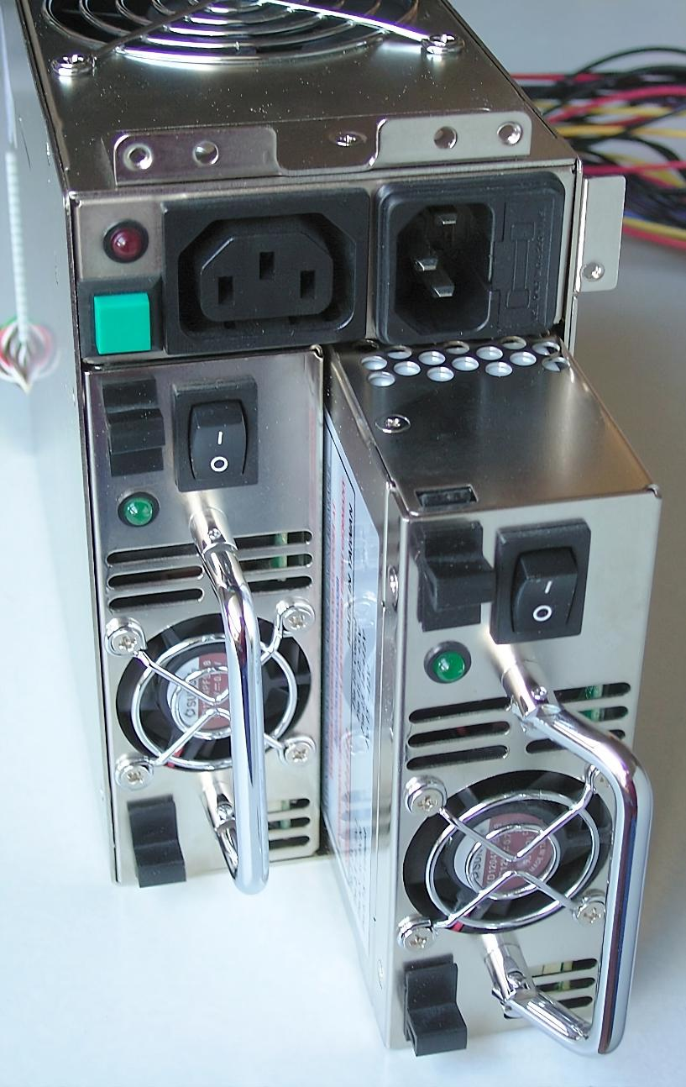
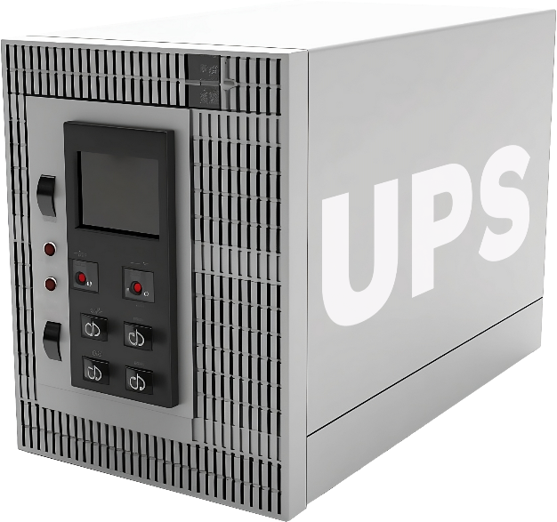
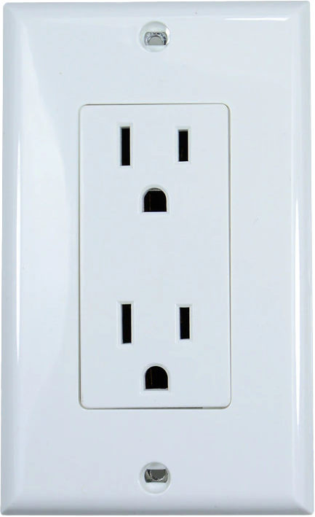
Redundant Power Supplies
Computer has two or more power supplies
Additional power supply acts as failover or is used for load balancing
Failover
Load balancing
UPS provides surge protection and regulates power
Mains should have surge protection
Check with manufacturer for supported configurations
ITFreeTraining.com
© Copyright 2024
Notes:
23:31 I will next look at redundant power supplies. This is when the computer has two or more power supplies. The additional power supply acts as either a failover or is used for load balancing. Depending on the device, this may be configurable or configured during manufacture.
When connecting the device, if available, you may want to plug it into an Uninterruptible Power Supply or UPS. A UPS provides surge protection and regulates power. That is, it removes power fluctuations.
If you power the device from the mains, you should have surge protection. A UPS provides better protection, but surge protection is better than nothing. When you have multiple power supplies, you have a choice between plugging them into the UPS, mains or a combination of the two.
If your power supplies are configured as failover, the first power supply will be used as the primary power supply. If this fails, it will switch to the second one. When you have a setup like this, you may want to consider plugging the first power supply into a UPS and the second into the mains. Thus, if your UPS fails your device will run off the mains and if the mains fails, the device will still be running off the UPS.
I would recommend you check with the manufacturer for supported configurations. If your device is using load balancing, then generally you would plug them into a UPS. The reason you would run them both off a UPS is, the UPS can calculate the power use and thus calculate how long the attached device will be running for if power is cut. With load balancing, half the power is going through the mains and thus when power is cut the draw on the UPS will double. This makes it hard to estimate the real power draw from the UPS and how long it will last if the power is cut. If you are not sure what you should do, check with the manufacturer.

Slide 15
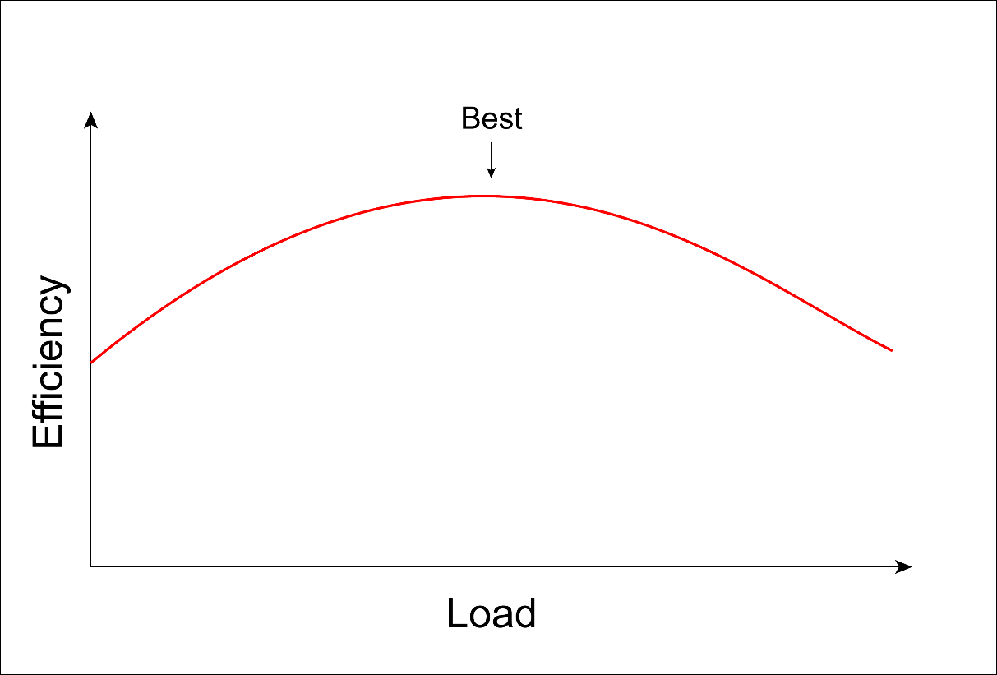
In The Real World
Too Low
Just Right
Too High
Power shutdowns
Best efficiency
Waste of money
Power problems
Stable power
Lower efficiency
PSU reduces output over time
ITFreeTraining.com
© Copyright 2024
Notes:
25:15 In the real world, when it comes to power supplies, you essentially want to try and get a power supply in the Goldilocks zone. Sometimes that may not be possible, for example, you know that you will be buying a second high-draw graphics card in the future, so you need a high Watts power supply to run two graphics cards.
If your power supply Watts is too low, the power supply may unexpectedly shut down. You may also have power problems since the power supply can’t supply the required load and your computer does not run as expected and may randomly crash.
Ideally, you want to purchase a power supply in the "just right” zone. This gives you the best efficiency. More on that in a moment. It also gives you stable power. The power supply calculators are good tools, but the math they use to give you the result is hidden. So, you never really know how close it gets to the real value. Generally, I would use one of these and round the result up a bit. In this example I would get an 800 Watts or 850 Watts power supply, but would not go over that.
It is important to understand, that as time goes on, your power supply unit reduces output. Essentially, the capacitors in the power supply start to wear out. So, I like to leave a little extra capacity to allow for wear and also for future expansion.
Even if you are running a high-performance gaming computer, it is unlikely all the components will be drawing maximum power at the same time. Thus, you will probably find that if you choose the right Watts power supply, you probably won’t get close to maximum output. To truly maximize the power draw of all your components in the computer, will need to be drawing maximum power at the same time which is tricky to do. You will generally find that components such as the graphics card may be drawing a lot of Watts, but the CPU will be drawing a lot less than maximum. Or the CPU will draw the maximum and the graphics card will be drawing less than this. Essentially, one component usually bottlenecks the other reducing its performance.
If your power supply is too high, you are essentially purchasing capacity you won’t be using. The high Watts powers supplies can be very expensive. Also, the efficiency of the power supply reduces when it is under low or high load. You basically want the power supply to be operating around the middle area. Having too many Watts essentially means your power draw will be in the low range and the power supply won’t be as efficient, which will increase the amount of power that it uses.
In my opinion, if you are looking at purchasing a power supply, you are better off, if you have extra money, purchasing a power supply with better safety features or higher efficiency rather than getting a power supply with higher Watts.
As you can see there is a lot to consider when purchasing a power supply. I hope this video has helped you understand what to look for.

Slide 16
Subscribe
Next video
Video content: https://ITFreeTraining.com/ap11/2a05
© Copyright 2024
Notes:
27:54 That concludes this video on power supplies. I hope you have found this video informative. Until the next video from us, I would like to thank you for watching.
References
“The Official CompTIA A+ Core Study Guide (Exam 220-1101)” pages 44 to 48
“Mike Myers All in One A+ Certification Exam Guide 220-1101 & 220-1102” pages 233 to 259
“Picture: 80 Plus” https://commons.wikimedia.org/wiki/File:80_Plus_Standard.svg
“Picture: 80 Titanium” https://en.wikipedia.org/wiki/80_Plus#/media/File:80_Plus_Titanium.svg
“Picture: ATX cable” https://commons.wikimedia.org/wiki/File:ATX_PS_ATX_connector.jpg
“Picture: Redundant Power Supply” https://en.wikipedia.org/wiki/Redundancy_(engineering)#/media/File:PC-Netzteil_(redundant).jpg
Credits
Trainer: Austin Mason http://ITFreeTraining.com
Quality Assurance: Brett Batson http://www.pbb-proofreading.uk

