Slide 1
Notes:
Let’s have a look at serial ports.

Slide 2
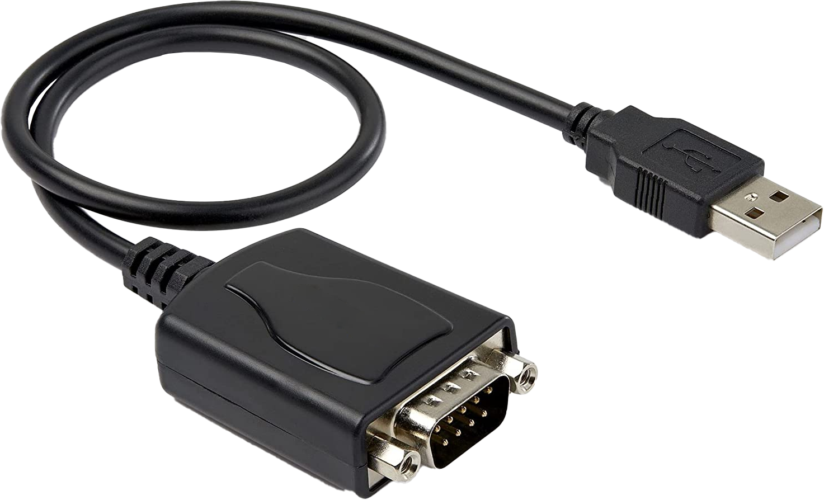
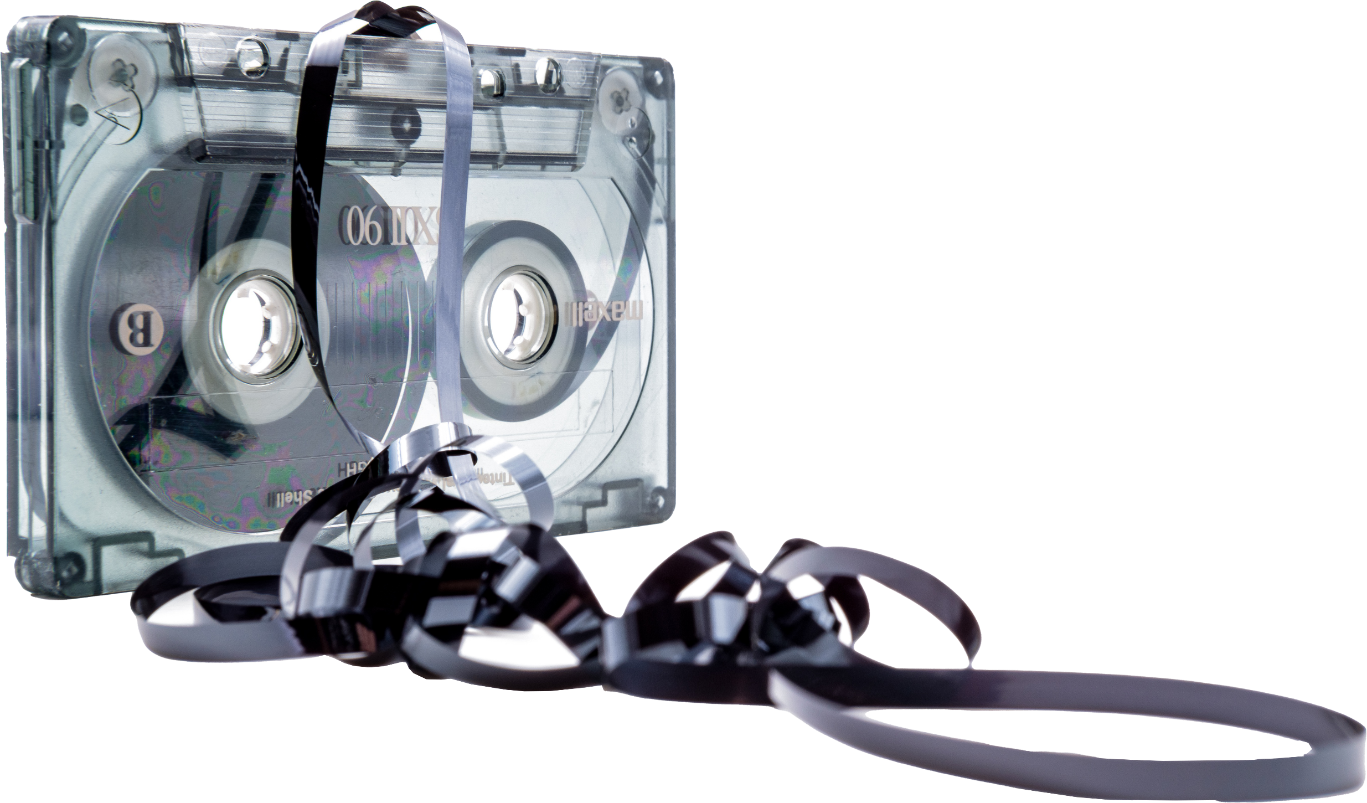
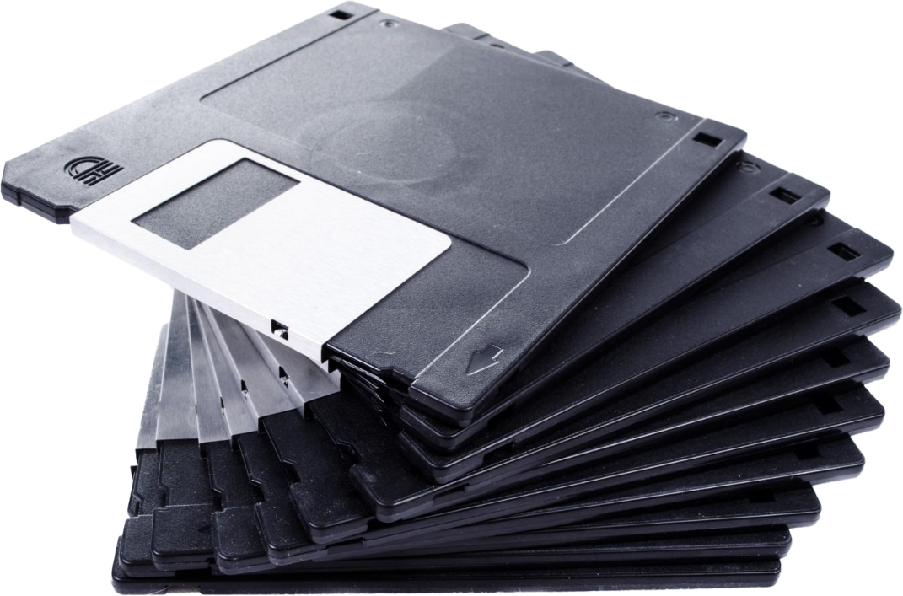
Serial Ports
Obsolete nowadays
- Only generally used to access old equipment
ITFreeTraining.com
© Copyright 2024
Notes:
00:02 Serial cables and their ports are mostly obsolete nowadays. You won’t find them used with new equipment and they are pretty close to being considered completely obsolete like many devices before them. If I were to take a guess, I would say this would be the last A+ course to include serial cables before it is dropped from the content.
The serial interface is only generally used to access old equipment. For this reason, I doubt you will see an exam question on it, because generally the exam will focus on new technology rather than old technology. In your IT career, you may never have the need to access a device using a serial cable. If you do, you may want to use a video like this one to assist you in the process. I personally would not worry about remembering too much about serial cables. Essentially, just have a basic understanding of how they work and where to find information about how to use them, in the rare case you may need to use one.

Slide 3
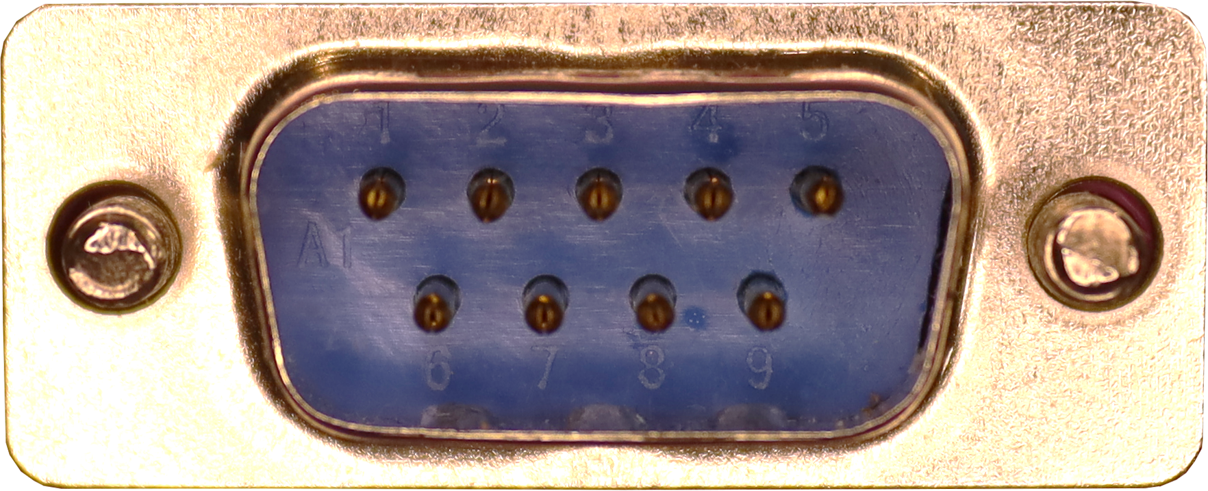
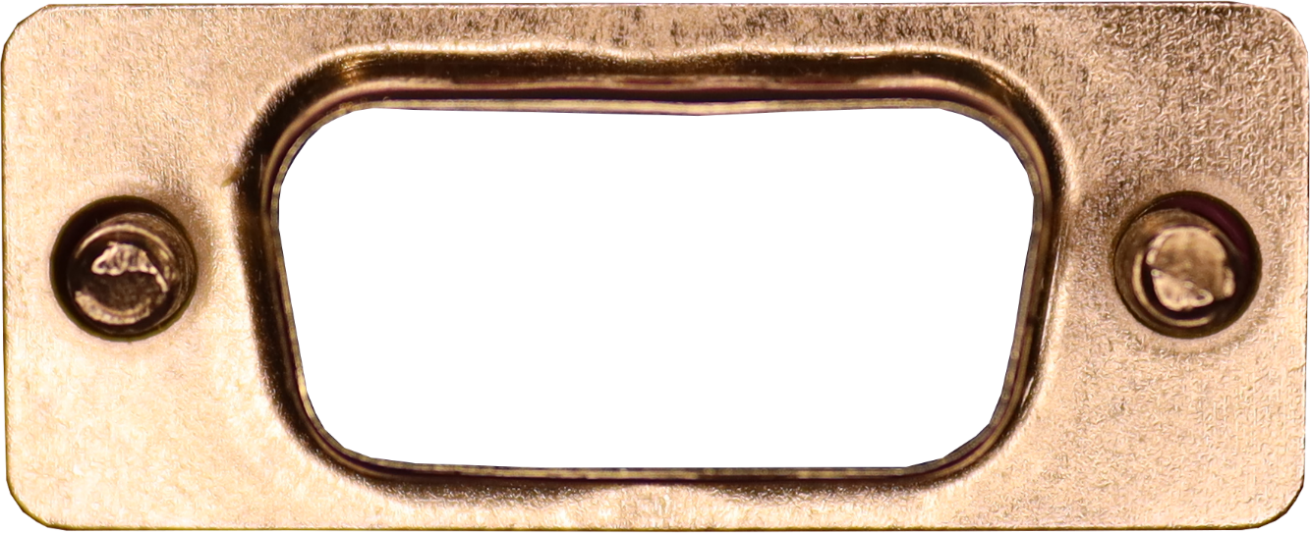
Serial Ports
In the old days common for computers to have both
Larger port became less common. 2x small ports
1x small port became common
Port replaced by header or not present
DE-9
DB-25
D refers to the shape of connector
E and B refers to the size of the connector
Number refers to the number of pins
RS-232 refers to the protocol used for communication
ITFreeTraining.com
© Copyright 2024
Notes:
00:59 In the old days of computing, a computer would commonly have two serial ports. The smaller DE-9 serial port and the larger DB-25 serial port. The D in the connector refers to the shape of the connector. The E and B in the connector refers to the size of the connector. The number at the end refers to the number of pins in the connector.
In some cases, you may hear a serial port referred to as RS-232. RS-232 refers to the protocol used by the serial port for communication.
The larger serial port transmits the same amount of data and speed as the smaller one. What is different between the two is the extra pins provide extra functionality. This extra functionality went mostly unused and as time passed manufacturers stopped using them in their devices. As a consequence of this, computers stopped using the larger port and it became more common to see two smaller serial ports.
As time went on, technology such as USB replaced the need to have serial ports. USB is simpler to use and offers much faster speeds. Thus, computers started only having a single serial port and more USB ports started being used. Time went on, and the serial port was removed completely. In some cases, your motherboard may have a header on it to connect a serial port to; however, even that is starting to become rare. There are USB to serial port adapters on the market. Therefore, if you need to access one nowadays, the simplest and easiest way is often to purchase a USB to serial port adapter.
Let’s have a look at an example of when you may use a serial port to get an idea of how it would work.

Slide 4
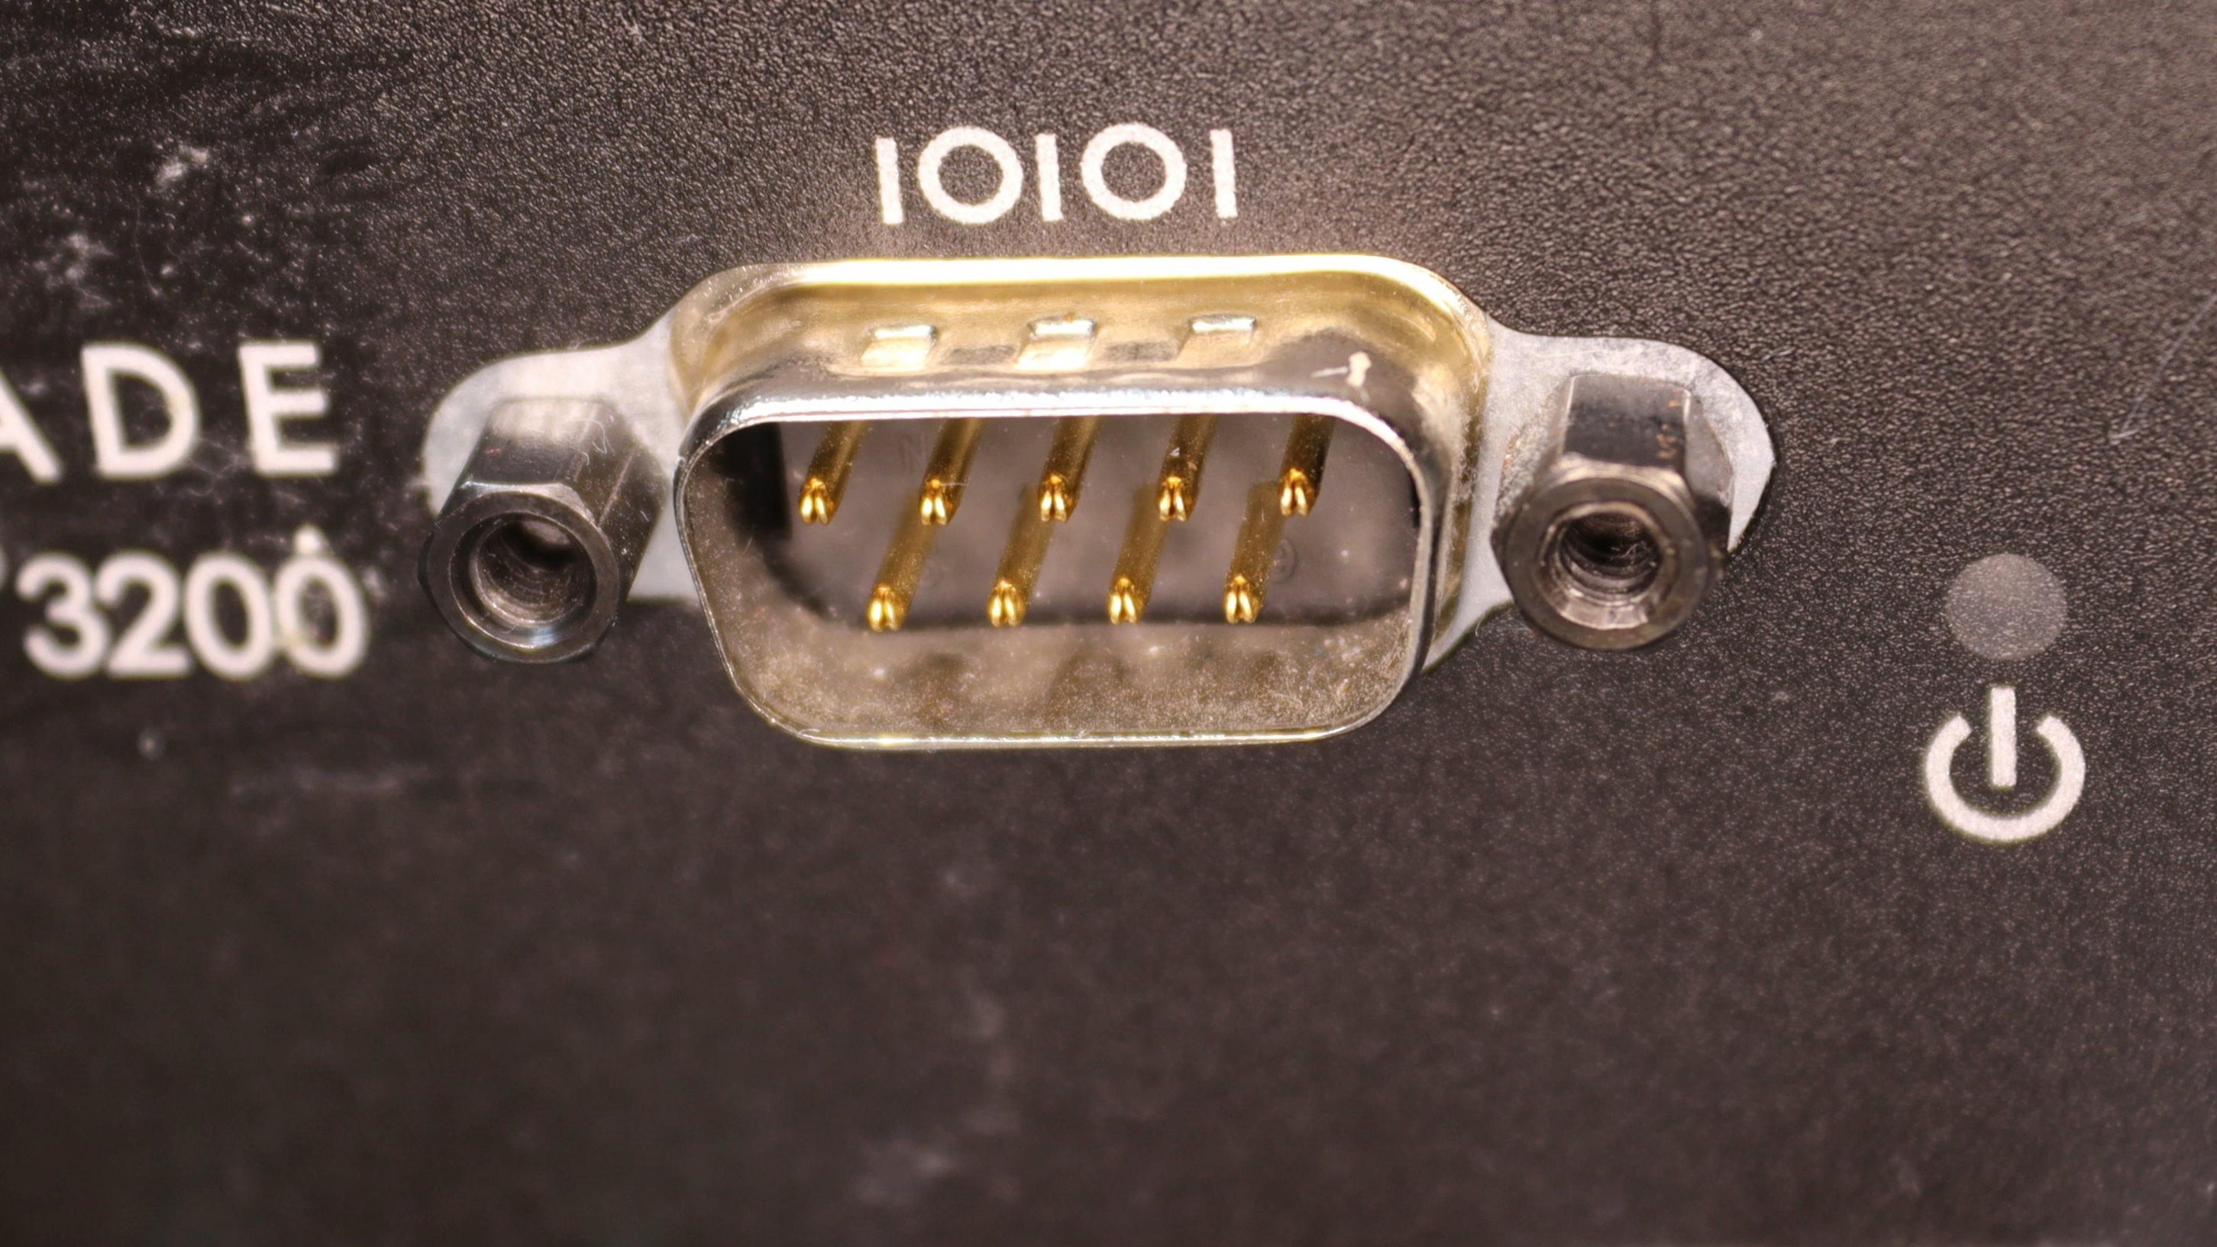
Serial Access to Fiber Switch
Serial port provides access to text console
ITFreeTraining.com
© Copyright 2024
Notes:
02:45 This is an old SilkWorm fiber switch that has a serial port on the front. You generally find nowadays, that, if a device has a console port, it will probably use an ARJ-45 port or a USB port rather than a serial port like this one.
Regardless of which port the device has, it will act as a serial port to access the text console of the device. Not all devices will have one. Nowadays, a lot of devices will be accessible using the network. Most administrators will use the console port for initial network configuration only. Once the network is configured, they will access the device via the network. For a lot of newer devices, the initial configuration can be performed using a network connection and the console port is not required.
In most cases nowadays, the device will also have an interface that can be accessed using a web browser, which will be simpler for making configuration changes rather than using the console. The other time that an administrator will access the device using a serial port is when they can’t access the device using the network, perhaps due to a network misconfiguration or a factory reset needing to be performed on the device.

Slide 5
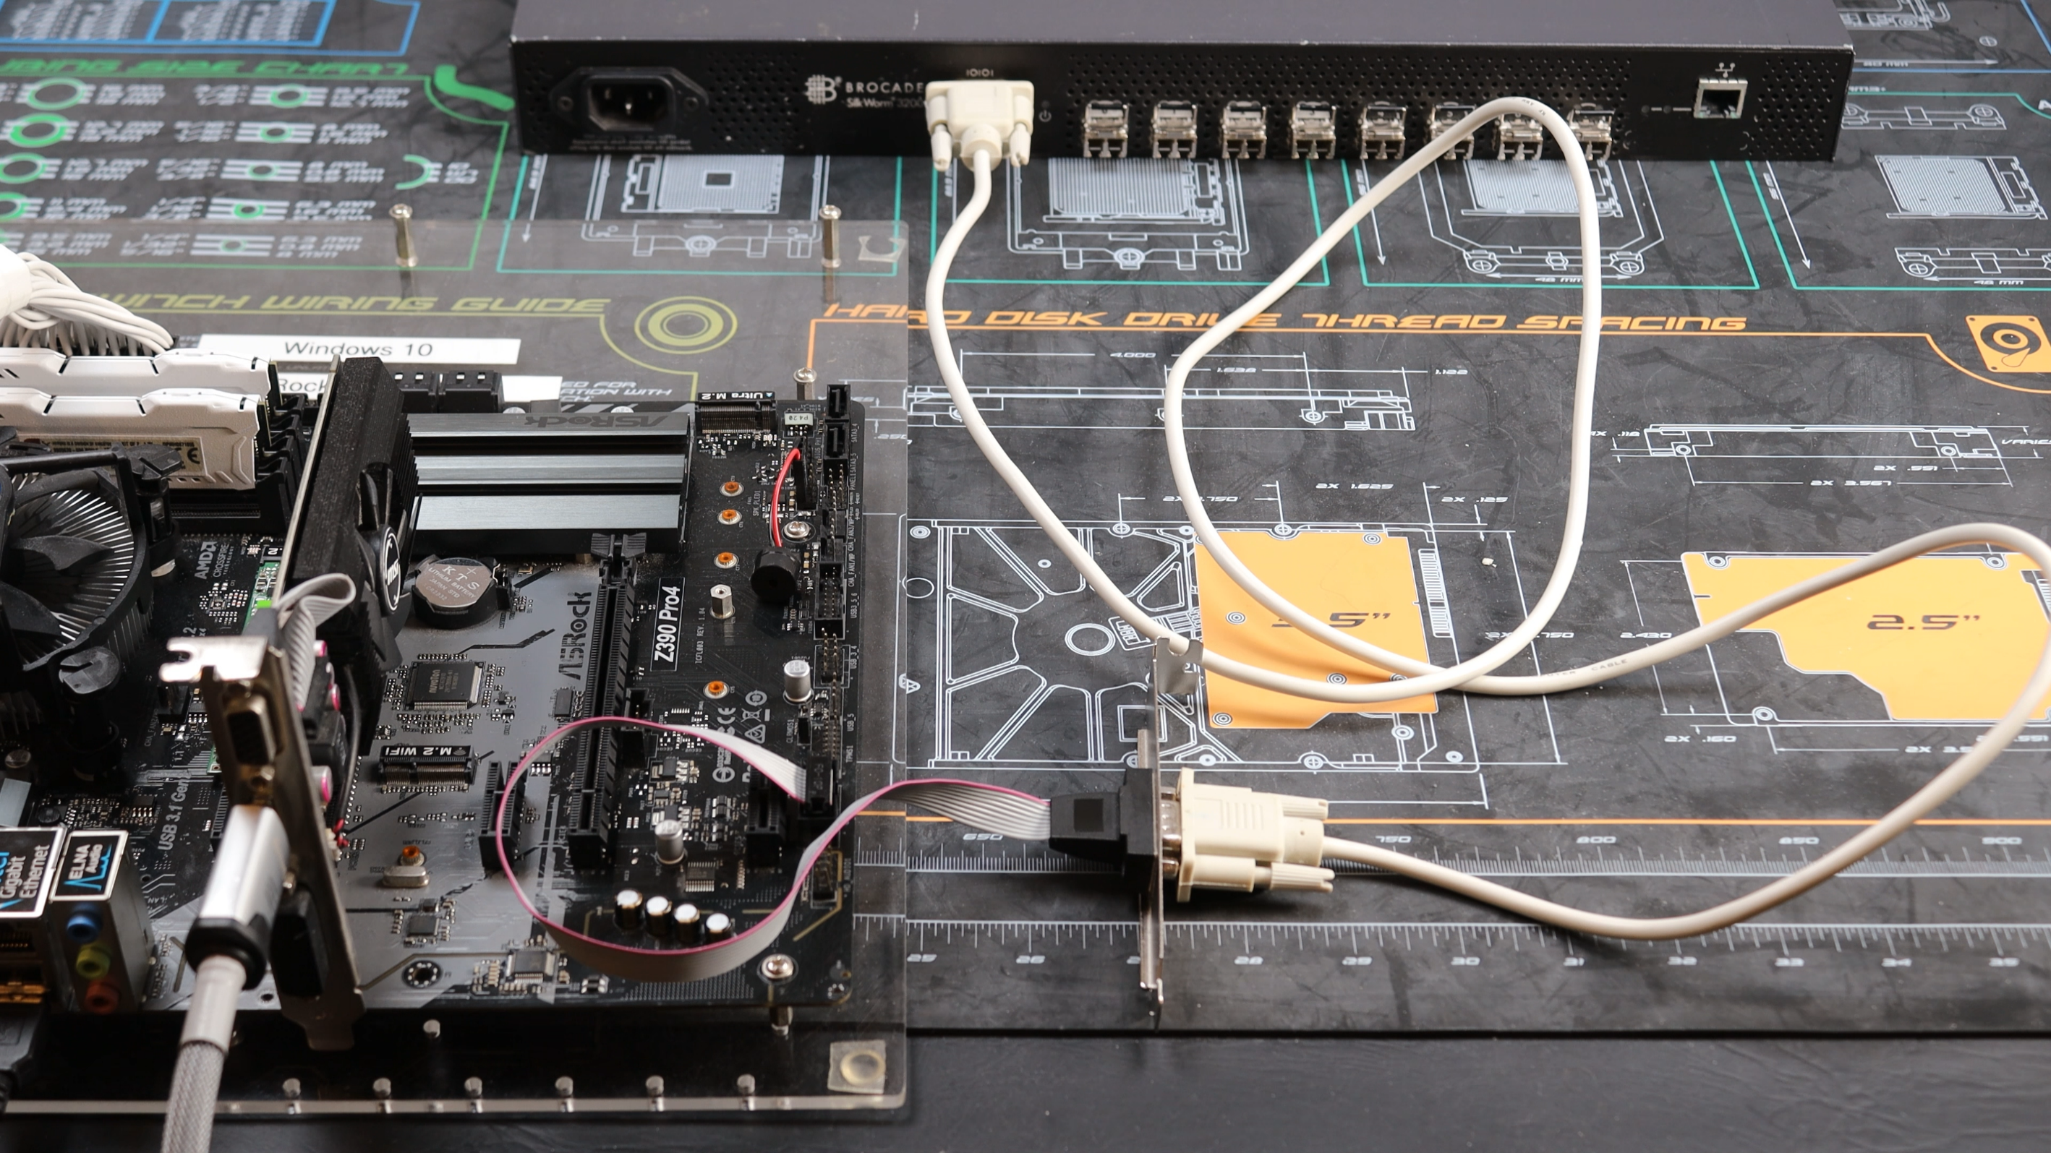
Serial Port Header
Becoming very rare on new motherboards
ITFreeTraining.com
© Copyright 2024
Notes:
03:58 Let’s now have a look at connecting our fiber switch to a serial port using the motherboard serial header. In this example, I will use a serial port bracket to connect to the serial port header on the motherboard. Since a serial port is often used to connect to a console, you may also hear this referred to as a console port or COM port.
Since serial ports are considered a redundant connection by today’s standards, serial port headers on motherboards are becoming more and more rare. Some motherboards will have them, while others will not.
It is just a simple matter of plugging it into the serial header on the motherboard. If I was using a computer case, I could connect the bracket on the other end to an expansion slot just like an expansion card, if I wished. I won’t in this example connect the bracket to a computer case.
The next step is to plug a cable into the serial port. You can see the cable has female connectors on each end. It is just a matter of plugging it in. The other end is plugged into the device. It is just a matter of purchasing the right cable. In most cases, a straight serial cable is required. For some devices, you may need a special cable called a rollover cable – here the pins are reversed on one side. Roll over cables are commonly used in Cisco devices.
The computer is now connected by the serial header to the device using a serial cable.

Slide 6
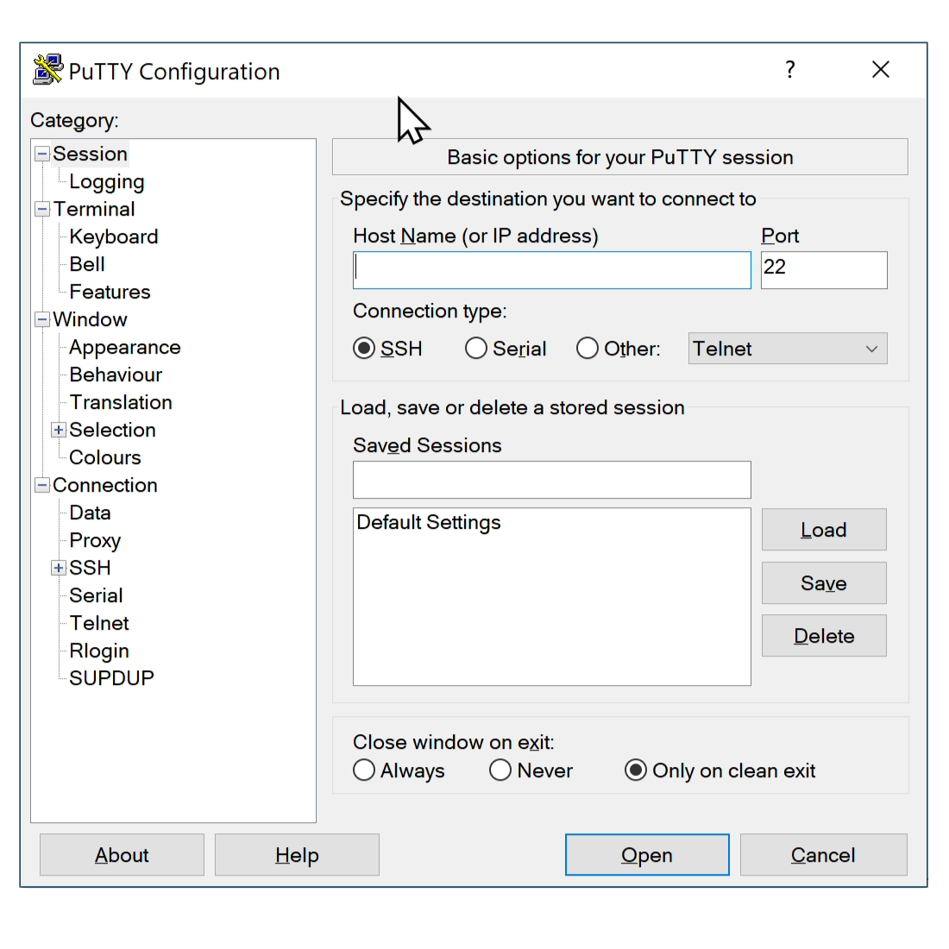
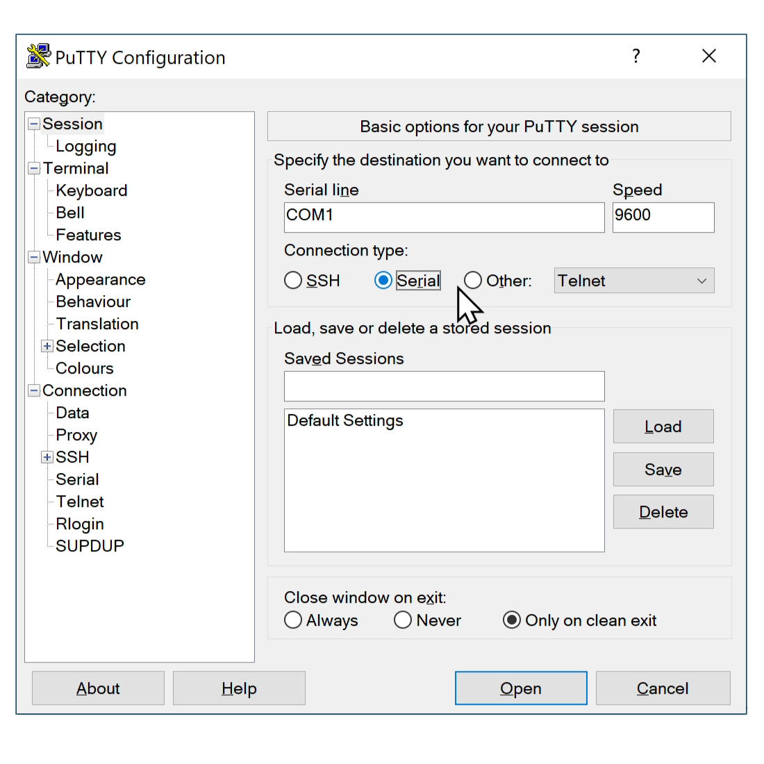
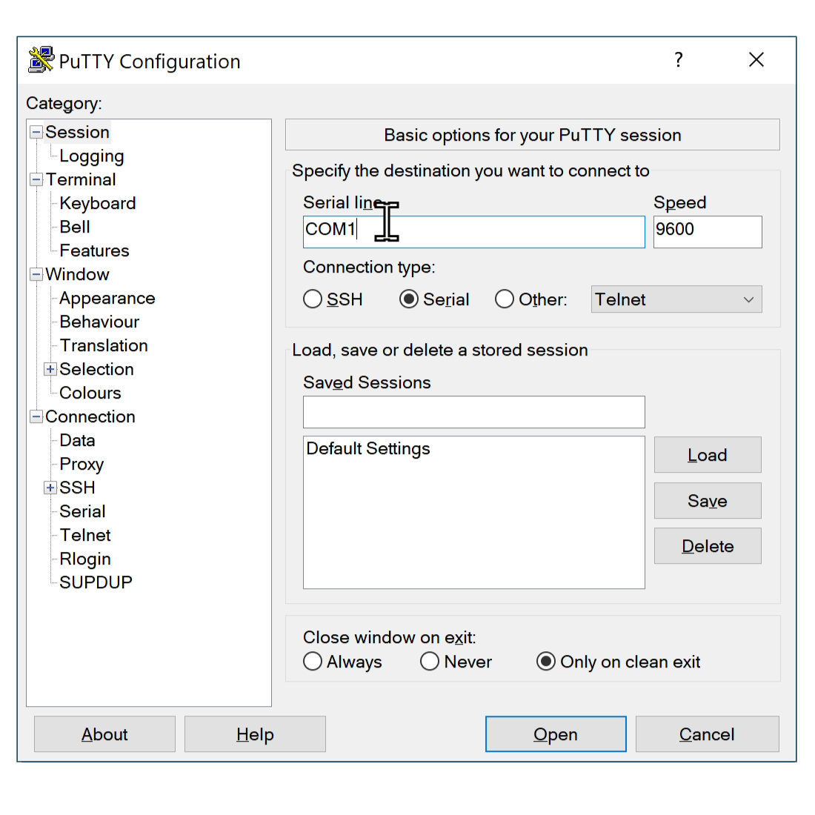
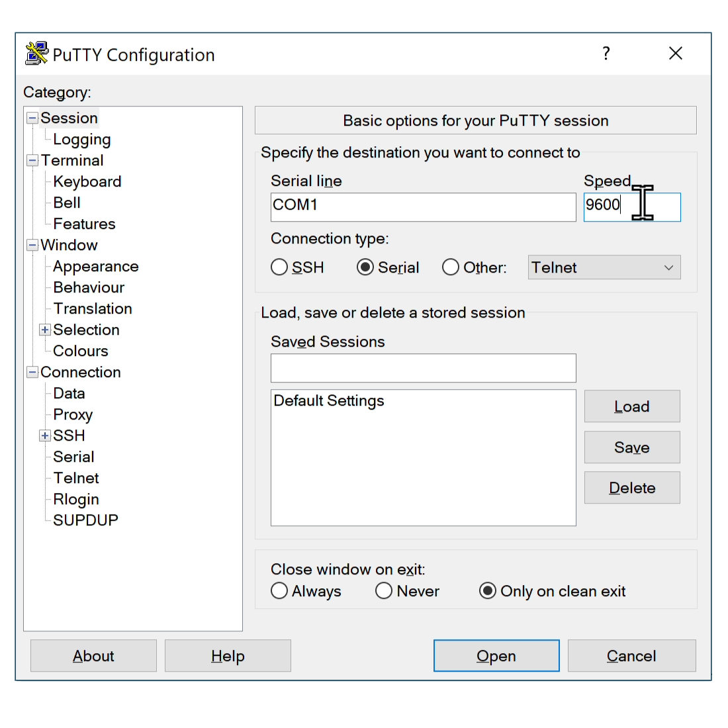
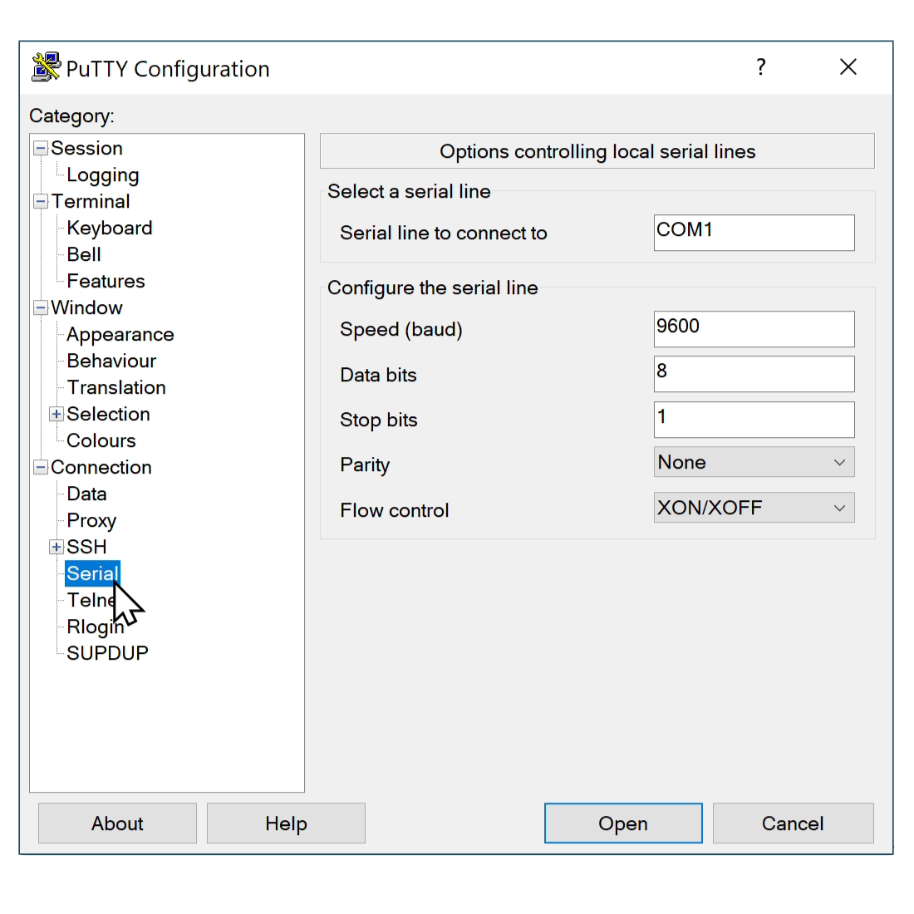
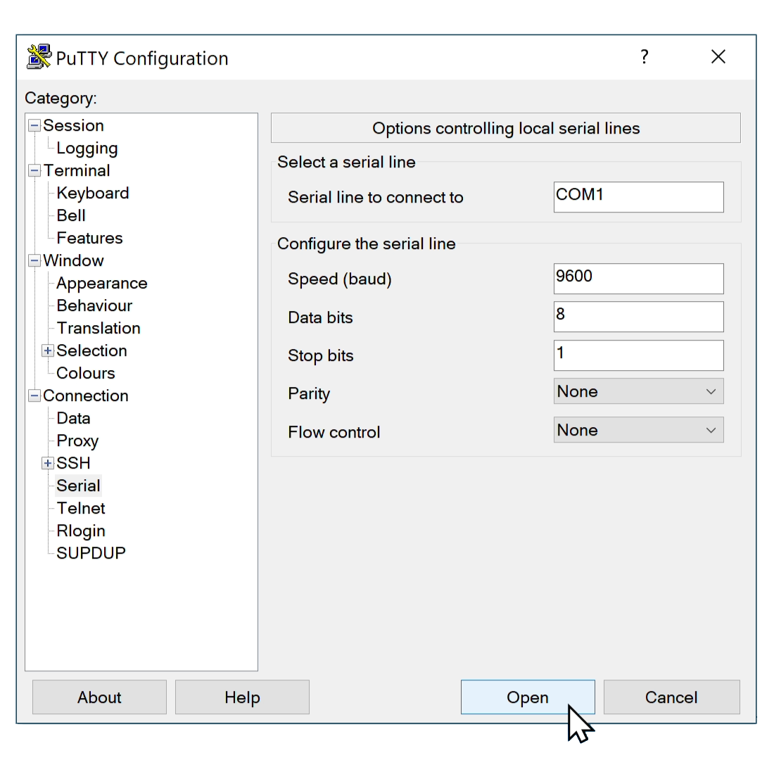
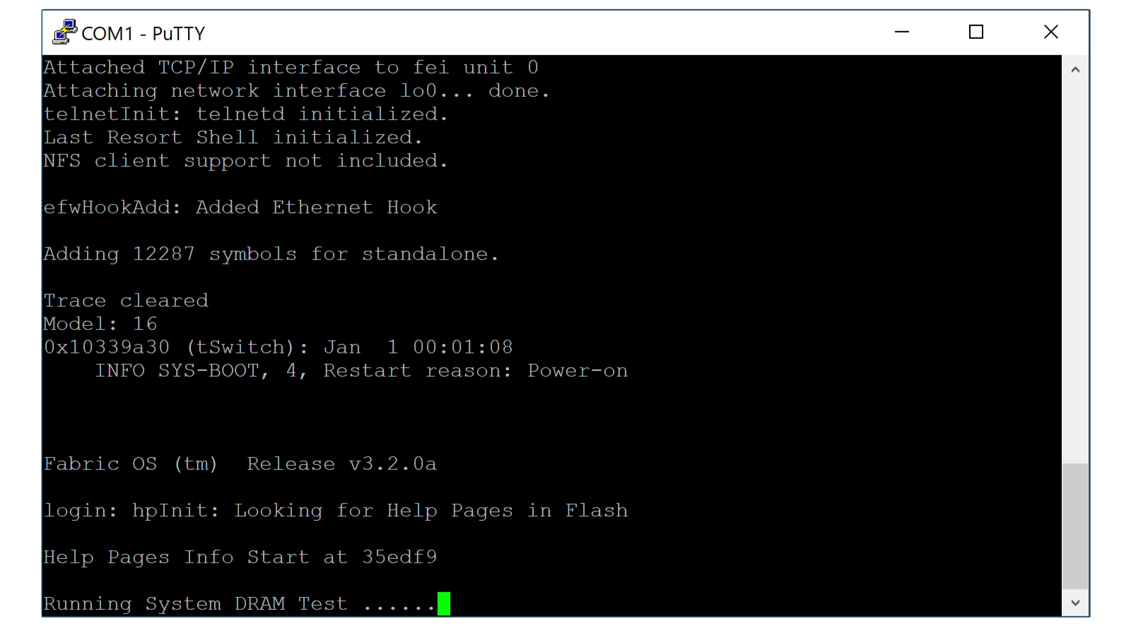
Putty https://www.putty.org/
Free Telnet/SSH/Serial
Select Serial option
Select Serial on left side
Press Open to connect
Enter port, e.g., COM1
Data bits: 8 Stop bits:1
Enter speed, e.g., 9600
Parity/Flow control: None
ITFreeTraining.com
© Copyright 2024
Notes:
05:23 For the next step, you need some software to access the serial port. In this example, I will use some free software called Putty. Putty supports Telnet, Secure Shell and also Serial. You will find that a lot of administrators will use Putty as it is easy to use, has a lot of features and of course is free!
To start with, run Putty and then select the option Serial. This will change the host name to serial line. By default it will be COM1. In this case, my serial port is serial port 1, thus I will leave it in on this. If your serial port is different you will need to change it.
For speed, the default is 9600. Nowadays, this speed will work with most devices. If it does not work, consult your documentation for your device to determine which speed you need to use.
Next you need to set the serial specific options. To do this, on the left-hand side, select the option Serial. The only option that I will change from the default is to change flow control to None. This gives us the following options: data bits 8, stops bits 1, parity and flow control both being none.
These options are pretty common for most devices. Sometimes, you may need to change the options. If this is the case, you will need to consult the documentation for the device to find out which settings you need to use or try trial and error until you get the right settings.
Once you have the settings configured, press the Open button. This will connect a terminal session to the device using the serial port. You will notice a text window will open and display the console output from the device. Using this terminal, you can also send input to the device using the keyboard. Nowadays, if you are not able to connect the device using other methods, you may need to connect using the serial port. Most administrators will connect to the device using other methods, such as via the network, and only use the serial port if all other methods fail.

Slide 7
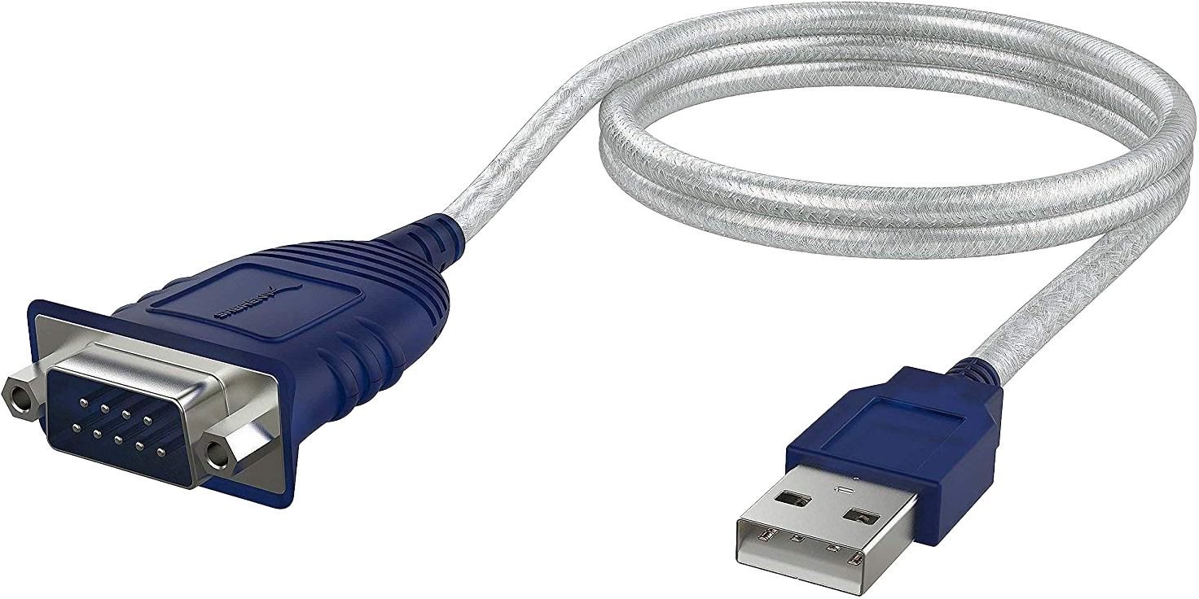
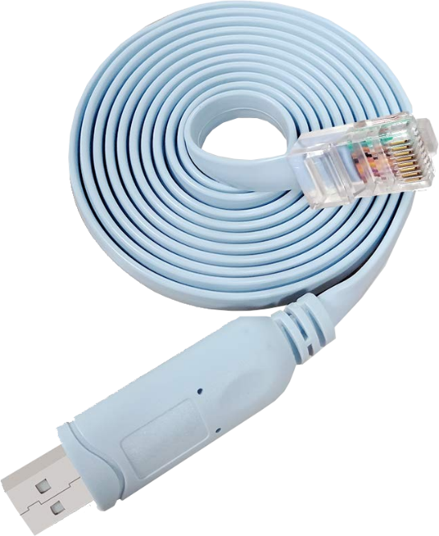
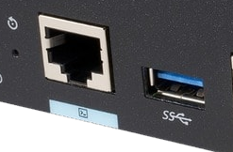
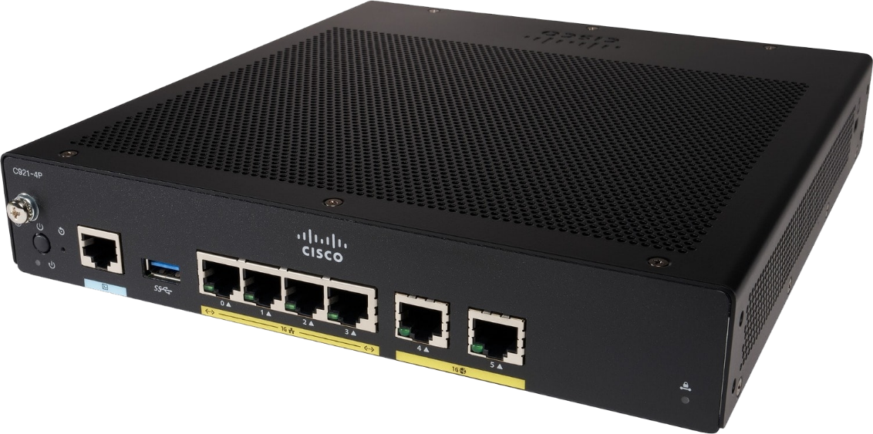
In The Real World
Simplest solution - use USB to serial
Find port number in device manager
Some devices have different plug
E.g., RJ-45 port
Requires different cable
Some devices support USB
May require additional device driver
Will appear as a COM port (Serial port)
ITFreeTraining.com
© Copyright 2024
Notes:
07:24 In the real world, the simplest solution to access a device using the serial port is to purchase a USB to serial cable. This is a lot simpler than using a serial port header, even if one is available. Once you plug in the USB to serial cable, have a look in the device manager to find out which COM port it is using. In this example, the port being used is number three. Thus, if I was using Putty, I would need to enter COM3.
If you unplug the USB serial cable and plug it back in, it may change to a different COM port number, so don’t expect it to always be the same if you plug it into a different USB plug.
Some devices may use a different plug for the console port other than a serial port. In this example, the console port is an RJ-45 plug. When this occurs, you will require a USB to RJ-45 cable in order to access the console.
Some devices, for example this device, also support USB for console access. If this is the case, you may require an additional device driver. Once the device driver is installed, the USB cable connected to the device should appear in device manager as a COM port. As before, it is just a matter of looking in device manager to determine the COM port number and then connecting to it using Putty.
Serial ports by today’s standards are old technology. You most likely will only need to use one to access old devices. If you find one on a new device with a serial port, most likely it will be using RJ-45 or USB. In some cases, the initial configuration may be required using the console, but many support initial configuration using the network. Configuration after that will most likely be done using the network. In some rare cases, the device may need to be accessed using the console, for example, if network access is not possible.

Slide 8
Subscribe
Next video
Video content: https://ITFreeTraining.com/ap11/1c25
© Copyright 2024
Notes:
09:23 I hope this video has helped you understand more about serial ports. You probably won’t get an exam question on serial ports, but I hope this video helps you if you need to access a device using a serial port. Until the next video from us, I would like to thank you for watching.
References
“The Official CompTIA A+ Core Study Guide (Exam 220-1101)” page 38
“Picture: Typewrite” https://pixabay.com/photos/black-typewriter-old-retro-vintage-686932/
“Picture: Floppy Disks” https://pixabay.com/photos/isolated-floppy-file-save-white-316392/
“Picture: Cassette Tape” https://pixabay.com/photos/mixed-up-confusion-cassette-4808775/
Credits
Trainer: Austin Mason https://ITFreeTraining.com
Voice Talent: HP Lewis https://hplewis.com
Quality Assurance: Brett Batson https://www.pbb-proofreading.uk

