Slide 1
Notes:
Let’s have a look at Video Graphics Array, better known as VGA.

Slide 2
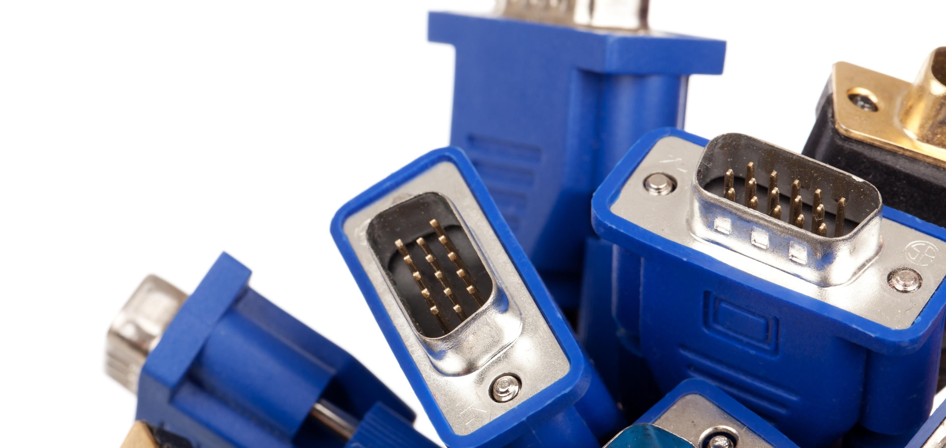
Video Graphics Array (VGA)
Released in 1987
Considered obsolete
Still used for compatibility
ITFreeTraining.com
© Copyright 2024
Notes:
0:00:05 VGA was released in 1987 and is now considered obsolete. You will see it pop up now and again for compatibility reasons, but there is better technology available, so you should never need to use VGA unless you have to.
It is unlikely that you will get asked a question about VGA on the exam given how old the technology is. CompTIA still has VGA listed as an exam objective, so I will spend a little bit of time explaining where you may come across it and why you should avoid using it in favor of newer technologies.

Slide 3
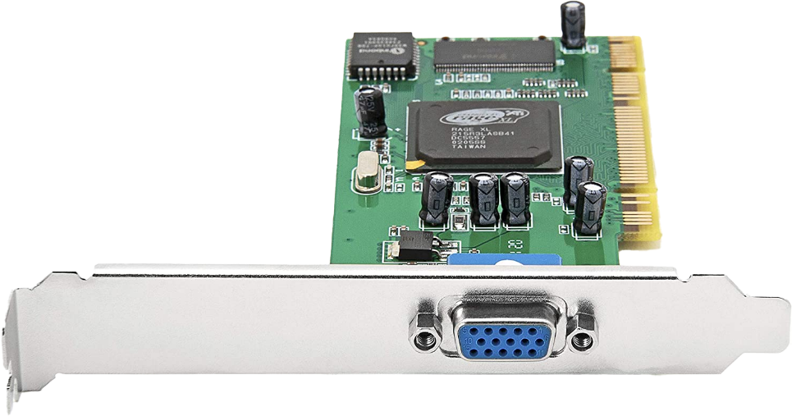
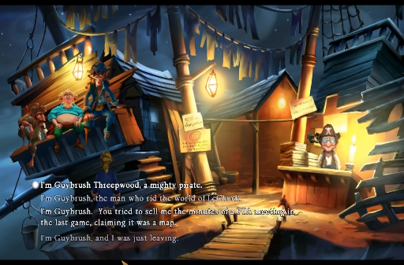
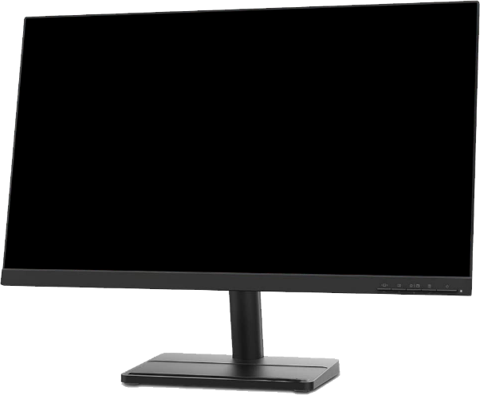
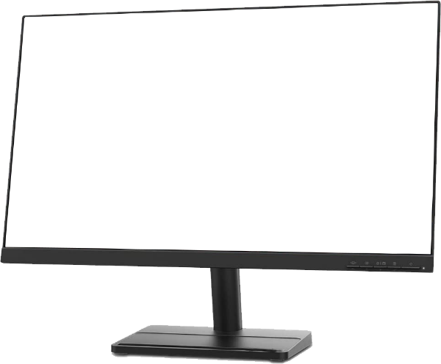
VGA Uses Analog Signal
CRT Analog
Digital to analog conversion
LCD Digital
Digital to analog conversion
Analog to digital conversion
ITFreeTraining.com
© Copyright 2024
Notes:
0:00:40 VGA uses an analog signal and not a digital signal. To understand why this was once a good thing, let’s consider an example. In this example we have a computer with a VGA graphics card.
Computers work digitally, thus communication with the graphics card is digital. The data is stored digitally in the memory on the video card. Back in the old days, CRT monitors used to display graphics from the computer using an analog input signal. The VGA graphics card outputs an analog signal and thus is the same signal type as the CRT monitor. Thus, one conversion from the computer to the monitor.
Now, let’s consider what happens when we use a computer that outputs to an LCD screen which is digital. Nowadays CRT monitors are obsolete and no longer made, so it would be rare to come across one. As before, the computer communicates with the VGA graphics card digitally.
The graphics card outputs an analog signal to the monitor since VGA was designed to use analog. As before, a digital to analog conversion is performed by the graphics card. However, in order to display the graphics on the LCD monitor, an analog to digital conversion must also be performed. You can see, besides VGA being old technology, it is not preferred for video displays nowadays as two conversions are required. One from digital to analog and then from analog back to digital. Each time you perform a conversion like this, you risk reducing the quality of the signal. Thus, since computers and their devices are all digital nowadays, you should only use VGA if you have no other choice.

Slide 4
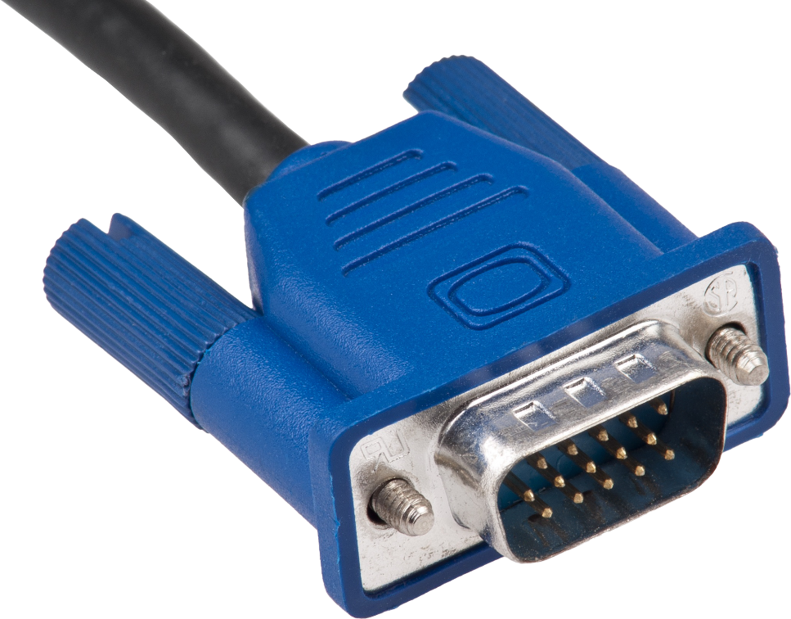
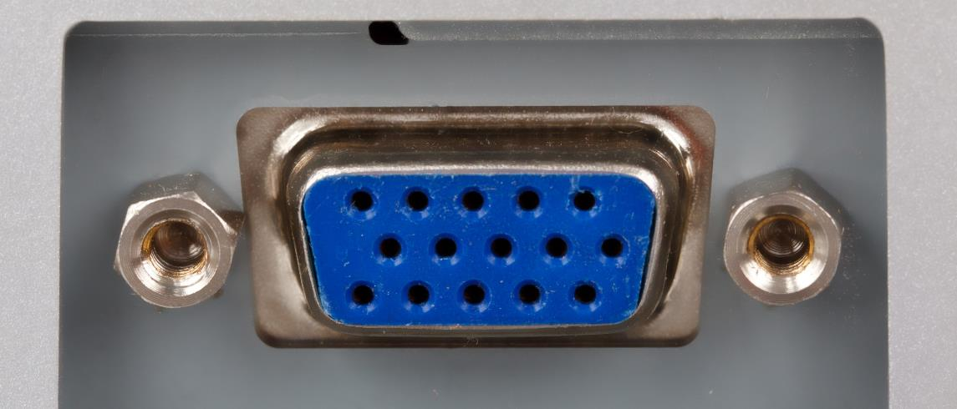
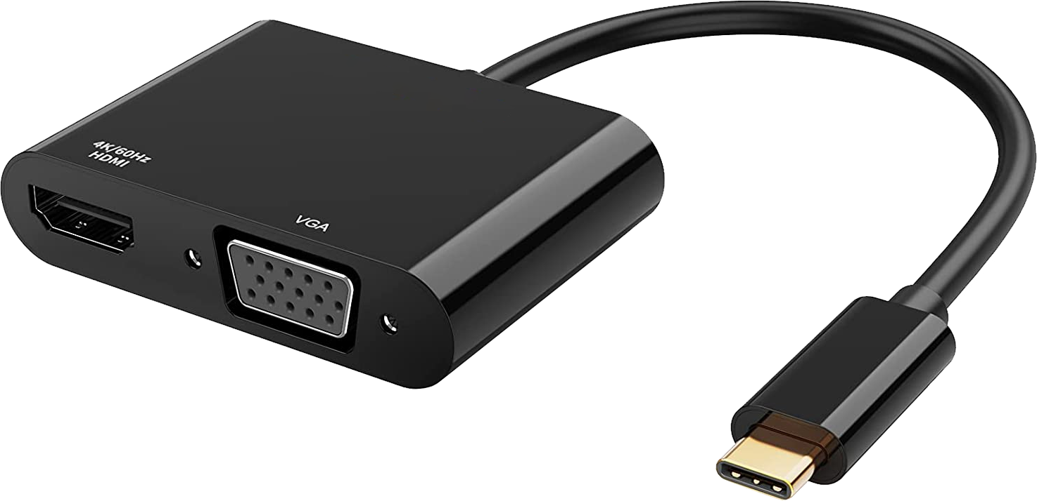
VGA Connector
15-pin D-subminiature
Recognize it
Use as last resort
Often found on a lot of projectors
Found on some adapters
ITFreeTraining.com
© Copyright 2024
Notes:
0:02:25 The VGA connector is a 15 pin D-Subminiature connector or D-Sub for short. It got its name because the metal around the connector looks like a D shape. It is important to recognize this connector so you will know to use it as a last resort.
You will find that the VGA connector is no longer included with computers and graphics cards. It was used frequently for backward compatibility, but is now very rarely found on new devices. With a plethora of digital options available, there is not much use for a VGA connector on new devices. You will, however, often still find it on a lot of projectors. Projectors tend to support more connectors than any other device. The reason I see behind that is, projectors cost quite a bit of money, even the low budget ones, and the manufacturer does not want to lose a sale due to not having even an old legacy connector on it. Thus, don’t be surprised if you see a VGA connector used on a projector. However, you will find on many modern projectors the VGA connector is starting to disappear.
The other place that you may still find VGA connectors is with adapters such as USB adapters. In the case of this adapter, it has a VGA connector and a HDMI connector. Since HDMI is digital, it is preferable to use HDMI over VGA.
You will also find that new monitors don’t tend to have a VGA connector on them anymore. If your monitor does have one, try not to use it unless you have to. The main takeaway with VGA nowadays is, unless you have old equipment that needs to use it, don’t.

Slide 5
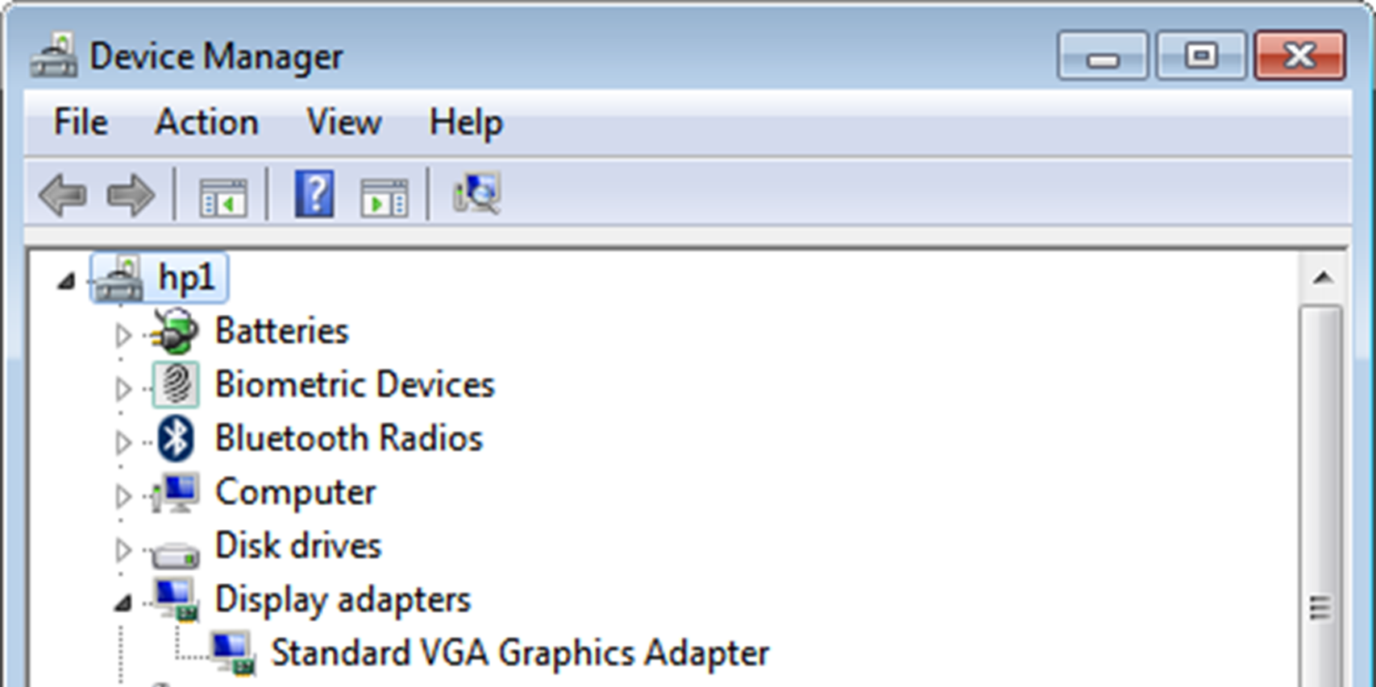
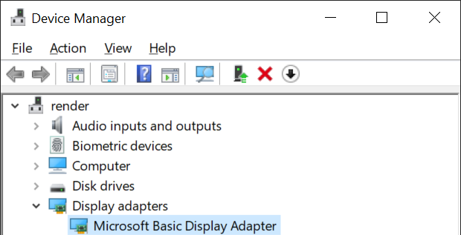
VGA Compatibility
VGA resolutions used for compatibility
Lower resolutions, e.g., 640x480, 800x600, 1024x768
Standard VGA Graphics Adapter
Microsoft Basic Display Adapter
Earlier Windows versions
Better performance than VGA adapter
Emulates graphics adapter (Slow)
Should change to manufacturer's driver
ITFreeTraining.com
© Copyright 2024
Notes:
0:04:03 You may hear the term VGA used to refer to lower graphics resolutions. Technically, some of the resolutions use different names like SVGA or XGA, but a lot of the time you will hear these lower resolutions referred to as VGA.
In older versions of Windows, when a graphics device driver is not present, the Standard VGA Graphics Adapter will be used. This device driver, essentially, emulates a VGA graphics adapter and thus is slow. It is designed to give you basic graphics support, so you don’t get stuck without any graphics. When you see this device driver being used, you should look at updating the device driver with one from the manufacturer of your graphics card.
In later versions of Windows, the device driver changed to the “Microsoft Basic Display Adapter”. This adapter offers better performance than the VGA adapter. You won’t be given a choice which to use, Windows will automatically install one or the other when it can’t find a device driver for the graphics adapter in your computer.
When you see one of these graphics adapters, you should update it to the manufacturer’s device driver. Although this device driver is an improvement over the Standard VGA Graphics Adapter, it still won’t give you the same performance as a device driver from your manufacturer.

Slide 6
Subscribe
Next video
Video content: https://ITFreeTraining.com/ap11/1c10
© Copyright 2024
Notes:
0:05:21 That concludes this video from ITFreeTraining on the VGA graphics adapter. I hope this video has helped you understand VGA a bit better. Nowadays you probably won’t need to use it, but if you do, best of luck.
References
“The Official CompTIA A+ Core Study Guide (Exam 220-1101)” pages X to X
“Video Graphics Array” https://en.wikipedia.org/wiki/Video_Graphics_Array
“Picture: Video connectors” https://pixabay.com/photos/blue-cable-computer-connection-19898/
“Video: PC Longplay [114] Monkey Island 2 Special Edition: Lechuck's Revenge” https://www.youtube.com/watch?v=AerjOGn6jGo
“Picture: VGA Plug” https://pixabay.com/photos/analog-computer-connect-connection-20871/
“Picture: VGA Connector” https://pixabay.com/photos/vga-cable-plug-computer-technology-2202321/
Credits
Trainer: Austin Mason https://ITFreeTraining.com
Voice Talent: AR Hellenberg https://humanaudioventures.my.canva.site/
Quality Assurance: Brett Batson https://www.pbb-proofreading.uk

