Slide 1
Notes:
Let’s have a look at DVI.

Slide 2
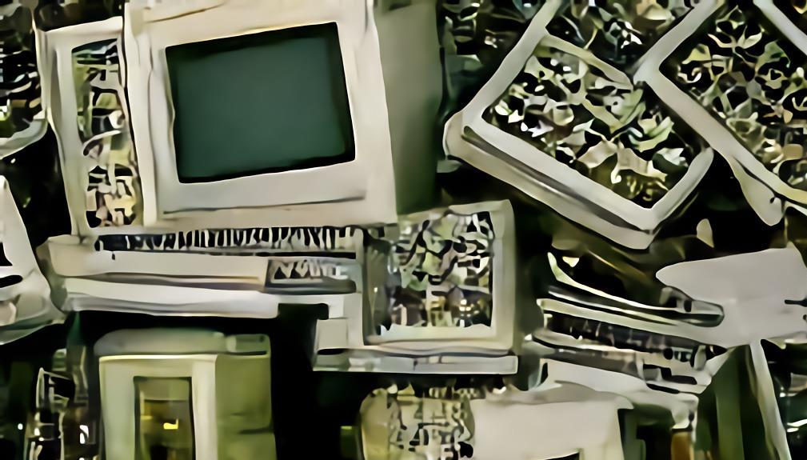
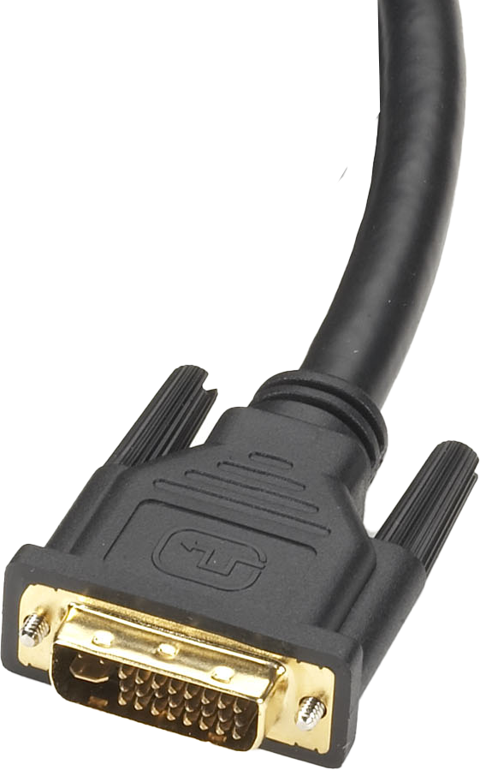
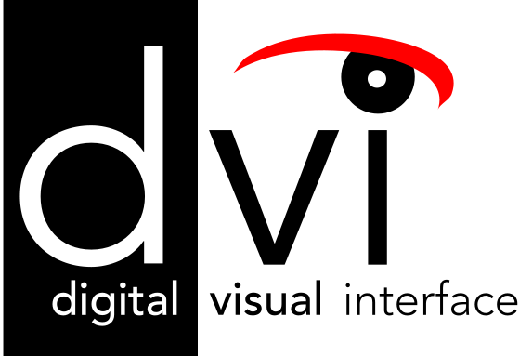
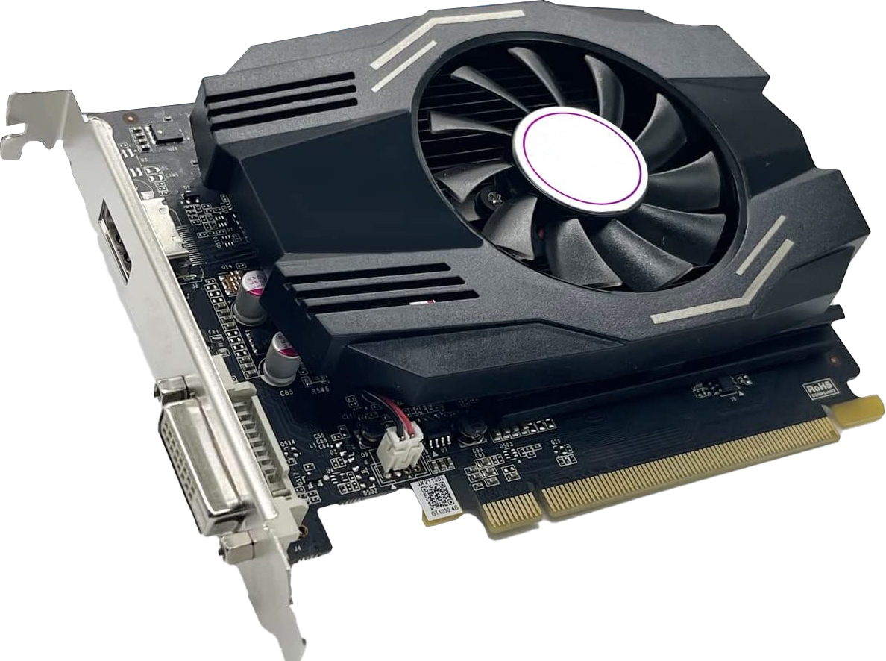
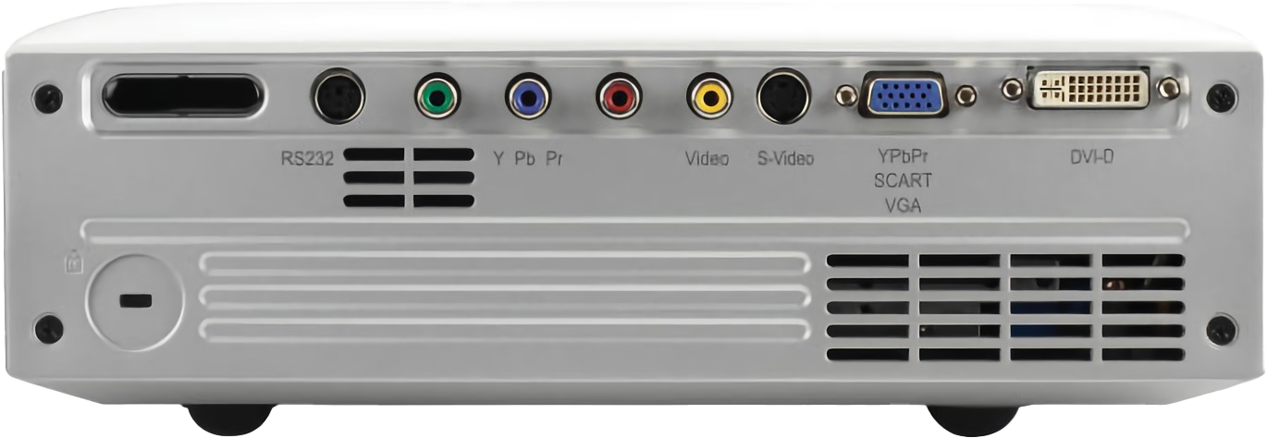
Digital Visual Interface (DVI)
Released in 1999 (obsolete)
No longer maintained
Found in old equipment
Found on projectors, but becoming rare
ITFreeTraining.com
© Copyright 2024
Notes:
00:03 Digital Visual Interface or DVI, was first released in 1999. It was the first cable to use digital but was also backward compatible with analog; however, nowadays it is obsolete and thus no longer maintained but does still appear as an exam objective. I doubt you will get a question about it. My guess at why it is an exam objective is, when you see it in the workplace, you will know what it is.
Nowadays, you will most likely come across DVI in old devices and projectors. Traditionally projectors had just about every connection possible; however, you will find DVI connections are starting to become rare even on projectors. So, if you purchase a new projector, you may find it does not have a DVI connector, but old projectors around the office probably have it.
I will have a quick look at the different DVI connectors, since it is in the course material, but you don’t need to know too much since DVI is pretty old technology.

Slide 3
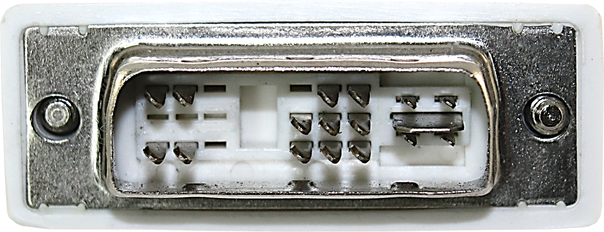
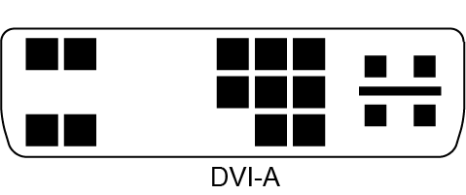
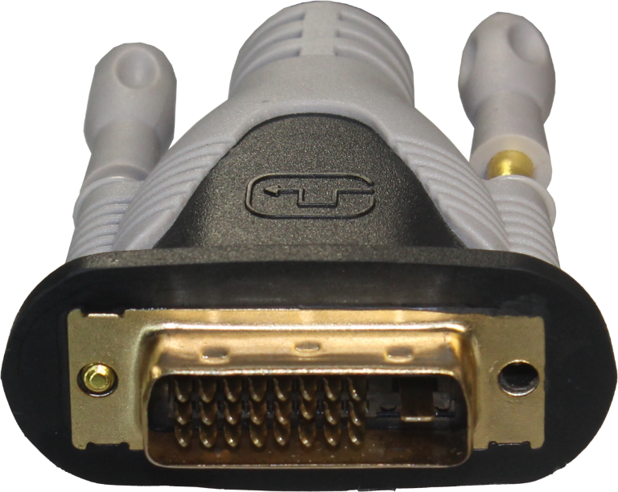
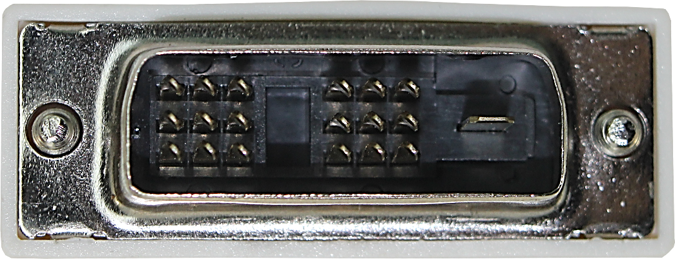
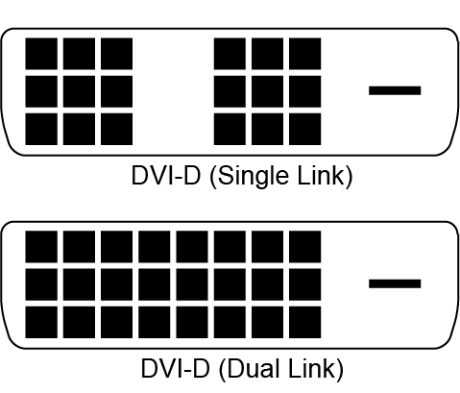
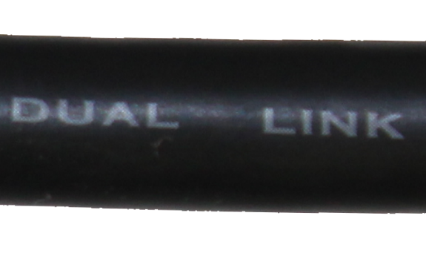
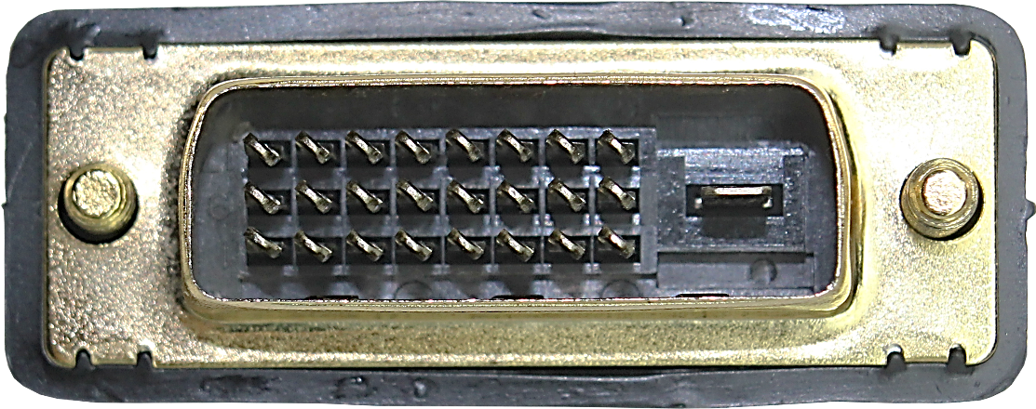
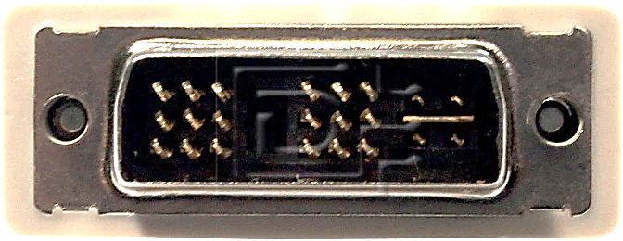
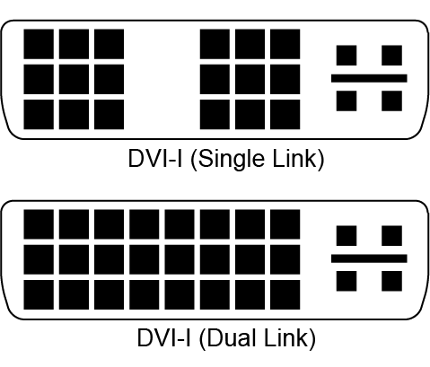
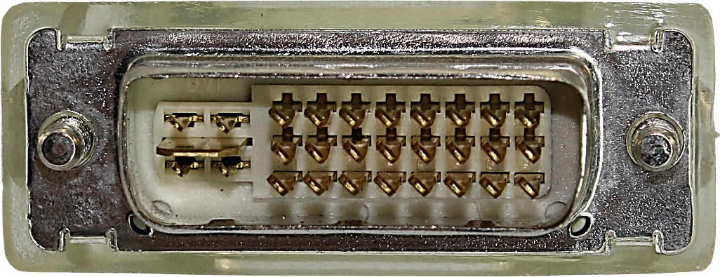
Connector Types
Analog (A)
Nowadays Buy DVI-I
Technically one data lane
Digital (D)
Single link (One lane)
Dual link (Double the bandwidth)
Digital and Analog (I)
Single link
Check packaging/cable
Dual link
Cable maybe single link
with dual-link plug
ITFreeTraining.com
© Copyright 2024
Notes:
01:03 There are a number of different connector types I will look at, starting with the analog connector, but I will give you a heads up, if you do purchase a DVI cable, I would purchase the DVI-I dual-link cable. This will support everything and thus you only need the one cable. In a moment I will explain why this cable is the one that you should get.
DVI superseded the older VGA standard which was an analog standard. To maintain compatibility with VGA it needed to support analog. The analog connector is referred to as DVI-A. This cable supports one data channel, so technically is one data lane; however, back then no one was using that terminology.
DVI was the first standard to support digital. Thus, the next connection that I will look at is DVI-D. This connector supports digital but does not support analog. It comes in two different types, the first being single link. Single link essentially means that one video data stream is sent over the cable and thus would be equivalent to one data lane. DVI-D also supports a second data channel which is called dual link. Since there are two data channels, this effectively doubles the bandwidth of the cable.
It would be good to have a cable that combines both analog and digital together. The good news is, we have such a cable, it is called DVI-I. Since DVI was released such a long time ago, there is a good chance most monitors will support both even if it is an old monitor. If you purchase a DVI-I cable, it will support analog and digital, so you can’t go wrong.
As before, DVI-I supports single link and dual link. You will notice that single link has fewer pins than dual link. The extra wires are required for the second data channel. Now there is one little caveat to look out for if you purchase a DVI cable. In some cases, particularly with cheap cables, the connector may be dual link, but only the single-link wires are connected. Thus, if you purchase a DVI-I cable, I would check the packaging or the cable to make sure that it is dual link. When you are purchasing cables, don’t assume anything. If you are not paying a lot for a cable, and this goes for any cable, there is a good chance that, because it is cheap, they have cut a corner in the manufacturing to save a little bit of money.
Since DVI is obsolete nowadays, let’s have a look at what you need to know so you can support it in the workplace.

Slide 4
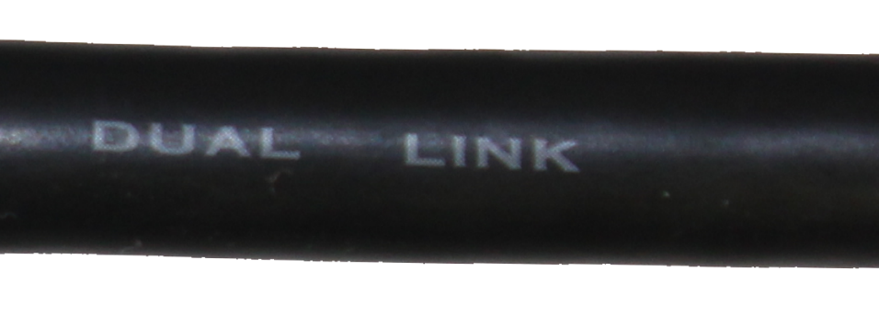
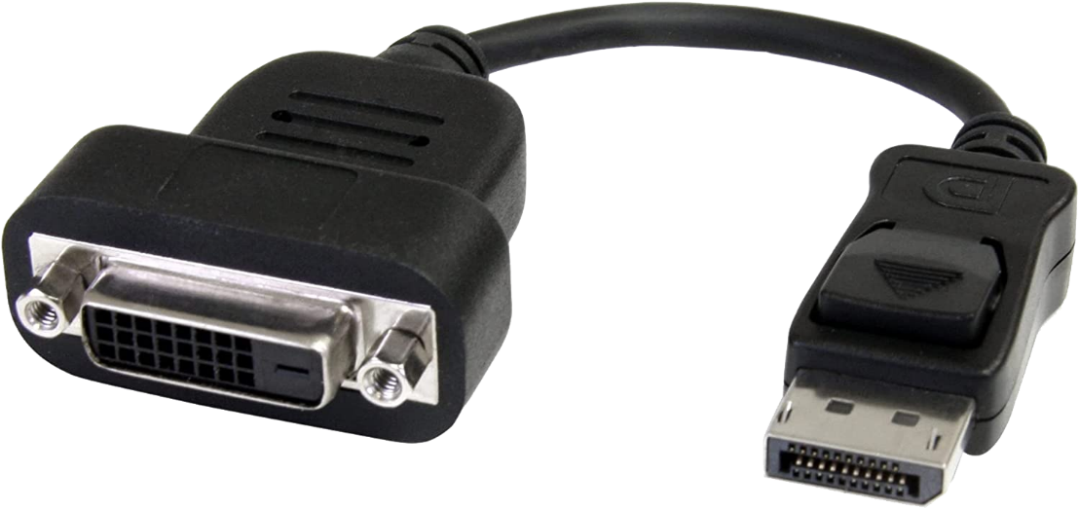
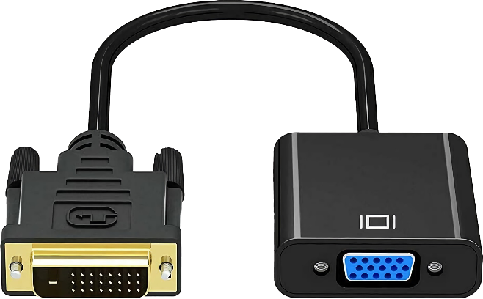
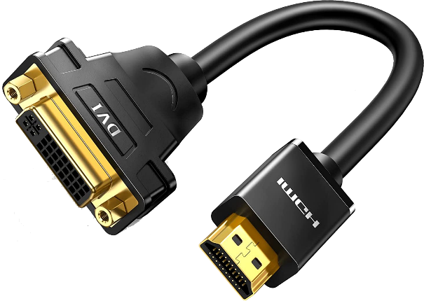
In The Real World
Nowadays obsolete and no longer updated/improved
When possible, use HDMI or DisplayPort
Most likely come across on projectors and old devices
If you purchase a DVI cable
Check packaging to make sure it is DVI-I dual link
Adapters available
Max resolution dual-link resolution 2560x1660 @ 60Hz
VGA analog only
HDMI analog and digital (Single link only)
DisplayPort digital only
(Single link only)
ITFreeTraining.com
© Copyright 2024
Notes:
03:49 In the real world there is not too much to know about DVI. It is useful to recognize a DVI connector – not so that you will use it, just so when you are looking through the cable box you can put the DVI cable back and get a HDMI or DisplayPort cable instead. Unless DVI is your only choice, I would not use it. The only time you will come across it is with old devices and projectors. Even then, a lot of these devices, unless they are very old, will have an HDMI or DisplayPort connector in addition to the DVI connection. So, when possible, use HDMI or DisplayPort.
If you have no choice and have to use DVI and you need to purchase a DVI cable, make sure the cable is DVI-I and dual link. You could of course purchase a different cable and it may meet your needs, but DVI-I dual link can be used for everything.
If you need to convert from DVI to other connector types, there are adapters available; however, there are limitations to these adapters. VGA is limited to analog since it does not support digital. HDMI will support analog and digital; however, it only supports single link. This will mean that this limits the maximum resolution that it supports. The maximum resolution of DVI dual link is 2560x1660 @ 60Hz. Thus, single link will be half of that resolution or approximately the equivalent of 1k resolution. I say equivalent since we were not using that terminology back then, so technically not correct, but it is about 1000 pixels across, thus if you are going to use this convention, it would be called 1k.
DisplayPort will only support digital and like HDMI only supports single link. Essentially the adapter does a remapping of the wires in the cable and can only map the wires to one data channel. The connectors simply don’t have enough wires to map a second data channel.
To sum all this up, if you are using DVI to DVI with a dual-link cable, you can get the equivalent of 2k resolution. With 4k screens becoming more common, this may not be sufficient, but it may be enough to get your projector running, since they tend to run at a lower resolution than the average desktop computer.
If you are using an adapter, you are going to get a resolution similar to a 1k resolution. Not a lot by today’s standards. So personally, nowadays, I would know how to identify a DVI connection and then try your best not to use it unless you have no other option.

Slide 5
Subscribe
Next video
Video content: https://ITFreeTraining.com/ap11/1c05
© Copyright 2024
Notes:
06:26 That covers it for DVI, hopefully you don’t need to use it anymore, but if you are in a position where you need to, hopefully this video has helped you. Until the next video from us, I would like to thank you for watching.
References
“The Official CompTIA A+ Core Study Guide (Exam 220-1101)” pages 34 to 35
“Picture: DVI Logo” https://en.wikipedia.org/wiki/Digital_Visual_Interface#/media/File:DVI.png
“Picture: AI generated obsolete computers” https://www.craiyon.com/
Credits
Trainer: Austin Mason https://ITFreeTraining.com
Voice Talent: HP Lewis https://hplewis.com
Quality Assurance: Brett Batson https://www.pbb-proofreading.uk

