Slide 1
Notes:
Let’s have a look at how to install a motherboard.

Slide 2
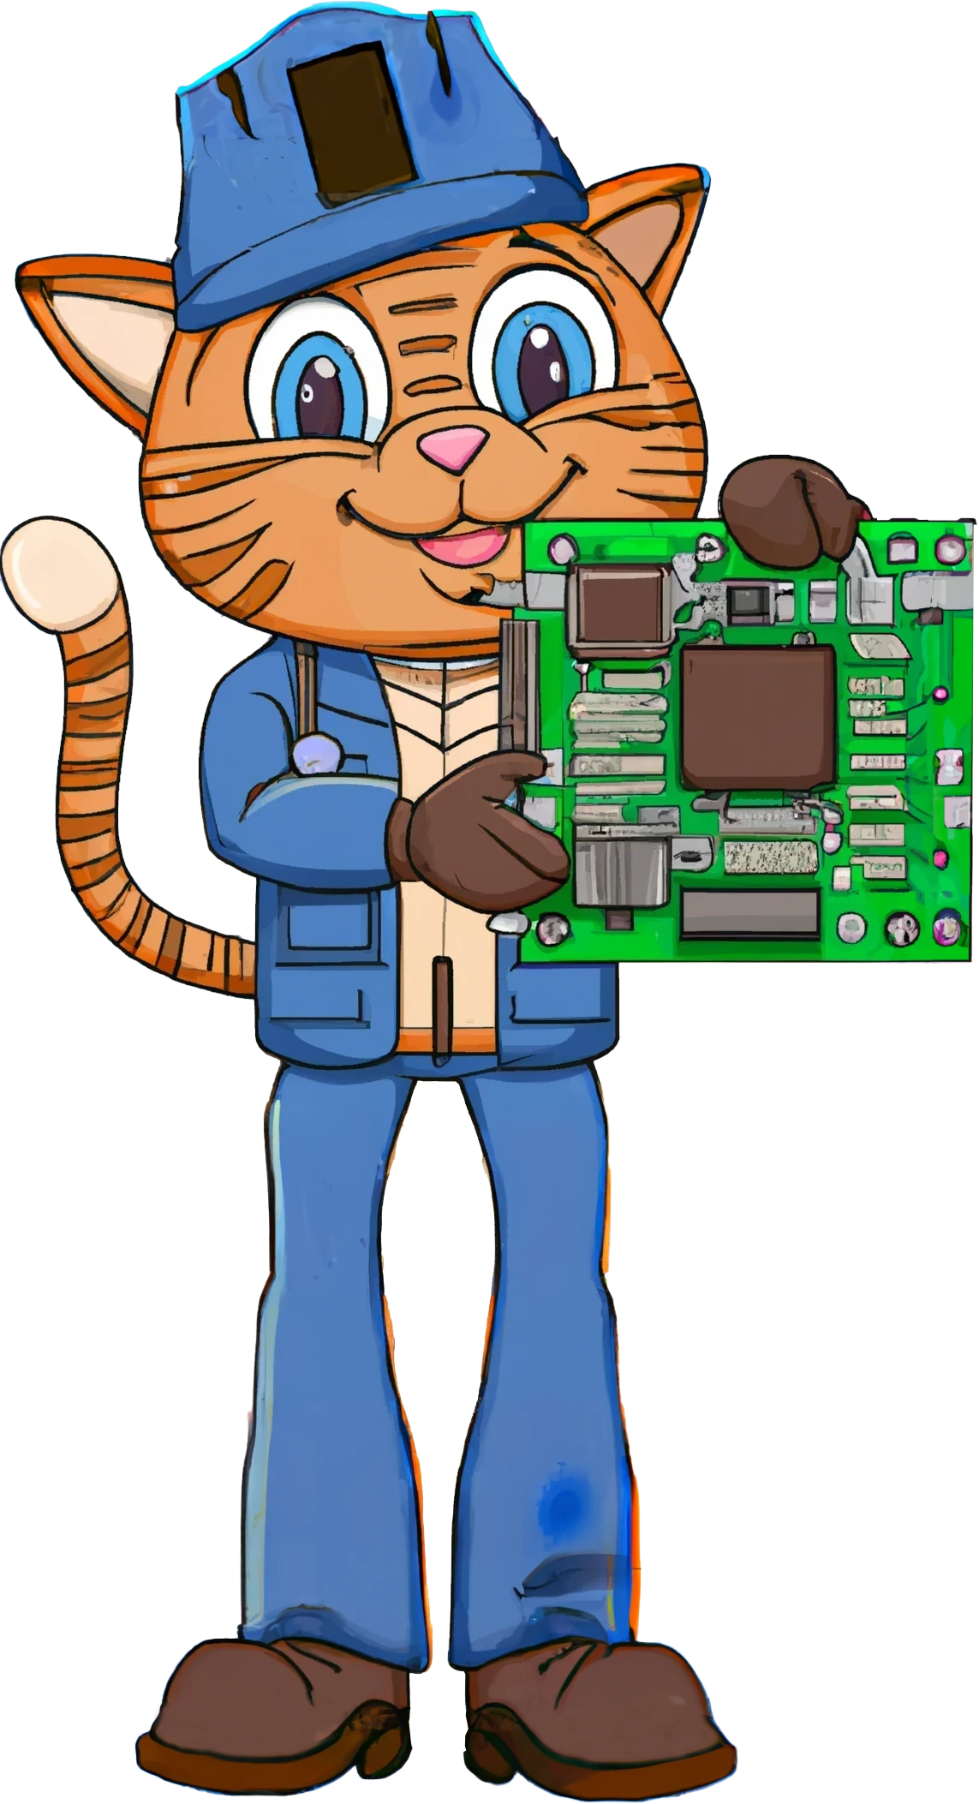
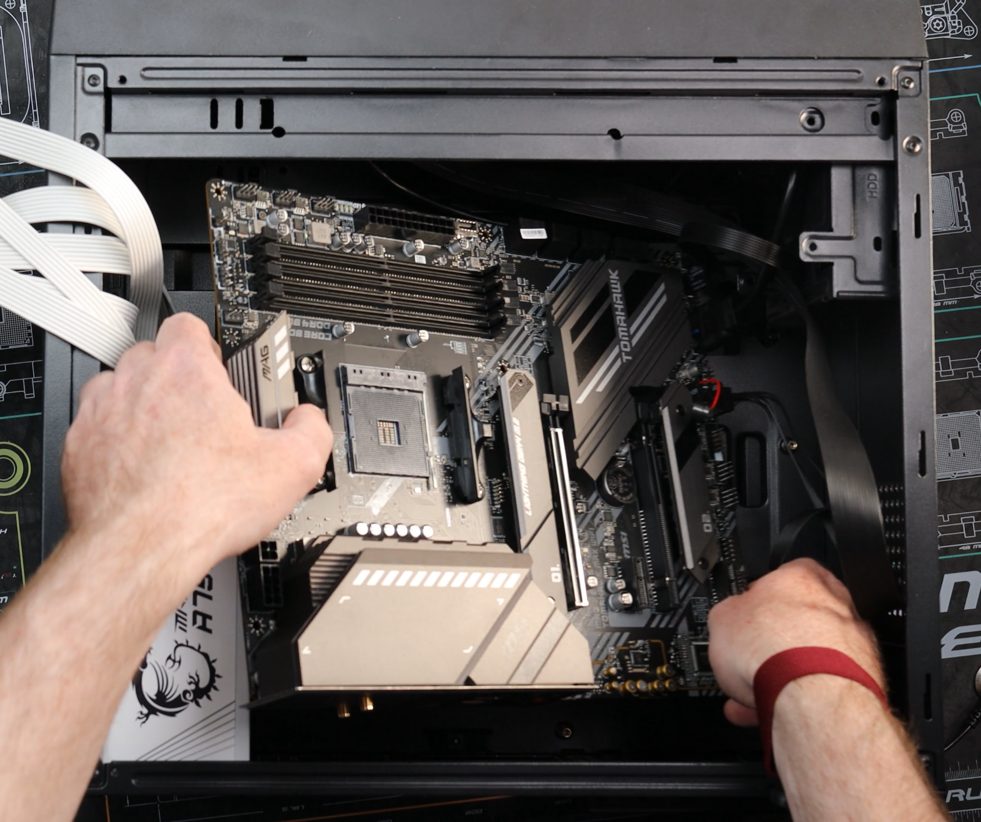
Installing a Motherboard
ITFreeTraining.com
© Copyright 2024
Notes:
00:04 In this video I will perform a demonstration of installing an MSI MAG X570S Tomahawk motherboard. I won’t be installing other components like the CPU and memory modules as I will leave them to another video.

Slide 3
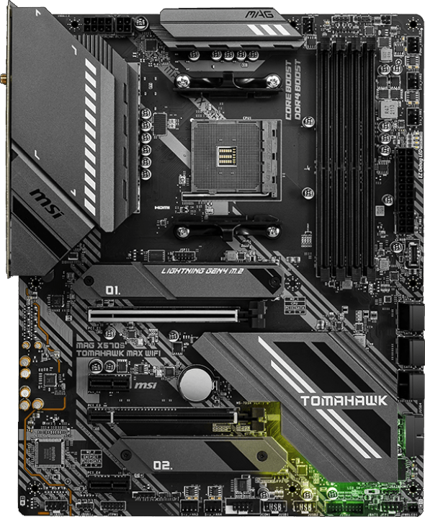
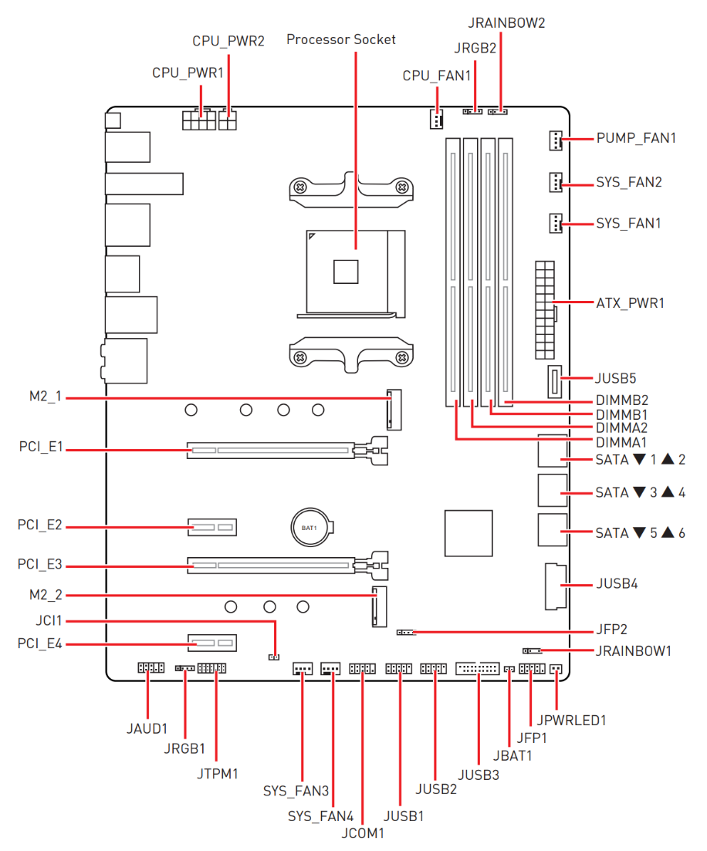
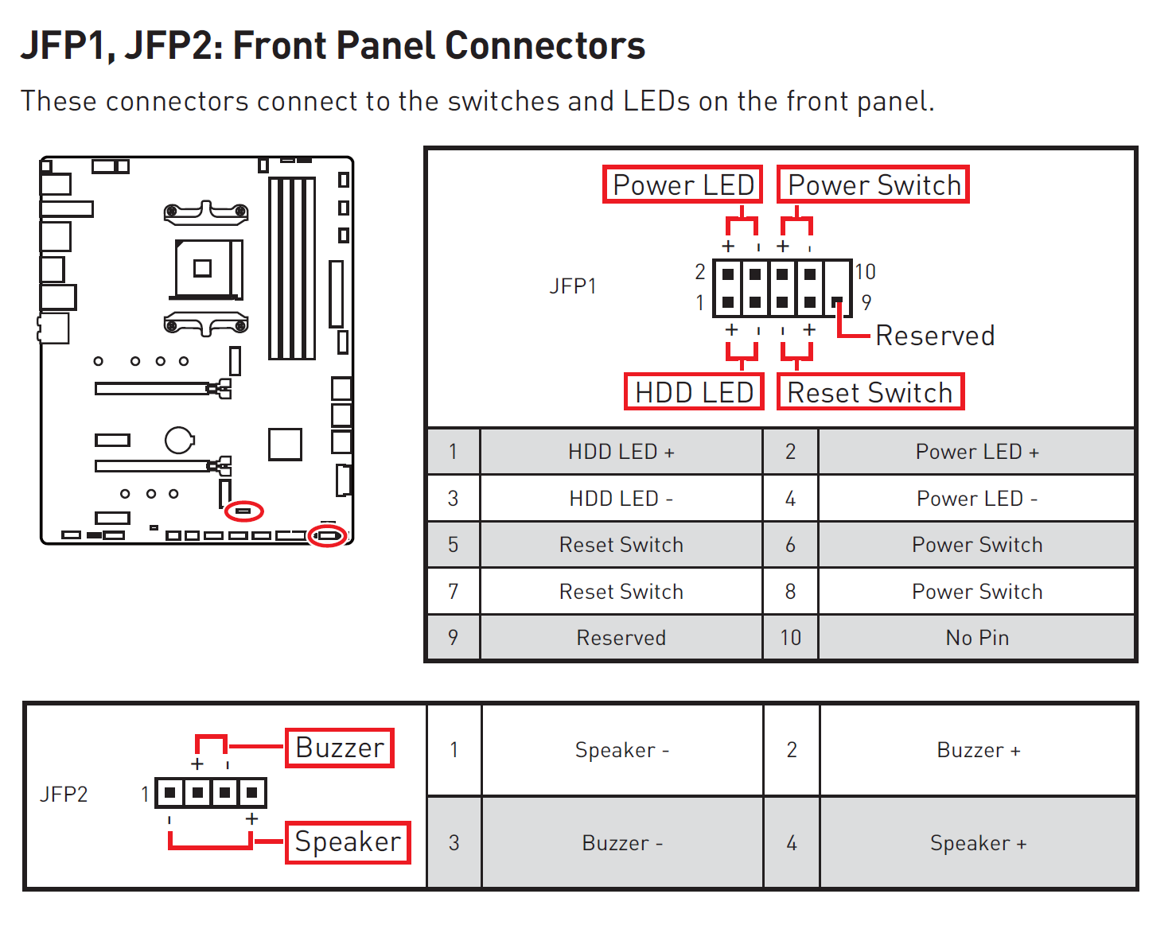
Demonstration
MSI MAG X570S TOMAHAWK MAX WIFI
Refer to documentation for additional install information
Motherboard diagram
Front Panel Connectors
ITFreeTraining.com
© Copyright 2024
Notes:
00:17 It is not a bad idea to have a look at the manual before installation. Some motherboards may have additional jumpers, although on modern motherboards this is pretty rare. Once you have installed a few motherboards, unless it is a proprietary motherboard, you will notice the installation process is pretty similar.
Generally, when I look in the manual, I will first look at the motherboard diagram. This will give me an idea of where everything is. If you are trying to plug a connector into the motherboard and are having trouble finding it, have a look at this diagram.
The next part of the manual I will look at is the section on front panel connectors. As we will see in the demonstration, these connectors are what connects the computer up to the computer case. This includes power, reset, USB and audio.
Now, let’s have a look at how to install the motherboard.
Motherboards are vulnerable to electrostatic discharge, so you always want to take some anti-ESD precautions before installing the motherboard. In this case I have an anti-static mat. If you don’t have an anti-static mat, as a substitute you can always put the motherboard on the box the motherboard came in. Some anti-static protection is always better than none.
Since I have an anti-static mat, I won’t need the box. On the corner of the anti-static mat are two grounding points. On one of these grounding points I will connect a ground cable with an alligator clip. I will use this later to ground the computer case.
I will next put on an anti-static wrist strap and connect the other end to the other ground point. This will provide a connection between me and the anti-static mat.
I will next place the computer case that I am going to use on the anti-static mat. To install the motherboard, I need to remove the side panel. For this particular computer case, there are two screws at the rear of the computer case that need to be removed.
Once the screws are removed, I next need to slide the panel and lift it upwards to remove it. Your computer case may be different. Some cases do not have screws but instead have clips that hold the panel in place. Other computer cases may have a lot more screws to hold the panel in place.
Now that the side panel is off, I can connect my alligator clip to a metal part inside the computer case. There is a problem – you will notice that as I look around the computer case everything is painted. In the old days there was always some metal edge that you could connect your ground cable to, but nowadays many computer cases don’t have any metal points to connect your cable to. The only possible points will be covered by the motherboard when I install it.
To understand how we are going to fix the problem, I will perform a quick experiment. You will notice with this multimeter, that when I connect the two terminals together, I get a reading on the LCD screen. This setting on the multimeter is designed to test for a closed circuit. That is a circuit that lets electricity through.
If I now connect the terminals to each side of the screw that I removed from the case, you will notice that I get a reading on the multimeter. This indicates that electricity can travel through the screw. Thus, if electricity can, so can static electricity. The learning outcome here is, that even though your computer case may be painted, electricity can still potentially travel through it.
Different parts of the computer case may be painted with different thicknesses of paint. You will notice that when I put terminals on different sides of the painted computer case no connection is made. Thus, painted computer cases don’t make a good choice for ground cables. Generally, the paint is too thick for a connection to be made.
The painted screws have a thinner coat of paint, so I will connect my ground cable to a painted screw still in the computer case. This should be enough to ground the computer case. If you connect the ground cable to a different part of the computer case, you risk scratching the paint, so the screws are generally a better choice if you don’t have an unpainted metal edge to connect the ground cable to.
Now that I have got my anti-static sorted out, I will next get out my motherboard. When removing the motherboard, I will generally try and hold it from the side and pull the anti-static bag away from the motherboard. Whichever way you do it, just do your best not to put your fingers on the components of the board. You want to hold it by the edges where there are no components if possible.
Before I can install the motherboard, I need to ensure there are enough stand-offs. A stand-off is a metal riser that goes between the computer case and the motherboard. You can see in this example how the stand-off elevates the motherboard from the motherboard tray. This helps prevent damage to the components and short circuiting of the motherboard.
My computer case has some stand-offs pre-installed. You can see an example of a stand-off here; I will need to add some more for this motherboard. When I look around the computer case, you can see the stand-offs that are pre-installed. On some computer cases the stand-offs may be fixed and cannot be removed, whilst in others the stand-offs have been pre-installed and can be removed. Different form factors, or different size motherboards, require the stand-offs to be in different positions. The computer case will, therefore, determine which different types of motherboards it will support.
When I have a look at my motherboard, there are screw holes for the six pre-installed stand-offs in my computer case shown in green. I will need to add three stand-offs shown in red. If you are not sure where to add the stand-offs, you can always put the motherboard into the computer and line it up with the screw holes. Once the motherboard is in place, you can see the three screw holes at the top of the motherboard.
This computer case has a drive bay at the back of the computer case which hangs over the motherboard. When I put the motherboard in, you will notice I had to tilt the motherboard under the drive bay to get it in. This makes putting the motherboard in harder than if a larger computer case was used. When purchasing a computer case, it is worth considering how the motherboard will go in the case and other components such as graphics cards. For a smaller computer case, it can sometimes be a bit of a squeeze to get everything to fit in. In some computer cases, everything won’t fit in unless you get a hacksaw and cut away some of the computer case. Trust me, I have done it before, but I would not recommend it. Just get a computer case that is designed to handle the size of the motherboard and other components you are going to use.
I will now remove the motherboard so I can install the stand-offs. I will screw in the first stand-off by hand. When screwing the stand-off in, you will notice that they are pre-threaded. You only need to screw it in until it is finger tight. When you feel it has got to the end of the thread, stop screwing it in. If you attempt to screw it in any harder, you risk damaging the thread. Also remember you may want to get the stand-off out again one day so you don’t want it in too tight. Finger tight is enough to prevent the stand-off coming loose during use and you should be able to remove it later if you need to.
To install the next stand-off, I will use a nut driver, which is found in most computer tool kits. It is just a matter of putting the stand-off in the nut driver and then screwing the stand-off in. In some computer cases, you may need to use a little force, particularly if the case is new. This is because the thread may be a little blocked with material or incomplete when manufactured. When you feel that the stand-off is screwed in all the way, stop screwing it in. If it is only partially screwed in, try turning it a bit harder. If you are having no luck, remove the stand-off and try again. If that does not work, try a different stand-off, as maybe the thread in that stand-off is damaged.
The last stand-off is a difficult one, since it is under the drive bay. This can only be installed by hand since the hard disk enclosure blocks the nut driver. Once it is in place, this is all the additional stand-offs that need to be installed. The next step would be to install the motherboard.
To install the motherboard, the next thing that I would normally do is install the IO shield. The IO shield is a piece of metal that is attached to the back of the computer. It prevents dust from getting into the computer and helps with electronic interference.
In the case of this motherboard, there is no IO shield as the motherboard is made to take up all the space of the IO area. So, we can understand how to install a motherboard that has an IO shield, I am going to perform a quick install of a different motherboard.
Before installing the IO shield, I will line it up with the motherboard to make sure the orientation is correct. It is quite easy to install an IO shield upside down. To install the IO shield, place it in the IO area.
The IO shield needs to click into place all around the edges. Push around the edges with your finger. If you are having trouble, you can always use the back of a screw driver to help push it in and click it into place. It can be troublesome to get them in; if you are having trouble, move around the IO shield pushing on each edge until it clicks into place. Once it is in place, all the edges should be flush around the IO shield and the IO area – that is all edges, not just the corners.
In a moment I will install the motherboard. If you are having problems putting the motherboard in, you may need to bend some of the clips on the IO shield up. This IO shield only has one clip, but you can see it is already quite high up so there is no need to bend it up any more.
Now it is time to install the motherboard. You want to hold the motherboard by the edges and place it into the case on an angle. You are essentially trying to get the connectors under the clips in the IO shield. Once you have done that, you next need to line the screw holes up with the stand-offs. You also don’t want to put the motherboard straight down. Even though we move the motherboard around slightly to line it up correctly, we don’t want to drag the motherboard over the stand-offs as this may damage the motherboard.
Now that I have shown how to install an IO shield, I will now remove this motherboard and also remove the IO shield, since this is not the motherboard that I wanted to demonstrate. This was simply done to show how a motherboard with an IO shield would be installed.
The motherboard I will install does not have an IO shield, however, before installing it I personally like to install everything I can onto the motherboard first. For example, CPU, memory and M.2 Drives. It is generally easier to do this than trying to install them when the motherboard is in the computer case. In this video, I will only be focusing on installing the motherboard, as I will cover installing the CPU and other components in another video.
There are a number of cables inside the computer case that plug into the motherboard. I will remove them from the computer case so I can plug them into the motherboard. When plugging in these cables, if you are having trouble working out where they go, have a look in the motherboard manual.
You can see in this manual, it shows the location of all the connectors. I also need to know the location of the front panel connectors. This information will be very useful shortly.
The first connector that I will put in is the USB 3 connector. This is located at the corner of the motherboard. You can always look around the motherboard and attempt to locate the connector, but if you can’t find it, look in the manual. With so many connectors on motherboards today, sometimes it can be hard to locate them.
You will notice that at the top of the connector is a notch. This is referred to as being keyed. This prevents the connector being put in the wrong way. It is just a matter now of plugging the connector into the motherboard. You just need to push it in until it is in place. If you find you are using a bit of force, you should stop and check you have the connector around the right way. You could also be attempting to plug the cable into the wrong connector. All the connectors are keyed, so if you attempt to plug it in the wrong one you won’t be able to.
The next two connectors are the USB 2 and HD Audio connectors. In this computer case, both are connected by the same cable, so I will look at them together. For your computer case they may be separate cables. Computer cases will vary in what connectors they have, but these are the three standard ones that most computer cases have nowadays.
The USB 2 and HD Audio connectors are not keyed the same way as the USB 3 connector. You will notice that each has the same number of pins, however, one of these pins is blocked. The position of the blocked pin determines which connector it is. This prevents incorrectly plugging in the wrong connector or doing so upside down.
You will notice that, unlike the USB 3 connector, on the motherboard there is no square plastic around the connector. When you see pins in a rectangle like this, they may be referred to as a header. Connector is also technically correct, however, the term header is more specific to a connector of this type. You will also see these terms used interchangeably. Think of connector as the more ambiguous of the two and header as the more precise term referring to connectors only of this type.
You will find that a number of headers on the motherboard will have similar or the same number of pins. This can make it difficult to determine which is which. Motherboards will generally have printed next to the header what the header is used for. On this motherboard there are two USB 2 headers. I will only use the first one. They both perform the same purpose, so it does not matter which one you use.
I will now plug them in starting with the USB connector. As before, you just need to push the connectors in. Just make sure that they are the right orientation and are in the right header.
These two connectors will connect USB and audio from the computer case to the motherboard. The computer case generally has these connectors either at the front or the top of the computer case. Although this is uncommon, the manufacturer of the computer case can put them anywhere they want.
I will next look at the front panel connectors. These connect the remaining items in the computer case, such as the power switch, reset switch, hard disk light and power light. In order to know where these attach on the motherboard, you may need to consult the motherboard manual. Usually, the front panel connectors are a group of pins, but on some motherboards they may be separated and not in the same place.
Usually, the motherboard will have printed on it what each pin connects to, for example, in this case, if you have trouble seeing, you can always use your mobile device camera to take a photo and zoom in so you can read the text. This example also has a speaker and chassis sensor. The chassis sensor is used to detect if the computer case has been opened. Both of these connectors are present on my motherboard, they are just not in the same location as the others. Don’t assume that these connectors will be in the same place, the motherboard manufacturer is free to put them anywhere they like.
The connectors on my motherboard connect to particular pins. It is just a matter of looking at the manual and matching the connectors to the pins. Each set of pins will have a positive and negative pin. When you are connecting LEDs, which are essentially little lights, they need to be connected correctly. If you connect them the wrong way the LEDs won’t work. In the case of switches like the power and reset switch, it does not matter which way you connect them since they are just a switch. Let’s now plug them in.
To start with, I will first plug in the Hard Disk LED connector. Since this connects to a LED, you need to make sure the positive and negative pins are around the right way. If they are not the LED will not work. This connector is called HDD since traditionally it referred to the activity of the hard disk drive. However, nowadays it refers to any built-in storage. That is, storage that is directly connected to the motherboard including Solid-State Drives. It will light up when the storage is accessed, including reading and writing.
I will next plug in the reset connector. This connects to the reset switch on the front of the case. Since this is a switch, it does not matter which way the connector is put in. Because of this, you will notice that the connector is not marked with positive and negative.
I will next plug in the power connector. This connector goes to the power switch. As before, since it is a switch, it does not matter which way you put the connector in.
The next connector is the LED connector. This connector provides power to an LED light on the computer case to let you know the computer is on, or blinks if in stand-by mode. It may also be referred to as a power connection, however unlike the previous power connector this is connected to an LED light not a switch, thus the connector must be put in the correct way otherwise the LED light will not work.
This connector is different to the others as it is divided in two rather than being a pair. This is because in the old days some computers used two pins for the connector whilst others had three pins with an unused pin in the middle. To allow for compatibility between either system the LED connector is separated into two so it can be used on either.
This motherboard only supports the two-pin power connectors. However, you will notice on a different motherboard it supports two-pin and three-pin power connectors. If you come across a motherboard like this, you simply need to choose one or the other. It does not matter which you use as they perform the same function.
I will now plug in the power connectors. Since they connect to the power light, the positive and negative need to be connected correctly otherwise the light won’t work. Once they have been plugged in, that is the last connectors for this computer case that have to be plugged in. There is however one more connector I need to plug in that is not part of the computer case.
This last connector is the PC speaker. On a lot of motherboards, this will be located in the same place as the other connectors, however, on this motherboard it is nowhere near the other connectors. In the old days, the PC speaker was part of the computer case, but when sound cards started becoming common it was replaced by small attachable speakers like the one shown. Although you could use the PC speaker to play audio, the quality was nowhere near as good as a modern-day basic sound card can provide. Thus, the PC speaker only gets used nowadays for making beep noises. These beep noises are generally used during start up to indicate the computer is working or there is a problem. Also, the PC speaker is used as an alarm if a fan stops or the CPU temperature gets too high. For this reason, it is recommended to install the PC speaker.
The PC speaker has a positive and negative wire, but will still work if you put them in the wrong way. It will sound a little different, but you would have to have a very keen ear to pick up the difference. I would recommend putting it in the correct way. In the case of this motherboard, the manufacturer has provided us some printing on the motherboard so we know which way to put it in.
I will now plug the PC speaker into the motherboard. It is just a simple matter of pushing it into the header, making sure it is oriented the right way. That is it for all the connectors. But before I can install the motherboard, there is one small problem with this computer case.
This motherboard has the standard 24-pin power connector, an eight-pin connector and a four-pin connector. The problem is the power supply that came with this computer case has only a 24-pin and four-pin power connector.
Something to consider when purchasing a computer case. Make sure the computer case has the required connectors for your motherboard. If the computer case is an older model, it is more likely to have less connectors than a newer model. If the computer case is very cheap, it may be old stock the seller is trying to get rid of.
I will need to replace the power supply in the computer case with one that has more connectors. To remove the power supply, I first need to remove the four screws holding the power supply in place. Once they are removed, I will slide the power supply to the front of the case as this computer case has metal retainers holding the power supply in place. Then I can remove the power supply from the computer case.
I will replace the power supply with a fully modular power supply. Fully modular means that you can plug as many or as few cables that you want into the power supply. Semi-modular means you can plug in some of the cables and the others are fixed, whilst in a non-modular power supply all cables are fixed.
Since I will only be looking at installing the motherboard, I will remove all the cables that are not required to power the motherboard. When installing a power supply like this, you are free to use as many or as few cables as you want. Keep in mind that if you don’t use the cable, make sure you know which power supply it came from. Even power supplies from the same manufacturer may change the wiring around. The plugs coming from the power supply don’t follow any standard. Thus, you may find a cable may plug into multiple power supplies. If the wiring is different, the voltage output will be different, and if you use them on the wrong power supply you risk damaging any components you plug that cable into. To eliminate this risk, I generally plug all the cables in so there are no mix ups, but in this case I will only plug in the ones that we need to make it to understand what is happening.
I will plug in three cables: one is the 24-pin cable and then there will be two eight-pin cables. As we will see, the eight-pin cable can be divided into two four-pin connectors. Before plugging in the cables, I will first flip the power supply over.
I will first plug in the eight-pin connector. You can see that CPU is printed on it, but make sure you plug the other end into the power supply. I will next plug in the second eight-pin power cable. The process is the same as before.
I will now plug in the 24-pin power cable. Often you will find the end that goes into the power supply is split into two different connectors. I will now plug both connectors into the power supply. Once they are plugged in, the next step is to put the power supply into the computer case. It is just a matter of placing it in the correct position and then sliding it into place. On some computer cases, it is possible to put the power supply in the wrong orientation so the fans are blocked. Always make sure the vent for the large fan, shown at the bottom, is not blocked.
The last step is to put the four screws in the power supply. This will make sure that it is secure and the power supply will not move. As with the other screws in the computer case, they only need to be finger tight.
Once in place, we are ready to put the motherboard in the computer case. If the cables are long enough, it is possible to plug the power cables into the motherboard before placing it in the computer case. Sometimes you may want to do this. In this demonstration I will not do this because I want to use the cable management inside the computer case.
To install the motherboard, I will pick it up from the edges and place it in the computer case. You will notice the drive bay at the back is getting in the way. I will need to maneuver the motherboard around a little to get it to go in.
Once in place, I need to make sure all the screw holes are lined up with the stand-offs. Once this is done, I can screw the screws into the stand-offs.
To start with, I will put in a corner screw but not tighten it up yet. I first want to get the motherboard lined up correctly and I want to allow it to move a little until it is in the right position.
I will next screw in the screw on the opposite side. This screw I will screw in all the way, essentially finger tight. Once it is in place, I will screw in the opposite corner all the way. This will hold the motherboard in place while I screw in the other screws. You essentially want the motherboard secure enough so it does not shift.
I will now tighten the corner screws up so they are finger tight. There should be enough screws in place to hold the motherboard in place while I put the other screws in. I will now screw in the other corner screw.
Normally I will screw in all the corner screws first, however, with this computer case there is a drive bay blocking one of the corner screw holes, so I won’t put this one in. It is generally a good idea to put all the screws in. Make sure you have a good look around the motherboard because the screws holes can be a little difficult to see.
You can see the last screw hole is under the drive bay. I can’t get to it with the screwdriver; I could potentially use my hands to get to it, however, considering how hard it will be to get in, let alone get this screw out if I ever need to remove the motherboard, I am going to leave it empty. Although it would generally be best practice to put all the screws in, in this example it is more trouble than it is worth, so I am not going to worry about putting it in.
There are eight screws holding the motherboard in place so this should be enough. You don’t want to make it a habit of not putting all the screws in, but in this case it makes sense. If you come across this problem, make sure you check to see if the drive bay can be removed or in the case of some computer cases the whole bottom tray holding the motherboard can be removed. For this computer case, everything is put together using rivets which is a permanent mechanical fastener. Your computer case hopefully has screws which can be removed or clips that can be removed to get to hard-to-reach screw holes.
Before I plug the power cables into the motherboard, I want to do some cable management, otherwise, the long cable may get in the way of the fans and other devices on the motherboard. To do the cable management, I need to remove the backplate of the computer case. To do this, I will turn the computer over and then remove the two screws holding the plate into place. Just for a moment, I will remove the anti-static cable from the computer. Normally you would move it somewhere else, but there are no more screws that are attached to the computer case.
So, what I will do in this case is replace one of the computer case screws and attach the anti-static cable to this screw. I don’t need to screw it in that much since I will be removing it later, just enough so it does not fall out.
I will now flip the computer case over so I can have a look at the cable management. Under the computer case you will notice that there are a number of gaps. These gaps are designed to allow cables to be put through so they can run under the motherboard rather than on top. This allows extra cable to be hidden away so it is not getting in the way of fans and other components.
You will also notice that there are some attachment points we can use for cable ties. These can be used to secure the cable. Different computer cases will have different cable management systems. On modern computer cases, have a look around, there is probably something there designed to tie cables to. Just be careful not to attach cable ties to parts of the computer case that were never designed for that purpose.
When I look closer, you will notice that the attachment point is just a part of the computer case that a cable tie can be threaded through. Let’s have a look at how to use it.
So firstly, I will stand the computer case up. This will allow me to thread the cables through the computer case easily. You will notice on the motherboard the three connectors on the motherboard I will need to connect power cables to. These are the eight-pin and four-pin at the top, then on the right next to the memory modules is the 24-pin connector. In the case of the top connectors, they are close to the power supply making them difficult to get to. You will find you have these kinds of problems with smaller computer cases, so often it is easier to buy a larger computer case.
To manage the cables better, I will first pull the two eight-pin cables through one of the cable management holes in the bottom of the computer case. I want to pull them through until there is a little bit of slack on the other side so I can reach the connector on the motherboard.
I will first plug in the eight-pin connector. As the name suggests, there are eight pins in the connector. It is just a matter of putting it in the connector and pushing it down until it clicks into place. These connectors are keyed so you will need to make sure that you put them in the correct way. When I plug in the 24-pin connector, I will look more at the keying since it is hard to do in this case because the power supply is in the way. The key is the same on all the power connectors.
I will next plug in the four-pin connector. You will notice that the other connector is eight pins, however, the connector can be split in half into two four-pin connectors. Once I split the connector, it is just a matter, as before, to push it into the connector on the motherboard until it clicks into place.
Once both connectors are connected, you will notice that the spare four-pin connector is up against the power supply intake. With these particular cables, they are designed so you can split the cable apart giving you more cable to work with. With the extra cable, I can put the four-pin connector somewhere so it is not near the intake fan. On this motherboard, I have not installed the CPU and other components; if I had done, I may have needed to put the four-pin cable in a different place. If you are having trouble getting it to stay away from in-takes and fans, you could always tape the cable to the other cables or use cable ties to hold the cable in place so it is out of the way.
I will now pull the 24-pin connector through the same place that I pulled the other two power cables through. You will notice that there is another hole to the left I could also have used. However, if I used that hole it would block the 5¼ inch drive bay at the front of the computer case. Be careful which ones you use, as some are designed to help you access components, like the one to the right helps you make contact with the power supply to assist installing and removing it. Note that not all the holes are always designed for cable management. Some are designed simply to make installing and removing parts easier.
You can see the 24-pin cable and the connector on the motherboard. When I have a closer look at the two, you can see there is a latch on the connector for the cable. When this is pressed it releases the connector. For the connector on the motherboard there is a protruding edge. When you put in the connector, the click noise you may hear is the latch springing back into place when it passes past the protruding edge.
If you look at the connector on the motherboard in more detail, you will notice that there are two types of pins. Ones that are square and the other that has a chamfered top. These are designed to stop the connector being put in upside down. This is why you should never force these connections. If you are having trouble getting it to click into place, check that you have it oriented the correct way.
I will plug the 24-pin connector into the motherboard. It is just a matter of making sure it is oriented the correct way and pushing it into the connector until it clicks into place.
All the power cables have been plugged in. I will next look at the cable management. You will notice that the extra cable is not organized yet. I will lie the computer down and start working on making the cable a bit neater.
Firstly, I will get a cable tie and put it through the cable attachment point. I will next make the cables as flat as I can. Once they are flat, I will thread the cable tie through the cables and pull the cable tie tight.
You want the cables as flat as possible, as when you put the plate back on you don’t want it pushing down on the cables. Also, run the cables where there is a metal tray behind it. Try and avoid running over areas where there are circuit boards. You don’t want the cable potentially pushing down on a circuit board.
I will now do the same for the 24-pin cable. Once again, I will put the cable tie through the attachment point, get the cable as flat as I can so there are no kinks or twists in it. Once I have done that, I will tighten the cable tie and trim off the excess. Different computer cases will have different cable management solutions. This computer case does not have a lot of cable management. Some people will put a lot of work into their cable management as in this example. How much time and effort you put into it is up to you, however, the main objective is to keep the cables away from components like fans and put them in locations that don’t prevent airflow.
Even with the small amount of cable management I have done, you will notice how flat the cables are. I can now put the plate back on, but before I can do that, I first need to remove the anti-static cable and the screw that I put in earlier.
Once that is removed, I can now put the plate back on. Notice on the backing plate, there is a recess area. This allows extra room for the cables, but you don’t have a lot, so make sure you get them as flat as you can.
Once the backing plate is back on, I will now put the two screws back into place to hold it firmly. Once in place, I will flip the computer over and have a look at what we have achieved.
You can see how the cables look more managed. I could have pulled the cables through a bit more near the power supply. Cable management does take some time and sometimes you may have to redo cable in order to get it just right.
To understand how cable management can help, let’s compare it with no cable management. You can see with no cable management there is a lot of cable inside the case. All those extra cables can get in the way of airflow and also get caught in fans. Thus, it is a good idea when installing a motherboard to see what kind of cable management your computer case supports.
That’s all we need to do to install a motherboard. You can see why your choice of computer case is important. A slightly bigger computer case would have made the process a bit easier, but a small computer case also has its advantages.

Slide 4
Subscribe
Next video
Video content: https://ITFreeTraining.com/ap11/1b25
© Copyright 2024
Notes:
32:57 That concludes this video on installing a motherboard. I hope you have found this video useful and I look forward to seeing you in more videos from us. Until the next video, I would like to thank you for watching.
References
“The Official CompTIA A+ Core Study Guide (Exam 220-1101)” pages 25 to 26
“Picture: Computer water cooled” https://www.pexels.com/photo/black-and-red-computer-motherboard-2399840/
Credits
Trainer: Austin Mason https://ITFreeTraining.com
Voice Talent: A Hellenberg https://www.freelancer.com/u/adriaansound
Quality Assurance: Brett Batson https://www.pbb-proofreading.uk

