Slide 1
Notes:
Let’s have a look at motherboard form factors.

Slide 2
What is a Form Factor?
Defines specifications for motherboard design
ATX (Advanced Technology eXtended)
microATX
ATX
MicroATX (Smaller version of ATX)
Mini-ITX
Mini-ITX (Information Technology Extended)
244 mm (9.6 in)
170mm (6.7 in)
170mm (6.7 in)
Screw Holes
244 mm (9.6 in)
305 mm (12 in)
ITFreeTraining.com
© Copyright 2024
Notes:
00:03 A form factor defines certain aspects of the computer, but still allows for some variation in design. For example, it standardizes certain sizes and layouts. The form factor specifies crucial aspects such as a motherboard's dimensions to ensure compatibility, the positioning of screw holes for stable installation and the number of expansion slots for components like graphics cards. It also influences the arrangement and types of ports on the rear panel, facilitating peripheral connections.
It is unlikely that you will get a question about a particular form factor, but it is important to be aware that these standards exist and understand their significance. CompTIA identifies three key standards: Mini-ITX, microATX and ATX.

Slide 3
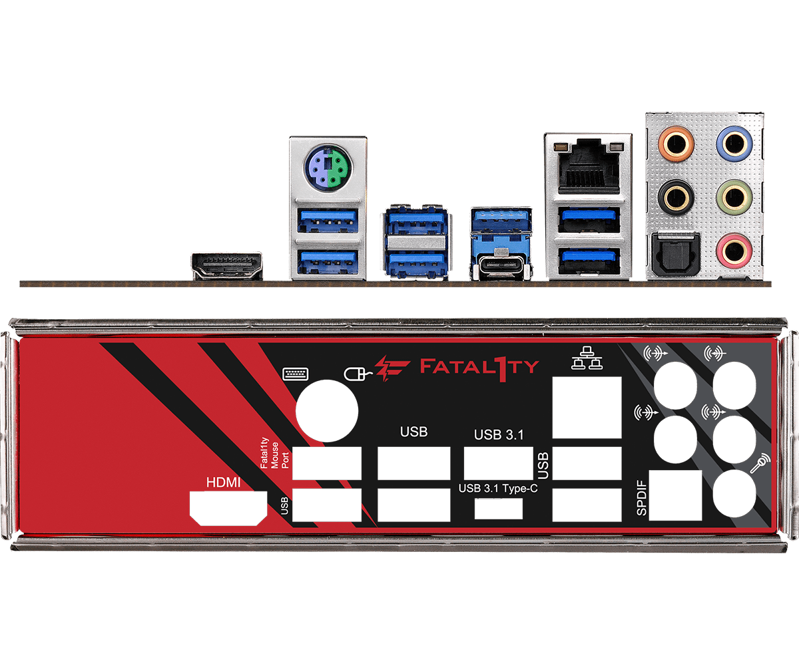
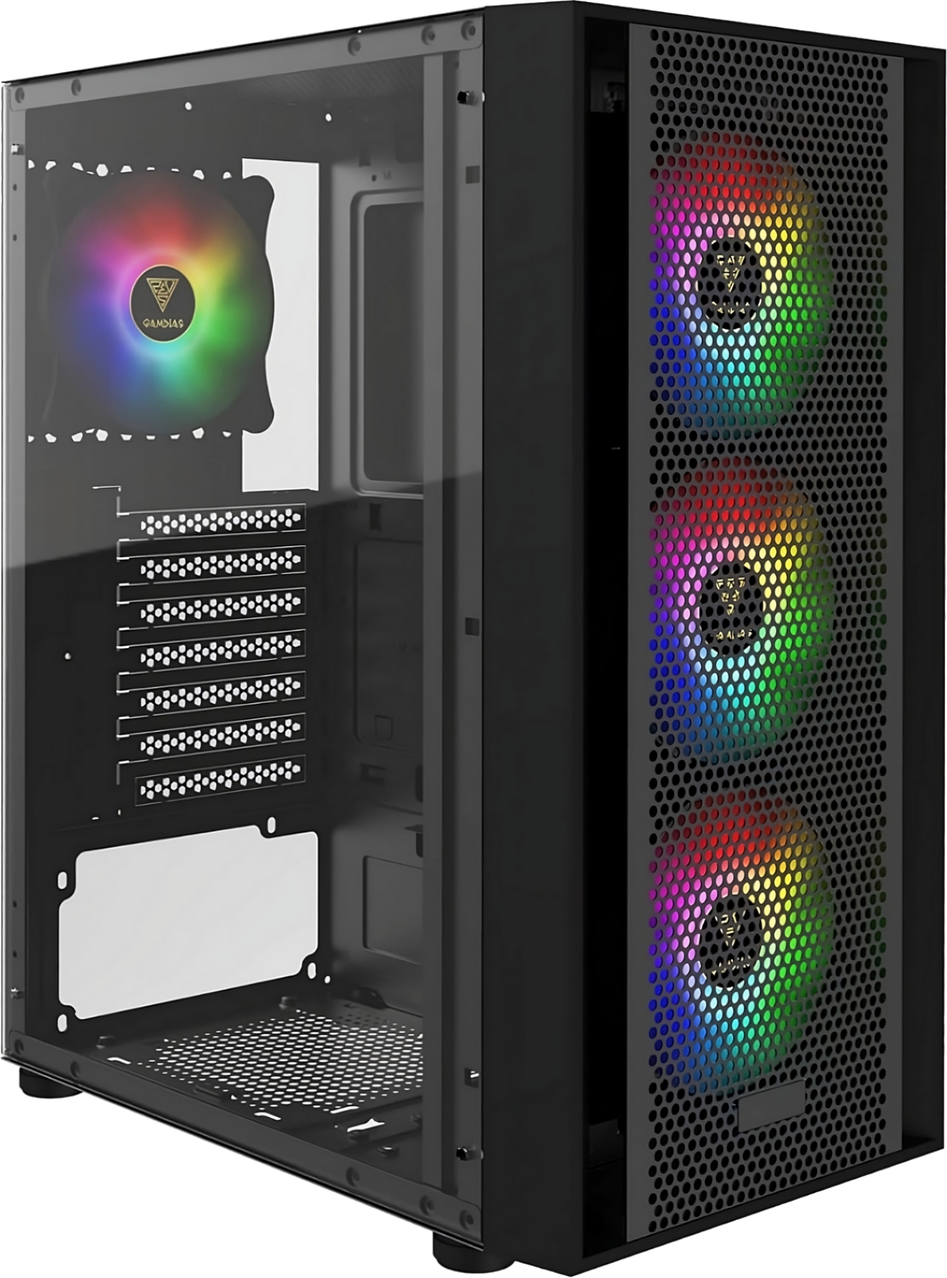
Form Factor Specifications
Defines how other components connect
Defines Power connectors
ATX form factor
Max 7 expansion slots
IO Area
Fixed size Manufacturer can use as they like
ITFreeTraining.com
© Copyright 2024
Notes:
00:53 The form factor specification also defines how other components connect to the computer. This includes the maximum number of expansion slots. For example, an ATX form factor supports up to seven expansion slots. However, it is important to note that the actual number of usable slots in a case might be less due to layout constraints. Even if a motherboard has the available slots, the case design might not physically accommodate certain cards, for example, extra-long expansion cards. So, it's always crucial to check both the motherboard and case specifications for compatibility with specific expansion cards.
The form factor also defines the IO area, often located on the computer’s back panel, where you connect peripherals like monitors, keyboards and mice. Manufacturers can use this area anyway they like.
The form factor not only dictates the motherboard's size and layout but also standardizes some of the connectors, such as power connectors. This ensures that a power supply designed for a specific form factor will be compatible with any motherboard adhering to that standard. Therefore, when you buy a motherboard with a particular form factor, you simply need to select components, such as a computer case and power supply, that are compatible with that form factor.

Slide 4
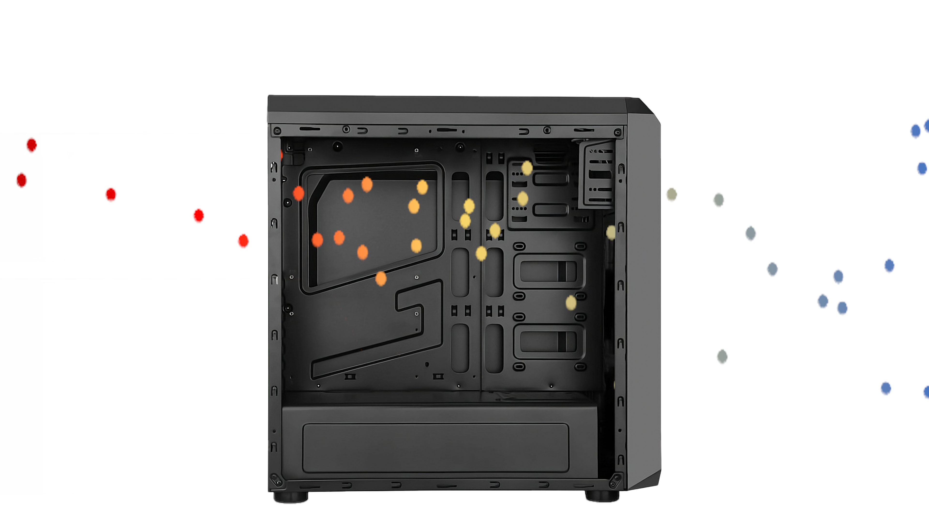
ATX Form Factor Air Flow
ITFreeTraining.com
© Copyright 2024
Notes:
02:12 The ATX form factor is the most popular. In terms of airflow, ATX cases typically employ a front-to-back pattern, drawing cool air from the front and expelling it through the rear and top, creating a positive pressure environment that minimizes dust buildup. However, variations exist based on case design and fan placement, influencing the efficiency of the airflow. This is the opposite of the previous AT form factor.

Slide 5
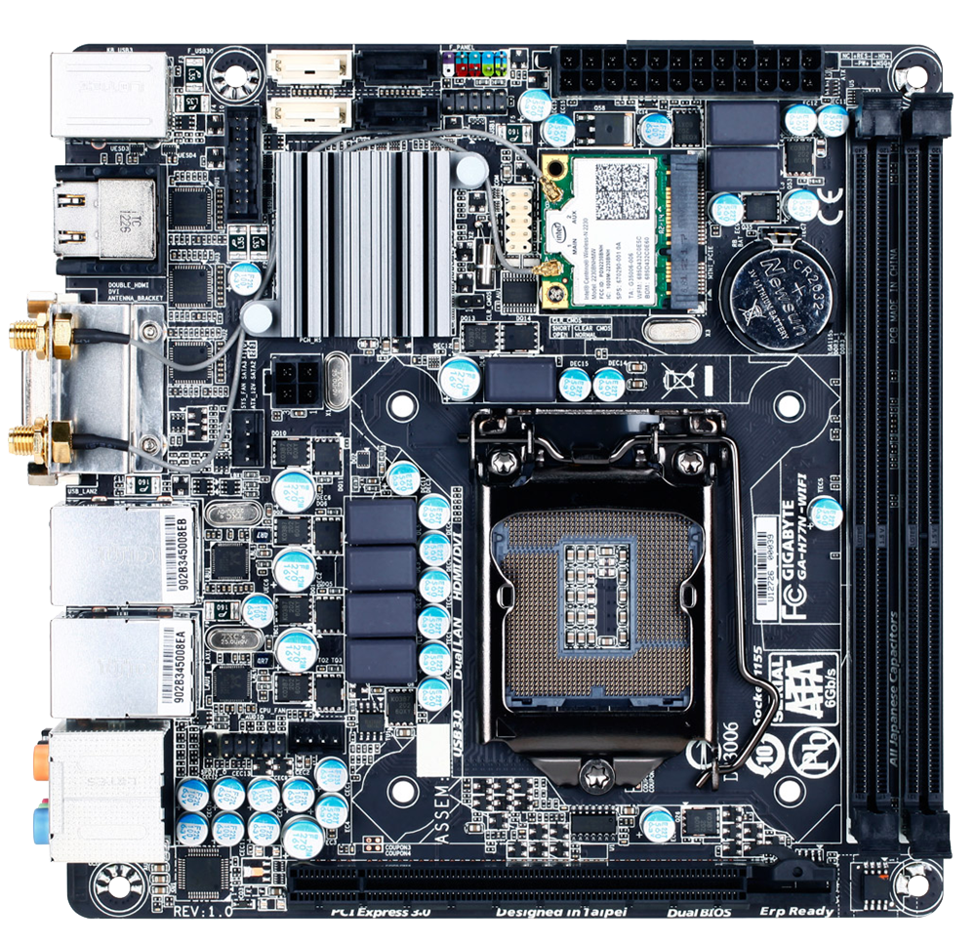
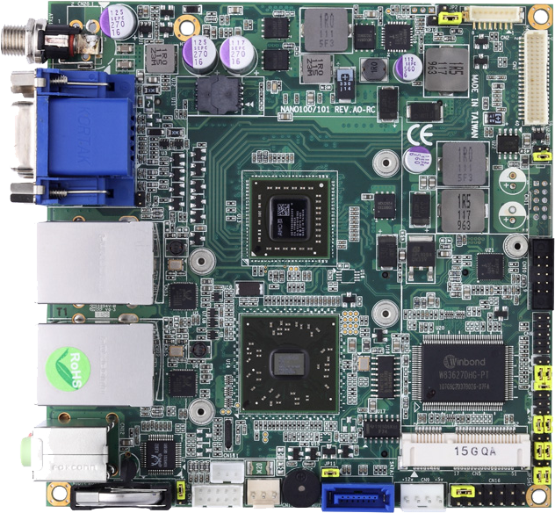
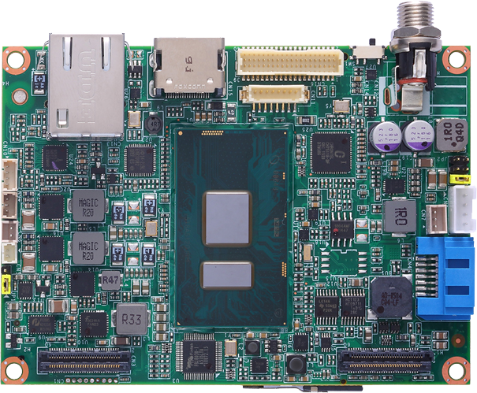
Small Form Factor (SFF)
Designed to be small and compact
Upgrade and expansion options limited compared with desktop computers
Mini-ITX
Nano-ITX
Pico-ITX
Mobile-ITX
45mm (1.8 inch)
72mm
(2.8 inch)
120mm (4.7 inch)
75mm
(3 inch)
170mm (6.7 inch)
100mm
(3.9 inch)
120mm (4.7 inch)
170mm (6.7 inch)
ITFreeTraining.com
© Copyright 2024
Notes:
02:41 Small Form Factor or SFF PCs have become increasingly popular for those seeking a compact computer. They have become popular as general-purpose computers for a lot of businesses. The advantages of SFF PCs include space savings, sleek designs, energy-efficient components, and generally lower noise levels due to smaller fans.
There are a lot of different small form factors available – I have shown four of the more common ones. For the A+ exam, it is doubtful that you will get a question on one of these form factors, so just be aware that they exist.
It is important to remember that there are also some trade-offs with SFF PCs. One of the main limitations is their restricted upgradability compared with desktop computers. The smaller size often means you won't be able to physically fit larger additional hard drives or expansion cards. Additionally, SFF cases typically use smaller power supplies, which can limit the overall power available to the system and restrict your options for adding power-hungry components. Furthermore, while smaller fans can be quieter, they also have less cooling capacity, so SFF PCs can have higher internal temperatures when pushed to their limits.
Nowadays, some of these limitations are less of a concern for general users, as many tasks can be done efficiently with limited local storage due to the availability of online storage and integrated graphics, meaning a graphics card is not required. However, it's still important to be aware of these limitations before choosing an SFF PC, especially if you anticipate needing to upgrade your system down the line.
Proprietary form factors are specialized systems created by large brand manufacturers that do not use a standard form factor design. These computers are often finely tuned to the brand's ecosystem, combining other features and software from that company and including features like inventory tracking and remote management. However, these computers have potentially higher replacement part costs compared with an equivalent part available on the open market. Because of the extra features, they are often purchased by large companies as their general use computer despite the disadvantages.

Slide 6
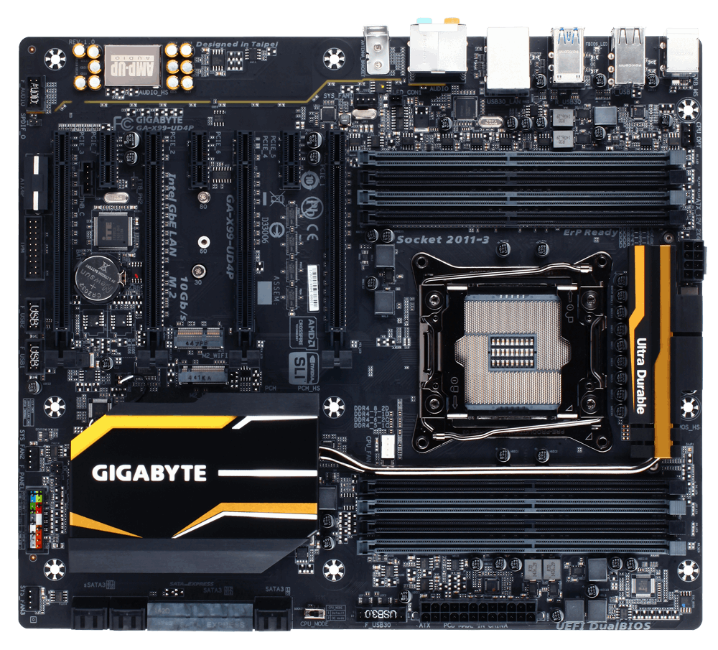
Extended ATX (EATX)
Long motherboard but same width as ATX
Will rarely use all the space (Meets standards if screw holes in correct location)
Most used in servers and enthusiasts’ systems
EATX
ATX
330 mm (13 in)
330 mm (13 in)
244 mm (9.6 in)
Screw Holes
305 mm (12 in)
305 mm (12 in)
ITFreeTraining.com
© Copyright 2024
Notes:
04:54 I will next have a brief look at Extended ATX or EATX. This is not covered by CompTIA, but I'll mention it because you may come across it in the workplace or see it referenced in a computer case. EATX is essentially the same width as ATX but allows the motherboard to be longer.
EATX motherboards take advantage of this extra length primarily to accommodate additional high-speed PCIe slots, which are often used for powerful graphics cards, RAID controllers or other performance-oriented expansion cards. The extra space also allows for larger heatsinks and cooling solutions, which is beneficial for high-end systems with components that generate significant heat.
However, EATX motherboards rarely use all the available space. To be compatible with the standard, they just need to have screw holes in the correct locations. The same applies to ATX motherboards. Thus, you will find some ATX motherboards don’t use all the available space either.
EATX tends to be used in servers and by enthusiasts. It is favored by enthusiasts and professionals for its capacity to host high-end CPUs, multiple GPUs and advanced cooling systems. However, with the decreasing size of electronics, you can fit a lot onto an ATX motherboard, so EATX motherboards are not that common. If you do purchase an EATX motherboard, keep in mind that you will need a larger computer case to accommodate it.

Slide 7
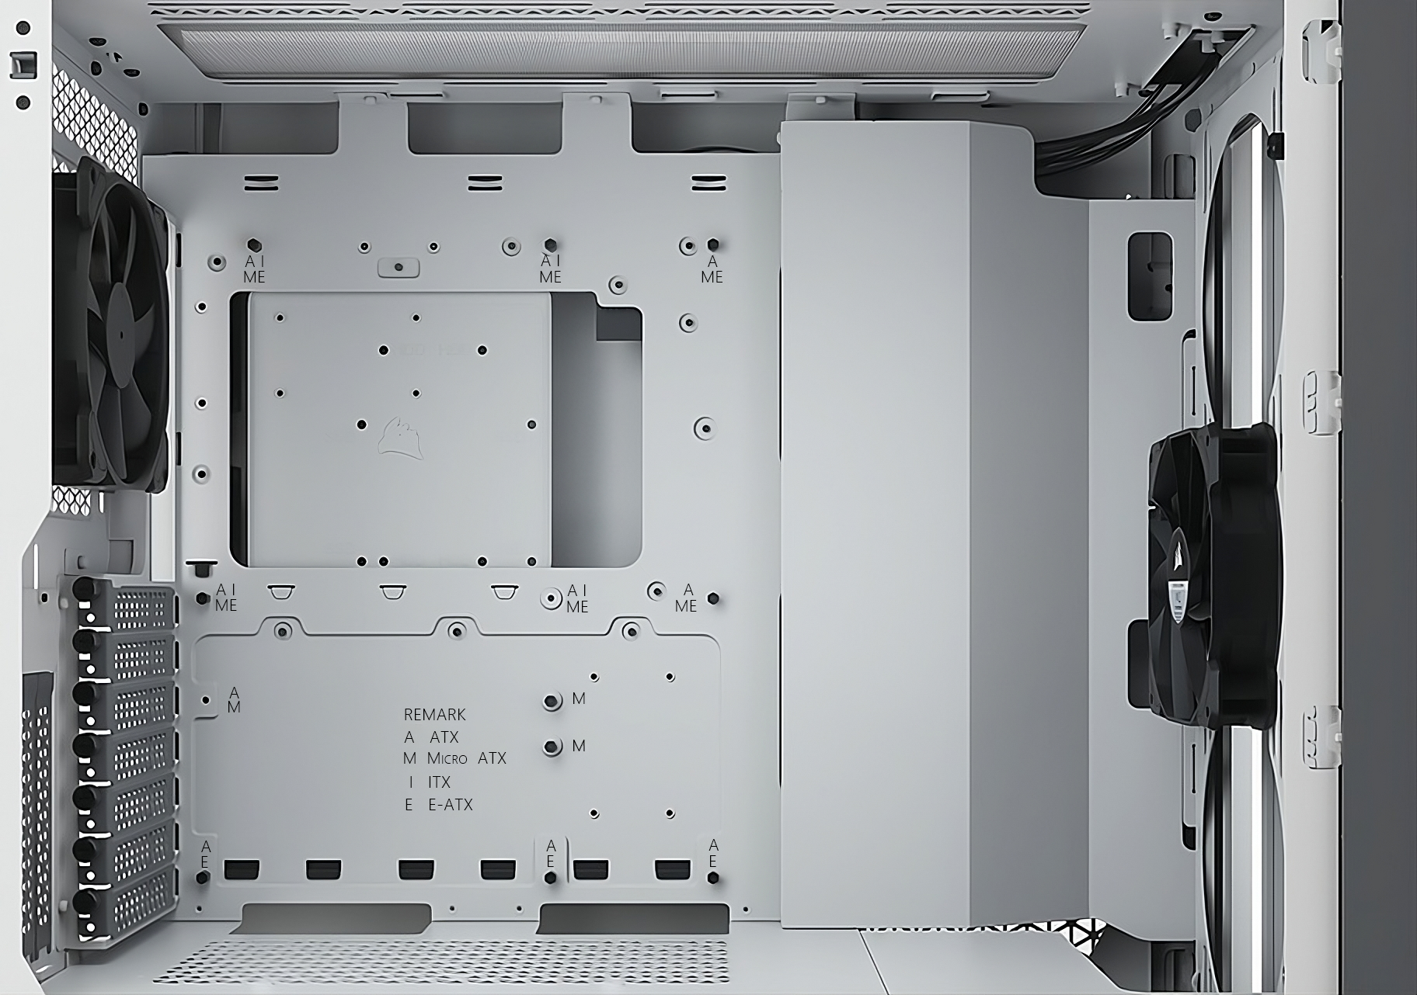
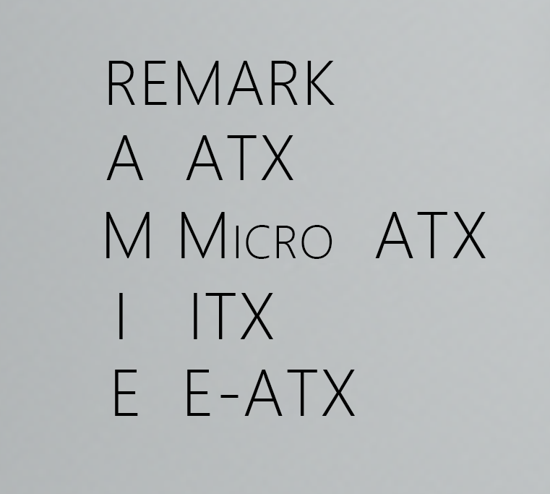
Other Form Factors
Most never widely adopted
Instructions/case may reference form factor
Use the ones you need. Ignore the others
ITFreeTraining.com
© Copyright 2024
Notes:
06:23 There are a lot of different form factors that have been developed over the years, most of which have never been widely adopted. When you purchase a computer case, check it supports the form factor you are using. The vast majority of computer cases on the market will support ATX.
On the computer case there may be markings indicating the screw holes for each form factor. In this example computer case, you can see the screw holes are marked with the different form factors. In many cases, the screw holes are marked with multiple form factors. You will find that the majority of computer cases will support multiple form factors, so before you purchase, just make sure the computer case supports the form factor that you want to use.

Slide 8
Subscribe
Next video
Video content: https://ITFreeTraining.com/ap11/1b20
© Copyright 2024
Notes:
07:06 That concludes this video on form factors. I hope this video has been informative. Until the next video from us, I would like to thank you for watching.
References
“The Official CompTIA A+ Core Study Guide (Exam 220-1101)” pages 36 to 37
https://en.wikipedia.org/wiki/Motherboard_form_factor
Credits
Trainer: Austin Mason http://ITFreeTraining.com
Voice Talent: AR Hellenberg https://humanaudioventures.my.canva.site/
Quality Assurance: Brett Batson http://www.pbb-proofreading.uk

