Slide 1
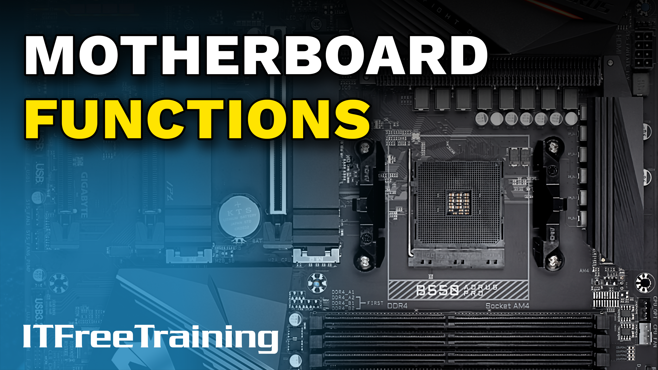
Notes:
The motherboard holds the core system functions of a personal computer. Let’s have a look at how it works.

Slide 2
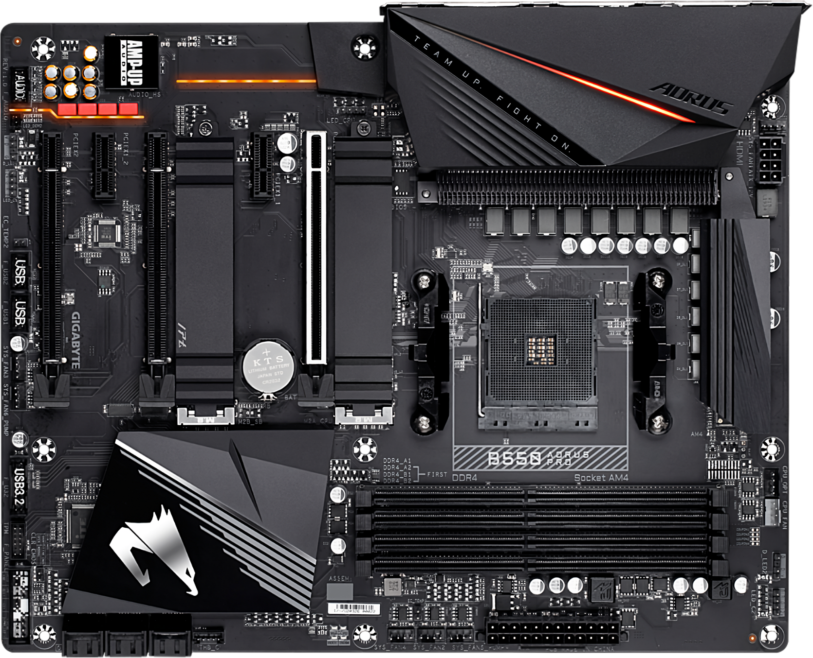
Motherboard Components
B550 AORUS PRO (AC) Motherboard
ITFreeTraining.com
© Copyright 2024
Notes:
00:06 For this video I will use the following motherboard as an example. Fundamentally motherboards work off a similar design. If available, a block diagram will allow you to have a better understanding of how the components inside your computer have been connected together. This will help you identify potential bottlenecks in the system.
Block diagrams have become a lot less common in the motherboard manuals than they used to be, so don’t be surprised if your motherboard manual does not include one. Hopefully it does have one, because they give you a lot of insight into how your motherboard works.

Slide 3
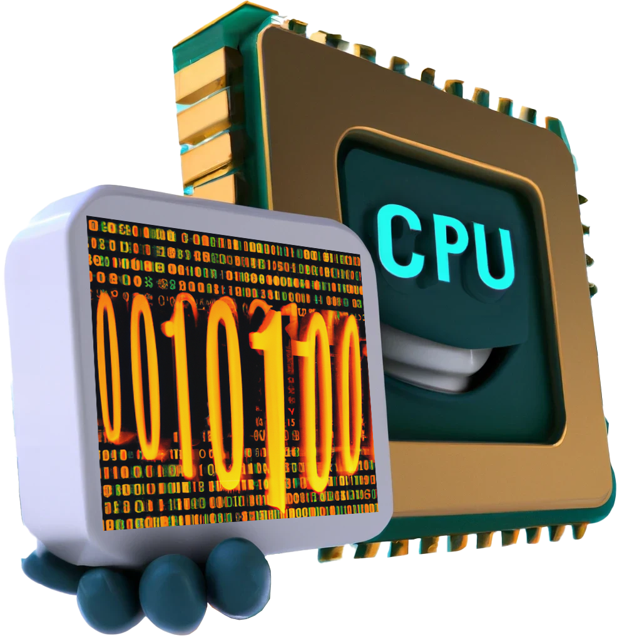

Basic Motherboard Functions
Data processing
Data storage
Fast
Slow
Lost if power lost (volatile)
No power required (non-volatile)
ITFreeTraining.com
© Copyright 2024
Notes:
00:43 When it comes down to basic functions, a computer’s functions can be generally broken down into data processing and data storage. Data processing needs to be fast. In order to be fast, the trade-off is that it generally requires power to operate, thus if the power is lost, the data is lost. This is referred to as being volatile.
In contrast, data storage is generally slower. It is slower because as a trade-off for speed, it does not require any power to keep the data intact. This is referred to as being non-volatile. Thus, your computer will generally be broken down into fast and slow components. You want your high-speed devices to be connected via high-speed links. Low-speed devices don’t require high-speed connections and thus can be connected by low-speed connections making better use of the computer’s available bandwidth.
Before I look at how these devices communicate with each other, I will first look at the basics of how these devices keep in sync with each other.

Slide 4
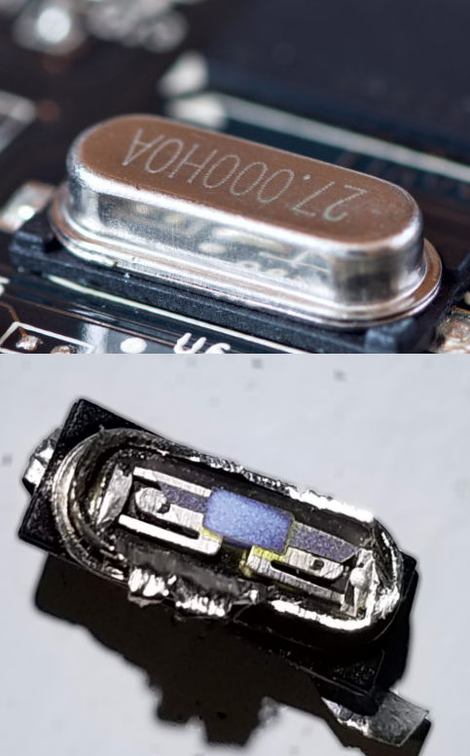
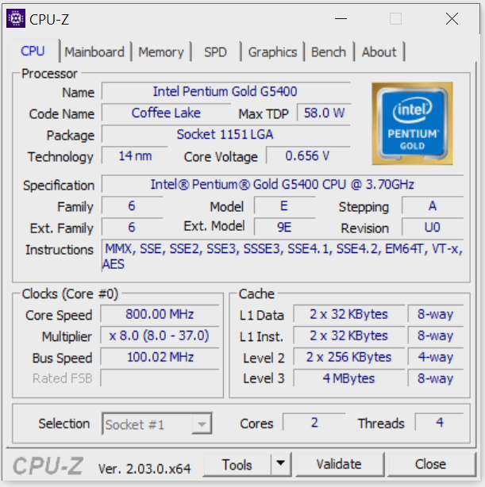
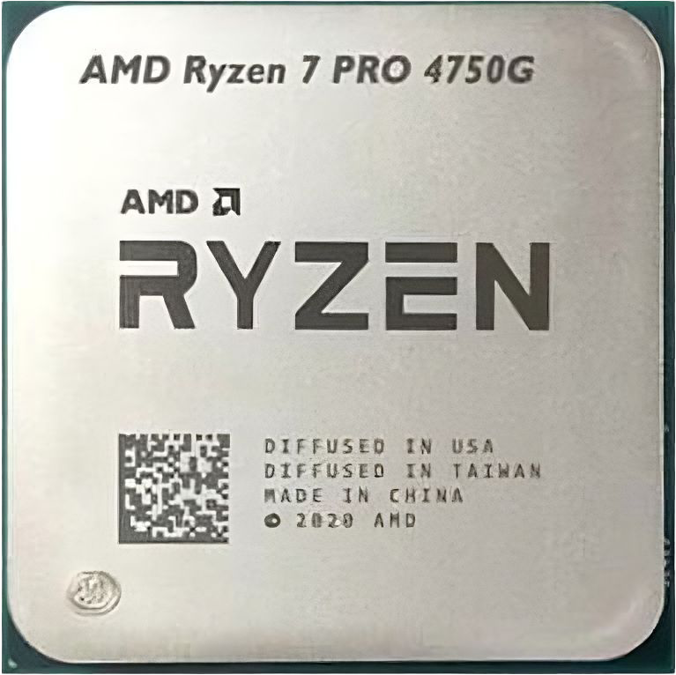
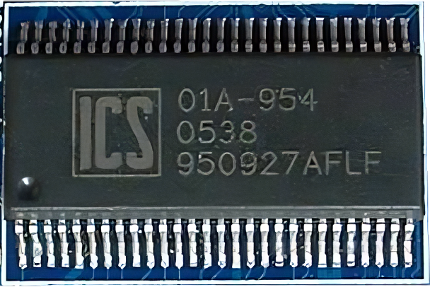
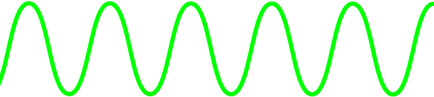


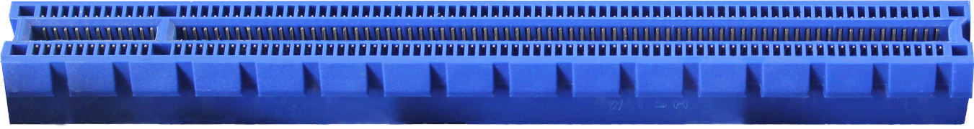
Crystal Oscillator
Crystal vibrates with precise stable frequency
Clock generator
Internally is a clock multiplier
Will be referred to as multiplier
PCIe Slot
ITFreeTraining.com
© Copyright 2024
Notes:
01:45 You won’t get asked a question on this in the exam, but it is nice to have a basic understanding of it to help you understand how computers work. On your motherboard there will be a crystal oscillator. This particular design was quite common in the old days, however, there are a lot of different designs nowadays. So don’t be concerned if you can’t locate it on your motherboard.
The crystal oscillator, as the name suggests, contains a small crystal. This crystal has electricity applied to it which creates a precise stable frequency. This frequency is too slow to run a computer, so the next step is to put it through a clock generator to speed it up. The clock generator will create all the basic clock signals a computer will use. For example, it will create a clock signal for the PCI Express slots.
A clock rate will also go to the CPU which is where it starts getting interesting. The CPU runs at a much faster speed than any of the components on the motherboard. Thus, the clock signal in the CPU needs to be much faster. As the clock signal gets faster, it gets harder to maintain over a longer distance. For this reason, inside the CPU is an internal clock multiplier.
This clock multiplier will take the existing clock signal and as the name suggests multiply it, thus it is referred to as a multiplier. Thus, modern CPUs will always be much faster than the motherboard.
To have a look at the clock speed of the computer, there is a tool called CPU-Z which allows you to see these settings. You can see the clock setting in the bottom left of the tool. In this example, the base bus speed is 100Mhz and the multiplier is set to eight. You will notice that the multiplier goes from eight up to 37. Essentially, when the computer is under load the multiplier can be increased which in turn speeds up the CPU. In modern CPUs the multiplier can be adjusted so the CPU uses less power when it is not under load.
From a troubleshooting perspective, you don’t need to know too much about how the timings work. Just have a basic understanding of the speeds of each component. This will help you if you are trying to troubleshoot a problem that involves bottlenecks.

Slide 5
Very High-Speed Devices
Have direct lane to CPU
Limited lanes/limited devices can be connected
ITFreeTraining.com
© Copyright 2024
Notes:
03:59 Having a look at the top of our block diagram, we can see that the PCI Express 4.0 slot is connected directly to the CPU. Essentially, the fastest devices in the computer will have a direct lane into the CPU. A lane is basically a bi-directional data path that provides a direct data connection from a device to the CPU.
You will find that a limited number of devices will be connected directly to the CPU. This is because there are a limited number of lanes that go to the CPU. Each lane requires additional pins on the CPU and thus there is a limit to how many a CPU can have. Therefore, CPUs with more pins generally have more lanes. The next question is, if there are limited lanes, how do other devices connect to the CPU?

Slide 6
South Bridge
4xPCI 3.0 Express lanes
South Bridge
Connects majority of devices
High/low-speed devices
Very high-speed devices connect to CPU
* North Bridge nowadays integrated in the CPU
ITFreeTraining.com
© Copyright 2024
Notes:
04:47 When a direct lane can’t be dedicated from the CPU to a device, the South Bridge is used to connect to these devices. In order for the South Bridge to connect to the CPU, some lanes are required. In this example, four PCI Express 3.0 lanes are used to connect the CPU to the South Bridge.
To make things simple, I have only added the four SATA connectors. SATA does not require a lot of bandwidth so you can see slow devices like these are not going to put much load on the four PCI Express lanes.
The South Bridge is used to connect the majority of devices in the computer. This includes high and low-speed devices. Keep in mind that very high-speed devices connect directly to the CPU, but the South Bridge can still handle some high-speed devices, but all devices on the South Bridge share the same link to the CPU. You can start to see where bottlenecks can start to occur.
You may be wondering where the North Bridge is. In older computers there were two chips, one for the North Bridge and another for the South Bridge. Nowadays, the North Bridge is integrated into the CPU and thus you no longer have a dedicated chip for the North Bridge. With modern computers, if you see a reference to the North Bridge it is referring to the parts of the CPU that handle functions previously done by the North Bridge.

Slide 7
Devices Connected to Both
USB connected to CPU and South Bridge
Not always the case
Slow performance
Try moving devices to different USB connections
ITFreeTraining.com
© Copyright 2024
Notes:
06:10 Although in this example high-speed USB is connected to both the CPU and South Bridge, this is not always the case. This is more the exception rather than the rule. If you are finding that you are having slow performance, try moving the devices to different USB connections.
In this example, moving a device performing slowly from a USB connection from the South Bridge to a direct connection to the CPU is likely to make your device perform faster. It really does depend on the device however. You may find your device is working fine, but when more load is put on the link between the South Bridge and the CPU, you may start having performance problems. The same applies even if all the USB connections are connected to the South Bridge. Sometimes you may find that changing the USB connection around may help with performance. Some motherboards have different USB controllers and sometimes different USB ports share the same connection back to the motherboard. Thus, changing the USB port your device is connected to may help with performance.
Not all motherboard manuals will come with a block diagram. So, you may not be able to tell where your devices are connected. Just keep in mind that very high-speed devices are most likely connected directly to the CPU. That is, the devices that use the most bandwidth. If you are having performance problems with your high-speed devices, try changing the connection to see if that helps.

Slide 8
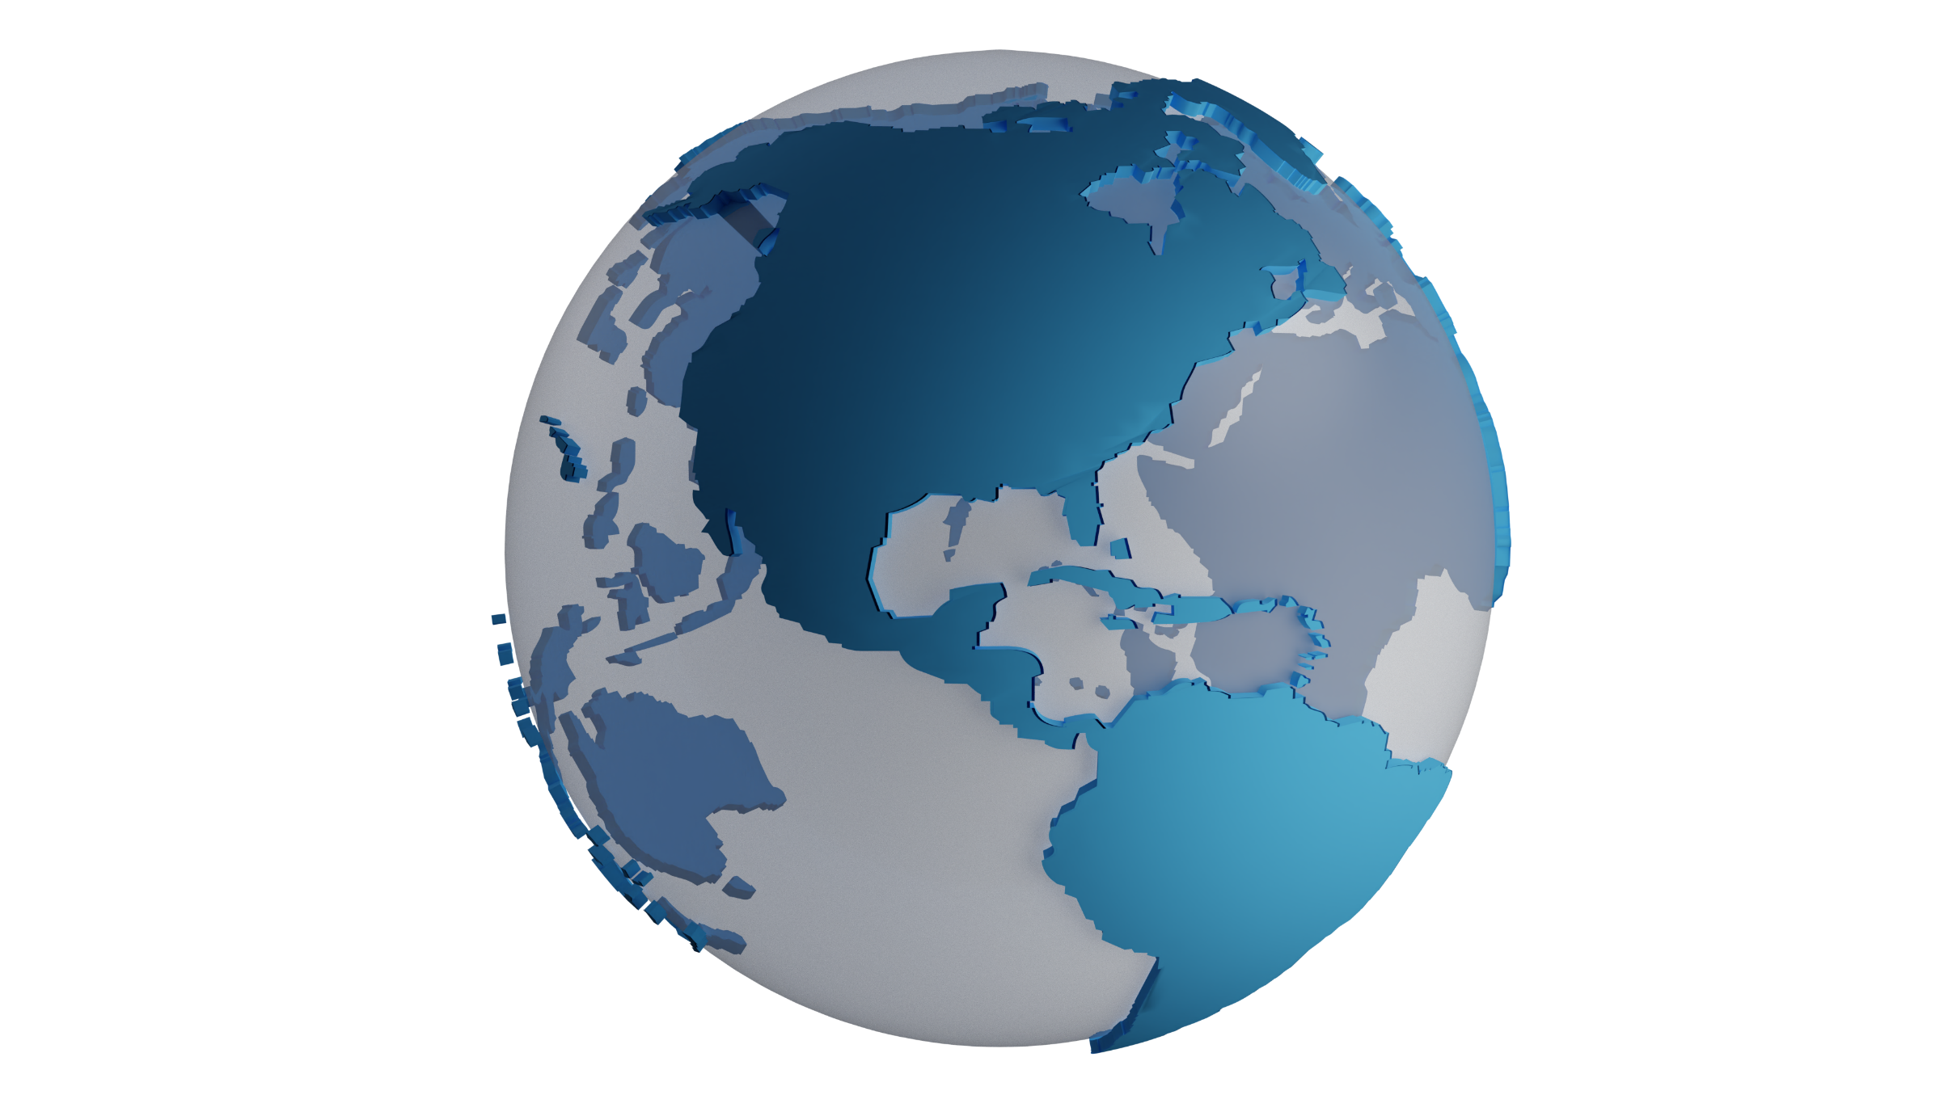
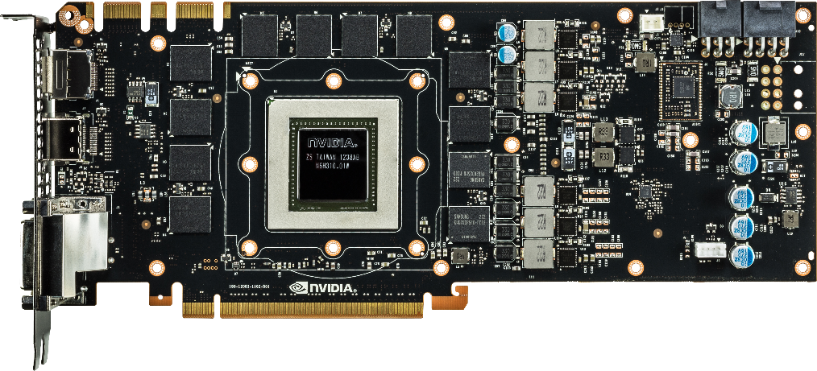
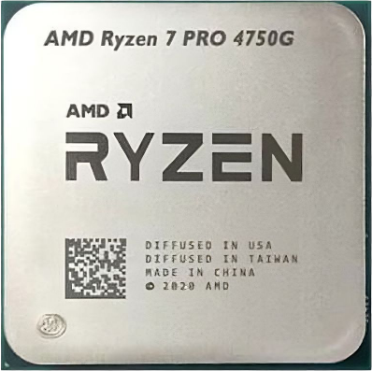
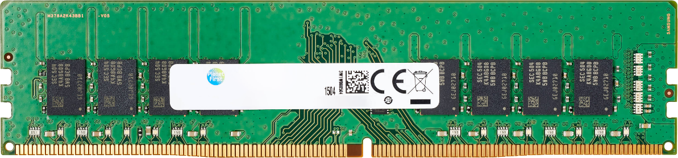
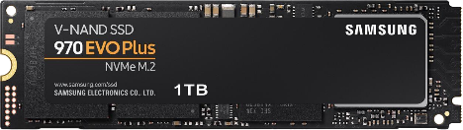
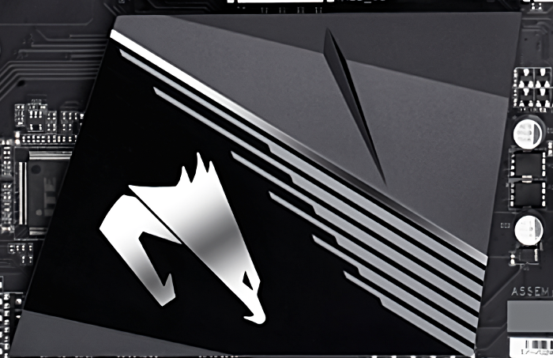
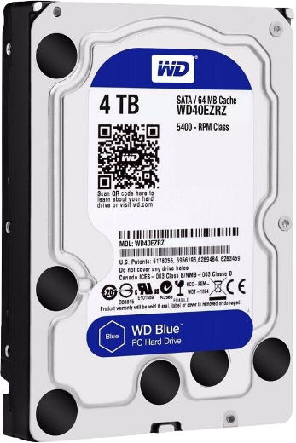
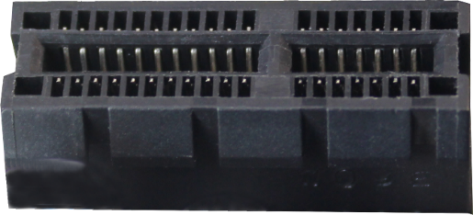
In The Real World
Have a basic understanding of data flow
ITFreeTraining.com
© Copyright 2024
Notes:
07:38 In the real world, you just need to have a basic understanding of how data flows around the computer. Your high-speed devices, like the video card, PCI Express storage like M.2 and memory modules will most likely be connected directly to the CPU.
Other devices like hard disks and slower PCI Express slots will connect to the South Bridge. Even though the South Bridge will generally have slow-speed devices, the amount of data going through the South Bridge can be quite a lot on modern systems. For this reason, don’t be surprised if the South Bridge has a heat sync or in some cases its own cooling fan.
Different CPUs will have different numbers of lanes. More lanes mean more high-speed devices can be connected directly to the CPU. Different motherboards will have different speeds between the CPU and the South Bridge. Thus, something to think about when purchasing a computer.
If you are planning to have a lot of very high-performance devices, you are going to need a CPU most likely with more lanes to support those high-speed devices. If you don’t plan on running a lot of very high-speed devices, you can probably get away with a cheaper CPU. Block diagrams are great for giving you an idea of how everything is connected, but unfortunately manufacturers do not always provide them.

Slide 9

Subscribe
Next video
Video content: https://ITFreeTraining.com/ap11/1b05
© Copyright 2024
Notes:
08:56 That concludes this video from ITFreeTraining on the basic components of a motherboard. I hope this video has given you a better understanding of how a motherboard works and helps you troubleshoot problems. Until the next video from us, I would like to thank you for watching.
References
“The Official CompTIA A+ Core Study Guide (Exam 220-1101)” pages 29 to 30
https://en.wikipedia.org/wiki/Crystal_oscillator
“Picture: Quartz Crystal” https://commons.wikimedia.org/wiki/File:Quartz_crystal_internal.jpg
“Picture” https://en.wiktionary.org/wiki/clock_generator
“Picture: Video card” https://commons.wikimedia.org/wiki/File:NVIDIA_GeForce_GTX_780_PCB-Front.jpg
Credits
Trainer: Austin Mason https://ITFreeTraining.com
Voice Talent: A Hellenberg https://www.freelancer.com/u/adriaansound
Quality Assurance: Brett Batson https://www.pbb-proofreading.uk

