Slide 1
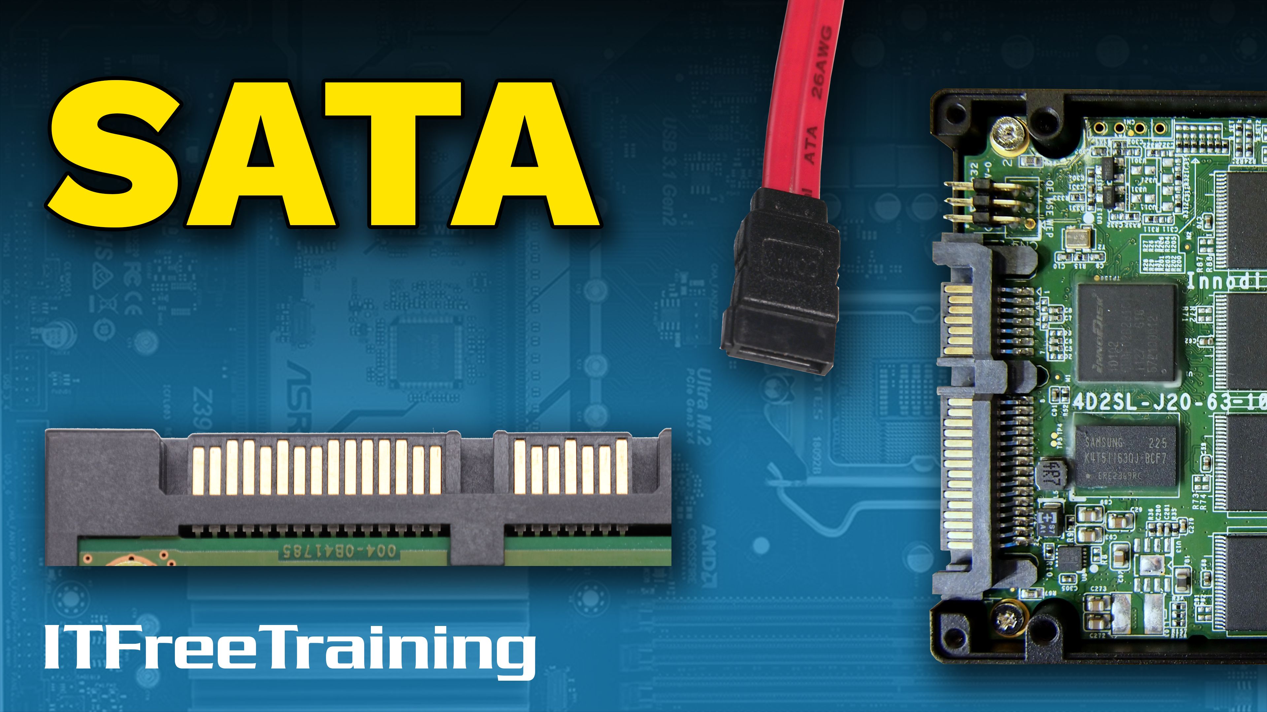
Notes:
Let’s have a look at SATA.

Slide 2
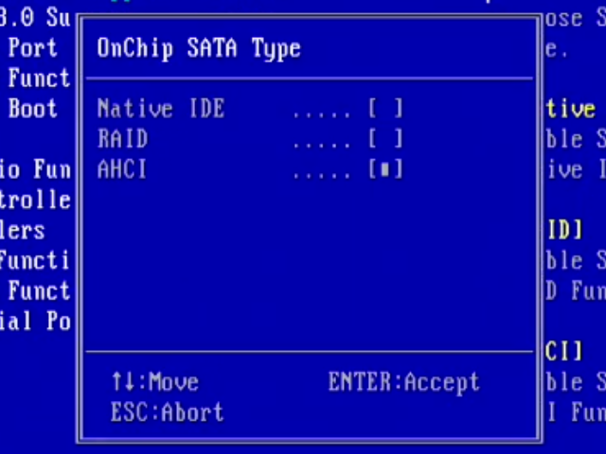
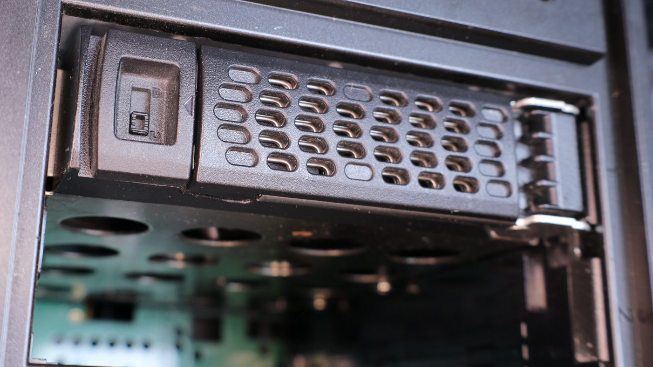
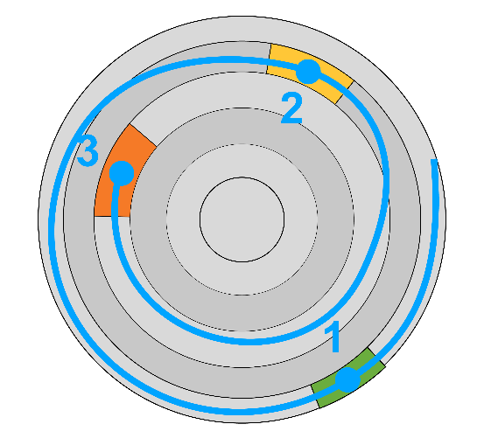
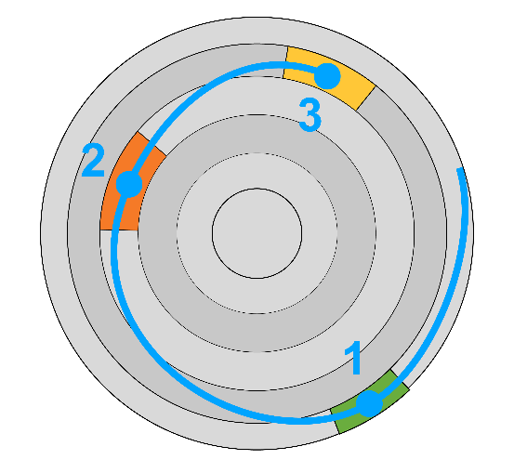
Serial ATA (SATA)
Serial ATA (Advanced Technology Attachment)
Released in 2000
Replaces Parallel ATA (PATA). Thinner cables and faster
No reorder
2 spins
Reorder
1 spin
Advanced Host Controller Interface (AHCI)
Adds
Hot Swapping
Native Queuing
Device can reorder requests
Adds
ITFreeTraining.com
© Copyright 2024
Notes:
00:03 SATA was released back in the year 2000, so it has been around for a long time. It replaced the earlier PATA standard. PATA used a larger ribbon cable. In contrast, SATA uses a much thinner cable. Due to the size of the PATA cable, it was difficult to work with and blocked air flow inside the computer. The thin SATA cables are easier to work with in comparison. PATA is long obsolete, so don’t worry about understanding how it works, I have just shown it to give you an idea of why SATA was developed the way it was.
SATA is short for Serial ATA. The ATA part stands for Advanced Technology Attachment. This term dates back to the early days of computing. If you have not guessed it, SATA is serial while PATA was parallel. With the advancements in data communication, it has become possible to send more data using serial than parallel. Parallel has the problem that when you start speeding the data rate up, it gets harder to keep multiple lines of data in sync with each other. Thus, you can see why serial is used nowadays over parallel.
The PATA interface was developed back in the days of slow-moving hard disks. SATA was designed to be compatible with PATA hard disks, but also added improvements. In order to be compatible, SATA supports two modes, IDE and Advanced Host Controller Interface or AHCI. IDE refers to a popular name used for PATA hard disks in the old days. What you need to know is that IDE, referred to here as Native IDE, is the old standard and AHCI is the new standard. You should always use AHCI whenever possible. Given SATA hard disks have been around since the year 2000, it is unlikely nowadays you will come across a storage device that does not support AHCI.
This particular BIOS has the option to set SATA type to Native IDE, RAID or AHCI. RAID is used when you want to combine multiple storage devices together, so the operating system sees them as one storage device. In a UEFI setup you may have these three options. With newer computers, you may find that the IDE option is no longer present. As time goes on, manufacturers are starting to drop support. It is by today’s standards very old technology.
SATA is much faster than PATA, but there are also other improvements that were made. In order to use these, AHCI needs to be selected. One of the features added is hot swapping. Hot swapping allows a hard disk to be installed or removed while the computer is on.
The next big improvement is native queuing. Native queuing means the storage device is able to change the order of the requests it receives. To understand this better, consider that three requests are coming in. These requests are colored green, yellow and orange. Without native queuing, the hard disk does not read the data efficiently. The head of the hard disk will go past blocks it could have read in favor of reading the next block in the queue. Native queuing allows the storage to re-order the requests. The hard disk knows that while it is spinning it can move the head and read the blocks out of order. This has the advantage that all three blocks in this example can be read in one spin of the hard disk rather than two spins. Thus, you can see why you would always want to use AHCI.
Now let’s look at the next big change in SATA, that is, the cables themselves.

Slide 3
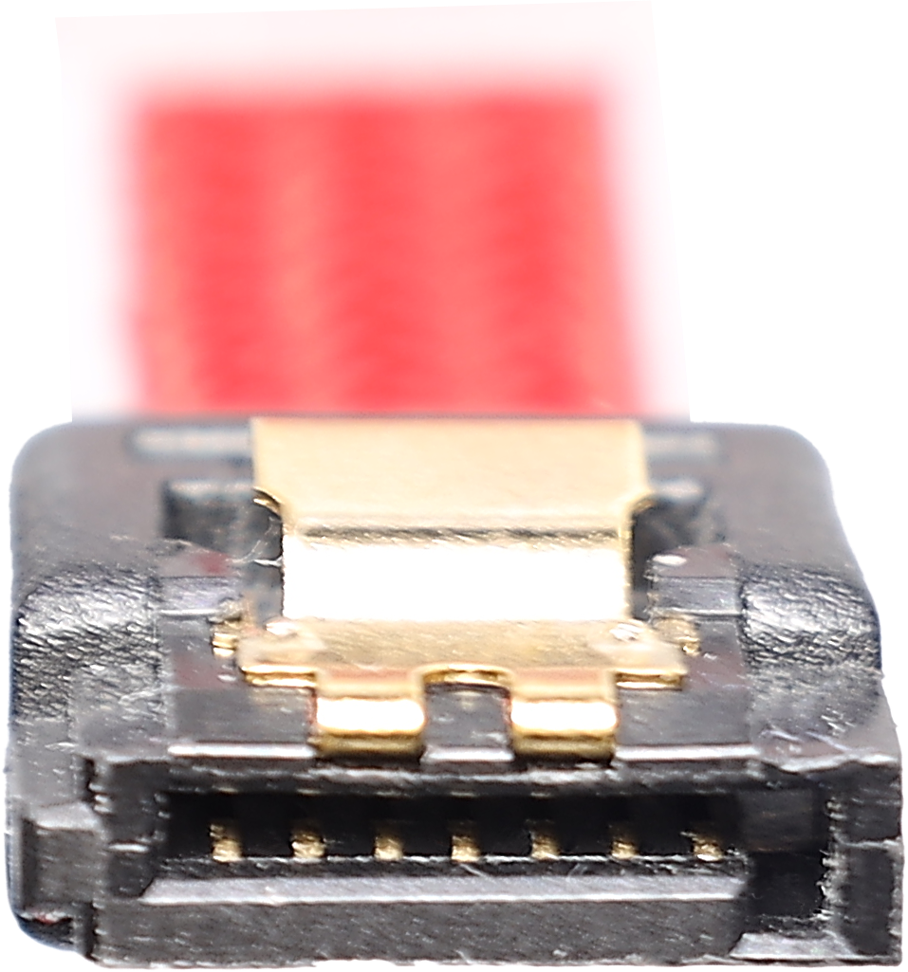
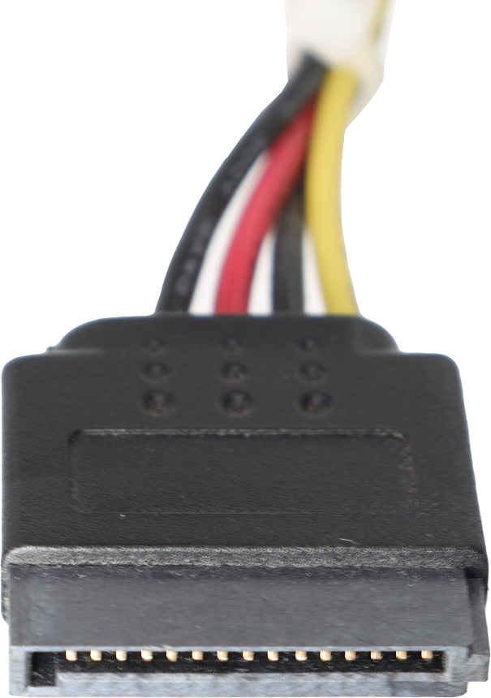
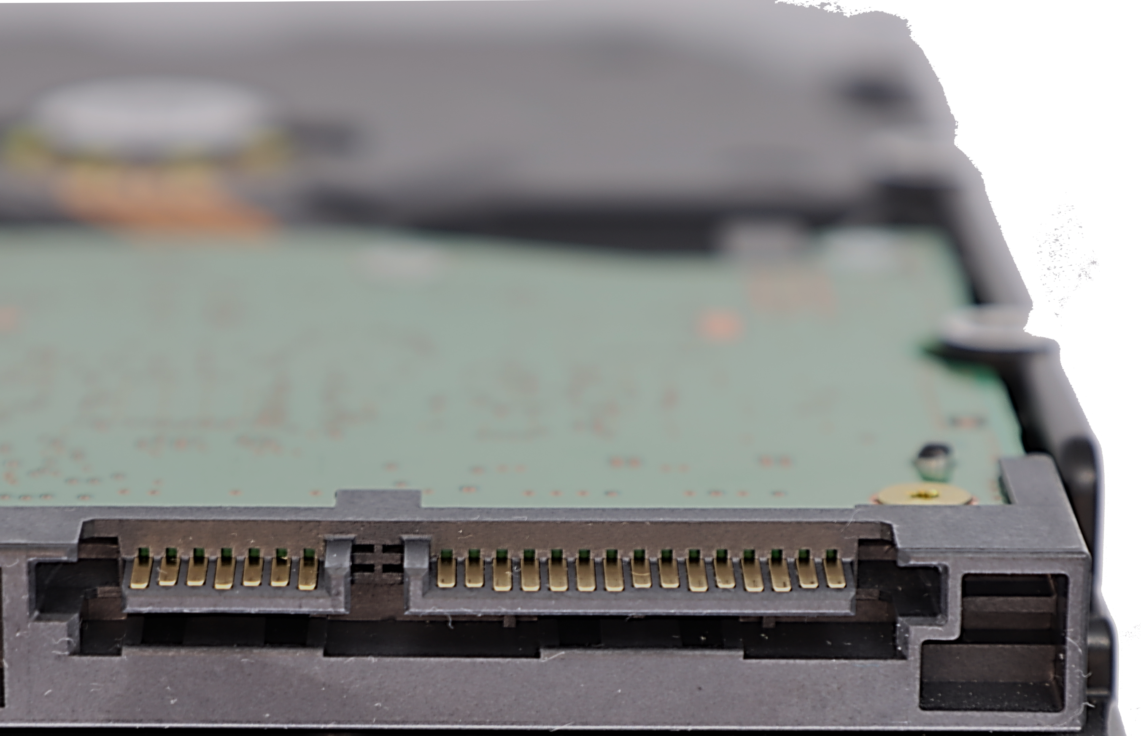
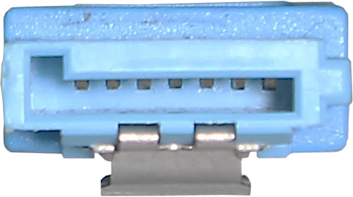
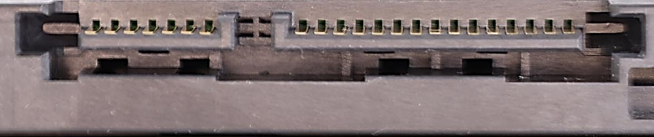
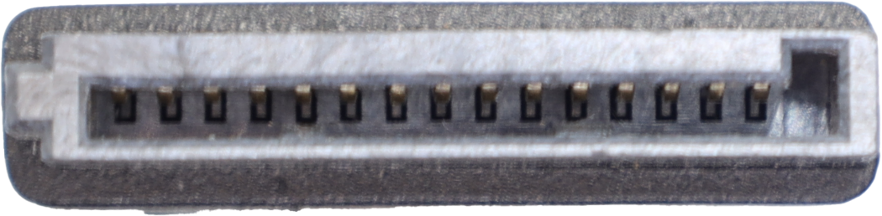
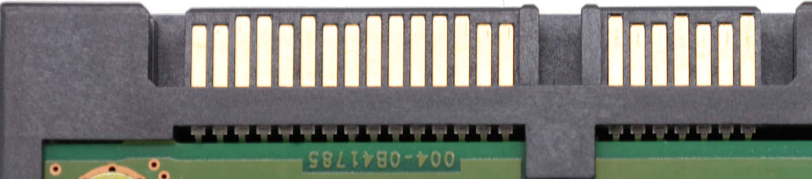
SATA Cables
Data Connector
Power Connector
L-Shaped connector
Also L-Shaped connector
One bi-directional data lane
Supports 3.3/5/12 volts
ITFreeTraining.com
© Copyright 2024
Notes:
03:42 SATA uses two different cables. The first one that I will look at is the data connector. This is an L-shaped connector. Essentially, a keyed connector preventing it from being put in upside down. It provides the equivalent of one bi-directional data lane. Given the number of wires in the connector, it is not possible to add any additional data lanes.
The next connector is the power connector. This is also an L-shaped connector. As before, a keyed connector like this prevents the connector being put in upside down. The connector itself supports three different voltages, these being 3.3, 5 and 12 volts. You don’t need to remember these voltages, but you will eventually start remembering them because these are pretty common voltages in a computer system.
To demonstrate how to use these cables, I have a motherboard and a hard disk that I will connect together. To start with, I will first plug in the SATA data cable. You will notice the L-shaped connector. In order to plug the connector in, I will need to locate a SATA connector on the motherboard. Your motherboard will most likely have a few of them. You will notice the L-shaped connector prevents the data cable being put in upside down.
The cable needs to be pushed into the connector on the motherboard. You should hear it click into place. The same applies for the hard disk, push the other end of the connector into the connector on the hard disk until you hear it click. To remove the connector, in some cases, you can just simply pull the cable out of the connector. In this case, this cable has a latch on the connector. In order to remove the connector, the latch needs to be pushed down. In most cases, the connector will go in without pushing down on the latch. With some cables, the latch will make it difficult to push the connector in, so if you are having problems getting the connector in, push down on the latch and try again.
Some SATA cables will have a latch and others will not. You may be tempted when doing maintenance, to pull on the cable to remove it, however, if the cable has a latch, you won’t be able to pull the cable out. If you look at the other end of the cable, if it has a latch, the other end probably has a latch as well. If you pull a cable that is connected with a latch, you risk causing damage to the connector. If you damage a connector on a storage device, this may mean you will need to replace the circuit board on the storage device. In some cases, this may work, in other cases it may work but you will lose all the data on that storage device.
The next step is to plug in the SATA power connector. As before, the SATA connector is an L-shaped connector. So, in order to plug it in, you just need to make sure that it is up the right way. That is really all there is to it for plugging the connectors in. The computer is off at the moment, but I could have plugged the hard disk in while the computer was on. Let’s have a closer look at how the connectors support hot swapping.

Slide 4
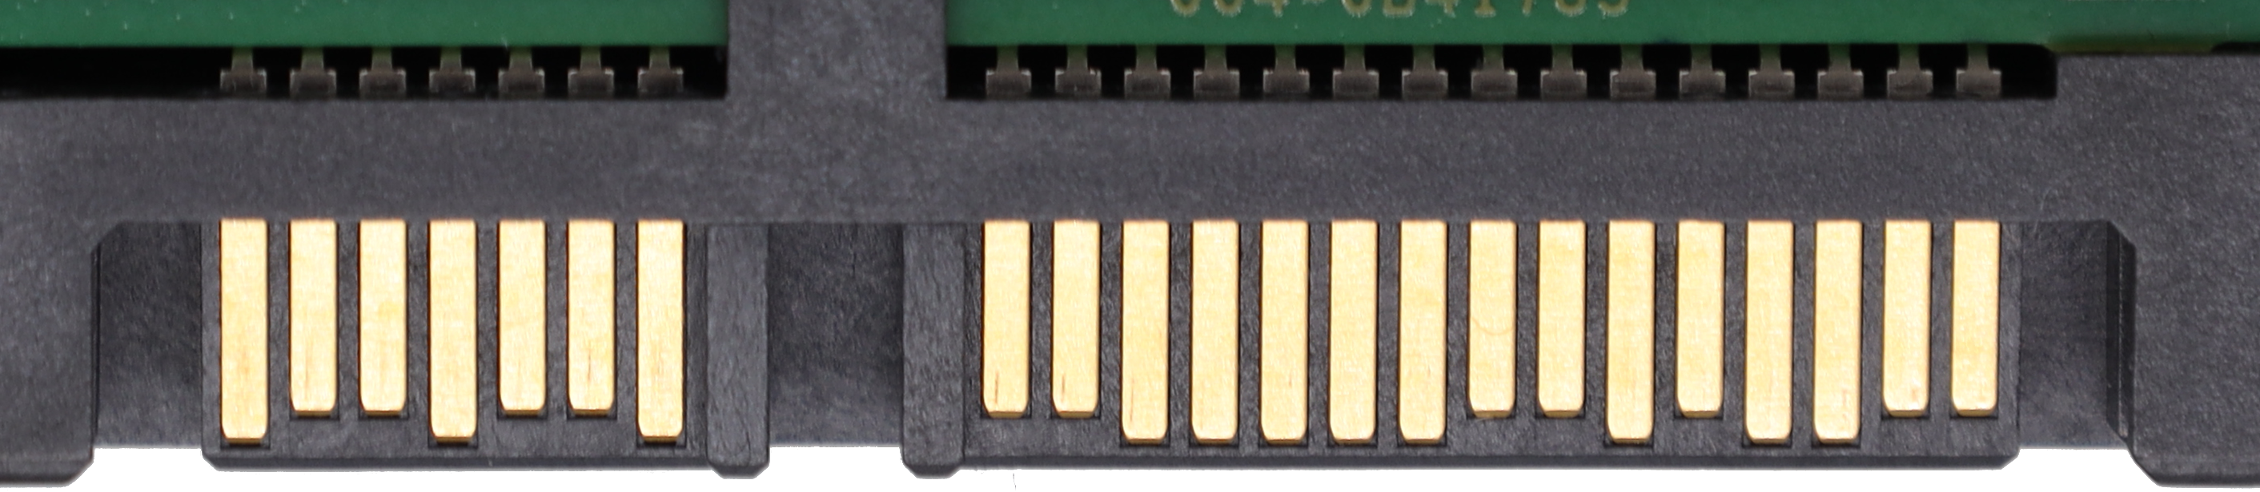
Hot Swapping
Staggered pins on connectors
Outer pins connect first and remove power spikes to stabilize power
Connect first
ITFreeTraining.com
© Copyright 2024
Notes:
06:48 SATA facilitates hot swapping at the hardware level, allowing storage devices to be connected and disconnected while the computer is operational. However, there is a risk associated with hot swapping. The risk occurs when the device is plugged in or unplugged as a power surge occurs during the connection or disconnection could potentially damage the storage device, with the highest risk occurring when the device is initially plugged in.
In order to prevent this from occurring, the pins on both the SATA connectors are staggered. When the connector is inserted, the outer pins make contact first. These pins are linked to components designed to dissipate any excess power. The inner connectors then establish a connection. These inner connectors aren't required to have surge protection capabilities. While the difference between the outer and inner pins might seem minimal, this small gap is sufficient for the electronics to stabilize the power connectors by drawing off any excess energy.
Newer computers will have plenty of SATA power connectors as the standard connection. In some cases, you may start running out of connectors. Let’s have a look at an option you can use if you do start running out of connectors.

Slide 5
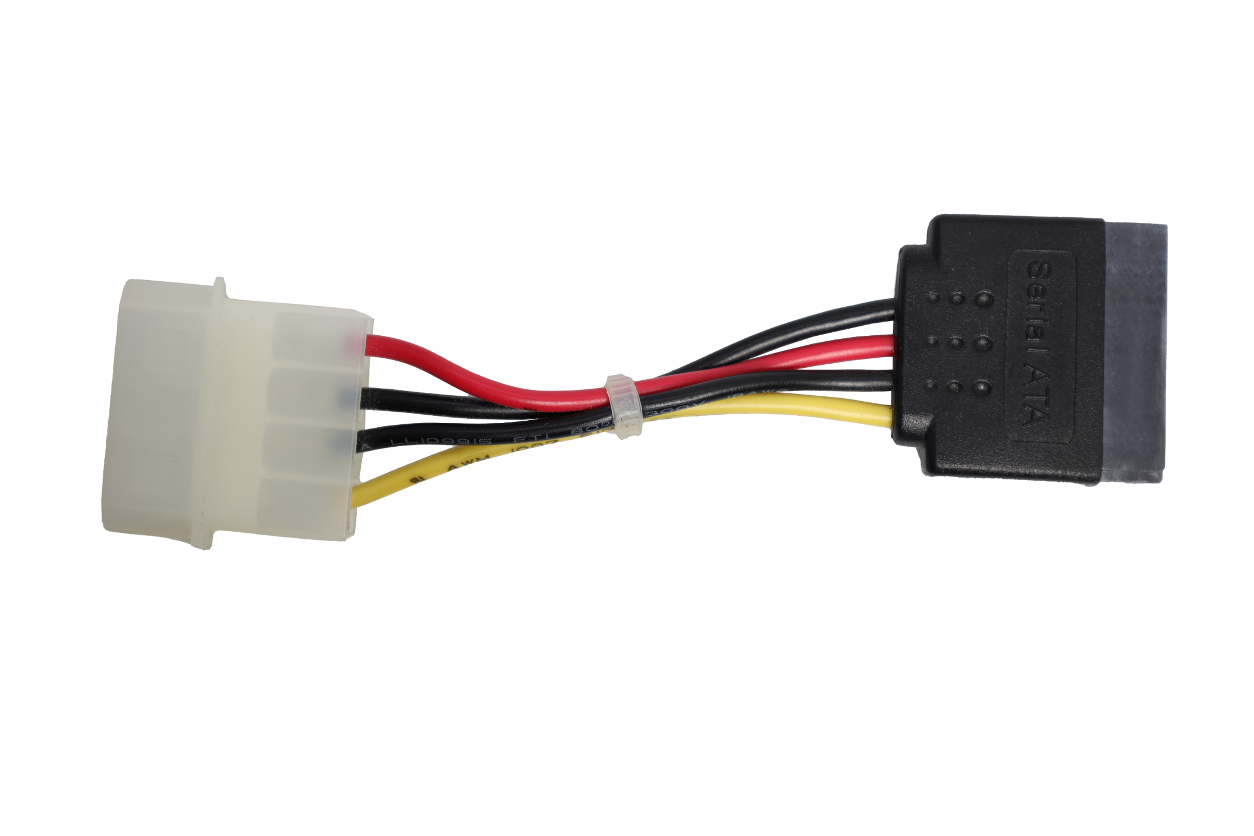
Molex to SATA Connector
Converts Molex to SATA connectors
Does not include 3.3 voltage
3.3 voltage not used very often
Some enterprise storage may not work with this adapter
ITFreeTraining.com
© Copyright 2024
Notes:
08:03 If you are running out of connectors, and you have free Molex connectors, you can use a SATA to Molex connector. This converts the Molex power connector to a SATA power connector. It is important to be aware, that if you use this connector, it does not include a 3.3 voltage. On the positive side, not many storage devices use this voltage. If it is used, it tends to be used for enterprise storage devices.
In later versions of SATA, there was a feature added that allows a hard reset of the hard disk to be performed. This is an optional feature that does use the 3.3 volt wires. You don’t see it used much, once again, most likely used if you have enterprise storage devices. This won’t present a problem with newer equipment, however, if you use these storage devices with older equipment they may not work.
Now that we have had a look at the cables, let’s have a look at the different versions of SATA.

Slide 6
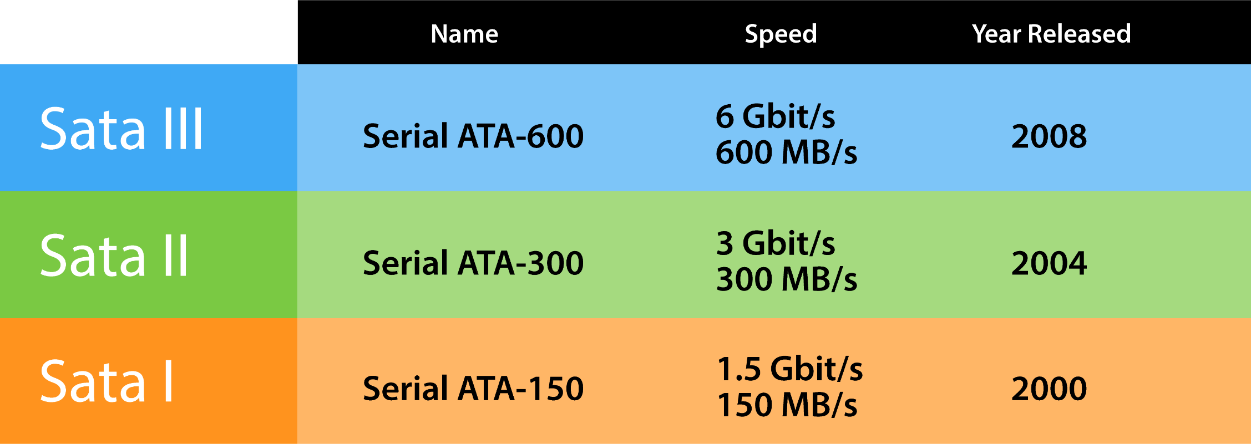
SATA Versions
Most likely to come across SATA III
All SATA versions use the same cables and connectors
ITFreeTraining.com
© Copyright 2024
Notes:
09:00 There are currently three different versions of SATA. SATA version III was released in 2008 and thus a long time ago in the world of computing. This means, nowadays, you are most likely to come across SATA III. The good news with SATA is that all versions of SATA use the same cables and connections. Thus, your old SATA cables should still work even if they were manufactured before SATA III was released.
I would not worry about remembering too much about the earlier versions of SATA; the main takeaway I think is important to keep in mind is, that the speed of SATA III is 600 MB/s. With storage devices getting faster and faster, there are devices that are able to transfer data faster than this. SATA is thus limited to what devices it can be used with if you want to get the best performance possible. Later in the video, I will look into this in more detail.
There have also been minor updates to each of the main versions. These added performance and bug fixes. At the time this video was made, the last version update was released in 2020. Thus, it may be worthwhile checking your storage devices and update your equipment to the latest firmware to take advantage of these fixes; however, don’t expect too much of a performance increase. A lot of the updates are minor in nature, although everything helps, and it is doubtful in most circumstances you would notice any difference.
Due to the technology in flash improving, minor updates to SATA won’t help you much in performance terms. To understand why, let’s have a look at how Solid-State-Drives were first introduced to the market.

Slide 7
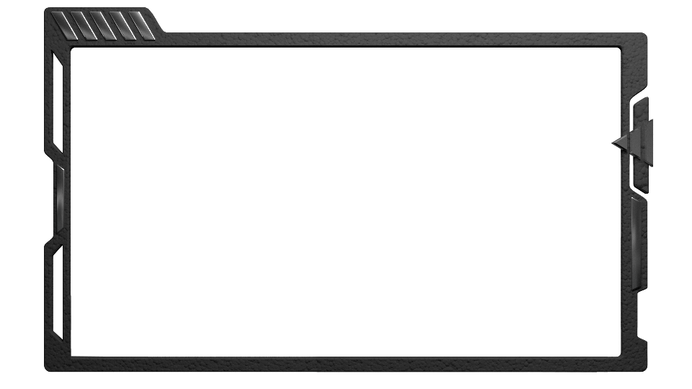
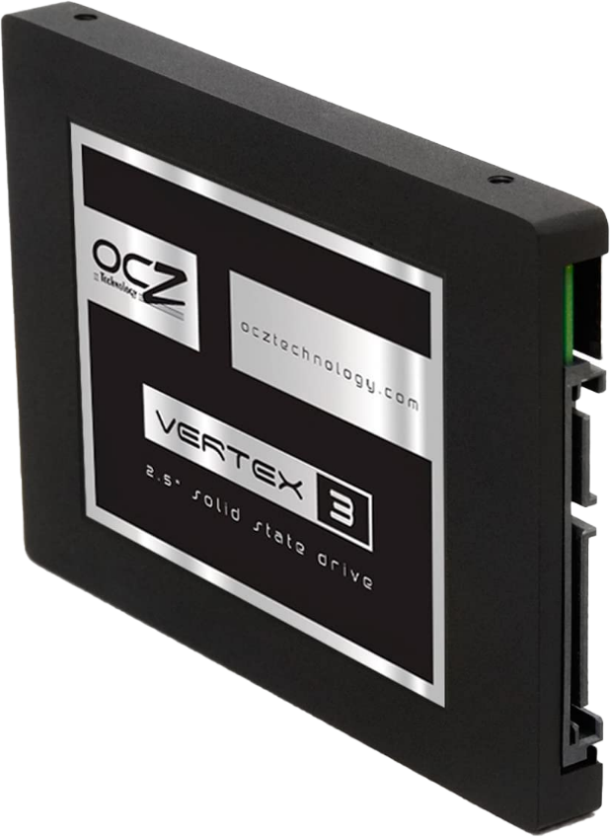

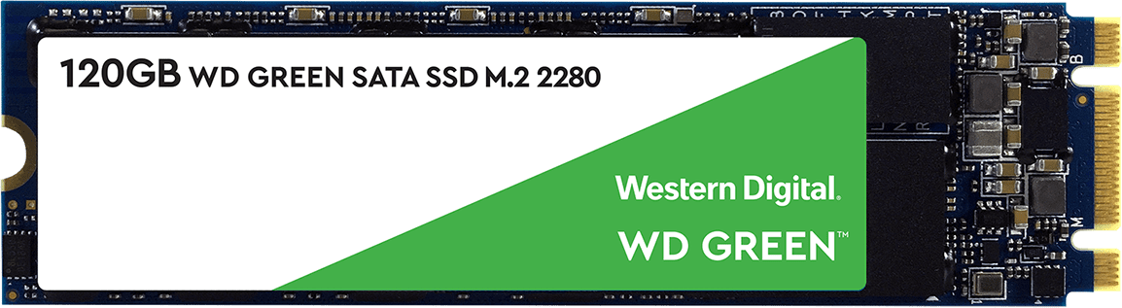

SATA and Flash Drives
SATA Solid-State-Drive
M.2 Solid-State-Drive
Top notch missing B-Key
B-Key used for SATA
Uses same interface as SATA
Bottom notch M-Key (NVMe)
SATA designed with HDD in mind
Both missing SATA (B+M)
Flash was slow. Not a problem back then
B-Key or B+M Key are SATA
ITFreeTraining.com
© Copyright 2024
Notes:
10:36 The first Solid-State-Drives introduced to the market used the same interface as SATA. This made sense since everybody already had SATA hard disks, and thus to make the changes you could use your existing hardware.
SATA was originally designed with hard disks in mind. Hard Disks have one moving arm, so the protocol was designed with that in mind. Back then, it was not really a problem because flash was not that fast. Nowhere near as fast as it is today.
SATA Solid-State-Drives can also use the M.2 form factor. Essentially, the underlying protocol used is the same, just the package it is delivered in has changed. Using the M.2 form factor means the storage is smaller and thus costs less to manufacture. It is also possible to get an enclosure like this one.
These enclosures are designed for an M.2 Solid-State SATA drive to be put inside. Basically, it looks just like the Solid-State-Drive that we just looked at, however, it will have an M.2 Solid-State-Drive inside. If I were to try and predict the future, I would say that manufacturers will stop producing the traditional Solid-State SATA drive and sell you an enclosure with an M.2 Solid-State-Drive instead.
There are currently two different types of M.2 storage devices currently sold on the market. These are SATA and NVMe. The SATA Solid-State-Drive has a notch missing at the top. The position of this notch corresponds to a specific letter designation. In the case of SATA, the notch position is in what is referred to as B-Key.
Although it is technically possible to have a Solid-State-Drive with only a single notch for SATA, we find in the marketplace this does not occur. Instead, there is often a second notch missing. This is located at the bottom and is referred to as M-Key. M-Key is used for NVMe or Non-volatile Memory Express. NVMe is a replacement for the SATA protocol. Later in the video, I will have a little bit of a look into NVMe, however, full details of NVMe I will leave to another video.
Although this Solid-State-Drive only supports SATA, it also has the M-Key notch, so it can also be used in M-Key slot motherboards. Some M.2 M-Key slots on a motherboard will support SATA and NVMe. In order to use SATA, it does not matter if the M-Key notch is present or not. However, not having this present would reduce the number of motherboards the storage could be used in, since the storage could not be used in M-Key slots that support SATA. Thus, all SATA M.2 storage devices that I have ever seen have the B and the M-Key notches. Thus, if you see both notches missing, it is safe to assume it is SATA. You will often hear this referred to as B+M Key. To put it simply, if you ever see B-Key or B+M Key mentioned, it is referring to SATA.
It appears that the market is moving slowly towards M.2 SATA rather than larger Solid-State-Drives. SATA won’t disappear anytime soon, and later in the video I will look at the reasons why. Before that, I will have a look at some of the SATA interfaces that have not been that successful in the market.

Slide 8
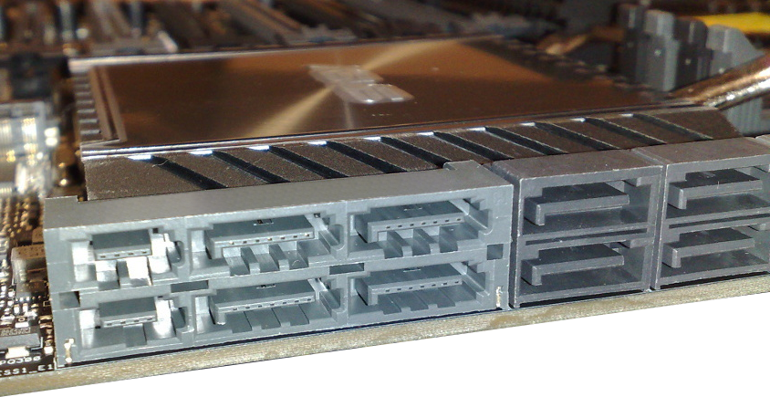
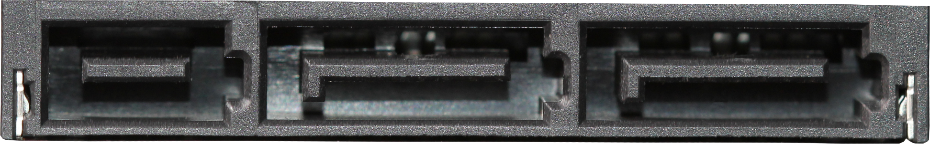
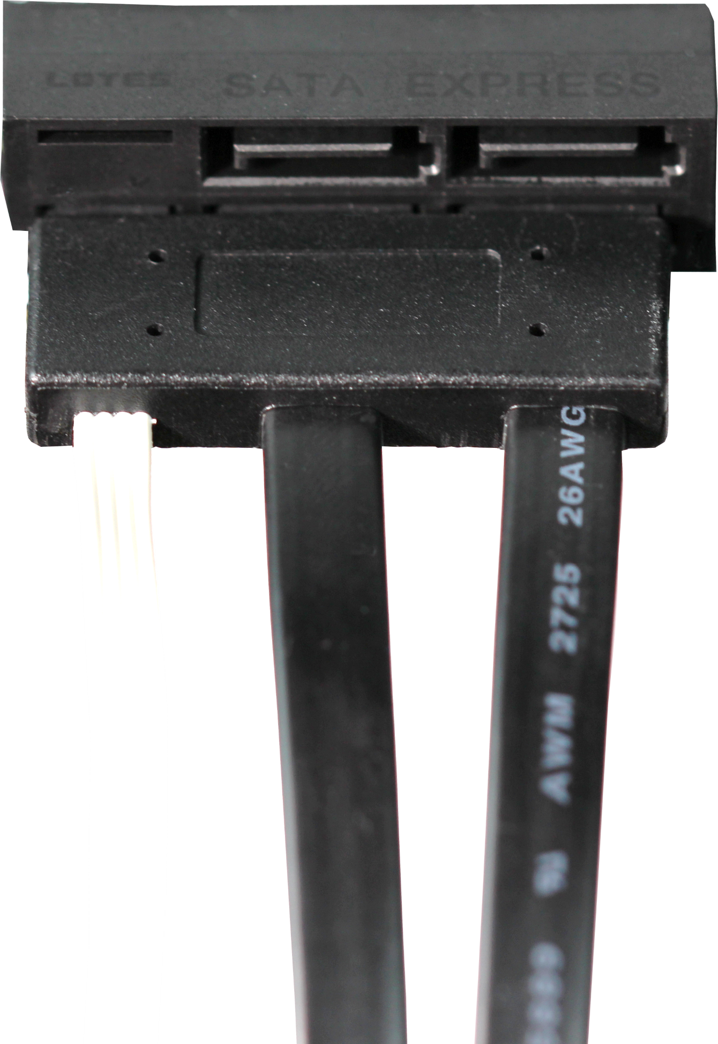
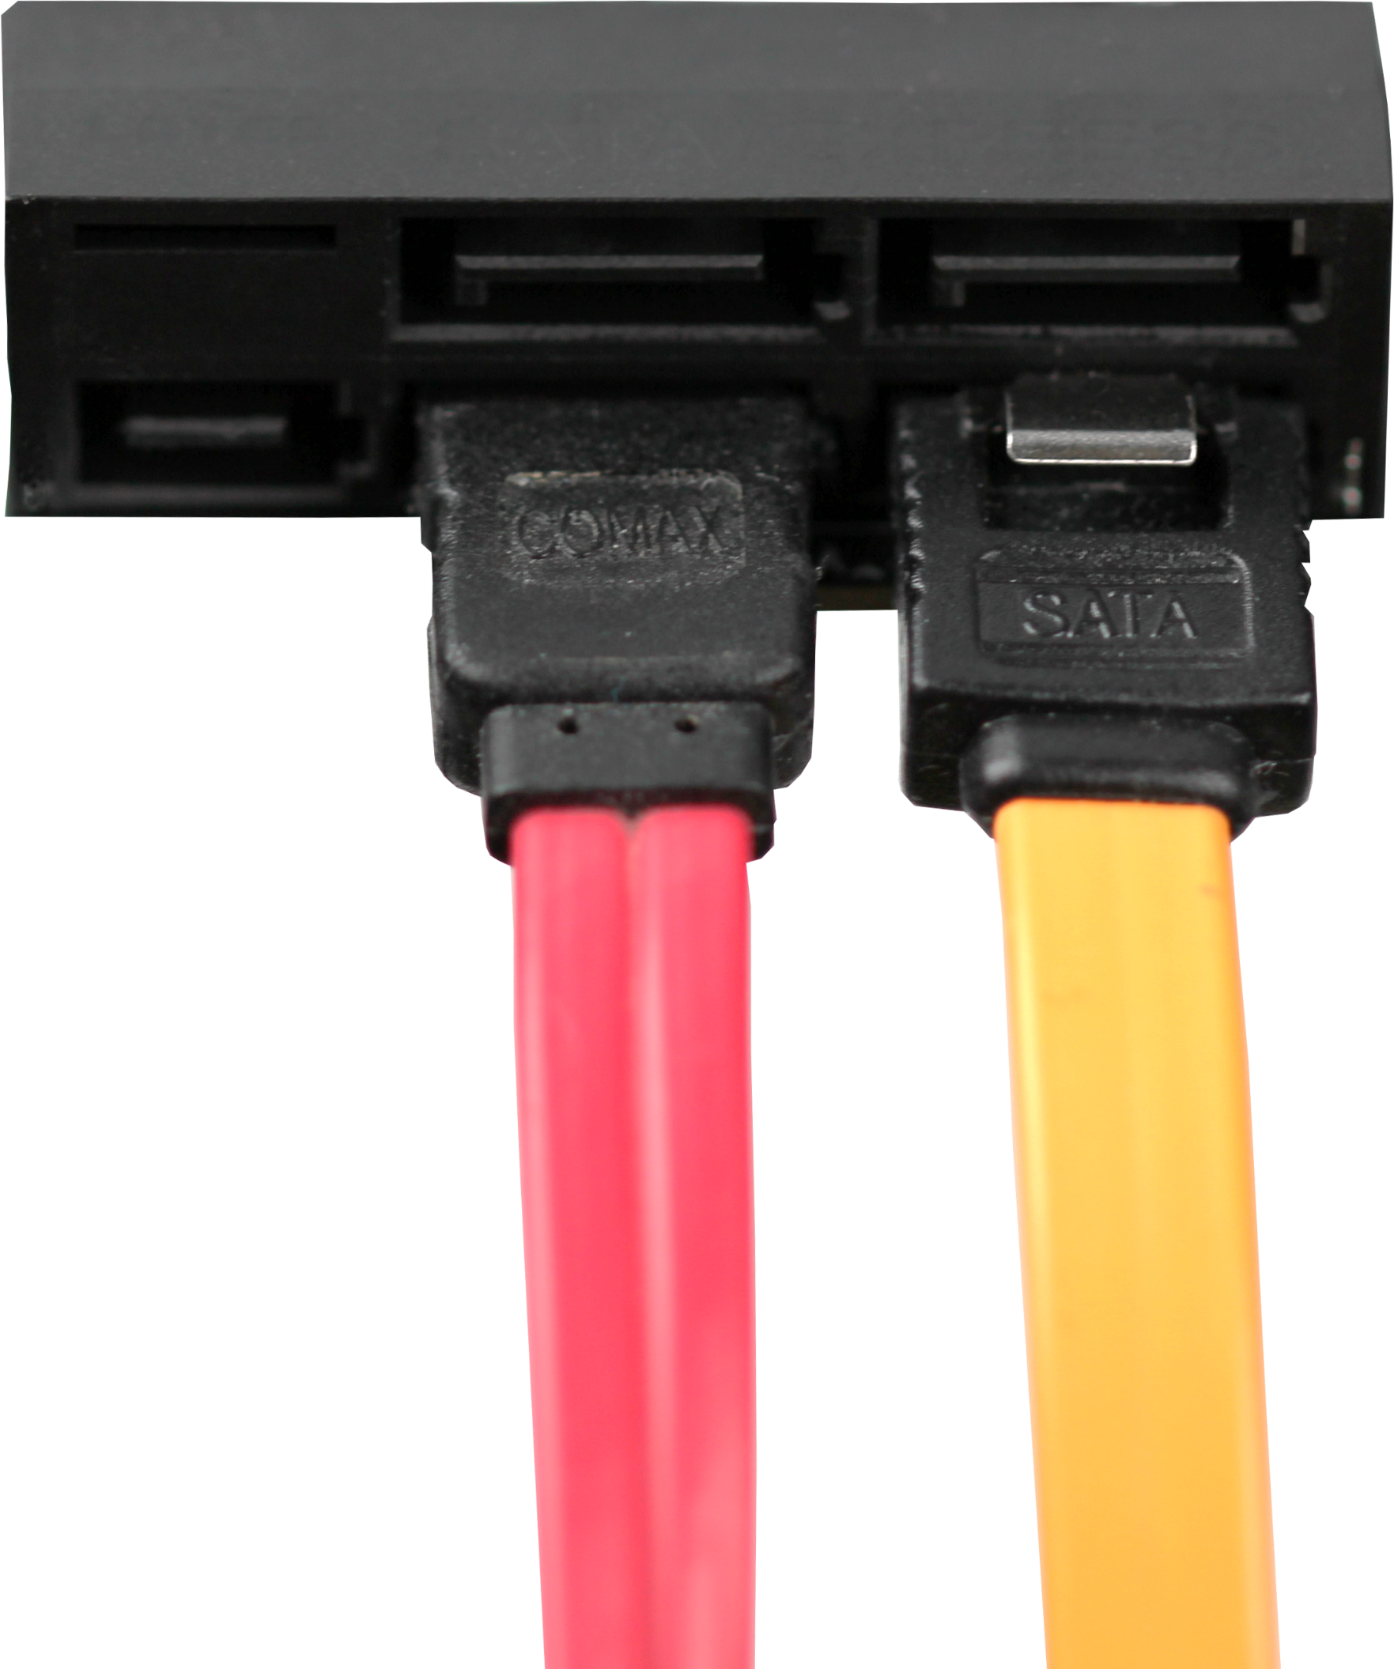
SATA Express Connector
Allows use of two lanes
Never really took off
Control
Connector
1x SATA Express connector
2x Regular SATA connectors
Uses special connector
Or 2x SATA connectors
2x Data cables
1x Control cable
ITFreeTraining.com
© Copyright 2024
Notes:
13:54 I will next look at the SATA Express connector. This connector allows the use of two lanes rather than just the one lane. The connector never really took off, so it is very doubtful you will be asked a question on it in the exam, and you don’t really need to know about it. The only reason I mention it is, if you are working on an old system and see it, you will know what it is.
The connector itself looks like two SATA connectors with an extra connector to the left of it. The left part is an extra connector for control signals. Since PCI Express is being used to transfer data, some extra wires are needed to transfer the PCI Express control information.
To the right of this are two SATA connectors. When these two connectors are used together with the control connector, this is where SATA Express gets two lanes from. In order to use it, a special connector is required. You can see that it is divided up into one control cable and two data cables.
In order to use the PCI Express connector, you need a device that supports it. Although you can get a lot of speed out of a PCI Express connector, after it was created competing products like USB 3 were released. Technology like USB 3 is simpler to use and thus you can understand why this connector did not take off.
If your motherboard supports this connector, you have the option to use two connectors as standard SATA connectors.
So far, I have only looked at using SATA for internal connectors, I will next have a look at what you can do if you want to connect an external hard disk.

Slide 9
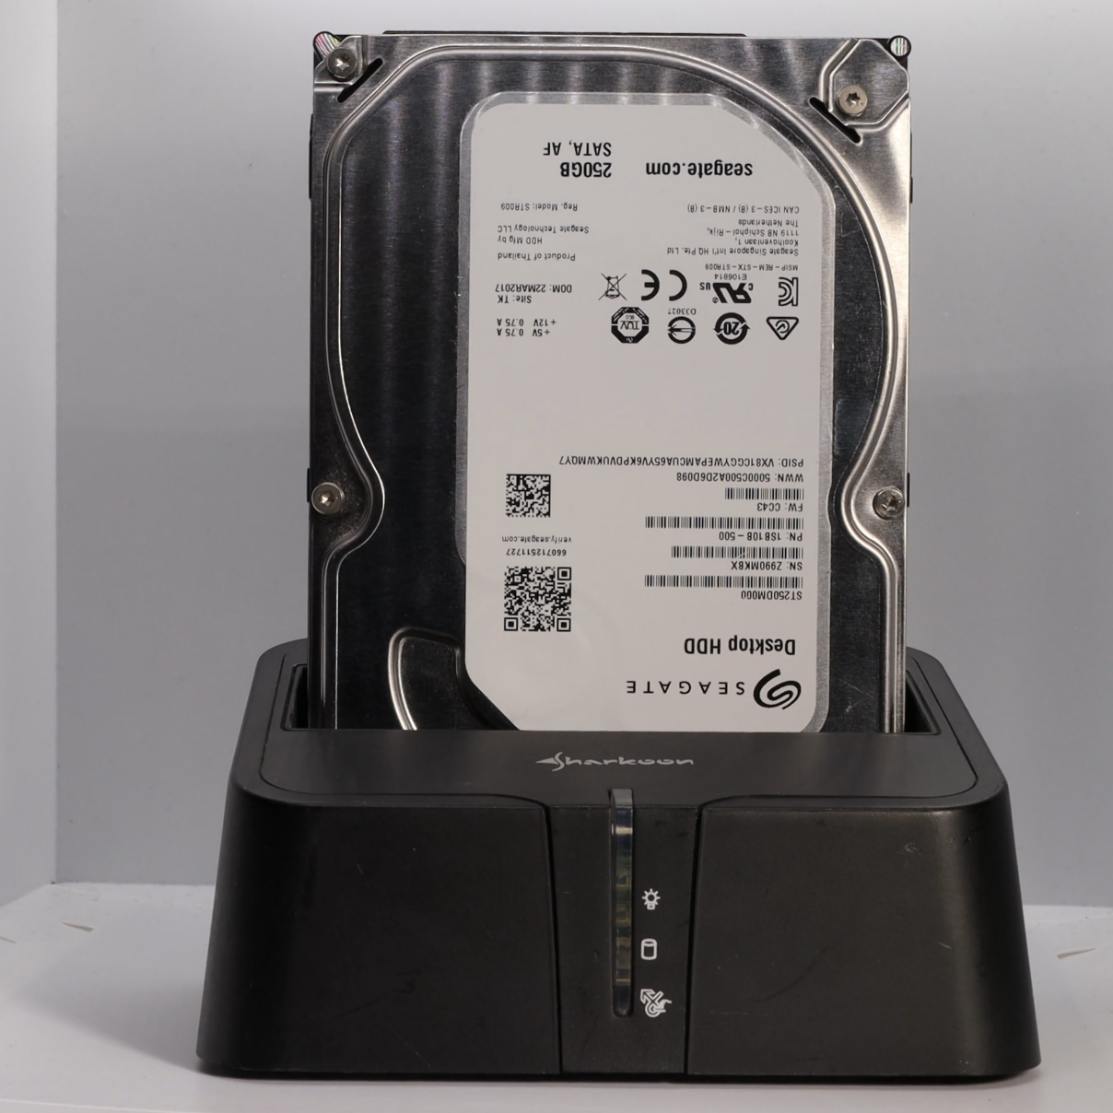
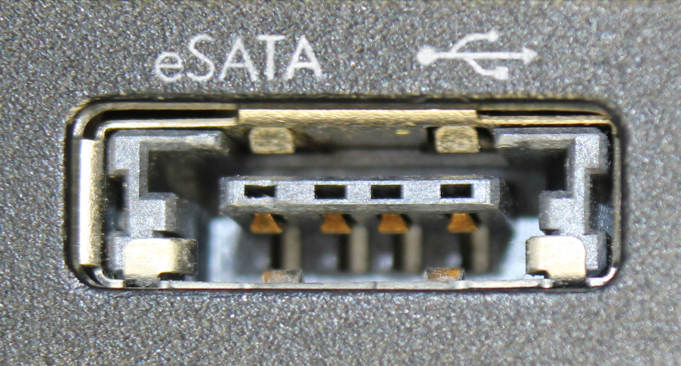
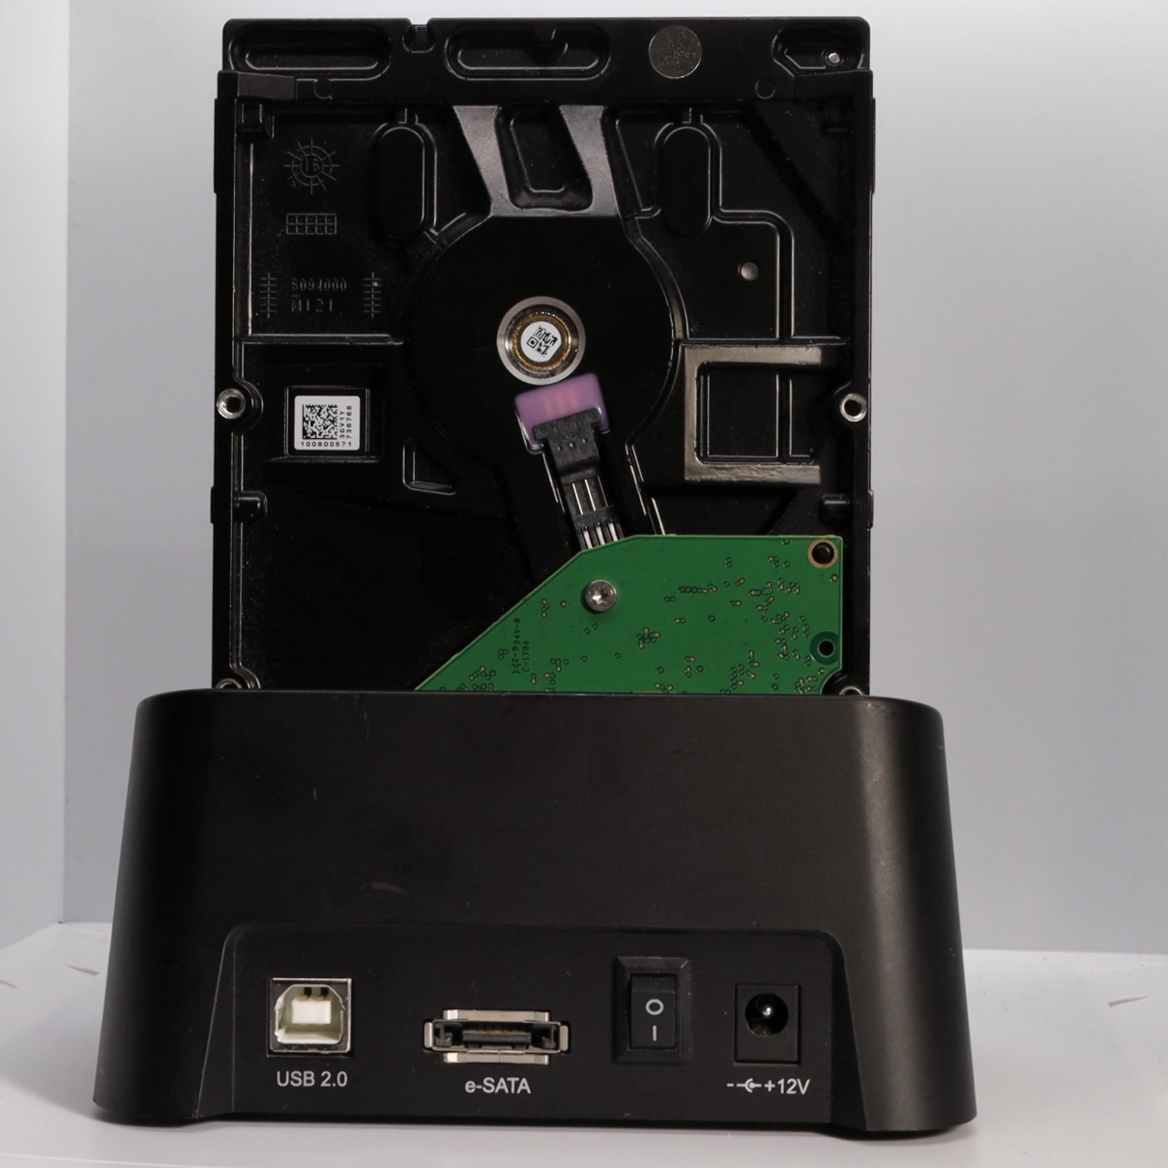
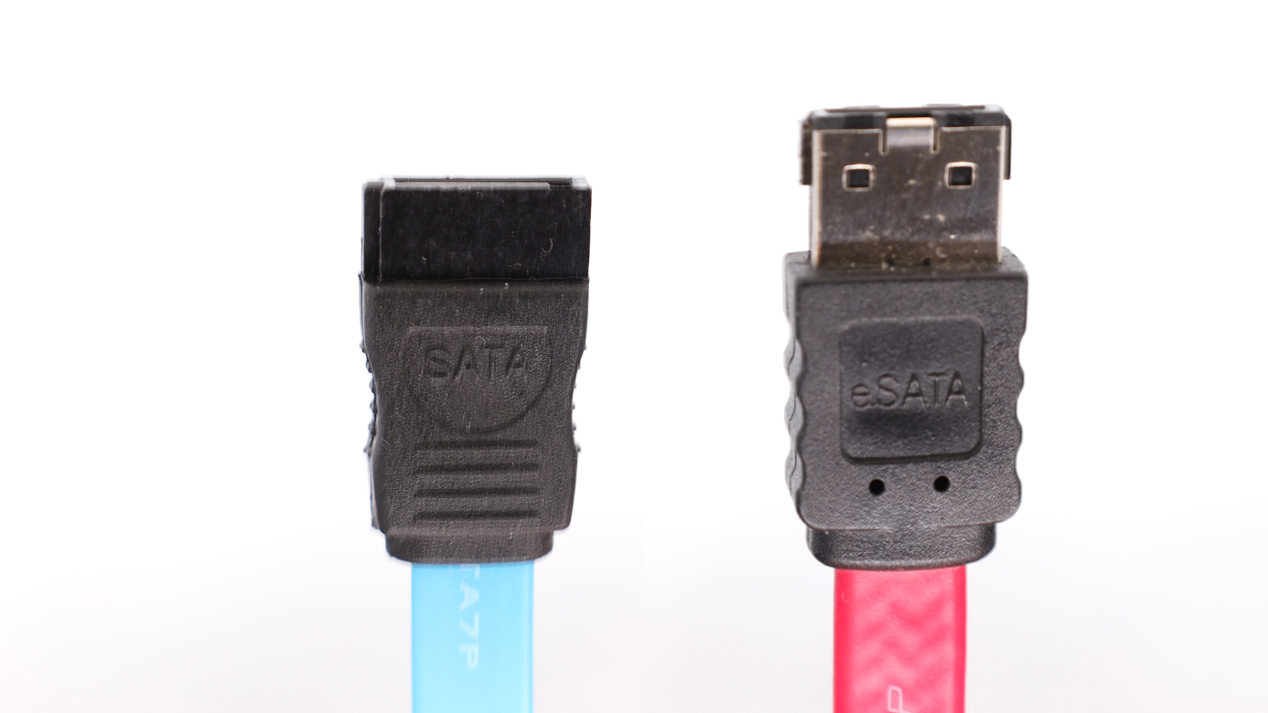
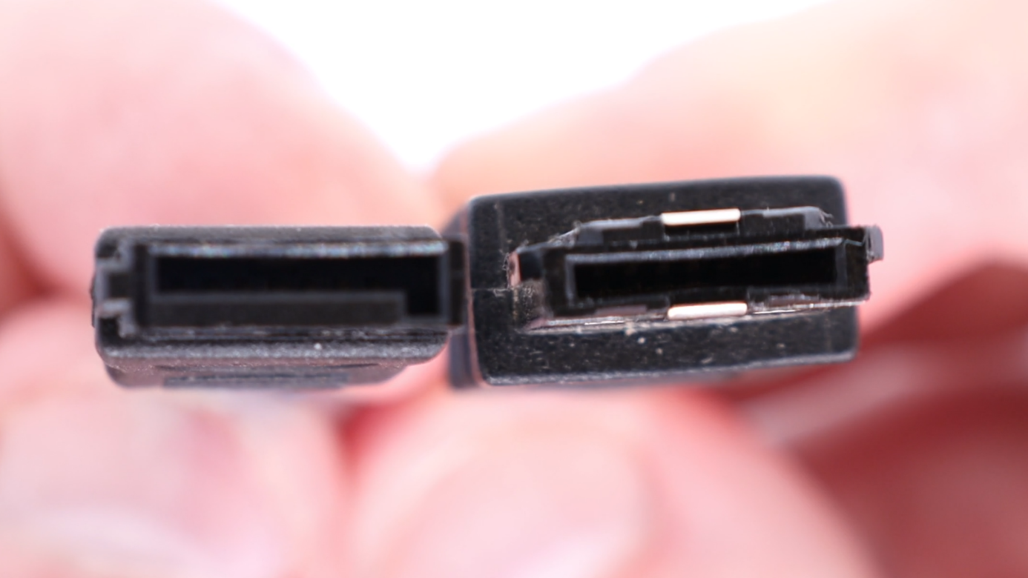
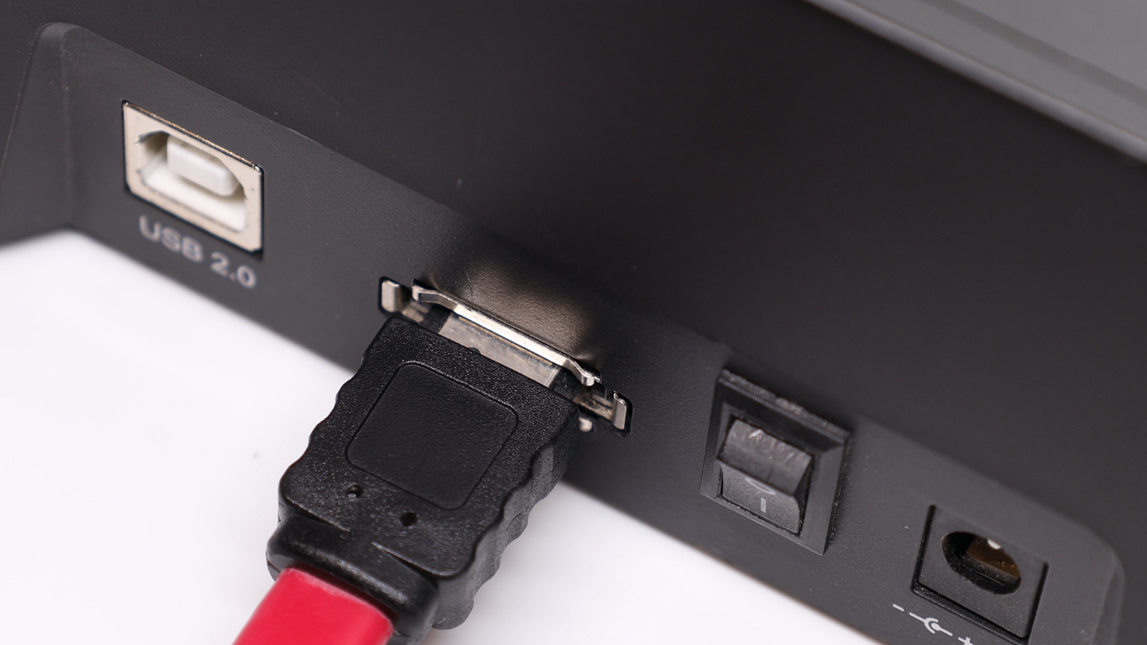
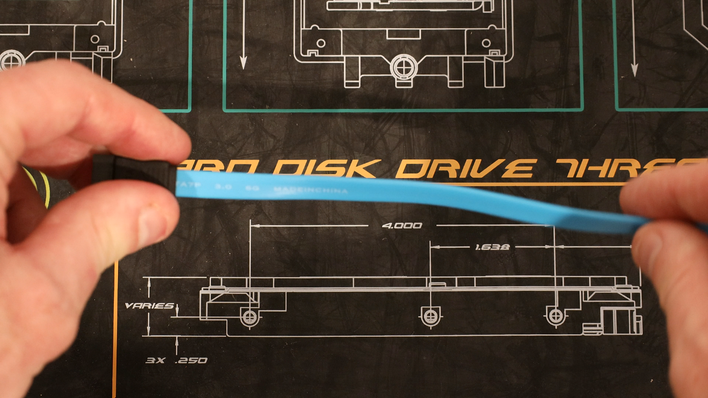
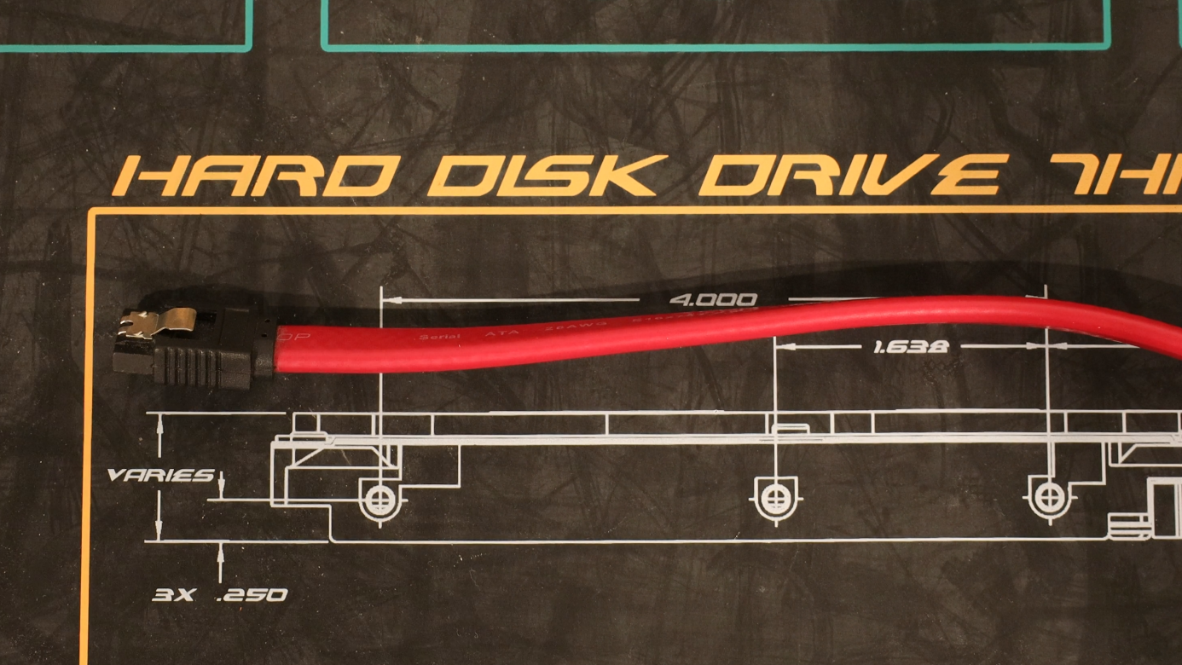
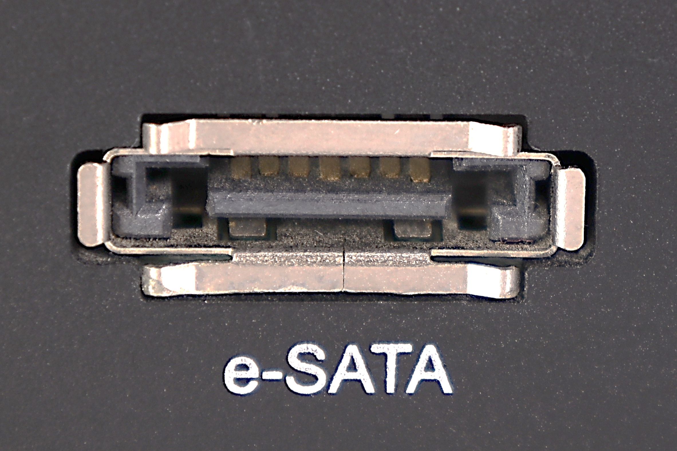
eSATA
External non-powered SATA connector released in 2004
Not really used anymore due to alternatives like USB/Thunderbolt
eSATA connector on laptop
eSATA cable thicker than SATA
ITFreeTraining.com
© Copyright 2024
Notes:
15:15 It is possible to connect an external hard disk to a computer using eSATA. eSATA was released in 2004 and provided a way to connect an external hard disk to a computer. It uses a non-powered connector and thus the external hard disk requires its own power supply. In this example, I have an external hard disk enclosure with a hard disk in it. You will notice on the back of the enclosure the connectors that it has available. In this particular case, it has an eSATA connector which is the one that we are interested in.
An eSATA cable is not the same as a SATA cable. When I compare a SATA and eSATA cable, the SATA cable is the blue cable and the eSATA is the red cable; you will also notice that the end of the eSATA connector is a little longer than the SATA connector. Notice the end of the connector is different as well. The eSATA connector is not an L-shaped connector. The connector, however, is keyed, so that means that you won’t be able to plug it in the wrong way.
There is also another difference between the SATA and eSATA cables. You will notice that the SATA cable is quite thin and also pretty flexible. This makes SATA cables easy to work with. eSATA cables are thicker and not as flexible, making them harder to work with.
At the time, eSATA allowed you to access external storage at the same speed as SATA would allow. However, as other technologies developed like USB and Thunderbolt, it became simpler for a user to use this other technology rather than using eSATA. Thus, eSATA is not really used because there are simpler and easier alternatives available that offer better speed.
If your computer has an eSATA connection, it will look something like this. These connections are generally found more often on laptops. But due to the decline in use, you don’t tend to find them on laptops nowadays. In some cases, the eSATA connection may also be used as a USB connection which is the case in this example. Simply plug an eSATA or USB connection in and the laptop will work out which to use.
Now that we have an understanding of how SATA works, let’s have a look at how to configure SATA on your computer.

Slide 10
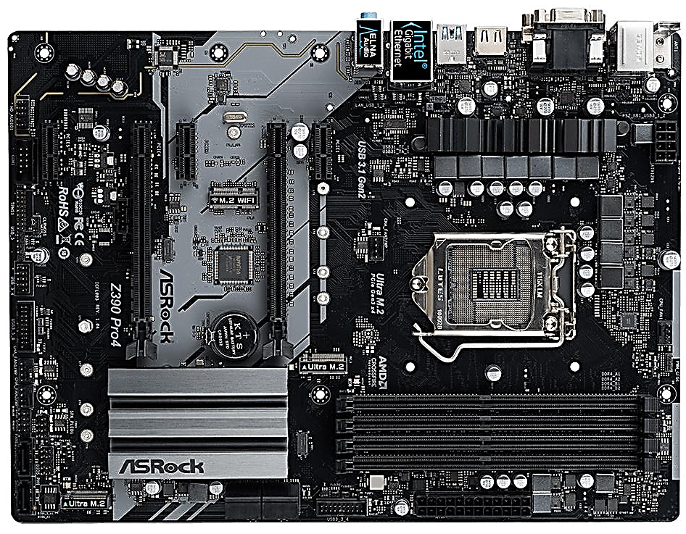
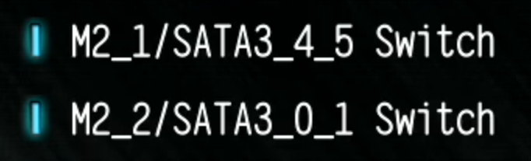
SATA Setup
Example supports 6 SATA connectors
Has 6x SATA connectors and 2x M.2 slots
Supports up to six storage devices
SATA Switch
Gives some choice which are used
ITFreeTraining.com
© Copyright 2024
Notes:
17:24 To configure basic SATA settings on the computer, first of all, I need to enter the computer’s setup. On this computer, I need to press F2 or Del when the computer starts up. In this case, the basic setup screen will be shown. Your BIOS or UEFI setup may look different. Somewhere on the initial screen or a summary screen there will be a list of the storage devices that have been detected. In this case, three hard disks have been detected, which I can see at the bottom left of the screen.
This screen does not have too many options and is more for displaying information. If you are having problems with a storage device, have a look at this screen and make sure it is being detected. To access more options, I will select the option at the top right “Advanced Mode”.
This screen will allow you to configure a lot more options than the basic screen. In this case, I want to configure the SATA options. On this computer, the SATA options are found under “Advanced”. To access the SATA options, I next need to select “Storage Configuration”.
The first option enables or disabled the SATA controller. In the vast majority of cases this will be enabled. It may be disabled for secure kiosks where SATA storage is not being used, to make it harder to hack into the computer. These requirements are rare, so more than likely it is going to be enabled. Other than security reasons, there is no real reason to disable it.
Following this is SATA Mode Selection currently set to AHCI. You will notice the older IDE option for compatibility is not available in this setup. In some setups you may need to enable some compatibility options in order to get the IDE option or in new computers it may not be available. Unless you have good reason to, you should leave this on the AHCI setting. If you do decide to change this option, you may need to re-install Windows or perform a work around in order to get Windows to boot again. ACHI was released in 2004, so it is well supported.
The next option is “SATA Aggressive Link Power Management”. This provides a different method for the computer to shut the storage device down when it is not being used. If you want to save more power then you may want to enable this. If you find your system is becoming unstable or you are having problems with the storage device then disable it. On old hard disks this option can cause problems.
Following this, the option for S.M.A.R.T. allows the computer to get statistics from the storage device. This is found on some hard disks and most Solid-State-Drives. It won’t cause any problems if this is enabled. If you were to disable it, it would probably be for security reasons, however, it would be rare to want to do this even in a secure environment. S.M.A.R.T allows software to get information such as how many times the storage device has been switched on and expected life left, etc. It is up to the manufacturer to decide which options they will implement and which not.
The next option is the M.2 SATA switch. Essentially, this motherboard supports six SATA storage devices. There are six SATA connectors on the motherboard and two M.2 connectors. When you install an M.2 Solid-State-Drive, one of the SATA connectors is lost. For M.2 slot 1, the computer can choose between connectors four and five to be disabled.
Different motherboards will function in different ways. Some motherboards will also disable certain connections, for example, if you install M.2 Wi-Fi. When you only have a few storage devices, hopefully you choose the right connections and you won’t have any problems. When you get close to maximum, keep in mind that you may reach the maximum before you use up all your connectors or slots. When this occurs, you will need to decide which ones you want to use.
This setup has the option to force a SATA storage device to be used, or force M.2 to be used. Thus, if you find that you add a storage device and it disables one of your existing storage devices, setting this option will allow you to decide which one you want to use.
Notice, at the bottom the three hard disks that I have installed in this computer are being displayed. This is essentially displaying the same information from the first setup screen.
I will now select the first hard disk which will allow me to configure options for that hard disk. The first option is “External SATA”. This is essentially eSATA. If I enable this option, notice the option below it for hot swapping is removed. eSATA by design supports hot swapping. What is different between the two is what kinds of messages the motherboard sends to the operating system when a storage device is disconnected. On this particular motherboard, when “External SATA” is enabled, the connector will change to SATA 2 which results in a speed drop. Although eSATA does support SATA 3, on this motherboard it does not. So, since this motherboard supports USB 3, I would personally use USB 3 rather than eSATA. USB 3 is easy to use and faster than SATA 2. You can see why eSATA did not really take off.
Once I disable this setting, notice that the “Hot Plug” option is available. If you are planning on using hot swapping, make sure that it is enabled in the computer’s setup.
The last option is “SATA Device Type”. This allows you to set the option to “Hard Disk Drive” or “Solid-State-Drive”. This option essentially changes the optimization for hard disks or Solid-State-Drives. I would be surprised if having this set incorrectly causes a storage device to not work correctly, it is more about optimization of the device you have installed. Having said that, the optimization is minor and won’t make too much of a difference to the performance of the computer.
Now that we have had a good look at SATA, I will now have a look at the future of SATA.

Slide 11
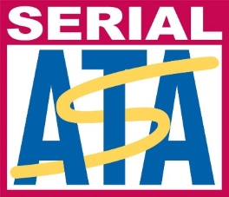


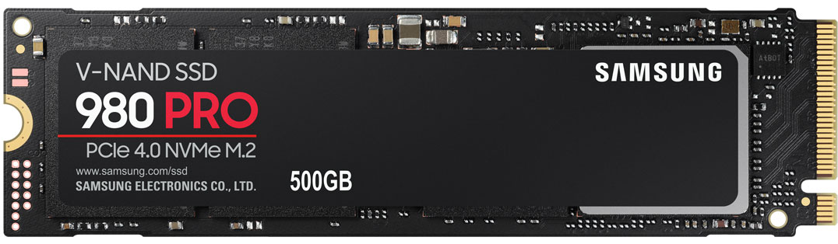


Future of SATA
SATA
NVMe
SATA 4 requires too many changes
Supports parallel reads and writes
Compatibility problems with older devices
ACHI protocol does not do parallel IO
1 queue
65535 queues
32 commands per queue
65536 commands per queue
ITFreeTraining.com
© Copyright 2024
Notes:
23:23 When looking at the future of SATA, the first thing to consider is will there be a version 4. The answer to that is nope. The organization that manages SATA has stated there will not be a version 4 of SATA. The reason behind this is, that in order to get higher speeds, this would require too many changes to the way data is sent over the SATA cable. Changes would include changing the voltage and signaling in the cable, which would cause compatibility problems with older devices. Thus, we will only see updates to the SATA protocol, but we won’t be seeing a version 4.
We are seeing a trend towards NVMe drives. In the old days flash memory provided similar performance to that of hard disks. Flash memory has improved and can now support features like parallel reading and writing. A hard disk can only perform one read or write at once which is a limitation of having one hard disk head. Flash memory, by virtue of having multiple chips and using cache can perform parallel reads and writes. The problem with this is, the ACHI protocol does not support parallel IO. Thus, if you use SATA with M.2 you are going to be limited to what the ACHI protocol allows.
To understand how NVMe achieves this, consider that SATA has one queue which has a maximum of 32 commands. As we learnt earlier, SATA has the ability to process these commands out of order, but that can only achieve so much. NVMe in contrast supports over 65 thousand queues with over 65 thousand commands per queue. Having so many queues and so many commands per queue allows the storage device to make a lot of optimization decisions about how it will read and write data. Having multiple queues allows the storage device to work in parallel.
You can see why, from a performance perspective, SATA 3 has reached the peak of what it can achieve. However, there is one big limitation of NVMe.

Slide 12
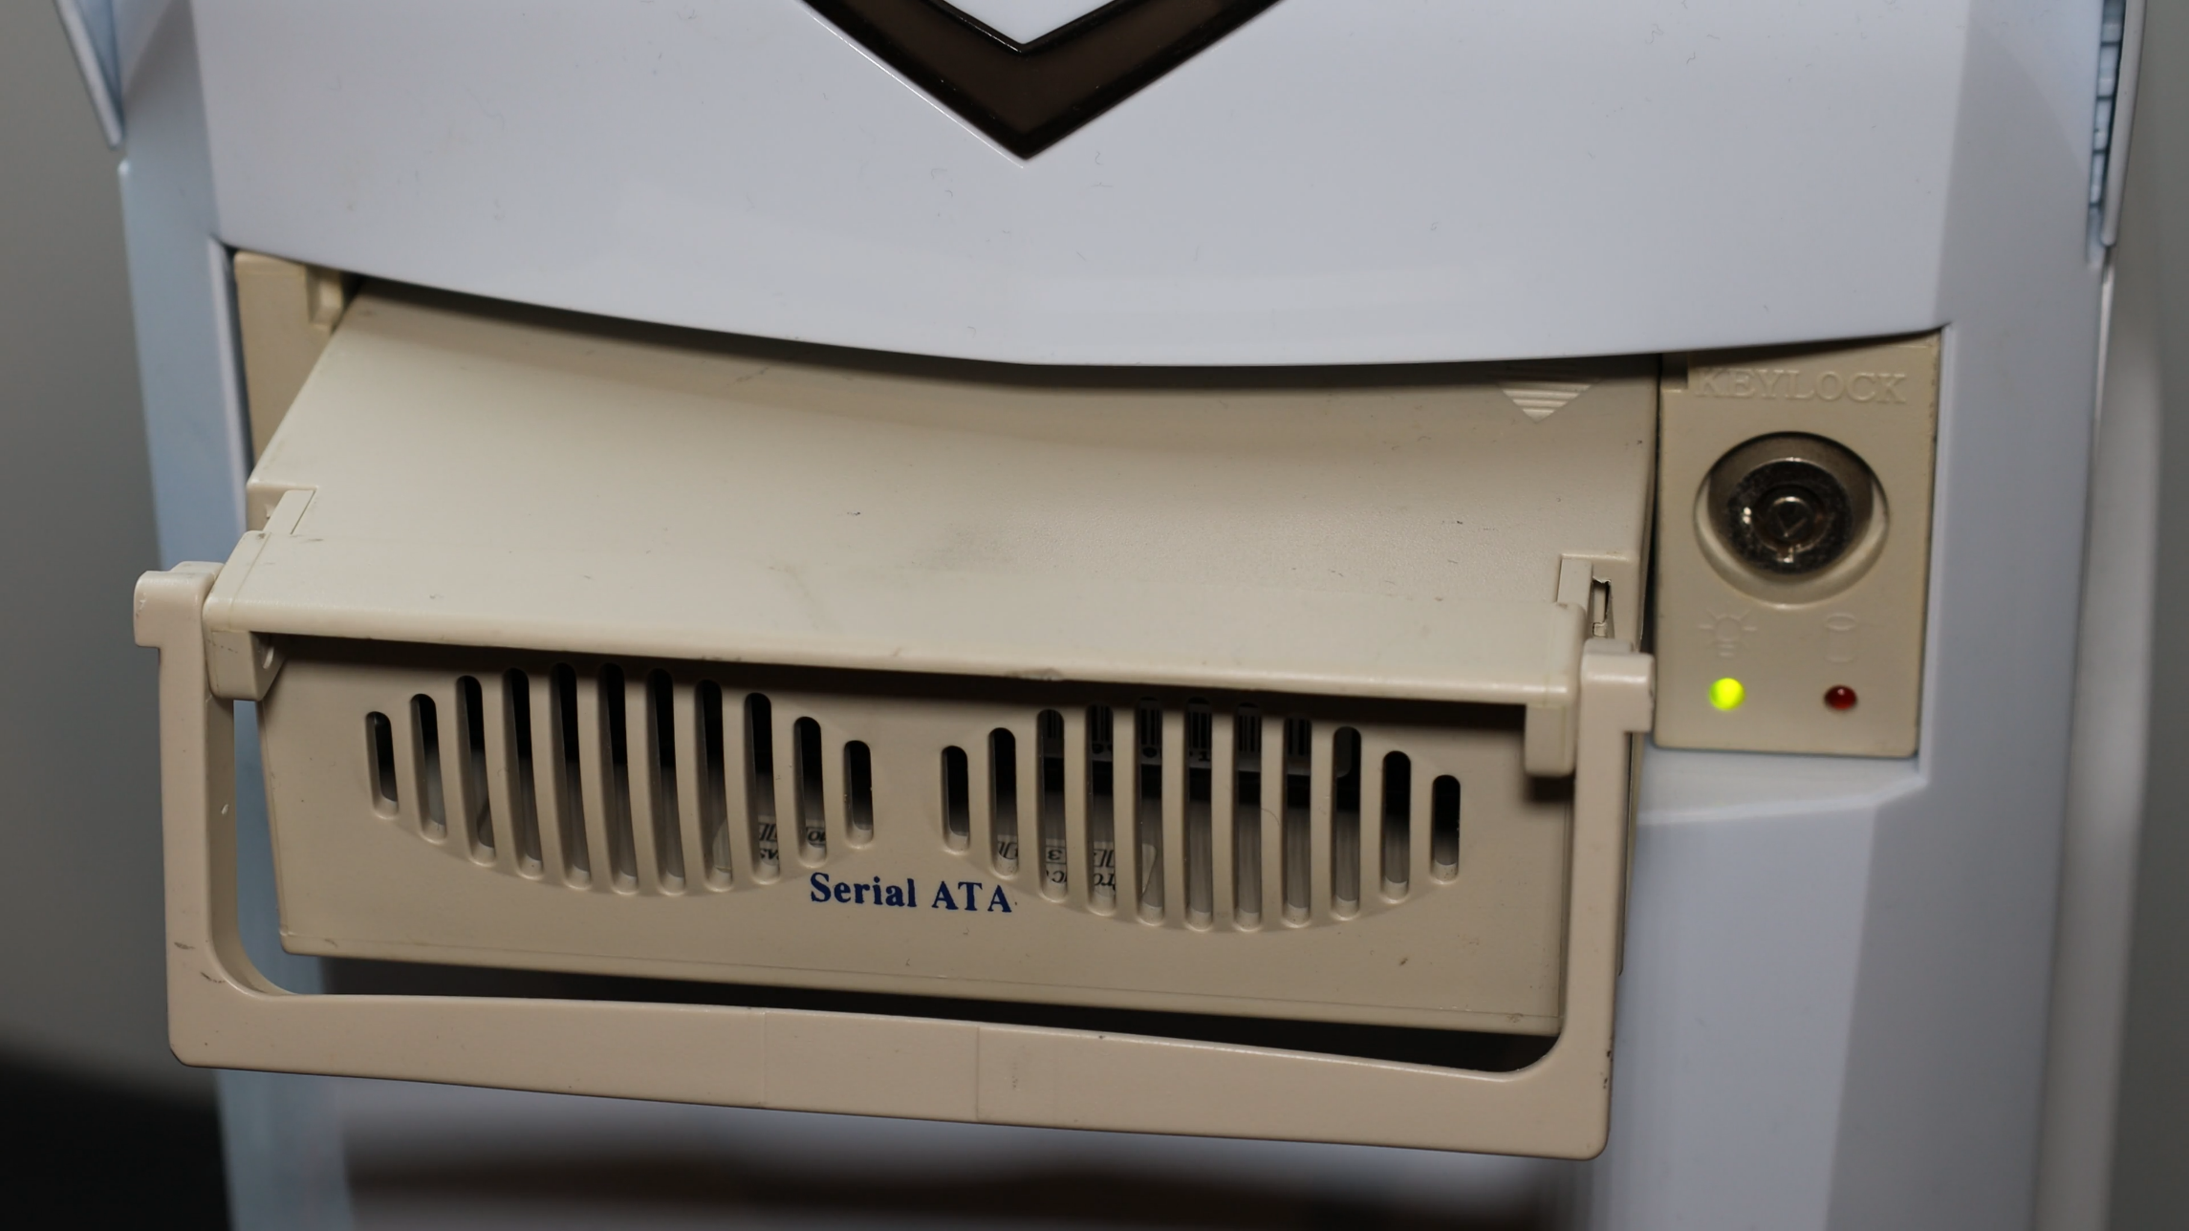
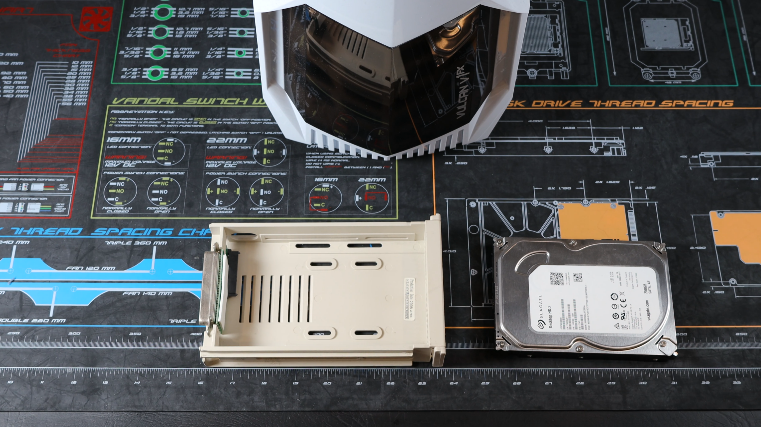
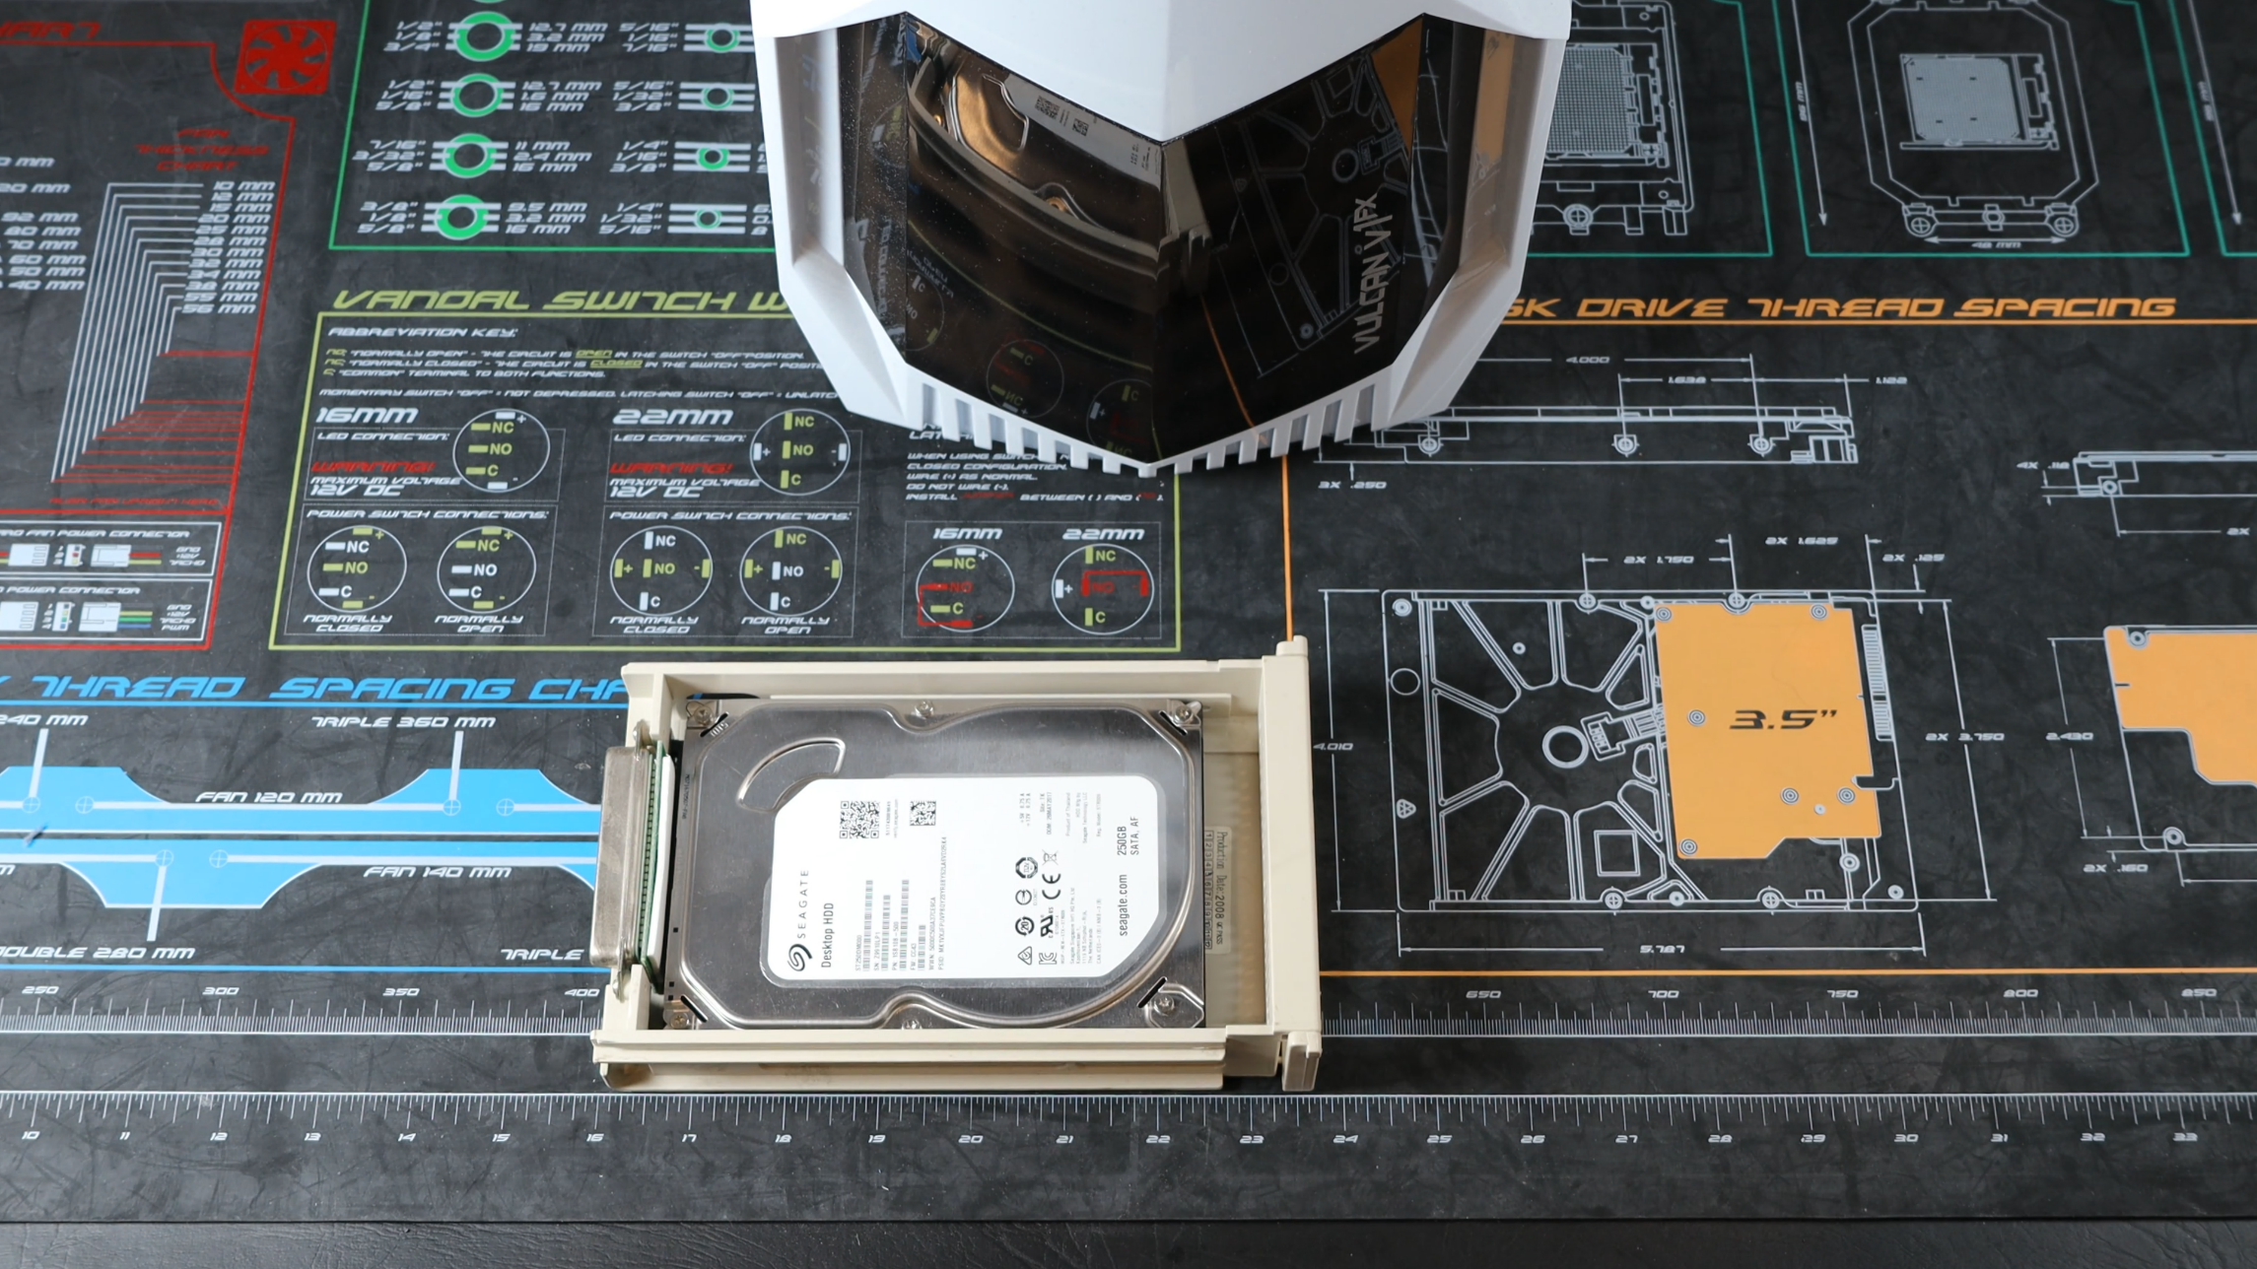
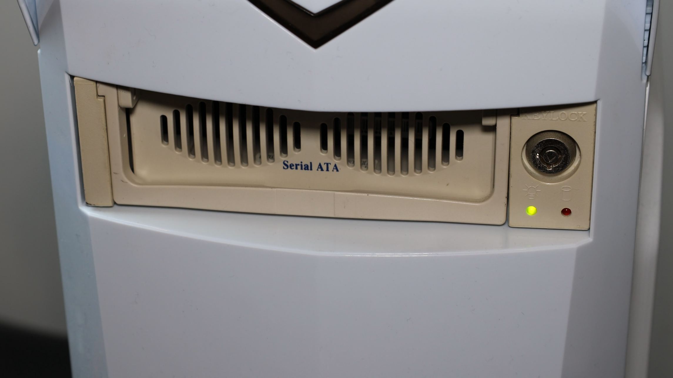
Future of SATA (Hot Swapping)
SATA has hot swap support NVMe does not
Most likely used for drive enclosures
ITFreeTraining.com
© Copyright 2024
Notes:
25:21 Pretty much the only big advantage that SATA has over M.2 is hot swapping. If you do come across SATA being used for hot swapping, it will most likely be with removable drive bays like this one. A removable drive bay allows you to plug a hard disk into the bay. Essentially the drive bay provides a SATA connection to the hard disk.
Once the hard disk is ready, I will next put the drive bay into the computer. Since SATA supports hot swapping, this can be done while the computer is on. If this does not work, make sure hot swapping is enabled in your BIOS or your UEFI setup. Keep in mind, the operating system also needs to support it which modern operating systems should.
Notice that the hard disk can be removed at any time. In order to use a hard disk enclosure like this one, it needs to be installed in the computer. Depending on the enclosure, sometimes, if you don’t push the drive in hard enough it won’t connect. Given you can purchase almost an endless number of USB and Thunderbolt external hard disks, you can see why enclosures like this one are not used that much nowadays. You can even purchase an external USB enclosure which works in a similar way to this enclosure but for USB. Thus, you can see, even though it is useful to have hot swapping, in the real world it does not get used that often.
Despite advancements in storage speed and the emergence of technologies poised to replace SATA, there remains one big reason why I believe SATA will continue to persist for some time.

Slide 13
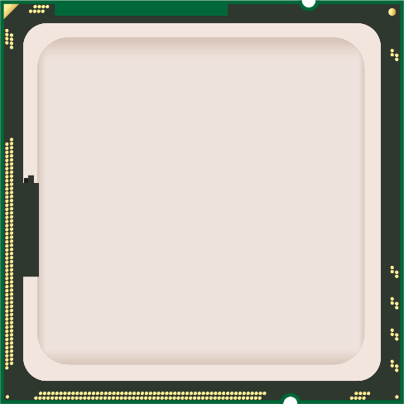

Cost
SATA is cheap
PCIe
Slow compared with PCIe lanes
CPU
PCIe
Nowadays put on South Bridge
PCIe
Does not cost a lot to have a few
PCIe
PCIe
SATA 6 Gbit/s
SATA 6 Gbit/s
South
Bridge
SATA 6 Gbit/s
SATA 6 Gbit/s
SATA 6 Gbit/s
SATA 6 Gbit/s
ITFreeTraining.com
© Copyright 2024
Notes:
26:55 The main reason I think that we will see SATA around for a while is that is relatively cheap to add it to a computer. To understand why, consider that you have your CPU. If you want to get the best performance, you want to connect your M.2 NVMe Solid-State-Drive directly to the CPU.
It is possible to connect M.2 to other chips on the motherboard, but in this example, we are talking about trying to get the best performance you can, thus you want a direct connection to the CPU.
In order to make the connection, the M.2 device may utilize up to four PCI Express lanes. A PCI Express lane is essentially a data channel that provides high speed transfers between devices. In most cases directly to the CPU, but in some rare cases from other chips.
SATA does not require the high speed of PCI Express and is relatively quite slow. Because it does not need to be as fast, SATA is often put on the South Bridge of the computer. The South Bridge is essentially a chip on the motherboard that handles devices in the computer that do not need direct access to the CPU. In order for the South Bridge to communicate with the CPU it does this using a PCI Express lane.
So essentially, we have the CPU handling high speed devices and the South Bridge handling low speed devices. If we want to have six SATA devices on the computer, we simply need six SATA connections from the South Bridge. Although SATA and PCI Express use different types of signaling, you still need the same basic number of wires on the motherboard for each. Thus, for the four lanes we used for one M.2 device, we could have the equivalent of four SATA devices. Thus, you can see from an engineering point of view, it is much cheaper to add SATA ports to a computer. Firstly, you don’t need to connect it directly to the CPU, each device connected to the CPU means more pins on the CPU, making it expensive to add devices. Secondly, only requiring the equivalent of one low speed lane makes it cheaper to implement.
Thus, the main takeaway from this is, it does not cost the manufacturer a lot of money to have a few SATA ports on their motherboards. Motherboard manufacturers don’t like adding things that are not needed, so as to keep the costs down, but if it does not cost much to start with and maybe the difference between a sale and not a sale, they are going to add it. It is all about costs and sales at the end of the day. You can see why I don’t think SATA will disappear any time soon – it does not cost too much to add a number of SATA ports to a motherboard and there are still a lot of devices on the market that will use them. SATA is also still the primary connection used for hard disks. At the time this video was made, the fastest hard disk in the world was just over 500 Megabytes per second, still under SATA’s 600 Megabytes per second limit.
There has been a lot covered in this video, so let’s have a look at how you would use SATA in the real world.

Slide 14


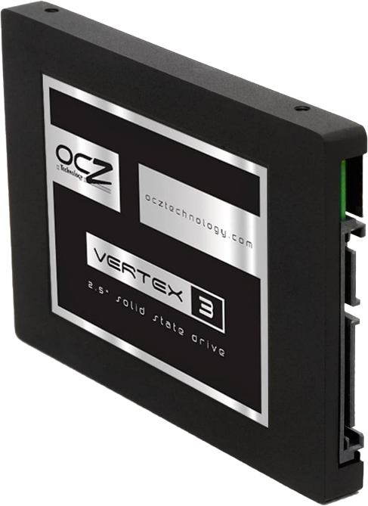
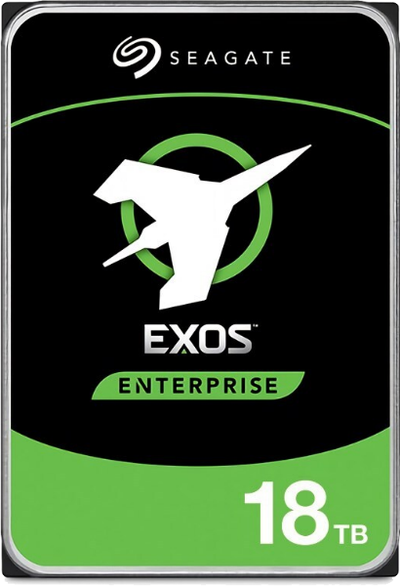
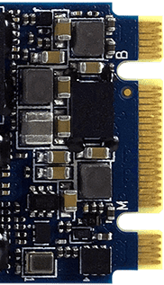
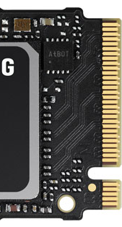
In The Real World
SATA 3 here to stay
There will be no SATA 4
SATA still used for hard disks
Hard disks used for mass storage
M.2 for fast storage
SATA SSD
Decline in manufacturing
OS/Small amounts of data
Replaced by M.2
No hot swapping
NVMe faster than SATA
Check motherboard supports it
SATA
NVMe (PCIe)
ITFreeTraining.com
© Copyright 2024
Notes:
29:55 In the real world, SATA for the moment is here to stay. There will be no SATA version 4, so SATA 3 will have to do until we need something better. For the future, the main use of SATA will be for hard disks. Since hard disk storage is getting bigger and bigger, the main use of SATA will be for utilizing hard disks as mass storage.
M.2 we are seeing used for fast storage. Fast storage is utilized for the operating system and small amounts of data. If the storage needs are not too great, we are seeing computers with only a M.2 storage device and no hard disks. This has become very common in laptops, to the point where some laptop manufacturers are no longer selling laptops with hard disks.
With the use of M.2, we are seeing a big decline in the manufacturing of SATA Solid-State-Drives. These devices have essentially been replaced by M.2 storage devices. The only disadvantage of doing this is that M.2 does not support hot swapping. Given the increased speed and availability of USB and Thunderbolt drives, most users will use these if they require hot swapping.
If you are going to install an M.2, NVMe is faster than SATA and has improvements in the protocol that SATA does not have. This is because SATA was designed with hard disks in mind. In order to determine if a M.2 Solid-State-Drive is SATA or NVMe, have a look at how many notches are missing. SATA will have two notches missing and NVMe will have one. NVMe refers to the interface specification used to access the Solid-State-Drive. The connection to the drive is PCI Express. So NVMe and PCI Express may get used interchangeably. If you hear either of these names, you know they are talking about the same thing. If you hear SATA used, you know they are only referring to SATA.

Slide 15
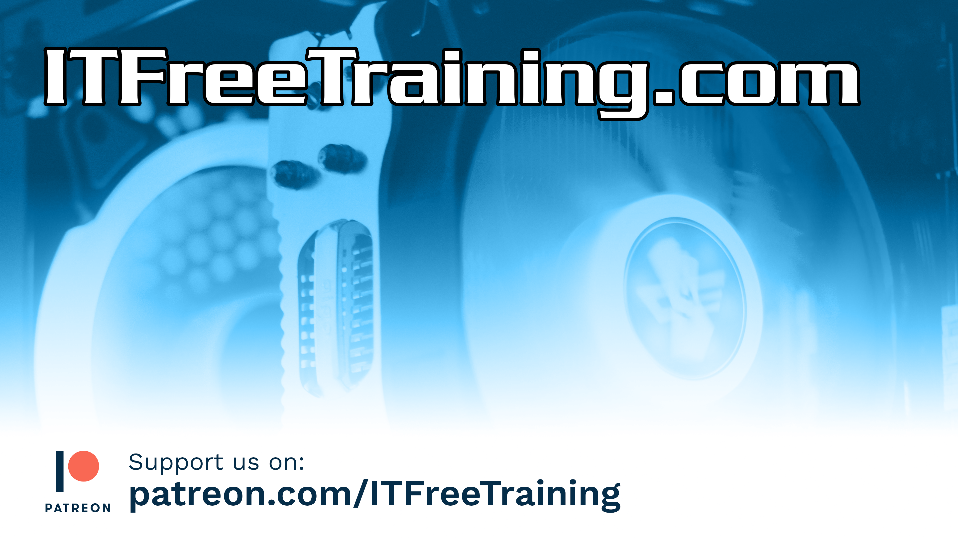
Subscribe
Next video
Video content: https://ITFreeTraining.com/ap11/1a40
© Copyright 2024
Notes:
31:47 That covers it for SATA. I hope you have found this video useful and informative. Until the next video from us, I would like to thank you for watching.
References
“The Official CompTIA A+ Core Study Guide (Exam 220-1101)” pages 25 to 26
https://en.wikipedia.org/wiki/Serial_ATA
“Picture: eSATA motherboard” https://upload.wikimedia.org/wikipedia/commons/f/f3/SATA_Express_connectors_on_a_computer_motherboard.jpg
“SATA-IO Frequently Asked Questions” https://sata-io.org/sata-io-frequently-asked-questions
“Picture: Number 4” https://pixabay.com/vectors/four-glossy-light-red-number-1293836/
“Picture: Nope” https://unsplash.com/photos/vBxbZokRL10
“Picture: People queuing AI generated” https://www.craiyon.com/
“Picture: CPU” https://pixabay.com/vectors/processor-icon-computer-chip-1714820/
“Picture: Crown” https://pixabay.com/vectors/crown-king-emperor-royal-royalty-42251/
Credits
Trainer: Austin Mason https://ITFreeTraining.com
Voice Talent: AR Hellenberg https://humanaudioventures.my.canva.site/
Quality Assurance: Brett Batson https://www.pbb-proofreading.uk

