Slide 1
Notes:
Let’s have a look at Thunderbolt.

Slide 2
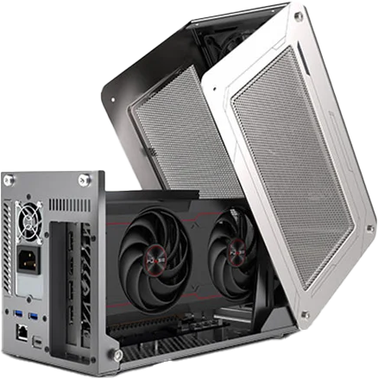
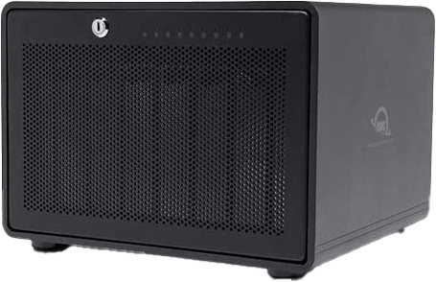
What is Thunderbolt?
Used to connect external devices like USB does
Traditionally faster than USB (But times change)
Uses PCI Express and DisplayPort
Connects
ITFreeTraining.com
© Copyright 2024
Notes:
00:02 Thunderbolt is a technology created by Intel that is used to connect external devices. Effectively it is similar to USB but the underlying technology is different. Over time, technology has converged to some extent, but I'll delve into that later in the video.
Thunderbolt, was developed by Intel to run on Intel CPUs and uses PCI Express and DisplayPort for device connectivity. While it shares USB's hot-plugging capability, Thunderbolt uses different protocols to USB. Essentially, Thunderbolt facilitates a connection to a computer's PCI Express bus, ensuring high-speed performance.
Thunderbolt, when it was originally released, was designed to provide faster communication to external devices than USB. It cost more, but if you needed the extra speed, it was a good option. Thus, it was generally used for external devices like high-speed storage devices, for example, RAID storage devices. This allowed users who were doing highly demanding activities such as video editing to connect an external storage device. Before Thunderbolt was released, portable external storage did not have a fast enough interface to be used effectively for disk intensive operations like video editing.
Thunderbolt allows an external device to use PCI Express as if it was connected directly to the motherboard. There are external graphics cards that use the Thunderbolt interface. They work just like an internal video card that connects via PCI Express, however, can be externally plugged into any computer that has a Thunderbolt connection. Therefore, devices like laptops that generally are difficult or not possible to upgrade, this is an option if you need to upgrade the video card. It is also an option if you want to move high-speed devices from computer to computer.
Thunderbolt supports DisplayPort and thus you can plug a monitor directly into a Thunderbolt port. USB video is only possible by the USB video adapter being essentially a mini video card. Natively, USB does not support video.
Thunderbolt, in contrast, provides DisplayPort directly from the computer. Thus, the computer requires a video card in order to transmit DisplayPort directly over the Thunderbolt cable to the monitor. Later in the video we will see a better example of this concept.
Thunderbolt differs from USB in that USB transmits only one protocol. Thunderbolt transmits two protocols, these being PCI Express and DisplayPort. It achieves this by dividing the data into packets and sending them down the cable. Thus, Thunderbolt devices need to be able to split the signal into PCI Express and DisplayPort signals when it arrives at the other end. The device may also pass this signal onto other devices. This is often called daisy-chaining. For example, two monitors can be combined. In order to use this feature, the device needs to have an input Thunderbolt port and an output Thunderbolt port.
Those are the basic features of Thunderbolt, now let’s have a look at how it has changed over time.

Slide 3
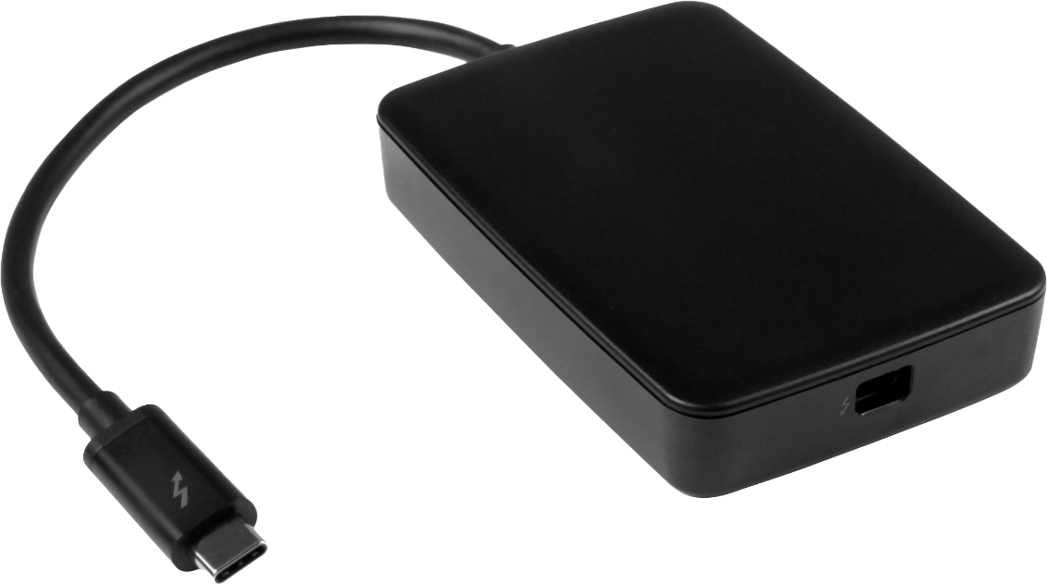
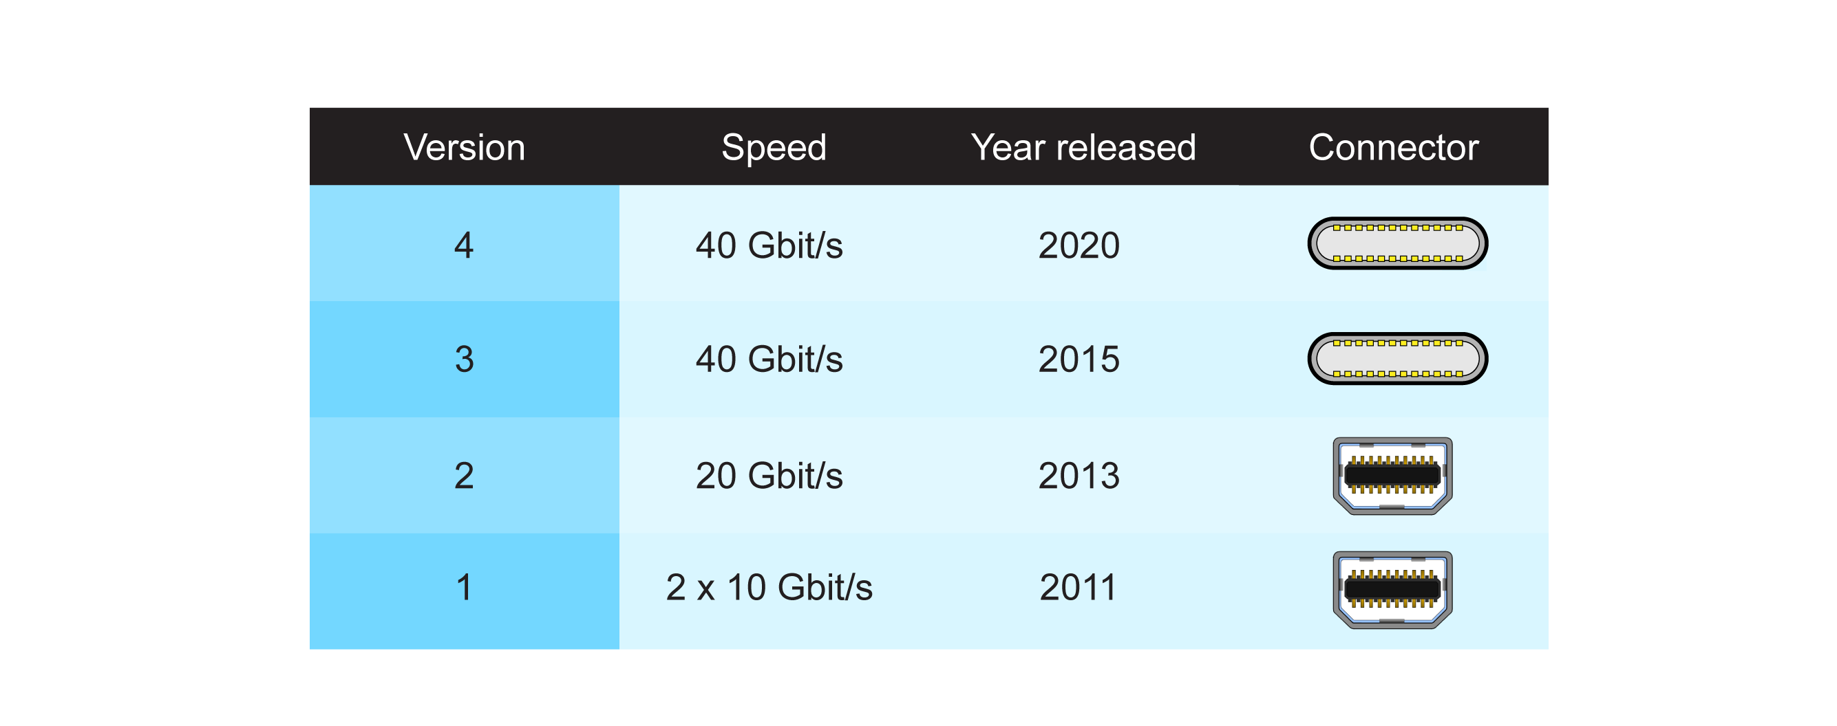
Thunderbolt Versions
Backward compatible with previous versions
Adapter required to change between Type-C and Mini DisplayPort
ITFreeTraining.com
© Copyright 2024
Notes:
03:19 There are currently four different versions of Thunderbolt. The main one that you most likely will come across is version 3. Version 3 runs at 40 Gigabits per second. Before USB 4, this was significantly faster than USB. Thus, if you wanted very high-speed external devices, Thunderbolt was your only choice.
Thunderbolt was popular on Apple products but did not appear that much on non-Apple products. Thunderbolt devices tend to cost more than other devices on the market, which may explain why it did not get much market adoption. If you have an old Thunderbolt device, it is backward compatible with previous versions.
Versions 3 and 4 use a Type-C connection, while versions 1 and 2 of Thunderbolt uses the Mini DisplayPort connector. There are adapters available which change between Type-C and Mini DisplayPort. To use an older Thunderbolt device with a computer equipped with the newer Thunderbolt 3 Type-C port, you will need to use an adapter.
Although this video is about Thunderbolt, we need to have a quick look at USB4, since the technology has merged together to a certain degree.

Slide 4
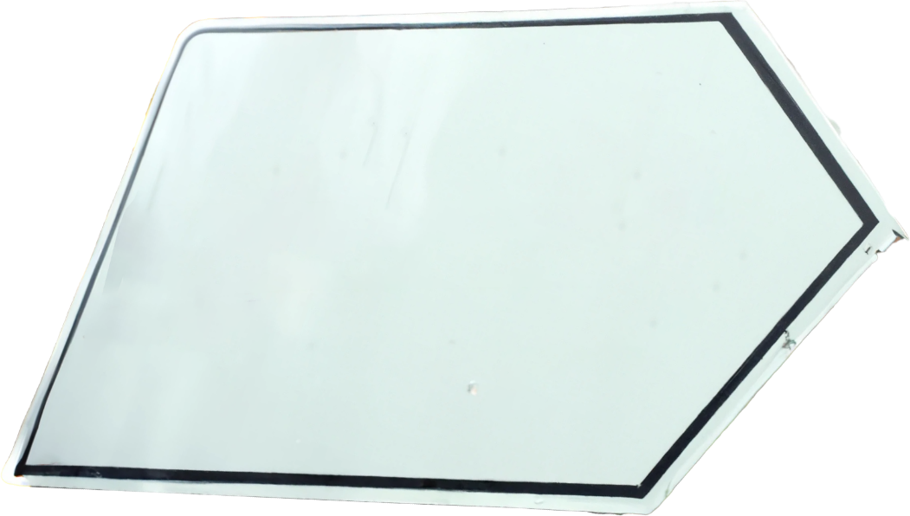
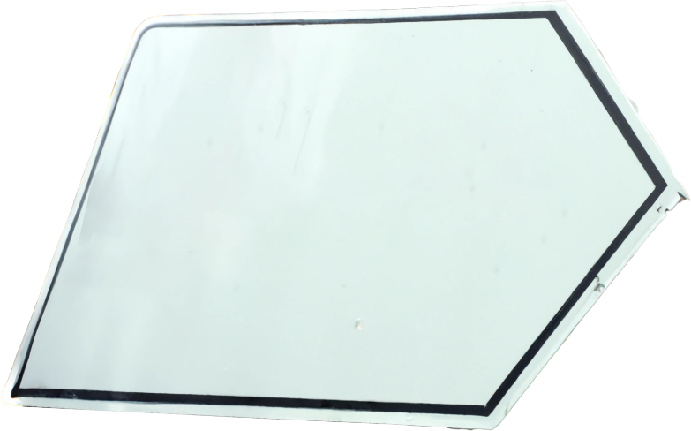
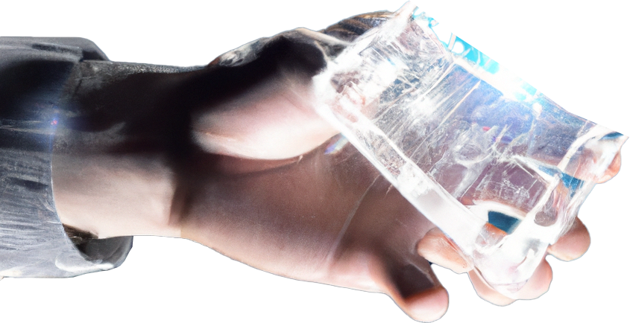
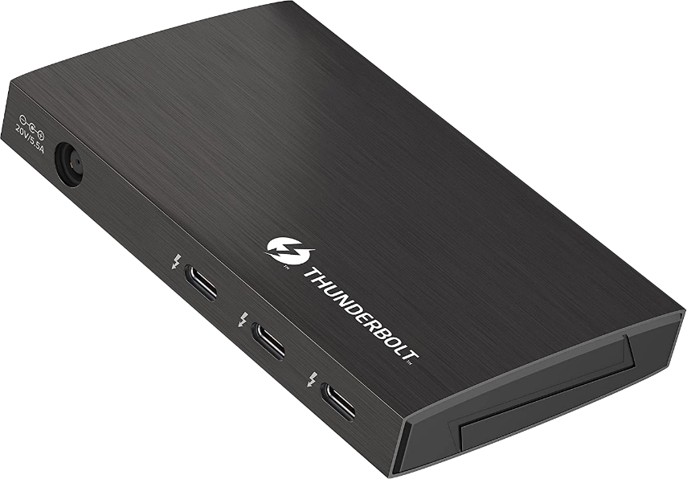
Thunderbolt 4 vs USB4
USB4 built off Thunderbolt 3 technology
Donated to
Created
Supports
Tunnels
USB4 Hubs
ITFreeTraining.com
© Copyright 2024
Notes:
04:26 Thunderbolt 3 was donated to the USB Implementers Forum. This is the organization that is responsible for USB and its development. They used Thunderbolt 3 as a basis to create USB4. Thus, it is fair to say that USB4 is built off of Thunderbolt 3 technology. Therefore, the underlying technology that USB uses is the same as Thunderbolt, but this does not mean that it is implemented in exactly the same way. Although built from the same technology, USB will always be USB and Thunderbolt will always be Thunderbolt. Let’s have a closer look.
USB uses Thunderbolt technologies to tunnel other protocols. For example, USB4 can tunnel USB 3.2, PCI Express and DisplayPort over the same connection. It does this by dividing the data into packets – this is the same concept as sending data over a network. The standard is left open, so potentially new protocols could be added later. Only time will tell if that occurs.
The standard requires that any USB4 hubs also support Thunderbolt 3. For devices and hosts this support is optional. Thus, don’t expect a computer with USB4 to support Thunderbolt devices. The good news is if you purchase a hub it should work with USB or Thunderbolt.
Although the standard only requires Thunderbolt 3 support, most likely we will see hubs supporting Thunderbolt 4 as well. Given the Thunderbolt 4 and USB4 run at the same speed, it makes sense to include Thunderbolt 4 support.
Thunderbolt 4 was also developed using Thunderbolt 3 technology. Thus, Thunderbolt 4 and USB4 essentially share some technology for sending data, however, they differ in some of the features they offer. The main feature difference of Thunderbolt is the ability to daisy-chain devices together which USB does not offer. However, USB can achieve a similar result by using HUBs.
The logical conclusion to this is, that because Thunderbolt did not gain much market share, Intel is trying to increase its market share by making it more compatible with USB4 and thus easier to implement in the future.
Let’s now have a look at what cables you need to use Thunderbolt.

Slide 5
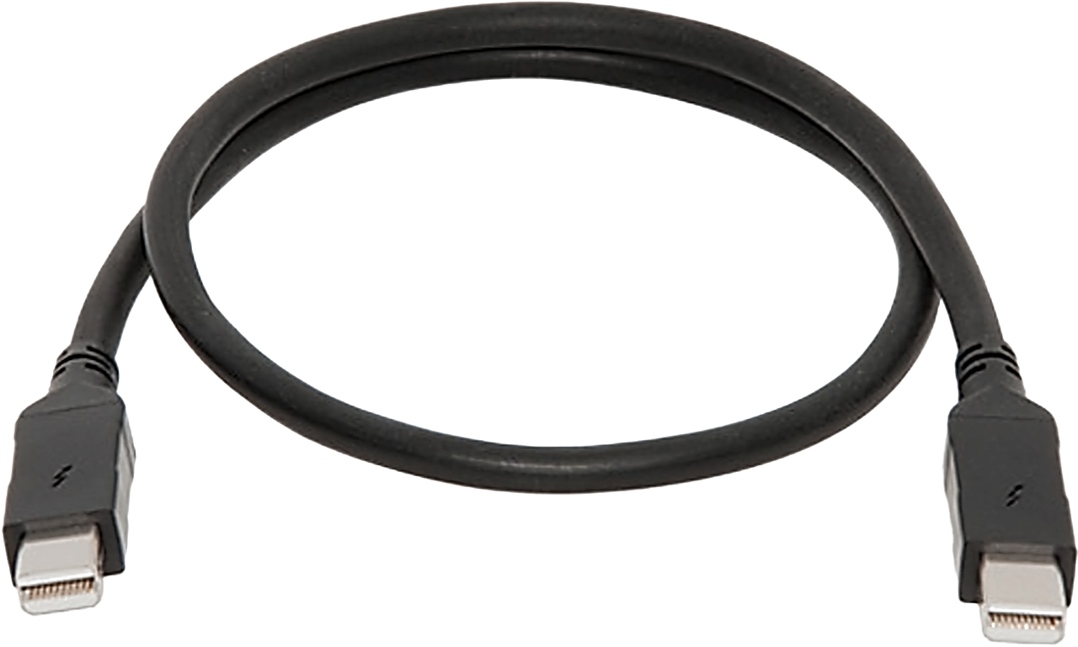
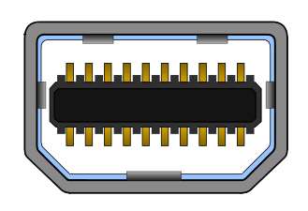
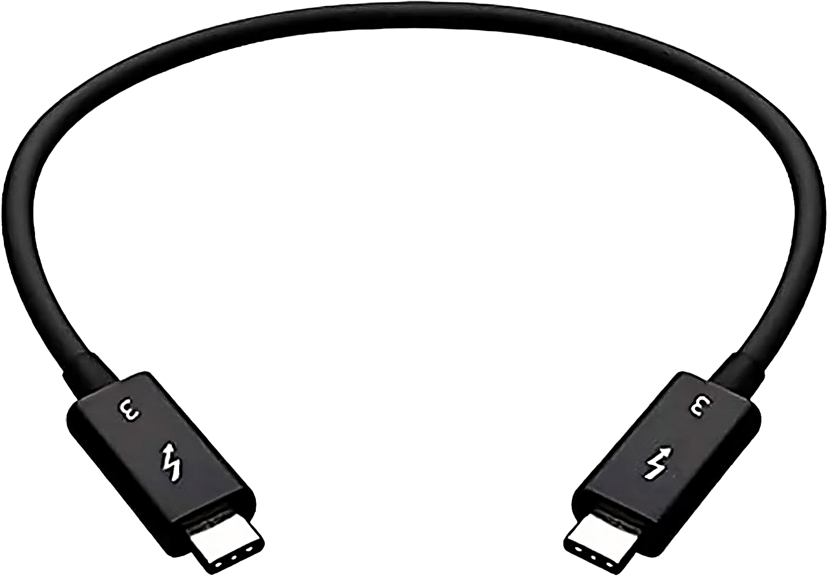
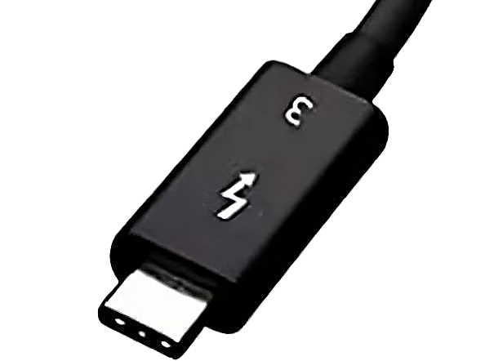
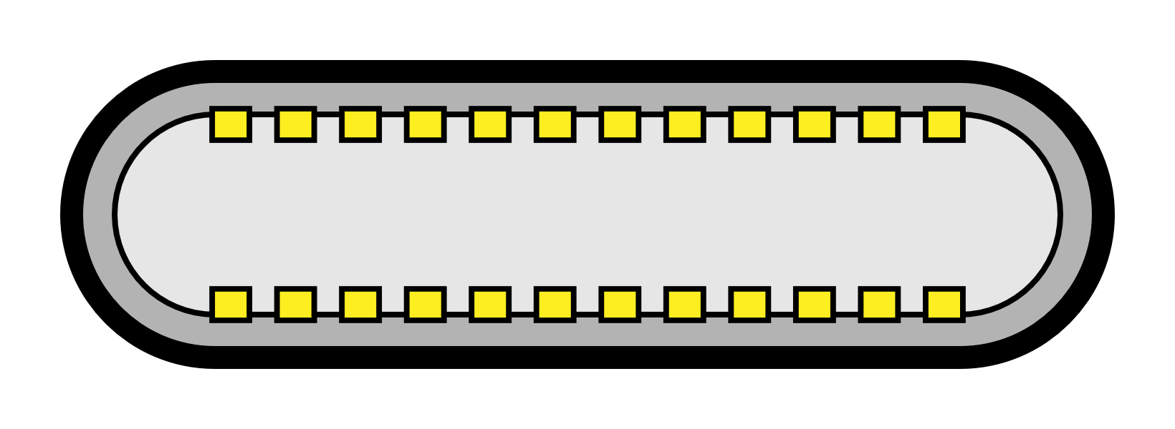
Thunderbolt Cables
Versions 1 & 2
DisplayPort cable
Standard cables should work
Version 3
Active cable over 0.5m (1.5 ft)
Thunderbolt cables work with USB
Version 4
Active cable over 1.0m (3.3 ft)
Short USB4 cables may work
ITFreeTraining.com
© Copyright 2024
Notes:
06:42 For versions 1 and 2 Thunderbolt uses Mini DisplayPort, thus standard Mini DisplayPort cables should work. If you are experiencing problems, you may just need to use a better-quality cable.
For version 3 of Thunderbolt, the Type-C connector is used, and thus you can use USB cables. However, if the cable is greater than 50 cm or 1.5 feet, it will be necessary to have an active cable. An active cable is a cable with additional electronics in it to help boost the signal. Active cables cost a bit more than passive cables. Generally, cables made for Thunderbolt will have a lightning bolt on the connector to indicate they are a Thunderbolt cable. It may also have the version of Thunderbolt that it supports. These cables will also work with USB. In some cases when I purchase a USB cable, if the Thunderbolt cable is a good price, I will purchase the Thunderbolt cable to use with USB. This is because, if it is good enough to work with Thunderbolt it is good enough to work with USB. There are a lot of poor-quality USB cables on the market and sometimes it is hard to tell what quality the cable is. However, if the cable is designed for Thunderbolt, it generally indicates it is a good quality cable.
For Thunderbolt 4, active cables are required for lengths over 1 meter or 3.3 feet. With USB4, the quality requirements for the cables increases. Thus, the reason why longer passive cables are able to be used. Shorter USB4 cables may work. I say may, because the quality of USB cables can vary a lot. Make sure the cable is rated for USB4 and hopefully it will work. There are plenty of cheap cables on the market that don’t live up to what they promise.

Slide 6
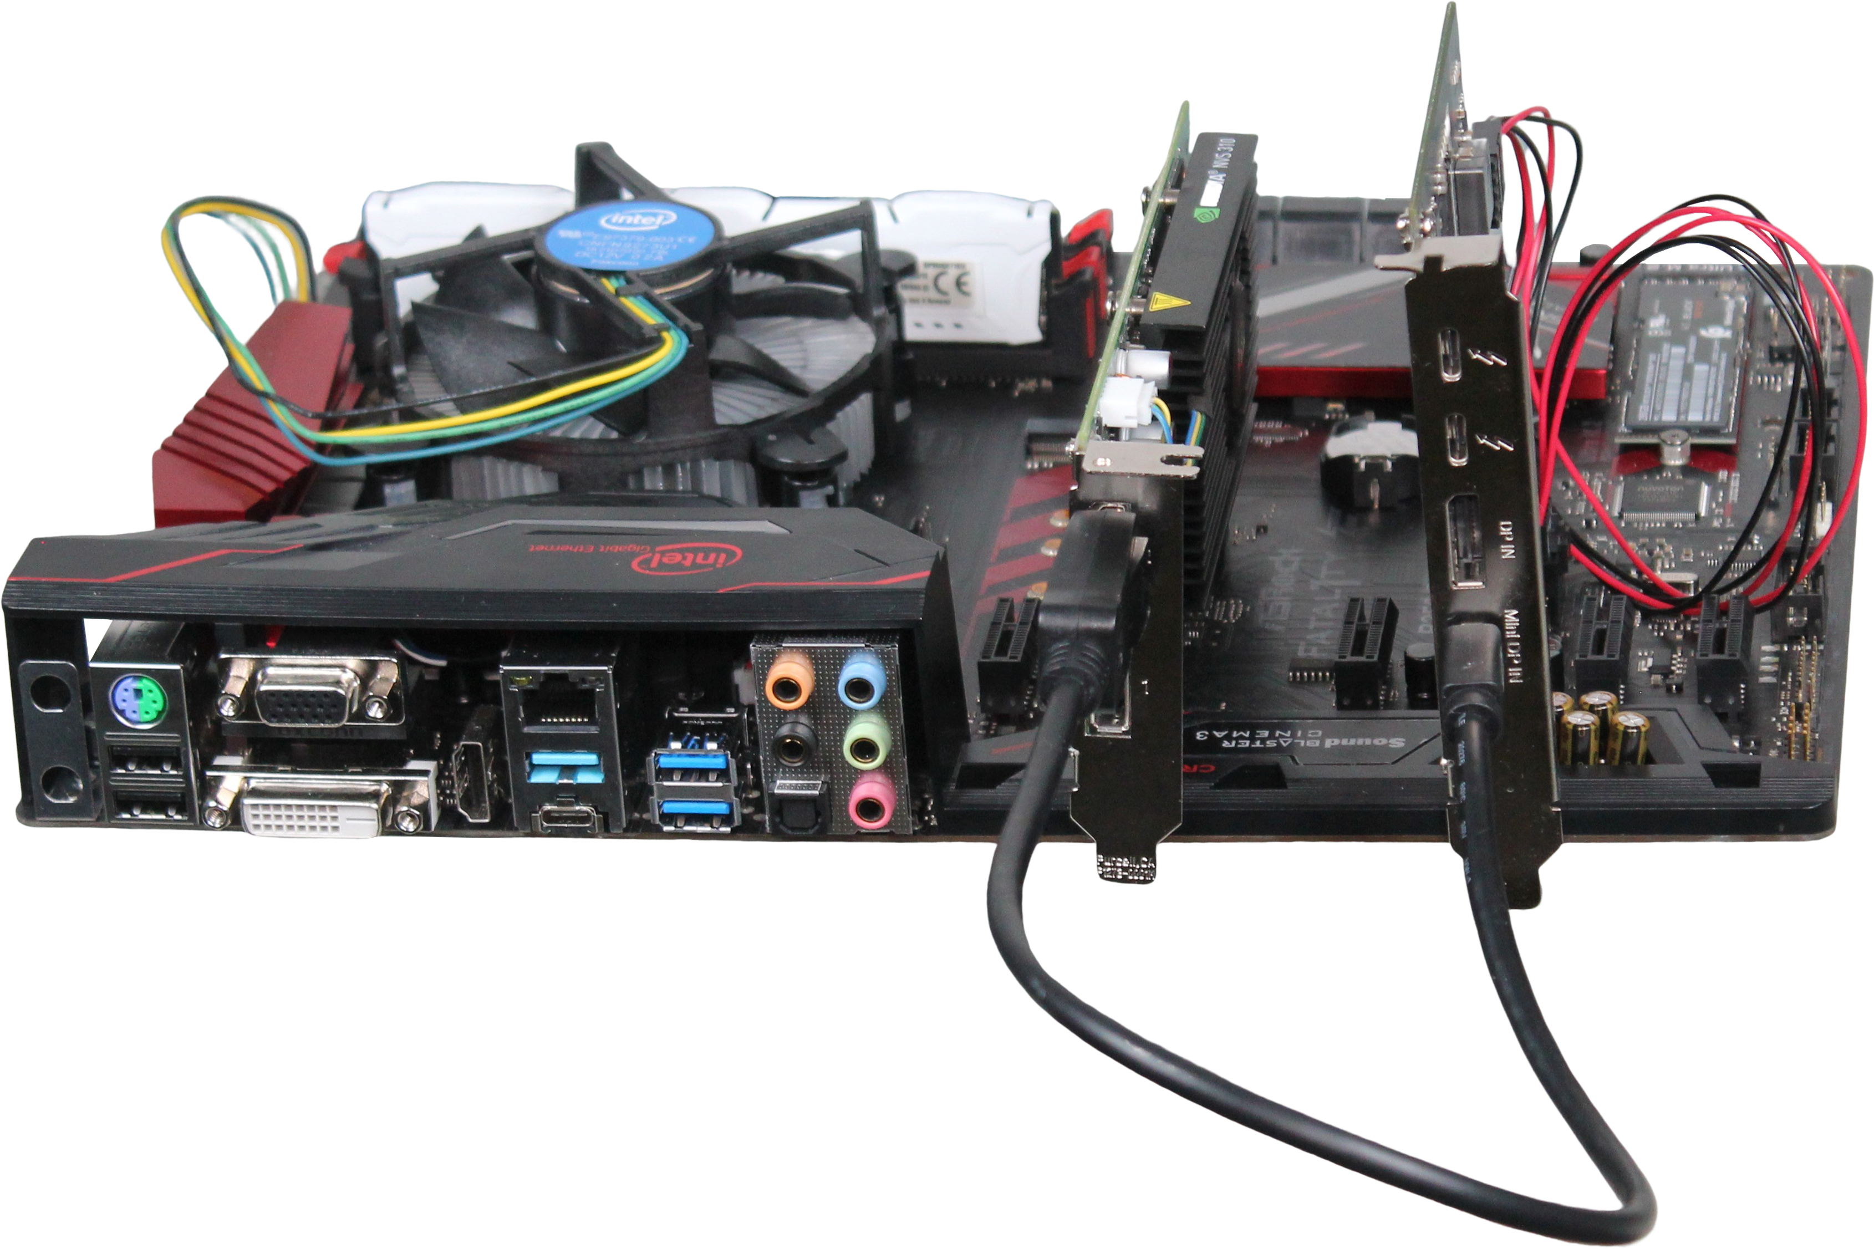
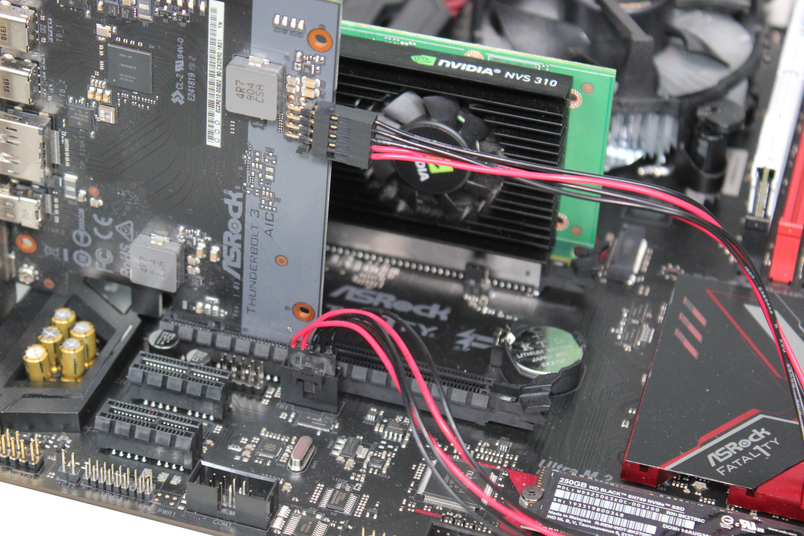
Thunderbolt Installation
Requires compatible motherboard and Thunderbolt card
Video card provides video to the Thunderbolt card using cable
Cable connects card to motherboard
Cable connects Thunderbolt to video card
ITFreeTraining.com
© Copyright 2024
Notes:
08:24 To install Thunderbolt into a computer that doesn't have it built-in, you'll need both a compatible motherboard and a Thunderbolt card. Keep in mind that Thunderbolt cards are often specific to certain manufacturers, and a single manufacturer might produce multiple Thunderbolt cards, each compatible with specific motherboard models. So, don’t assume a Thunderbolt card will work with a particular motherboard, check first.
The Thunderbolt card will have a cable that connects to the motherboard. There is no standard for this cable, thus can be different depending on the Thunderbolt card and the motherboard. So if you purchase a Thunderbolt card, make sure it is compatible with your motherboard. There is also a video cable that connects the Thunderbolt card to the video card. This is usually provided with the Thunderbolt card and usually will be a short video cable since it only needs to connect the two cards together.
The Thunderbolt card does not have video capabilities. Thunderbolt, however, allows for the transmission of video signals. Since the Thunderbolt card does not have video, the video card provides video to the Thunderbolt card using the cable.
If you are planning to add Thunderbolt to a motherboard, I would do some research first. Particularly with the first Thunderbolt cards, there were a lot of problems getting them to work. Before purchasing, I would check to see if other people have had success installing it or if they have had issues.

Slide 7
Subscribe
Next video
Video content: https://ITFreeTraining.com/ap11/1a30
© Copyright 2024
Notes:
09:46 That concludes this video on Thunderbolt. I hope this video has been informative and has helped you understand Thunderbolt better. Until the next video from us, I would like to thank you for watching.
References
“The Official CompTIA A+ Core Study Guide (Exam 220-1101)” pages 23 to 24
“Thunderbolt (interface)” https://en.wikipedia.org/wiki/Thunderbolt_(interface)
“Picture: Thunderbolt logo” https://en.wikipedia.org/wiki/Thunderbolt_(interface)#/media/File:Thunderbolt.svg
“Picture: Intel Logo” https://en.m.wikipedia.org/wiki/File:Intel_logo_(2006-2020).svg
Credits
Trainer: Austin Mason http://ITFreeTraining.com
Voice Talent: AR Hellenberg https://humanaudioventures.my.canva.site/
Quality Assurance: Brett Batson http://www.pbb-proofreading.uk

