Slide 1
Notes:
Welcome to ITFreeTraining’s free training course on CompTIA A+.

Slide 2
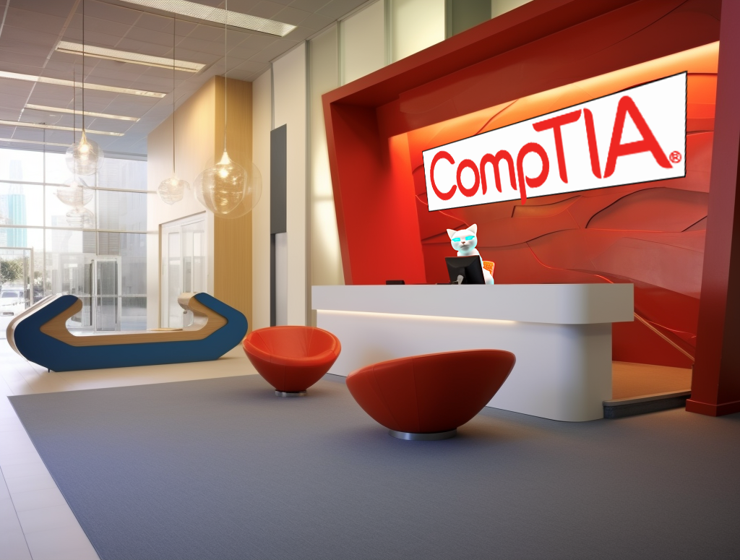
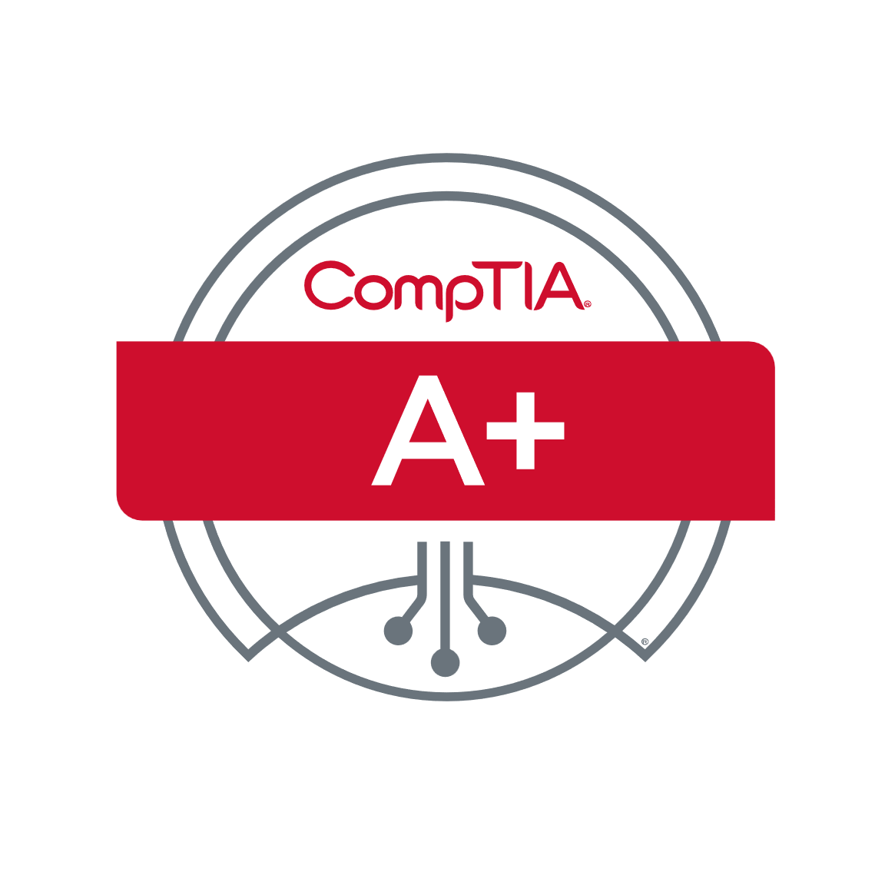
Course Introduction
Established 1982
Exam Codes 220-1101 & 220-1102
Non-profit
Entry technician
Vendor neutral
12 months experience
Not the real CompTIA office
Validates entry-level
technical support skills
Computer hardware
Networking
Cloud
ITFreeTraining.com
© Copyright 2024
Notes:
00:04 The A+ course was created by CompTIA. CompTIA is a non-profit organization established in 1982 that provides vendor-neutral certifications. Certifications are provided on various different topics including computer hardware, networking, cloud, security and Linux to name a few.
Since CompTIA provides a vendor-neutral approach, that is they don’t focus completely on one vendor’s products, this provides more of a focus on fundamental concepts and skills than on specific vendor technology. Certifications provided by any given vendor will have a big focus on the technology provided by that vendor.
The A+ certification consists of two exams. We hope to provide you with video content for both of these exams. Our ability to do this mainly relies on funding. The A+ certification is recommended for the entry-level technician with 12 months of hands-on experience.
If you don’t have 12 months experience, there is no reason you can’t try and get the certification. As a substitution, you can always build your own computer system to work on or do some volunteer work to get some experience. Securing your first job in IT can be challenging without prior experience. However, obtaining an A+ certification can sometimes give you an edge and facilitate you getting that first job. While experience tends to be a more influential factor in hiring decisions, a certification can still play a valuable role. So, what exactly can a certification contribute to your job search?
A certification, such as the A+ certification, serves to validate entry-level technical skills. Ideally, if you have a year of experience on your resume, obtaining this certification should corroborate and authenticate your skills. In essence, it provides evidence that you possess the skills claimed by your experience.
That is the way it is supposed to work, however, sometimes people get the certification before the experience. At other times, an employer may view you having the A+ certification as a cost they don’t have to pay and will save them money on training. In the real world, having something is better than nothing, but experience trumps everything else.

Slide 3
Need to know (Green)
Very high probability you will be asked about this
Good to know
Fair game for exam question
Nice to know
Unlikely but possible to get an exam question on
Additional context
Very unlikely to get an exam question on this
ITFreeTraining.com
© Copyright 2024
Notes:
02:16 At ITFreeTraining, we like to provide additional context on topics we teach as we believe this helps you get a better understanding of the topic. Also, we like to cover additional information about what you may come across in the workplace which may not be covered by the exam. We have received feedback from our viewers that at times it may become hard for them to understand exactly what they needed to know for the exam. So, we came up with the following color-coding scheme.
Each slide that we present will be color coded to help you understand what you need to know for the exam. Green means that you need to know this. There is a high probability that you will be asked a question on the information presented. Since the CompTIA exam covers so many topics and is quite general in nature, there are not too many slides that are colored green.
Most of the information in this course will be color-coded blue. This information is good to know. This content is fair game for an exam question to be asked about the content on the slide.
Orange color-coded slides are of the nice to know category. With these slides, it is unlikely you will get an exam question, but it is still possible.
The slides marked in red offer supplementary content, delving deeply into the technical aspects of the subject matter. These slides aim to enhance your comprehension of the topic, potentially aiding you in practical real-life scenarios. While it's improbable that the exam will test this detailed content, it's beneficial for grasping the concept. However, don't be concerned if you're unable to recall it later on.

Slide 4
In The Real World
What we learn does not always match what we do
How do we apply the knowledge in the real world and would we?
Additional information that may not be in the exam but helps you do your job
For the exam
Real world
We always backup
Backup is a judgement call
ITFreeTraining.com
© Copyright 2024
Notes:
03:38 In the training we also have sections we call ‘In The Real World’. This takes the knowledge we have taught you and applies it to the real world, because unfortunately what we learn does not always match what we do. These sections address how we apply the knowledge learned in the real world should we need to. CompTIA for example may have a topic on certain hardware, but you are unlikely to come across that hardware. For example, the hardware is no longer being manufactured or there is a better way to achieve the same thing that everyone uses nowadays. So, in this case, you simply just need to learn about the hardware for the exam.
In the real world provides additional information that may not be in the exam but helps you on the job. This is information that CompTIA has not included in the course; however, it will be useful for you to know.
In these sections, we may also point out differences in the mindset you should have in the exam and in the real world. For example, for the exam you should always do a backup. So, if you see a question that mentions backups for the purpose of the exam, you did one. The only exception may be, if the question specifically says the data is not critical and can be lost.
In the real world, deciding to perform a backup is often discretionary. For instance, when installing an additional memory module, it's common to forego creating a backup. Many businesses centralize their data storage on servers, rendering desktop data expendable. In such situations, backups may not be deemed necessary. However, for exam purposes, it's prudent to assume that all data is critical and irreplaceable, unless explicitly indicated otherwise.

Slide 5
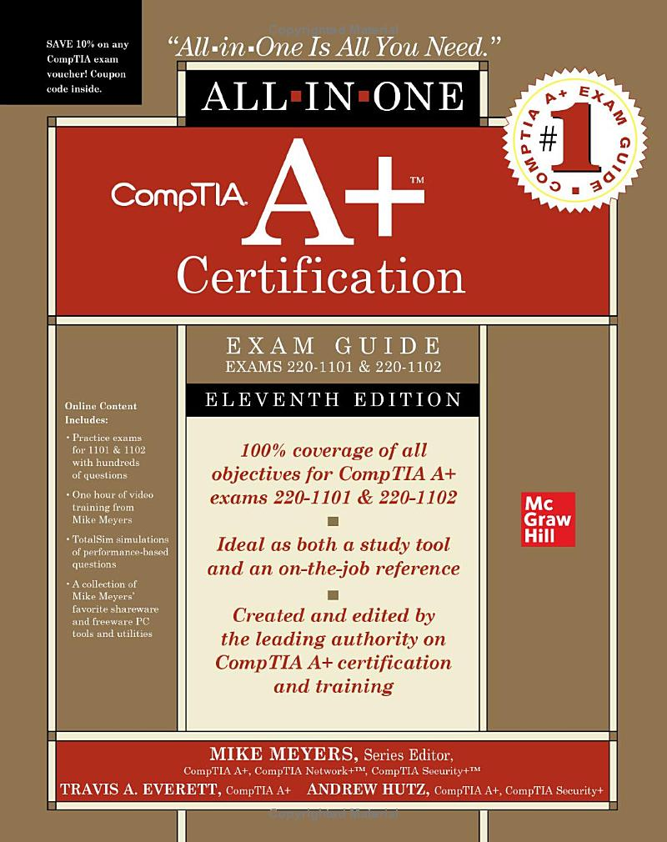
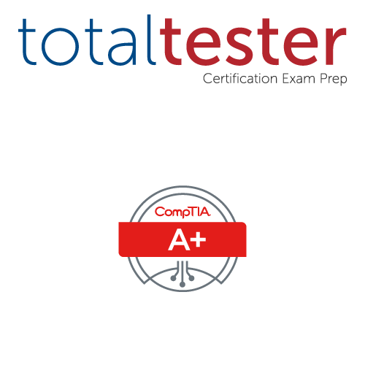
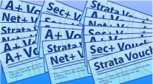
Commercial Materials
Total seminars
https://www.totalsem.com
Exam guide
Exam questions
Exam vouchers
ITFreeTraining.com
© Copyright 2024
Notes:
04:45 If you are interested in purchasing commercial materials, we would recommend Total Seminars. Total seminars provide an exam guide, exam questions and exam vouchers. Before you start studying, it is often worth having a look at what bundles are available. The bundles often contain discounts for the exam. Purchasing a voucher is often cheaper than just purchasing the exam outright.
We don’t receive anything for recommending Total Seminars, so we can’t give you a discount code or anything like that, we just like and use their products.

Slide 6
Subscribe
Next video
Video content: https://ITFreeTraining.com/ap11/0005
© Copyright 2024
Notes:
04:59 We look forward to seeing you in the rest of the videos from this course. Until then, thanks for watching.
References
“The Official CompTIA A+ Core Study Guide (Exam 220-1101)” prefix to ix to xi
“Picture: CompTIA logo” https://commons.wikimedia.org/wiki/File:Comptia-logo.svg
“Picture: CompTIA A+ logo” https://en.wikipedia.org/wiki/File:CompTIA_-_Cert-logo-usage.svg
Credits
Trainer: Austin Mason http://ITFreeTraining.com
Voice Talent: AR Hellenberg https://humanaudioventures.my.canva.site/
Quality Assurance: Brett Batson http://www.pbb-proofreading.uk

