Slide 1
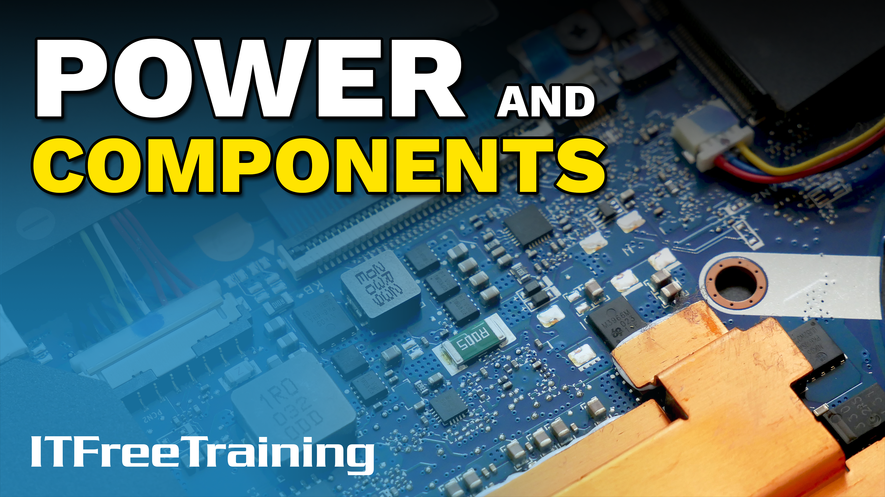
Notes:
In this video from ITFreeTraining I will look at how power is used inside a computer. I will look at how electricity works and look at how some of the basic electronics inside a computer work. It's very doubtful in the exam you'll be asked any questions in relation to basic electronics in a computer. Understanding the electronics in a computer will help you troubleshoot problems and get a better understanding of which computer parts on the market are better than others.

Slide 2

Electrical Circuits
A closed path which electrons move along
This produces an electric current
Open
Closed
ITFreeTraining.com
© Copyright 2023
Notes:
00:29 To start with, I will have a look at what is an electrical circuit. A lot of this video is going to be a basic introduction to electronics. Don’t worry if you don’t understand everything in this video. In computing, a very basic understanding will be helpful sometimes, but unless you want to get into electronics a very basic understanding is all you will need.
So essentially, an electrical circuit is a closed path which electrons can move along. When electrons move this causes an electric current. The path that the electrons follow is what is referred to as a closed path. If the path is open the electrons will not be able to flow. So, in this example you can see that the circuit is open. This will generally be because the wire the electrons are going down is broken or there is a switch in the circuit that is open and thus preventing electrons from traveling along it.
By contrast, a closed circuit is one in which the path the electrons move through is not broken, thus they can freely move along it. If there is a switch in the circuit, the switch is considered to be in the closed position. If you consider a power switch, if the power switch was in the open position the device would be switched off. If the power switch was in the closed position the device would be switched on.
So, now that we understand how a circuit works, let’s look at the concept of voltage.

Slide 3
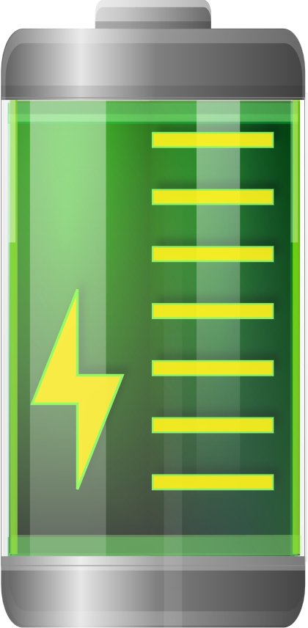
Voltage
Difference in electrical potential between two points
1.5 Volt
Battery
ITFreeTraining.com
© Copyright 2023
Notes:
01:53 The voltage is the difference in electrical potential between two points. So, what does that mean? Let’s consider an example. In this example we have a simple circuit which is connected to a 1.5 Volt battery.
The electrons will travel from the negative end of the battery to the positive end. Keep in mind that voltage is defined as the electrical potential between two points. This essentially means the ability or power of the battery to push electrons. This will make more sense later on. But, before I explain in more detail about voltage, I first need to look at current.

Slide 4
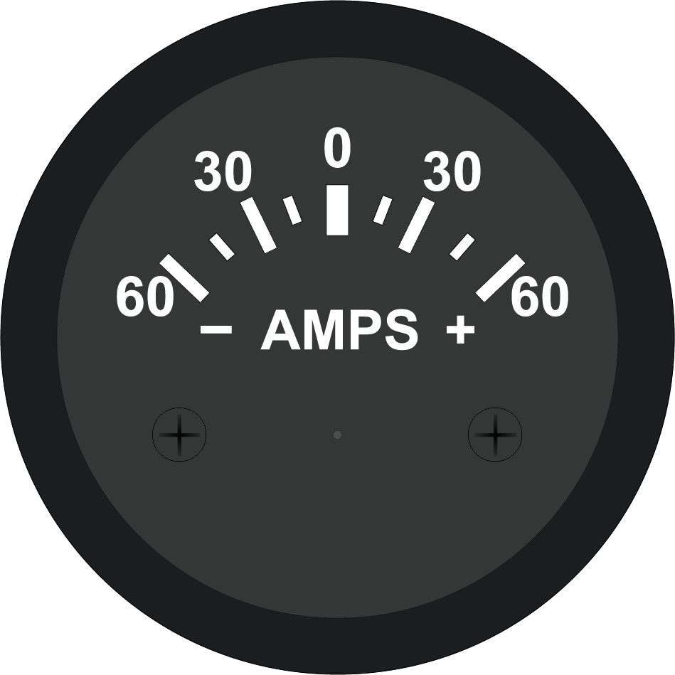

Current
Count of flow of electrons. Measured in Amps (I)
ITFreeTraining.com
© Copyright 2023
Notes:
02:30 Current is defined as a count of the number of electrons that pass a point. This is measured in Amps which is short for amperage. So, if you consider a single point on a wire, the current, measured in Amps, is simply a measure of the number of electrons that pass that point.
For the moment, I will only look at a current going in one direction, called direct current. Later in the video I will look at alternating current. That is current that goes in both directions. Now that we have a little bit of understanding of voltage and current, let’s have a look at analogy that will help us understand the basic principles. Keep in mind that, you won’t get asked a question on this in the A+ exam, but a little understanding of the concepts will help you when working as an IT technician. Later in the video I will explain why.

Slide 5
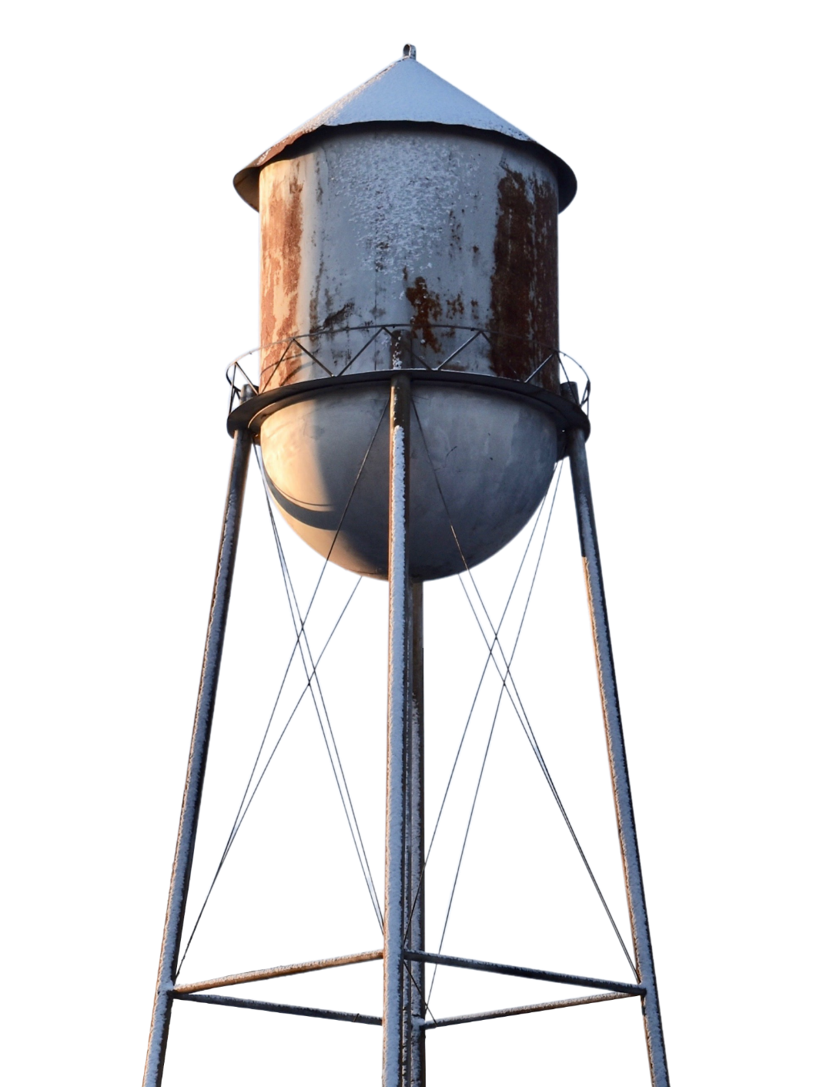
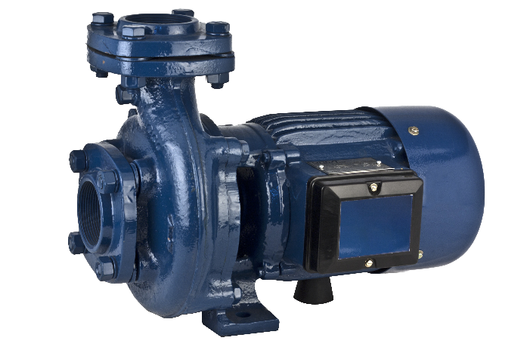

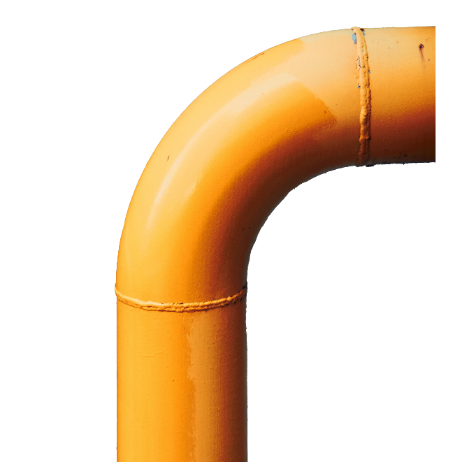

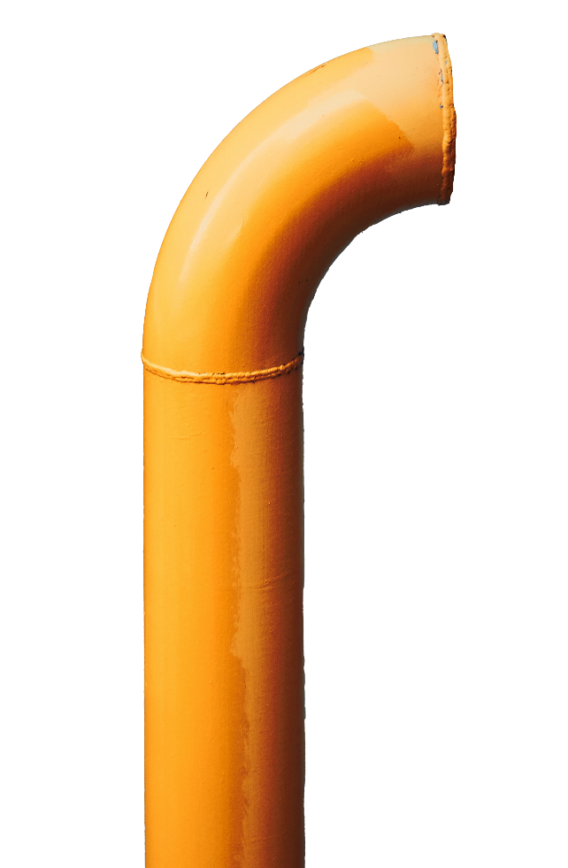
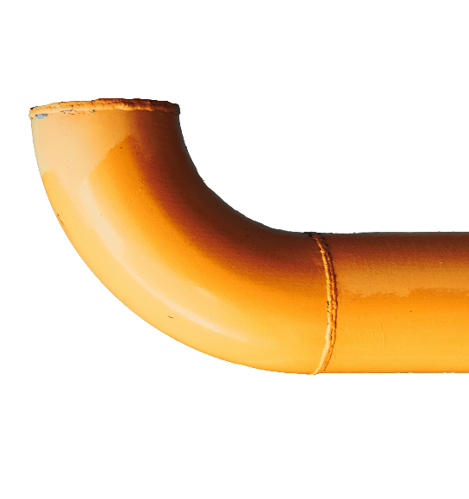
Hydraulic Analogy
Electricity acts like water
Water will flow from high pressure to low pressure
Amount of water in
tank determines
pressure
(Voltage)
Water pipe size
determines water flow
(Amps)
ITFreeTraining.com
© Copyright 2023
Notes:
03:28 When attempting to understand electricity, it often helps to compare it with water. Since electricity is a flow of electrons, it acts in a similar way to water. Water will essentially flow from a place of high pressure to one of lower pressure.
So, if you consider an example of a water tank. The more water in the water tank, the more pressure the water applies. This is the same as voltage. The higher the voltage, the more power it has to push electrons.
If I now add some pipes to carry the water. The amount of flow through the water pipes can be measured. Measuring the water flow is the same principal as measuring electron flow or Amps. To increase the amount of water pressure, you just need to add more water to the water tank. To increase the flow of water, you would increase the size of the pipes.
Before I move on, I am going to have a quick look at a battery. Not something you really need to know, but I think helps to understand the concept of how electricity works.

Slide 6
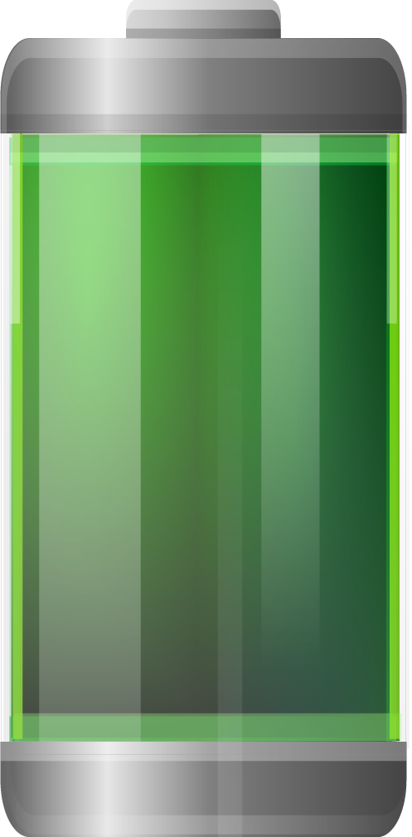
Battery
Materials with different numbers of electrons
When equal, battery flat
Full battery
Flat battery
ITFreeTraining.com
© Copyright 2023
Notes:
04:30 This is a simplified example, but essentially most batteries contain two different types of material which hold electrons. In a full battery, one of the materials will have significantly more electrons than the other material.
When a circuit is made using the battery, the electrons will travel from one material to the other. When the two materials have about the same number of electrons, the battery will be flat. Essentially the battery works because there is a different number of electrons on each side of the circuit, thus the battery sends electrons over the circuit attempting to stabilize the number of electrons on both sides.
So, you can see, this illustrates the basic principles of electricity. A difference in electrons will cause electrons to flow to the other side attempting to balance the two sides. Voltage is a measure of the electric potential between the two different sides.
The next point to consider is, what can affect the flow of these electrons between two points?

Slide 7
Resistance
Measurement of opposition to electrical flow
Measured in Ohms (Ω or R)
ITFreeTraining.com
© Copyright 2023
Notes:
05:29 Therefore, the next thing to consider is resistance. Keep in mind you won’t get a question about this in the exam, but it is in the official CompTIA A+ Study Guide so I will cover it. Unless you start working in electronics, you probably don’t need to know too much about it.
Resistance is the measurement of opposition to electrical flow. So essentially, how hard or easy is it for the material to allow electrons to travel through it. To understand this better, consider you have a material in which it is easy for electrons to flow through.
Now let’s consider a second material. This material does not allow electrons to flow as well as the first, thus it has a higher resistance than the first.
Resistance is measured in Ohms. When you compare things in electronics, different components will have different levels of resistance. Using these properties, you can achieve different results, something that is important if you work with electronics, but not really that useful for computer support.
Let’s have a look at something that you will come across in computer support.

Slide 8
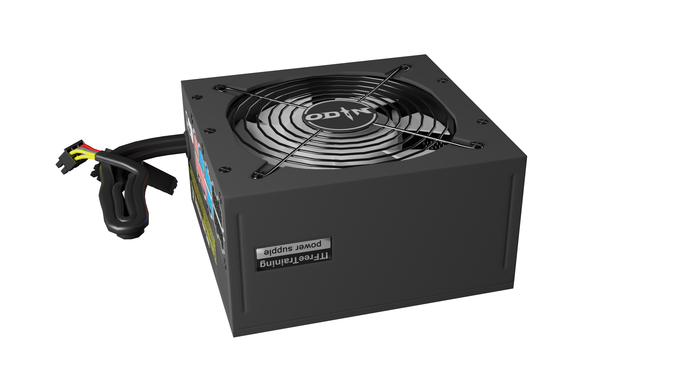
Power (Watts)
Measure of electricity drawn from power supply
Watts = V*I (Voltage*Current)
For example
Power Supply Unit (PSU)
Will have output in watts
ITFreeTraining.com
© Copyright 2023
Notes:
06:38 Watts is the measure of electricity drawn from a power supply. For example, when you purchase a Power Supply Unit or PSU, the PSU will have as one of its specifications the number of Watts it outputs. I will cover this more in the Power Supply video; however, you simply just need to make sure that the sum of the components in your computer doesn’t exceed the number of watts the Power Supply Unit will output.
The formula for working out watts is Voltage times Current. Not something that you need to worry too much about for computer support. The main thing is working out if your power supply outputs enough watts for the components in your computer.

Slide 9

Energy
Amount of power consumed by a device over time
Measured in Watt-Hours
ITFreeTraining.com
© Copyright 2023
Notes:
07:19 The next topic I will look at is energy. This is the amount of power consumed by a device over time. This is measured in Watt-Hours. If you are working in a data center or mining cryptocurrency than this becomes important. Power saving here can add up to a lot of money. Otherwise, you probably won’t need to worry about it in your IT career.

Slide 10
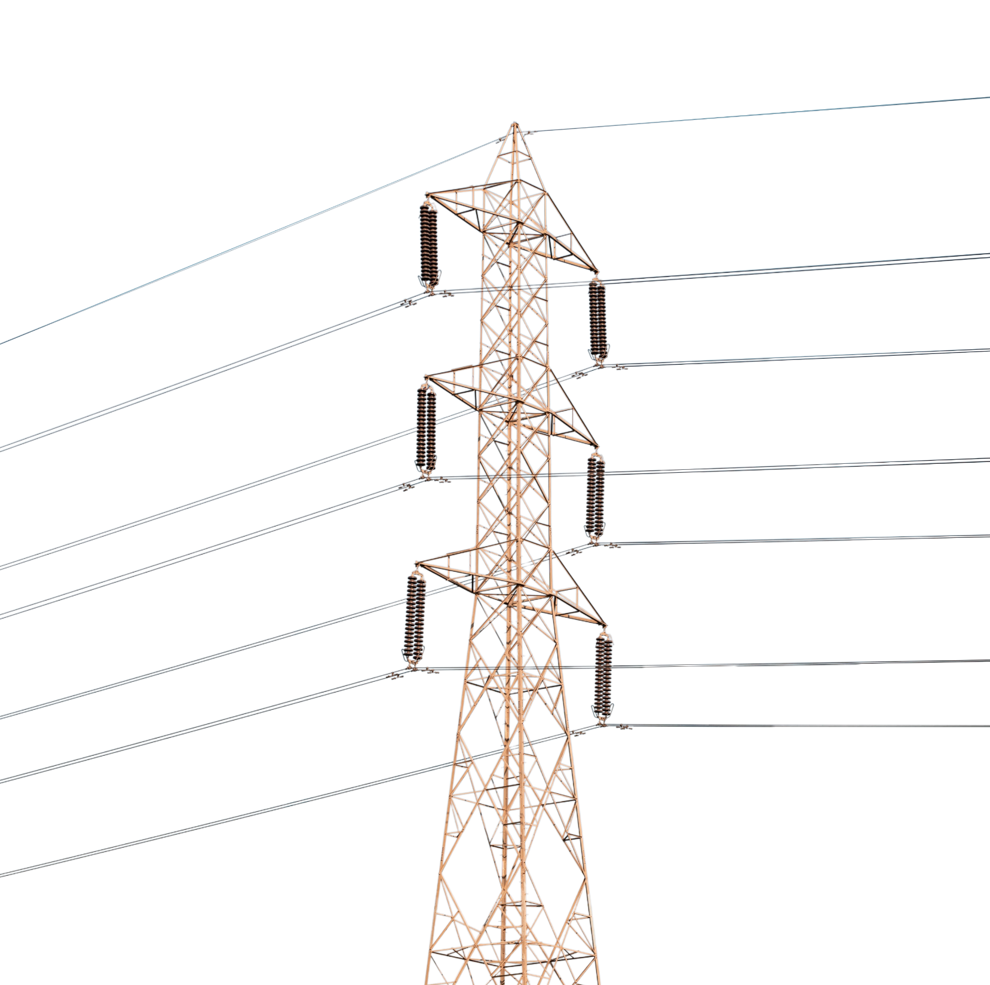
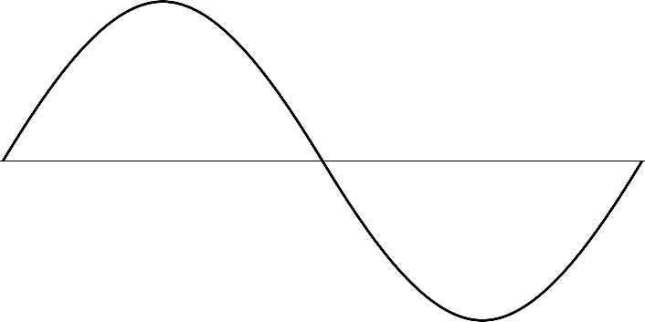
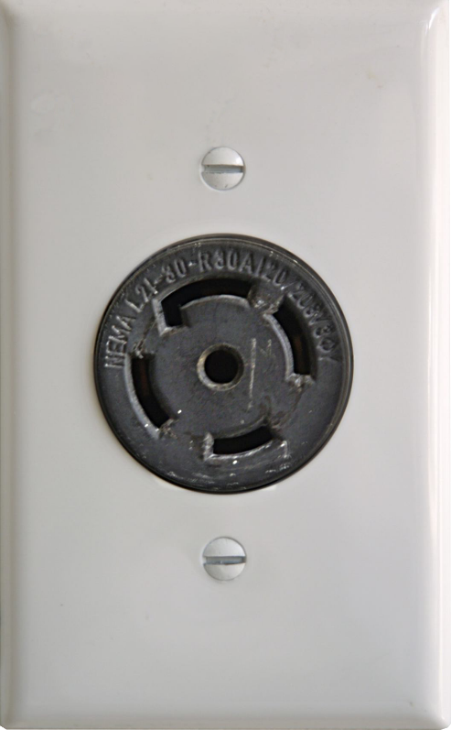
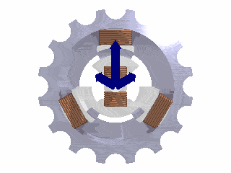
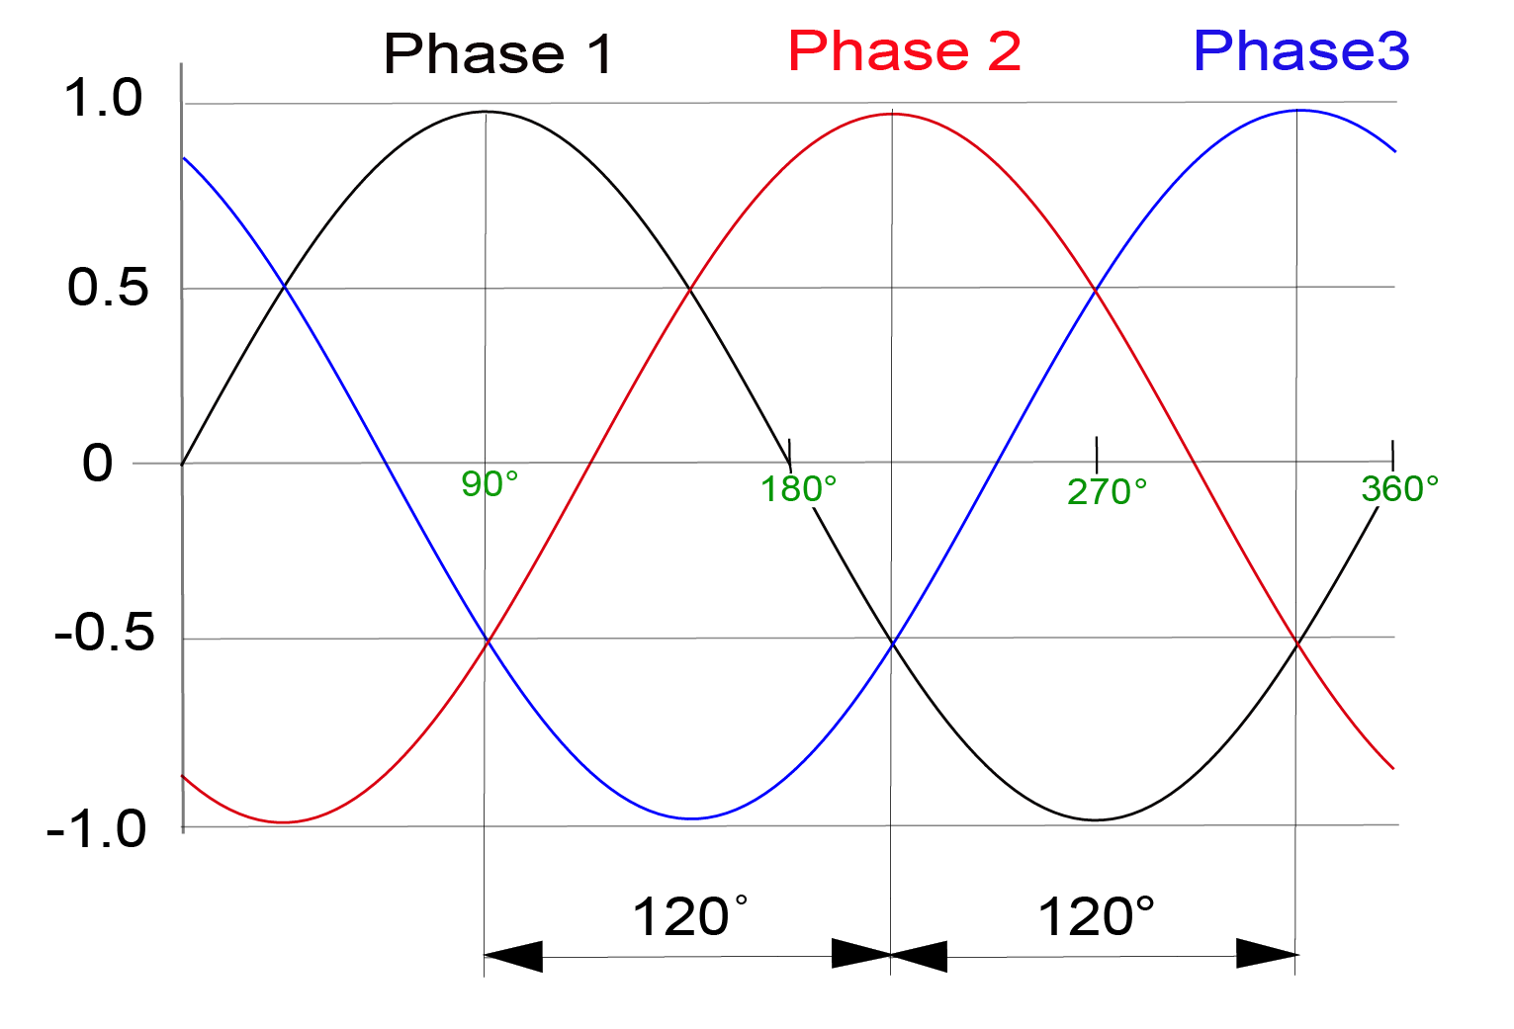
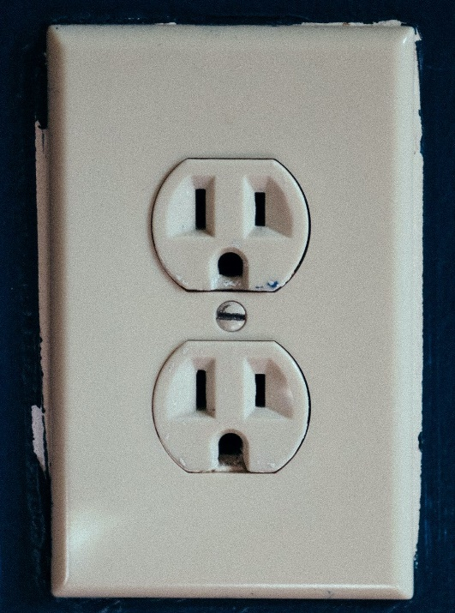
Alternating Current (AC)
Current flows between low and high
3-phase power point
Created as
3-phase power
Single-phase power outlet
ITFreeTraining.com
© Copyright 2023
Notes:
07:44 The next topic I will look at is the two forms of electricity supplied. The first is alternating current otherwise known as AC. In AC, the current will change between low and high. That is, the current will alternate between positive and negative. Depending on the country this will generally happen between 50 to 60 times per second. Due to the predictable number of times this occurs per second, AC electricity is good for measuring things like time.
When electricity is created, it is output in three phases. The generators used to create electricity spin through three different magnetic fields creating power. The three phases essentially look like three AC currents overlaying each other.
You could generate power in a single phase. The reason power companies don’t generate power in in single phase is that three-phase power generation is cheaper to run, the generators are more stable and thus less prone to wear. Three-phase power is, however, useful in certain circumstances since it can deliver more current than single-phase power. Thus, the power is transmitted in three phases to its destination.
At the destination or close to the destination, the power will be converted to a single phase or provided as three phases. In the case of three phases, the power outlet will look different to a standard single-phase outlet. Keep in mind that how these outlets look will differ in different parts of the world. Single-phase outlets are generally the same whichever country you are in; however, depending on what country you are in, there maybe a number of different standards for three-phase outlets.
So, your building may have three-phase power available, or it may not. A lot of modern houses won’t have access to it since they generally don’t need it, but larger business buildings will generally have it.
In the case of computers, the only time you will be dealing with alternating current is when you plug the computer or device directly into a power outlet. In the case of single phase, the power cable will simply be plugged into a standard output. In the case of three-phase the same principle applies, however the outlet will be a three-phase output plug. There are also two-phase outlets, which as the name suggests deliver two phases instead of one. If you plug a two-phase device into a three-phase outlet, you risk damaging the device.
In computers, three-phase outlets don’t get used that much. You may see them used in devices such as large Uninterruptible Power Supplies or UPS. The other time you may come across them is in large air conditioners in service rooms or when servicing a computer connected to industrial equipment.
I would seriously recommend, that if you are doing anything other than working with a single-phase outlet, consult with an electrician first. Once you start dealing with anything above single phase, you are working with a lot more electricity. Single phase has enough electricity to kill you in the right circumstances, but three phase is even more dangerous. Also, since there are three-phase and two-phase power outlets, plus there are also different ratings for the amount of current the outlet can produce, there is too much that can go wrong. So personally, unless an electrician or suitably qualified person verifies it is okay to plug it in, I would not plug anything other than one phase in.
There are a couple of things that can go wrong with single-phase power which I will look at next.

Slide 11
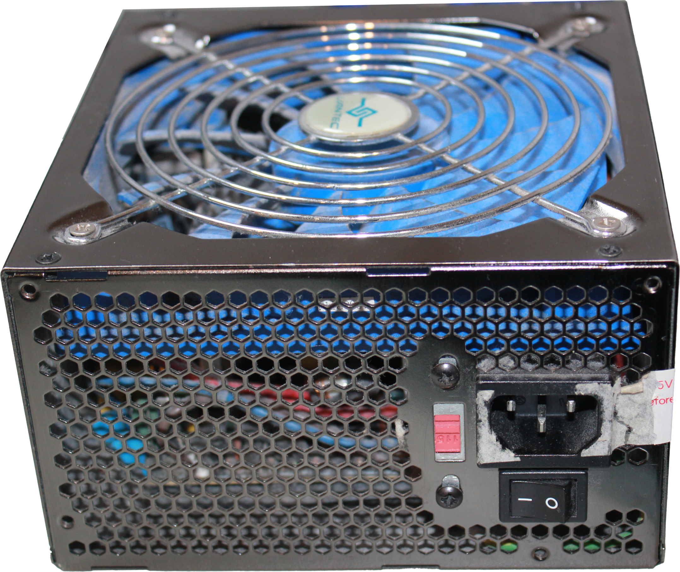
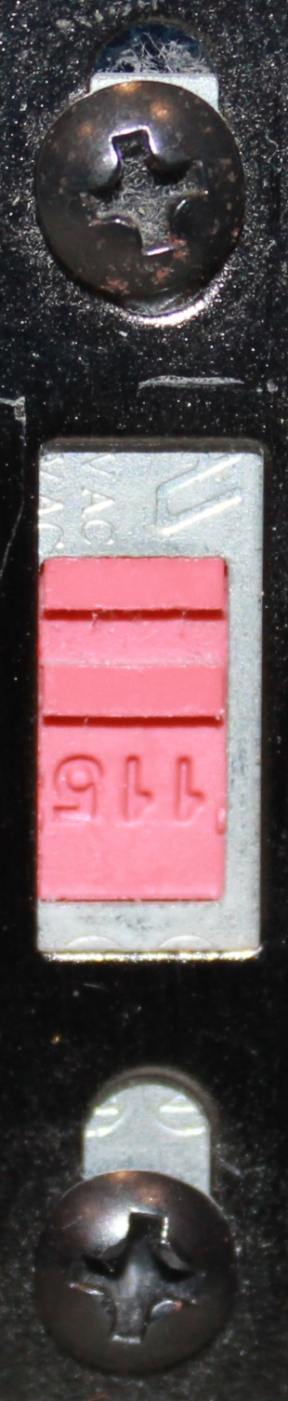
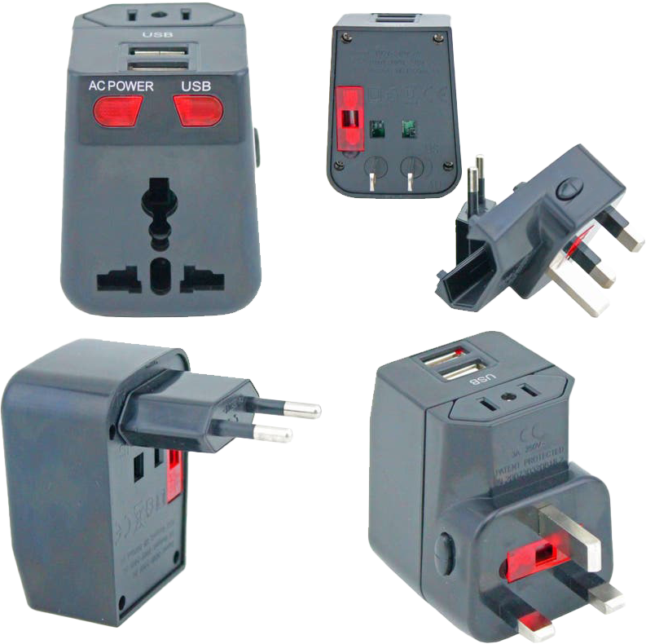
AC Considerations
Power Supply Unit
Some will have voltage switch
Universal power adapters
(Do not convert voltage)
Ensure device is compatible
Usually, small devices
ITFreeTraining.com
© Copyright 2023
Notes:
11:34 The first thing you may come across is that some power supply units have a voltage switch on the back. When you purchase a power supply, this should be set to the voltage requirements for your country. However, if for whatever reason this switch is in the wrong position, if the power supply is plugged in and switched on, most likely you will hear the sound of a component blowing up. You will then need to purchase a new power supply.
The next consideration is, if you have a device that has a different power connector to your wall outlet. When this occurs, you can purchase a universal power adapter. This will essentially change the pins on the outlet. This will allow a device from another country to be plugged into a different outlet. Keep in mind, these adapters do not change the voltage. If the device does not support the different voltage, it will most likely damage the device.
Smaller devices will often support these adapters, particularly if the device uses a power pack like a laptop would. With bigger devices there is a good chance they won’t support it. It is best to check before you use it, otherwise you risk damaging the device.
Alternating current suffers less power loss over long distances, therefore you can understand why it is transmitted in this form. Depending on where you are in the world, the voltage is generally 220-240 volts or 110-120 volts. To be compatible with electronics two things need to occur. These are, alternating current needs to be changed to direct current and the voltage needs to change to that which the components require. Let’s have a close look at how this is achieved.

Slide 12
Direct Current (DC)
Flows in one direction at a constant voltage
V+
DC 12 Volts
V-
AC
DC 3.3 Volts
ITFreeTraining.com
© Copyright 2023
Notes:
13:19 In a Direct Current (DC) circuit, the charge flows in one direction from the positive to negative terminals. The current is constant and does not change between positive and negative like alternating current does.
In order to convert alternating current to direct current, a Power Supply Unit or PSU is used. The PSU takes the alternating current and converts it to direct current. A computer power supply will supply a number of different voltages. It will also supply both positive and negative voltages. For example, a computer power supply will supply a motherboard with positive and negative 12 volts. The power supply’s job is essentially to provide stable voltages to the components in the computer system. It does this by cleaning up the power it receives and outputting a steady voltage.
The electronic components inside a computer require direct current in order to operate. Let’s now have a look at some of those components.

Slide 13
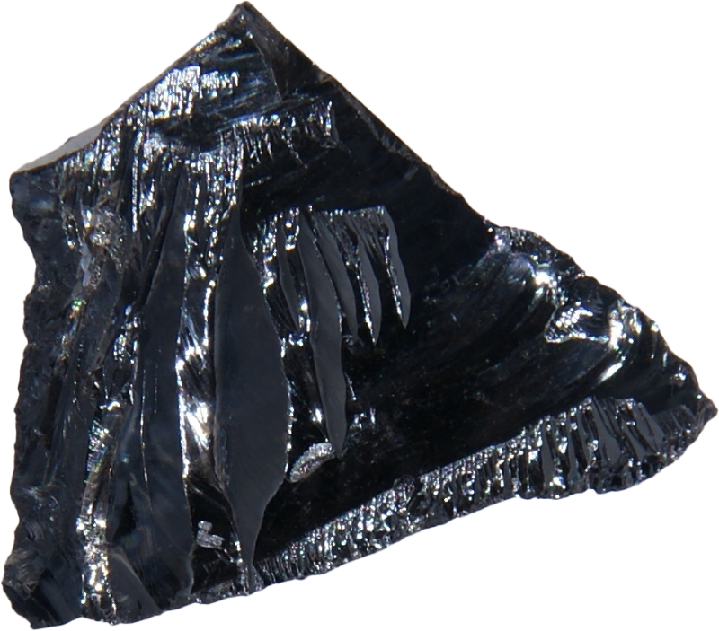
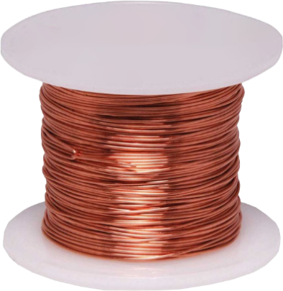
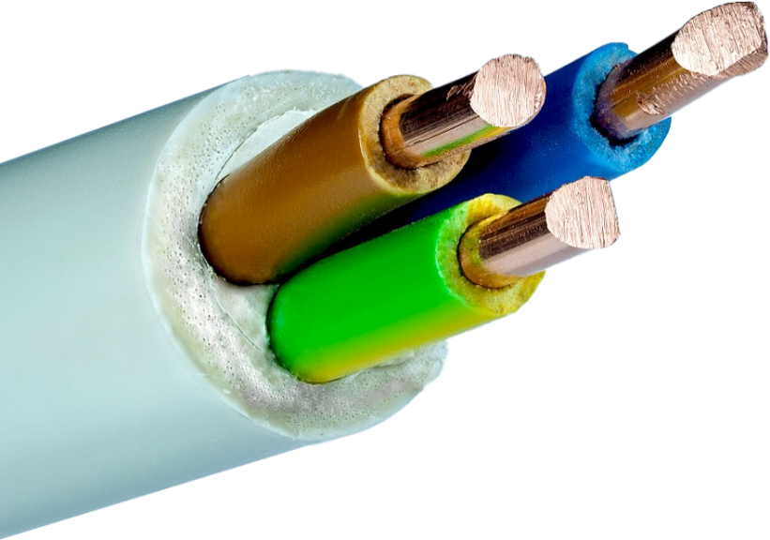
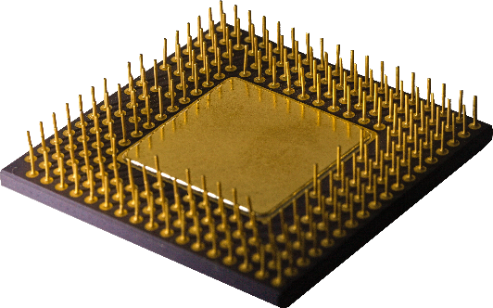
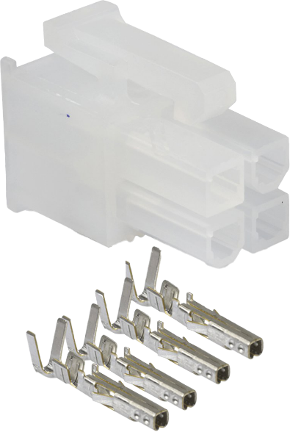
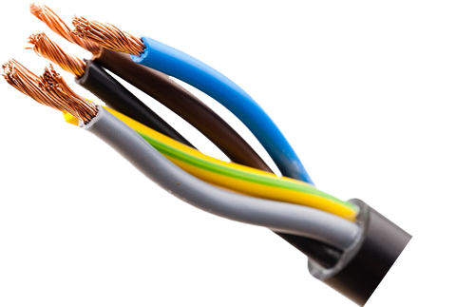
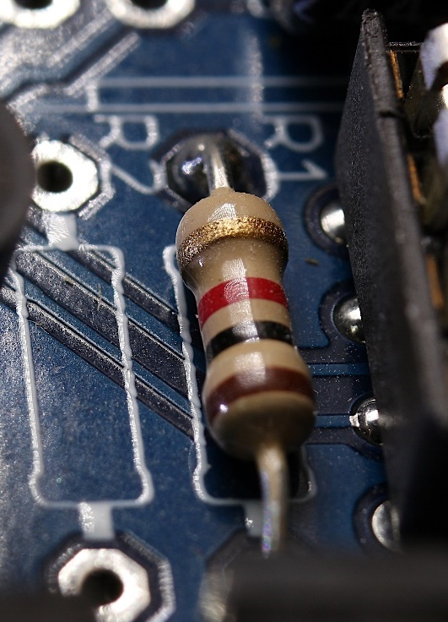
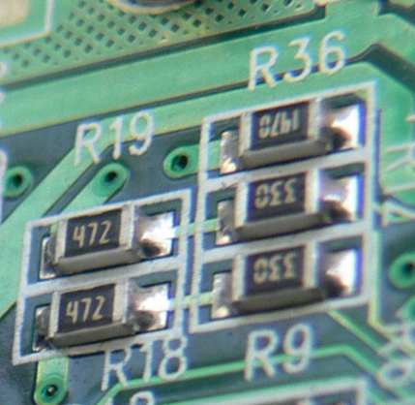
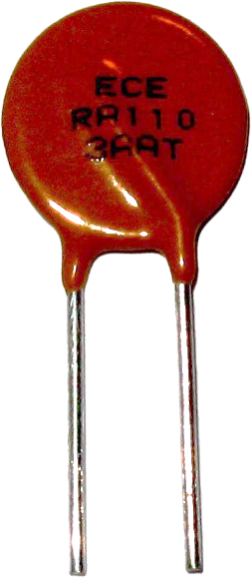

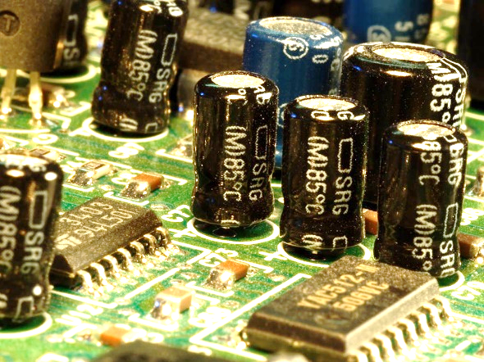
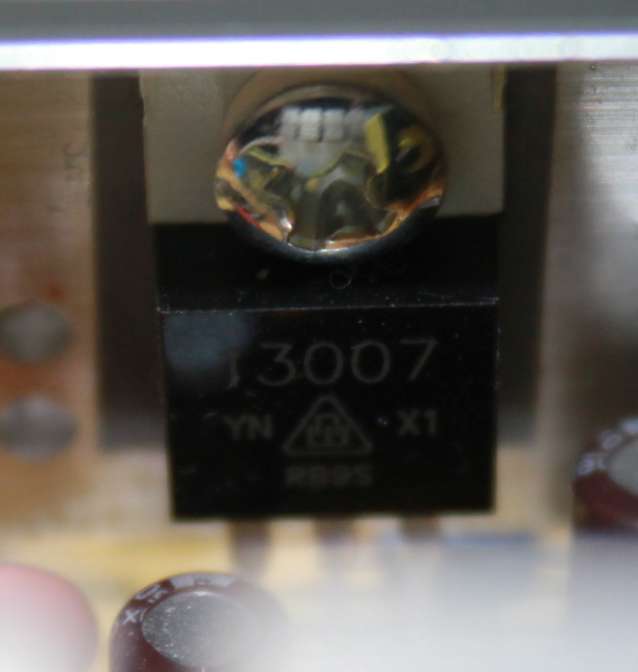
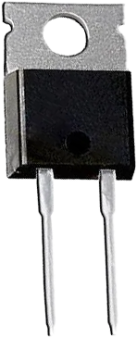
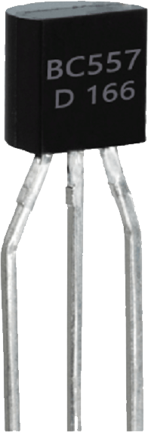
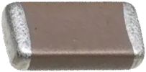
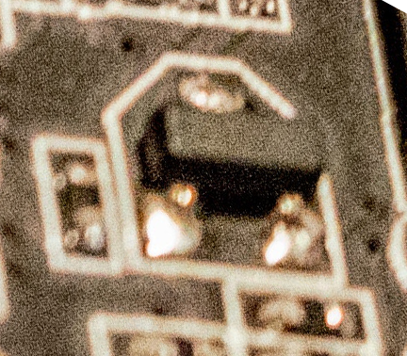
Electronic Components
Conductor
Gold/Copper/Tin
Used to conduct electricity
Insulator
Rubber/Plastic
Prevents conduct of electricity
Semiconductor
Silicon
Can prevent/allow flow of electricity
Resistor
Reduces current flow
Fuse
Overcurrent protection
Single use/Resettable
Capacitor
Stores charge
Diode
Current travels in one direction
Transistor
Creates logic switch
ITFreeTraining.com
© Copyright 2023
Notes:
14:22 The first component I will look at is conductors. As the name suggests, these materials conduct electricity. Different metals are better at conducting electricity than others. For data wires, particularly high-speed data wires, you may find that the pins of the connector are gold plated.
The gold plating generally ranges from a quarter of a micron to five microns in thickness. To give you an idea how thin that is, a human hair is 20 microns. The gold plating helps protect against corrosion, but in computers we are more interested in how it conducts electricity. Gold is an excellent conductor of electricity and even a thin layer will increase how well the pins conduct electricity. When you have electronics that send a lot of data, thus a lot of changes in electricity, gold plating helps prevent data loss. This is why you will often find that high-speed video cables will have gold-plated pins. You will be able to get cheaper cables that don’t have gold-plated connectors, but don’t expect them to work as well.
Copper is often used for wires as it is cheap and conducts electricity well – not as good as gold of course, but copper is a lot cheaper than gold. You will also find tin used as well. Tin will often be found at the end of power connectors. Tin is cheap but not the best when it comes to data transmission. With power connectors this is not a concern, thus tin is a good choice for the pins of power connectors.
Conductors are good at allowing electricity to flow, so let’s now have a look at what stops electricity flowing. An insulator does the opposite and prevents electricity from flowing. Insulators are often rubber or plastic. Insulators allows components and wires to be touched without the person touching them getting an electric shock or affecting the transmission of electricity.
So far, we have looked at materials that allow electricity to flow and other materials that don’t. The next materials are semiconductors which can do both. Semiconductors have a property in which they can either allow or prevent electricity from traveling through them. Although there are different things that can trigger this change, depending on the material, in the case of computers it is often electricity. Semiconductors are used in many different components in the computer.
The next component I will look at is a resistor. A resistor reduces the amount of current that flows through it. If you think of it like a water hose. A resistor would be like putting your foot on the hose and pushing down just enough to slow down the water flow, but not hard enough to stop it. Resistors perform the same process but with electricity.
Older style resistors were large and had colored bands. Newer style resistors often used on motherboards are small and rectangular in shape. Sometimes, the motherboard will have letters printed on the motherboard starting with R indicating that it is a resistor, but not always.
In some cases, the electricity may attempt to go back in the direction it came from. This is like a wave hitting the side of a pool, where it wants to rebound and go back the way it came. In order to try and prevent this happening a diode may be used. A diode attempts to have current travel in one direction only. Diodes may be found in your power supply and sometimes on the motherboard. Often the ones found on the motherboard will be small rectangles like resistors, but they don’t have any printing on them.
The next important component is fuses. Although fuses take on many different forms, traditionally fuses were a clear cylinder with a metal wire inside. If too much current travels through the wire in the cylinder, the fuse would break, often referred to as the fuse having blown.
You don’t see this type of fuse use much anymore, they have been replaced with resettable fuses. These fuses are made of materials that will break the circuit if the current gets too high. However, after a period of time the fuse will reset itself and allow current through again.
A lot of these are temperature based, so essentially when too much current goes through, the material heats up breaking the circuit. When the temperature returns to normal, the circuit is restored.
If you have a computer where the power suddenly switches off, this may be because a fuse tripped. A lot of the time, a computer will restart if there are electricity problems. However, if it switches off and won’t switch back on for a minute or two this may be because of the fuse. If this is the case, it may be a component inside the computer drawing too much power or maybe your power supply is not providing enough current to run the computer.
One of the core components of a computer is a transistor. A transistor provides a logic switch inside the computer. Most of the transistors are found in the chips on the motherboard, but you will still find the odd one around the motherboard. Transistors will always have three connectors, so they are generally easy to spot.
The last component I will look at is capacitors. Capacitors store electric charge for a small period of time. They perform two roles. The first is storing electricity so that components can draw on it when they need to and not run out. The other, is that they even out the flow of electricity, that is take out spikes and dips thus providing a stable flow of electricity.
Capacitors often take the shape of a cylinder, but they can be found in many different forms. On motherboards they will often take the shape of a rectangle. You can see that many different components on the motherboard may look the same. There are also a lot of other components that I have not covered, but which perform similar tasks. For example, voltage regulators are often found on a motherboard, and their purpose is to reduce the voltage. Just by looking at a motherboard, it may be difficult to work out what each component is. Sometimes in order to know you may need to look the part number up.
For modern computer repair, it is often a matter of working out the faulty component in the computer and replacing it. For example, replacing the motherboard or the graphics card. Since the electronic components are very small, they are difficult to replace and not worth the time.
You don’t need to have a good understanding of electronic components, just understand what to look for when something goes wrong. If your computer fails to start up, keeps restarting unexpectedly or shutting down, have a look at the motherboard and other components. A damaged capacitor will often have a buckled top and possibly the material inside may be leaking out. Other components may have burn marks around them indicating they are damaged. When you see this, it is time to replace the part.
Other things to consider are, if you put the computer under a lot of load and the computer restarts, this may be a problem with the power supply, capacitors or other components that regulate power. These problems may also occur due to heating problems, but it generally takes a little bit of time for the component to heat up before problems arise. If the problem happens within a few seconds, it is more likely to be a power problem.
For computer repair, you won’t need to know too much about electronics but helps if you know a little bit when trying to diagnose problems. This may help lead you to which component needs to be replaced. Recognizing that a computer is randomly restarting and then noticing damaged capacitors, will hopefully lead you to which component needs to be replaced.

Slide 14

Subscribe
Next video
Video content: https://ITFreeTraining.com/ap/4c05
© Copyright 2023
Notes:
22:28 That concludes this video. I hope you have found it informative. Until the next video from us, I would like to thank you for watching.
References
“The Official CompTIA A+ Core Study Guide (Exam 220-1001)” Chapter 4 Paragraphs 220-232
“Picture: Sphere” https://unsplash.com/photos/3AdY3phAq_Y
“Picture: Battery” https://pixabay.com/vectors/battery-energy-green-technology-162065/
“Picture: AMPs” https://pixabay.com/vectors/current-meter-ampere-amp-car-35991/
“Picture: Water tower” https://unsplash.com/photos/lLAwUTS7XeE
“Picture: Pipe” https://unsplash.com/photos/xMwAYhBEI6E
“Picture: Water pump” https://pixabay.com/photos/water-pump-iron-pump-steel-metal-286080/
“Video: Windmills” https://pixabay.com/videos/windmill-field-sky-nature-86618/
“Video: 3 phase power” https://commons.wikimedia.org/wiki/File:3phase-rmf-noadd-60f-airopt.gif
“Picture: Power line” https://www.pexels.com/photo/brown-electric-tower-under-blue-sky-6469669/
“Picture: 3 phase power” https://commons.wikimedia.org/wiki/File:3_phase_AC_waveform.svg
“Picture: Power point” https://unsplash.com/photos/s0FBvCk9-DU
“Picture: 3 Phase power outlet” https://en.wikipedia.org/wiki/File:L21-30receptacle_proc.jpg
“Picture: CPU” https://pixabay.com/photos/microchip-chip-processor-integrated-5881456/
“Picture: Register large motherboard” https://pixabay.com/photos/circuit-computer-chip-electronics-4199160/
“Picture: Register small motherboard” https://pixabay.com/photos/electronics-motherboard-capacitors-1480784/
“Picture: Motherboard” https://unsplash.com/photos/jXd2FSvcRr8
“Picture: Fuses” https://en.wikipedia.org/wiki/Resettable_fuse#/media/File:Photo-Polyswitch.jpg
“Picture: Motherboard” https://www.pexels.com/photo/green-and-black-circuit-board-3665442/
“Picture: Capacitors” https://pixabay.com/photos/capacitors-electronics-circuit-board-3588/
Credits
Trainer: Austin Mason http://ITFreeTraining.com
Voice Talent: HP Lewis http://hplewis.com
Quality Assurance: Brett Batson http://www.pbb-proofreading.uk

