Slide 1
Notes:
In this video from ITFreeTraining I will look at external storage devices. External storage has become more common for backup and to provide extra storage. This video will look at the different types that are available.

Slide 2
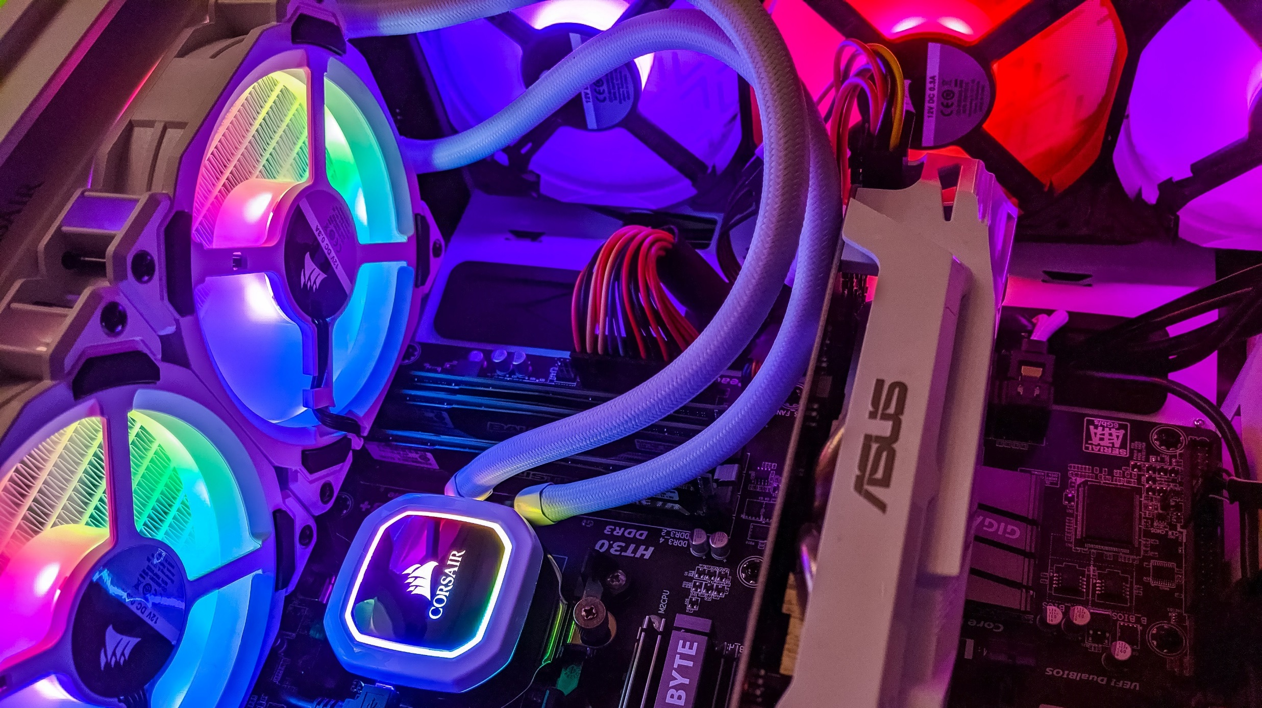
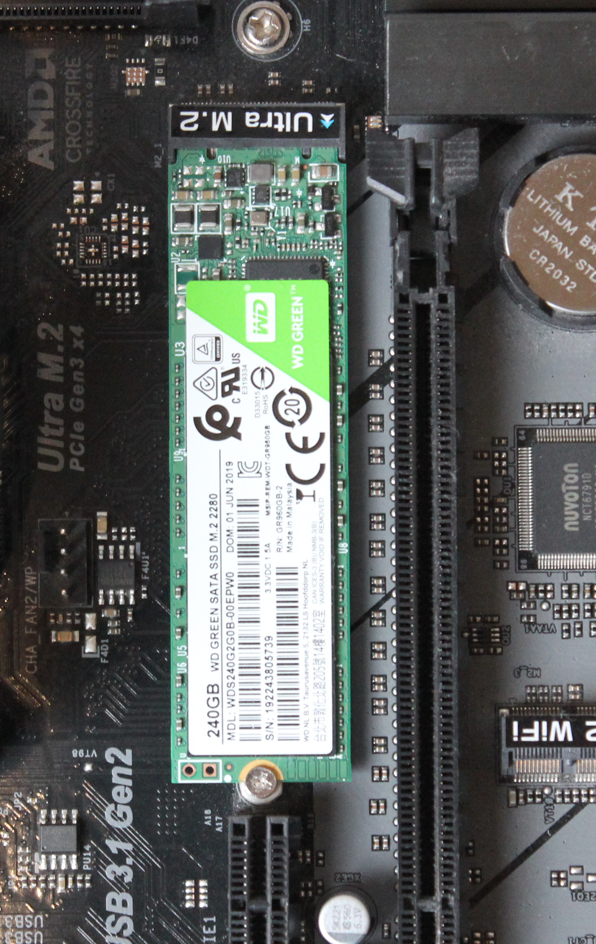
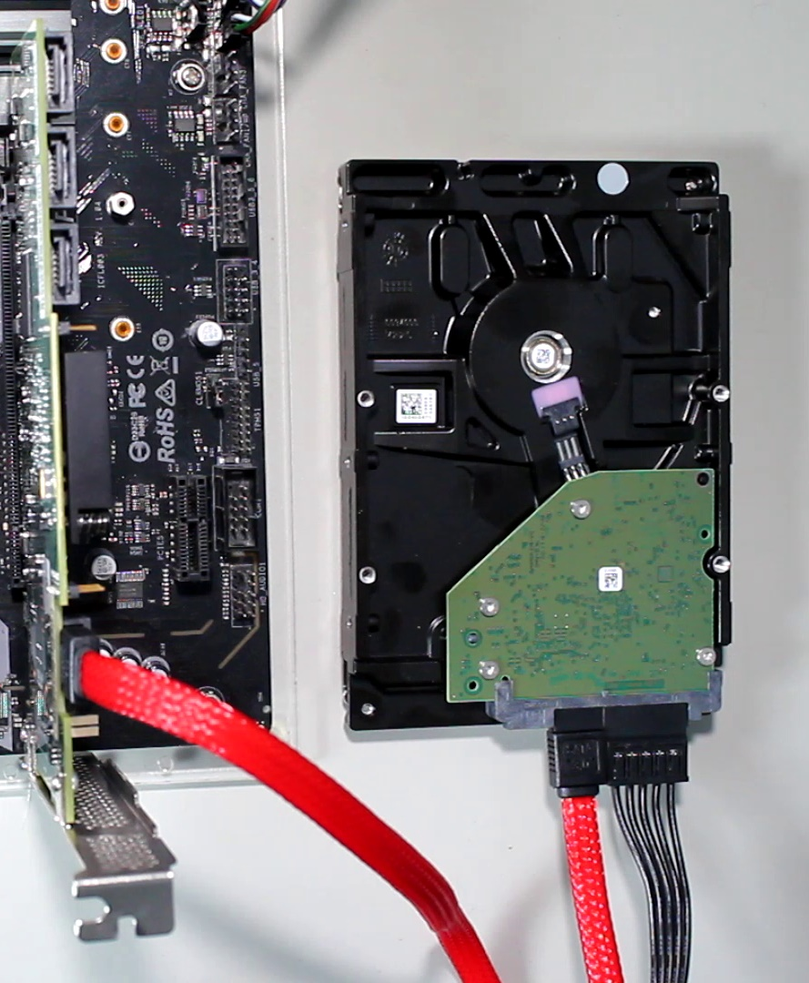
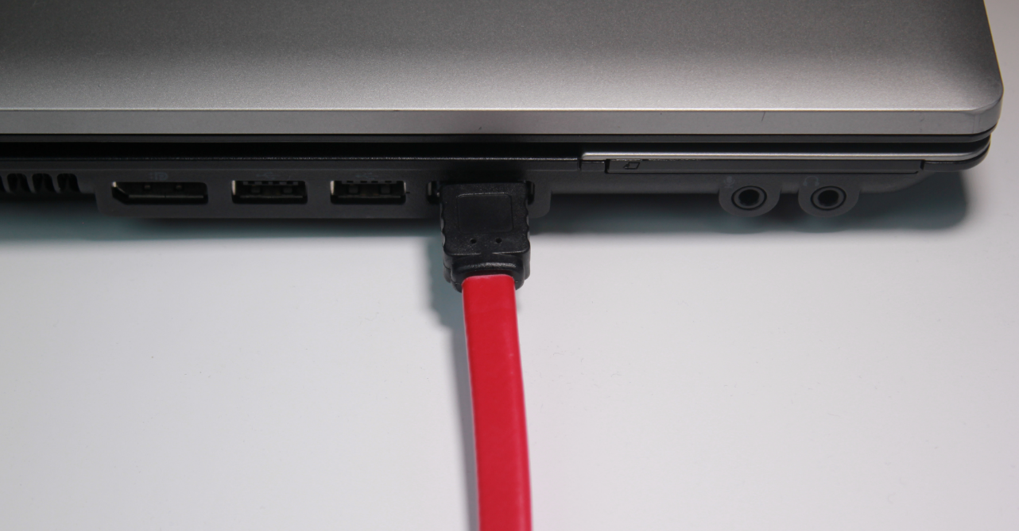
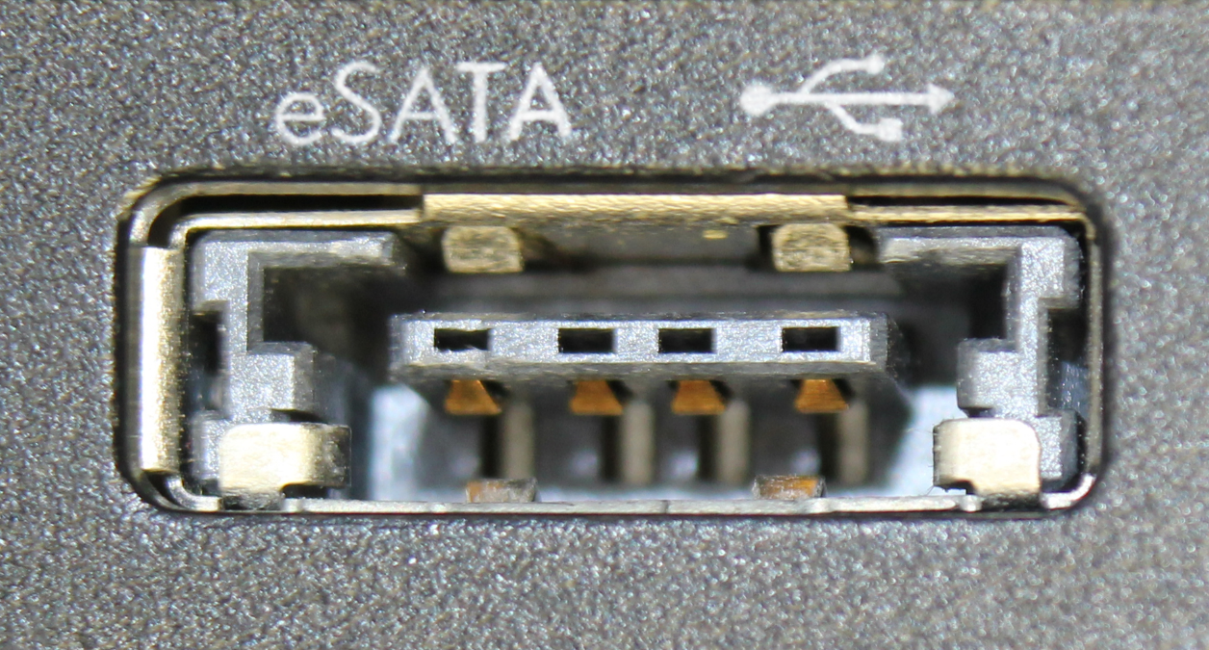
Internal Vs External
Connected to internal connector
Connected to external connector
Generally faster
Generally slower
May not support hot-swapping
Generally, support hot-swapping
Less likely to accidently be unplugged
Easy to accidently unplug
ITFreeTraining.com
© Copyright 2024
Notes:
00:13 To start with, I will first look at the differences between internal and external storage. Internal storage is essentially connected to the computer via an internal connector. That is, a connector inside the computer that is not accessible from the outside. You can see in this example an M.2 Solid-State Drive used as internal storage. You can also see this hard disk is an example of internal storage although it is not physically mounted inside a computer case. The point being, if the connector is inside the computer and not accessible from the outside, it is considered internal storage.
Internal storage is generally faster and less likely to support hot-swapping. The advantage of it being inside the computer is it is less likely to be accidently unplugged.
By contrast, external storage is connected to the computer using an external connector. These will be found generally in the IO area or an external port like a USB, eSATA or Thunderbolt connector. These connections are generally slower, although new connections like USB 3 and Thunderbolt are pretty fast.
The advantage of external connectors is they are generally hot-swappable. That is, you can plug and unplug them without having to shut down the computer. The disadvantage is that they are easy to accidentally unplug. Since they are external to the computer, they are more subject to being bumped and a connection breaking. The connections are generally more prone to coming loose. For example, once you screw in an M.2 Solid-State Drive it is not coming out; however, a USB connection can come loose from either being knocked or pulled. So, let’s have a look at when you would use an external storage device.

Slide 3
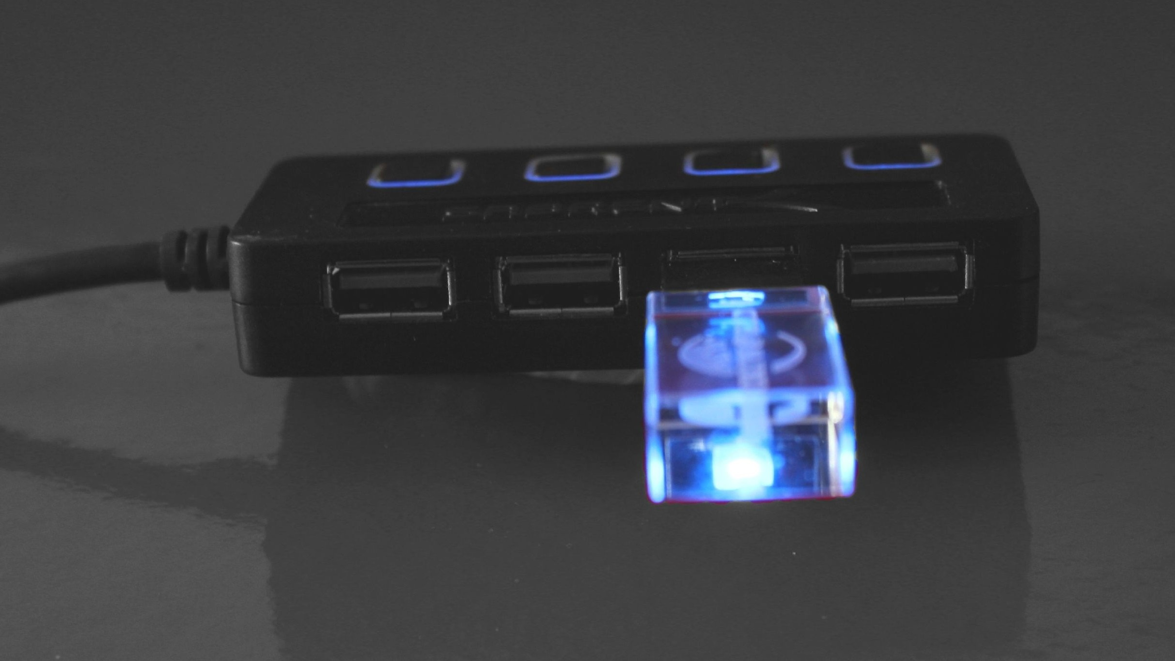
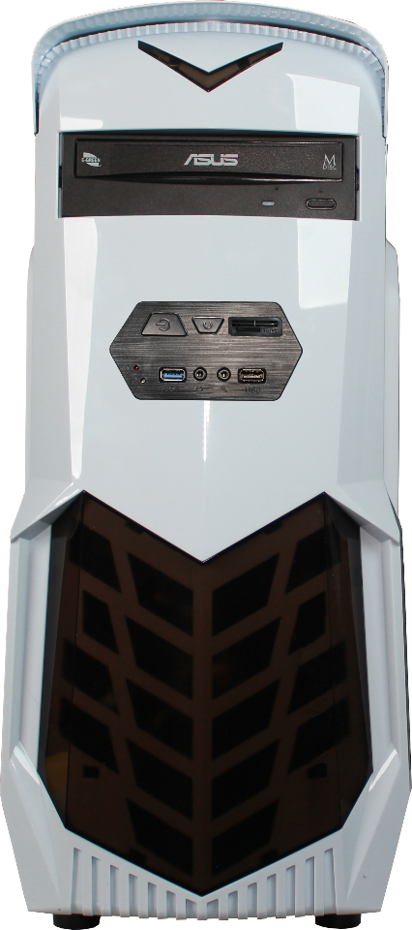
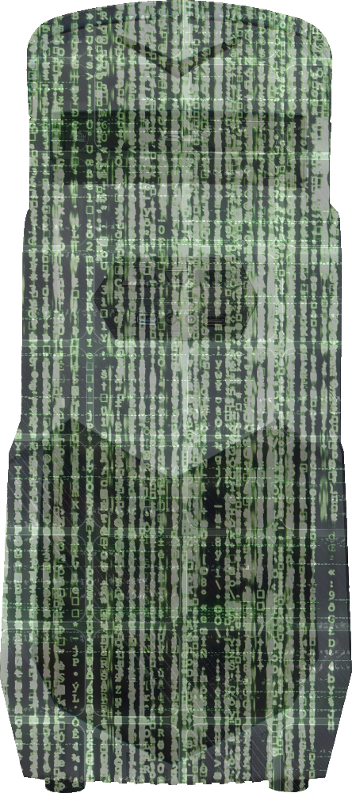
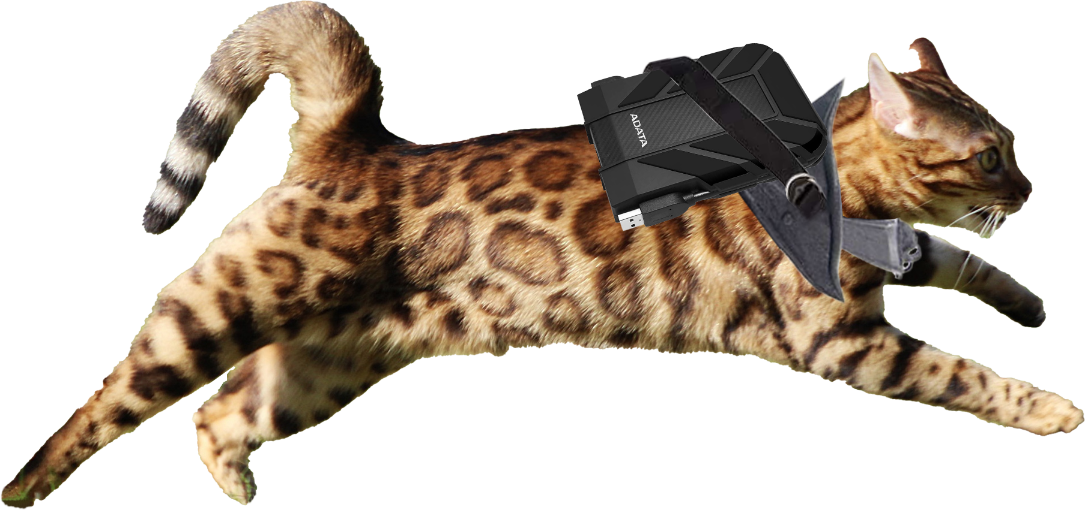
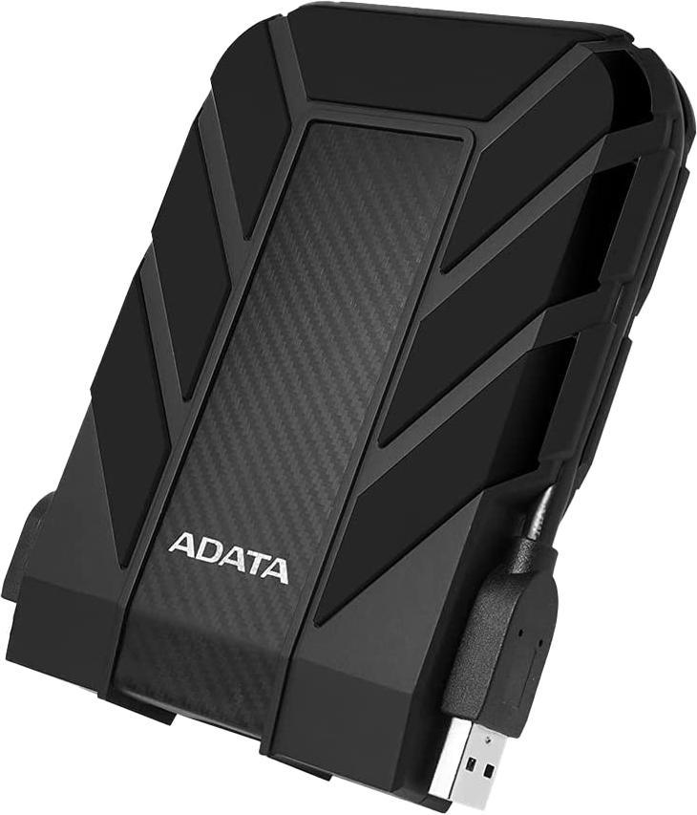
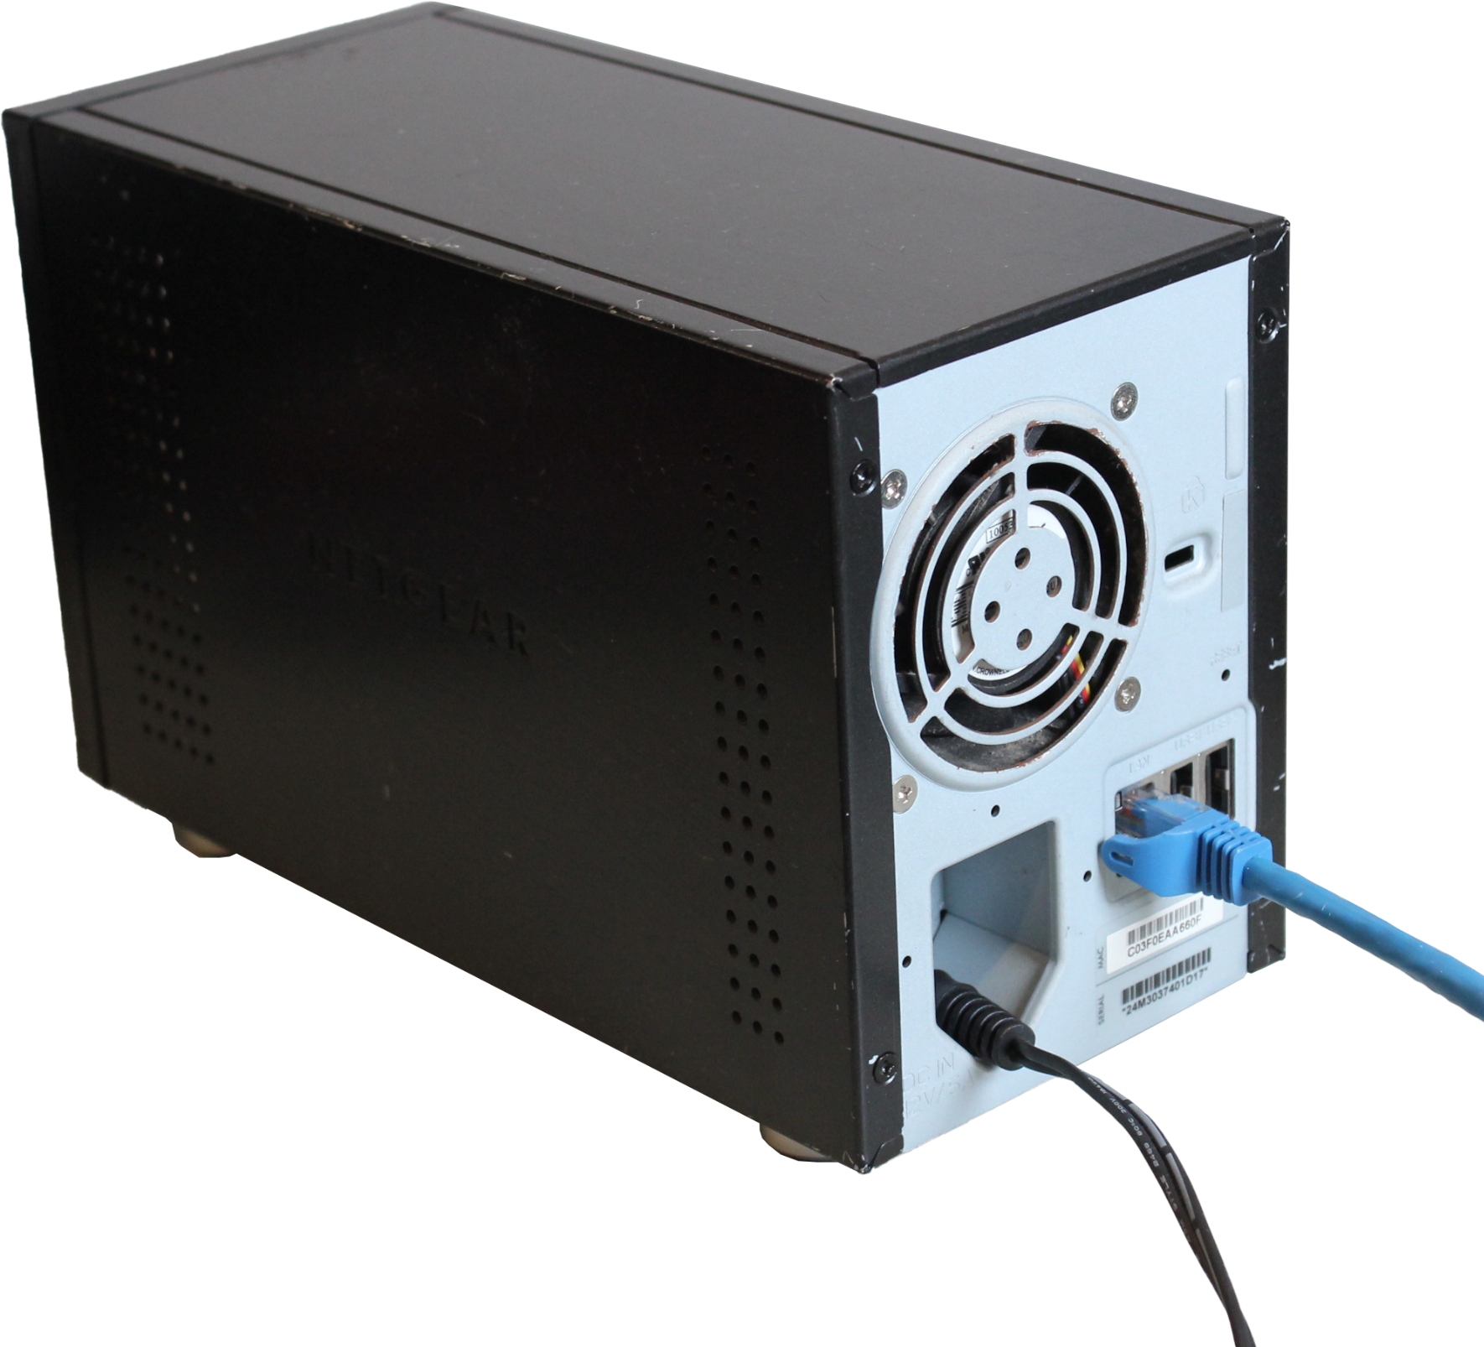
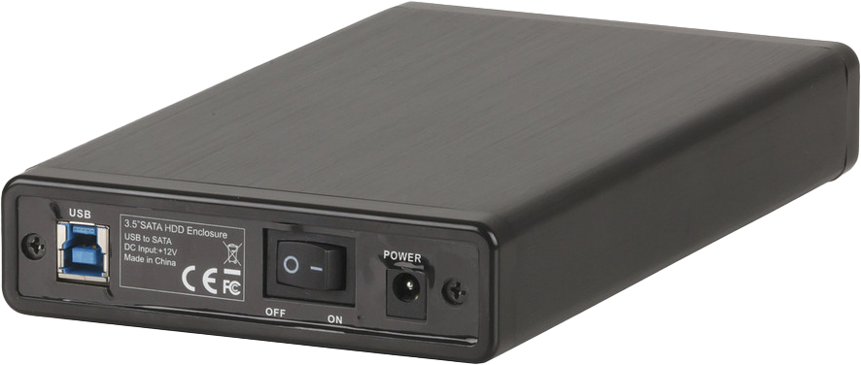
External Storage
Extra
Storage
Increases total data capacity
Used for backups
Portable: Easy to move around
Requires data/power plugs
One plug only
Network
ITFreeTraining.com
© Copyright 2024
Notes:
02:05 One of the common reasons to use external storage is to increase the data capacity of a computer. For example, if you have a lot of video files, a common method of storing these would be to use external storage. You could of course install an extra storage device inside the computer, however, in some cases it is easier just to plug in an external storage device. This is also an option if the computer does not support any additional internal storage devices.
The next common use is for backups. External storage devices don’t cost that much nowadays. Purchasing one is an easy way to back up your data. You can use the backup software that comes with the operating system or simply copy the files you don’t want to use onto the storage device.
External storage is useful in that it is very portable. This makes it easy to transport the storage between different computers. This also makes it useful for transferring data between computers.
What kind of external storage you purchase will determine how you will connect it to your computer. Some are essentially enclosures and will require power in order to operate. This makes them a little harder to use since you have to plug the power cable in as well as the data cable.
Other external storage will get their power from the computer, thus only needing the one plug. This makes them easier to use and you will generally find that these storage devices are becoming more popular on the market.
The other method is that external storage is connected to the network. These devices have the advantage that multiple people can access the same data. In some cases, small offices may use these devices to store files rather than purchasing a dedicated server.
To start with, let’s have a look at USB external devices.

Slide 4
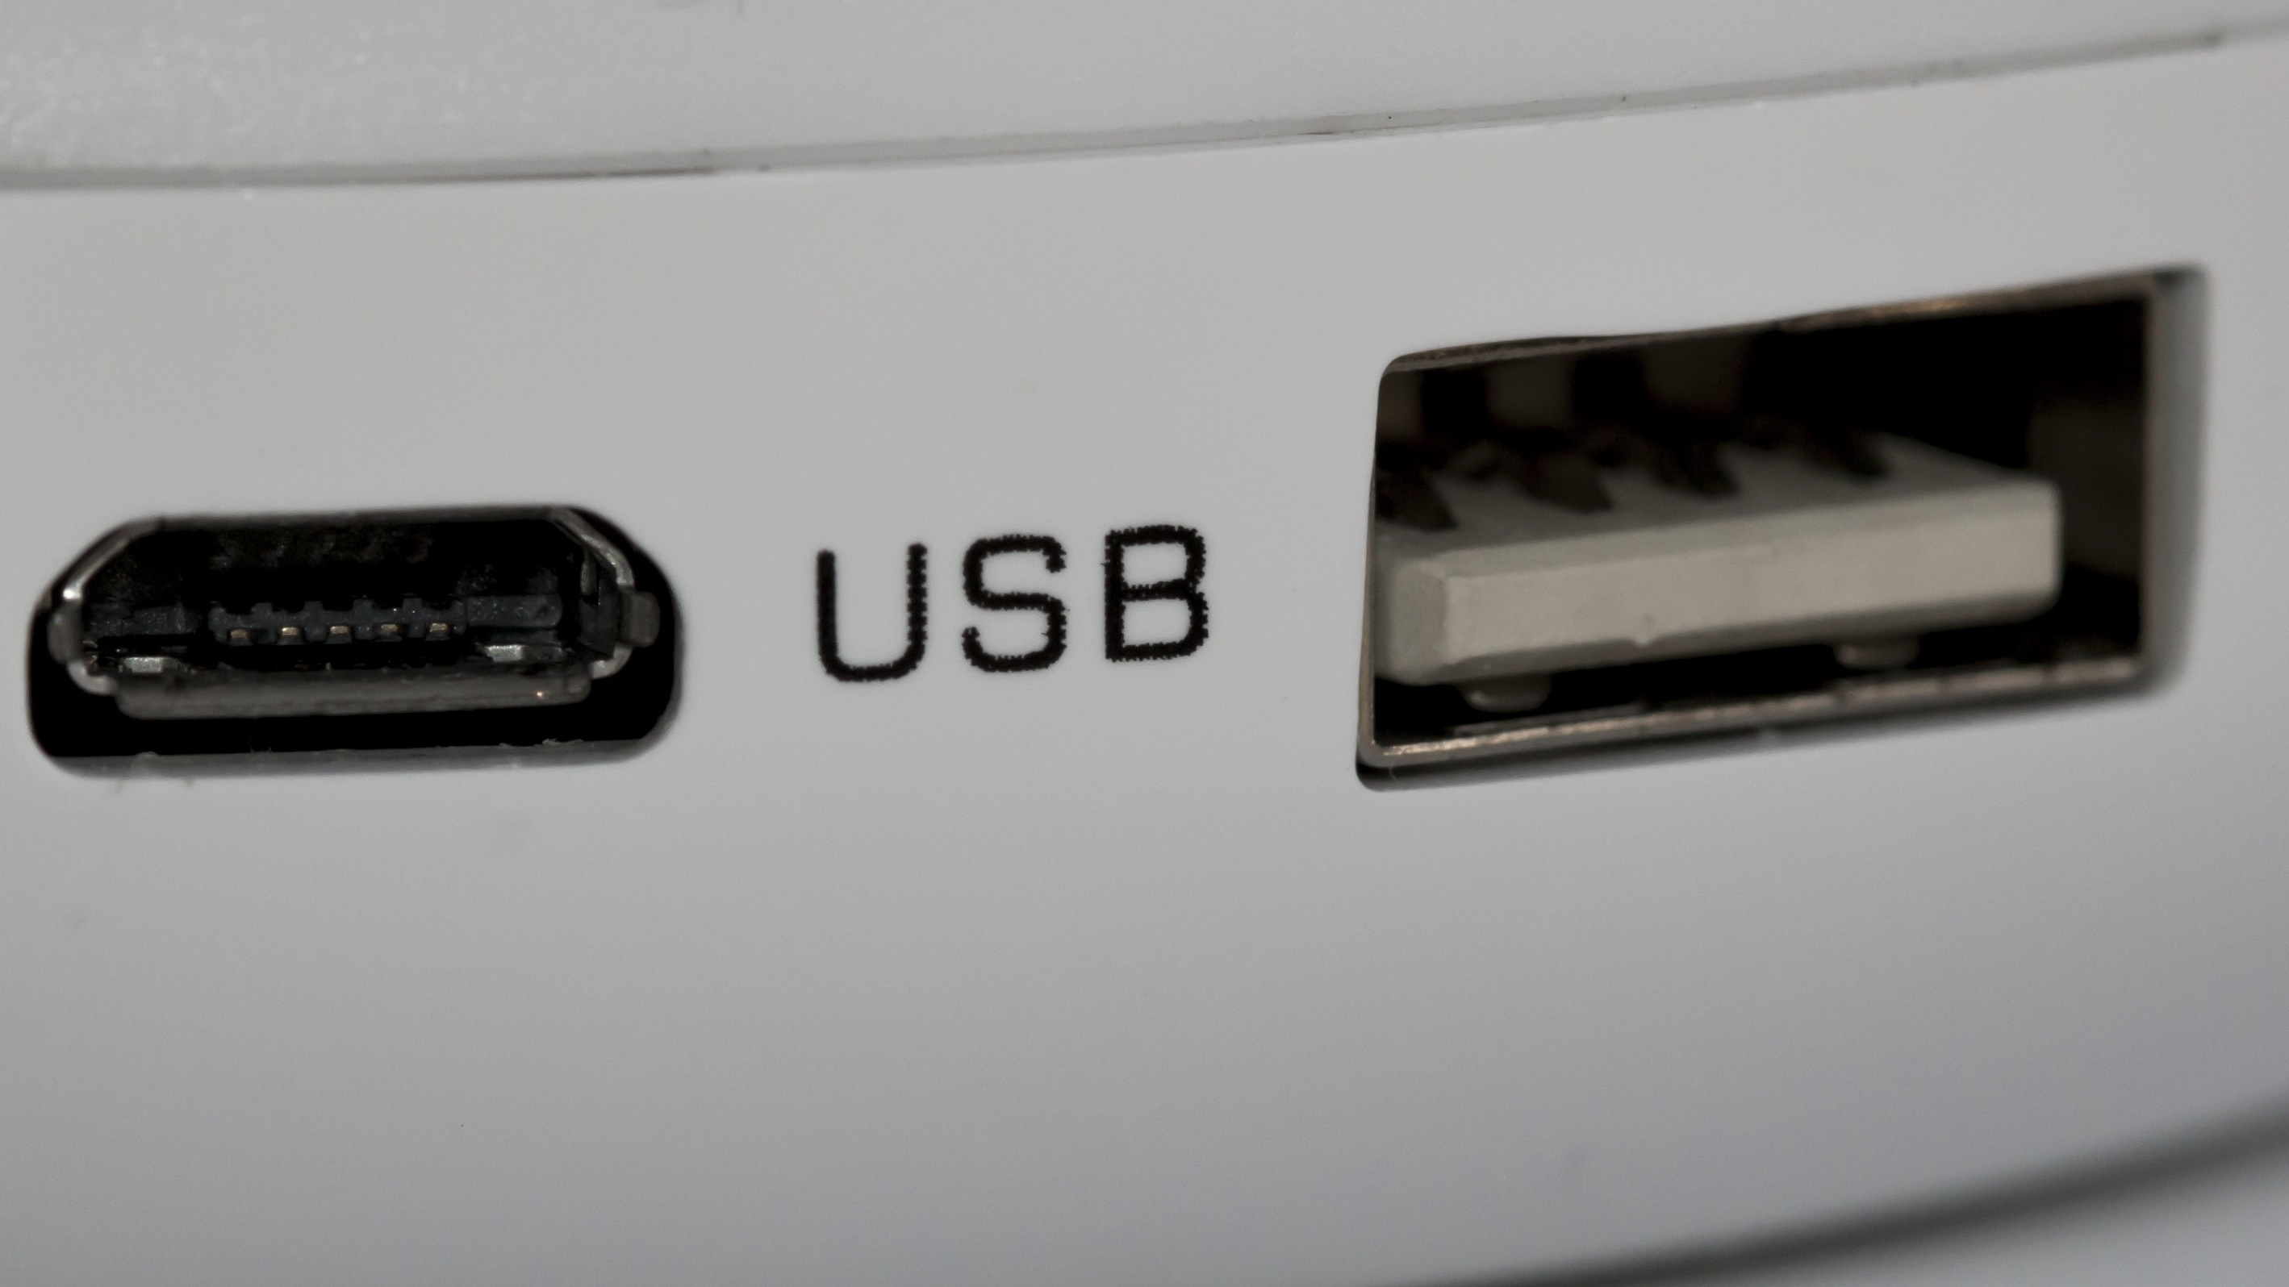
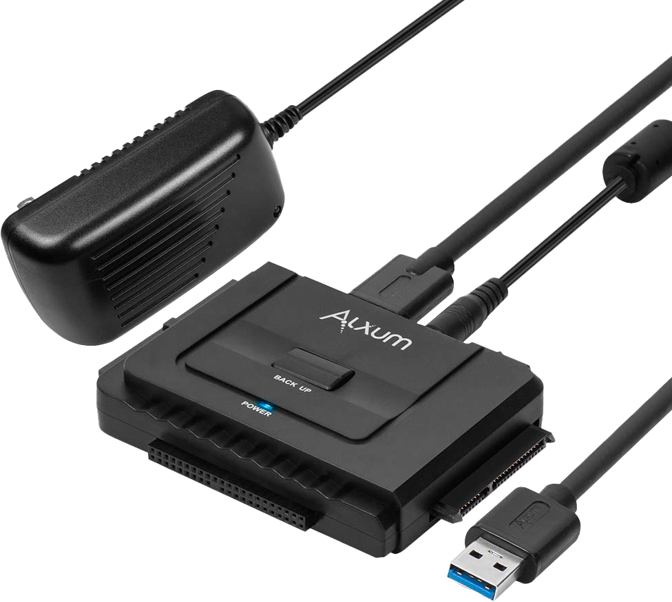
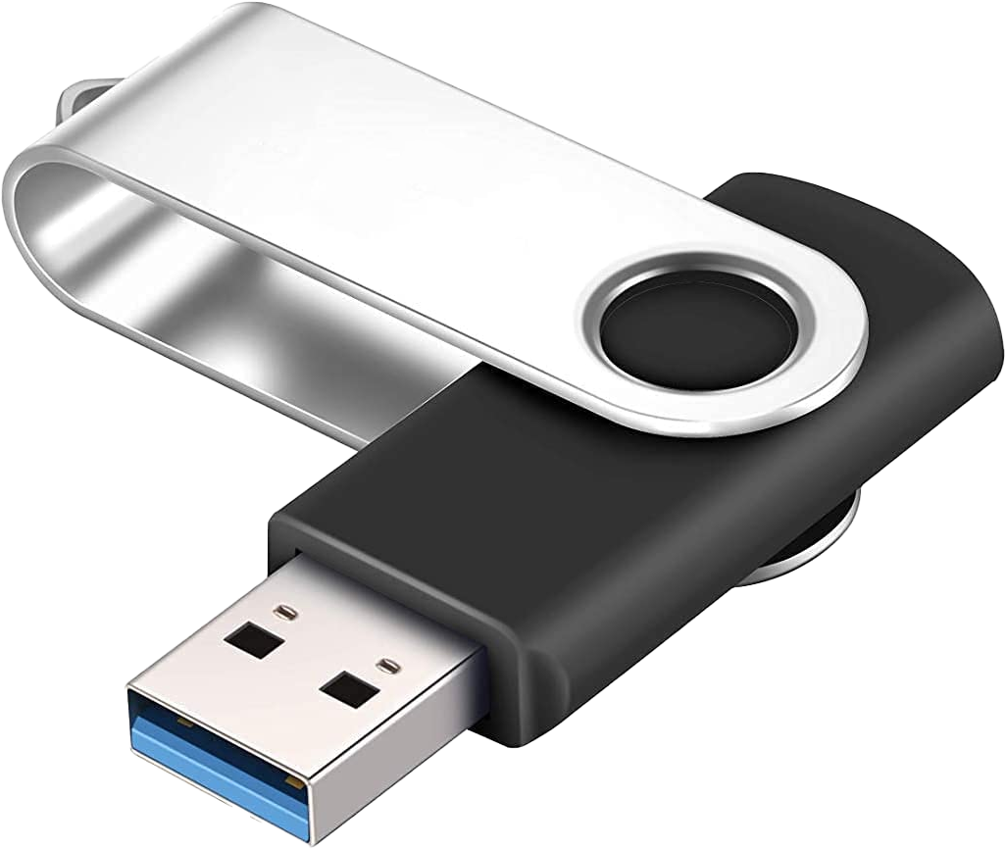
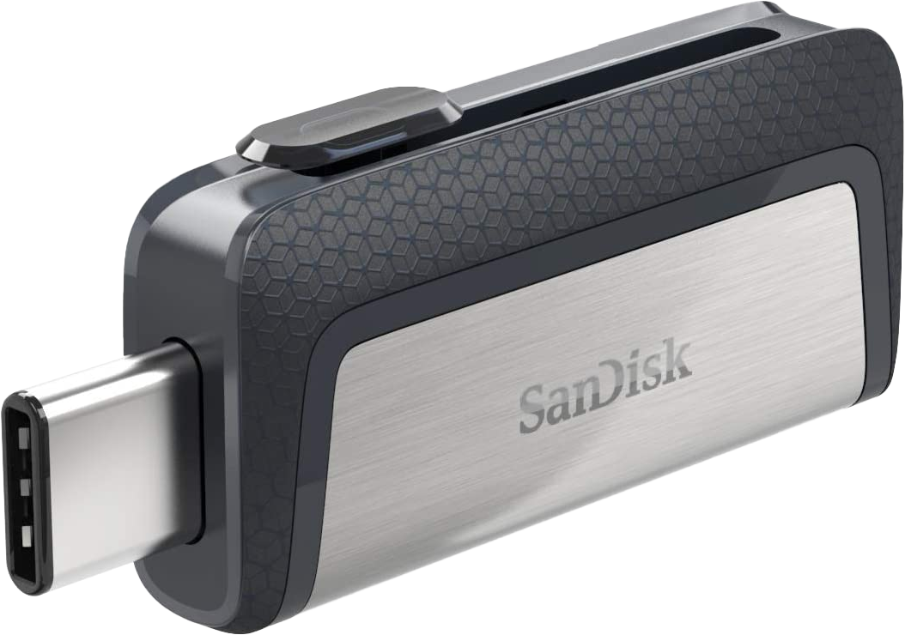
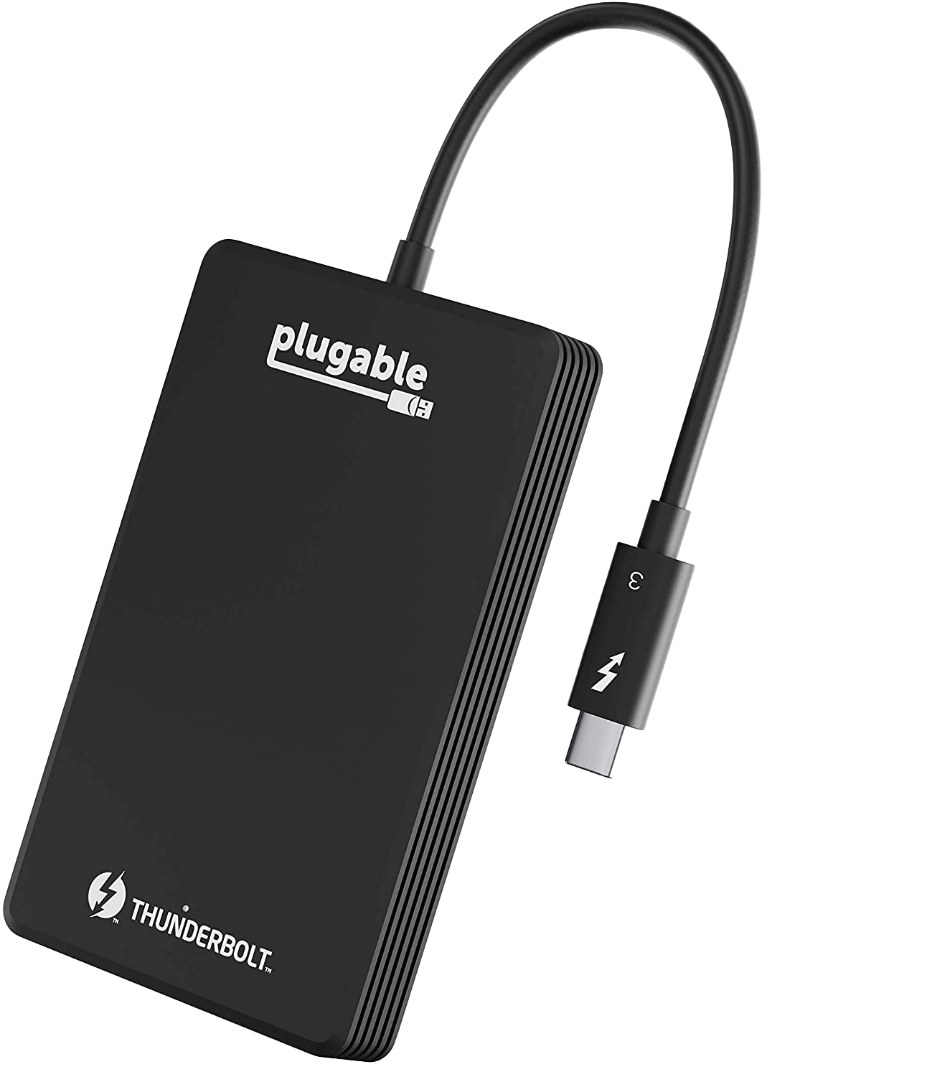
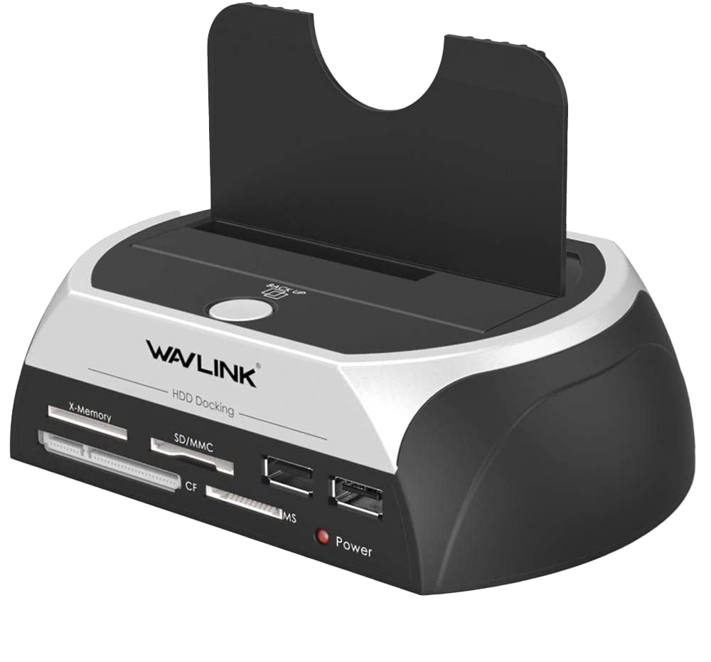
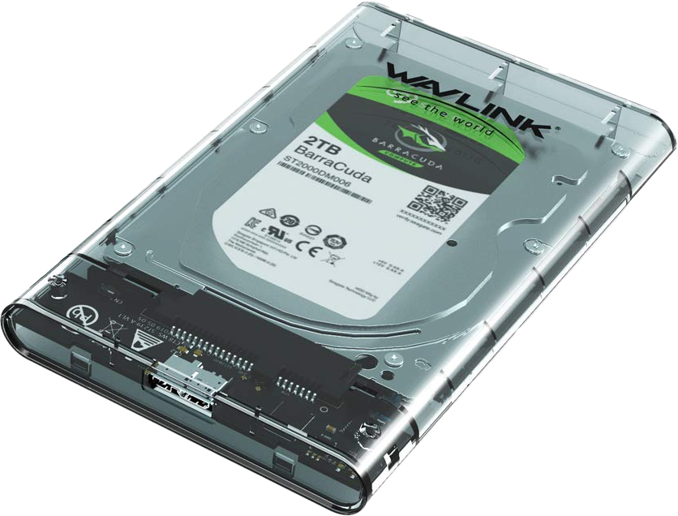
USB Storage
Type-A connector
Type-C connector
USB Hard Disk
USB Adapter
Docking Station
USB enclosure
USB/Thunderbolt Solid-State
ITFreeTraining.com
© Copyright 2024
Notes:
03:49 USB external storage comes in many different types. In some cases, the USB will provide the interface and you will need to add your own storage. One of the common USB storage devices you will come across is a USB thumb drive with a USB A connector. These are small and easy to transport. The capacity of thumb drives has increased and capacities of one Terabyte are now available; however, for a capacity this size it is going to cost a lot.
USB thumb drives have been using the Type-A connector for the last 20 years, but recently some have started using the Type-C connector. The Type-A connector is still very popular since it is the dominant connector used in computers. The Type-C connector is used in some computers, but is not that popular yet. The main use of the USB thumb drive with a Type-C connector is to plug it into a smart device like a phone. You can always get adapters to convert Type-A to Type-C or vice versa. In some cases, the USB thumb drive may come with both Type-A and Type-C connectors.
Since USB thumb drive storage uses flash memory, it costs more than other storage devices. Thus, in order to get more but cheaper storage, a hard disk may be used. These devices, instead of using flash memory, use a hard disk. The hard disk is accessed by using a USB. In many cases, the hard disk can be removed from the enclosure, some being harder to remove than others. For example, in some, it may be as simple as removing a few screws, while in others you may need to remove glue or break open the plastic case to get access to the hard disk.
If you wish, you can purchase a hard disk and purchase an adapter. The hard disk will plug into the adapter. The adapter will have a USB plug that will plug into the computer. The adapters can be a little tricky to use. In order to make it easier to use, docking stations are available. Using a docking station like this one, the storage device is plugged directly into the docking station. It is essentially the same as the adapter, although a little easier to use.
An alternative to this is to buy a USB enclosure. These are essentially an enclosure where you can add a storage device like a hard disk. Depending on the enclosure, it may have screws that need to be removed in order to install the hard disk, or in other enclosures the case may pop open without the need for screws.
There is also other USB storage that uses Solid-State for the storage. These storage devices will operate faster than hard disks, however, will cost more for the same amount of storage. In the case of this example, this storage device also supports Thunderbolt. Generally, Thunderbolt is compatible with USB, but it is always best to check. Let’s have a close look at some of the connection types you are likely to use to connect to external storage.

Slide 5
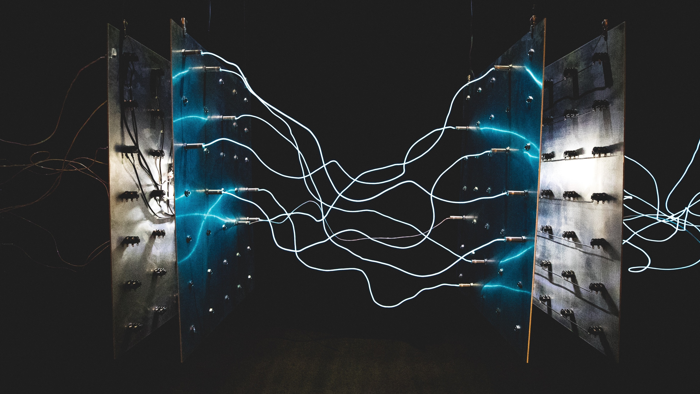
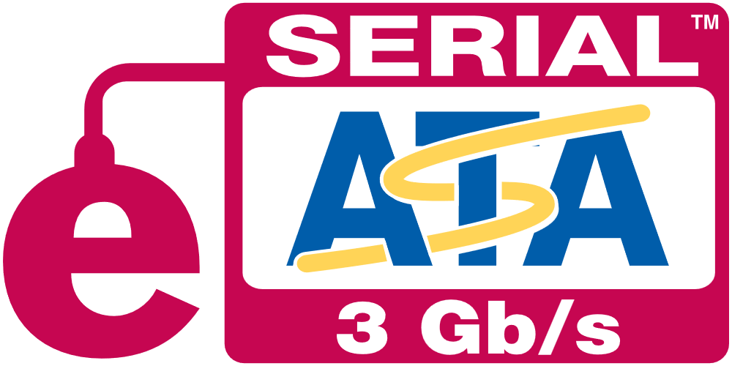
Connection
Needs be same or higher max speed to device
Extra speed can be used for burst mode
2
3
3.1
3.2
4
Signaling: 480 Mbit/s
Data: 53 MByte/s
5 Gbit/s
500 MByte/s
10 Gbit/s
1.2 GB/s
20 Gbit/s
2.5 GB/s
40 Gbit/s
5 GB/s
1
2
3
4
Signaling: 2x 10 Gbit/s channels
Data: 2.5 GByte/s
20 Gbit/s
2.5 GB/s
40 Gbit/s
5 GB/s
40 Gbit/s
5 GB/s
6 Gbit/s
600 MB/s
ITFreeTraining.com
© Copyright 2024
Notes:
06:45 When connecting your external storage, one of the things to consider is what type of connection you are going to use to connect to the computer. The connection that you use needs to be the same or have a higher maximum speed than the device you are using. If you use a lower speed, the device will still work, however the transfer will be capped to the lower speed.
If the device is not able to transfer data at the maximum speed, which generally devices won’t be able to do, the extra speed can be used for burst mode. This mode utilizes a buffer to hold data, allowing the device to transfer data faster than the physical working speed of the storage. This will give you an initial extra burst of speed, but this extra burst of speed is short-lived.
Shown here are the different speeds for different types of connections. When purchasing storage, you need to ensure the storage device can meet your requirements. That means that the storage device needs to be able to transfer data to and from the storage device at the speed that you require. Thus, the connection you use needs to meet these requirements.
As the version numbers of USB and Thunderbolt go up, the speed increases. You will notice that Thunderbolt 4 and USB 4 are the same speed. This is because Thunderbolt 4 uses the same underlying protocol as USB 4. Thunderbolt supports a few additional features over USB 4, for example, support for multiple monitors.
Nowadays, most devices on the market are at least USB 3. You will however find some cheap USB thumb drives that are still USB 2. If you only need the storage to copy a few small files from one computer to another, USB 2 should meet your needs. If you have large files or a lot of data, you probably want to be looking at USB 3 or above.
There is also eSATA; however, most people nowadays will use a USB connection. If they have a SATA hard disk, often they will use a USB adapter or docking station rather than using an eSATA connection. eSATA was quite good before USB 3 became more commonplace, but nowadays you don’t really see it used anymore.
USB has a lot of market share, so I will have a closer look at how it works.

Slide 6
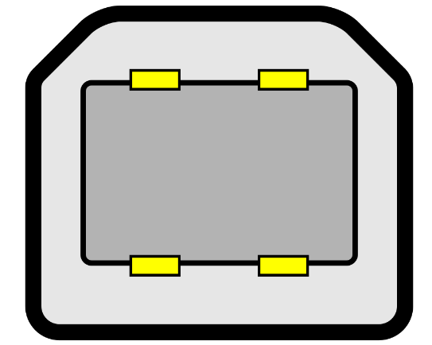
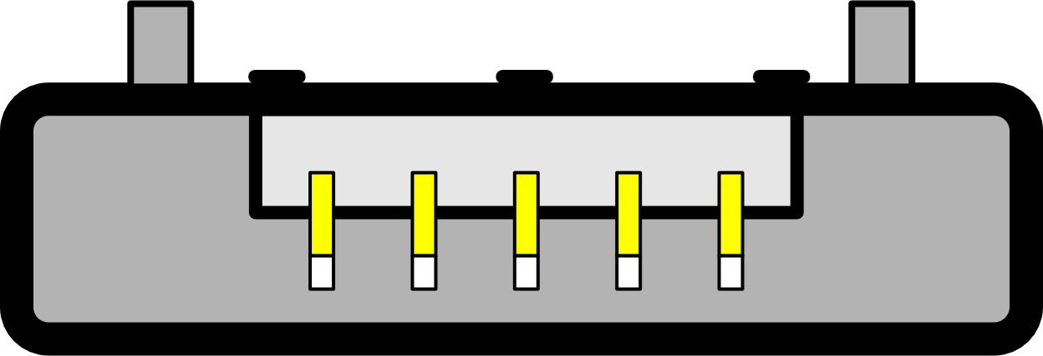
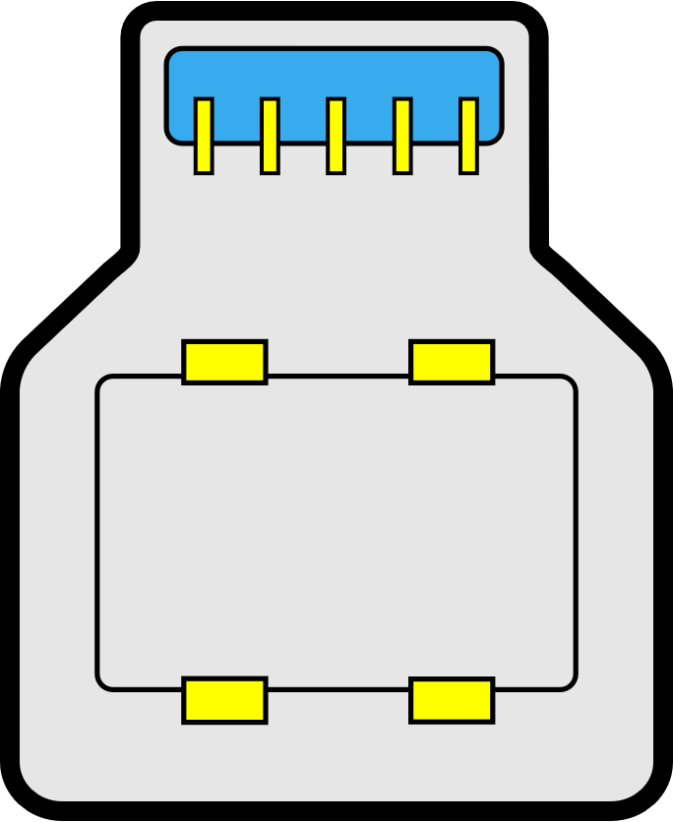
USB Connections
USB 2 and USB 3 run over separate wires
Using wrong connection speed will drop to USB 2
USB 2 connections
USB 3 connections
Type-C connection
USB 3 wires
ITFreeTraining.com
© Copyright 2024
Notes:
09:05 USB 3 uses very different signaling to previous versions of USB. In order for both signals to run over the same cable, USB 2 and USB 3 run over separate wires. This means, if you use the wrong connection, the speed will drop from USB 3 to USB 2.
To understand this better, let’s consider what a USB 2 connection looks like. Here you can see the yellow pins carry the USB 2 signal. The USB 3 connections are similar and, in some cases, will plug into a USB 2 connection. When this occurs, only the USB 2 wires will be used and thus the connection can only use USB 2 speed.
Since USB 3, in some cases, can be used interchangeably, most USB connections when they support USB 3 are light blue in color so you can tell them apart. There is no official standard, but that is the convention that manufacturers generally follow.
I will now have a look at the USB 3 connections. To make it simple in this example, I have colored the areas where there are USB 3 wires in blue. Normally, a USB cable that supports USB 3 inside of the connector will be all blue.
You will see in each connector, the USB 3 pins are simply added to the connector. In the case of the first connector, it is the same size as the USB 2 connector. For the other two connectors, the connector is bigger than the USB 2 connector.
When using USB 3, you need to ensure that both ends are USB 3 connectors. If one side is USB 2, only USB 2 speed will be used. If both sides are USB 3, both USB 2 and USB 3 will be available.
In the case of the Type-C connector, the same applies. USB 2 wires are in the center. The other wires are USB 3 and some are shared between USB 2 and USB 3, so they are in a different color. If you have high-performance storage devices and it is running very slow, check the cabling, as you may be using a USB 2 cable and thus the reason why you are getting poor performance. I will now have a closer look at performance.

Slide 7
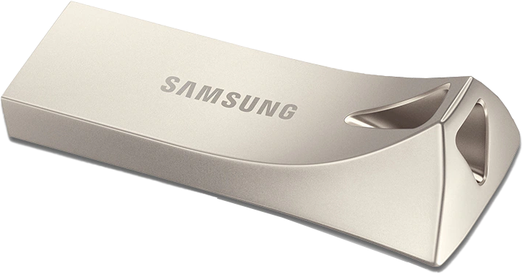
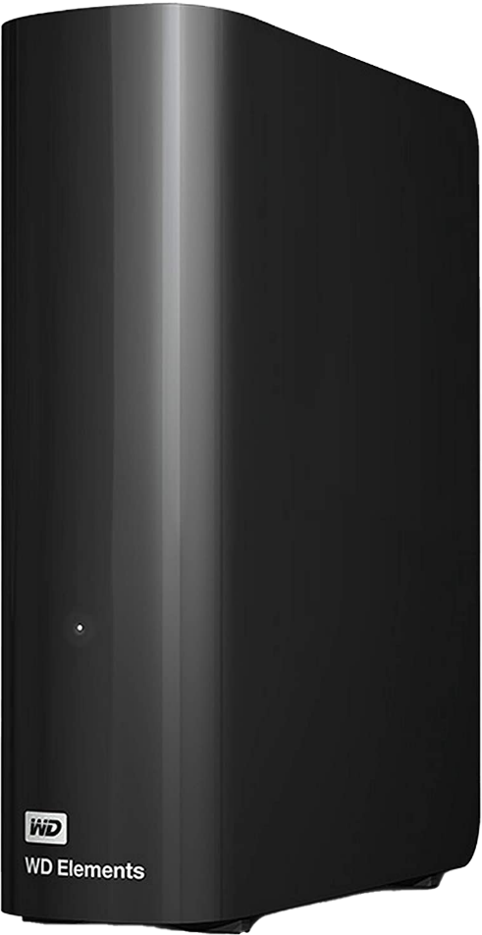
Performance
You get what you pay for
Some devices may only include read speeds
Low-cost devices may not have performance stats
ITFreeTraining.com
© Copyright 2024
Notes:
11:22 With storage devices, generally you get what you pay for. Some storage devices may only include read speeds, and low-cost devices may not have any performance statistics. For example, a low cost USB thumb drive may only include the read speeds if it includes any statistics. If it does include the read speeds, it would be rare to find the write speeds.
If you are looking at a storage device that contains a hard disk, generally it will include the read and writes speeds. High-performance devices like Solid-State Drives will include read and write statistics. Although this particular Solid-State Drive is not an external storage device, it can be used as one by using an enclosure or an adapter. You may find that when you purchase an external storage device it may include an internal storge connection. Essentially, it is an internal storage device with an external interface. I will now have a look at some storage devices to get a better understanding of how to use them.

Slide 8
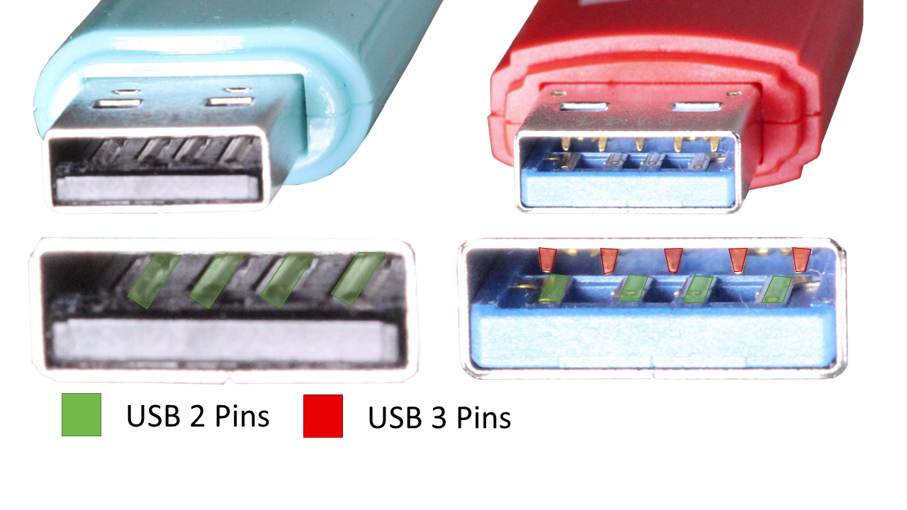
Demonstration
ITFreeTraining.com
© Copyright 2022
Notes:
12:24 I have a USB 2 and USB 3 thumb drives, both 16 Gigabytes in size. I will turn the USB thumb drives around. When I do this, you will notice that the USB 3 thumb drive has a blue connector. USB 2 connections can have different colors, but generally they don’t use blue. Although this is now a pretty strong convention that USB 3 uses blue, it is possible for the manufacturer to use a different color. For example, a fake USB thumb drive attempting to look like a USB 3 drive when it is in fact USB 2.
I will take a closer look at the connection of the thumb drives. It is difficult to spot, but you can see that the USB 2 thumb drive has four pins. The same four pins are on the USB 3 thumb drive. The difference is that the USB 3 thumb drive has five additional pins at the top of the connection. These extra pins are used by USB 3. Thus, one way to tell if a thumb drive supports USB 3 or not is to look for these extra pins, even though they are difficult to see.
To use the USB thumb drives, it is a simple matter of plugging them in. In the case of the USB 2 thumb drive the connector looks like USB 2, so I will plug it into a USB 2 plug. In most cases, you can tell the difference between the USB plugs on the computer by their color. USB 2 are generally black and USB 3 are generally blue. This is not always the case and sometimes there may not be color-coded like this. If this is not the case, they will generally have a logo on the port, so you know what it supports.

Slide 9
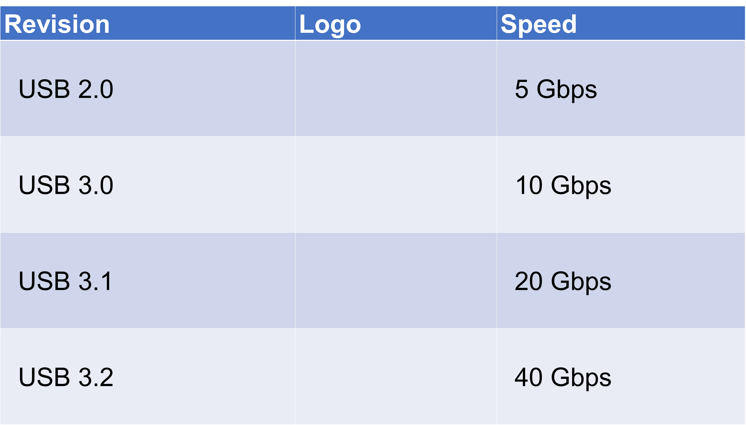
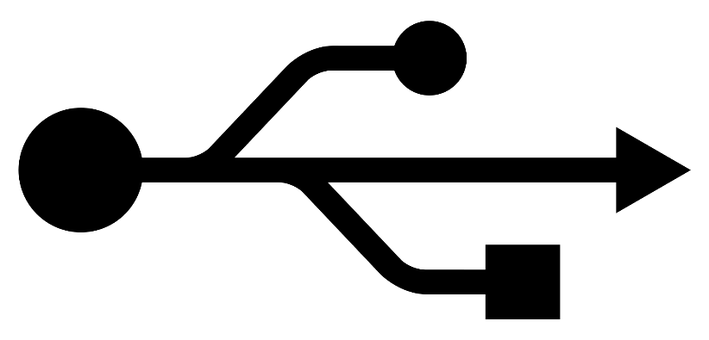
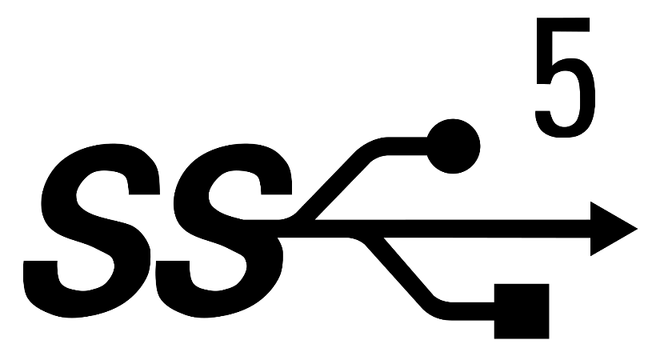
USB Logos
ITFreeTraining.com
© Copyright 2024
Notes:
14:01 You can see here some of the logos you may come across. The standard USB logo is a trident logo. USB 3 has the same logo with SS added – SS for super speed. Also, there may be a number next to the logo. This number indicates the speed of the connection. If the ports are not color-coded, have a look to see if you can see this logo.

Slide 10
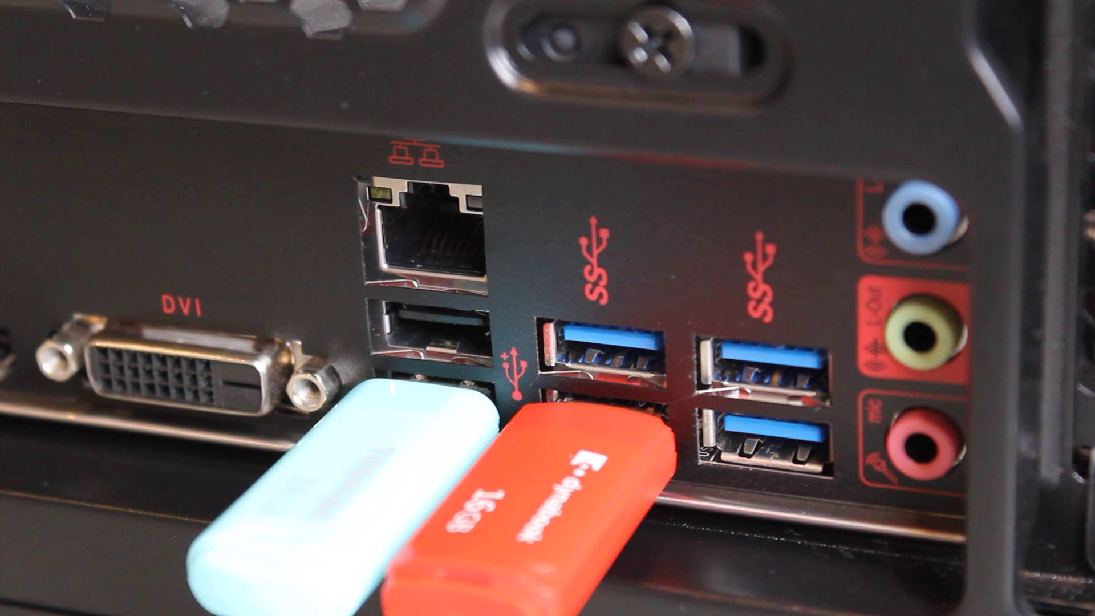
Demonstration
ITFreeTraining.com
© Copyright 2024
Notes:
14:25 I will next plug in the USB 3 thumb drive. You can see the connector is blue, so I will plug it into a blue plug. If you plug it into the USB 2 port, the USB thumb drive will still work but will only do so at USB 2 speed.
If you need to, you can also plug the USB 2 thumb drive into a USB 3 port. Since USB 3 support USB 2 it will still work, however you will get reduced performance. To understand how your performance may be reduced, I ran some performance tests.

Slide 11
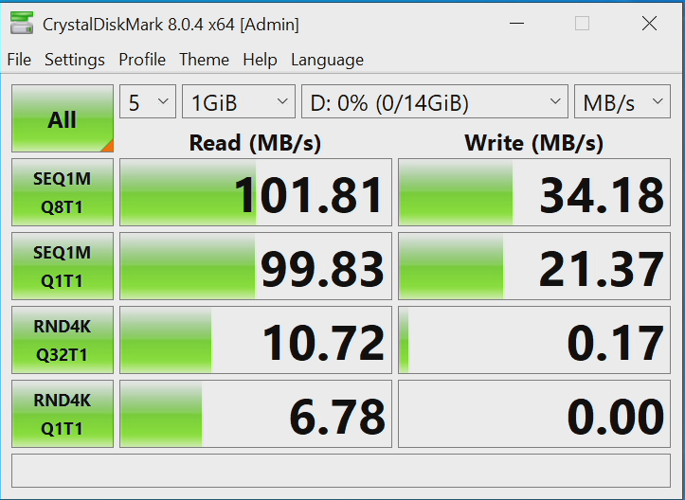
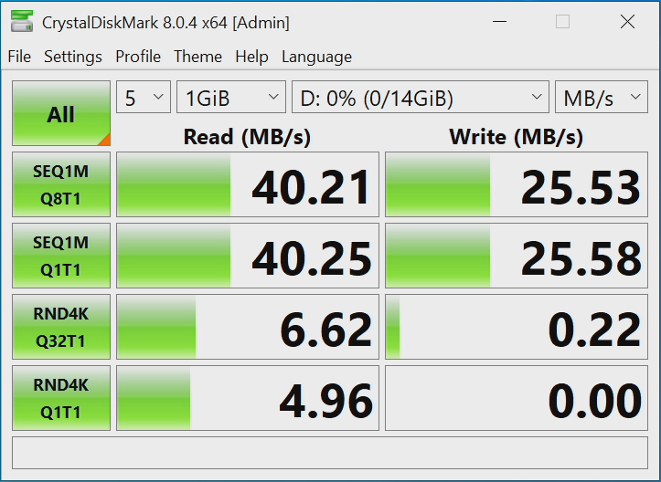
USB 3 Vs USB 2 Performance
USB 3 in USB 3 port
USB 3 in USB 2 port
ITFreeTraining.com
© Copyright 2024
Notes:
14:58 The first test was with the USB 3 thumb drive in a USB 3 port. The next test was with the USB 3 thumb drive in a USB 2 port. You will notice read performance is about half the speed. Write speed is affected, but not as much.
This thumb drive is not a high-performance thumb drive. It was quite cheap and when it comes to thumb drives, you get what you pay for. Write speed will be slower than read speed as it takes longer to write to flash memory than it takes to read from it. If you are only transferring a small amount, you probably won’t notice the speed difference. If you are transferring a lot of data, you will notice the speed difference. Even a small difference such as 30% means you will be waiting 30% longer for your transfers to finish.

Slide 12
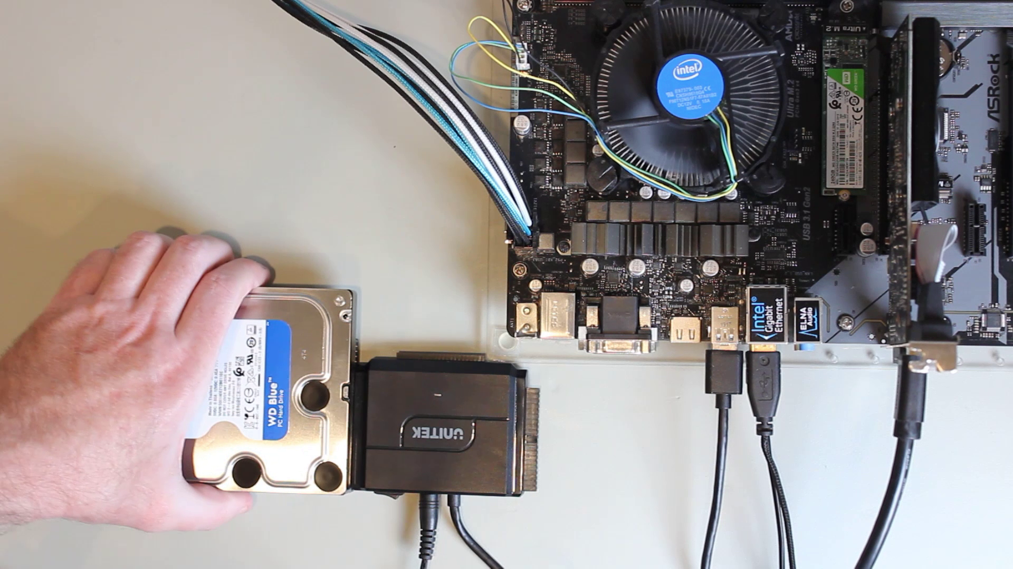
Demonstration
ITFreeTraining.com
© Copyright 2024
Notes:
15:46 I will now have a look at using a USB adapter to connect an external storage device. In this case, the adapter has a SATA connector on one end. You will notice that it has data and power connectors. On the other end of the cable is the USB Type-C connector.
What I will do next is plug a hard disk into the adapter. This won’t actually work, but I am doing it to show a limitation of the adapter. Next, I will plug the Type-C connection into the computer. You will notice that in Windows the hard disk won’t be detected. This is because USB is not able to provide enough power to spin up the motor on this hard disk. If your hard disk requires more power than what USB can provide, so you won’t be able to use this hard disk with this adapter.
You will notice, that when I swap the hard disk for a Solid-State Drive, the Solid-State Drive will be detected by Windows. The Solid-State Drive does not need as much power as a hard disk and thus will work with this adapter.
You will notice, that when I swap the hard disk for a Solid-State Drive, the Solid-State Drive will be detected by Windows. The Solid-State Drive does not need as much power as a hard disk and thus will work with this adapter.
The connector on this adapter is a Type-C connector. If you do not have any Type-C connectors, you can always use an adapter. In the case of this adapter, the Type-C adapter is on one side and the other side is the Type-A connector. The connector is blue which is a good sign it is USB 3. They are hard to see, but you can also see the extra pins inside the connector at the back.
Using this adapter, I can change the connector type, but I won’t lose any speed. If you are using USB 3, you need to make sure that nowhere in the connection path do the extra USB 3 wires get lost. If these wires are not connected through the entire path, your connection will use USB 2.
If you want to use a hard disk as external storage, you need a way of providing extra power to the adapter. To do this, I will unplug this SATA adapter and replace it with a powered SATA adapter. Generally speaking, adapters like this have an external power pack which you need to plug into the adapter.
I will next plug the hard disk into the adapter. Following this, plug the USB 3 cable into the computer. The next step is to switch the adapter on. With the extra power the hard disk will be able to spin up and it will appear in Windows.
Adapters like these are good, but if they are bumped the connection can come loose causing the hard disk to stop working. Considering how easy they are to bump, they are not the best for less tech savvy users.
To make a SATA adapter a bit more resilient to bumps, the hard disk can be placed in a hard disk enclosure. I will remove the SATA adapter and leave the hard disk. I will place the hard disk inside this hard disk enclosure. Essentially, the hard disk enclosure performs the same function as the adapter but having the hard disk in an enclosure means, if the enclosure gets bumped, it is less likely the hard disk will come loose from the connector.
To use this enclosure, I first need to remove the external case. In this example, the external case is held in place with screws. Some hard disk enclosures may be held in with clips to make them easier to remove.
To use the hard disk in the enclosure, I first need to put the hard disk in the enclosure. Once in the enclosure, I need to push it into the connector. Make sure it goes all the way in otherwise the hard disk may not work or will only work intermittently.
Once the hard disk is in the enclosure, the next step is to put the four screws in to hold the hard disk in place. Putting all these screws in will also help keep the hard disk connected to the connector if the hard disk is knocked or bumped. The enclosure won’t protect the hard disk if it experiences too much force, such as being dropped.
Once the screws are in place, I will replace the outer case. The next step is to put the end of the enclosure on. Once done, there are two screws to be put in to hold it in place. These two screws also keep the outer case together. You can see that using an enclosure like this the connection inside is less likely to come loose compared to the adapter I looked at previously.
The next step is to plug external power into the enclosure. Most enclosures like this one will be powered using an external power pack. Next, I need to plug the data cable in.
I have two different data cables. You will notice that the connectors are the same but they are of different colors. They are both USB Type-B connectors and they are both USB 3. The USB 3 wires are at the top and the USB 2 wires are on the bottom. You can see on the right a USB 2 Type-B connector. The USB 2 connector only includes the bottom part and not the top part.
In the vast majority of cases, USB 3 connectors like this one are blue in color. However, it is possible to get an odd cable like this one that is not. Since it includes the USB 3 wires, we know that it supports USB 3. Later in the video I will look at the USB 2 Type-B cable.
Now it is just a matter of plugging one of the cables into the USB enclosure and the other end into the computer. Once done, I will switch the enclosure on. You will notice that the hard disk will be detected in Windows. If you a have a hard disk that you want to move from computer to computer, using an enclosure like this one is a good way to make it safer to move between computers and also makes the process a little easier.
I will next have a look at a USB 2 cable, so I will first unplug the USB 3 cable. The hard disk will work with the USB 2 cable; however, the speed will be limited by the speed of the USB 2 cable. For best performance you need to use the USB 3 cable.
You will notice that the USB 2 connector is smaller than the USB 3 connector. This is because it does not contain the extra wires for USB 3. I will next plug the USB 2 cable into the hard disk enclosure and into the computer.
The hard disk will once again be detected in Windows. Windows won’t give you an indication that USB 2 is being used. Thus, it is important to use the right cable, otherwise the performance of the hard disk may be reduced.
You will notice that the USB 2 plug fits into the USB 3 plug of the hard disk enclosure; however, you will notice that the USB 3 wires are not connected. This allows devices like this to be backwards compatible.
I will now remove the hard disk enclosure and look at a small portable hard disk. These hard disks are designed to require only a single cable in order to operate, thus are easy to use and also portable. This storage device supports USB 3 and uses the micro-B connection.
This is a USB 3 micro Type-B connector. You will notice that the there are two parts to the connector. The left side has the USB 3 wires. The right side has the USB 2 wires. Smaller connectors like these are generally not blue, but you can tell by looking at them that they are USB 3.
I will next plug the USB 3 cable into the hard disk and the other end into the computer. You will notice that the hard disk will be detected in Windows. These hard disks are designed to run off less power and thus USB is able to provide enough power to spin up the hard disk.
I will now unplug the hard disk and try using a USB 2 cable. The USB 2 cable is only the right side of the connector. Thus, the USB 3 cable is half USB 3 and half USB 2, this cable is only the USB 2 part.
Like before, I will plug the USB 2 cable into the hard disk. Again, Windows will detect the hard disk. USB 3 provides more power than USB 2 does. So, if you find that the device works with USB 3 but not with USB 2, it maybe that it requires more power than USB 2 can provide.
When I look at the hard disk, you will notice that only half the connector is being used, the USB 2 half, thus this hard disk will only run at USB 2 speed, and therefore you should always use the USB 3 cable to get the best performance out of the hard disk.
To get an idea of how these enclosures work, I will open it up using my Spudger. A Spudger is a tool made of plastic with an edge like a flat-headed screwdriver. It is designed to separate plastic components without damage or at least minimizing damage. If I were to use a metal screwdriver, there is a higher probability of damaging the plastic case.
Once the plastic case is open, I can next remove the hard disk from it. You will notice in this particular hard disk, there is no adapter inside the case, the USB connection is part of the hard disk’s circuit board.
Some hard disk enclosures, like the one we looked at before, have an adapter inside that allows a standard hard disk to be used. When you have a hard disk enclosure like this and the adapter fails, you can remove the hard disk from the enclosure and access the data using the adapter.
With this particular hard disk, since the adapter is part of the circuit board, you won’t be able to use an adapter to access the data. If the connector on the hard disk is broken, it is not a simple matter to remove the hard disk and plug it in to another enclosure or use an adapter.
I will now remove this hard disk and have a look at a docking station. This docking station allows two different SATA drives to be plugged in at a time and be connected to the computer using USB. There are a lot of different docking stations, some of them also supporting storage such as flash memory by allowing it to be plugged in, as well as the storage devices.
Like the adapter, the docking station needs to be plugged into power in order to operate. The next step is to plug in the data cable. This docking station is very unusual in that it uses two USB Type-A connectors.
Most USB devices will use a Type-A connector to plug into the computer and a Type-B to plug into the storage device. Sometimes you will see a device that uses a Type-A connector on both sides. This is an interesting one because it is supported under the USB 3 standard but not the USB 2 standard. A Type-A to Type-A cable that meets the USB 3 standard should have the power of the USB 2 wires disconnected. This is because, if you connect two hosts together using USB 2, for example one computer to another computer, both will try and send power which can cause problems.
USB 3 by contrast supports Type-A to Type-A cables and thus detects what is on the other end and thus won’t send power in both directions. Personally, whenever possible, I would avoid purchasing devices with a Type-A connection. If you get a customer accidently plugging two USB 2 hosts together it is possible to cause some damage.
I will plug the cable into the docking station and the other end into the computer. Once the data cable has been plugged in, I will next switch on the docking station. The docking station is hot-swappable, so the storage device can be removed at any time.
I can plug a hard disk into the docking station. It is just a matter of plugging the hard disk into the connector and making sure it is a good fit. You will notice that Windows detects the presence of the hard disk.
This docking station has a reset button, so if you are having problems with the hard disk not detecting you can try the reset button. You can also try switching the docking station off and on again to see if that helps.
SATA hard disks, in most cases, work very well with USB connections. If you have a hard disk that is failing and you want to run recovery tools on it and it is not working, I suggest connecting the hard disk directly to the computer. Sometimes, if the hard disk is having problems, a direct connection may work a little bit better than a USB connection.
I will now remove the docking station and have a look at a different enclosure. This enclosure is designed for M.2 Solid-State Drives. It requires a USB Type-C connection in order to operate. With this particular enclosure, there is a clip that allows the outer case to be removed. Some enclosures will use clips like this, while others will have screws to hold the enclosure in place.
You will notice inside the enclosure is the M.2 connector. To install an M.2 Solid-State Drive, it is just a matter of plugging in the M.2 at an angle and pushing it until it clicks in. Many M.2 enclosures will have a screw that needs to be put in place to hold the M.2 down. With this particular M.2 enclosure, as long as the M.2 is 80 millimeters long, it does not require anything to hold it down. This M.2 enclosure was designed to make installing the M.2 as simple and as fast as possible.
Now all I need to do is hold the M.2 down while I slide it back into the outer case. This is unusual for M.2, as a screw is usually required to hold the M.2 in place.
I will now plug the USB cable into the enclosure and the computer, and you will notice that the Solid-State Drive is detected in Windows. That is the last external storage device that I wanted to look at.

Slide 13
Subscribe
Next video
Video content: https://ITFreeTraining.com/ap/3c60
© Copyright 2024
Notes:
29:44 I hope this video has given you a better understanding of what to look for in an external storage device. Until the next video from us, I would like to thank you for watching.
References
“The Official CompTIA A+ Core Study Guide (Exam 220-1001)” Chapter 6 Paragraph 261-266
“USB hardware” https://en.wikipedia.org/wiki/USB_hardware
“Picture: Inside computer” https://unsplash.com/photos/EOAKUQcsFIU
“Picture: USB Hub” https://pixabay.com/photos/usb-hub-memory-stick-computer-4558673/
“Picture: Cat running” https://pixabay.com/photos/bengal-cat-cat-run-race-pet-6307545/
“Picture: Matrix graphic” https://pixabay.com/photos/matrix-earth-global-international-2502954/
“Picture: Matrix code” https://pixabay.com/photos/neourban-laptop-hardware-computer-1808082/
“Picture: USB plugs” https://pixabay.com/photos/usb-outlet-link-informatics-cable-2327518/
“Picture: USB 2 logo” https://upload.wikimedia.org/wikipedia/commons/c/c8/Certified_Hi-Speed_USB.svg
“Picture: USB 3 logo” https://upload.wikimedia.org/wikipedia/commons/a/a7/Certified_SuperSpeed_USB_5_Gbps_Logo.svg
“Picture: USB 4” https://upload.wikimedia.org/wikipedia/commons/6/65/Certified_USB4_40Gbps_Logo.svg
“Picture: eSata logo” https://upload.wikimedia.org/wikipedia/en/0/09/ESATA_Logo.svg
“Picture: Thunderbolt logo” https://upload.wikimedia.org/wikipedia/commons/6/67/Thunderbolt.svg
“Picture: Wiring background” https://unsplash.com/photos/ImcUkZ72oUs
“Picture: Race track” https://unsplash.com/photos/ij5_qCBpIVY
Credits
Trainer: Austin Mason http://ITFreeTraining.com
Voice Talent: HP Lewis http://hplewis.com
Quality Assurance: Brett Batson http://www.pbb-proofreading.uk

