Slide 1
Notes:
To start with, I will have a look at how optical drives work. Inside the optical drive there is a disc mount in the center. This holds the disc in place and also allows it to spin. The next important part is the laser and lens assembly. This holds the laser in place and also allows it to be moved to different parts of the optical discs as required.

Slide 2
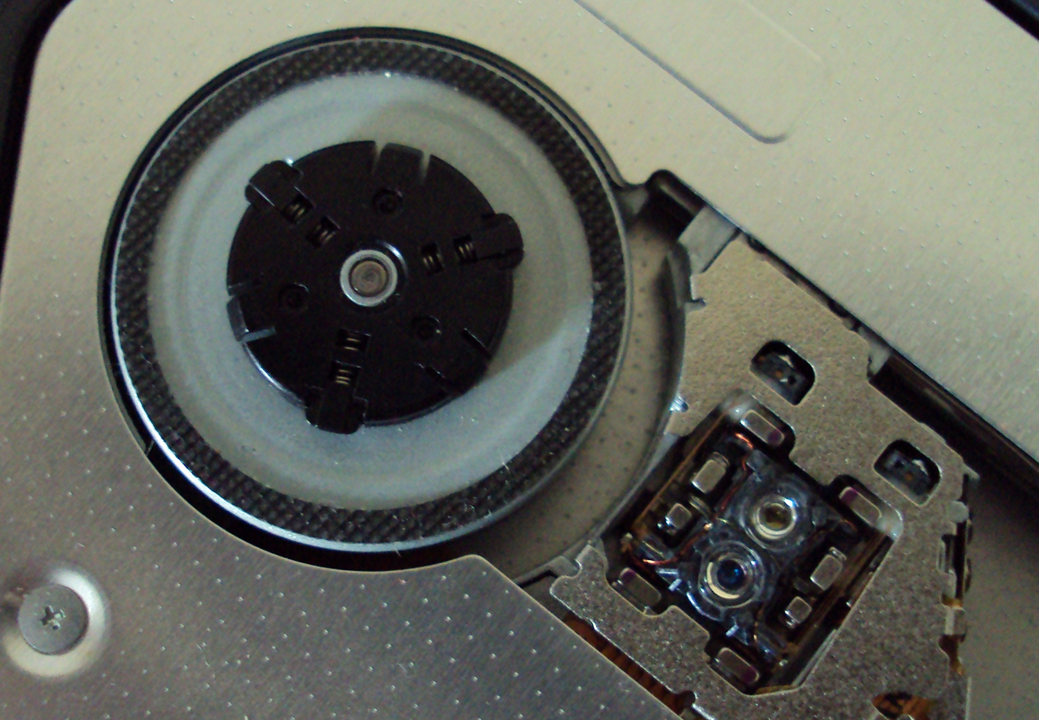
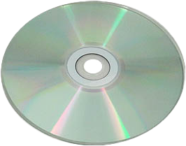
How Optical Drives Work
Laser
Disc mount
Laser used to burn pits
or read existing pits in disc
Laser/lens assembly
Notes:
Let’s have a closer look at how the laser works. Firstly, let’s consider an optical disc. A laser is needed to either read or burn to the optical disc. The laser will need to be focused, thus the assembly contains a lens to do this. All these parts are manufactured inside a housing. Thus, there are no servable parts inside, since the housing is generally incased in plastic, thus you won’t be able to access them.
That is the basics of how an optical drive works, so let’s now have a look at the differences between different optical drives.

Slide 3
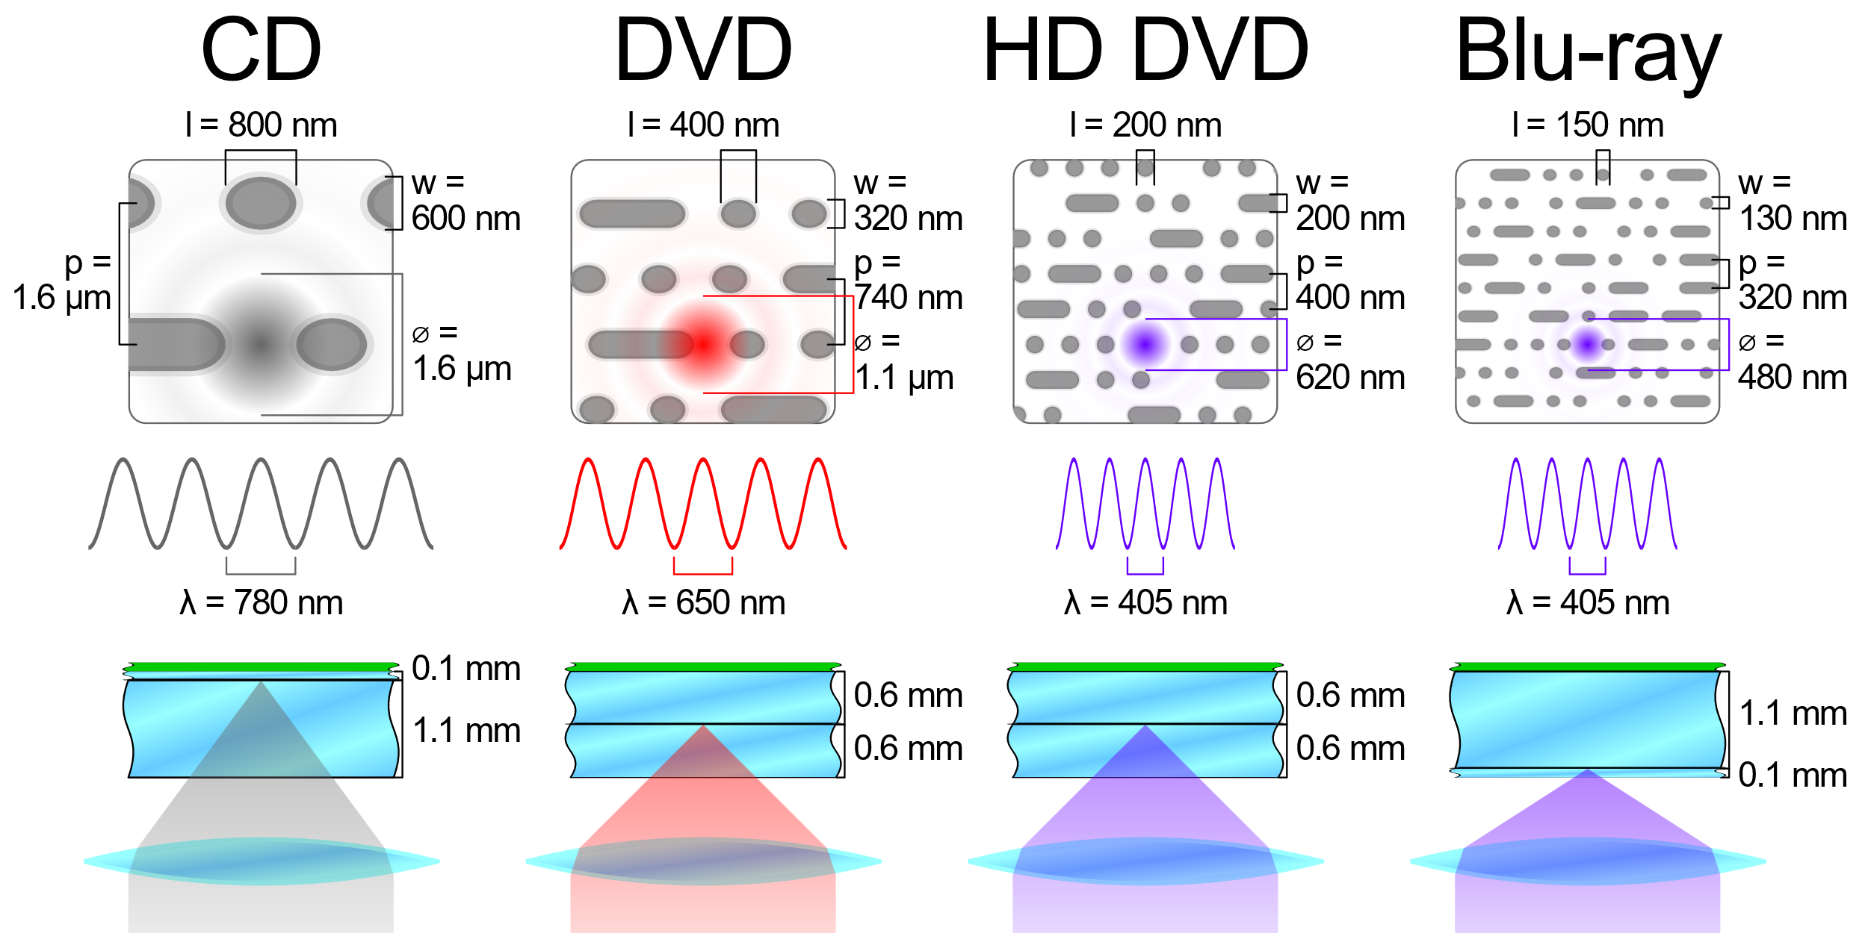
Lasers in Optical Drives
Notes:
Shown here, you can see the differences in the sizes of the pits on the optical disc between different optical technologies. You can see that when you compare CDs with Blu-ray how much smaller the pits on the disc are. Essentially, this is achieved by changing the frequency of the laser. Changing the frequency of the laser also changes the color of the laser, thus you can see where the name blue came from in Blu-ray, since the laser is blue in color.
Now that we have a basic understanding of how optical drives work, let’s have a look at what types are available.

Slide 4
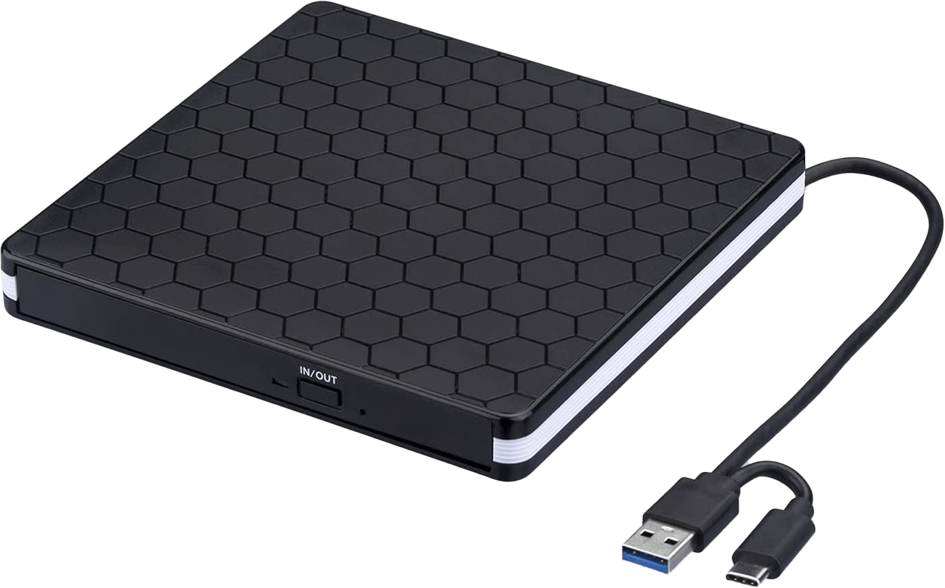
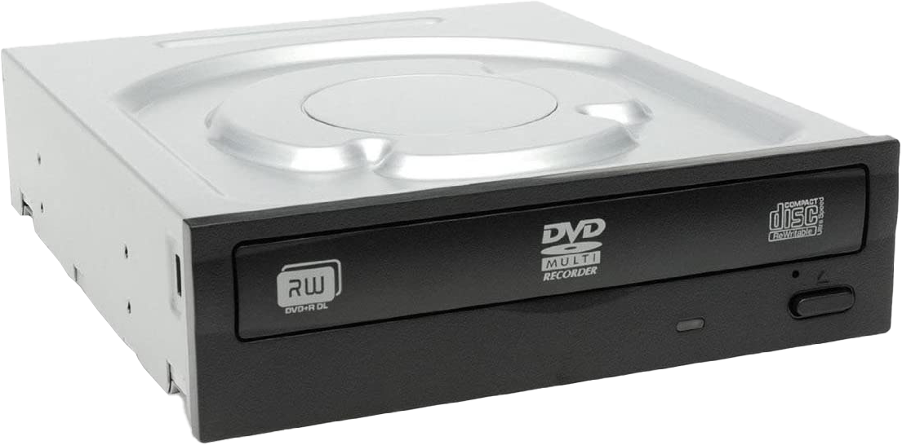
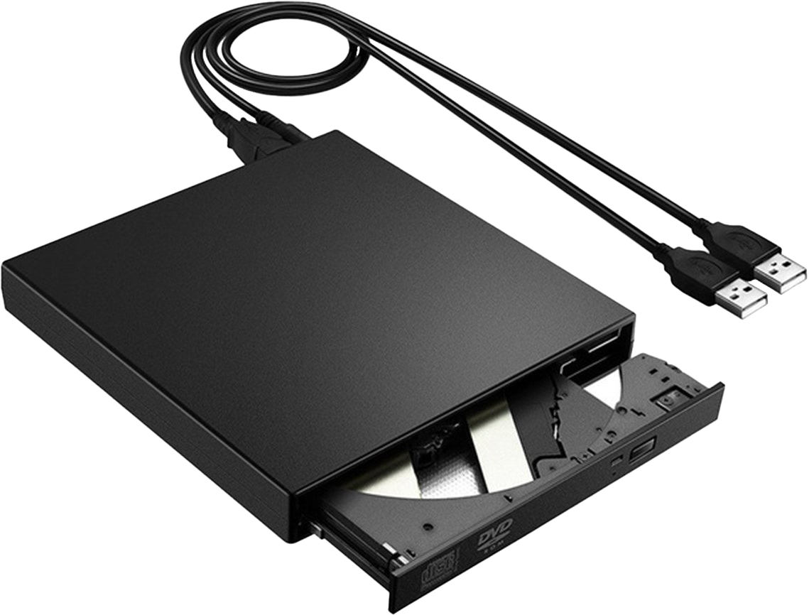
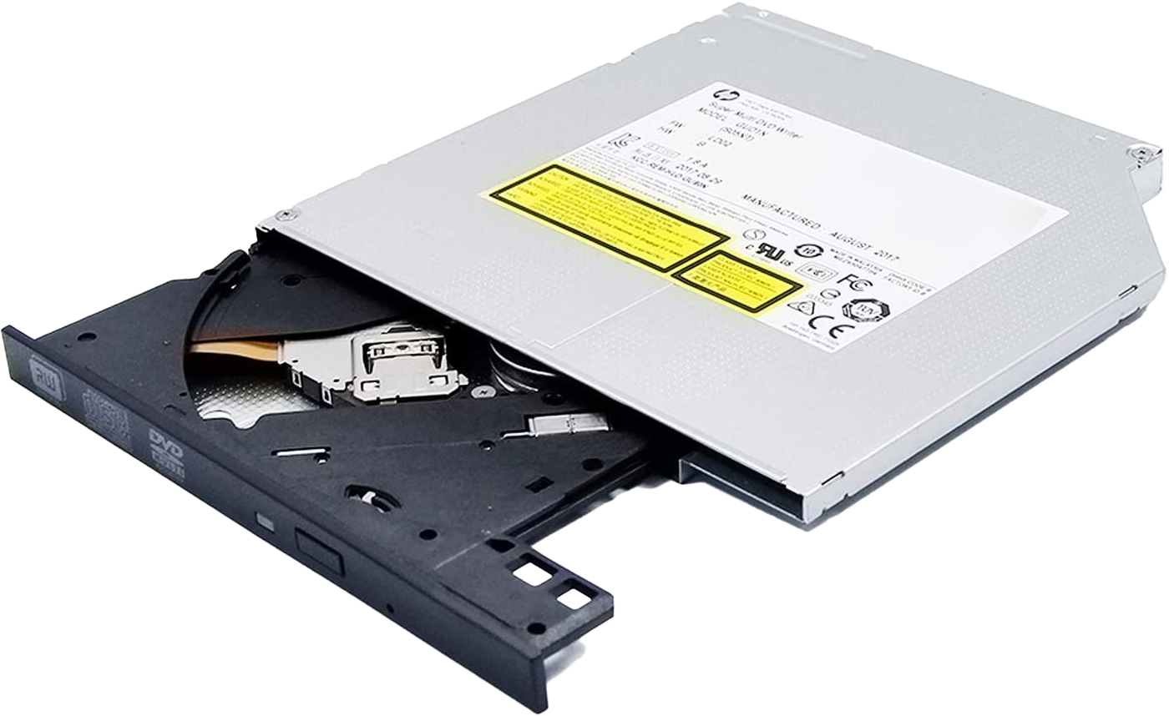
Different Types of Optical Drives
Internal SATA
USB 3
USB 2
Internal Laptop CDROM
Notes:
Although there have been a lot of optical drives made with different features, they tend to look pretty similar. One of the common types of optical drives are the internal SATA drives. These optical drives are installed in desktop computers. They are not designed to be portable.
The next type are portable drives, for example USB. There are also portable drives that support interfaces like Thunderbolt. In this case this optical drive is USB 3. This optical drive has two plugs which are the type A and the type C connector. The second plug in this case is only for convenience as only one is required to operate it. USB 3 provides more power than USB 2, but in the case of this optical drive, only one plug is required even if it is operating with a USB 2 connection.
The next type of portable optical drive that I will look at is USB 2. You will notice, in this case, there are two USB plugs. One is for power and the other one is for data. If you come across an optical drive like this one, in order for it to operate, it needs both USB plugs plugged in. Keep this in mind if you come across an optical drive with two USB plugs, depending on the optical drive, both may be required to be plugged in for the optical drive to operate.
The last type of optical drive that I will look at is an internal laptop optical drive. These optical drives are used in older style laptops. They could be easily installed or removed from the laptop. With the reduced use of optical drives, you don’t see them used in laptops anymore. If an optical drive is required for a laptop, they are generally an external USB or are fixed inside the laptop.
Since optical drives have been around for a long time, the technology has matured so much that if you are purchasing a new optical drive, the only real features that you need to worry about is if it is internal or external and if it supports DVD or Blu-ray. Blu-ray drives are more expensive than DVD drives. If I am purchasing one for home, I will generally purchase a good external Blu-ray drive so I can use it on any computer that I wish. For business, often a DVD drive will be good enough as Blu-ray did not really take off in the business world. To be honest, DVD drives are slowly disappearing from the business world as well.
However, if you are working in IT support and someone requests an optical drive, they all look pretty similar. I will now have a look at what you need to look at when picking an optical drive.

Slide 5
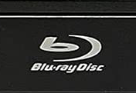
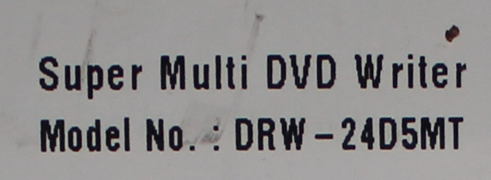
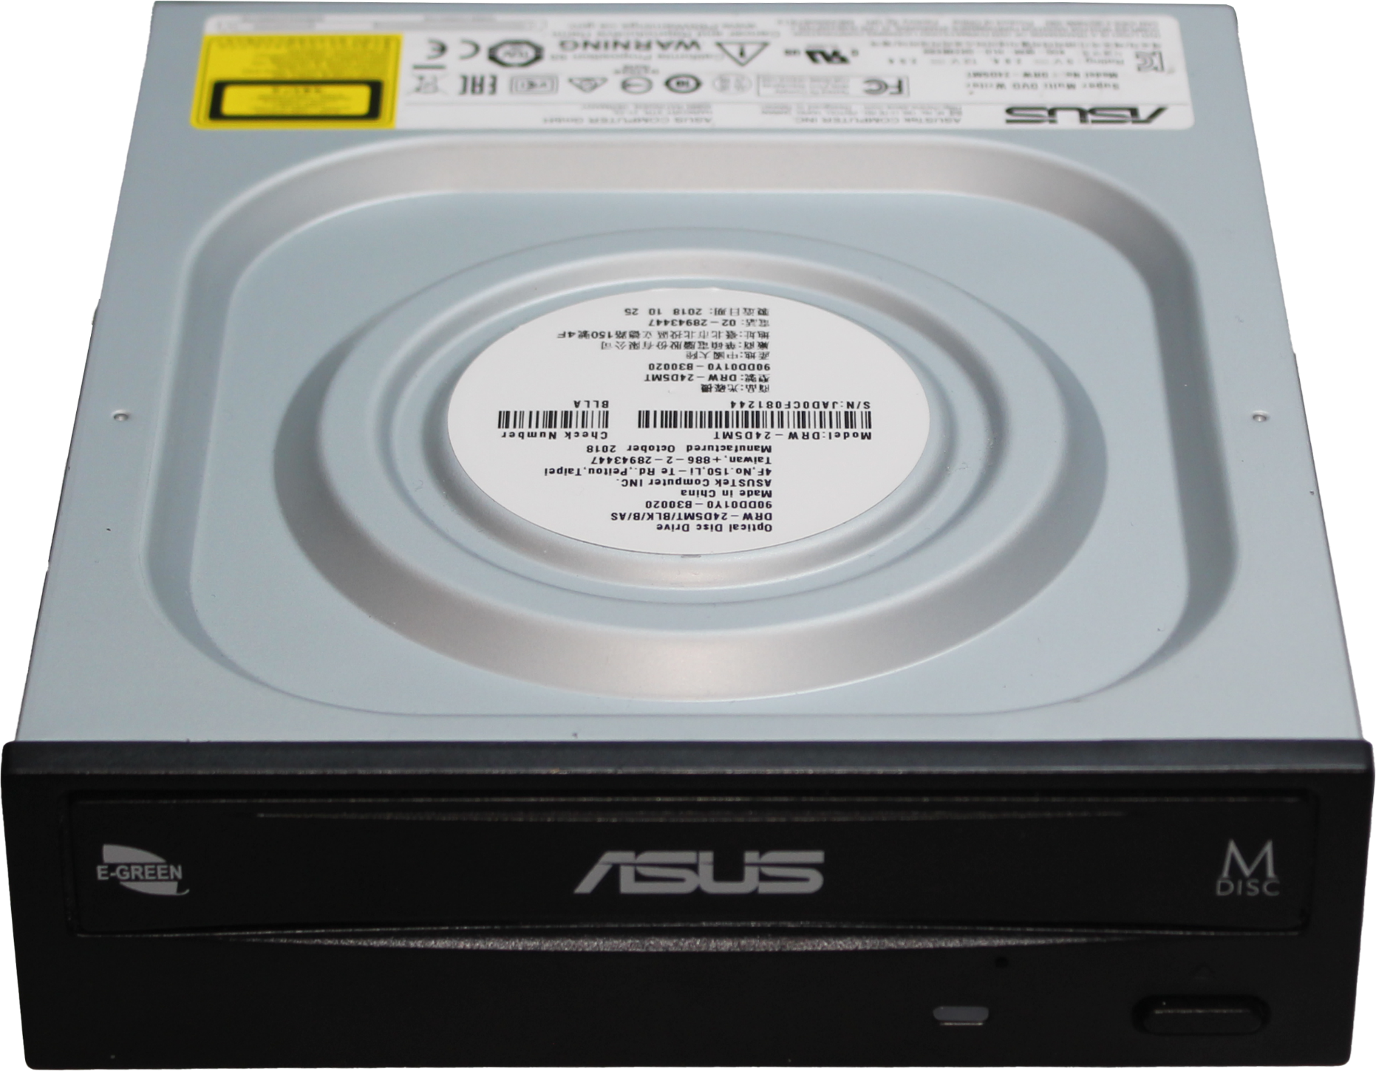
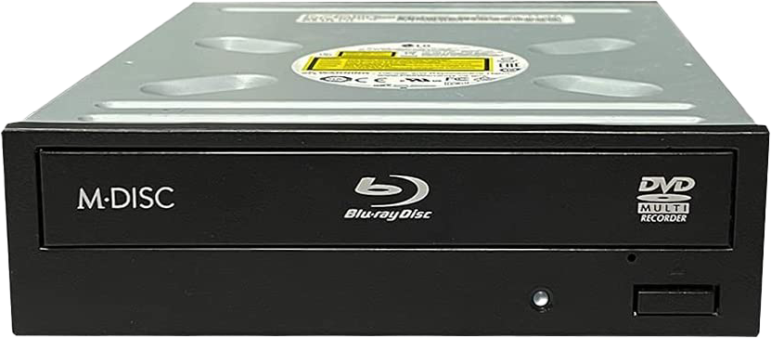
Optical Drive Identification
Notes:
If you pull out an old optical drive, it is not always that easy to tell what the optical drive supports. In some cases, a logo will be on the front of the optical drive indicating what type of optical drive it is. In the case of this optical burner, there is a Blu-ray logo on the front, so it makes it easy to tell. The optical drive will be backwards compatible. That is a Blu-ray will also support DVDs and compact discs. Keep in mind, however, that sometimes an optical drive may not support burning on all media. For example, some Blu-ray optical drives will burn DVDs but not Blu-ray. These are generally called combo drives.
In some cases, it may not be so clear by looking at the optical drive, what it supports as there will be no logos on the front of the drive. When this occurs, you will need to look at the rest of the drive for clues like the stickers on the drive. In the case of this drive, a small part of the stickers says “Super Multi DVD Writer” letting us know that is a DVD optical drive. The word multi, unlike combo, means that the drive supports burning for CD and DVD.
Combo drives, although rarer nowadays then they used to be, are still sold, so keep this in mind when purchasing an optical drive. A combo drive will be able to read newer media and older media but will only be able to write to older media.
That concludes this video on optical drives. I hope you have found this video useful, and I look forward to seeing you in more videos from us. Until the next video from us, I would like to thank you for watching.
References
“The Official CompTIA A+ Core Study Guide (Exam 220-1001)” Chapter 6 Paragraph 231-244
“CompTIA A+ Certification exam guide. Tenth edition” Page 436
“Blu-ray” https://en.wikipedia.org/wiki/Blu-ray
“Picture: Blu-Ray Laser” https://en.wikipedia.org/wiki/File:BluRayLaser.JPG
“Picture: Difference between different optical burners lasers” https://upload.wikimedia.org/wikipedia/commons/a/ad/Comparison_CD_DVD_HDDVD_BD.svg
Credits
Trainer: Austin Mason http://ITFreeTraining.com
Voice Talent: HP Lewis http://hplewis.com
Quality Assurance: Brett Batson http://www.pbb-proofreading.uk

