Slide 1
Notes:
In this video from ITFreeTraining, I will look at Optical Region Coding. This allows optical media to be region locked, meaning that if you purchase an optical disc in a particular region, it will only work in players from that region.

Slide 2
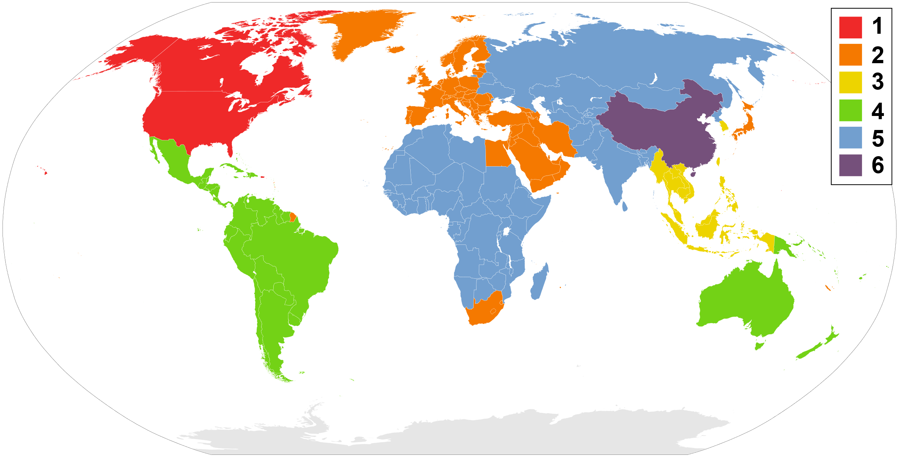
DVD Regions
- Region 7 MPAA-related DVDs and "media copies" of pre-releases in Asia
- Region 8 International venues such as aircraft, cruise ships and spacecraft
ITFreeTraining.com
© Copyright 2023
Notes:
00:16 Before I get started, I would just like to say that it is pretty unlikely that you will get asked a question in the A+ exam about anything in this video. It is, however, covered in the official study guide, so I will go through it.
When you purchase a commercial DVD movie, it is most likely going to be locked to a certain region, although it is possible for it not to be. Shown here is the world divided up into six DVD regions. When you purchase a DVD movie, on the back will be an icon to indicate which region it is for. Some DVDs will not be region locked, and when this occurs, then a logo with the word “all” in it will be shown. It is also possible for multiple regions to be flagged and thus the DVD can be used in those regions.
There are also two other region codes that are supported. Normally, you would not come across them. The first is reserved for media copies and press releases. The second is for international venues like aircraft, cruise ships and maybe one day spacecrafts, since they are not located in one particular region.
There are a lot of different reasons why region locking is used. Before I go into that, I will first have a look at Blu-ray region locking.

Slide 3
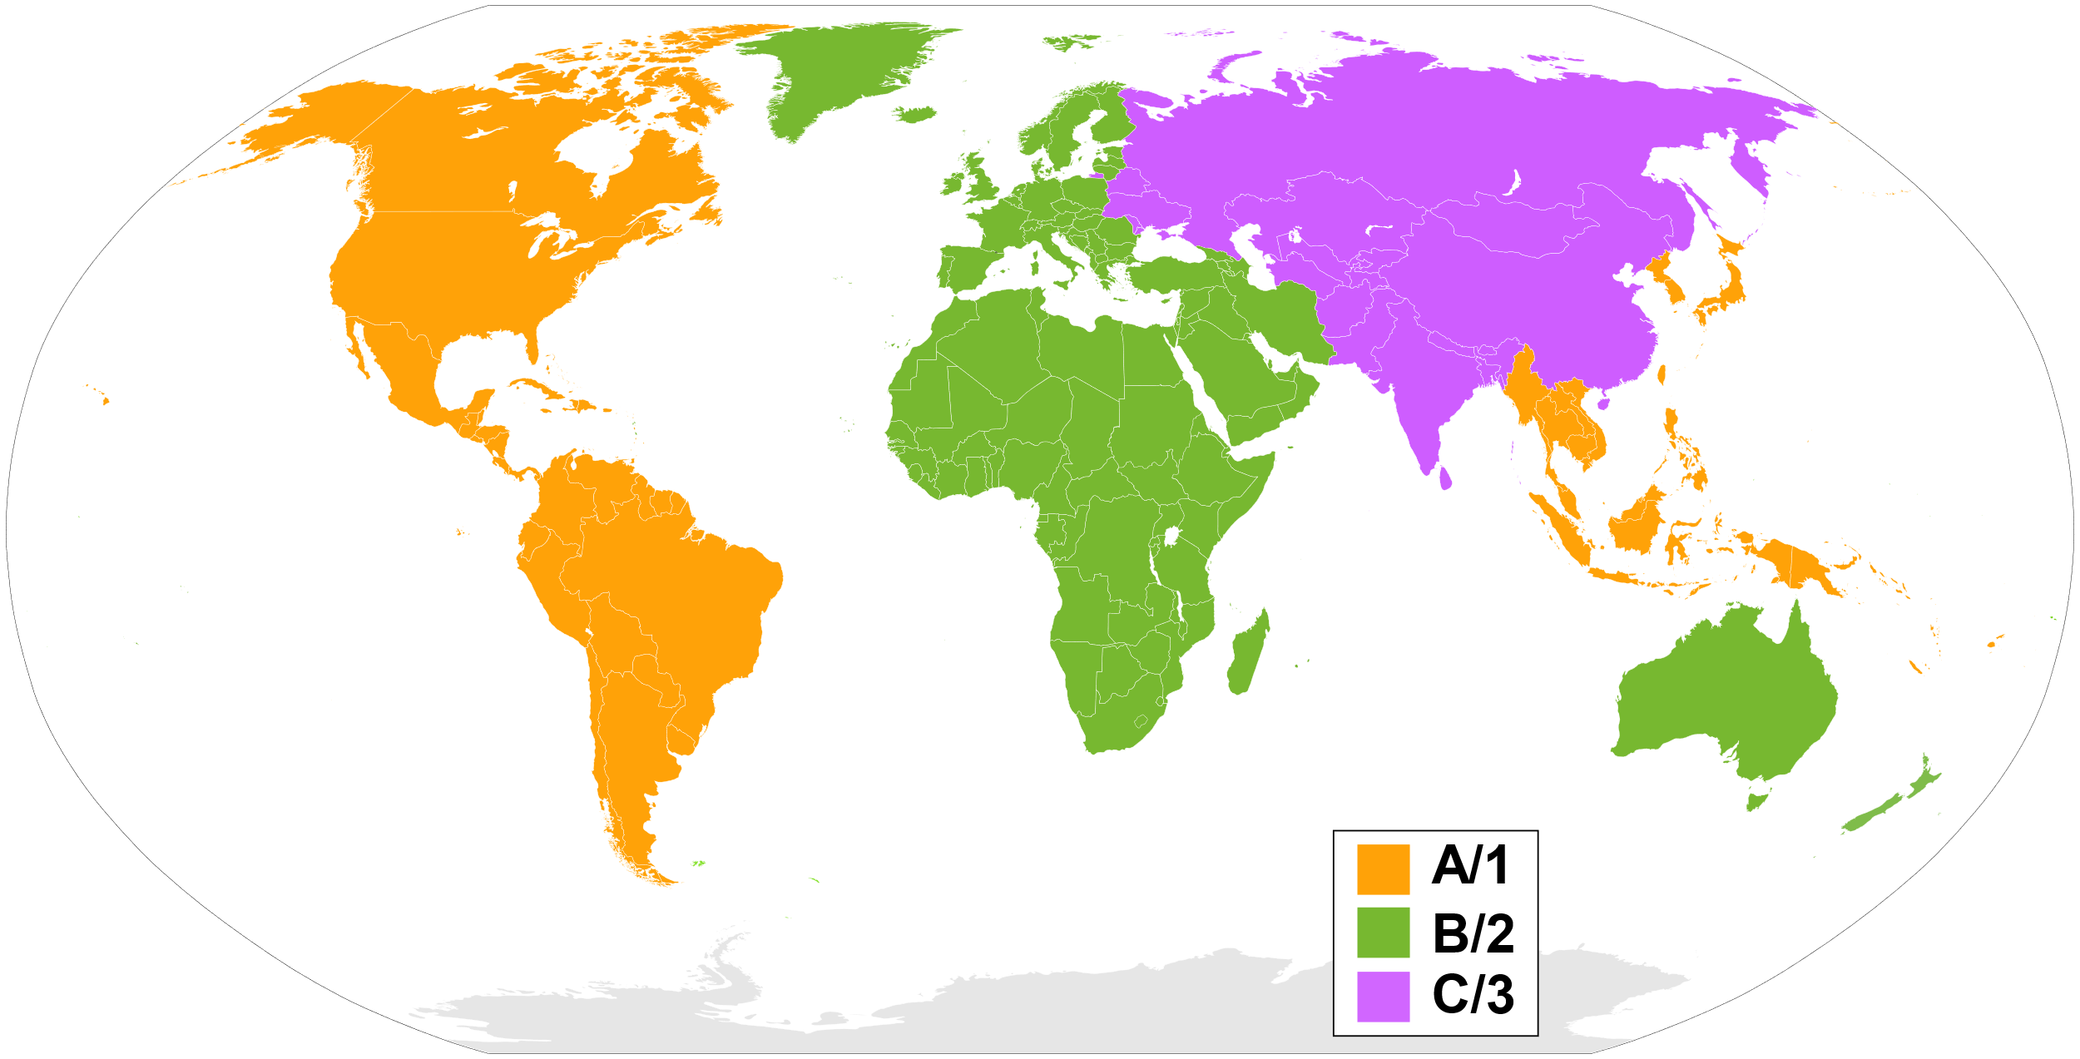
Blu-Ray Regions
- If ABC regions are all flagged disc is region free
ITFreeTraining.com
© Copyright 2023
Notes:
01:29 Blu-ray regions work in a similar way to DVD regions. However, in this case, the world is divided up into three regions. To indicate which region the Blue-ray movie will work in, the DVD package will be printed with the logo A, B or C. As before, it is possible for the Blu-ray to support more than one region. If all the regions are flagged, the Blu-ray disc is considered to be region free.

Slide 4
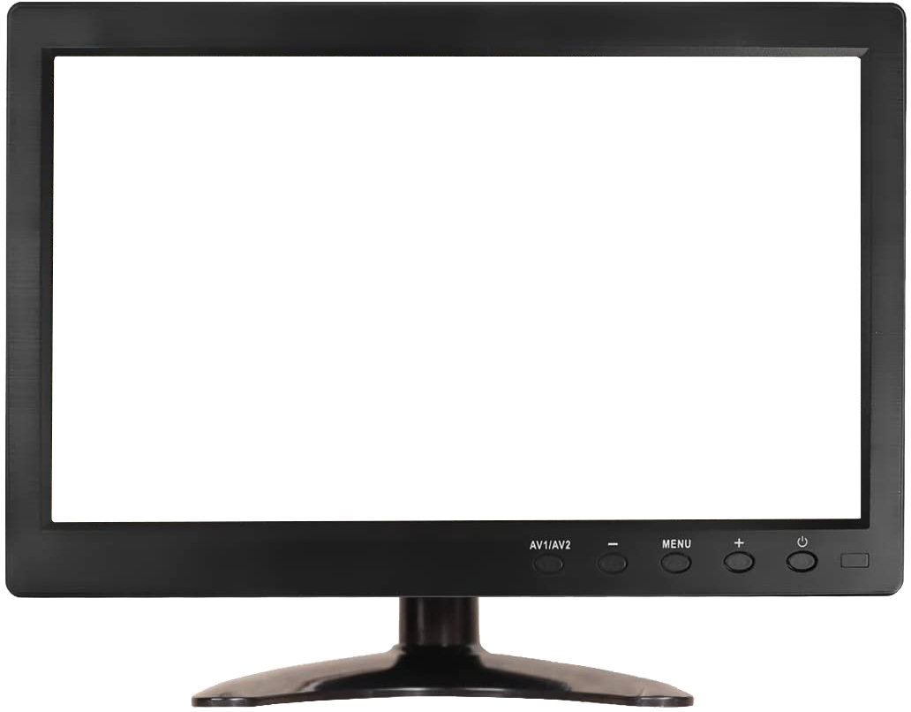
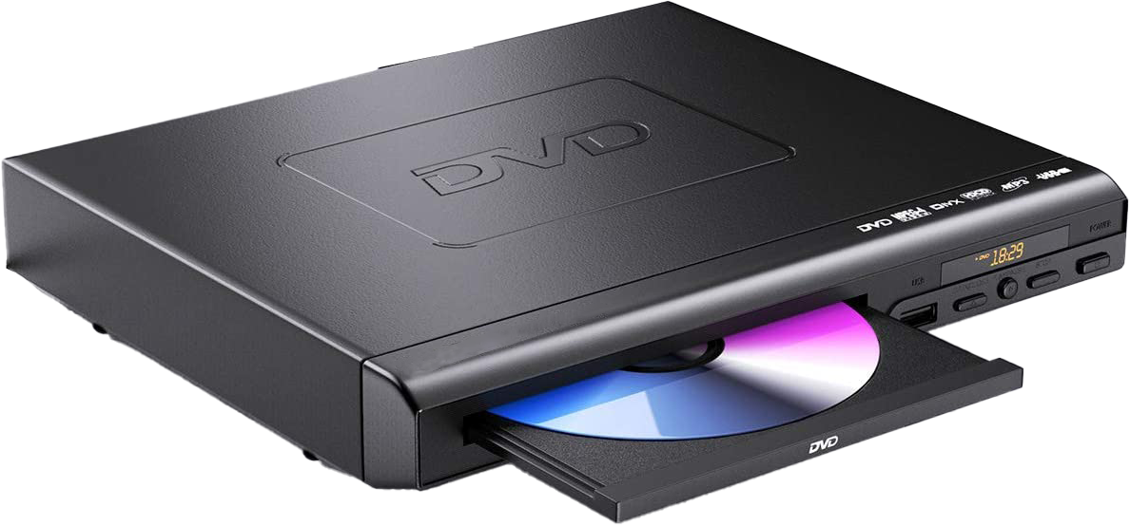
Digital Rights Management (DRM)
Key
DVD compliant player
Requires a key to be purchased
Encrypted
Player decrypts
ITFreeTraining.com
© Copyright 2023
Notes:
01:55 To understand regions a little bit better, let’s have a look at Digital Rights Management or DRM. DRM is a system designed to prevent media from being copied or used when it should not be. DRM, in the case of DVDs, works by encrypting the movies on the DVD. The encrypted DVD is then put into a DVD player.
The DVD player needs to be able to decrypt the DVD. In order to do this, DVD compliant players purchase a key that is installed in the DVD’s firmware. Using this key, the DVD player can decrypt the DVD and then display the movie on a screen.
This system helps to prevent the optical media from being copied. A DVD player purchased in a particular region will only be able to play DVDs for that region or ones that are region free. Since DVDs are sold in stores, having regions helps to control distribution. For example, if a company pays for the rights for DVD distribution in a particular region, they can sell the DVD in that region. Another company may pay for the rights for distribution in another region. Using regions allows for control of distribution and prices for sales.
In some cases, DVD players are able to change regions. Let’s have a look.

Slide 5
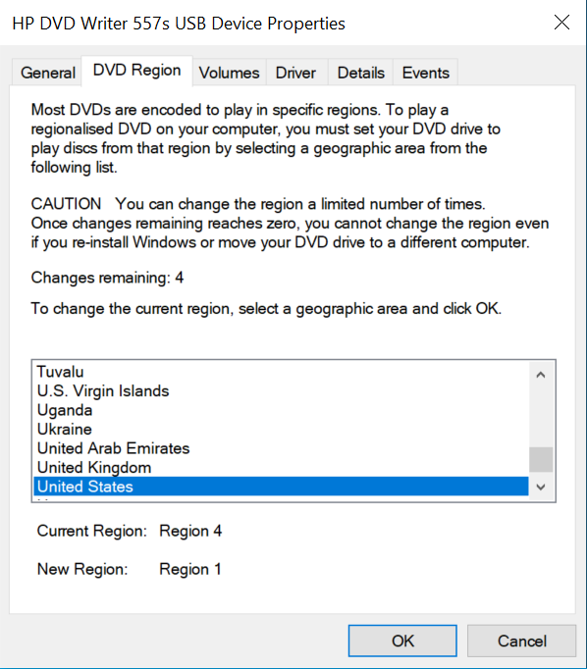
Region Changing
Found in device properties
Limited number of changes available
Select required country
ITFreeTraining.com
© Copyright 2023
Notes:
03:12 Some DVD players, not all, support the ability to change regions. In the case of Windows, changing the region this is done through the device properties of the optical device. This is found on the DVD region tab. There will be a limited number of times that the region can be changed. You will see on this screen the number of times left that the change can be made. This number is controlled by the firmware inside the device, so can’t be reset.
You will notice at the bottom the current region and the new region if you decide to change the region. In order to change the region, select the country that you want and press OK. This will change the region and allow you to play DVD movies from that region.

Slide 6
Subscribe
Next video
Video content: https://ITFreeTraining.com/ap/3c30
© Copyright 2023
Notes:
03:56 That concludes this video from ITFreeTraining on Digital Region Coding. I hope you have found it useful and I look forward to seeing you in more videos from us. Until the next video, I would like to thank you for watching.
References
“The Official CompTIA A+ Core Study Guide (Exam 220-1001)” Chapter 6 Paragraph 222-231
“DVD region code” https://en.wikipedia.org/wiki/DVD_region_code
“Picture: DVD Region” https://en.wikipedia.org/wiki/DVD_region_code#/media/File:DVD-Regions_with_key-2.svg
“Blu-ray” https://en.wikipedia.org/wiki/Blu-ray
“Picture: Blu-Ray regions” https://upload.wikimedia.org/wikipedia/commons/3/3f/Blu-ray-regions_with_key.svg
“Video: Sleeping cat” https://pixabay.com/videos/cat-kitten-kitty-sleepy-pet-cute-61355/
“Picture: Key” https://commons.wikimedia.org/wiki/File:Crypto_key.svg
Credits
Trainer: Austin Mason http://ITFreeTraining.com
Voice Talent: HP Lewis http://hplewis.com
Quality Assurance: Brett Batson http://www.pbb-proofreading.uk

