Slide 1
Notes:
The use of optical media became popular in the 80’s. Since then, it continued to develop. The development has slowed down due to there being less demand for optical media. The need has reduced due to alternatives like online videos becoming popular and more accessible. The second big use was for transferring data; again, the need reduced when low-cost alternatives such as flash media became available.

Slide 2
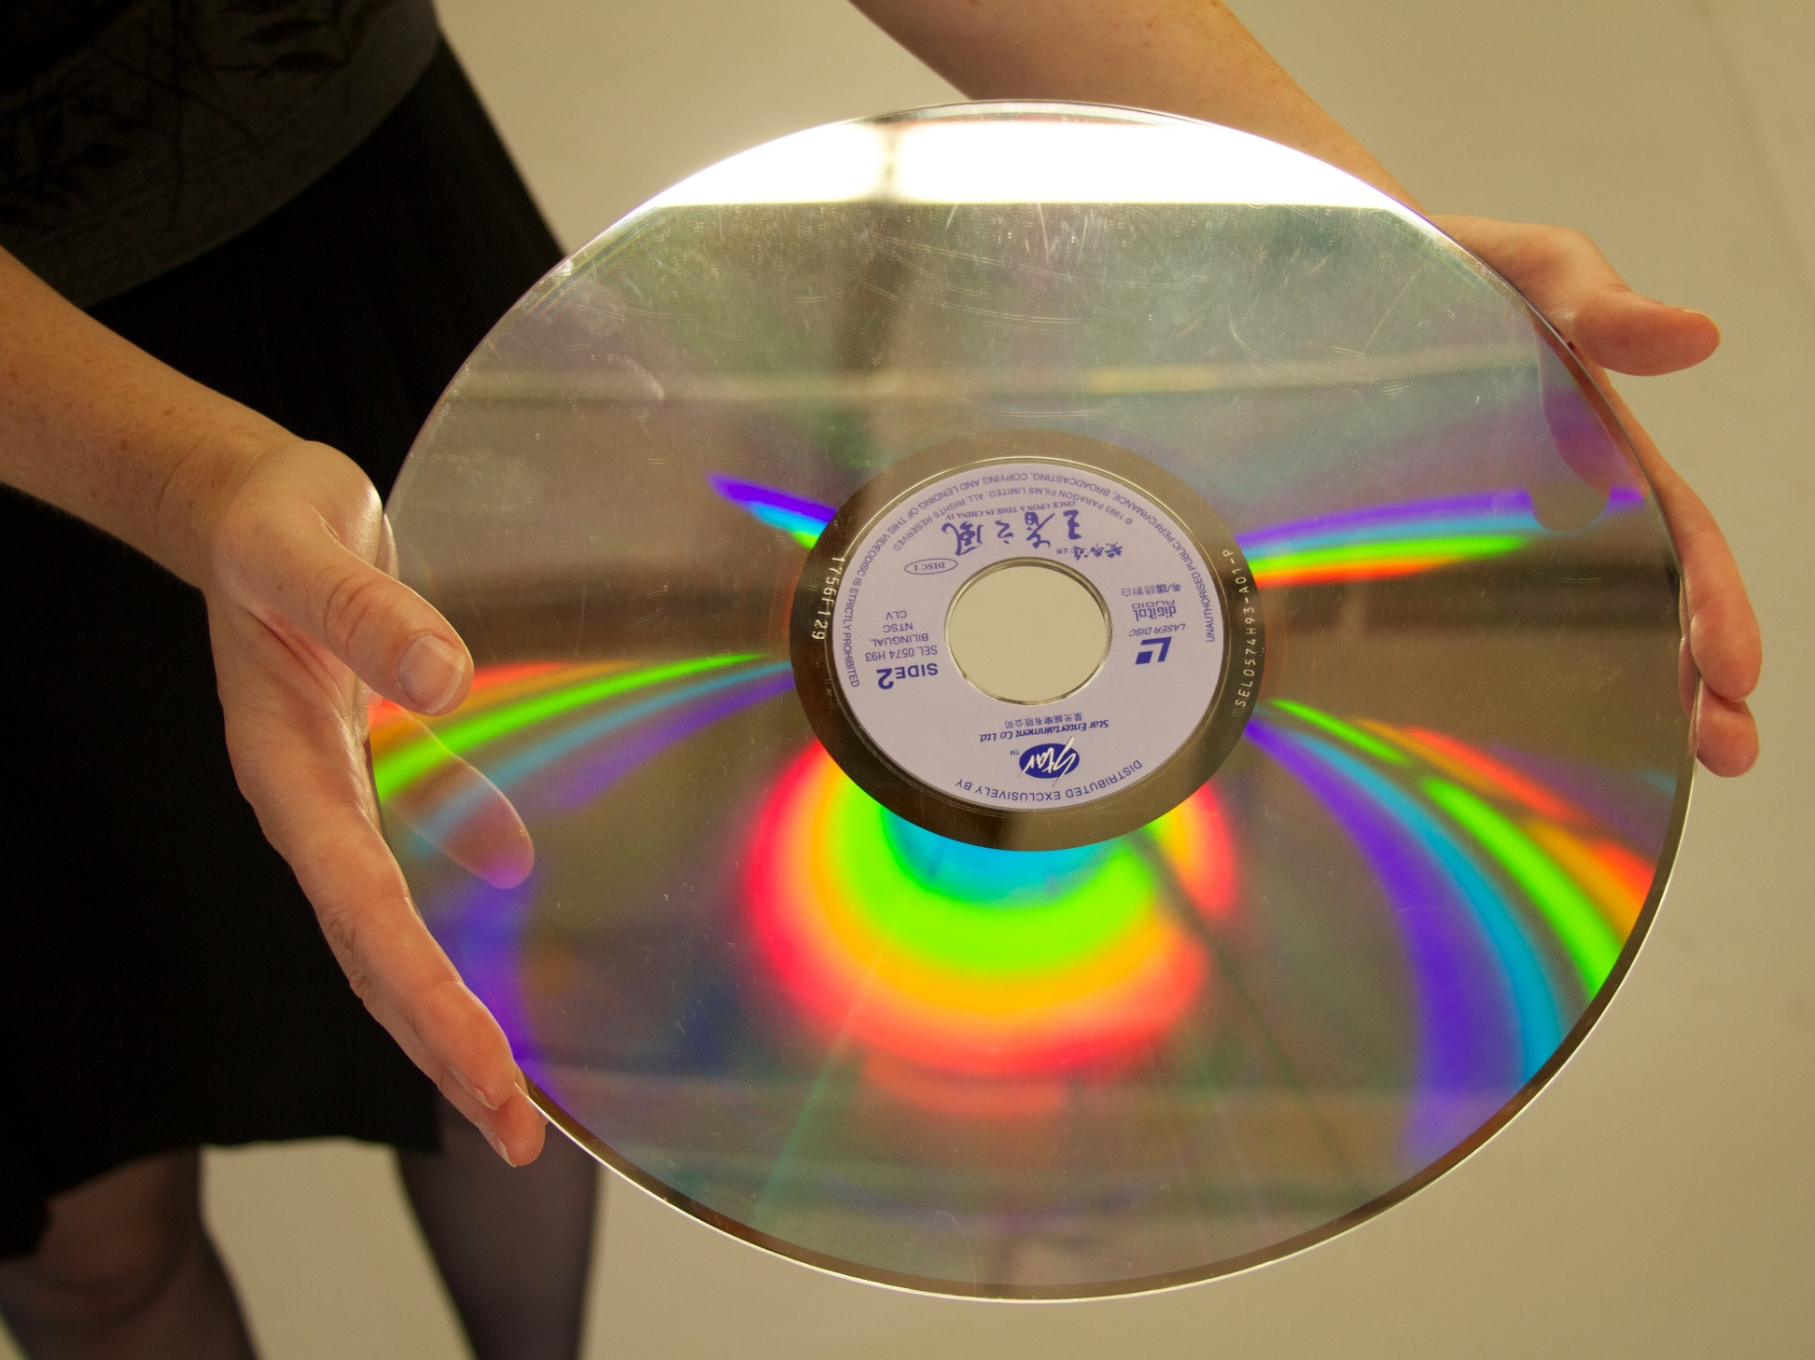
History
Optical technology mainstream use in the 80’s
Compact DICS (CD)/CD-ROM
650 Megabytes
Audio and later data
Popular in the marketplace
Laser Disc
60/64 minutes per side
Did not take off
Notes:
For the CompTIA exam, you most likely won’t get asked any difficult questions on optical media, if you get a question at all. So, I would not worry about memorizing the information in this video, just have a bit of an understanding. At the end of the video, I will cover what you need to know to support optical media in the real world.
The first optical media to take off in the marketplace was Compact Disc or CD. These were originally designed to store audio for music for use in CD players. Computers needed the ability to store data on a compact disc, so the standard was expanded to include data and was called CD-ROM.
These optical discs could store 650 Megabytes, which back then was a lot of data. For this reason, optical disc was widely used to distribute and backup data.
Optical discs have been around since the 70’s but did not get market acceptance. The other big optical disc standard attempting to gain market share was the laser disc. Although there were different sizes, the larger size was about the size of a vinyl record. They were designed with video in mind and stored about 60 minutes of video on each side, thus a total of about 120 minutes. This was enough space for some, but not all movies.
Although laser discs were popular for a little while in some countries, the technology quickly died out. It is unlikely that you will come across it nowadays. The big problem with CD-ROMs was they needed to store a lot more data in order to store decent quality video.

Slide 3
Video Support
Stores 4.7GB/8.5GB/9.4GB/17.0GB
Very popular for movie distribution
Released late 90’s
Digital Video/Versatile Disc (DVD)
Notes:
The next major optical media to take off was DVD. Depending on who you ask, it either stands for Digital Video Disc or Digital Versatile Disc. DVD was released in the late 90’s. Although it was possible to use a CD to store video, the quality was not great. DVDs however, could store a whole movie in a decent quality. Because of this, DVD became very popular for the distribution of movies.
The original DVDs were able to store 4.7GB using a single side and single layer. By using both sides of the disc the amount of storage was able to be doubled. Also, using dual layer the storage was again able to be doubled. Dual layer is when the DVD is manufactured with a second layer that can be accessed by refocusing the laser to access the second layer. The problem with this is, tracking of the second layer takes a little bit of time and thus there may be a small pause during playback. Since this only happens when changing layers, it is usually not that noticeable.
You can see that a DVD could potentially hold 17GB of data which would be enough for high-definition video; however, doing this required both sides of the DVD to be used. Using both sides means that you can’t use one side to print information about what the DVD has on it and also the DVD is more prone to damage. For this reason, a new standard was required for high-definition video.

Slide 4
Blu-ray
New development slowed due to competition
Several hours of video
Uses a different colored laser
Holds 25GB/50GB
Released to the market 2003
Notes:
The next technology that I will look at is Blu-ray. Blu-ray was released to the market in 2003. It increased the amount of storage to 25 Gigabytes or 50 Gigabytes if dual layer was used. In order to do this, Blu-ray uses a different color laser. The laser is blue in color and thus the name Blu-ray. Using a different colored laser changes the frequency allowing more data to be packed on the disc.
Having more data on the disc means that several hours of video can be stored on it. This includes higher resolutions like 4k. Development of Blu-ray has been slow due to competition. The shift to storing data online has decreased the need to have high-capacity discs. There are however more improvements that can be done in order to increase the amount of data stored on Blu-ray discs.

Slide 5
Ultra HD Blu-ray/4K Ultra HD
Holds 50GB/66GB/100GB
But not compatible with older Blu-ray drives
Enhancement of Blu-ray
Released in 2015
Notes:
The next standard of Blu-ray released was Ultra HD Blu-ray, otherwise often marketed as 4K Ultra HD. This was first released in 2015. This was essentially an enhancement to the original Blu-ray standard but not compatible with older Blu-ray devices. For this reason, if you purchase an Ultra HD Blu-ray, you may find the package contains a Blu-ray disc as well for backwards compatibility.
The technology for Ultra Blu-ray costs more than Blu-ray and thus these Blu-ray devices tend to be expensive. The media costs about the same, so the only thing slowing market acceptance of the newer standard is the cost of the drives. However, due to other factors, optical disc media is not as popular as it used to be.
Let’s now have a quick look at the future of optical discs.

Slide 6
Archival Disc (AD)
Very little market share
Resistance to temperature/humidity/dust/water
Planned improvements 500GB/1TB
Initial capacity 300GB
Released in 2015
Notes:
One possible future for optical media is Archival Disc. This technology was released in 2015, the same year as Ultra HD Blu-ray. It was released with an initial capacity of 300GB with planned improvements to increase the capacity to 500GB and then 1TB. Archival Disc has improved resistance to temperature, humidity, dust and water. The idea being, it is a better choice for storing your data long term.
At the time of the making of this video, Archival Discs did not have a lot of market share. Given the current market, it would probably be difficult to get some. It seems the market is staying with Blu-ray, at least for the moment. Will Archival Disc replace Blu-ray or will another technology emerge? Only time will tell. I will say, however, it appears that the demand for optical media is declining, which also means the speed at which the technology will develop will probably also decrease. If people are happy with Blu-ray and think that is enough data for them, it is unlikely they are going to spend more for technology that they don’t need.
Next, I will have a look at the different media types for optical drives.

Slide 7
Optical Media Types
Disc Designation | Capacity (GB) | Rewritable
CD | 0.65 – 0.90 | No
CD-R | 0.65 – 0.90 | No
CD-RW | 0.65 – 0.90 | Yes
DVD | 4.7 single layer/8.5/17 dual layer | No
DVD+R (DL) | 4.7 single layer/8.5 dual layer | No
DVD-R (DL) | 4.7 single layer/8.5 dual layer | No
DVD+RW (DL) | 4.7 single layer/8.5 dual layer | Yes
DVD-RW (DL) | 4.7 single layer/8.5 dual layer | Yes
DVD-RAM | 4.7 single layer/8.5 dual layer | Yes
DB (DL) | 25 single layer/50 dual layer | No
DB-R (DL) | 25 single layer/50 dual layer | No
DB-RE (DL) | 25 single layer/50 dual layer | Yes
Notes:
There are a lot of different optical media types shown. I will run through them quickly; however, nowadays you don’t need to remember them all and I will explain why. The three different types of media in the table are CD, DVD and DB. When the media is written without any additional letters after it, it is referring to optical disks that are manufactured.
When the optical disc is manufactured, the manufacturer has some choices about how much data they will put on the CD. In the case of CD or compact disc, the minimum amount of data that can be stored is 650 megabytes up to a maximum of 900 megabytes. CDs were originally designed for audio and later used for data.
DVDs like CDs, without any letters following DVD, refers to DVDs that are manufactured. In this case, if a single layer is used, the data available is 4.7 Gigabytes. If dual layers are used, this can be increased to 8.5 Gigabytes or 17 Gigabytes.
In the case of DB or Blu-ray, once again referring to manufactured Blu-ray discs in the factory, a single layer holds 25 Gigabytes and dual layer 50 Gigabytes. So, CD, DVD and DB cover any optical disc that is manufactured in a factory and the amount of data stored on these discs can vary.
That covers the standards for manufactured optical discs, however there are also standards for burnable optical media. In the case of DVDs there were a lot of different standards. When you purchase an optical media drive, it will have some logos printed on it. Some examples are shown. These logos will tell you what your optical drive supports.
In the old days, some optical media drives would only support particular standards. For example, may only supported DVD+R and not DVD-R. The difference between the two is how the data is burned to the DVD. In those days, you had to purchase the right media for your optical drive. Nowadays, since the standards are so old, all optical burners support all the standards. Therefore, you generally won’t find all the logos on the optical drive, since it assumed it is supported. If the logos are present, they will generally be for the more modern media, for example, if the burner supports Blu-ray or not.
In the old days, there were some compatibility problems to bear in mind if you burned plus or minus media. Nowadays, if I was purchasing DVD media, I would not be concerned if it was plus or minus media as modern optical drives will read and write both. Only really old optical drives may have problems, and by old, I mean dating back to the late 90’s.
After the plus or minus will be an indication of how many times the optical disc can be written to. If the media just has an R, then it can be written once (R stands for Read).
If the media has RW, this means that it can be written to many times (RW stands for Read Write). Generally, the term that is used for being able to write many times is rewritable. In the case of Blu-ray the term RW is not used but rather RE is used (RE stands for Rewritable). If the optical media supports dual layers, the letters DL will follow.
There is also one other standard called RAM. This was only implemented in DVDs. DVD-RAM had some popularity in personal video recorders but not so much with computers. The standard never really took off, so you are unlikely to come across it these days.
Given that optical media has been around for so long, you don’t really need to know this table. Let’s have a look at what is important for you to know in the real world when purchasing optical media.

Slide 8
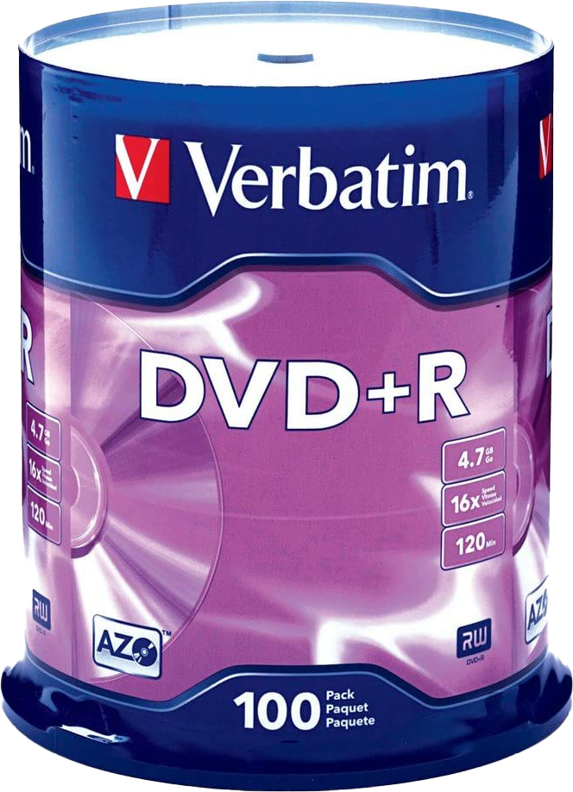
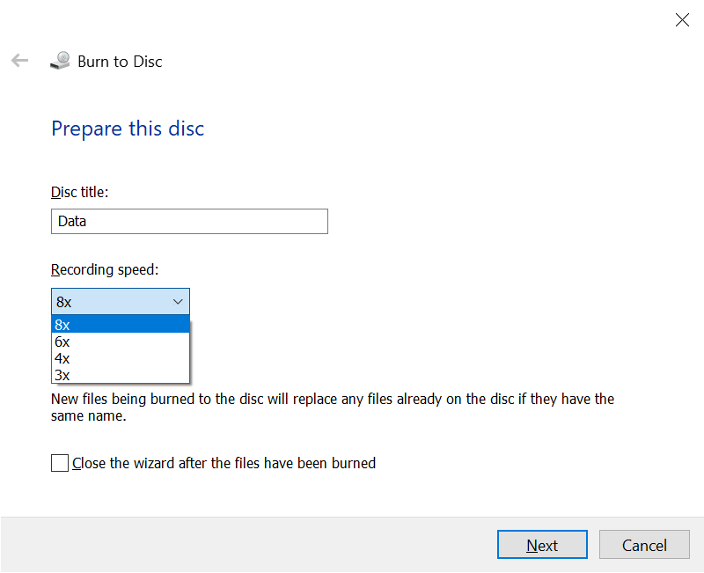
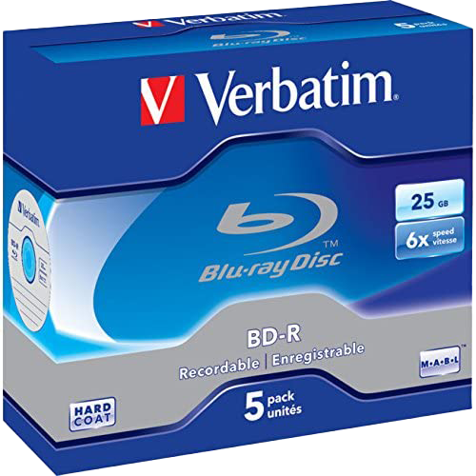
Real-World Optical Media
* 1x CD 150KB/second 1x DVD 1352.54KB/second (Single speed)
Notes:
When you burn an optical disc, one of the first things you will be asked is, what speed you wish to use to burn the optical disc. This essentially changes how fast the drive will spin the disc when it is burning. CD and DVD both have a base which is referred to as single speed. Thus, two speed is the base speed multiplied by two. The other speeds are calculated the same way.
It is important to understand this when purchasing optical media. For example, if I were to purchase some blank CD discs, commonly referred to as CDRs, on the packaging would be the maximum burning speed that they support. In the case of these CDRs, the maximum speed is listed as 52. This is what the manufacturer of the media has indicated they will work at. If you burn the CDs at a higher speed than that indicated by the manufacturer, there is a higher chance of failure or errors. Personally, when I burn optical media, I burn them at a lower speed than the manufacturer recommends, as they seem to be more reliable if done this way. Keep in mind that single speed for a CD is the speed it plays back audio. So, if you select single speed, it will take just over an hour to burn a full CD. If you only have a small amount of data, it won’t take too long. Personally, I would select the middle ground, or the goldilocks zone, where it is not too fast and not too slow.
Notice that the capacity of the CDRs is 700 Megabytes. In the old days you could get smaller capacity CDRs, but nowadays they only really sell the 700 Megabyte capacity CDRs. If you consider that it costs about the same to make either capacity and there is not much demand for CDRs any more, you can understand why they don’t sell both. Extra capacity can be obtained using a process called Overburning which uses more of the optical disc to store data. This is not recommended as it increases the chances of there being problems with the disc.
The second optical media you may come across is DVD. In this case, the media is +R but you can still also get -R. Unless you are using very, very old hardware, it should not matter which one you purchase. As before, the capacity and maximum burn speed is displayed on the packaging. In this case, 4.7 Gigabyte and 16 speed. Although dual layer DVDs are available, you will generally find that due to the amount of data that a single DVD can hold and the extra cost of dual layer media, single layer DVDs are more common. Also, due to the low cost of DVDs, you will find that re-writeable media is not used that often.
The last media you will most likely come across is Blu-ray. As before, the capacity and the maximum speed will be displayed on the packaging. Optical media no longer has the market share that it once had, so there is not even that much choice of what media to buy like there used to be. The last time I purchased optical media I had to go to a few different stores because the places that used to sell it no longer did. Today, you will find that optical media will often be used when businesses exchange data with each other, but even than that is getting replaced by USB storage and by putting data online.
That concludes this video from ITFreeTraining on optical media. I hope that you have found this video useful. Until the next video from us, I would like to thank you for watching.
References
“The Official CompTIA A+ Core Study Guide (Exam 220-1001)” Chapter 6 Paragraph 199-221
“CompTIA A+ Certification exam guide. Tenth edition” Pages 429 – 435
“Picture: Optical discs” https://pixabay.com/photos/background-blu-ray-blank-burn-89176/
“Picture: CD ROM” https://en.wikipedia.org/wiki/CD-ROM#/media/File:CD-ROM.png
“Picture: Laser Disc” https://commons.wikimedia.org/wiki/File:LaserDisc.jpg
”Picture: DVD logo” https://upload.wikimedia.org/wikipedia/commons/9/9b/DVD_logo.svg
“Picture: Video Camera” https://unsplash.com/photos/SpDOwp6PnBs
“Picture: DVD disc” https://en.wikipedia.org/wiki/DVD#/media/File:DVD-Video_bottom-side.jpg
“Picture: Blu-ray logo” https://en.wikipedia.org/wiki/Blu-ray#/media/File:Blu-ray_Disc.svg
“Picture: Blue-ray disc” https://en.wikipedia.org/wiki/Blu-ray#/media/File:BluRayDiscBack.png
“Picture: HD DVD logo” https://upload.wikimedia.org/wikipedia/commons/a/a4/HD-DVD.svg
“Picture: Blue electronic” https://unsplash.com/photos/HdLYxUirwfI
“Picture: Ultra HD Blu-ray” https://en.wikipedia.org/wiki/Ultra_HD_Blu-ray#/media/File:Ultra_HD_Blu-ray_(logo).svg
“Picture: Laser lights” https://pixabay.com/photos/green-laser-light-rays-light-games-1757807/
“Picture:
Archival Disc” https://en.wikipedia.org/wiki/Archival_Disc#/media/File:Archival_Disc_logo.svg
“Picture: Archival” https://pixabay.com/photos/archive-files-register-office-3859388/
“Picture: Stack optical CD’s” https://pixabay.com/photos/blank-cd-rom-compact-disc-data-72140/
Credits
Trainer: Austin Mason http://ITFreeTraining.com
Voice Talent: HP Lewis http://hplewis.com
Quality Assurance: Brett Batson http://www.pbb-proofreading.uk

