Slide 1
Notes:
This video will look at some of the considerations that you should consider before installing mass storage devices. In your IT career, you will often be installing or replacing storage in a computer, so it is important to understand what things need to be considered.

Slide 2
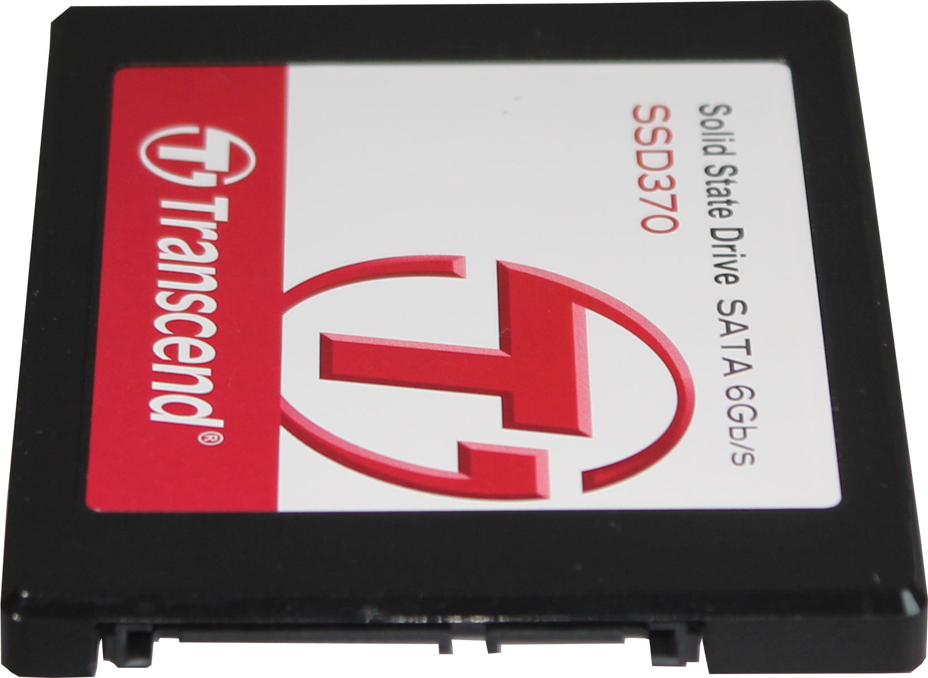
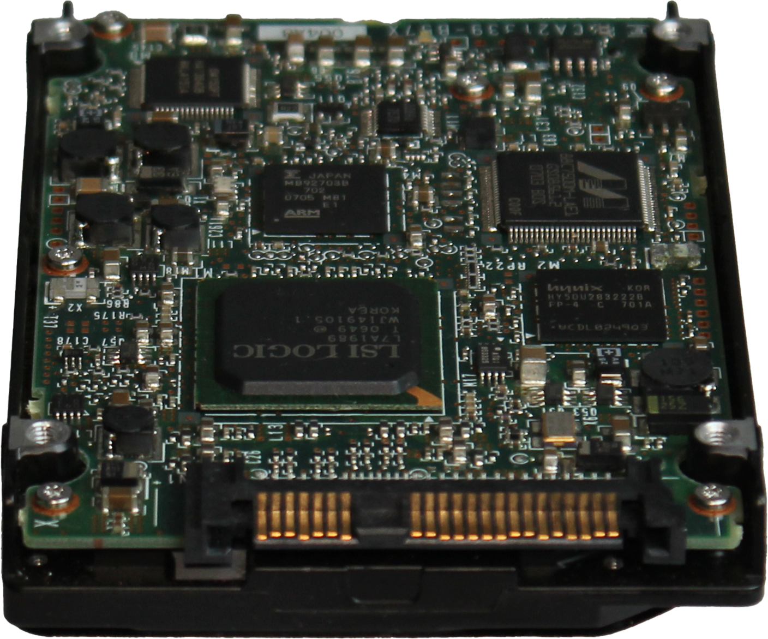
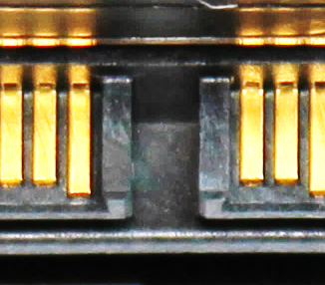
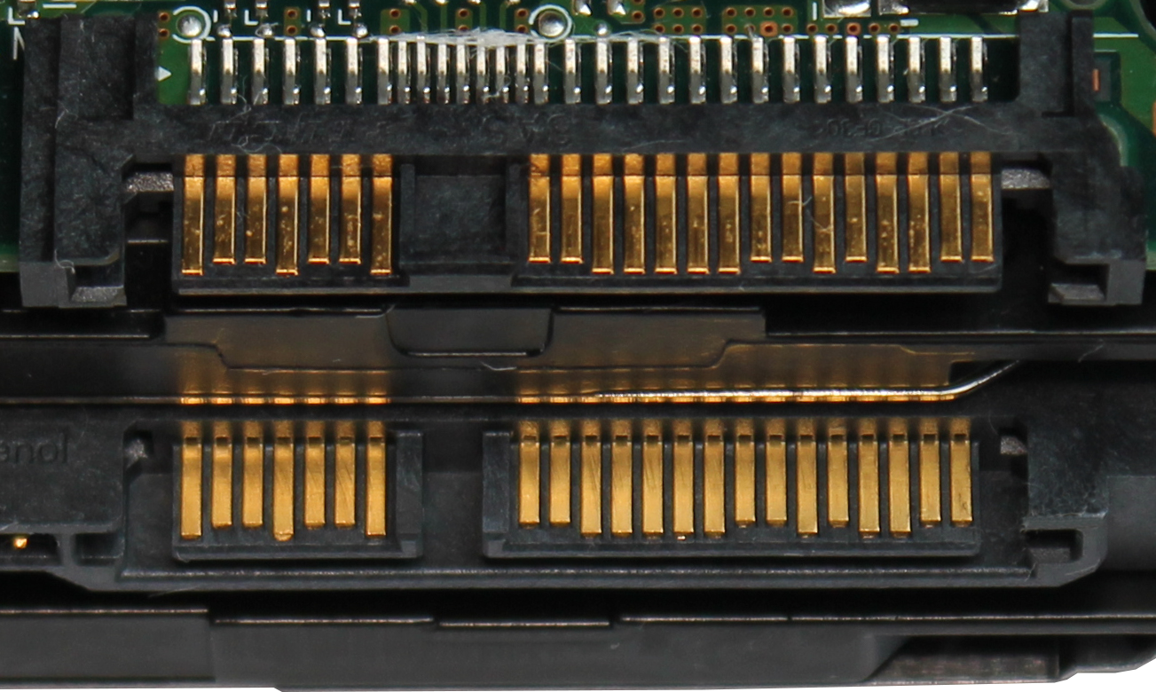
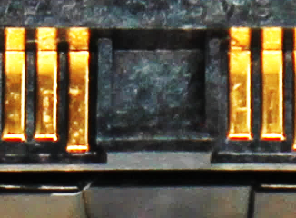
Form Factor
M.2
SATA
SAS
M-Key
B-Key
SATA
Open
SAS
Blocked
ITFreeTraining.com
© Copyright 2024
Notes:
00:17 The first thing to consider before installing mass storage is the form factor. The form factor will determine what connection and hardware you will need in order to use the storage. Although there are a lot of different kinds of storage, nowadays, they generally fall under three different types – these being, M.2, SATA and SAS.
In order to install additional mass storage in your computer, you will need to ensure that your computer supports the storage and has a compatible place to install it. In the case of M.2, this will be used by Solid-State Drives and is currently not used for hard disks. This is unlikely to change any time soon.
Although there are a lot of different standards for M.2, there are two different standards for M.2 Solid-State Drives currently on the market. Each type is keyed differently to prevent it being installed in a device that does not support it.
If I have a closer look at the M.2 storage on the left, you will notice that it has two notches taken out of the board. Although it is possible to have others, motherboards and devices currently on the market support either B-Key or M-Key. The other keys are generally used for other devices, for example wireless cards. For a B-Key device, the notch will be on the left side. For an M-Key device, the notch will be on the right.
You will find that currently on the market, B-Key storage devices will also be M-Key. This means they can be put in motherboards that use either B-Key or M-Key connectors. M.2 storage that uses B-key, this includes B + M Key storage devices, will use the SATA protocol to access the storage on the device. Thus, check the M.2 connector on your motherboards supports the storage that you are trying to install.
B + M key is done for compatibility and, like most things done for compatibility reasons, will reduce the maximum connection speed the M.2 connector can achieve. For this reason, for the best performance, you always want to get an M-Key Solid-State Storage Drive if your device supports M-Key.
M.2 is used for Solid-State devices, but not for hard disks. In the case of hard disks, nowadays, they will either use SATA or SAS. In the case of this example, the SATA storage device is a Solid-State Drive. Therefore, SATA or SAS can support hard disks or Solid-State Drives. We are generally seeing a trend where smaller storage devices will be Solid-State Drives to get better performance and when more space is required hard disks are used.
SATA is used in the home and business markets. You will only see SAS drives in high-performance servers and large storage environments like cloud storage. SAS is compatible with SATA; however, SATA won’t work with SAS.
I will now have a closer look at the connections for SAS and SATA. In this example, I have a SAS and SATA hard disk. I placed one on top of the other so we can compare the connection type. The SAS drive is on the top. You will notice that both connections appear to be exactly the same. In a lot of ways they are, as they use the same number of pins for the data and power connectors.
It is hard to see, but there is a gap between the power and data on the SATA connection. By contrast, the SAS connection is blocked. This prevents a SATA cable being plugged into a SAS drive; however, since SAS is compatible with SATA, a SAS cable can be plugged into a SATA drive.
In order to use a SAS drive, generally you will have a special cable or enclosure. So, your connection may look different. Once you remove the device from the enclosure, you should find that the connection to the storage will look like the one shown, unless it is a specialized device designed to work in a particular device like RAID storage. I will look at RAID in another video, but for this video, just understand that RAID allows a lot of storage devices to be combined into one logical storage device.

Slide 3
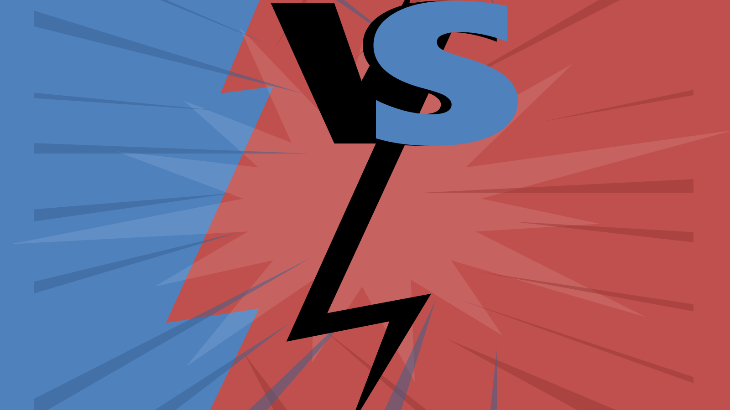
Internal VS External Storage
General comparison
Internal
External
Better performance
Supports more devices
Hot swappable
Longer cable lengths
ITFreeTraining.com
© Copyright 2024
Notes:
04:30 When looking at storage options, there is a choice between internal and external storage. Internal storage is directly integrated with the motherboard, generally offering seamless and faster data access. In contrast, external storage devices are connected via external ports on a computer, providing support for more devices, hot swappable and longer cable lengths. However, distinctions between the two can sometimes blur. Take eSATA devices, for instance: while they connect externally to the computer, their connection interfaces directly with the motherboard just like an internal connection would. Also, high speed USB and Thuderbolt could run faster than internal connections like SATA. Thus, generally internal devices are faster than external connections, but there are exceptions to this rule. You will often see internal devices being used for your faster devices and externals devices for devices that need to be hot swapped.

Slide 4
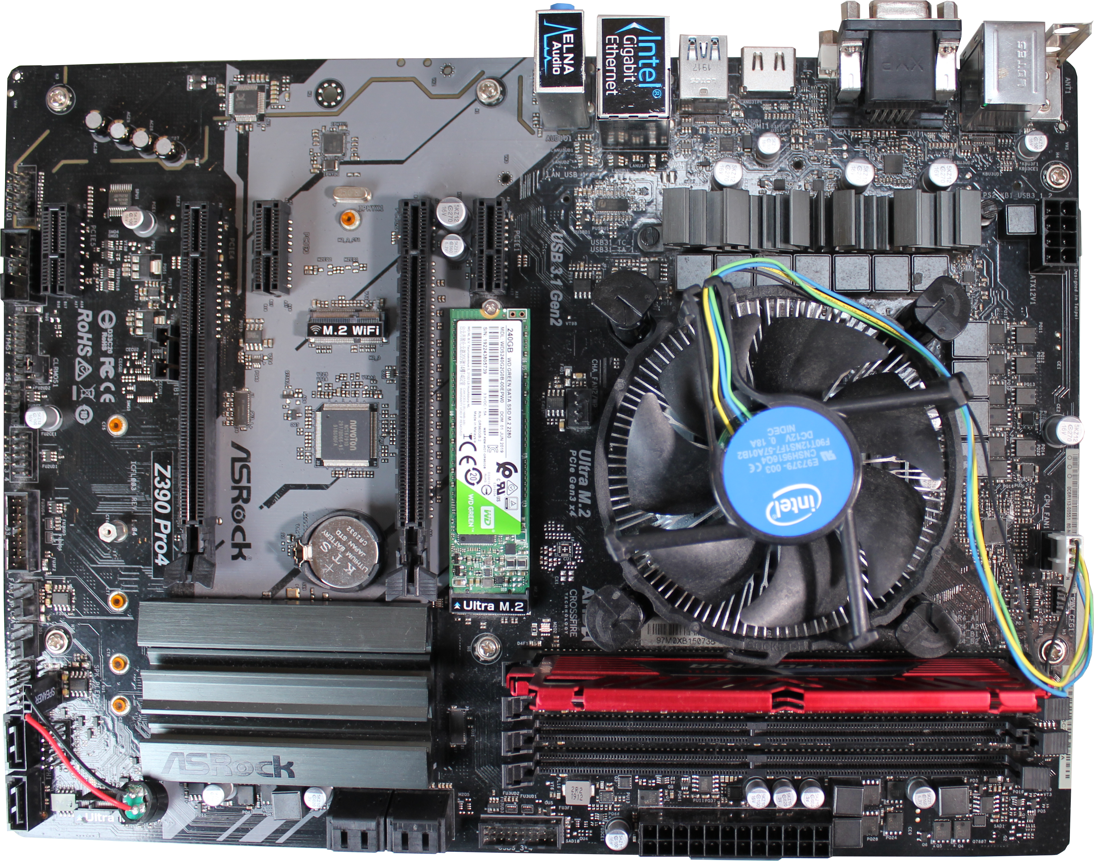
Example ASRock Z390 Pro4
M.2 M-Key
M.2 E-Key (Wi-Fi)
M.2 M-Key (large)
2xSATA
4xSATA
ITFreeTraining.com
© Copyright 2024
Notes:
05:33 To understand some of the problems you may come across when installing internal storage, I will have a look at an ASRock Z390 Pro4 motherboard. Nothing particularly special about this motherboard, but it does highlight some of the problems you may come across.
This motherboard has four SATA ports at the bottom. There are also another two SATA ports on the left of the motherboard making a total of six SATA ports. When you see SATA ports in different parts of the motherboard or the ports are different colors, this should raise questions. Generally, differently colored SATA ports will mean that the ports will support different features. For example, one color will be SATA two and another color will be SATA three. In other cases, differently colored ports may indicate that RAID or other features are supported.
In the case of this motherboard, the ports being in different locations doesn’t seem to have any bearing on the features supported. The ports seem to support the same features and also connect to the same controller, so initially it does not make any sense why they are separated. In this case, it is a choice the manufacturer made to divide them. This may have something to do with the wiring to the South Bridge on the motherboard or another reason we are not aware of.
The next thing to consider on this motherboard is, the first M.2 slot. In this case, an M.2 Solid-State Drive has been installed on this motherboard already. The M.2 slot in this case is an M-Key slot, however a B plus M-Key Solid-State Drive has been installed. Generally, an M-Key slot will support both an M-Key and B plus M-Key Solid-State Drive. However, there are some motherboards, generally the newer ones, where only M-Key is supported. Later in the video, we will have a look at why this may be the case.
Next, notice that there is a second M.2 M-Key slot on the motherboard. This slot is larger than the first M.2 slot. So, here is one of the first things that you need to consider when installing storage. You don’t want to use the larger slot for a smaller storage device and then have to remove it and re-install it later to make room for a larger Solid-State Drive.
Currently on the market, most Solid-State Drives are 80 millimeters in length, so in most cases you won’t need to worry about it. If, however, you are purchasing a very large capacity Solid-State Drive or caching devices, these may be of a larger size. So, best practice is to keep it free, just in case. There is also another reason which I will look into shortly.
Lastly, this motherboard has an M.2 E-Key which is used for Wi-Fi. This is not used for storage, but shortly it will make sense why I mention it. To start with, let’s have a look at the simple case in which we have just the one Solid-State Drive installed, which is becoming commonplace in computers nowadays.

Slide 5
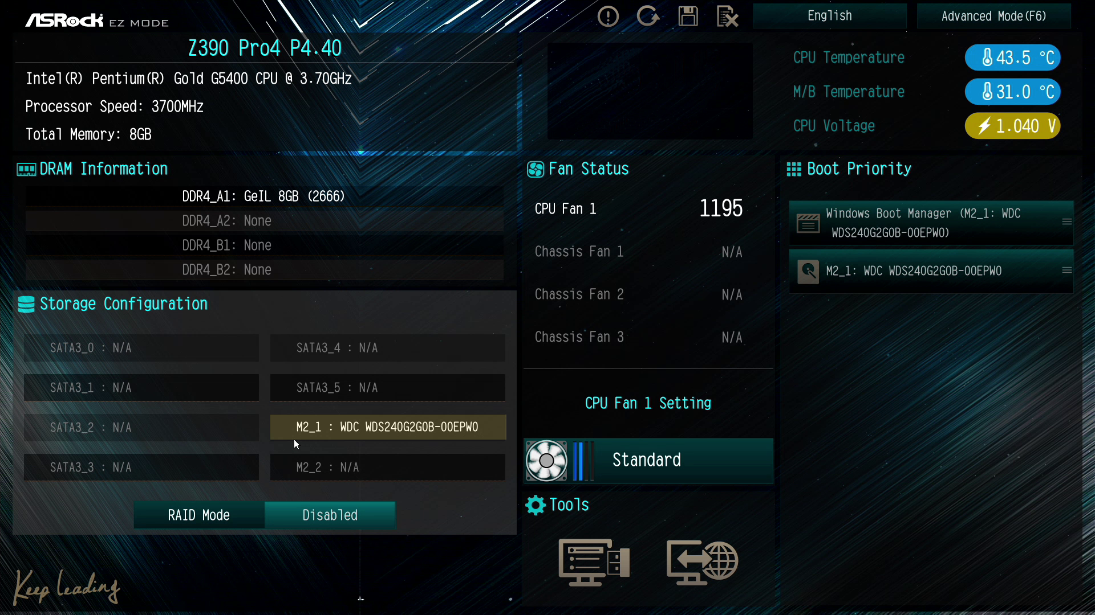
UEFI Single Solid-State Drive
ITFreeTraining.com
© Copyright 2024
Notes:
08:34 To understand a little bit better about what is happening, I will start the computer up and go into the setup. In the case of this computer, to access the setup I need to press the F2 key when the computer is starting up.
Once in the setup, you will notice that the M.2 drive has been detected. It is generally a good idea to use the first M.2 drive or in the case of SATA use the first SATA connection. You can configure the setup to boot from any drive, but it will default to the first one, so it just makes things simpler to do it this way when you can.
When the first M.2 slot is used, on this motherboard the SATA five connector will be disabled. This essentially means that if I attempt to plug in a SATA drive to SATA port five, it won’t be detected or be accessible – essentially it is disabled or switched off.
Basically, the SATA connection is being re-routed to the M.2 slot to provide a data lane for the Solid-State Drive. If the Solid-State Drive uses PCI Express, the SATA connection will still be disabled. Essentially, there are limited data lanes in the computer. Lanes can be redirected and the data transferred over them can change; however, you can’t share the same lane with different devices, so somewhere a choice needs to be made about which connection is used.
This is the same case if a second M.2 drive is installed. If the second M.2 SATA drive is installed, SATA connector one will be disabled. If a second M.2 PCI Express drive is installed, port zero will be disabled. If you are planning to use multiple storage devices together, keep in mind what you choose will disable other options. In some cases, certain RAID options are available on certain ports, but not on others.
On this motherboard, you are limited to a total of six storage devices which can be any combination of M.2 and SATA. Depending on your configuration, SATA ports will be disabled. Keep in mind when troubleshooting, that installing extra storage may disable existing storage devices. If you have a free port, you may need to move a connector from one port to another to get the storage working again.
Later in this video, I will look into how to install storage if you have available ports. However, if you find yourself short on ports, you'll need to explore alternative solutions. Sometimes, this might entail adding extra storage controllers to accommodate and manage more storage devices.

Slide 6
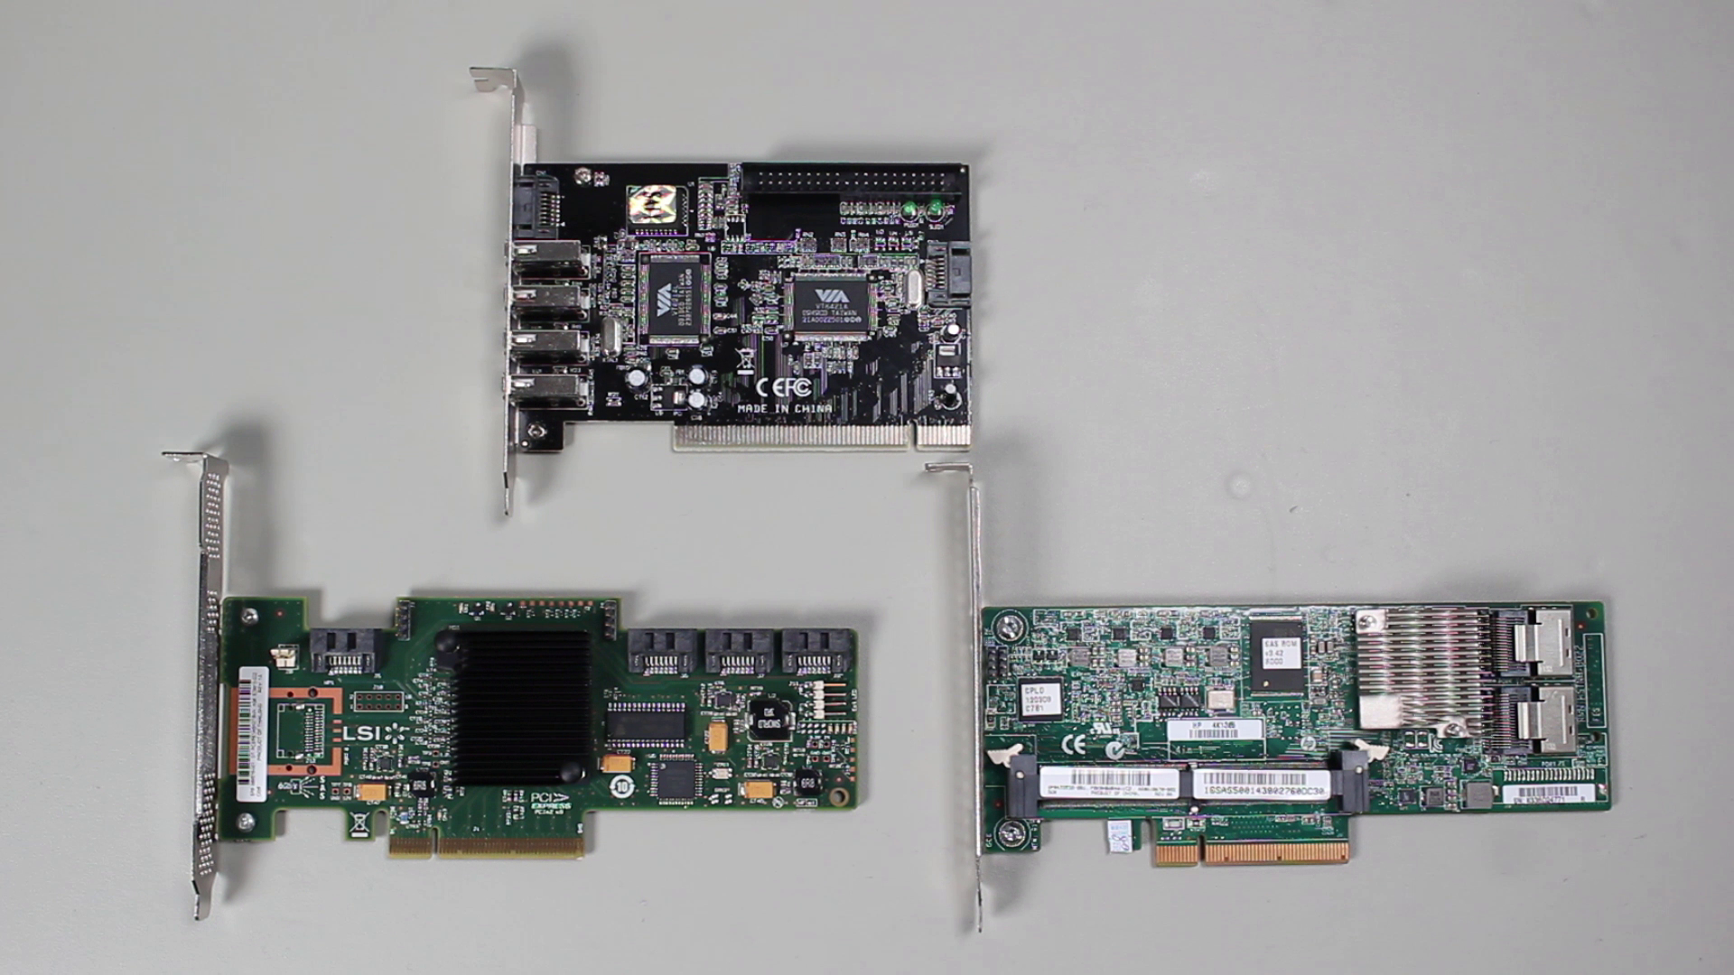
Expansion Adapter
Provides additional connections to the computer
ITFreeTraining.com
© Copyright 2024
Notes:
11:09 In this example, I will have a look at three different expansion cards and will install one of them. There are many different expansion cards on the market, so it is just a matter of finding one that meets your needs.
This particular expansion card is based on the older PCI standard. To clarify, PCI (Peripheral Component Interconnect) is an earlier standard for connecting expansion cards, while PCI Express (or PCIe) is its successor, offering faster data transfer rates and more efficient performance. For this card to work, your motherboard would need to be compatible with PCI. However, many contemporary motherboards have phased out PCI support in favor of PCIe.
Notice this expansion card has an IDE connector at the top. IDE based hard disks have not been manufactured for a long time, so it is unlikely you will come across one. Notice all the SATA connectors on the side, also on the back of the card is another SATA connector and four USB connectors. Different expansion cards will have different connectors. It is just a matter of finding one that suits your needs and that your motherboard supports.
If you have old hard disks and are having difficulty finding an expansion card, you may also want to consider looking for an adapter. For example, there are many IDE to USB adapters on the market.
I will now have a look at this PCI Express SAS expansion card. SAS expansion cards generally also support SATA, so this card could be used for SATA hard disks. You will notice that this card has four connectors. Cards like these would normally be used in servers; however, they can be used in a desktop as well. Some particular expansion cards will only support certain hardware. For example, some RAID cards may require a particular server motherboard. So, if you find a card like this lying around, look the card up and see what hardware and software it supports. The less specialized expansion cards will generally be supported in more systems. So, if you want extra SATA connections, I would look for a card that supports SATA connections rather than one that supports more specialized connectors like SAS, unless you have a need for them. If you have one of these cards available, you may as well use it rather than buying a new one, if it meets your needs.
I will look at one more expansion card. This is another SAS expansion card; however, this card has SAS connectors on it. You will notice the large connector on the card. This is for additional cache to be installed to improve the performance of the card. On the more expensive cards, you may find additional options like these. Depending on what your needs are, it may be worth spending the extra money to install additional cache. You may also find that you have some additional, unused components in your storage room that you can use.
At the end of the card, notice that there are two specialized SAS connectors. For the CompTIA A+ exam, you won’t need to know what these connectors are, but I will show you to demonstrate an important point that you will come across, even working with common cables like SATA.
Each port on this card supports four SATA hard disks. In order to connect them you need this cable. Notice the four SATA connectors on the end of the cable. If you were planning to use SAS hard disks, you would need to use the cable with the SAS connectors or use an adapter. Notice on the other end is a specialized SAS cable. Keep in mind that SAS hard disks are only found in servers and cloud storage, so it is very unlikely you will be asked a question on the CompTIA exam about this. By looking at this particular expansion card, I am trying to show an important point which you may come across.
Watch what happens when I plug the cable into the adapter. Notice that the cable is at right angles and pointed straight down. If I have two of these cables, I won’t be able to use both ports because one will block the other. In order to install this into the motherboard, the cable would be jammed up against the motherboard and have to be bent. Not ideal at all.
The point I am making here is that you need to also consider what cables you buy. Make sure the cables work with the adapter and also don’t block anything. When I know that I am going to install an expansion card, ahead of time I will check to make sure that I have the required cables. This also includes the cables are of the right length. If the cables are too long, it is often worth ordering shorter cables to make your cable management better. Checking these things beforehand will save you getting halfway through an install and having to run out and buy new cables. You can now understand why a lot of technicians will keep spare cables.
For this video, I will look at installing the SAS expansion card. Since the CompTIA A+ exam will focus on SATA, I will only be looking at its ability to control SATA hard disks.
Since it is a standard PCI Express card, all I need to do is plug the expansion card into an expansion slot. You will notice that this PCI Express card has eight lanes. So, since the connection is 16 lanes, the card can still be plugged in; however, if the PCI Express slot supports 16 lanes, then eight lanes will not be used; thus, if you have a PCI Express slot with eight lanes, you should use that expansion slot.
Now that the card is installed, I will next connect a SATA hard disk to the controller. In this case, I will use a SATA cable that has a right-angled connector to demonstrate a point. To connect this cable, it is just a matter of pushing the cable into the connector until you hear a click.
You will notice that the cable will run along the card making it difficult to plug other cables in. Rather than using this cable, I could also use a different right-angled cable. Notice this time, that the cable is not running along the card, but is pointing towards the next expansion card. This becomes more of a problem when it is next to a large card, such as a video card.
In this case, I will remove the connector and use a straight cable connector. This would be a good choice if I put this motherboard in a computer case as the cable won’t get in the way of expansion cards or other connections.
Next, I need to plug the power connector to the hard disk. Once this is done, I can switch on the computer.
When the computer starts up, notice that the BIOS on the expansion card will appear. Depending on the expansion card, this may appear before or after the BIOS or setup on the computer. Once the expansion card has finished initializing, notice that I get the option to press ctrl-C to enter the configuration utility. I will now press ctrl-C to enter the configuration utility.
Essentially, the expansion card has its own BIOS independent of the computer’s BIOS. The BIOS or UEFI on the computer will be able to pass control to this BIOS as required. This allows the manufacturer to create their own code to run the devices on the expansion card. This freedom also means the computer setup will have limited control over the expansion card. Since BIOS has limited control, the expansion card will need to have its own configuration utility.
Every expansion card will have a different configuration utility. In the case of this expansion card, if multiple expansion cards of the same type are installed in the same computer, they will be displayed on this screen. This is not a common feature, as most expansion cards will require configuration to be performed through the configuration utility for that expansion card. This makes sense to do it this way because this particular expansion card is often used in servers where there may be a lot of expansion cards. Some expansion cards support additional features like failover between expansion cards. For this reason, it makes sense to have the configuration utility be able to manage all the expansion cards in the one place.
Since I only have the one expansion card in this computer, I will select it and move on. Notice that the first option is “Boot Support”. This option will determine if the expansion card will support booting. In a lot of cases, you will boot from storage in the computer and use the expansion card for additional storage, so you will not need to boot this way. In the cases of some servers, all the storage may be accessed through the expansion card, so you will want to be able to boot from the expansion card.
The next option down is “Raid Properties”. If you have multiple hard disks installed, this option allows you to combine multiple hard disks so they appear as one physical hard disk to the operating system. The option that you choose is based on whether you want redundancy, performance or a combination of the two. In later videos I will look at RAID in a lot more detail, so I won’t worry about it here, and I will go back to the main menu.
The next option down is “SAS Topology”. When I select it, notice that it will display the devices connected to that controller. Your configuration utility will be different; however, somewhere it will have the option to display what is connected. It may also display additional information such as serial numbers and additional statistical information.
I will now exit out of the configuration utility. I have not made any changes, so I will not select the option to save changes. The computer will reset, and the expansion card will be initialized again. Notice that once complete, it will list the devices that are connected to the expansion card.
In this case, since the expansion card is SAS, which is Serial Attached SCSI, the expansion card will be listed as a device. Also notice that the hard disks will also be listed. This is a good little quick check when the computer starts up to see that all the hard disks are connected. In many cases, this screen will flash on the screen for a brief second and you may miss it.
Once past this screen, the next screen will display the startup logo for the computer. At the bottom right, notice the option to press F2 to enter the setup. I will press F2 and enter the setup to have a look at how the expansion card BIOS (and UEFI, in the case of this computer) are linked together.
Once in the setup, I will first select the option at the top right to enter advanced mode. Your setup may be different depending on what computer you have.
Once in the advanced option, to have a look at how the expansion card works with this computer, I will select the menu “Boot”.
This screen will show the boot order. Essentially this is the order the computer will attempt to boot from the storage devices that it finds in the computer. When I select boot option 1, you will notice there are two possible options. Both of these refer to the M.2 Solid-State Drive. One will use the Windows Boot Manager and one will use UEFI.
The options on your computer may be different. Essentially Windows Boot Manager is the older system where a boot loader is installed on the storage device. The bootloader may present the user additional options or give a choice of multiple operating systems to boot from.
The second option is UEFI. In a lot of computer setups, UEFI will be listed first. Essentially, this will use UEFI to load the UEFI bootloader stored on the storage device. How you installed the operating system will determine which one that you should use.
You will notice that there is no option for the hard disk connected to the expansion card. You may need to hunt around to find the setting. In some cases, you may need to enable a setting; however, in most cases, this won’t be necessary.
In this particular setup, the setting we are after is under the option “Hard Drive BBS Properties”. BBS stands for BIOS Boot Specification. This is essentially a standard that allows the computer to boot off different storage devices. In this case, since the booting from the storage device requires access to the BIOS on the expansion card, this is the option that needs to be configured.
You will notice that the option is set to the M.2 Solid-State Drive; however, if I select this, notice that there is a second option. This is the option for the hard disk connected to the expansion card.
The hard disk has no data on it, so I won’t change the boot order. If I had set the option, the computer would attempt to boot from the expansion card first. If this failed, it would follow the order listed on the previous screen.
In your setup, the options may be different. For example, listed in the boot options may be an option for add-on expansion cards. The important point to note is, the computer will attempt to boot from any add-on expansion card connected to the computer. In a lot of cases, from the computer’s setup, you won’t be able to control which storage device the expansion card will boot from, so you will need to enter the setup for the expansion card in order to configure this.
Notice at the bottom of the screen is the option “AddOn ROM Display”. If this option is enabled, boot up messages from the expansion card, including which key to press to enter the expansion card’s setup, will be displayed. If this option is disabled, these messages will not be displayed. This will make the computer faster to boot, but means you won’t get any additional information and won’t be able to access the expansion card’s setup. In order to do this, you may need to use software or reset the expansion card back to factory defaults.
I will now exit the setup and let the computer boot. You will notice that when the computer boots up, some messages from the expansion card will be displayed. The option to enter the expansion card setup will be displayed, but I will just let the computer continue to boot. As before, the hard disk will be displayed and since the expansion card is SCSI based, the expansion card will also appear as a device.
Notice that a message will be displayed saying the boot ROM was installed. Not all expansion cards will support booting. In some cases, booting may also need to be configured using the expansion card configuration tool before it will work.
I will let the computer boot as normal. The computer will boot Windows from the Solid-State Drive. Once booted up, I will login into Windows. I will next check to see the expansion card device drivers have installed correctly and the hard disk was detected.
To do this, I will open “Computer Management” from the start menu. Once Computer Management is open, I will next select “Device Manager” to see what device drivers are installed on the computer.
Under “Storage controllers”, notice the device driver called “LSI Adapter, SAS2 2008 Falcon”. This is the SAS expansion card that I installed. If you find that your hard disks are not appearing, make sure that the device driver is working. If it is not working correctly, you may need to update the device driver.
If you are planning to boot the computer from an expansion card, you will need to make sure the hardware supports it – this includes the hardware in the computer and also the expansion card. For example, if you are using PCI Express booting, the motherboard will need to support this. In some cases, booting will not be supported but you will be able to use the storage as data drives.
To confirm the computer can access the hard disk, I will select the option “Disk Management”. You will notice that under disk management the hard disk has appeared as Disk 1. Even though this hard disk is connected to an expansion card, it will appear in Windows just like a hard disk connected directly to the motherboard.
So far, I have had a look at how to add storage for a computer that is not in a computer case. I will now have a look at how to install storage devices inside a computer case.
Here I have a basic tower computer case. To install additional storage, I will first remove the cover. I have already removed the screws holding the cover in place, so the cover will just pop off. In this computer case, there are three dedicated areas for installing three and a half inch Solid-State or hard disk drives. You can see the imprints in the metal where they would go.
Before installing any storage, have a think about what effect the location that you install it may have in the future. In this case, if I were to install a large video card, notice that it would stop just short of the mounting area. If the video card was a bit longer, this may cause a problem in the future.
Although it is hard to tell, the mounting area is designed to be low enough not to hit an expansion card when a storage device is installed. Manufacturers will take this into account during design, but if an expansion card is blocking a storage device, it will make it difficult to get to later, if needed. Thus, if you have an option, it may be easier to use a mounting area that won’t get blocked by components in the computer.
You will notice the mounting areas for this computer case are only for two and a half inch drives. There is nowhere for larger drives. In order to install a larger drive, for this computer case they must be done from the back of the computer case. Every computer case will be different, and if you don’t see some you can use straight away, have a look around; it is probably hidden somewhere or difficult to see.
To access the back of the computer case, I will spin the computer around to get to the rear panel. Once done, I will remove the rear panel. To make the process quicker, I have already removed the screws from the rear panel.
You will notice, at the bottom of the computer case, there are two bays for the larger three and a half inch drives. This computer does not have a large bay for five and a quarter inch storage devices. Nowadays, these bays are mostly used by optical drives and optical drives are becoming less common. If you need to use an optical drive, make sure the computer case you purchase can accept it. A workaround is to use a USB optical drive.
In this case, the two bays have HDD-SSD printed on the tray to make them easy to find. Your computer case may not have anything printed on them or may not use removable trays. To install storage, the first step is to remove the tray from the computer case.
You will notice that the tray has a lot of screw holes in it. This allows two different size storage devices to be installed. Notice also, on the side, there are some pins. These pins support tool less installation of storage. Essentially, this means no screws are required. Some computer cases have this feature; however, in a lot of cases it will cost more to get this feature.
Notice on this tray, the pins stick out. They are designed to go into the screw holes of the storage device to hold it in place, rather than by using screws.
In this case, I will install a three and a half inch hard disk. To do this, it is just a matter of placing the hard disk in the tray. Once in the tray, bend the plastic back of the tray a little bit, so the pins will go into the hard disk. In this case, that is all that needs to be done. Computer cases that support tool-less storage installation will have different methods of doing this. Some may have levers or slides that need to move in order to lock or unlock the hard disk.
The tray also supports two and half inch drives such as Solid-State Drives. You will notice that, when I turn the tray over, you can see a number of screw holes. In the case of this tray, they are marked. The three and a half inch holes are marked with HDD and the two and a half inch holes are marked with SSD.
In the case of three and a half inch storage devices, the pins in the tray will hold it in place, so there is no need to use screws. In the case of two and a half inch storage devices, the pins are too far away, and you will need to use screws to hold the storage device in place.
Before installing the storage device, I will first plug the SATA cable into the motherboard. In order to do this, I will turn the computer case around. Before plugging in the SATA cable, it is a good idea to have a look at the motherboard manual to determine the best connection that meets your needs.
In the case of this motherboard, there are six different SATA connections. This motherboard also supports a SATA Express connection. SATA Express, not to be confused with eSATA, allows two SATA connections to be combined together. This essentially doubles the transfer speed. In order for this to work, a third plug at the bottom is also used which transfers control signals.
SATA Express did not really take off, as other technology like M.2 provided better results, so you don’t see it used anymore. If you were planning on using it later, I would avoid using SATA ports one and two. All motherboards will be different and using certain ports may disable other features. If you are only using a single storage device then you don’t really need to worry, but if you plan on adding additional storage devices later on, then you should check to make sure you are not disabling a feature that you may need later. It’s not the end of the world, but getting to these cables later on can also be difficult.
In this case, since I won’t be using SATA Express later on, I will plug the SATA cable into port one. Since the hard disk is being installed at the rear of the computer case, I will put the cable through the back plate. Some computer cases are designed to have cables run in certain places; have a look around and see if you can see anything that was designed to manage the cables better. Keeping the cables managed helps to stop them getting stuck in fans and other components.
Now that the cable has been plugged in, I will turn the computer case around and plug in the SATA cable to the hard disk. Once the SATA cable is plugged in, I next will need to plug in the power cable. I have tucked the power cables away in a recess of the computer case, so they are out of the way.
On this particular power cable, there are four SATA connectors. In this case, I will use the first connector.
Before plugging in a storage device, have a think about cable management and what devices you may be plugging in later. If you can, you want to make it so unused cable is easy to manage and get to if you need it. You also want to ensure that if you need another power connector later on, you don’t have to go unplugging and replugging in storage devices in order to move the connectors to somewhere that is more accessible.
Once I plug the power connector into the hard disk, it is just a matter of putting the tray back into the computer case. Now that I have installed a three and a half inch storage device, I will next have a look at installing a two and a half inch storage device. To do this, I will spin the computer case around.
For this example, I will install a two and a half inch Solid-State Drive to the top mounting area. Sometimes these mounting areas will be difficult to see. To see where there are, look for raised screw holes. The manufacturers raise storage devices a little bit off the computer case to assist with air flow to provide better cooling. Some computer cases may not have raised screw holes, and if they don’t, they will generally have a sunken area to indicate which way the storage devices should be installed.
To install the Solid-State Drive, I will hold it up to the mounting area and put a screw in on the other side to hold it in place. Once one screw is in place, I need to move the Solid-State Drive so the other screw holes line up, and then place a screw in. It is just a matter of screwing it in to hold the Solid-State Drive-in place. Once this is done, screw in the other two screws. I like to start with opposite screw holes first as this tends to keep the storage device aligned better when installing, but it is not a problem if it aligns up correctly. If it is not aligned with the screws, you will find that it is difficult to screw the screws in and you risk stripping the threads in the screw holes if you screw them too tightly.
Once complete, just check each screw to make sure they are screwed in correctly. The first screw that I put in is generally very loose so I can move the storage device around to make sure it is aligned with the other screw holes. You don’t want to over tighten because this can damage the thread of the screw holes. Essentially, just make sure they are finger tight. When you look at them, they should be flush with the computer case. If they are not and they don’t want to screw in anymore, try removing them and screw them in again. If this fails, swap the screws. If this still fails, the storage device may be not aligned correctly. If this occurs, I would remove it and try again.
The next step is to install the SATA cable. In a lot of cases, I will do this step first because it is often hard to get to the storage device once it is installed; however, in this case there is room so I have done it in the reverse order to what I would normally do. There is nothing worse than taking all the time to install a storage device and not being able to get the cables in and having to remove it again.
First, I will connect the SATA cable to the motherboard. For cable management, I will run the cable out of the back of the case and then connect it to the Solid-State Drive. In this case, I have used a
right-angled connector to demonstrate a problem that you may come across. It is difficult to see, but if you look closely, it is not sitting at a right angle.
The computer case is essentially stopping the connector from sitting at a 90-degree angle. This stops the connector from clipping in correctly. When latching connectors like this, you will generally hear a clicking noise when they go in correctly. In this case, the connector has not latched to the plug correctly and thus, when I wiggle it a little bit, it falls out.
So, I will next remove this SATA connector and replace it with a SATA cable with straight connectors on the end. As you can see, I will have a little trouble getting the cable in, so it is not a bad idea to plug the cable in before you install the storage device.
You can see here the cable is a little bit bent; if I look at it from a different angle, you can get a better view of how it looks. The bend isn't too bad, but you do want to be careful not to bend cables too much. If the cable is bent too much, this may risk damaging the cable. I could also have run the cable on the other side of the backing plate, but this would have meant that the cable was running towards the motherboard. This would then mean that you run the risk of the cable interfering with other components on the motherboard. So, you can see sometimes, it's a trade-off between having some bends in the cable or running the risk of having the cable get stuck in other components like fans.
I will next have a look at how to install a five and a quarter inch CD ROM drive; however, this computer case does not have any five and a quarter inch drive bays. For this reason, I’m going to change to a different computer case which has these bays and have a look at the things you need to consider.
This computer case has one five and a quarter inch drive bay. Since optical drives are becoming less popular, it is getting harder and harder to get a computer case with a five and a quarter inch drive bay.
The first step to installing the optical drive is to take off the side cover. For this computer case, this is a matter of removing two of the screws at the back and then the side case can be removed.
There is a blanking panel covering the five and a quarter inch drive, so I just need to push on the back of the blanking panel to push it out. Once the blanking panel has been pushed out, it is just a matter of sliding the optical drive into the computer case. Make sure that the optical drive lines up with the computer case.
The last step would be to screw the optical drive into place and connect the cables. Since I have already done these steps with the SATA drive previously in the video, I won’t worry about doing them again.

Slide 7
Subscribe
Next video
Video content: https://ITFreeTraining.com/ap/3b50
© Copyright 2024
Notes:
40:50 That concludes this video on installing mass storage devices. I hope you have found this video useful. I hope to see you in other videos from us. Until the next time, I would like to thank you for watching.
References
“The Official CompTIA A+ Core Study Guide (Exam 220-1001)” Chapter 6 Paragraph 172-188
“Picture: Circuit board” https://pixabay.com/illustrations/circuit-board-pattern-background-5907811/
Credits
Trainer: Austin Mason http://ITFreeTraining.com
Voice Talent: HP Lewis http://hplewis.com
Quality Assurance: Brett Batson http://www.pbb-proofreading.uk

