Slide 1
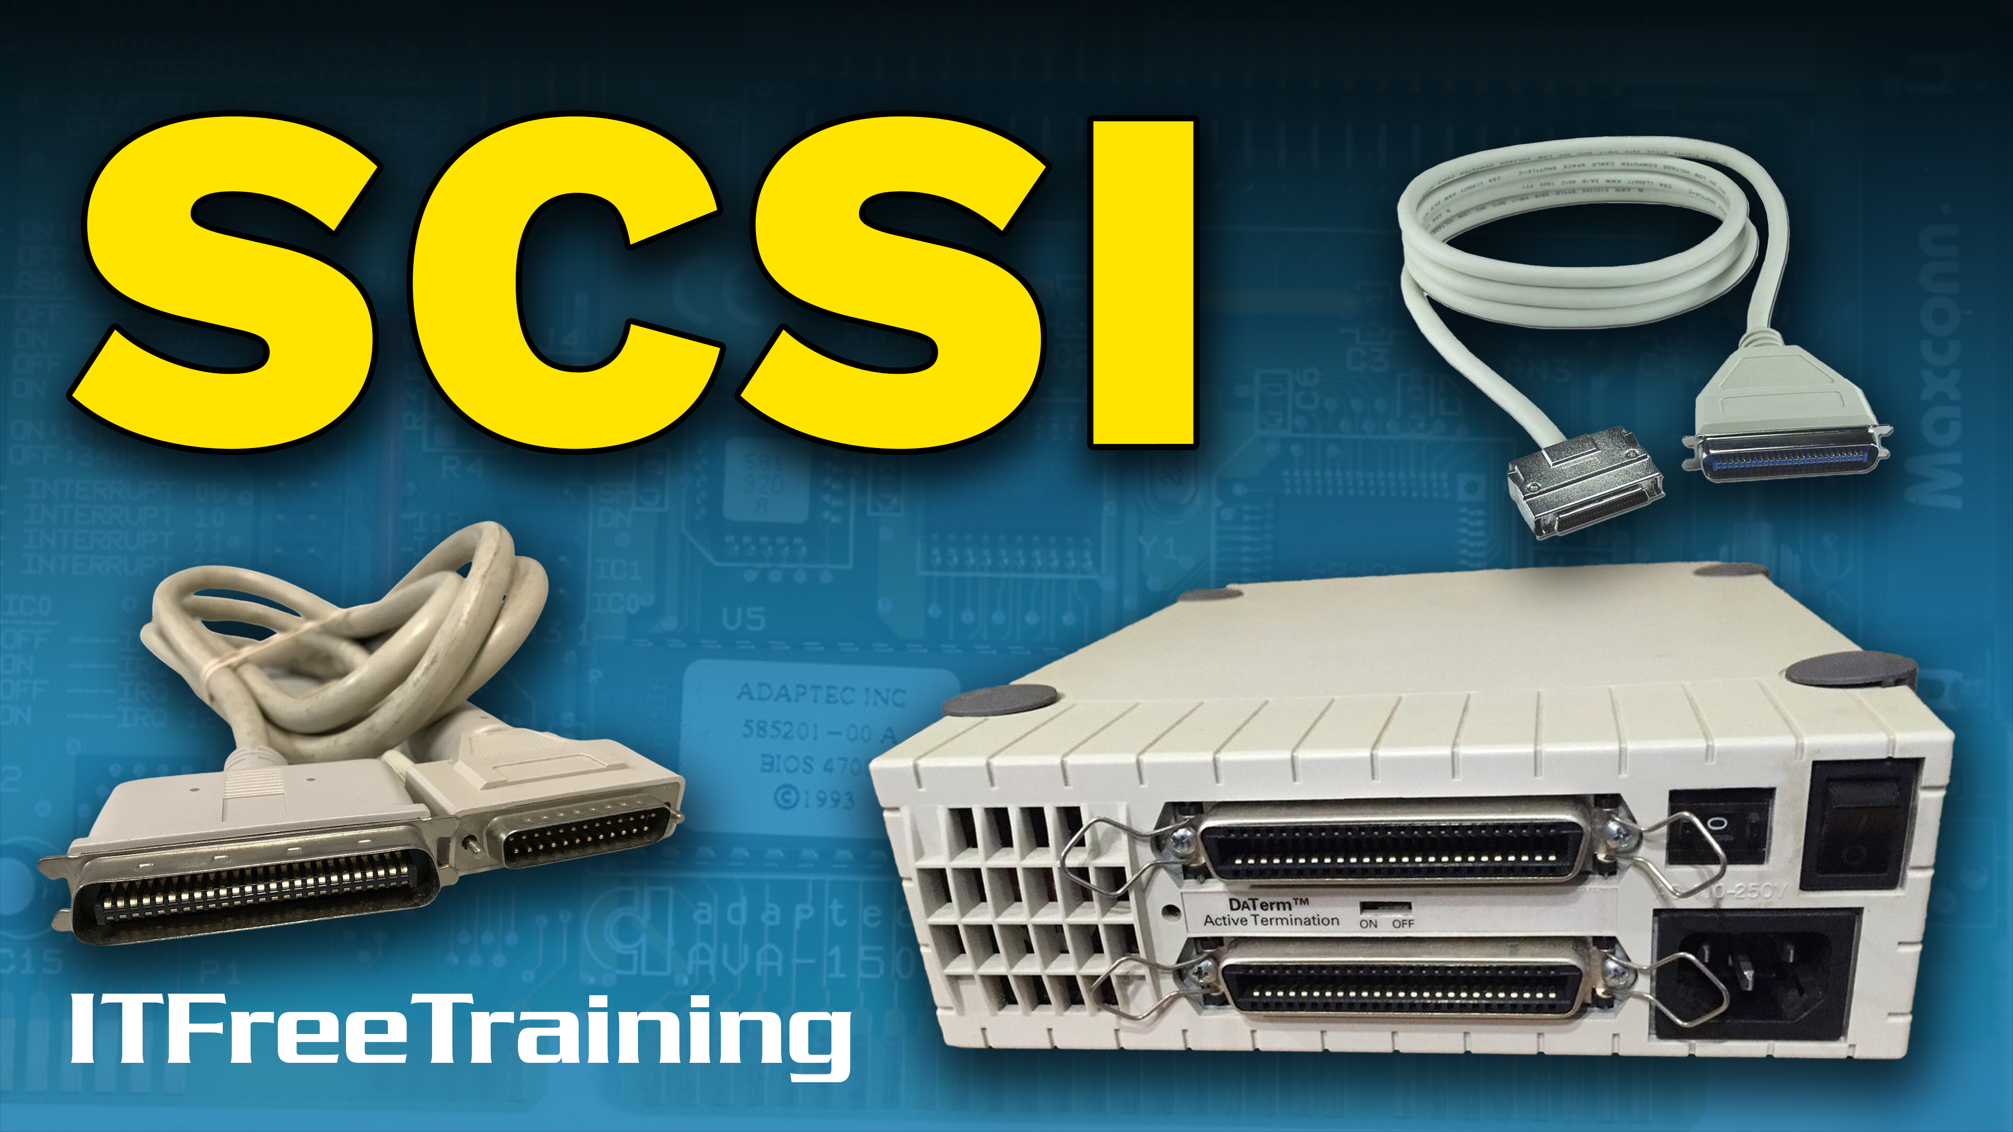
Notes:
In this video from ITFreeTraining, I will be having a more detailed look into SCSI. Nowadays, SCSI is obsolete, so you won’t come across it unless you are working with an old computer. There are some SCSI concepts that we still use today and also some new technology that is based on the original SCSI design.

Slide 2


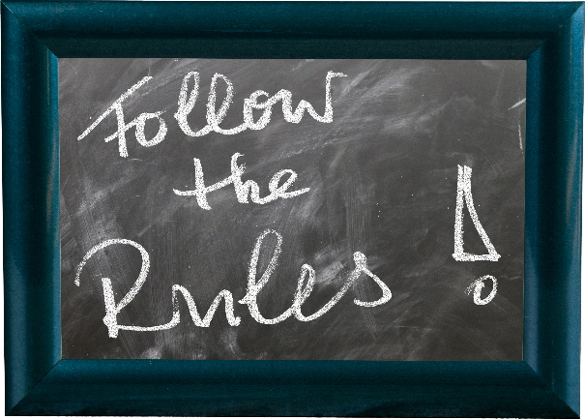
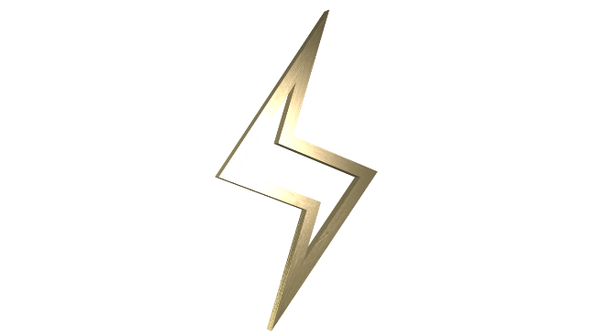

Small Computer System Interface (SCSI)
First developed in 1986
Defines
Commands
Protocols
Electrical/optical signals
Interface
ITFreeTraining.com
© Copyright 2022
Notes:
0:00:19 The Small Computer System Interface or SCSI was first developed in 1986. It defines the commands, protocols, electrical signals, optical signals and the interface that SCSI uses. SCSI was originally designed to connect devices like hard disks, scanners and printers together.
Although SCSI is obsolete nowadays, I will have a quick look at how it works and what parts of SCSI we still use today and how we use them.

Slide 3


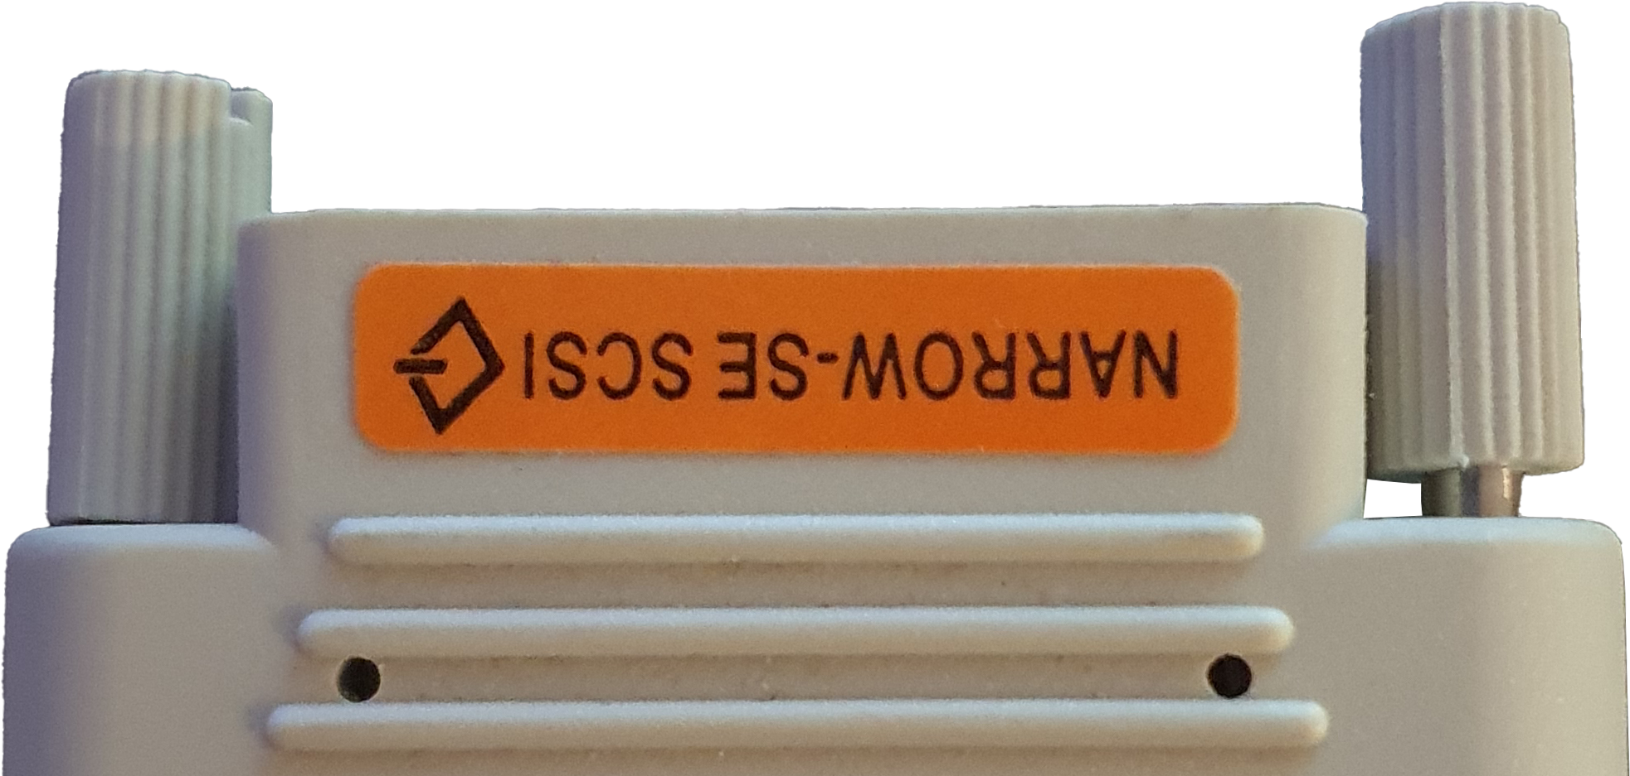
SCSI-1
Released in 1986
50-pin connector
8-bit Parallel interface
Was single ended (SE)
- Utilized a lot by Apple
ITFreeTraining.com
© Copyright 2022
Notes:
0:00:49 To start with, I will have a look at SCSI-1 first released in 1986. For the CompTIA A+ exam, you won’t need to know a lot about SCSI. I will do an overview of SCSI simply to give you a starting point, so you know where to look if you have to support an old SCSI system.
SCSI-1 uses a 50-pin connector. The connector was quite large by today’s standards, but was very durable. This version of SCSI uses an 8-bit parallel interface. This means that it can transfer eight bits of data at once.
The original version of SCSI signaling was called singled ended or SE. The SE connection was utilized a lot by Apple, so if you are working on an old Apple system it is probably has an SE connection.
In some cases, your SCSI devices and cables may be labeled as SE, in other cases they may not. Before I go into more detail about the different types of signaling used in SCSI, I will first have a look at the different types of connectors.

Slide 4
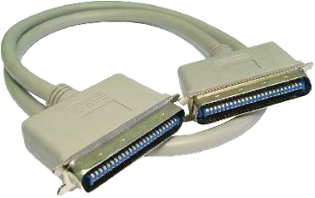
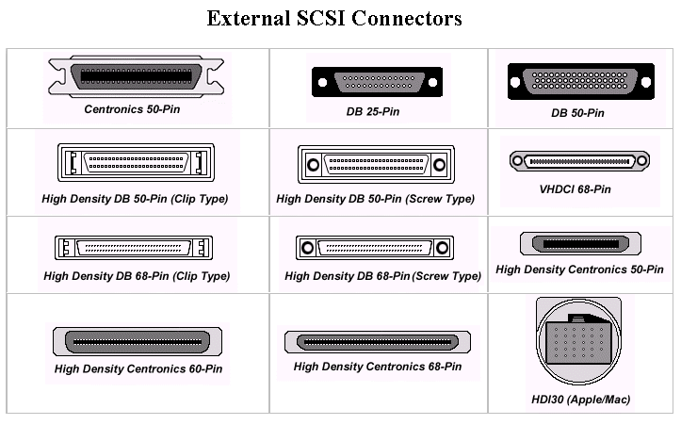
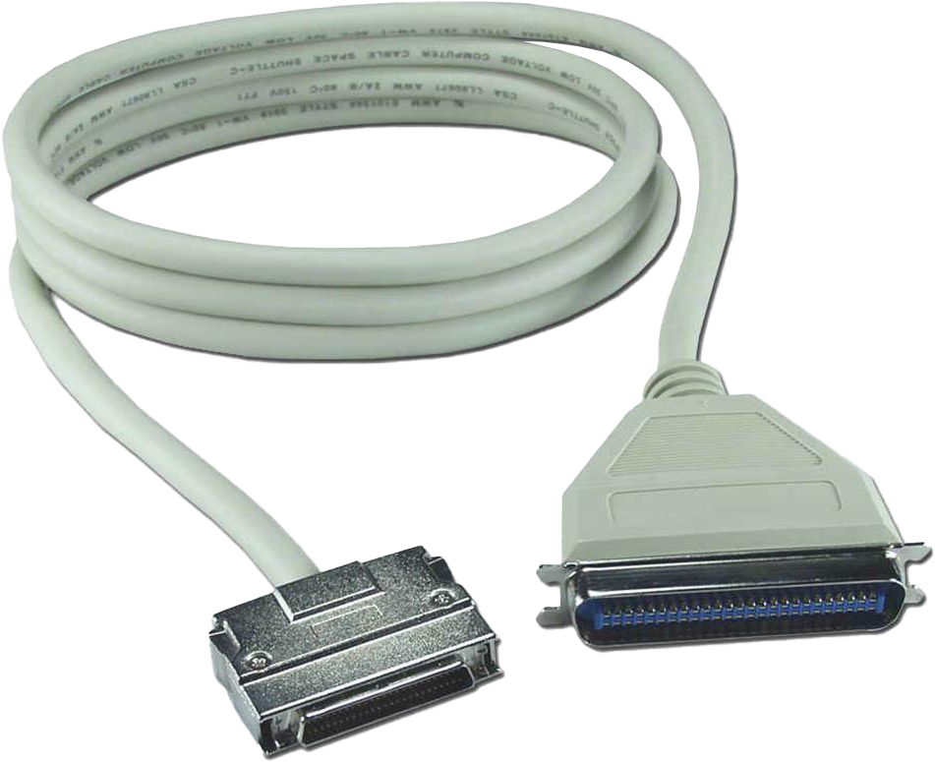
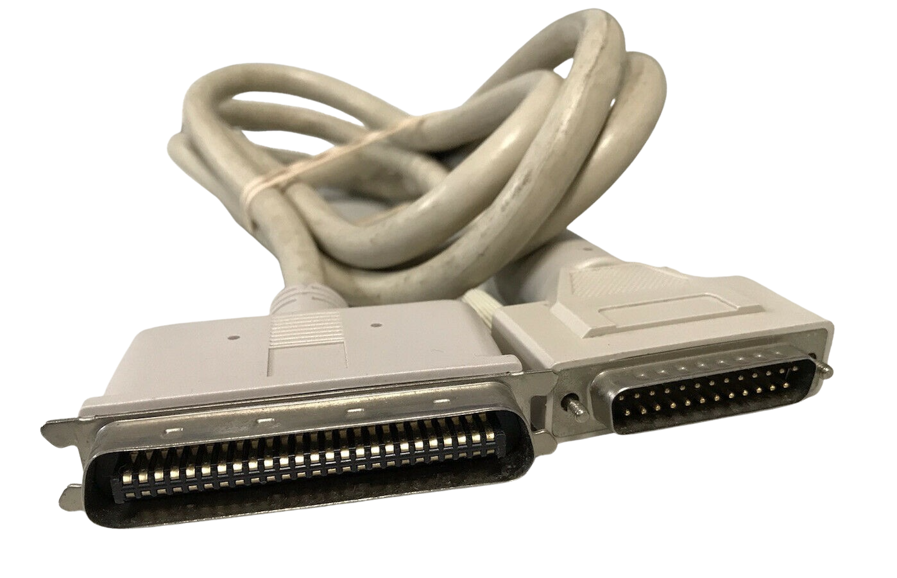
SCSI Connectors
Cables may have
different connectors
ITFreeTraining.com
© Copyright 2022
Notes:
0:01:51 There are a lot of different SCSI connectors available. Shown here are a few of them. This is not a complete list of all the different connectors. Although there are a lot, most of the time, it is a matter of matching the connector to the correct plug.
Shown here is a SCSI cable with the same connector on each end. SCSI allows multiple devices to be connected together sharing the same bus. Notice, however, the cables do not have to have the same connectors.
If you purchase a pre-made cable, you won’t need to worry about compatibility issues since they are made with compatibility in mind; however, there are some things that you should be aware of.

Slide 5



Signaling
Backwards
Compatible
Not
Compatible
Single Ended
(SE)
Low Voltage
Differential
(LVD)
High Voltage
Differential
(HVD)
ITFreeTraining.com
© Copyright 2022
Notes:
0:02:33 SCSI has three different types of signaling. The first is single ended or SE. This was the first signaling type used by SCSI. If you are working on an old Apple computer, it is most likely using this connector. In some cases, the cable or the plug will be labeled with SE.
The next signaling type is Low Voltage Differential or LVD. This worked similarly to SE in that it uses two wires – one data wire and one ground wire for each bit of data that is transferred. Having multiple groups of two wires allows data to be transferred in parallel. More on that later in the video.
Since SE and LVD use similar signaling, LVD is backwards compatible with SE. Keep in mind, however, that if you put an LVD and SE device on the same SCSI bus the whole SCSI bus will change to SE. This allows for compatibility, but SE is generally slower than LVD.
The last signaling type is High Voltage Differential or HVD. This type of signaling still uses two wires, however there is no ground wire. Instead, the wires are used for data and the difference in signal between the two is measured in order to determine if a zero or a one bit has been sent.
Since the signaling is so different to the other two, it is not compatible with the other two types. If you mistakenly connect the devices together, it can potentially damage them or the SCSI adapter. You generally won’t need to worry about this as the plugs are different for HVD compared to LVD and SE. This could be a problem if you purchased a custom cable or made your own cable.
Now that we understand the basics of signaling, let’s have a closer look at the differences in the types of cables.

Slide 6



Cable Types
50 wires
68 wires
80 wires
Narrow
8-bit
Wide
16-bit
With power
wires
ITFreeTraining.com
© Copyright 2022
Notes:
0:04:26 There are a lot of different cable types out there for traditional SCSI when you start looking at the different plugs on the end. However, these can be broken down into three basic types. The first type is a 50-pin cable which is often referred to as ‘narrow’. This type of cable is limited to transferring eight bits at once.
The next cable type has 68 wires. This cable is often referred to as ‘wide’ and can transfer 16 bits at once in parallel. The last cable type has 80 pins and includes power wires.
Although there are many different types of plugs for SCSI, they essentially all work with these numbers of wires. Before I look at the issues you may have if you combine different types of SCSI, I will first look at how the SCSI bus works.

Slide 7
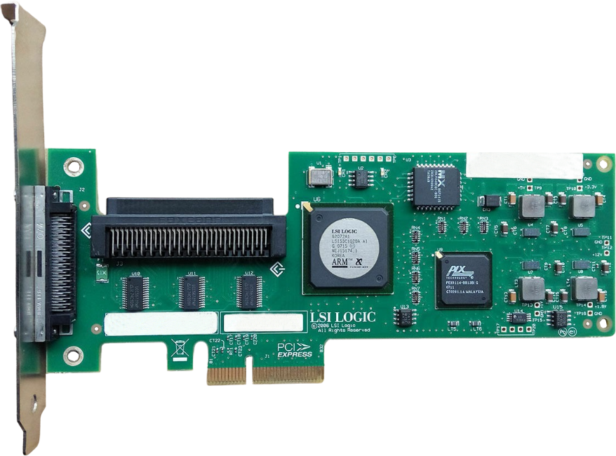
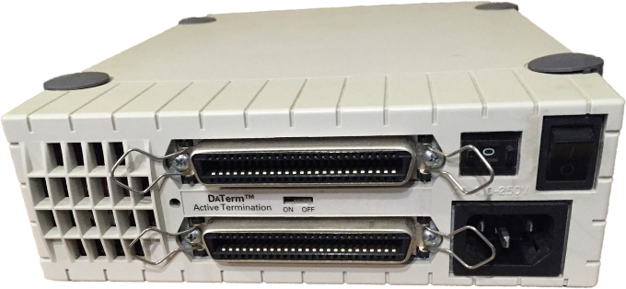
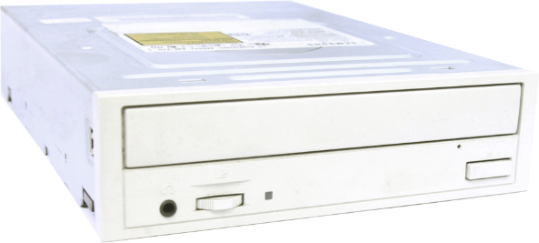
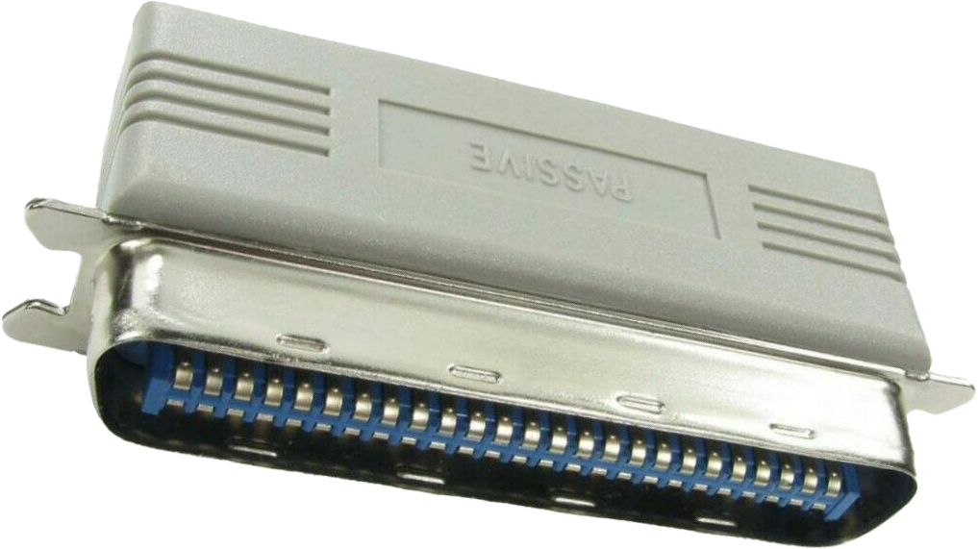
SCSI Bus
SCSI Bus
SCSI Bus
SCSI Bus
SCSI
Controller
SCSI
Device
SCSI
Device
SCSI
Terminator
First device is the SCSI controller
Devices connected in daisy chain
Last device needs to be terminated
ITFreeTraining.com
© Copyright 2022
Notes:
0:05:17 SCSI allows a number of SCSI devices to be connected together which utilize the same bus. The first device on the bus is the SCSI controller. This is different to other storage devices like SATA where the controller does not count as a device.
In order to use the SCSI controller, a SCSI device can be connected to it. In this case, the SCSI device is external to the computer; however, it could also be inside the computer itself. For example, SCSI RAID devices in servers are often built into the server itself.
Additional devices are connected in a daisy chain. A lot of external SCSI devices will have two plugs in them. One plug is for the previous device or a controller and the second to connect to the next device.
At the end of the SCSI bus there needs to be a terminator. Either a terminator needs to be plugged into the device or the device itself has to be self-terminating. When the signal travels down the SCSI cable without a terminator on the end the signal will be reflected back down the cable. Both ends of the cable need to be terminated, so the SCSI controller itself will also have a terminator built in. If a terminator is missing or damaged on either end of the cable, the bus will not work.
Let’s have a closer look at the terminator and see what affect it has on the SCSI bus.

Slide 8
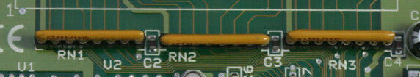
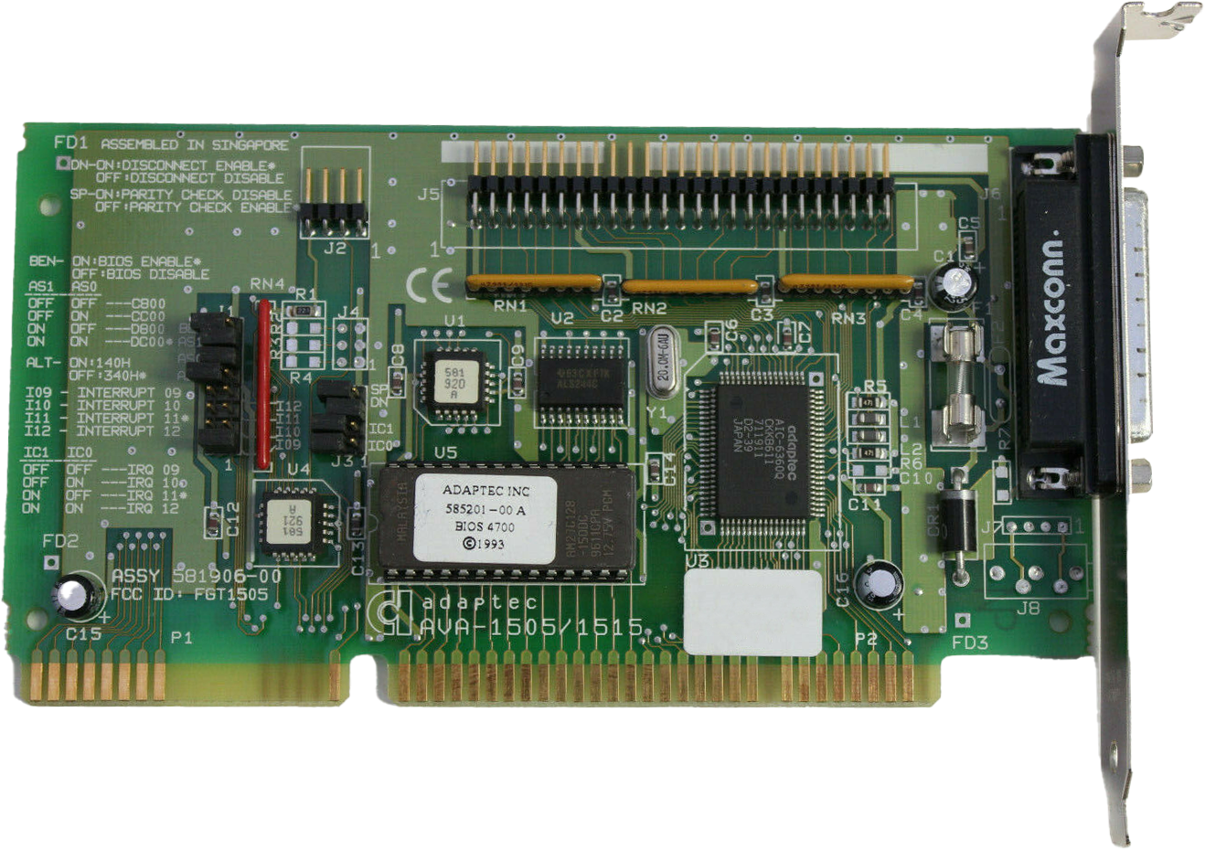
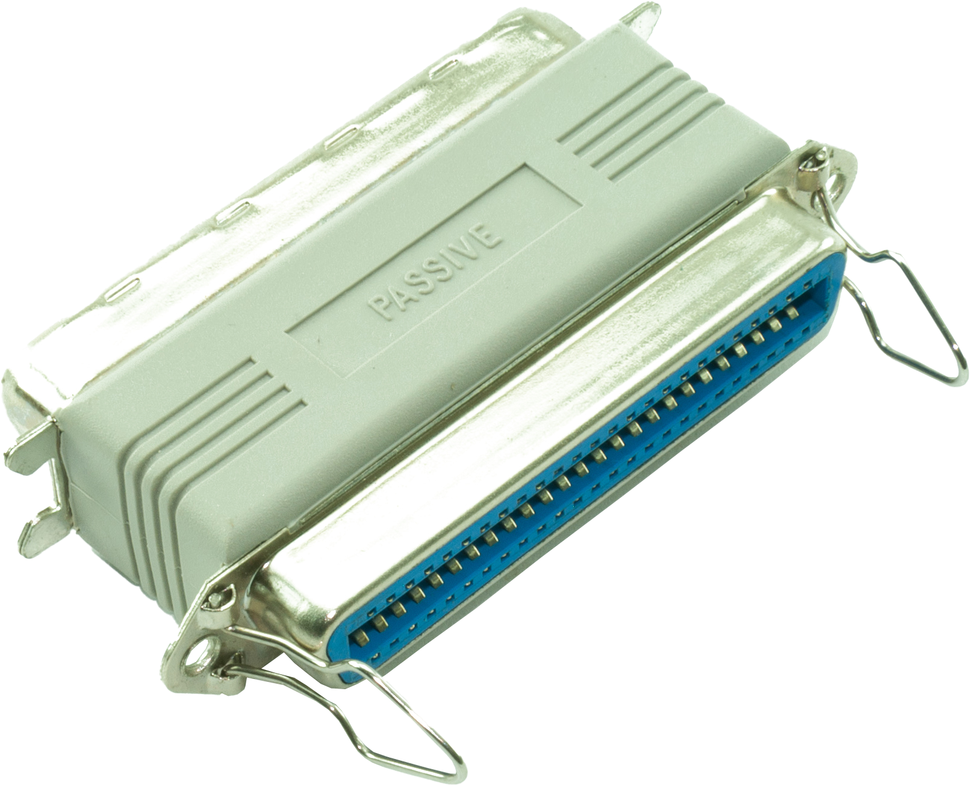
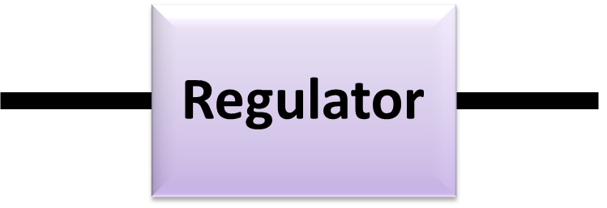
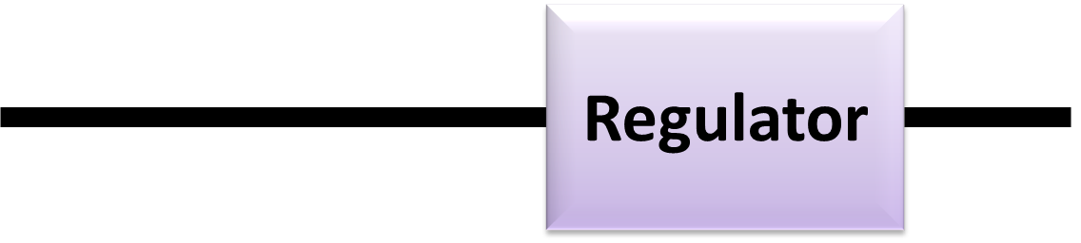
Passive/Active/Pass Through
Prevents reflections of electrical signals
5v
Same output
voltage
Long cable
Reduced
voltage
Passive – Uses resistors
Active – Voltage regulator
Pass Through
Notes:
0:06:42 A terminator is essentially a device that prevents reflections of electrical signals. A terminator needs to be installed on either end of the cable. If a terminator is not present, the signal on the cable will be affected and most likely will not work.
There are different types of terminators available. The simplest is a passive adapter. A passive adapter uses resistors at the end of the cable. You can see in this old SCSI card, the resistors on the card that perform the termination.
Using resistors like these is the cheapest option; however, problems arise if you start using a longer cable. The longer the cable, the more likely the voltage on the cable will start to drop. The effect the resistors has does not change depending on how long the cable is. Thus, if you use a longer cable with a passive terminator, you are more likely to have signal problems.
To get around this problem, active terminators can be used. Active terminators use voltage regulators rather than resistors. A SCSI cable will use five volts to transfer a signal over the cable. The problem occurs when using a long cable. When the SCSI cable gets longer, the voltage starts reducing.
Resistors are not able to adapt to the reduced voltage; however, by using regulators, the voltage that passes through the terminator will always be the same. This makes the cable more reliable, particularly when the cable length gets longer.
Active terminators give better signal quality, so it is recommended that you use an active terminator over a passive terminator whenever possible.
The next type of terminator that you may come across is a pass-through terminator. These terminators have a connector on each side. These connectors work like the other terminators. However, if you plug another device into the terminator, the terminator is effectively disabled. You will still need to have a terminator on the other end. In some cases, the next device may be a self-terminating device. Self-terminating devices do not require a terminator, as the name suggests, as they will self-terminate if they are the last device in the chain.
Now that we understand how terminators work, let’s now have a look at how devices on a SCSI cable are identified.

Slide 9
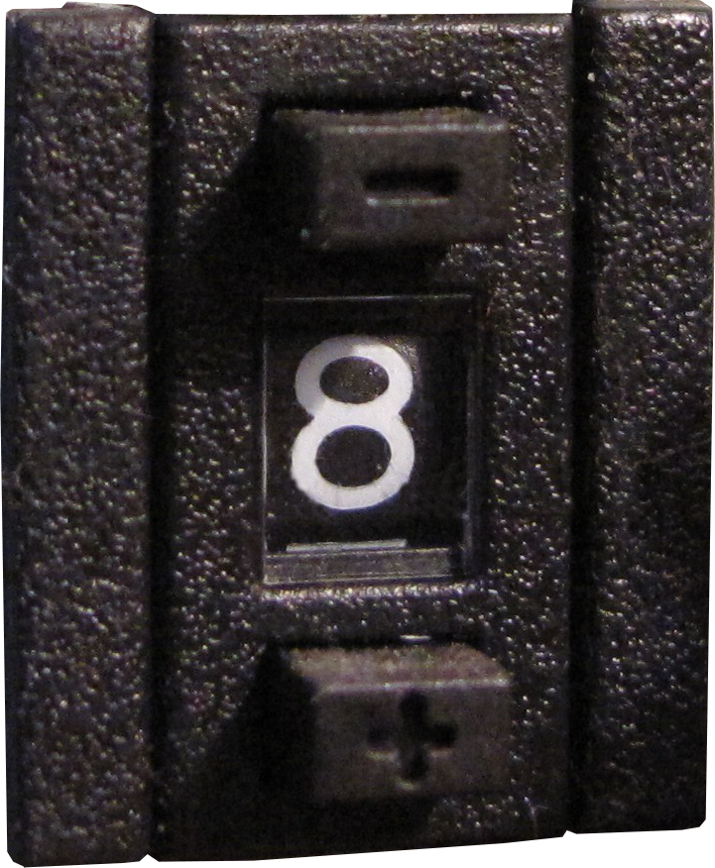
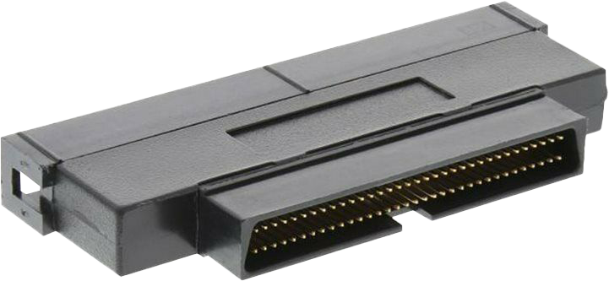
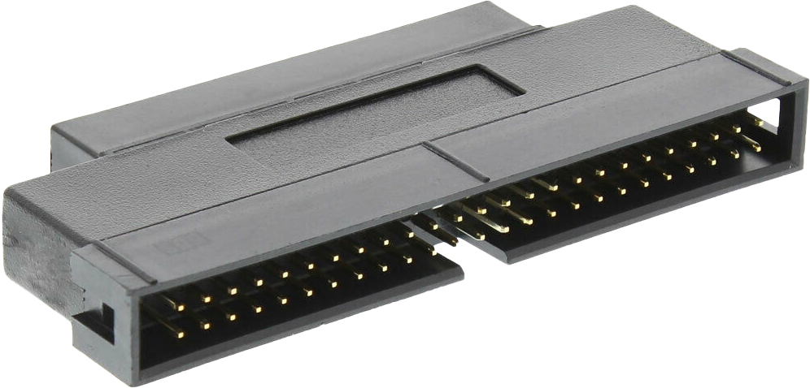
SCSI ID
Number uniquely identifies device on the SCSI bus
ID 7 usually used for SCSI adapter
Wide 0-15 IDs (68 wires)
Narrow 0-7 IDs (50 wires)
ITFreeTraining.com
© Copyright 2022
Notes:
0:09:02 SCSI uses a unique ID to identify each device on the SCSI bus. On the back of your SCSI device there may be a number to indicate which ID the device is using. Often this number, the SCSI ID, can be changed by clicking a button above or below the number to increment or decrement this number. In some cases, there may be jumpers at the back of the device to change the SCSI ID.
In the case of wide SCSI, the SCSI device will support 16 IDs starting from zero. The SCSI adapter requires a SCSI ID as well and generally this will be seven. So, in the case of wide SCSI, a device won’t be able to use SCSI ID seven.
In the case of narrow SCSI, there are eight SCSI IDs. Once again, the SCSI adapter will usually use SCSI ID seven. It may seem strange in the case of wide SCSI to have the SCSI ID in the middle of the ID range. The reason for this is, it is possible to combine wide and narrow SCSI together. When this occurs, the bus will change to narrow SCSI. You can see why they use seven since it won’t change if the bus changes from wide to narrow. Perhaps they should have used SCSI ID zero for the SCSI adapter, however it appears the thinking at the time was to use the last SCSI ID on the bus. When they created wide SCSI, they had already set a convention, so it was too late to change.
Also notice in this case, the wide plug is smaller than the narrow plug. When using SCSI devices, keep in mind that it is not the size of the plug that determines if it is wide or narrow, it is the number of pins.
In the case of single-ended SCSI devices, it is possible to have an adapter in the chain that sends the wide signals back to the bus so the whole bus does not drop to narrow. Thus, if you are using narrow devices on a wide bus, you should put the narrow devices at the end of the cable. This way, if supported, some of the bus will be wide and some will be narrow.
Let’s have a look at the different standards of SCSI.

Slide 10
SCSI Standards
Interface Protocol | Interface | Bandwidth (MB/s)
SCSI-1 | SCSI-1 | 5
Fast SCSI | SCSI-2 | 10
Fast-Wide SCSI | SCSI-2 | 20
Ultra SCSI | SCSI-3 | 20
Ultra Wide SCSI | SCSI-3 | 40
Ultra2 SCSI | SCSI-3 | 40
Ultra2 Wide SCSI | SCSI-3 | 80
Ultra3 SCSI (Ultra 160 SCSI) | SCSI-3 | 160
Ultra 320 SCSI | SCSI-3 | 320
ITFreeTraining.com
© Copyright 2022
Notes:
0:11:14 As you can see, there were a lot of different versions of SCSI and this is not even a complete list. If you work with a SCSI device, you may see it referred to as one of these names. For example, fast SCSI, Ultra Wide SCSI or Ultra 320 SCSI to name a few. With so many different versions of SCSI and the difficulty of setting it up, you can see why SCSI was primarily used with servers and high-performance workstations. SCSI offered great performance at the time; however, due to how complex it was and the additional cost, it did not take off in the home market or in
low-performance computers.
You will only come across SCSI like these in old computers and servers; however, there are parts of SCSI that are still used today.

Slide 11
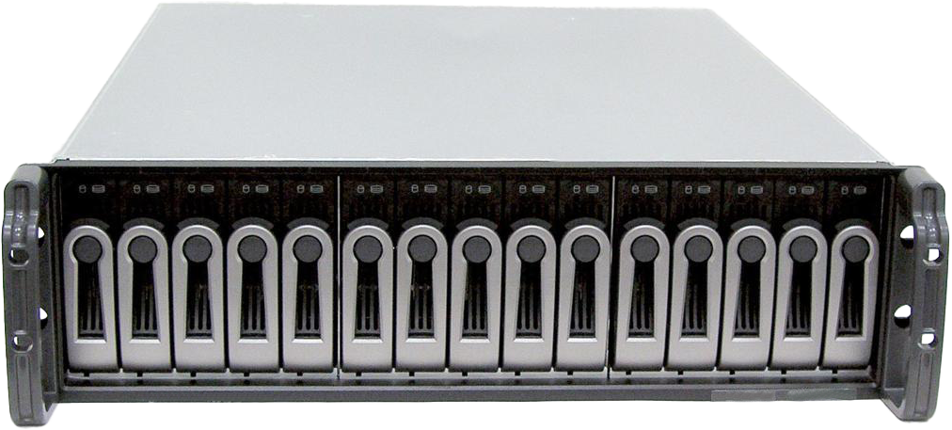
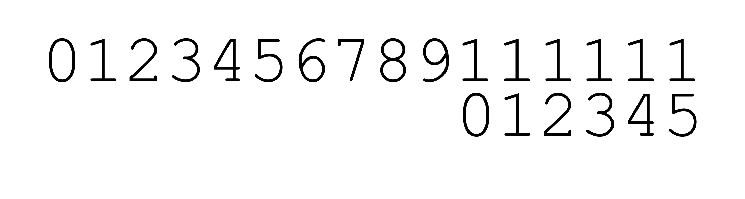
Logical Unit Number (LUN)
Used to identify a logical unit
SCSI ID 0
ID used to
identify individual HDD
ITFreeTraining.com
© Copyright 2022
Notes:
0:12:03 When working with some devices, you may come across the term LUN. A LUN is used to identify a logical unit. For example, let’s consider that you have a SCSI enclosure. This SCSI enclosure has 16 hard disks, however, given that it is a RAID enclosure all the hard disks will appear as one storage area. Thus, the enclosure is given the SCSI ID of zero. Each hard disk is given a number which is the LUN. The LUN is used to identify each hard disk. We now have a way of accessing the whole device and also the individual hard disks.
In this case, the LUN has been used for each hard disk, however it could also be used to split up the storage area. For example, the storage could be broken into halves with each half having its own LUN. The ways the LUNs are used is up to the manufacturer, so keep in mind they may refer to different things depending on the implementation.
The old SCSI connectors are obsolete nowadays, so you probably won’t come across them unless you are working with old hardware. However, the protocol behind SCSI is quite good and is still used today. Let’s have a look.

Slide 12
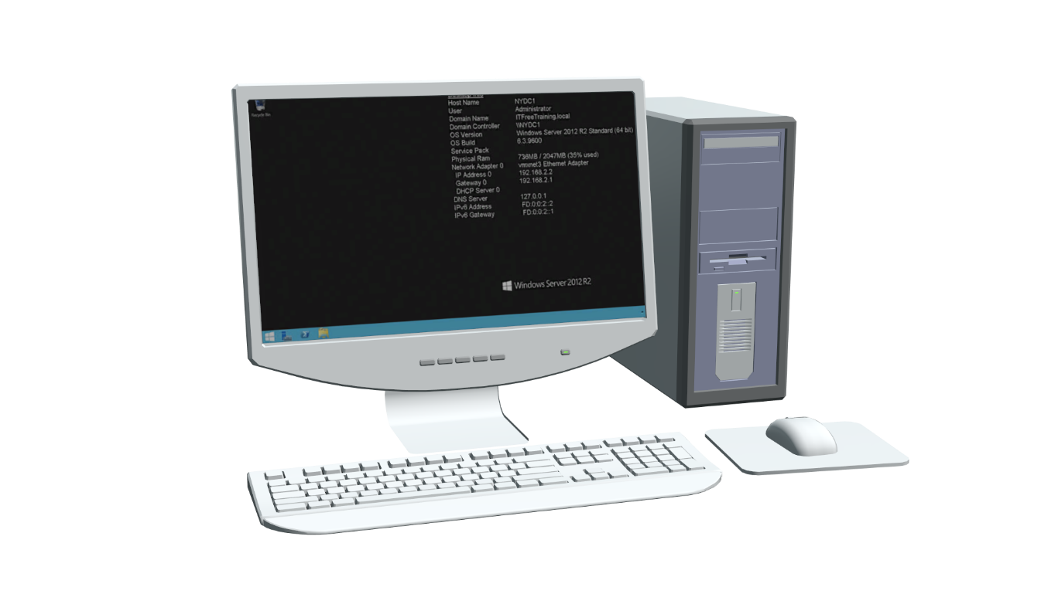
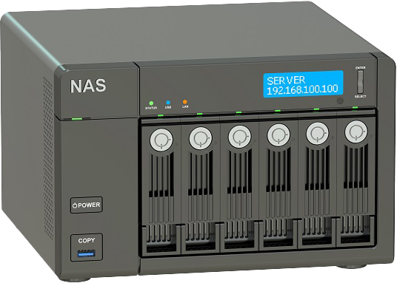
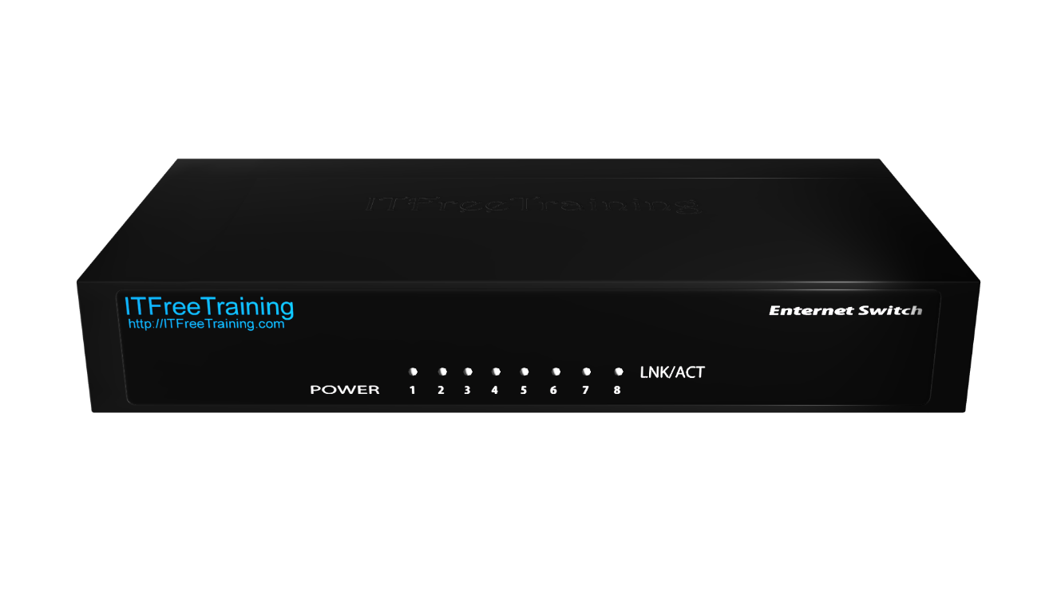
iSCSI
SCSI over IP
Allows block access to remote storage
iSCSI Initiator
iSCSI Target
Network
ITFreeTraining.com
© Copyright 2022
Notes:
0:13:19 One of the ways SCSI is still used today is iSCSI. iSCSI is essentially SCSI over IP. Instead of using a cable it uses the network to transfer signals. Without having to pay for SCSI cables, that includes hardware that goes with them, storage could be accessed using existing networks and hardware.
In order to get iSCSI to work, a computer needs to have software installed called an initiator. These may come with the operating system, or they may need to be purchased separately. The initiator will send the SCSI commands over the network. On the other end, there will need to be a device that will accept these commands. These devices will have a target configured that the initiator will connect to. For example, a device like Network Attached Storage or NAS.
Devices like these often provide a low-cost way to access storage over other methods like a fiber solution or devices like SANs (Storage Area Networks). This is different to sharing files over the network as iSCSI provides block access to the remote storage. Block access essentially means the operating system will access it the same way as locally attached storage. The remote storage will appear to the operating system just like a hard disk and can also use the same low-level instructions as a hard disk would.
Let’s have a look at another common implementation of SCSI that is used today.

Slide 13
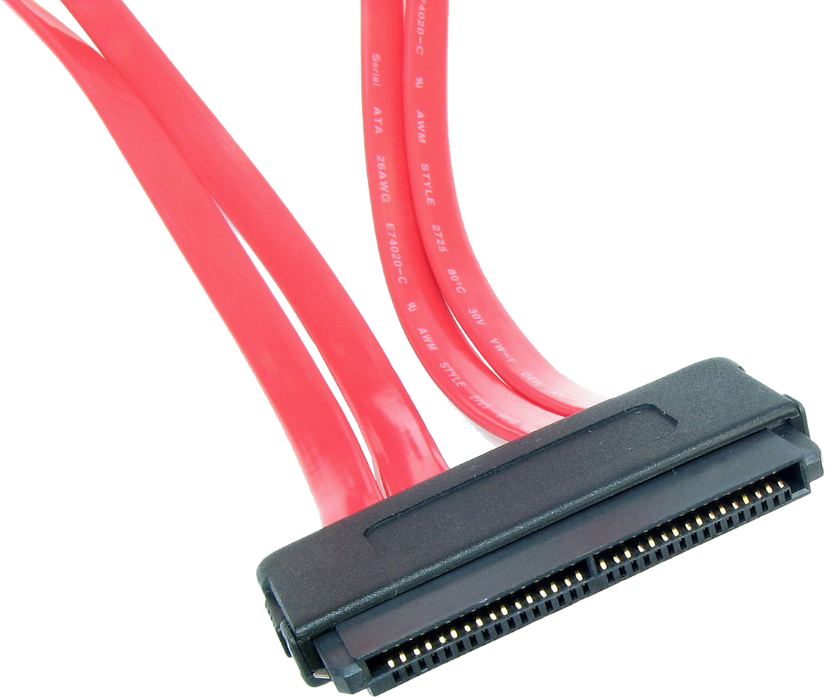
SAS (Serial Attached SCSI)
Uses serial rather than parallel
Each port has unique identifier
Each device has unique identifier
Mainly used for cloud/servers
ITFreeTraining.com
© Copyright 2022
Notes:
0:14:48 The most common implementation of SCSI that you would come across today is Serial Attached SCSI otherwise known as SAS. SAS uses serial rather than parallel for communication. Serial communication nowadays can obtain much higher transfer rates than parallel due to the difficulty of keeping parallel data in sync.
Each port in SAS has its own unique identifier and also each device has its own unique identifier. This replaces the need for LUNs. You may see LUN terminology used with SCSI implementation, but in a lot of cases different terminology will be used. You generally find that each implementation will have a way of referring to small parts of the storage. Since each port and device has its own unique number, SAS does not use SCSI IDs.
SAS is mainly used for cloud storage and servers. You won’t see it in home and business computers. Even high-end workstations don’t tend to use it. Now that we have a good understanding of SCSI, let’s have a look at when you may come across it.

Slide 14

In The Real World
Traditional SCSI obsolete
Make sure devices on bus have unique ID
Both ends of SCSI bus are terminated
SCSI protocol still good and used
iSCSI for network use
SAS for high-end use
ITFreeTraining.com
© Copyright 2022
Notes:
0:15:56 Nowadays, traditional SCSI is obsolete. As we have seen, there are a lot of different cables; however, the cables do come with different connectors. Hopefully if you work with it, it is just a matter of making sure the right connectors are used. If the connectors don’t match, the devices may be using different versions of SCSI.
When connecting a SCSI device, make sure the device has a unique ID on that bus. Both ends of the SCSI bus also need to be terminated. Some devices are self-terminating, while for others you will be required to put a terminator on the end. In a lot of cases, devices can be hot swapped in a SCSI bus; however, not in all cases. If you have a SCSI bus that is also connected to a RAID or another device inside the computer, adding a new device may cause a failure. Sometimes the reason for this may not be clear. For example, sometimes a RAID controller will have a plug on the back of the server that is connected to the RAID device inside the server. Don’t assume that just because there is a spare plug on the server or SCSI card it is on a separate SCSI bus.
Even though traditional SCSI is obsolete, the protocol is still used today. For this reason, it is used in iSCSI for network use and SAS for high-end use usually in large storage devices. In most cases, this will be the only time that you will come across it.

Slide 15

Subscribe
Next video
Video content: https://ITFreeTraining.com/ap/3b45
© Copyright 2022
Notes:
0:17:20 This concludes this video on SCSI. I hope you have found this video informative. Until the next video from us, I would like to thank you for watching.
References
“The Official CompTIA A+ Core Study Guide (Exam 220-1001)” Chapter 3 Paragraph 163-171
“CompTIA A+ Certification exam guide. Tenth edition” Pages 302-303
“SCSI” https://en.wikipedia.org/wiki/SCSI
“SCSI FAQ” http://www.paralan.com/scsifaq/scsifaqanswers.html
“Picture: Follow the rules” https://pixabay.com/photos/board-empty-rule-instruction-3772063/
“Picture: Picture Frame” https://unsplash.com/photos/22ikHjykXg4
“Video: Cat putting head in jar” https://www.pexels.com/video/animal-pet-cute-kitten-6853193/
“Picture: SCSI ID” https://commons.wikimedia.org/wiki/File:Skener_UMAX_PowerLook_II,_SCSI_ID.JPG
“Picture: SAS Cable” https://en.wikipedia.org/wiki/Serial_Attached_SCSI#/media/File:SFF-8484-internal-connector-0a.jpg
“Picture: SAS Raid” https://commons.wikimedia.org/wiki/File:HuaweiRH2288HV2.JPG
Credits
Trainer: Austin Mason http://ITFreeTraining.com
Voice Talent: HP Lewis http://hplewis.com
Quality Assurance: Brett Batson http://www.pbb-proofreading.uk

