Slide 1
Notes:
CompTIA still has PATA listed as an exam objective. Manufacturers of hard disks stopped making them around 2013 and other than on sites like eBay you won’t be able to find them. If you are stuck using this old technology, I will look at some work arounds later in the video.

Slide 2
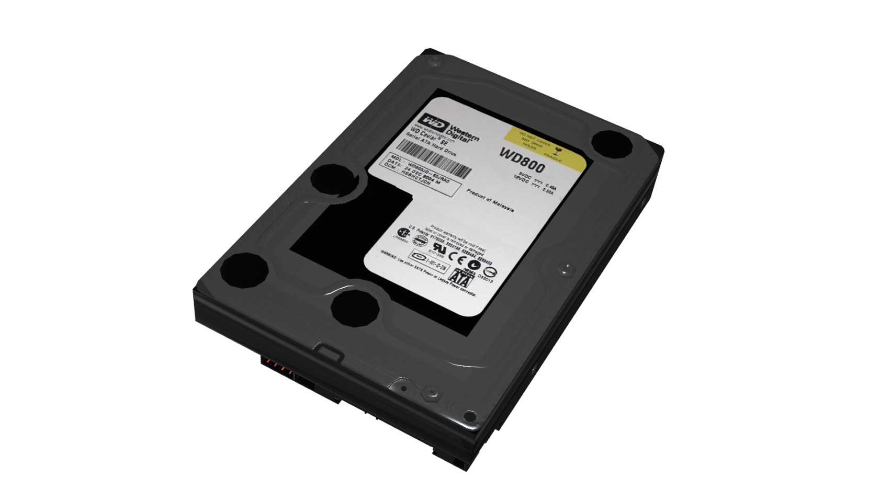
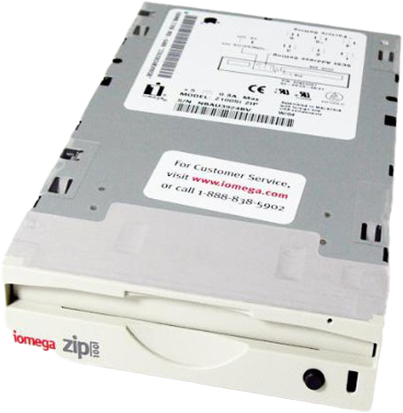
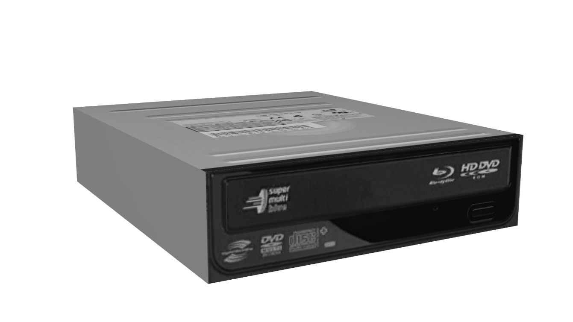
AT Attachment (ATA)
Used to connect storage devices
Started to be used in 1986
Notes:
To start from the beginning, AT Attachment or ATA started to be used in computers in 1986. It was designed to connect storage devices, so is used to connect devices such as hard disks, CD ROMs and large capacity removable drives like zip drives.
ATA used a cable to allow the computer to communicate with the storage device. Although it is the technical name for it, we will see why you may see it called by several different names.

Slide 3
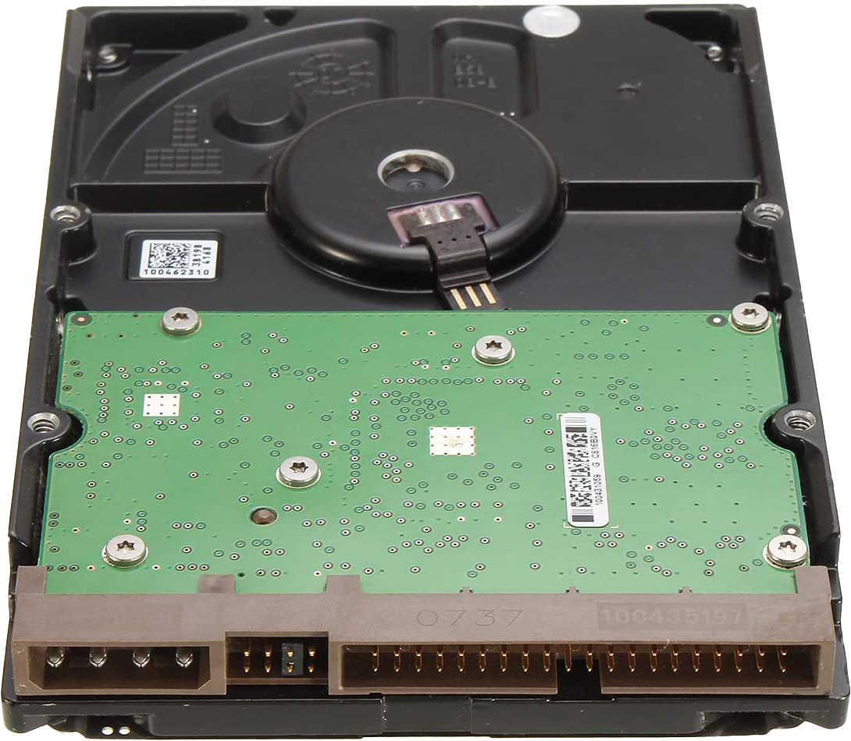
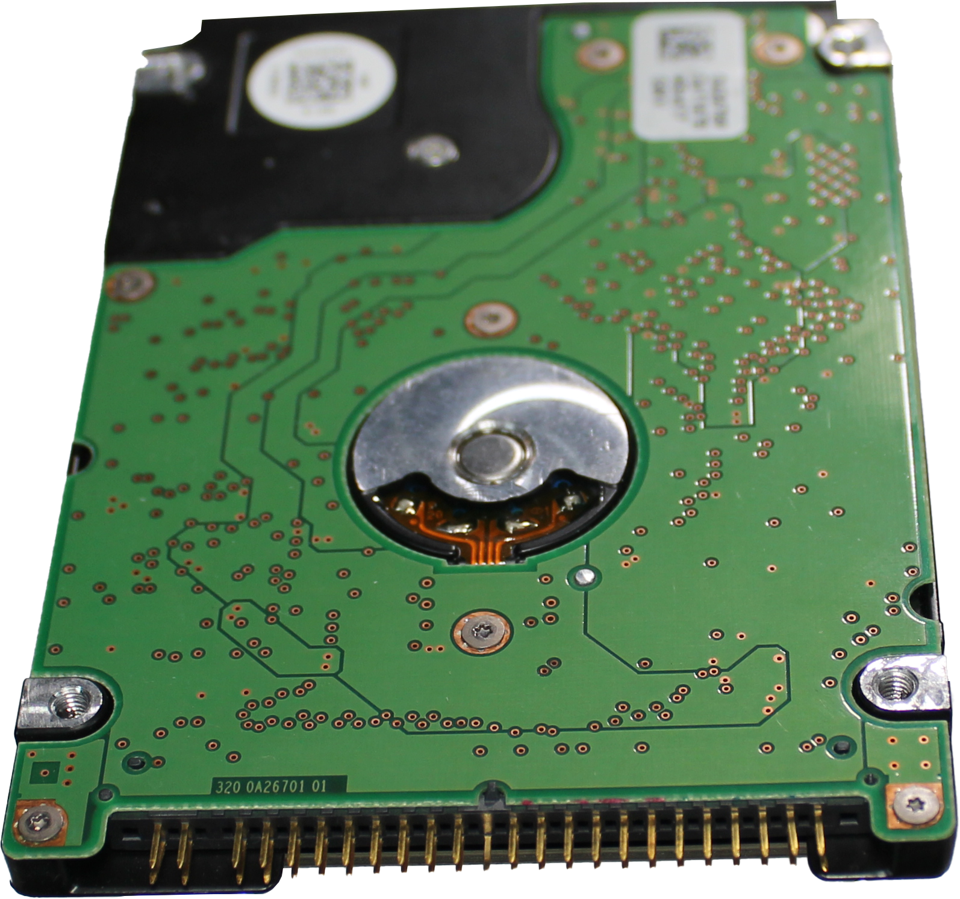
Integrated Drive Electronics (IDE)
Incrementally improved but often called IDE
First release version in 1986 (ATA-1)
Circuit board
Handles some of
the processing
Notes:
The first release of ATA was in 1986. This was a Western Digital design called Integrated Drive Electronics or IDE. It was called this because the hard disk included electronics which took instructions from the computer and translated them into hard disk commands. For example, moving the hard disk head to read a particular sector. If you think about it, every hard disk on the market, nowadays, has electronics that technically make them an IDE drive, however this term was only applied to the first hard disks and stuck for a while before the term was no longer used with newer hard disks.
If I consider two different IDE hard disks. The one on the left is the larger one often used in desktop computers. The one on the right is a smaller version that is often used in laptops. Both of these have a circuit board which provides the interface. Essentially the circuit board is a drive controller creating a standard interface between the computer and the data on the drive. Before this, the drive controller was part of the motherboard. With IDE, the drive controller made the transition from the motherboard to the hard disk. This means a hard disk manufacturer only needed to make their hard disks compatible with this standard and then they would work with any computer that supported that standard.
The hard disk circuit board would handle steps such as working out where the data was, where to move the hard disk head and controlling other operations of the hard disk. This effectively took the load off the computer as it no longer had to perform these calculations, it only had to send the request to the hard disk’s circuit board to be actioned. This reduced the overhead on the computer as some of the processing was now done by the hard disk.
This initial design was incrementally improved over time and technically only the first design was called IDE, however the name stuck. Since every hard disk after this used a circuit board to process instructions, they effectively have integrated device electronics, so technically this is also incorrect. The main point to take away is, that if you see a hard disk like these, they may be referred to as IDE. Let’s have a closer look at the interface used by these hard disks.

Slide 4
ATAPI
E.g., added features like media ejection
Added support for other devices
ATA Packet Interface
Interface Standard | Other names | MBps
ATA/ATAPI-4 | UDMA 2 (Ultra ATA/33) | 33
ATA/ATAPI-5 | UDMA 4 (Ultra ATA/66) | 66
ATA/ATAPI-6 | UDMA 5 (Ultra ATA/100) | 100
ATA/ATAPI-7 | UDMA 6 (Ultra ATA/133) | 133
* PATA, ATA, ATAPI, UDMA, IDE, EIDE used interchangeably
Notes:
Before I start having a closer look at how these hard disks work, I will first have a look at the standard ATAPI. The technology is obsolete nowadays, so you don’t need to remember it, the only time you may need to know it is if you are looking at product packaging or motherboard manual and you see it. When you see it, you will know they are talking about the same technology.
ATAPI stands for ATA Packet Interface. ATA was designed for hard disks and thus lacked some features required for other devices. ATAPI added additional features to support non-hard-disk devices. For example, it adds the ability to eject media which is required for some devices.
Shown here are the common standards used. Don’t worry about remembering them as you are unlikely to come across this technology and it is backwards compatible anyway. If you do come across this technology, you may see it referred to as ATAPI followed by the version number, or UDMA. UDMA stands for Ultra Direct Memory Access. This allows the hard disks to transfer data at high speeds; however, required a change to the cable which I will cover later in the video.
The name Ultra ATA was a name created to differentiate it from the earlier ATA standard. After Ultra ATA is the speed in Megabytes per second. Since this technology is so old, if you come across a device, it will most likely support Ultra ATA/133 since this is the latest version.
The most important point to take away from this video is, that if you come across the terminology PATA, ATA, ATAPI, UDMA, IDE or EIDE they are all referring to the same technology. EIDE or Extended IDE referred to a newer version of IDE. I have not covered PATA yet but will cover it next.

Slide 5
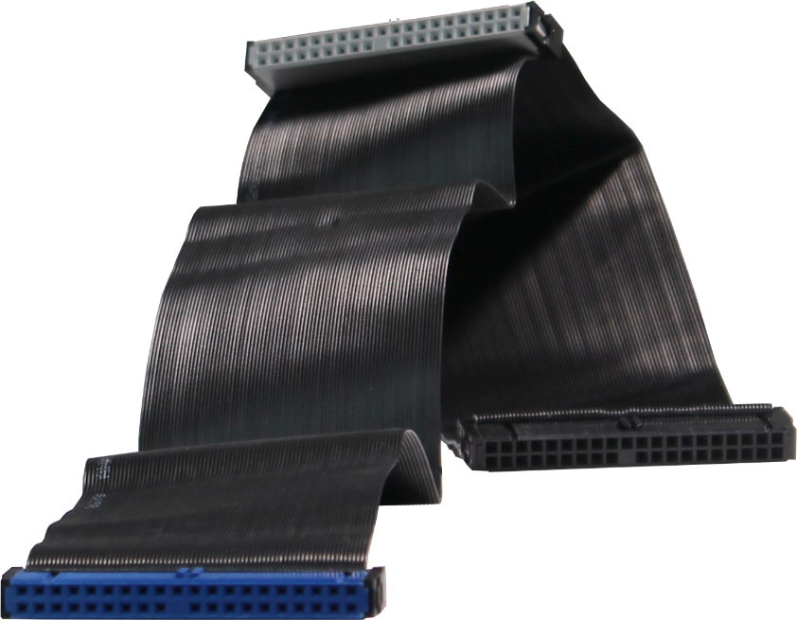
PATA
Should be referred to as this but may not be
Parallel Advanced Technology Attachment (PATA)
In 2003 (SATA released) ATA was renamed to
40-pin cable
Motherboard
(Blue)
Master/Device 0
(Black)
80-pin cable (Adds 40 ground wires)
Slave/Device 1 (Gray)
Notes:
To try and make things less confusing, in 2003 SATA was released and ATA was renamed to Parallel Advanced Technology Attachment or PATA. Going forward, this covers all the other terms I talked about before. So PATA should be used in the future for IDE, ATA and all the others, but the old terminology could still be used. From now on I will just refer to any of those standards as PATA.
The reason that we can bring all these standards under the same name is that they are improvements of the previous standards but are backwards compatible. The most noticeable similarity is that they all use a 40 or 80-wire ribbon cable.
Both cables have 40 pins, the difference is that the 80-wire cable has an extra ground wire for each data wire making 80 wires in total. Having a ground wire for each wire in the cable allows the cable to send more data at a higher speed. The top cable shown has 40 wires and the bottom cable 80 wires. You can see that it is difficult to tell which is which.
PATA cables will generally have three connectors. The first connector is plugged into the motherboard. As time went on, the convention was that this connector was colored blue. It is up to the manufacturer to follow this convention, so you may purchase a cable which has a different color connector.
Since the cable has three connectors, one motherboard and two drive connectors, it can support two hard disks. If there are two hard disks connected, there needs to be a way to determine which hard disk is which. There are two different ways of doing this. The first one that I will look at is what is called ‘cable select’. That is, the hard disks are identified by which connector they are plugged into.
You will notice there is a big gap in the cable before the connection. The next connection is referred to as the slave or Device 1. By convention, this connector should be gray, but it may not be. The very first hard disks required one hard disk to be a master drive and the second to be a slave drive. Very old systems would not work if one of the hard disks was not configured as a master drive. As time went on, this was no longer a requirement. Thus, it was later referred to as Device 1 rather than Slave.
If you had not guessed it already, the next connector is the master or Device 0 connector. If you are installing a single hard disk, you would generally plug it into this connector. This is one way that you can configure the hard disk to be Device 0 or Device 1. Let’s have a look at the next way.

Slide 6
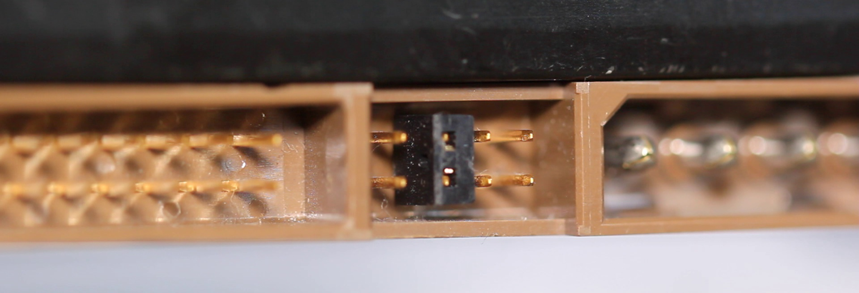
Cable Select Master/Slave Device 0/1
Jumper determines drive configurations
 | Master or single drive
 | Drive is slave
 | Master with non-ATA compatible slave
 | Cable Select
 | Limit drive capacity
Notes:
Most PATA drives will have jumpers at the rear of the drive. These jumpers determine the drive configuration. The hard disk will generally have a sticker on the top of the drive to let you know what effect the jumpers have on the hard drive.
Shown here is an example of the jumper configuration. Many hard disks will follow this jumper convention; however, you should always check just in case. In a lot of cases, you will find the hard disk is shipped with the jumper in the cable select position. This means the hard disk is determined to be Device 0 or 1 by which connector on the cable it is plugged into.
In the case of this hard disk, if I remove the jumper, which can be removed with tweezers or needle nose pliers or your fingers if you are nibble enough, the hard disk with no jumpers is now a slave or Device 1.
If I now put the jumper into the first position, that hard disk is now a master drive. Nowadays, it is generally much simpler to leave the jumper in the cable select position rather than change the jumpers around.
You will also notice that there are different jumper configurations available, that is ‘Master with non-ATA compatible slave’ or ‘limit drive capacity’. It is unlikely you will need to set the non-ATA compatible slave option as PATA drives have been around since 1986. In this time, the standard has matured and become well adopted so that only the very early computers would have this problem. The option limit drive capacity would only be required if you are using a computer with a BIOS that does not support large drives. Once again, if this is the case you are using a very old system and it is unlikely you will come across one.
Now that we have had a good look at PATA, let’s now have a look at how to install a PATA hard disk.

Slide 7
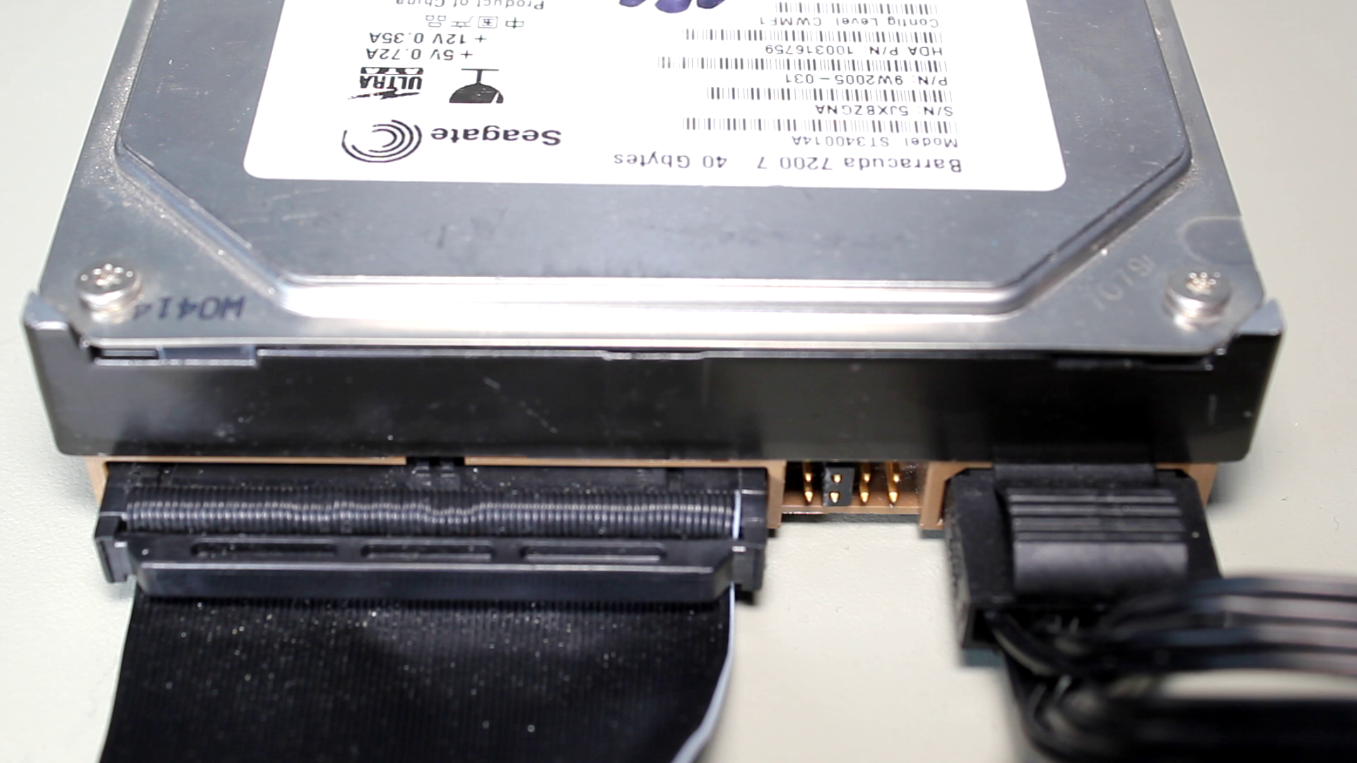
Demonstration
Notes:
In this demonstration I will install a PATA hard disk. Given how old the technology is, it is unlikely that if you purchase a motherboard nowadays it will have a PATA connector. You will only come across it if you are working on an old system.
You can see in the case of this motherboard that there are two PATA connectors at the bottom of the motherboard. As time when on, a lot of motherboards reduced these connections down to one and later still to none.
Since there are two connectors on this motherboard, the bottom is labeled as PRI for primary and the top is SEC for secondary. Both are labeled IDE; however, any of the other terms I looked at previously in the video could also be used.
The connectors are keyed to prevent them being put in the wrong way. It is difficult to see the keying due to the sticker being in the way, so I will remove it so you can see it better. You can see the plug has a bit of plastic removed so the cable will only go in the one way.
If I now look at the cable, notice the left side of the cable is blue, indicating this is the connector that goes into the motherboard; in the middle is the gray connector which is the slave connector and on the right is the black or master connector. If you are not sure or the cable connectors are the same color, look for the largest gap in the cable between the connectors. The end of the cable with the largest gap will always be the end that goes into the motherboard.
When I pick up the cable and have a closer look, you can see the connector has a notch in the middle to prevent it going in the wrong way. You could get the cable to go in the wrong way, using a lot of force, but you should never force a cable in. If you find the cable will not go in, check the cable as you probably have it upside down.
Next, I will get the cable and plug the blue connector into the motherboard. It is just a matter of putting the connector into the plug and giving it a little bit of a push down to make sure that it is firmly in place.
The next step is to plug in the hard disk. To do this, I will use the black connector. Flip it over, so it is oriented the correct way, and plug it into the hard disk. You may need to apply a little bit of pressure to get the connector to go in.
You will notice that the cable is plugged in, and the jumper is in the cable select position. When I start this computer up, if everything is working correctly, this hard disk should be detected as Device 0 on the primary controller. If I wanted to add a second hard disk, I would plug in in the gray connector and it would appear as Device 1.
Hopefully, you won’t have to support any PATA drives, but let’s have a look at what you can do if you come across a system that is still using them.

Slide 8
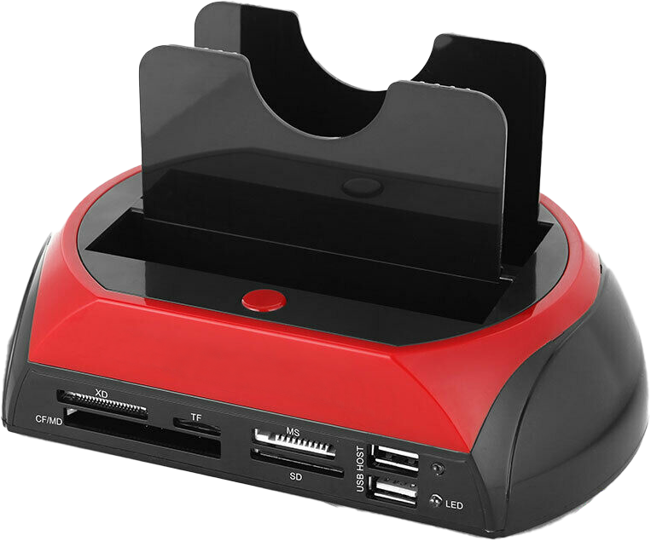
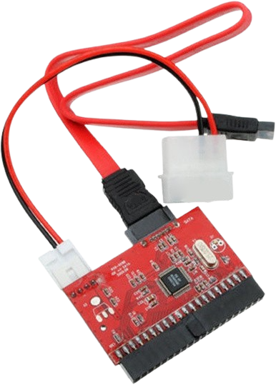
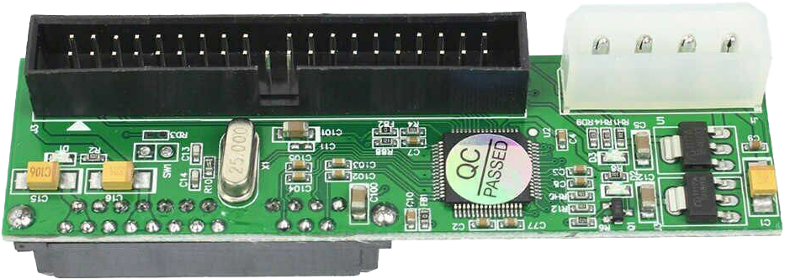
Providing Support
PATA drives no longer manufactured
Upgrade where possible
Plugs into motherboard
Converts PATA to SATA
Converts SATA to PATA
USB docking station
Read old HDD
Notes:
If you do come across a system that does use PATA drives, consider upgrading it where possible. Given that PATA hard drives are no longer manufactured, if something goes wrong with the hard disk, it is going to be difficult to find a replacement.
If you are stuck with an old system, there are adapters which will plug into the motherboard to convert PATA to SATA. This will mean you can replace your old PATA hard disk with a SATA hard disk. Given that hard disks fail after a while, it is a good idea to do this to protect you from data loss.
The next option is the opposite, where you can convert SATA to PATA. This will allow you to use your PATA drive in a system that does not support PATA. You can also purchase adapter cards which will provide a PATA connector to the computer.
I do stress, however, that if you have an old PATA hard disk you should look at replacing it. One option to read the data is a USB docking station. A docking station like this will allow you to plug in the hard disk and read it on a computer using USB. Some docking stations will support PATA but are getting harder to find. Some like this one will also support removable media such as USB thumb drives and flash memory. If you need to access data on a PATA hard drive, it may be worth buying a good docking station like this one which will meet your current and future needs. Personally, I would use a docking station like this to read the data and replace the hard disk.

Slide 9
In The Real World
Upgrade where possible
If it supports PATA at all
Motherboard may have primary/secondary
PATA is the new terminology
All used interchangeably
ATA, ATAPI, UDMA, IDE, EIDE
Notes:
In the real world, PATA is obsolete technology, so you are unlikely to come across it. CompTIA decided to include it as an exam objective, but I doubt they will in the future. You may come across the terms ATA, ATAPI, UDMA, IDE and EIDE. These terms may be printed on the motherboard, adapter or in a manual. They are all used interchangeably nowadays. To make it less confusing, the umbrella term for all this name is PATA.
If you come across a motherboard, it may use the terms primary and secondary controller. This is assuming that it supports PATA at all, which current motherboards on the market do not. If you do come across a PATA hard disk, it’s time to upgrade. Look at replacing the hard disk or system. Companies may have an old system running that they never get around to upgrading. A lot of the time, it is better to upgrade these systems before they fail rather than waiting for them to fail.
This concludes this video from ITFreeTraining on IDE and PATA drives. I hope you have found this video informative. Until the next video from us, I would like to thank you for watching.
References
“The Official CompTIA A+ Core Study Guide (Exam 220-1001)” Chapter 6 Paragraph 151 - 163
“CompTIA A+ Certification exam guide. Tenth edition” Pages 312 - 314
“Parallel ATA” https://en.wikipedia.org/wiki/Parallel_ATA
“Picture: ATA cable” https://commons.wikimedia.org/wiki/File:ATA_cables.jpg
Credits
Trainer: Austin Mason http://ITFreeTraining.com
Voice Talent: HP Lewis http://hplewis.com
Quality Assurance: Brett Batson http://www.pbb-proofreading.uk

