Slide 1
Notes:
In this video from ITFreeTraining, I will have a look at Hybrid and Dual-Drives. These drives combine Solid-State and hard disks together to give better performance. You need to have an understanding of it for the CompTIA exam; however, in the real world you are unlikely to come across them. I will explain the reasons for this in the video.

Slide 2
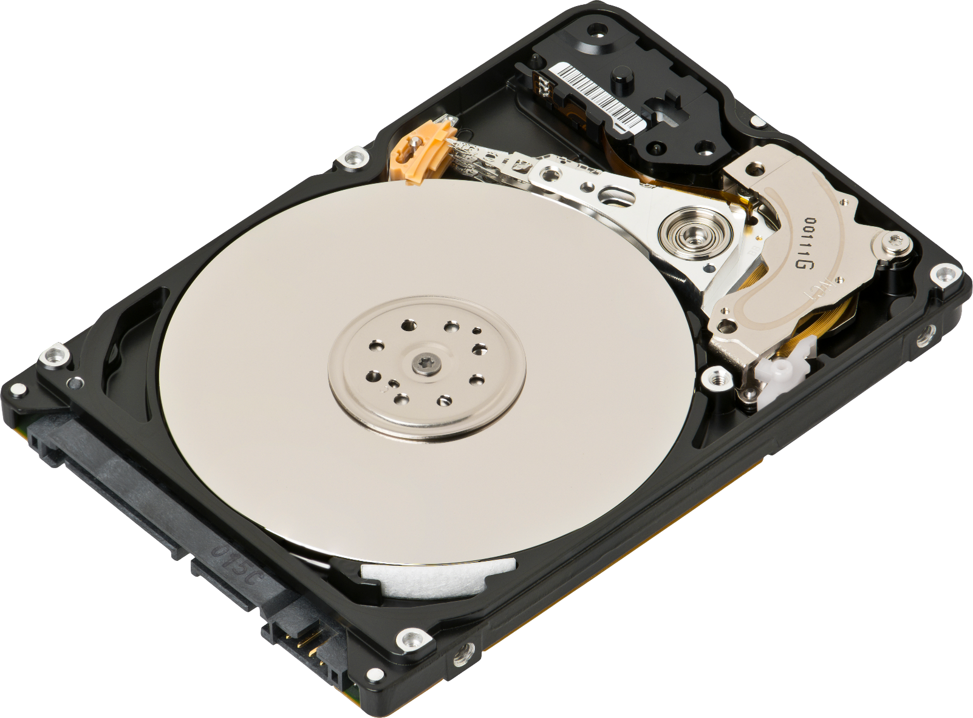
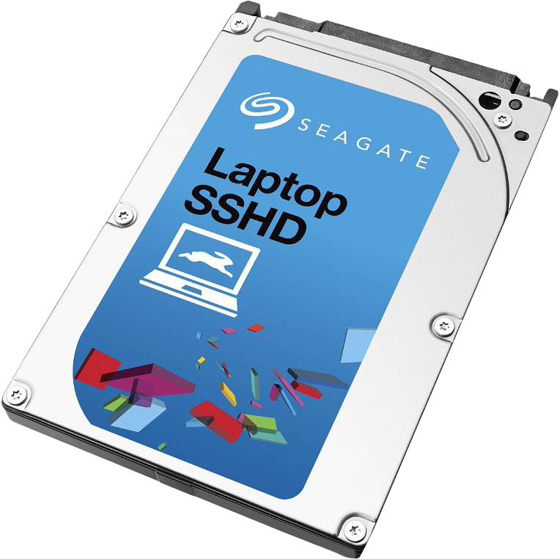
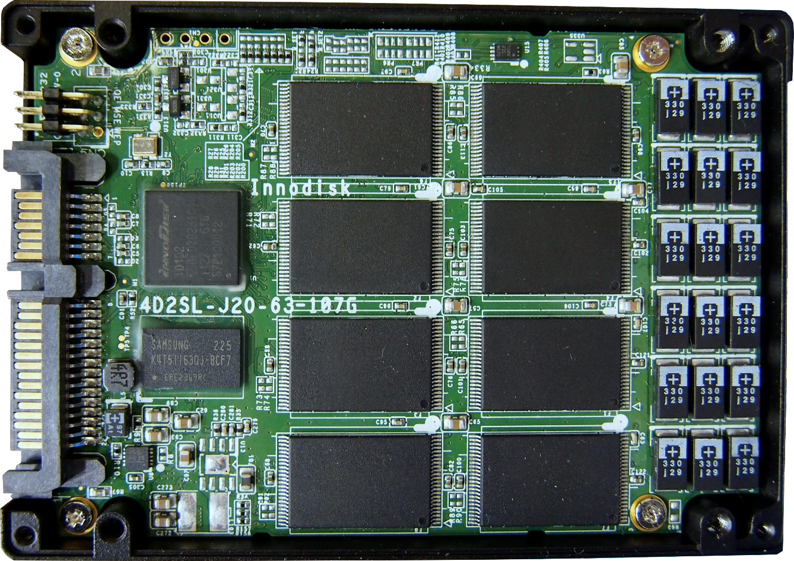
Hybrid Drives (SSHD)
Not widely adopted
On market from 2007-2015
Combines
HDD platters
Looks the same as
traditional hard disk
SSD flash memory
Notes:
A number of different Hybrid-Drives were released on the market approximately between 2007 and 2015. These were not widely adopted on the market so you may not come across one. The drives themselves look just like a traditional hard disk. So, you would install and use one just like you would a hard disk.
Essentially, what occurs is a Hybrid Drive combines a hard disk and Solid-State drive together. The SSD parts of the Hybrid-Drive are used as a cache and the hard disk is used as storage. These drives were often called Solid-State Hybrid-Drive or SSHD. Let’s have a closer look at the components inside a Hybrid Drive.

Slide 3
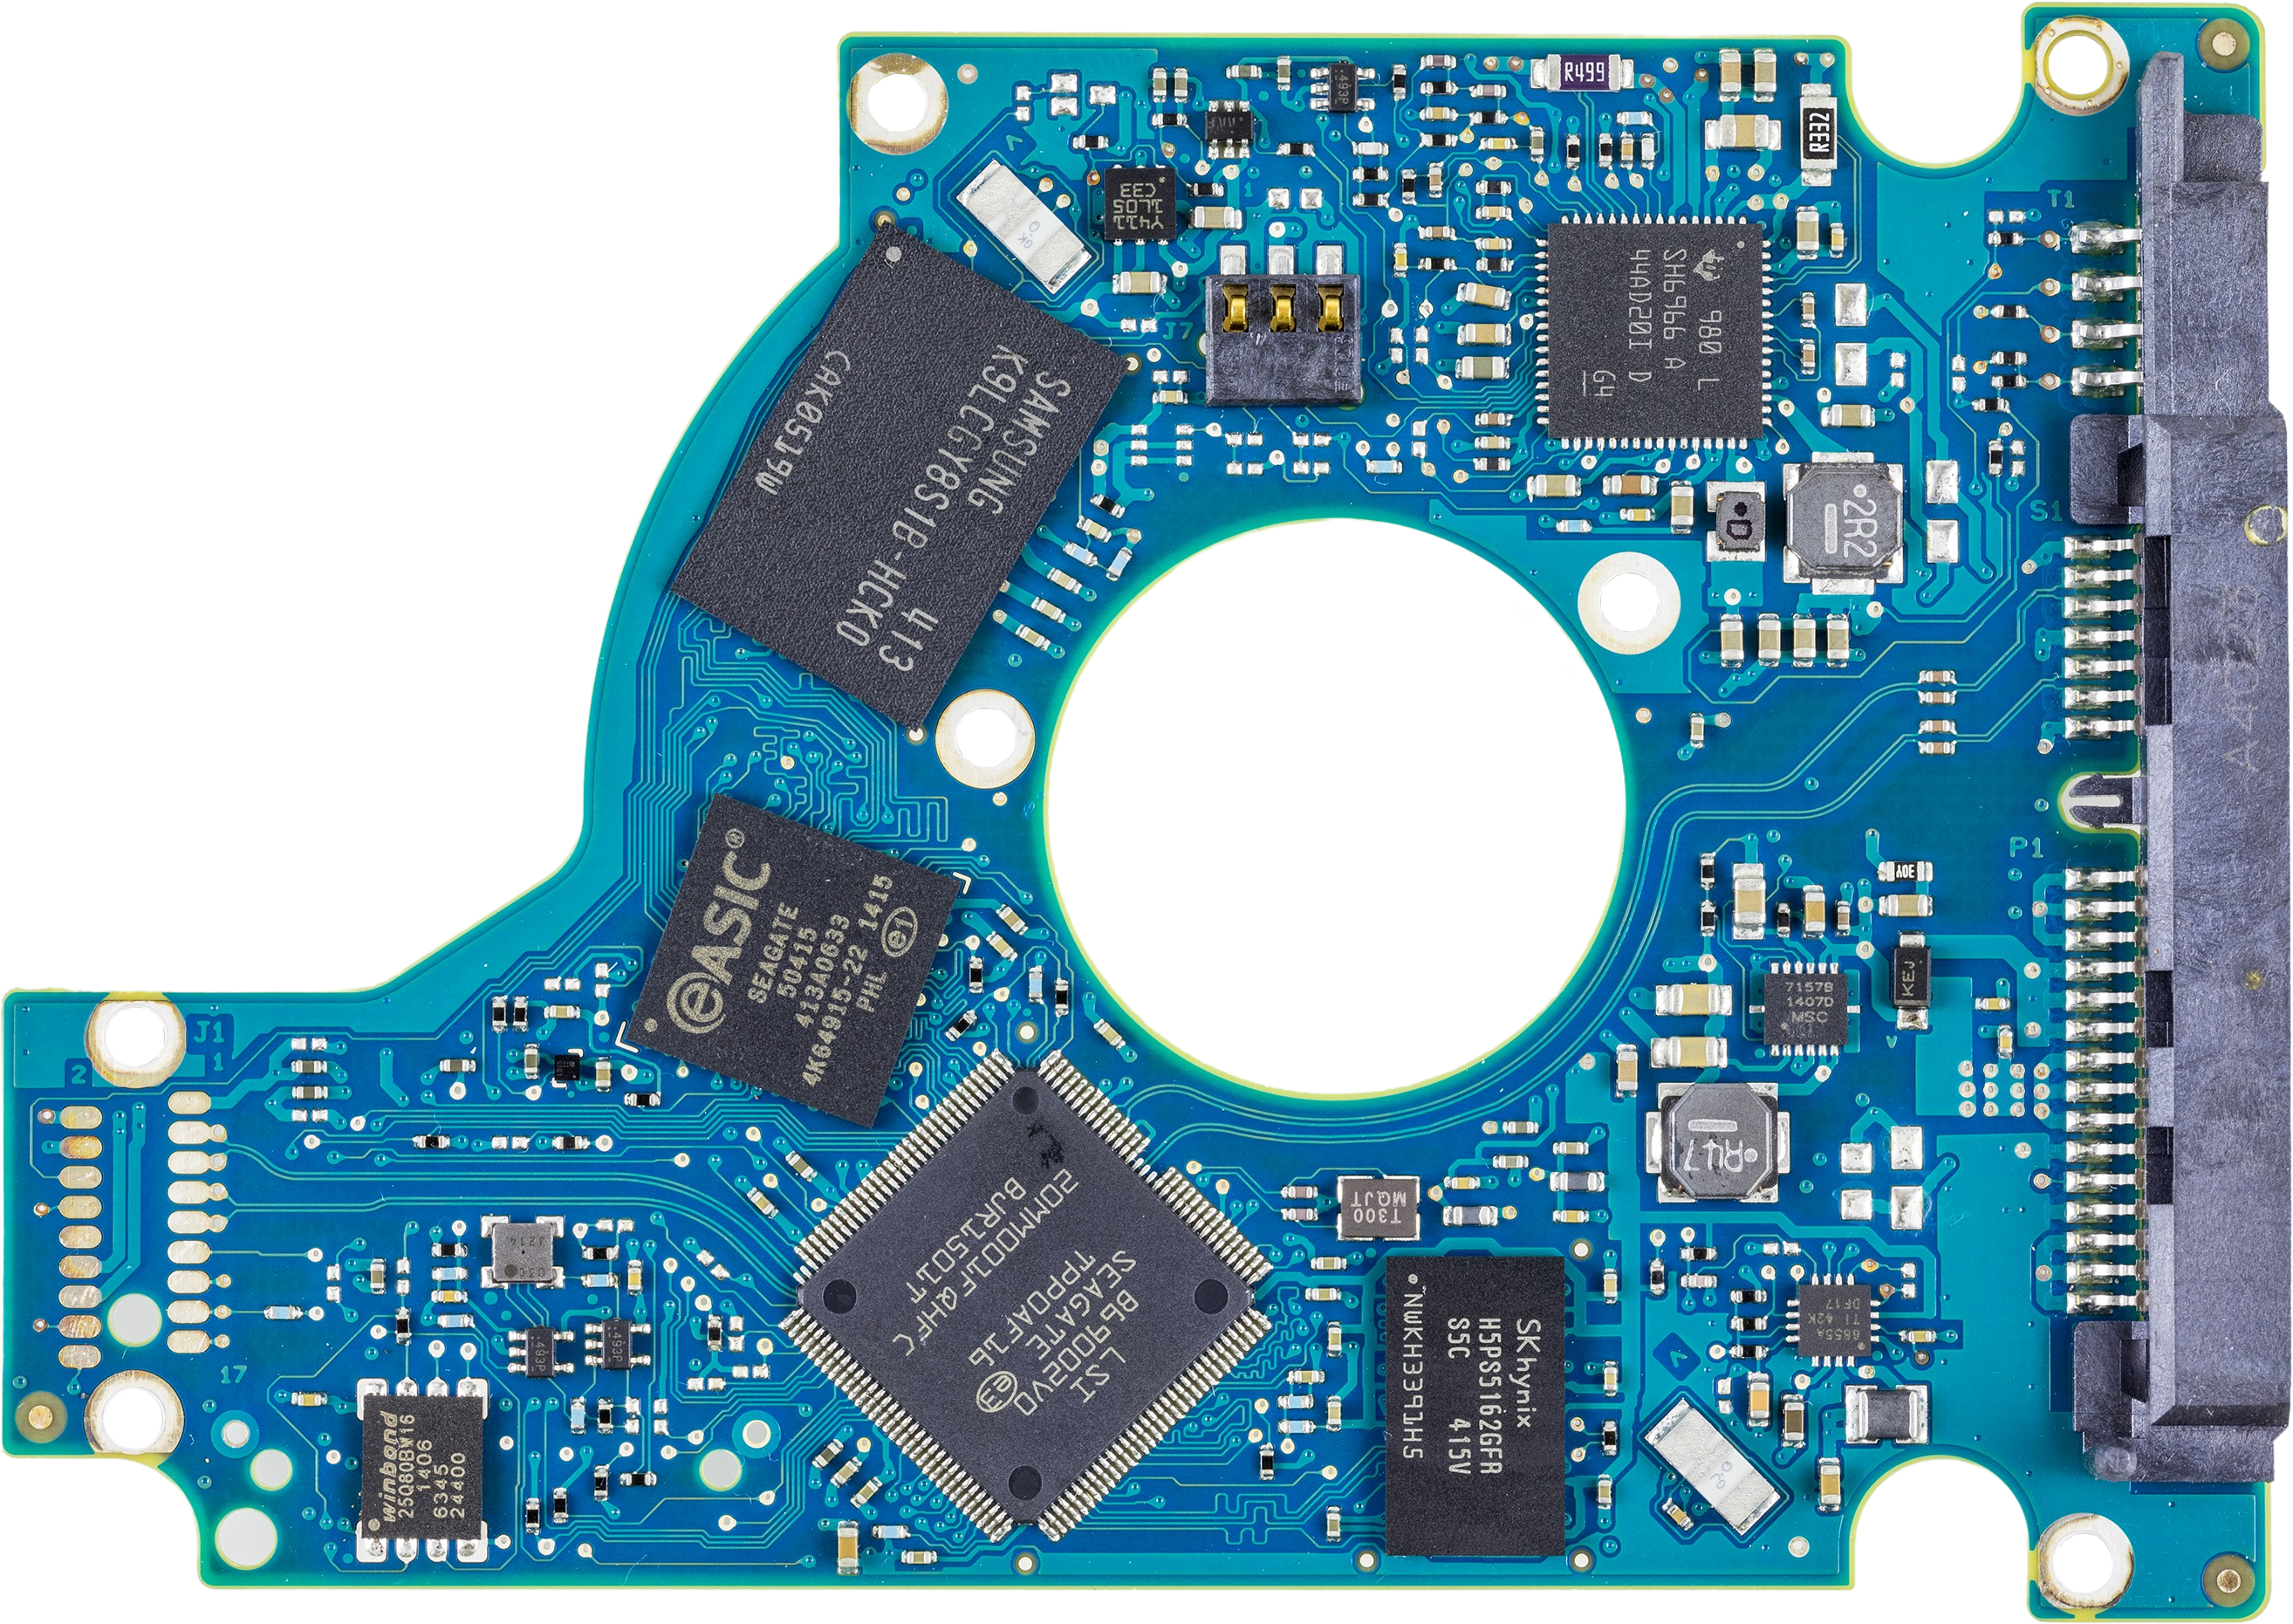
Hybrid-Drive Circuit Board
Voltage motor controller
Flash memory
Flash controller
Hard disk controller
Hard disk cache
Notes:
Shown here is an example of a Hybrid-Drive circuit board. At first glance, it looks similar to a hard disk circuit board. Since a Hybrid-Drive uses the same technology as a hard disk, that is a platter to store data, it uses the same electronics.
You can see, in this particular case, which chips that are used to control the hard disk part of the Hybrid-Drive. Essentially, there is a chip to control the voltage of the motor. This is used to control the speed the platters are spinning at. There is a chip to cache requests of the hard-disk part of the Hybrid-Drive. Lastly, there is a hard-disk controller chip. These are the same chips that are used on standard hard disks.
So far, the technology is the same on a Hybrid-Drive as it is on a hard disk drive. The difference is the Hybrid-Drive also has chips on it for the Solid-State part of the drive. You can see that there is a chip that is the flash controller. The next chip is the flash memory. The flash controller stores data in the flash memory to be used as cache. This chip also needs to communicate with the hard-disk controller.
Some Hybrid-Drives may have more than one flash memory chip. The point to remember, however, is these memory chips are only used for cache. They do not increase the amount of storage the Hybrid-Drive has. Let’s have a closer look at how this cache works and this will give us a better understanding why the technology never really took off.

Slide 4
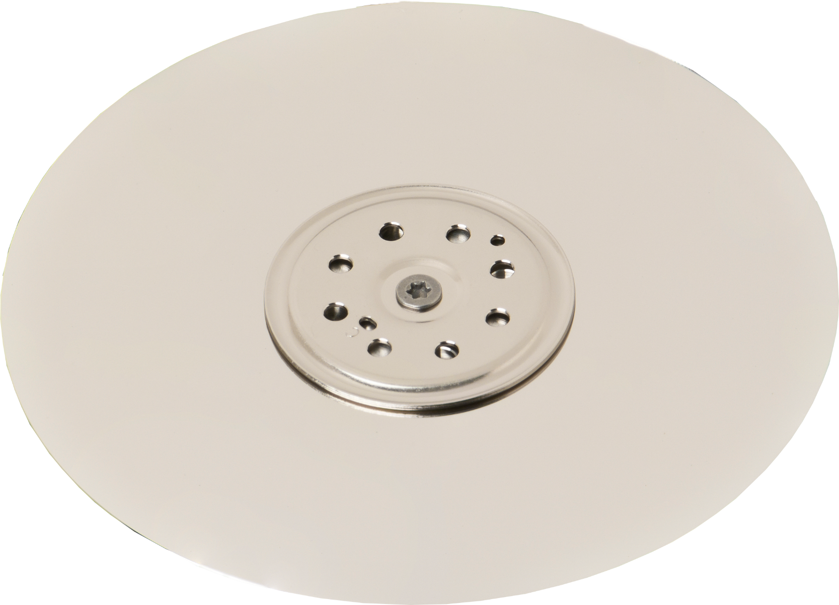
Hybrid-Drive Cache
Uses flash memory to cache small amount of data
Flash
Memory
Request
Request
Contains cache of data
Improves response time
Improves boot time
Platters contain all data
Cached and non-cached
Notes:
A Hybrid-Drive basically uses flash memory to store a small amount of data. The platters on the Hybrid-Drive store all the data the same way a traditional hard disk would. This is a complete copy of the data.
The flash memory contains a copy of a small amount of data from the platters. This flash memory is used as cache; this improves response time if the file is cached and is often seen in improved boot times.
The operating system will request data from the Hybrid-Drive as it would a hard disk. If the data is not in the flash memory, the request will be sent to the platters to obtain the data. Since the flash memory is much faster than the platters, if the data is in the flash memory the request will be completed faster. This illustrates one of the problems with Hybrid-Drives. In order for the flash memory to be effective, the requests need to be in the flash memory in the first place. For this to occur, the data needs to be requested on a regular or at least semi-regular basis.
The performance improvement in Hybrid-Drives would often be seen in boot-up times. The boot-up times would often be a few seconds faster than a computer using a hard disk. However, when you first purchase the Hybrid-Drive the flash memory will be empty. Once you start using it, the Hybrid-Drive will attempt to work out what data it should keep in the flash memory to use as cache. As time goes on, hopefully it will start to work out which data you access regularly and keep this in cache rather than the data that you don’t access very often. Since certain files are used every time the computer boots up, there is a good chance these will be stored in the cache and this is why you see a faster boot time. In reality, you don’t see too many improvements in other areas, so let’s have a look at why.

Slide 5
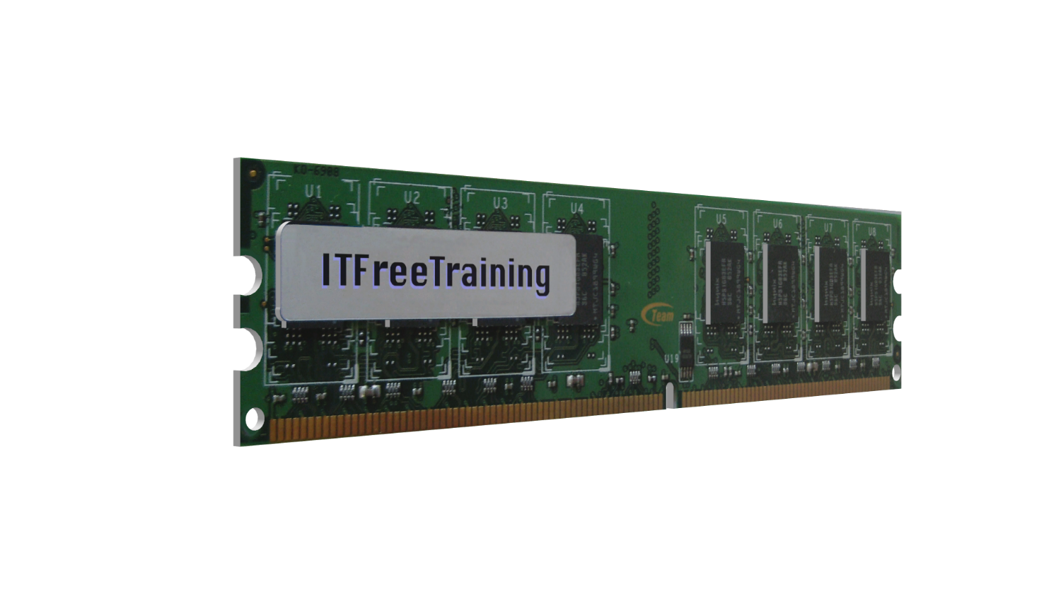
Hybrid-Drive Adaptation
Flash memory cheaper
SSD often used for OS
or fast access
History based
Takes time to learn
which files to cache
Memory cheap
OS will cache
storage excess
Notes:
When Hybrid-Drives were first introduced to the marketplace, flash memory was quite expensive. Thus, purchasing a storage device that only used flash memory was very expensive. As time went on, flash memory became significantly cheaper. Also consider that Hybrid-Drives have two drive controllers meaning more chips need to be used, which increases the price.
One of the main areas where Hybrid-Drives showed performance improvements is in boot time. However, with the reduced price of Solid-State Drives, they will often be used to run the operating system and a hard disk will be used for additional storage. Since the computer is booting off a Solid-State Drive, the boot time should be quicker than a Hybrid-Drive which is only using flash memory.
The next issue with Hybrid-Drive adaptation is it is history based. This essentially means that it needs some time to learn which data to cache and which not to. As time goes on, the Hybrid-Drive will work out what to cache and what not to and the performance of the drive will increase up to a certain limit. This is not a perfect system. If you start using your computer a different way (for example, installing new software that utilizes the drive differently), the Hybrid-Drive will need to adapt.
Now, let’s consider that the cost of memory has also come down. Modern operating systems will use any free memory for caching to improve performance. Since Hybrid-Drives use flash memory for cache, this history will be available between reboots. The operating system will not keep this history between reboots. However, since memory is so cheap, you can purchase more than what you need, knowing the extra will be used for file cache. You can see that having more memory helps with performance, thus some of the benefits of having a Hybrid-Drive can also be achieved by having extra memory in your computer.
So, consider that Hybrid-Drives require some extra chips to operate, and this is on top of the cache memory that is already used with hard disks; the cache does not increase the storage capacity of the drive and the cost of technology has generally come down. You can start to understand why Hybrid-Drives have not taken off.
Hybrid-Drives are not the only implementation for using Solid-State Drives as cache. Let’s now have a look at some of the other ones.

Slide 6
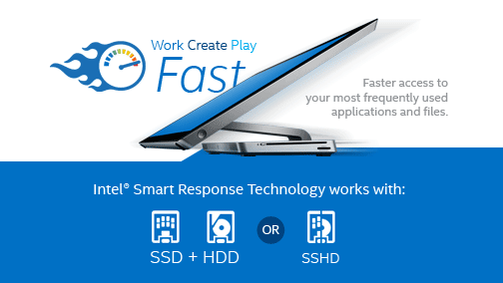
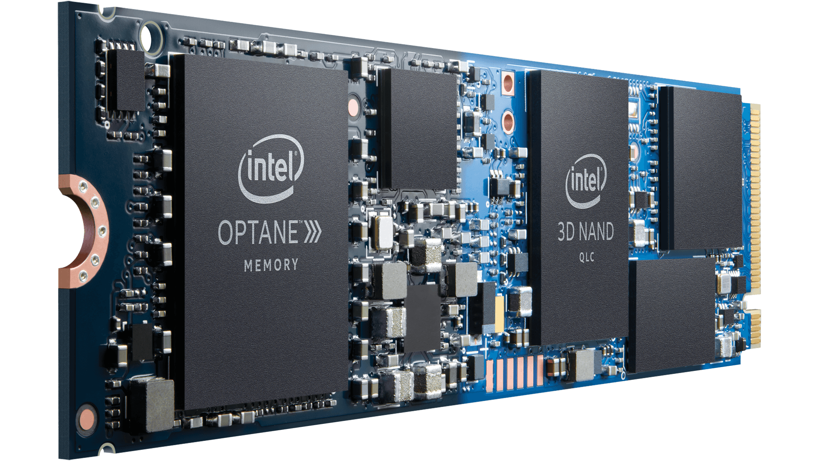
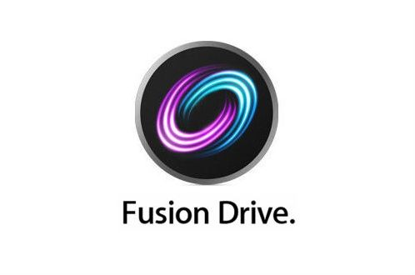
Dual-Drive
Smart Response Technology
Utilizes SSD for HDD caching
Intel Optane
Caches HDD and SSD
Macintosh
Uses SSD to cache
HDD
Notes:
Rather than utilizing flash memory inside the storage devices, other solutions use a separate Solid-State device to provide caching. These types of configurations are often referred to as Dual-Drive. In 2011 Intel introduced Smart Response Technology or SRT. This technology allows a separate Solid-State Drive and a hard disk drive to be combined together to work the same way a Hybrid-Drive would work.
In order to use the technology, you require a motherboard that supports it. SRT is currently limited to 64 Gigabytes. If you have more than 64 Gigabytes of space on the Solid-State Drive, the remaining part of the Solid-State Drive can be used to store data.
SRT never really took off and is no longer on the market. To replace it, Intel released Optane. Optane fundamentally works the same, however it can also be used to cache Solid-State Drives. In order to do this, it uses extremely fast flash memory.
Considering that Solid-State Drives are pretty fast already, and you can also purchase high-performance Solid-State Drives, it is for this reason that Optane has really only taken off in high-performance solutions where really fast performance is required. It is arguable if Optane gives you much benefit if you are using a high-performance Solid-State Drive already. You may be better off using your money to purchase the highest performing Solid-State Drive you can get.
The last Dual-Drive I will look at is Fusion Drive. Fusion Drive was developed by Apple for Macintosh computers. It uses the same principle, that is, uses a Solid-State Drive to cache data from the hard disk drive. Certain computers will support it. It tends to be more common in laptops to improve performance.

Slide 7
In The Real World
Optane used for high-performance environments
Generally, SSD used as OS drive nowadays
Dual-Drive not that popular
No longer on the market
Probably won’t come across too many SSHD
Notes:
In the real world, nowadays, you probably won’t come across too many SSHD or Hybrid-Drives as they are no longer sold on the market. Dual-Drive configurations are also not that popular. This is because most people will use a Solid-State Drive for the operating system drive. This gives very good performance and given the low cost of Solid-State Drives it is possible to purchase one that will meet people’s needs. If a user needs more space, a second Solid-State Drive or hard disk drive can be added.
Optane is only used in high-performance environments. If you want to give your computer a bit more performance, it may be worth looking to see if your motherboard supports it, but most people will generally go for the best performing Solid-State Drive they can get. It all depends on whether you have the money, and you want to spend it. Solid-State Drives already give really good performance, it just depends on whether you want to get even better performance; but don’t expect the performance increase to be very big unless you have a very low performing Solid-State Drive. Even then, the best Optane performance is seen when it is used with hard disks.
This concludes this video from ITFreeTraining on Hybrid-Drives and Dual-Drives. I hope this video has helped you to understand the technology and where you may come across it. Until the next video from us, I would like to thank you for watching.
References
“The Official CompTIA A+ Core Study Guide (Exam 220-1001)” Section 6 Paragraph 144-149
“CompTIA A+ Certification exam guide. Tenth edition” Page 295
“Hybrid drive” https://en.wikipedia.org/wiki/Hybrid_drive
“Fusion Drive” https://en.wikipedia.org/wiki/Fusion_Drive
“3D XPoint” https://en.wikipedia.org/wiki/3D_XPoint
“Picture: Seagate ST1000LM04 controller” https://commons.wikimedia.org/wiki/File:Seagate_ST1000LM014_-_controller-8425.jpg
“Picture: Hard disk” https://commons.wikimedia.org/wiki/File:Laptop-hard-drive-exposed.jpg
“Picture: Inside SDD” https://commons.wikimedia.org/wiki/File:Embedded_World_2014_SSD.jpg
Credits
Trainer: Austin Mason http://ITFreeTraining.com
Voice Talent: HP Lewis http://hplewis.com
Quality Assurance: Brett Batson http://www.pbb-proofreading.uk

