Slide 1
For the free video please see http://itfreetraining.com/ap/3a75

Slide 2
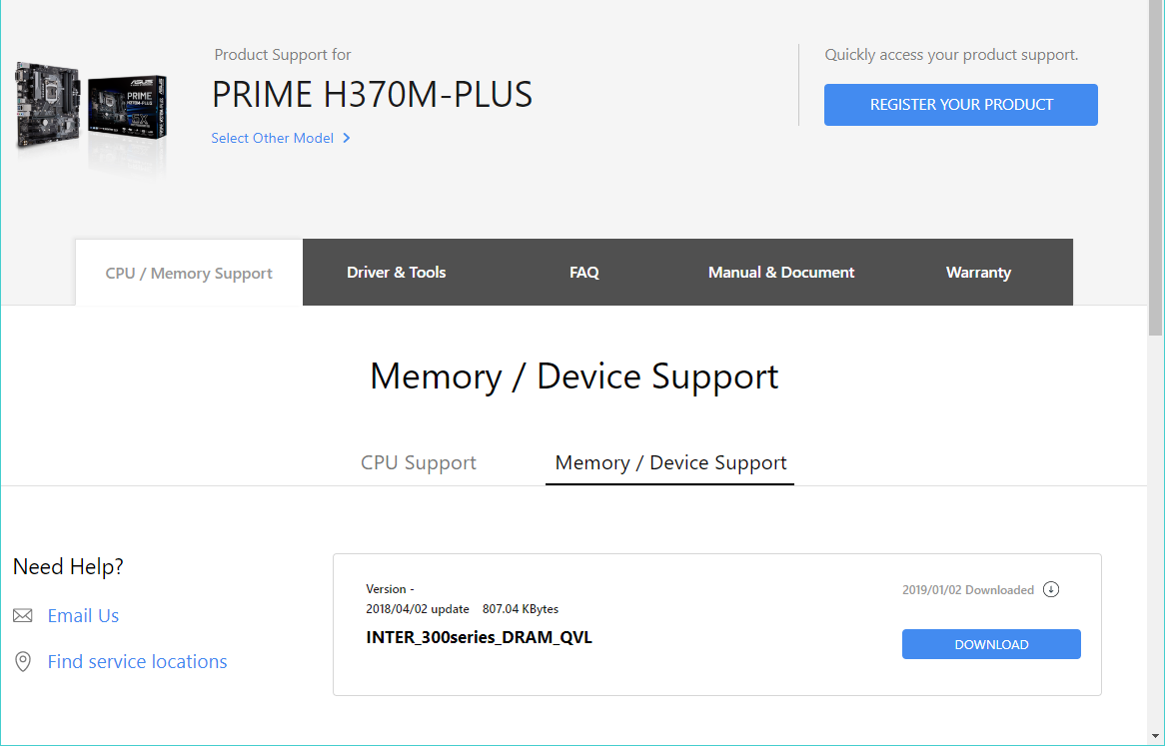
Confirm Compatibility
Manufacturer will have list of tested memory
Notes:
Before you purchase memory, it is a good idea to check that the memory is supported. The manufacturer’s website will have a list of memory that has been tested with the motherboard. For example, in the case of this motherboard, the manufacturer has provided a PDF with tested memory listed. Some manufacturers will have a compatibility document while with others you will be able to perform a search to see if the memory is supported.
If the memory does not appear, it does not mean that it will not work, it just means that it has not been tested. In a lot of cases, memory is released a lot faster than the manufacturer can test it and therefore the list could well be out of date.
In most cases the memory will still work. If it does not work, try a BIOS update as this will sometimes fix the problem.

Slide 3
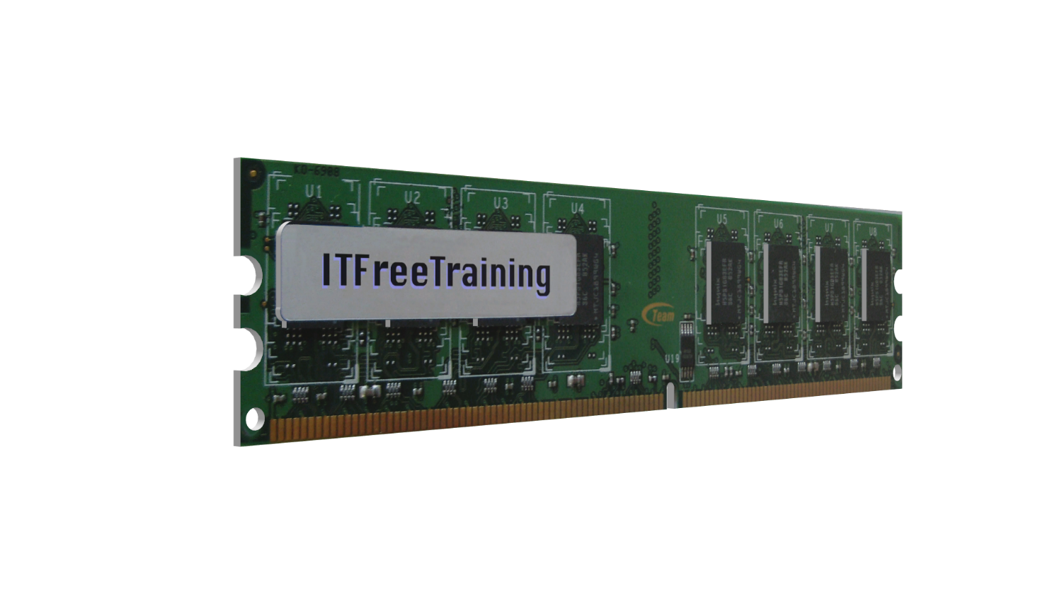
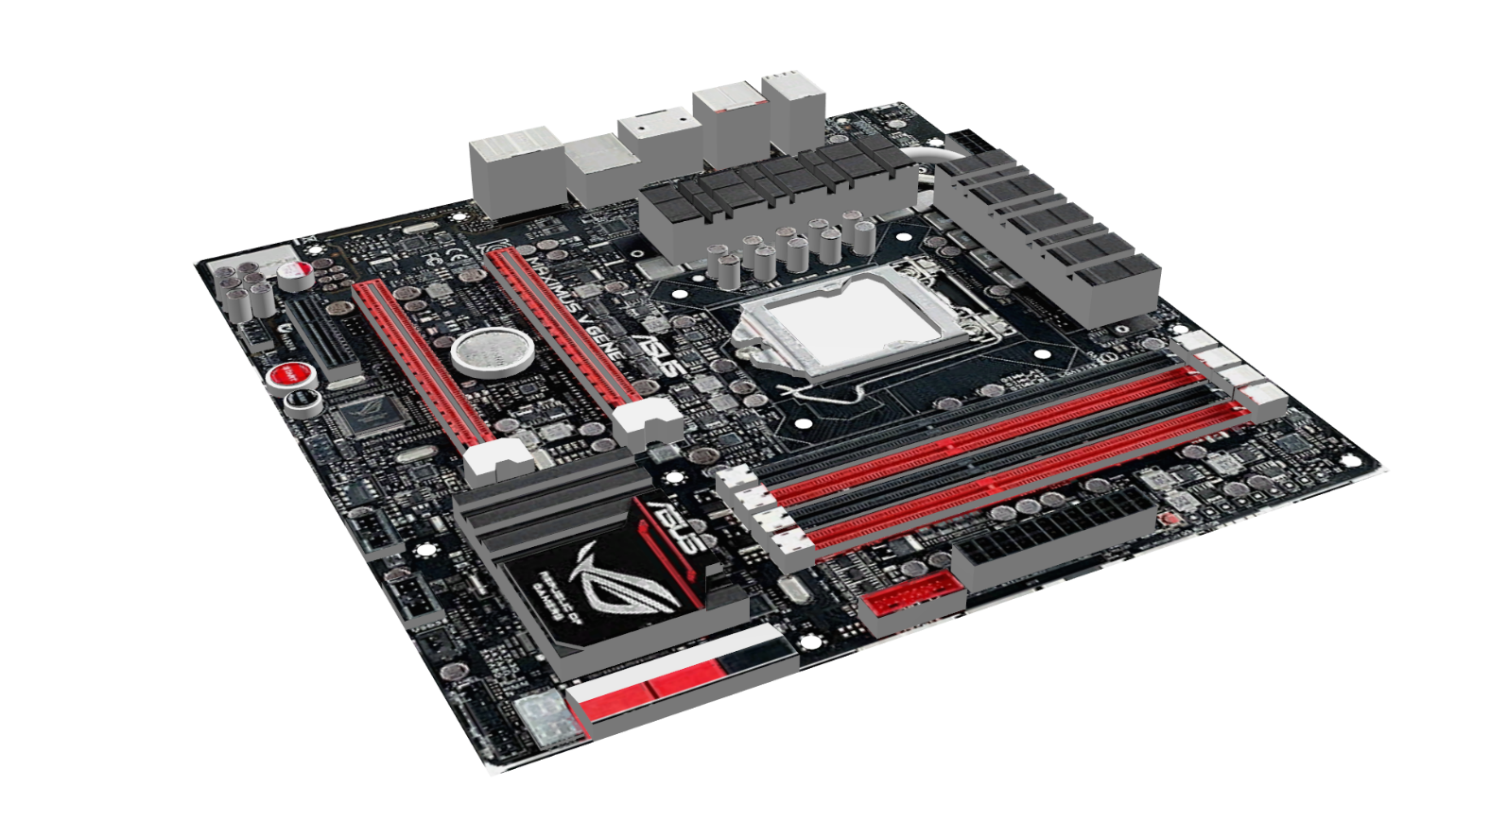
Speed Differences
Motherboard will drop speed
to match memory
Memory should support lower
speeds
* Should work in theory *
Notes:
In some cases, the speed of your motherboard and your memory may not match. With modern motherboards, the motherboard will drop the speed to match the memory. If the memory is faster than the motherboard, the memory should support lower speeds. The memory module should have a number of different timing profiles to support lower speeds. Running memory slower than its max speed should not be a problem.
So basically, in theory it should work. However, in computing sometimes things don’t work the way you expect. If the memory is supported, even if it is of a different speed, it should work as the memory will drop to the lowest memory module speed. There is no guarantee it will work.

Slide 4
Mismatched Memory
It’s really not recommended
Not recommended
May or may not work
Speed dropped to lowest in channel
If installed dual/triple/quad channel
May drop all memory slots to same speed
Not recommend at all
Notes:
In some cases, you may have mis-matched memory modules in the same computer. That is, memory modules of different types, manufacturers, and speeds. Some motherboards will be able to run the different memory slots at different speeds, while others may drop all the memory slots down to the same speed.
If the memory modules are installed in dual, triple or quad channel, essentially, they will work as one. When this occurs, the speed will be dropped to that of the lowest speed memory module. Memory modules have primary timings and sub timings. When you combine multiple memory modules in the same channel, they may or may not work.
If you are planning on running memory modules in the same channel, get modules of the same manufacturer and type. Generally, memory is sold in pairs to prevent problems like this. If the memory is of different sizes, one of two things will happen.
The first problem that can occur is the memory module will not be accessible. For example, if you have a one gigabyte and a two gigabyte memory module put in dual channel, only one may be available. A workaround for this is to put one of the memory modules in a different slot or disable dual channel, which may be referred to in your BIOS as ‘ganged’. If your BIOS refers to it as ganged, try switching it to un-ganged to see if this fixes the problem.
The second problem that may occur is the extra memory in the memory module is not accessible. So, in this example, only two gigabytes of memory will be accessible. The last one gigabyte won’t be accessible. This is because only the first one gigabyte of memory in each memory module can be paired.
In some motherboards, the motherboard will be able to use the first gigabyte of memory in dual channel and the last one gigabyte will be used in single channel. It all depends on your motherboard. To summarize, the motherboard may work in dual channel reducing the speed to the lowest memory module. The extra memory may or may not be accessible in single channel. Some motherboards you may just disable dual channel altogether when memory modules of different sizes are used.
I would not recommend you mix and match your memory modules. When I say this, I mean that I really would not recommend that you mix and match your memory modules! You may be able to get away with it if you run them in different channels or disable multi-channel support; however, you are still taking a risk, but this risk increases when they are run in the same channel. If you do decide to do it, monitor the computer afterwards to see if you are experiencing any stability or random crashing. Did I mention I would not recommend it?
I will now have a look at how to install memory modules in your computer.

Slide 5
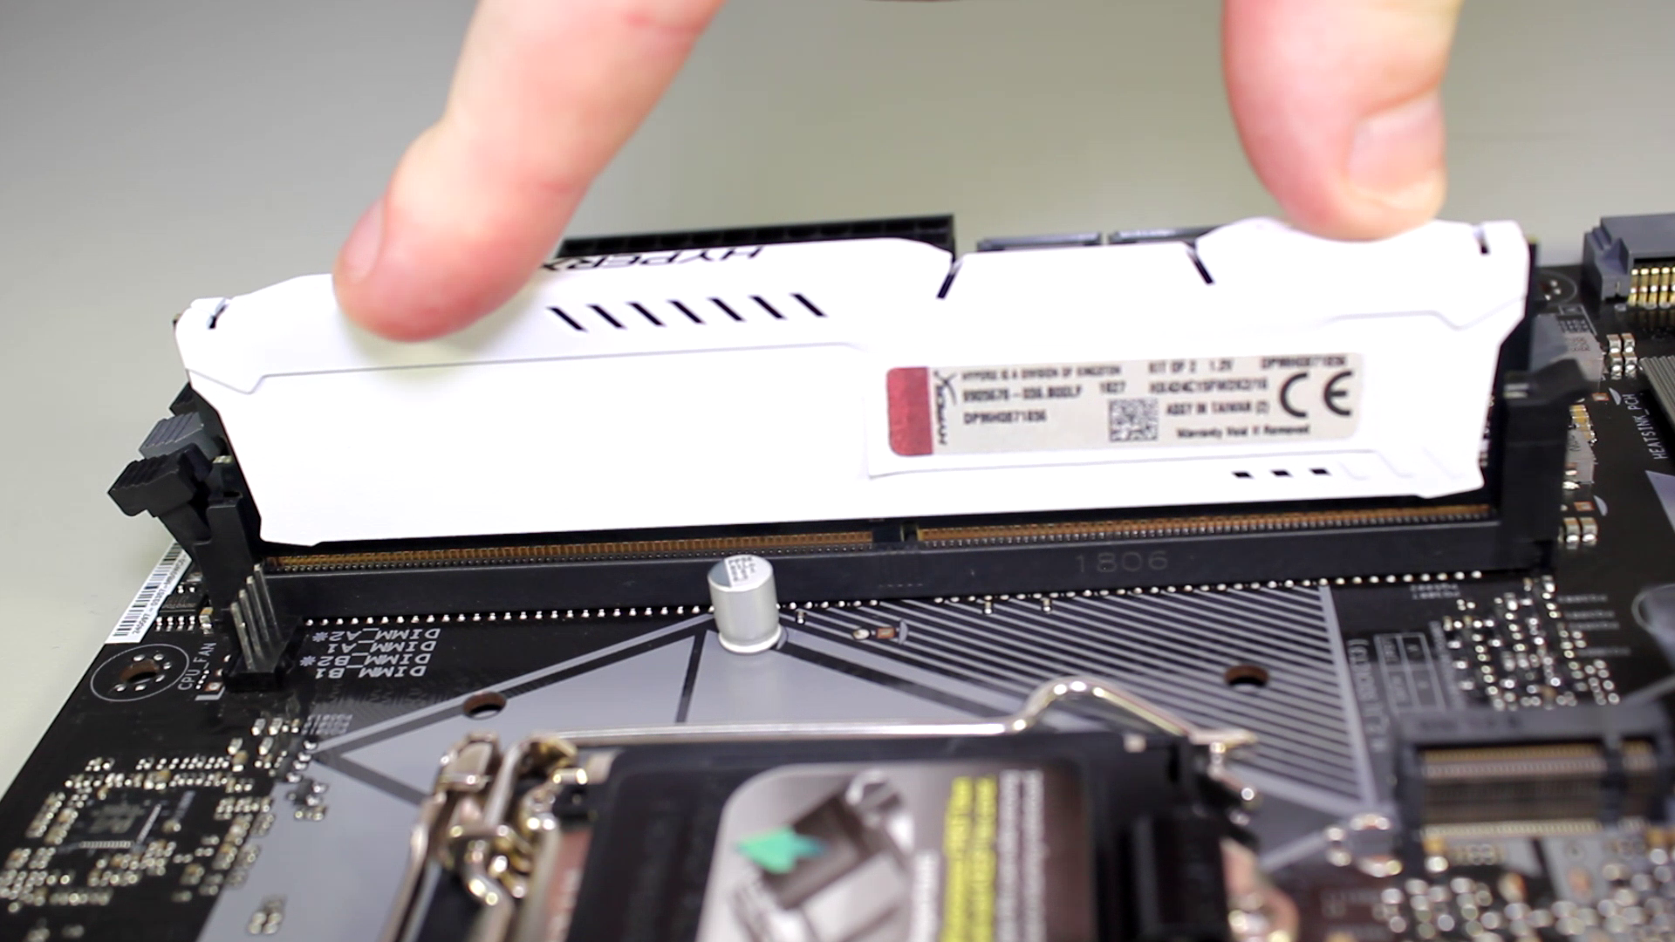
Demonstration
Notes:
Memory is quite sensitive to static electricity. In this case, I have the motherboard on an anti-static mat and I also have my anti-static wristband on with the other end connected to the anti-static mat. If you don’t have any anti-static equipment, I would suggest touching the case to ground yourself before touching the memory. Static electricity is caused by a difference in electrical potential between you and what you are touching. Having an anti-static wristband or touching the case equalizes this charge, preventing static electricity jumping to the memory module.
Printed on the motherboard should be some writing indicating which memory slot is which. Otherwise, you may need to consult your motherboard manual to determine which is which. Some motherboards will require a memory module to be in a certain memory slot in order for the computer to work.
In this motherboard manual, it refers to the four memory slots either being on channel A or channel B. That is, A1 and A2 being on channel A, B1 and B2 being on channel B. This should not be confused with dual channel. In order to use dual channel, a memory module on each channel is required. One on channel A and one on channel B. Essentially, it is using two channels, that is channel A and channel B, at the same time and thus the name dual channel.
Modern memory slots have a notch on them that is offset from the middle. This prevents the memory module being placed in the wrong way. You can see here the notch on the memory module lines up with the notch on the memory slot.
On the memory slots, you can see on one side are tabs. When the memory module is installed, these tabs will lock into place. To remove the memory module, you need to unlock the tabs and pull out the memory module.
On the other side of the memory module, you can see that there are no lockable tabs. On some motherboards you will have lockable tabs on both sides, while on others they will be present only on one side. This is done because if an expansion card is added to the computer, it will block access to the tabs. This makes it difficult to remove the memory modules later or install new memory modules as the expansion card needs to be removed to access the tab. Having one tab lockable and one that is not makes this process easier. This is only the case with small expansion cards; large expansion cards will block access to both tabs and will have to be removed in order to add or remove memory modules. To get around this, you will find motherboard manufacturers will often make the first expansion slot support only smaller expansion cards and the next one support larger expansion cards. This helps keep the larger expansion cards away from the memory modules.
Before I insert the memory module the correct way, I will first show you the incorrect way. In the old days, memory used to be inserted by putting one side in first followed by the other side. I have exaggerated it a bit in this case to make it easier to understand what I am referring to.
Inserting one side first followed by the other was possible due to the small number of pins on the memory module. Modern memory has a lot more pins and it is not recommended to do it this way.
In this example, I am installing DDR4 memory; starting with DDR4 memory, you will notice that there is a curve on the connector. This was done to reduce the amount of force require to insert the memory module. You will see why this is important in a moment.
To install the memory module, insert the memory module into the memory slot, attempting to keep it level. Once level, simply push down on both sides and you should hear an audible click.
If you have a second memory module you wish to install and also wish to take advantage of dual channel, generally the memory slots will be spaced so you need to skip a memory slot when installing the second memory module.
In most cases, the memory slots on the motherboard will be of different colors. You simply need to put the memory in the memory slots of the same color. If you are not sure, check your motherboard manual.
Now that the memory has been installed, I will quickly install a CPU, start the computer, and go into the BIOS, where you will notice that both memory modules have been detected. If they are not detected, usually the memory module is not seated correctly. To fix this, turn off the computer, remove the memory module, and plug it back in.
That concludes this video on how to install memory. I hope you have found this video useful and best of luck if you attempt to upgrade the memory in your computer. I hope it works out for you.
References
None
Credits
Trainer: Austin Mason http://ITFreeTraining.com
Voice Talent: HP Lewis http://hplewis.com
Quality Assurance: Brett Batson http://www.pbb-proofreading.uk

