Slide 1
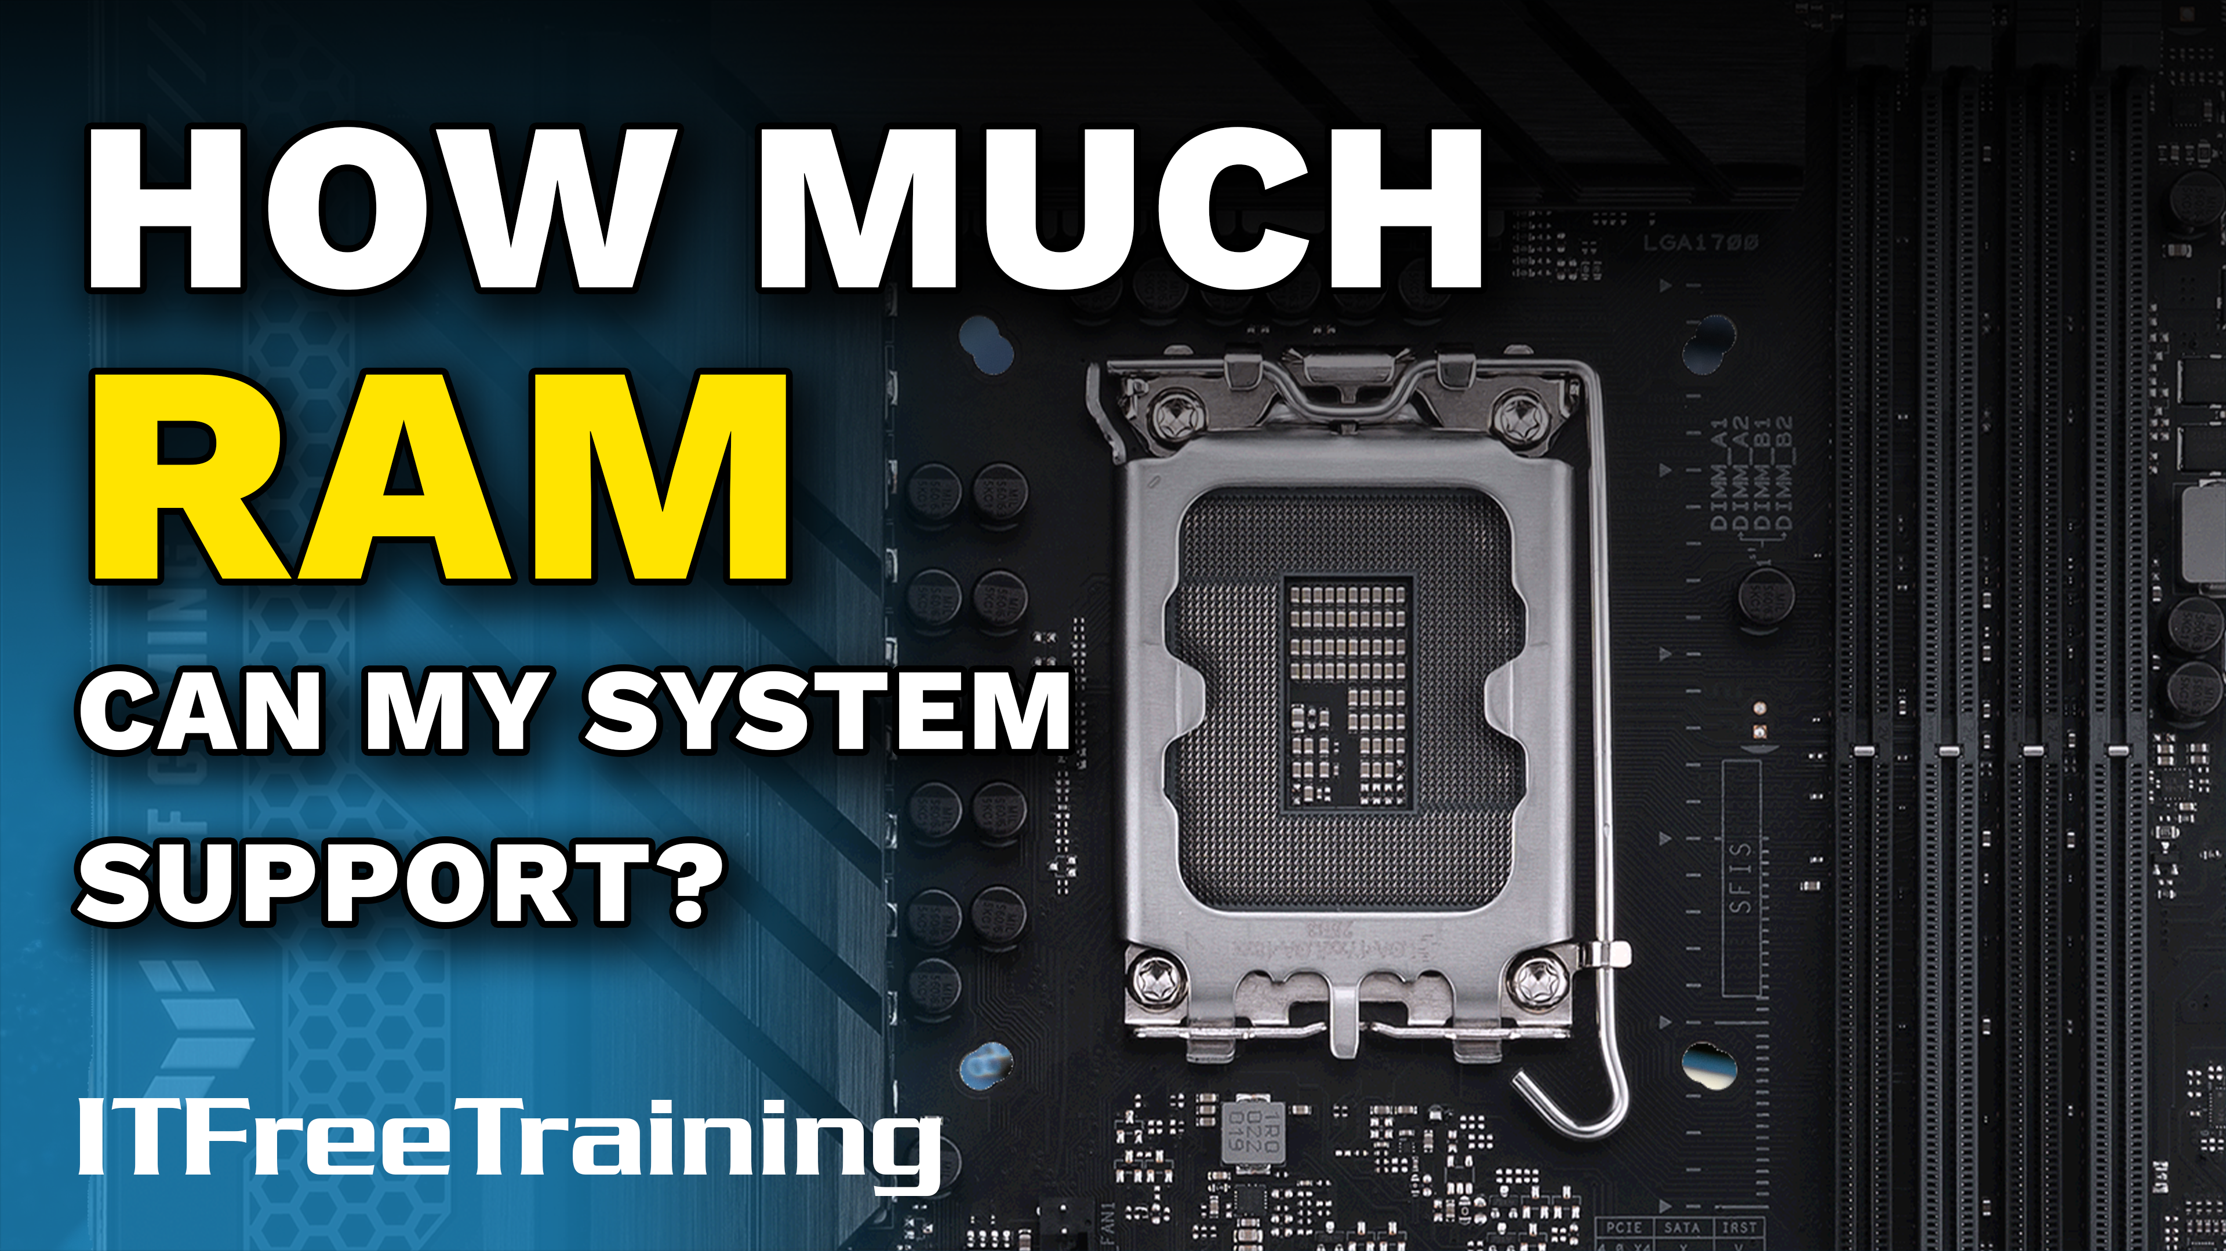
Notes:
In this video from ITFreeTraining, I will look at how much RAM you will need and what signs to look for when you need a memory upgrade. This will help you when you purchase a new computer and in troubleshooting.

Slide 2




Memory Recommendations
Specialized applications
Servers
16GB
Recommend
Power user
8GB
Bare
minimum
Bare minimum
Good starting point
4GB
Very basic use. Limited number of applications at once
ITFreeTraining.com
© Copyright 2023
Notes:
00:12 To start with, I will have a look at some memory recommendations. This will give you a guide as to how much memory you should be looking at when purchasing a computer. Consider having at least four gigabytes of memory.
A computer with this much memory will run basic applications. It will be limited in how many applications that it can run at once. If you attempt to run too many applications, there will be performance problems.
32-bit computers will have a maximum of four gigabytes of memory; however, due to hardware limitations, the computer will only be able to access just over three gigabytes of memory.
As a bare minimum, I would be looking at around eight gigabytes of memory. This is a good starting point, but at the end of the day, more memory is always better. More memory does cost more money, so how much memory you get will depend on your budget. Eight gigabytes of memory will run a few basic applications well. You may get some performance problems if you start trying to run too many applications at once or run applications that require a lot of memory.
If you can afford it, 16 gigabytes of memory is a good amount of memory to have for standard and power users. I would recommend this if you can afford it. If you are a power user, I would suggest this much memory to start with. 16 gigabytes of memory means you have enough to run power user applications and some games which will want this much memory. This much memory should be able to run multiple applications together. 16 gigabytes of memory for the average and power user should give you good performance.
Anything above 16 gigabytes of memory and you start looking at specialized applications and servers. Some of these applications and servers require large amounts of memory. I can’t give any particular recommendation, so you will need to look at each on a case-by-case basis.
Let’s have a look at what happens if you start running low on memory.

Slide 3
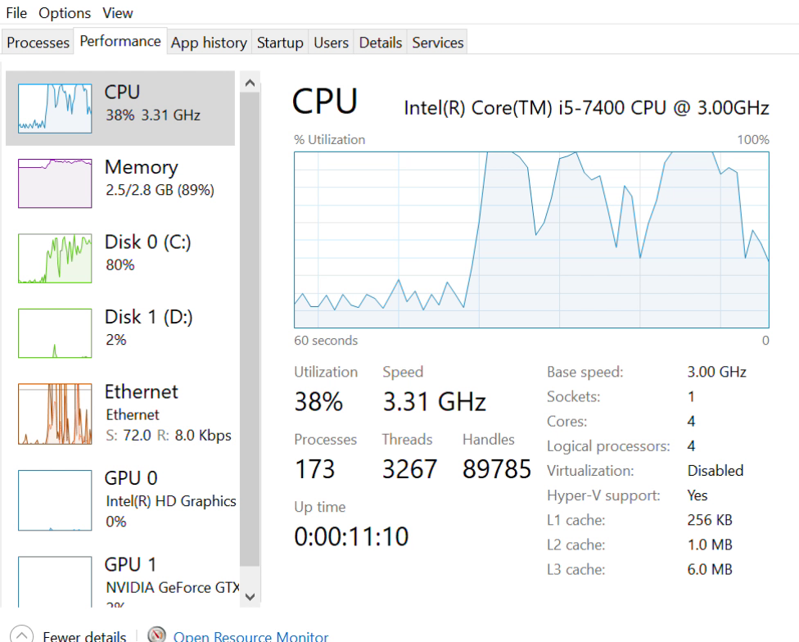
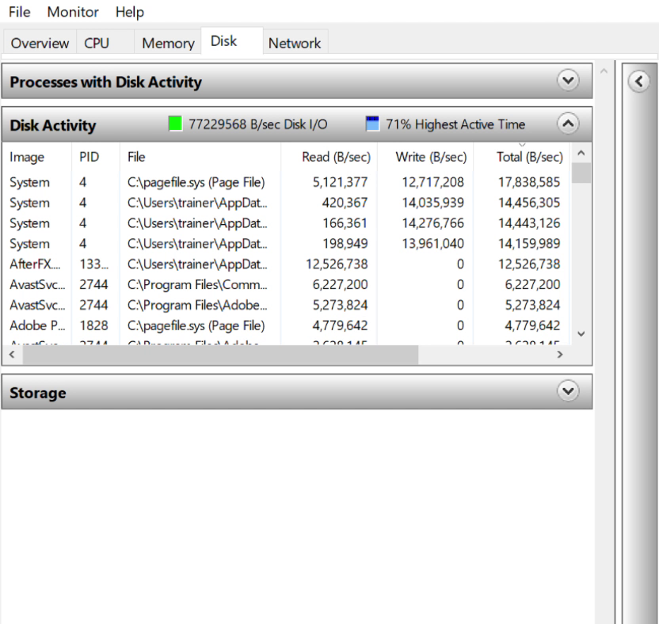
Low Memory
Storage will be used for memory (Paging)
Large amount of paging will affect performance
ITFreeTraining.com
© Copyright 2023
Notes:
02:13 When you start running low on physical memory, the operating system will start using storage such as the hard disk or solid-state drive for memory. Essentially, when the computer starts running out of memory, blocks of memory will be written to a swap file. Each block of memory in physical memory is called a page. Thus, the process of swapping these blocks between physical memory and storage is called paging. Paging, essentially means that memory will be written to storage and, when it is required again, it will be read from that storage and placed back in memory
Using storage for memory is a lot slower than with physical memory. Under normal operations, there will always be a little bit of paging because the operating system takes a guess on some memory that it thinks it won’t need again or at least for a while. The reason it does this is that if some memory has been paged already, this will improve performance a little when the operating system runs low on memory, as some of the work has already been done.
However, a large amount of paging is not normal and will affect performance. This is because this would put a lot of load on the computer’s storage, since the computer is reading and writing lots of page files. Let’s have a look.
On this computer, I have reduced the physical memory down to 2.8 Gigabytes. I don’t have anything running as yet, but you will notice that the memory is already full. I will now open a few applications and you will notice that the CPU and disk usage have gone up. This is to be expected; However, after running the applications if the computer remains sluggish, you may need to add more memory to the computer.
To find out if low physical memory is the problem, I will open the resource monitor. I have sorted the disk activity section by total bytes per second of activity. Notice that at the top is the file Pagefile.sys. This file is used when Windows swaps memory for storage space or vice versa. Some usage is expected for normal operations, but if you see it consistently towards the top of the disk activity list all the time, you need more physical memory.
Now that I know we need more memory, let’s look at how we will go about purchasing new memory.

Slide 4
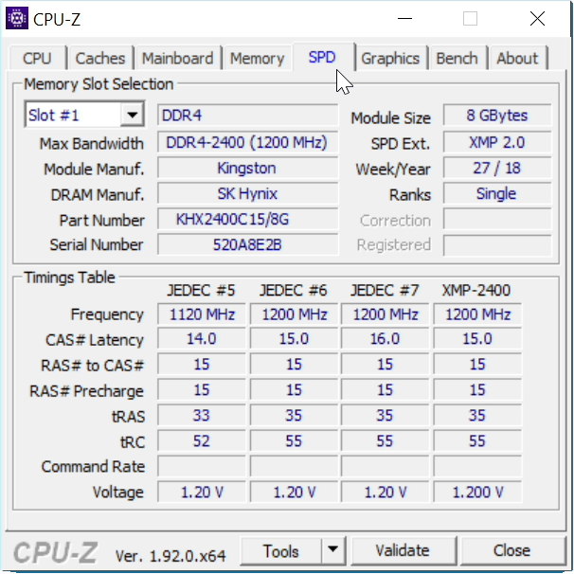
Motherboard (MB) Memory Support
Work out what memory your MB will support
CPU-Z http://cpuid.com (Info MB/memory)
ITFreeTraining.com
© Copyright 2023
Notes:
04:34 To install more memory, you first need to work out what memory your motherboard supports. If you don’t know what motherboard you are using or what memory is already installed, the simple way to find out is to open the computer case and have a look.
If you don’t want to open the computer case, you can use the tool CPU-Z. CPU-Z is free software which I have already downloaded. You can install it or run it as a standalone executable, which I will do now. The advantage of standalone tools like this are you can place them on a USB stick or network share, and run them when you need them without having to install them.
CPU-Z has also been ported to Linux and Android, if you wish to run it on those platforms. The first screen of CPU-Z will give you information about the CPU. Since I am only interested in what memory is installed, I will select the tab ‘Mainboard’ to try and work out what memory the motherboard supports.
On this tab, the manufacturer of the motherboard is ASRock. Under this, you can see the model is Z390 Pro 4. With this information, you can have a look at the manufacturer’s website and find out what memory the motherboard supports. In some cases, the motherboard may need a BIOS update in order to support a particular memory module. The manufacturer’s website should be able to provide you with this information. Since so much memory is manufactured, it is not possible for the manufacture to test every memory module with the motherboard. Thus, if your memory module is not listed you may just need to give it a try to see if it works.
In some cases, you may have some free memory in your storeroom and just need some more information to work out which memory you want to use. To get more information, select the ‘Memory’ tab.
The memory tab will give you some information about the current memory that is installed. In this case, you can see the memory is DDR4. Also, you can see that the amount of memory installed is eight gigabytes. We know that there are eight gigabytes installed, but we do not know how many memory modules there are inside the computer and how many are in use.
To find out this information, I will select the ‘SPD’ tab. SPD or Serial Presence Detect, is a protocol supported by memory modules that allows information to be retrieved from a memory module about what timing it supports. You can see that there is a lot of useful information on this tab.
By default, the first memory slot will be selected. We can see on the far right that this memory module is eight gigabytes in size. Since there are eight gigabytes of memory installed, we know that there is only one memory module in this computer, but we don’t yet know how many memory modules this motherboard supports.
To find out this information, I will select the ‘Memory Slot Selection’ pull down. You will notice that there are a total of four memory slots, slots two through to four are currently empty. We now know that there is a total of four memory modules that can be installed and what type of memory modules they are. Memory modules work best in pairs. Some motherboards may support three or four memory modules working together. It is best to check the manufacturer’s website to work out what is supported.
In order to get memory modules to work together, they need to be the same size and preferably from the same manufacturer. If the memory modules run at different speeds, one of the memory modules will need to slow down to the speed of the other one in order to work correctly, which should happen automatically. However, if you ever miss-match your memory there is always a risk of compatibility problems. You can always switch this feature off in the BIOS if you need to.
To upgrade this computer, if possible, I would add a second eight gigabyte memory module to increase the memory to 16 gigabytes, preferably from the same manufacturer and type if possible. Sometimes upgrading will not be so easy; for example, if all the memory slots are in use. When this is the case, you will need to remove or replace memory modules in order to increase the amount of memory in the computer.
I will now have a look at the manufacturer’s website to look at what other things you need to consider.

Slide 5
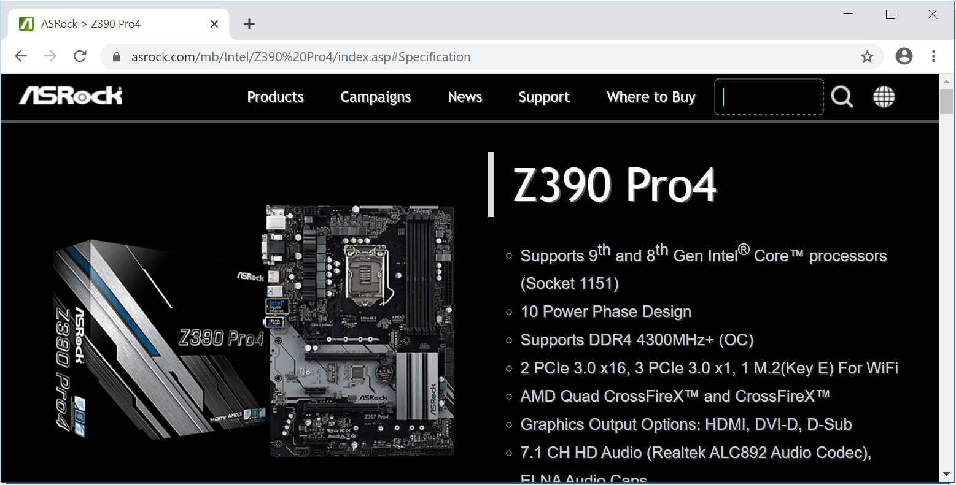
Motherboard Support Information
ITFreeTraining.com
© Copyright 2023
Notes:
08:59 To get more information about the motherboard, I will have a look at the information on the ASRock website. The first thing to consider is the maximum amount of memory the motherboard can support. This will be listed in the specifications for the motherboard; in this case the motherboard can support 128 gigabytes. Keep in mind that if you are running a 32-bit operating system, you will be limited to four gigabytes, but not all of these four gigabytes will be usable.
I will next have a look at what memory this motherboard supports. In the case of this website, this will be under the ‘Support’ section. In the support section I need to select ‘Memory QVL’ ¬– this will show all the memory modules that are supported by the motherboard. You can see that this is a very, very long list.
If you find that your memory module is not listed, you can still give it a try in the motherboard. There is a good chance that it will still work. I would also recommend a BIOS upgrade. Sometimes memory modules may have problems working on the motherboard, but the manufacturer may have already released an update that corrected the problem.

Slide 6

Subscribe
Next video
Video content: https://ITFreeTraining.com/ap/3a70
© Copyright 2023
Notes:
10:09 That concludes this video on how much memory you will need in your computer. Hopefully, you have found the video useful. Until the next video from us, I would like to thank you for watching.
References
“CompTIA A+ Certification exam guide. Tenth edition” Page 150
“How much RAM do I need?” https://www.newegg.com/insider/how-much-ram-do-i-need-2018/
“Picture: Hopscotch” https://unsplash.com/photos/r9T0LZv8xWQ
“Picture: Cup” https://unsplash.com/photos/nDd3dIkkOLo
“Picture: Cat sleeping” https://pixabay.com/photos/cat-dream-cat-resting-closeup-2605502/
“Picture: Gold thumbs up” https://pixabay.com/photos/thumbs-up-statue-gold-hand-finger-206671/
“Picture: Superman” https://unsplash.com/photos/en7G3hTSjBQ
Credits
Trainer: Austin Mason http://ITFreeTraining.com
Voice Talent: HP Lewis http://hplewis.com
Quality Assurance: Brett Batson http://www.pbb-proofreading.uk

