Slide 1
For the free video please see http://itfreetraining.com/ap/3a42

Slide 2
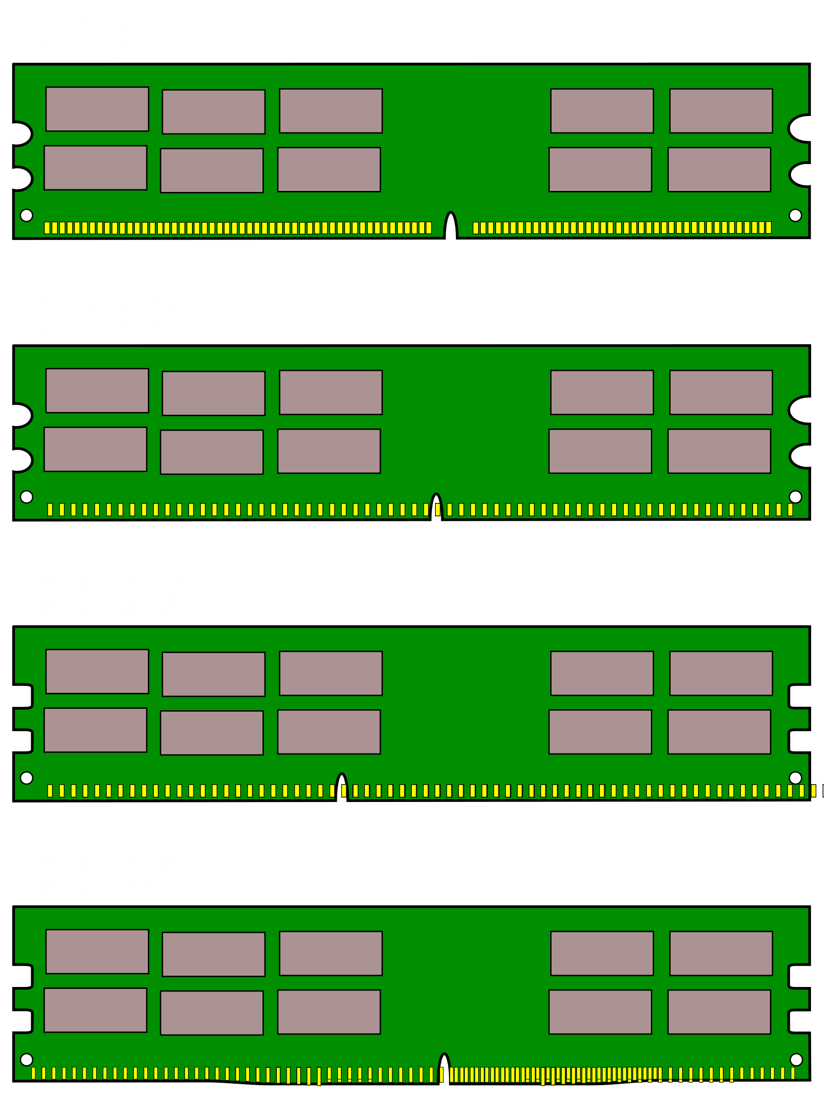
DDR (Desktop) vs SO-DIMM (Laptop)
Pins: 184
Pins: 200
Pins: 240
Pins: 200
Pins: 240
Pins: 204
Pins: 288
Pins: 260
Notes:
To start with, let’s compare laptop memory with desktop memory. You can see that the memory is about half the size of desktop memory. The memory is made smaller due to the limited space in laptops. I will refer to this memory as laptop memory, however, it can be used in other devices. You may also find it in smaller devices such as network storage devices. Although I will refer to it as laptop memory, keep in mind you may see it pop up in other devices from time to time.
Although the memory modules are about half the size of desktop modules, in many cases they have about the same number of pins. So, the first question is, how does performance differ between the two?

Slide 3
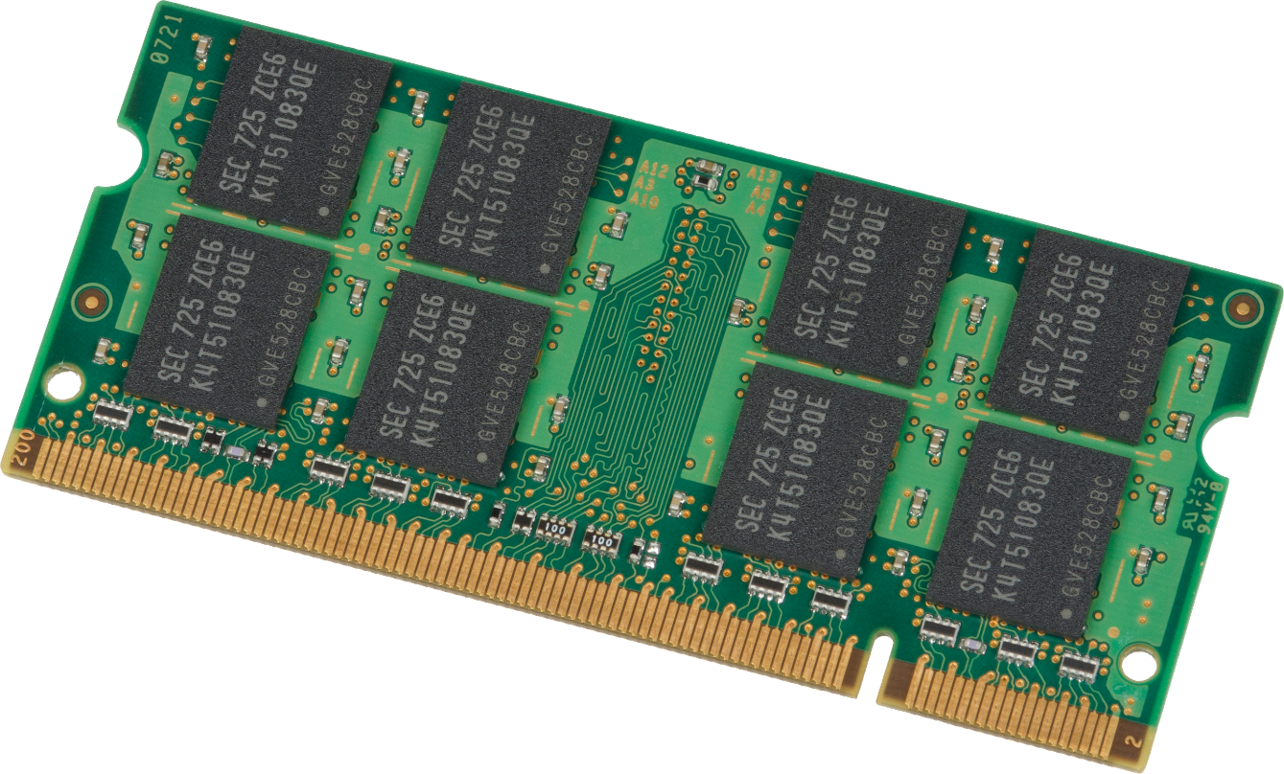
SO-DIMM
Slower transfer rates
Max memory size is smaller
Generally speaking
Device may support dual channel
Uses 64-bit bus just like desktop
Small Outline Dual In-Line Memory Module
Notes:
Laptop memory is called SO-DIMM which stands for Small Outline Dual In-line Memory Module. Like DDR memory it may contain memory chips on one or both sides. Since it is essentially a smaller version of desktop memory it uses a 64-bit bus just like desktop memory. This essentially makes it easier as memory controllers do not need to be redesigned to use a different bus size.
Depending on which device the memory is being installed in, it may support dual channel. Dual channel is when two memory modules work together rather than independently of each other. This has been commonly used in desktop computers since the early days of computers. So essentially every desktop computer should have it, but a laptop may not.
Depending on your device, it may or may not support it. However, most laptops should support it. In order to use it, the device needs to have two slots of SO-DIMM memory installed. To get it to work, both memory modules should be the same or at least pretty close. At the minimum they need to be the same sizes. If they are of different speeds, hopefully the hardware will run them at a slower speed to prevent problems; However, this also means that one of the memory modules is performing slower than it should be.
Generally speaking, the max memory of SO-DIMM will be smaller than the DDR equivalent. That makes sense since they are smaller in size. However, nowadays the largest SO-DIMM are very large. For example, it is possible to get a SO-DIMM DDR4 memory module that is 16 Gigabytes in size.
SO-DIMM generally have slower transfer rates, and while the bus width is the same, some SO-DIMM can have very high clock rates. So, it really depends on which one you buy. DDR memory modules will generally have eight chips on either side for a total of 16. These all work together. A SO-DIMM may have a lot less. Less chips generally means a slower transfer rate since you don’t have as many chips working together.
Now that we understand laptop memory a bit better, I will now have a look at how to remove and install the memory into a laptop.

Slide 4
Demonstration
Notes:
In this demonstration, I have a laptop that already has memory installed. I will remove the memory from the laptop to show how this is done and then re-install it. Most laptops will have a panel that can be removed in order to get to the memory. This may not be the case in all laptops and you may need to take the laptop apart to get to the memory.
There may be a few different panels on the back; so look for any marking on the laptop to give you an indication what is behind the panel. In the case of this laptop, there is a small memory module icon to indicate which screw needs to be removed. If you can’t locate it, refer to the manual or you could use trial and error until you find the right panel.
Once you loosen the screw, sometimes the panel may still be in place. You can see, in the case of this laptop, there is a small recess; this can be used to lever the panel open with a flat-headed screwdriver. We can now see the memory module in the slot in the laptop.
On either side of the memory module there will be some clips holding it in place. It is just a matter of using your finger to release them. The slot is spring loaded, so hopefully once the clips are released, the memory module will pop up to a 45-degree angle. If you have problems, you can use your flat-headed screwdriver, but if you do this, be careful not to use too much force. You want to use just enough force so the memory module pops up.
Once the memory module pops up, it is just a simple matter of removing the memory module by holding it by the sides. You can see, in this particular memory module, it has eight chips on either side. So effectively, this has the same number of chips as a DDR memory module has, they are just in a smaller space. The performance you can expect will depend on the specifications of the memory module, which is often directly related to how much you pay for it.
To install the memory module, it is a matter of first placing it in the slot at a 45-degree angle. Once in place, push down on the corners until the memory module snaps into place. Once the memory module is in, put the cover back on and screw it into place. Sometimes the cover may not go back on completely flush. If this occurs, push down on the corners and hopefully it will click into place. If it does not, you may need to remove the cover and put it back on again.

Slide 5
SO-DIMM to DDR
Allows SO-DIMM to be installed in DDR slot
Notes:
SO-DIMM will not be able to be installed in a DDR slot due to the size difference. However, there are adapters on the market that are available which allow SO-DIMM to be installed in a DDR slot.
In the case of a laptop, an upgrade may mean having to replace the existing memory module due to there only being one slot, meaning the old memory module can’t be used. If you want to get a bit more use of the memory module, you can purchase one of these adapters so the memory module can be used in a desktop.
These adapters can be a little bit of hit and miss. In some cases they work great, in other cases the computer may not even start up. Unfortunately, it is not a sure thing, but something you can try if you wish.
That concludes this video from ITFreeTraining on laptop memory. I hope you have found it informative. Until the next video from us I would like to thank you for watching.
References
“The Official CompTIA A+ Core Study Guide (Exam 220-1001)” Chapter6X Paragraph 47-52
“CompTIA A+ Certification exam guide. Tenth edition” Pages 139-140
“SO-DIMM” https://en.wikipedia.org/wiki/SO-DIMM
“Picture: SO-DIMM memory” https://commons.wikimedia.org/wiki/File:Laptop_SODIMM_DDR_Memory_Comparison_V2.svg
“Picture: DDR compare” https://en.wikipedia.org/wiki/File:Desktop_DDR_Memory_Comparison.svg
“Picture: SO-DIMM memory” https://en.wikipedia.org/wiki/File:Samsung-1GB-DDR2-Laptop-RAM.jpg
Credits
Trainer: Austin Mason http://ITFreeTraining.com
Voice Talent: HP Lewis http://hplewis.com
Quality Assurance: Brett Batson http://www.pbb-proofreading.uk

