Slide 1
For the free video please see http://itfreetraining.com/ap/3195
Notes:
In this video from ITFreeTraining, I will look at USB to Ethernet adapters. These devices allow you to connect to the network using a USB port which can be invaluable in certain situations.

Slide 2
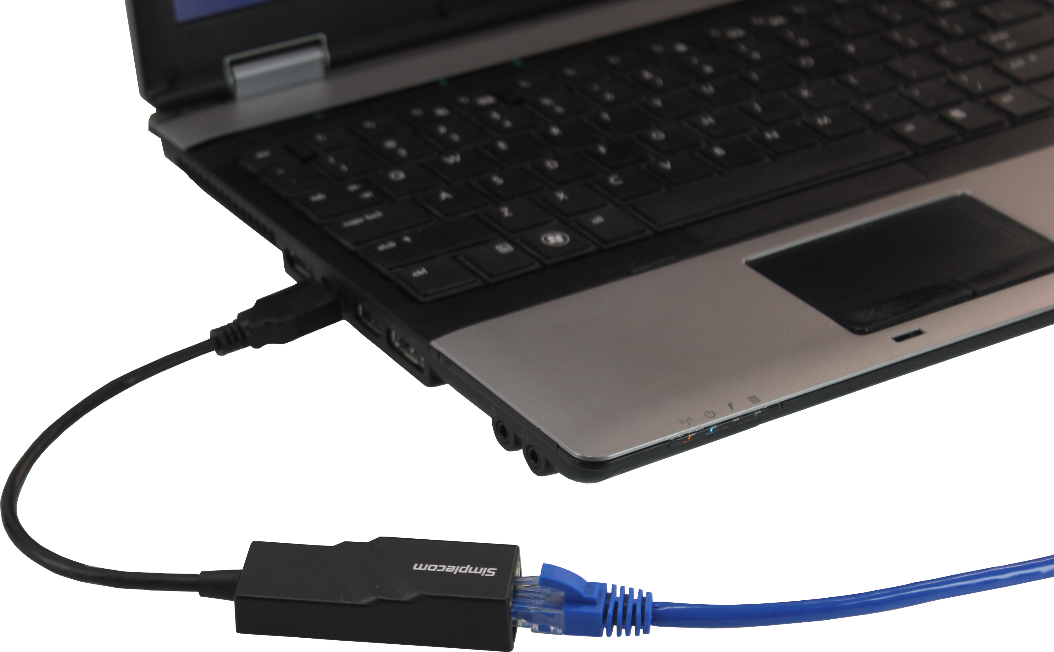
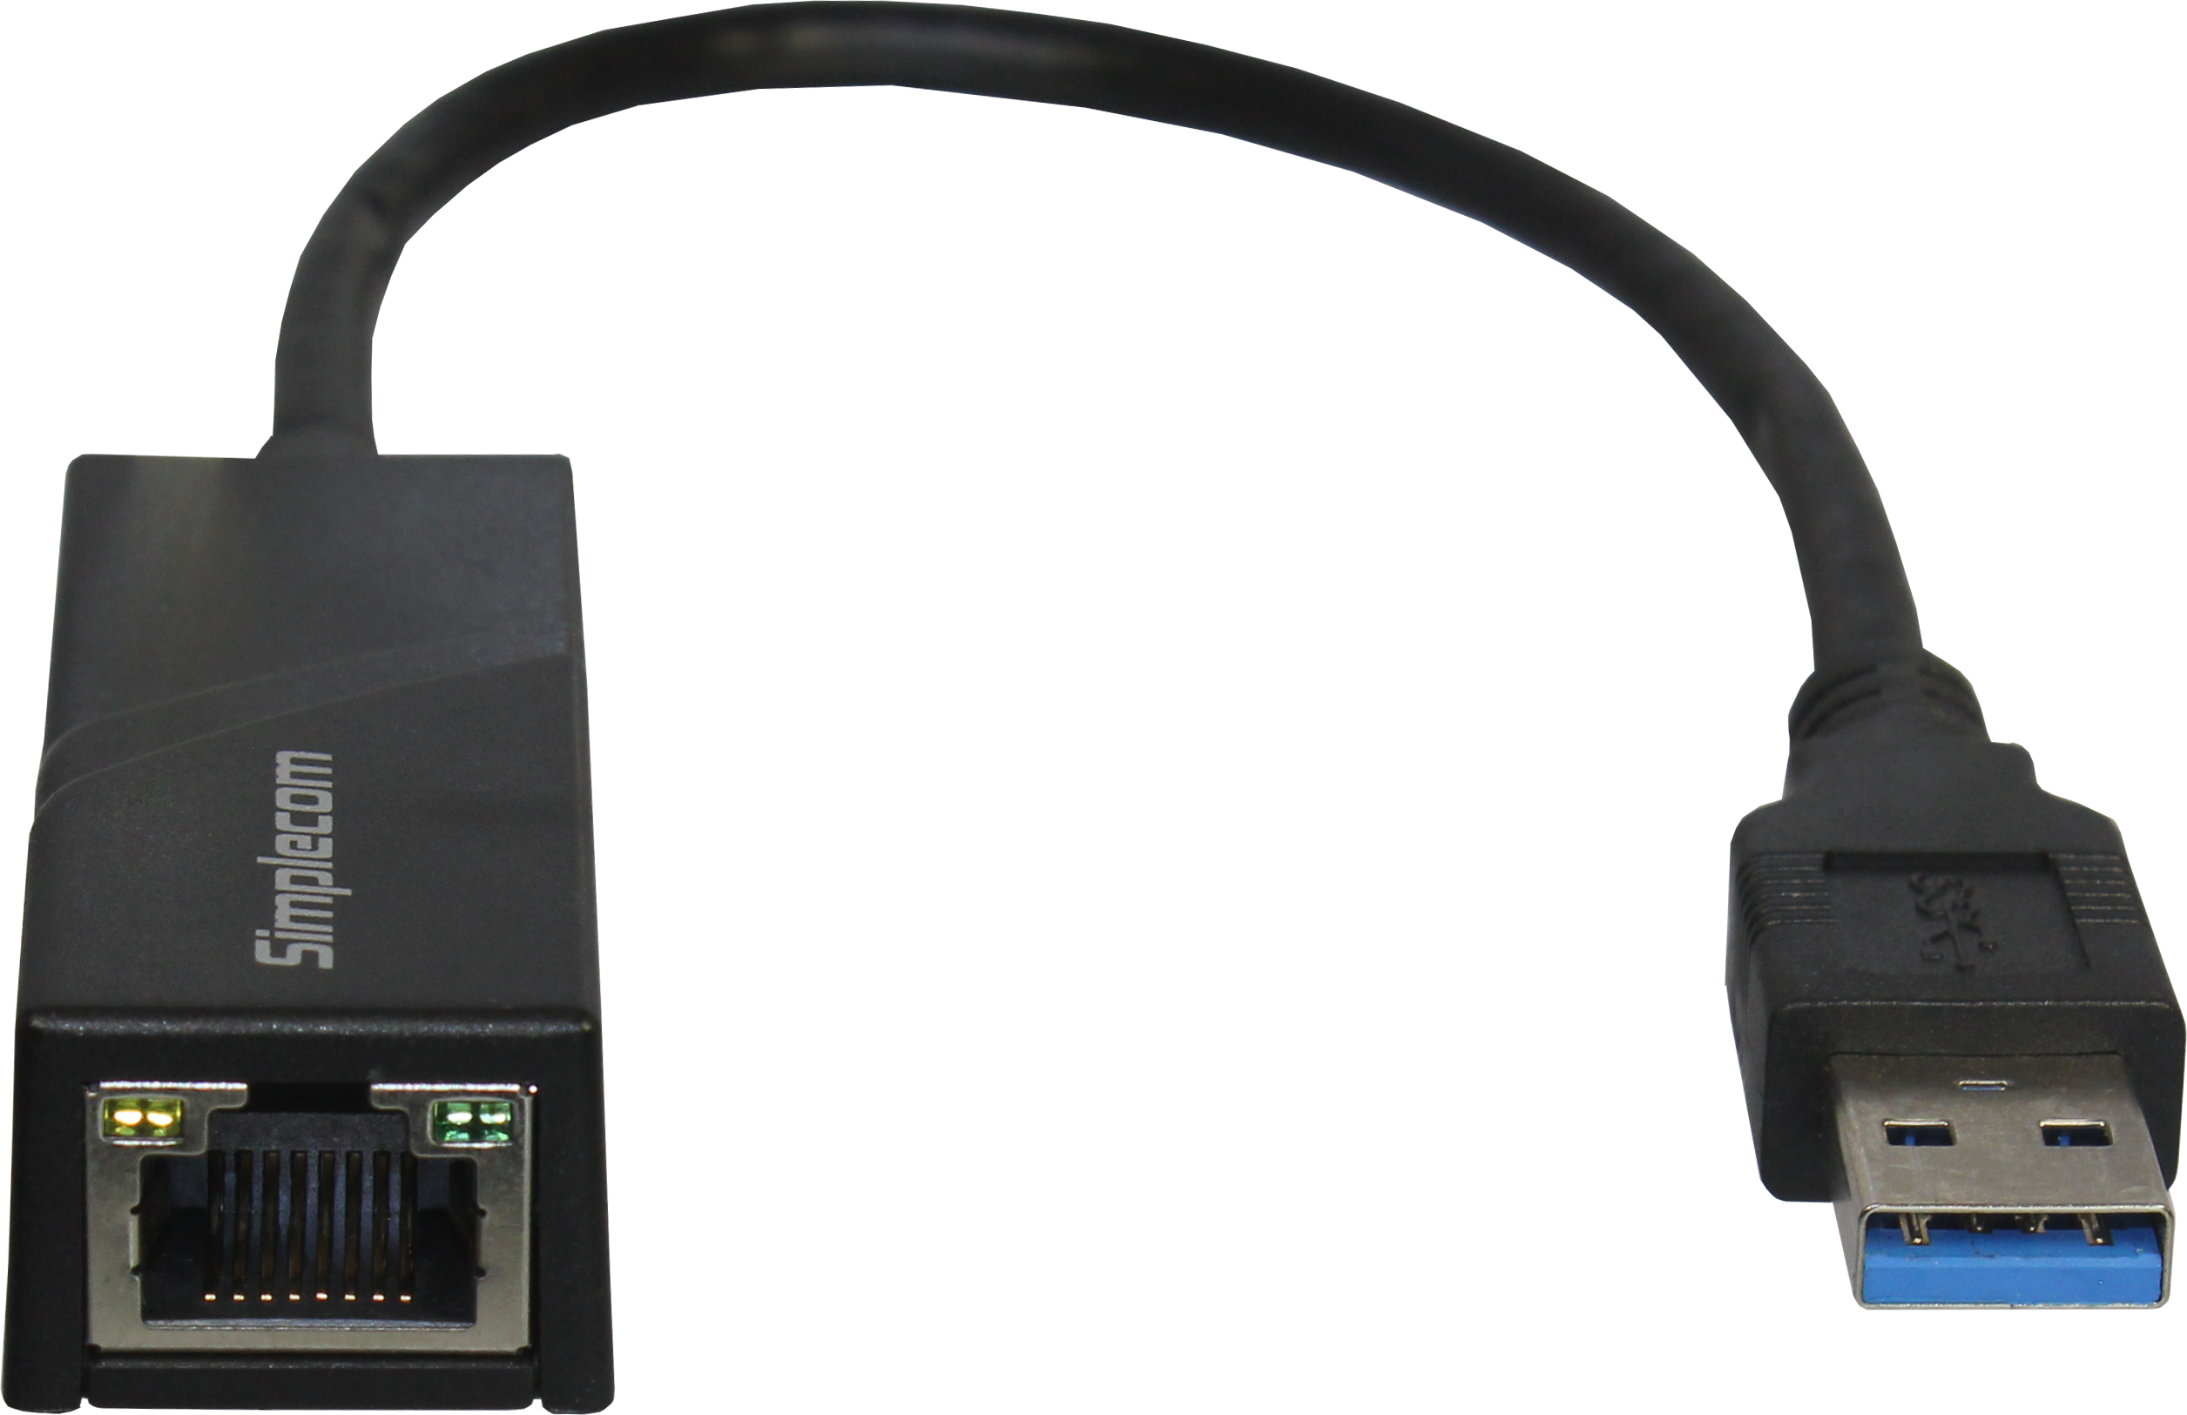
USB to Ethernet
Useful for installing/imaging computers
Replace/upgrade existing network adapters
Notes:
0:13 There are many USB to ethernet devices on the market. The one shown here is a 1 Gigabyte USB 3 adapter. To use it, it is just a matter of plugging the adapter into a USB port and the other end into the network.
USB to ethernet adapters are useful in certain situations. For example, they provide a way to replace or upgrade existing network adapters. This is particularly useful if you have a laptop with a damaged network adapter. On some laptops the network adapter may be physically soldered to the motherboard. When this occurs, if the network adapter is damaged or you want to upgrade it, the network adapter cannot be easily replaced. Most of the time this will mean replacing the whole motherboard which can be expensive.
USB adapters are also useful when you are installing a computer or imaging a computer. In some cases, Windows or your imaging software will support the network adapter you have in the computer. In other cases, they will not. When this occurs, you will be left with a computer with no network support.
Using a USB to ethernet adapter allows you to essentially connect the same network adapter to any computer that you install or image. The advantage of this is that you always know which network drivers you will need and can add these to your install. As a system administrator, if you are installing Windows on a lot of computers, having the same network adapter can be very useful.
The USB to ethernet adapter could also be used to connect to a network or internet to download network drivers for the network adapter in the computer. The alterative to this would be to copy the network drivers onto a storage device like a USB device in order to get them onto the computer.
Some network adapters have the device drivers included in the network adapter to make them easy to install. To have a look at this, I will change to my computer running Windows 7 to have a look at how it works.

Slide 3
Demonstration
Notes:
2:12 This computer does not have any network adapters currently installed. To demonstrate this, I will open “View network connections” from the Start menu. You can see that there are currently no network adapters listed.
I will now plug the network adapter into the laptop, Windows will attempt to locate a device driver and will not be able to. When the process fails, notice that a new optical drive will appear. If I open the drive, you will notice the device driver for the network adapter. It is just a matter of executing the file and the device driver for the network adapter will be installed.
You will notice, that after the driver is installed, the network adapter will appear in Windows. You can see that having a network adapter is very useful in certain situations. For example, after performing a fresh install of Windows - the base install of Windows may not have the device driver for your network adapter. Using a network adapter like this, allows you to quickly install a functioning network adapter to download the missing device driver - A useful option to consider when you are quickly trying to get a computer operating. Otherwise, you will need to download the missing driver on another computer and copy it to the computer you are working on.
This concludes this video on USB to ethernet. I hope to see you in other videos from us. Until the next video I would like to thank you for watching.
References
None
Credits
Trainer: Austin Mason http://ITFreeTraining.com
Voice Talent: HP Lewis http://hplewis.com
Quality Assurance: Brett Batson http://www.pbb-proofreading.uk

