Slide 1
Notes:
In this video from ITFreeTraining, I will be looking at how the computer creates sound. I will also look at what benefits you can get from adding a dedicated sound card or external sound devices to the computer. By the end of the video, you will have a good idea of what you can achieve and what hardware you will need in order to do it.

Slide 2
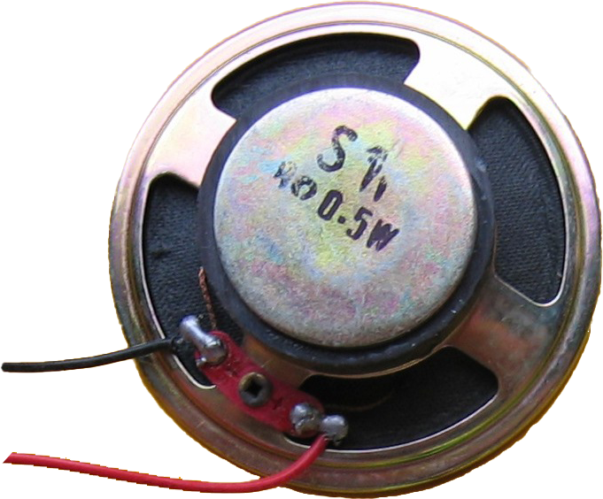
PC Speaker
Large speakers used in first IBM PCs
Smaller speaker
used in modern
PCs
Only used for
warning beeps
ITFreeTraining.com
© Copyright 2023
Notes:
00:19 To start with, let’s do a quick history lesson. The first IBM computer shipped with a large speaker called the PC speaker. This speaker was used to provide sound for the computer. This included beeps to indicate a hardware fault, but also sound for applications, including music.
The speaker was limited to what it could achieve. Being just a speaker, it could not do stereo, did not have dedicated hardware support and thus required a lot of CPU power to operate. As sound cards were developed, the PC speaker was used less and less for computer audio. As this occurred, the larger speaker was no longer produced and was instead replaced by a smaller speaker.
You might think that with the improvements in audio there would be no need for the PC speaker; however, it is still used today to produce beeps. Generally, when the computer is first switched on, a single beep will be produced sounding like this.
For this reason, it is important to still have the PC speaker connected so you will be able to hear these beeps. Either a single beep when the computer starts up or a number of beeps in succession to indicate an error has occurred.
PC speakers provide basic sound; however, they were limited to what they could produce and put an extra load on the CPU.

Slide 3
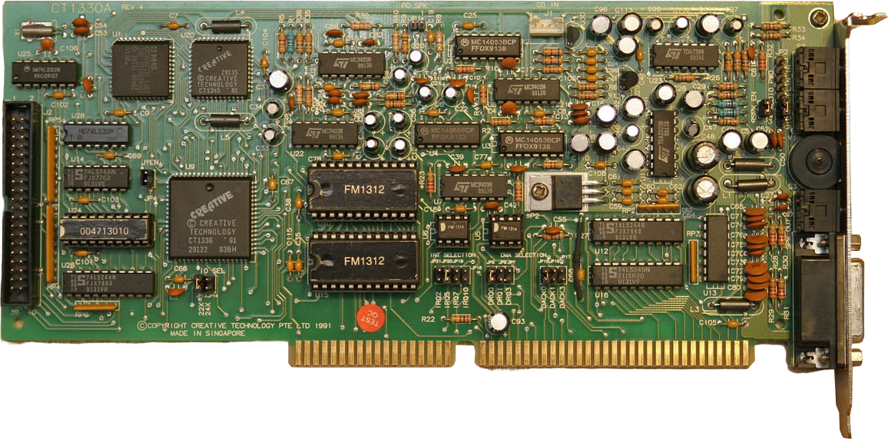
Sound Cards
Significantly improved sound quality
Hardware performs audio functions/reduces CPU load
ITFreeTraining.com
© Copyright 2023
Notes:
01:36 To overcome these problems, sound cards were developed. There have been many sound cards released over the years. Shown here is a Sound Blaster PRO which was popular back in the early 90’s. Sound cards like these significantly improved the sound quality over the PC speaker. The other advantage was the hardware on the card performed audio functions, which reduced the load on the CPU.
The sound card could provide functions like stereo, sound mixing and also play music. These cards became very popular as they addressed the limitations of the PC speaker and provided superior sound. However, they would slowly start to disappear, so let’s have a look why.

Slide 4
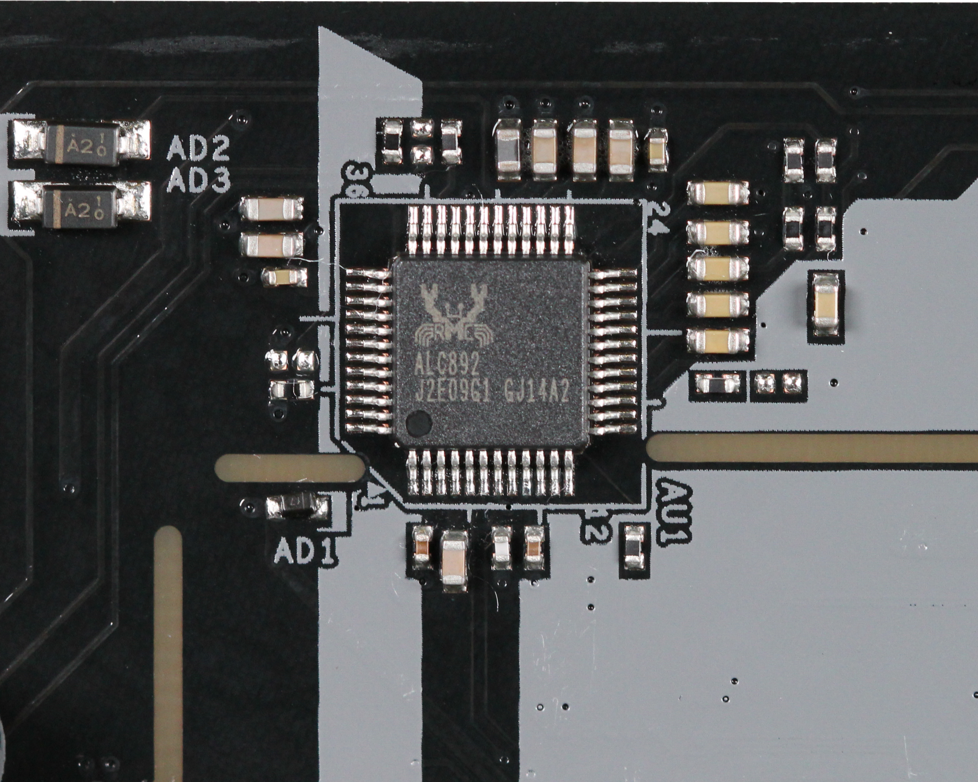
Sound Hardware on Motherboards
Late 90’s started appearing on motherboards
Sound support in OS improved
Reduced hardware requirement for audio
Improved CPUs meant less overall CPU loading
ITFreeTraining.com
© Copyright 2023
Notes:
02:19 In the late 90’s, sound chips started being integrated onto the motherboard. Sound cards were better than integrated sound chips and offered more features. However, surprisingly it was not hardware improvements that saw fewer sound cards being purchased. What caused sound cards to decline in favor of integrated sound on the motherboard was improvements in sound support in the operating system.
Nowadays, functions like mixing different sound effects together and other functions that were performed by hardware on the sound card are now done by the operating system. By doing this, it reduces the hardware requirement for audio. So, you can understand that the hardware on the motherboard for sound does not need to be that powerful since the operating system is doing most of the work.
This may seem like it will be a problem, since we are putting more load on the CPU that could be done by the hardware on a sound card, but due to improvements in CPUs, this translated into less load on the CPU. Put simply, even if you have complex sound being played, including surround sound, on modern CPUs this does not create much load. You can see why, even though integrated sound on the motherboard does not have the same hardware support as a sound card, on modern operating systems it does not need to; this accounts for the decline in the use of sound cards over integrated sound chips. However, there are some benefits to having a sound card.
Before I look at the benefits of having a sound card, notice that there is not much around the audio chip. On most motherboards you will find this is the case; however, on cheaper motherboards the chip may be near other components. All the space on a motherboard is valuable real estate. This is because it costs the motherboard manufacturer more to make the board if they do not use all the space efficiently, and therefore you may find with cheaper motherboards the audio chips are closer to other components.
This is important because, if components are too close to the sound chip, this can cause interference. Sound devices are particularly susceptible because you will be able to hear interference coming through the speakers like this.
In some cases, you will hear the sound change when the computer is under load or doing something like accessing storage. To get around this, generally the audio chip is positioned away from the other chips. Think of it like this, if you build your house near a freeway, you will hear all the vehicles going past. If you build your house further away, you will hear less of the vehicles. The same applies to electronics, the further you space things away from each other, the less interference they will experience. Since the audio chip essentially converts digital to audio to output to the speakers, you are more likely to have interference problems if electrical fields are near the chip.
Integrated sound chips have improved a lot since the early days due to manufacturers getting smarter about where they put these chips and also by adding shielding inside the chip. This has improved the quality of the output audio; however, you may have problems with the recording quality. If recording quality is something you are concerned about, you may need to purchase an internal sound card or an external sound recording device. However, even if you are not worried about recording, there are still some advantages to having an internal sound card.

Slide 5
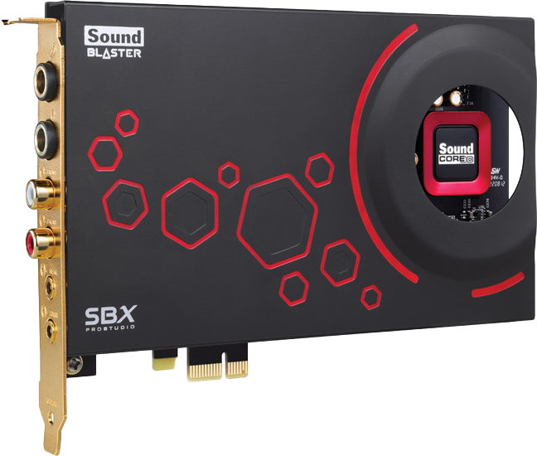
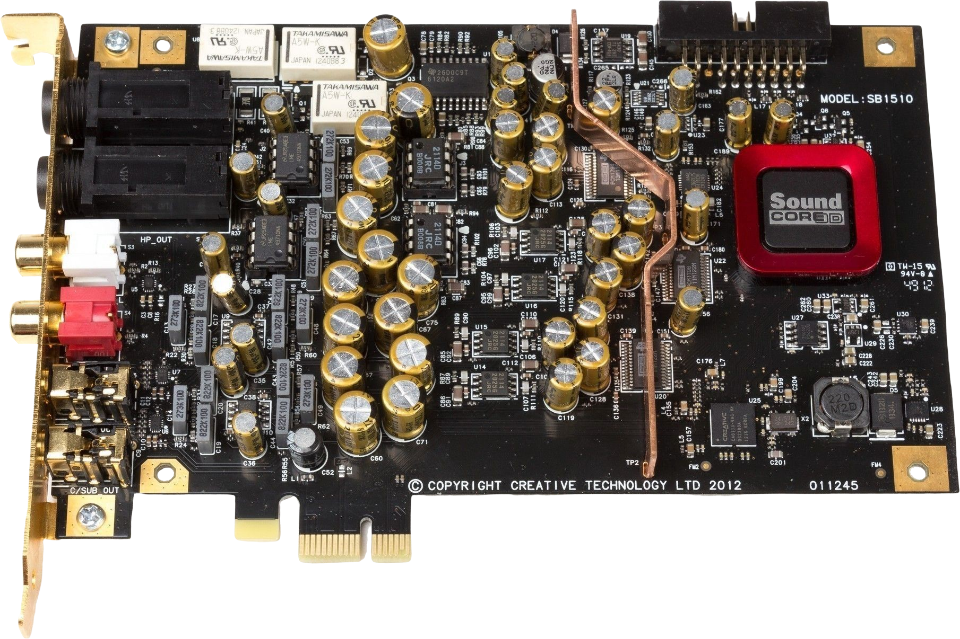
Internal Sound Cards
Less subject to interference
Additional ports and features
EMI copper shielding
ITFreeTraining.com
© Copyright 2023
Notes:
05:51 An internal sound card is subject to less interference than an integrated sound card. However, remember that integrated sound chips have come a long way and interference is not as big a problem as it once was.
This particular internal sound card has an EMI shielding around the card itself. This has been removed, essentially the outside cover, to see what is inside. The EMI shielding helps protect the sound card from electrical interference inside the computer. Notice however, that there is also additional EMI copper shielding inside the card. This copper runs from one end of the card to the other and creates a divide between the digital and analog parts of the card. This helps prevent interference by the card itself affecting the output.
Having an internal sound card may also provide additional ports and features. For this particular sound card, there is also a second card that can be attached to provide additional ports. Although the operating system provides a lot of features, software provided by the manufacturer of the sound card may provide additional features. For example, you may have better control over the sound that is outputted from the card.
The extra shielding does help with interference; however, nowadays people will often go for an external device rather than an internal sound card.

Slide 6
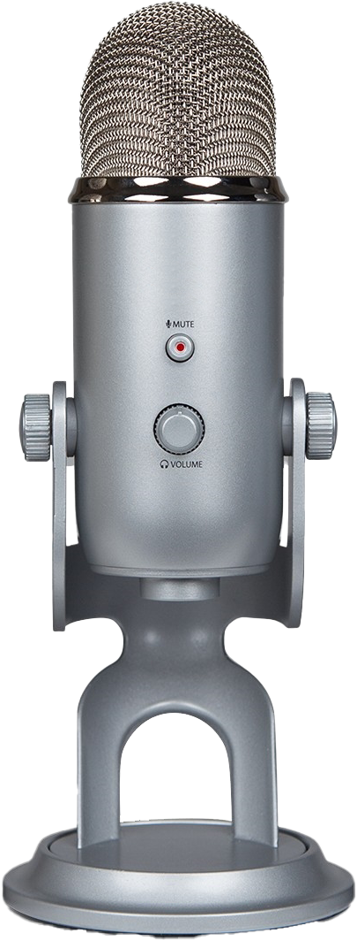
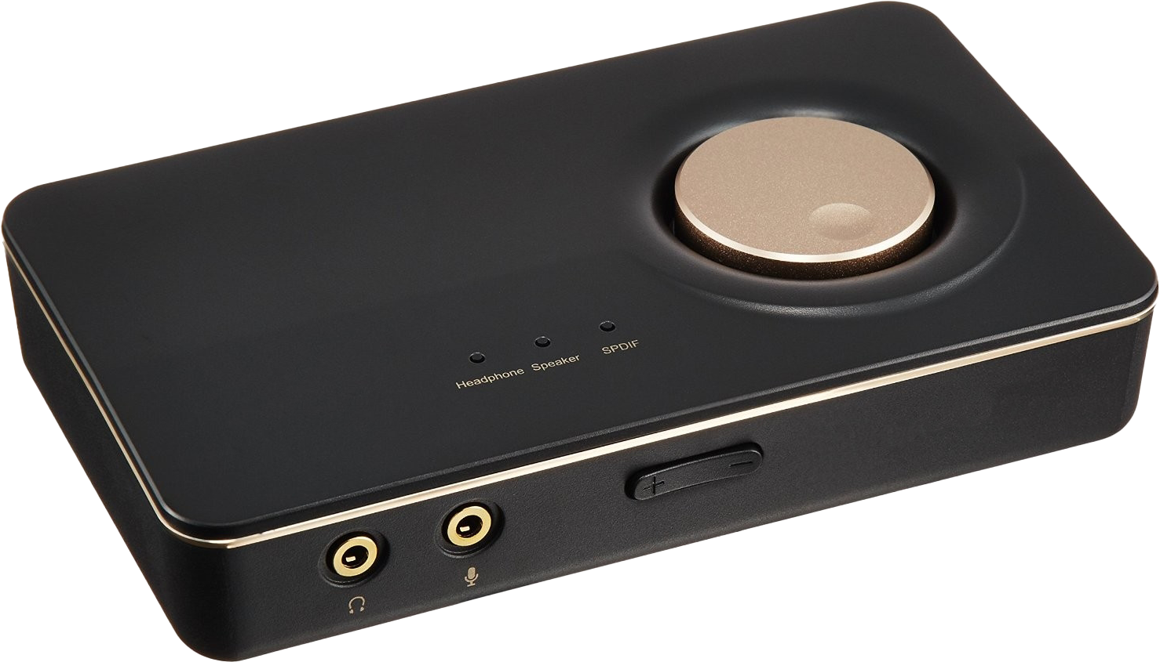
External Devices
Digital Analog Converter (DAC)/May include AMP
Analog-to-Digital Converter (ADC)
External sound device Connects headphone and microphone
Provides additional power for headphones
External microphone
Converts analog to digital
ITFreeTraining.com
© Copyright 2023
Notes:
07:13 External devices that provide sound capabilities may be referred to as a Digital Analog Converter or DAC. These devices may also include an AMP. Nowadays, these devices generally connect to the computer using USB. A lot of them do not require any extra software to operate and Windows will detect them automatically. The AMP in the device increases the power for the headphone jack. If you are using cheap headphones, this will probably not matter. But if you have some expensive headphones, they will use more power. The AMP provides extra power and, without it, you may get some distortion in the audio when you use a good set of headphones.
An external device may also include an analog-to-digital converter (ADC). Generally, they are not called this – in this example, this would just be called a microphone. The DAC device will generally support external devices, for example for an external microphone jack, so would also need to be able to provide analog-to-digital conversion, but generally they are still called DACs.
The microphone in this example plugs into the computer using USB. The process of converting the analog signal to digital is all done in the microphone. For this reason, the microphone is not subject to interference unless you put it next to something that is creating electrical interference. This also applies to the DAC. You can see why these devices have become popular, since they take all of the conversion process away from possible interference that may occur inside the computer.
If you are looking at professional level sound, most people will consider external devices like these. You could also use an internal sound card, but most professionals swear by external devices nowadays. The choice however is ultimately up to you.
I hope you have enjoyed this video from ITFreeTraining on sound cards. For more free videos for this course, please see our webpage or YouTube channel. Until the next video from us, I would like to thank you for watching.
End Screen

Slide 7
Subscribe
Next video
Video content: https://ITFreeTraining.com/ap/2c10
© Copyright 2023
Notes:
09:20 I hope you have enjoyed this video from ITFreeTraining on sound cards. For more free videos for this course, please see our webpage or YouTube channel. Until the next video from us, I would like to thank you for watching.
References
“The Official CompTIA A+ Core Study Guide (Exam 220-1001)” Chapter 5 Position 184 - 192
“PC speaker” https://en.wikipedia.org/wiki/PC_speaker
“Picture: Large PC Speaker” https://commons.wikimedia.org/wiki/File:PC-Speaker_IMG_8161_(cropped).JPG
“Secret of Monkey Island intro sound track” https://store.steampowered.com/app/32360/The_Secret_of_Monkey_Island_Special_Edition/
“Sound Blaster” https://en.wikipedia.org/wiki/Sound_Blaster
“Sound Blaster Pro” https://commons.wikimedia.org/wiki/File:CT1330A.jpg
Credits
Trainer: Austin Mason http://ITFreeTraining.com
Voice Talent: HP Lewis http://hplewis.com
Quality Assurance: Brett Batson http://www.pbb-proofreading.uk

