Slide 1
Notes:
In this video from ITFreeTraining, I will replace a laptop screen on an Acer Aspire V 13 laptop. During your IT career, in order to repair a computer, you will often have to replace a faulty part such as damaged laptop screen or a hard drive that has died on a PC. While It’s not possible to cover every scenario, this video hopefully will give you some insight into how to go about replacing faulty parts on a work computer or a laptop.

Slide 2
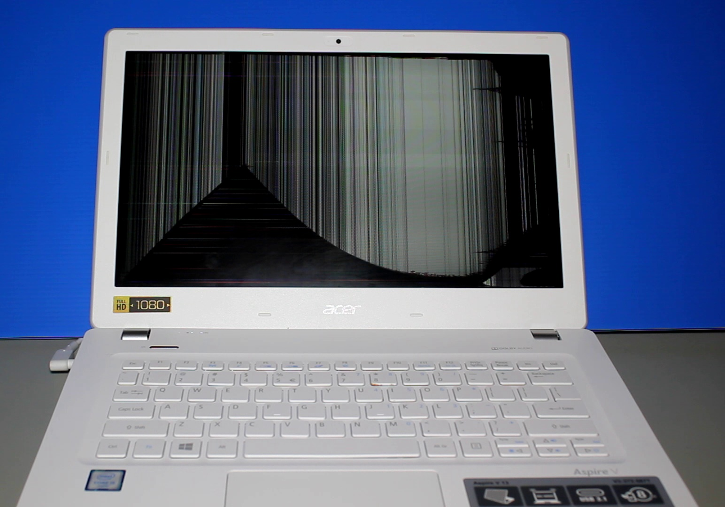
Broken Screen
ITFreeTraining.com
© Copyright 2023
Notes:
00:27 As you can see in this video, I have a laptop that has a cracked screen. When switching it on, you can see the cracks seem to be worsening and that the screen needs to be repaired or the laptop totally replaced. After being stored in an ordinary backpack without any proper padding, the Laptop’s screen was damaged when other items in the backpack were packed too tight beside it. Because the laptop was not encased in a proper hardcase sleeve with proper protective padding, the fragile screen cracked on the inside of the screen. That is why it is important to invest in a proper laptop bag that has enough storage and as well as being able to protect your laptop. Nevertheless, you will still need to be careful carrying your laptop in a special laptop bag. Even a hardcase sleeve placed into a laptop bag with proper padding will not protect it if it accidently falls from an overhead luggage compartment or when it gets thrown onto a footpath or tarmac. Laptops are fragile items. So, you should always handle with care, no matter how well they are packed.
As you will see, replacing a laptop’s screen is quite difficult to do. Because of this, most people will take their laptop to an authorized repairer. Also, attempting to fix a laptop yourself may void the warranty. Sometimes It is much easier to just bite the bullet and go and replace the laptop altogether. But if you do decide to go about repairing your laptop, you will end up finding it much easier to replace the whole screen and the casing around it, rather than just repair the screen itself. It’s just a lot easier. Do not worry! The A+ exam will not expect you to be able to complete difficult repair jobs such as this so early in your career. Hopefully though, this video will give you an idea on how cumbersome and laborious such a task would be to actually to do, thus making it easier to explain to your boss why it’s just not economically feasible to do an in-house repair of such a thing as a laptop - i.e. You cannot be expected to repair everything yourself.

Slide 3
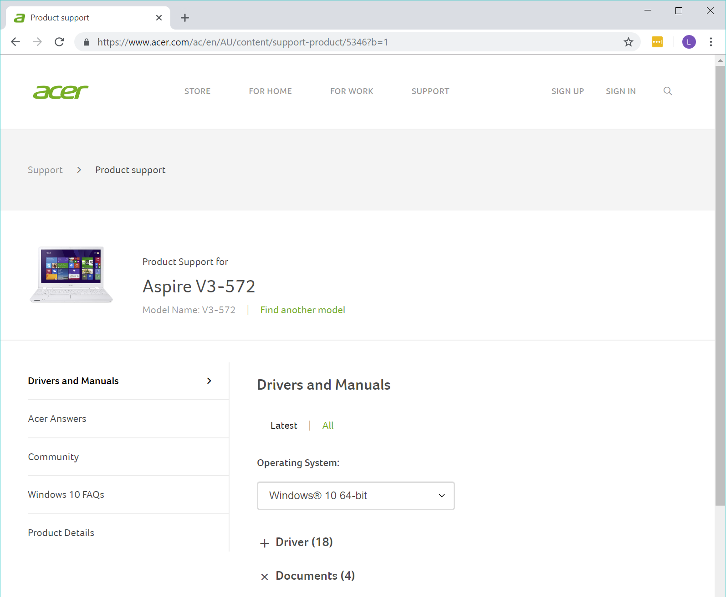
Support Homepage
Check for support documents
Part numbers for replacement parts
ITFreeTraining.com
© Copyright 2023
Notes:
02:34 Before replacing a part in a computer, in many cases it helps to check the manufacturer’s website for supporting documentation. The website will often contain instructions on how to replace parts in the computer. It may also contain the part numbers you will need for replacement parts. This can be found in the product details of the computer and/or in supporting documents.
This is particularly important with laptops. Unlike desktops, laptops do not follow strict standards in their design. The manufacturer is free to design the laptop anyway they want. Often the manufacturer does not provide these details to the consumer. Only the authorized service center will have access to this information. Yet another reason to take it to an authorized repairer in the first place.
In this case, the manufacturer’s website does contain some supporting documentation and information but nothing that will help us replace the LCD screen. When purchasing computers, particularly laptops, the manufacturer may offer some customization options. For example, you may wish to pay a little bit more for a network or Bluetooth adapter. Another option may be to increase the resolution you want your computer to be able to support.
This modular approach to computer building means that even computers with the same model number may not be identical. In the case of two similar laptops, each of them could have totally different screens to each other, even though they bear the same model number. So, this is why there is often no mention of a screen part number on the manufacturer’s website.
So, before you even think about replacing it, you will first have to double check and find out what exact part/model no. your laptop screen is. To do this you will have to look inside your laptop’s casing. Let us now have a proper look at our laptop - and work out how we’re going to replace the screen.

Slide 4
Replace Screen Demonstration
No details about the LCD Screen
ITFreeTraining.com
© Copyright 2023
Notes:
04:35 First, before I even begin, I am going to switch the laptop off and unplug the power. It’s also a good idea to remove the battery; however, in the case of this laptop the actual battery cannot be removed.
As already stated, I will first need to find out, what type of laptop screen has been installed. If I flip the laptop over, you can see it has a label that contains a lot of details about the laptop, such as the product and serial number. However, since different LCD screens can be attached to this laptop, this information does not tell us what LCD screen is currently attached. In order to find out that information, I will need to look at the product label attached to the back of the LCD screen.
In order to do this, I will have to remove the back cover. This involves removing all the screws from the bottom of the laptop, which in this case there are 12 in total. In other cases, you may find that not all the screws will need to be removed. Usually when this occurs, the screw-holes will be marked differently, or a different type of screw is used altogether.
Once all the screws are removed, the next step is to remove the laptop casing itself. With this laptop the casing has clips inside it, so to be able to remove it, I will need to use a small flathead screwdriver to lift the casing up slightly between the case, and the screen in order to pry the back cover off. If you have a good set of fingernails this works as well! Better still, if you have a plastic tool, often called a Spudger, this works a lot better, as the plastic tool is less likely to damage the case. Be patient! It may take a few goes before you have any success.
To remove the cover, you may need to pry the cover off in a few different locations around the laptop. If I’m having trouble, I turn the laptop around and try a different area until I am successful. Once you pry open two areas of the back cover it should come off more easily. If you are finding that you are having to apply a lot of force, though, and the cover is just not coming off - most likely you have missed a screw. Do not worry - It can be quite easy to miss one of them. Be careful with this. If you do attempt to forcibly remove a cover with even one screw still in place, this can end up damaging the laptop.
The next step is to separate the screen from the laptop itself. You can see that the screen is attached to the laptop in two places using hinges. To the left is a small cable that is used to send video to the screen.
You also need to look for additional cables and attachments. In this case, you can see that there are two wires connected to the laptop for the webcam. These will also need to be detached before the screen can be removed.
In this case, the two wires for the webcam just need a little pull to unplug. Take careful note of which way the wires are put in though, as putting them back in the wrong way will end up disabling the webcam altogether. Laptops will often also have the Wi-Fi antenna in the screen casing. If you damage the antenna or don’t reconnect it, this will affect your Wi-Fi signal. You can start to see why so many people will replace the whole screen and case rather than just replace the LCD screen.
The next step is to remove the screws around the hinges of the laptop screen. With this laptop, there are hinges on either side. It is just a matter of removing the two screws holding each hinge in place.
Notice that, on this laptop, the solid-state drive is attached to the hinge as well as the bracket. In order to free the hinge so the screen can be removed, it is just a matter of moving the bracket to the side.
The last step to freeing the screen from the laptop is to disconnect the video cable. On this laptop, the cable is located next to the left hinge. To remove it, I need to peel the tape back, to reveal the cable. The cable is locked in place, so to unlock it, I need to lift the cable upwards. It may take a few goes to do this. The important thing is to be patient, as these cables are comprised of very fine wires and are easy to break. The connector on your laptop may be different.
Now that all the hard work is done (laugh)….Who am I kidding! We have only just started. The screen can now be removed from the laptop. To remove it, just move the hinges away from the laptop itself, so the two parts can be separated.
The next step is to remove the case from the laptop screen. This is the same process that I used for the back case of the laptop. The case is on quite tight, so I will use a knife to gently pry the case open. Once it is open a little bit, I can use my flat head screwdriver to open it up further. Once I have got part of it open, it is just a matter of going around and prying the rest of it open until it is separated into two parts. You could also use a Spudger, but given how tight the two halves of the case on this laptop are, the Spudger may actually be too wide.
If you find that part of it is being difficult, use the screwdriver to lever it open. Be careful though - If you use too much force, you risk breaking the plastic clips inside it that hold it together.
Once the LCD screen has been separated, the next step is to remove the four screws holding it in place. These are located on each corner of the screen.
It is now a simple matter of removing each screw. There are also screws which hold the hinges in place. You do not need to remove these. In general, when removing screws from computers, have a look at what they are connected to first, so you are not removing screws unnecessarily.
Now that all the screws have been removed, it is simply a matter of pulling the LCD screen away from the back plastic case. This allows us to do one important thing. That is to see the product ID for the screen, on the back. This is what we need in order to buy the new screen. You can see the product ID on the left-hand side starting with LP.
Now all I need to do is order a new LCD screen with that same part number. Make sure you get this part no. correct! Otherwise, the replacement screen may not end up working with the laptop. I have ordered the replacement screen. All I have to do is now wait…
And here it is. That is what I call fast shipping!
Before I can start attaching the new screen, I first need to disconnect the old screen. To do this, locate the cable connector. If it has tape on it, you will need to remove the tape in order to get to the connector.
Once all the tape has been removed you can then remove the connector. To remove it, it simply needs to be gently pulled out. The cable is quite fragile, so take your time removing it and try not to pull too hard. You do not want to break any of the fine wires inside the cable. If you do, the LCD screen will not work.
I will next get my new LCD screen. It has a protective plastic layer taped to the front. I will now take the protective layer off by carefully removing the taping.
Earlier I removed the damaged LCD screen from the laptop to be recycled. It is now superfluous. The process is now reversed.
To start with, I will plug the cable into the LCD screen. It is a very small connection and may take a few attempts to get in. Remember - Do not force it or you may break it. Make sure that when it is in, each side lines up correctly. If the connector is at an angle, you can use a screwdriver to gently press it in. Once complete, put the tape back in place, to keep the connection secure.
The next step is to attach the LCD screen to the plastic backing case. To do this, flip the screen over and line it up with the plastic backing case. After this is done, the next step is to secure it in place by putting the four screws back in, one screw for each corner of the screen.
Once the screws have been put back in, place the plastic case back over the LCD screen. Once in place, press down on it to click it into place. Make sure that you check each side to ensure that the case has clicked back into place. The two pieces of plastic should be flush up against each other.
The next step is to attach the laptop to the screen. I generally find it easier to put the laptop onto the screen and then, once in place, I move the hinges into place. In this instance, once the left hinge is in place, the bracket that holds the solid-state drive next to it can be put back into place.
For this laptop, on the left hinge there are three screw holes. However, one of the screw holes is used to hold the back of the case and not the hinge. You will notice on this laptop there are triangles next to two each of the screw holds. This tells you which screw holds are for the hinges. So, I will put the second screw in the screw hole marked with the triangle.
Not all laptops use this system. Generally, when taking apart a device like this, take particular notice of where the screws were removed from and also the type of screws. On this laptop all the same screws were used, however it is not uncommon for different screws to be used. If you find the screw is not going in correctly, it may be the wrong screw for that screw hole. Be careful! If you force it in, you most likely will damage the thread of the screw hole.
I will now put in the screws for the right hinge. Once completed, the new LCD screen will now be attached to the laptop. The right hinge also has three screw holes, so I will only put screws in the holes with triangles next to them.
The next step is to reattach the webcam. To do this it is just a simple matter of attaching two small wires back in. . You just need to line them up, push down and they will then click into place. If you have trouble, you can use a screwdriver to help push down on them. Then they will definitely click into place. Why you little…..
So, there we have it! As easy as that! Once done, you can give it a little bit more of a press down with the screwdriver to make sure it is in place. These wires do pop out easily, so once you have them in place, do not fiddle with them again.
The next step is to connect the video cable to the laptop. This is done by moving the ribbon cable into place. Once in place, take a screwdriver and move the retaining latch down to hold the cable in place. Now, give it a light press down with the screwdriver on either side to make sure it is clicking in. Then, the tape needs to be put back into place, ensuring it does not come loose.
FINALLY - The next step is to put the plastic backing case on. Place it on top and press down so it clicks into place. Then check each side to make sure both plastic parts are flush all around the laptop. If you find a gap, push the plastic together, until it clicks into place.
With the case in, I can now put all the screws back in.
If you have done everything correctly, they should all go back in. Also, all the parts and screws should now be in place. If you find anything extra on your work bench, you have missed something. It means you have gone and missed a screw hole – Don’t worry! It is very easy to miss one, the hard bit is working out where you missed it.
OK For the last step – Wow! And you are thinking we would never get there!!! - is, turning the laptop on, to make sure it works. Time to take a deep breath!
It works. That was a lot of work, but worth it in the end. Once AGAIN I would recommend to your boss. PLEASE buy a PROPER LAPTOP BAG, preferably with a lot of padding or at least a hardcase laptop sleeve. Then they will not damage the screen to begin with and you not have to attempt to repair such a fiddly screen yourself or have to pay an authorized repairer to replace it in the first place.

Slide 5
Subscribe
Next video
Video content: https://ITFreeTraining.com/ap/2b30
© Copyright 2023
Notes:
17:13 Once again, thanks for taking the time to watch this video from us. I hope you have found it somewhat informative and have learned a great deal. Until the next time, thank you for watching.
References
“Aspire V3-572” https://www.acer.com/ac/en/AU/content/support-product/5346?b=1
Credits
Trainer: Austin Mason http://ITFreeTraining.com
Voice Talent: HP Lewis http://hplewis.com
Quality Assurance: Brett Batson http://www.pbb-proofreading.uk

