Slide 1
Notes:
In this video, I will look at troubleshooting display devices. Display device problems will cause problems seeing an image on the screen or in the worst case not seeing the image at all. If the display is not working correctly, this will affect the customer’s use of the computer, so is something you need to be able to fix quickly.

Slide 2
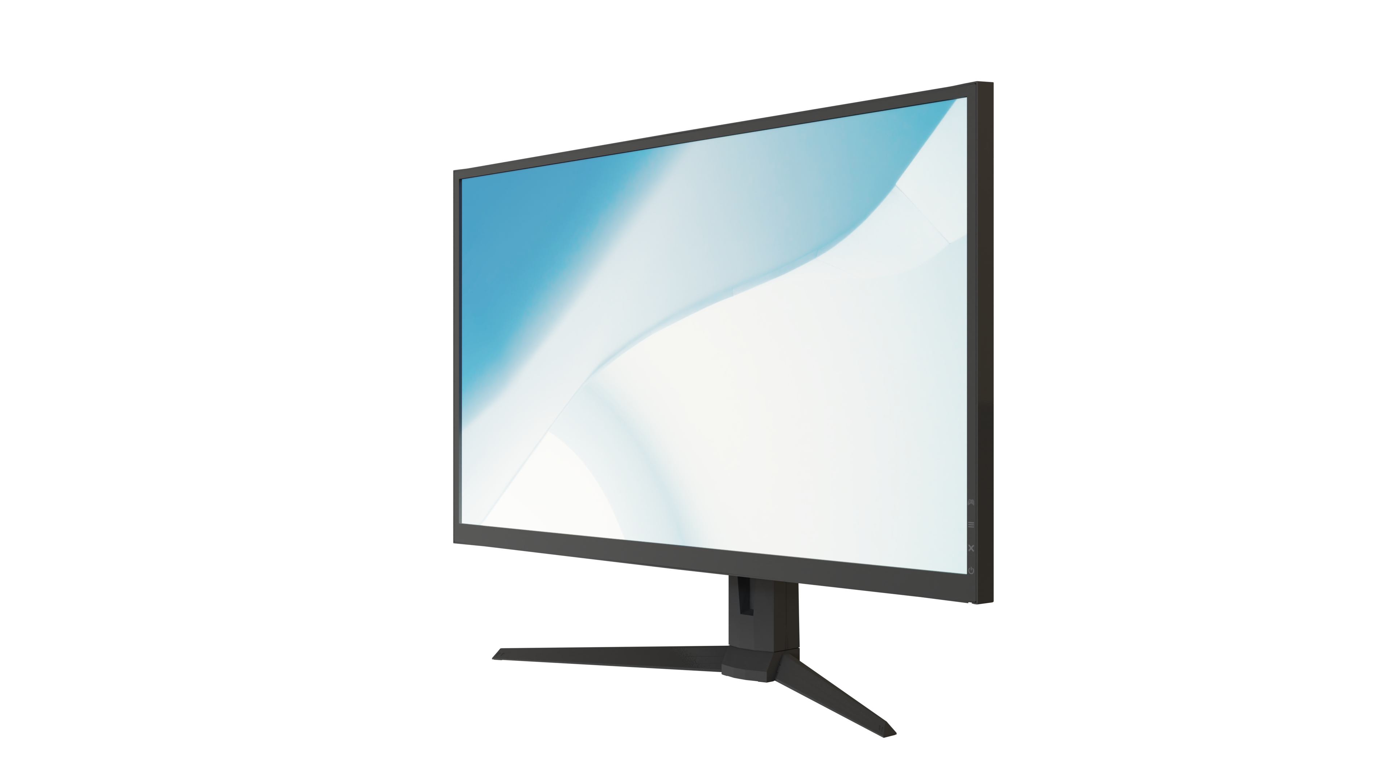
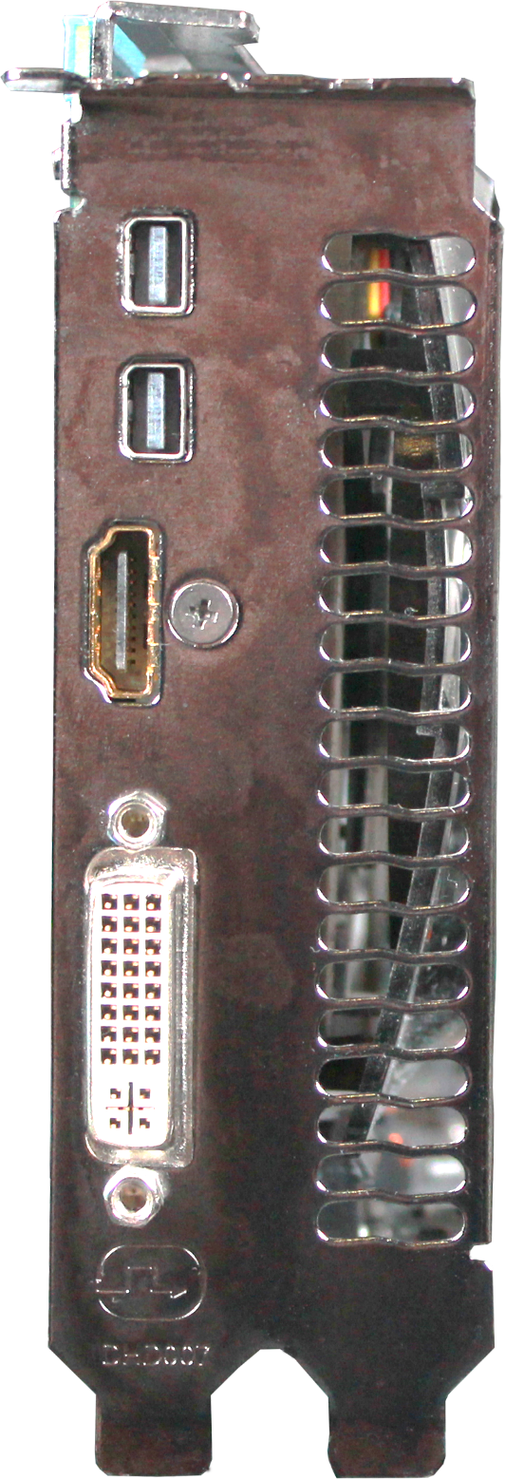
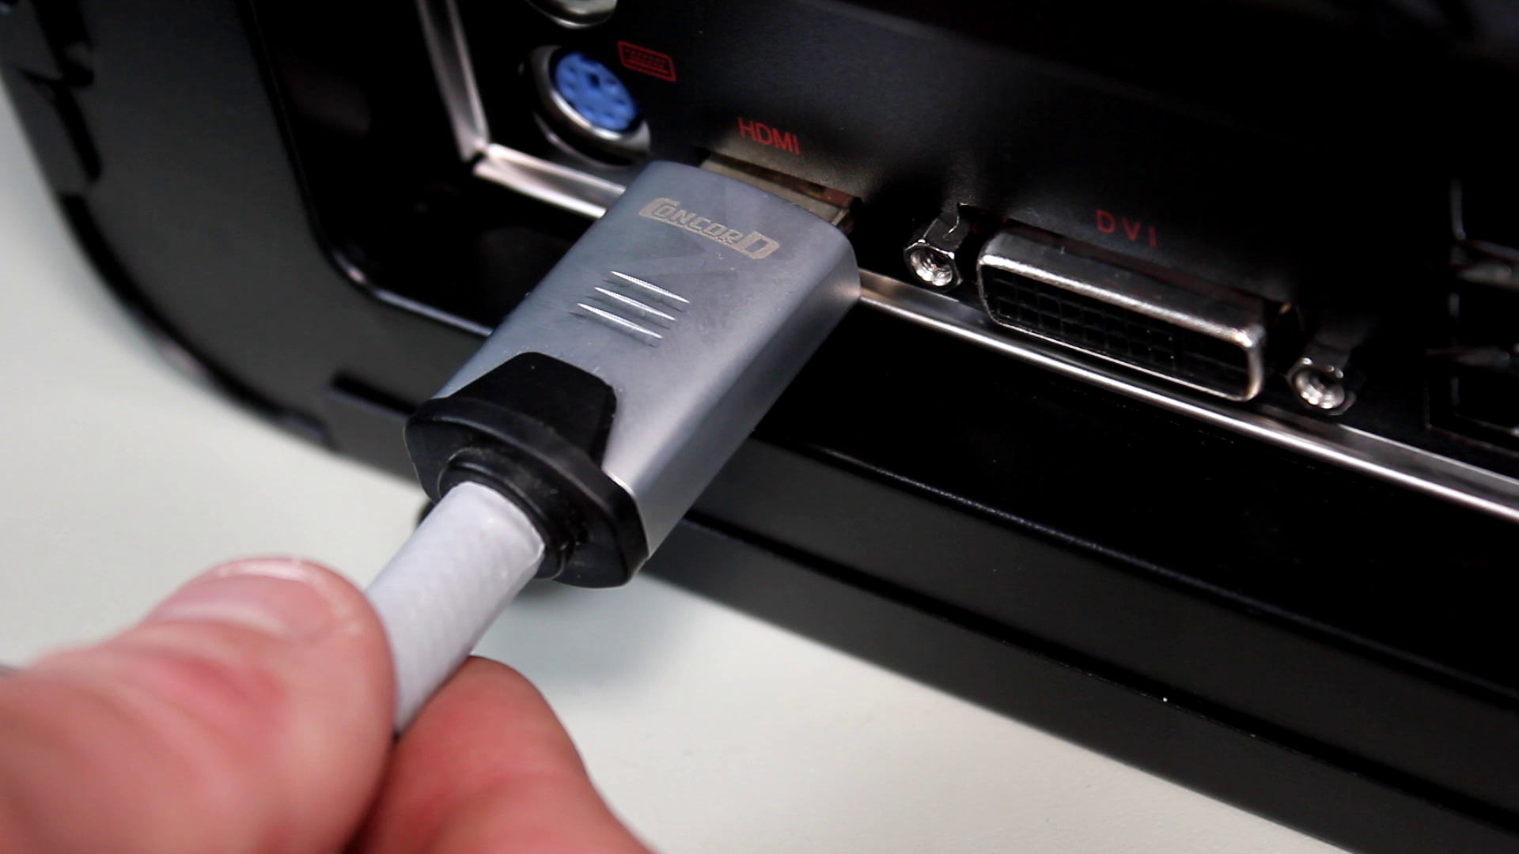
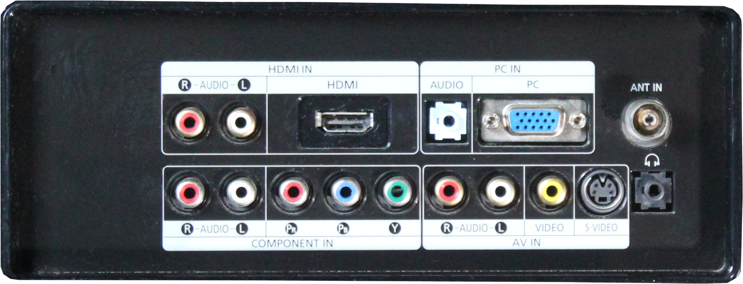
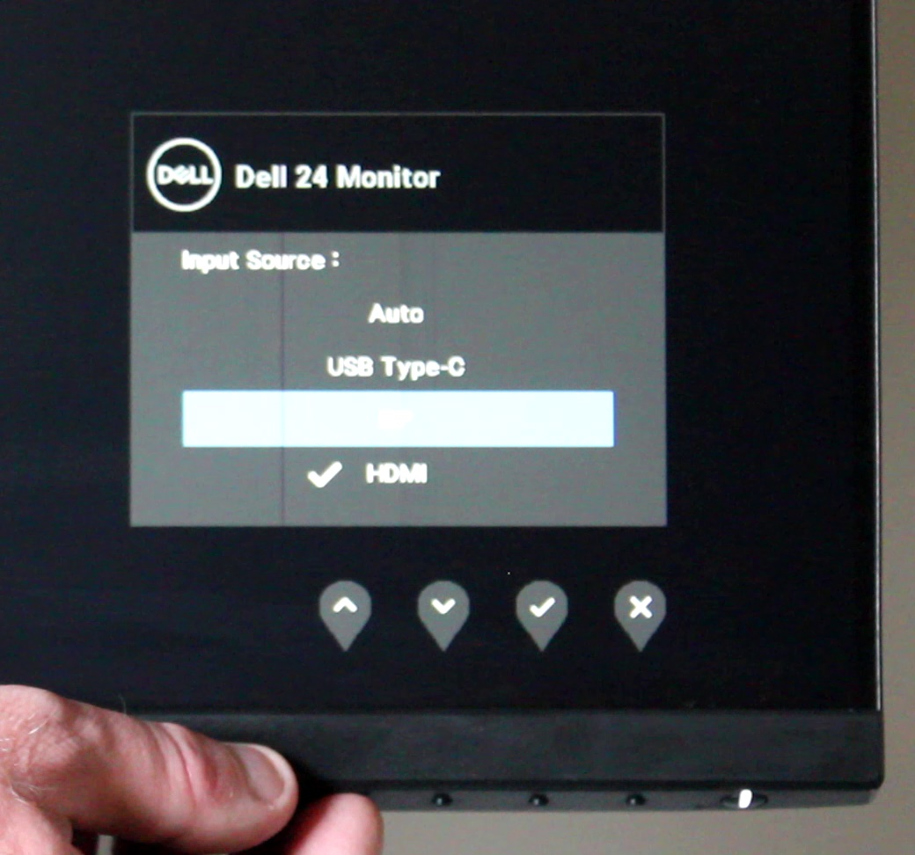
No Image
Check plugged in
Plugged in correct port
ITFreeTraining.com
© Copyright 2023
Notes:
00:18 To start with, I will look at when you get no image at all. Although it may seem obvious, the first thing would be to check the cable is firmly plugged in. This is one of the more common problems. If the cable is even just a little loose, this can cause it to stop working. Also, ensure that it is plugged all the way in. A video cable can appear to be plugged in, but on closer inspection it may not be plugged in all the way and thus not making a connection.
The next step is to check the video cable is plugged into the correct port. Video cards, motherboards and monitors will often have a number of different ports on them. Modern monitors will generally automatically detect which plug is being used; however, they may not have been set to auto detect. Depending on the monitor and your requirements, you may need to change the input setting on the monitor. Most monitors nowadays have an on-screen menu to access these settings. If the monitor is in power saving mode, you may need to press a button on the monitor in order to wake up the monitor. In some cases, rather than changing the input on the monitor, it is easier to switch it off and back on to force the monitor to auto-detect what is plugged in.
All video cards will hopefully detect which plug you are using. If you are having problems, restarting the computer or monitor may help. For example, some integrated graphics adapters will only work if they detect a monitor plugged in during booting. In some cases, you may need to power down the computer to get it to detect the monitor; however, a restart should be all you need in most cases.
It this does not fix the problem, there may be something wrong with the cable.

Slide 3
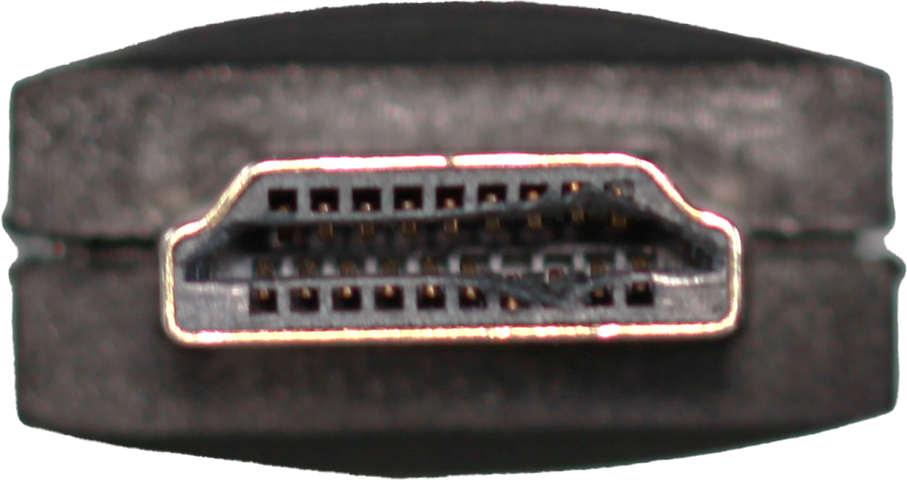
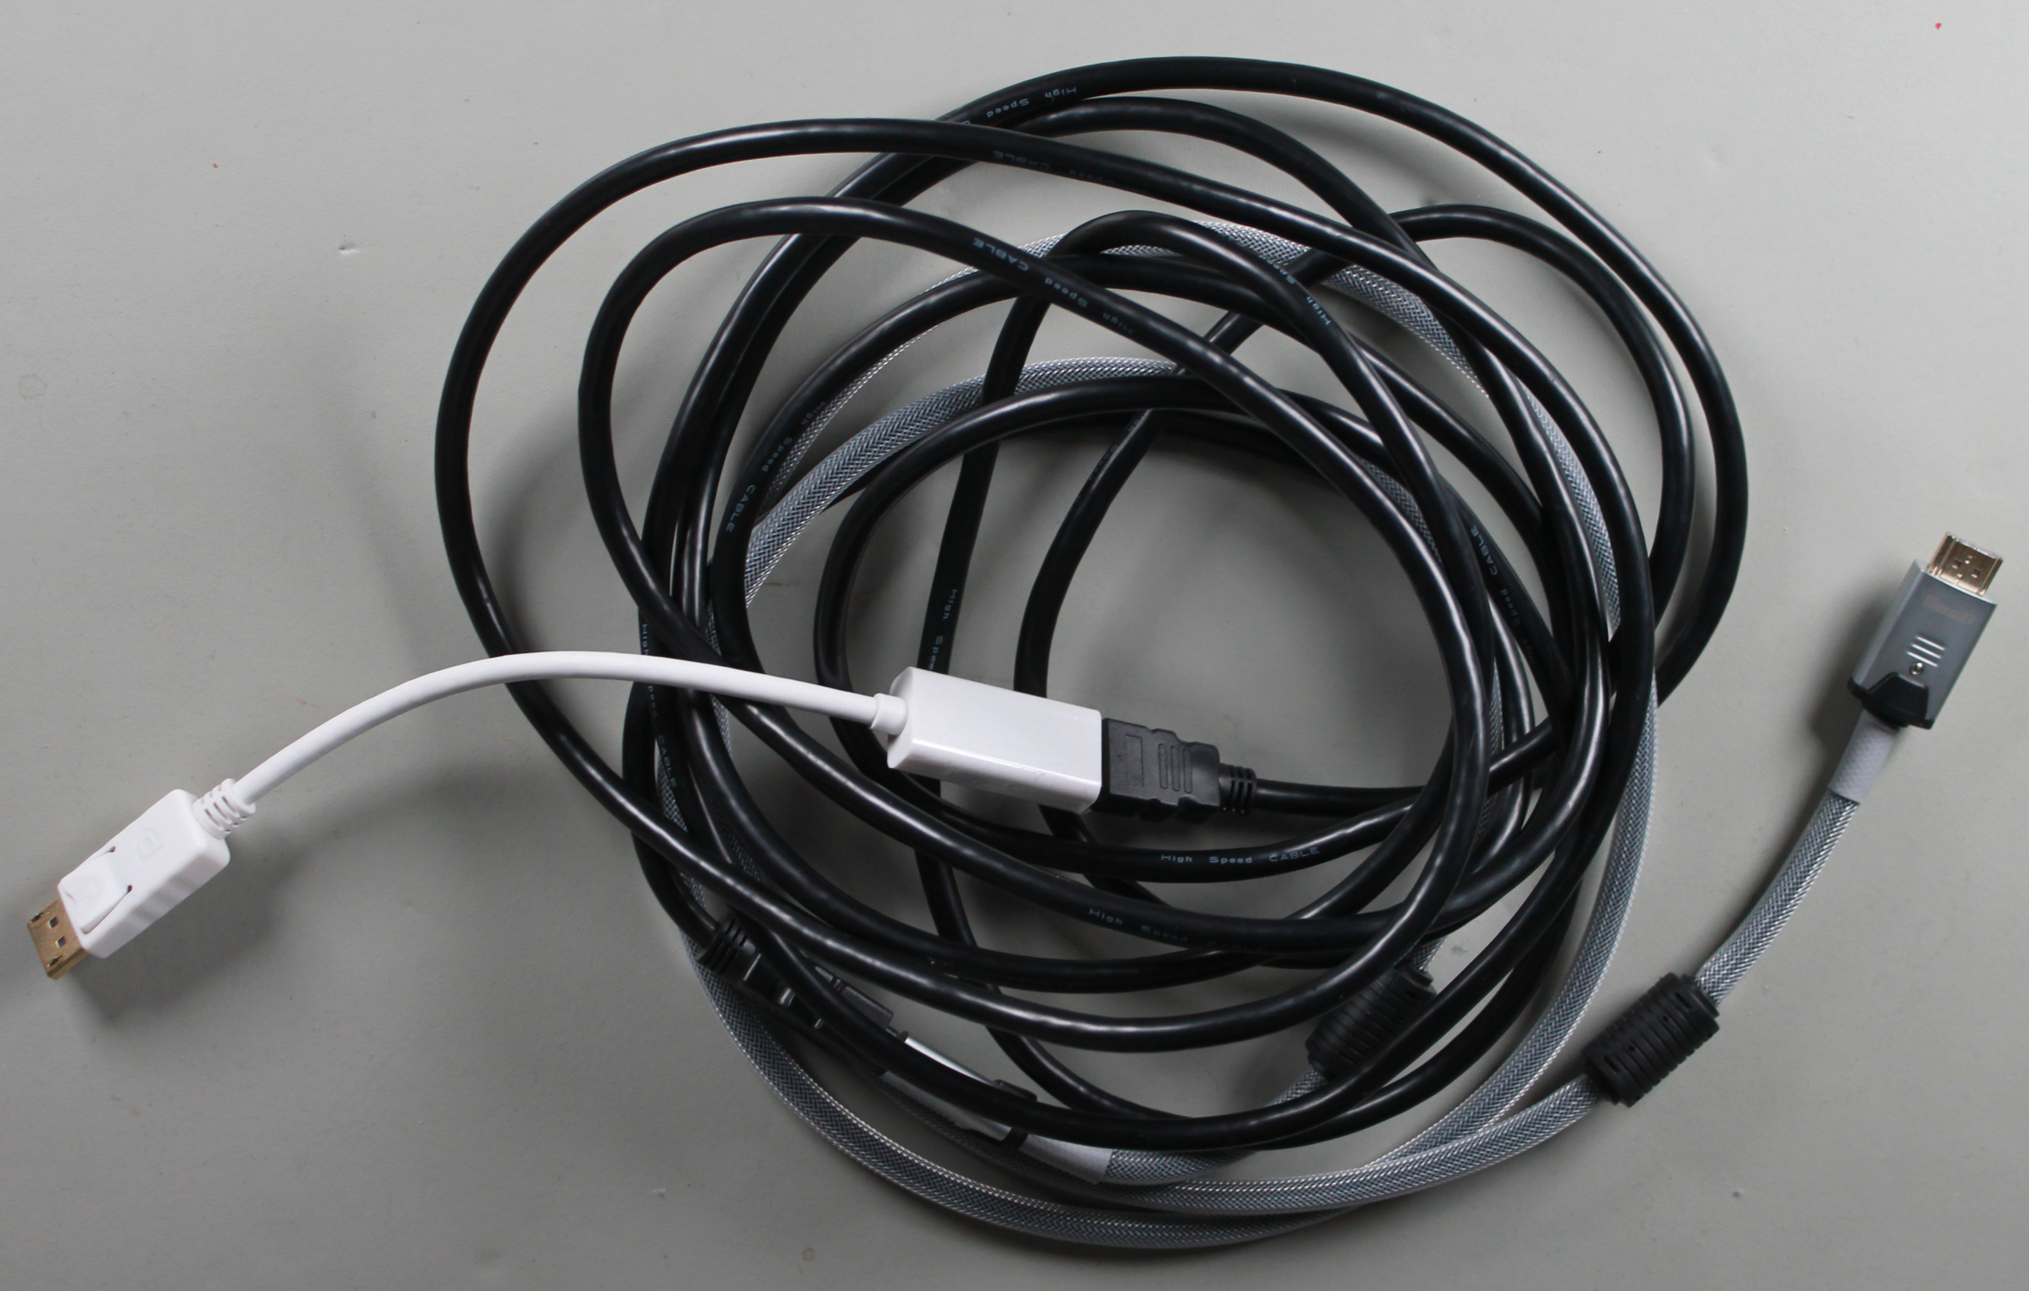
Cable Problems
Cable damaged
Cable too long
Too many adapters
ITFreeTraining.com
© Copyright 2023
Notes:
02:03 If there is a problem with the cable, this can also mean that no image will be displayed. In some cases, the cable may be damaged. For example, the pins in the connector or the cable itself may be frayed. It only takes one pin or wire to be damaged to stop the cable working. Some damage you may not be able to see; one of the first things I would try, if you can’t get an image to appear on a computer, is to try another video cable to see if this fixes the problem.
The next problem you may have is if the cable is too long or there are too many adapters. Due to the signal getting degraded, when the signal reaches the other end, it may not be strong enough. This problem can also occur if you use low quality adapters. If you are having problems like these, try using a short cable or a high-quality cable. If you need to run the cable over long distances, there are video repeating devices that are designed to amplify the signal to send it over these longer distances.
If all this fails, try the monitor with a different computer. Troubleshooting in a lot of cases is a process of elimination. First work out what is working, and this will help you work out what is broken.
I will next have a look at some of the problems you can have with the image when it is not a cabling problem.

Slide 4
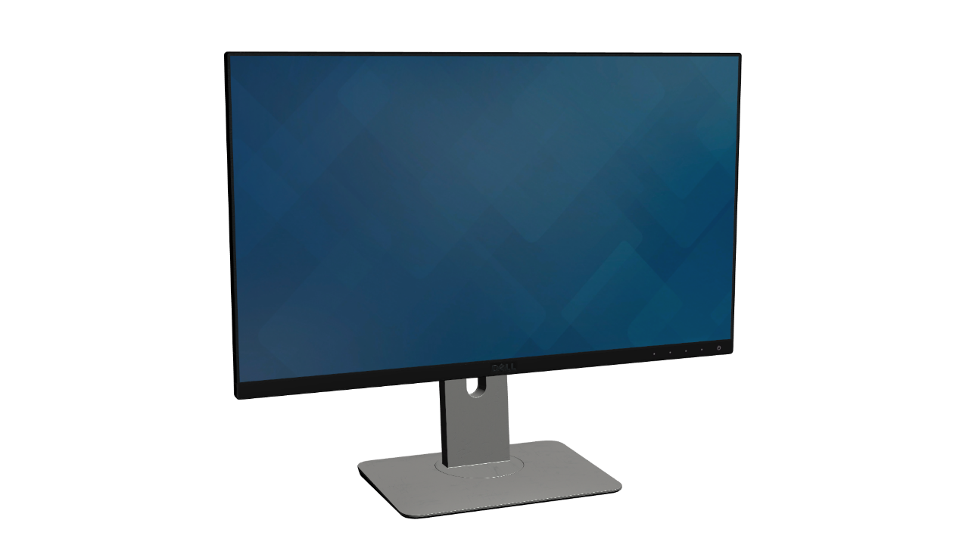
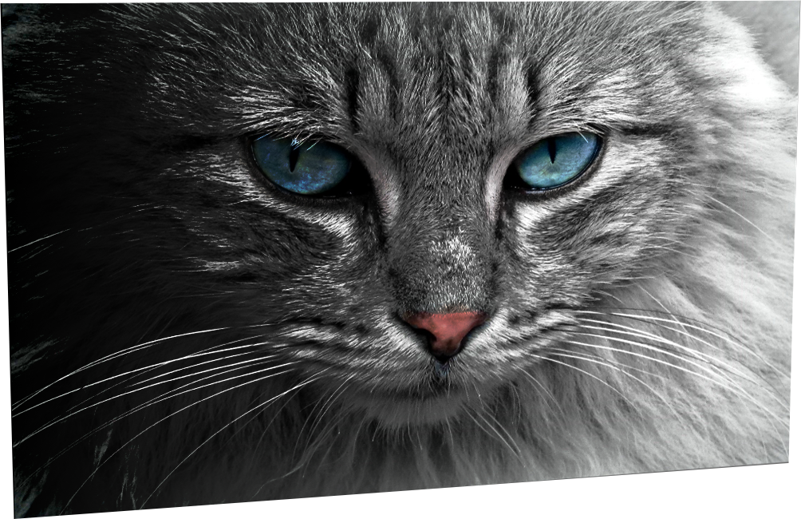
Uneven Image
Backlight needs replacing
ITFreeTraining.com
© Copyright 2023
Notes:
03:20 In some cases, you may find that the screen is not evenly lit. Generally, you will find that the left and right sides of the screen are of different brightness or maybe the top and the bottom. When this occurs, it is most likely that the backlight needs replacing. The backlight essentially lights up the screen; the light it provides is tinted and is allowed through or blocked to provide the image that you see. Some LCD screens will have two or more backlights. If one fails, you may get this effect. You may also get this effect if the backlight is not providing enough light for the whole screen. Generally, when this occurs, part of the screen will look dimmer when compared with other parts of the screen.
If you have a screen that looks uniformly dim, this will be easier to see if the screen is all the same color, for example if you are looking at the Windows desktop with a single-colored background. When this occurs, it may be the backlight is not giving out enough light; however, there are other problems that can cause the screen to look dim.

Slide 5
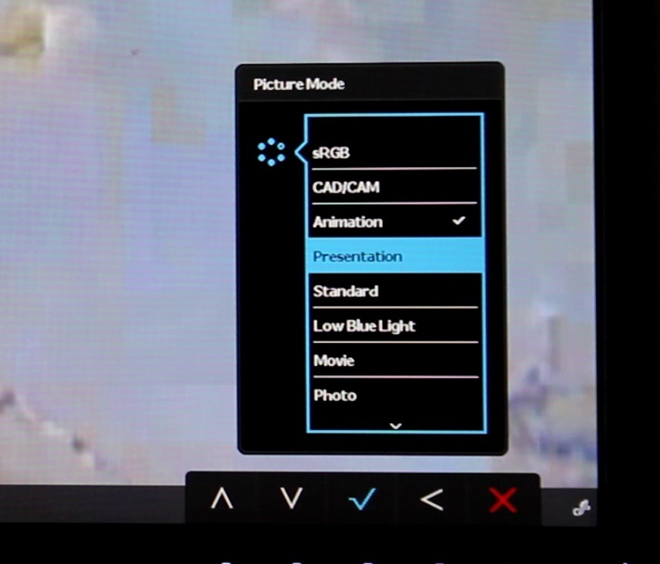
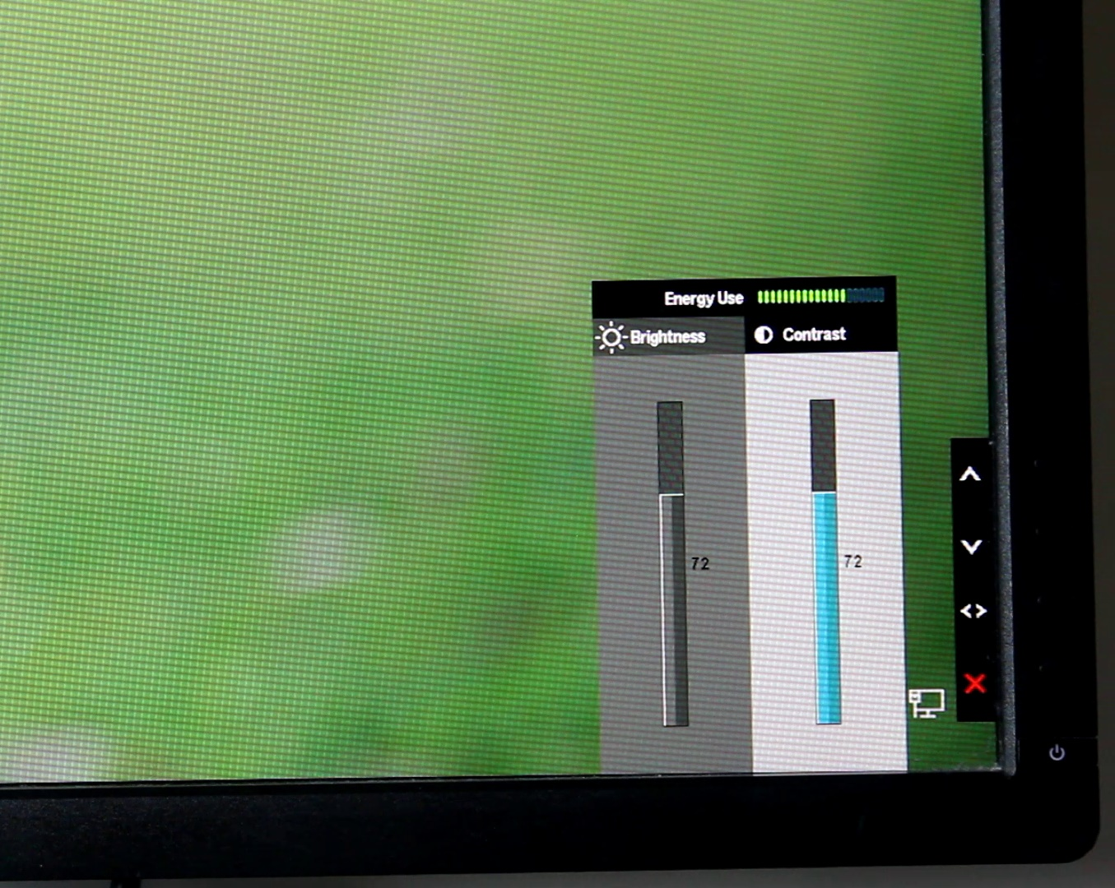
Dim Image (Monitor)
Picture modes
Check image/contrast controls
ITFreeTraining.com
© Copyright 2023
Notes:
04:20 The next thing to consider is what happens when the image on the monitor is dim. One of the first things I would check is what picture mode the monitor is currently using. Your monitor may refer to this as display mode, pre-sets or a number of other different terms.
Regardless of what it is called, selecting it effects how the image on the screen is displayed. In this example, you can see the current display mode is set to animation. You will notice that if I change it to presentation the screen suddenly becomes noticeably brighter. The setting you choose may also affect how the colors on the screen are displayed. If you find that the image on the screen looks a little too dark or colors don’t quite look right, check which setting the monitor is set to.
If you find that the screen is still dim, check the brightness and contrast settings on the monitor. You can see in this example that the monitor is quite dark. To change the settings, I just need to go into the menu and adjust the brightness and the contrast. In some cases, you may find that the customer has changed these settings, maybe for good reason at the time.
You can see that when I change the settings to the maximum values there is a very big difference to how well lit the screen is. Most monitors nowadays use LCD lights for the backlight. LCD lights, as time goes on, don’t give out as much brightness as they used to. One trick to extend the lifespan of the backlight is, as the LCD lights get dimmer over time, to turn up the brightness of the monitor.
Turning the brightness up also means that the monitor will use more power, so you can see why on a lot of monitors the brightness and contrast will not be set to their maximum levels by default.
That covers the settings for the monitor, but the image can also be affected by the settings on the computer, so let's have a look.

Slide 6
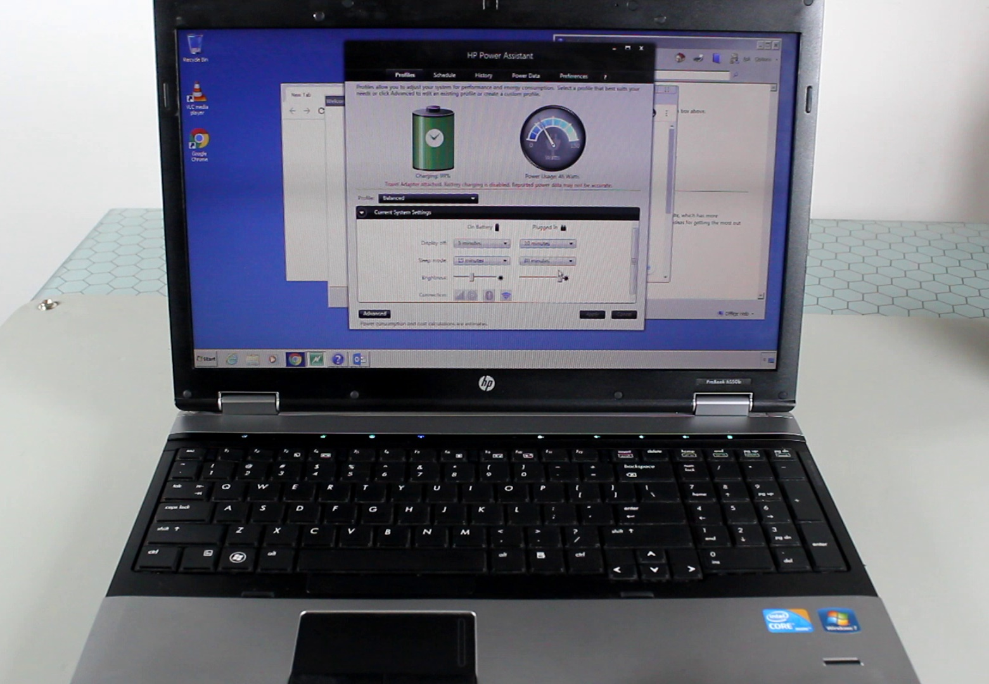
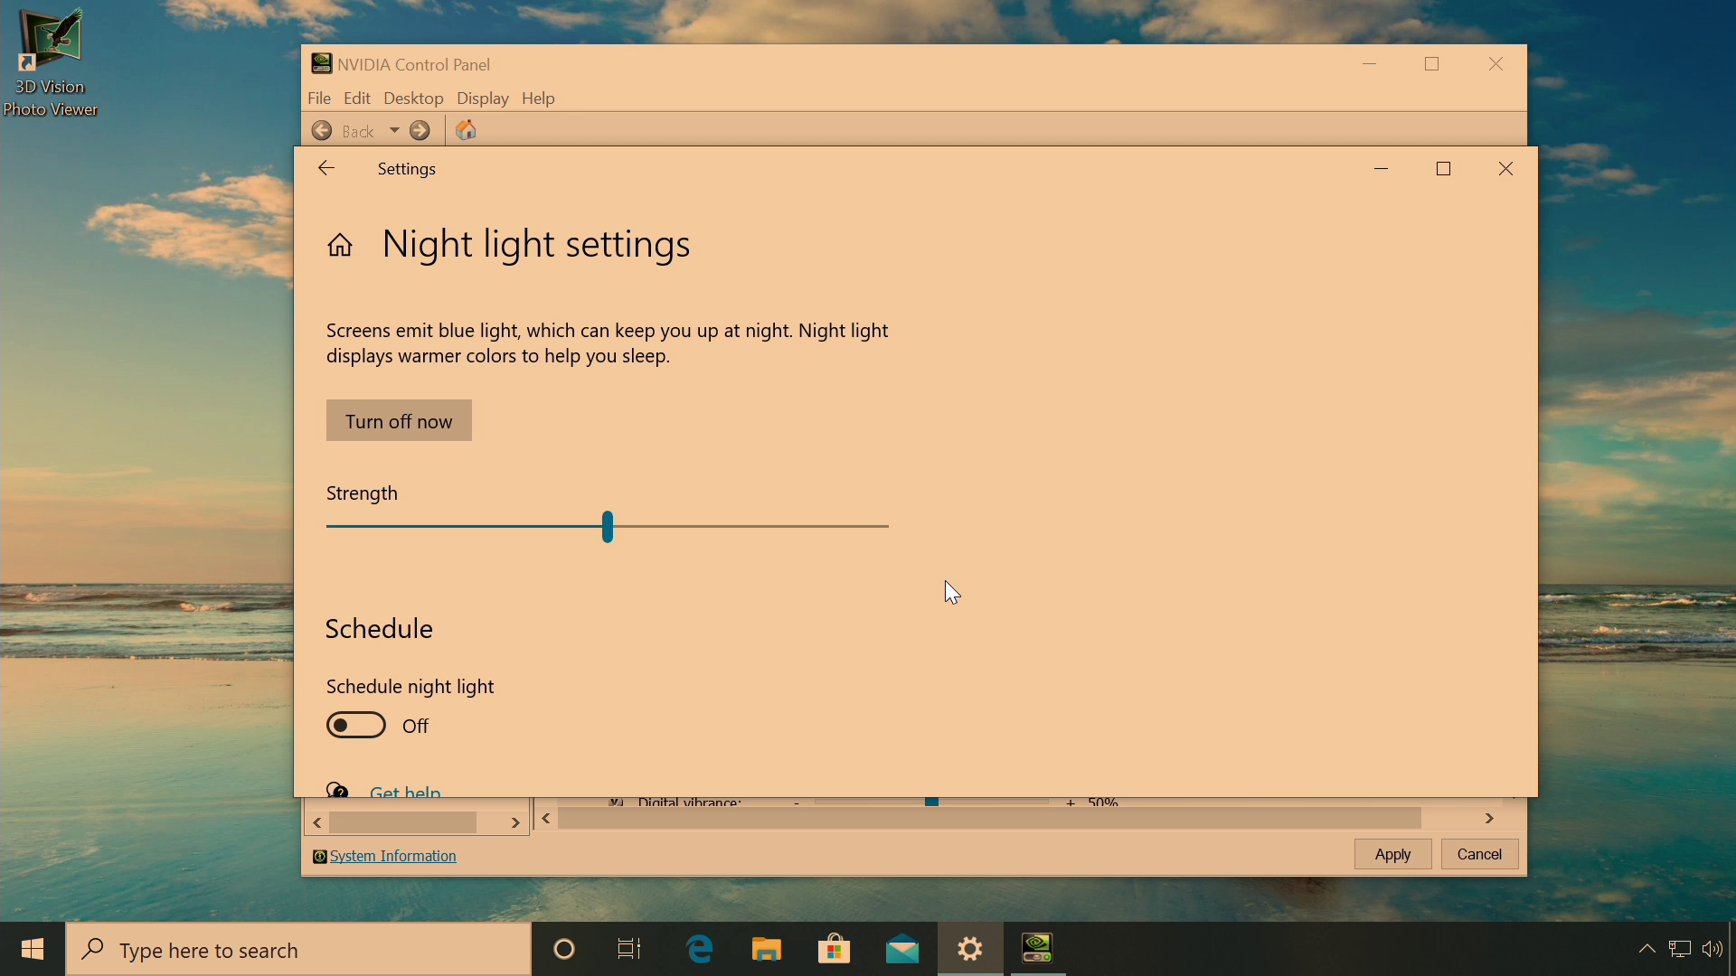
Dim Image (Computer)
Power saving
Vendor settings
Night light
Check image/contrast controls
ITFreeTraining.com
© Copyright 2023
Notes:
06:17 It is very common in the case of laptops to have power saving settings. You will notice that when I unplug the laptop, the screen of the laptop gets dimmer. This is an indication that power saving has been enabled. When in power-saving mode, this will mean that the laptop will run longer using battery power than if it would if the screen was set at full brightness.
You will notice that when I plugged the power back into the laptop, the screen returns back to full brightness again. The vendor may also provide additional settings for changing the brightness and contrast for the screen. You will notice, in the case of this laptop, there is a slider for changing the brightness and contrast. Notice that when I move the contrast all the way to zero, how dark the screen gets.
Different vendors will supply different software with their products. It is possible they have included software like this to change how the display looks on the screen.
The next thing to consider is what settings are configured in the operating system. When Windows is installed on a laptop, you may be able to adjust the brightness in the action center, but with a desktop computer this option may not be available.
Windows 10 included an option called night light; this option is also available in some earlier versions of Windows. When this option is enabled, which is the case on this computer, this essentially filters out some of the blue light. We now see increased use of LED technology, and this LED technology puts out more blue light than what we would typically find in nature, for example from the sun. Studies have indicated that too much blue light can affect sleep and also cause other age-related conditions like macular degeneration. Only time and more research will be able to tell us the effects of blue light.
Windows settings like the night light reduce the amount of blue light that a monitor will display. If you are having trouble sleeping and you are using LCD screens, it may be worth at night-time enabling the blue light filter and see how you go. You can also set night light up on a schedule so that it will operate at certain times.
You can see, in this case, the night light is enabled and has made the screen look a little less bright. You can see that when I switch off the night light, the screen gets noticeably brighter. It is a good idea to check settings like these if you are having problems with your screen looking a bit dull.
You will also notice that the graphics card may have options in it to change how the image is presented to the monitor. In the case of Nvidia, notice that in their control panel there are a number of settings to change the brightness, contrast and gamma.
By default, these settings are able to be controlled by the application and normally you would not change them. However, you may find that a customer or perhaps one of their children got in and changed these settings.
Notice that when I move the brightness slider, I can make the screen dull or very bright. I can also change the gamma settings. Gamma changes the brightness and color of the image. Since humans can perceive certain color changes better than others, gamma tries to change the colors that we can see and do less for the color changes that we can’t. The gamma slider essentially changes certain colors that have the most effect on what we can see, essentially moving the yard stick where changes occur. In simple terms, reducing the gamma will make the screen look darker, while increasing the gamma will make the screen look brighter but more washed out.
I will change the settings back to their defaults in which applications have control over these color settings. This is generally the best option as you can understand that there are a lot of different places that you can potentially change how an image is presented on the screen, with some easier to find than others. So, what should you do if you are having trouble locating the setting that is causing the problem?

Slide 7
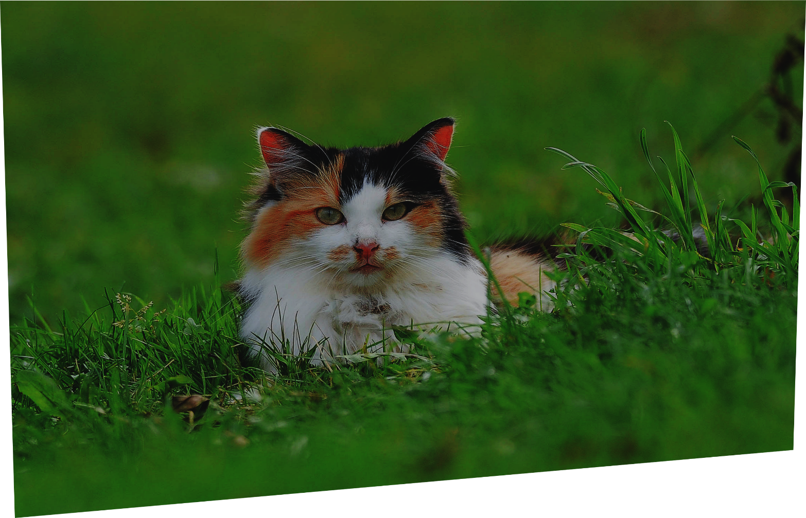
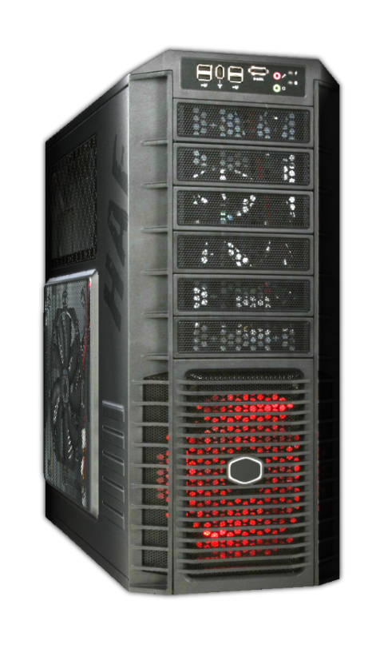
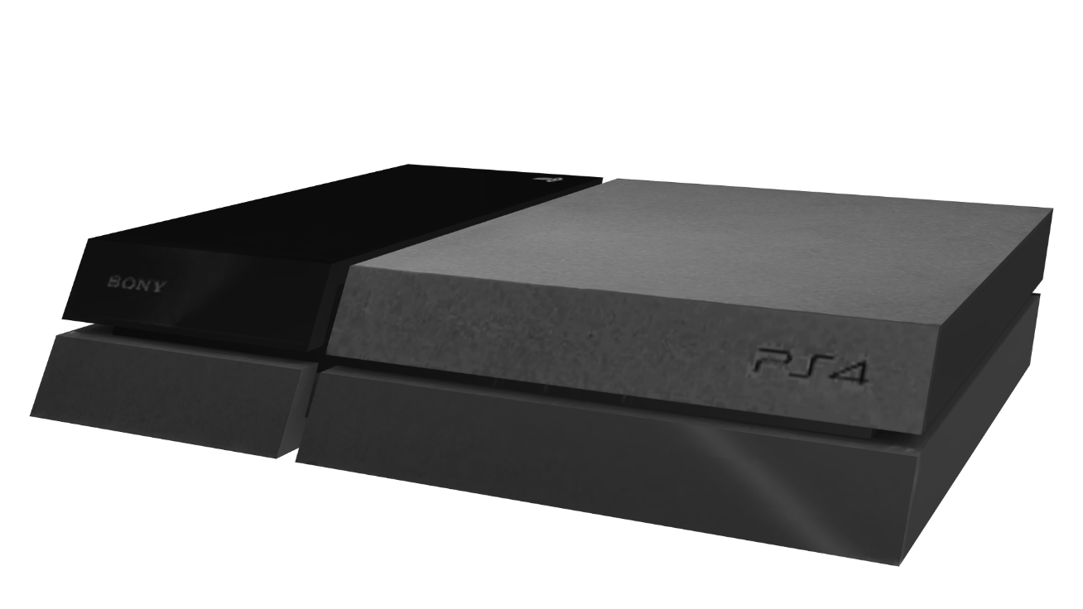
Try a Different Working Device
Dull display (Computer configuration problem)
Display good (Monitor working correctly)
ITFreeTraining.com
© Copyright 2023
Notes:
10:19 In this example our computer is displaying a dull image on the display. The problem with the display is a setting on the computer, but we are having trouble finding which setting it is. To make sure that the display is working, test the screen with another device. The device can be any device and does not need to be another computer. The device just needs to be able to display an image so you can determine that the screen is working correctly. If you are using a laptop, simply plug a monitor into the laptop and select the mirror option. If both images look the same, then the problem is caused by a setting on the laptop. If they look different, for example the screen on the laptop looks very dark, the problem is with the laptop, and maybe the backlight needs replacing.
Remember that a lot of troubleshooting is a process of elimination. Once you eliminate something that is working correctly, you are getting closer to working out where the problem is. If you are still getting problems with the image, the problem maybe the screen or the cable connecting the two together.

Slide 8
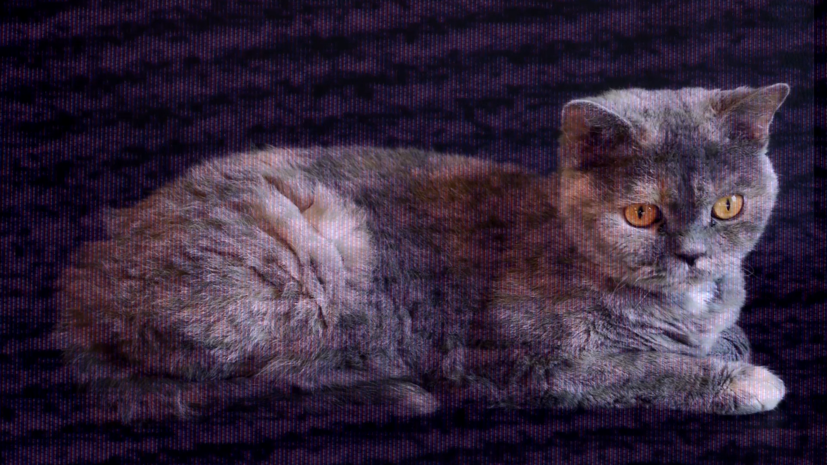
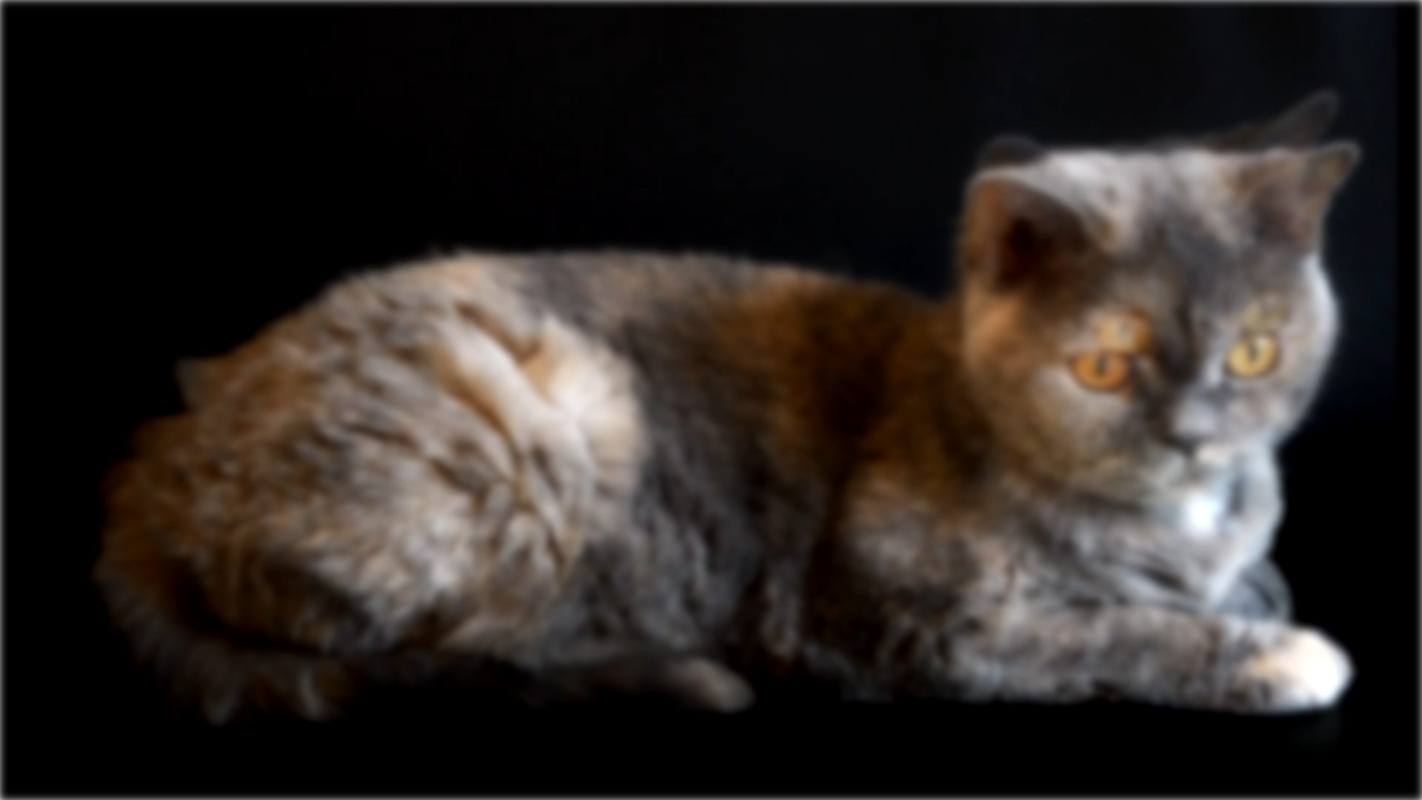
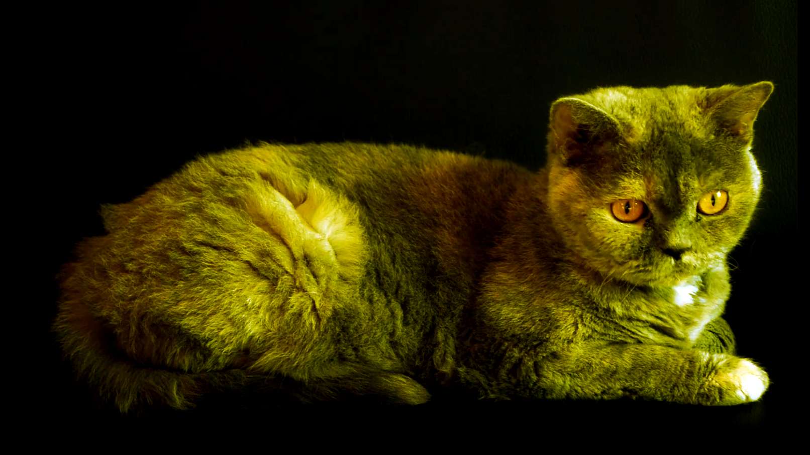
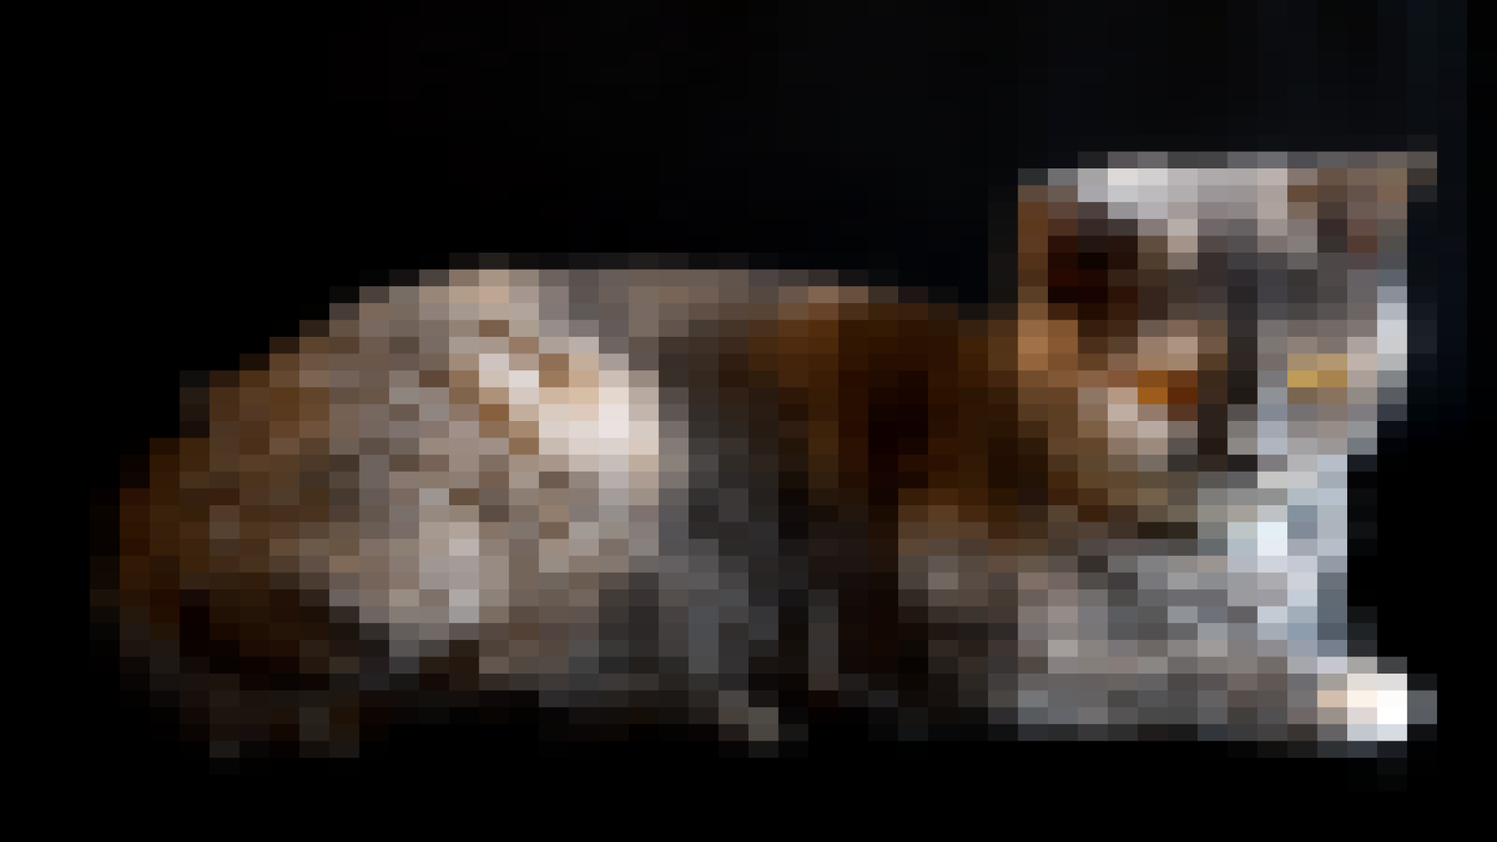
Image Quality
Check or replace the video cable
Noise/Flickering
Poor quality
Missing color
No high resolutions
ITFreeTraining.com
© Copyright 2023
Notes:
11:24 If on your screen you have noise, flicker, poor quality, missing colors or no high resolution, there may be a problem with the video cable itself. You should check that the cable is firmly plugged in. If the problem continues, replace the cable. These problems can result from damaged pins in the cable or just a poor-quality cable, particularly when dealing with higher resolutions. Higher resolutions require more data to be transmitted and thus require better cables.
Not all cables are created equal. When your purchase a cable, have a look at the packaging, as this will tell you what resolutions that cable can support. Since we are moving towards data transmission using lanes, you probably won’t get color problems at higher resolutions due to problems with the pins. With older standards, different colors were transmitted using different wires and it was not uncommon that if one of these pins was damaged or not connected, it would affect one of the colors in the signal. Nowadays, if you get some noise in the image it won’t work at higher resolutions or features won’t be available, for example, features such as higher color depth.
In some cases, everything may be working correctly, however it may still be difficult reading and writing on the screen.

Slide 9
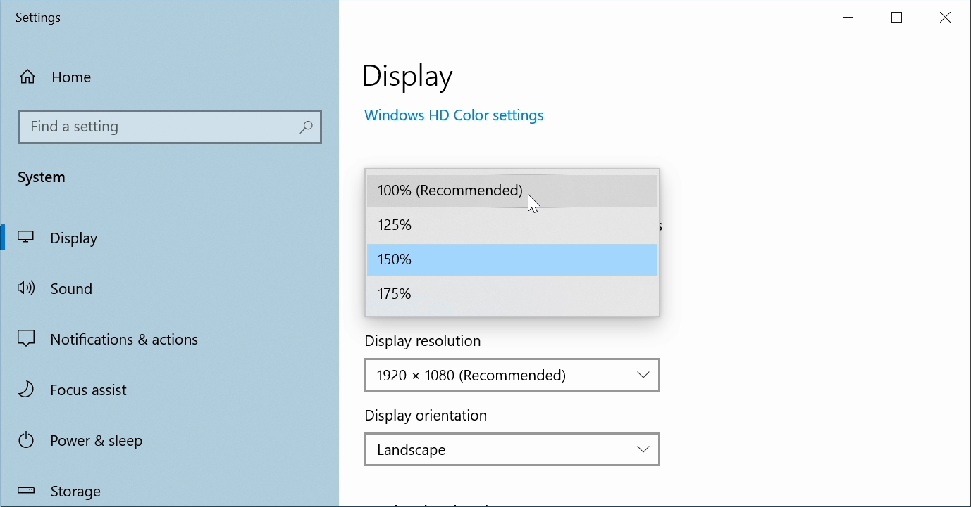
Display Fuzzy
Check resolution and scale
ITFreeTraining.com
© Copyright 2023
Notes:
12:42 If you are finding that the writing on your display is fuzzy, you may need to change the resolution or the scaling of the image. In Windows, to do this, right click on the desktop and select the option “Display Settings”. Once open, scroll down to the section “Scale and layout”.
Older versions of Windows have an option to change the font size, while newer versions have included a scale to change the font and also the application’s size to match. In Windows 10 for example, it is easy to do this by using the following pull down menu. Windows will recommend a percentage to scale by and in most cases this will work well. Depending on your needs, you may need to increase or decrease this. For example, if the customer has poor eyesight they may need to increase the scale. Other customers may have good eyesight and want to decrease the scale so they can fit more on the screen.
If you do decide to decrease the scale, the results may be interpolated. Interpolated means that the pixels for the graphics you are trying to display are smaller than the number of pixels available. When this occurs, Windows attempts to take a best guess at what color the pixel should be. For example, if the pixel is half colored, rather than using white or black it may choose a color in- between which will be gray. The end result is that the writing may be a bit hard to read or fuzzy.
Interpolation can also occur if the resolution is lower than what the monitor supports. When possible, you should always select the native resolution of the monitor to get the best results. This should be displayed in the resolution list in Windows as recommended. If the resolution is lower than what it can support, the interpolation process will occur; however, it is reversed. The monitor will scale up the image, filling in missing pixels by taking an average of the pixels around the missing pixels.
If you find that the resolution of your monitor is not listed, and this can occur for many different reasons, it may be that your video card does not support the resolution of your monitor. This is generally because the video card does not have enough memory. With modern, even entry level video cards having at least one gigabyte of memory, this generally is not a problem.
The problem can also occur if the monitor has not been correctly detected in Windows. In most cases modern monitors will automatically be detected by Windows and will be configured correctly. In some cases, you may need to install a device driver for your monitor. If one is not available, you can select a device driver that is as close as you can get to your monitor. Modern operating systems nowadays come with a number of generic monitor device drivers that may be suitable if you are not able to find a specific device driver for your monitor.

Slide 10
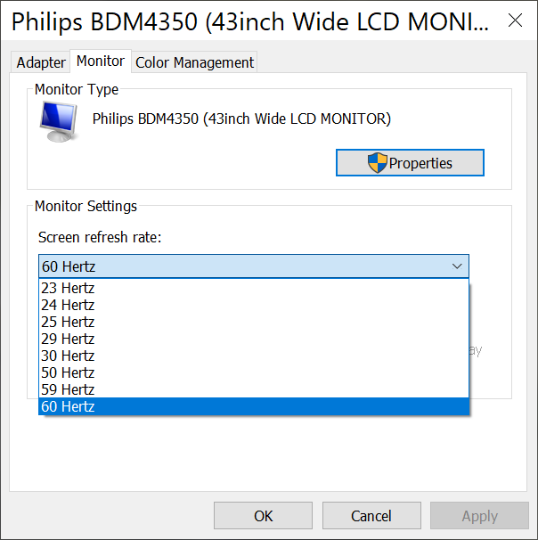
Refresh Rate
Update monitor driver if refresh rate not available
Check monitor settings and cable
ITFreeTraining.com
© Copyright 2023
Notes:
15:33 The next setting does not affect the quality of the image but does affect how responsive the images on the monitor will appear to be. The refresh rate will be available in the properties for the monitor. When possible it should match the native refresh rate of the monitor. If you find that the refresh rate is not available, update the monitor’s device driver. When installed correctly, the name of your monitor should appear. If it is instead listed as a generic device driver, Windows was not able to install a device driver for that monitor and thus, this is why some of the settings may not be available.
If you find lower refresh rates work, but not the higher refresh rates, it may be something to do with the cable going to the monitor or the monitor not supporting that refresh rate. The higher the refresh rate, the more data that needs to be transferred over the cable. If the cable cannot support the amount of data required, you won’t be able to use that refresh rate. You may find that if you decrease the resolution, that refresh rate may work since the amount of data it needs to transfer will be less. Generally, nowadays, you will find that 60 Hertz is a good refresh rate to use and should not cause any flicker or response problems for the vast majority of users.
In some cases you may see a refresh rate of 59 Hertz rather than 60 Hertz. This may seem like an odd number. The number has been rounded down and is really 59.94 Hertz which is pretty close to 60 Hertz. The reason for this rather odd refresh rate is due to compatibility with the NTSC standard when the switch was made from black and white to color. To allow the color signal to be added but still be compatible with black and white, the refresh rate had to be reduced slightly.
You don’t need to be aware of the exact technology reasons why the refresh rate needed to be dropped slightly, just understand that it is there for old compatibility reasons and it is very close to 60Hertz. For this reason, do not be too worried if the refresh rate is set to 59 Hertz, even if your monitor is a 60 Hertz monitor since it is pretty close. If you have the choice, I would set the refresh rate to match your monitor. With modern LCD monitors they should all be manufactured to use 60 Hertz not 59 Hertz.

Slide 11
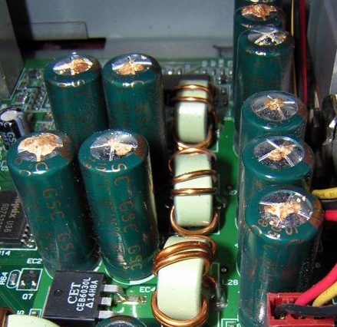
Faulty Capacitors
Black screen
Switches off randomly
Reduce brightness
Works longer
Fix capacitors
Board replacement
Replace capacitors
ITFreeTraining.com
© Copyright 2023
Notes:
18:05 The next problem that I will look at with monitors is faulty capacitors. Faulty capacitors may be physically broken at the top. In some cases, material will leak from the capacitor. Other times, the capacitor may be swollen. On some occasions, you won’t be able to tell from the capacitor that it is damaged.
Capacitors are generally cylinder in shape and act as storage for power. Essentially like a tank for electricity. Electronics will draw on this power in order to operate. This gives them a stable form of power and also gives them a reserve to draw on when needed.
When the capacitors are damaged, this affects the electronics in the monitor. One symptom of this is a black screen. When you switch the monitor on, you may get a black screen or shortly afterwards it switches itself off.
The screen may also switch off randomly. That is, the monitor may seem to be working fine but then suddenly, without notice, may switch off. If you find this is the case, try reducing the brightness. This will reduce the strain on the capacitors. If you find doing this causes the monitor to run for longer periods of time then the problem may be with the capacitors.
To fix this, the capacitors need to be replaced. This can be done either by replacing the circuit board with the faulty capacitors or if you are skilled enough replace the faulty capacitors on the circuit board. Nowadays, monitors don’t cost too much so, if you have a problem like this, it is often better just to replace the monitor. If you don’t have the training and qualifications to replace the board or fix the capacitors, there are many places out there that will fix the monitor for you.

Slide 12
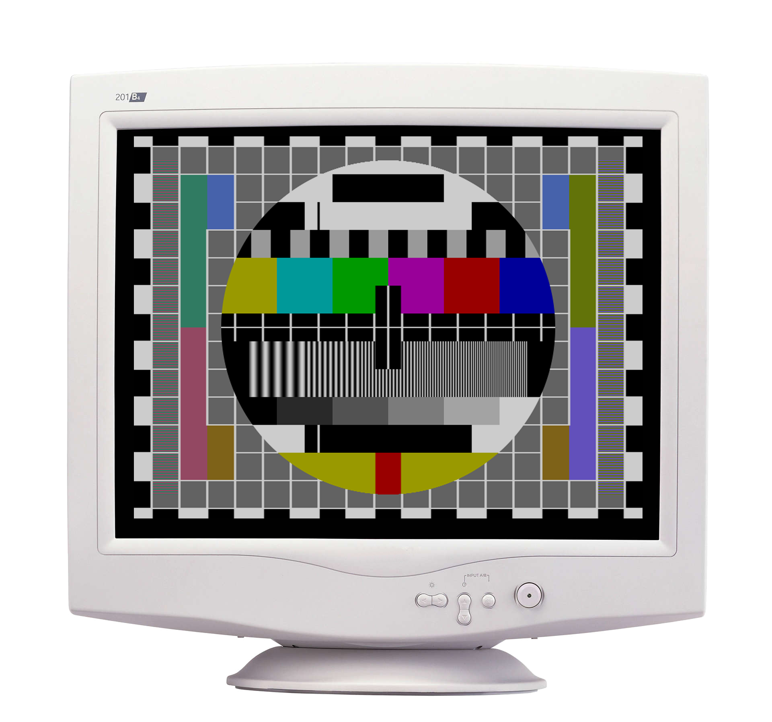
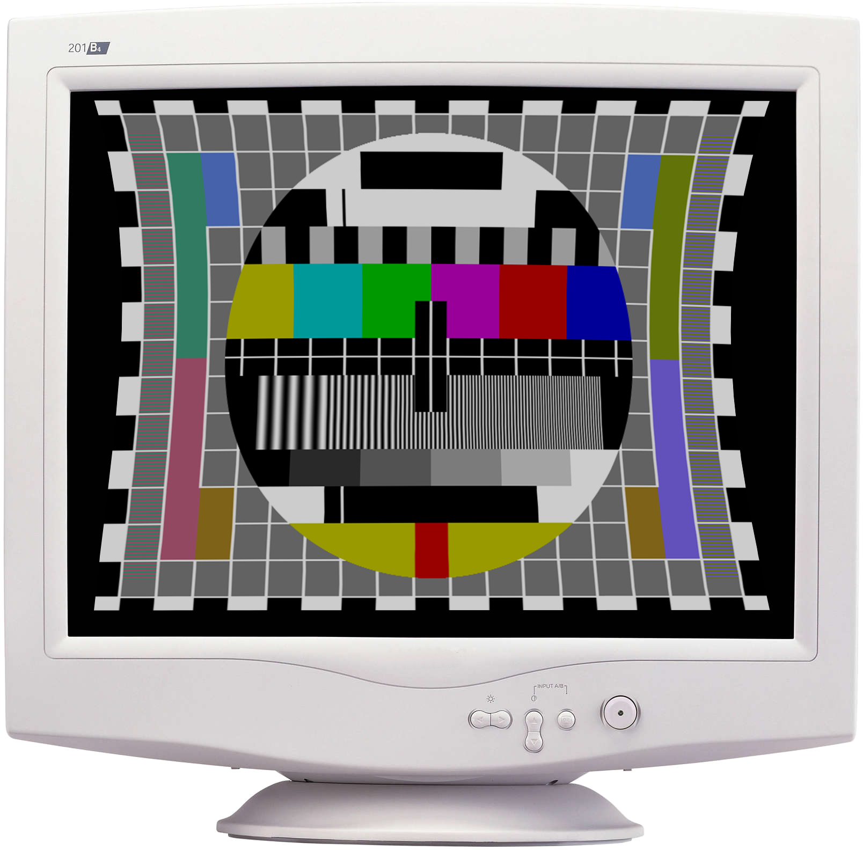
CRT Pincushion
Adjust to make the image look less distorted
ITFreeTraining.com
© Copyright 2023
Notes:
19:46 If you come across an old CRT monitor, the image may look at bit bowed. That is, it is stretched or is narrow in the horizontal direction. The CRT monitor has a setting called pincushion that can correct this; it is just a matter of adjusting this until the image looks even. In the old days, this was the first thing you needed to do when setting up a CRT monitor. The newer CRT monitors would auto set this, so you did not need to worry about it. Nowadays it will be extremely rare, if at all, that you come across a CRT monitor.

Slide 13
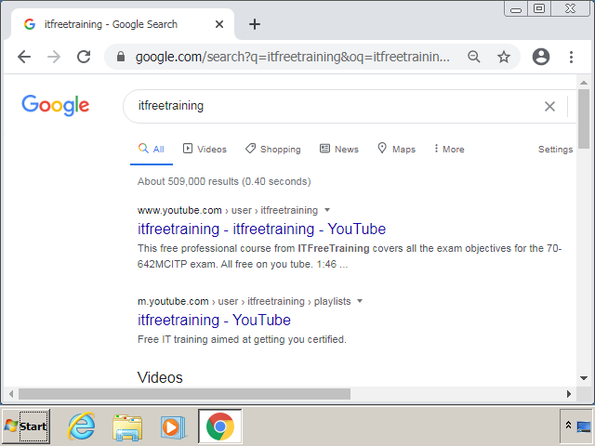
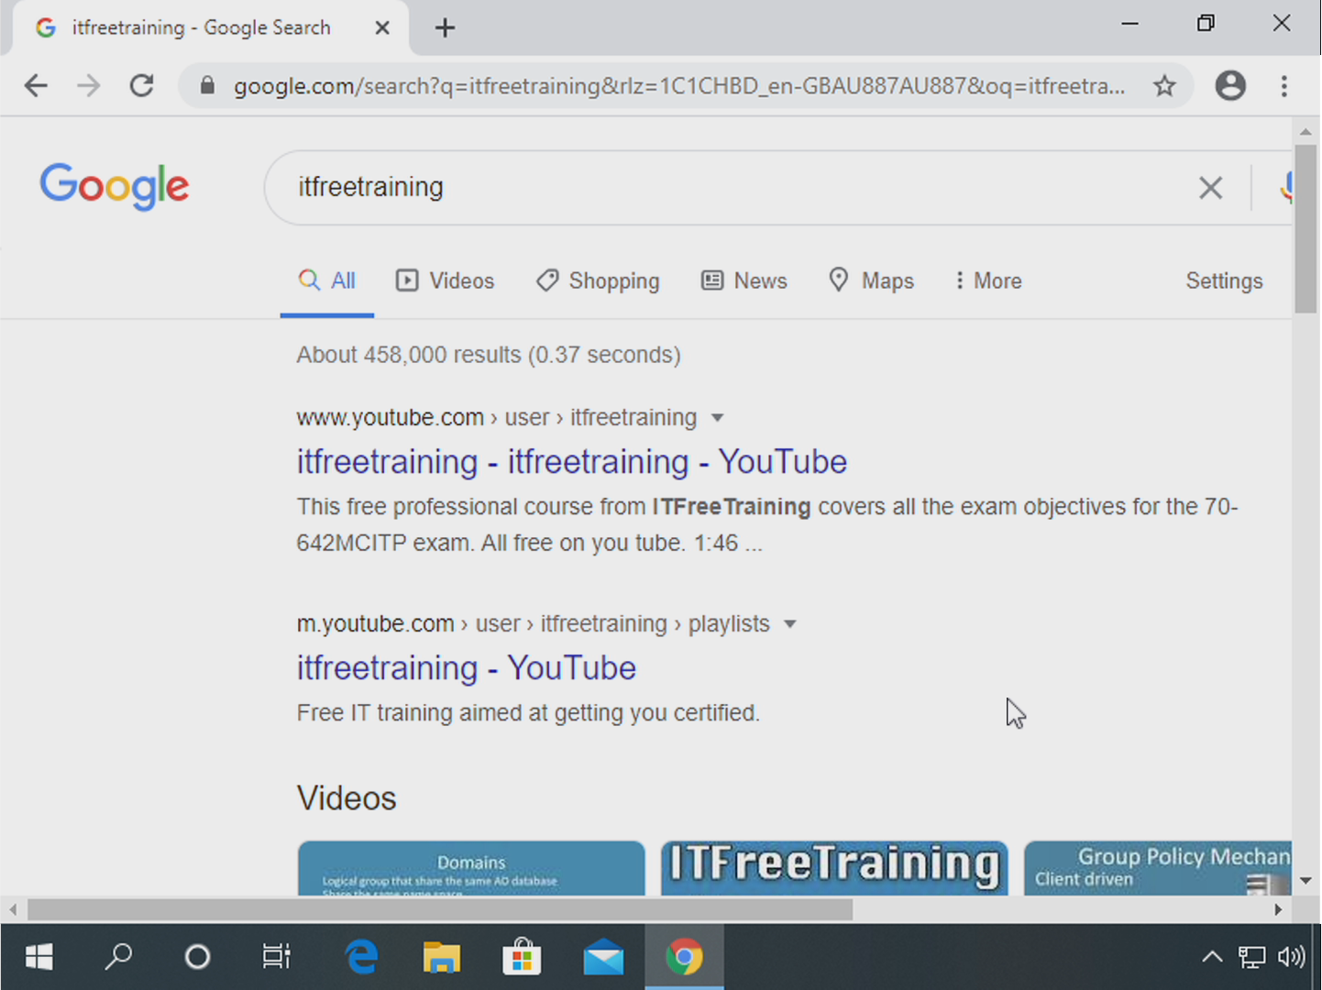
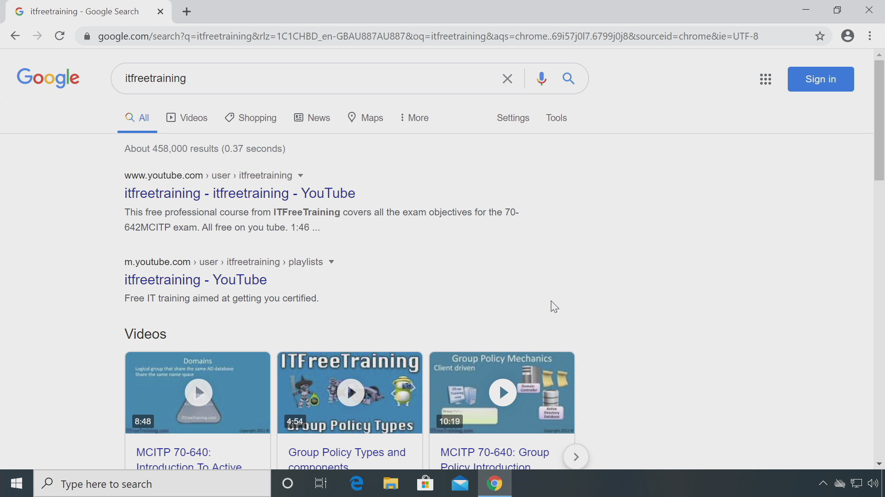
VGA Mode
Windows 10 lowest resolution SVGA (800x600)
Check display driver is installed and working
640x480
(Pre Windows 10)
800x600
(Windows 10)
1920x1080
ITFreeTraining.com
© Copyright 2023
Notes:
20:21 In some cases, the computer may appear to boot up okay; however, it will boot into what is called VGA mode. It is also possible to force the computer to boot into this mode. Before Windows 10, VGA mode was 640x480, but Windows 10 has a minimum resolution of 800x600.
The idea behind VGA mode is that if there are problems with the video card, this mode will allow you to boot the computer with a graphical interface that you can use.
Modern operating systems nowadays are pretty good at detecting what monitor is plugged into it and changing the resolution as required. However, in the old days if you configured the resolution to be higher or changed monitors then, when you booted the computer, you may not have been able to see the screen. VGA mode provides a fallback that allows you to access the graphical interface. It won’t perform well and is not high resolution, but it is high enough to allow configuration changes and to hopefully get your computer up and running again.
With Windows 10, VGA is no longer supported and the lowest resolution is 800x600. You can see that VGA mode looks very square-like, if I compare it with another common resolution. You can force Windows to boot into VGA mode; however, if it does it by itself, check the display driver is installed and configured correctly. Usually if VGA mode is being used, this means there is a problem installing the display device driver. If you install the latest device driver, this will fix the problem. You can generally tell that the computer has booted into VGA mode, because everything will appear a lot bigger.
So hopefully your monitor is displaying the images on it correctly, but in some cases the colors on the monitor may not look correct.

Slide 14
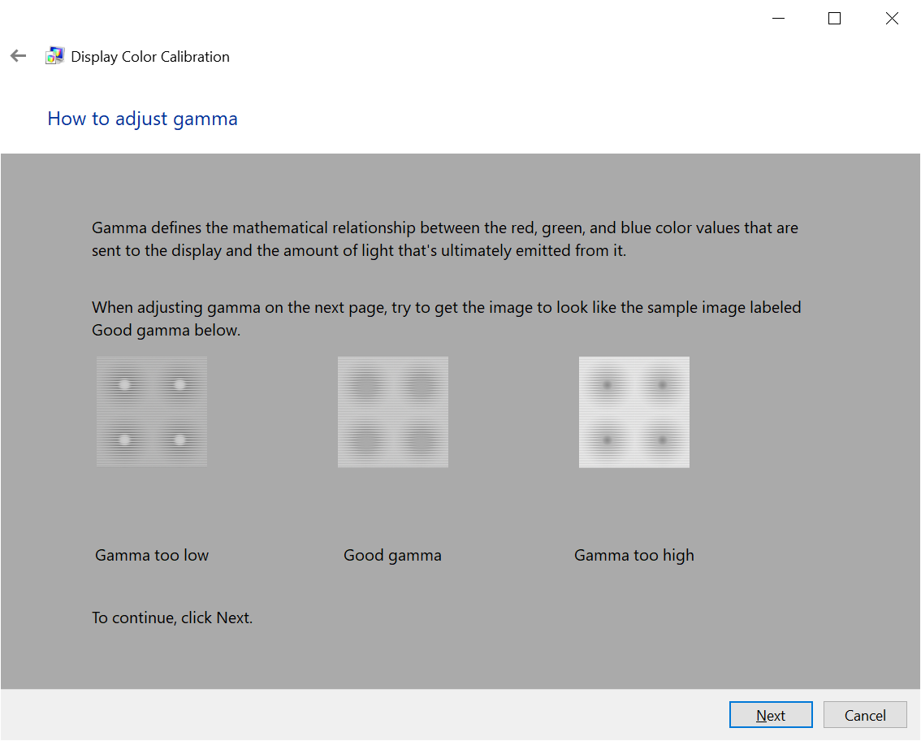
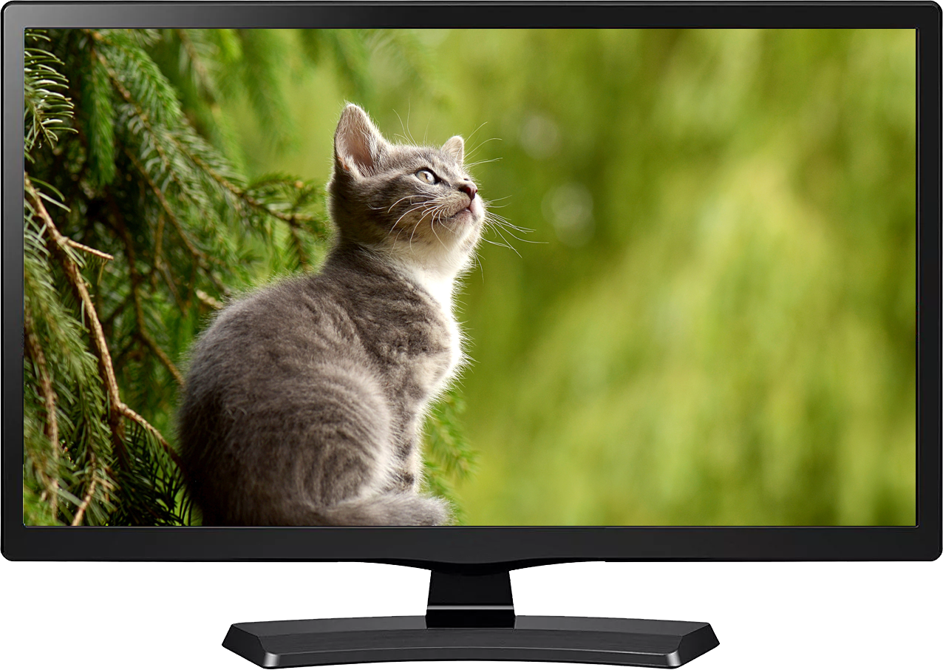
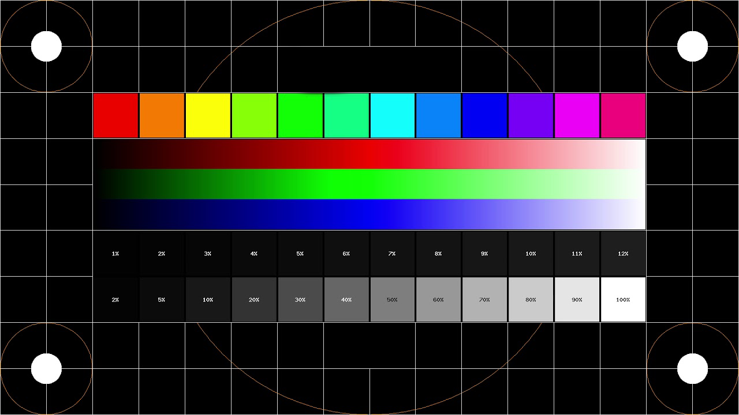
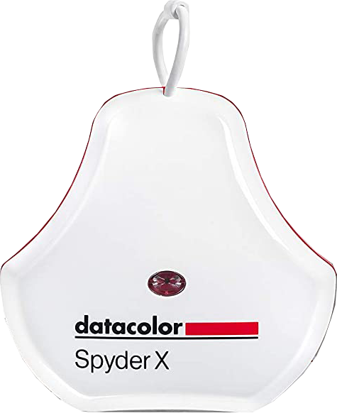
Color Calibration
Vendor may supply color profile
Operating system may include color calibration
Hardware display calibration system
ITFreeTraining.com
© Copyright 2023
Notes:
22:12 If the computer is being used for graphics work, then many graphics people will require the monitor to give as true a representation of the graphics on the screen as they look in real life as possible. The best way to do this is to buy a good monitor that supports a wide color range and has good color reproduction. However, to get the best out of the monitor, many vendors will supply a color profile. A color profile will change the output of the colors from the computer to what will look best on the monitor.
The operating system may also include a color calibration tool. This will allow you to fine tune settings like gamma, brightness and contrast. If the vendor provides software, you should use this software over the operating system software.
Most users will not need to calibrate the color on their monitor to this level. If the user is doing graphics work all day, for example working on visual effects for the next block buster movie, then this may be required. If this is the case, you can purchase a hardware display calibration system.
These systems attach to the front of the monitor. They work by displaying a test pattern on the monitor. The hardware samples the color displayed to work out what color is actually being displayed, giving a much better result then what our eyes can pick up.
These devices are good for calibrating your monitor; however, they do cost a bit of money. For this reason, you only generally find them in professional production environments.

Slide 15
Subscribe
Next video
Video content: https://ITFreeTraining.com/ap/2b10
© Copyright 2023
Notes:
23:44 Well, that is it for all the basic troubleshooting of display devices. I hope this video helps you troubleshoot problems with your monitor at home and at work. Until the next video from us, thanks for watching.
References
“The Official CompTIA A+ Core Study Guide (Exam 220-1001)” Chapter 5 Paragraph 171 – 176
“CompTIA A+ Certification exam guide. Tenth edition” Pages 786-787, 790-791
“Effects of blue light technology” https://en.wikipedia.org/wiki/Effects_of_blue_light_technology
“How to calibrate Monitor Windows 10” https://www.youtube.com/watch?v=6rbIbnA-Id0
“Picture: Cat mackerel” https://pixabay.com/photos/cat-animal-cat-portrait-mackerel-1045782/
“Picture: Cat on grass” https://unsplash.com/photos/egfS7HzgKcc
“Video: TV noise” https://pixabay.com/videos/tv-noise-damage-glitch-tv-noise-39821/
“Video: Cat playful” https://pixabay.com/videos/cat-playful-big-eyes-sweet-cute-18284/
“Picture: Cat in green area” https://pixabay.com/photos/cat-young-animal-curious-wildcat-2083492/
“Picture: Blown capacitors” https://commons.wikimedia.org/wiki/File:Al-Elko-bad-caps-Wiki-07-02-17.jpg
Credits
Trainer: Austin Mason http://ITFreeTraining.com
Voice Talent: HP Lewis http://hplewis.com
Quality Assurance: Brett Batson http://www.pbb-proofreading.uk

