Slide 1
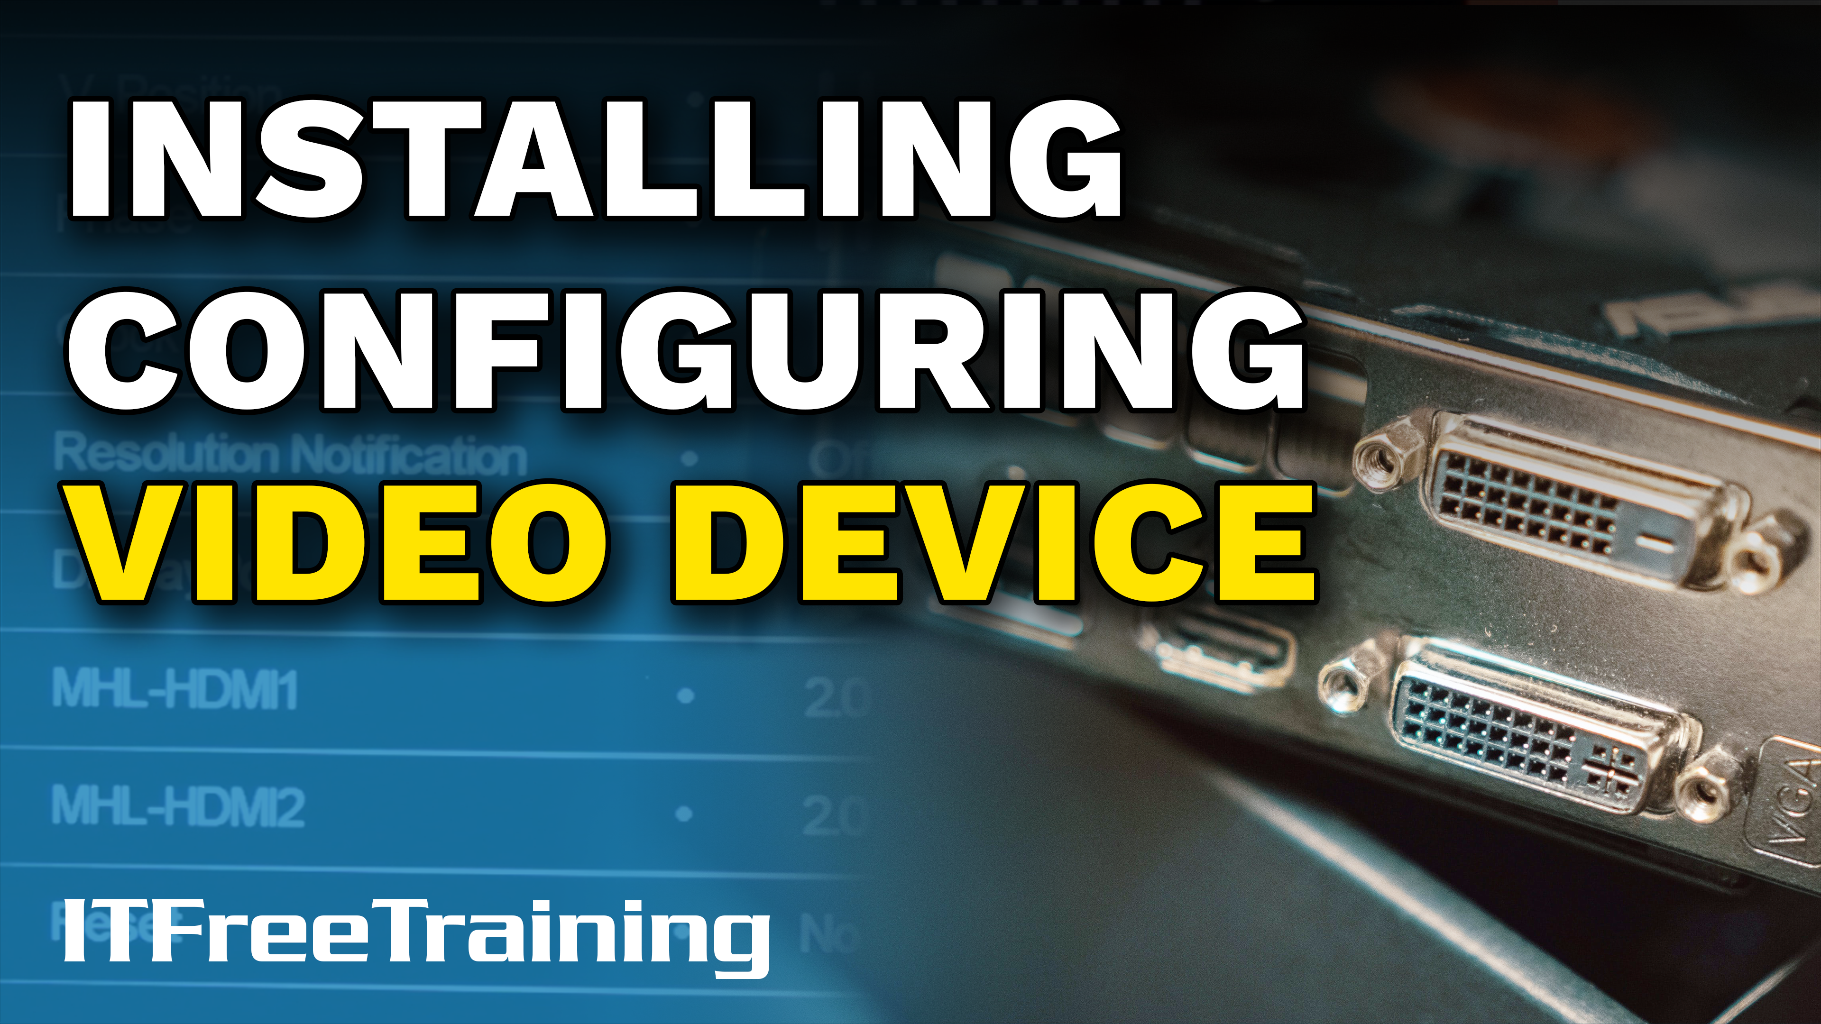
Notes:
In this video from ITFreeTraining, I will look at how to perform basic configuration of the monitor for your computer. This will cover the basics from plugging the monitor in to configuring it. Although this video covers some basic things, if a customer’s monitor is not working, you will need to know how to fix it pretty quickly.

Slide 2
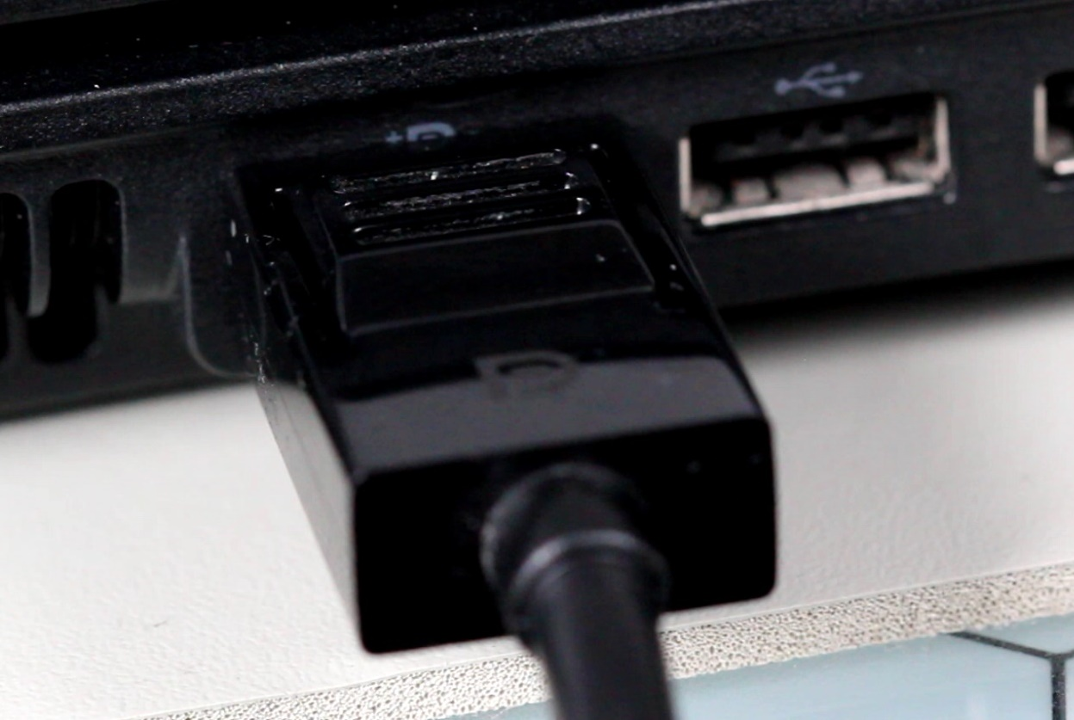
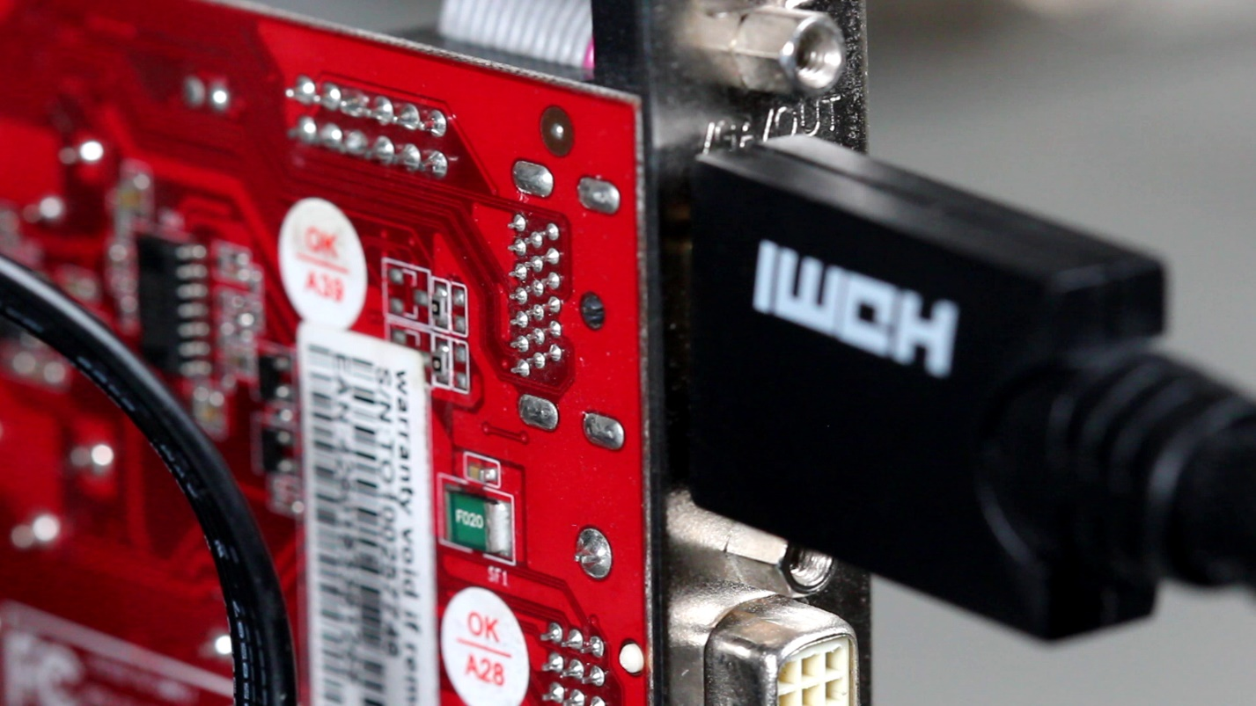
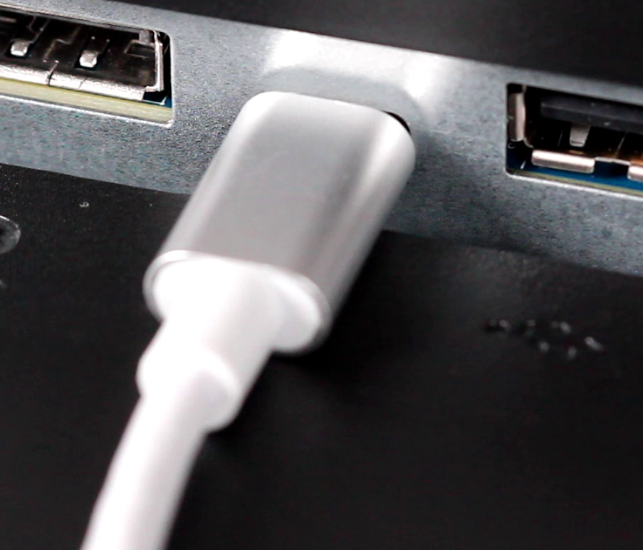
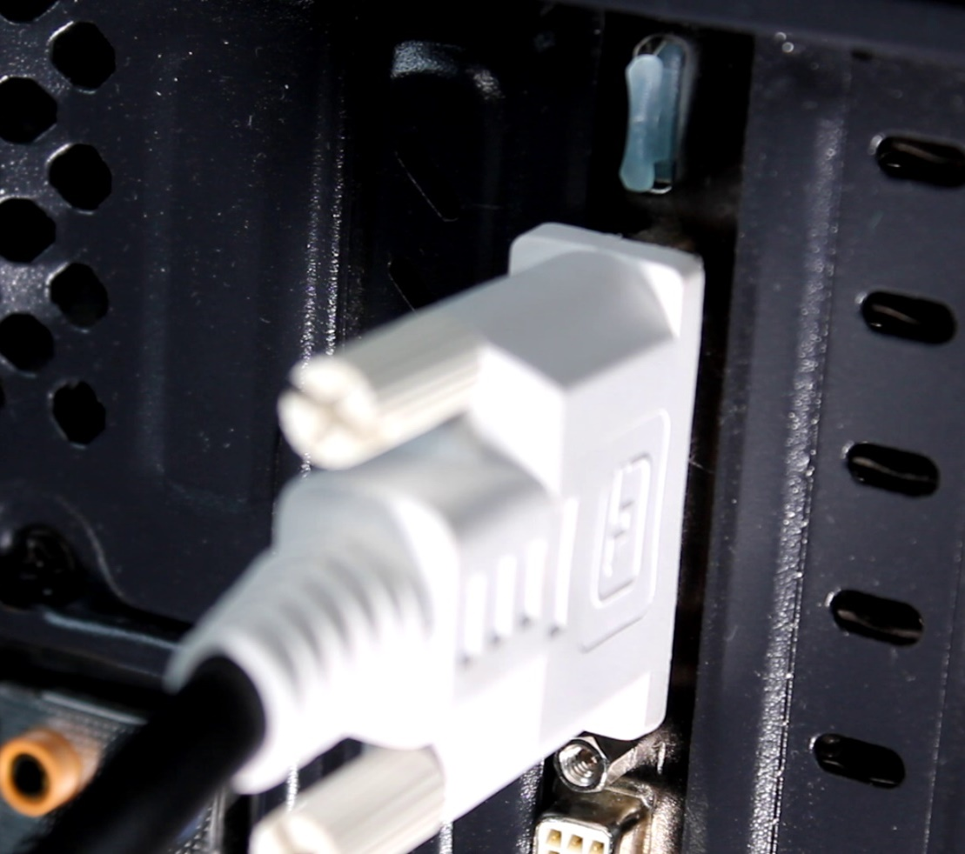
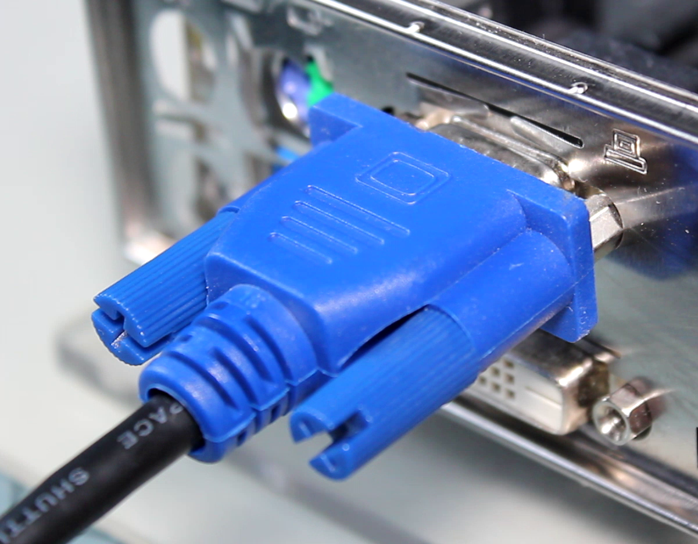
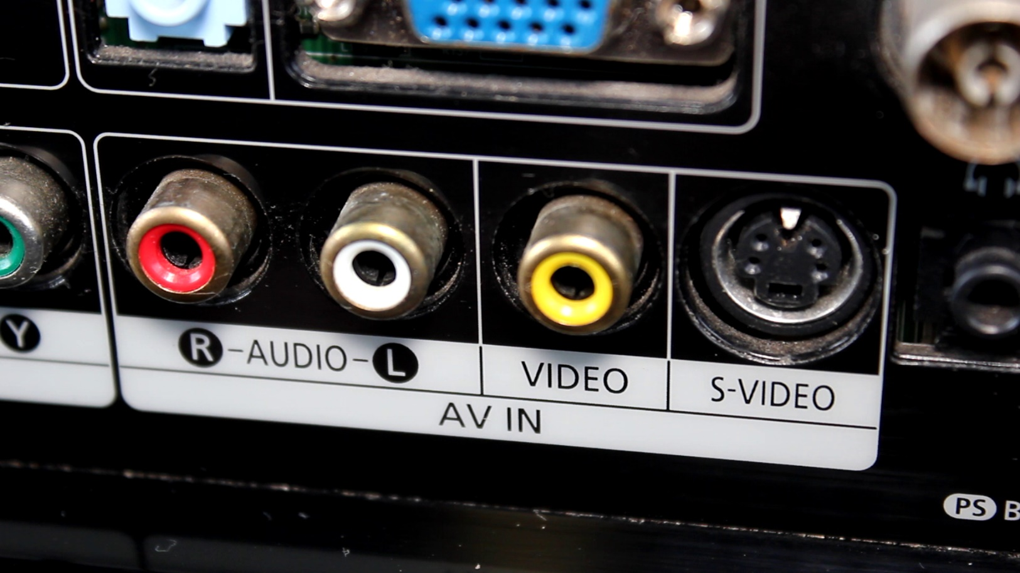
Plugging the Cable in
Ensure cable is firmly plugged in
DisplayPort
HDMI
Thunderbolt/USB-C
DVI
VGA
Others
ITFreeTraining.com
© Copyright 2023
Notes:
00:20 To start right from the beginning, the first step to getting a video device to work is to plug in the cable. Shown here are the common connections for video cables. DisplayPort is becoming more common on computers and monitors. HDMI is very popular with home entertainment and is used a lot with computers. USB-C is also starting to become more common. Thunderbolt, which is mostly used with Apple computers, uses the USB-C connection.
DVI is an older connection method which is there for backwards compatibility. This connection was created when video made the transition from analog to digital – the older analog connection being VGA. There are other connections that use plugs like RCA, BNC or specialized plugs, however you don’t generally see these too much nowadays. Plugs like these are not able to push enough data through to support higher resolutions.
The first step, although this may seem obvious, is to make sure the cable is plugged in firmly. Often if you have a computer that has a black screen, the cable has simply come out. Even if it seems to be in okay, push it in to make sure. If the cable is slightly loose, this can cause the pins not to connect correctly and the signal to be lost. A lot of the time the cable may just be knocked or come loose. Let’s look at how the cable can be better secured.

Slide 3
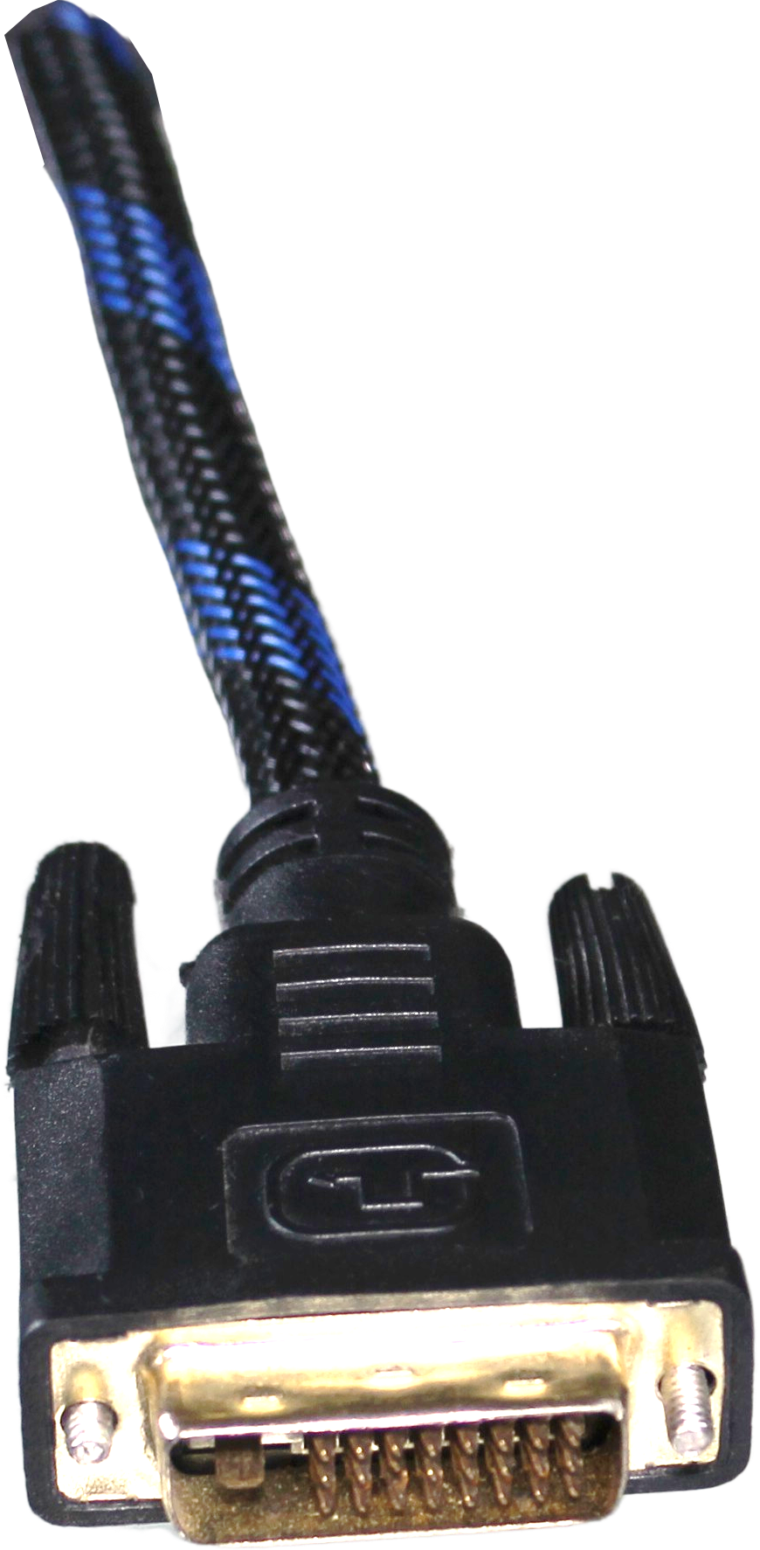
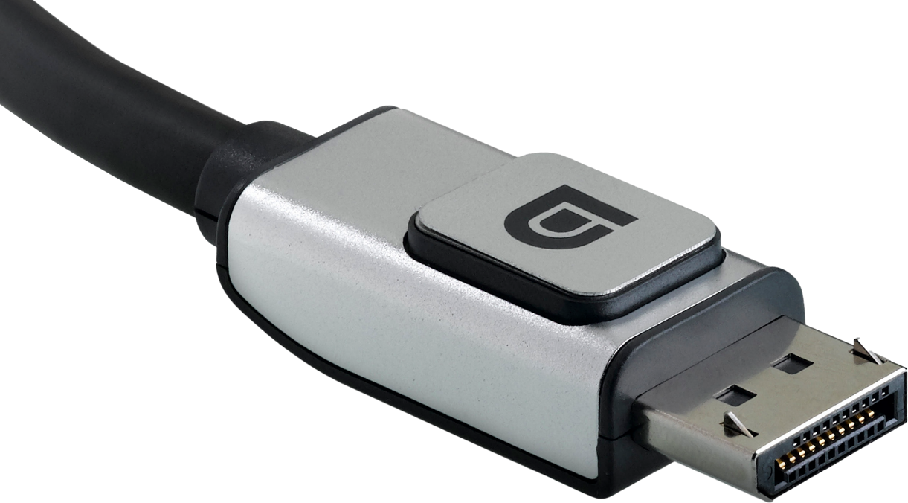
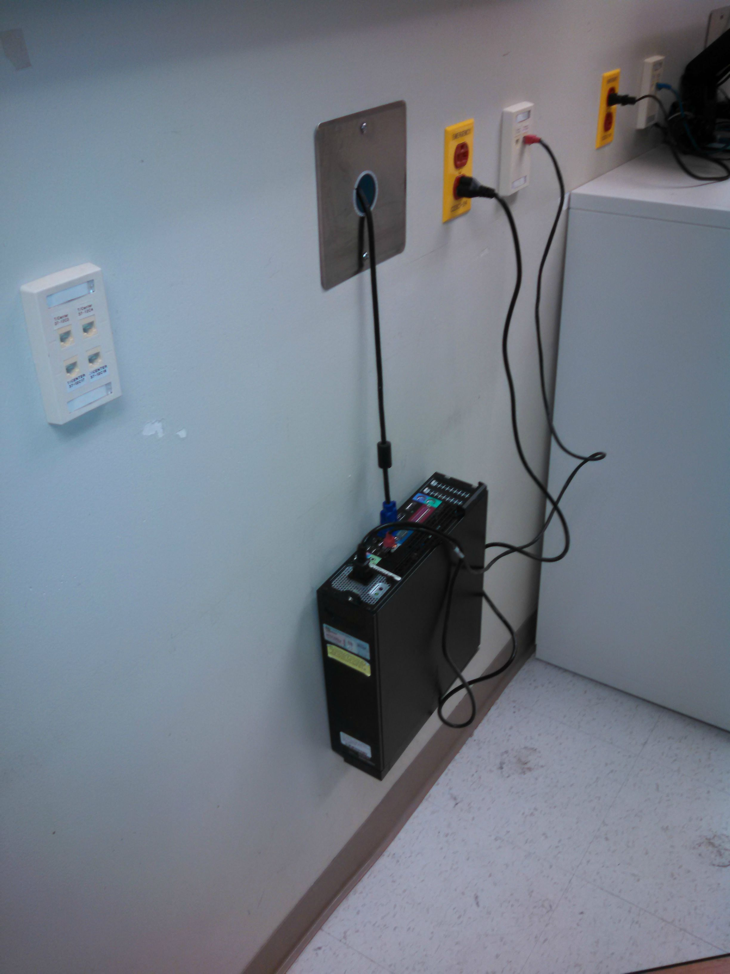
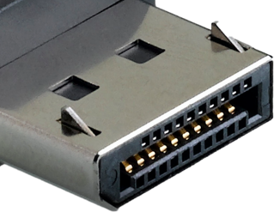
Screws and Clips
Hold cable in place
Can be very strong
ITFreeTraining.com
© Copyright 2023
Notes:
01:46 In order to hold the cable in place, some cables have either screws or clips which hold the cables. In modern cables, only DisplayPort cables will commonly have clips to hold them in place. Other modern cables do not have any way of keeping the cable locked in place.
DVI and VGA have screws that will allow the plug to be screwed in to keep it in place. Once the plug is locked into place it will be difficult to get it to come out even when a lot of force is used. This is one of the risks with using a cable like these. If the cables are locked in place, then if the cables are pulled suddenly, for example someone tripping on the cable, this puts a lot of force on the computer or monitor. In some cases, it may damage the connector on the other end, the cable comes lose or, in the worst case, pulls part of the device at the other end out, damaging it. Let’s have a look at how modern cables are designed to help prevent problems with them coming loose.

Slide 4
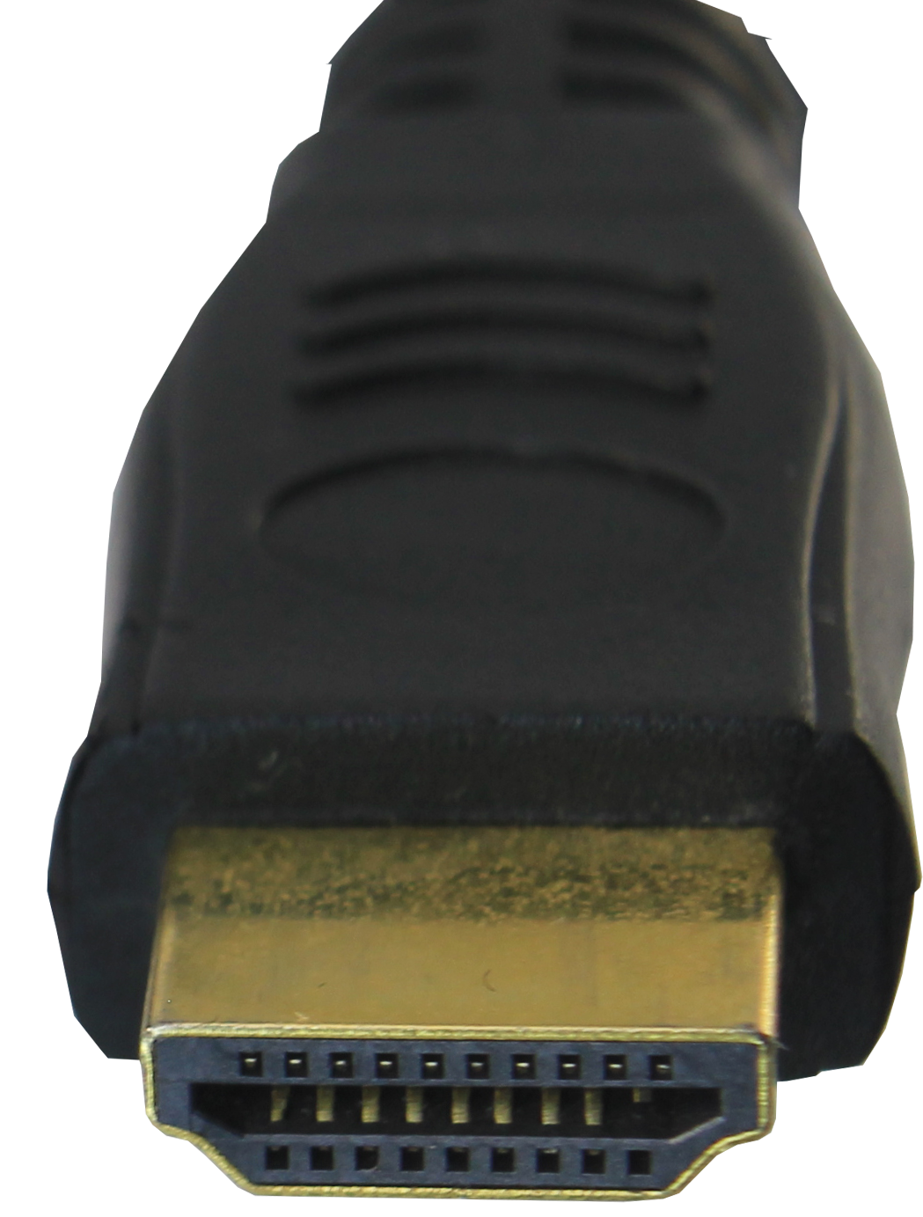
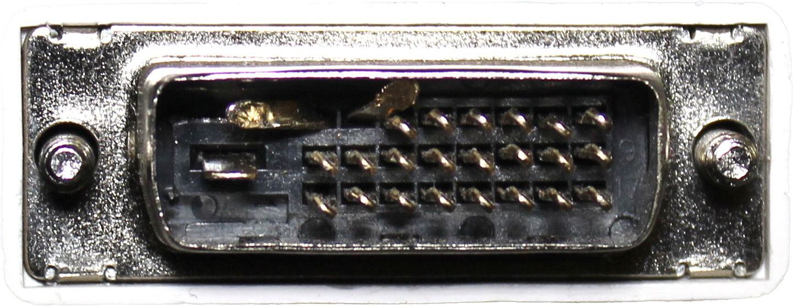
Pins Vs Blade Connectors
Pins can be bent
No pins to bend
Harder to connect/disconnect
Easier to connect/disconnect
Poorer connection
Better connection
ITFreeTraining.com
© Copyright 2023
Notes:
02:46 Older connectors were pin-based connectors where the pins were inserted in a plug that contained cylinders for each pin. One of the problems with these connectors was that the pins could be bent. This does not tend to happen that much with newer cables as they are made of better materials. If you are plugging in one of these connectors, and if you are finding that you are having to use a lot of force to get the connector in, pull the connector back out and make sure none of the pins are bent. If you do find that you have a bent pin, use pliers to carefully bend the pin back into place. Once back in place, or as close as you can get, slowly plug the connector back in. As long as you do it right, the connector should help bend the pins back into shape.
By contrast, newer connectors use a blade-like connector rather than pins. These connectors have nothing that can be bent. The blade connectors are easier to connect and disconnect, whereas pin connectors are harder to connect and disconnect. The blade connectors offer a better connection whereas the pin connectors have a poorer connection. You can see why blade connectors replaced pin-based connectors. Since they offer a better connection, they are less likely to lose their signal even if the cable is a little loose.
Now that we have the cable plugged in, let’s have a look at what else we need to configure.

Slide 5
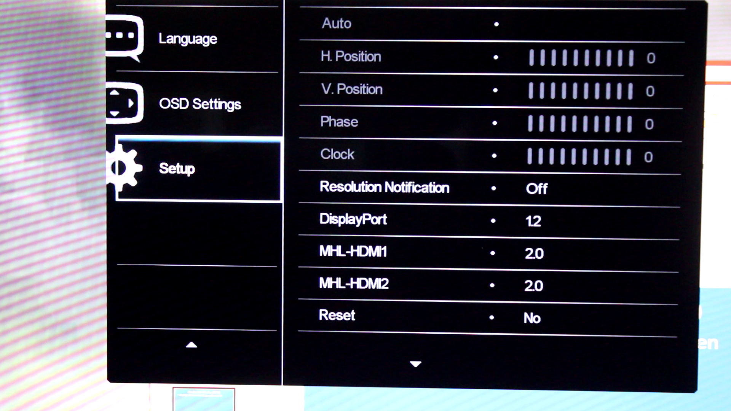
On-Screen Display (OSD)
Displays menus and settings on the screen
ITFreeTraining.com
© Copyright 2023
Notes:
04:11 Hopefully you will plug in your monitor and it will just work. However, sometimes you may need to do some more configuration in order to get the monitor to work. All monitors nowadays, even older CRT monitors, will have an on-screen display. This is the ability for the monitor to display menus over the image that is currently displayed on the screen.
The most common use of these menus is for setting the input to the monitor. You can see in this example the monitor is saying there is no cable connected. There is a cable connected to this monitor; however, the monitor is configured to use DisplayPort and not HDMI. To change it, locate the buttons on the monitor to activate the menu; in this case the buttons are on the front next to the power button. They are difficult to see because when they are not lit up, they are black just like the monitor case. The buttons may be anywhere, but oftentimes are located on the side or the back. There may be a number of buttons or one button that you press in different directions to produce the same output as multiple buttons. If you can’t find them, have a feel around the monitor and hopefully you will find them. On some monitors, the buttons will be hidden away in a little compartment which you will need to open in order to get to the buttons.
In this case, you can see the monitor has displayed icons that show the different types of input it supports. To change the input, all I need to do is select the one that looks like HDMI.
If you are not able to find them or you want to get a quick result, most monitors will run an auto-detect sequence when they are switched on. So, if you switch the monitor off and on again, this will trigger the monitor auto-detect sequence and hopefully it will switch to the required input.
If I now activate the menu again, this monitor has four different menus that can be accessed. If I select the first one, you will notice that I can access the picture mode. This changes how the image on the screen will look. Depending on your requirements, you may want to change it to another setting. If you are using the monitor at night, you may want to select the low blue light setting. If you are using the computer in an office, you may want to use a different setting, or if you are doing graphics editing all day, you may want a different setting again. When you set up a monitor for a customer, they may not know how to do this, so select the best setting for them.
The next menu I can change the input for is the monitor. This is useful if you have multiple input connections to the same monitor. The next setting on the monitor is for volume control. Keep in mind that you can change the volume on the computer. If you want the most control set this to 100% and you will be able to control the volume using the computer, so you can get the full volume range.
The last menu is additional configuration for the monitor. Each monitor will most likely have a different menu system. In this case I will change to a different monitor as it is easy to see the menu, and it also has some settings that illustrate some important points.
On this particular monitor, you can see the menus are very different. On the first sub-menu, you can see I can change the input as before. On the next sub-menu, settings like the brightness, contrast, sharpness, and other color settings can be changed. If you find that the monitor is very dark or very bright, it may be a simple matter of changing the settings in here. Sometimes customers or children will change these settings. Before replacing the screen because it is too dark, check these settings to make sure they are correct.
The next sub-menu is for “Picture in Picture” and “Picture by Picture”. These allow the monitor to use two input signals and display them on the same screen at the same time. Different monitors will have different features and it is not a bad idea to go through the menu to have a look at what the monitor supports.
I will skip past the other sub-menus since they are similar to what I have already looked at. The last sub-menu is setup. This has the settings for horizontal and vertical position. This allows you to move the image displayed on the screen around if it is not centered on the screen. With LCD monitors, you should not need to do this, but with older CRT screens, you may need to do this. It was not uncommon for CRT screens, when they were first switched on, to have some of the screen cut off or slightly bent. More modern CRT screens had an auto-configuration option which would fix this, but in some cases, you would need to manually set the options.
Notice the option for DisplayPort. When I select it, I will be able to select version 1.1 or version 1.2. When this monitor was first set up the default setting was for version 1.1. Since this is a 4K monitor, this limited the resolution to 4k at 30Hertz. When using the monitor, the frame rate was noticeably slow in some applications. To fix this, it was just a matter of changing the settings to 1.2. Version 1.2 allows the monitor to run at 4k at 60Hertz. If you are having performance problems with the monitor, have a look through the settings on the monitor to see if there are any settings like these that may be causing the problem.
You can see that if I select HDMI, you will also have the choice of different options. I would recommend switching this setting to its highest value as the monitor should drop down to the lower setting if required. If, however, you are having problems, change it to the lower setting.
The last option in the sub-menu is information. This will give us information about the model and serial number. If you are looking through the menu for a Smart TV, this may also tell you information such as what firmware the Smart TV is using.
In some cases, you may be setting up multiple monitors or adding a second monitor to an existing computer. When this occurs, you may need to make some changes to the BIOS.

Slide 6
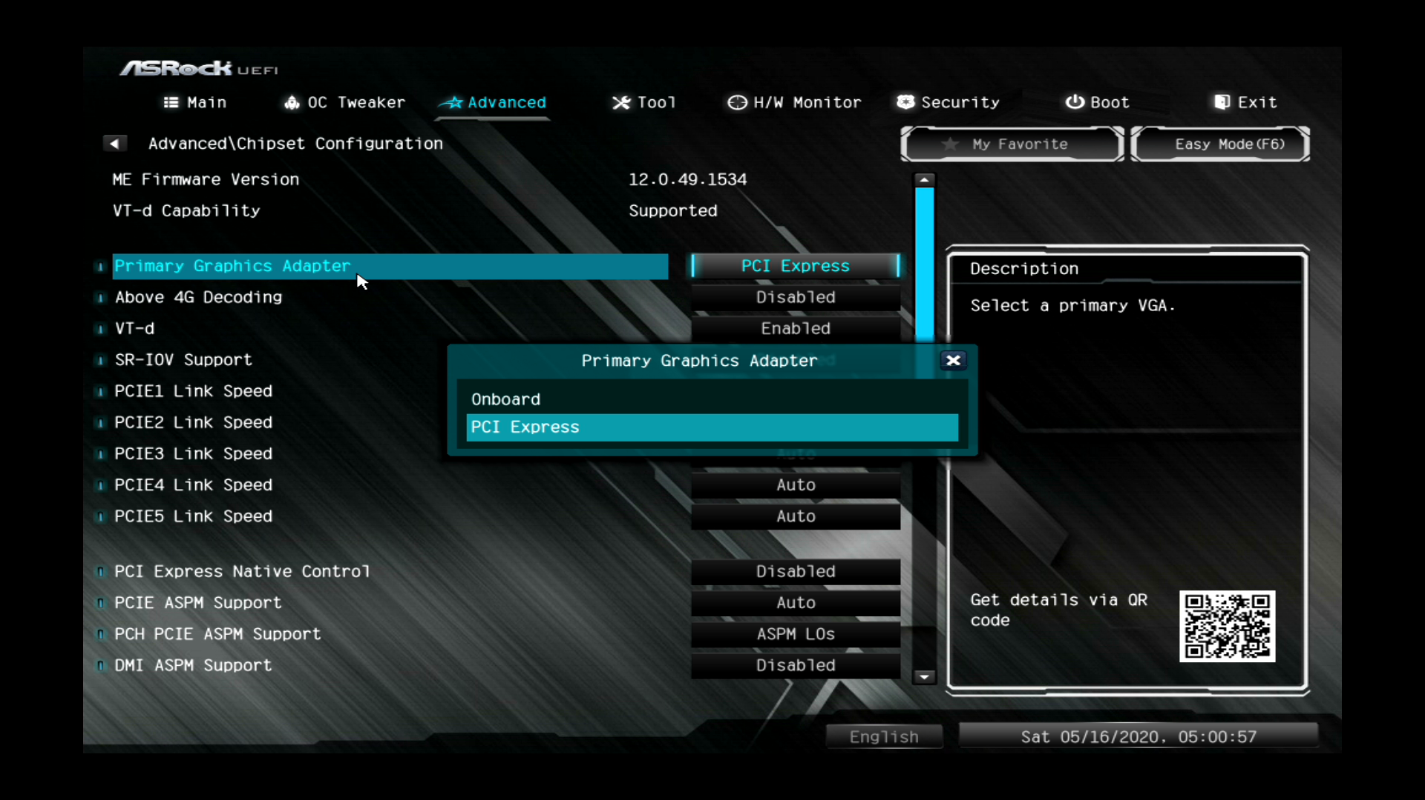
BIOS Setup
Configure primary adapter used or enable/disable
ITFreeTraining.com
© Copyright 2023
Notes:
10:19 If you have a computer that has an integrated video card, either on the motherboard or as part of the CPU, this can cause some issues if you install a second video card in the computer. When this occurs, you may need to configure some settings in the computer’s setup. To have a look at how to do this, I will start my computer and enter the setup, UEFI in this example; a BIOS setup would be similar.
In this particular setup, to access the setting that I am interested in, I will need to select the option for “Advanced Mode”. Your setup will most likely be different, but if you have a look around enough you should be able to find the options.
In the advanced options, I will select “Chipset Configuration”. Your setup may be different such as “Integrated Peripherals” or something else. You may need to go through a lot of menu options in order to find it.
In this menu, I will next select the option “Primary Graphics Adapter”. In this case, the setting is configured to “PCI Express” which essentially means the video card that is installed in this motherboard is being used as the primary video card.
Generally, you will want this to be the case, because if you installed another video card, it is most likely better than the onboard video card. In some cases, you may want to use the onboard video instead. For example, if the computer is providing the graphics for a video board, maybe a large video advertisement board, you may want to use the onboard monitor for configuring the computer. The video card would be used to supply graphics to the video board, which may not even be in the same room as the computer. If you consider an extreme case, you probably would not want to be configuring BIOS settings on a mega screen used at a sports stadium, but in this case an onboard video and a small monitor would be fine.
I will now scroll down through the settings; you will notice a setting called “IGPU Multi-monitor”. Notice that this setting is set to disabled. When this setting is disabled, this means the integrated video will be disabled when a video card is detected. If you want to use multiple monitors, one monitor running the integrated video card and the other using the installed video card, you will need to enable this setting.
In this case, since I want to use multiple monitors, I will enable this setting. Once enabled, I will save the settings and exit setup.
Now that I have plugged in and installed the graphics adapter, the next step is to configure it in the operating system. To do this, I will change to my computer running Windows 10.

Slide 7
Windows Desktop Settings (Demo)
Right click windows
Select “Display settings”
Select “Personalize”
Vendor software should also appear
ITFreeTraining.com
© Copyright 2023
Notes:
13:01 Once you have your video working, you may also want to change a few settings in Windows. To start configuring these settings, right click on the desktop and select the option “Display settings”. One of the recently added features is night light. When enabled, this will dull the screen. Useful if you are using the computer at night. This setting also reduces the amount of blue light that is emitted by the monitor. Blue light has been linked with affecting the circadian rhythm. Circadian rhythm is the natural rhythm of the body which tells us when to be awake and when to be asleep. Windows also has options that allow the night light to be switched on and switched off at certain times.
Further down, there is the option for “Windows HD Color settings”. If your video card and screen support it, features like high dynamic range or HDR will be switched on. This provides a larger range of colors than the standard 8-bit color palette. If you want to check to make sure that these settings are working, select this option.
When I scroll down, notice the section “Scale and layout” and in particular note the section “Change the size of text apps and other items”. This setting is currently set to 150% which is what Windows recommends. Notice that this setting ranges from 100% to 175%. This setting has become particularly important as screen resolutions have gone up. For example, if you are using a 4K resolution and this setting was set to 100% the font on the screen would be extremely small and thus very difficult to read. Windows will automatically configure this setting based on the resolution; however, depending on your needs, you may want to change it.
The next setting down is “Display resolution”. Any LCD screen will have a recommended resolution that it should run at. Windows should automatically detect the recommended resolution of the monitor and use this resolution. If you find the display resolution does not match the resolution that the monitor recommends, you may need to update the graphics device driver. It may also be that the video adapter does not support the same resolution as your screen does; however, with modern video adapters, this should not be a problem unless you are using a very high resolution. LCD monitors work best when the recommended resolution is used, so you should always configure windows to use this resolution when possible.
The next option down is “Display orientation”. This option allows you to change your monitor from landscape to portrait – you can also flip the image if you need to.
Scrolling down to the bottom, you will notice the section for “Multiple displays”. On this computer, I have two displays. Windows is currently showing only one of these displays, so in order to get the other display working, I will press the detect button. Hopefully, windows will be able to detect the second display.
You will notice that when I scroll up, the second display will now appear. If you're having trouble getting the second display working, you may need to restart the computer. Although in some cases Windows will be able to detect when an additional display is added, some displays will not work correctly unless the computer is started up with the display connected.
When you start working on computers with multiple displays connected, it can become confusing to work out which display is which. I once worked on a CCTV system which had six displays connected to the one computer. To work out which display is which, you can press the Identify button which will put the number of the display on the screen for a short period of time.
In some cases, the monitors may not be in the layout that you want, for example the left monitor is on the right and the right monitor on the left. You could always pick up the monitors and move them, but an easier way is to simply drag the monitor that you want to reposition to where you want it.
You are not limited to putting the monitors next to each other. You could also put one monitor above another one. The monitors also do not have to line up correctly, so for example, you could offset one monitor so it is not lined up with the monitor next to it. Generally, you want to line the monitors up as it makes it easier to use Windows; however, if your monitors have different resolutions, you will need to decide how you want the monitors to line up. For example, when using monitors with different resolutions, you may want to line the task bars up. Other users may prefer to line up the top of the monitors. There is no right or wrong way, it is simply what the user prefers.
In this case, the monitors were already in the correct spots, so I will put them back where they were, making sure they are lined up with each other correctly.
When I scroll down, notice that under “Multiple displays”, I have a new option. Currently this is configured to “Extend these displays” which essentially means that my desktop will be extended over the two monitors. I could also switch off one of the monitors if I had a need to. For example, if one of your monitors was broken, Windows will still allow you to move the mouse onto the broken screen and you won't be able to see it; but disabling the monitor prevents this from occurring.
You will notice the tick box “Make this my main display”. When you open an application on Windows, by default it will open on the monitor that is the main display. Generally, you will want to tick this for the monitor that is directly in front of you. If you have two monitors and they're both directly in front of you, you will just have to choose one monitor that is your preferred monitor.
Notice that when I tick the option, that option will then become grayed out. Only one monitor can be the main display at any one time, so if you want another monitor to be the main display, you need to select that monitor and then tick this option.
Those are all the options that I wanted to look at for “Display settings” so I will now close this window, right click on the desktop, and select the option “Personalize”. Personalize, as the name suggests, allows the look and feel to be configured to make it a little more suited towards the user.
You will notice the first option down allows you to change the background of Windows. You can select a picture, a color, or a slideshow of pictures. Scrolling down further you will notice an option “Choose a fit”. This is currently configured to Stretch which means that the image used for the desktop wallpaper will be stretched to fit the resolution on the screen. If your image is the same aspect ratio as the resolution of the screen then using the stretch option should work quite well; otherwise, you may need to select a different option. Many companies will have their own desktop wallpaper that they like to use; however, users will often change it so you need to know how to change it back. Many companies will lock the settings so that users are not able to change them, but you would be surprised how clever some people are at getting around this.
The next section that I will look at is colors. You will notice that you will be able to change the default windows mode to either Light or Dark mode. Light mode will change the start menu and other parts of Windows to make them look a bit brighter.
Below this, notice that you have the option to change the default application mode. When I select dark, notice that the color schemes of Windows get changed. Changing this has more of a noticeable effect than just changing the start menu and task bar.
Below this, notice the option for “Transparency effects”. When this is enabled, you will be able to see a little of what is behind the Window, like looking through cloudy glass which only allows some light through. The effect is not that easy to see; however, notice what happens to the left of the window when I switch it off. Although a little subtle, the left side of the screen is now completely solid and I cannot see any of the background through it.
Although not much of a concern for modern computers, if you have an old computer and want to get it to run a little faster, you can switch off things like transparency effects. This computer’s hardware is quite good, so I will switch transparency effects back on. You will notice that I can see some of the background on the left side of the window.
If you find that you are not able to enable transparency effects, most likely the problem is that the video driver needs to be updated.
Once you have Windows looking the way you want, you may want to save these settings. To do this, go to “Themes” and then select the option Save theme. Notice that if I scroll down, you can also get more themes from the Microsoft Store. Some organizations will create their own themes so the computers in their organization will have the same look and feel. Having the same look and feel is useful when testing and deploying new software. If the computers are running the same theme then, in theory, the applications used by the organization will look the same or similar. This should therefore reduce the amount of testing required before deploying applications.
That covers all the options that I want to look at in Windows to perform basic video configuration. Some graphics adapters may also come with additional configuration software. To access this software, I will now close the personalization window and right click on the desktop. At the top, notice the option “AMD Catalyst Control Center”. In a lot of cases, when you install the device driver from the manufacturer, the additional software will be installed with the device driver and will appear in this menu. If it is not in this menu, you may need to access it using the start menu.
This computer has an AMD and an Nvidia card, so notice further down the Nvidia software. If I had an Intel graphics adapter, this may also appear here. This software will allow further configuration of the graphics adapter. In some cases, the same settings can be configured, for example changing the resolution or rotating the display. The end result will be same; however, the interface may be easier or harder to use, so the choice is up to you which to use unless you need to access a specific setting that is only available using the vendor’s own software.

Slide 8

Subscribe
Next video
Video content: https://ITFreeTraining.com/ap/2a98
© Copyright 2023
Notes:
23:49 That covers it for the basics of how to configure a video device. Hopefully, you won’t have any problems configuring your video device. If you do, most of the time it can be solved by checking the connection and restarting the computer. Until the next video from us, I would like to thank you for watching.
References
“The Official CompTIA A+ Core Study Guide (Exam 220-1001)” Chapter 5 Position 144 - 164
“CompTIA A+ Certification exam guide. Tenth edition” Page 758
“On-screen display” https://en.wikipedia.org/wiki/On-screen_display
“Picture: Computer hanging by VGA cable” https://imgur.com/lJ4RqnL
Credits
Trainer: Austin Mason http://ITFreeTraining.com
Voice Talent: HP Lewis http://hplewis.com
Quality Assurance: Brett Batson http://www.pbb-proofreading.uk

