Slide 1
Notes:
In this video from ITFreeTraining I will look at multiple monitors. Multiple monitors are becoming more and more common; thus, it is important to understand how to setup them up and support them.

Slide 2
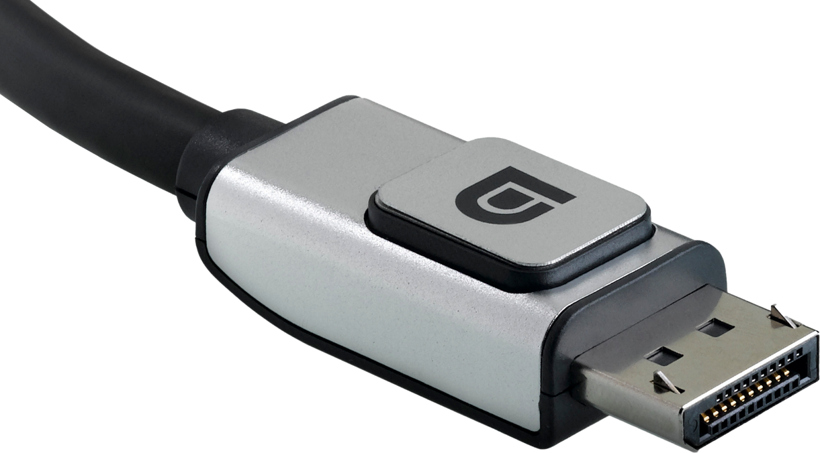
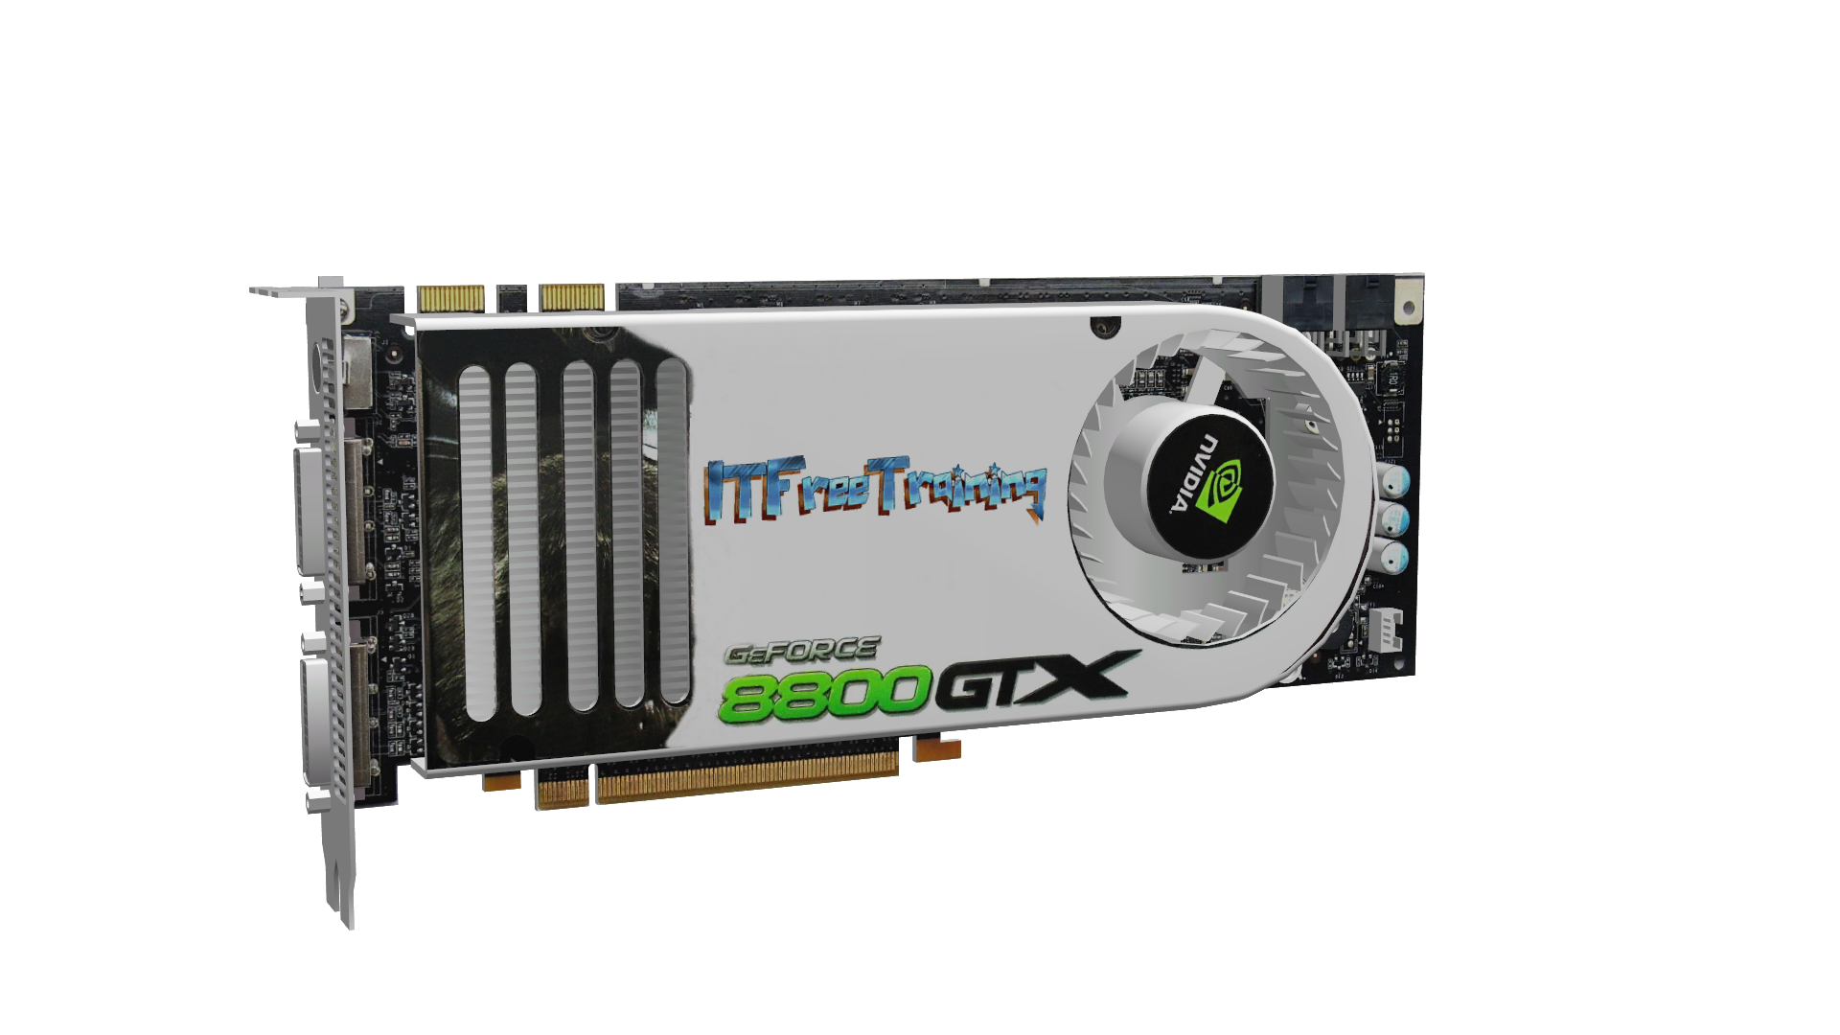
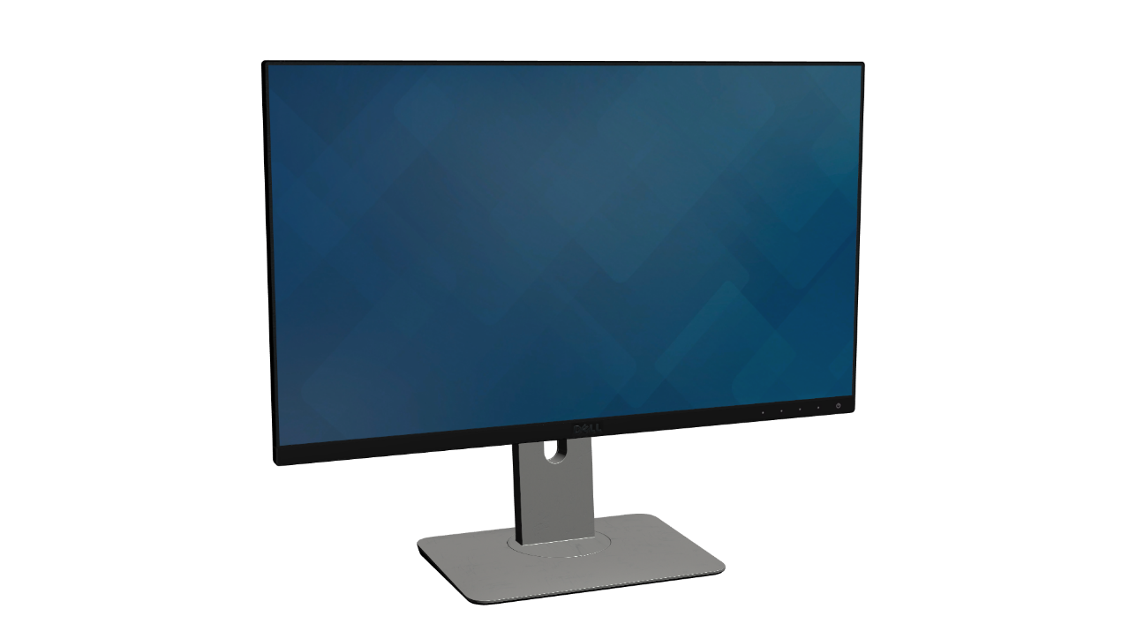
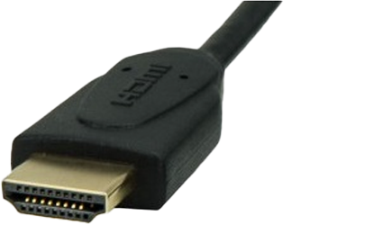
Hardware Requirements
Video card(s)
Resolution supported
Multi-Monitor support
Monitors
Resolution supported
Do not need to be identical
Cables
Not all cables equal
ITFreeTraining.com
© Copyright 2023
Notes:
00:13 To start using multiple monitors, you need to meet some hardware requirements. Firstly, your video card or video adapter needs to support the resolution required. If you are using the same adapter to run a second or third monitor, it will need to support multiple monitors. Your video adapter may have multiple plugs on it, or a splitter cable can be used to divide a single plug into two.
The next consideration is the monitors that you want to use. The monitors do not need to be the same; however, they will need to support the resolution that you want to use. In some cases, when a request for a second monitor comes in, rather than buying a new monitor they will use an old unused monitor found in a storeroom. These old monitors may not support higher resolutions. You can use two monitors that have different resolutions, but this will cause some problems which I will look at later in the video.
The last thing you need to consider is the cables used to connect the monitors. All cables are not created equal. Some cables will be able to transfer more data than others. A good rule to follow when possible is to use the cable that came with the monitor. If the monitor is not able to display the required resolution, you may need to change the cable.
Before I look at the hardware requirements in more detail, I will first have a look at how multiple monitors can be used. Knowing what you are trying to achieve will also have an effect on what kind of hardware you will require.

Slide 3
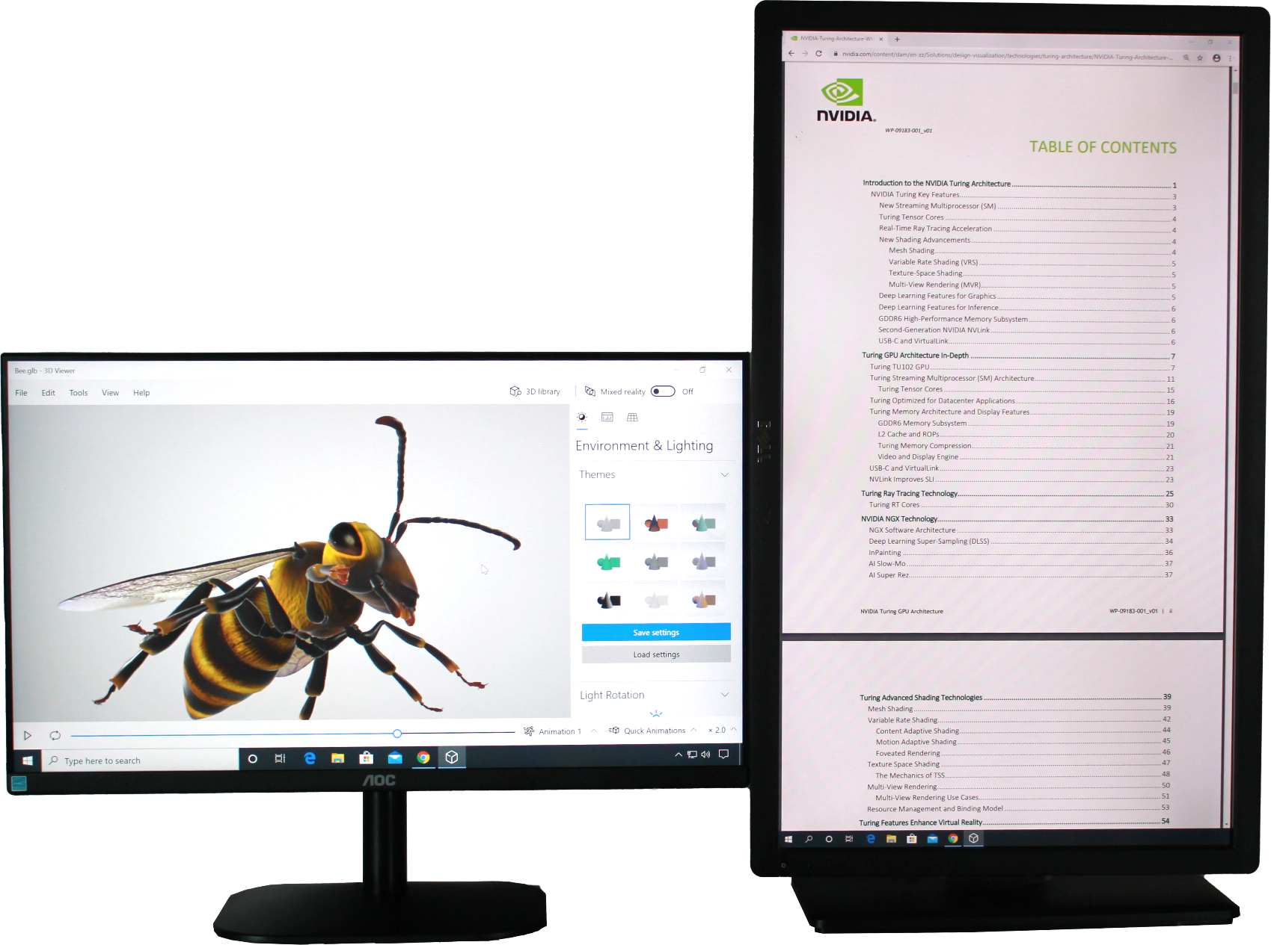
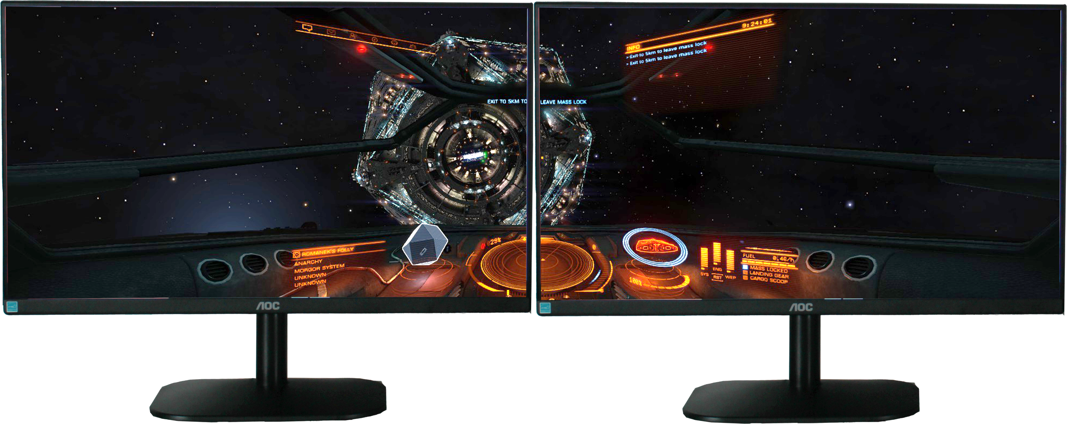
Multiple Monitor Setups
Same principles apply for more than two monitors
Primary: High performance
Secondary: Low performance
Equal performance for both monitors
ITFreeTraining.com
© Copyright 2023
Notes:
01:42 When looking at multiple monitors, they generally fall into two categories. The first category is when you have the first or primary monitor used for high-performance applications. The second monitor is used for low performance applications. For example, you may be running a 3D application on the primary monitor and the second monitor is used for looking at reference material or running applications like Office or E-mail. Since these applications do not require much graphics hardware, the performance of the second monitor does not need to be as high as the first monitor.
The next configuration is when both monitors are set up for equal performance. Essentially both monitors should be configured to provide the same amount of performance. This means they generally will have the same hardware or the same video card will be running on both monitors. This set up is often used for computer games where you want to split a large image over two screens.
I will essentially focus on looking at how to configure displays for one of these setups. However, the same principles that I will look at can be extended for more than two monitors. You can also combine them together. For example, have two monitors of equal performance and a third as a
low-performance monitor.
To start with, I will look at setting up one monitor for high performance and a second monitor for low performance. This will be when you want to maximize your performance on one monitor, while the second monitor’s performance is not as important.

Slide 4
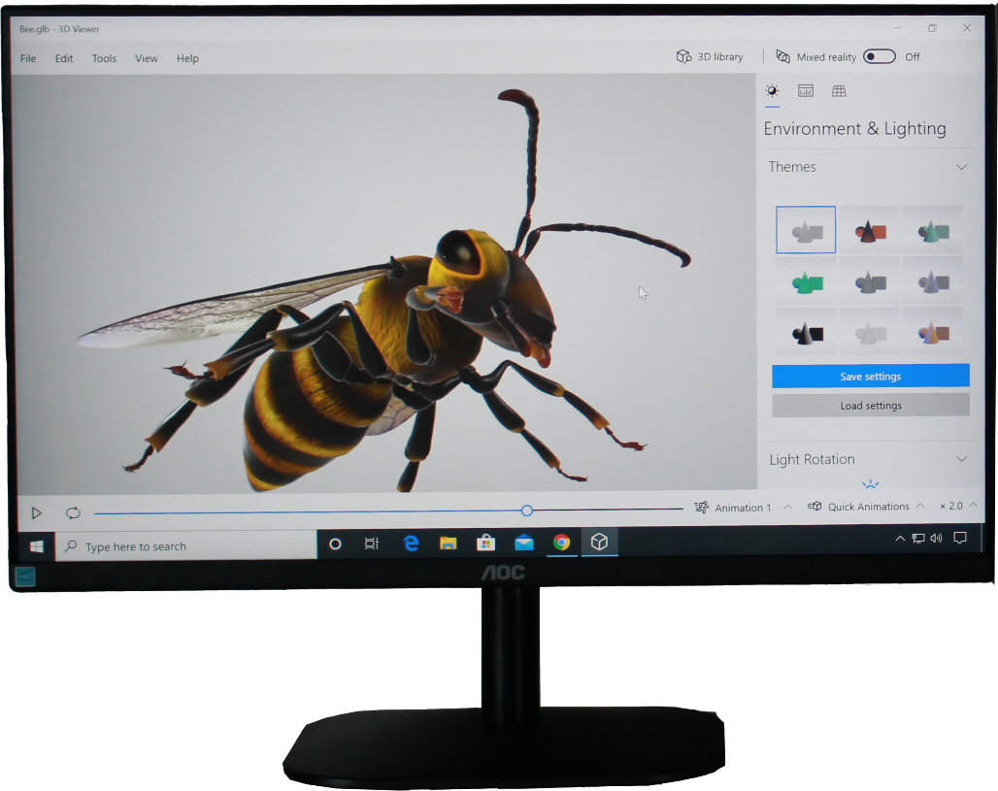
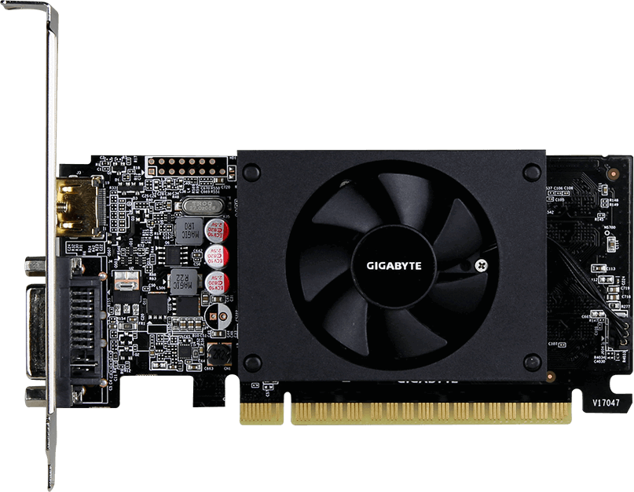
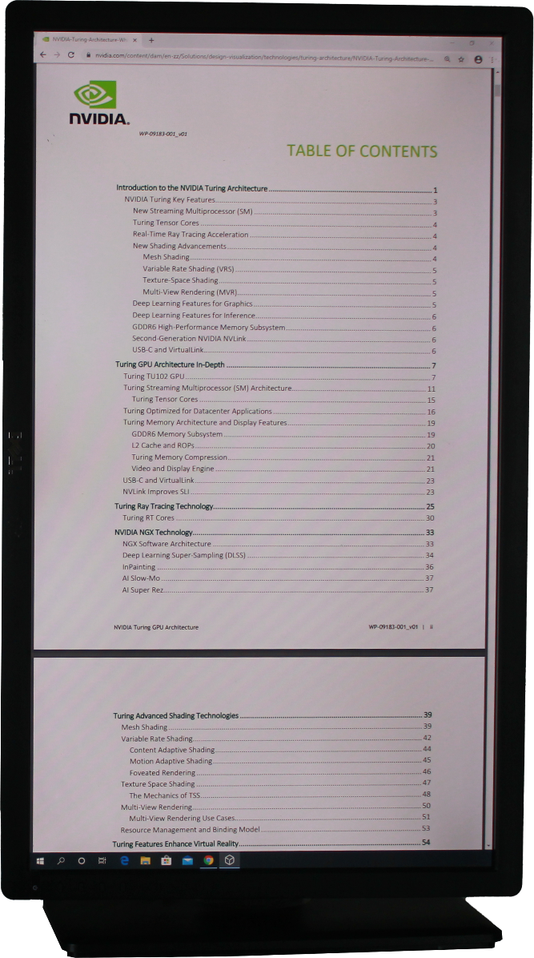
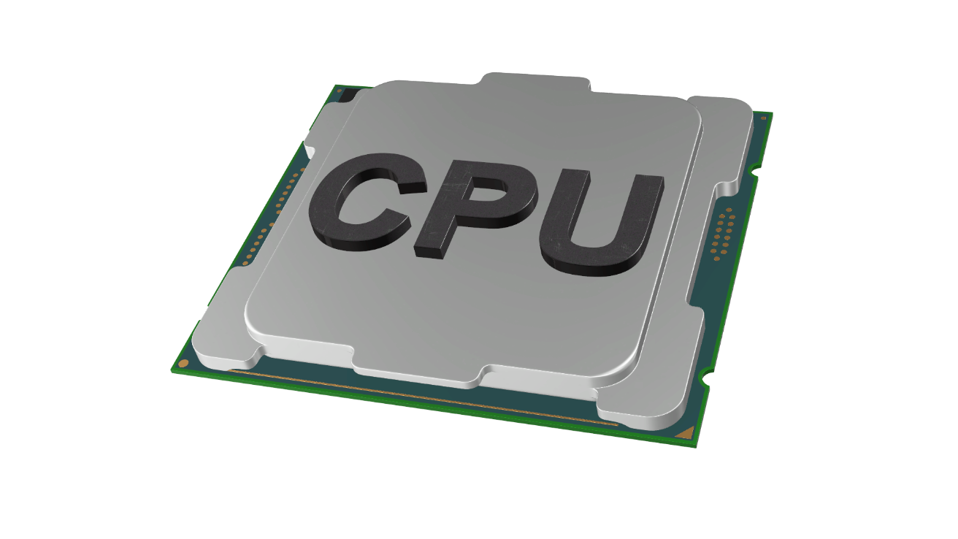
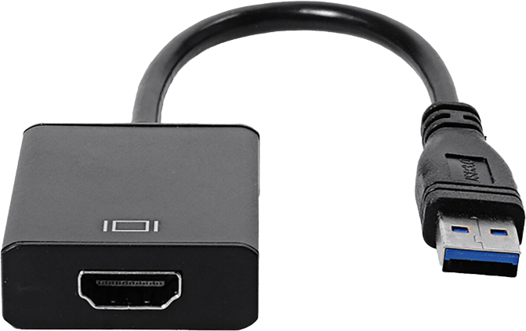
High/Low Performance Setup
High-performance video connected
to primary monitor
Integrated graphics
USB to Video
Inexpensive video card
Low-performance video connected
to secondary monitor
ITFreeTraining.com
© Copyright 2023
Notes:
03:09 In this example, there is a high-performance video card that is connected directly to our primary display. If you have spent a lot of money on a video card, you want to get the most performance you can out of that video card. Although it is possible to have the same video card run the second monitor, ideally you want to connect a second video adapter to the second monitor. This way, you are not using performance from your expensive video card to run your low performance monitor. These video cards cost a lot of money; so you want to get your money’s worth. In some cases, this may not be possible, and you need to use the same video card to run both monitors. Later in the video I will look at how to set this up.
To run your second monitor, if your CPU and motherboard support it, you can use integrated graphics. Integrated graphics is when a chip on the motherboard or part of the CPU is used as a graphics adapter. This won’t be as powerful as a dedicated video card; however, it should be good enough to run a monitor only being used for low-performance graphics.
Next, you can also purchase a USB to video adapter. This device provides an additional video adapter by plugging it into a USB plug. They are generally low in price and since they plug into a USB plug, they are easy to set up. Performance may not be that great, however.
The next option is to purchase an inexpensive video card. Like the other options it takes the processing for the second monitor away from the primary video card. Of course, doing this costs money; maybe you may have an old video card laying around that you can use. You also need to be careful to make sure that the second video card does not take resources away from the first video card. Later on in the video, I will look at ways this can be overcome. If you have integrated graphics, some configuration may be required in order to get it to work. Let’s have a look at how to do this.

Slide 5
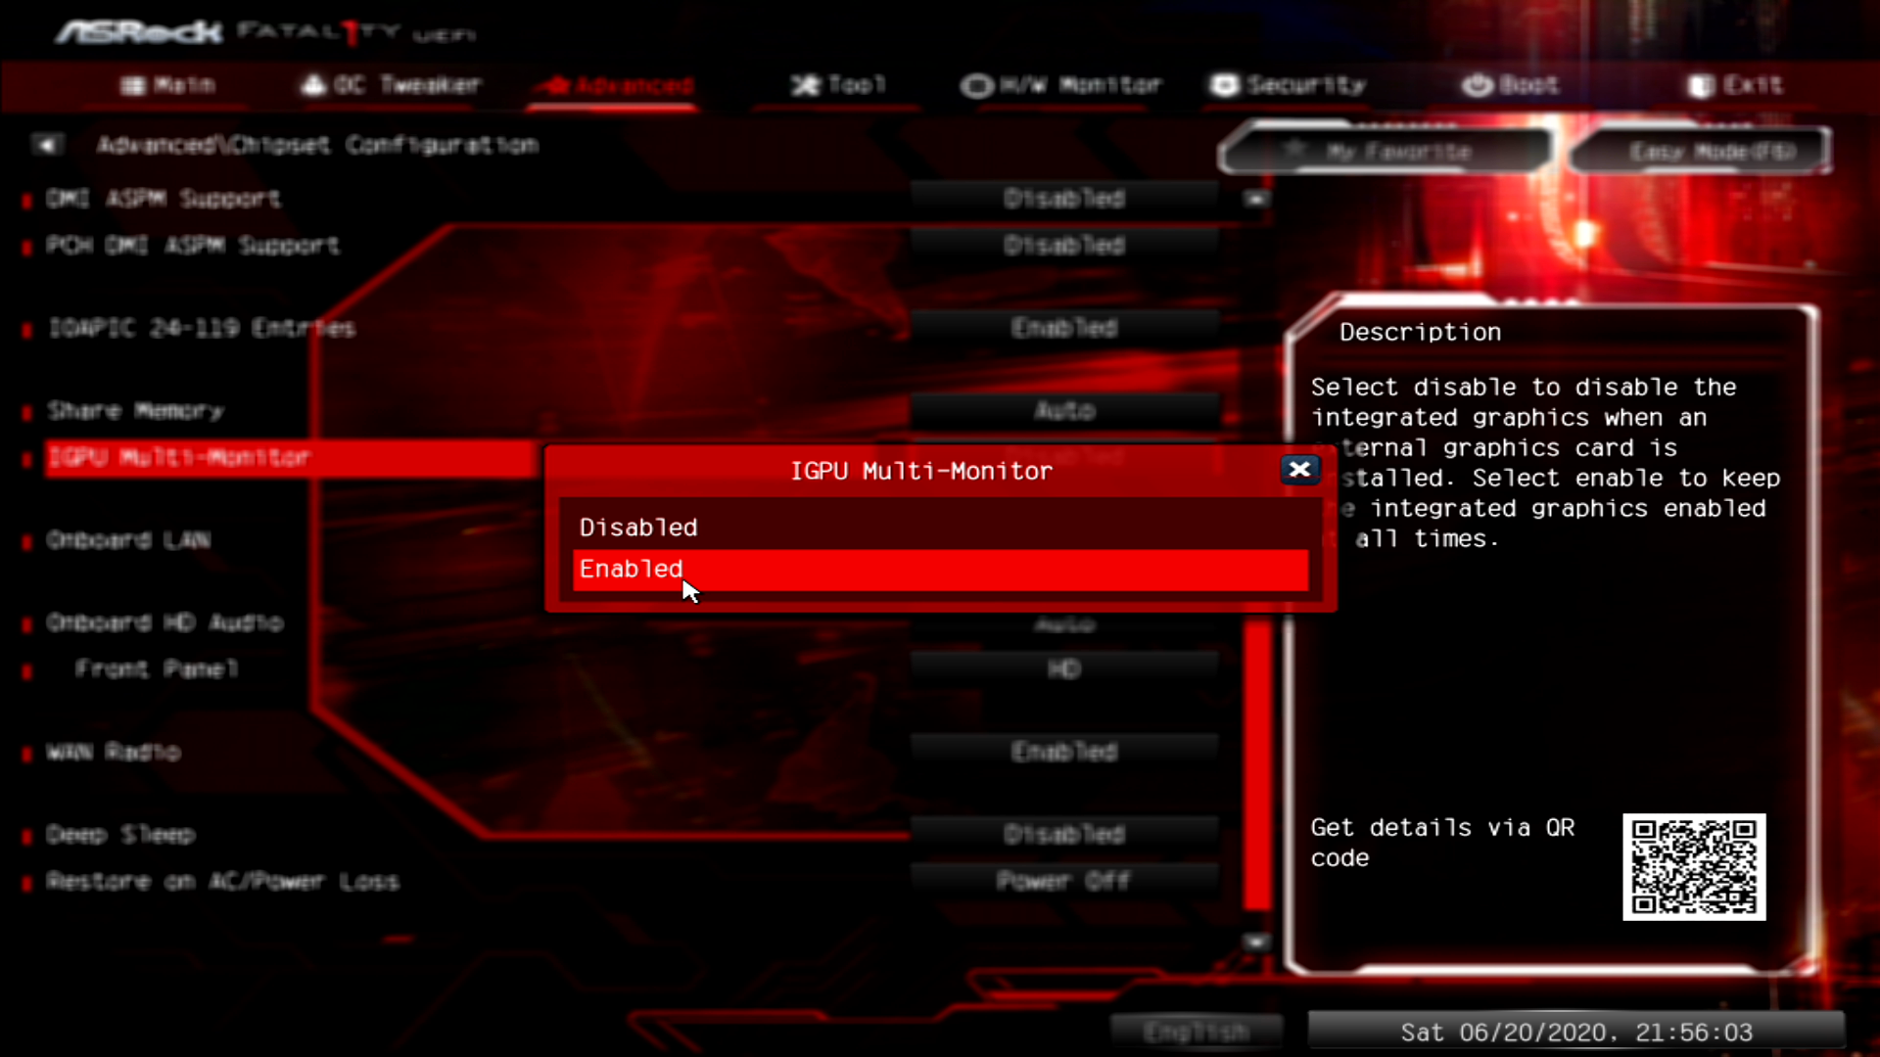
Integrated Graphics
MB or CPU support (CPU requires MB support)
May need to be enabled in setup (BIOS/UEFI)
ITFreeTraining.com
© Copyright 2023
Notes:
05:07 Using integrated graphics requires that your motherboard or CPU support it. If your CPU supports it, it will also require motherboard support in the form of a connector on the motherboard, in order for it to work.
In a lot of cases, integrated graphics will be disabled if you install a graphics card and will need to be enabled in the computer’s setup. To do this, start your computer and enter the set up. Usually the computer will display the key that is required to enter the setup. In this case, the F2 key needs to be pressed, in order to enter the setup.
This setup will start in easy mode which does not display a lot of options. In order to access the setting that I need, I will need to select the option at the top right “Advanced mode”. Once in advanced mode, I will next select the menu “Advanced”. Under the advanced menu, I will next select the option “Chipset Configuration”.
When there is an integrated graphics adapter and a dedicated graphics card installed in the same computer, your setup may have an option to determine which one will be the primary graphics adapter. In this case, you can see the option is “Primary Graphics adapter”. When this option is selected, it can be configured for onboard or PCI Express.
When there are both a dedicated graphics card and integrated graphics installed, this option essentially determines which will be used for the primary display. The primary display will be the display that is used when the computer is first switched on. The other displays won’t be used until the operating system boots. You want to make the primary display the display that you want for accessing the computer’s setup and will be used to show the operating system when it is booting. Which you choose is up to you and this can always be changed once the operating system has booted.
Keep in mind that this setting does not mean anything unless the integrated graphics adapter is enabled. In this case, to enable it, I need to scroll down to “iGPU Multi-Monitor” and enable this setting. If this is not enabled, installing a dedicated graphics card will disable integrated graphics.
Once the settings have been configured, all I need to do is exit - making sure that the settings are saved. The integrated graphics and the dedicated graphics card will now both be enabled, allowing for each to control one monitor independently of the other.
Depending on your computer, the setting may be in a different place. To illustrate this, I will have a look at the setup on another computer.
As in the previous example, in order to make the required changes, I need to go into the “Advanced” section. In the advanced section I will need to select “System Agent Configuration”. In this section, notice the sub-section “Graphics configuration”. Under this is the settings that need to be configured. These are the “primary display” option and also the “iGPU Multi-Monitor” option.
On your computer the options may be in a different location. If you can’t find them, search around as they may be in a place you would not expect. If you don’t have integrated graphics in your computer, there are other options you can look at to control your second monitor.

Slide 6
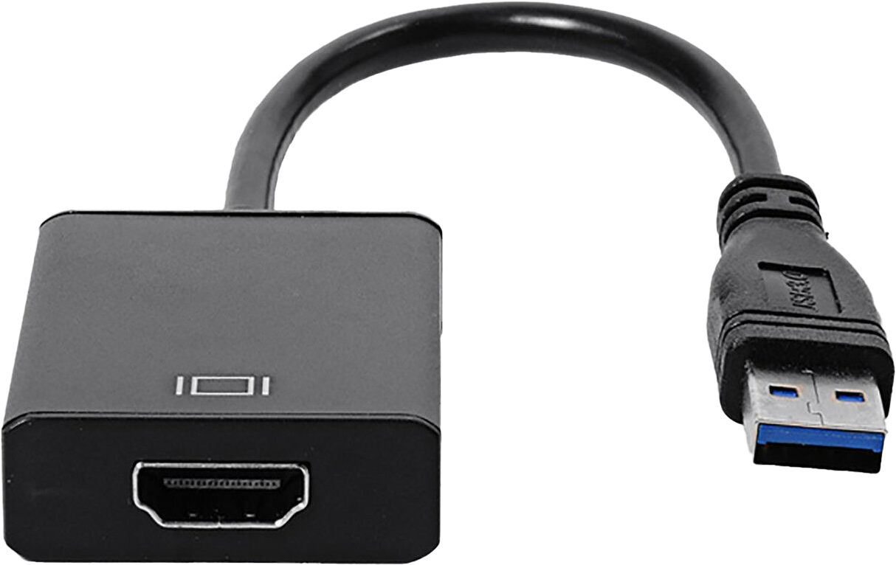
USB Video Adapter
Check compatibility
Driver operating systems
Max resolution/frame rate
Limited features
Not much 3D support
Performance varies
Most should be able to play videos
ITFreeTraining.com
© Copyright 2023
Notes:
08:27 The next option that I will look at is a USB video adapter. A USB video adapter can be as easy as plugging it in, but check for compatibility with your computer before purchase. In particular, there are device drivers available for the operating system that you are using. Windows is generally well supported, but other operating systems may not be as well supported.
The next specification to check is the max resolution and frame rate the USB video adapter can support. To get the best results, it will need to support the resolution and frame rate of your monitor.
USB video adapters have limited features when compared to a dedicated video card. The most noticeable of these features is not much in the way of 3D support. It may be able to run some 3D applications to some level, but don’t expect too much from them.
Performance varies between different USB video adapters, with some being better than others. However, most should be able to give reasonable performance for tasks like playing videos. Thus, USB video adapters are not a bad choice for a second monitor for playing videos or surfing the internet. They are generally pretty cheap for what you get. If you want a bit more performance than USB video can provide, you may want to consider installing a second video card.

Slide 7
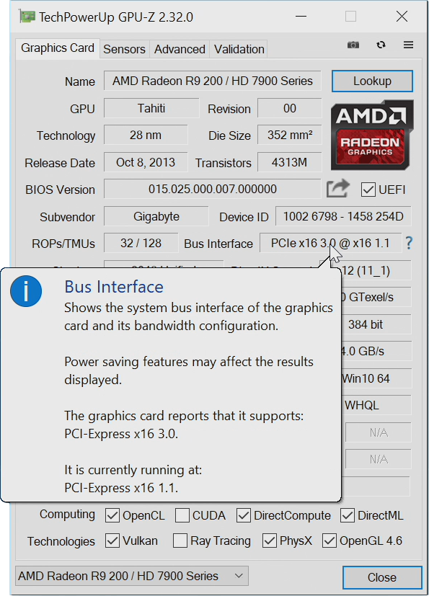
Second Video Card
Install second video card
For low performance
Max resources to primary card
ITFreeTraining.com
© Copyright 2023
Notes:
09:49 If you install a second video card (the second video card in this example is installed for low performance compared with the primary video card), essentially you want to make sure that the maximum resources are able to be used by the primary video card. This may mean making sure that you install the video card in a particular slot on the motherboard.
To check what resources your video cards are using, you can use software like GPU-Z. This tool will tell you a lot of information about the video card; however, the information I am interested in is the bus interface. Notice that when I cursor over the video card, it will tell me how many PCI lanes it is using and the PCI Express version of the video card. This will tell you what it is currently running at and what is capable of running at.
In this case, notice that the video card is currently running with 16 lanes and is capable of running with 16 lanes. So, the video card is using the maximum number of lanes it is capable of running with. Lanes are important for a video card to transfer data, but many video cards on the market don’t utilize the full 16 lanes at PCI Express 3 speed, so you should get pretty good results even with eight lanes. Keep in mind, this is only the current market and this may change in the future.
Notice that the bus is running at PCI Express version 1.1 speed even though the video card is capable of PCI Express version 3.0. This is a feature of the video card. The video card will reduce its speed when not under load to reduce its power usage.
I will now start up a process that utilizes the video card. You will notice that the speed changes to PCI Express 3.0 once the video card is put under load. Keep in mind that you may need to put the video card under some load to check that it is working correctly.
Different motherboards will support a different number of lanes. What makes it more complicated is that some CPUs will have more lanes than others. This affects how many available lanes there will be allocated to each slot on the motherboard. When installing a second video card for low performance, keep this in mind as you don’t want it taking resources away from the primary video card.
To check what is being used on the second video card, I can select it from the pulldown at the bottom of the GPU tool. Notice that this video card supports eight lanes, however it is only using four lanes. For a low-performance second video card four lanes is not too bad. You may want to experiment a little bit. For example, if your primary video card is running with 16 lanes and your second video card with eight lanes, this is fine. If you find both video cards are running with eight lanes, as your main priority is the primary video card, you may want to move the second video card to a different slot, so it uses fewer lanes. If you have spent a lot of money on your primary video card, you don’t want the cheap second video card reducing its performance.
Now that we have had a look at some of the hardware that you can use for two displays, I will next look at what you can achieve using two displays.

Slide 8
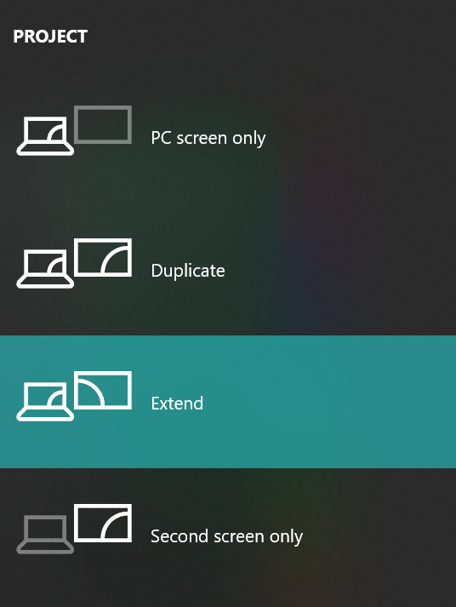
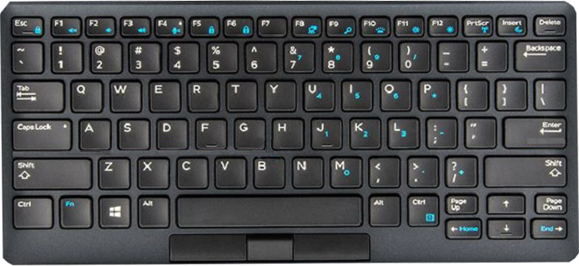
Project Modes
Windows Windows key + p
Laptops vendor specific keys
FN + Function key (Sometimes blue)
ITFreeTraining.com
© Copyright 2023
Notes:
13:05 In Windows, you can quickly change how your second display will be used. This is called ‘project’ mode because often this is used when your computer is connected to a projector. You can press the Windows key and the P key together. This will bring up a menu which will allow you to quickly set how your second monitor will be used.
If you have a laptop, the laptop may have specific keys to perform this function, however pressing the Windows key and the P key together will work as well. On many laptops there will be a function key that is generally next to the Windows key. To make it easier to see, it may be blue in color which is the case on this keyboard.
When you hold down the function key, generally labeled FN, this will allow other key combinations to be used. In the case of this keyboard, the Function key and the F8 key will change the display settings. Different keyboards will use different key combinations. If the keys are not in blue to make them easy to see, what the key does when pressed with the function key will be printed at the bottom of the key. Even if you are not using a laptop, you will find that some keyboards will come with a function key that will allow extra functions such as adjusting the sound volume.
This only allows you to change some basic settings; let’s have a look at how we can change some more of the display settings and what effects changing these will have.

Slide 9
Demonstration
Press CTRL + ALT + (Arrow key)
Rotate screen
ITFreeTraining.com
© Copyright 2023
Notes:
14:28 To change the display settings on Windows, right click on the desktop and select the option “Display settings”. This will allow you to configure all the basic settings for your monitors. In some cases, it may be difficult to determine which monitor is which. To help work out which monitor is which, you can press the button “Identify”. This will show the number of the monitor briefly on the screen. This can be particularly useful on computers that have a large number of monitors.
If you find that a monitor is missing, you can press the “Detect” button. When pressed, Windows will do a scan of the hardware to see if any monitors are connected but are not currently showing; useful for when you connect a second monitor, and it is not automatically detected. Pressing the “Detect” button may save you having to reboot the computer.
I will now scroll down to configure some of the settings. The first setting I will look at is “Display resolution”. Displays like LCD will have a native resolution which will be displayed as the recommended resolution. When possible, you should leave this configured to the recommended setting.
The next setting that I will look at is the display orientation. This will determine which way the screen is orientated. When I select portrait, the screen will be rotated 90 degrees. In some cases, your monitor may be able to be rotated 90 degrees to portrait mode. Portrait mode is good for reading documents so is often use for document creation. Sometimes people will use portrait mode when doing live streaming as having a monitor in portrait mode is good for reading chat windows.
There are two other options which are the same as landscape and portrait, however they just flip the screen. In some cases, you can rotate the screen by pressing CTRL and ALT at the same time and then pressing an arrow key. Some people will use this in the office to rotate people’s screens as a practical joke. At least if they do this to you, you will now know how to rotate it back.
The next setting that I will look at is the option “Multiple displays”. This will determine which monitors Windows will use and what will be displayed on them. The default option is “Extend these displays” which will essentially extend the desktop to the displays that are connected to the computer.
If you are using a device like a projector, you may want to select the option “Duplicate these displays”. This option will display the same image on both screens. Useful when giving a presentation so you can see the same thing that your audience is seeing.
I will press the “Revert” button to go back to the previous setting to illustrate an important point when using multiple displays. Notice that the display setting window has been moved to the second monitor. I will move it back to where it was.
Windows will prefer one display for opening new windows, referred to as the primary display. Thus, when I pressed revert it moved the Window to the primary display which is the monitor currently in portrait mode.
To change this, I will need to scroll up to the top to see the layout of the displays. You will notice that monitor one is currently selected and is in portrait mode. To make changes to the other monitor, I will need to select it - in this case it will be monitor two. Windows will assign numbers to the monitors automatically, and hopefully they will be in the order you want. In this case it would be less confusing if they were ordered the other way. In some cases, you may simply be able to swap the video cables around. If you have both high-performance and low-performance video cards you won’t be able to just swap the cables.
You will notice that you will be able to drag and drop the monitors into different locations. In this example, since the second monitor is in portrait mode, the screens will not line up. Depending on what works for you, you may want to line the monitors up at the top of the screen. The problem will occur when trying to move the mouse from one screen to the other when you are in an area of the screen that does not match up. When this occurs, the mouse will not be able to move between the monitors and will get stuck. Some users may prefer the bottoms of the screens to line up, this will mean when moving the mouse along the taskbar they will line up. At the end of the day, it is really up to the user’s preference what they would like. However, it is generally a better experience if both monitors are using the same resolution.
You can also move the monitors from one side to the other. In this case, since the monitors are already positioned next to each other, moving one to the other side like this would just be confusing as you would need to move the mouse in the opposite direction from the physical location of the monitors. You can essentially move the screen anywhere you want. For example, you could move the monitor above or below the other monitor if your setup required it.
In order to change the primary display, so when applications are opened they will appear on monitor two, make sure the monitor is selected and scroll down to the tick box “Make this my main display”. Notice that when this option is ticked, the displays will be reset; however, this time the display settings window stays on this monitor rather than being moved to the other monitor. Any new applications that I open will now open by default on this monitor rather than the portrait monitor.
Notice that once ticked, the option goes gray and cannot be changed. The only way you can change it is by selecting a different monitor and then clicking the tick box to change the primary display to that display.
These settings will allow you to change the settings for multiple displays, regardless of how many monitors you have or how many video adapters you have for them. So far, I have concentrated on two video card setups, I will now have a look at what you can achieve using a single video card.

Slide 10
Single Video Card (Multiple Monitors)
Check for multiple monitor support
More than two monitors not guaranteed
Maximum digital resolution
DP/HDMI/USB-C/Thunderbolt/DVI-I
Maximum analog resolution
VGA/DVI-A
Check manufacturer’s specification carefully
ITFreeTraining.com
© Copyright 2023
Notes:
20:27 Depending on your video card, it may support multiple monitors on the same video card. On the back of your video card there may be a large number of plugs. Don’t assume that the video card will support multiple monitors even if there are multiple plugs on the back. Check that your video card has multiple monitor support. Most video cards on the market nowadays will support multiple monitors; however, don’t assume this is the case.
Even if your video card supports multiple monitors, support for more than two monitors is not guaranteed. Once again, check the manufacturer’s specification to see what is supported. Keep in mind that companies like Nvidia and AMD sell their chips to other companies to make video adapters. In some cases, the chip may support a certain number of monitors; however, the video card or motherboard it is installed on may not support the same number.
When looking at the video adapter specifications, one of the most important specifications to look at is the maximum resolution. This will determine what monitor you will be able to use with the video card. There will generally be two resolutions that will be listed in the specifications.
The first one will be the maximum digital resolution. This is the resolution supported by the video card when used with a digital interface. These include DisplayPort, HDMI, USB-C, Thunderbolt and DVI. Keep in mind that DVI supports digital and analog signals. When using a digital signal, you will need to ensure your video card and monitor support the same resolution to get the best results.
If the video card supports analog adapters, the manufacturer should also include a maximum analog resolution. This will be the maximum resolution supported when the video card is plugged into an analog display like VGA or DVI. If you find that your video card does not support a second digital monitor, in some cases you will be able to plug the second monitor into an analog port. Video cards nowadays generally support multiple monitors, so hopefully you won’t have to worry about doing this.
Once again, check the manufacturer’s specifications carefully. Video graphics adapters have got a lot better at supporting multiple video cards, and even integrated graphics adapters can potentially support multiple monitors. It is also possible to run multiple monitors on the same cable. Let’s have a look at how to do that.

Slide 11
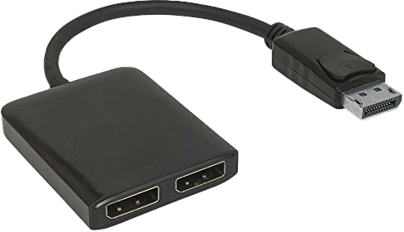
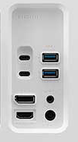
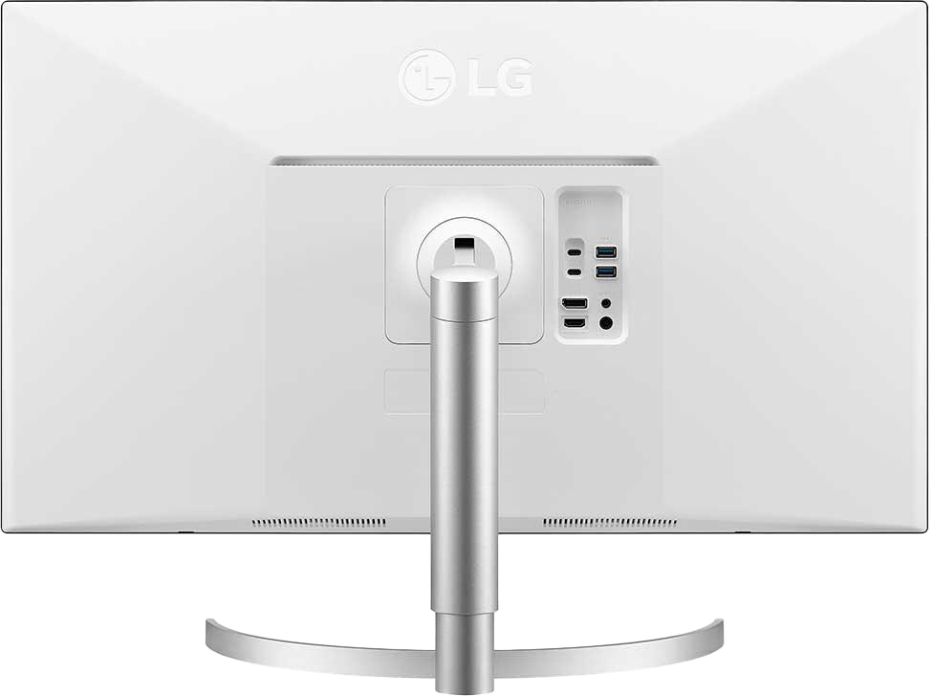
Single Cable/Multiple Monitors
Bandwidth shared between monitors and devices
DisplayPort
Out port
Monitors are chained together
Monitors require DisplayPort out
DisplayPort Hub/Splitter
Multi-Stream Transport (MST)
Divides signal in two or more
Thunderbolt
Costs a bit of money
Second port outputs to next device
ITFreeTraining.com
© Copyright 2023
Notes:
22:58 In some cases, you may want to run multiple monitors from the same cable. There are essentially two different ways this can be achieved. The first one is using a hub or splitter like device.
DisplayPort supports this using Multi-Stream Transport or MST. MST was added in version 1.2 of DisplayPort in 2010 so has been around for a long time.
Essentially, devices like these divide multiple signals from the one port into two or more ports. You simply plug each monitor into the device. These devices do cost a bit more money, so personally I would look at purchasing a second video adapter as it is the cheaper option. In some cases, for example with a laptop, you may not be able to add a second adapter. In cases like this, if a USB video is not an option, you may want to consider using a device like this. I am not personally against devices like these, it is just that if you want to pay less it may be worth considering other options.
The next option that you can consider is chaining one monitor to the next monitor. So essentially, the computer is plugged into the first monitor and the second monitor is plugged into the first monitor. In order to do this, the monitor requires a DisplayPort Out. This is not that common on monitors, so don’t assume your monitor will have one. Also, you may need to change some settings on your monitor to get it to work. Currently, HDMI allows multiple video signals to be transported on the same cable to be displayed on the same monitor, however it does not support chaining monitors together. An example where this may be used is a CCTV system where you may want to display multiple camera feeds on a single monitor.
The next choice you have is to use Thunderbolt. Thunderbolt is often found with Apple devices but can be used with PCs as well. The Thunderbolt device will need to have a second port which outputs the data to the next device. I say next device, because with Thunderbolt this can be an additional monitor or a Thunderbolt device. For example, an external hard disk can use a Thunderbolt connection.
If you decide to connect multiple monitors together like this, remember that the bandwidth of the connection is shared between the monitors and any devices that are also connected. This will affect the resolutions that your monitors will display. For example, you may be able to run two 4K monitors; however, if you connect four monitors together, you may be limited to 2K for each monitor.
In the case of Thunderbolt, even if you are only using a single monitor, if you attach a hard disk to the monitor, the hard disk may not perform as fast as if the hard disk was connected directly to the computer. Keep this in mind if you use this approach. At the end of the day, all the data has to go through one cable and there is a limited amount of bandwidth in the cable.
If one video card can handle all the monitors you need, this may be a good solution. If not, you will need to add an additional video card. I have already looked at adding a second video card of lower performance, so I will now have a look at what happens when you want to add a second video card but want to get the same performance as the first video card.

Slide 12
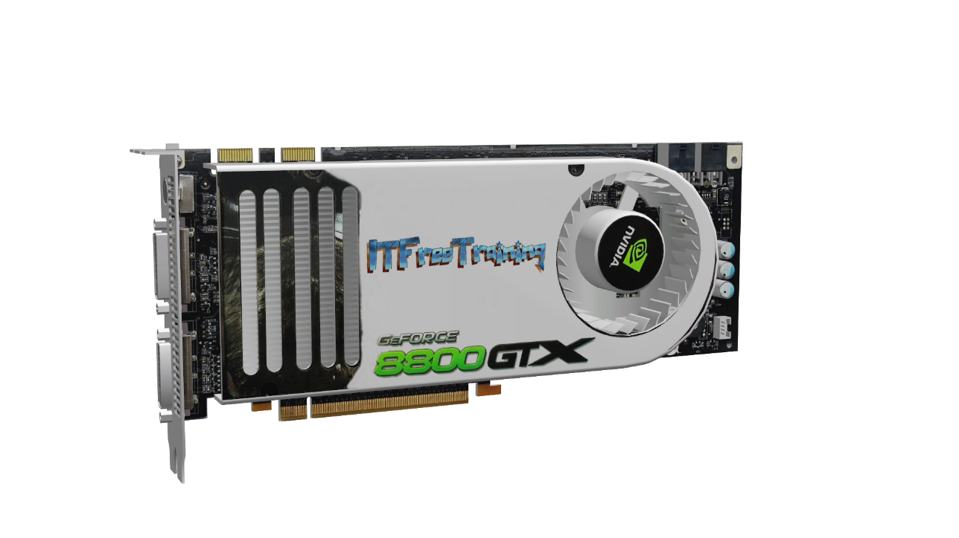
Equal Performance
Video cards need to be the same
Video card runs
one monitor
SLI or CrossFire
Video card runs
one monitor
Make sure cards are in slots of similar performance
ITFreeTraining.com
© Copyright 2023
Notes:
26:27 In order to get equal performance from two or more video cards, you basically need the video cards to be the same. In some cases it may not be possible to get two identical video cards, particularly if there is a delay between purchases, but essentially if they have the same GPU and have the same amount of memory on them, their performance should be pretty similar.
In order to utilize two or more video cards, you can use them independently of each other or combine them together. When they are used independently of each other (such as in this configuration), each video card will run one monitor. Depending on what your requirements are, this may work quite well. The advantage of a setup like this is all the performance of that video card will be used by that monitor.
You could also configure the video cards to work together. This is known as SLI with Nvidia and Crossfire with AMD. When you combine two video cards together, you don’t get double the performance, due to the additional overhead required for the two video cards to coordinate with each other. If you were to add a third, the law of diminishing returns applies. You essentially get some extra performance but by the time it gets to the third video card, don’t be surprised if the performance gain is less than 50%. For this reason, combining more than two video cards together is not always supported. Essentially, given the small amount of performance increase it is often considered not worth it. Also, given the extra cost of the third video card, the extra software testing required, and the lack of performance gain, you can understand why manufacturers might not support this configuration. For this reason, you may find that if more than two video cards are supported in hardware, it is an unsupported configuration in software. In other words, you may be able to get it to work, but no software will support it and the manufacturer won’t help you getting it to work if you run into problems, which you more than likely will.
On the newer Nvidia cards, the SLI hardware is still present on the video card; however, Nvidia does not support it. So, if you are currently buying the newest Nvidia cards, don’t expect SLI to work or be supported.
To get the best performance, make sure the video cards are installed in slots of similar performance. They should both be installed in PCI Express slots of the same version. For example, both being installed in PCI Express version 3 slots. Next, both video cards should have the same number of lanes. In some cases, this will not be possible due to limitations of the motherboard or the CPU used. Currently, video cards don’t utilize all the bandwidth that 16 lanes supplies. So, if your hardware only supports eight lanes, this hopefully won’t cause performance problems. Even if one video card is running with 16 lanes and the second with eight, this should be ok, even if using SLI or CrossFire. Lanes are responsible for getting data to the video cards; however, the PCI version number will determine the speed the video cards run at. So always make sure the video cards are in PCI Express slots of the same version - matching lanes where possible or otherwise allocating as many lanes as you can to each video card.
When you start using multiple monitors together, there are some other considerations to be aware of.

Slide 13
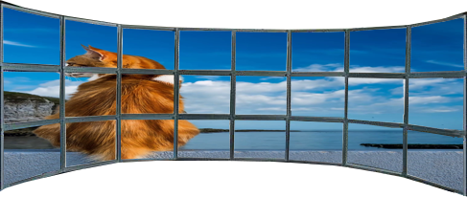
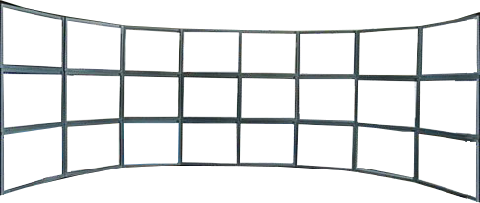
Privacy/Viewing Angles
Monitors may need to be placed in a curve
More privacy concerns when using more screens
ITFreeTraining.com
© Copyright 2023
Notes:
29:56 Let’s consider an example of where 24 monitors have been configured to use the same computer. It is difficult to find a computer that has enough slots and video cards with enough video plugs to run this many monitors, but it is possible to have a configuration like this using USB video adapters.
If you consider that the user is in the middle, remember that LCD monitors have a viewing angle. To get the best result, consider placing the monitors on a curve. If you place them in a straight line, the outer monitors will appear darker than the inner monitors when viewed from the center.
More monitors also mean more privacy concerns. Essentially it is a lot easier for people around the office to see information on the screens than when only a single monitor is used. Also, devices like privacy screens are harder to setup on monitors when they are not viewed from directly in front, since privacy screens make it so only the user sitting directly in front can see the screen - something to consider if you are displaying information on the screens that needs to remain private.
The last thing to consider when setting up multiple monitors is cable selection.

Slide 14
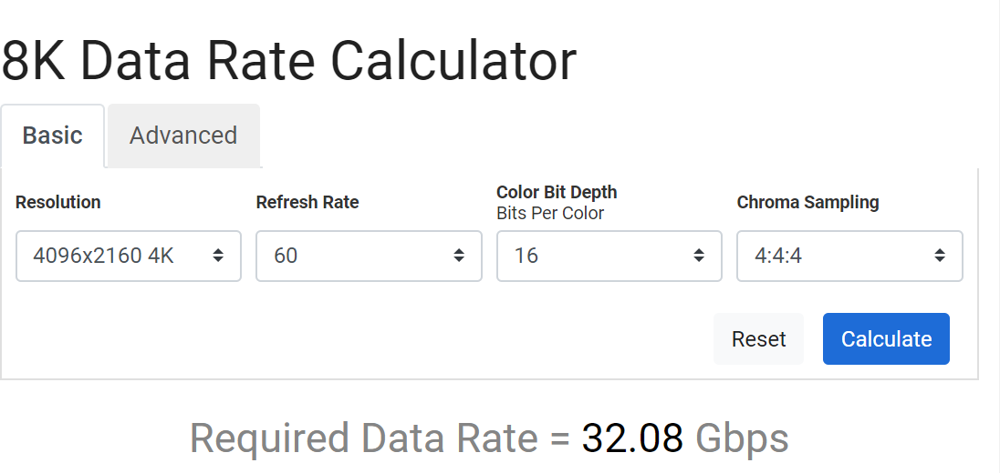
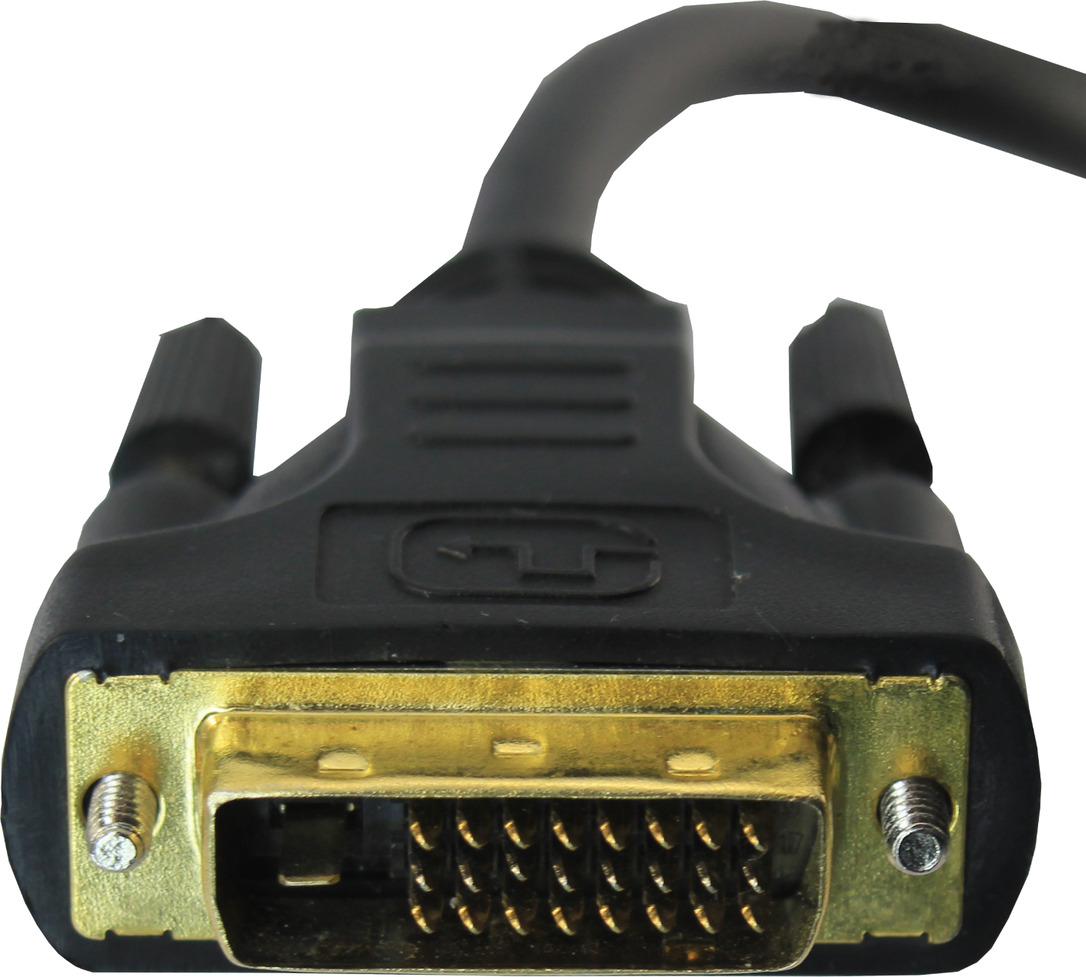
Cable Selection
Not all cables are equal
https://www.extron.com/product/videotools.aspx
HDMI/DisplayPort
Check version
Max resolution
Data throughput
DVI
Higher resolutions
require dual link
ITFreeTraining.com
© Copyright 2023
Notes:
31:07 The important point to remember with cables is that not all cables are created equal. If you purchase a DisplayPort or HDMI cable, there are a few things to check for on the packaging before you buy.
On the packaging should be the version that the cable supports. Also included should be the max resolution the cable supports. Max resolution can be a little misleading as it depends on the frame rate that is being used. For example, a cable may say it supports 4K, however it only supports a frame rate of 30Hz. The other consideration is the color sampling that is used. Higher color sampling will mean more data needs to be transferred over the cable.
In some cases, the cable may also include information on data throughput. This rating will be how much data the cable will support, which is also a good indicator of what resolutions the cable will support. However, not all cables will include this.
To get an idea of how much data throughput you will need, you can use an online calculator like this one. Calculators like this will allow you to put in the resolution, frame rate, color depth and color sampling. This will give you an indication of how much data you will need. As long as the cable supports that much data or more, you are good to go.
If you are using a DVI connector, higher resolutions will require a dual-link cable. A dual-link DVI cable essentially means that it can transmit two signals at once. This extra signal is required for higher resolutions.
When in doubt, use the cables that came with the monitor. These will work since they are designed to work with that monitor. If you find that the resolution that you want to use is not working, consider changing the cables as the cables you are using may not support the amount of data required.

Slide 15
Subscribe
Next video
Video content: https://ITFreeTraining.com/ap/2a95
© Copyright 2023
Notes:
33:04 That concludes this video from ITFreeTraining on multiple monitors. If you decide to give it a go, I wish you the best of luck. Until the next video from us, I would like to thank you for watching.
References
“The Official CompTIA A+ Core Study Guide (Exam 220-1001)” Chapter 5 Position 132 - 144
“CompTIA A+ Certification exam guide. Tenth edition” Pages 791 – 792
“Picture: 24 monitor set up” https://www.pinterest.com.au/pin/156992736983859365/
“Video: Cat near ocean” https://pixabay.com/videos/cat-ocean-sea-water-coast-clouds-33328/
“Picture: Back of cat” https://pixabay.com/photos/cat-pet-domestic-cat-move-back-642197/
Credits
Trainer: Austin Mason http://ITFreeTraining.com
Voice Talent: HP Lewis http://hplewis.com
Quality Assurance: Brett Batson http://www.pbb-proofreading.uk

