Slide 1
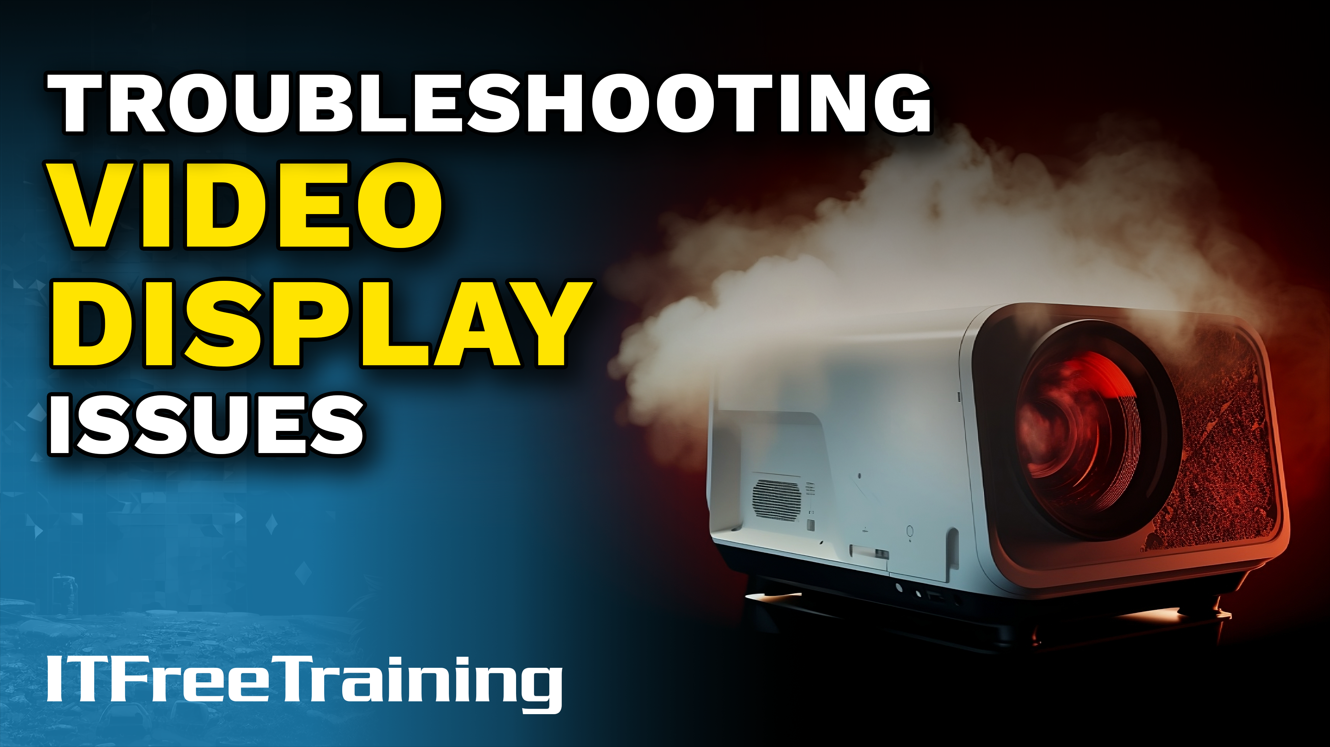
Notes:
Let’s have a look at how to fix video display issues.

Slide 2
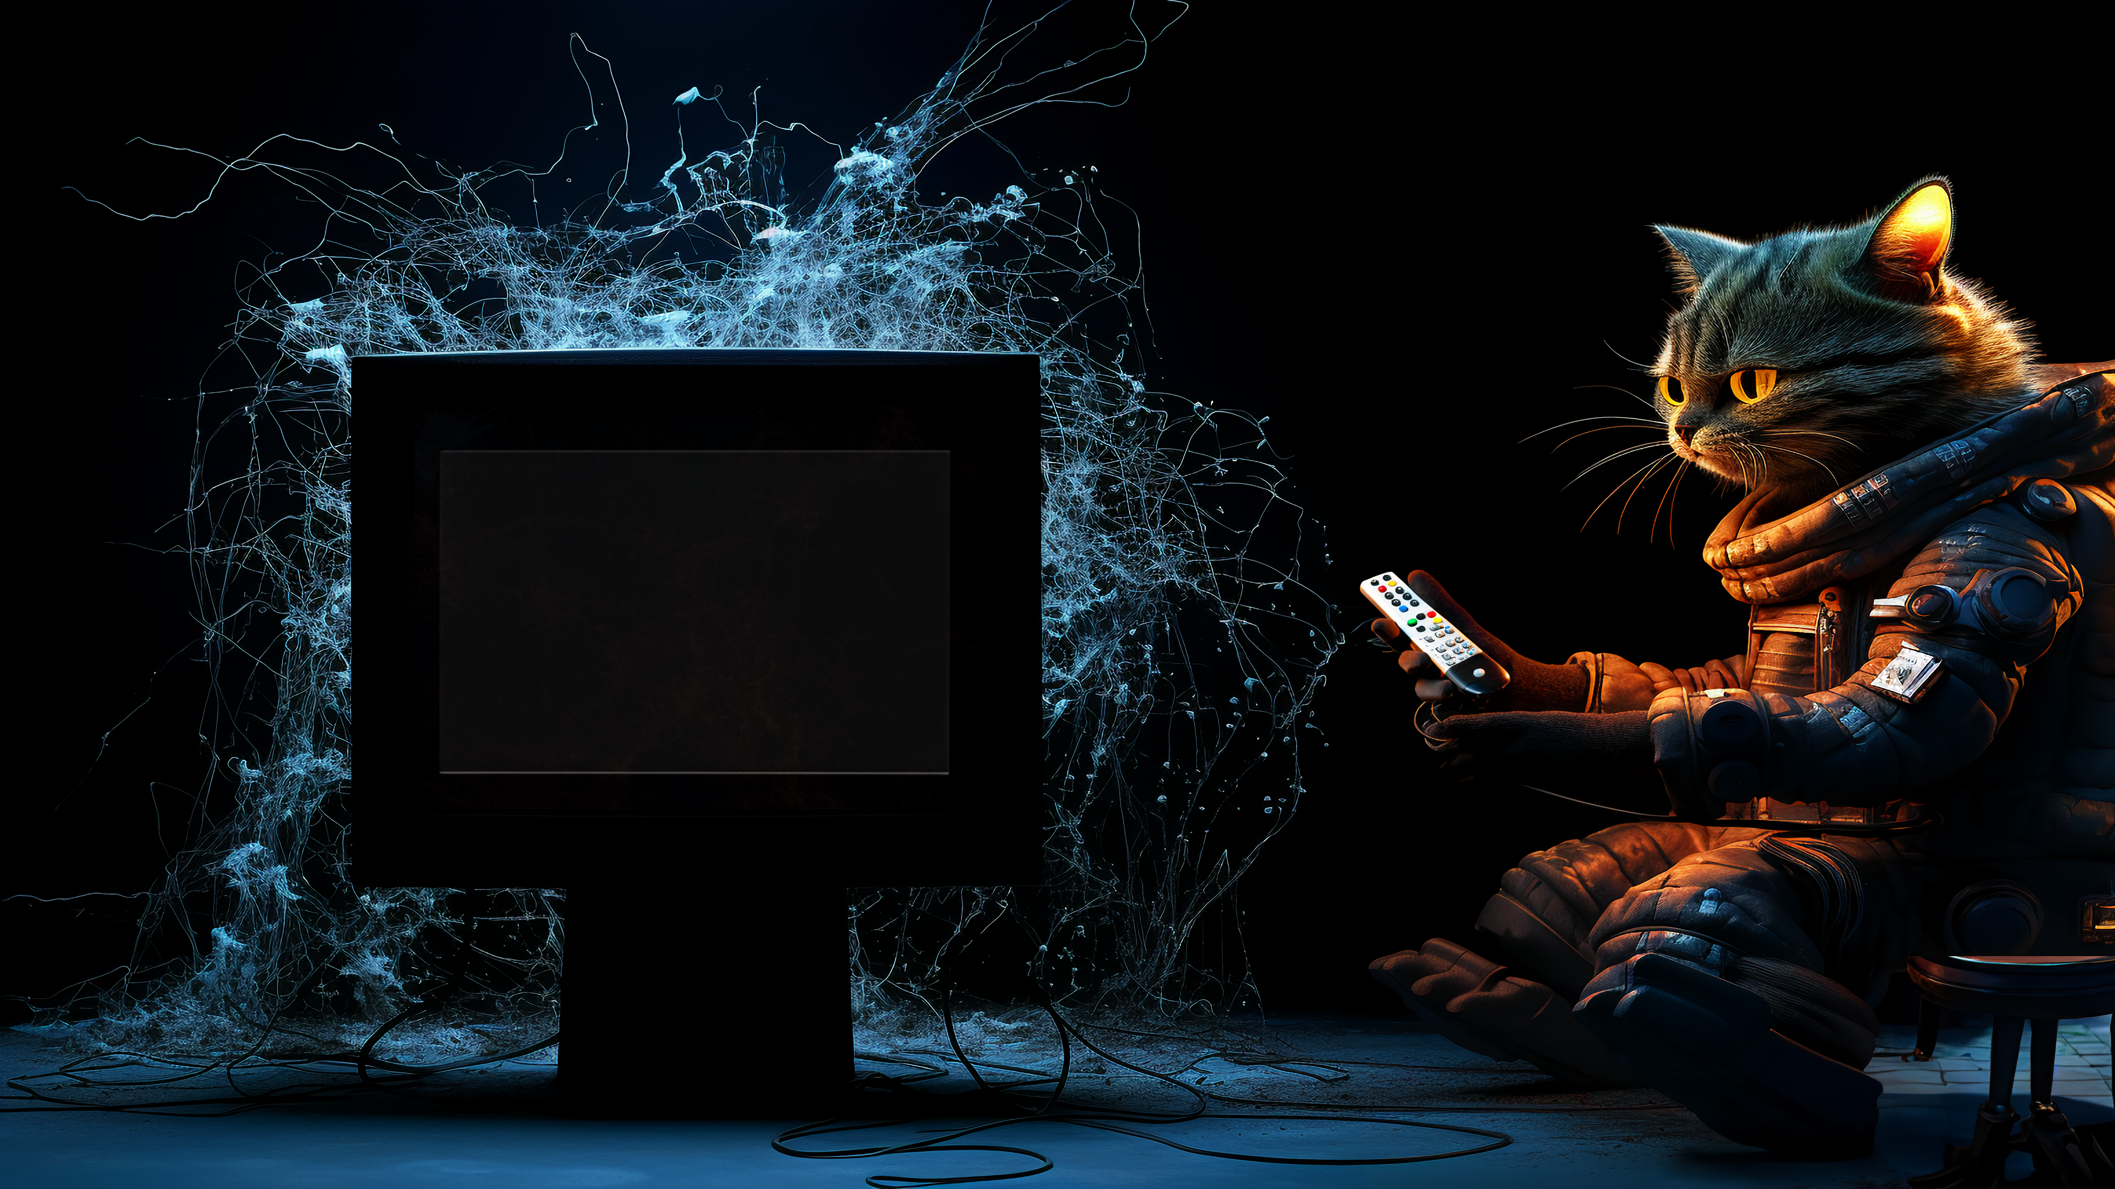
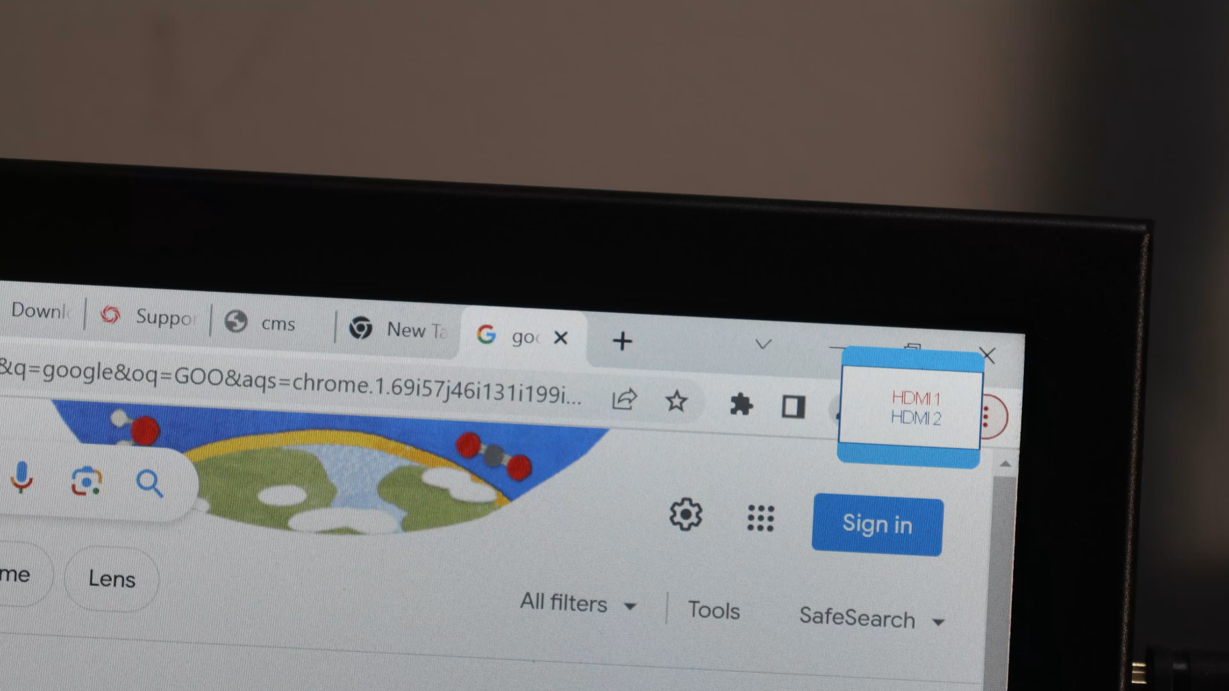
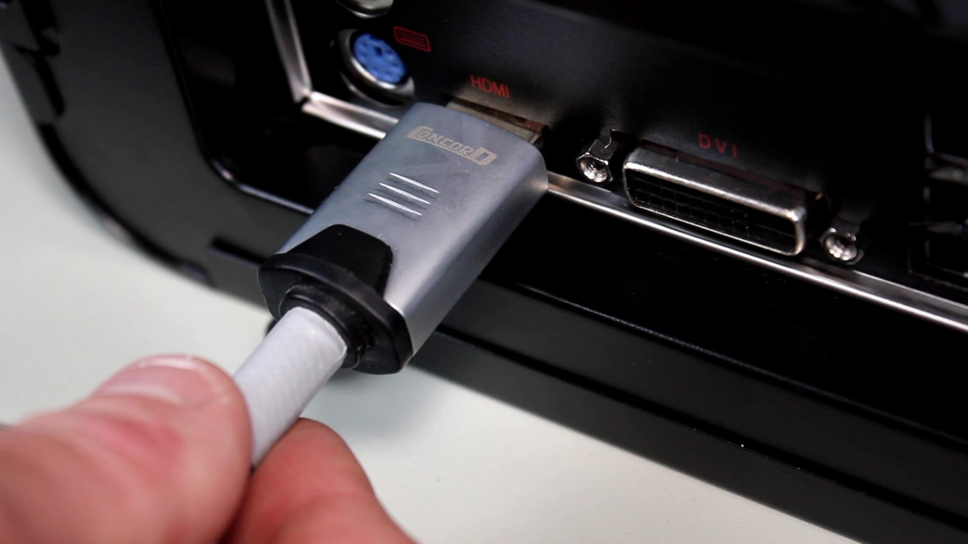
Missing Video
Check cables plugged in
Check video source
ITFreeTraining.com
© Copyright 2024
Notes:
00:04 One of the most common problems you will come across is missing video. The first step in troubleshooting is to check that cables are plugged in. This includes the power cables and making sure the monitor is on. Cables can appear to be plugged in, however, even if they are out by a little bit, you won’t get a video signal. So, the first step is, make sure they are plugged in. Just to make sure, I will often pull the cable out and then plug it back in again, making sure it is all the way in.
In the next step, I would check that the video source is correct. Most monitors will have multiple input ports. For this monitor, there are two. So, I will unplug it from one port and plug it into the other one. If you have a remote control, you could use the remote control, but there is an easier way that I will show you in a moment.
In this example, the monitor is off. So, all I need to do is switch it on. Of course, this is one of the first things you should check for. When you check the cables are plugged in, check the power cables are plugged in and the power is on. Even if the power was on, often I will switch the monitor off and back on again. On most monitors this will trigger it to test each input port to see if it is connected. This can be easier than cycling through the input ports looking for the one that is connected.
On your monitor, there should be a button or an option to change the input source. For this monitor, there is a button on the back which when pressed will cycle between the two input ports.
In a lot of cases, you will find the problem is that a cable has come out or the monitor is set to the wrong input port. Assuming of course it is plugged in and switched on, which I assume you would have checked before doing anything else!

Slide 3
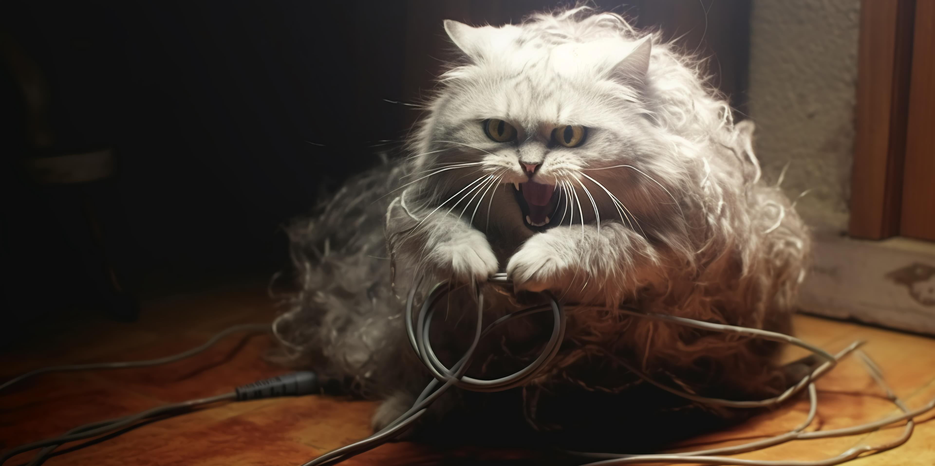
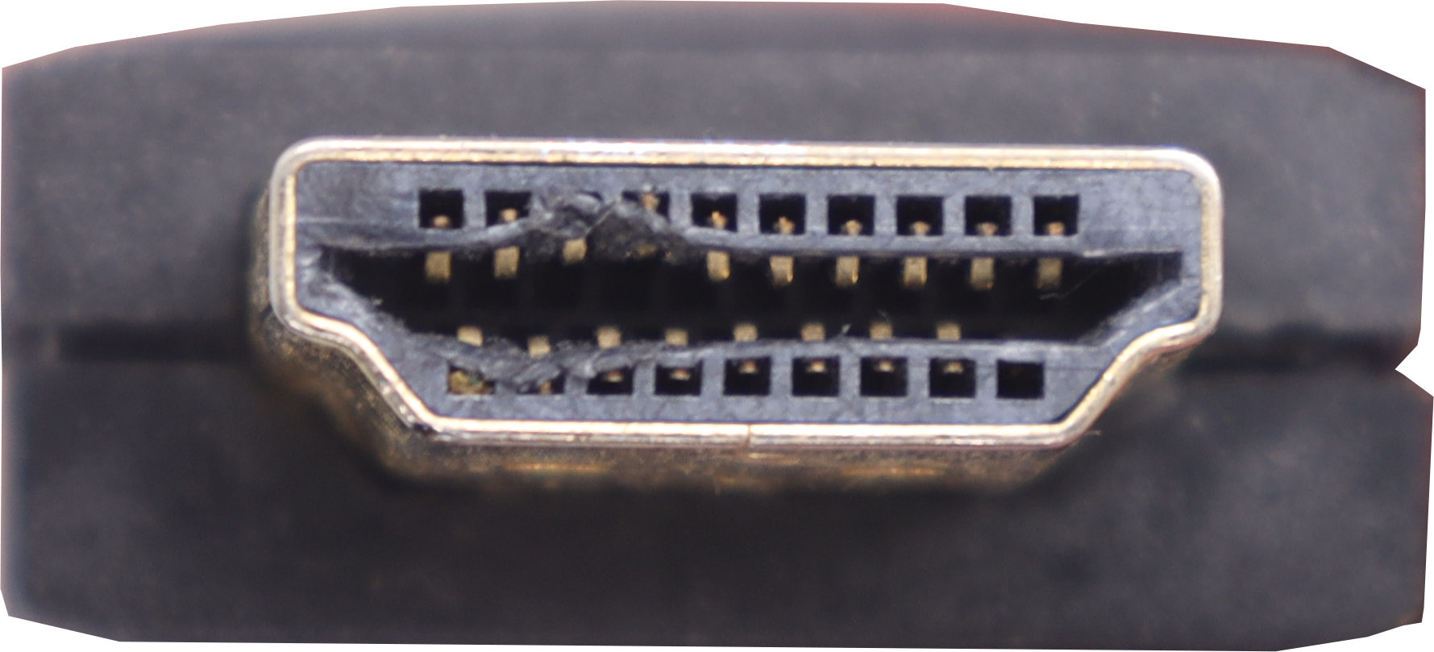
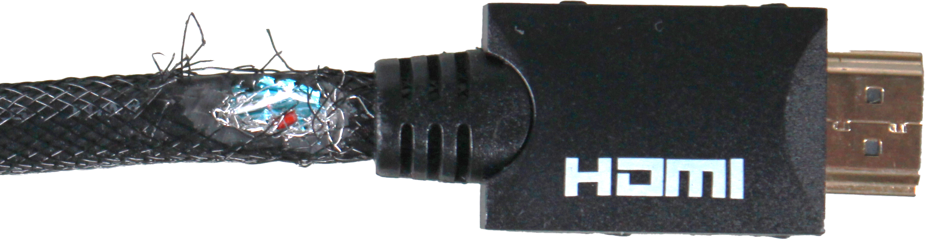
Damaged Cables
Check if cable is damaged
Sometimes damage is noticeable
Test by using a known good cable
ITFreeTraining.com
© Copyright 2024
Notes:
01:45 If you are not getting a video signal, or an intermittent connection or distortion, it is possible that you are dealing with a damaged cable. Modern cables often use blade-style connectors, which offer improved durability over older pin-style versions. Despite their enhanced robustness, blade connectors are not impervious to damage. Consequently, it's wise to conduct a detailed inspection to verify that your connectors remain in optimal condition.
Sometimes the damage is noticeable, as in these examples. At other times you may not be able to see the damage. To test the cable, use a known good cable. If the known good cable works, then there is something wrong with the other one.

Slide 4
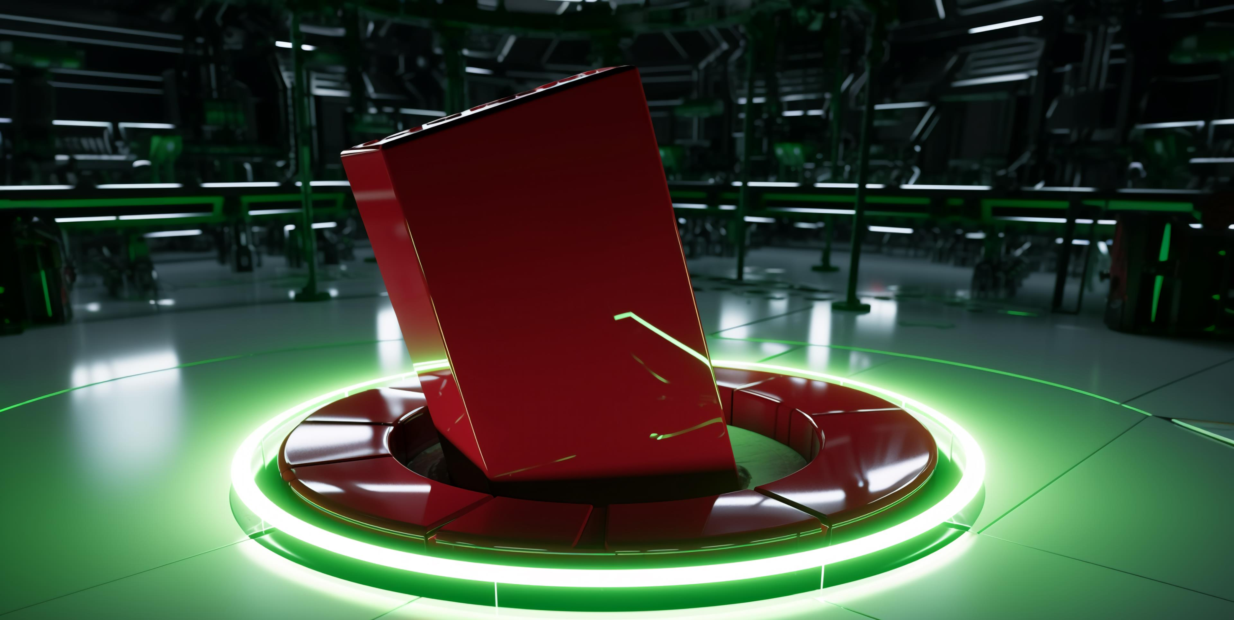
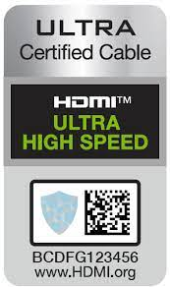
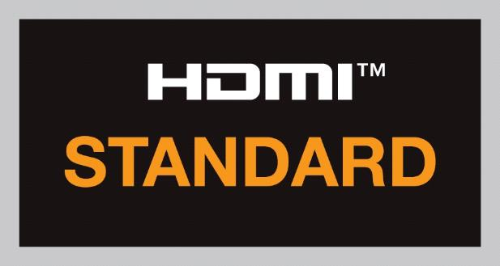



Cable Compatibility
HDMI standards
Test by using a known good cable
+ eARC
4.95 GB/s
10.2 GB/s
18 Gbps
48 Gbps
Category 1
Category 2
Category 3
Ver 1.4
Ver 2.0
Ver 2.1
ITFreeTraining.com
© Copyright 2024
Notes:
02:28 Problems can also occur with cable compatibility. For example, HDMI has a number of different standard cables. For the exam, you won’t need to know the different cable standards, but you may get a question that will test to see if you understand that some cables are of better quality than others. Better-quality cables allow for high data speeds, or as I like to say, not all cables are created equal.
Cable manufacturers don’t have to make their cables to these standards, but if you do see logos like these, you know what standard the cable was designed for. If the cable does not meet a particular standard, have a look at the specifications of the cable and see if the max data speed is listed. This will allow you to determine what maximum resolution the cable supports.
As before, test if this is the problem using a known good cable. Generally, the best cable to test a monitor with is the cable that came with the monitor if it is available. Unfortunately, there are a lot of cheap cables on the market, and often you won’t be able to tell what the cable supports by looking at it. Don’t assume, test the cable to make sure that it is working and that it supports the resolution that you are trying to use.

Slide 5
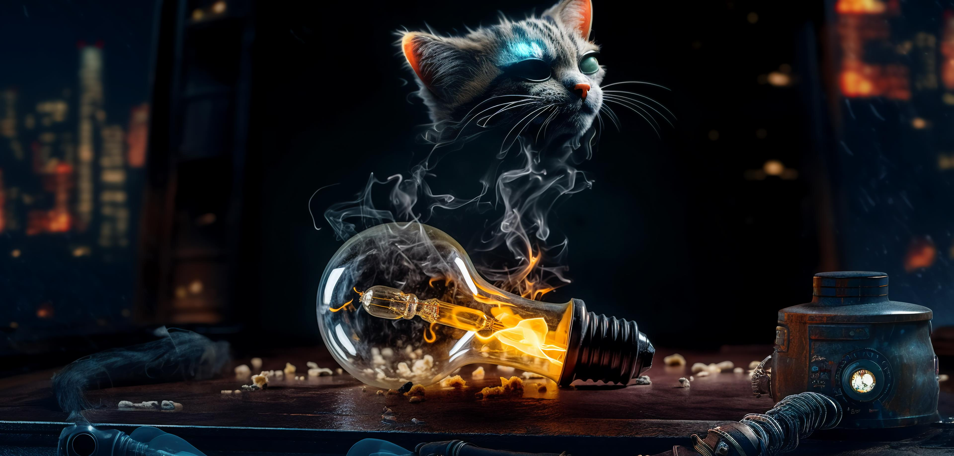

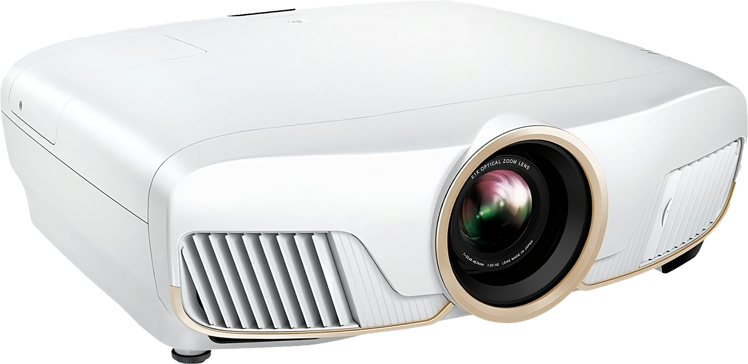
Burned-Out-Bulb Issues
Video projector bulbs have a limited lifetime
When image starts going dim, bulb will need to be replaced
Do not handle when hot
Allow to cool
ITFreeTraining.com
© Copyright 2024
Notes:
03:40 If you are using a video projector, video projector bulbs have a limited lifetime. When the bulb starts coming to the end of its lifetime the image will start to go dim. Some video projectors will give you a message when the bulb starts reaching this stage.
When replacing or handling the bulb from a video projector, do not handle it when it is hot, allow it to cool down first. If you handle it when it is hot, the bulb will be a lot more fragile, making it much more likely to break. Even if you are replacing it, you don’t want the bulb to break while you are trying to remove it and glass to fall inside the projector.

Slide 6
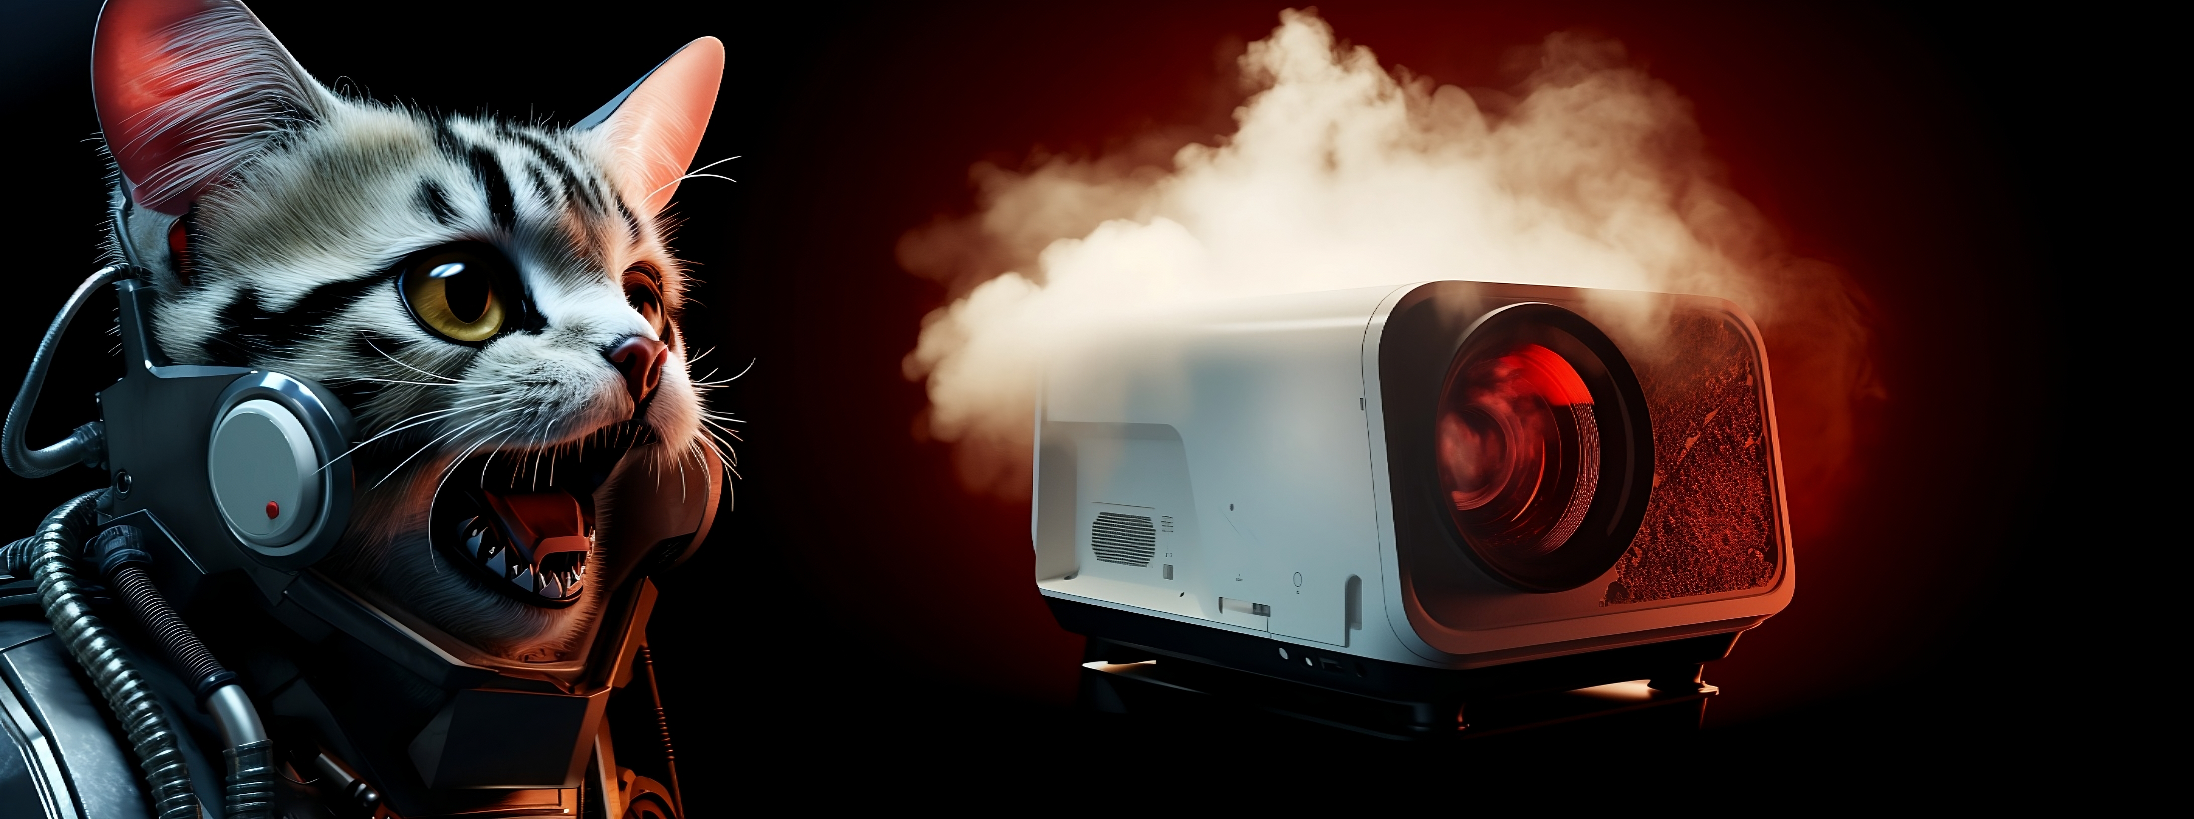
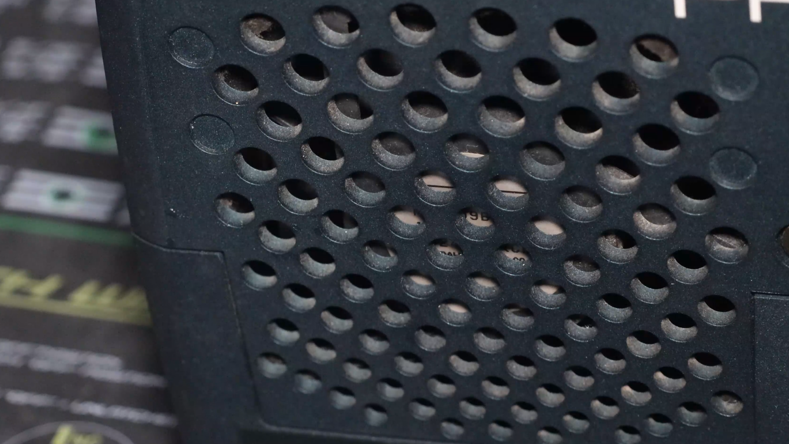
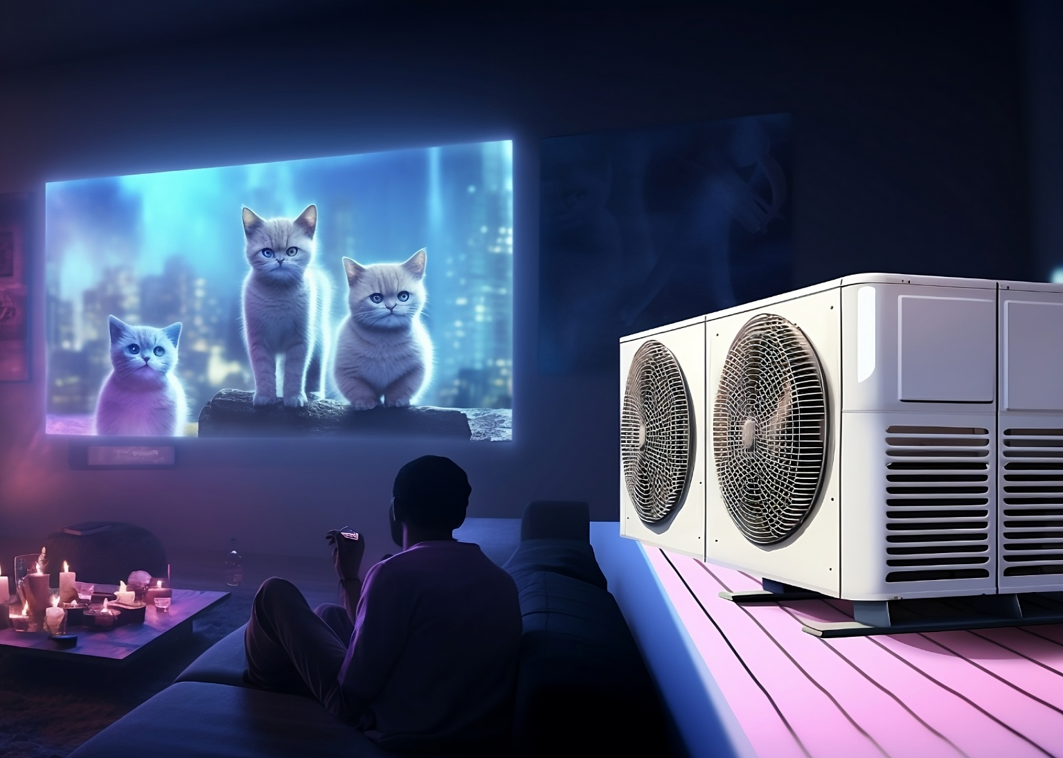
Intermittent Projector Shutdown
Projector will shut down if it overheats
Keep vents clear
Use in areas that are not too hot
ITFreeTraining.com
© Copyright 2024
Notes:
04:15 If you are having trouble with your projector shutting down, it is most likely overheating. The projector will shut down if it overheats. To keep the projector cool, make sure the air vents are not obstructed. Some projectors will have air vents on the bottom of the projector, so it is not recommended to put the projector on carpet as this will block them.
Also, use the projector in rooms that are not too hot. If the room is too hot, the projector’s fan will just be pulling in hot air which won’t cool it down.

Slide 7
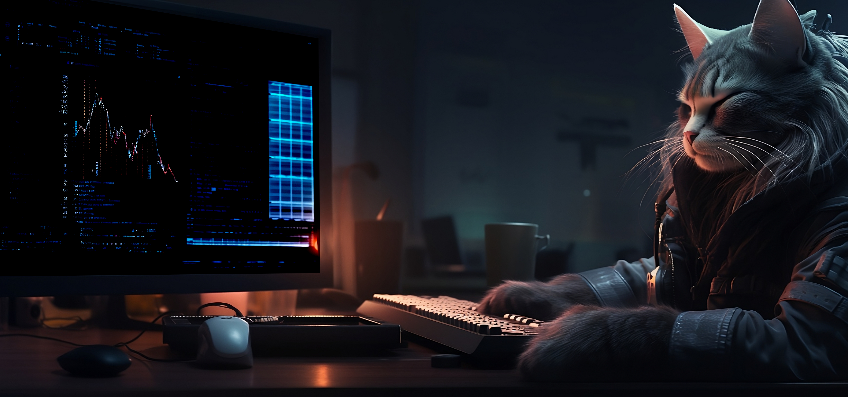
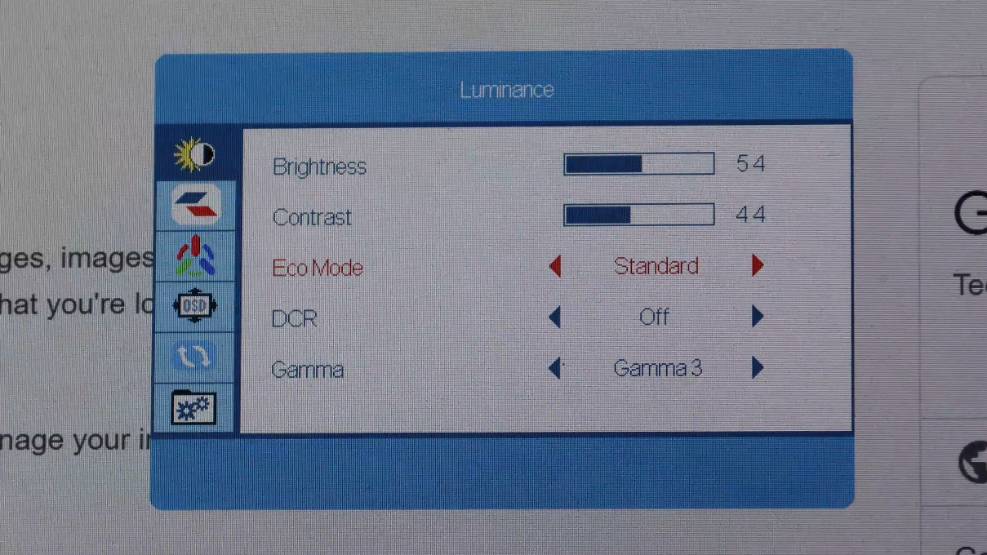
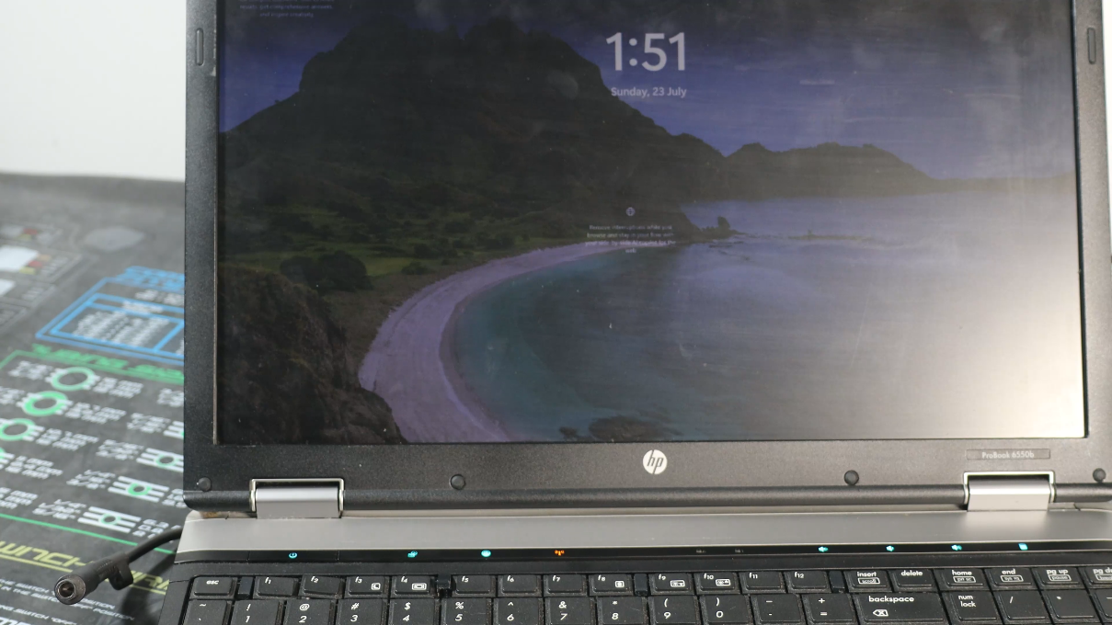
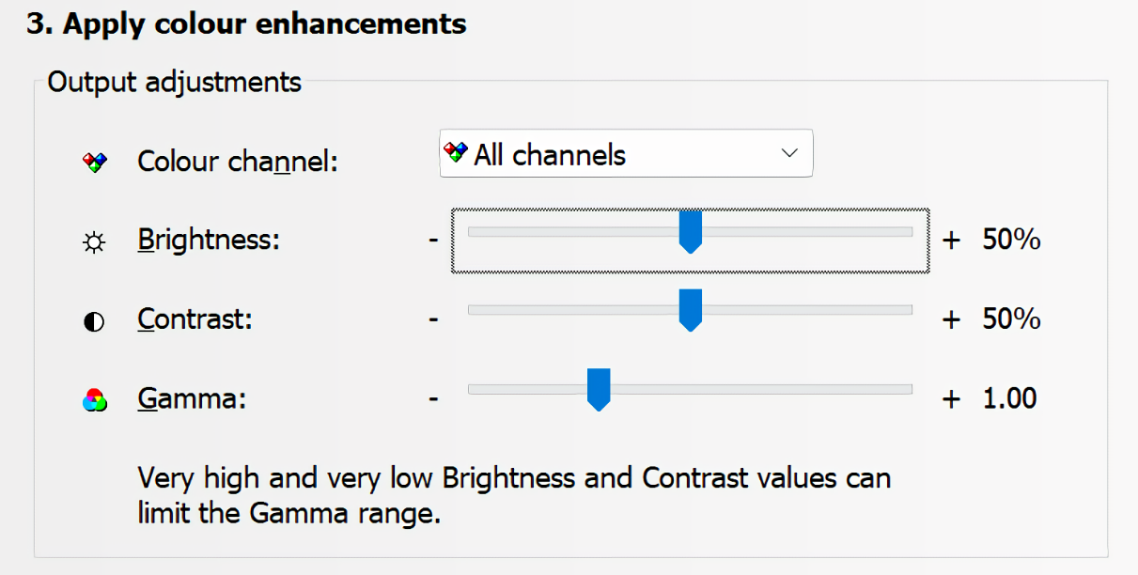
Dim Image
On-Screen Display
(OSD)
Power saving
Change by OS
ITFreeTraining.com
© Copyright 2024
Notes:
04:43 One of the problems you may come across is a dim image. One of the first things that I check is the monitor using the On-Screen display or OSD. OSD displays a menu on the screen so you can adjust the settings. To activate the menu, usually you press a button on the front or the back of the monitor and the menu will appear.
You can see in this example, the brightness and contrast are set very low, and this is the reason the image appears dim. I will adjust them, so they are higher. Usually, I will make the brightness and contrast values pretty similar in value as that tends to give good results, but it ultimately depends on your own personal preference.
You will notice below this is a setting called ECO mode. On your monitor it may be called something different. When I change this setting, it changes the other settings to pre-determined values. Many monitors will come with pre-defined settings like this. They are configured with different objectives in mind, for example, some may be designed to reduce power consumption and this makes the screen look a little dimmer. If your monitor does not quite look right, have a look at these settings, as you may need to make some adjustments.
There are other options that can cause a dim screen. For example, it is not uncommon for laptops to enter a power saving mode which may dim the screen if the battery is low or if the power cable is unplugged. When I see a laptop that has a dim screen, one of the first things I check for is that the power cable is plugged in. Sometimes the problem is the power cable has just come loose.
The screen can also be made dim through software in the operating system. Shown here is the control panel for Nvidia which allows you to change the brightness, contrast and gamma of the screen, all of which can make the screen look dim. In some cases, there may be multiple places in the OS and other software where these settings can be changed, so you may need to have a good look around.

Slide 8
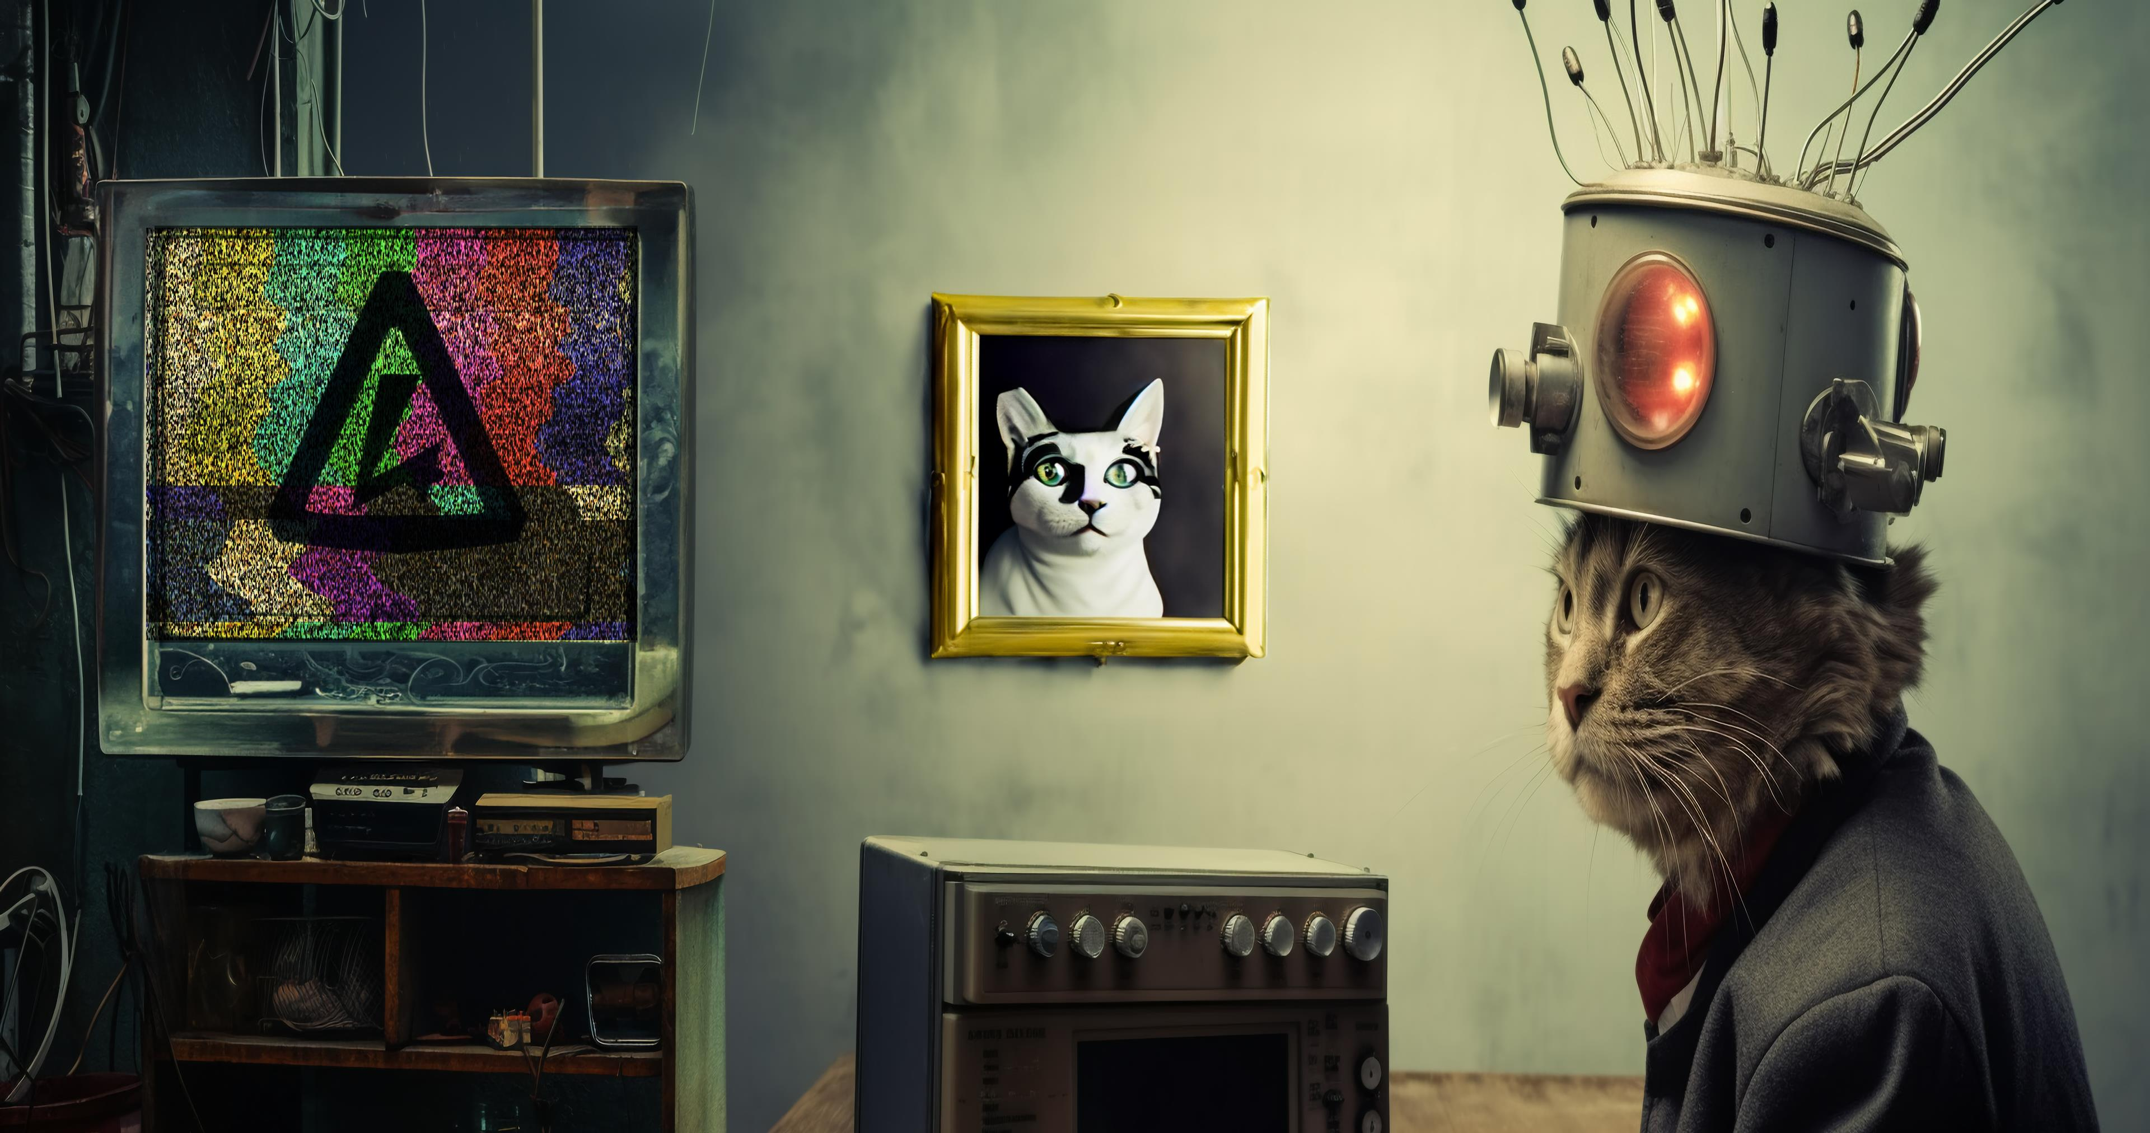
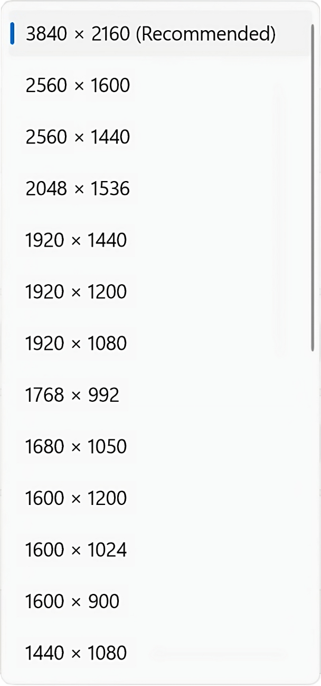


Fuzzy Image
Usually monitor resolution not set to native resolution
Often caused by video/monitor drivers not installed or configured correctly
Set to native
Fuzzy, not set to native
Set to recommended
ITFreeTraining.com
© Copyright 2024
Notes:
06:38 If your image is a little fuzzy, this is usually caused by the monitor not being set to its native resolution. For example, the top desktop is the correct resolution and the bottom one is not set correctly. Depending what quality setting you use to look at this video, you should be able to see the bottom one is a little fuzzy while the top one is very crisp.
This problem is usually caused by a video driver or monitor driver not installed or not configured correctly. When the video driver is not installed or not working, Windows will use the basic video driver, which depending on your computer may not support higher resolutions. If Windows does not have the correct monitor driver, it can reduce the maximum video resolution to that which the computer supports. When I am having problems like this, I check the video display driver is installed correctly and also check the monitor device driver is working correctly.
In Windows, the native resolution will be shown as ‘Recommended’, assuming the video and monitor drivers are working correctly. If you see it set to anything else, you should change it to this setting to get the best results.

Slide 9
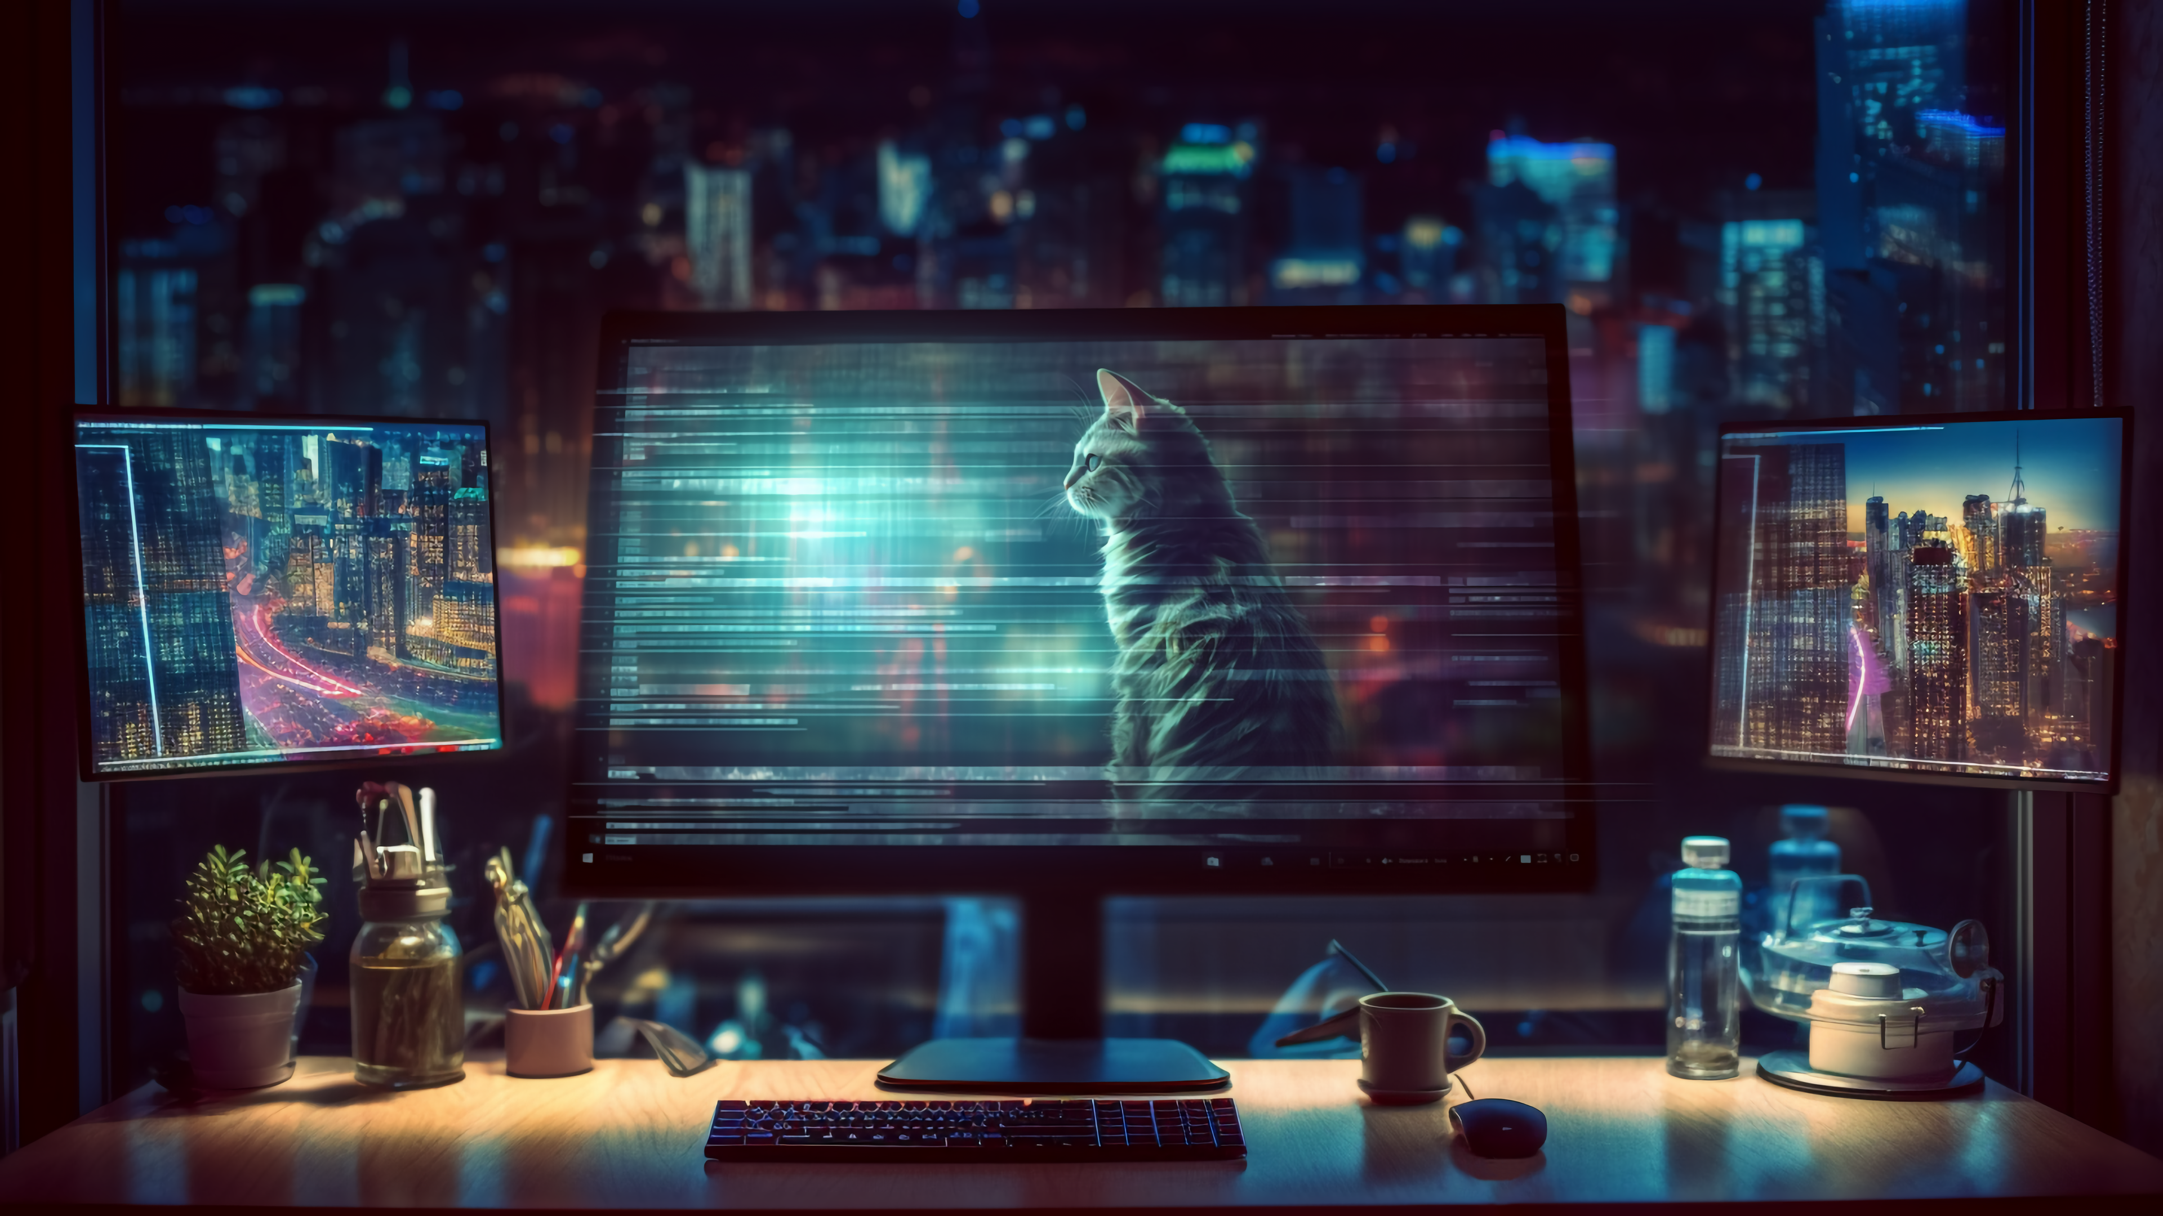
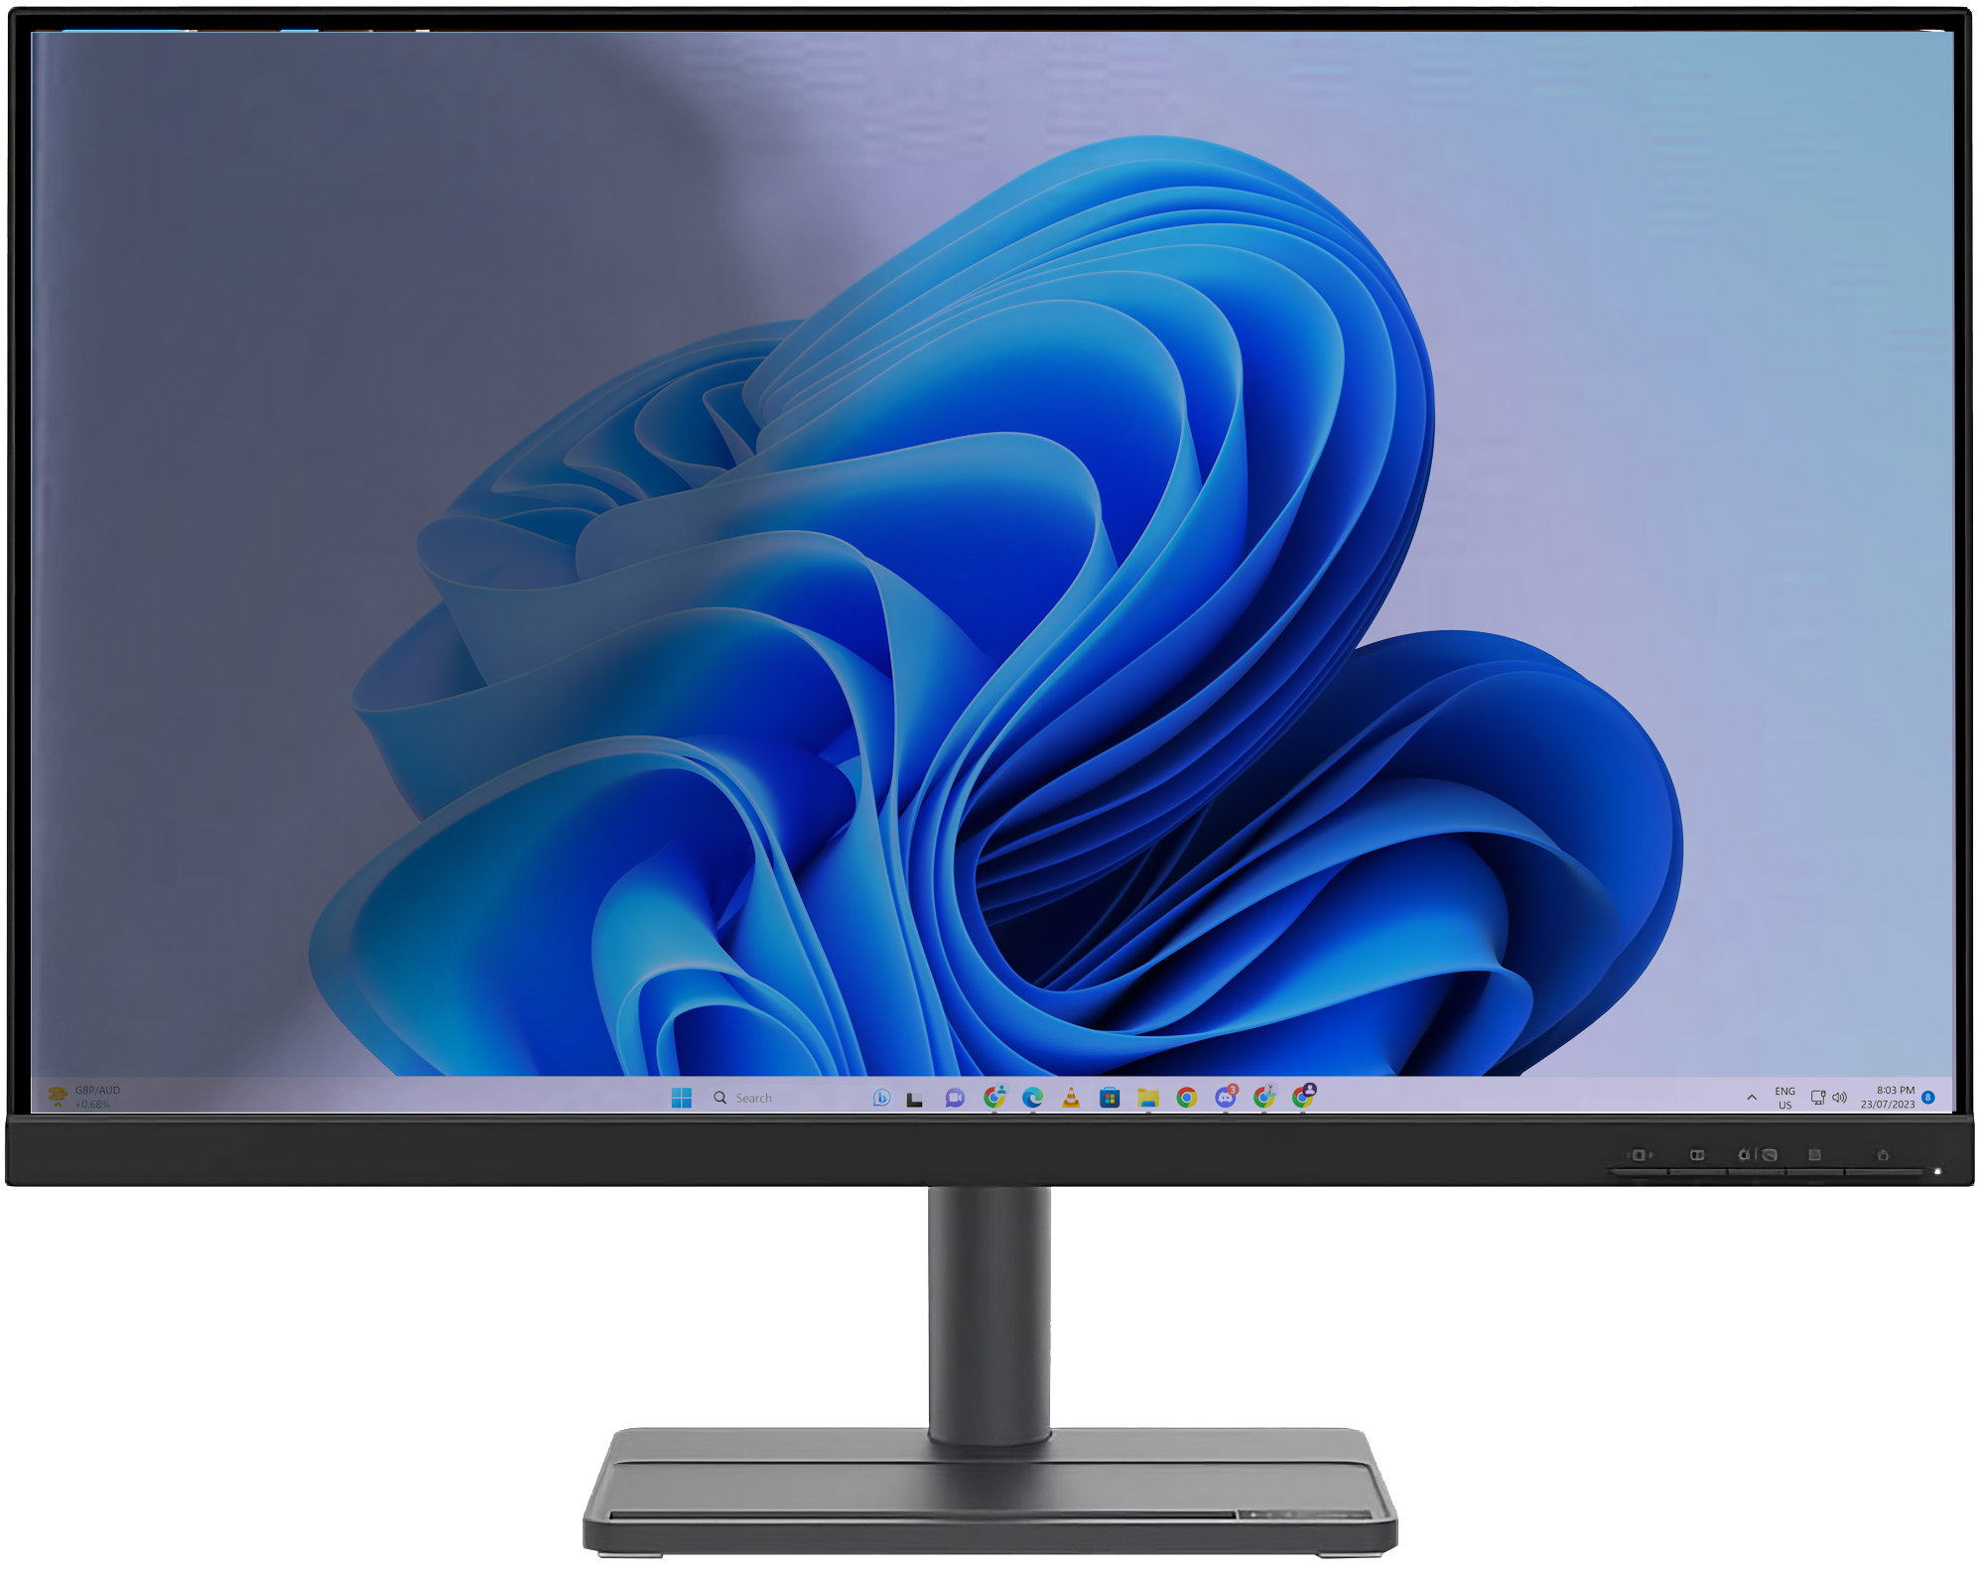
Flickering/Flashing/Distortion
Check cables plugged in
Uneven/flickering backlight
Poor connection/poor signal
Backlight failing or power problem
ITFreeTraining.com
© Copyright 2024
Notes:
07:44 If your screen is flickering, flashing or there is distortion on the screen, I would first check the cable is plugged in correctly. A poor connection means a poor signal. Like most problems with computers, swap with known good parts to determine what the problem is. When it comes to video cards, try different video cables.
Often, I will try a shorter video cable as they will often work better than a longer one. Keep in mind you are trying to work out what is causing the problem. If you work out the problem is a long video cable, once you know this is the case, you can work on a solution. Perhaps you need a better-quality cable or a device that will boost the signal.
If you have problems with uneven or flickering backlight, it may be an indication that the backlight is failing or there is a power problem. The backlight’s job is to evenly light the back of the monitor. If it starts failing, the screen may no longer be evenly lit. Capacitors in the power supply are required to provide an even power to the monitor, so if you start to see flickering, it may be a problem with a failing power supply. In some cases, if the monitor has power problems, it will randomly switch itself off.

Slide 10
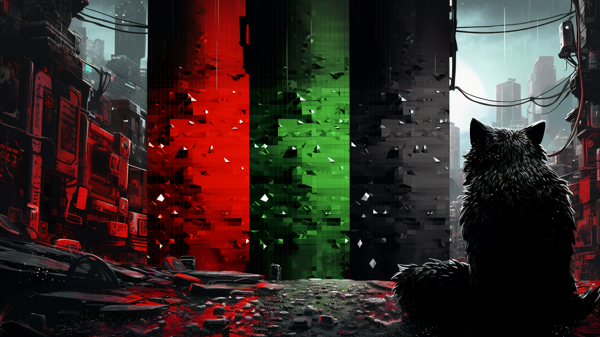
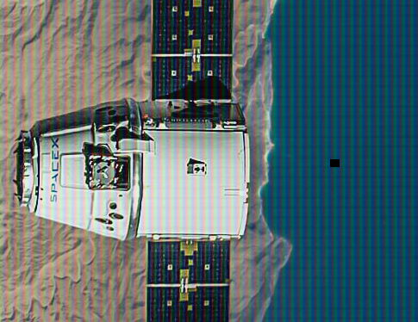
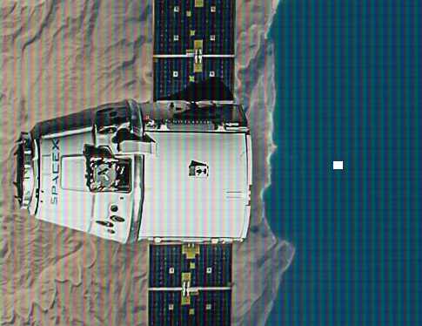
Dead Pixels
Pixel no longer functions correctly
Fully dead pixel will always appear black or white depending on the monitor
ITFreeTraining.com
© Copyright 2024
Notes:
08:55 Dead pixels occur when one or more pixels on your monitor ceases to function properly. Each pixel consists of red, green and blue sub-pixels. If all three components fail, the pixel will appear either black or white, depending on the monitor's design. In monitors where blocking light is the default state, a non-functioning pixel will appear black. Conversely, in monitors that naturally allow light to pass through, a dead pixel will show up as white. This is because a broken pixel loses its ability to either permit or obstruct light and reverts to the monitor's inherent default state.
Since each pixel is made of three different components, it is possible for just one color to fail, so for example, the red component may fail. When this occurs, the pixel may look off color depending on how much red the pixel was trying to display. If you are looking for these kinds of pixels, make the screen all red, all green and all blue in turn to see if you can spot anything.
Upon purchasing a new monitor, it is generally expected to be free of dead pixels. However, manufacturing standards permit a minimal number of dead pixels depending on the monitor's quality class. Higher-class monitors, which guarantee fewer dead pixels, typically come at a higher price. Ideally, your monitor should have no more than a few dead pixels, if any at all. If you suspect an excessive number of dead pixels, it's advisable to consult the monitor's specifications. Should the number exceed the manufacturer's allowed limit, you may be eligible for a replacement under the product's warranty or return policy.

Slide 11

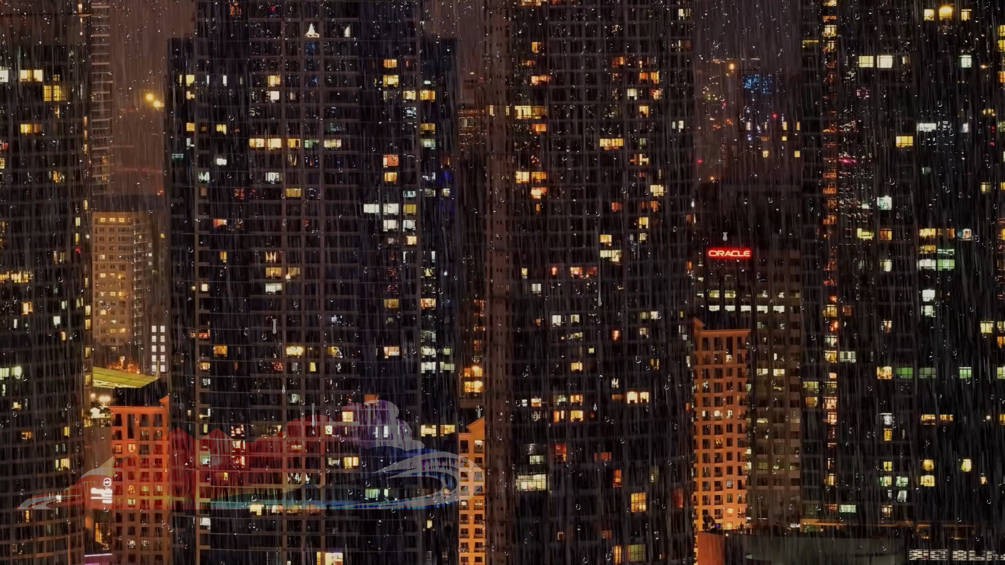
Burn-in
Static image displayed over extended period causes ghost effect
Modern monitors resistant to it (Can still happen)
OLED more prone to burn in
ITFreeTraining.com
© Copyright 2024
Notes:
10:29 Burn-in is when the same static image is displayed over an extended period of time causing a ghost effect. For example, a logo that is always displayed on the screen in the same place. When the logo is displayed you probably won’t notice anything. Since the same image is always displayed, this part of the screen starts to wear out at a different rate to the rest of the screen. When the logo is removed, you will notice that it will still appear on the screen but it will be faint. You may hear this referred to as a ghosting effect.
Modern monitors are generally resistant to burn-in, but the issue can still arise, particularly with newer OLED screens. Although OLED technology has improved, it consists of individual cells that function like tiny light bulbs. Over time, these cells can wear out. If certain cells are consistently illuminated at the same intensity, they may degrade at a different rate compared to the rest of the cells. This uneven wear can lead to the phenomenon known as burn-in, where persistent images or patterns become faintly visible on the screen.
If your monitor displays a variety of different images in its regular usage, burn-in is typically not a concern. However, if the monitor is used as an electronic notice board, frequently showing the same static images, you might need to take proactive measures to prevent burn-in. Continuously displaying static content can lead to premature wear, potentially necessitating an earlier replacement than would otherwise be expected with normal use.

Slide 12
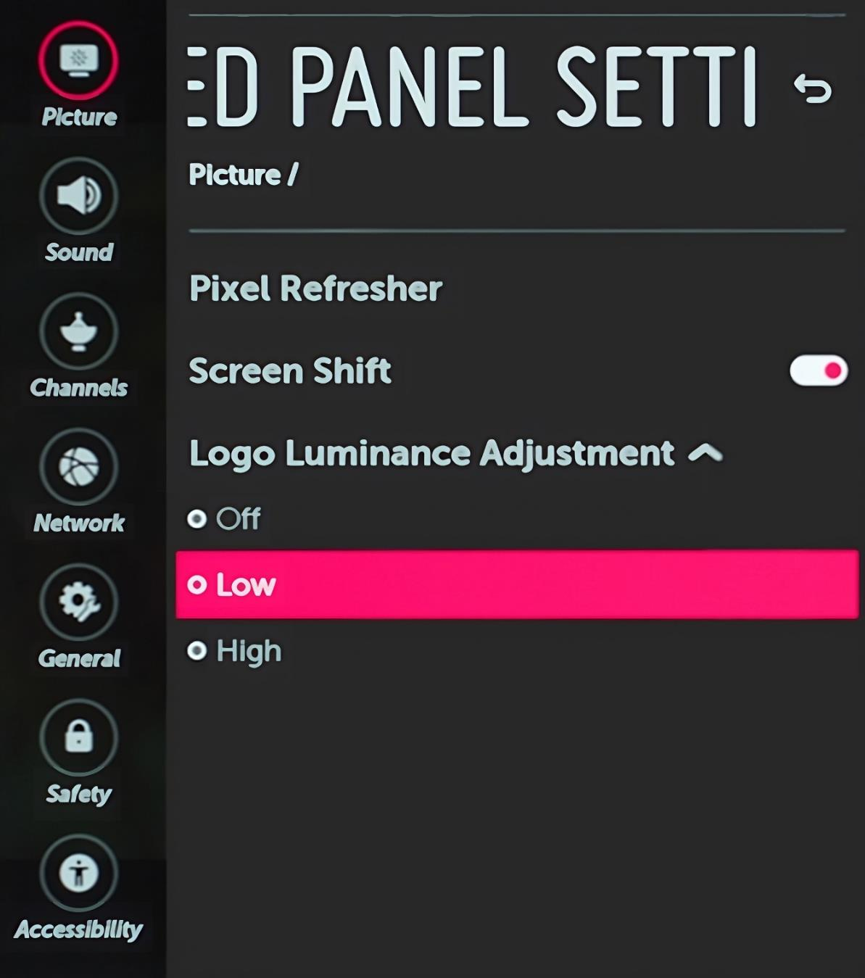



Reduce Burn-in
Monitor may have reduced burn-in options
Periodic slight
movement
Enable logo detect
Reduces brightness
Moves screen around slightly (You won’t notice)
ITFreeTraining.com
© Copyright 2024
Notes:
12:00 Some monitors may have reduced burn-in options. For example, there may be an option to slowly move the screen around. Essentially what occurs is, the video is slowly shifted around the center of the screen so you won’t notice. This screen shifting will hopefully reduce the amount of burn-in, since the location of the static items like logos will move around the screen.
The monitor may also have an option to detect logos. These monitors will attempt to detect a logo and reduce its brightness, thus reducing the amount of burn-in. These options will help reduce the effects of burn-in, however, they won’t eliminate it. OLED monitors are more likely to have features like these, but not all will.

Slide 13
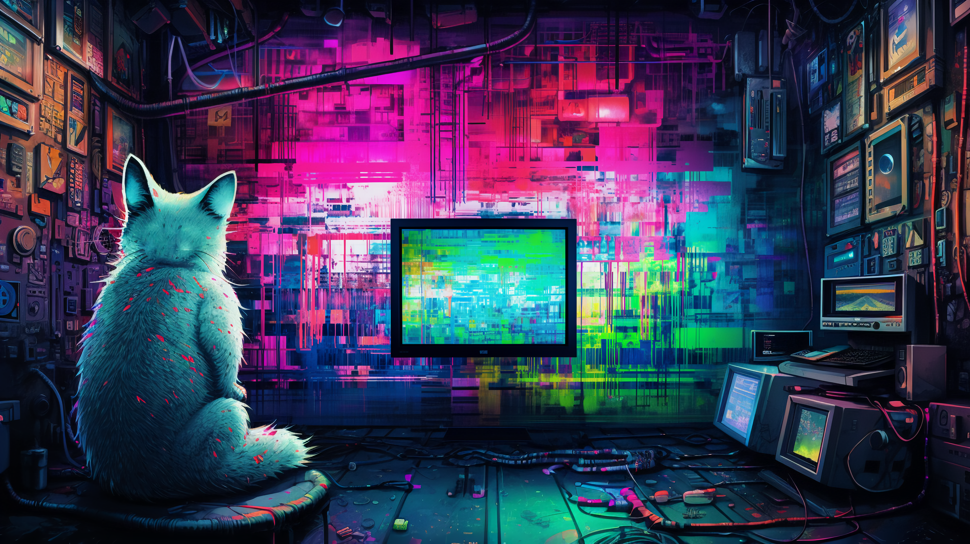
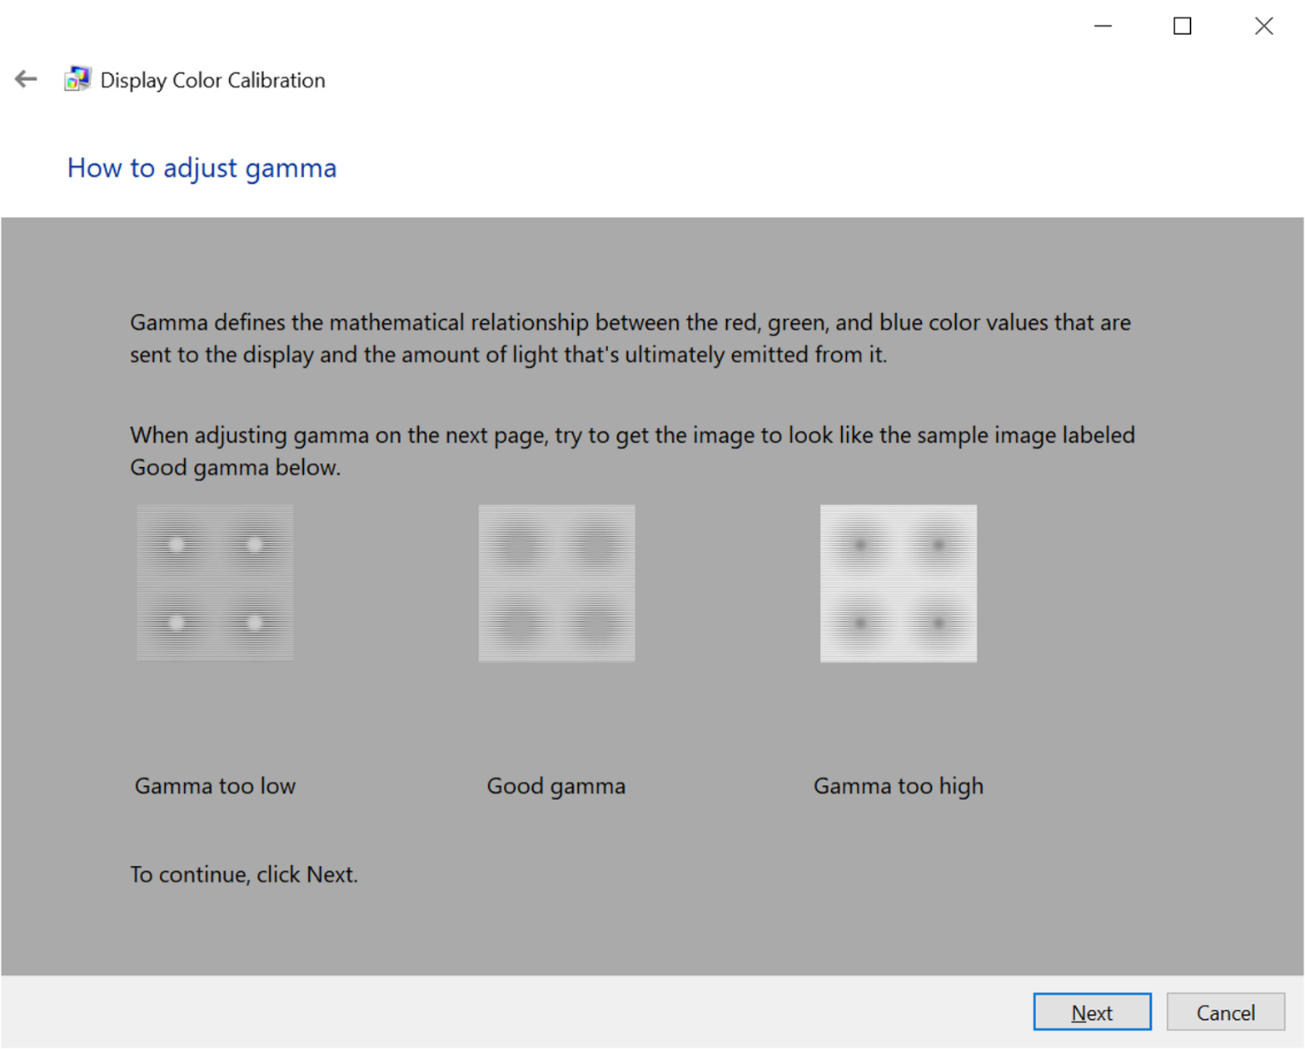
Incorrect Color Display
Important if the computer is used for digital art
Windows has color-calibration utility
ITFreeTraining.com
© Copyright 2024
Notes:
12:39 For most people, the colors displayed by the monitor don’t have to be perfect. However, color reproduction is important if the computer is being used for digital art. Windows has a color calibration utility that can be used to adjust the colors displayed on the monitor. If you are deploying a computer that is being used by a graphic artist, you may need to calibrate the colors on the monitor. There are also more expensive monitors that are designed specifically for graphic art, but they do cost more. To test the monitor is calibrated correctly, there are hardware calibration devices that can test the monitor color, if your company wants to spend the extra money.

Slide 14

Subscribe
Next video
Video content: https://ITFreeTraining.com/ap11/3d20
© Copyright 2024
Notes:
13:18 That concludes this video on troubleshooting video issues. I hope you have found this video useful. Until the next video from us, I would like to thank you for watching.
References
“The Official CompTIA A+ Core Study Guide (Exam 220-1101)” pages 113 to 116
“Picture: Space craft from space” https://unsplash.com/photos/VBNb52J8Trk
“Video Driving in rain” https://pixabay.com/videos/driving-rain-freeway-highway-8359/
“Video: Cat touching screen” https://pixabay.com/videos/cat-feline-whiskers-animal-pet-85461/
“Video: Space shutter take off” https://pixabay.com/videos/rocket-thrusters-nasa-space-shuttle-235/
“Video: Rain” https://pixabay.com/videos/rain-rain-outside-window-raindrops-141606/
“Video: Metro” https://pixabay.com/videos/tube-metro-subway-underground-9005/
“Video: Woman drinking coffee” https://pixabay.com/videos/coffee-woman-girl-drink-cup-youth-20564/
“License CC BY 4.0” https://creativecommons.org/licenses/by/4.0/
Credits
Trainer: Austin Mason http://ITFreeTraining.com
Voice Talent: AR Hellenberg https://humanaudioventures.my.canva.site/
Quality Assurance: Brett Batson http://www.pbb-proofreading.uk

