Slide 1
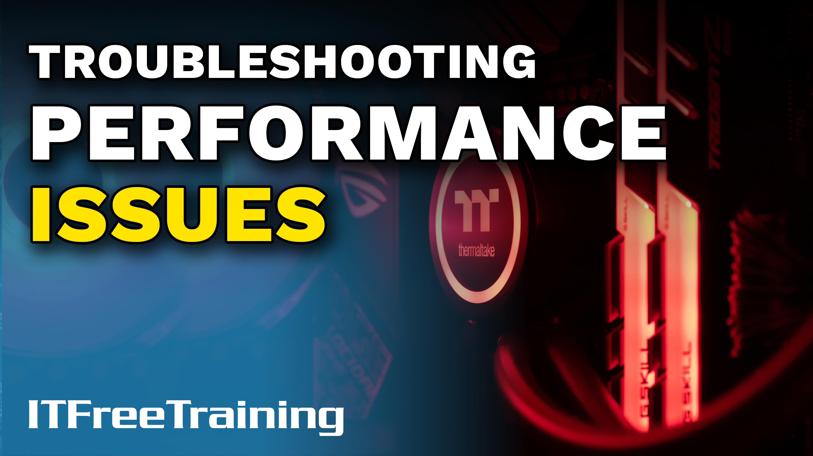
Notes:
Let’s have a look at how to diagnose performance issues.

Slide 2
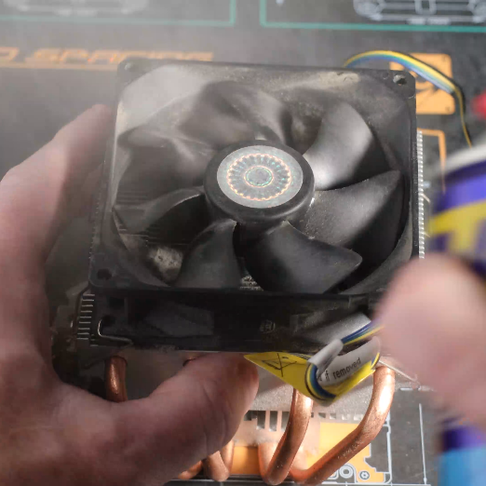
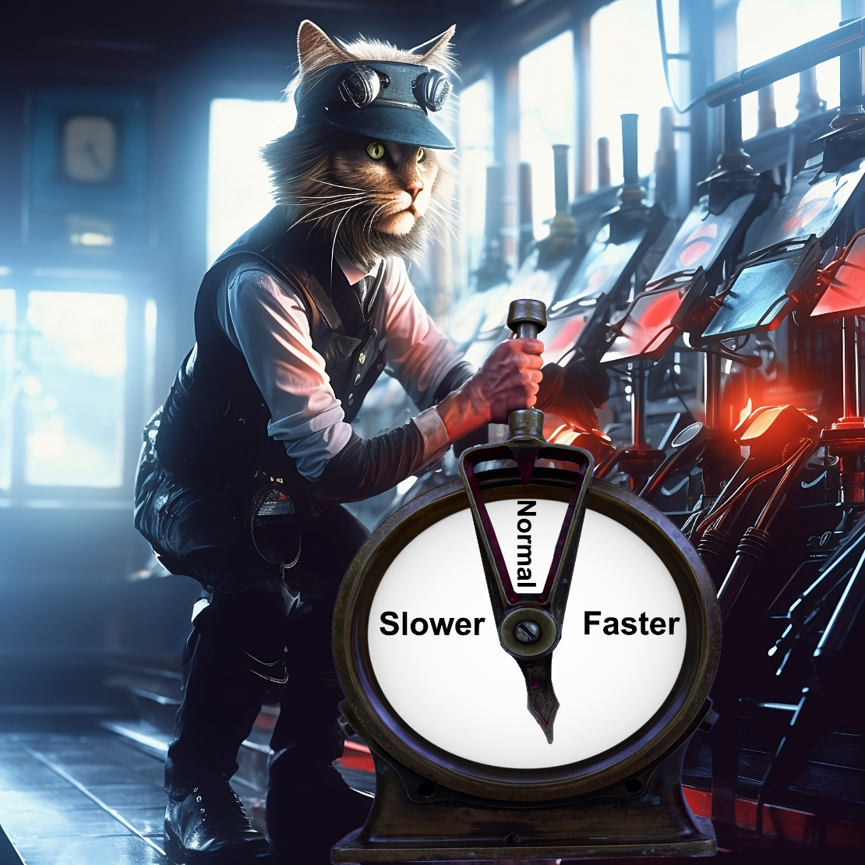
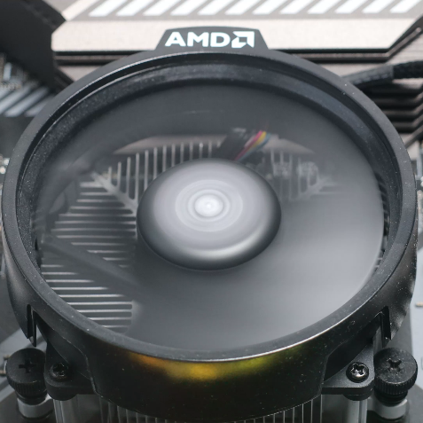
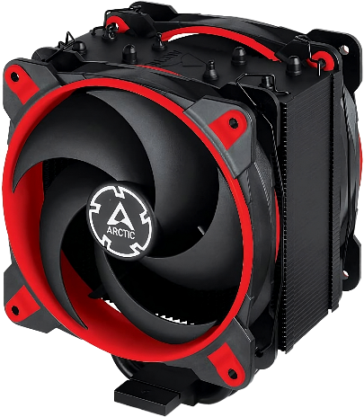
Performance Issues
Thermal controls
Check
Fix
Temperature sensors
Cleaning
Gets too hot slows down (Throttling)
Fan speeds
Replace/Upgrade
ITFreeTraining.com
© Copyright 2024
Notes:
00:05 Performance issues can be one of the hardest problems to diagnose, because performance problems don’t always crash the computer; they just make it run slower than it should. This is because modern computers have thermal controls. Essentially, components in the computer monitor their own temperature and reduce their performance if the temperature starts getting too high. Higher performance generates more heat; thus, one way to reduce the heat in components is to reduce performance.
Therefore, if your computer is not performing at its optimal speed, it is advisable to check the temperature sensors of its components. Many components in the computer are equipped with thermal monitoring that indicates their operating temperatures. Consult the manufacturer's guidelines to determine the ideal temperature range for these components. Should you notice that the temperatures are higher than recommended during idle periods, this could be a sign that the computer's cooling system isn't functioning as efficiently as it should.
Another indication of a cooling problem is the fan speeds. When the computer starts getting hotter, the fans will get faster. Depending on the computer, you may hear the fans spinning faster. If the computer is at idle and the fans are spinning faster than normal, this is an indication that the cooling is not working as well as it should be.
The problem might stem from a fan requiring cleaning. For instance, using compressed air to blow out dust from the fan can help resolve the issue. Additionally, ensure that no cables are obstructing the fan's movement. A fan hindered by cables or clogged with dust will struggle to spin at the necessary speed, thus impeding airflow. Remember, adequate airflow is crucial for fan efficiency. Therefore, keeping the air vents unblocked is essential for keeping the computer cool.
If you find cleaning does not help, you may need to replace or upgrade the cooling inside the computer. To get the best performance, the cooling inside your computer needs to be working effectively.

Slide 3
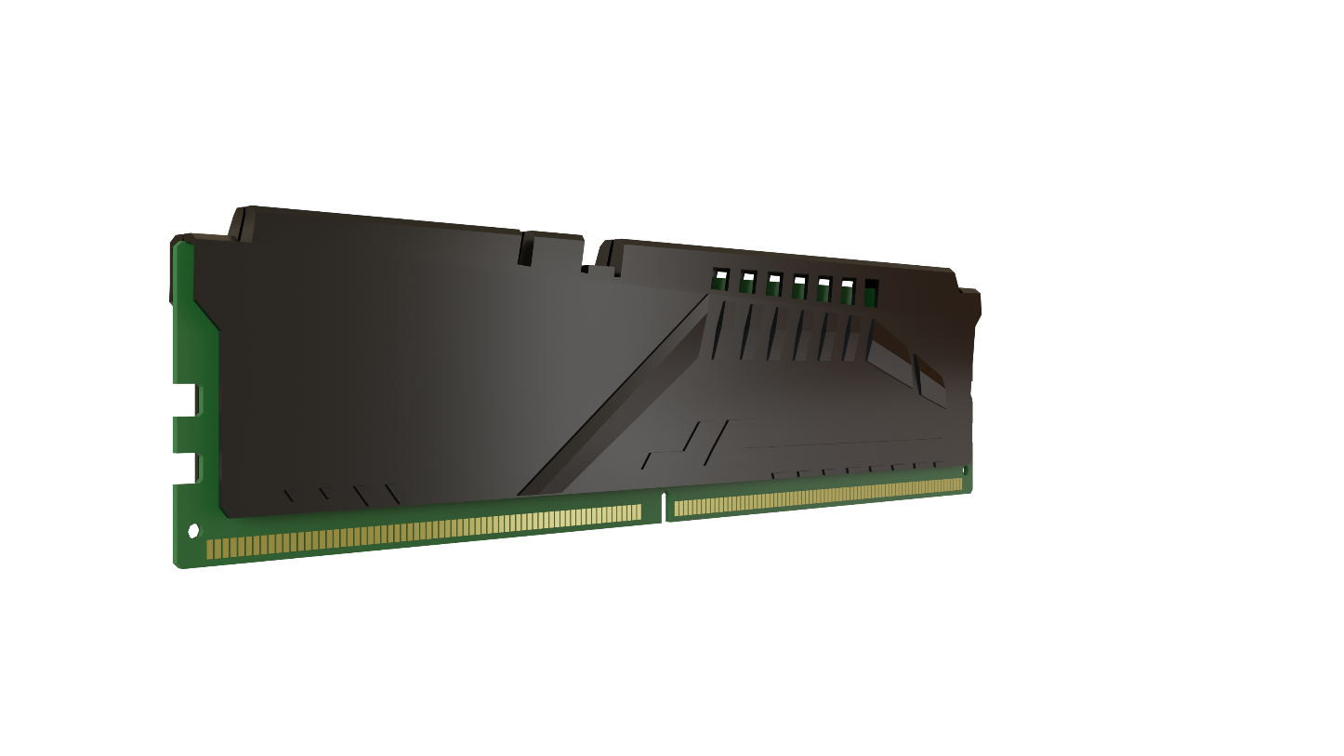
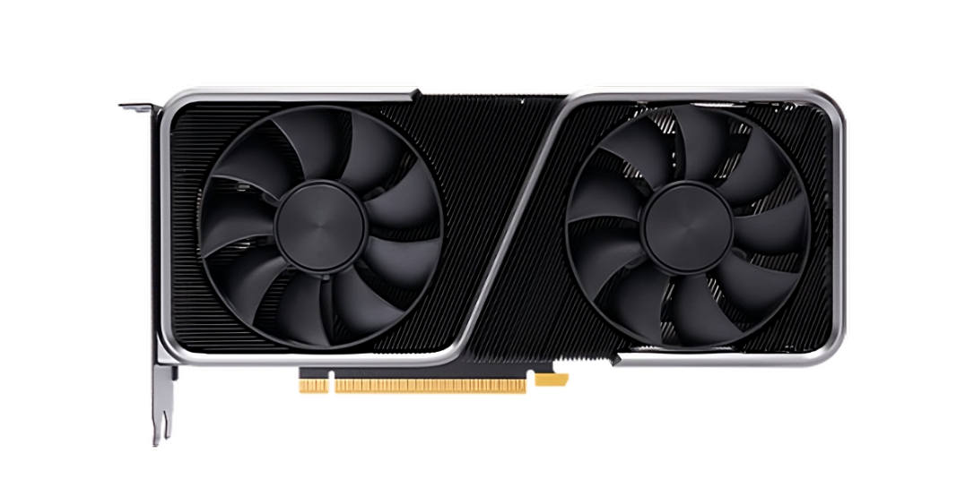
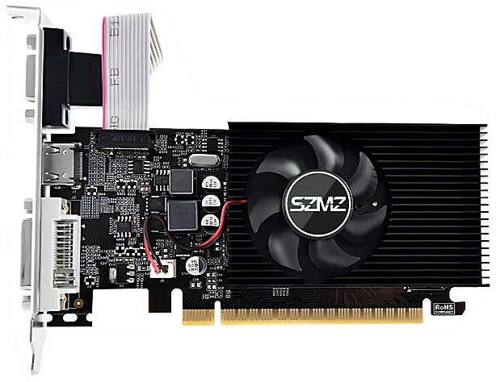
Check for Misconfiguration
Upgrade Memory
Second Video Card
If not compatible. May:
Second video card:
Disable dual channel
Uses extra CPU lanes
Reduce clock speed
Halves lanes for first video card
ITFreeTraining.com
© Copyright 2024
Notes:
02:05 Misconfiguration often results in decreased performance. If you observe a slowdown after an upgrade or maintenance, it's crucial to examine any recent modifications to identify potential causes of the issue.
For example, adding an extra memory module that is not compatible with those already present may disable dual channel. It may also reduce the clock speed of the other memory modules. Either can reduce the performance of the computer.
Installing a second video card for an additional monitor could potentially impact your computer's performance. The CPU provides a finite number of lanes for video card connectivity. Adding a second card might divide these lanes, thereby reducing the allocation to the primary video card. The specific slot used for the video card often dictates the number of lanes it utilizes. Additionally, in some instances, adjustments can be made in the computer's setup to configure the number of lanes allocated to each video card.
The key takeaway here is that adding new hardware can unexpectedly alter your computer's performance. It's crucial to ensure compatibility and understand the potential impact of integrating new components with an existing setup.

Slide 4
Verify the Problem
Bottleneck
Test with baseline
One slow component
Slows down everything
CPU
Baseline from earlier
Measurements from good machine
Memory
GPU
Manufacturers’ specifications
ITFreeTraining.com
© Copyright 2024
Notes:
03:19 Numerous factors can lead to slowdown in a computer's performance. Often this is due to a bottleneck, where one component's limitations hinder the overall system's efficiency. A bottleneck is like having a car equipped with an exceptionally powerful engine, yet fitted with small, narrow tires. These tires, due to their limited size and grip, will spin and struggle to handle the excessive power output of the engine, thereby constraining the maximum performance that the engine can deliver.
In computing, consider a computer with high-speed memory and a powerful graphics processor. If it's paired with a low-end CPU that struggles to transfer data quickly enough to the graphics card, the graphics card won't operate at its full potential, due to the slow data transfer rate. This imbalance in component capabilities is what typically causes a bottleneck in system performance.
Bottlenecks in a system often arise from significant speed disparities between components. For example, when downloading a large file over a high-speed internet connection to a slower USB flash drive, the drive won’t be able to match the data transfer rate. As its buffers fill up, the computer will reduce the network speed to align with the flash drive's slower writing capability. This scenario highlights how performance bottlenecks can subtly occur when one component's speed lags that of another, impacting overall system efficiency. In this case, the slow USB drive is the root cause of the issue, not the internet connection, highlighting the importance of accurately diagnosing the source of the problem rather than just its symptoms.
To effectively identify potential issues, it is advisable to conduct comparative tests of the computer against a previously established performance benchmark, commonly known as a baseline. In the context of server systems, an administrator often records key performance metrics to create this baseline. The value of a baseline lies in its ability to serve as a reference point for future comparisons. For instance, if additional software installations have led to a bloated and sluggish server, a comparison with the baseline can clearly illustrate the extent of performance degradation. This approach is equally beneficial when implementing changes, as it allows for an evaluation of their impact on the system's performance.
In the absence of an established baseline, you can use a computer with identical or similar hardware as a comparative benchmark. Alternatively, online benchmarks or user reviews can offer valuable insights, serving as practical reference points. These resources often reflect real-world usage, providing a more accurate depiction of performance than manufacturers’ specifications alone. It's important to note, however, that manufacturers' specifications might be based on optimal hardware configurations, which could differ significantly from your setup. Consequently, these specifications might present an idealized performance scenario rather than a realistic expectation, especially under everyday operating conditions. By considering online benchmarks or user reviews, you can gain a more comprehensive understanding of how your device is likely to perform in typical scenarios.
Determining the specific component responsible for performance issues is crucial for targeted upgrades. Your initial task is to pinpoint which component requires enhancement. For instance, if your CPU is bottlenecking the performance of your graphics card, it is the CPU that necessitates an upgrade, not the graphics card. By accurately identifying the component that is hindering overall performance, you can make a more informed and effective upgrade decision.

Slide 5
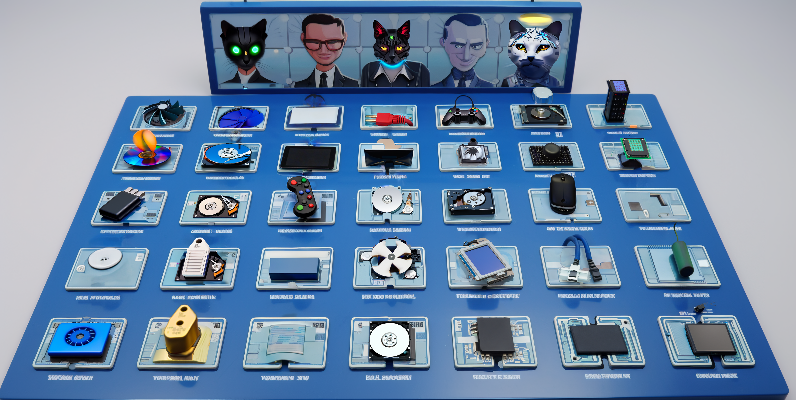
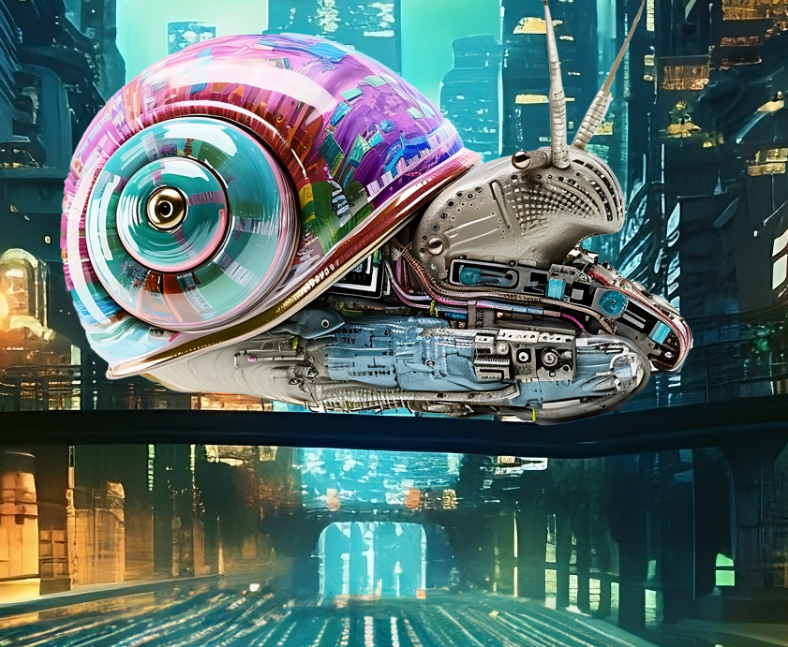
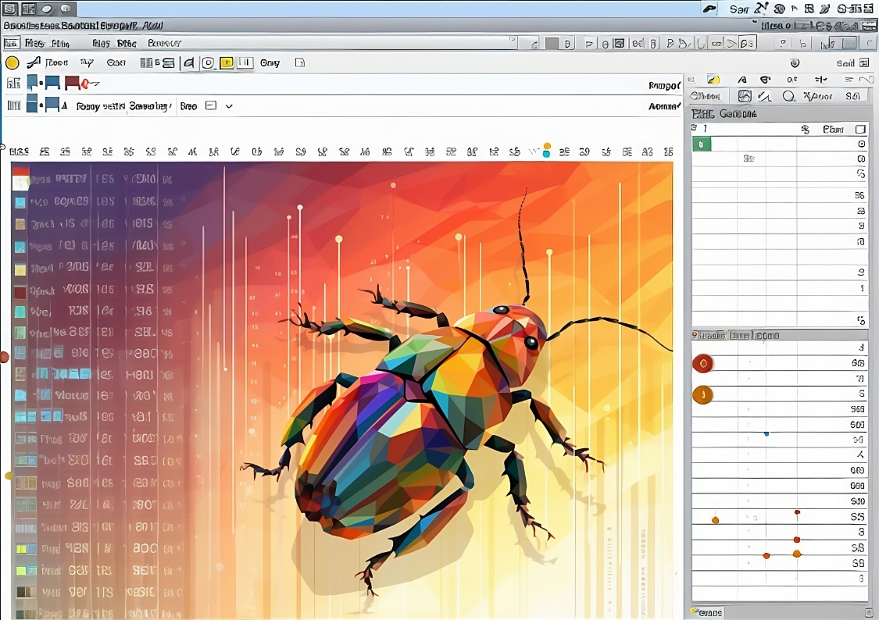
Rule Out Other Causes
Network problems
Application problems
Diagnostic tools
Overloaded network
Misconfiguration
Verify components working
Slowing down the computer
Needs updating/bugs
O.k. - suspect software/config
ITFreeTraining.com
© Copyright 2024
Notes:
07:16 When working out the problem, rule out other causes. For example, a user may report that the computer is sluggish;, however, the problem may be with the network. If the network is overloaded, this can cause certain applications to run slowly. More and more applications are storing data in the cloud, so if there are problems accessing this data, it can slow the application down.
Problems with the application itself can cause the computer to run sluggishly. For example, an application that runs in the background may slow everything else down. This can be caused by misconfigurations or perhaps the application needs updating due to a bug. If a computer is having problems, one of the first and easiest steps to take, is to update all the software on the computer. For example, installing any software and OS updates. Device drivers can also cause problems. Graphics drivers often get updated and are good candidates to update.
Lastly, run diagnostic tools. These tools can be used to verify components are working. If all the components are working, then it may be the software or the configuration causing the problems. Let’s have a look at an example.

Slide 6
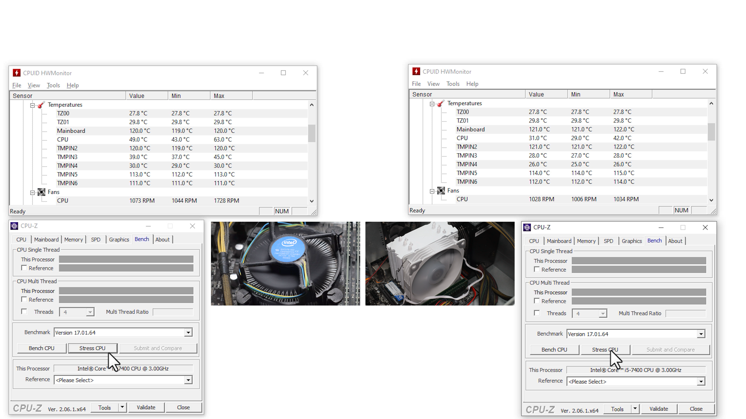
CPU Cooler Demonstration
Same computer
different CPU coolers
ITFreeTraining.com
© Copyright 2024
Notes:
08:30 In this demonstration, I have a computer on the left with a CPU cooler that is old, loosely attached and the thermal paste has dried out. On the right-hand side, I have the same computer, but I have replaced the CPU with a bigger CPU cooler. The CPU cooler has been correctly installed and new thermal paste has been used.
I am using HWMonitor to view the temperature and CPU fan speed. I am also using CPU-Z to perform a stress test. CPU-Z will put the CPU under load to give you a rating based on how fast your CPU is and compare it with other CPUs. CPU-Z can also save the results; Thus, you could use CPU-Z to create a benchmark for the computer. This will give you something to compare it to later on, if you start having performance problems. Also, there is then something to compare it with if you later upgrade the computer.
You can see that with no load on the system, the computer on the left has a temperature of around 49 degrees while the one on the right has a temperature of 31 degrees. So, even with no load, we can see that having a good, correctly installed CPU cooler has already made a difference.
The speed of the fans in both examples is around 1000 RPM. Since it is the same computer with different CPU coolers, I have pre-recorded the footage so we can compare the results. I will now start the playback for the stress test I performed earlier.
You will notice that the CPU temperature on the left will quickly increase. It will eventually get up to around 100 degrees. 100 degrees is the maximum temperature this CPU can run at. Although technically it can run that hot, it is not recommended to do so, as you are running the CPU at its limit. Running CPUs very hot does reduce their lifespan.
As the CPU heat increases, the fan speed will increase in an attempt to cool the CPU down. On many computers when the fans start spinning faster you will be able to hear them.
Notice, on the right-hand side, the CPU even under load has only gone up to the low 40 degrees. Notice also, the fans are still spinning at around 1000 RPM, whereas on the left-hand side, it is around 3000 RPM. This CPU cooler has made a massive difference in cooling the CPU. Keep in mind this is a low-end CPU, so higher performing CPUs will generate more heat. In this example, the CPU cooler is more than enough to keep the CPU cool.
In terms of the ratings for the CPUs, there is not too much difference. The right-hand side figure is slightly above the left-hand one, but nothing too amazing. With different CPUs, you may get different results, particularly those where you have a burst period that will only last until the CPU gets too hot.
If you are planning on upgrading your computer, it may be worth taking the time to use software like this to get a benchmark both before and after. At least by doing this, you have some figures to quote your manager. In this case, I can say with confidence that replacing the CPU cooler has cut the CPU temperature under load by just over 50%.

Slide 7
Subscribe
Next video
Video content: https://ITFreeTraining.com/ap11/3d10
© Copyright 2024
Notes:
11:51 If you found this video helpful, don't miss out on our next insightful video. Click the link to dive into more tips and tricks to enhance your IT skills. Stay curious, keep learning, and we’ll see you in our next video!
References
“The Official CompTIA A+ Core Study Guide (Exam 220-1101)” page 112
“License CC BY 4.0” https://creativecommons.org/licenses/by/4.0/
Credits
Trainer: Austin Mason http://ITFreeTraining.com
Voice Talent: HP Lewis http://hplewis.com
Quality Assurance: Brett Batson http://www.pbb-proofreading.uk

