Slide 1
Notes:
Let’s have a look at drive reliability and performance.

Slide 2
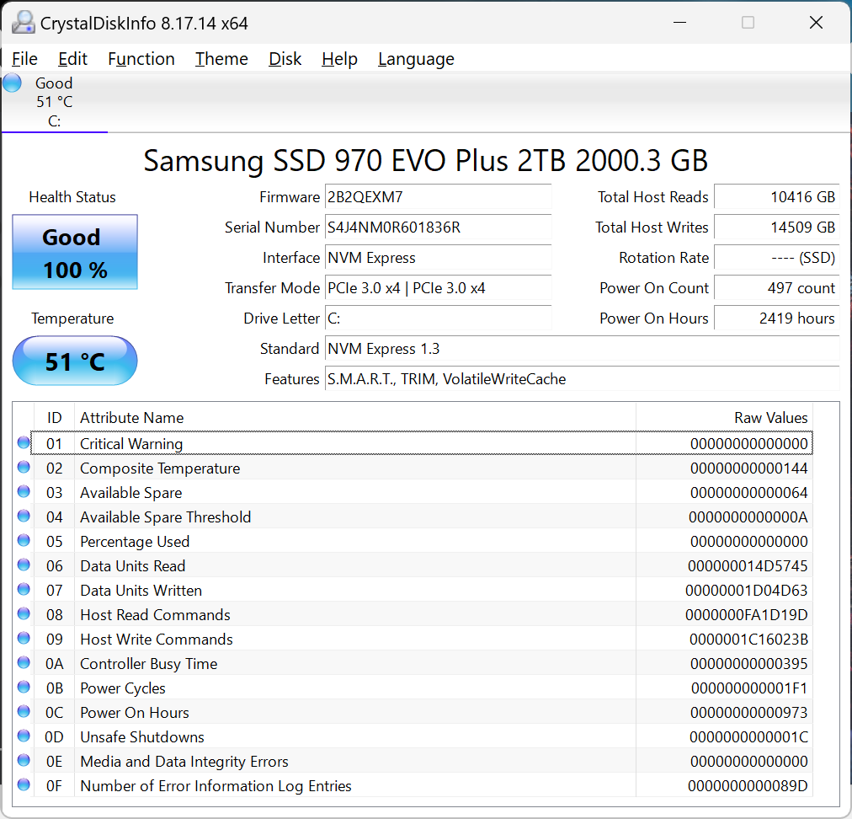
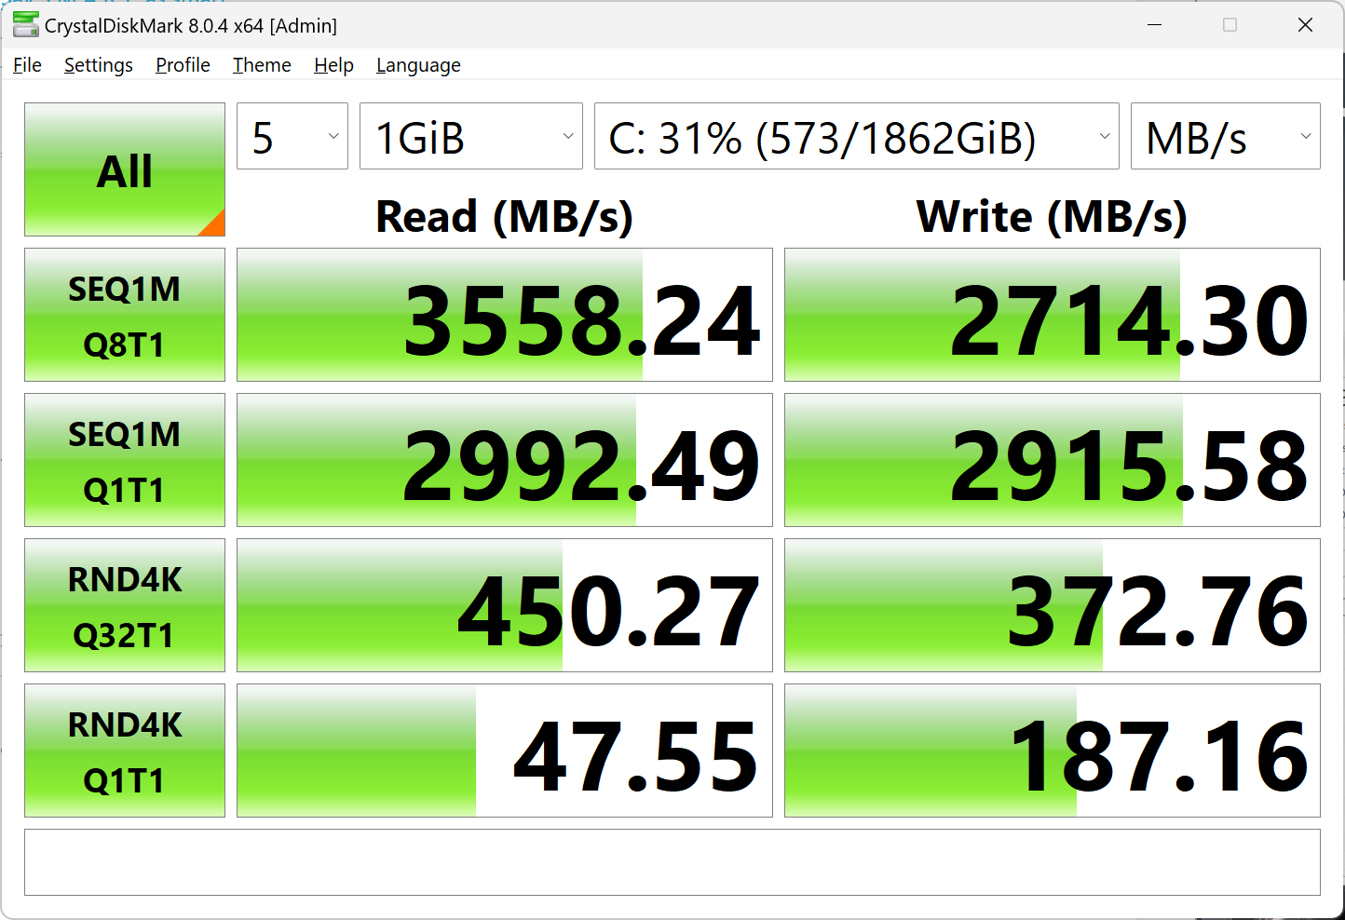
Reliability and Performance
Smart (CrystalDiskInfo)
Performance (CrystalDiskMark)
ITFreeTraining.com
© Copyright 2024
Notes:
00:05 In this video I will look at some of the ways we can check the reliability of our storage devices. For example, using S.M.A.R.T. to measure reliability and tools like CrystalDiskMark to measure performance.
Let’s have a look at how to read this information and use it.

Slide 3
S.M.A.R.T.
Self-Monitoring, Analysis and Reporting Technology
Reports various indicators of drive reliability
Anticipates hardware failures
Vendor specific
S.M.A.R.T.
Reporting
No standards
Implementations different
Some better than others
ITFreeTraining.com
© Copyright 2024
Notes:
00:22 Many drives have built-in reporting called S.M.A.R.T., short for Self-Monitoring Analysis and Reporting Technology. S.M.A.R.T. reports various indicators of drive reliability and other information. It can also anticipate hardware failures. However, before you start using S.M.A.R.T. there are some things to understand.
S.M.A.R.T. reporting is vendor specific. Unfortunately, there are no standards. Thus, it is implemented differently on different devices and some implementations are better than others. You will generally find that S.M.A.R.T. is always implemented on Solid-State-Drives, but not all hard disks support it.

Slide 4
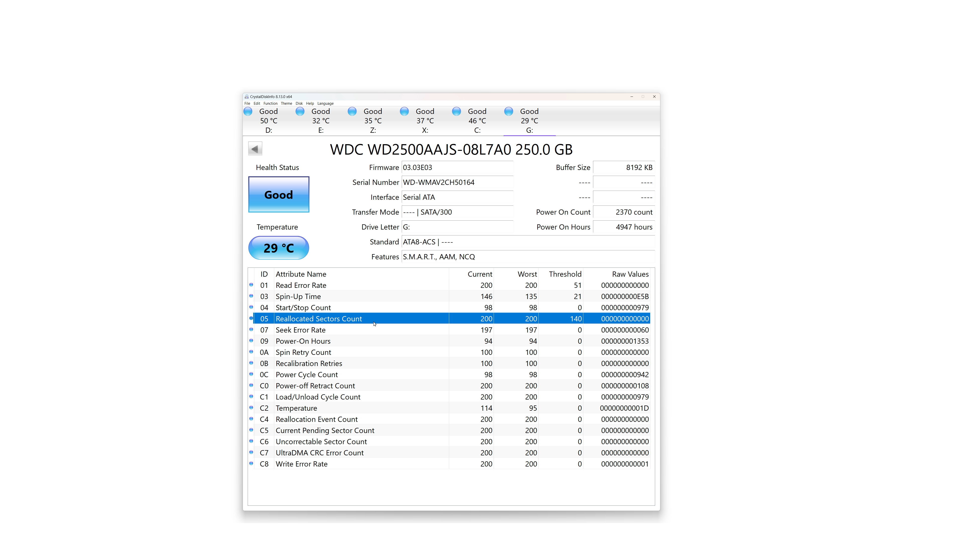
CrystalDiskInfo https://crystalmark.info
ITFreeTraining.com
© Copyright 2024
Notes:
01:02 I will now have a look at the software CrystalDiskInfo. This freely available software reads S.M.A.R.T. and other information for storage devices. Interpreting S.M.A.R.T can be challenging as each manufacturer may provide S.M.A.R.T. information differently.
The storage device I am showing is a Solid-State-Drive. The software processes the information it finds and attempts to present it in a friendly way at the top. The S.M.A.R.T. data is at the bottom of the screen.
In the case of Solid-State-Drives, the main factor affecting life expectancy is how many writes have been performed. Once cells in a Solid-State-Drive are worn out, it has some spares to replace the failed cells. You can see in the S.M.A.R.T. data a value called “Available Spare”. This value is 6 4 in hexadecimal and 100 in decimal.
If the number of spare cells available starts going down, you should consider replacing the storage device.
In the S.M.A.R.T. data, you can also see the amount of data that has been written to the Solid-State-Drive. The software provides a friendly version of this number at the top. In this case, almost 50,000 Gigabytes have been written to this drive. This storage device has a lifespan of some 200 Terabytes of data, so there is still some life left.
I will now change to a hard disk. Hard disks suffer from wear and tear but writing a lot of data to the drive does not affect it the same way. However, sectors on the hard disk can still go bad. When this occurs, the hard disk drive swaps the bad sector with some spares reserved at the end of the drive.
You will notice the value, “Reallocated Sector Count” has a current value of 200. So, this would tend to suggest that there have been 200 sectors reallocated. However, this is incorrect. The raw value is zero, which would tend to indicate no sectors have been reallocated. One value suggests the hard disk needs to be replaced, while the other indicates it is fine. This goes to show how difficult it can be to understand and interpret S.M.A.R.T. data. To understand what the S.M.A.R.T. data is telling us, I will have a look at a tool from the manufacturer.

Slide 5
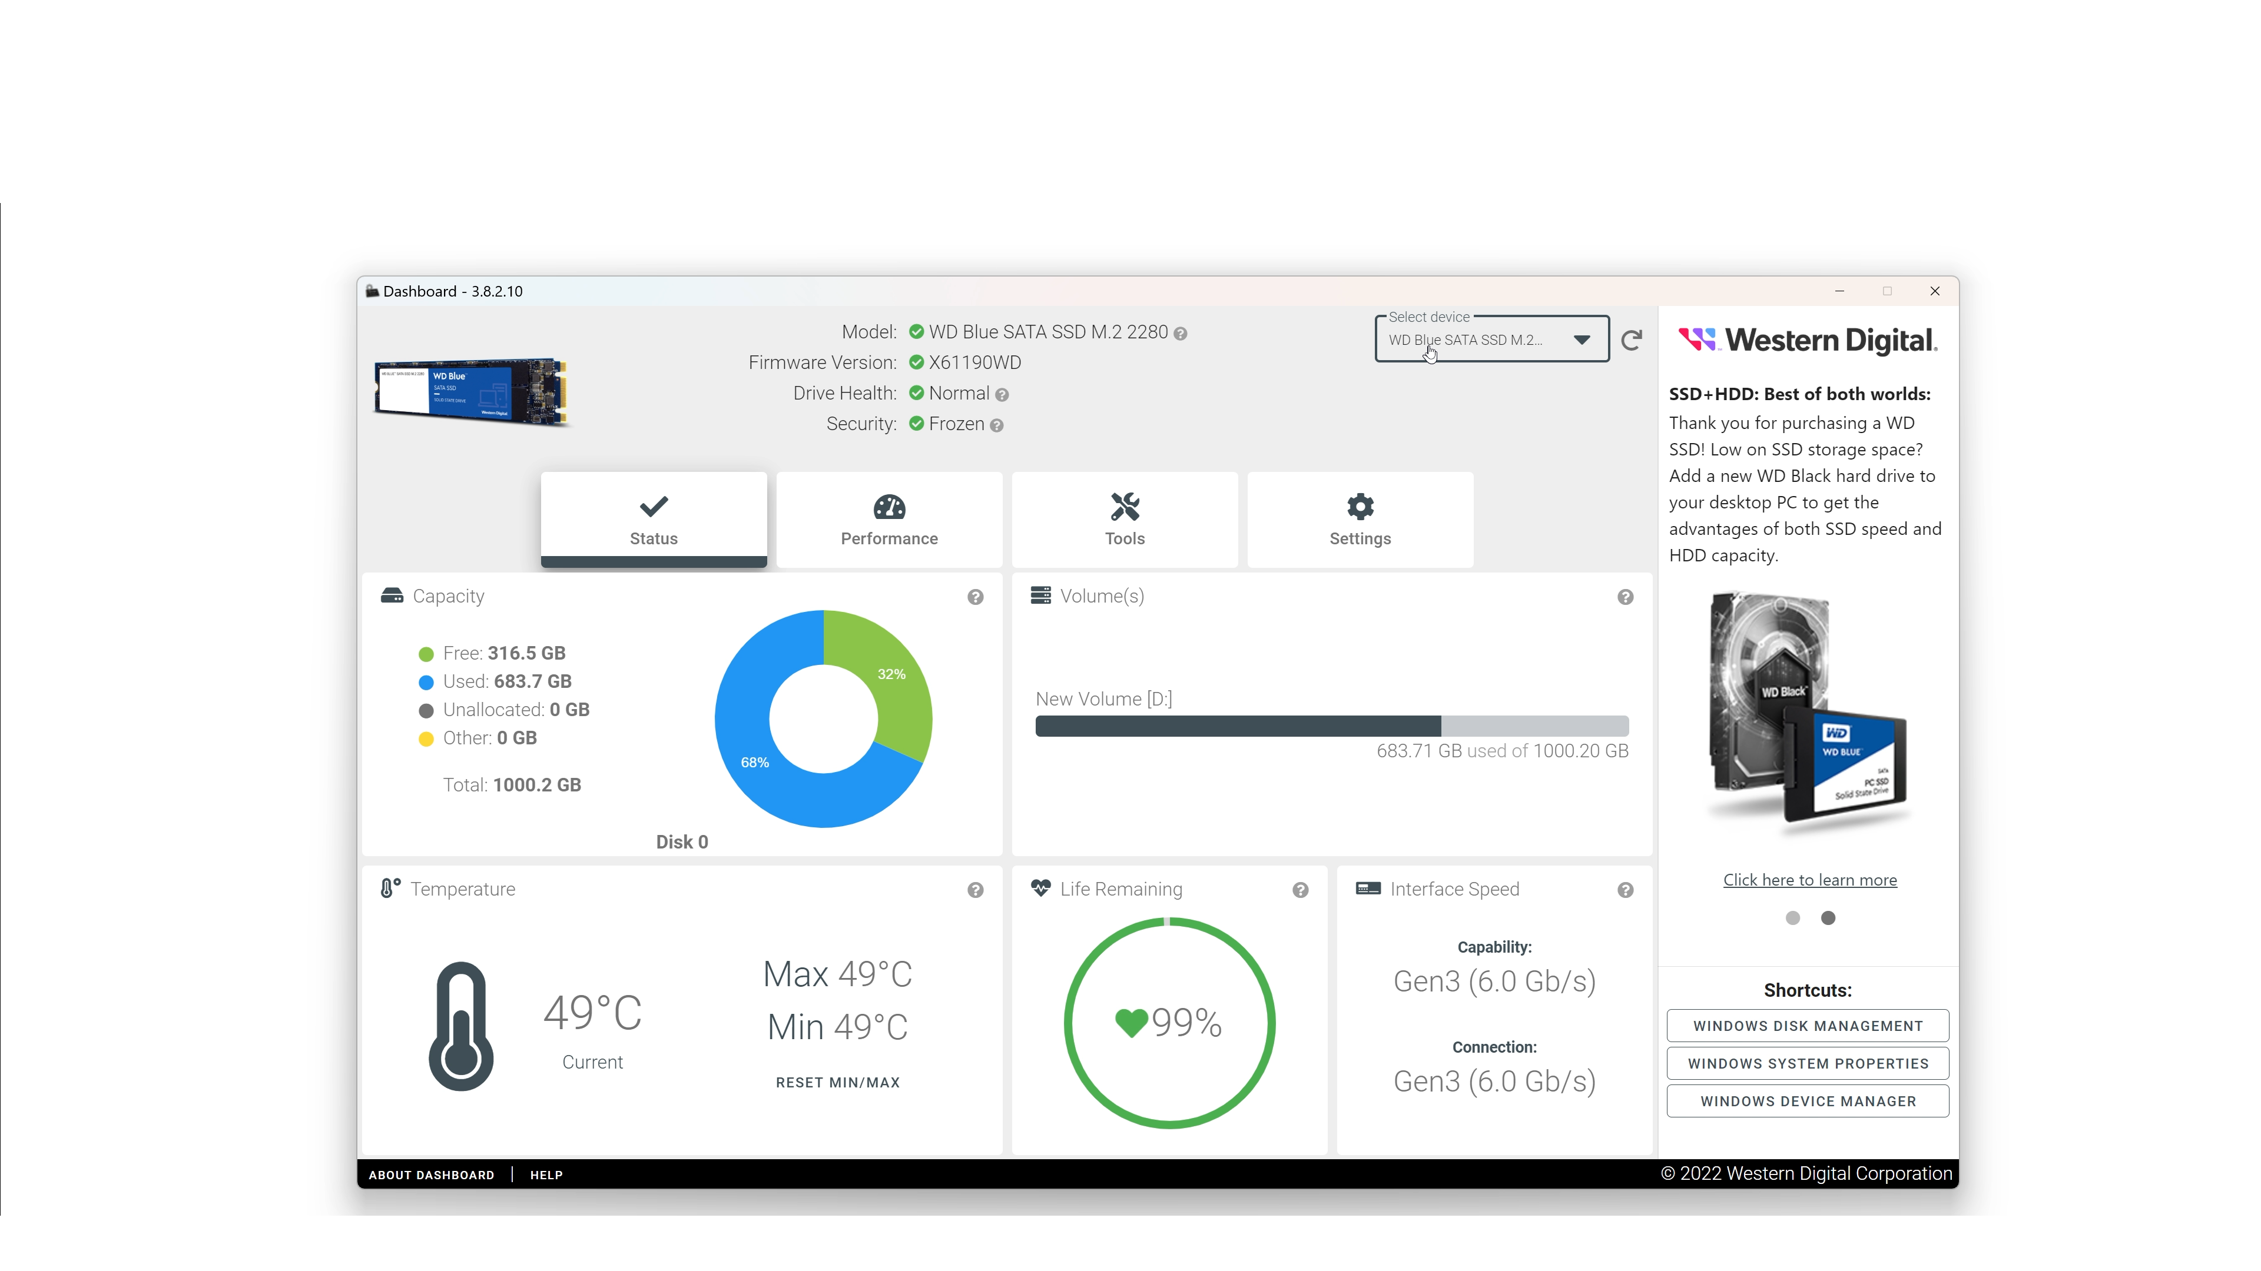
Manufacturer’s Tools
ITFreeTraining.com
© Copyright 2024
Notes:
03:20 Each storage manufacturer has their own tools. I will have a look at a dashboard provided by Western Digital. These tools will often only work with storage devices from that manufacturer. You will find these tools often provide additional information and options that are not available in non-specific manufacturer tools.
The first screen provides general information including health information. If there is a serious problem with your storage device, it should be shown here.
I will now select a hard disk from the pull-down menu. You will notice that some of the information displayed changes slightly, since the health of these storage devices is measured differently.
I will now select the tab “Tools”. The manufacturer will generally provide some additional tools to test the storage device. In this case, I will select the option to open the S.M.A.R.T. data.
You will notice that only five S.M.A.R.T. settings are shown. Some tools will show more information than others. Even tools from the manufacturer may not show all the available options but will generally show some options not available in other tools. You will notice that the option, “Reassigned Sector Count” is displayed here.
Comparing this to the other tool, the data has been displayed slightly differently, so we can understand what it means. Notice the value on the left is zero, meaning no sectors have been reassigned so far.
The threshold value is the number of sectors that can be reassigned before it is reported as a problem. On the right-hand side, the current value is 200. In this case, it is saying that 200 is the highest value.
This can be difficult to understand, but let’s consider, if the value was 100, you would probably recognize this as being a percentage, which would mean the percentage of sectors that have been reallocated. You will find that different manufacturers will present data differently. For example, some will present a percentage, sometimes the value will be scaled and thus have to be modified to obtain a percentage. Some will start from zero and others will start with the number left and go down. At other times, the manufacturer will provide a S.M.A.R.T. value, however, the hardware in the storage device does not keep it up to date.
The main takeaway from this is, S.M.A.R.T. data is notoriously unreliable. Unless you know how to correctly interpret the data, I would not trust it to be reliable.
I will exit out of here and go to the option, “Run Short Test”. When I select this, it will take the hard disk offline to run a number of diagnostic tests. Once I select continue, the test will take a few minutes to run, so I will skip to after the test is complete.
Once the test is complete, notice that the test returns an error code of 7. The dashboard does not provide a lot of information, others may provide a lot more. I looked up this code and it indicates a read error with the hard disk. Thus, it is recommended to replace the hard disk as there is something wrong with it. Sometimes, tests like these will fix problems that may not be noticeable at first. If you are about to use a storage device and are not sure if it is reliable, it is worth doing a short test like the one I just did or select the other option to run a long test. The long test will generally read all the sectors or cells on the storage device and thus will take longer to complete.
There is also information provided by the manufacturer that can help give you an idea of how reliable your storage device may be.

Slide 6
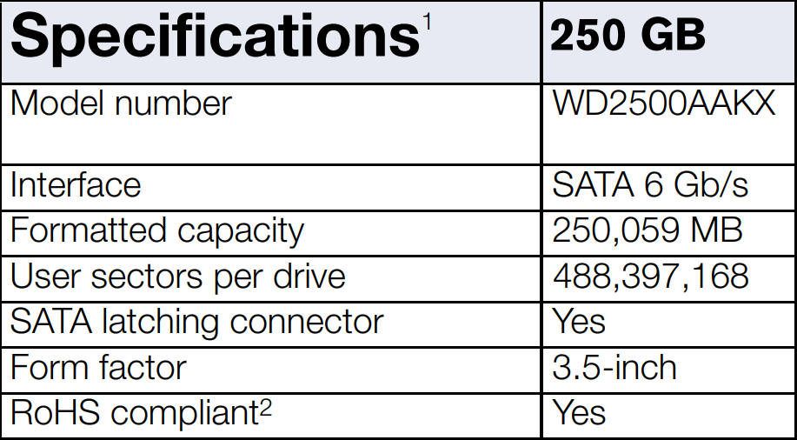
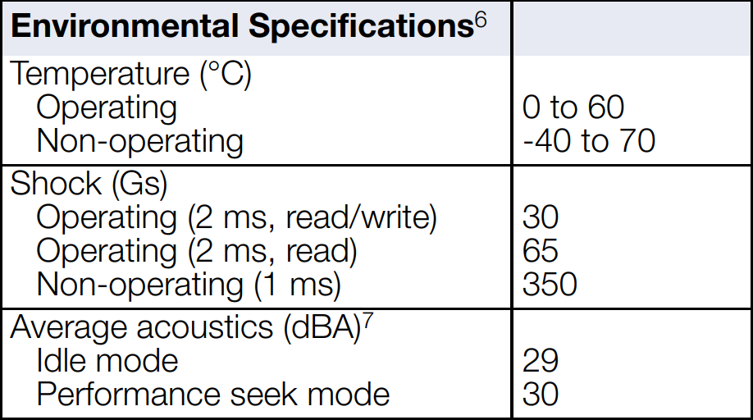
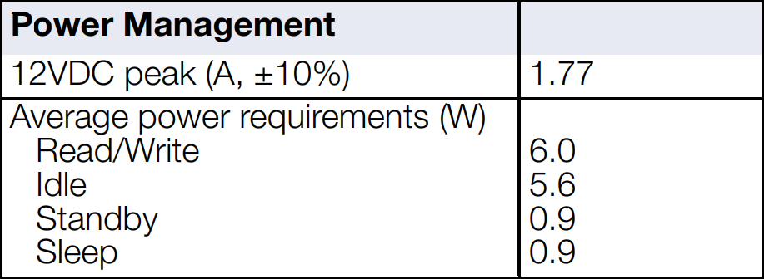
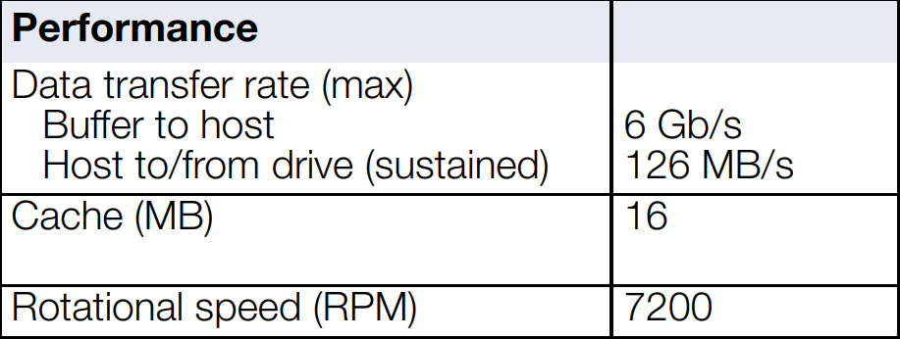
Manufacturer’s Specifications
ITFreeTraining.com
© Copyright 2024
Notes:
07:06 The manufacturer of the storage device will release specifications for their device. An example is shown here. It is important to understand that, when looking at these specifications, they are often reported with a marketing focus. That is, the storage manufacturers want to release specifications that make their device look good.
When reading specifications, make sure you read the footnotes and fine print. This often gives information about what sort of testing conditions were used. Often the specifications quoted are in situations where the device performs best. For example, many devices will perform better when writing large blocks of sequential data rather than random writes of small blocks.
The specifications will also include information about the life expectancy of the storage device and its operating temperature. Operating a storage device outside of this temperature will reduce its lifespan.
You can get an idea of how well the storage device will perform, but often the manufacturer does not release all the specifications that you may want to know. To get a better idea of how the storage device will run, we will use another tool.

Slide 7
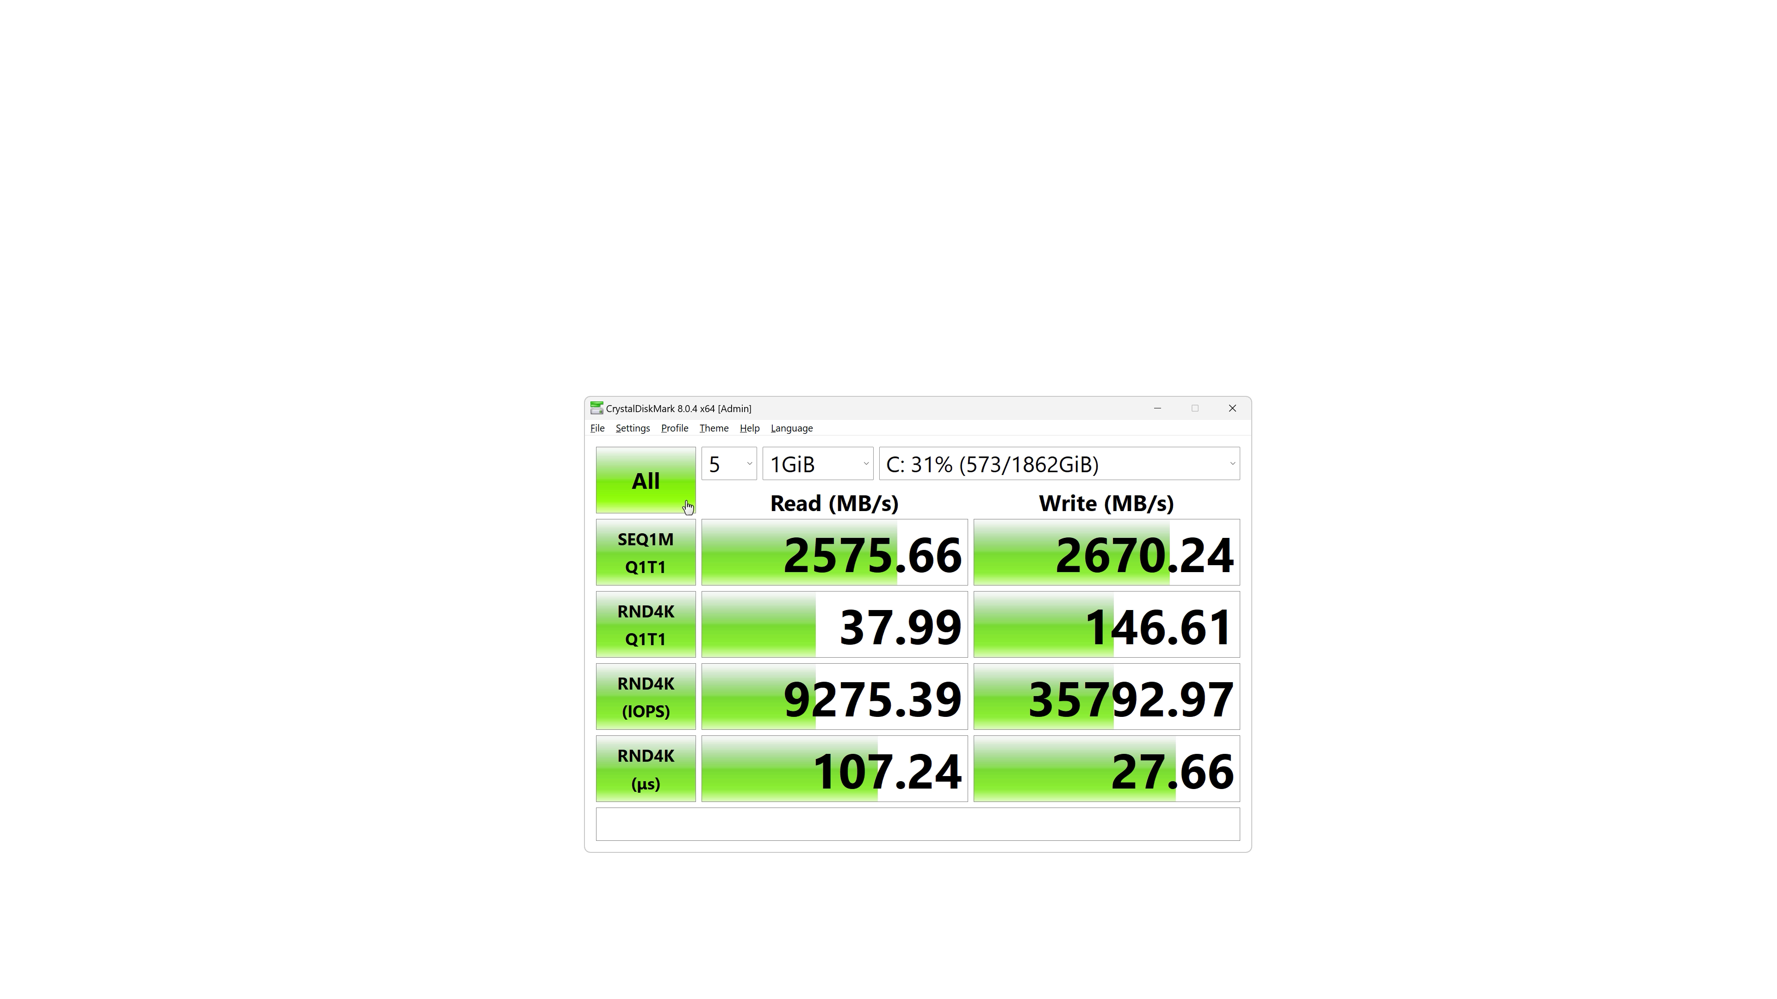
CrystalDiskMark
https://crystalmark.info/
Popular benchmarking software for storage devices
ITFreeTraining.com
© Copyright 2024
Notes:
08:20 CrystalDiskMark is a free performance tool that is a popular benchmarking software for storage devices. You will even find that some manufacturers of storage devices will publish results from this tool. Well, the results from this tool that makes their storage look good, anyway.
The tool essentially reads and writes data to the storage device. Since storage devices can use cache, this can make them perform better under certain conditions. For example, caching the data and writing it later allows more optimized writing to the device. Therefore, the tool runs for a few minutes to get a better result.
There are a lot of options in the tool, but in this case I will choose the profile, “Real World Performance” to get a better understanding of how the storage will perform under real-world conditions.
The profile will configure the tests, of which there are four shown on the left-hand side. Each test will examine both reading and writing. To run all four, I will select “All” at the top. The tests take a few minutes, so I will pause the video and return shortly.
Once the tool has finished, it will show some statistics for how fast the storage device is. The tool tests sequential and random access to give you a good idea of how well the storage device will work in most situations.
In some cases, the manufacturer may also provide performance measuring tools.

Slide 8
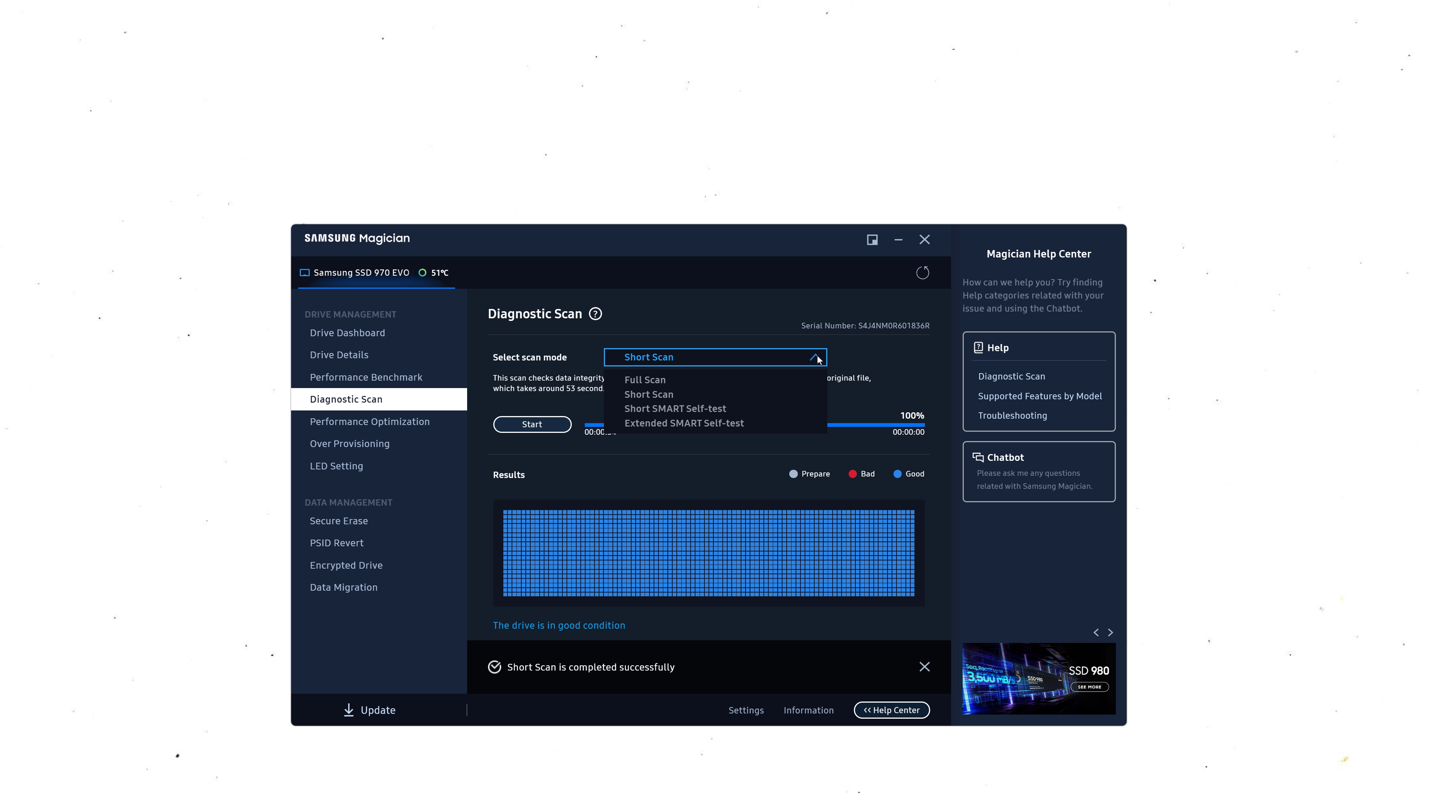
Samsung Magician
ITFreeTraining.com
© Copyright 2024
Notes:
09:48 I will next have a look at Samsung Magician. This is a Samsung tool used with their storage devices. The first screen has some information about the drive’s health.
To open the S.M.A.R.T. settings.
The S.M.A.R.T. data has “Available Space” which is a value indicating how many reserve blocks are still available. You will notice this value is set to 100. In our previous example, the equivalent value was set to zero.
When I cursor over the question mark, this gives us some more information about the settings. You can see that it informs us that the value is a percentage, with 100% meaning all the reserve blocks are available. This just goes to further enforce the idea that, when using S.M.A.R.T., you need to know exactly how the manufacturer stores the data, as different manufacturers can do it differently.
I will now exit out of here and select, “Performance Benchmark”. I will press the start button to run the test and return once it is complete.
The good thing with this tool is it keeps a record of each test completed. So, if you wish, you can run this test periodically to check the performance of the storage device.
I will now select, “Diagnostic Scan”. This allows you to test the drive. I will start a short test and return when it’s complete.
The device appears to be working correctly. You can also run longer S.M.A.R.T. tests if you wish. If you are using an old storage device you found somewhere and are planning to give it away, it is not a bad idea to run a full scan to see if the storage device is still functioning correctly.

Slide 9
In The Real World
S.M.A.R.T.
Confirm what the values mean for that specific device
Very helpful in large server rooms and cloud storage
Manufacturer’s tools
Good for testing the storage device to make sure it is working correctly
Performance specifications
Manufacturers like to make their storage devices look good. Check fine print
ITFreeTraining.com
© Copyright 2024
Notes:
11:28 In the real world, if you decide to start using S.M.A.R.T., confirm what the values mean for that specific device. Since there is no standard, different manufacturers implement S.M.A.R.T. differently. I have even seen some storage devices where the S.M.A.R.T. settings are there but the manufacturer does not update them. So, don’t assume that, if it has S.M.A.R.T., it is used (until you verify it).
S.M.A.R.T. is very helpful in larger server rooms and cloud storage. In environments like these, you tend to have a lot of the same storage devices. With cloud storage, if possible, you want to retire storage devices before they go bad. Used well, S.M.A.R.T. can potentially detect a drive failure before it occurs.
The manufacturer of the storage device will often provide tools to use with their storage device. These tools are often good for testing the storage device to make sure it is working correctly. It can be particularly useful if you are not sure if it is failing or if you find a storage device in a storage room and don’t know if it is working correctly.
Manufacturers release performance specifications. As they like to make their storage devices look good, check the fine print of any specification. Common tricks include, quoting a maximum bus speed rather than the typical speed data is transmitted at and publishing figures for sequential access rather than random access, as this is generally faster. Before you buy, read the specifications carefully and understand what they are referring to. There are also plenty of benchmarking sites where you can get some real-world figures if you want them.

Slide 10
Subscribe
Next video
Video content: https://ITFreeTraining.com/ap11/3c25
© Copyright 2024
Notes:
13:09 That concludes this video from ITFreeTraining on troubleshooting drive reliability and performance. I hope you have found this video informative. Until the next video from us, I would like to thank you for watching.
References
“The Official CompTIA A+ Core Study Guide (Exam 220-1101)” pages 103 to 105
“License CC BY 4.0” https://creativecommons.org/licenses/by/4.0/
Credits
Trainer: Austin Mason https://ITFreeTraining.com
Voice Talent: HP Lewis http://hplewis.com
Quality Assurance: Brett Batson https://www.pbb-proofreading.uk

