Slide 1
Notes:
Let’s have a look at power supply issues.

Slide 2
Power Problems
No power
Intermittent
ITFreeTraining.com
© Copyright 2024
Notes:
00:03 When dealing with power problems, they will generally take two forms. First, when there is no power. No power essentially means the computer won’t start up. Generally, this occurs due to cabling problems or a dead power supply.
The other type of problem is intermittent. These problems appear to happen randomly. Usually, this is either a stop error, otherwise known as a blue screen of death, or in the second case, a random unexpected restart where the screen suddenly goes black and the computer reboots.
Let’s have a look at how to troubleshoot these problems.

Slide 3
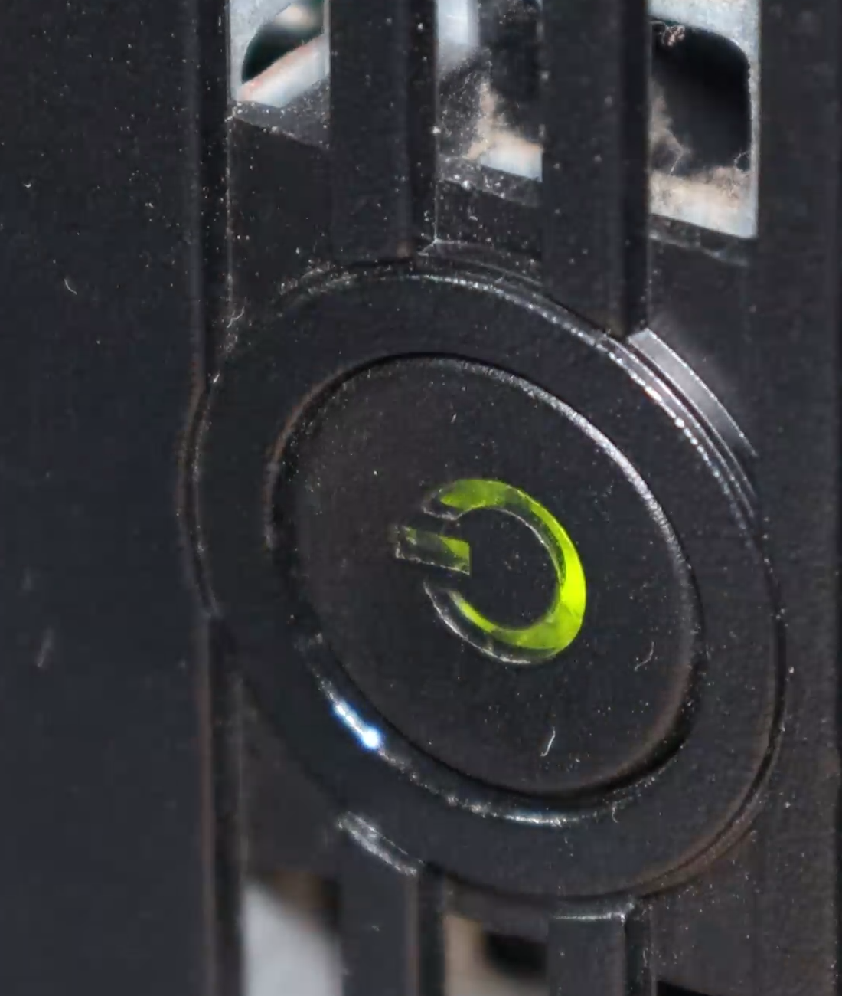
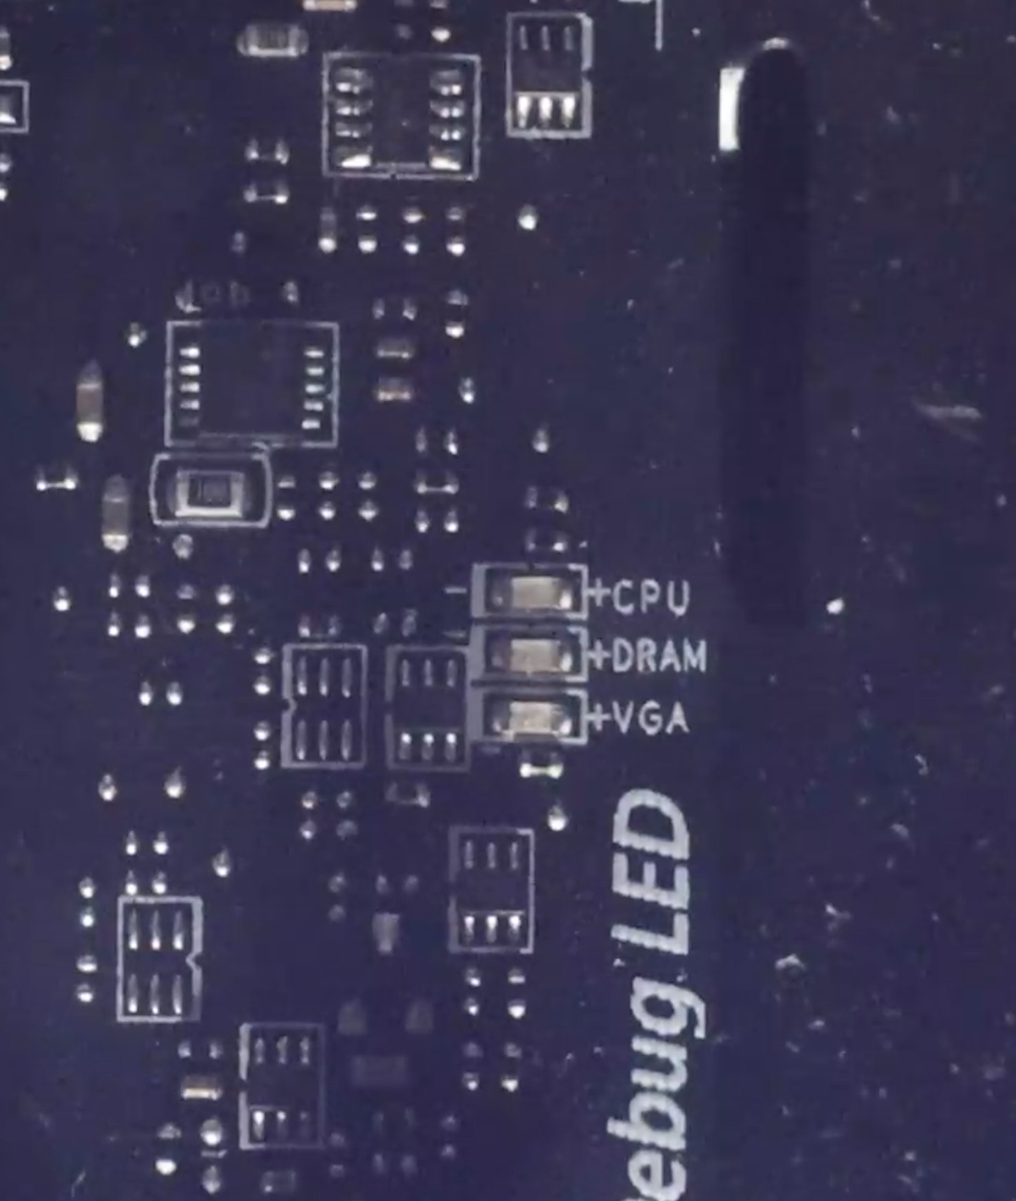
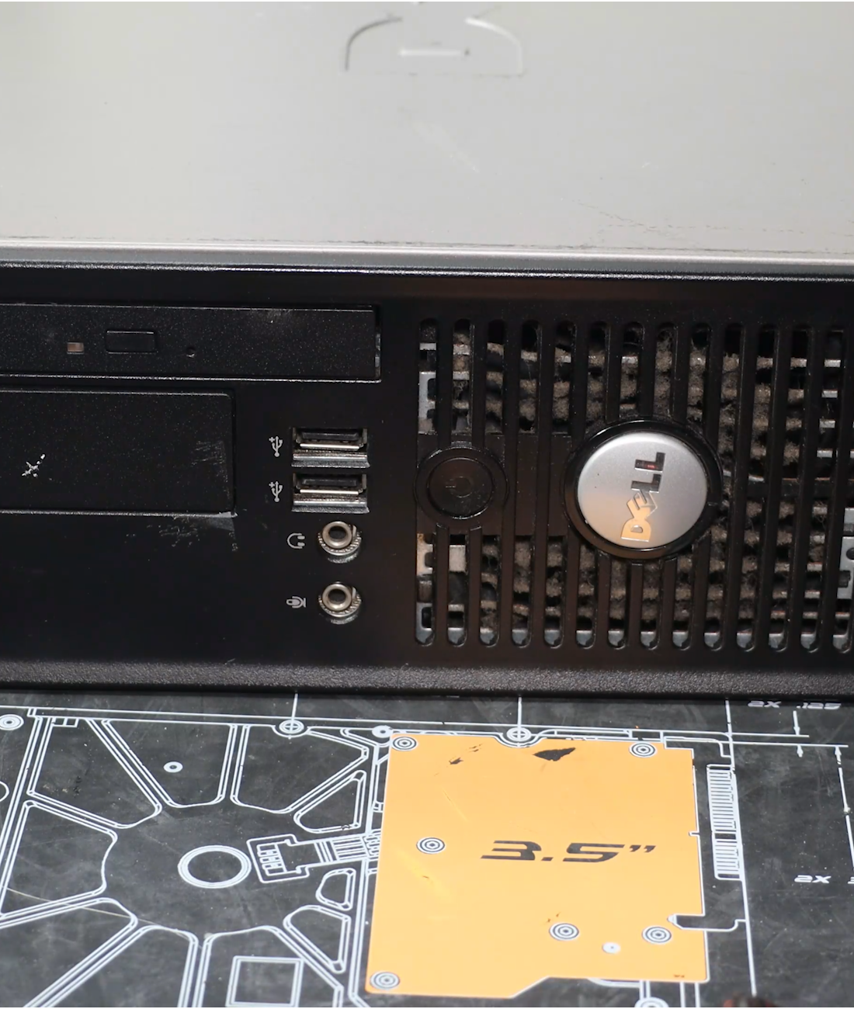
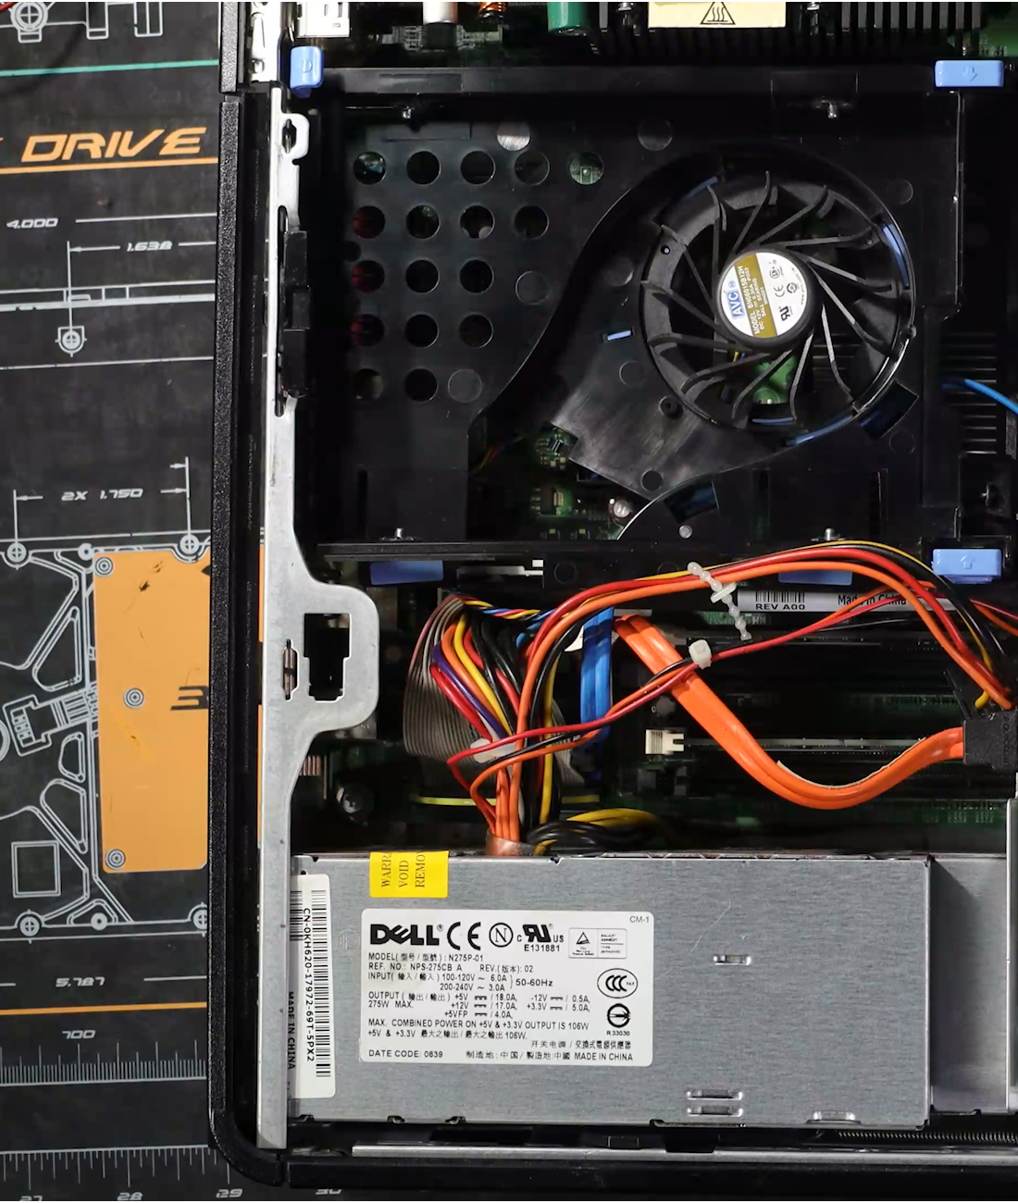
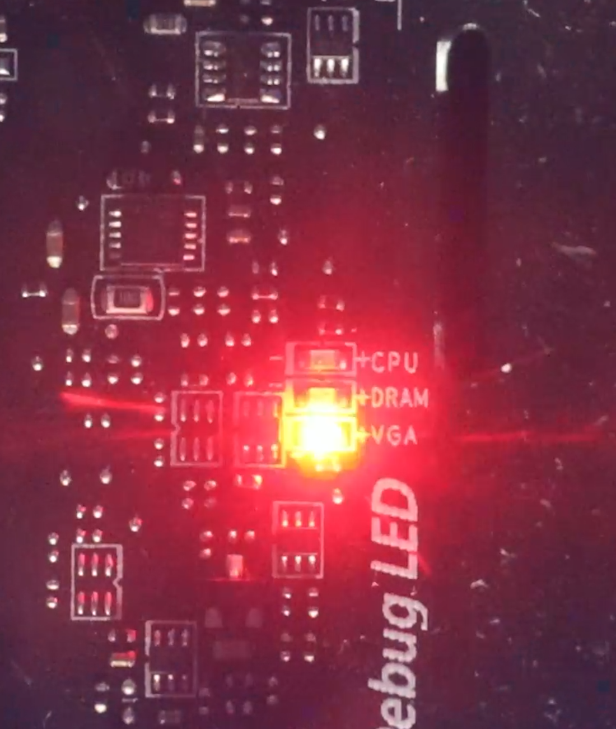
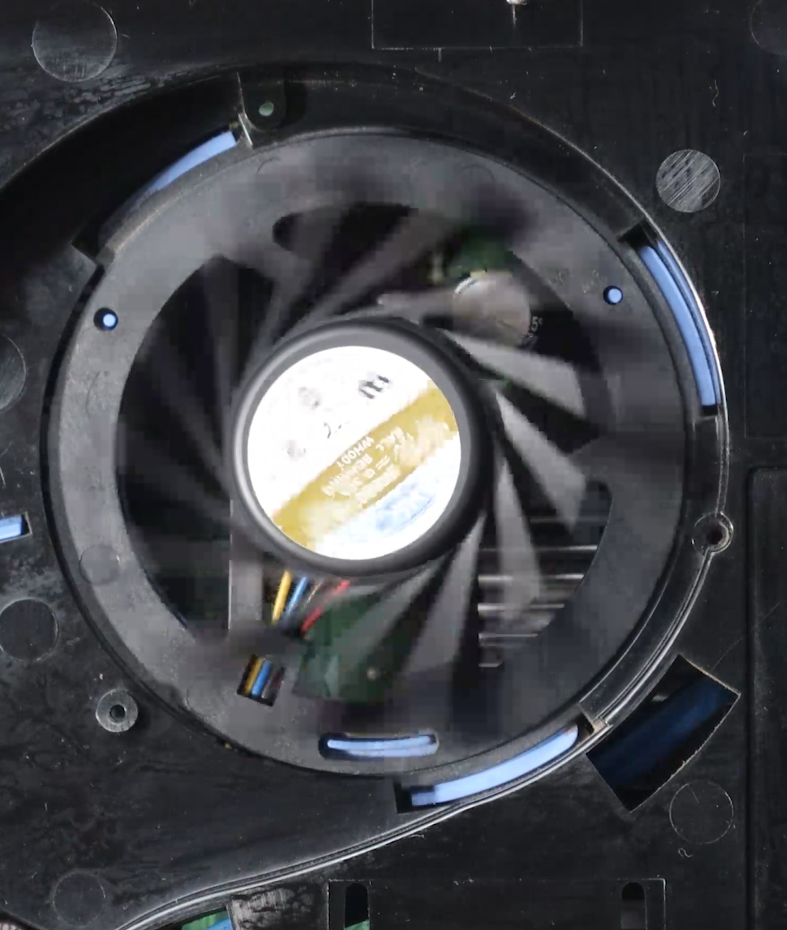
Check for Any Signs of Life
Front panel lights
Fan spinning
MB Lights
ITFreeTraining.com
© Copyright 2024
Notes:
00:39 The first step is to check for any sign of power going to the computer. So, let’s have a look at the front of the computer and see if there are any lights on. If there aren’t any, press the power button right in. If you are getting nothing, make sure you push it all the way in and hold it for a second or so. If the computer is sleeping or hibernating, sometimes it may have trouble waking up from a quick button push and so you may need to hold it down for a bit longer.
The next thing to check for is are there any fans spinning? In a lot of computers, the power supply fan will be spinning when the computer is working. However, some power supplies are designed to be as quiet as possible. Thus, if the power supply is not very hot, the fan may not be spinning. So, don’t assume that because the fan is not spinning that there is a power problem.
You will notice on this computer, when I plug the power into the computer it will spin the fans up briefly to test them. This is not the case with all computers. If your computer does do this, unplugging the computer and plugging it back in is a good test to make sure it has power. Keep in mind that, with some computers, the capacitors in them will need to drain before this approach works. Therefore, you may need to leave it unplugged for 20-30 seconds to allow the capacitors to drain before plugging the power cable back in.
Another thing you can look for is motherboard lights or lights on other devices. If you have a see-through panel on your computer case, you should be able to see the lights on the motherboard. In this video we are trying to find power problems, thus we are simply trying to identify any lights on the motherboard that may show that it is getting power.
In computing, you want to work out what is working and what is not. If the power supply is completely dead, no power will be going to the motherboard. At this stage, we are just trying to find any sign of life to indicate that the power supply is working.

Slide 4
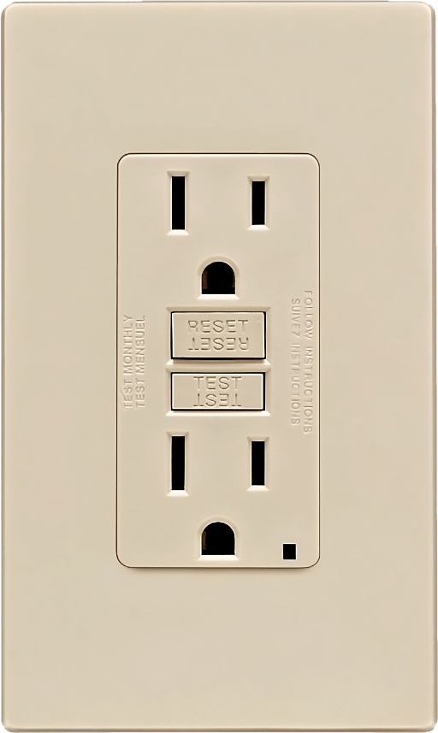
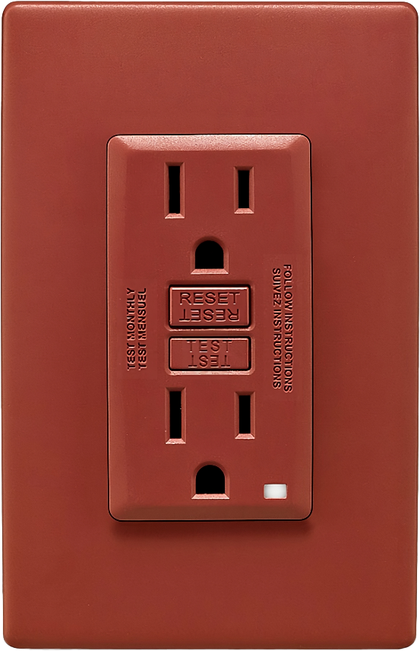
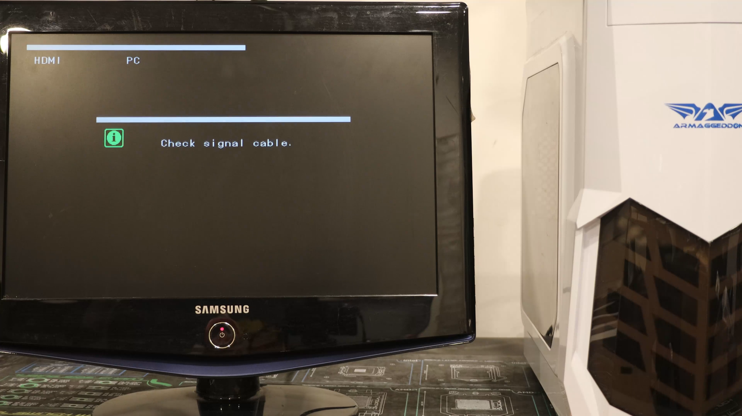
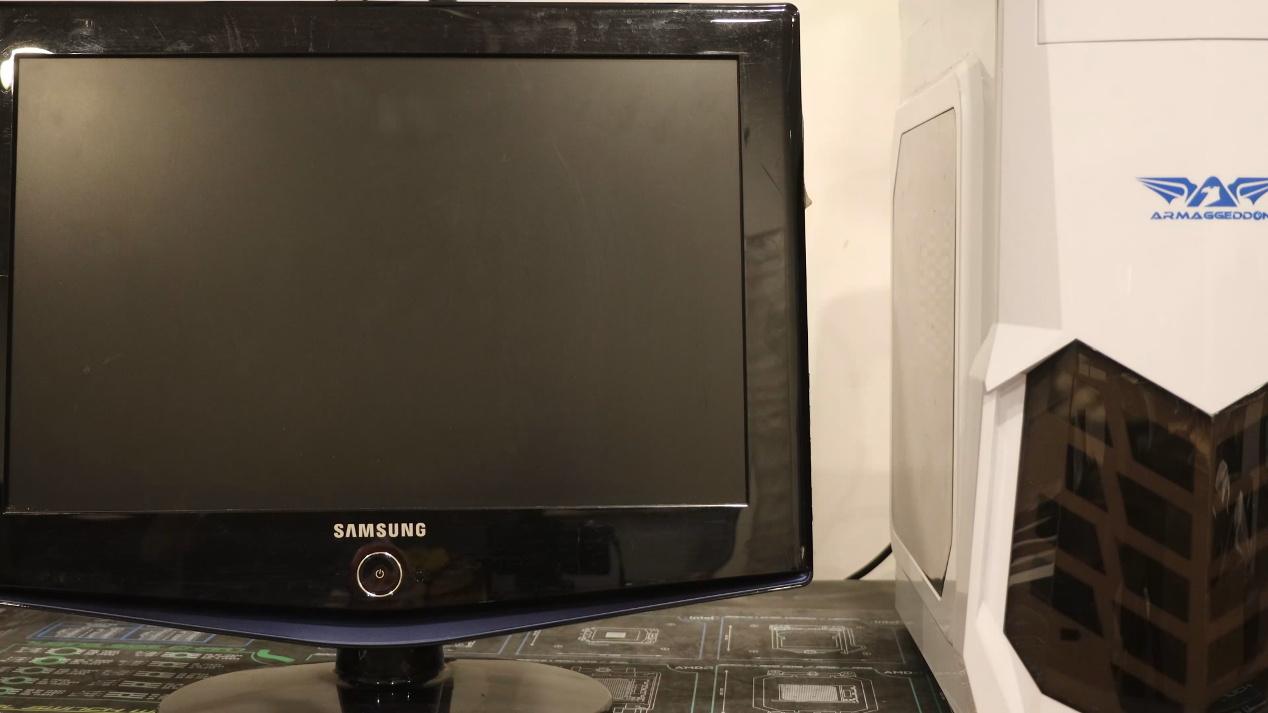
Check Other Equipment is Working
Test power cable works
Make sure - same circuit
Different outlets - maybe different circuit
ITFreeTraining.com
© Copyright 2024
Notes:
02:33 If you can’t see any signs of life in the computer, check if other equipment is working. Make sure equipment on the same circuit is working. Don’t assume that power outlets next to each other are on the same circuit. Different outlets may be on different circuits. If the outlet is a different color, then that is generally a good sign it is on a different circuit. Different color outlets may indicate that a circuit is on a UPS or a backup generator. Standard color power outlets are generally just connected to a regular power supply.
If you are not sure or the outlet is difficult to get to, you can always test that the power cable works. One of the simplest ways to do this is to unplug the computer and plug it into the monitor. This will test the power cable going to the computer and also that the power outlet is working. By doing this, we have now troubleshooted and shown that power is getting to the computer.

Slide 5
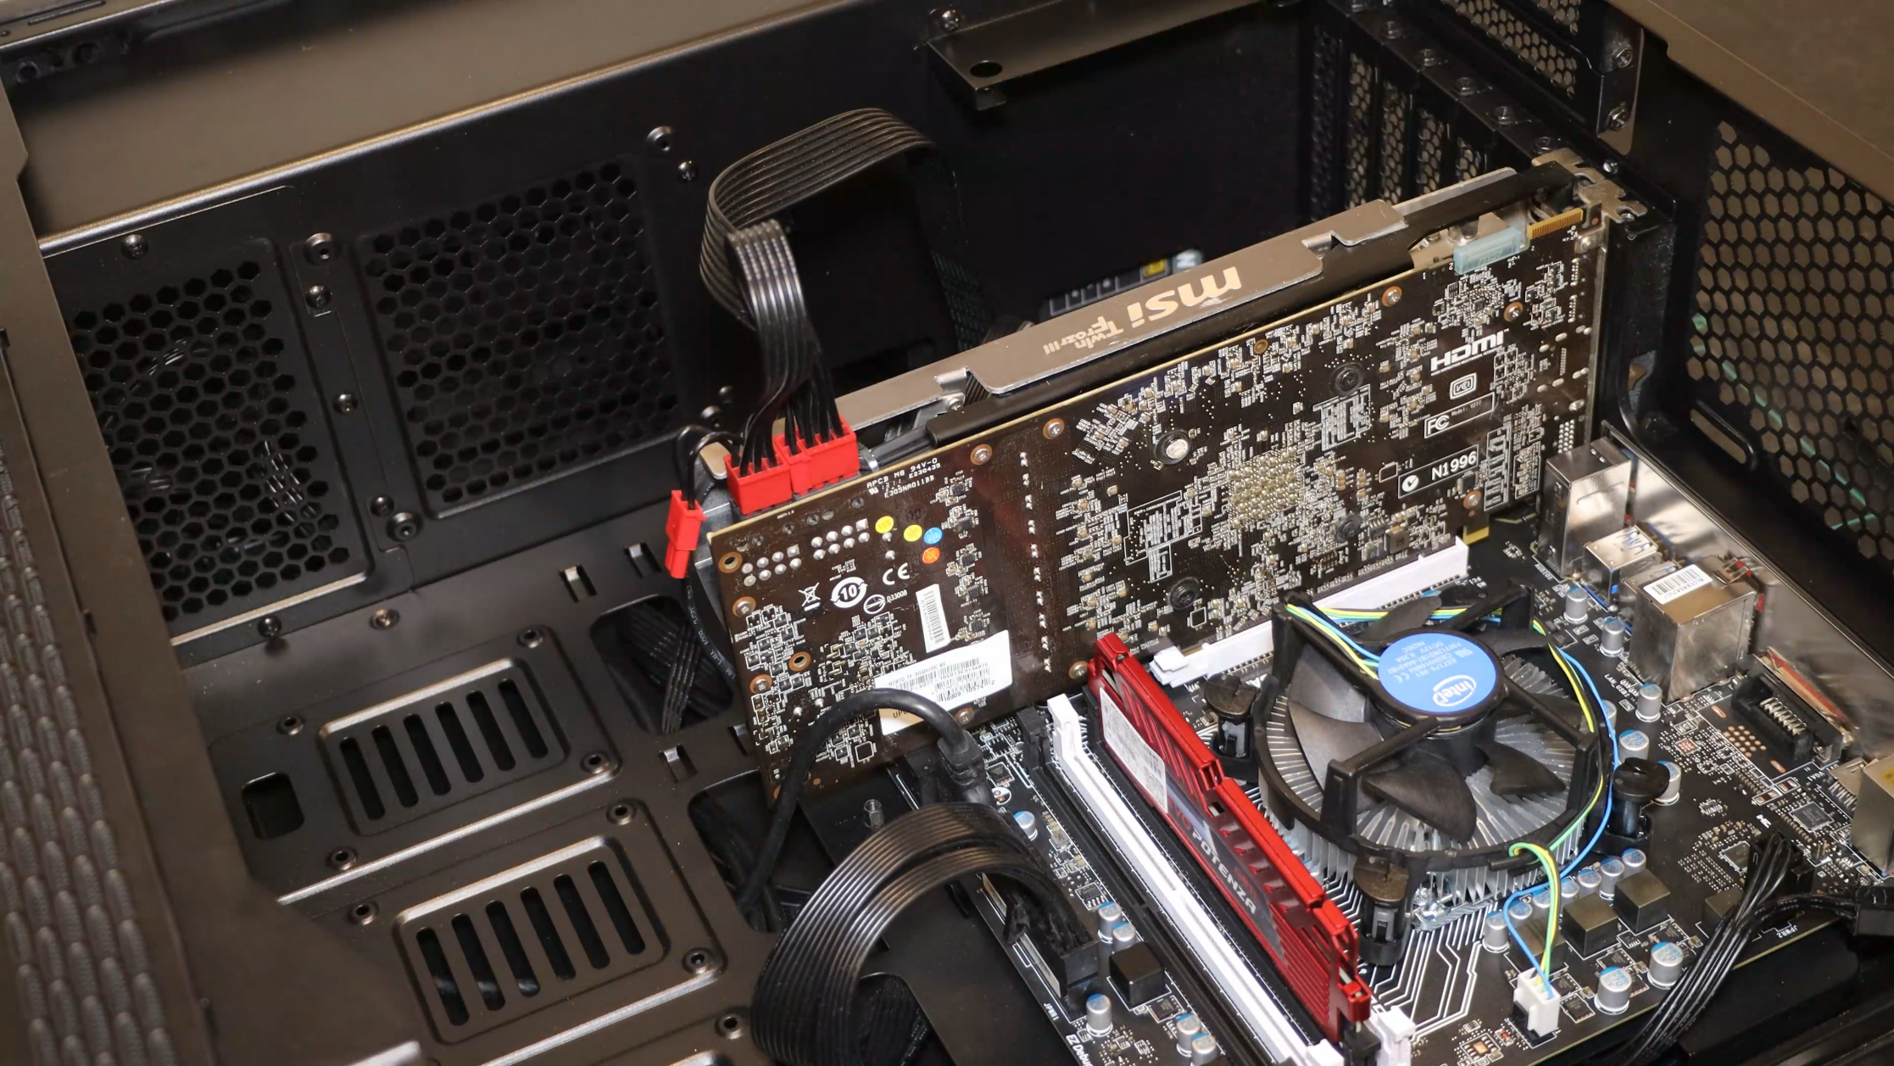
Disconnect Extra Devices
Reduce the power draw and possible damaged devices
Computer may not start up with power supply underrated (Not common problem)
ITFreeTraining.com
© Copyright 2024
Notes:
03:27 If all this fails, you can consider removing extra devices to see if any of them are causing the problem. This will reduce the power draw on the computer and also possibly remove any damaged devices that may be causing the issue.
If the computer is drawing more power than the power supply can provide, it may not start up. This is not a common problem. Although the computer draws a lot of power at start up, this is less than when the computer is under a high load. Usually, you will see this problem as random crashes when you put the computer under load. But you never know, maybe someone has built the computer with a very underrated power supply.
I would start with any high drawing power devices. For example, removing high performance video cards as these generally have the biggest power draw on a modern computer.
Even if your computer does not have integrated video, it is still worth turning the computer on to see if you get any beeps indicating it has detected a missing video card. If you get these beeps, you know the motherboard is getting power and the problem may be the video card. To test if this is the case, you can plug in a low-power video card. Since this video card does not use a lot of power, it is useful to test if power draw is the problem.
Typically, a power supply wouldn't hinder a computer from starting unless it's significantly underpowered for the system's requirements. More often, the issue lies with a damaged component within the computer. By methodically removing each device, you can isolate and identify the malfunctioning component that's preventing the startup.

Slide 6
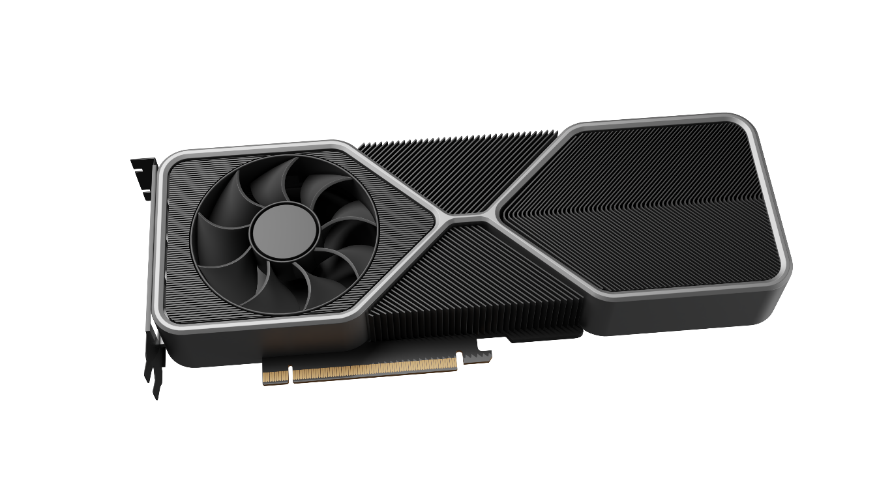
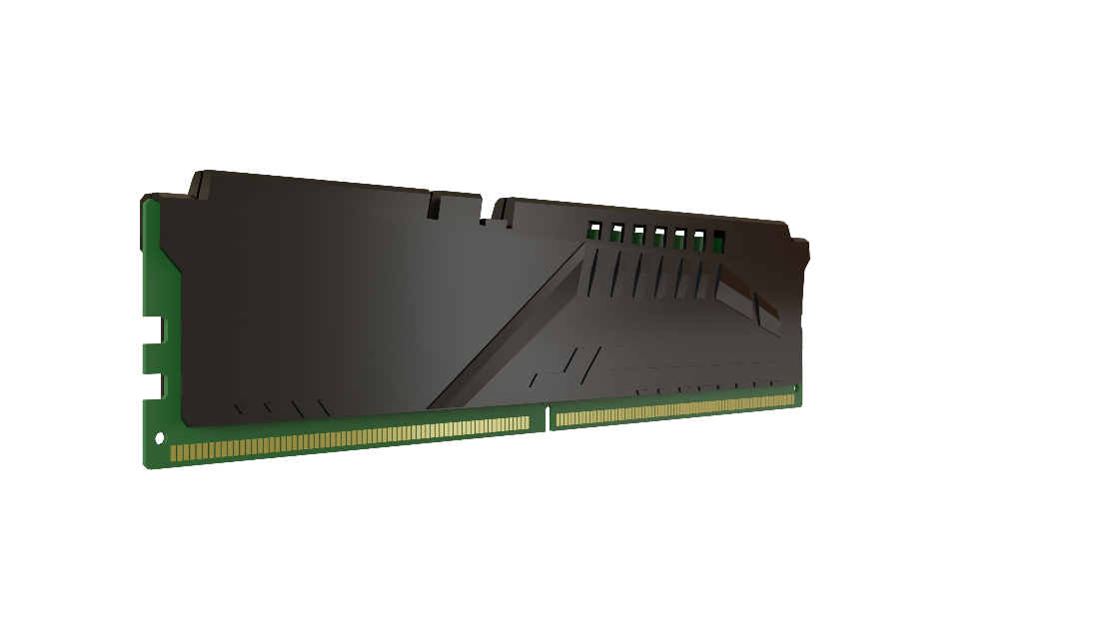
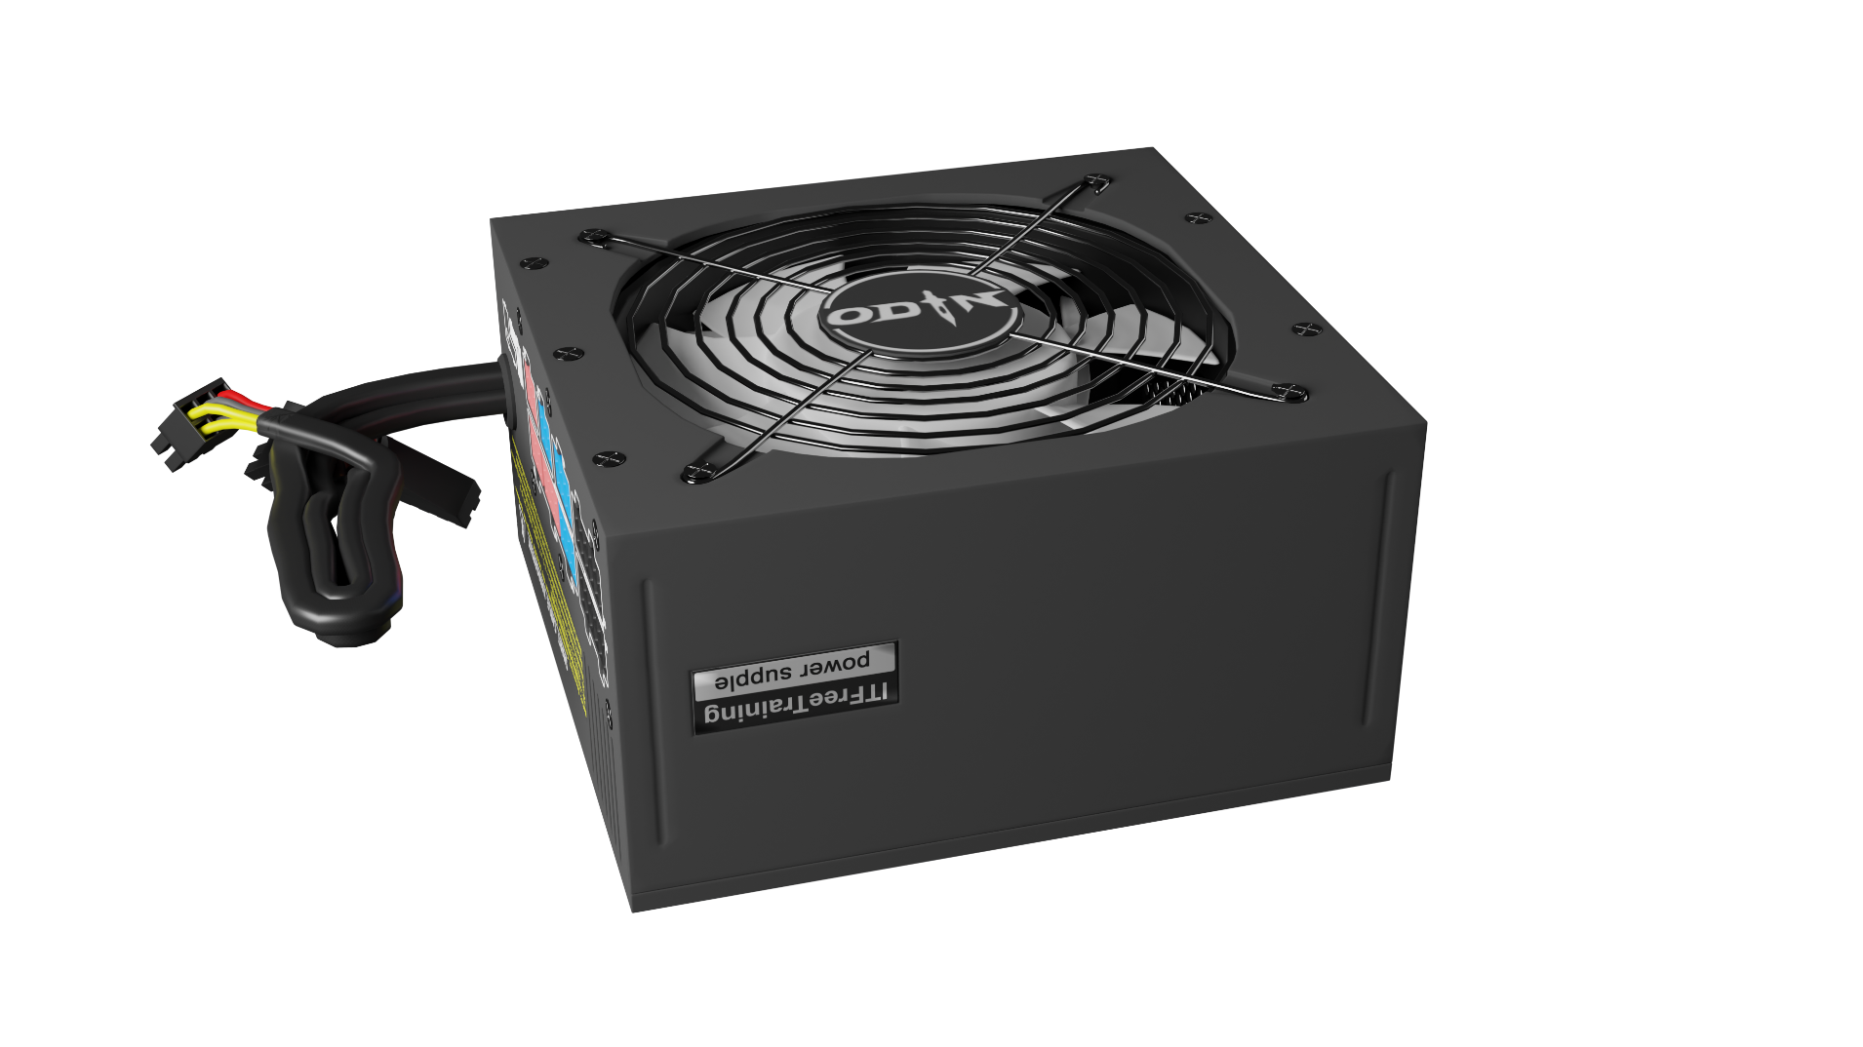
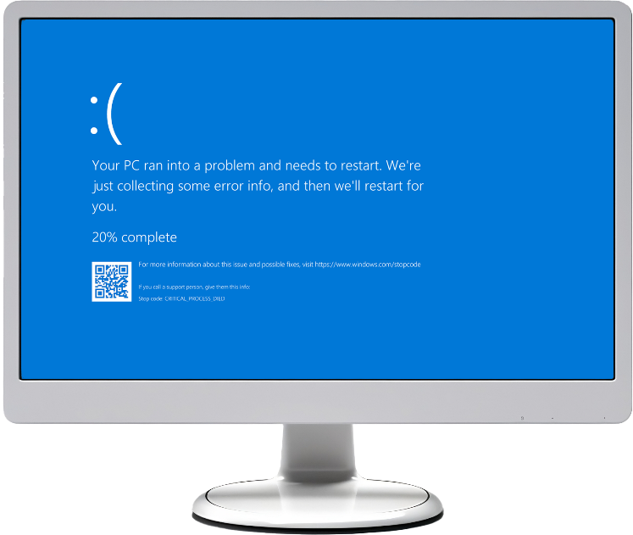
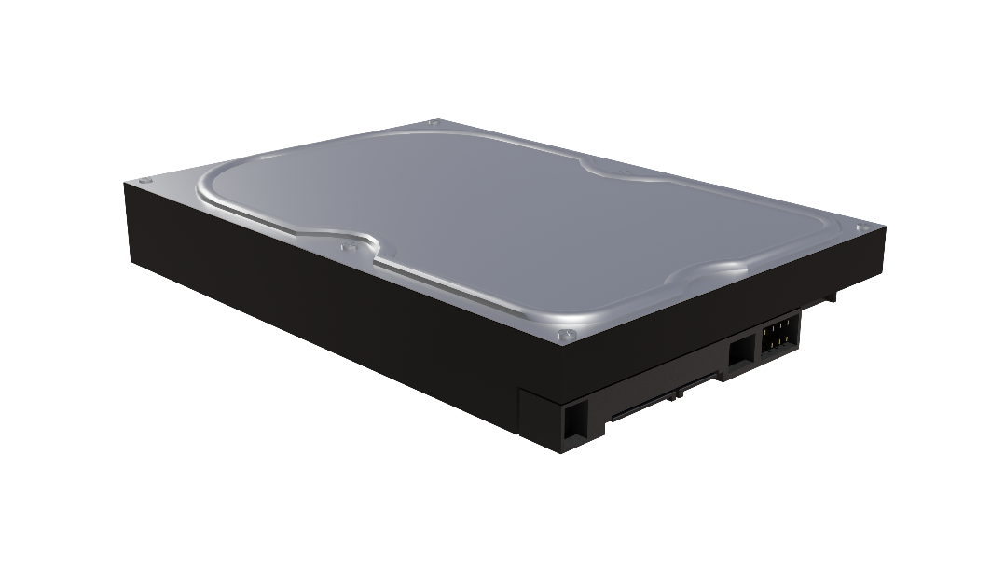
Intermittent Power Problems
PSU overloaded
PSU circuit breaker may trip
Power unstable
PSU may take time to reset
Random blue screens
ITFreeTraining.com
© Copyright 2024
Notes:
05:04 Let’s now have a look at intermittent power problems. These are problems that seem to occur randomly. The power supply will provide power to the electronics in the computer. If the draw on the power supply is too great, the Power Supply Unit, known as a PSU, can become overloaded.
When the power supply becomes overloaded, generally two things will occur. The PSU circuit breaker may trip. A circuit breaker is tripped when too much current is being pulled through it. In the case of electronics, a malfunctioning component can start pulling more power than normal or the computer could have too many components that are drawing more power than the power supply is rated to provide.
Modern power supplies will generally use resettable circuit breakers rather than manual ones. These circuit breakers may take some time to reset themselves. Usually, they will reset in less than a minute. During this period, the power supply won’t provide any power to the computer and will appear to be dead. No matter how many times you press the power button, the power supply won’t start up. Once the circuit breaker resets, the power supply will start and run like nothing ever happened.
Thus, if your computer suddenly switches itself off without warning, it may be that the power supply is overloaded and the circuit breaker has tripped. If the computer won’t restart for a little while, this tends to indicate the circuit breaker has tripped.
If the circuit breaker does not trip, the power output from the power supply may become unstable. Essentially, the power supply’s output is above what it is rated at. Thus, it is having trouble keeping the power stable. When this occurs, you may get hardware-related blue-screen stop errors.
It can be hard to work out if these stop errors are related to the power supply. This is because there will generally be different hardware errors each time. So, if you see a lot of random stop errors that seem to be hardware related on the computer, it could be your power supply is overloaded.
As power supplies age, they become less capable of outputting power. This is one of the reasons why a power supply unit may start becoming overloaded when previously there was not a problem.
It is difficult to determine if this is the case, but I will have a look at a device that may help.

Slide 7
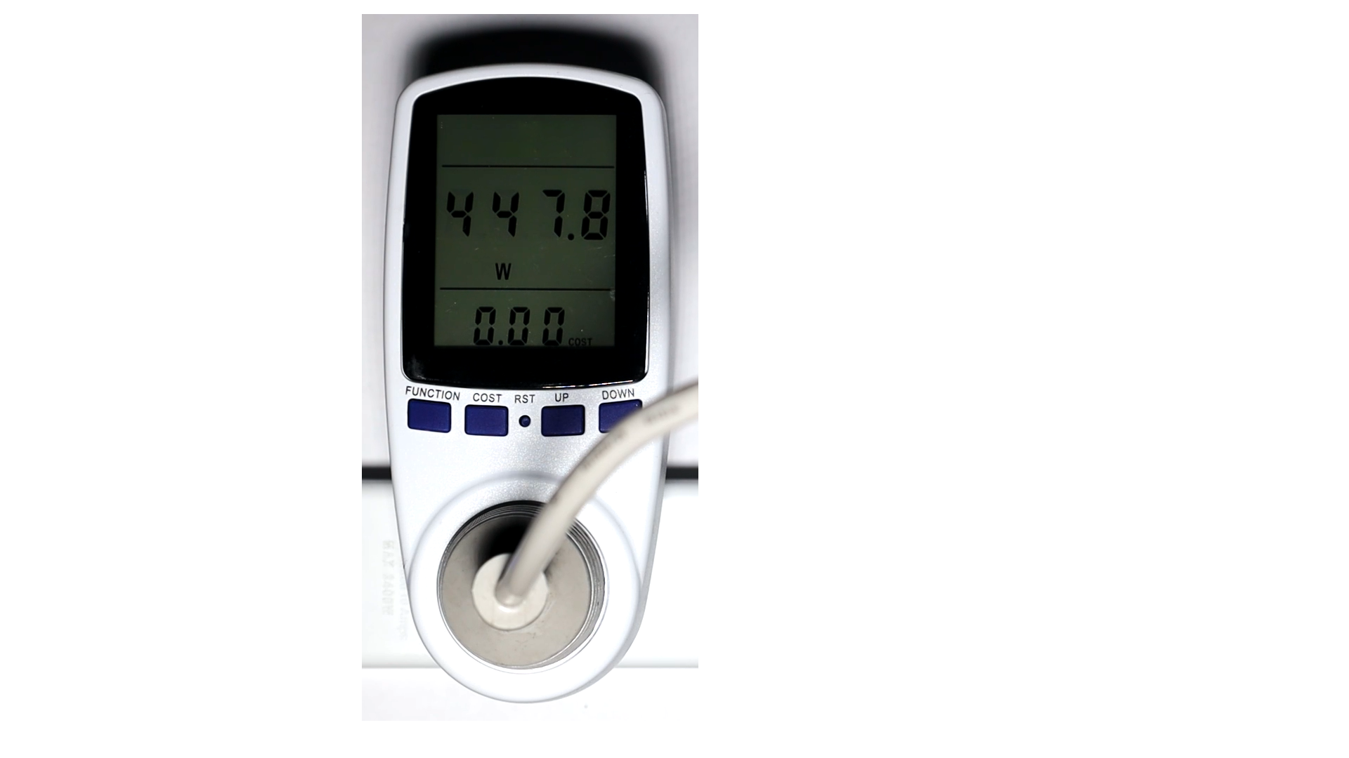
Power Supply Meter
Real-time power consumption monitor
Measures Volts/Amps/Watts
Measures maximum/minimum
Rated high enough for your PSU
ITFreeTraining.com
© Copyright 2024
Notes:
07:25 You can plug a power supply meter between your power outlet and computer. You won’t be tested on this in the CompTIA A+ exam, but it is good to know they exist because they can be useful when troubleshooting. A power supply meter will measure Voltage, Amps and Watts. This can be in real time, or you can set it to report the maximum and minimum values. Before you purchase one, make sure that it is rated high enough for your power supply unit. Computer power supplies can draw a lot of power and cheap power supply meters may not support a high-power draw.
I will now open a 3D application and you will notice how the power usage goes up. If you start having random blue screens or crashes when the power draw is high, it may be that the power supply is not able to provide enough power.

Slide 8
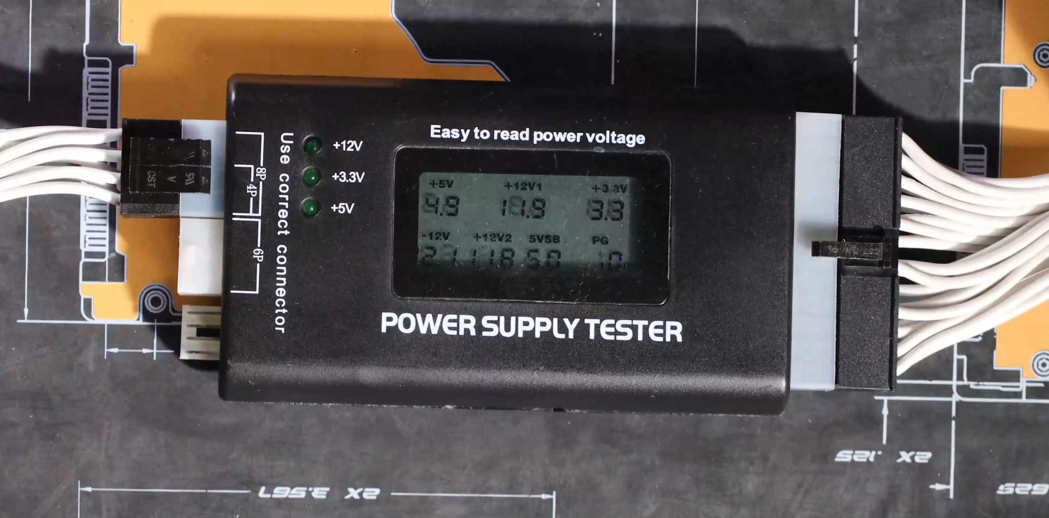
Power Supply Tester
Simple device to test if the power supply is working
Does not test the power supply under load
ITFreeTraining.com
© Copyright 2024
Notes:
08:17 Another way to test your power supply is with a power supply tester. CompTIA has removed power supply testers as an exam objective but wants to make you aware they exist. They are simple tools to use, just plug the power supply cables into the tester.
The power supply tester will tell you if your power supply is outputting the correct voltages. Keep in mind that the power supply tester does not test the power supply under load, it simply checks the voltages that the power supply outputs to make sure they are in the allowable range.

Slide 9
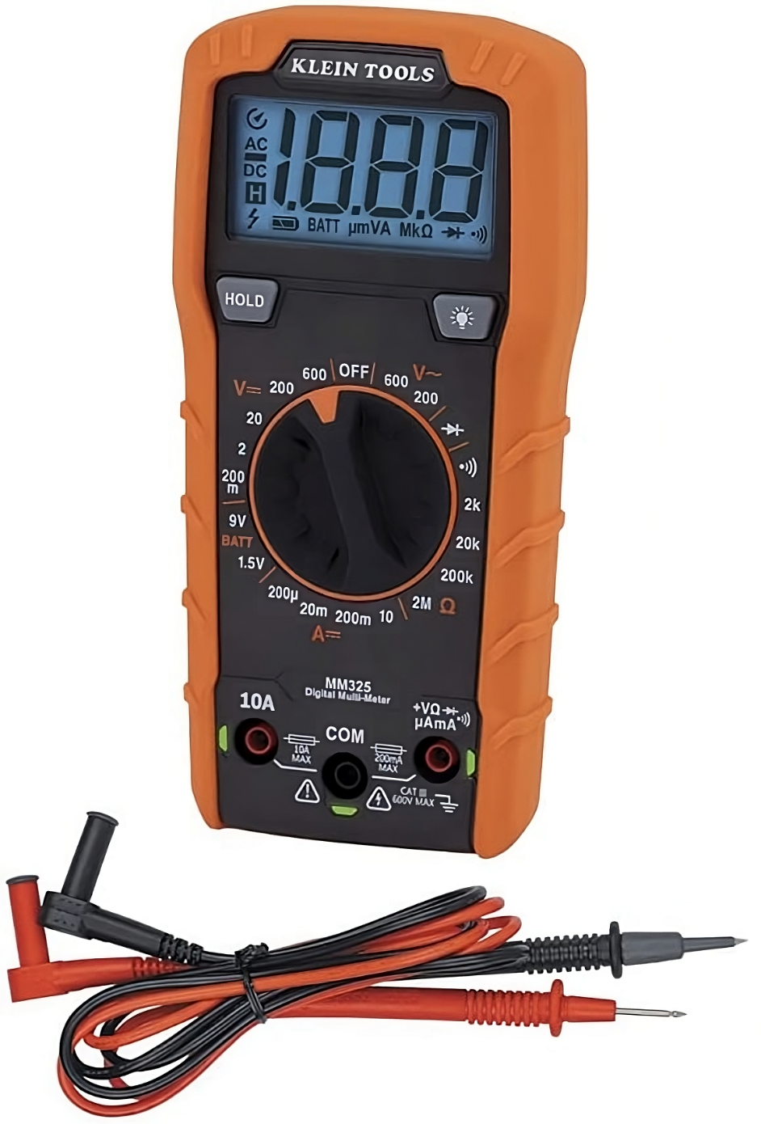
Multimeter
A measuring instrument for electrical properties
Measures voltage, resistance, current
ITFreeTraining.com
© Copyright 2024
Notes:
08:51 The last tool I will look at is the Multimeter. Like the power supply tester, this has been removed from the A+ exam objectives and thus CompTIA just wants you to have a basic awareness of it. The multimeter can measure voltages, resistance and current. If using a multimeter, make sure you use the proper settings, particularly when measuring voltages.
In the case of power supplies, you could use it to test the voltage output but in my opinion it is much safer and simpler to use a power supply tester.

Slide 10
Subscribe
Next video
Video content: https://ITFreeTraining.com/ap11/3c05
© Copyright 2024
Notes:
09:25 That concludes this video on power supply problems. I hope this video has helped you understand what to look for if you are having problems with your power supply. Until the next video, I would like to thank you for watching.
References
“The Official CompTIA A+ Core Study Guide (Exam 220-1101)” pages 98 to 99
“Picture: Blue screen stop error” https://commons.wikimedia.org/wiki/File:Bsodwindows10.png
Credits
Trainer: Austin Mason https://ITFreeTraining.com
Voice Talent: HP Lewis http://hplewis.com
Quality Assurance: Brett Batson https://www.pbb-proofreading.uk

