Slide 1
Notes:
Let’s have a look at adapter cables.

Slide 2
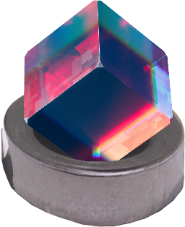
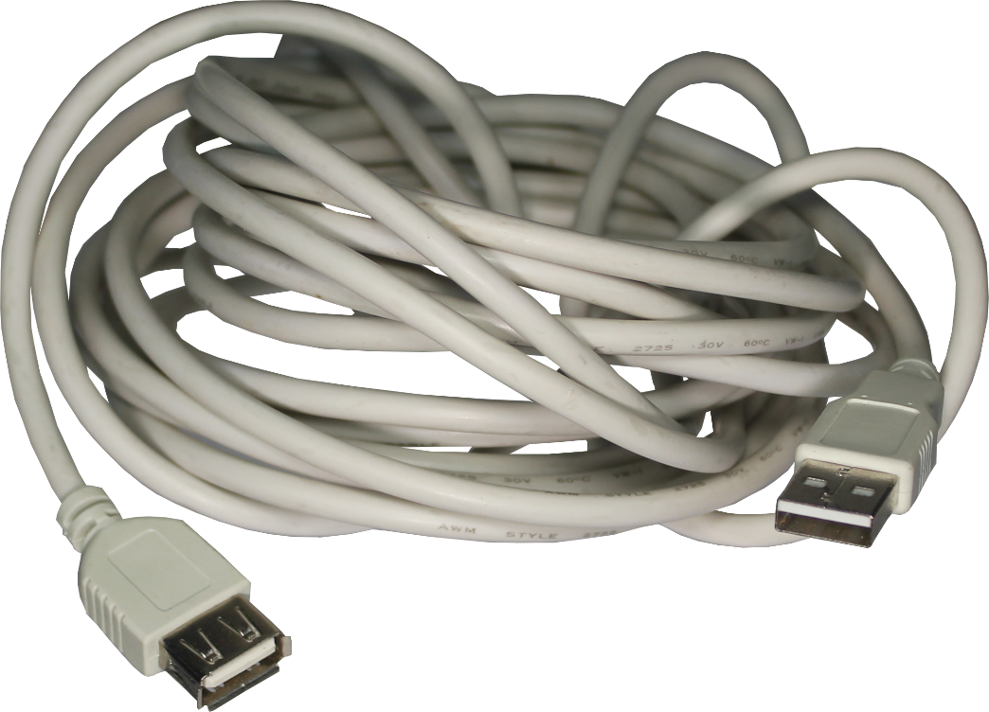
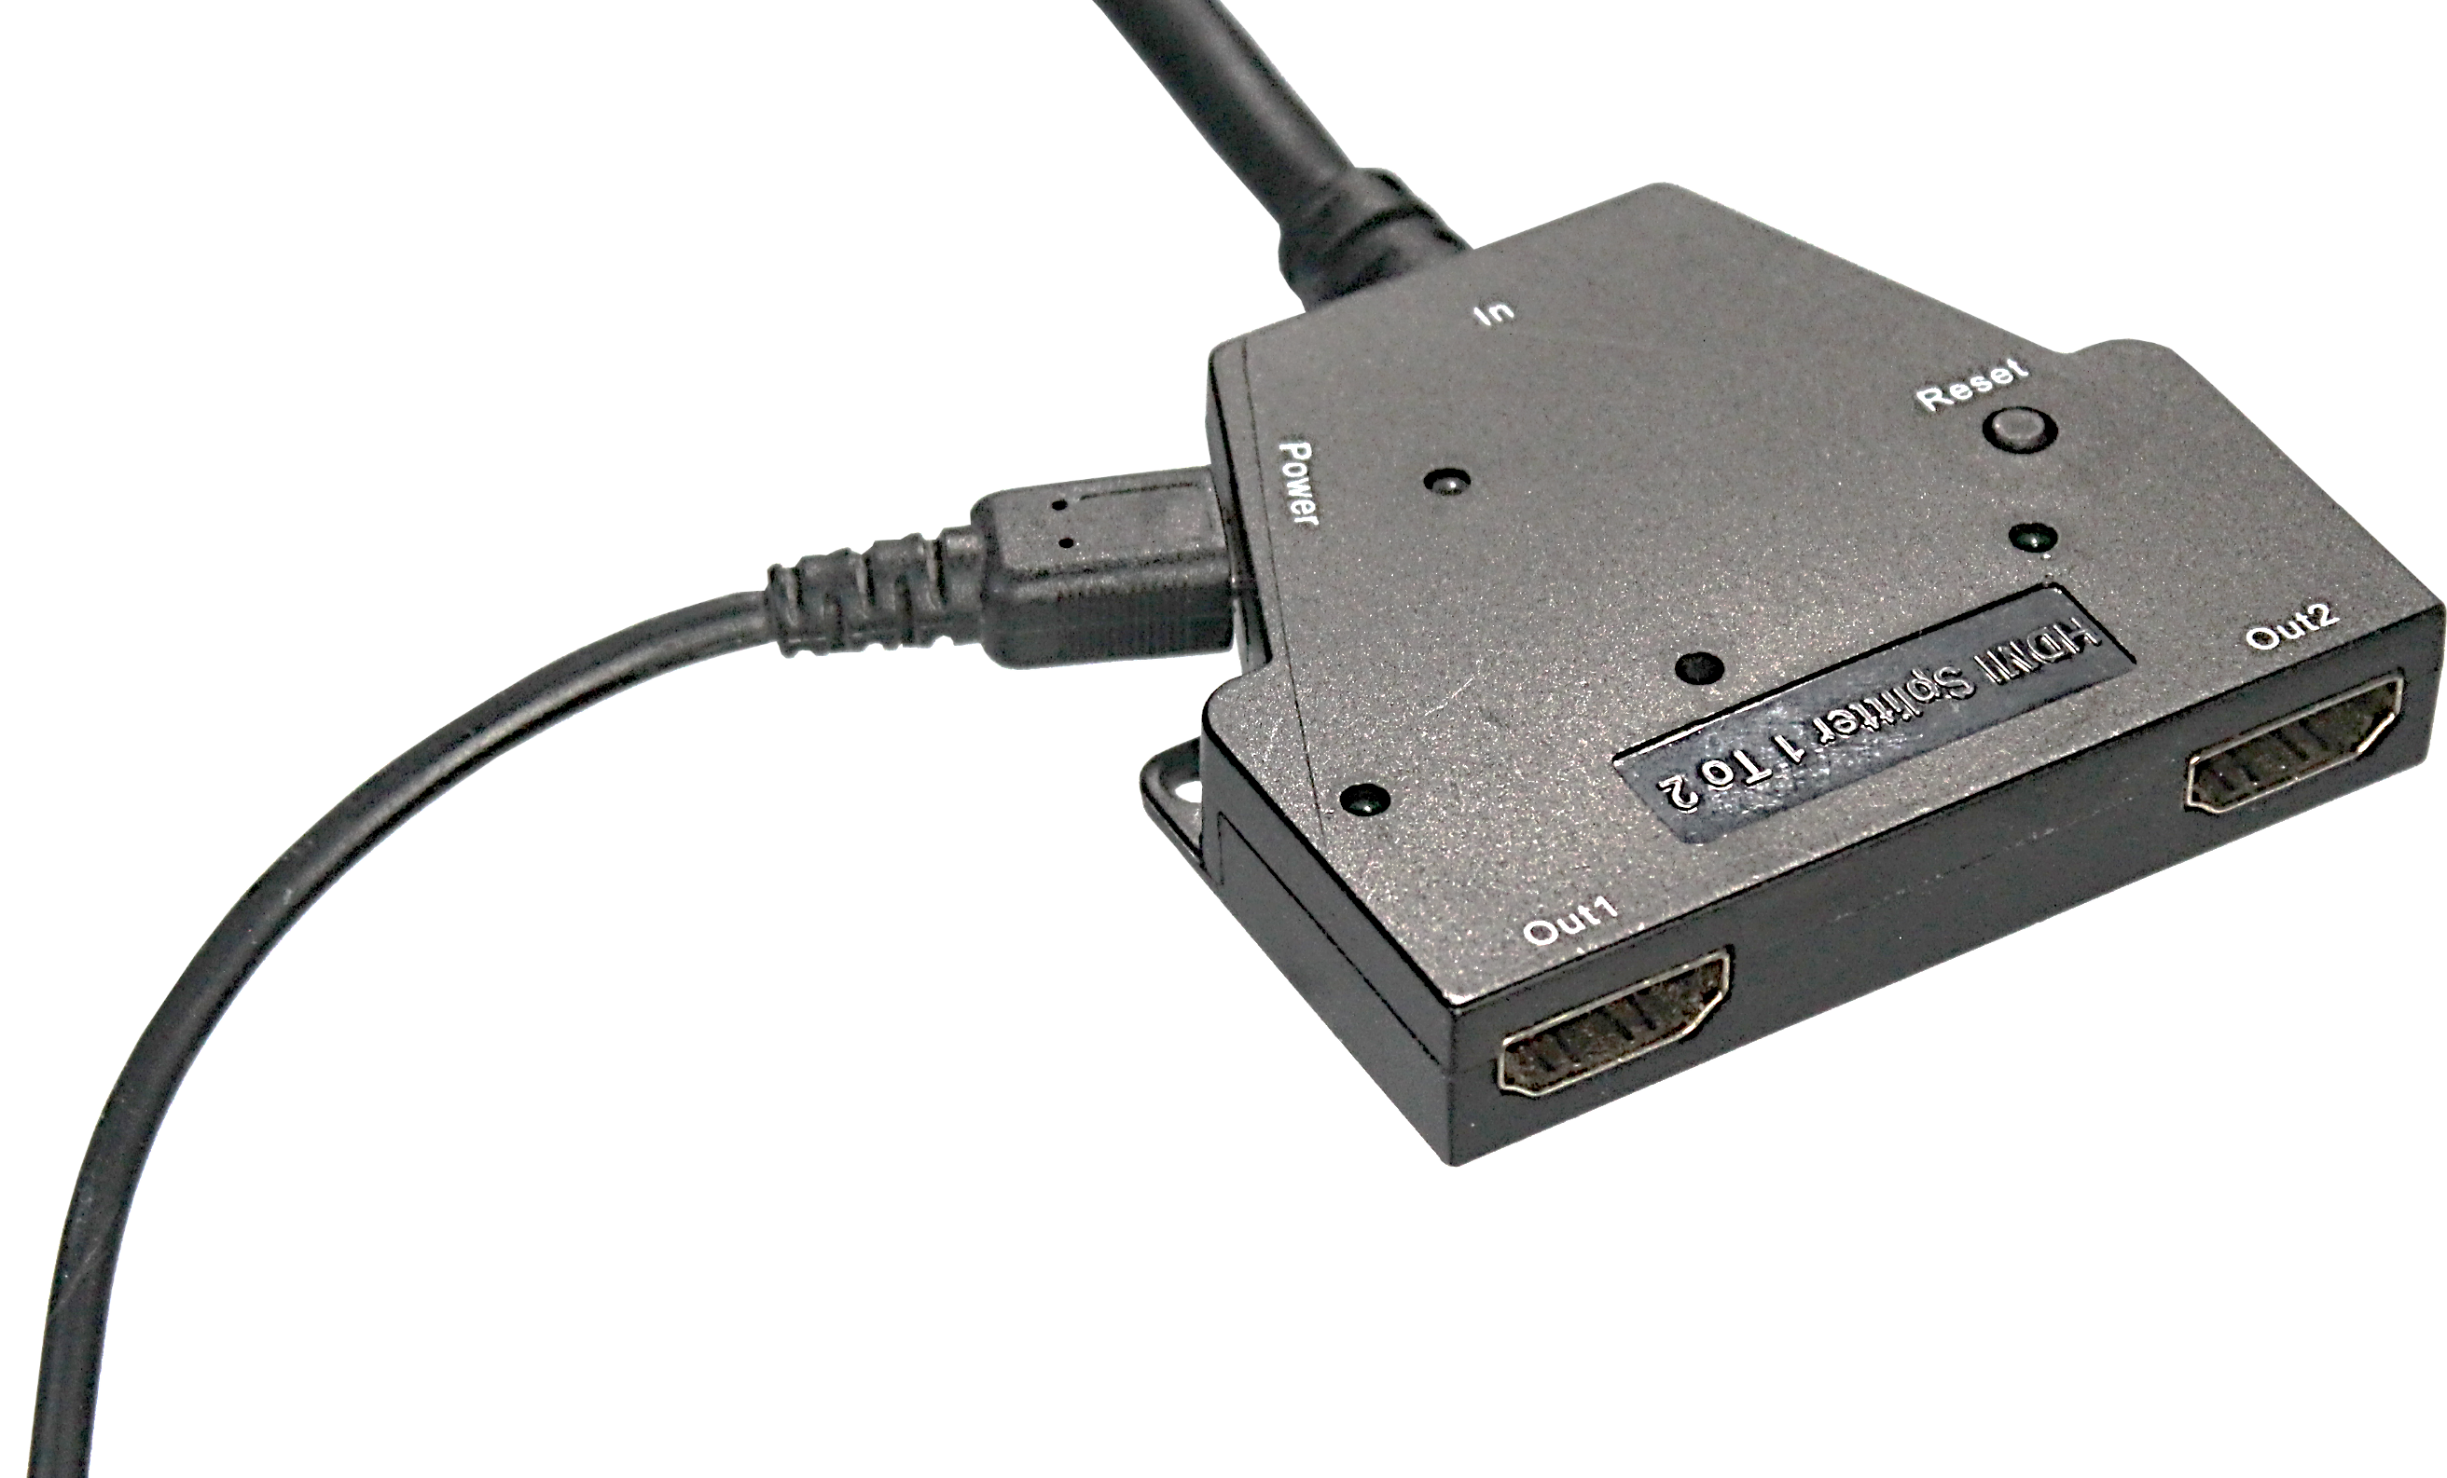
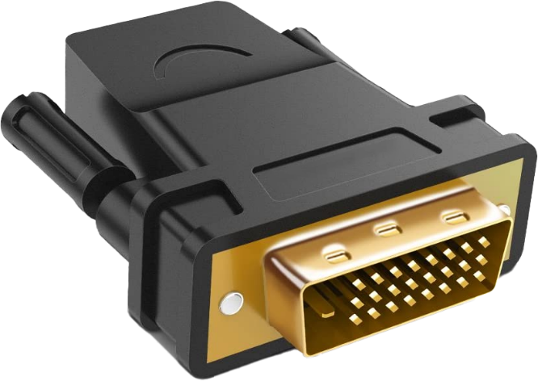
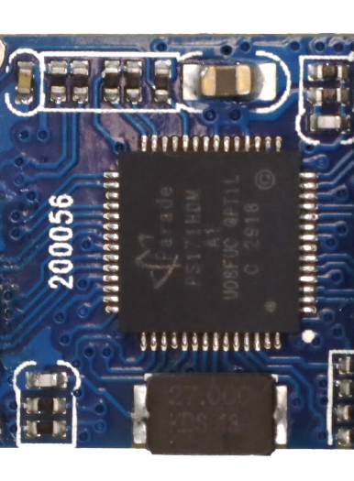
Adapter Cables
Converts/extends one connector to another
Passive
Active
Some adapters/cables
have external power
No/minimal electronics
Has electronics
Cheap
Convert/boosts signal
ITFreeTraining.com
© Copyright 2024
Notes:
00:03 Adapter cables essentially change or extend one connector to another. They come in two different types, the first being passive. These cables and adapters have no electronics or only minimal electronics. If the cable does have any electronics, it only has very basic features such as changing voltages. Nothing too significant. The advantage of these cables is that they are inexpensive.
The other type is active. Active have additional electronics in the cable or the adapter. These additional electronics convert and/or boost the signal. In the case of conversion, the input signal is completely recreated and output as a new signal. In the case of boosting, the signal is amplified. Either of these allow the cable to be longer in length.
In some cases, in order to power the electronics, some adapters and cables allow external power to be connected. A lot of the time, the adapter or cable will work without the external power plugged in. However, the external power will allow the electronics in the device to transmit a better signal. If you find that you are having transmission problems or other problems, such as not being able to use higher resolutions, make sure the external power is plugged in.
When you purchase a cable, the packaging will generally tell you if it is a passive or active cable. If this is missing, the cable or adapter is most likely passive. Let’s have a look at some adapters.

Slide 3
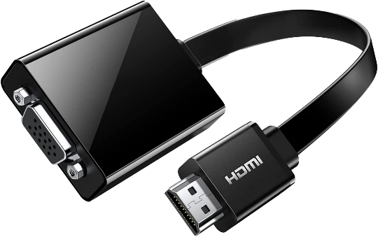
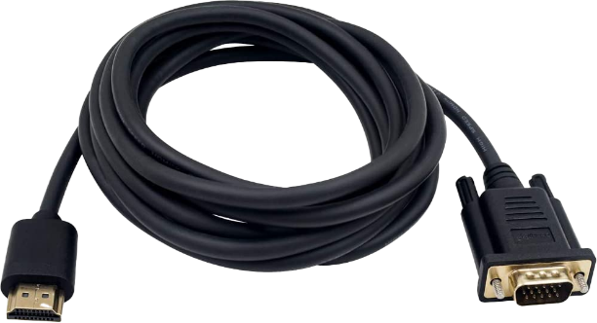
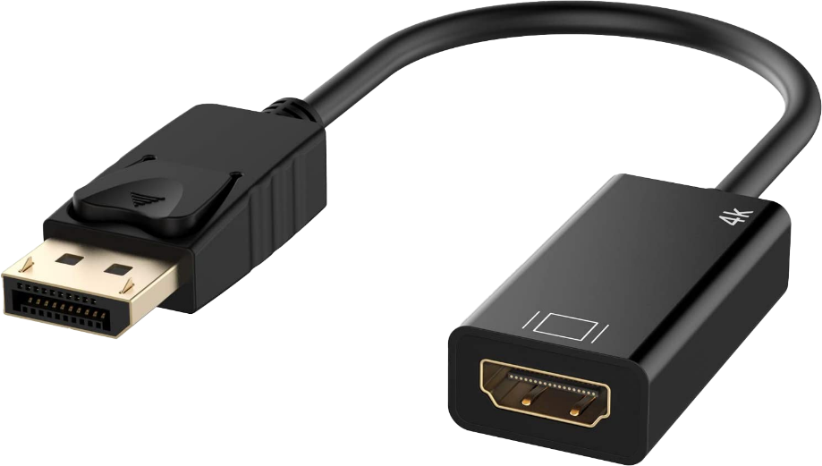
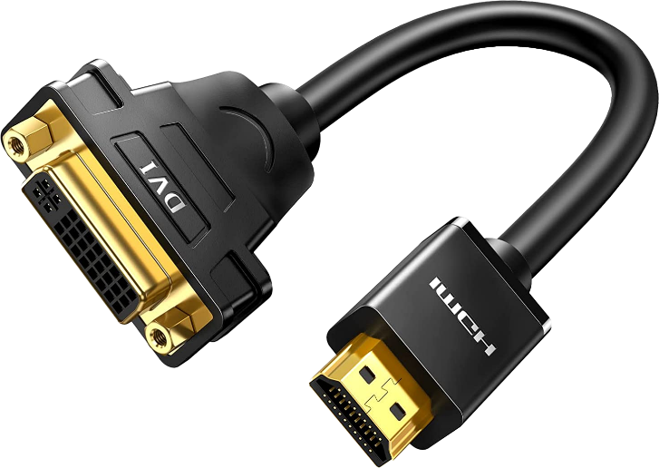
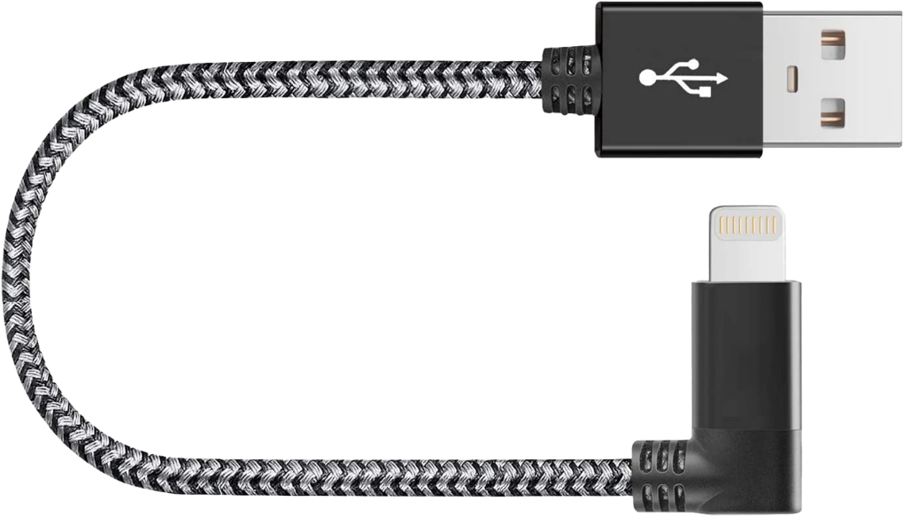
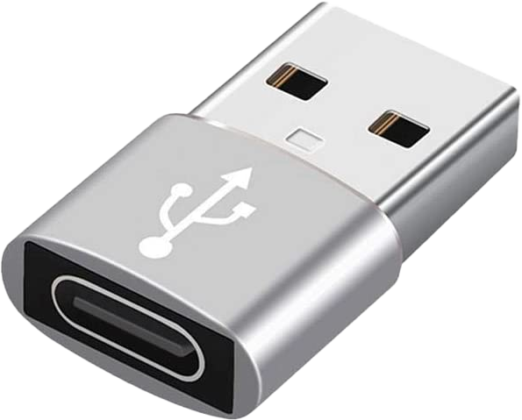
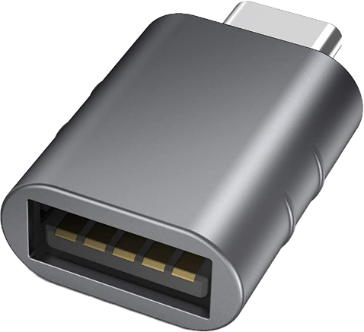
Adapter Types
Passive
Active
HDMI to VGA
HDMI to DisplayPort
HDMI to DVI
USB 2.0
USB 3.0
USB Adapters
Lightning to USB
ITFreeTraining.com
© Copyright 2024
Notes:
01:32 There are many different adapters and cables that allow you to connect different connector types together. The first example is HDMI to VGA. The first one is passive and the second one is active. Looking at both, you can’t tell which is which. So don’t assume, if a cable or adapter looks a particular way, that it is passive or active.
There are also other adapters on the market, such as HDMI to DisplayPort and HDMI to DVI. You don’t need to remember them all, just be aware they exist. If you need to convert one connector to another, have a look to see if a cable or adapter exists. When looking at these cables and adapters, they will usually have specifications for what they can do. For example, in the case of video cables they generally will list the resolutions that they support.
There are also adapters and cables that convert different types of USB connectors. It is important to check what they support. In this example, one adapter supports USB 2.0 and the other supports USB 3.0. Notice that the adapters are pretty similar. Don’t assume, because a particular connector is used, that a particular standard is also used.
There are also cables like Lightning to USB cables. Cables like these have microchips that authenticate with the device. This prevents a non-certified cable being used with these devices. If you purchase a non-certified cable, you may find the cable has problems authenticating with the device and may not work.
When purchasing a cable or adapter, read the specifications of what is supported. Passive devices are cheaper; however, active adapters and cables are generally more reliable and work over longer distances.

Slide 4
Subscribe
Next video
Video content: https://ITFreeTraining.com/ap11/1c30
© Copyright 2024
Notes:
03:23 That concludes this video. Hopefully this video has helped you understand what to buy and what you may use a particular adapter/cable for. Until the next video from us, I would like to thank you for watching.
References
“The Official CompTIA A+ Core Study Guide (Exam 220-1101)” page 39
“Picture: Cube” https://www.pexels.com/photo/purple-and-pink-diamond-on-blue-background-5011647/
Credits
Trainer: Austin Mason https://ITFreeTraining.com
Voice Talent: HP Lewis https://hplewis.com
Quality Assurance: Brett Batson https://www.pbb-proofreading.uk

