Slide 1
Notes:
Let’s have a look at IDE, which today is known as PATA.

Slide 2
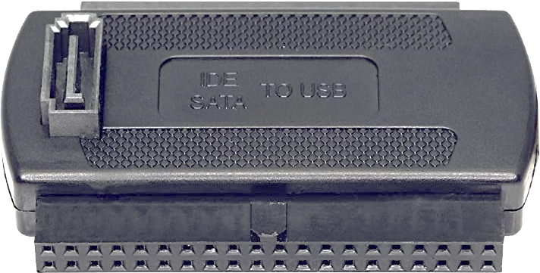
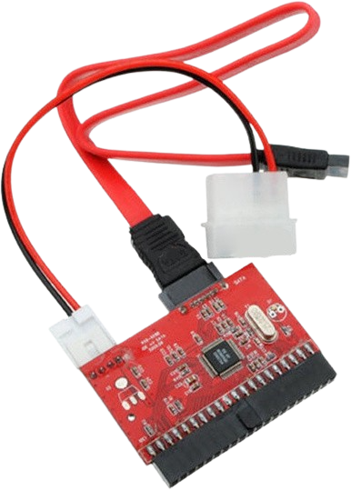
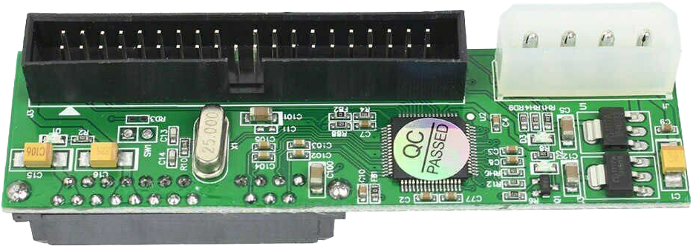
In The Real World
PATA (Otherwise known as ATA/ATAPI/UDMA/IDE/EIDE)
Last hard disk was manufactured in 2013
Have an idea what the connector/cable looks like
Then ignore it if you can and use something else
Adapters available
PATA to SATA
SATA to PATA
ITFreeTraining.com
© Copyright 2024
Notes:
00:05 In the real world, the term PATA covers all the other terminology that was previously used. If the term PATA is not being used, probably IDE will be used. Nowadays, you will find that most of the time, the terms IDE and PATA are used interchangeably and the other terminology rarely used, if at all.
Don’t worry too much about remembering any of this, because the last IDE hard disks were manufactured just over 10 years ago. When talking about hard disks, generally IDE will be used to describe the hard disk itself and PATA will be used for the connection, but there is no fixed rule in place.
Considering that the replacement, SATA, was released in the year 2000, IDE hard disks were well and truly on the way out when the last IDE hard disk was manufactured. So, the question is, why is this still an exam objective? Since it is old and obsolete technology, I can’t really understand why it is still an exam objective. That is a question for CompTIA.
In the real world, I would have an idea what the connector and the cable look like. This will allow you to hopefully ignore it and look for something else to use. The technology is obsolete, and you will most likely only see the connector on a USB storage adapter. When this occurs, you will probably be using a SATA connector and when you see the IDE connector, just ignore it.
If you do come across one of these IDE hard disks, you are probably working on a computer over 15 years old. There are adapters available, but I would recommend replacing the hard disk with a SATA hard disk. If the computer is that old, it is probably going to fail at some stage, so you should consider replacing the computer anyway.
If you want to know more about PATA, we have some older videos that go into more details about it. For this video, I will only cover the information that is provided by CompTIA.

Slide 3
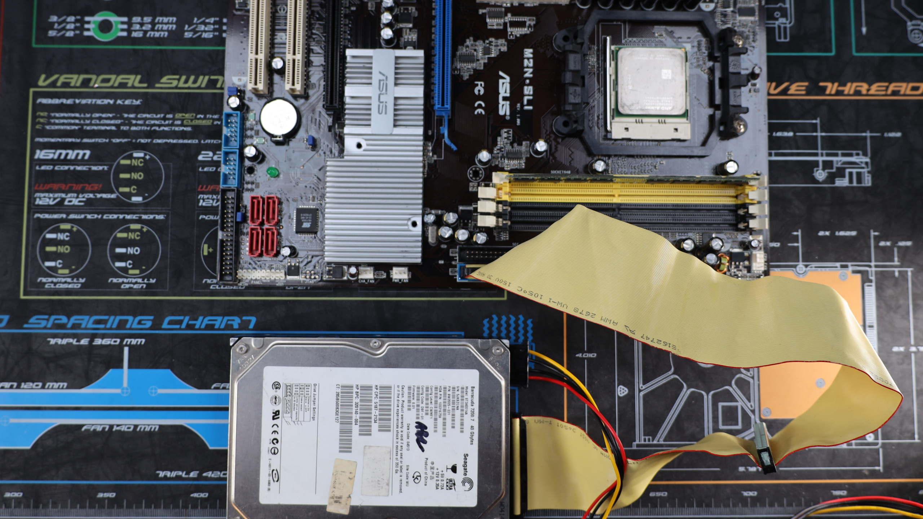
Integrated Drive Electronics (IDE)
After SATA was released, IDE referred to as PATA
As well as any other previous versions and other terminology
Once referred to as Master/Slave. Now called Device 0/1
ITFreeTraining.com
© Copyright 2024
Notes:
02:04 IDE, or Integrated Drive Electronics was a name that became synonymous with early hard disks. I won’t go into the technical DETAILS of how accurate calling a hard disk IDE is, but accurate or not, it became the common name used for hard disks which had a particular connector.
When SATA was released, IDE and all the other versions and terminology were collectively referred to as PATA. PATA supports two hard disks on a single cable and thus is parallel. SATA supports one hard disk per cable and thus is serial.
To understand this better, let’s look at connecting a hard disk to a motherboard. This motherboard has two IDE connectors, which was common back in the day. This was later dropped down to one and nowadays motherboard manufacturers don’t include these connectors on the motherboard at all.
The cable that is used is a ribbon cable with three connectors. You will notice that, on the left side of the cable, there is a lot of space between the two connectors, whereas on the right side of the cable, there is less space between the connectors. These cables are designed so one end is plugged into the motherboard and the other two ends are plugged into the hard disks. Thus, IDE can support two hard disks on the same cable.
I will first have a look at the connector for the motherboard. A lot of the time, the cables will be color coded. In this case the motherboard connector is green; however, a lot of the time it will be blue. You will notice the cable has a blocked pin and also has a raised protruding edge to prevent the connector being put in the wrong way.
If you have trouble working out which end is the motherboard connector, look for the big space or gap between two of the connectors. On the other end of the cable is the connector for the first hard disk – it is the same as the first connector. All the connectors are the same, thus you can easily put the wrong connector in. If you do this, it does not affect the operation of the cable; however, it may affect the order of the hard disks, that is, which is device zero and which is device one. We don’t cover that in this video, but in our other videos, we look at how to change the jumpers on the hard disk to determine which hard disk is first and which is second.
I will next have a look at the middle connector of the cable. Notice it is the same connector but is of a different color. In some cases, the cable and the connector may all be the same color, but generally they are color coded so you know which is which.
I will next plug the motherboard connector into the motherboard. The keying prevents the connector from being plugged in the wrong way.
The last step is to plug the connector into the hard disk followed by the power connector. Once this is done, the hard disk is now installed and ready to go. PATA differs from SATA in that it supports two hard disks on the same cable, therefore I could add a second hard disk if I wished.
In old reference material, you may hear the first hard disk referred to as the master and second hard disk as the slave. In the very, very old days of computing, the first hard disk had a bit more control and responsibility than the second hard disk. You could not run a system without a master hard disk and hard disks were not always compatible with each other. As technology improved, this was no longer a requirement. Thus, the master and slave terminology was dropped and now the drives are referred to as device zero and device one. Although you would normally install a single hard disk as device zero, you could install it as device one. Nowadays, there is nothing stopping you doing that if you wished.

Slide 4
Subscribe
Next video
Video content: https://ITFreeTraining.com/ap11/1c20
© Copyright 2024
Notes:
05:44 That concludes this video from ITFreeTraining on IDE and PATA. A technology that is now long obsolete, so I doubt you will come across it. If you do, we have other videos that cover it in more detail. Until the next video from us, I would like to thank you for watching.
References
“The Official CompTIA A+ Core Study Guide (Exam 220-1101)” page 37
Credits
Trainer: Austin Mason https://ITFreeTraining.com
Voice Talent: HP Lewis https://hplewis.com
Quality Assurance: Brett Batson https://www.pbb-proofreading.uk

