Slide 1
Notes:
Let’s have a look at SCSI.

Slide 2
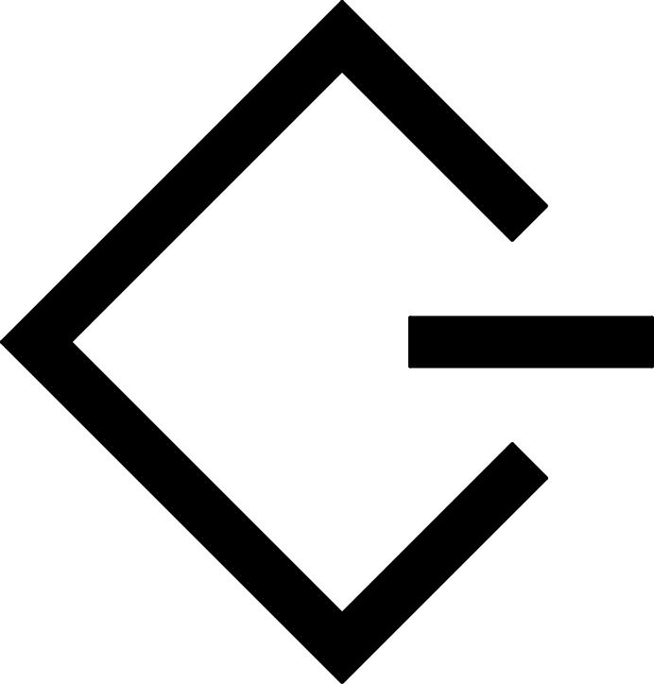
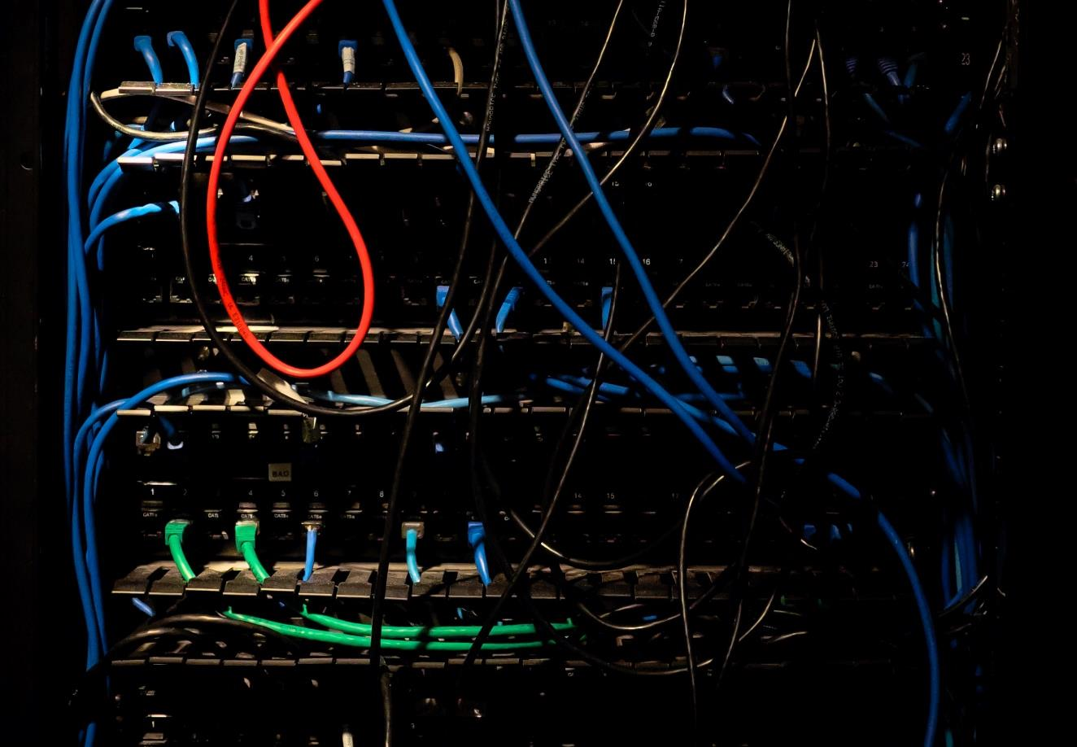
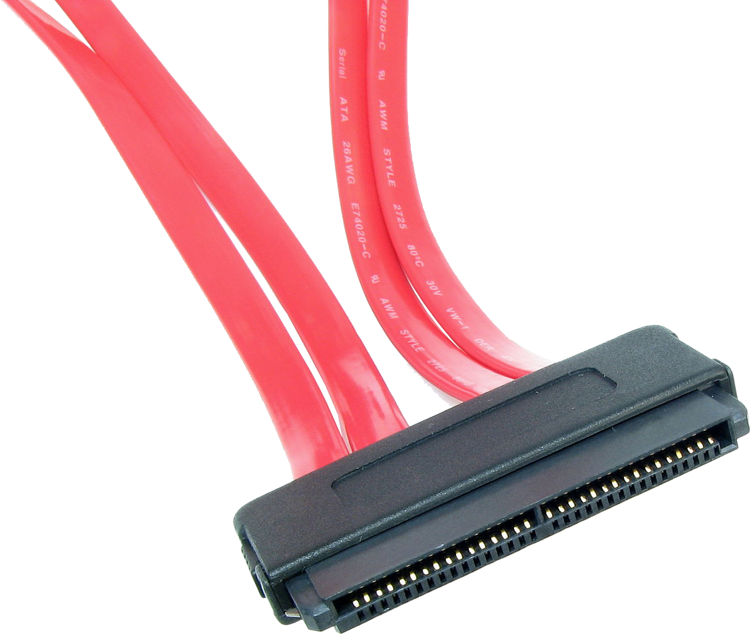
In The Real World
Small Computer System Interface (SCSI)
Traditional SCSI Obsolete
SCSI protocol however is not
SAS (Serial Attached SCSI)
iSCSI (Internet SCSI)
Cloud/Servers
Makes available on network
ITFreeTraining.com
© Copyright 2024
Notes:
00:02 In the real world, Small Computer System Interface, otherwise known as SCSI, in its traditional form is obsolete; however, the SCSI protocol is still used. Therefore, it is unlikely you will be working with traditional SCSI unless you are working on a very old computer.
Nowadays, if you come across a SCSI connector, it most likely will be using Serial Attached SCSI or SAS. Originally SCSI used to transfer data in parallel. That is, SCSI sent data over multiple lines at the same time. The data needed to be transferred in sync over all lines, which is difficult to achieve, particularly when the data rate increases. For this reason, SCSI changed from sending data in parallel to sending it in serial, thus the name Serial Attached SCSI.
SAS drives are mainly used in cloud and server storage. In the old days, you would have found SCSI used in high performance workstations, but we don’t really see that occurring with SAS. If you find there is a lot of storage, and I mean storage that uses tens if not hundreds of storage devices, it is most likely using SAS. There is one exception where you may find an implementation of SAS that is used in workstations. I will have a look at this exception, why it is needed and when you may use it.
The other main place that you may come across SCSI is Internet SCSI or iSCSI. iSCSI makes SCSI available over the network and it provides block level access. Block level means the storage will appear to the computer as local attached storage. Thus, iSCSI can be used to provide storage over the network to a computer and the computer will see that storage the same way as it would see directly connected internal storage. It is possible to use iSCSI to boot a computer from the network, thus you could remove the hard disk from a computer and boot the computer using storage from the network instead. As the name suggests, it is possible to use iSCSI over the internet; however, iSCSI is generally used on local networks or high-speed networks. Although possible to use over slow networks, the risk of data loss goes up. Therefore, on slow networks, traditional data sharing such as using file sharing is recommended.

Slide 3
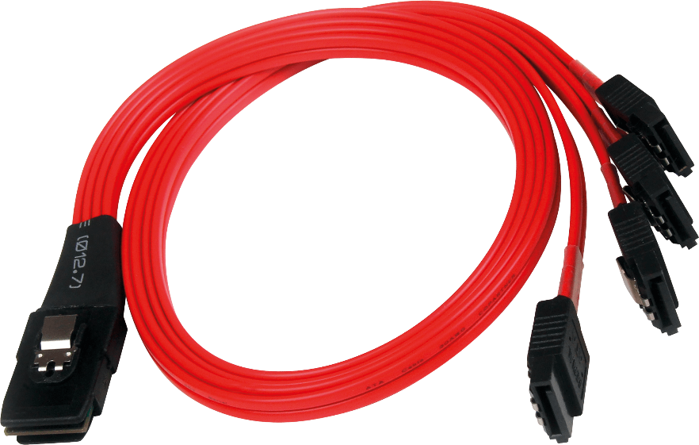
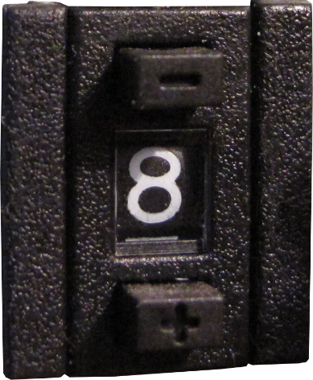
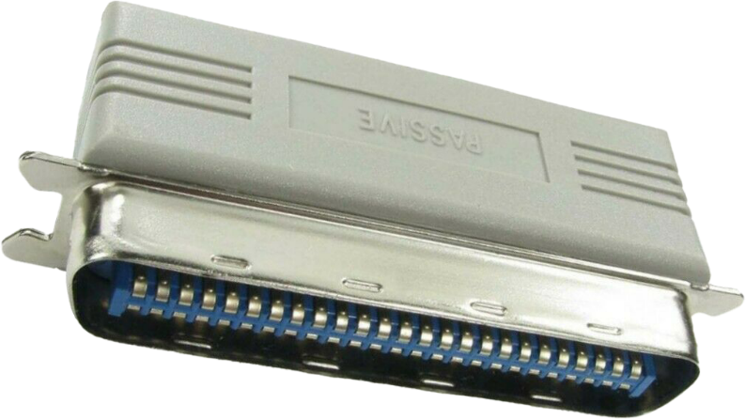
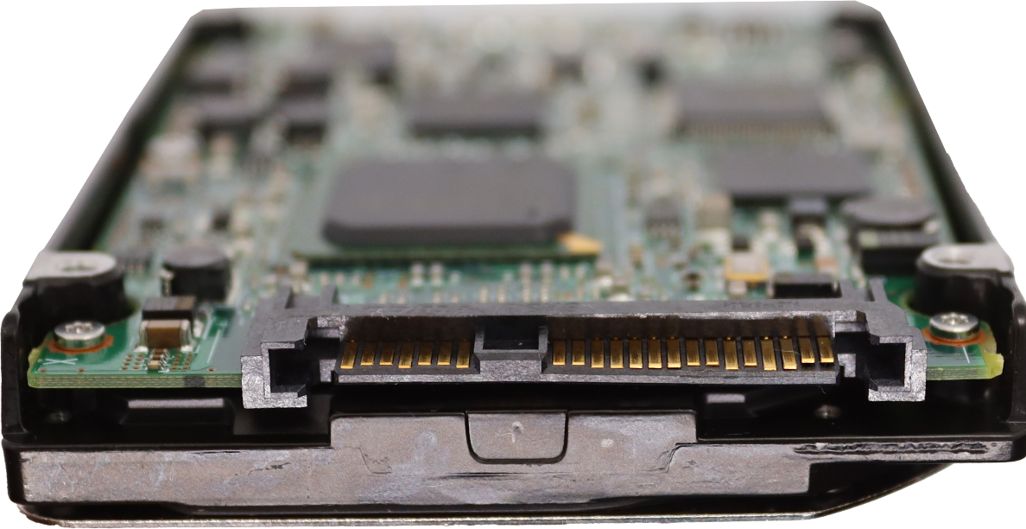
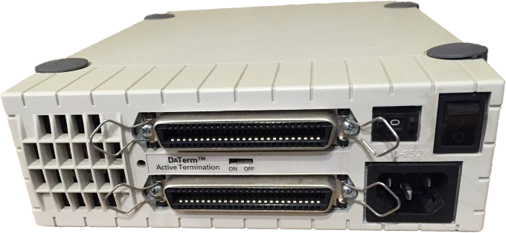
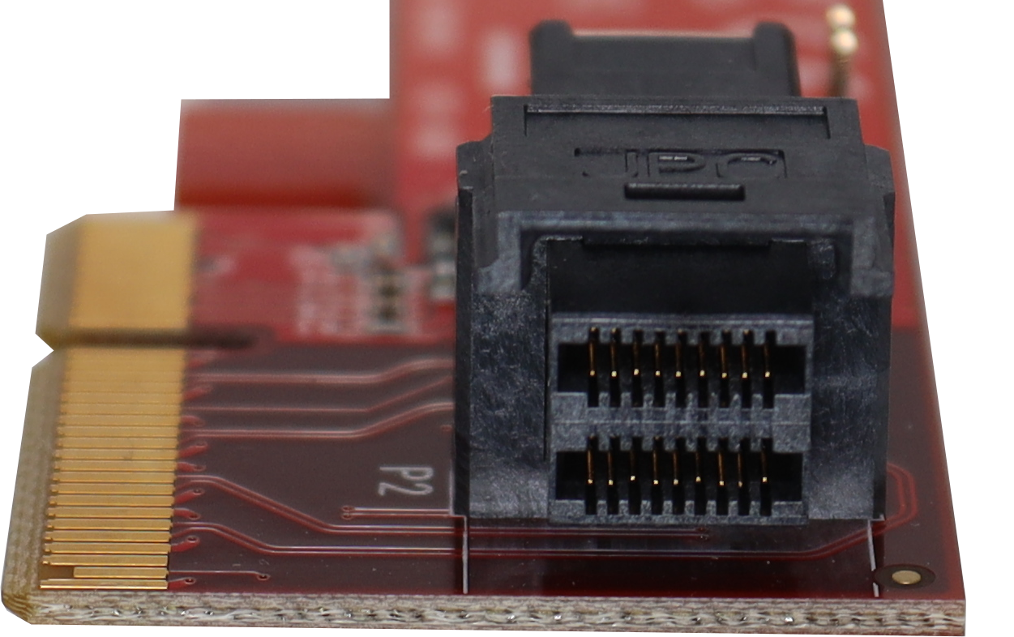
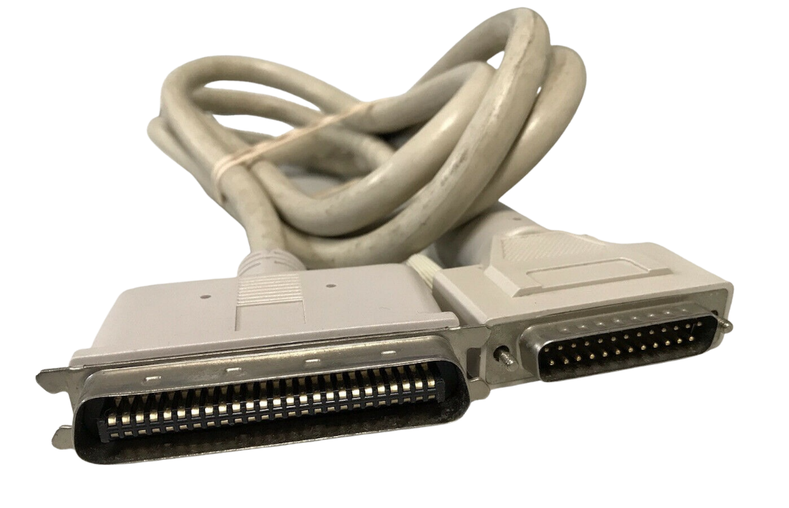
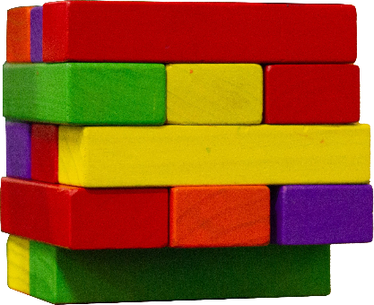
In This Video
SCSI ID
LUN
Logical Unit
SCSI Concepts
SAS
U.2
Traditional
SCSI
ITFreeTraining.com
© Copyright 2024
Notes:
02:18 SCSI is still included on the exam objectives of the A+ exam, although it is unlikely you will get a question in the exam on it. In our older videos we talk about traditional SCSI in a lot more detail, so in this video I will start by looking at the basic concepts of SCSI that are still used today.
I will next have a quick look at SAS. This is one of the places that you will find modern SCSI used. You generally find SAS used on servers and cloud storage. For a workstation, you may find SCSI used with a U.2 connector. The U.2 connector is essentially one of many SAS connectors. We will have a look at why this particular connector is being used in workstations.
Lastly, I will have a quick look at traditional SCSI. This is pretty old technology, so there is a good chance you won’t come across it nowadays. CompTIA still has this as an exam objective, so I will have a quick look at it, although I doubt you will get asked a question about it.

Slide 4
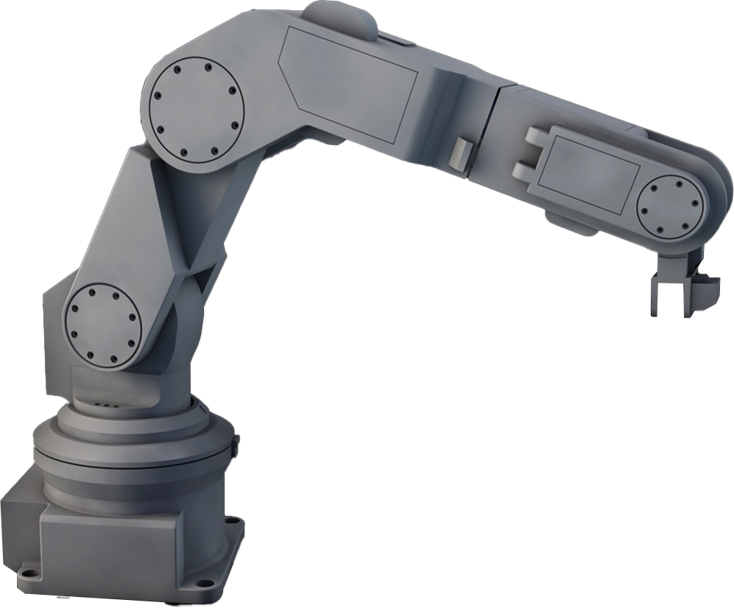
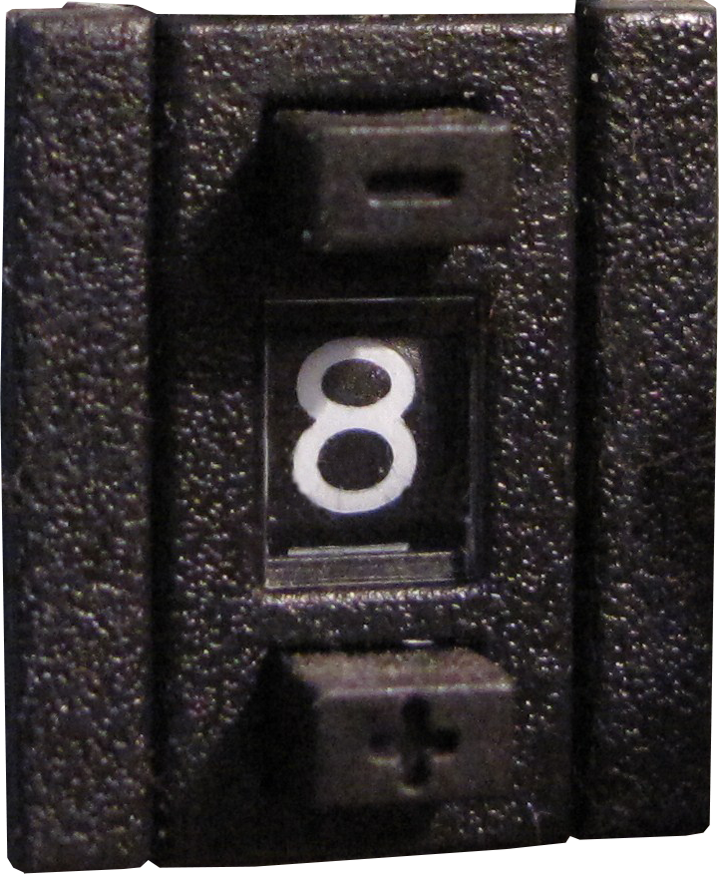
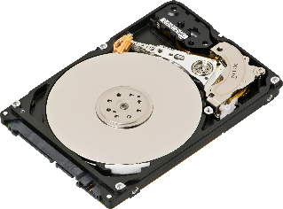
SCSI ID
Number uniquely identifies device
Maybe called other names like device ID, slot no, etc.
2
Old days needed to manually set
Nowadays process is automated
Maybe based on physical connection
ITFreeTraining.com
© Copyright 2024
Notes:
03:17 The SCSI ID uniquely identifies the device. In the old days, the ID needed to be set manually. The SCSI device would generally have a switch on the back or jumpers to configure the ID. Nowadays, the SCSI ID is generally set automatically. In a lot of cases, the SCSI ID will be set based on the physical connection that is used. In other words, the physical connection that you use will determine what SCSI ID is used.
Since the process is automatic, this prevents two devices having the same SCSI ID. If two devices were to have the same SCSI ID, the computer would not be able to determine which is which. SCSI ID is old terminology, so with newer devices, you may see it referred to by names like device ID, slot number or something similar.
The number the device is allocated becomes important when attempting to access it. For example, the operating system may list the storage devices based on the numbers allocated. Also, if you are trying to locate a physical hard disk in a drive enclosure, knowing this number may help you locate which port in the enclosure the physical hard disk is plugged into. The storge devices can also be divided up into logical units, referred to as a LUN.

Slide 5
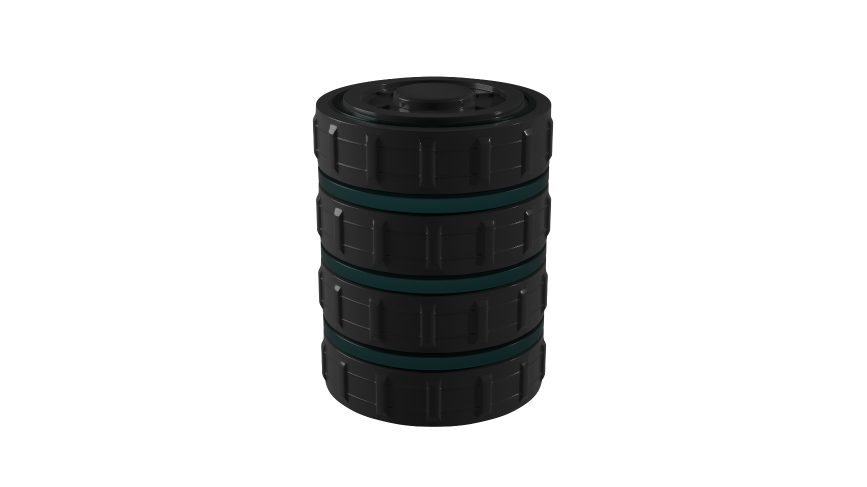
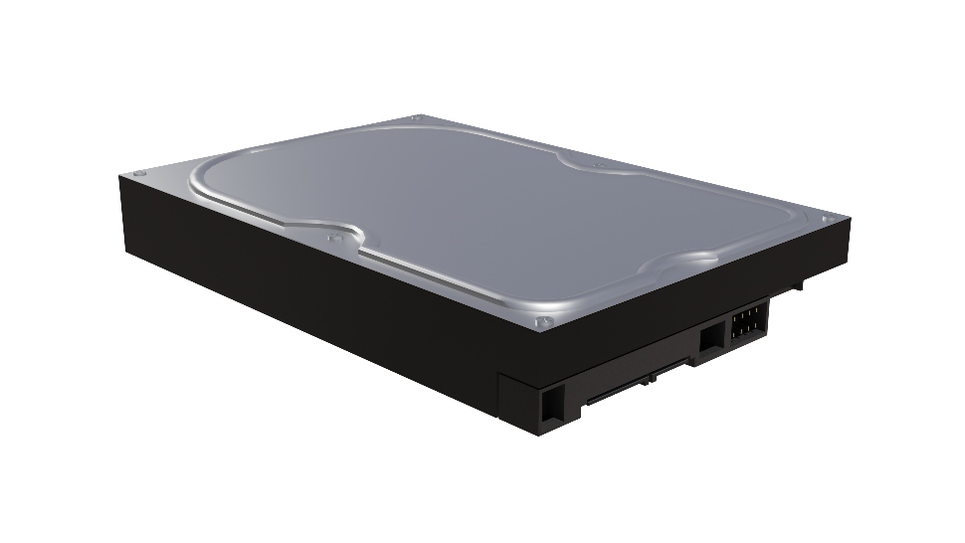
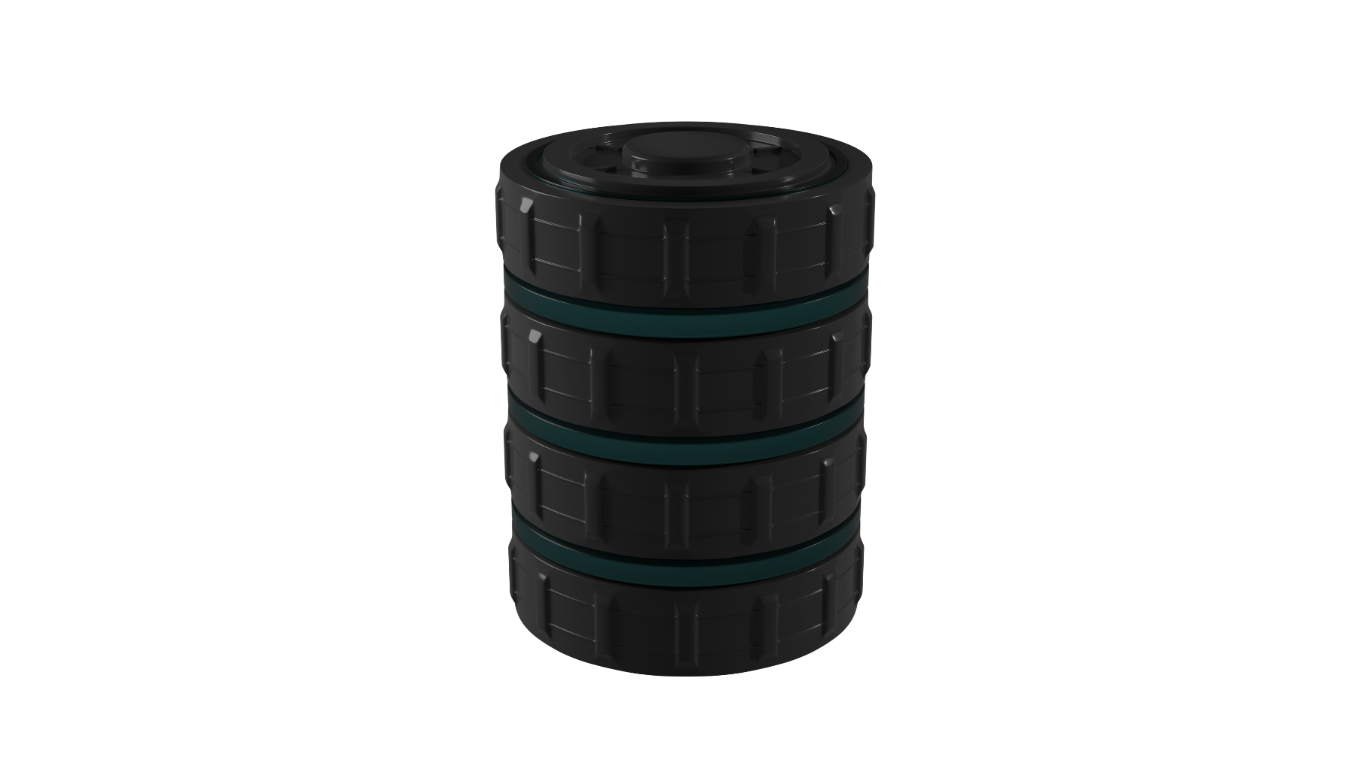
LUN (Logical Unit)
Used in SCSI/Storage Area Networks (SAN)
Allocates storage into units
OS sees the LUN as a single storage unit
Storage Device
Storage Device
* LUN maybe smaller than single storage device
ITFreeTraining.com
© Copyright 2024
Notes:
04:35 In SCSI, and often used in Storage Area Networks or SANs, there is the concept of a LUN. A LUN essentially allocates storage into units. When storage is divided up like this, it is seen by the OS as a single unit.
When dividing storage up like this, it may not be referred to as a LUN, but the concept is still the same. The term LUN is commonly used with SANs and sometimes with SCSI. Let’s consider some examples.
In the simplest case, a single hard disk can be allocated to a single LUN. When a LUN is created, the operating system will see this as a single storage device. However, you can also have multiple storage devices combined together to form a single LUN. As before, this will be seen by the operating system as a single storage device.
As you can see, a single LUN can be multiple storage devices combined together. It is also possible that the LUN may be spread over multiple enclosures. It is also possible for a LUN to be smaller than a single storage device. This is not really used with SCSI devices; however, you may find it used within larger devices like SANs. In SAN environments, it is possible for a LUN to even include standby storage that replaces storage devices when they fail. Essentially, a LUN is just a way to manage storage so the operating system sees only the one storage device; however, on the back end, there may be multiple storage devices and potentially storage devices in multiple storage units.
To manage a lot of storage devices in multiple units you need some way to do this. Standard storage devices like SATA are not designed specifically for this, so this is where SAS comes into play.

Slide 6
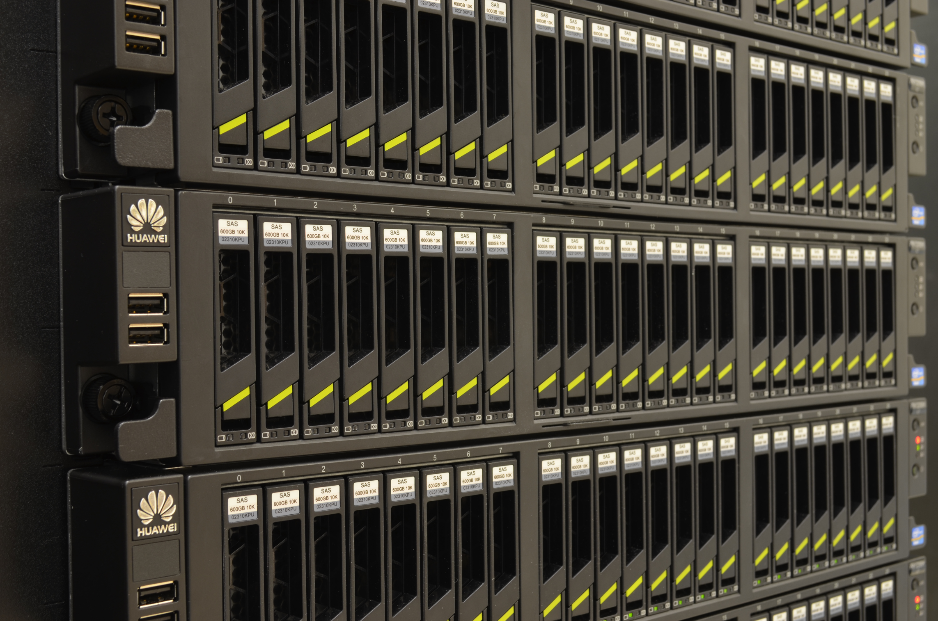
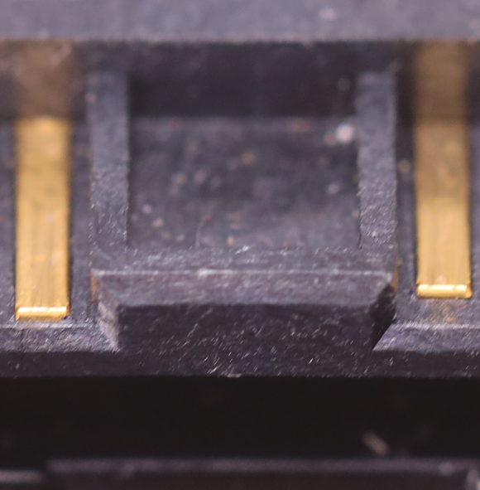
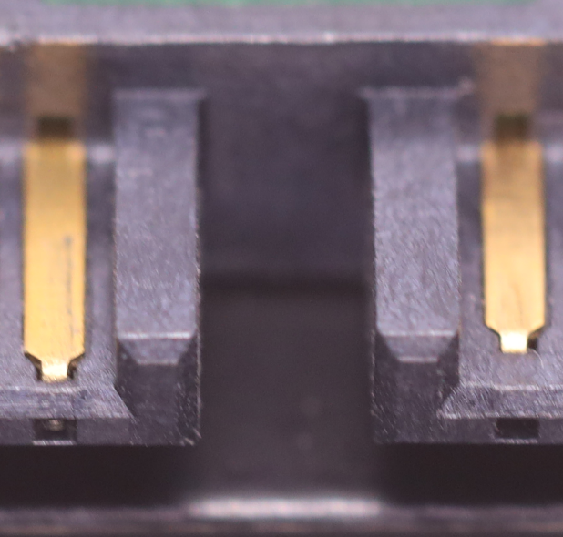
Serial Attached SCSI (SAS)
Mainly used in Servers/SAN/Cloud
Connection similar to SATA
SAS supports SATA (Probably)
Hot swapping supported
Servers with 24 SAS hard disks each
SAS Blocked
SATA Open
ITFreeTraining.com
© Copyright 2024
Notes:
06:23 If you see SAS, it will most likely be used in servers, SANs or cloud storage. You don’t really see it used in desktops, even high-end workstations, as these devices tend to use M.2 drives nowadays if performance is important. You can see in this example of a SAS storage system, there are rows of hard disks that work together to provide a large amount of storage. Setups like this are common in remote servers and cloud storage centers.
For the CompTIA exam, you most likely won’t need to know much about them. The main take away I would remember is that the connector is similar to SATA, but slightly different. To understand the difference between the two, I have a SAS hard disk and a SATA hard disk side by side.
When you look at them, the connection looks very similar. However, on a closer look, you can see that, with the SAS connection, the middle of the connector is blocked. In contrast, the middle of the SATA connector is open.
The block means that if you attempt to plug a SAS hard disk into a SATA enclosure, it won’t go in. However, a SATA drive will go in a SAS enclosure. Thus, SAS supports SATA, but SATA does not support SAS. Modern SAS controllers should support SATA, but I never like to give guarantees in computing. In some cases, you may need to enable SATA support. If you are using an old controller, note that there were firmware problems in the old days. If you are having problems, you may need to update the firmware in the storage controller and on the storage devices.
SAS, like SATA, also supports hot swapping. Hot swapping is important in large storage devices, as you don’t want to shut the storage device down to replace a failed storage device. To get a better understanding of how the SAS connection is different from the SATA connection, I will have a closer look at the connectors.
To understand the difference, I have a SAS hard disk and a SATA hard disk. To start with, I have a SATA data cable. As you would expect, the SATA cable is able to be plugged into the SATA hard disk. If I now attempt to plug the SATA cable into the SAS hard disk, notice that it will not plug in due to the block in the middle of the connector.
I will now have a look at a SAS connector. Since the connector on the device has the block between the data and power cables, the SAS connector has to include both the data and power parts because of this block.
Notice, that when I plug the SAS connector into the SATA hard disk it goes in without any problem. This connector has a separate SATA power connector that I will plug in. Also notice, that I can unplug the cable from the SATA hard disk and plug it into the SAS hard disk. Thus, SAS controllers can be used with both SAS and SATA devices; however, SATA controllers can only be used with SATA devices.
SAS does offer some additional features over other storage devices, making it a good choice for large amounts of storage; let’s have a look.

Slide 7
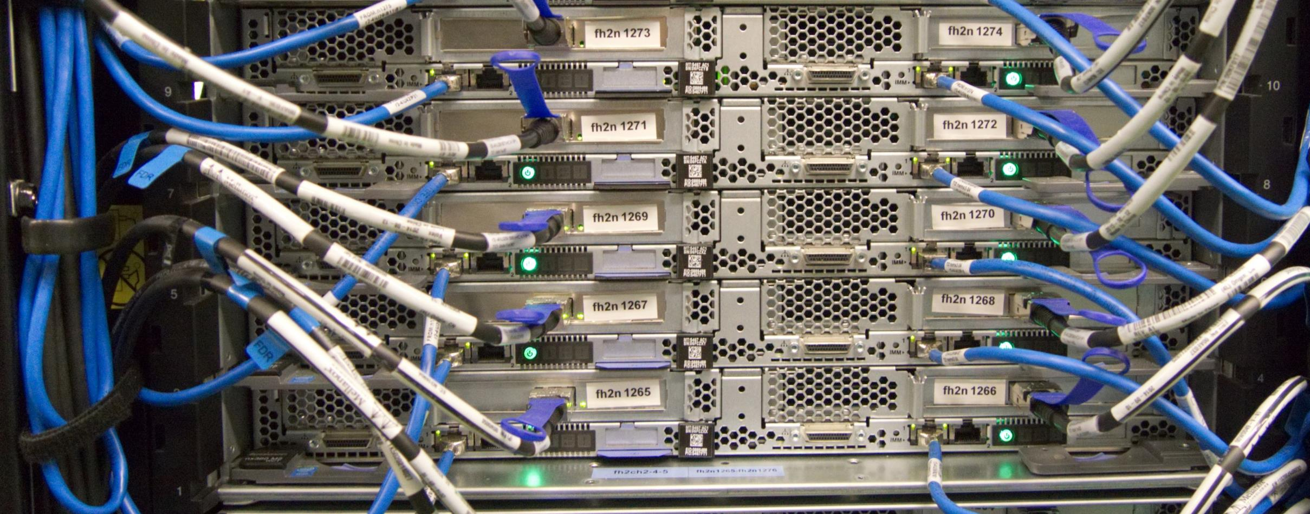
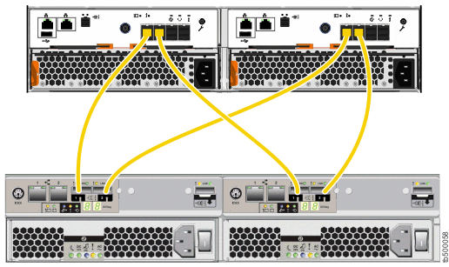
SAS Features
Supports Topology
Each port has unique identifier
Each device has unique identifier
Networking for storage
Supports redundancy
ITFreeTraining.com
© Copyright 2024
Notes:
09:27 SAS also supports “Topology”. Topology means defining an arrangement of storage devices and the connections to these storage devices. To do this, each port and each device have a unique identifier. I like to think of SAS topology as networking for storage devices.
In this example, you can see the back of a large number of servers. Each server has a network connection and a storage connector. The storage connectors use SAS to connect to a storage device. In large environments, you may have many devices connect to a storage device and many storage devices connected together.
SAS also supports redundancy, thus there may be multiple path connectors between storage devices and devices like servers. If an adapter were to fail, for example, data could be transferred through a different adapter, and this prevents downtime from occurring. You can see why I think of SAS like networking for storage, as, in a lot of ways, it is similar to what you can achieve with networking.
SAS you will generally only find in servers, SANs and cloud storage. You generally won’t see SAS in a workstation with one exception.

Slide 8
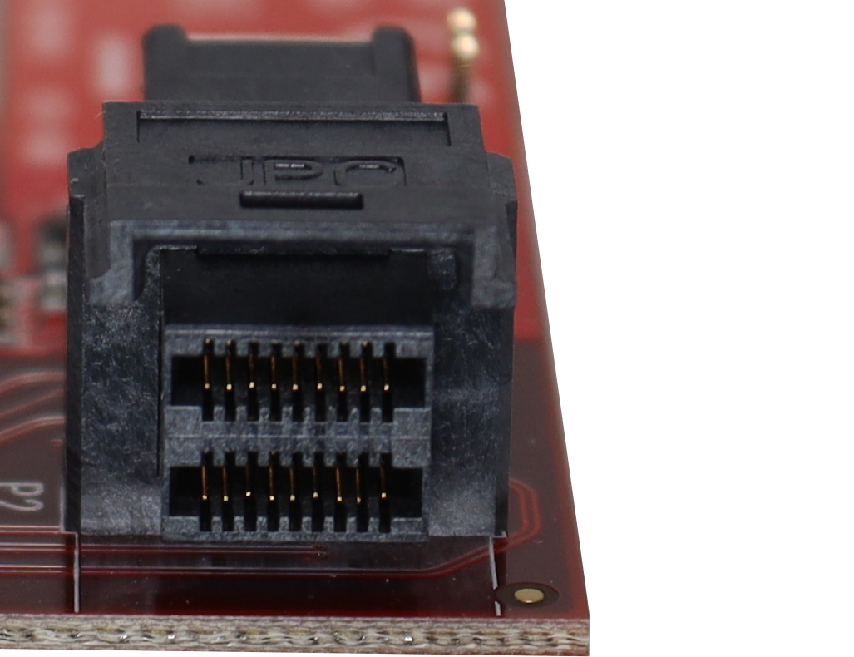
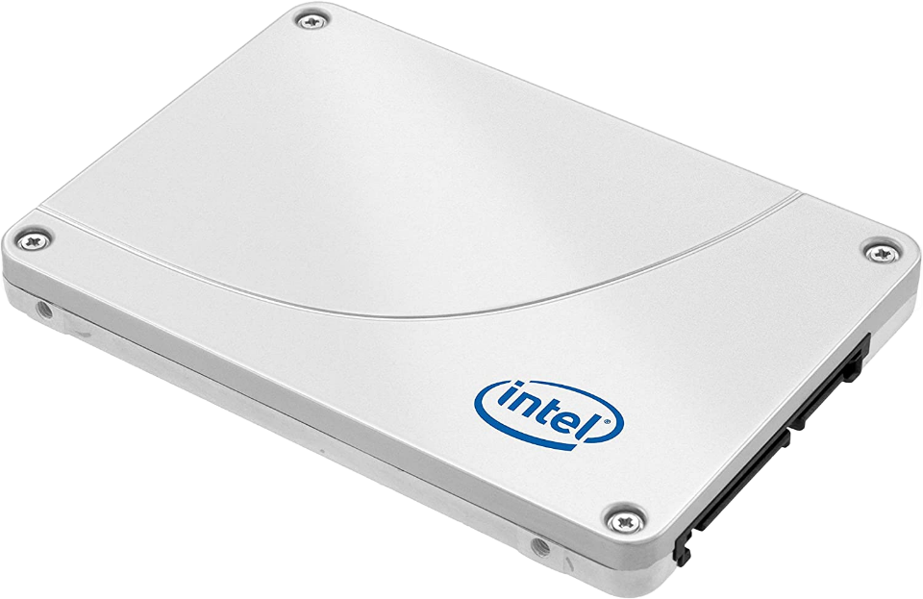
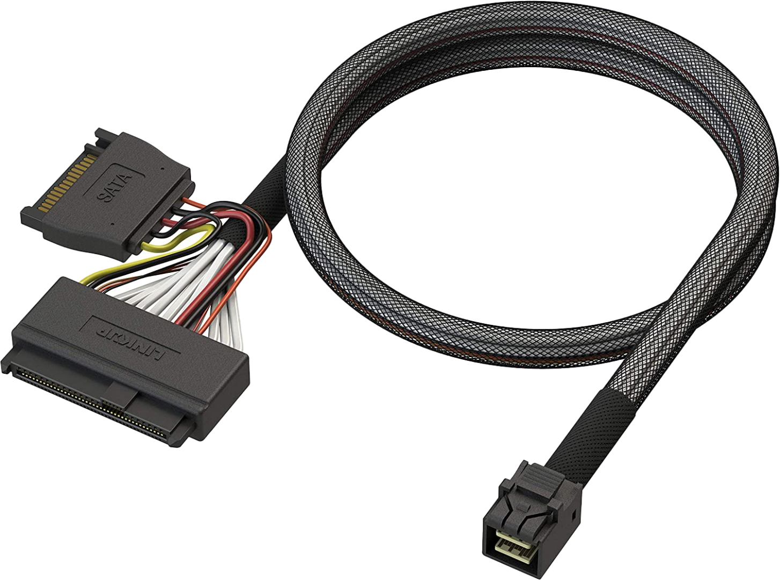
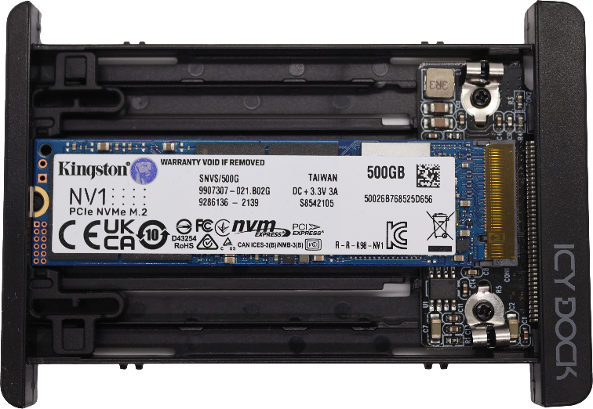
U.2 (SFF-8639)
SAS port for workstations/servers
Only on high-end workstations and servers
Not much market share
High-speed SSD(Faster than SATA)
M.2 to U.2 enclosure Allows hot swapping
Same cable used
SAS Port
4xPCI Express Lanes
SATA Support
ITFreeTraining.com
© Copyright 2024
Notes:
10:41 The U.2 interface, officially known as SFF-8639, provides a SAS port for workstations and servers. You will only find this used on high-end workstations and servers. U.2 did not get much market share so if you pay a lot for a motherboard or server, don’t expect it to have one. If it does have a U.2 port, it may be accessible from outside the computer or in some cases only available inside the computer.
U.2 supports standard SAS storage devices. So, all you need to do is use the U.2 cable to plug the SAS storage device into the computer. SATA is a widely used interface; however, it is limited to 600 MB/s transfer rate. Modern Solid-State Drives are able to transfer faster than this and also the original SATA protocol was not designed with Solid-State Drives in mind.
U.2 addresses this by having four PCI Express lanes that have direct access to the Solid-State Drive. This allows the computer to access the Solid-State Drive at the speed of its internal PCI Express lanes. This is much higher than the 600 MB/s limit of SATA.
In desktop computing, M.2 Solid-State Drives have become very popular. These storage devices can also use PCI Express and thus offer very fast speeds. SAS Solid-State Drives, by comparison, are a lot more expensive and thus, most likely, one of the reasons while U.2 is not used that much.
One of the limitations with M.2 is that it does not support hot swapping. However, you can get around this by using an M.2 to U.2 enclosure. These enclosures support an M.2 Solid-State Drive and allow it to be accessed using U.2. It is just a matter of plugging it in and unplugging it when you are finished. This is a cheaper option than purchasing the more expensive SAS Solid-State Drives. SAS drives are designed with long-term reliability in mind, but if you are just interested in performance over cost, it is a good option.
Lastly, the U.2 interface supports SATA. With the amount of SATA ports that a computer comes with nowadays, you are most likely to use an internal SATA port. However, if you run out of ports or want to plug in an external storage device, it is an option. To use it, you just need to use the same cable that you would use for the SAS device.
U.2 interfaces are not very common, so let’s have a look what you can do if your motherboard does not have one.

Slide 9
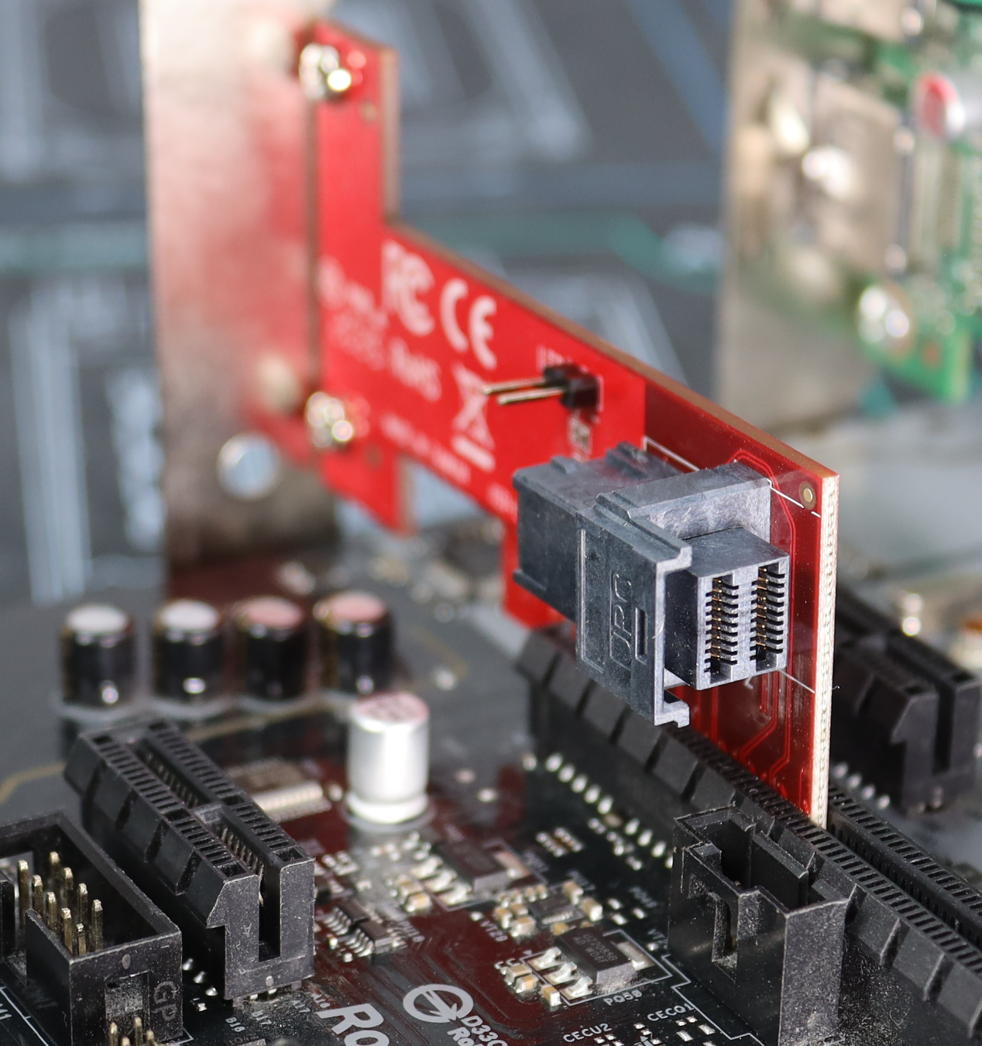
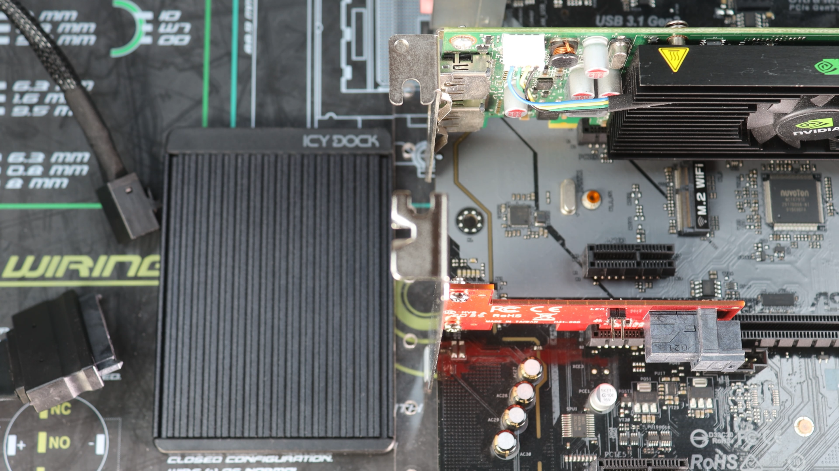
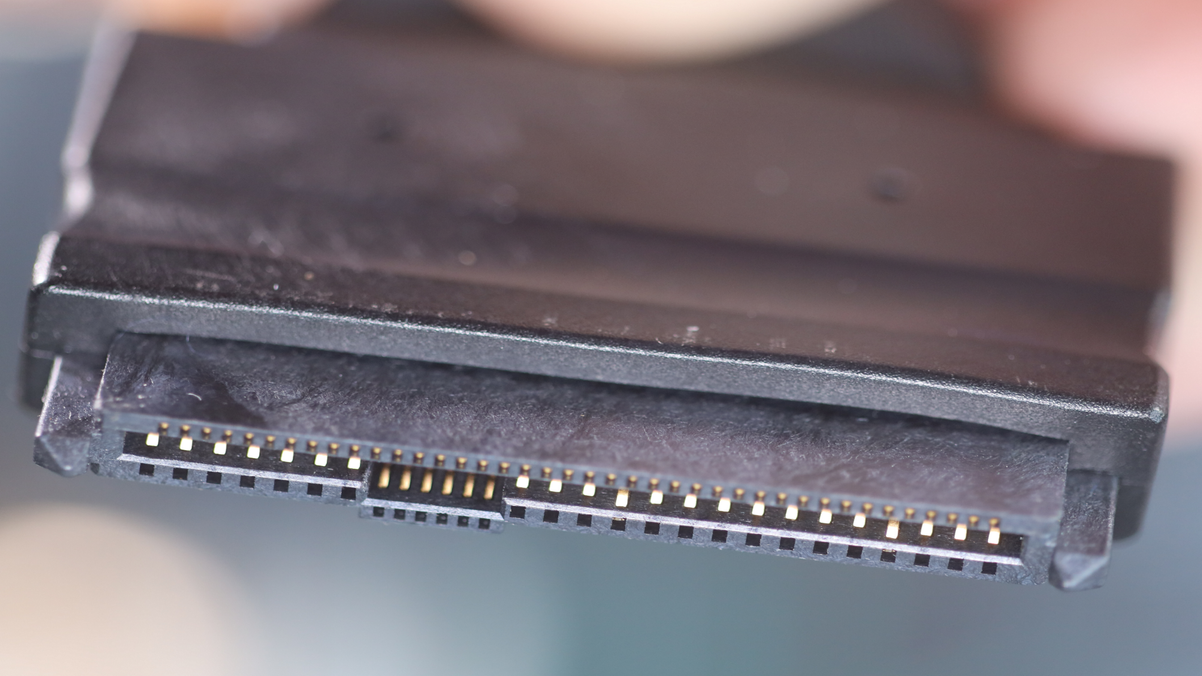
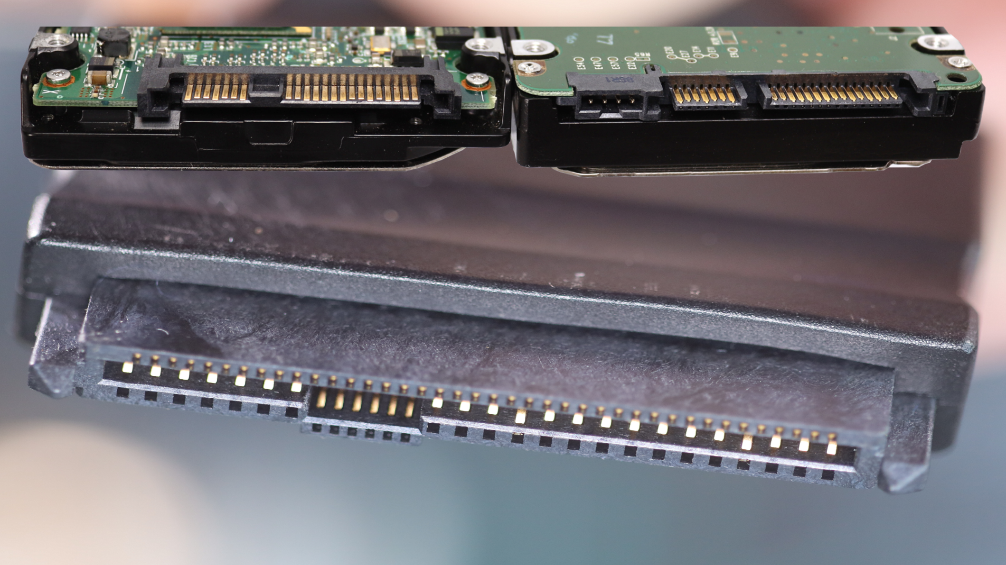
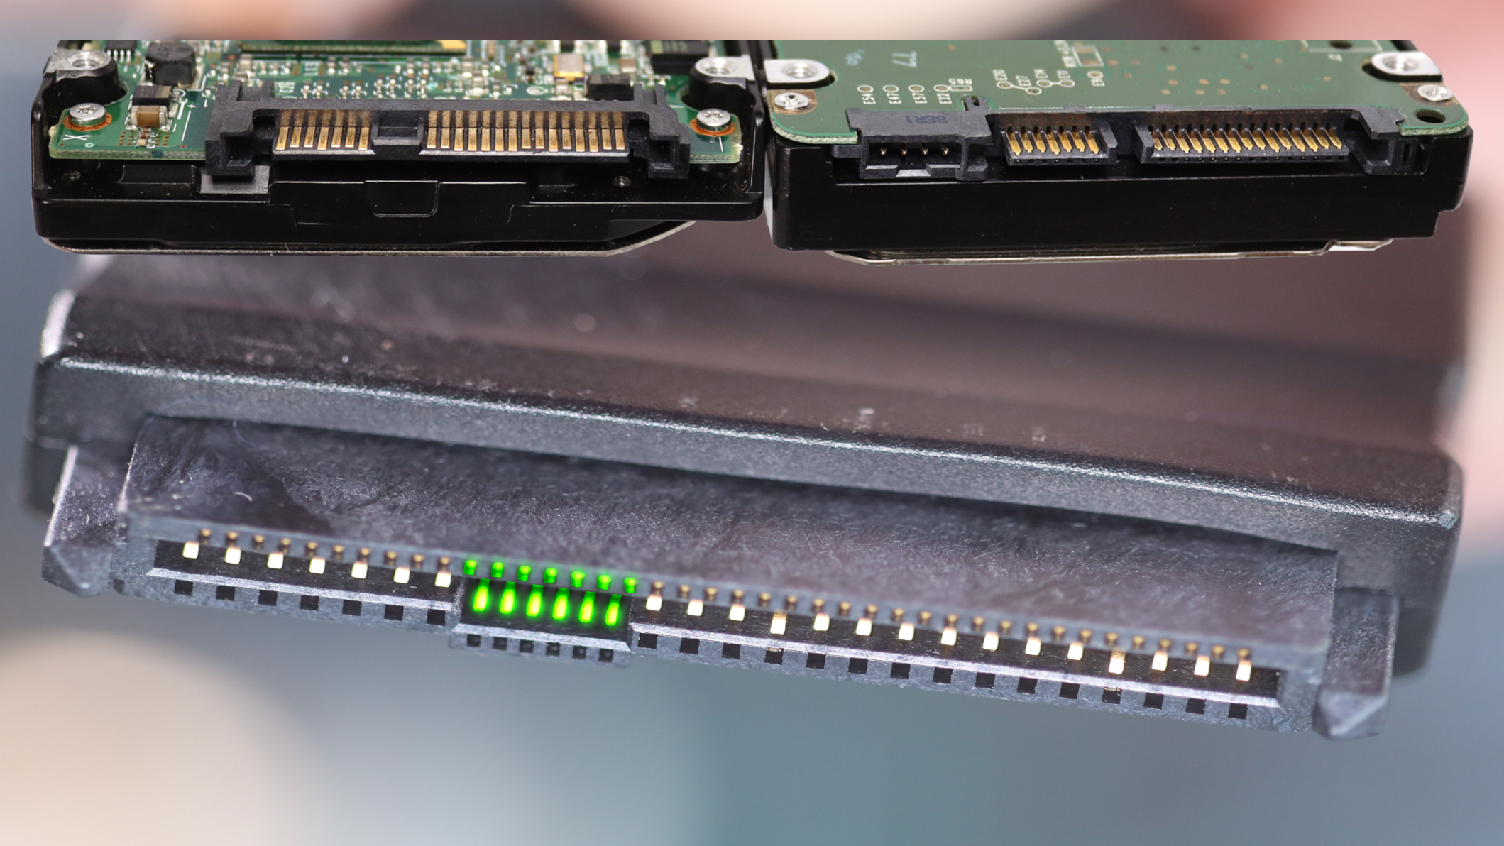
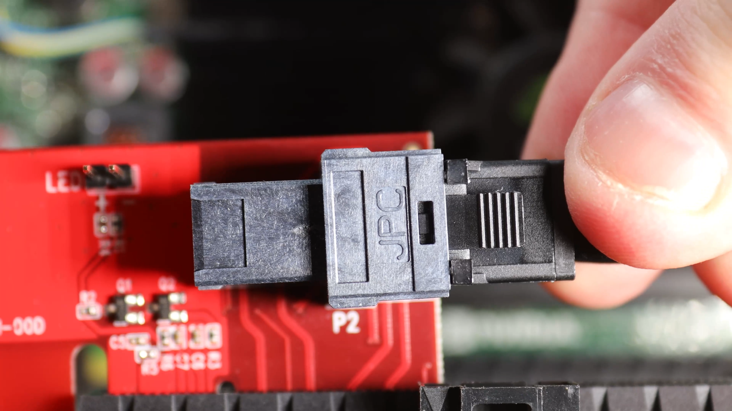
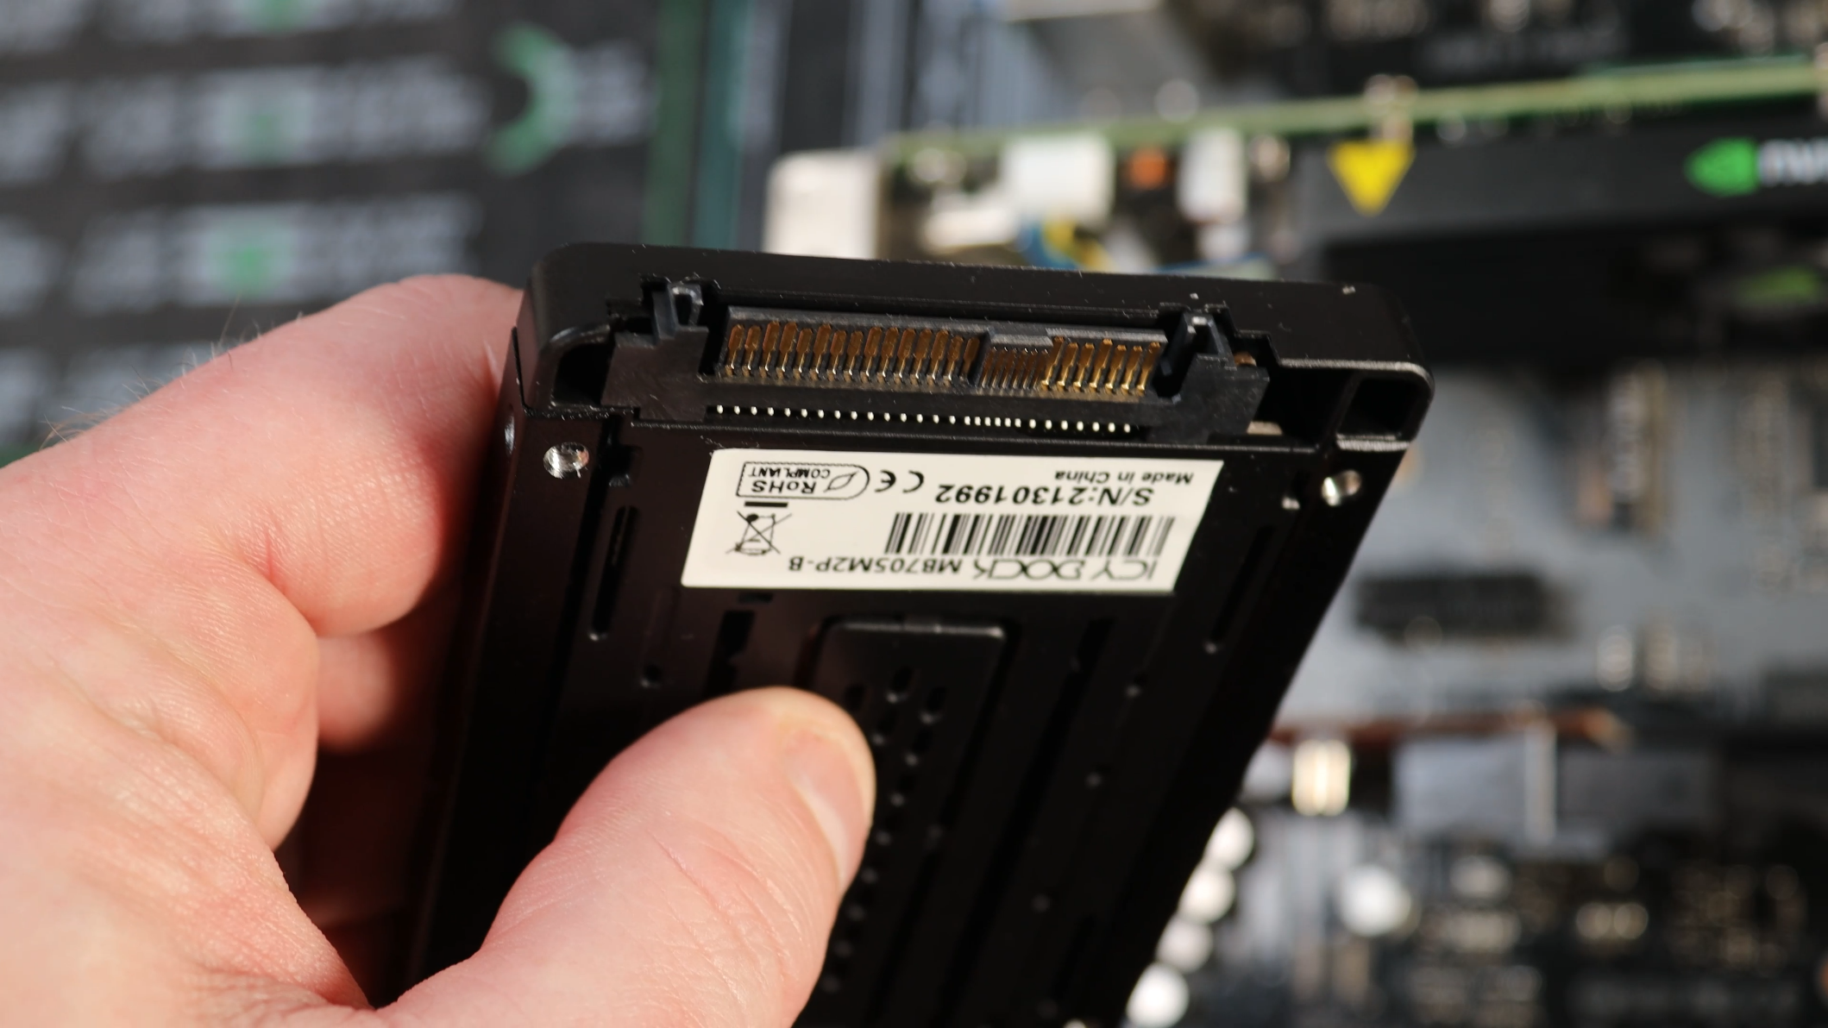
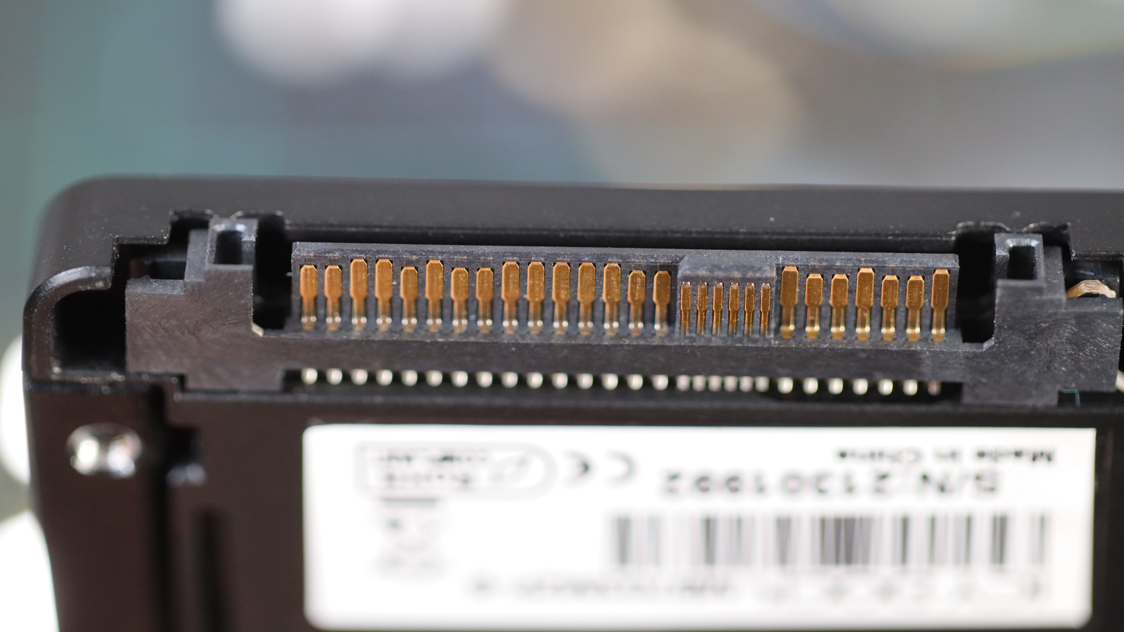
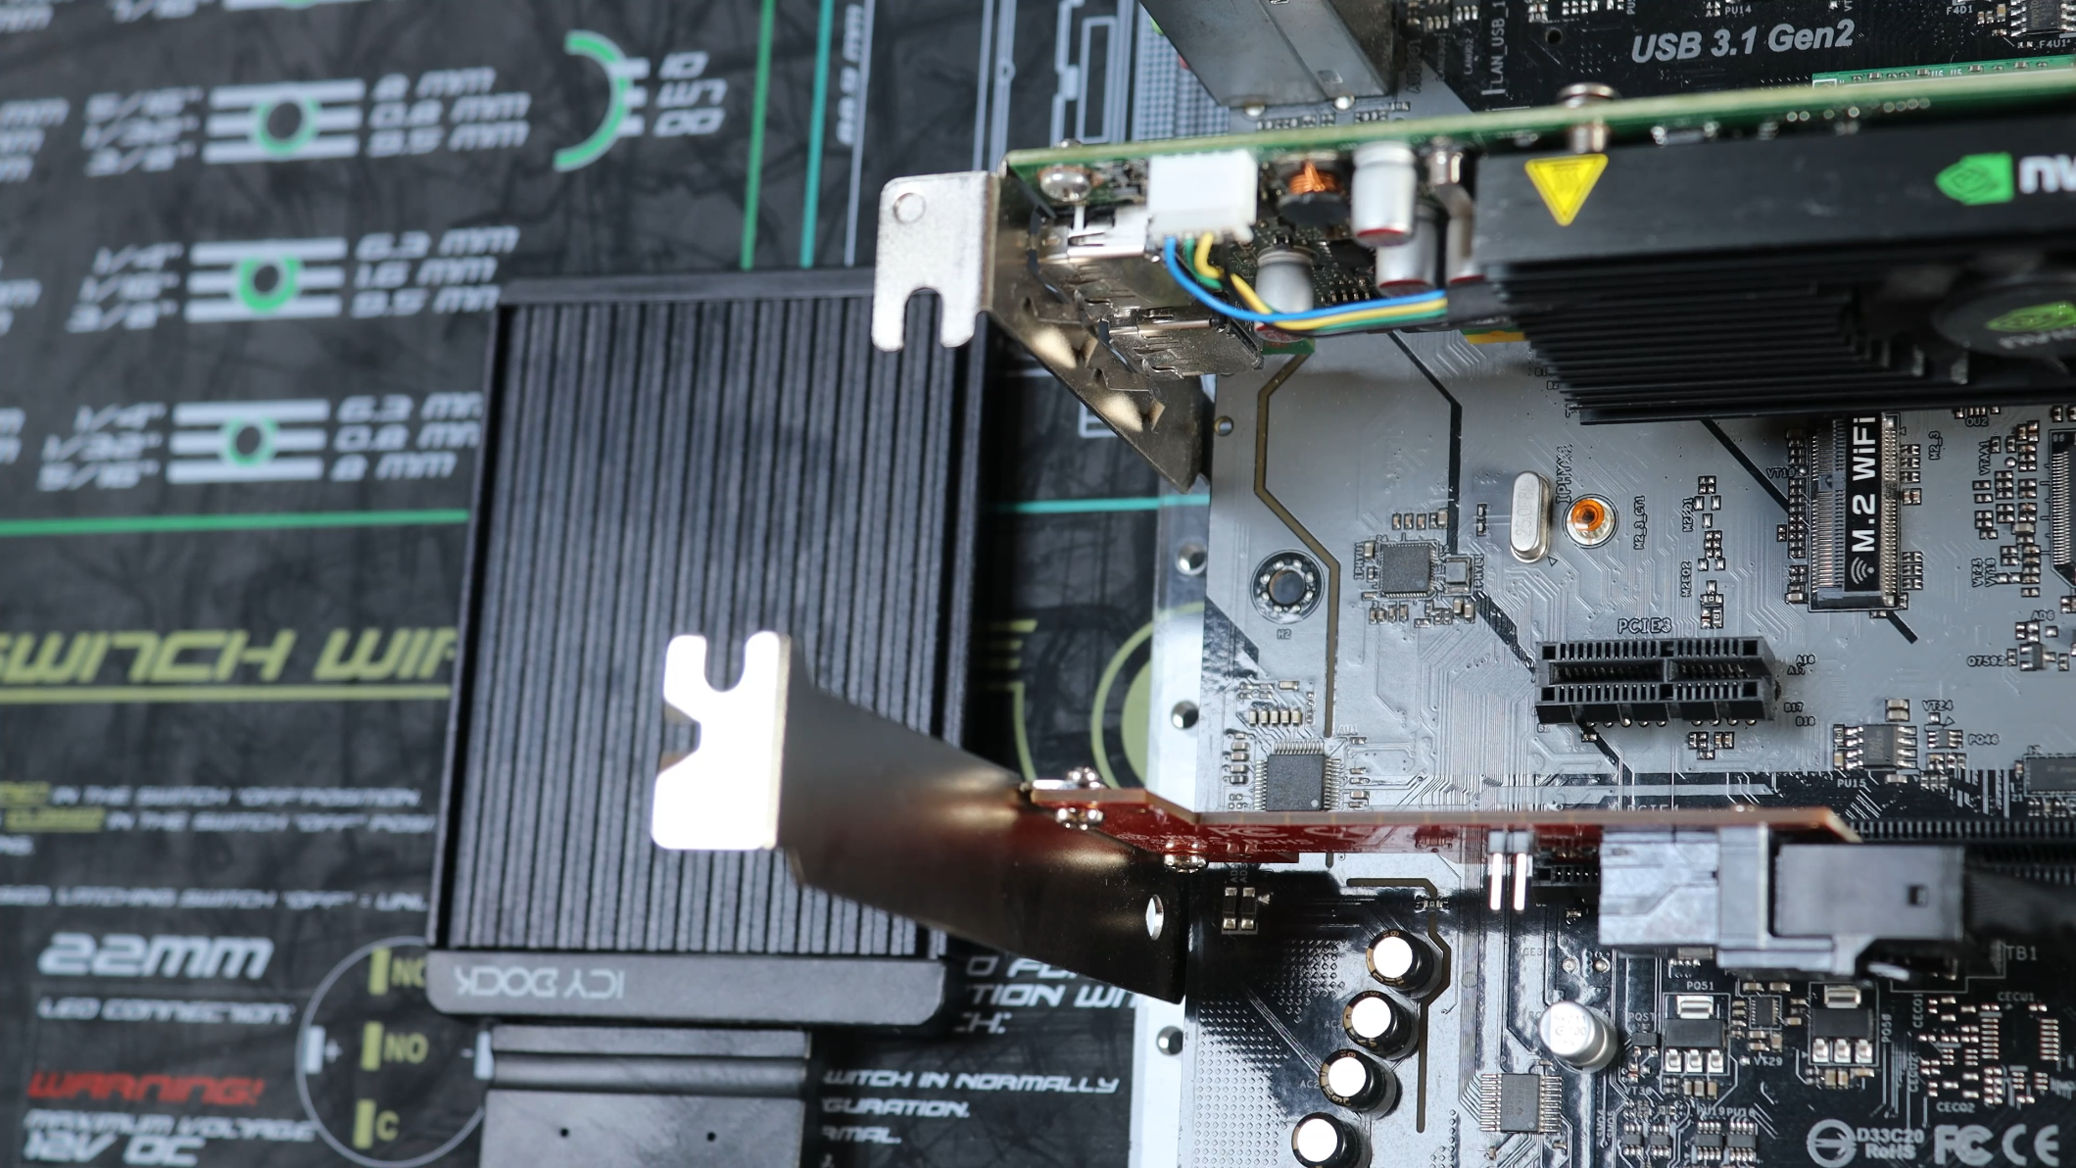
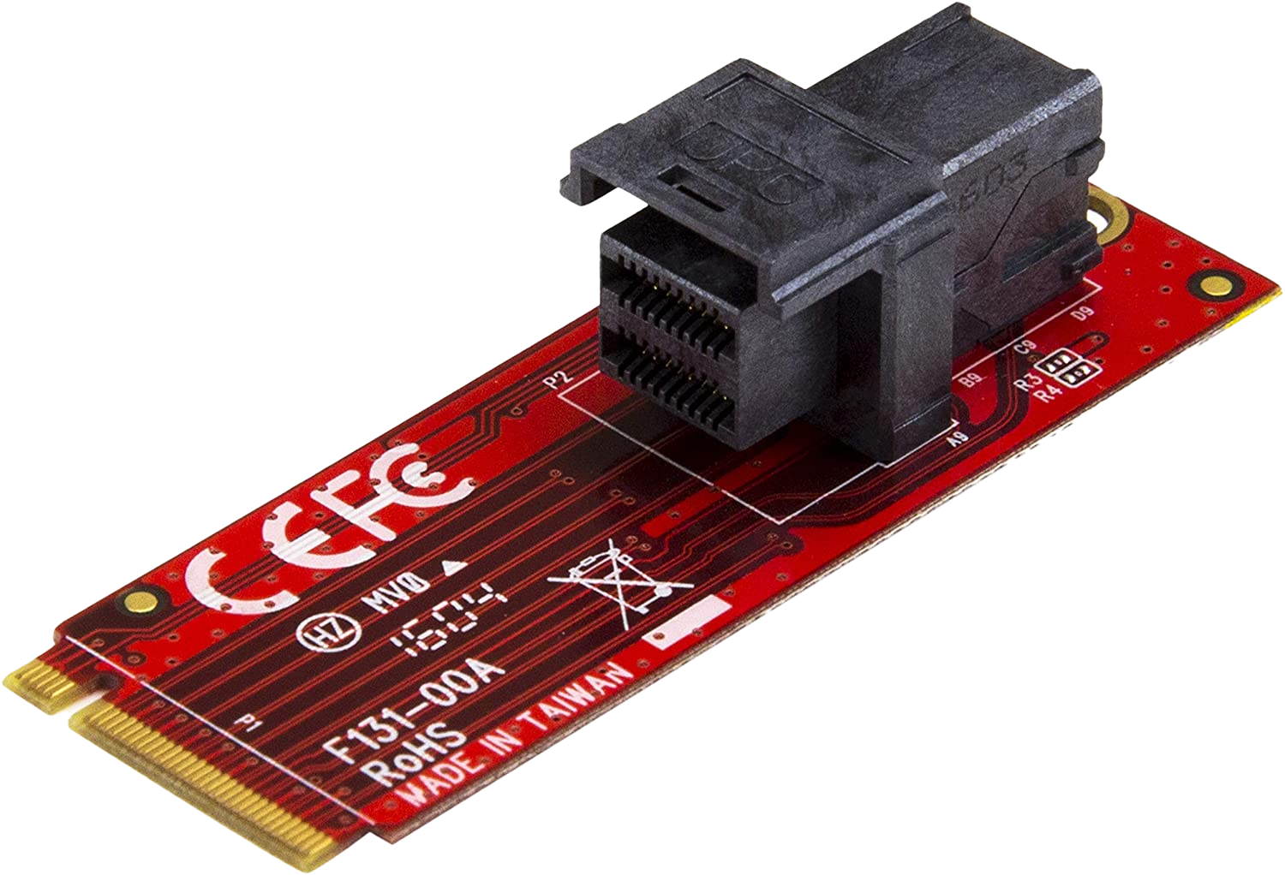
U.2 Adapters
Adds U.2 interface to computer
Cheaper than purchasing high-end motherboard
PCI Express to U.2
M.2 to U.2
ITFreeTraining.com
© Copyright 2024
Notes:
13:22 If your computer does not have a U.2 interface, you can always purchase an adapter to add one. One of the simplest options is use a PCI Express card like the one shown. This is a basic PCI Express card that adds one U.2 port. There are also others on the market that add more ports and also add additional features such as RAID options.
There is also an adapter that will work with an M Type M.2 slot. This adapter will add a U.2 port using an M.2 slot. If you require a U.2 port in your computer, purchasing one of these adapters is often much cheaper than having to purchase an expensive motherboard.
I will next have a look at how to plug in a PCI Express U.2 storage device. Firstly, I will have a look at the storage cable, in particular the cable going to the storage device. If you remember from before, the SAS hard disks have a block between the connectors and the SATA hard disk has a gap between the connectors. Both do not have any connectors in this area. Notice however, this cable has additional pins in this area. These additional pins are required for PCI Express. Keep this in mind when connecting PCI Express SAS storage devices. If you don’t use a cable with these additional pins, it is not going to work.
I will next plug the other end of the cable into the U.2 plug. The cables will generally have a clip on them; if you unplug the cable, make sure that you press the clip to unlock it, otherwise if you attempt to pull the cable out without pressing the clips in, you may damage the plug.
I will next plug in the storage device. Notice, that when I look at the connector for the storage device, it has the extra pins on it. If you are not sure if the SAS device is PCI Express compatible or not, look at the connector and see if it has these extra pins.
The last step is to plug the cable into the storage device. Once this is done, the storage device only needs power connected to it and it is ready to go. The points to take away with the U.2 connector are, it supports PCI Express and therefore you can get the same kind of speeds as an M.2 Solid-State Drive. Unlike M.2 Solid-State Drives, U.2 supports hot swapping.
That covers it for modern SCSI, now let’s have a look at traditional SCSI.

Slide 10
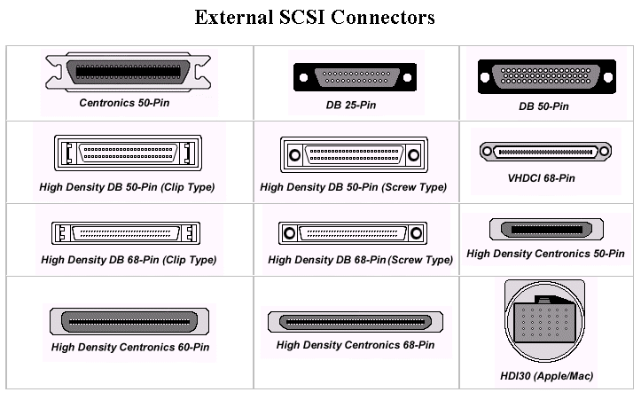
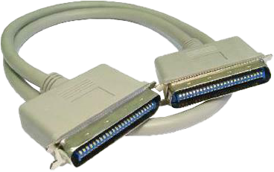
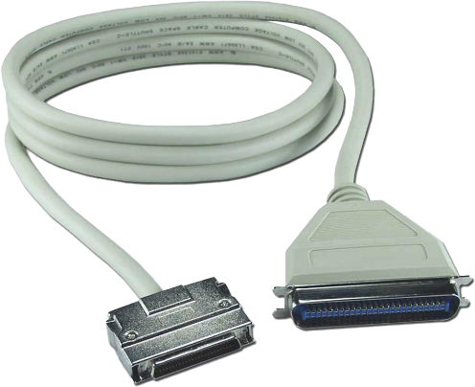
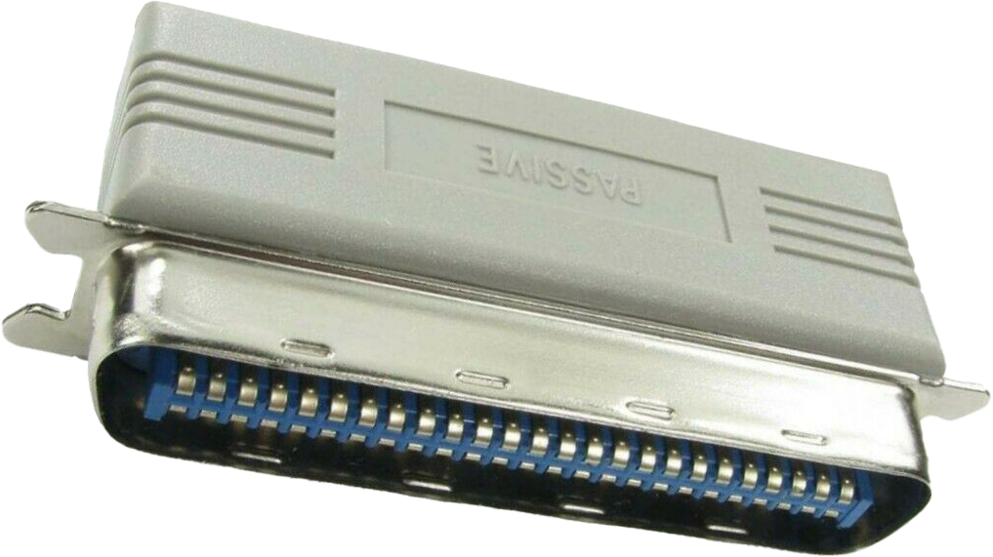
Traditional SCSI
Many different SCSI connectors released
Each device has an ID
Wide supports IDs 0 to 15
Narrow supports IDs 0 to 7
Host adapter either 7 or 15
SCSI requires terminator on each end
Either active terminator or terminator attached
ITFreeTraining.com
© Copyright 2024
Notes:
15:56 I won’t spent too much time with traditional SCSI, since it is unlikely you will come across it in the workplace and unlikely to get an exam question on it. Over the years, a lot of different versions of SCSI were released. You can see some of the different connectors. With SCSI, if you plug devices together in a daisy chain using the same connectors, you are off to a good start.
SCSI has a large number of cables to go with the large number of connectors. In some cases, the SCSI cable may have different connectors on each end. SCSI supports what is called “wide” and “narrow”. Wide has more wires than narrow. As a result, the wide version supports more devices.
Each device in SCSI needs to have its own device ID. This is configured automatically or manually. On very old devices this is achieved by using jumpers. Wide supports IDs from 0 to 15, so 16 devices in total. Narrow supports IDs 0 through 7. If you are using a cable with different connectors on each end, if one connector has less pins, it is more than likely changing from wide to narrow. Once the connector changes to narrow, you will only be able to use IDs 0 through 7. In very old implementations of SCSI, if part of the cable changed from wide to narrow, the whole cable would effectively become a narrow cable.
With SCSI, the host adapter also counts as a device. The host adapter will usually use the device ID 7 or 15. SCSI also requires a terminator on each end. This will either be an active terminator, active meaning it is included inside the device, or a terminator needs to be attached. If both ends are not terminated the cable won’t work. Generally, in the host adapter, the terminator will be built in, so you only need to worry about terminating the last device on the cable, either using a device that has an active terminator or manually connecting a terminator to the last device.
For traditional SCSI, that is all I will cover in this video. If you do come across traditional SCSI and need more information, we have some old videos that cover this topic in more detail. For the CompTIA exam, I doubt you will get a question on it.

Slide 11
Subscribe
Next video
Video content: https://ITFreeTraining.com/ap11/1c15
© Copyright 2024
Notes:
18:20 That covers it for SCSI. I hope you have found this video informative. Until the next video from us, I would like to thank you for watching.
References
“The Official CompTIA A+ Core Study Guide (Exam 220-1101)” pages 48 to 49
“Picture: Patch panel” https://unsplash.com/photos/uq5RMAZdZG4
“Picture: SCSI logo” https://en.wikipedia.org/wiki/SCSI#/media/File:Scsi_logo.svg
“Picture: Lightblub and post it notes” https://pixabay.com/photos/post-it-brainstorming-teamwork-idea-4129907/
“Picture: Lightblub” https://www.pexels.com/photo/bright-bulb-close-up-conceptual-269318/
“Picture: Blocks” https://unsplash.com/photos/KuCGlBXjH_o
“Picture: Robotic arm” https://pixabay.com/photos/robot-robotic-arm-earth-globe-3009602/
“Picture: Hard disk” https://en.wikipedia.org/wiki/Hard_disk_drive#/media/File:Laptop-hard-drive-exposed.jpg
“Picture: SAS HardDisks” https://en.wikipedia.org/wiki/Serial_Attached_SCSI#/media/File:HuaweiRH2288HV2.JPG
“Picture: Server Cables” https://pixabay.com/photos/sever-digitization-mainframe-3100049/
“Picture: SAS Cabling” https://systemx.lenovofiles.com/help/index.jsp?topic=%2Fcom.lenovo.storage.v5030.8.1.0.doc%2Fv3500_qisascables_b4jtyu.html
Credits
Trainer: Austin Mason https://ITFreeTraining.com
Voice Talent: HP Lewis https://hplewis.com
Quality Assurance: Brett Batson https://www.pbb-proofreading.uk

