Slide 1
Notes:
Let’s have a look at network cards.

Slide 2
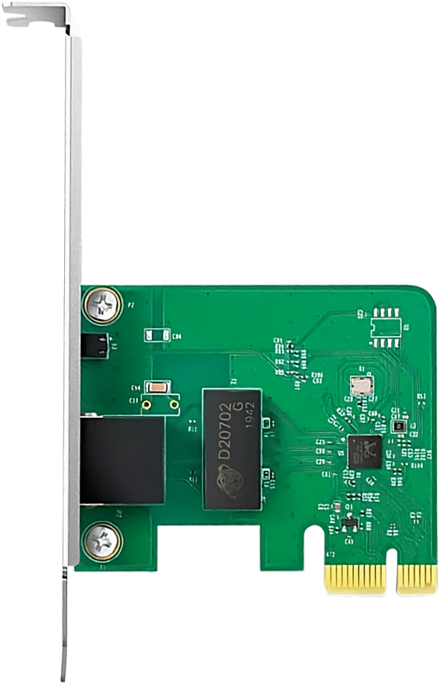
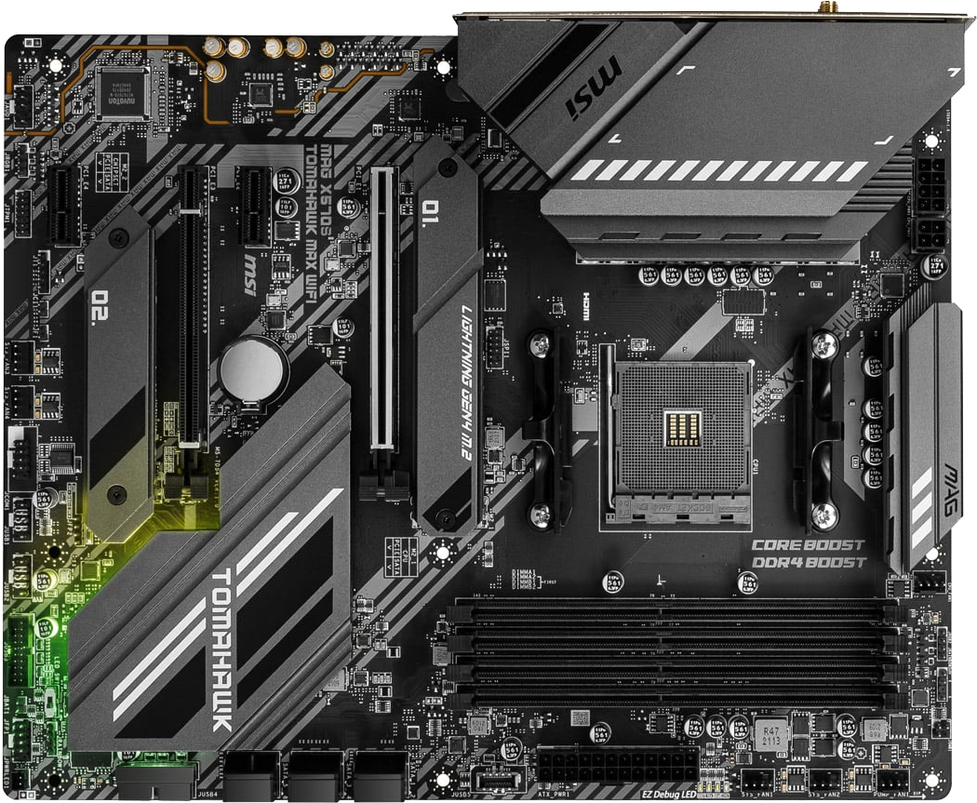
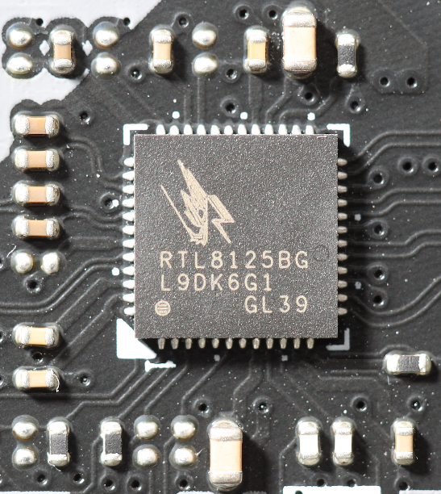
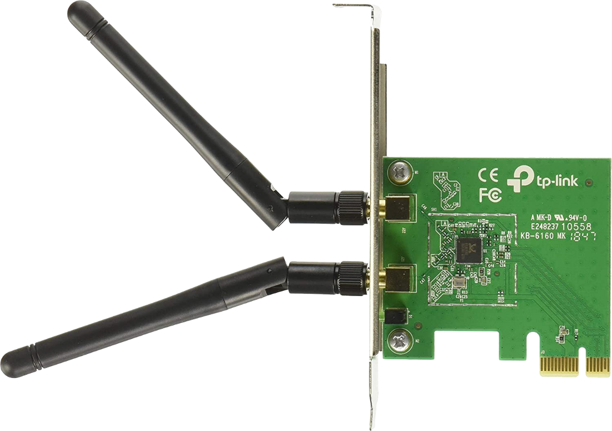
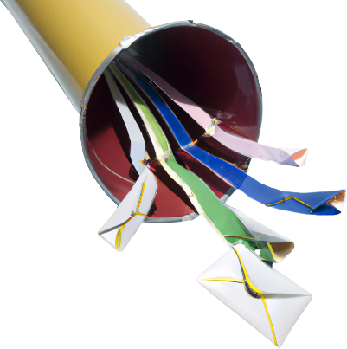
Network Interface Cards (NIC)
Physically connects a computer/device to a network
May be called Network Interface Controller/Network Interface Adapter
Cable
Wireless
Chip very small
Network
ITFreeTraining.com
© Copyright 2024
Notes:
00:02 A network Interface Card or NIC, physically connects a computer or device to a network. Traditionally, a network card was added to the computer. It was a physical expansion card and thus where it gets its name. Nowadays, the network card is often part of the motherboard. Technology has improved so much that it is a very small chip on the motherboard. Although technically an integrated chip like this on a motherboard is not an expansion card, you may still hear it referred to as an expansion card. Terminology that is also used includes, network interface controller and network interface adapter. They are all used interchangeably.
In this video, I will have a look at physically installing cabled network cards and wireless network cards. I won’t go into a lot of details, because that will be covered later on in the course. This video is primarily aimed at how to install network cards and network adapters in a computer.

Slide 3
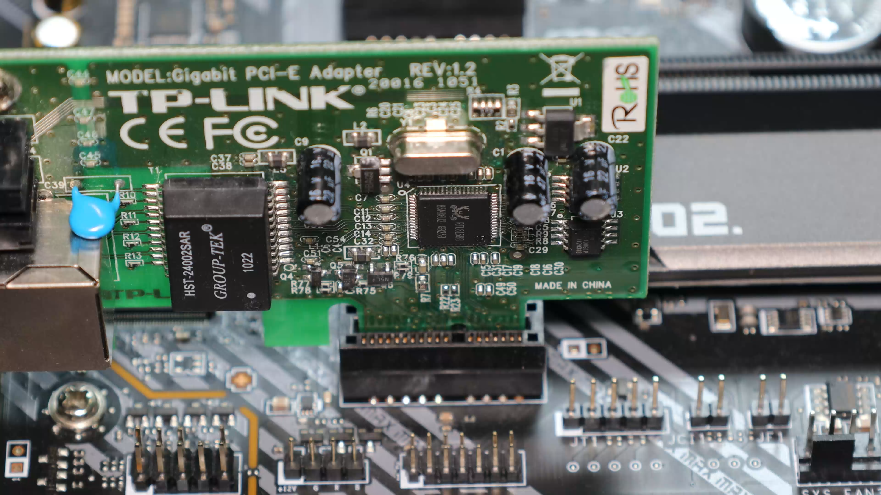
Demonstration
ITFreeTraining.com
© Copyright 2024
Notes:
01:04 Let’s now have a look at how you would use and install a network card. In the workplace, you will often come across small form factor computers like this one. These computers are designed with the workplace in mind. They are small, have features that businesses would use and have limited customization options, since businesses don’t normally add too much to their basic computers. As more and more data is being stored in the cloud, you may find businesses are buying even smaller computers.
At the back of the computer is the IO area. In this particular case, we are interested in the network port. You will find that the vast majority of motherboards will have an on-board network card with the network port being in the IO area. It is just a matter of plugging in the network cable.
Different computers will have different built-in network cards. It is pretty common nowadays for most computers to have a 1 Gigabit network card. However, some motherboards are now starting to be shipped with 2.5 Gigabit network cards. You may even see 5 Gigabit network cards.
Traditionally, with network cards we have seen speed increases of a factor of ten. That is, each version is ten times faster than the previous one. This also occurred going from 1 Gigabit to 10 Gigabits, however, there was a problem. This jump, of a ten-fold speed increase, unlike the others, turned out to be quite expensive to implement. Thus, 2.5 Gigabit and 5 Gigabit standards were created to provide smaller increment gaps between the versions, thus making it cheaper to increase the speed from 1 Gigabit without having to pay the full price for 10 Gigabit. Like any other speed increase, it requires both devices to support the new speed.
In most cases, you will use the on-board network card. There are some times you may want to add a network card to the computer. For example, if the on-board network card is damaged or you want a faster speed than the on-board network card supports. I have also added a network card to a computer because I was installing an alternative operating system and only certain network cards were supported. The on-board network card was not supported, so I purchased a network card that was. Nowadays, installing a network card does not happen too often.
In this example, I will install a ‘by one’ network card. That is, a network card that supports only one lane. Since it only supports one lane the connector is short.
To install the network card, you just need to push it into a free slot. Notice that the network card will go into a much larger slot. This slot is a full ‘by 16’ slot, which means that 15 of the available lanes are wasted if I put the network card into this slot. Thus, I would not recommend doing this unless you don’t have a choice. When installing the network card, take care not to handle it by the sides, don’t touch the electronics and follow anti-static procedures.
Since this motherboard has a ‘by one’ slot, I will move the network card to this slot. This will mean there won’t be any wasted lanes. You may find that faster network cards may use more lanes, for example, network cards with two ports or fiber optic network cards. The same principles apply. Do your best to put it in a slot that matches or one where you can minimize the number of wasted lanes. In some cases, you may be able to make changes to the computer setup to reduce the number of wasted lanes.
Let’s now have a look at the different types of network cards.

Slide 4
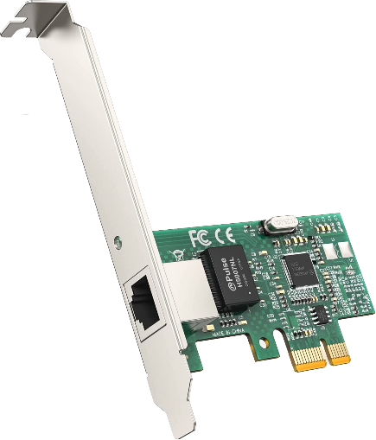
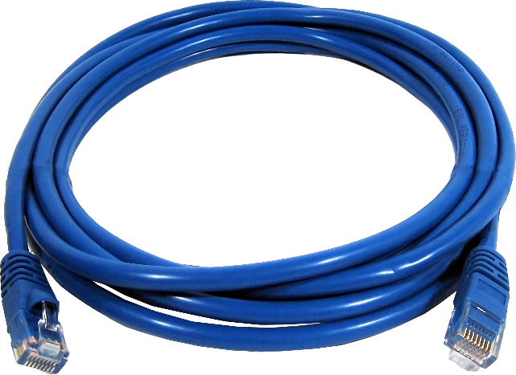
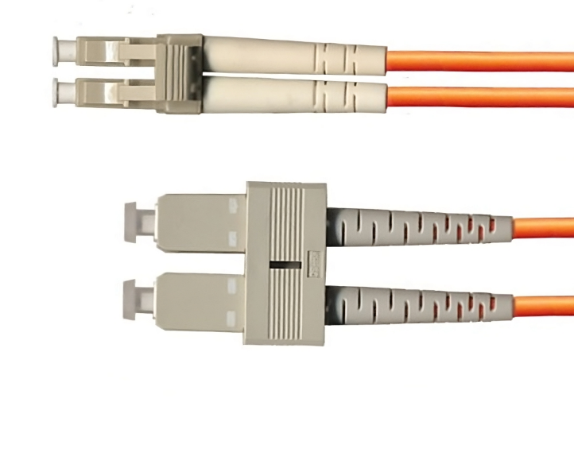
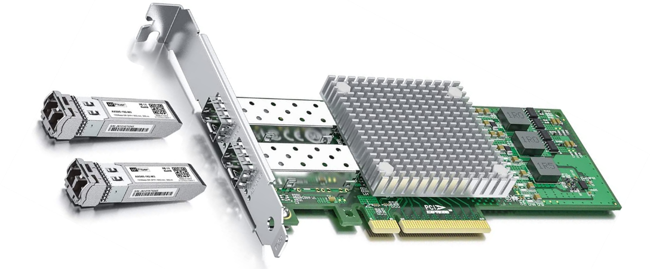
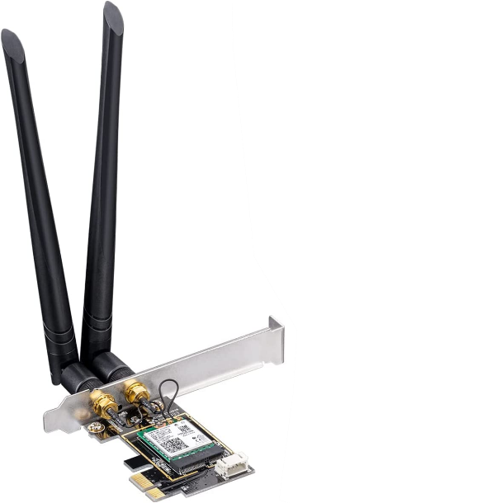
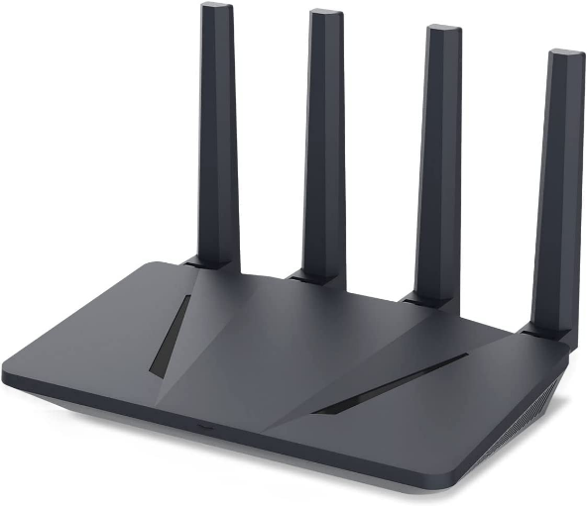
Network Card Types
Copper
Easy to install (Popular)
Supports speeds up to 10Gbps
Fiber Optic
Not subject to electromagnetic interference
Cabling harder to work with. Speeds up to 100Gbps
Wireless
Generally, devices connect to Access Point (AP)
Speeds close to 50Gbps
ITFreeTraining.com
© Copyright 2024
Notes:
04:59 The most common network card that you are likely to come across will be using copper cabling. Since it uses copper cabling, it is easy to install. With it being easy to install, it has become quite popular. It currently supports speeds up to 10 Gigabits per second. The higher speed that you use, the better quality cable you will require.
The next type of cable you may come across is fiber optic. Fiber optic cable is not subject to interference as copper cable is. Since the cable contains glass or plastic, it is harder to work with, however, it does support speeds up to 100 Gigabits per second.
Fiber optic is a lot more expensive than copper. Given that it is also harder to work with, you generally find it used in server rooms and for telecommunication lines. For connecting desktop workstations, copper is generally used. In highly secure environments, fiber optic may be used to connect desktop workstations. This is because it is harder for an attacker to connect listening devices up to the network lines, since to do so would mean cutting the cable, whereas, it is pretty simple to cut copper cables. Fiber optic, on the other hand, is more difficult since the material inside is a lot harder to cut and insert a connector into the cable.
The last type is wireless. Although you can connect a network card directly together, most users nowadays will connect to wireless using an access point. There are a lot of different standards for wireless. With the newest standards, in theory, you could get close to 50 Gigabits per second, but in the real world, even with a good signal and being close to the access point, you are unlikely to get speeds that high.
In later videos, I will have a look at networking in more detail.

Slide 5
Subscribe
Next video
Video content: https://ITFreeTraining.com/ap11/1b45
© Copyright 2024
Notes:
06:54 That concludes this video looking at network cards. I hope you have found this video useful. Until the next video from us, I would like to thank you for watching.
References
“The Official CompTIA A+ Core Study Guide (Exam 220-1101)” pages 30 to 31
Credits
Trainer: Austin Mason https://ITFreeTraining.com
Voice Talent: A Hellenberg https://www.freelancer.com/u/adriaansound
Quality Assurance: Brett Batson https://www.pbb-proofreading.uk

