Slide 1
Notes:
Let’s have a look at how sound is produced in a computer and how sound cards work. It is unlikely you will get an exam question on the information in this video, so this information is aimed at helping you configure and support sound in your organization.

Slide 2
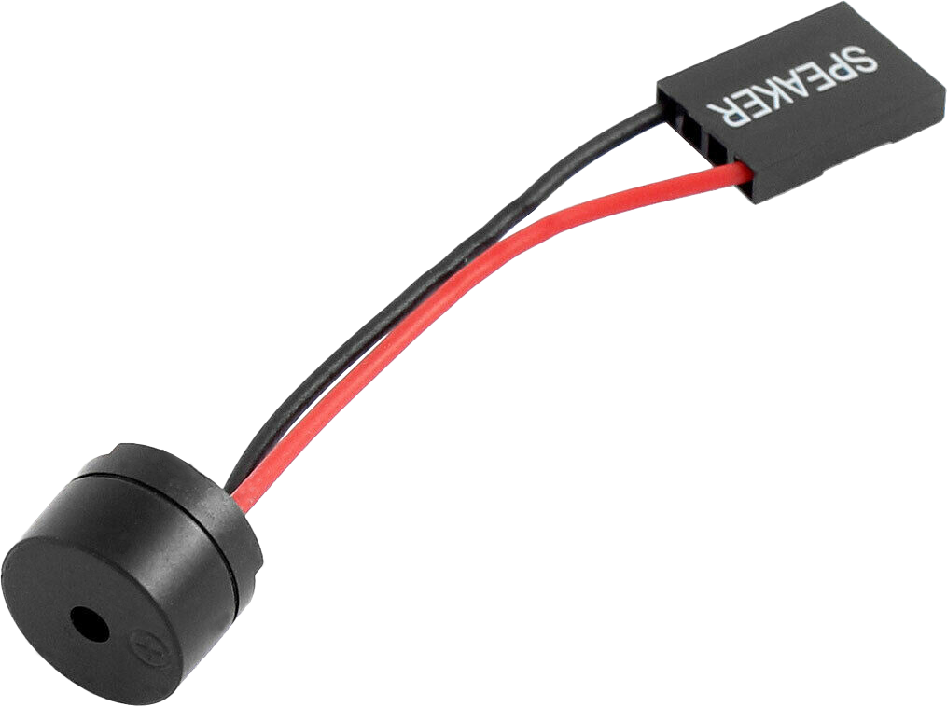
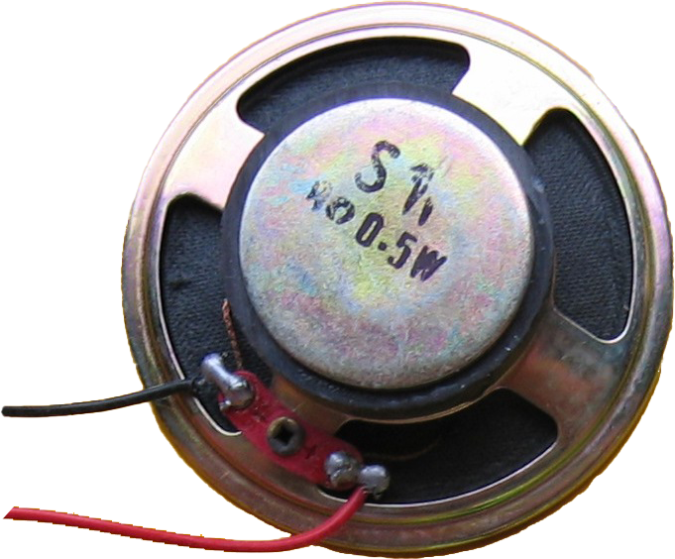
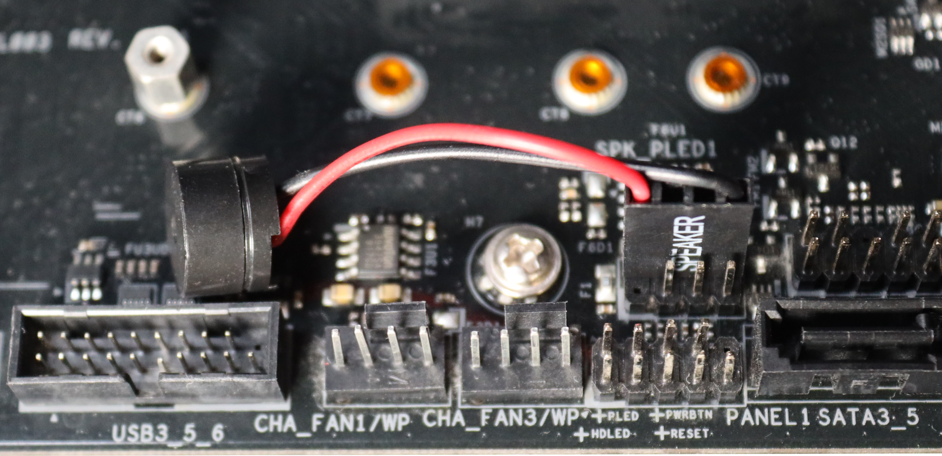
PC Speaker
Speaker used in
first computers
Speaker used in
modern computers
ITFreeTraining.com
© Copyright 2024
Notes:
00:16 I’ll start by doing a quick history lesson. The first personal computers had a large speaker, referred to as the PC speaker. It allowed the computer to make basic sounds like beeps and basic music. Since there was only one PC speaker, it was limited to mono sound. Back in those days the PC speaker was very CPU intensive to operate. More on that later in the video.
In modern computers, the PC speaker has been shrunk down. Its purpose in modern computers is to make beep sounds when the computer starts up to indicate everything is o.k. or that there is an error.
Thus, although the PC speaker is only used nowadays for making beeps, these beeps are very valuable when something goes wrong with the computer and you need to troubleshoot what is causing the problem. Nowadays, the vast majority of motherboards come with a sound chip embedded on the motherboard which provides superior sound quality over the PC speaker. You may want to replace this embedded sound chip with a dedicated sound card; however, to know if this will meet your needs there are a few things to understand first.

Slide 3
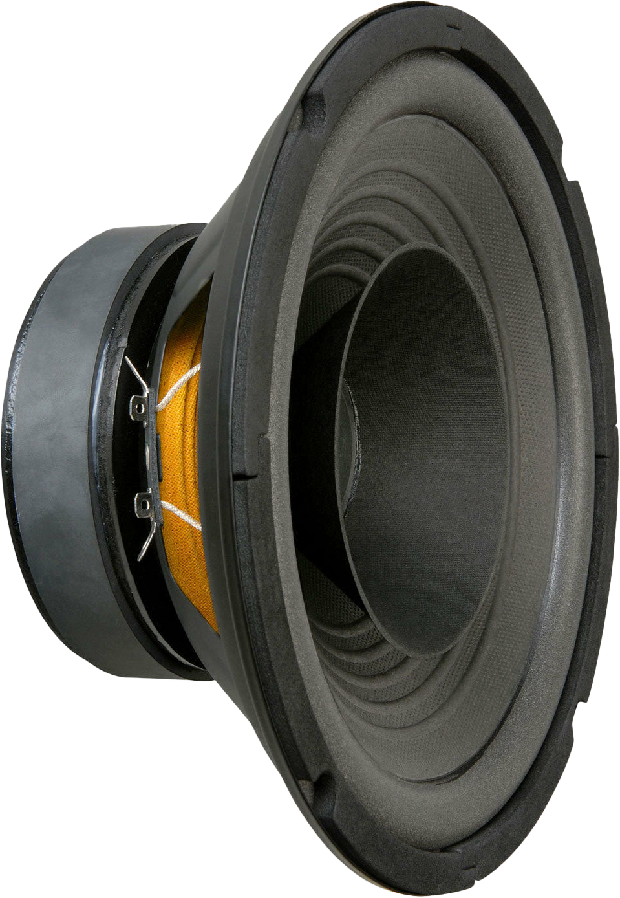
Digital To Analog (DAC)
Converts digital signal to analog signal
DAC
0
1
0
1
1
0
8-bit
16-bit
24-bit
32-bit
Digital signal
Analog signal
* Digital signal needs to be converted to analog somewhere
ITFreeTraining.com
© Copyright 2024
Notes:
01:25 The first thing to consider is Digital to Analog otherwise known as a DAC. A DAC converts a digital signal to an analog signal. To understand this process better, consider that you have a digital signal entering the DAC. This digital signal at some stage originated from the CPU. Nowadays, in most cases, the sound mixing is performed by the CPU. In order for humans to hear the sound it needs to be played through some speakers; however, speakers don’t work using digital signals; they work using analog signals. Thus, it is the DAC’s job to convert the digital signal to analog so that it can be played on a speaker.
The DAC will support one or multiple resolutions. This is essentially the number of possible levels it is designed to reproduce. This is generally defined in bits. The higher the number of bits the better quality the sound will be; however, as the number of bits increases, it gets harder to notice the difference.
The point to remember is that a digital signal needs to be converted to analog somewhere. If this occurs in a location where there is electrical interference, this interference will be heard as noise in the speakers. So now we are starting to understand one of the first things to consider if you are planning on purchasing a sound card rather than using the embedded sound chip on the motherboard. That is, the location of the DAC and is it subject to interference in that location.

Slide 4
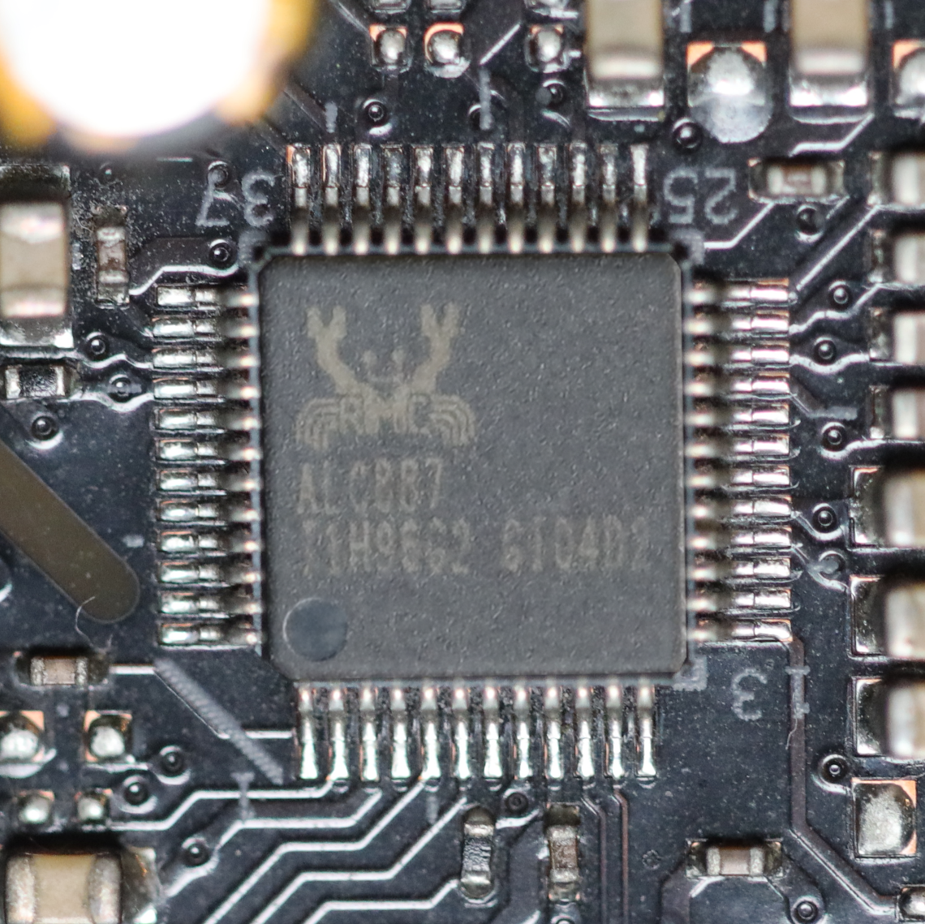
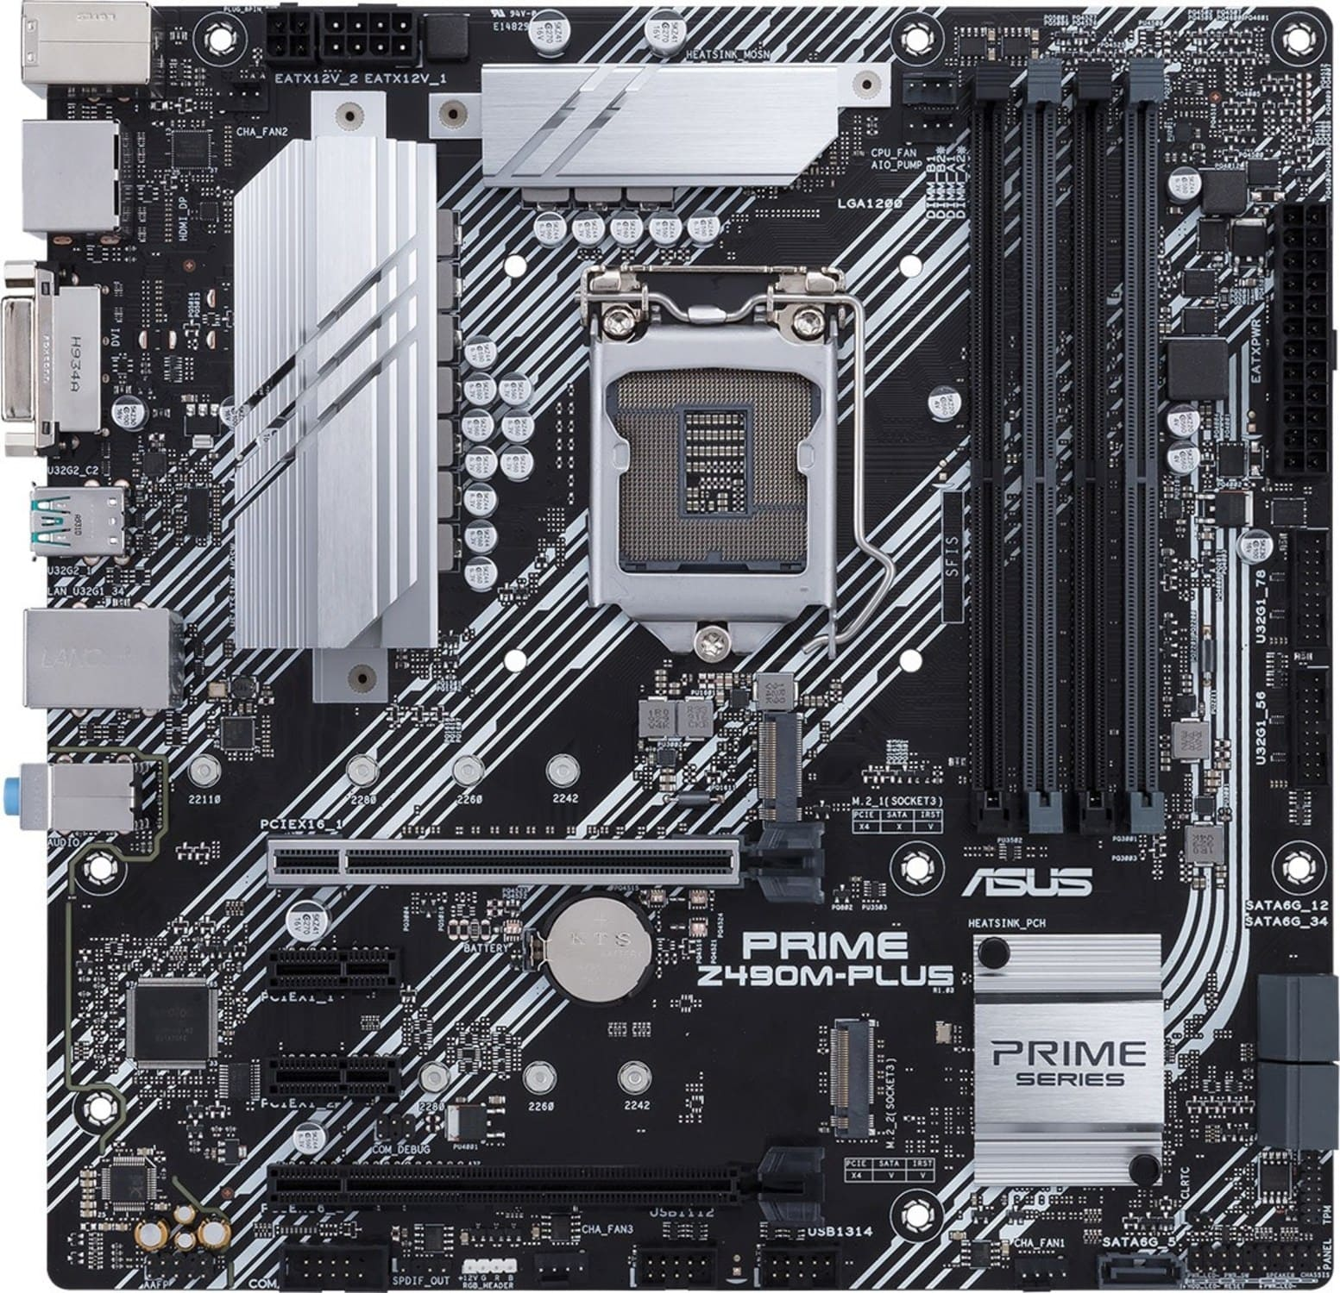
Prime Z490M-PLUS
Realtek ALC887 (7.1 channel/Audio shielding)
Placed away from interference
ITFreeTraining.com
© Copyright 2024
Notes:
02:57 Let’s consider an example motherboard. This motherboard has an embedded sound chip on it like the vast majority of motherboards do nowadays. Even though it is a chip on the motherboard, you may hear it referred to as a sound card. In the early days of computers motherboards did not have embedded sound chips and thus to have good sound quality, a dedicated sound card needed to be installed. Therefore, sometimes a sound chip may be called a sound card because they are used to using that terminology.
In the old days, motherboard manufacturers did not put much thought into where these chips were put on the motherboard. Thus, if the chip was placed near an electromagnetic source, it would be subject to interference. Interference can be heard as background noise such as the sounds you are hearing now. When the computer is under load the noise may change as electromagnetic sources in the computer also change under load.
You will most likely notice interference when sound is quiet or there are breaks in the sound. The interference will also get worse as the volume gets louder.
Nowadays, motherboard manufacturers have learnt to place these sound chips away from electromagnetic interference. Also, the sound chips often have shielding around them, and this helps prevent them being affected by electromagnetic interference.
There is a bit of variation between the sound chips used on motherboards. More expensive motherboards generally have a better sound chip. To get an idea if it is worth getting a motherboard with a better sound chip, let’s have a look first at historically why you would purchase a dedicated sound card in the first place. This will give you more of an idea of what you should be looking for.

Slide 5
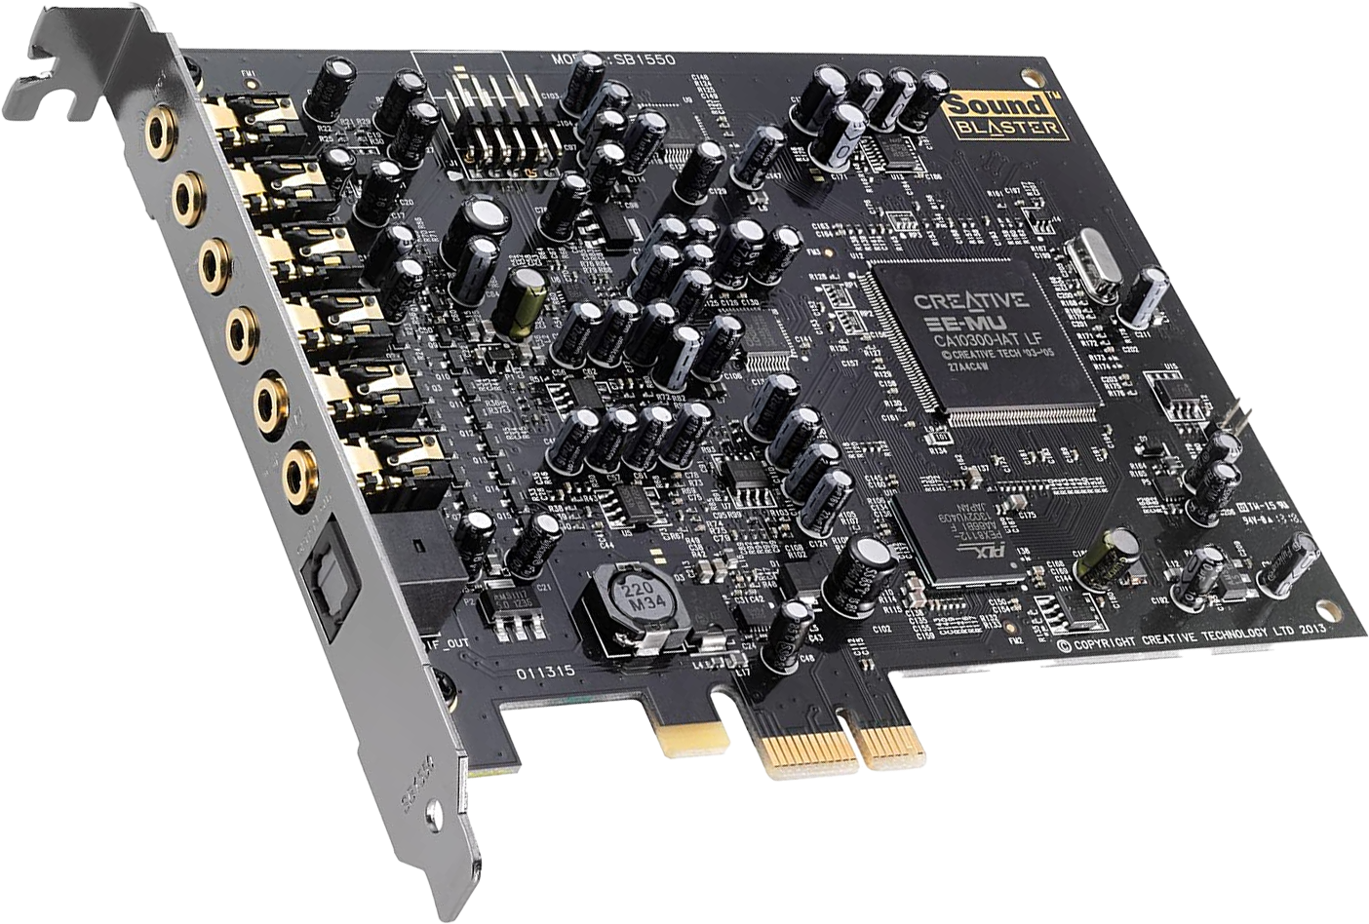
Sound Card
Additional hardware processing
E.g., E-MU Chipset for advanced effects processing
ITFreeTraining.com
© Copyright 2024
Notes:
04:41 Historically speaking, sound cards added additional hardware processing. In this example, the sound card has an additional chip which provides additional effects processing. Having additional hardware on the sound card takes load off the CPU. In the old days, this was important because CPUs were not very fast; however, this is not a concern with modern CPUs because they are much faster. With the increased speed of CPUs, this allowed the operating system to perform a lot of the tasks a sound card would have historically done. This meant that a sound card would no longer require specialized processing hardware. Let’s have a closer look.

Slide 6
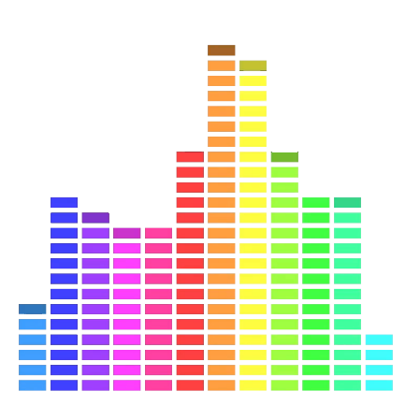
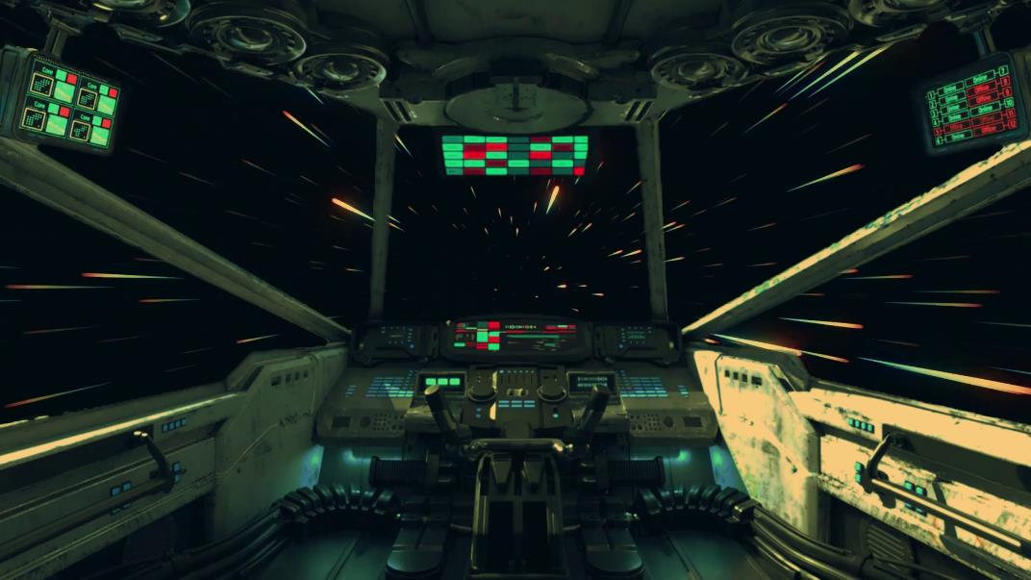
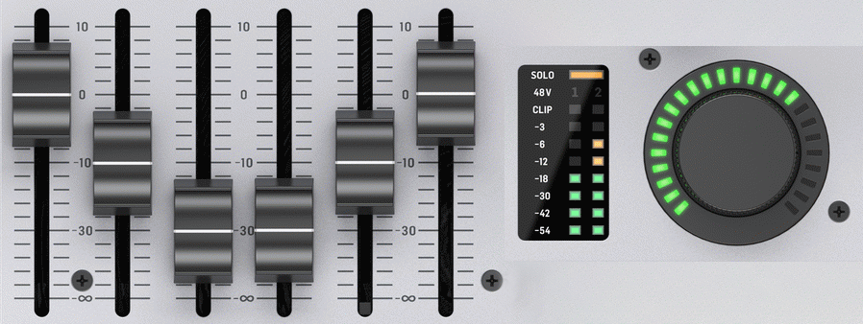
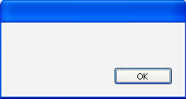
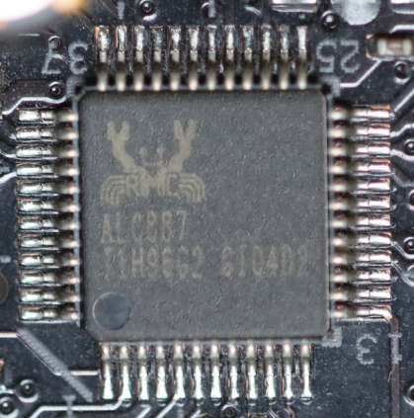
OS Sound Processing Example
OS performs majority of the sound processing
Volume
Equalizer
Effects
Mixing
Multiple channel
Different types
Sound card
Virtual
Mixer
ITFreeTraining.com
© Copyright 2024
Notes:
05:22 In modern operating systems, the OS performs the majority of the sound processing. What used to require specialized hardware, due to limited CPU speed, can now be performed by the OS using faster CPUs.
To get an idea what can now be achieved, consider that you are playing a video. The video has sound. The OS can make changes to the sound, for example, to change the volume, apply an equalizer and apply effects.
You could also be playing a game. The game has its own sound. These sounds are independent of the previous sound from the video and as before can have the volume changed and effects applied. Games can potentially have a lot of different sound effects playing together and even a music track. The OS handles mixing all these sounds down to channels, for example, to stereo channels or surround sound channels.
On top of this, you may have applications or even system sounds. These go through the same process as before. The next step is for the OS to mix these sound sources together. Each application can have its own volume control and the OS can also change the volume when mixing the sounds together. Also, if you require it, the OS can apply additional effects; for example, it can make the output sound like it is being played in an opera house.
The end result is that all the sound sources are mixed together and outputted to the sound card. This mixing allows multiple channels to be mixed together, that is, from different applications and different types of audio. For example, mono, stereo and surround sound can be mixed together. Considering that all the work is done by the operating system and a single output is created. You can understand why all the work of a sound card can be done by a single small chip on a motherboard. This small chip simply needs to take the pre-mixed output and send it to the next step of the process. Gone are the days when the sound card needed to perform a lot of processing – this processing is now performed by the operating system. Now the question arises, why would you want to purchase a sound card if most of the work can now be performed by the operating system?

Slide 7
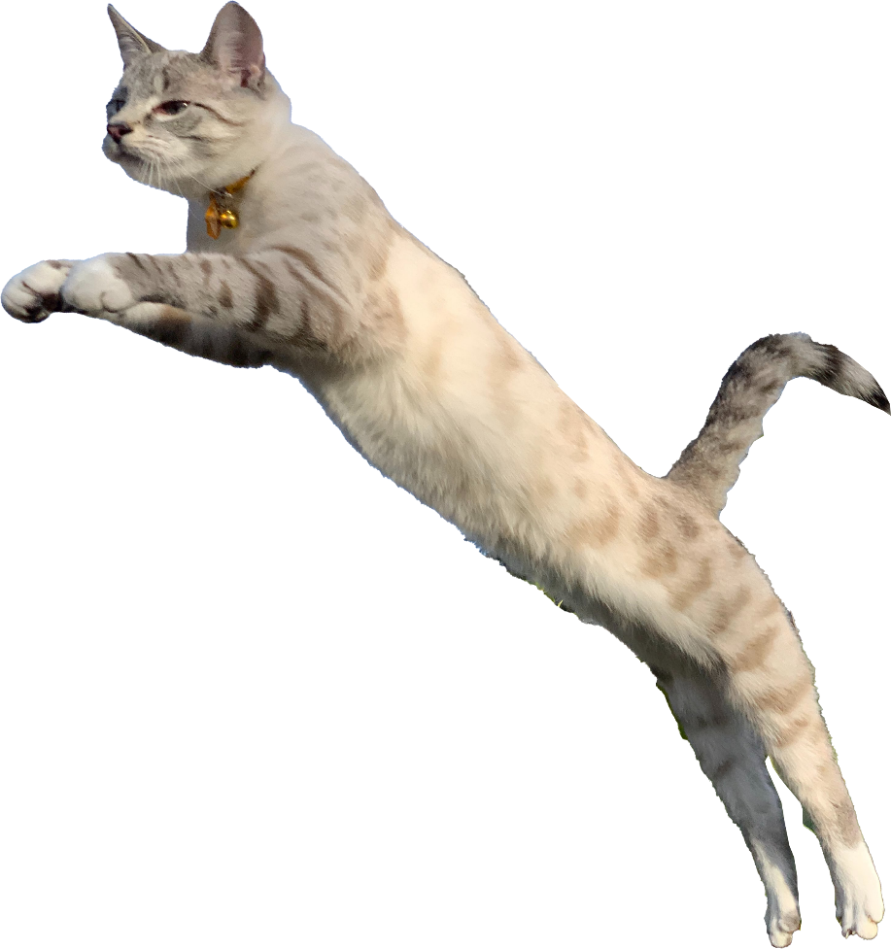
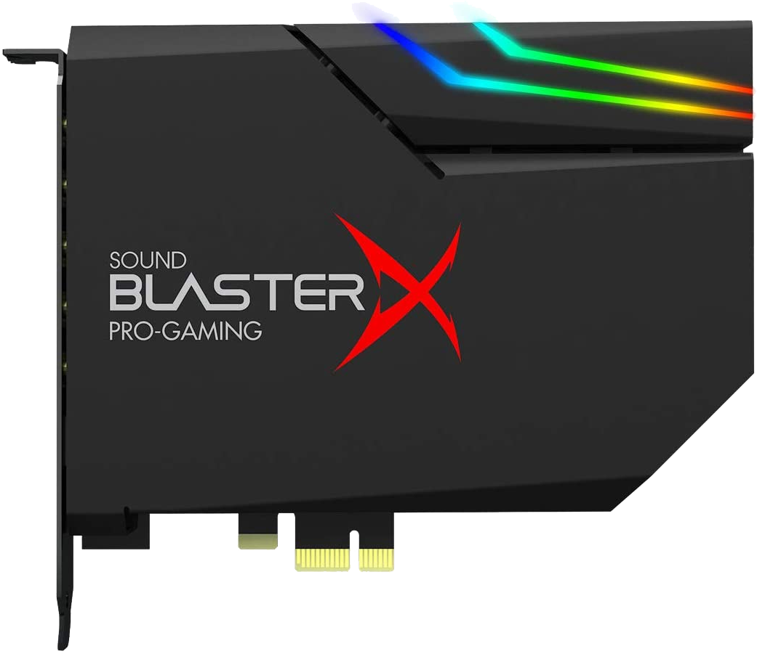
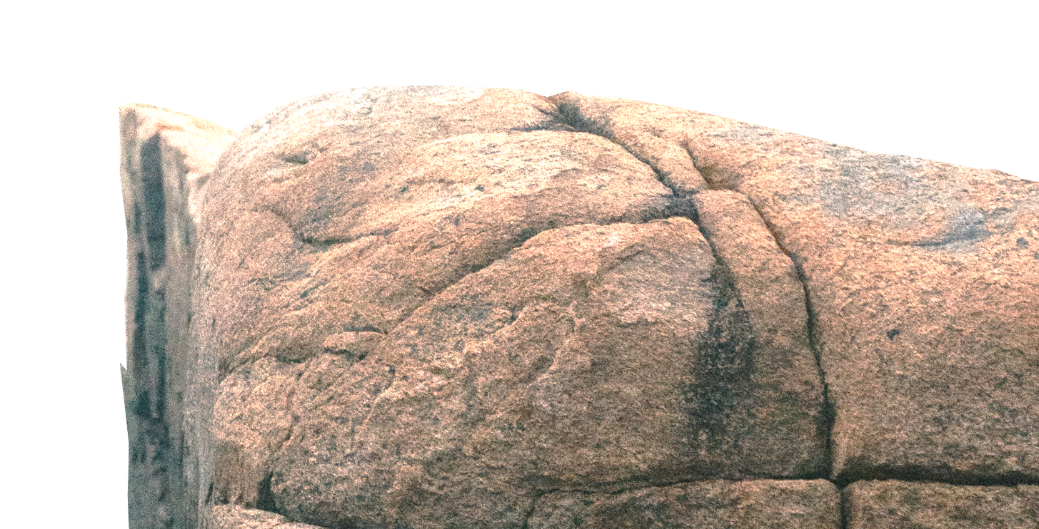
Motherboard vs Sound Card
Gap between motherboards vs sound card small
Results can vary between different motherboards and sound cards
Signal to Noise Ratio (SNR) better on sound cards
SNR ratio of signal power to noise power
Often expressed in dB. Higher is better
Better DAC bit rate and sample rate
97dB (SNR)
122 dB (SNR)
24-bit DAC
32-bit DAC
192 kHz
384 kHz
ITFreeTraining.com
© Copyright 2024
Notes:
07:38 The difference in benefits between motherboard sound and sound cards is very small nowadays. Results can vary between different motherboards and sound cards. With older motherboards the gap tends to be a bit bigger, but as technology improved the sound chips got better.
One of the reasons you may want to purchase a sound card is generally they have a better Signal to Noise Ratio or SNR. SNR is the ratio of signal power to noise power. Essentially, in basic terms, when you turn the volume up, this is how much noise you can expect to get. This ratio is often expressed as a signal in decibels (dB), where higher values means less noise and thus is better.
To get an idea, let’s compare a motherboard sound chip to a sound card. In this example, and your results may vary, the motherboard sound chip has an SNR of 97 dB. The sound card in comparison has an SNR of 122 dB. On the surface this may seem like a big difference, however there are a few things to consider. Firstly, in the case of the sound chip it essentially means that to hear one dB of noise the sound would need to have a signal power of 97 dB. Basically that means, in simple terms, the volume needs to be pretty high before you hear any noise. Keep in mind that if you have poor quality speakers you are going to hear noise regardless of what sound hardware you are using. Thus, to get the benefit of having a sound card you need some good quality speakers.
The next thing to consider is that sound cards generally have a better DAC bit rate and sample rate. In this example the sound chip has a 24-bit DAC and the sound card has a DAC of 32. To give you an idea what this means, consider that Blu-Ray discs will often use 16 or 24 bits. In fact, up to 24 bits is quite common. The only time you really see 32-bit is in recording studios. When recording and combining multiple audio sources together, 32-bit is often used for the extra accuracy. Once all the studio work is done, the sound is often outputted to 24 bits or lower. In other words, 32-bit for professional use, 24-bit and lower for consumer use.
The next thing to consider is that, in this example, the sound chip has a maximum sample rate of 192 kHz. By contrast, the sound card has a sample rate of 384 kHz. Sample rate is how many times a sound wave is measured per second. Blu-Ray will often use 48 kHz or 96 kHz, thus 192 kHz is significantly higher than the average person and even professional may use. Therefore, the only place you may find 384 kHz used is in a sound studio, and they may not even use a sample rate that high, but it is there if needed.
The main takeaway is that for motherboards and sound cards, the gap in performance is not that great nowadays. For the consumer, most people will use the motherboard sound chip which produces good results. A sound card may be purchased by a sound professional or enthusiast as they may be able to hear the slight difference in quality, but for the rest of us they will both probably sound the same.
If you do decide to purchase a sound card, there is one other thing to consider.

Slide 8
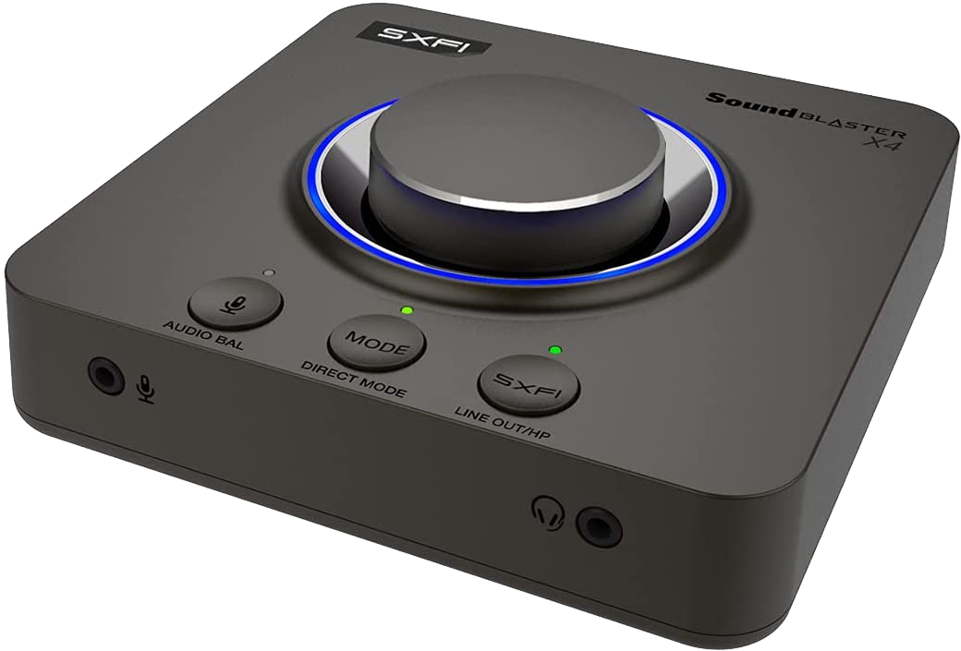
External Sound Cards
Not really a card
Reduces interference
Not subject to interference from computer
Helps for audio recording
ITFreeTraining.com
© Copyright 2024
Notes:
11:08 The next thing to consider is, do you want an internal or external sound card? Keep in mind that external devices are not really sound cards. Just like the sound chip on the motherboard, they will often be referred to as sound cards even though technically they are not.
The advantage of an external sound card is it reduces interference. This is because it is not subject to interference from inside the computer. Keep in mind that internal sound cards will have shielding to help prevent interference; however, it can still occur. Of course, having an external sound card can still result in interference. Generally, external sound cards will have shielding and also, by design, the components that may cause interference are separated.
Having an external sound card also helps when recording audio. If you use the motherboard’s sound chip for audio recording, you may not get the best results. Although these chips have come a long way in terms of audio output, audio recording may not be as good. For general use, such as virtual phone calls and virtual meetings, the quality will probably be fine. However, if you are doing professional or semi-professional work you may want to consider using a different device for audio recording.

Slide 9
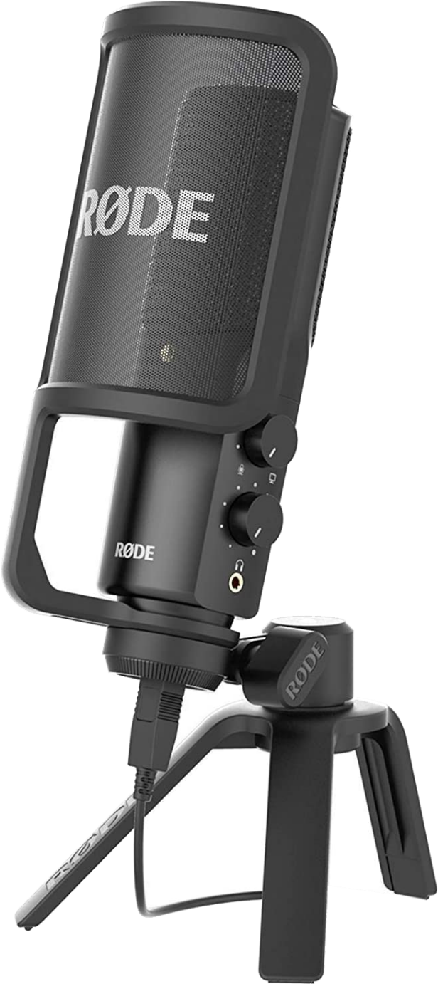
External Audio Capture
Analog-to-digital (ADC) convertor
USB Microphone
USB Recording/External box
Good quality/Simple to use
Digital output
ITFreeTraining.com
© Copyright 2024
Notes:
12:21 In order to capture audio, you are essentially performing the opposite steps to a DAC, that is, the steps required are to convert analog to digital.
As before, these devices can be external to the computer. Remember, that interference can occur whenever the signal is analog before it gets converted to digital. Once the signal is digital, it is difficult for interference to corrupt the signal, although it is possible.
If you want a simple solution, it is worth considering a USB microphone. Assuming you don’t purchase a very cheap microphone, these microphones offer good quality and are simple to use. Since they are USB, they bypass the sound card in the computer, so it does not matter what sound card you are using.
Another option is to purchase an external recording box. Nowadays, there are plenty of USB compatible solutions. To use one of these, you just need to plug your microphone into the external audio box and it will convert sounds into digital signals for your computer to read. The advantage of either of these solutions is that, since they are USB, they are easy to setup.
This is just a basic run down of the options that are available. When it comes to audio, the sky is the limit. Now that I have had a look at sound cards, let’s look at how you get the sound out of the sound card and into the speakers.

Slide 10
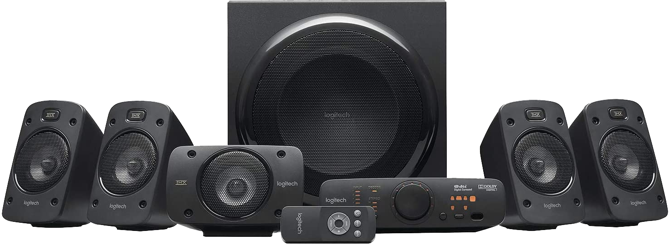
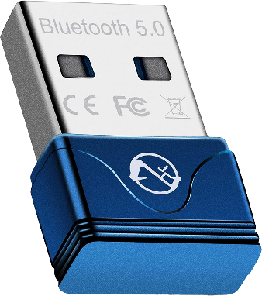
Sound Output
Many speakers have Bluetooth/USB
DAC not in the computer
No digital to analog conversion inside computer
Sound jacks
Sleeve
Ring
Tip
Tip, ring, sleeve (TRS) connectors
Stereo audio line-in signal supplied by most devices, e.g., CD players (Light blue)
Stereo audio out or line-out. Suitable for speakers/headphones/front speakers (Lime)
Mono microphone (Pink)
Audio out for rear speakers in 5.1 surround sound system (Black)
Audio out for subwoofer in 5.1 surround sound system (Orange)
Audio out for side speakers in 7.1 surround sound system (Gray)
ITFreeTraining.com
© Copyright 2024
Notes:
13:43 Nowadays, you will find that a lot of speakers and headphones will use USB or Bluetooth. Both of these transfer data using digital signals. This means the DAC inside the computer is not being used. Essentially, no digital to analog conversion is being done inside the computer. The advantage of this is the signal is less subject to interference inside the computer or the cable from the computer to the speakers. However, if the interference is strong enough, even a digital signal can be corrupted.
You will find that for compatibility, pretty much all computers will have sound jacks. A sound jack generally has three different parts called the tip, ring and sleeve. Thus, you may hear it called TRS. Your computer will have multiple sound jacks. These will be color coded; however, some computers may use colors differently.
Shown here are the six common colors that are used for sound jacks. Six are required for 7.1 surround sound; however, if your system does not support 7.1 surround sound it will have fewer sound jacks. If your computer only supports stereo sound, it may only have three sound jacks or in some cases only two.
Sound jacks are pretty old technology by today’s standards but still give pretty good results. Since digital signals offer advantages over sound jacks, we are seeing a decline in their use in newer devices. There are still a lot of devices that support them, so I would say that it will be a while before we start seeing computers without audio jacks.

Slide 11
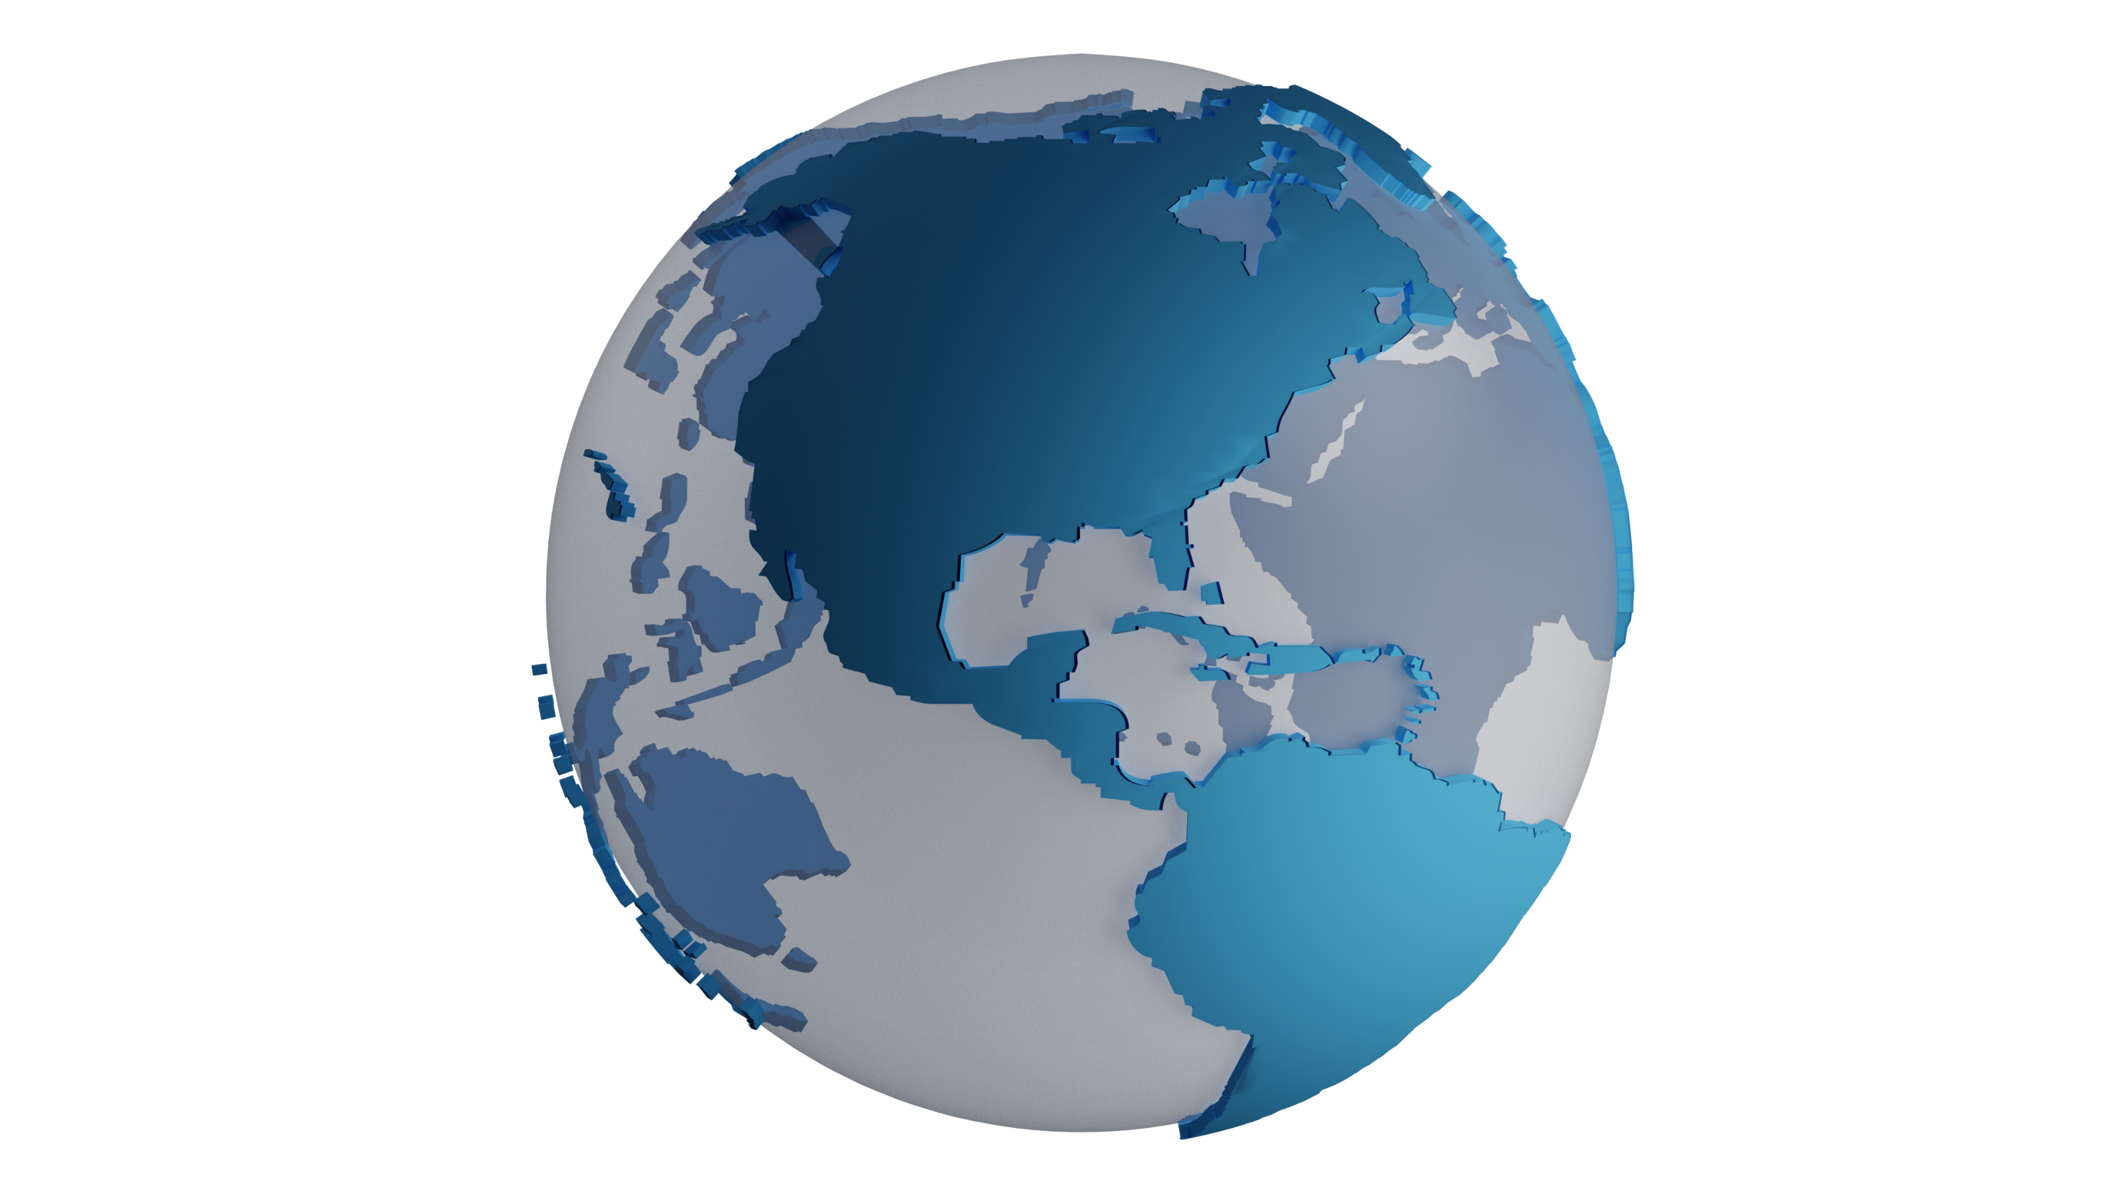
In The Real World
Vast majority of computers
Will use sound chip on motherboard
Nowadays, gives pretty good sound quality
Sounds cards for the professional/enthusiast
Generally, offer better sound quality
Less interference (SNR)
May have hardware acceleration
ITFreeTraining.com
© Copyright 2024
Notes:
15:20 In the real world, the vast majority of computers will use the sound chip on the motherboard, also called integrated sound. You may hear this referred to as a sound card even though technically it is not. Nowadays, these tiny little sound chips provide good sound quality which is more than enough for most computer users.
Sound cards, nowadays, are used by the professional or the enthusiast. They generally offer better sound quality. Results can vary depending on which sound card you purchase, but assuming you purchase a quality sound card, you should get better results than with a motherboard sound chip. Keep in mind that modern motherboard sound chips offer quality as good as Blue-Ray if not better. Thus, you can see why a lot of people simply use the sound chip on the motherboard.
Sound cards generally offer less interference, known as sound to noise ratio. To notice the difference, you need to have some good speakers or headphones. The casual listener may not notice the difference even if good speakers are used.
Sound cards may have hardware acceleration or additional hardware features. Since the operating system is capable of doing so many of the functions a sound card used to do, in most cases, there is generally no need for hardware acceleration on modern sound cards. Some sound cards may have some hardware for additional acceleration and effects, but don’t expect too much since the operating system does so much already.

Slide 12
Subscribe
Next video
Video content: https://ITFreeTraining.com/ap11/1b40
© Copyright 2024
Notes:
16:47 That concludes this video on sound cards. I hope this video has helped you understand what modern sound cards can do. Nowadays, most people won’t purchase a sound card, but if you do, we hope you get some good results. Until the next video from us, I would like to thank you for watching.
References
“The Official CompTIA A+ Core Study Guide (Exam 220-1101)” pages 29 to 30
“Video: Cat Meow” https://pixabay.com/videos/cat-kitten-mackerel-meow-85567/
“Video: Audio meters” https://pixabay.com/videos/digital-audio-meter-meter-animated-46280/
“Picture: Speaker” https://pixabay.com/vectors/loudspeaker-volume-music-audio-48534/
“Video: Space Craft” https://pixabay.com/videos/spacecraft-stars-universe-cosmos-82659/
“Picture: Exclamation mark” https://pixabay.com/vectors/sign-caution-warning-danger-safety-304093/
“Picture: Cat Leap” https://unsplash.com/photos/BokzGWmcs-Y
“Picture: Cliff gaps” https://unsplash.com/photos/BzIC8ioj7Ms
Credits
Trainer: Austin Mason https://ITFreeTraining.com
Voice Talent: HP Lewis https://hplewis.com
Quality Assurance: Brett Batson https://www.pbb-proofreading.uk

