Slide 1
Notes:
Let’s have a look at capture cards.

Slide 2
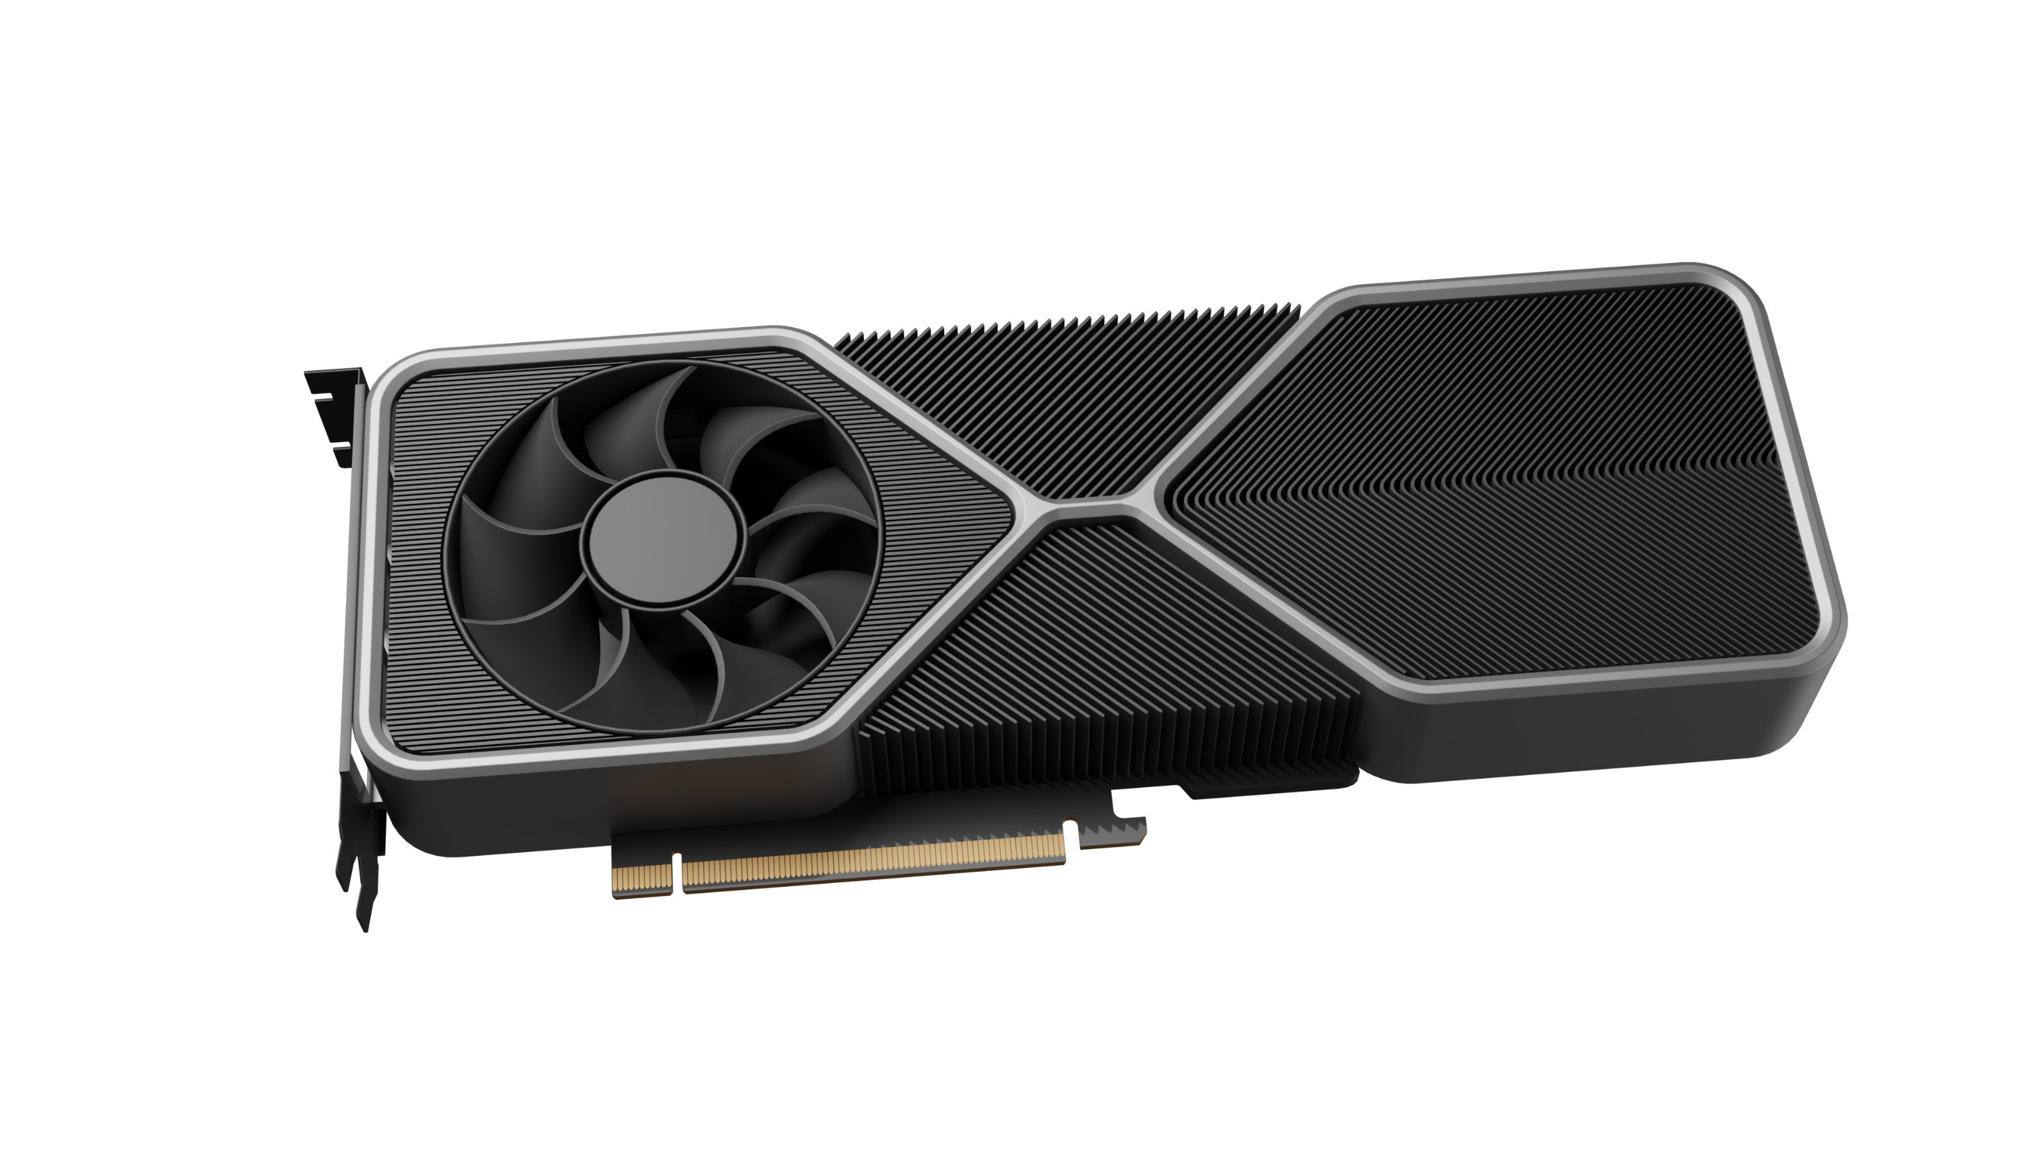
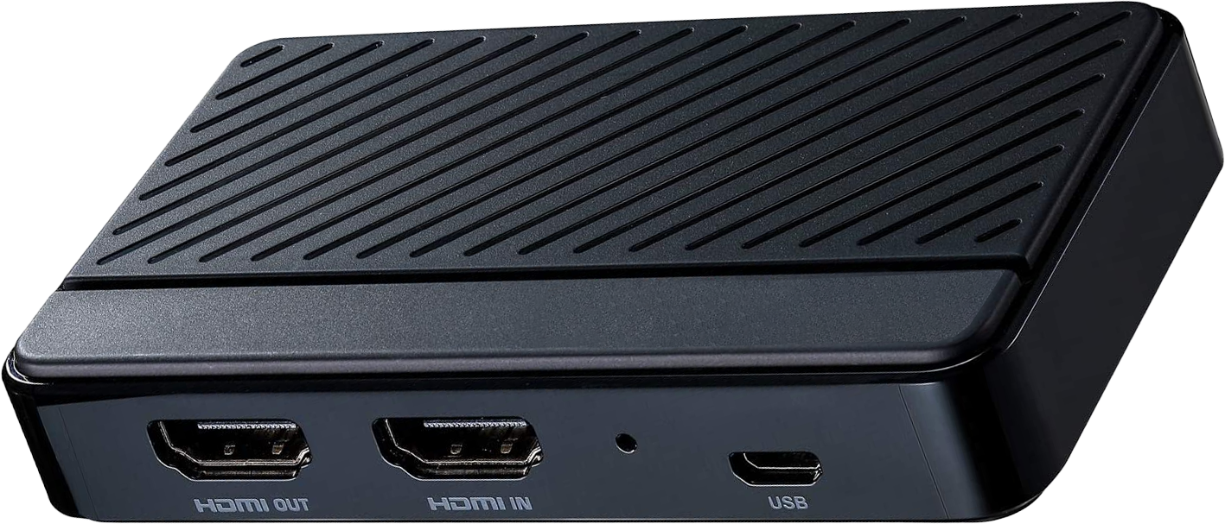
Capture Cards
Captures a feed of images with or without audio
Real-time
Encoding
Hardware real-time encoding (Compression)
Output to file or stream
Creates
file/stream
ITFreeTraining.com
© Copyright 2024
Notes:
00:03 A capture card essentially captures a feed of images. A capture card may also capture audio as well; however, technically it does not need to capture audio but most do. Essentially, the way a capture card works is that a video adapter will output a feed of images which goes to the capture card.
Although the term capture card will often be used, a lot of these devices nowadays are external devices and technically not an expansion card. In many cases, these devices will connect to the computer using USB. I personally prefer the external devices, as if something goes wrong, I can disconnect the device and plug it back in, essentially turning it off and on again. With an internal capture card, if something goes wrong, you will need to shut down or reboot the computer which is more of an inconvenience. For this video, I will be referring to all capture devices as video capture cards.
A video feed contains a series of images which results in a lot of data. For this reason, a capture card needs to have hardware real-time encoding, that is, compression to make the data a more manageable size.
Real-time means the capture card needs to output compressed data at the same speed as it is receiving compressed data. Since the compression is done in real-time, the output file tends to be larger than if you don’t use a real-time compressor. Generally, hardware is excellent at compressing video in real-time over what a CPU can achieve; however, it is still limited in the results it can achieve. You can only achieve so much if you want to maintain real-time compression. The amount of video frames you receive must match the number you output, otherwise the capture card will start dropping frames which will cause the video to look glitchy when you play it back.
Once the video is compressed, it is generally sent to a file or to a stream – a file is simply saved to local storage. Generally, it is not recommended to save the file over the network, as if the network has performance problems this may cause frames to be lost.
If you output the data to a stream, this is essentially sending it somewhere else. Nowadays, this often means an online streaming service which will broadcast it to others on the internet.
This basically covers what you need to know for the exam. For the rest of the video, I will have a closer look at capture cards, so you have a better understanding of what is available and what you may need if you decide to purchase one or have to support one.

Slide 3
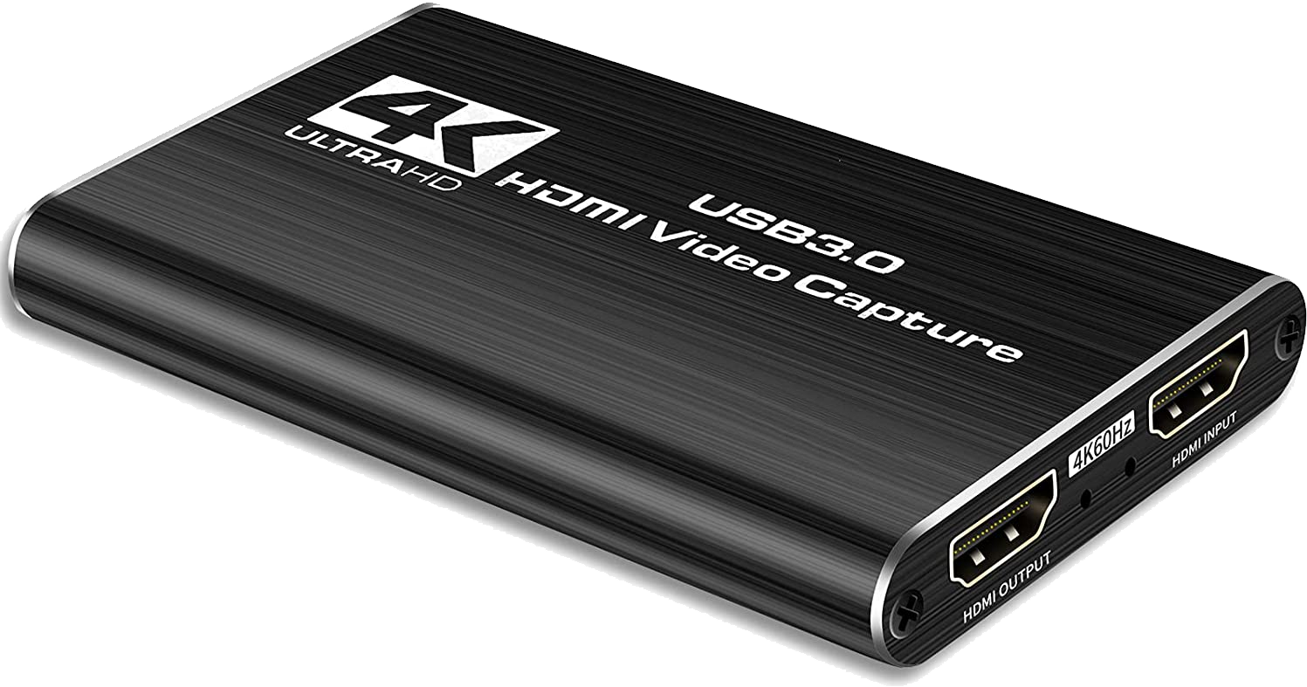
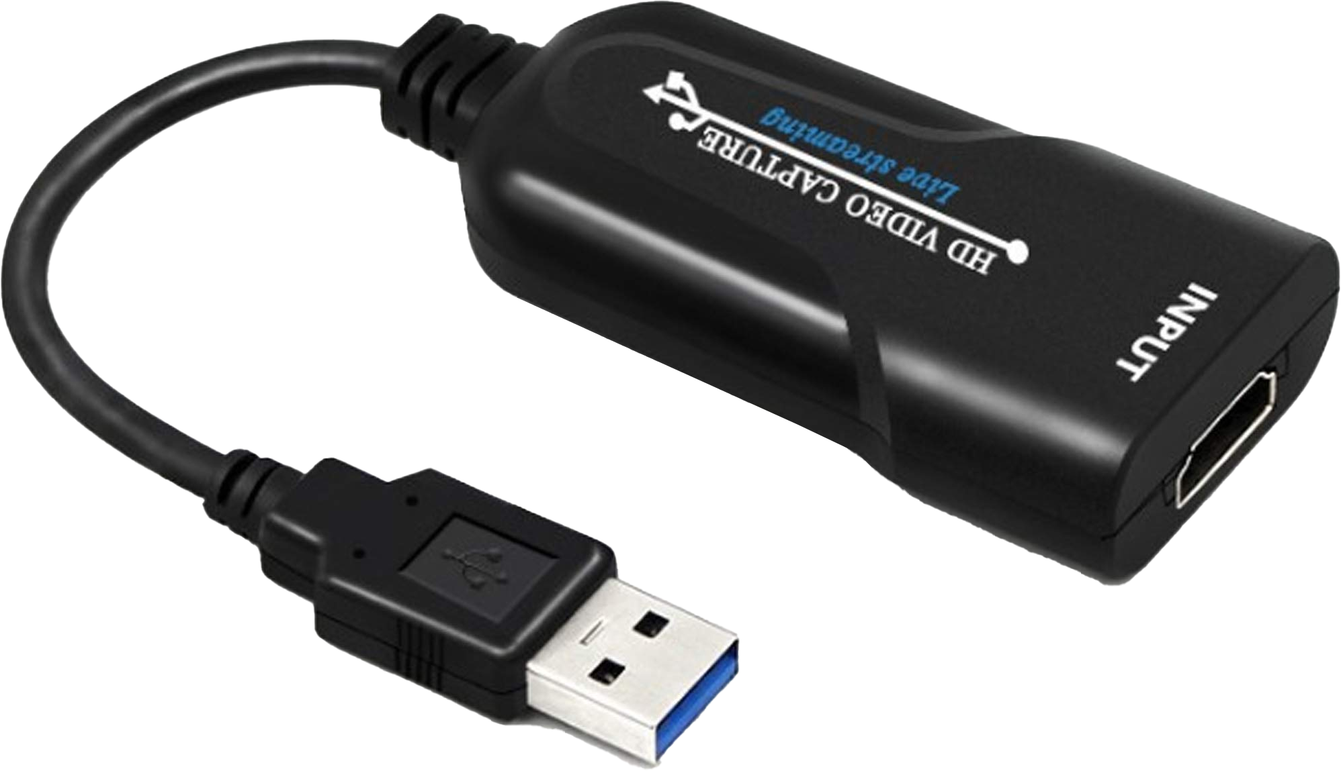
Passthrough Capture Cards
Has input and output ports
Referred to as passthrough as signal passes through unaltered
Has input and output ports for passthrough
No passthrough
0_Picture Left
© Copyright 2024
Notes:
02:35 One of the considerations when purchasing a capture card is if it has passthrough or not. Video capture cards with passthrough have both an input and an output port. Thus, the input will go to your device producing the video you want to capture, for example, a device like a computer or a game console. The output will go to your monitor or TV. Since the video is essentially transferred through unaltered, it is referred to as passthrough. Therefore, the video signal passes through the device and the capture card captures the signal as it goes through it.
The other option is no passthrough. These capture devices only have an input connector. In some cases, this may be all that you need. For example, if you have a video camera that can’t be used as a webcam (however, it does have a video out), you can plug your video camera output into a capture device like this one and it will convert the signal to USB so you can use the video camera as a webcam. In some cases, you may need to capture the video and also display the video on a device like a monitor. If your capture device does not have passthrough, there is another option.

Slide 4
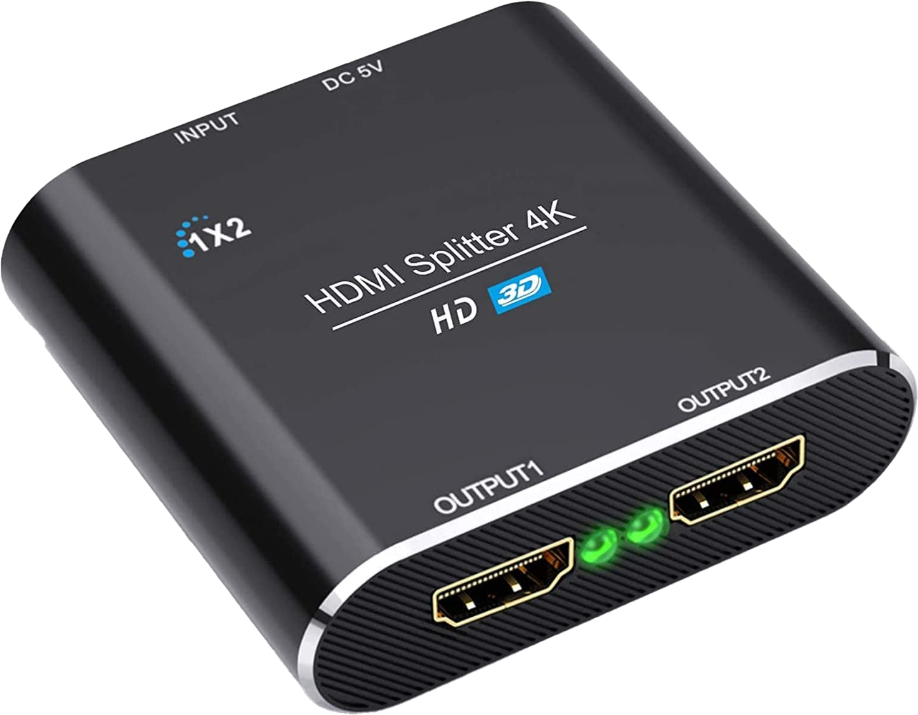
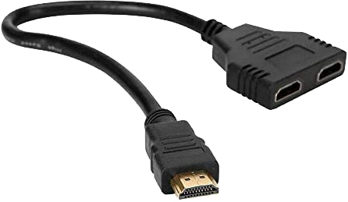
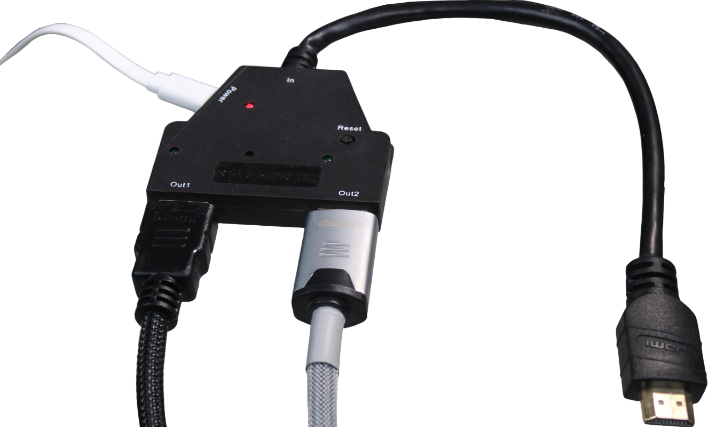
Splitters
Divides the signal into two
One connection goes to capture card and other to display device
Ensure splitter supports the resolution you want to use
Additional power
Splitter no power (Passive)
Splitter powered (Active)
Remove HDCP
Less reliable/lower resolutions
More reliable/higher Resolutions
Copy protection
ITFreeTraining.com
© Copyright 2024
Notes:
03:46 If your capture card does not have passthrough you can, in addition, use a splitter. A splitter essentially divides the signal into two. One connection goes to the capture card and the other to your display device.
There are a number of different types of splitters on the market. The most basic, and also cheapest, is a passive splitter. These splitters don’t have power, so they essentially halve the signal strength as it goes through the cable. This makes them less reliable and they won’t support higher resolutions.
In order to make the splitter more reliable, a splitter with a power option is available. Depending on the splitter, it may be powered externally, sometimes with a power pack and other times with USB. If the splitter is powered, this makes it an active splitter. Having the splitter powered makes it more reliable and allows it to support higher resolutions. If you don’t power the splitter, it will generally still work but it becomes a passive splitter. When you have the option, you are generally better off powering the splitter. Even if the splitter still works, not having it powered means you are more likely to have reliability problems such as loss of signal resulting in the screen going black for a few seconds.
The last point to consider with splitters is copy protection. One of the more commonly used copy protections is HDCP. If you are having problems with the splitter not working, you may need to disable copy protection on the device. This is common with devices like PlayStation which may work fine with a TV but the image may go black when adding a splitter. Not all splitters and video cards support copy protection and you may need to switch off copy protection to get it to work.
Some splitters have the ability to remove HDCP from the signal, or in other words, remove the copy protection. Thus, if your video capture card does not support copy protection, purchasing one of these splitters may be an option. Keep in mind the law in regard to using these types of devices. Using devices like this so you can live stream a game may be legal in your country; however, using it to copy movies would be illegal. If in doubt, see if disabling the copy protection is available rather than using a device like this.
When purchasing a splitter, ensure it supports the resolution that you want to use. Splitters are just like cables, they are rated to support particular resolutions. When you connect cables, devices and splitters together, the weakest link will determine the maximum resolution you can support. So, if you use devices like splitters, make sure the splitters and cables are rated to at least the resolution that you want to use. Since a splitter needs an extra cable, one common mistake people will make is not using a second cable that is rated high enough. Often, they will use a cable they found lying about which may not support the resolution required.
Now, let’s have a look at the kind of quality you can expect to get using a video capture card.

Slide 5
Video Capture Quality (Video)
Not all video capture cards are equal
File size much larger for low-quality capture card
High-Quality Capture Card
Low-Quality Capture Card
Occasional frame drops
ITFreeTraining.com
© Copyright 2024
Notes:
06:53 For this example, I have two different video capture cards. The left one is of good quality and the right one is a low-quality capture card, essentially the cheapest one we could find.
All video capture cards are not created equal. In this example, the low quality capture card produced files that were four times as large as the high-quality capture card. There may also be differences in the colors and image quality. In some cases, the differences may not be that noticeable and in other cases more noticeable. In this case, although the video looks similar in quality, the colors in the videos are slightly different. You will notice that every so often the low-quality capture card drops frames. Basically, it can’t encode fast enough so it skips frames. This results in the video appearing to jump and look a little less smooth. Because of this, even though the videos were started at the same time, the low-quality video card starts to get out of sync.
You will find that the cheaper video capture cards will have to cut some corners somewhere due to them having less processing power. This may translate to dropped frames or poor image quality and larger files sizes. The image quality will generally show itself by the colors in the video not looking as good and sharp as with the high-quality video card. Depending on what you are recording, it may not be that noticeable. If you are planning to live stream over the internet, it is worth paying the extra money to get a capture card that will produce smaller video streams. Smaller video streams means that, if you are having network performance problems, you are less likely to drop frames.
Regardless of how you capture video, because the encoding is in real-time, your files will be quite big. If space is a concern for you, you should consider re-encoding your files to reduce the file size. You will find that if you choose the right settings, you won’t have much loss in quality after the re-encoding, but will significantly reduce the size of the files. All the video we capture, particularly 4k video, we re-encode to reduce the file size. Recompressing the files reduces the raw video size by at least 50% without any noticeable quality reduction.

Slide 6
Subscribe
Next video
Video content: https://ITFreeTraining.com/ap11/1b35
© Copyright 2024
Notes:
09:11 That concludes this video on video capture cards. I hope this video has been informative. Until the next video from us, I would like to thank you for watching.
References
“The Official CompTIA A+ Core Study Guide (Exam 220-1101)” page 29
“Picture: Video icon” https://pixabay.com/vectors/file-format-type-extension-doc-7084008/
“Video: STRAY Launch Trailer” https://www.youtube.com/watch?v=4uP2MyUL49s
Credits
Trainer: Austin Mason https://ITFreeTraining.com
Voice Talent: HP Lewis https://hplewis.com
Quality Assurance: Brett Batson https://www.pbb-proofreading.uk

