Slide 1
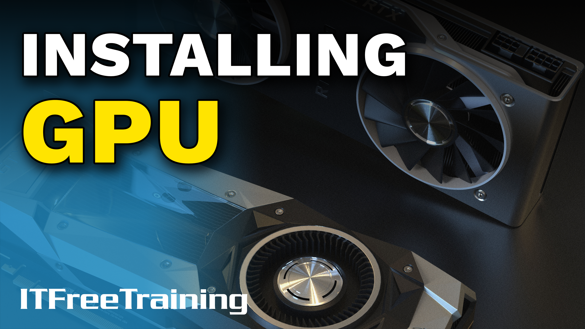
Notes:
Let’s have a look at how to install a video card.

Slide 2
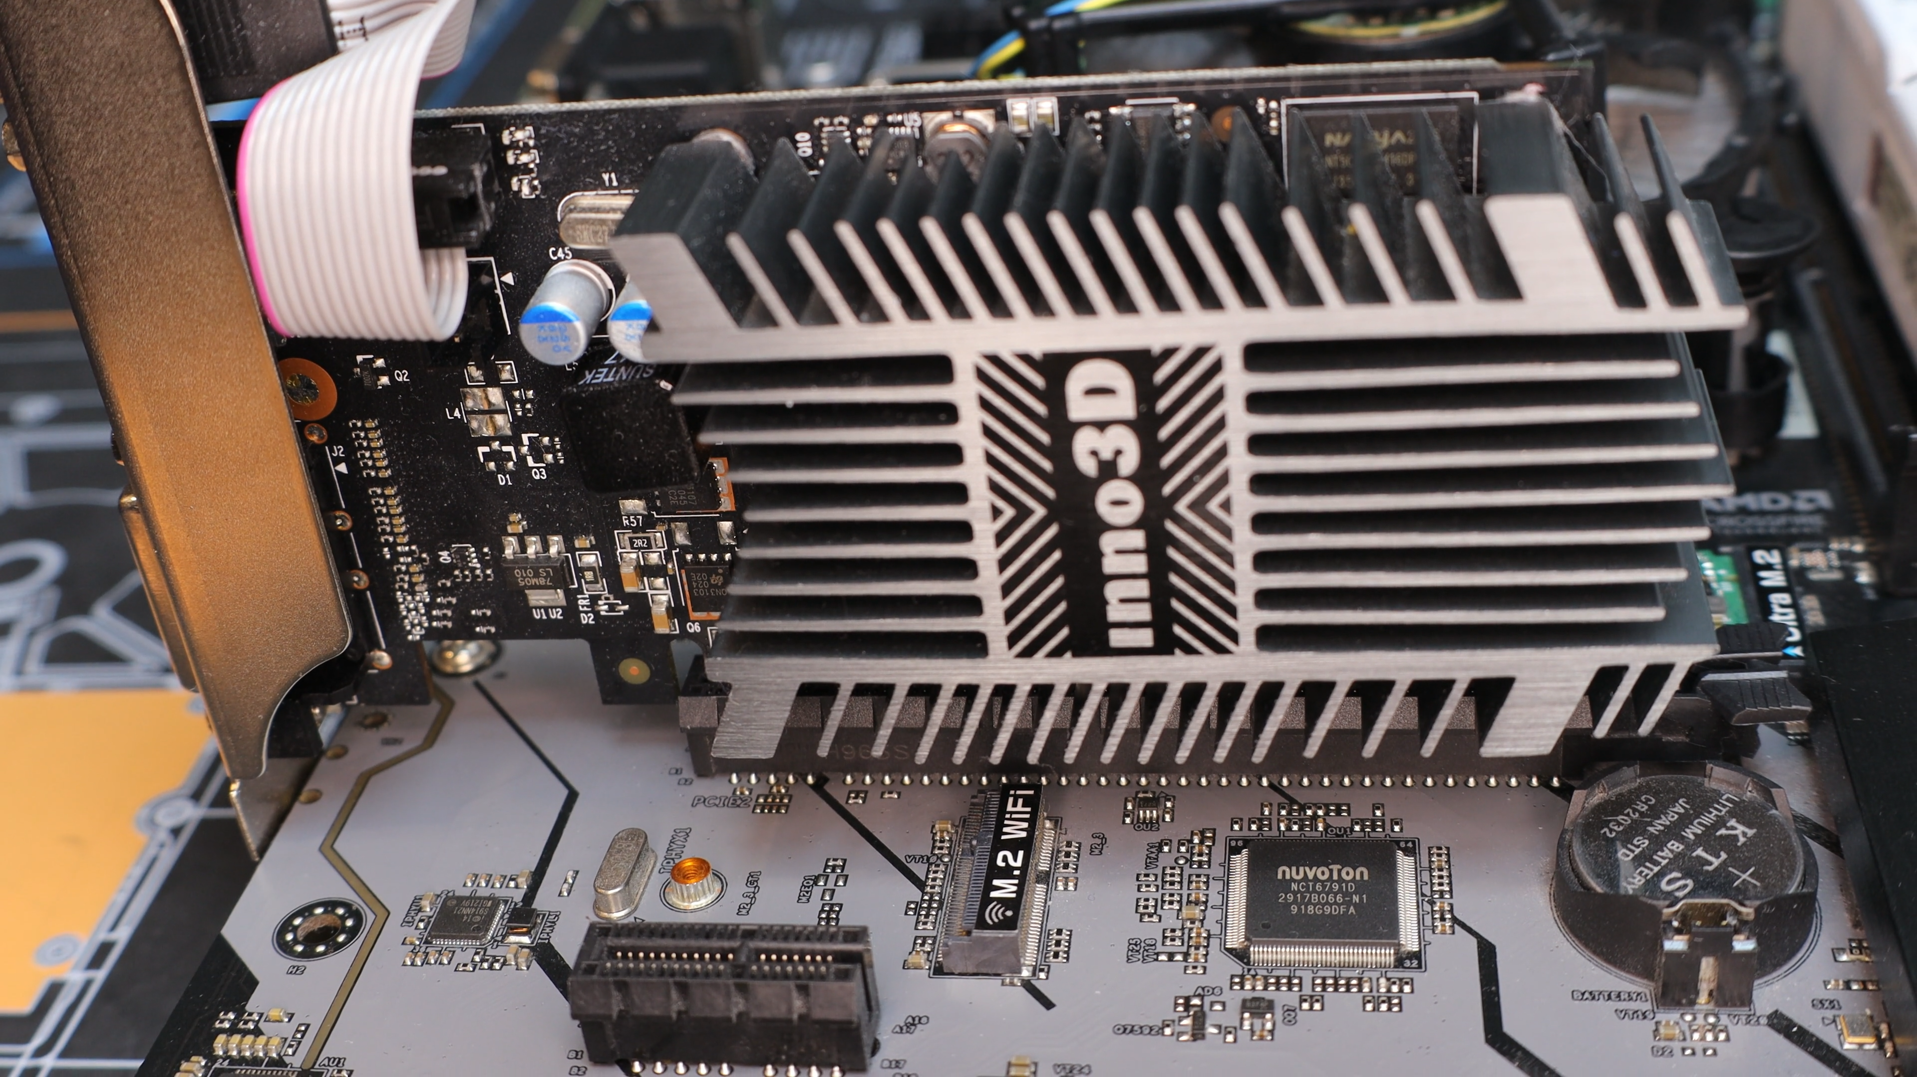
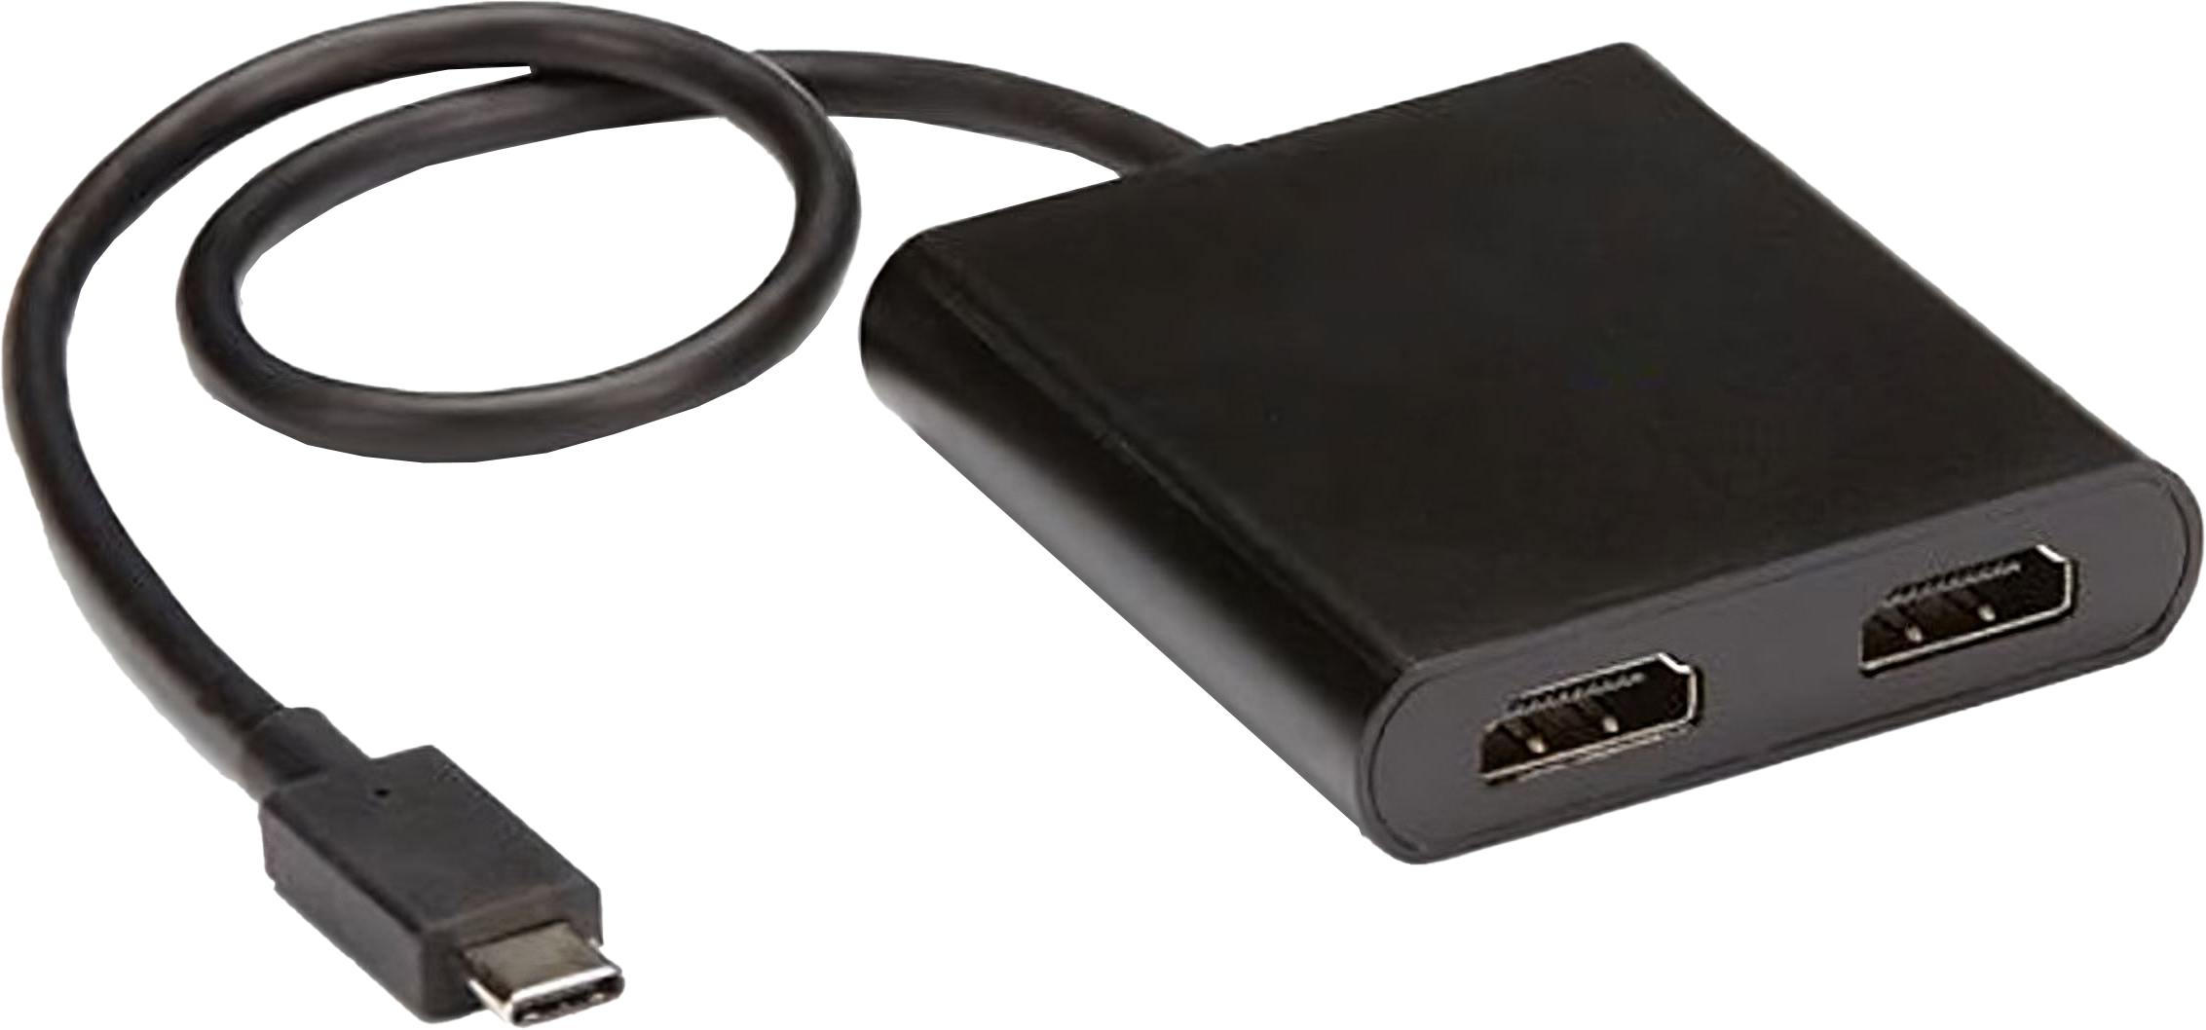
In This Video
Installing a Video Card
Multi-Stream Transport (MST)
ITFreeTraining.com
© Copyright 2024
Notes:
00:04 In this video, I will look at how to install a video card and also have a brief look at how to install Multiple-Stream Transport or MST. You won’t need to know much for the CompTIA exam, so I will have a look at the basics at the start of the video. In the rest of the video, I will look at some more details about video cards if you want to know more. This extra knowledge will help you in the workplace to install video cards, but you are unlikely to get an exam question on it.
Let’s have a look at how to install a video card.

Slide 3
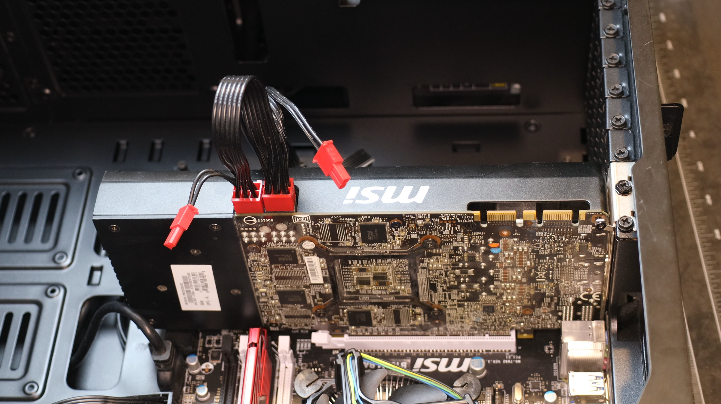
Installing a Video Card
ITFreeTraining.com
© Copyright 2024
Notes:
00:35 To install a video card, I first need to remove the side panel of the computer case. For this computer case, there are four screws that need to be removed. Once the screws are removed, the side panel can be removed. Some panels will require you to slide the panel before it can be removed. For this computer case, I need to push it down and then lift it upwards to remove it.
Before installing the video card, I first need to see how many expansion slot blanking plates need to be removed and their positions. To do this, I will hold the video card just above the PCI slot. To prevent damage to the video card, hold the video card by the plastic parts making sure you don’t touch the electronics on the back of the card and hover it over the PCI slot.
The end result is, we should be able to tell which PCI blanking plates need to be removed. In this case two blanks need to be removed. The location of the PCI slot on the motherboard will determine which blanking plates need to be removed.
So, I will next take the video card out of the case and remove the two blanking plates. In this computer case, it is just a matter of removing one screw and the blanking plate will come out. On some computer cases the blanking plates don’t have screws and will pop out.
With some computer cases, the blanking plates are part of the computer case. For these computer cases, wiggle the blanking plate till it breaks lose. Be careful of other parts on the motherboard that the blanking plate may hit. You don’t want to damage a component on the motherboard when removing the blanking plate.
The next step is to plug in the video card. Place the video card in the slot and push down on either end of the video card on the non-electronic parts. If you have trouble getting the video card to go in the slot, you can rock the card a little bit, but not too much. Once it is in, you should hear a click.
The next step is to screw in the two retaining screws. This will hold the video card in place. It is important to put in these retaining screws because bumping the computer case or simply plugging in a video cable can force the card out of the slot. If this happens, your computer will most likely restart and you risk damaging the video card and/or the motherboard.
In the case of this video card, the video card will draw power from the PCI slot, but this will not be enough to power the video card. To provide extra power, two additional power plugs are on the top of the video card.
This video card has two additional six-pin power plugs on the top. Your power supply should have a PCI Express power plug, unless it is really old. This power supply has a six-pin power plug which can be changed to an eight pin. The extra pins provide more power. Different video cards have different power needs, and this will determine which connectors you will use.
I will next plug in the two PCI power plugs. Once these are plugged in, the video card hardware installation is complete. In most cases, the video card installation will be quite simple; later in the video I will look at some more advanced installations and how to configure the hardware, but for the CompTIA exam you will just need to know how to install the video card.
In some cases, you may have a CPU and motherboard that support video. Generally, when you install a video card, the video from the motherboard will be disabled. In some cases, you may not want that because you want to use it for a second monitor. It can, however, be re-enabled. Let’s have a look at how to do that.

Slide 4
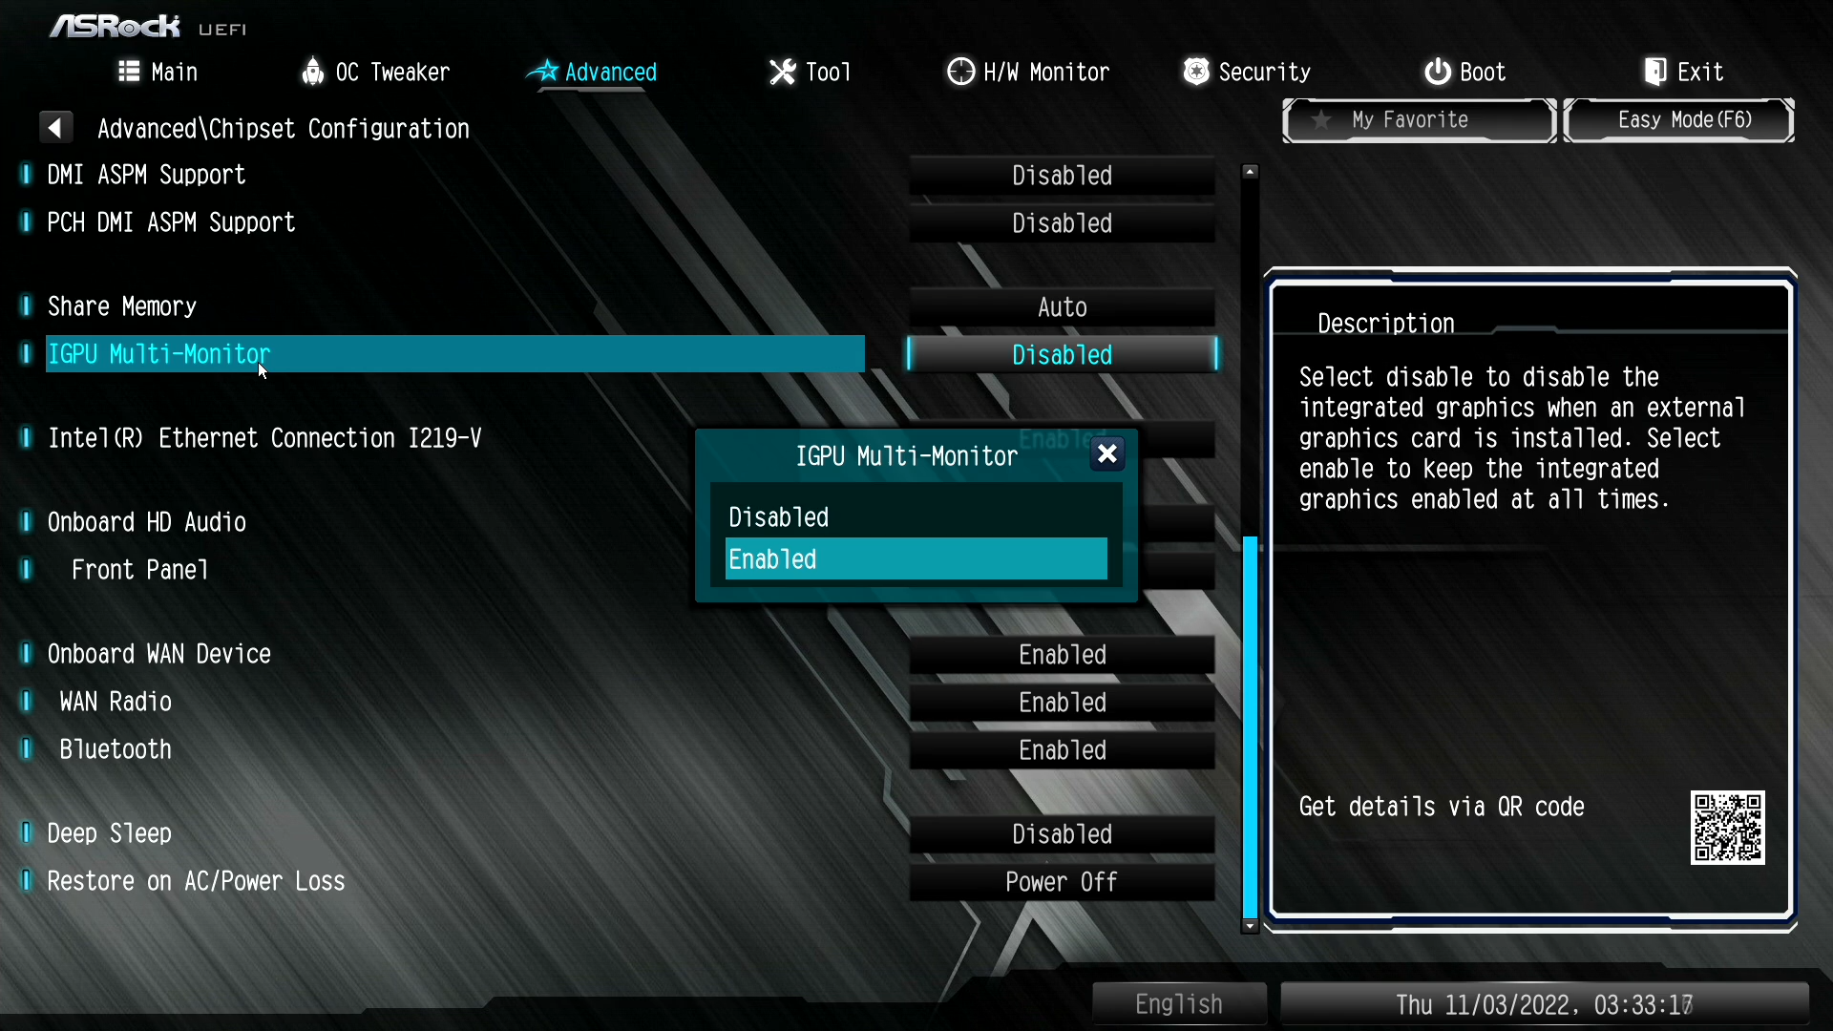
Computer Setup
Installing GPU will generally disable motherboard video
Motherboard video can be re-enabled
Can change primary video to motherboard or video card
ITFreeTraining.com
© Copyright 2024
Notes:
04:11 If your CPU and motherboard both support video, then you can plug your monitor directly into the motherboard rather than installing a video card. On this computer, when the video card was installed, the onboard video on the motherboard was disabled, which is a fairly common thing to occur. If you are not sure, you can always plug the video cable in and see if it works. In some cases, the video cable will need to be plugged in when you first switch the computer on, otherwise it will be disabled. The video connector in this example will need to be enabled so you can use both the onboard video and the video card at the same time.
This needs to be done in the computer’s setup. On this computer, pressing F2 or the delete key will enter the computer’s setup. Your computer’s setup may look different, but you essentially need to locate the option to enable the motherboard video. On this computer, I need to select the option “Advanced mode” to get to that setting.
On this setup, I next need to select the option “Advanced”. Your setup may be different, and you may need to look around for the options. Next, I need to select the option “Chipset Configuration”. On this setup, I next need to select “Primary Graphics Adapter”. This will give you two options: “Onboard” and “PCI Express”.
This option does not enable the motherboard video. This option, however, does determine which adapter will be the primary adapter. The primary adapter essentially means which adapter will be used first when the computer starts up. When your computer first boots up, it will only use one monitor. The setting here will determine which monitor will be used. Thus, this option determines on which monitor you will see your start-up screens, computer setup and your login screen. Which option you choose will be determined by your needs. For example, if your computer is running a giant sized electronic board, then you probably don’t want the start-up screen to appear on that screen. If you are using a second monitor to display extra information, you probably want to use your main monitor as the primary monitor.
I next need to enable the motherboard video. To do this, select the option “IGPU Multi-Monitor” and set it to enabled – this will enable the motherboard video. In your computer’s setup the option may be called something else. In some cases, the video won’t work if the monitor is not plugged in when the computer is switched on. So, if you are having problems, shut the computer down; don’t just restart the computer and try it again.
Using your motherboard’s video card is a great way to have a second monitor where it does not need to be too powerful. Now let’s have a look at how to set up MST which allows two monitors to be run on the same cable.

Slide 5
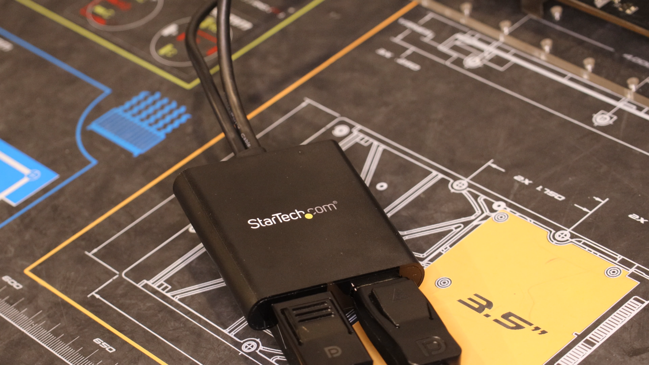
Multi-Stream Transport (MST)
A DisplayPort connector to split into multiple connectors
ITFreeTraining.com
© Copyright 2024
Notes:
06:59 Multi-Stream Transport or MST is essentially a DisplayPort connector that can be split into multiple connectors. It is a DisplayPort feature and is not available in HDMI. In this example, I have a two-port MST splitter. The far-left connector is a mini DisplayPort, but you can also get a standard DisplayPort connector. The connectors on the right are the two DisplayPorts. You can get splitters with more ports, for example three or even four.
In the case of this DisplayPort splitter, there is also a USB connector which is used to supply power to the DisplayPort splitter. This makes the splitter an active splitter which helps boost the signal as it goes through. You can use splitters without additional power, but these splitters may not give you the same quality.
The next step is to plug two monitors into the splitter. Installing the splitter is simple – don’t expect too much from these splitters. The two monitors will share the bandwidth from the computer. Thus, if your computer outputs 4k resolution, then your two monitors will have to share that 4k bandwidth. For example, you could have 2k resolutions on each monitor. Or, you could have a 4k screen and the second monitor would have the bandwidth that is left over. Don’t be surprised if what is left over provides a very low resolution.

Slide 6
Subscribe
Next video
Video content: https://ITFreeTraining.com/ap11/1a50
© Copyright 2024
Notes:
08:23 That covers it for this video. I hope that you have found this video informative. Until the next video, I would like to thank you for watching.
References
“Picture: Dual monitors” https://unsplash.com/photos/XiyRsNHw16s
Credits
Trainer: Austin Mason http://ITFreeTraining.com
Voice Talent: HP Lewis http://hplewis.com
Quality Assurance: Brett Batson http://www.pbb-proofreading.uk

