Slide 1
Notes:
In this video I will look at Molex connectors.

Slide 2
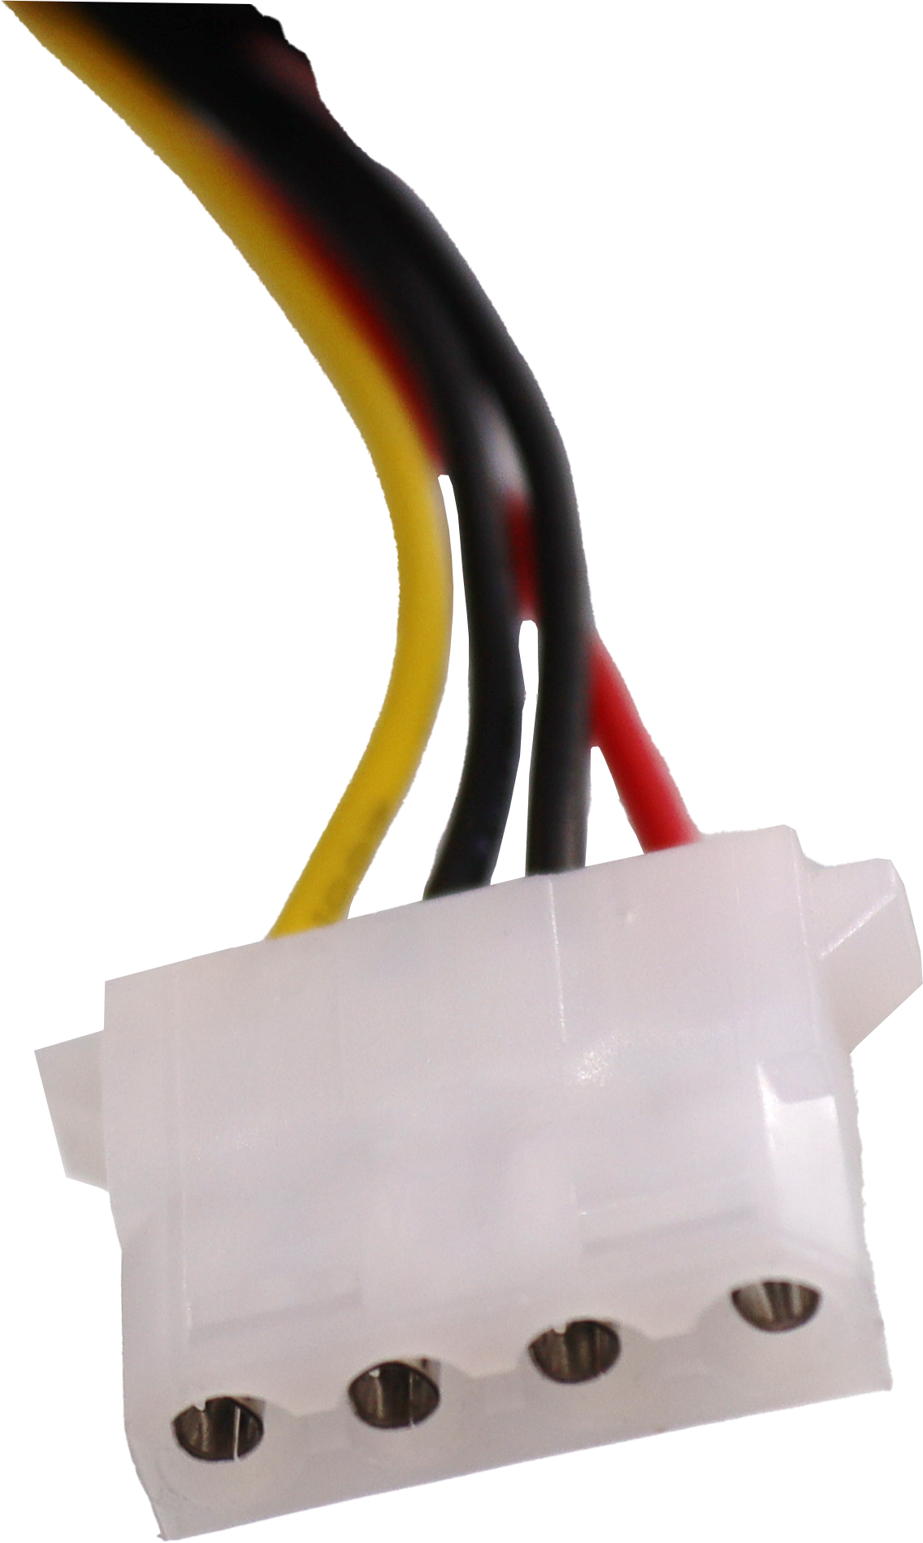
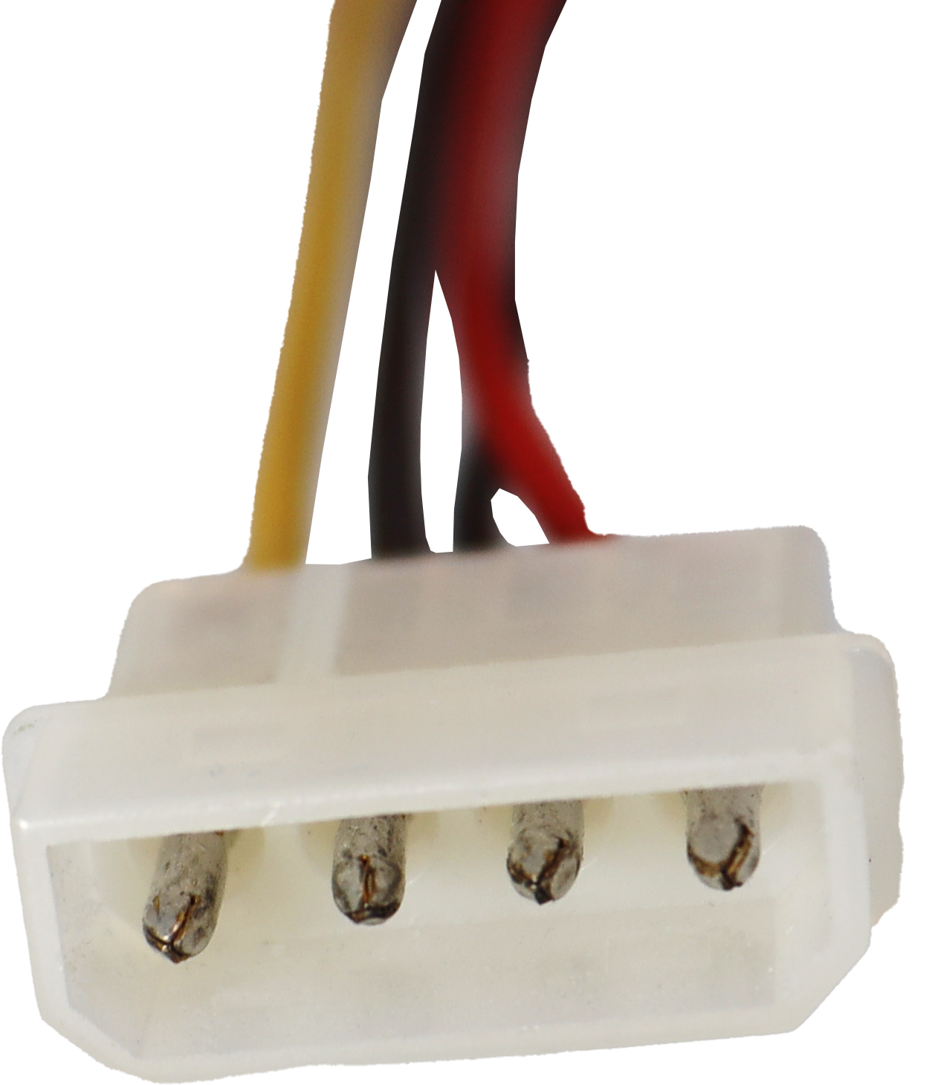
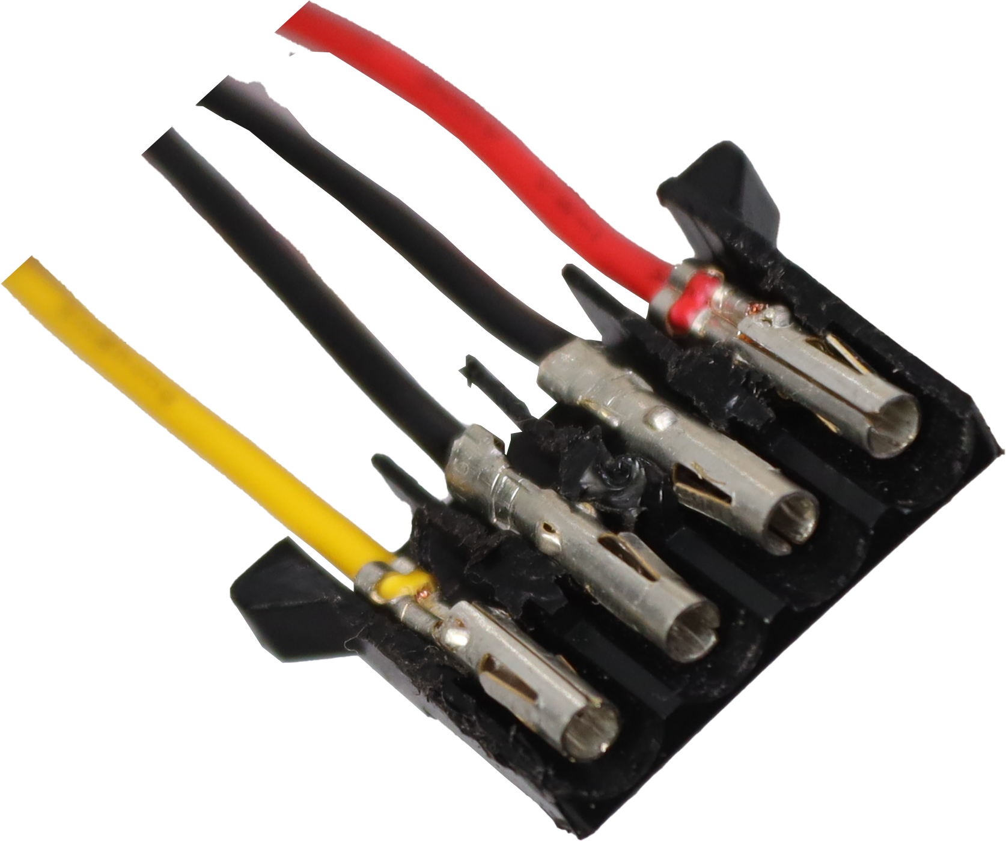
Molex Connector
Two-piece pin and socket connector
Mostly obsolete, but occasionally still used
Molex connector
Chamfered socket
connector
Chamfered pin
connector
ITFreeTraining.com
© Copyright 2024
Notes:
00:03 When it comes to computers, the Molex connector refers to a 4-pin power connector. This connector nowadays is mostly obsolete. I say mostly obsolete, because it does not tend to get used on new devices, but occasionally is still used on storage devices, card readers and case fans.
The term Molex was first pioneered by the Molex company back in the 1950s. The connector itself uses cylindrical sprung-metal sockets that fit into cylindrical sprung-metal pins. Thus, by definition, it includes any type of connector with this design. However, in the case of computing, we only call this 4-pin power connector a Molex connector. Even if you find another connector that fits the definition, in computing it won’t be called a Molex connector, it will be called something else.
Nowadays, the Molex connector is not used very much. Most of the time you will find it used for devices like case fans. However, even in this instance, you may find the case fan supports other connectors or you can purchase an adapter if you need to.
In this example I have a case fan and I will use the Molex connector to power it. You can see the Molex connector has a chamfered end, meaning part of the connector at the top is cut off at an angle. This means that, if you attempt to put the connector in the wrong way the connector won’t go in. Around the right way, the connector will go in with a small amount of force. It is difficult, but not impossible, to insert a Molex connector in the wrong way. If you do this the power will be reversed and the device connected to it may be damaged. Although you should always have the computer power off when plugging in connectors, if you do decide to connect a Molex connector while the power is on and the connector is upside down, the connector most likely won’t go in; however, if the pins in the connector touch forming a connection, it can cause a short in the computer potentially damaging components or having it switch off.

Slide 3
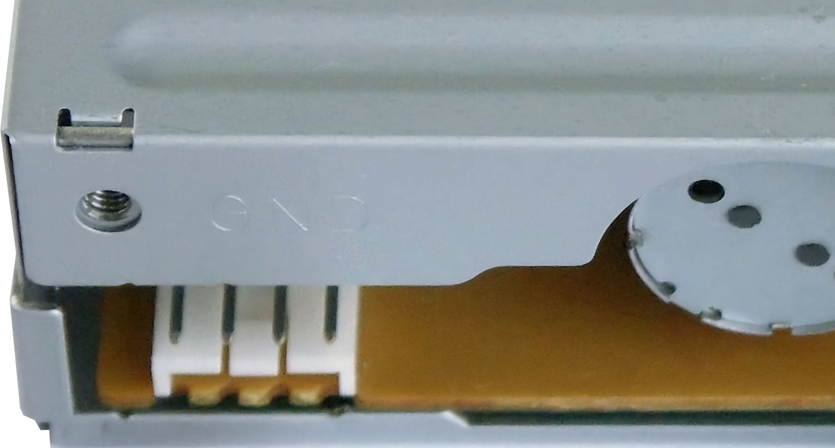
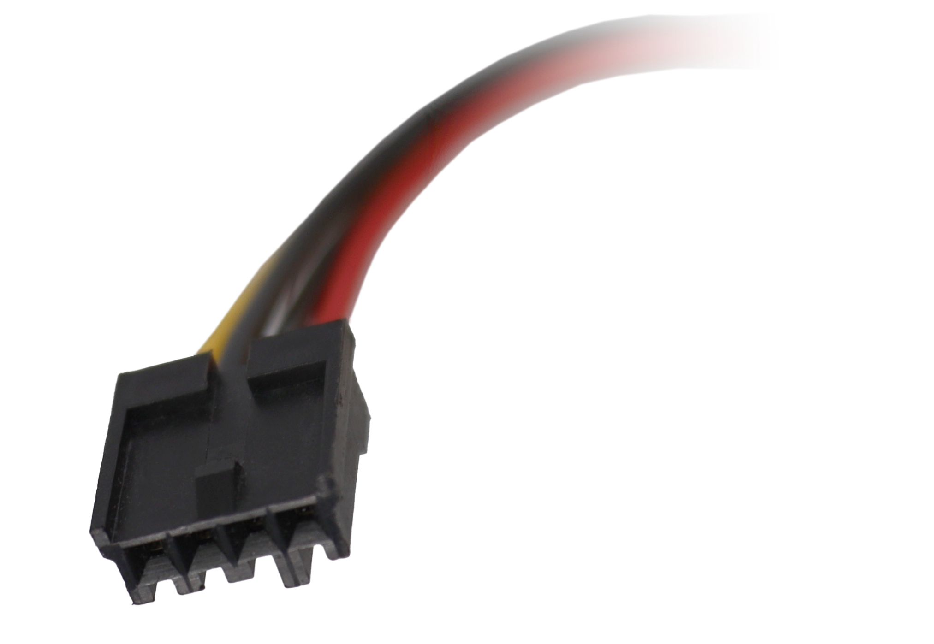
Berg Connector/Floppy Disk Connector
May be called Mini-Molex but technically not correct
Easier than Molex to insert upside down
ITFreeTraining.com
© Copyright 2024
Notes:
02:10 In many cases, the cable with the Molex connector may also have a Berg connector. This will often be referred to as a floppy disk connector. As with the Molex connector, the Berg connector is named after the company that designed it. And, like the Molex connector, there are other Berg connectors that were manufactured, but in modern-day computing this is the only one we use.
The connection is called the floppy disk connector, because traditionally it was used for floppy disk drives. Floppy disk drives are obsolete, but sometimes this connector is still used for other devices. Given that it is now a legacy connector, you won’t find it used on new storage devices; occasionally you may find a device that uses it although nowadays this is very rare. You may also find that newer power supplies may not even have this connector.
It has the same number of wires and the same voltage as the Molex connector. For these reasons, you may see it referred to as a Mini-Molex connector, however, in computing this is technically not correct.
The floppy connector is only designed to be put in one way, but it is still possible to insert it in the wrong way if you use enough force. It is much easier than the Molex connector to insert upside down. It is difficult to find a device that uses a floppy disk connector nowadays, and if you do find you have a need for it, it probably won’t be for a floppy disk drive. If you do get your hands on a floppy disk drive and you put the plug in upside down, if you switch the computer on, you will most likely destroy the floppy drive and cause it to release a smell, letting you know it will never work again.
In this example, I have a USB front case panel designed to provide an additional four USB ports to the front of the computer. The device uses the floppy disk connector to provide additional power, but it comes with a floppy disk connector to SATA connector, so if your power supply does not have a floppy disk connector power cable, you can always connect it to a SATA power connector.
On this device, you will notice the 4-pin connector on the board. This is the connector the floppy disk connector power plug goes into. You will notice the plug has a locking protrusion on the top, essentially a square piece of plastic that is offset from the center. This is designed to prevent the connector being put in upside down.
When I attempt to put the connector in upside down, notice that it will not go in. This is because the locking protrusion is preventing the connector going in. To plug in the connector, make sure the locking protrusion is facing upwards and the plug should go in.
Now that we understand what the Molex and Floppy Disk drive connectors look like, I will next have a look at the power they use.

Slide 4
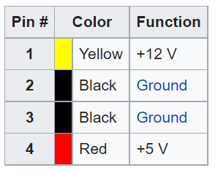
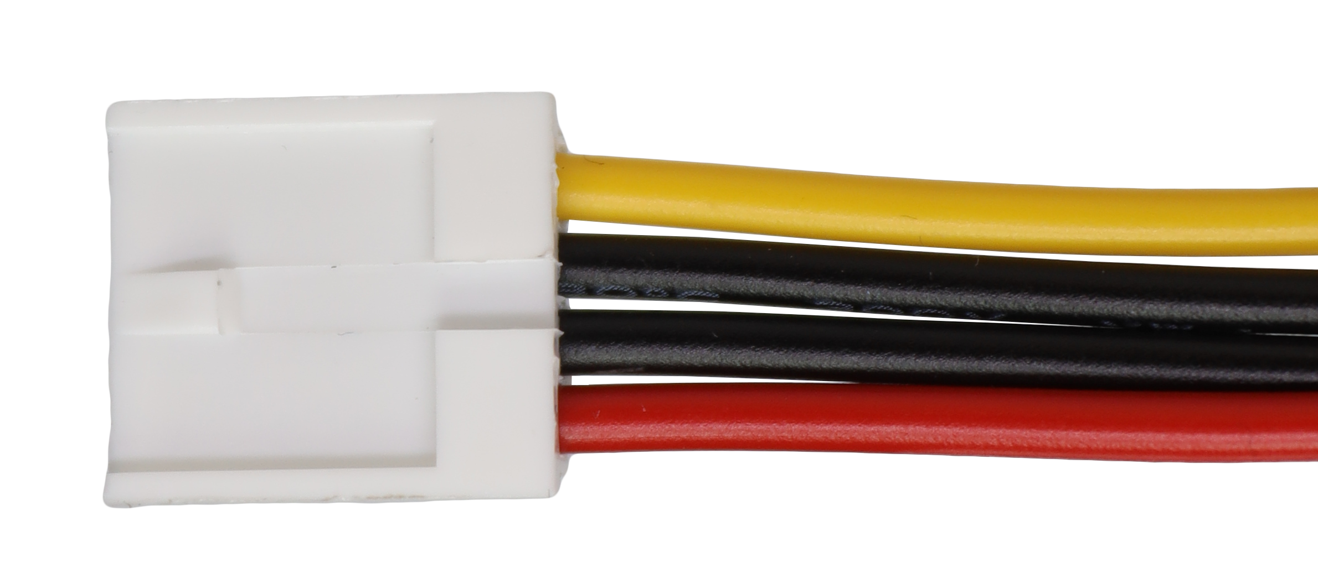
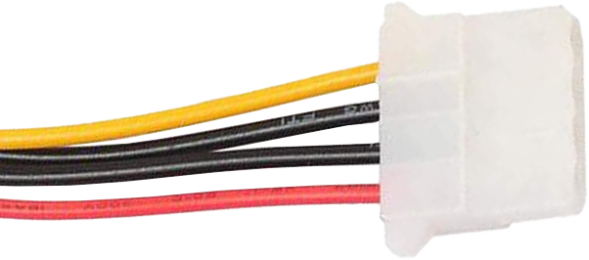
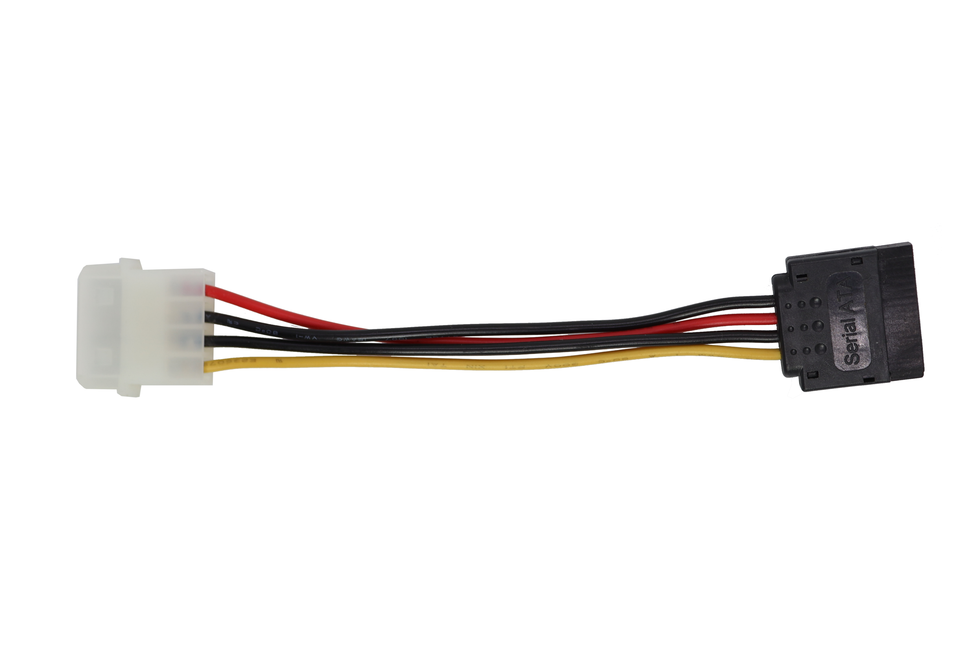
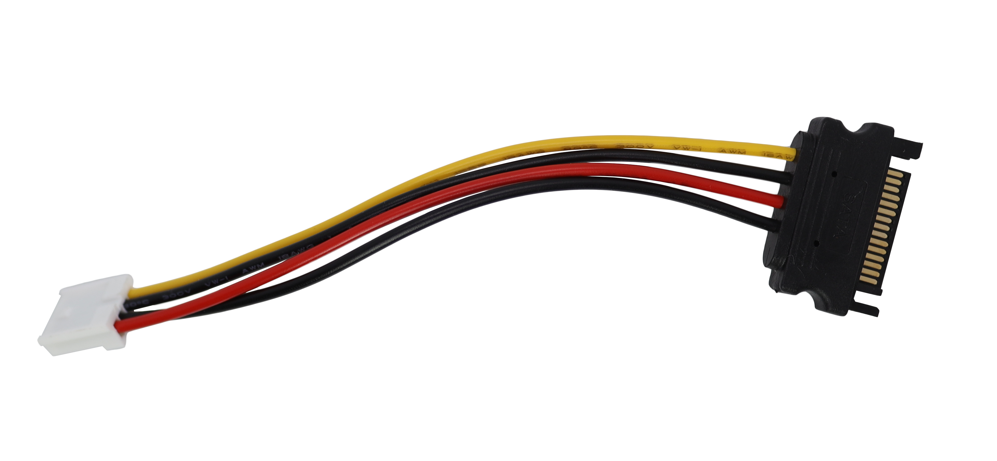
Molex/Floppy Disk Connector Power
Compatible with SATA connectors (Mostly)
Missing 3.3 Volts
Adapters won’t include 3.3 volts
Not many devices use 3.3 volts
ITFreeTraining.com
© Copyright 2024
Notes:
05:00 Both the Molex and the Floppy Disk power connectors deliver the same voltage and use the same wires. You will often find that the power supply for the floppy disk connector and the Molex connector are on the same cable.
The cable provides both 12 volts and 5 volts of power, but notice that it does not provide 3.3 volts. This was added when SATA connectors came along. This becomes a concern if you are using adapters to convert from SATA to Molex or to a Floppy Disk connector. If you use one of these adapters, you won’t have 3.3 volts of power in the connector.
This is not much of a concern as not many devices use 3.3 volts. If you are not sure if your device needs 3.3 volts, you can always try it. It won’t damage the device, it simply won’t work. Devices such as fans are very unlikely to need 3.3 volts and most modern storage devices also won’t require 3.3 volts. You will probably only come across it on enterprise storage or low-powered storage devices.

Slide 5
Subscribe
Next video
Video content: https://ITFreeTraining.com/ap11/1a45
© Copyright 2024
Notes:
06:05 That concludes this video on the Molex connector. I hope you have found it informative. Until the next video from us, I would like to thank you for watching.
References
“The Official CompTIA A+ Core Study Guide (Exam 220-1101)” page 26
“Molex connector” https://en.wikipedia.org/wiki/Molex_connector
“Picture: Floppy disk drive” https://commons.wikimedia.org/wiki/File:FDD_with_Cables.JPG
Credits
Trainer: Austin Mason http://ITFreeTraining.com
Voice Talent: A Hellenberg www.frelancer.com/u/adriaansound
Quality Assurance: Brett Batson http://www.pbb-proofreading.uk

