Slide 1
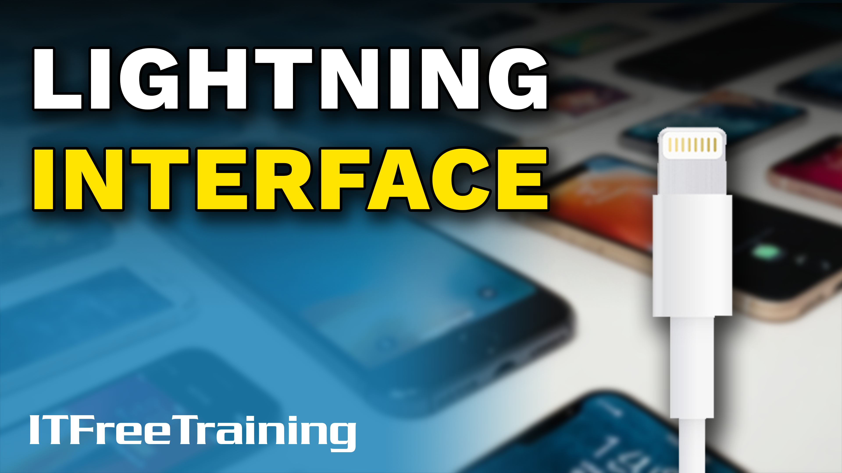
Notes:
Let’s have a look at the Lightning cable.

Slide 2
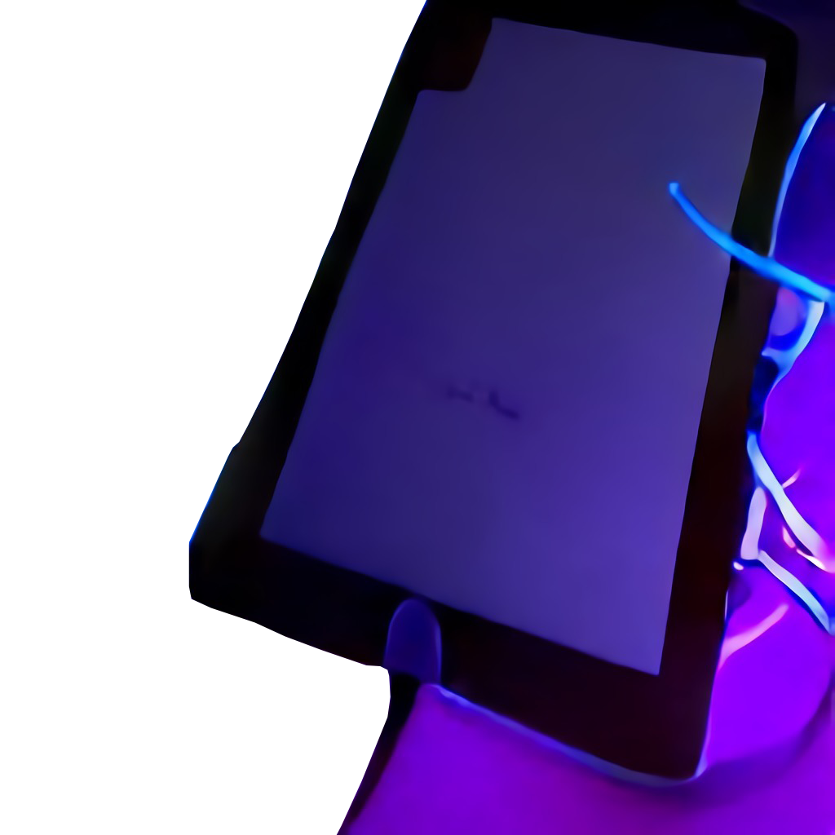
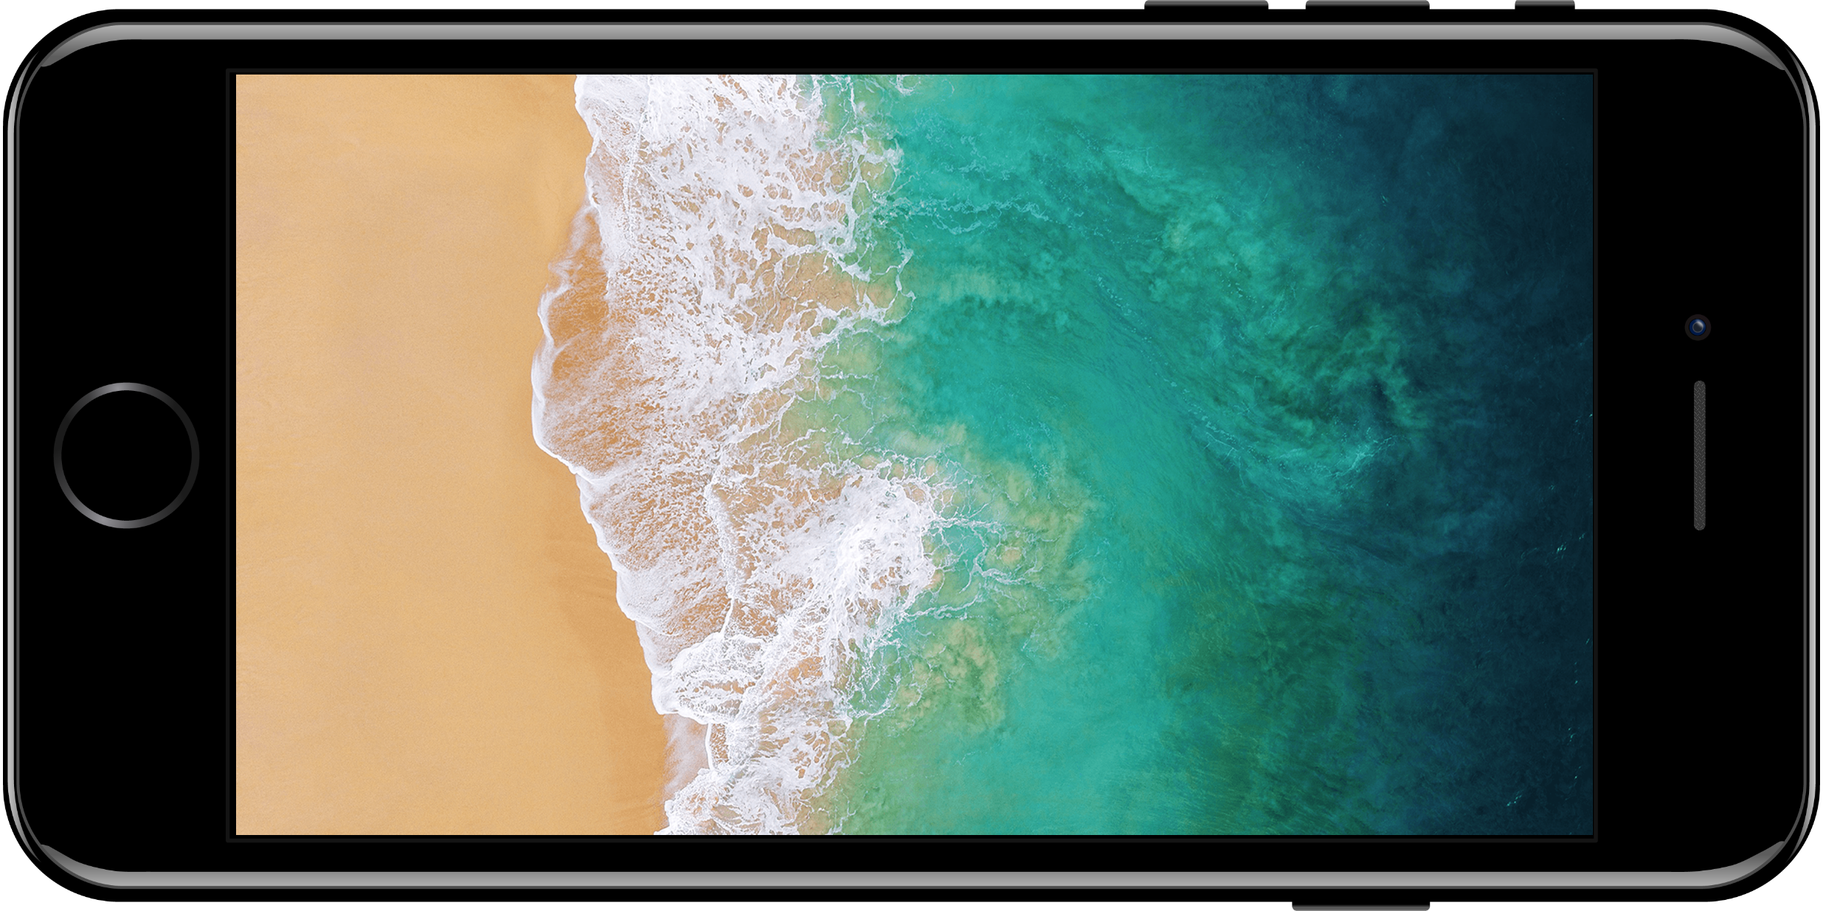
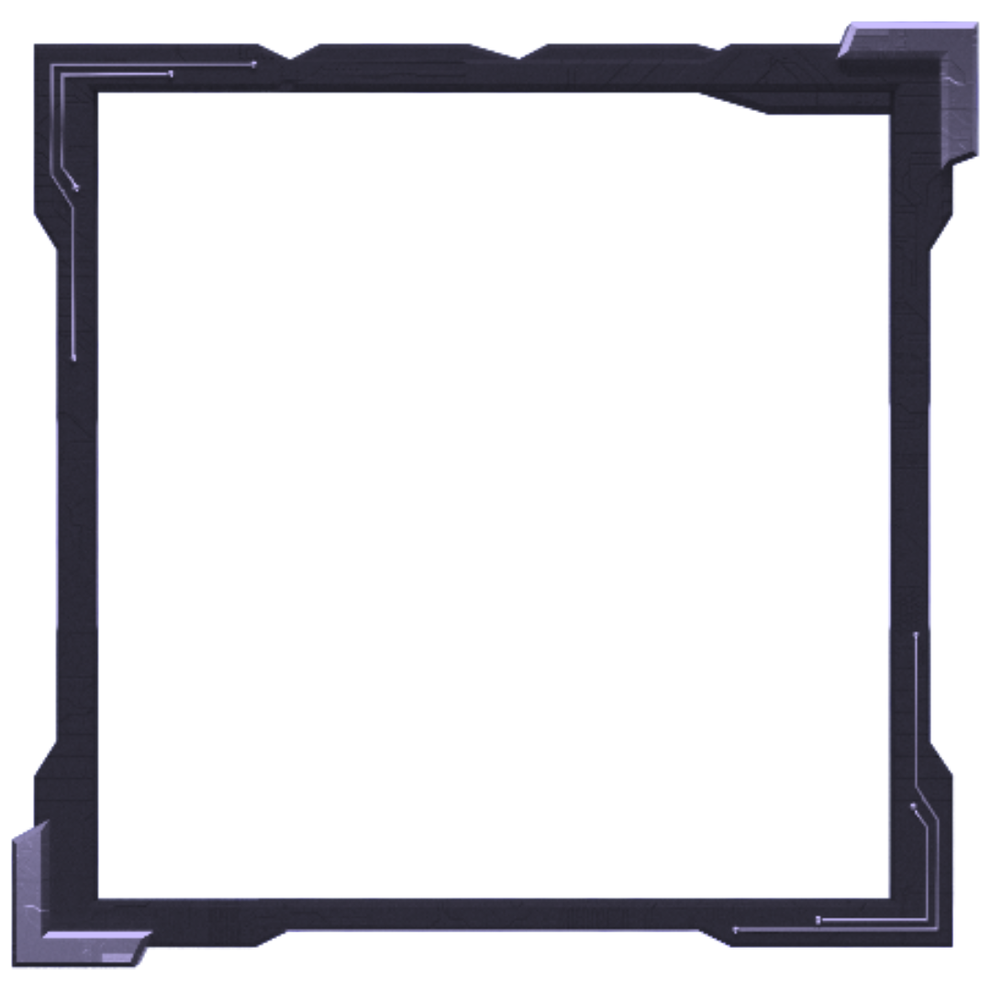
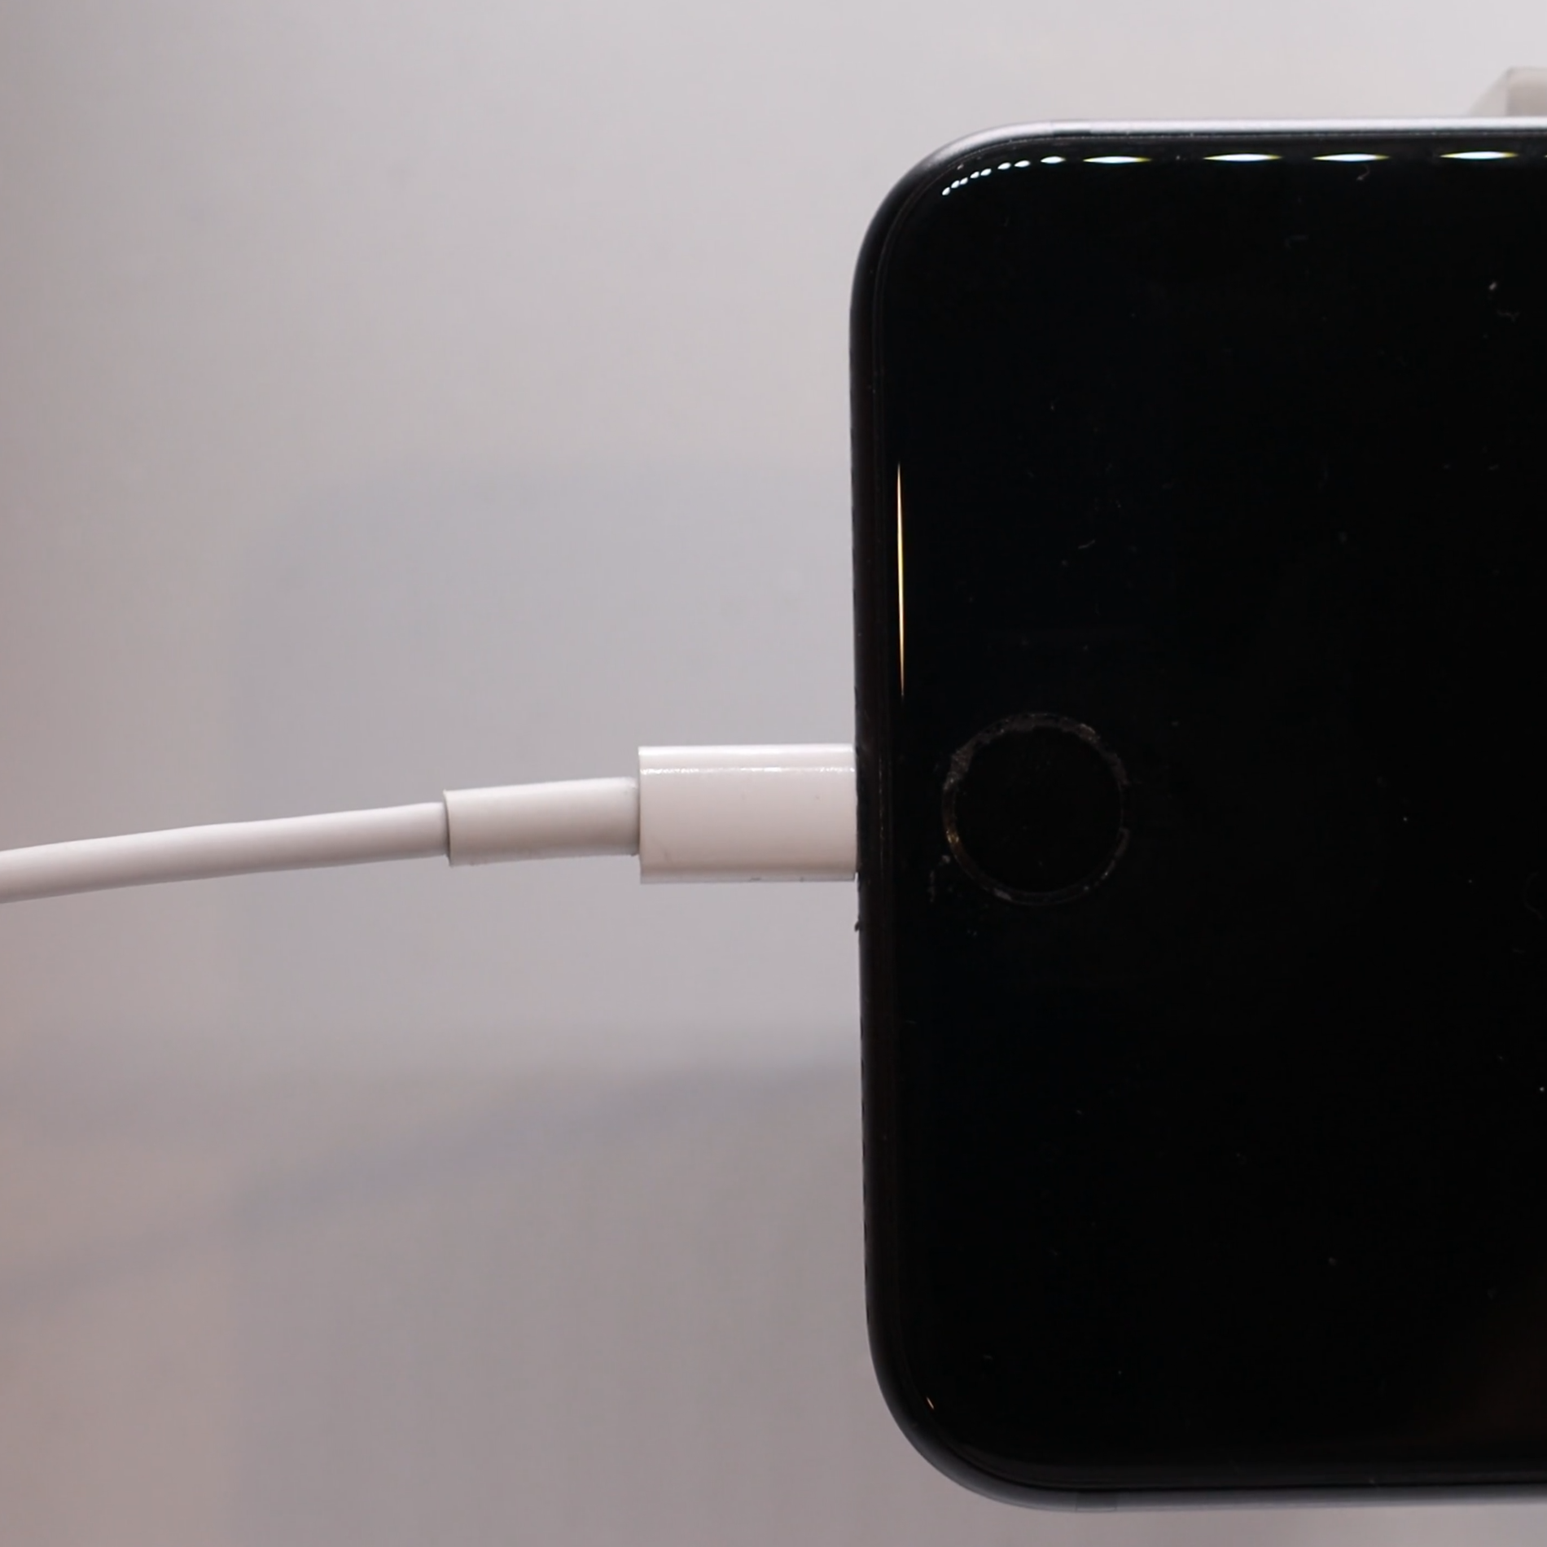
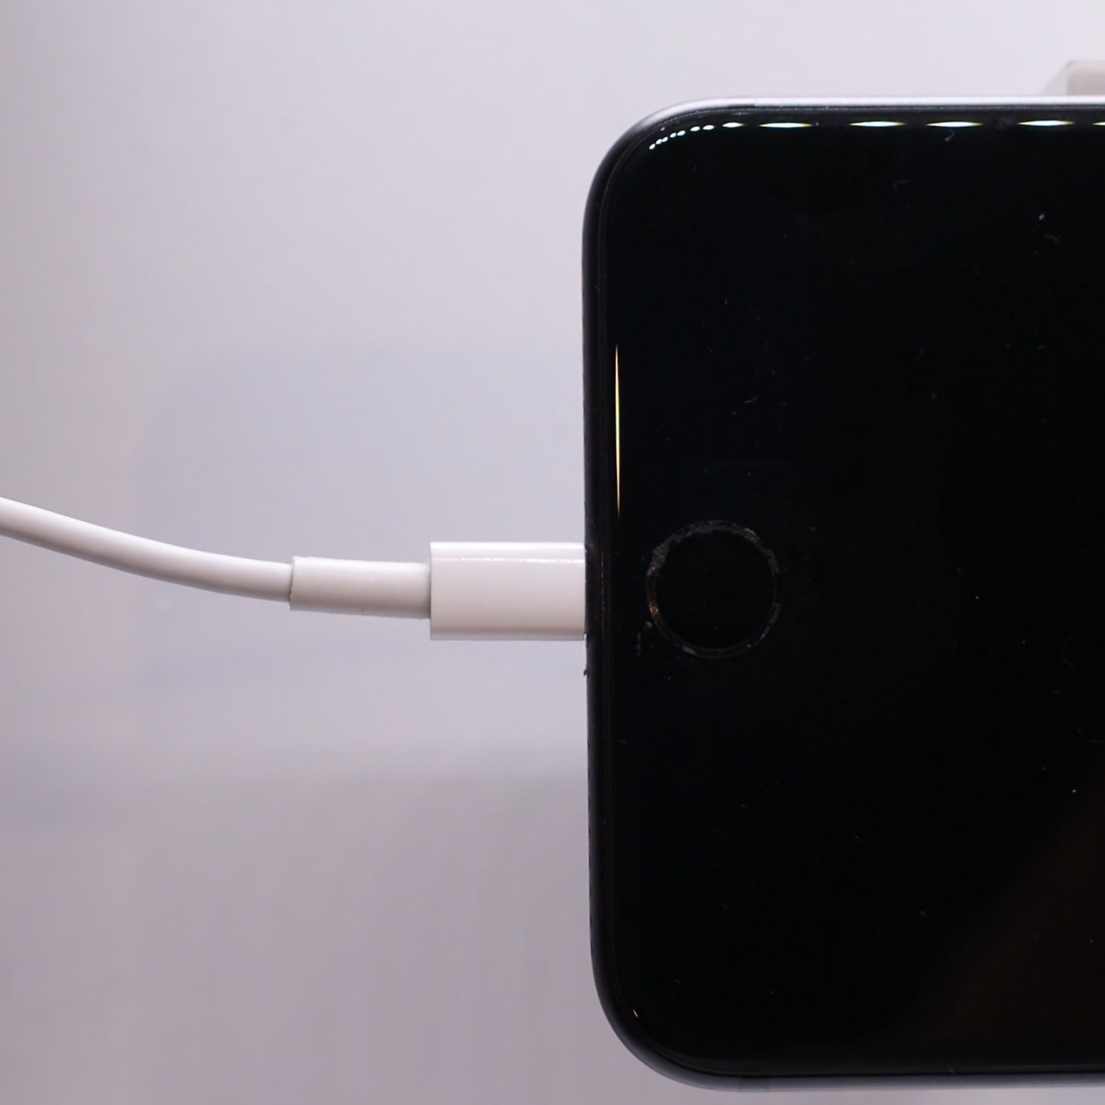
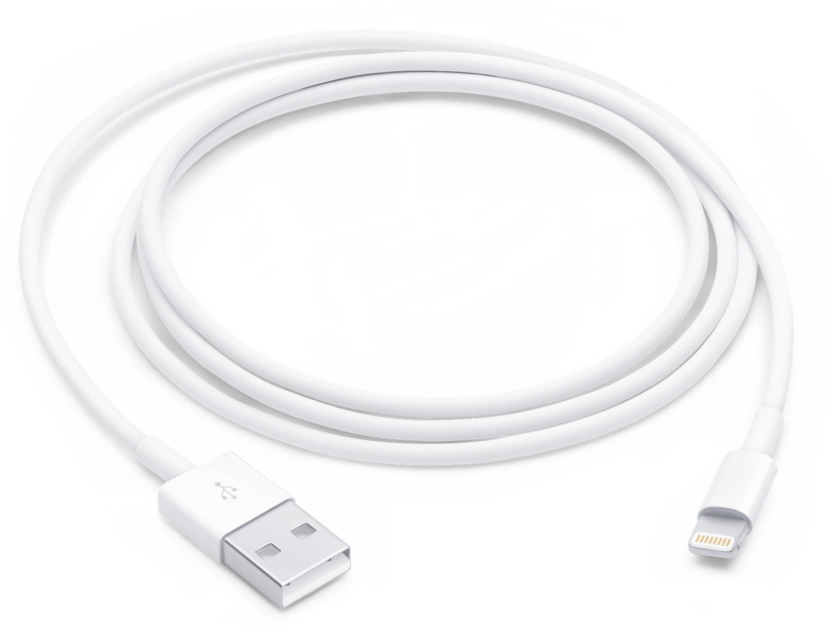

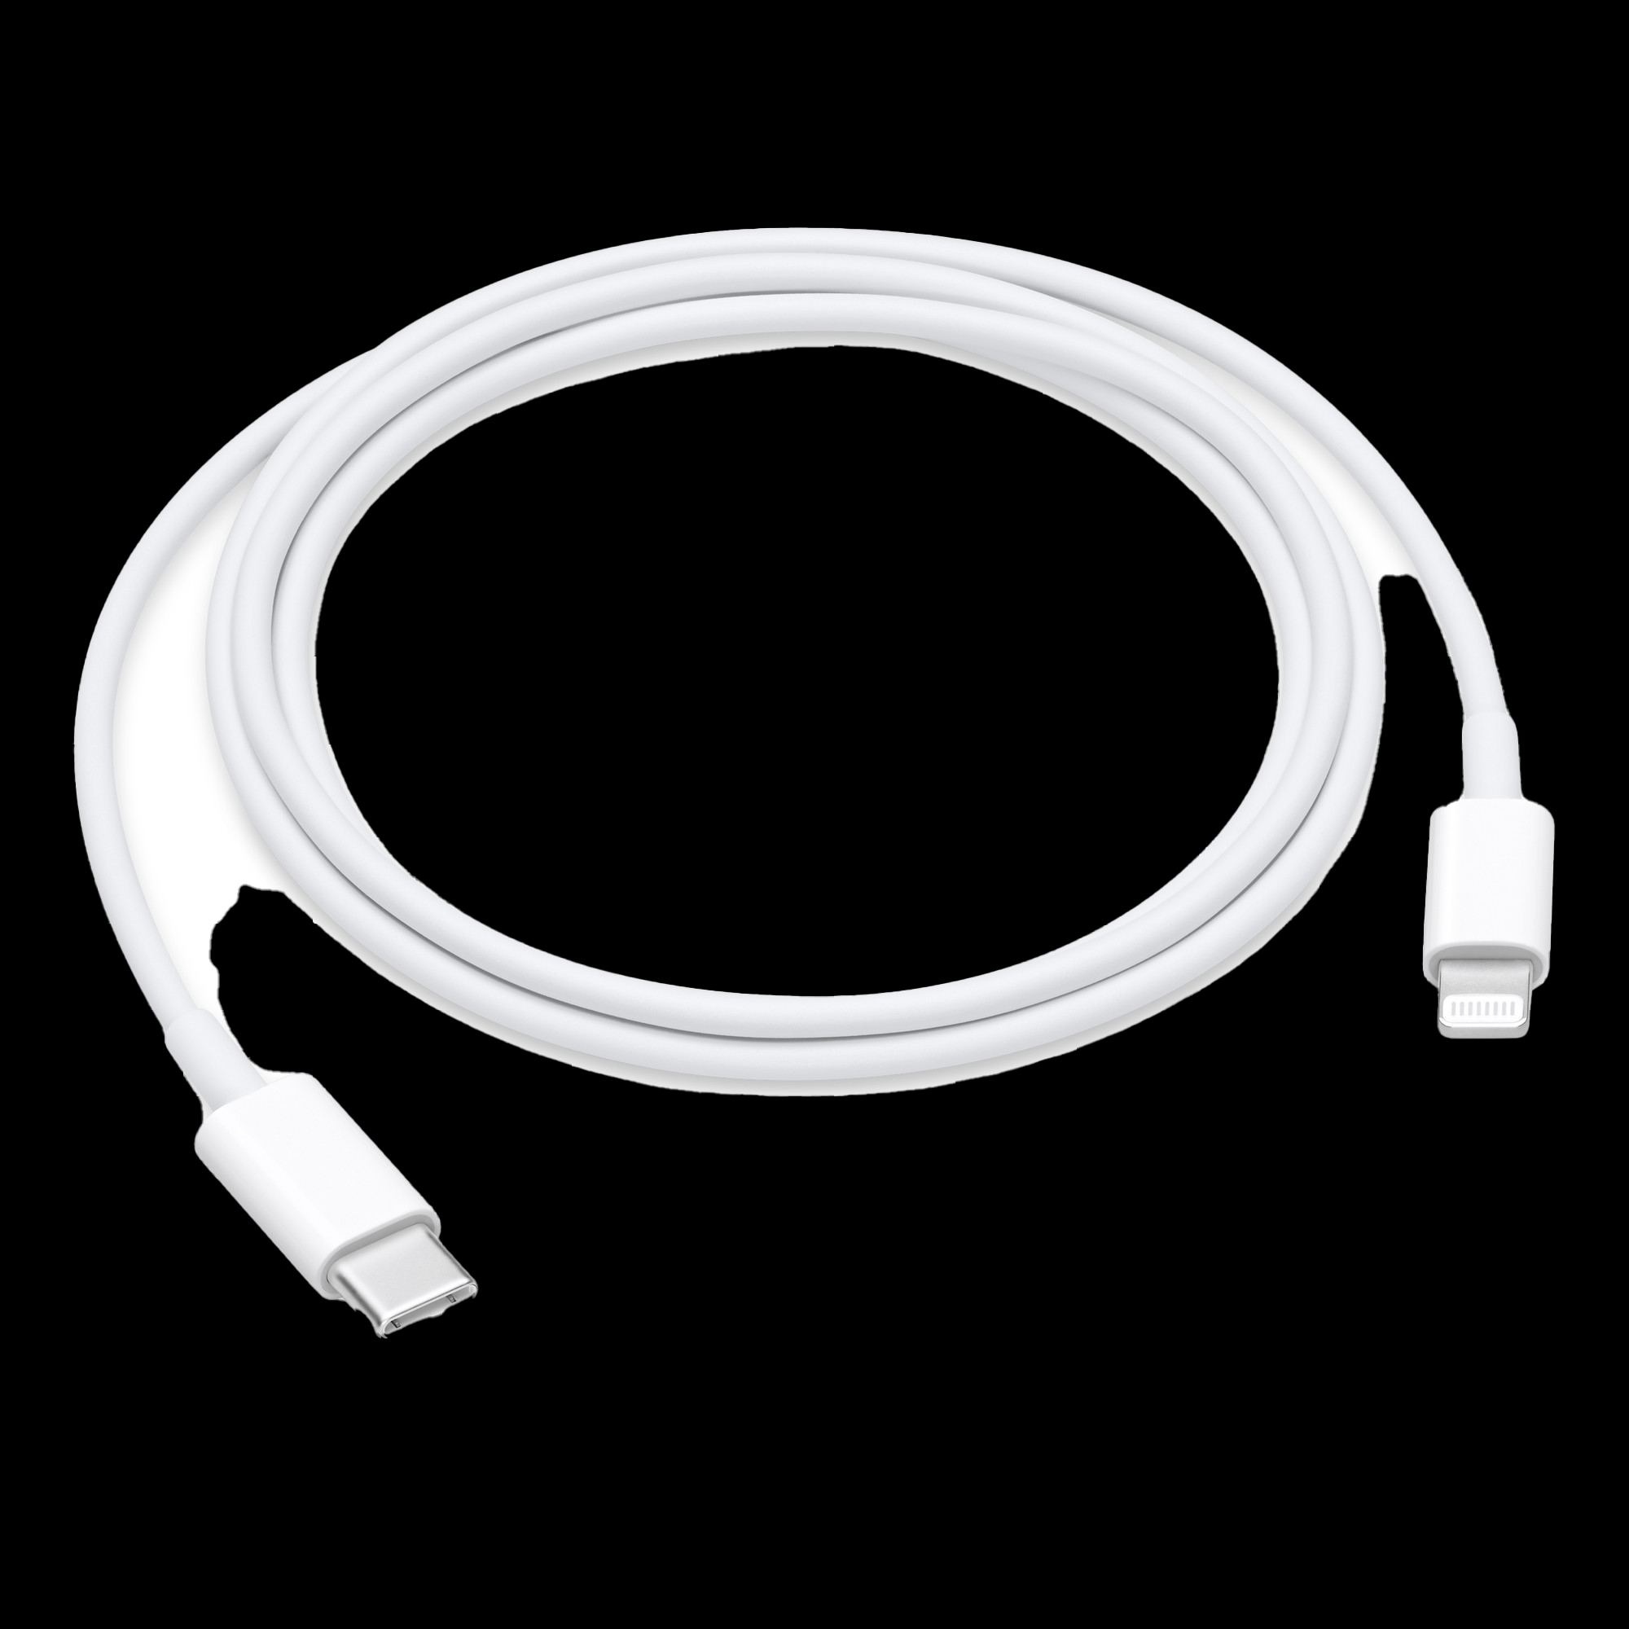
Lightning Cable
Introduced in 2012
Reversible plug
Used to connect to Apple devices
USB-C used in newer devices
USB to Lightning
Can be plugged in either way
USB-C to Lightning
ITFreeTraining.com
© Copyright 2024
Notes:
00:03 The Lightning cable was released in 2012 and is used to connect to Apple devices. It is a proprietary connector and thus only works with Apple devices. It is used to connect to devices like iPhones and iPads. The cable is generally used to either connect to a device like a computer or for charging. Therefore, the other end is often a USB connector, either the older USB-A connector or the newer USB-C connector. You will find that in newer Apple devices, Apple uses a USB-C connector rather than a Lightning one. Although a big reason for this is compatibility, there are some other reasons that I will look at later in the video which may help explain the reason for the change.
The Lightning cable is a reversible cable. This simply means that you can plug in the cable either way. This was one of the first cables that used a design that allowed the user to plug in the cable without having to worry about the orientation of the cable. Although Apple received some criticism for using the Lightning cable rather than USB-C, the USB-C cable would not be released until 2014. Thus, the USB-C cable was not an option at that stage.
For the CompTIA exam, that is most likely all you need to know about the Lightning cable. I will now do a deep dive into the Lightning cable to help you support it in your organization. If you are only studying for the exam, you can end the video here if you wish.

Slide 3


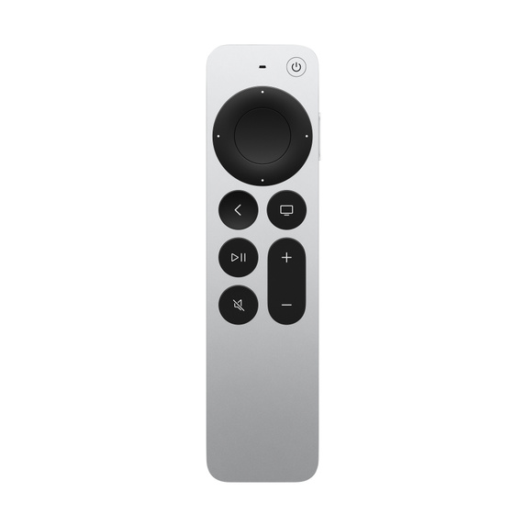


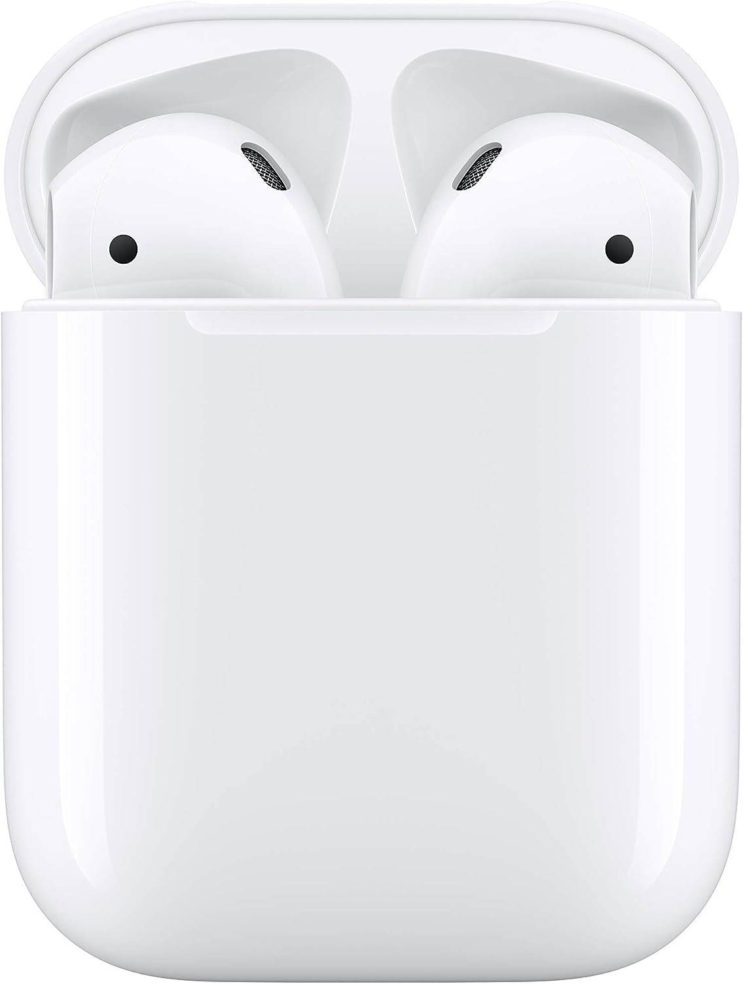
Lightning Accessories
Large number of devices support Lightning cable
Only approved devices can be used
ITFreeTraining.com
© Copyright 2024
Notes:
01:35 There are a large number of accessories on the market that support the Lightning connector. These include devices such as mice, keyboards, remote controls and AirPods. In some cases, the connection’s primary purpose is to charge the device. Regardless of whether the connector is being used for charging or data, only approved devices can be used with the Lightning connector.
Let’s have a look at how this is achieved.

Slide 4
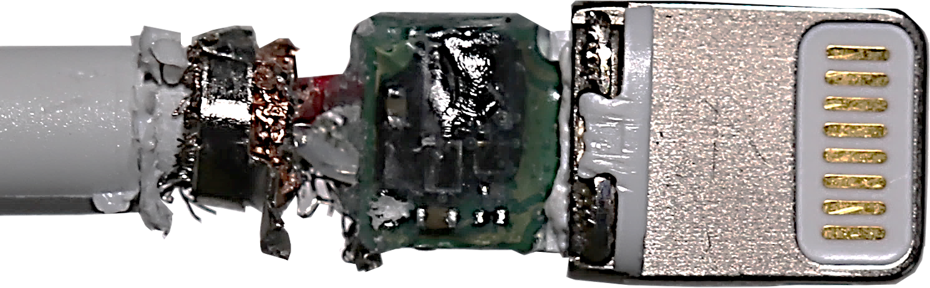
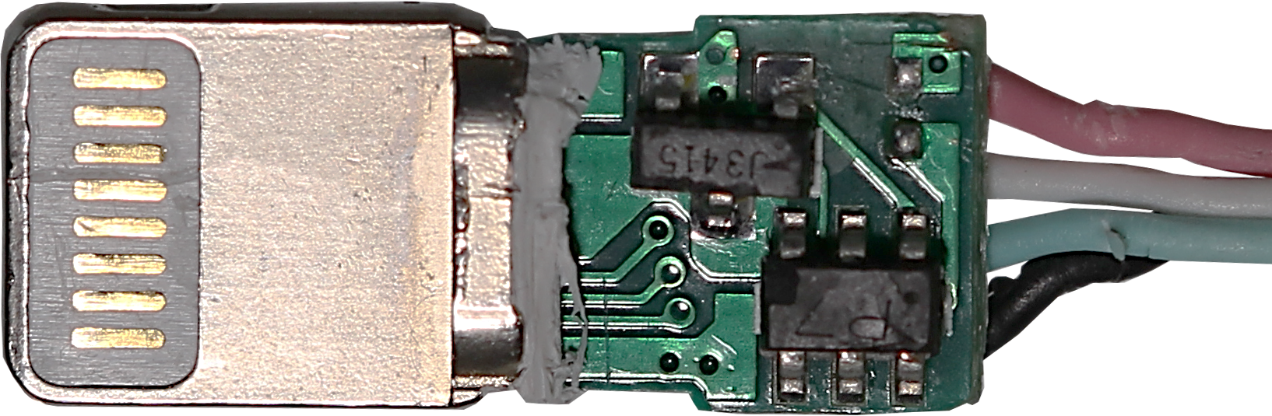
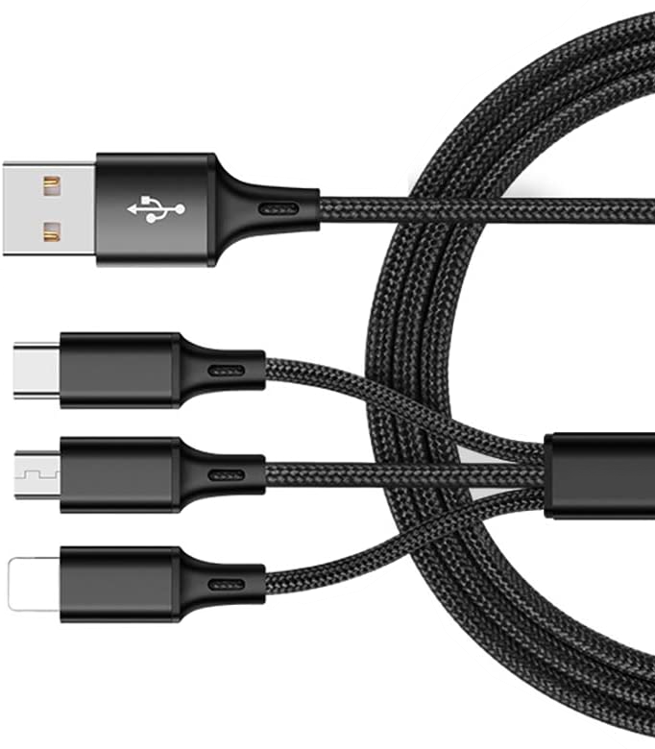
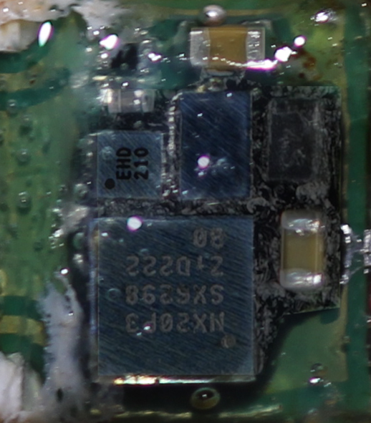
Inside the Lightning Cable
Apple cable
Non-Apple cable
Chips authenticate device
May be of less quality
Works with approved devices only
May be intermittent
May not work
3-in-1 cable
Non-Apple cable
May not be reliable
ITFreeTraining.com
© Copyright 2024
Notes:
02:02 You can see here the inside of a genuine Apple Lightning cable. Inside the cable there are a number of chips which authenticate a device when it is plugged in. If the connected device does not authenticate, that is, it is not an approved device, the cable will not work.
The technology used in the cable has been reverse engineered, thus you may find non-Apple Lightning cables on the market. These cables attempt to replicate the functionality of the Apple chips. However, they may be manufactured to a lesser quality than a genuine Apple cable. For this reason, they may work intermittently or not work at all. My personal experience with these cables is, if they work, they do so for a little while and then tend to become unreliable. With cables, you often get what you pay for.
On the market there are some three-in-one cables. These cables are not manufactured by Apple and thus may not be reliable. I would use these cables for charging devices and I would generally use the genuine cables for data connections; however, the choice is up to you. These cables are often very cheap and you can get a number of them for the price of a genuine cable. Therefore, some people will buy a few cheap cables and try their luck, hoping they will be okay, while others may just want to pay a bit more and get a cable that is more likely to be reliable.
There was not really any other standard like Lightning when it first came out, that is, another standard offering a reversible connector. Let’s compare it with the USB-C connector.

Slide 5
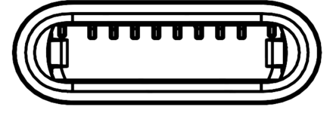
Limitations Compared With USB-C
Lightning Cable
USB-C
Low data transfer speed and less power
More data transfer speed and more power
Approx 12W(2.5A) charging
Up to 100W(5A) charging
Only one row of pins is used
All pins are used
Top row connected to bottom row
* Both detect connector orientation and change wires accordingly
ITFreeTraining.com
© Copyright 2024
Notes:
03:33 As Apple has not released an official specification for the Lightning cable, we can only approximate certain details based on reverse engineering techniques. The Lightning cable can deliver approximately 12 Watts of power at a maximum of 2.5 Amps. In contrast, USB-C can deliver up to 100 Watts of power at a maximum of 5 Amps. In order to get higher amps you need to increase the voltage, but you get the idea that the Lightning cable cannot provide as much charging power as USB-C is potentially able to offer.
If your device is able to draw a lot of power, you will be able to charge the device faster using USB-C. Assuming that is, you are using a faster charger that supports that kind of power drain.
The reason that the Lightning cable is not able to deliver the same power as USB-C comes down to it not having the same number of usable pins as the USB-C connector does. With the Lightning connector, only one row of pins is used. In order to allow the cable to be put in upside down, the top row is connected to the bottom row. The connector then simply detects which way the cable was plugged in.
In contrast, USB-C uses all the wires. Therefore, since it uses more wires, it can transmit more power. As with the Lightning cable, USB-C detects which way the cable was plugged in and changes the wires accordingly. Essentially, both connectors detect the orientation the cable was plugged in and make changes to what is sent on particular wires.
A Lightning cable uses an older signaling technique and thus is limited to the speed it can send the data at. In contrast USB-C uses a more modern signaling technique called “Differential Signaling” which allows higher bandwidth. Thus, the Lightning cable, less pins, older signaling technique means lower data transfer speeds and less power. USB-C with more pins and faster signaling translates to high data transfer and more power. You can see why Apple is making the change to USB-C as there are a lot of advantages to using it. There has also been a big push in the European Union to standardize the connector used in mobile devices. This is another reason why it appears that Apple is starting to move over to the USB-C connection rather than using the Lightning connector.

Slide 6

Subscribe
Next video
Video content: https://ITFreeTraining.com/ap11/1a35
© Copyright 2024
Notes:
05:59 That concludes this video from ITFreeTraining on the Lightning cable. Although the Lightning cable is slowly disappearing, there are many devices on the market that still use it. I hope this video has helped you understand how to better support those devices. Until the next video, I would like to thank you for watching.
References
“The Official CompTIA A+ Core Study Guide (Exam 220-1101)” page 12
“AI Picture of iPad” https://www.craiyon.com/
Credits
Trainer: Austin Mason http://ITFreeTraining.com
Voice Talent: A Hellenbergs www.freelancer.com/u/adriaansound
Quality Assurance: Brett Batson http://www.pbb-proofreading.uk

