Slide 1
Notes:
Let’s have a look at DisplayPort.

Slide 2
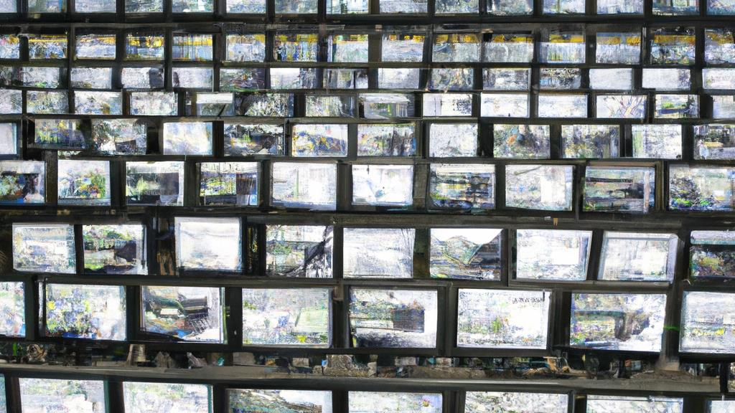
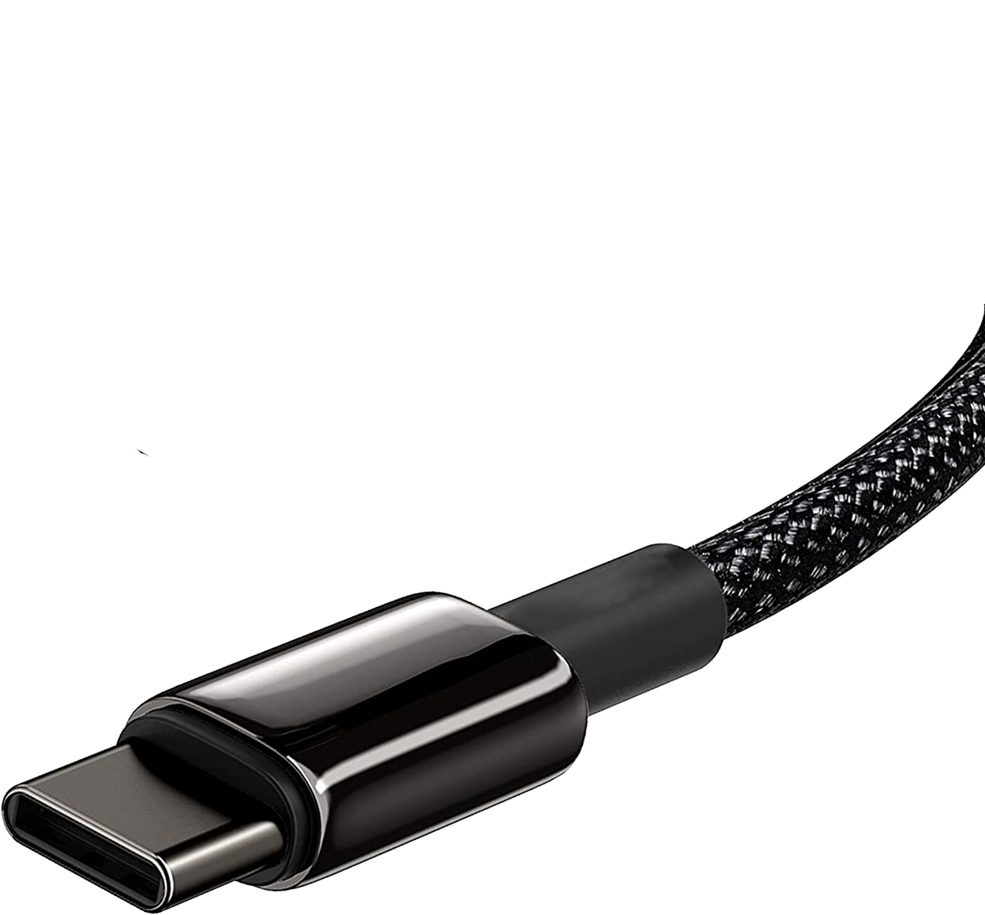
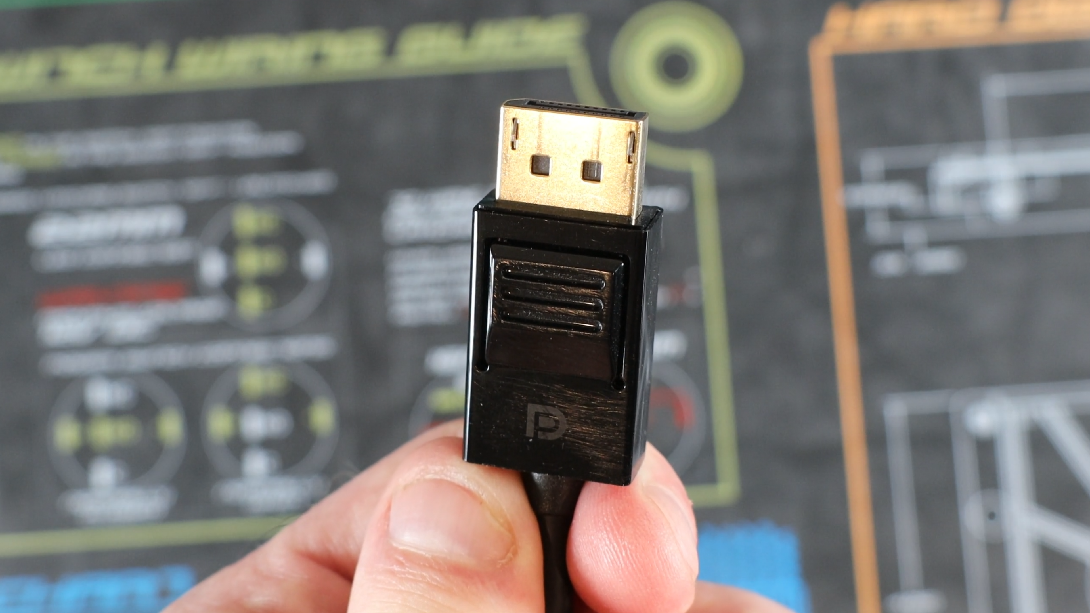
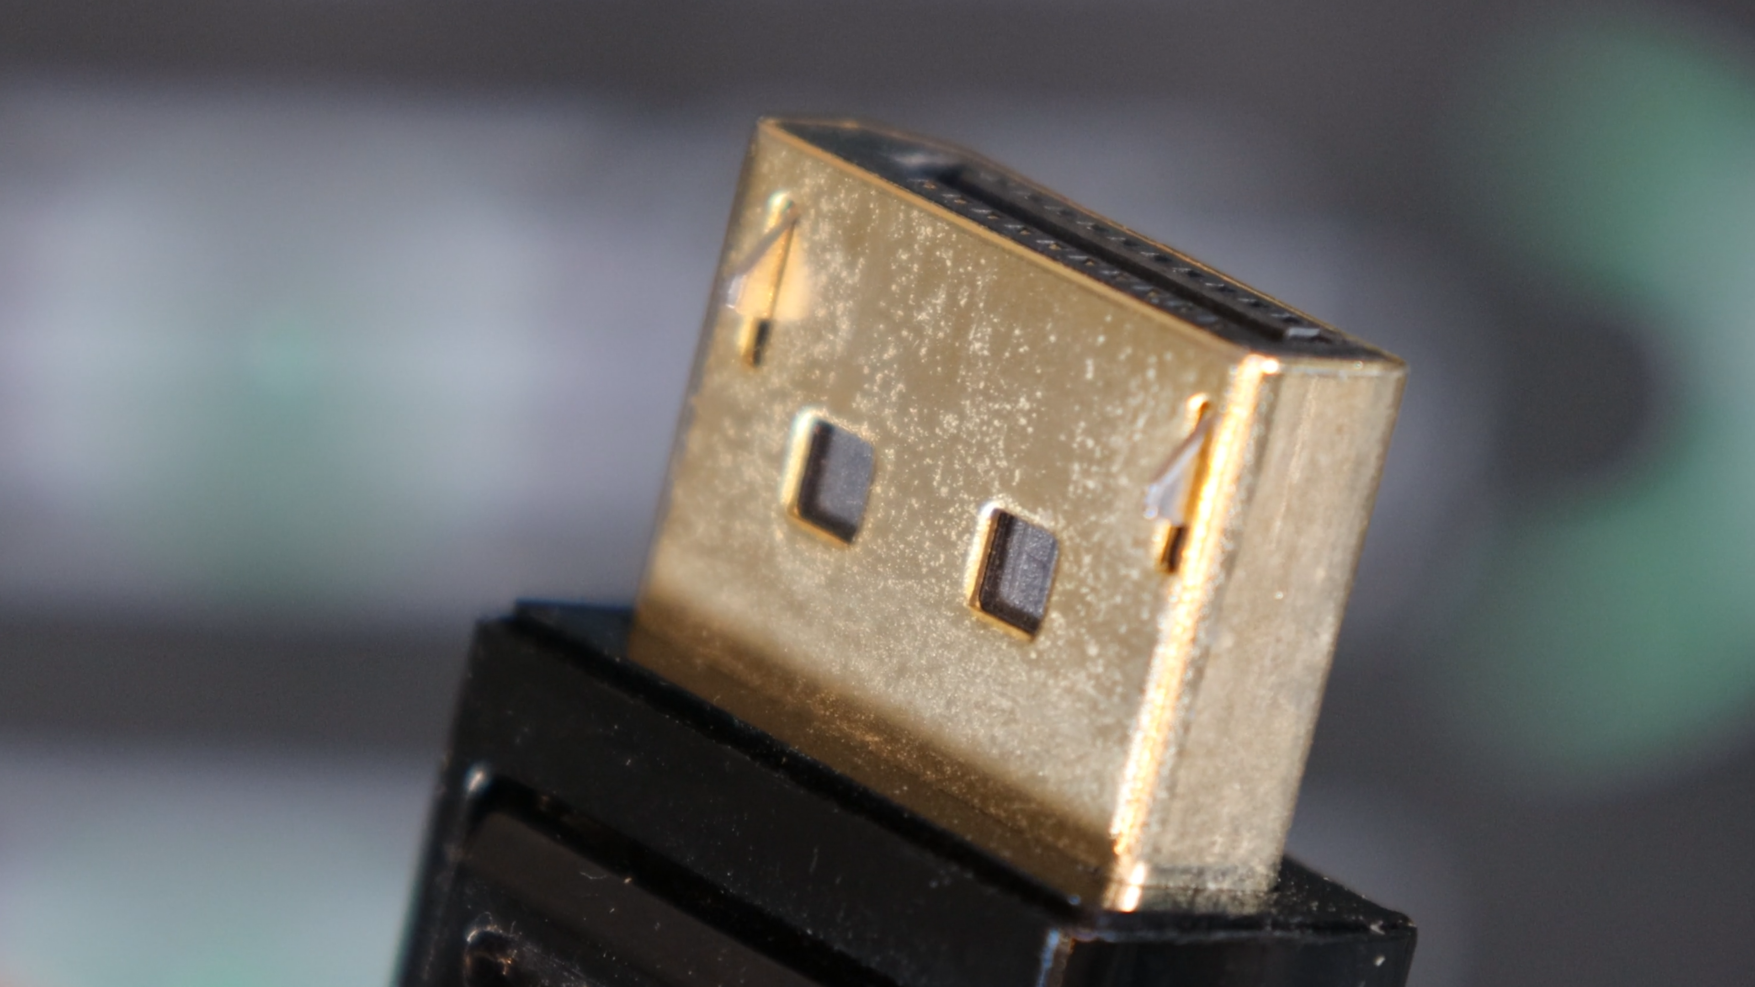
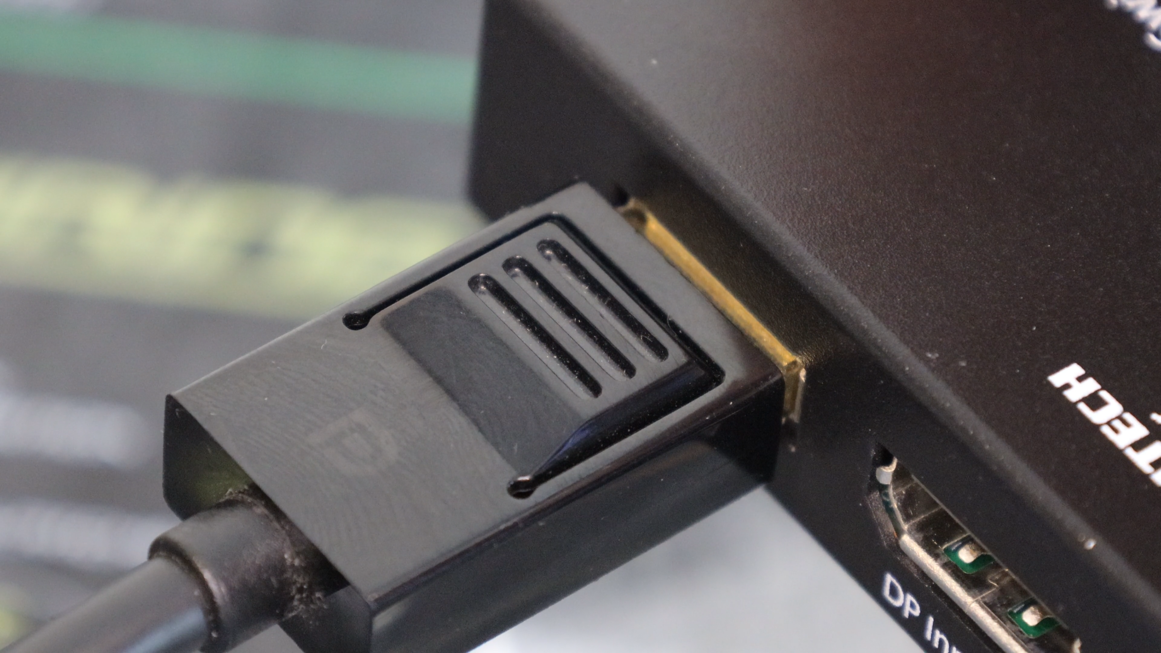
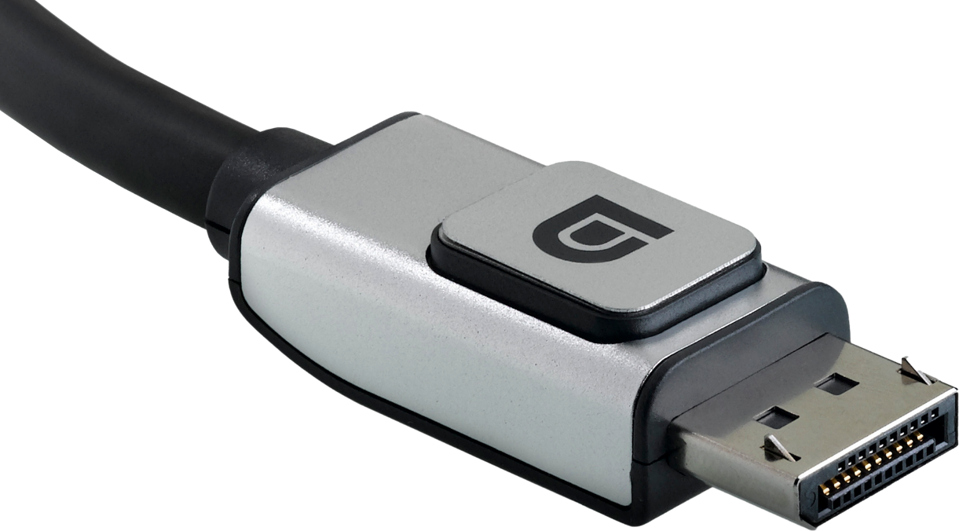
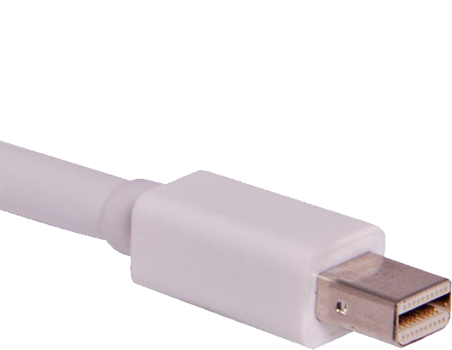
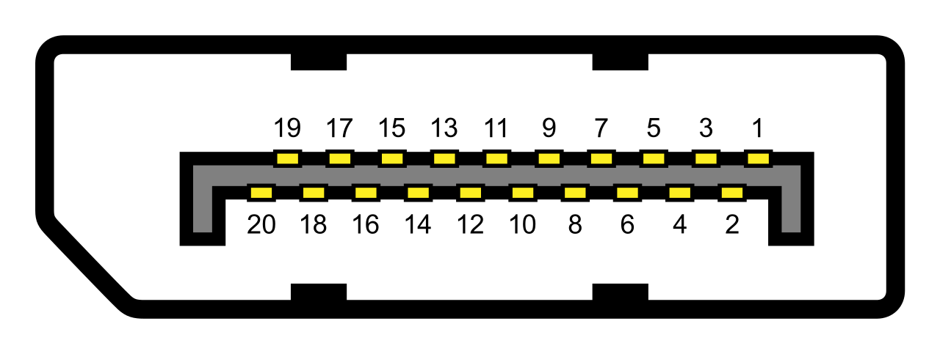
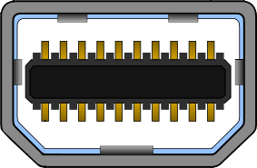
What is DisplayPort?
Video Electronics Standards Association (VESA)
Released in 2007 as royalty-free standard
DisplayPort connector
Can use Type-C
Mini DisplayPort connector
Supports DisplayPort
ITFreeTraining.com
© Copyright 2024
Notes:
00:01 DisplayPort is a standard that supports the transfer of video and audio. It was released in 2007 by the Video Electronics Standards Association, otherwise known as VESA. VESA is a royalty-free standard. Essentially this means that, in order to put a DisplayPort into a device, you are not required to pay a fee. However, a yearly membership is required to get the specifications for the standard. You are allowed to manufacture as many devices as you want using that standard without paying any additional costs.
DisplayPort comes in two different connector types. The standard connector is the larger of the two, while the second is the mini-DisplayPort connector. This is often used in Apple computers. There is no difference to the connector’s features and abilities other than the size of the connector.
The DisplayPort protocol can also travel over a USB-C connection. Thus, you will see some monitors with a USB-C connector. Thunderbolt is also able to transfer video using DisplayPort. Thunderbolt uses a Type-C connector, thus if you have a Thunderbolt port you should be able to use it for video. On some computers, you may need to use a short video cable to connect the Thunderbolt card to the video card.
You will notice that when I look at a DisplayPort cable, it has a locking mechanism built into the cable. Essentially, there are two small pieces of protruding metal edge to hold the cable in place. When plugging in the cable, it will plug in quite easily; however, to unplug the cable you will need to push down on the unlocking mechanism at the top. If you attempt to remove the cable without pushing down, the cable won’t come out. The cable comes out easily if you push down on the top of the cable. Take care to do this before removing the cable, as you may damage the connector if you attempt to pull the cable out while the locking mechanism is still engaged.

Slide 3
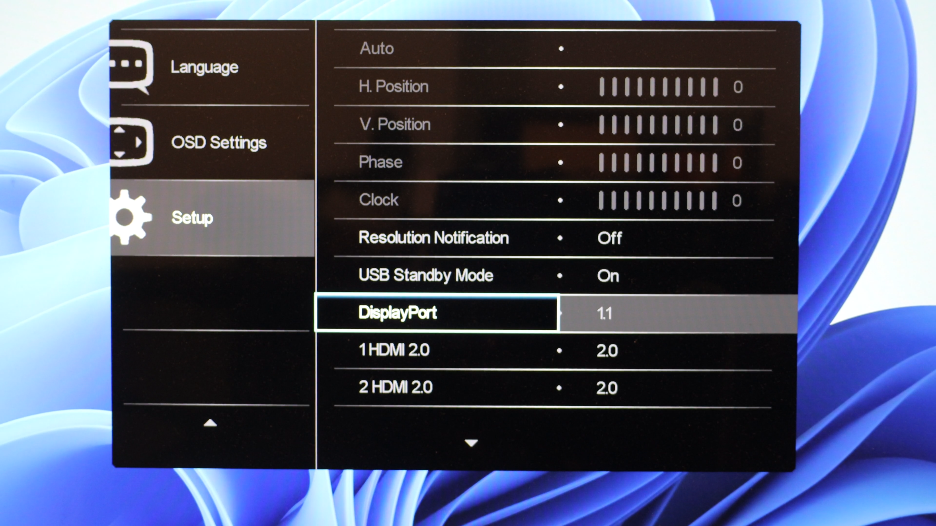
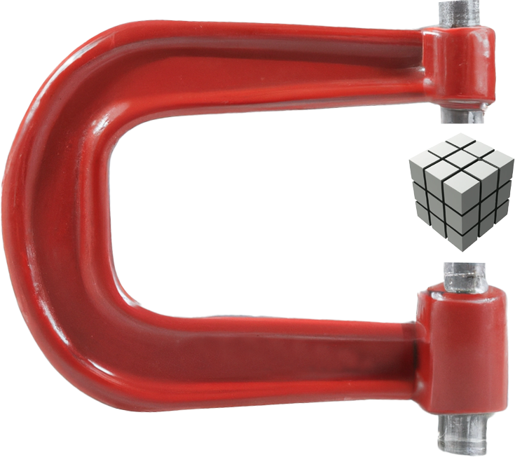
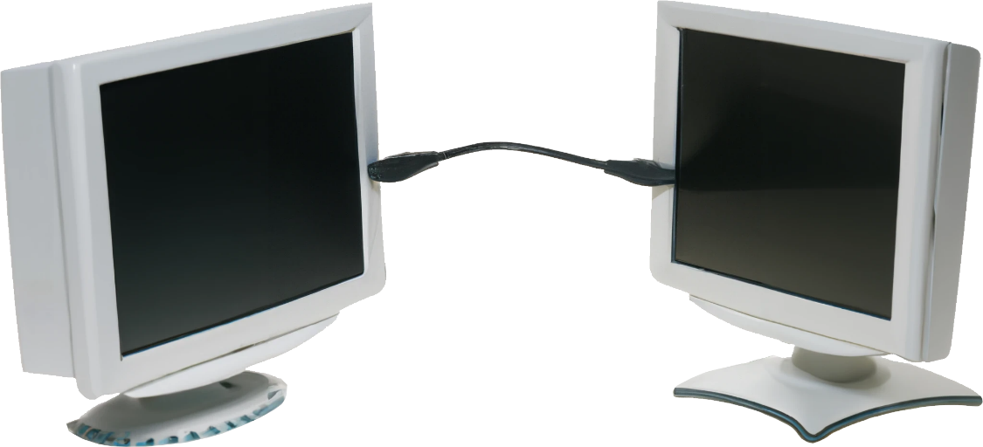
DisplayPort Versions
Backwards compatible
Ensure you have the correct cables and setting
1.1
1.2
1.3
1.4
2.0
Display Stream Compression (DSC)
Compression
Multi-Stream Transport (MST)
Daisy-chaining
ITFreeTraining.com
© Copyright 2024
Notes:
02:03 I will now have a look at the different versions of DisplayPort. There are a lot of improvements between versions. The most important feature for most people will be the resolution supported. You can see that when we get up to version 1.2, we have already reached 4k resolution at 60 Hertz. At present, this should be good enough for most users.
Version 1.2 also introduces a new feature called Multi-Stream Transport or MST. This essentially allows multiple monitors to be daisy-chained together and connected to the same video card. Although, for reasons I will go into later in the video, I don’t think you will come across this too often, but CompTIA talks about it, so let’s take a look.
Version 1.4 introduces data compression and thus you may be able to get a higher resolution than the cable supports by using this compression. Version 2.0 has not seen much market adoption – you will find some new video cards using 1.4, but not many using 2.0 as of now. Given that 2.0 can run 8k at 60 hertz, I don’t think we will see it that much for a few years, as there are not many monitors on the market that support 8K just yet.
Generally, when purchasing video cards or monitors you will look at the resolution it supports. DisplayPort is backward compatible, so having a higher version won’t be a problem. The important point is to ensure that you use the correct cables and settings. If your device is set to a lower version than required, you may not be able to use the resolution you want or the hertz rate will drop.
In most cases, make sure you have the right cables and simply plug them in. If you are still having problems, check your device settings are correct. In the case of this monitor, the DisplayPort version is set to 1.1. Thus, it will run 4k resolution, however, only at 30 Hertz. This may make the response on the monitor look sluggish. To correct this, I will simply set it to 1.2. Since DisplayPort is backward compatible, I would always set this setting to its highest value. You may find the manufacturer of the monitor may change the default to a lower setting for compatibility reasons. It would be pretty unusual that changing this to a higher setting will cause any problems. In some troubleshooting cases, you may need to change it to a lower setting, but that should be very rare.

Slide 4
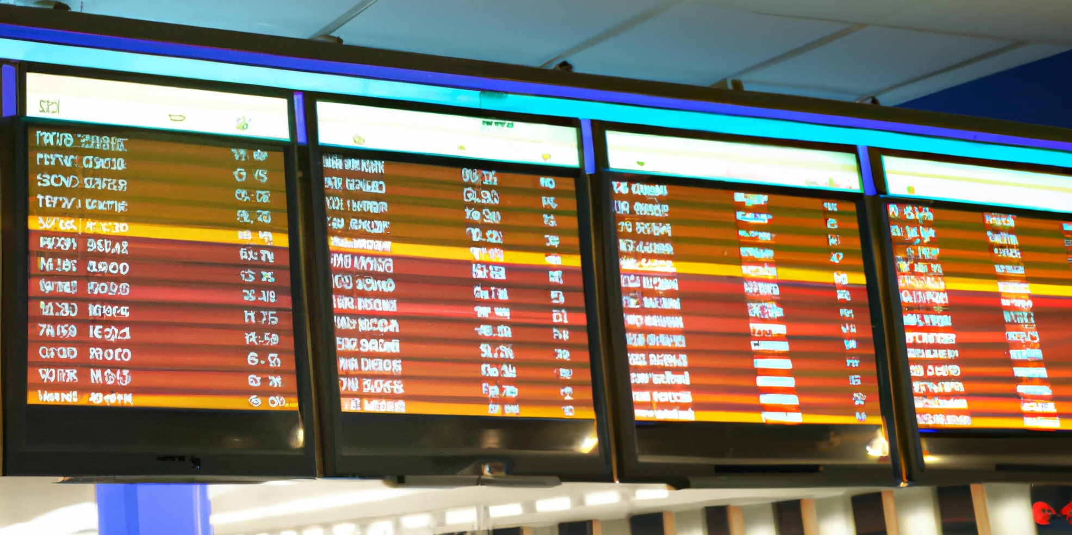
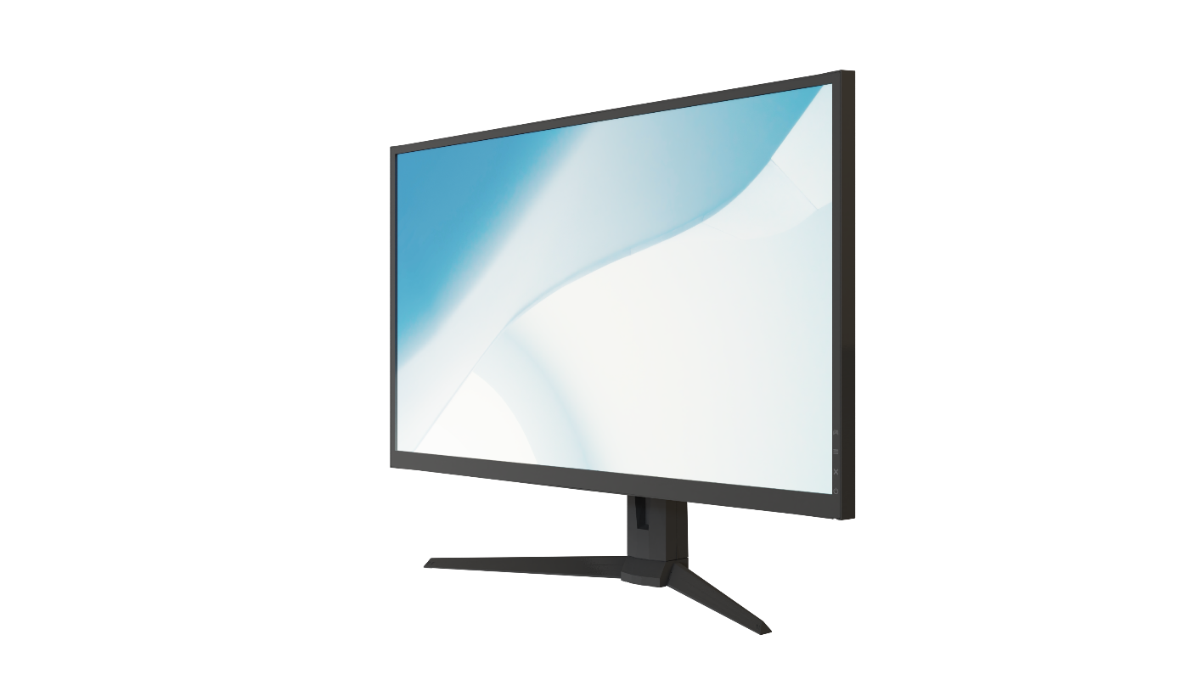
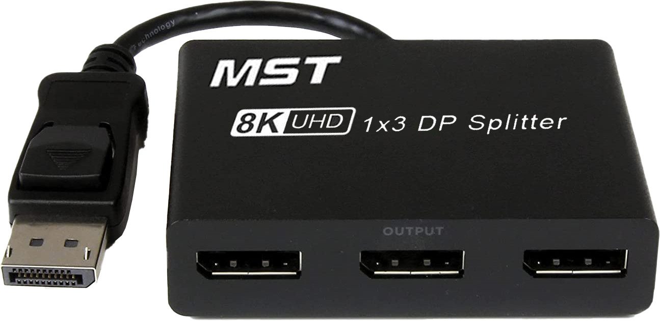
MST (Daisy-Chaining)
Allows multiple video signals over same cable
Number limited by video card and transfer rate limits\resolution
1x
Option 1
DP In
DP out
DP In
OR
4x
Option 2
Combined output video can’t
exceed cable transfer rate
ITFreeTraining.com
© Copyright 2024
Notes:
04:23 Although I don’t think that you will come across MST very often, CompTIA does cover it, but it is not listed as an exam objective. So, you never know you may get a question about it, but I don’t think you will need to know a lot about it.
To understand how it works, consider that we have a computer plugged into a monitor. MST is effectively daisy-chaining, so the computer would be plugged into the input DisplayPort on the monitor as we would normally do.
A second monitor would then be connected to the first. In order to do this, the first monitor needs to have a DisplayPort Out connection. Not all monitors will have this, in fact most don’t. You can start to understand why you won’t see this too often. Given that a lot of video cards will have multiple video out connections, if you want to set up a second monitor, in most cases you would simply plug the second monitor directly into the video card.
When using MST, there is something you need to take into account. That is, the amount of video data that can travel through the cable. Different versions of DisplayPort will be able to support more or less data, so for our example, this may not match the results that you get. Your results may be different depending on the equipment and cables you are using.
In this example, our cable supports one 4k video resolution. This is the highest resolution supported. This resolution could be broken down into four smaller resolutions. You could also break it down to any combination you wanted, as long as you don’t exceed the maximum transfer speed of the cable. Also, different video cards will support a different number of monitors. For example, some video cards may only support two monitors using MST, while others may support more.
If you are using multiple monitors for electronic display walls, this may be a good use of MST, since the monitors are generally running at low resolution and occupy a large area. For these reasons, it may be easier chaining the monitors together rather than running long cables to each monitor. High quality cables will work over longer distances, but you may get to a stage where the furthest monitor is too far away. To increase the distance, you can use DisplayPort extenders, which can be expensive. It may be a cheaper option to use MST, since each monitor will re-create the signal as it passes through eliminating the need for extenders.
There is another place where MST may be used. This is with MST splitters. These devices take one video signal containing within it multiple video signals and divide it into the separate video signals. In this example, three video signals are traveling over the same cable using MST. The signals are then divided up into three signals and transmitted to three monitors. Because the monitors are connected by separate cables, the monitors don’t require a DisplayPort Out connector on the monitor. If you are going to use this, it would most likely be for a laptop that has a limited number of video output ports. Make sure that before you purchase one, you check that your laptop can support it.
The other place that you may find this is in docking stations. If the docking station has multiple DisplayPort outputs, it may be using MST to transfer multiple video signals to the docking station. When doing this, keep in mind that the maximum combined resolution of the DisplayPorts on the docking station will be based on the amount of data that can be transferred to the docking station.
If I were to take a guess at what sort of question CompTIA would ask about MST, if they did ask a question, I would say it would be in relation to knowing that output resolutions are limited by what the output cable in the computer supports. So, your answer may involve reducing the resolution of one of the output screens or plugging one of the monitors directly into the computer to reduce the amount of data traveling through the cable. But, that is me taking a guess.

Slide 5
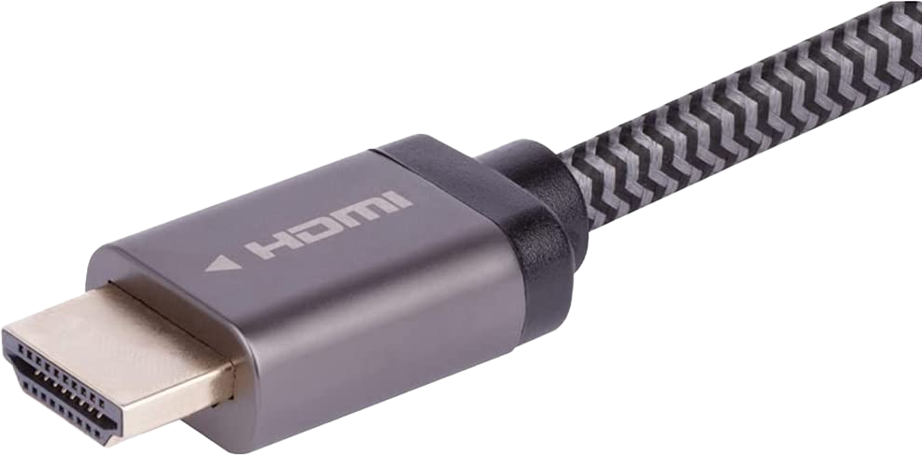
DisplayPort vs HDMI
Feature wise pretty similar
DisplayPort
HDMI
Multi-Stream Transport (MST)
ARC and eARC
ITFreeTraining.com
© Copyright 2024
Notes:
08:23 DisplayPort and HDMI are the two most common video connectors you will come across. If these are not being used, it is probably a Type-C connector which is transmitting the DisplayPort or HDMI signal using the Type-C connection.
DisplayPort was originally designed with computers in mind. HDMI was designed with home entertainment systems in mind. As time went on, more features were added to both. Nowadays, feature wise, both are pretty similar to each other. There are two features that stand out that one has over the other.
In the case of DisplayPort, DisplayPort supports MST whereas HDMI does not. HDMI supports ARC whereas DisplayPort does not. ARC allows audio traffic to travel in the opposite direction to the video. This is useful in some situations, for example, when you have a sound system connected to your entertainment system; however, in some cases the video will travel through the sound system to get to the TV, and in other cases the sound will need to travel in the opposite direction to get to the sound system. HDMI supports both cases. DisplayPort does not have this feature. However, DisplayPort is generally used with computers, where you plug the sound system directly into the computer, so this is not normally a concern.
For computers, it does not really matter if you use DisplayPort or HDMI. Since HDMI has been around a lot longer, you generally find that accessories are cheaper and there is more selection. This may change in the future if DisplayPort gains more market share.

Slide 6
Subscribe
Next video
Video content: https://ITFreeTraining.com/ap11/1a25
© Copyright 2024
Notes:
09:54 That concludes this video from ITFreeTraining on DisplayPort. I hope you have found this video informative. Until the next video from us, I would like to thank you for watching.
References
“The Official CompTIA A+ Core Study Guide (Exam 220-1101)” pages X to X
“Dell UltraSharp U2417H
User’s Guide” https://dl.dell.com/manuals/all-products/esuprt_electronics_accessories/esuprt_electronics_accessories_monitors/dell-u2417h-monitor_user's-guide_en-us.pdf
“Picture: Full HD 1080” https://commons.wikimedia.org/wiki/File:Full_hd_logo.svg
Credits
Trainer: Austin Mason http://ITFreeTraining.com
Voice Talent: A Hellenberg https://www.freelancer.com/u/adriaansound
Quality Assurance: Brett Batson http://www.pbb-proofreading.uk

