Slide 1
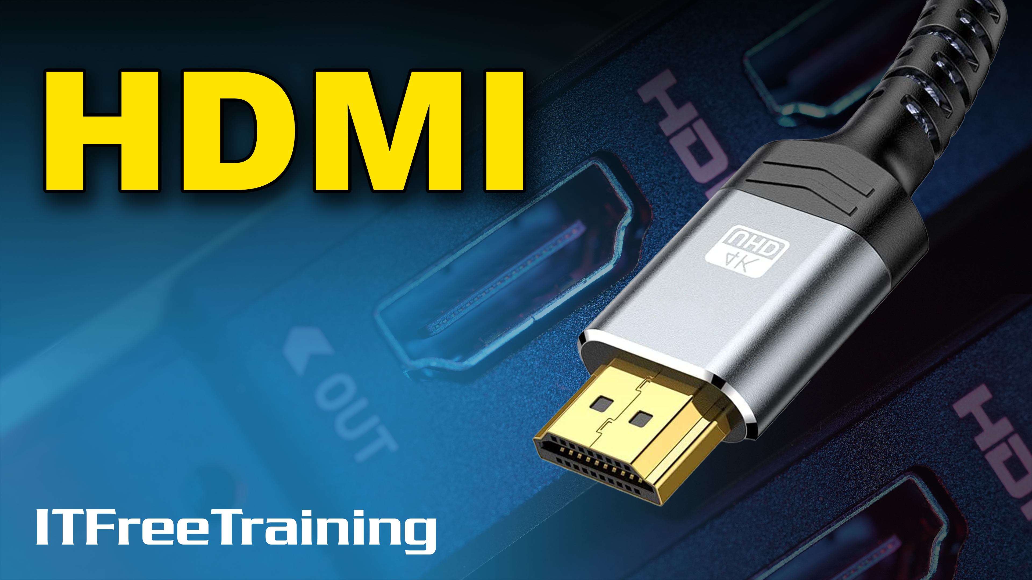
Notes:
Let’s have a look at HDMI.

Slide 2
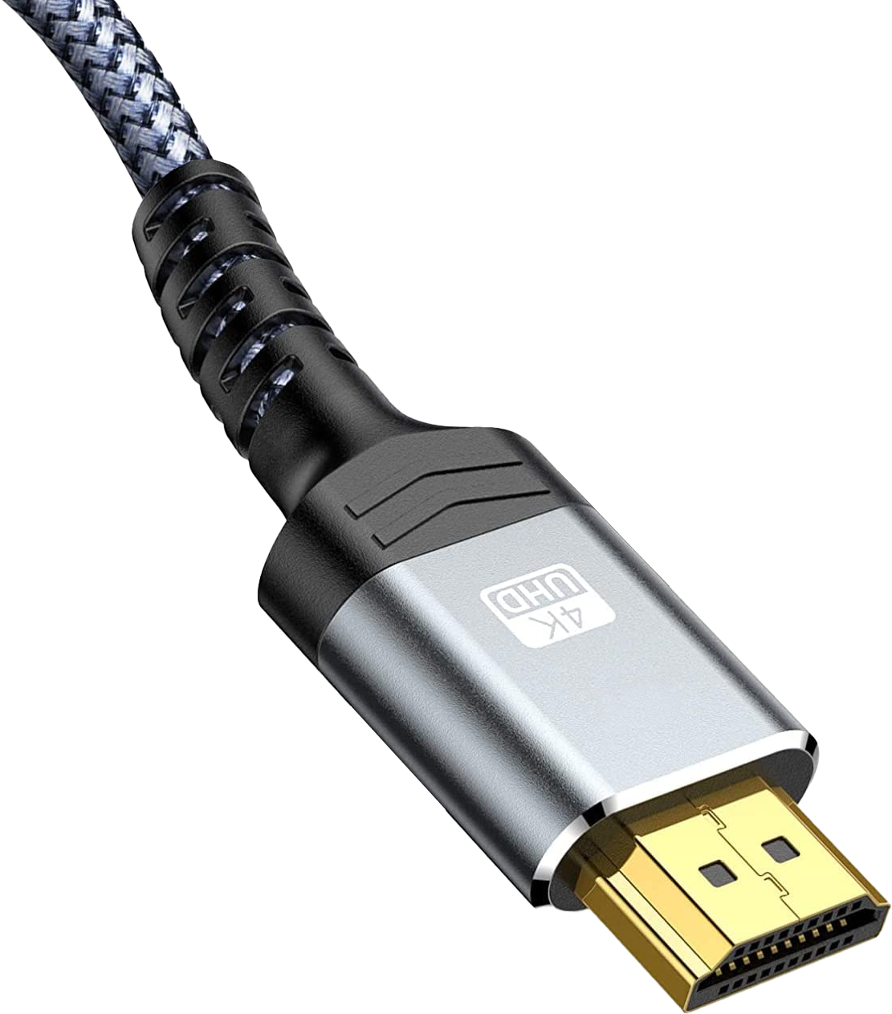


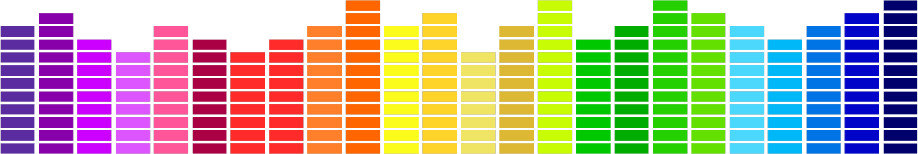



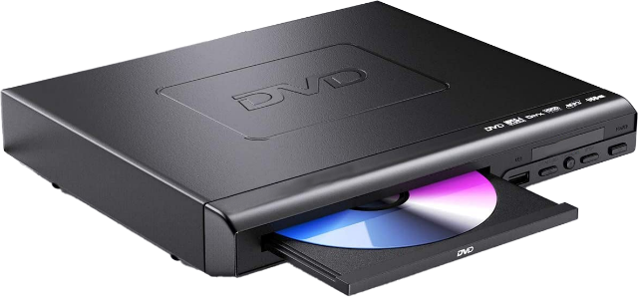
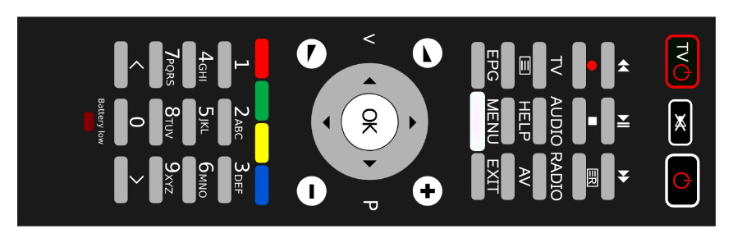
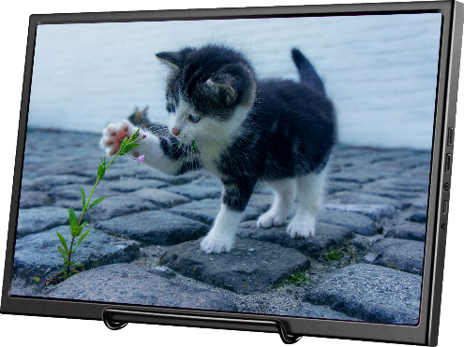
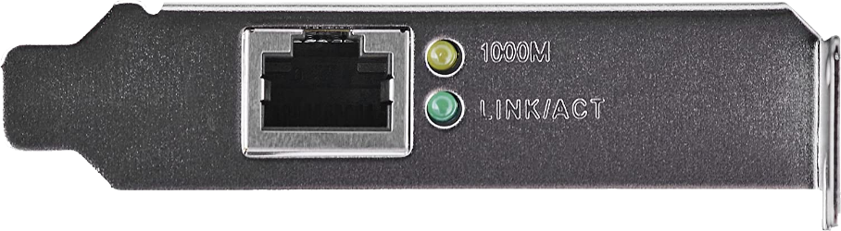
10
HDMI
BILLION
High-Definition Multimedia Interface
Devices
Supports the transfer of
Video
Main use
Audio
Used often
Copy protection
Problematic/Cracked
Remote control
Problematic
Networking
Not really used
ITFreeTraining.com
© Copyright 2024
Notes:
00:02 HDMI or High-Definition Multimedia Interface has been quite popular in the marketplace with approximately 10 billion devices being manufactured that use it. HDMI supports the transfer of many different types of data over the cable.
The main use of HDMI is the transfer of video. Although there is other technology, like USB, that can achieve high transfer speeds, HDMI was mainly designed with the transfer of video in mind.
The second big use for HDMI is audio. Since HDMI is often used in consumer products, such as home entertainment systems, it is essential that it supports sound.
HDMI also supports copy protection. Copy protection is designed to prevent unauthorized copying from media like optical disk. It does this by encrypting the data traveling between devices, meaning that only authorized devices will be able to decrypt the data. The copy protection has been known to be problematic, with different devices not being able to work with each other. The copy protection has also been cracked, so individuals with the right equipment can defeat it.
HDMI also supports a remote-control feature. Essentially what this means is, multiple devices, in theory, can be controlled through the HDMI cable even if they are not connected directly to each other. To give a simple example of why this would be useful, think of a TV, a sound system and an optical media player. In theory, you would be able to have one remote control to control all the different devices. That is, HDMI would pass the control codes between different devices. Sounds good in theory, but in reality, devices don’t generally communicate with each other unless they are from the same manufacturer, but even that can be problematic.
The last main feature of HDMI is networking, essentially replacing the need to run a separate network cable. This feature never really took off and it would be difficult to find a device that supports it. Later in the video I will look at the reasons why.

Slide 3
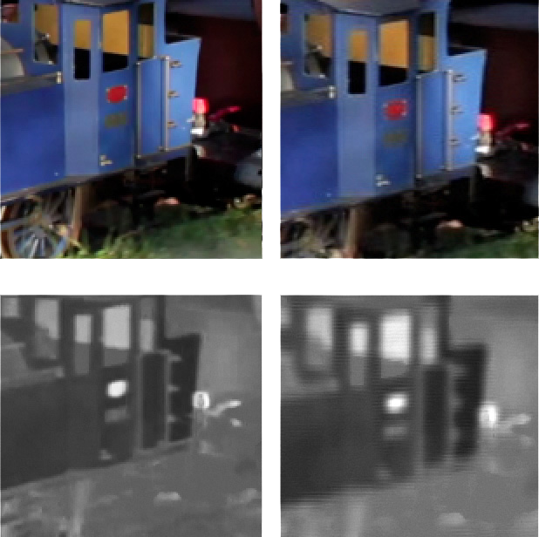
HDMI Versions
2.1
Speed 42 Gbps
Max Resolution 7680x4320 120hz (DSC)
5120x2880 60hz
Released 2017
2.0
Speed 14.4 Gbps
Max Resolution 7680x4320 30hz (4:2:0)
3840x2160 60hz
Released 2013
1.4
Speed 8.6 Gbps
Max Resolution 5120x2880 30hz (4:2:0)
4:4:4
4:2:0
2550x1440 60hz
Released 2009
No data lost
Favors luminance
ITFreeTraining.com
© Copyright 2024
Notes:
02:04 There have been many different versions of HDMI, however, I am going to look at three of them as they are the most likely ones that you will come across. Version 2.1 was released in 2017. It is currently the newest version of HDMI, having a maximum data speed of 42 Gigabits per second and a maximum resolution of 8K. What you will find is, to get higher resolutions there is often a trade-off or a reduction in quality. In the case of 2.1, to achieve this result Display Stream Compression or DSC is used. DSC compresses the stream which allows for the higher resolution. DSC is lossy compression, meaning that some quality is lost in the compression process; however, under testing a test group was not able to accurately tell the difference between compressed and non-compressed video.
To make it easier to compare different standards, I have included the highest resolution that is supported at 60 Hz at full quality since this is a common resolution that is used. In the case of 2.1 this is 5K resolution.
In 2013 version 2.0 of HDMI was released. You can see that 2.1 data speed is almost three times as fast as 2.0. Even so, it can support a maximum resolution of 8k just as 2.1 can. However, it does come at a cost. Firstly, it is limited to only 30 Hz and secondly the color chroma sampling is reduced. Color sampling is a way of compressing videos by reducing the color of an image in favor of luminance. To understand this better, let’s consider an example.
In this example are two images, one recorded using one color chroma sampling and another using a different color chroma sampling. The first one is 4:4:4. I won’t get into too much of the technical details about this, but essentially the video gets divided into three different streams. The number represents how much or how little this stream is compressed. Four is the highest number, so essentially 4:4:4 means that the video is not compressed.
In our example, the image on the left is thus not compressed. In the case of 2.0, the maximum sampling used is 4:2:0. You can see the right image is not quite as good quality as the left image, although they look similar. Essentially 4:2:0 favors luminance over color. In simple terms, parts of the signal used to display differences in brightness in the image get more data then changes in color get. Our eyes pick up changes in luminance over changes in color, so if you are going to sacrifice something, it makes sense to sacrifice something you are less likely to see.
It is quite common for 4:2:0 to be used for movies. So, you have probably been watching without even realizing, particularly with resolutions such as 4k, since the resolution is so high it is hard to tell the difference between 4:4:4 and 4:2:0.
In the case of movies, there is often a lot of motion and when there is no motion there is not a lot of fine detail; for example, fine detail like printing characters on a solid background which would require the image to be sharper. For this reason, this resolution may work quite well for many applications, however, if you are doing work that requires fine quality the loss will be more noticeable.
In this example, it is easy to make out the shape and details of the train, so you can see the difference is minor. If you are using a high resolution with a lot of text on solid backgrounds, or applications like graphic design tools, the lines and curves on the screen may not appear as crisp on 4:2:0 as they would on 4:4:4. The difference, however, is still quite small. For movies and video games, you probably will not notice it. However, if you have a lot of text on the screen or are working with fine lines and curves like graphics design packages, it will be more noticeable.
The last version that I will look at is 1.4 released in 2009. This version has a data speed of 8.6 Gigabits per second. The maximum resolution is 5k at 30 Hz. As before, the color chroma sampling is reduced to 4:2:0 at this resolution. At 60Hz, the maximum resolution is 1440p. Given how much screen resolutions have increased, for example, how common 4k resolution has become, you can see that most devices nowadays will use at least HDMI version 2.0. Now that we understand what versions you are most likely to come across, I will next have a look at what features you may get in different versions.

Slide 4

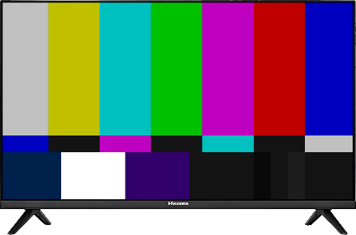
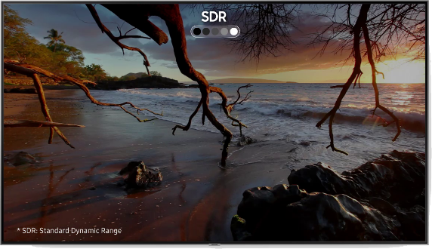




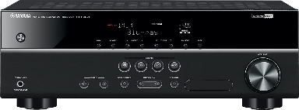
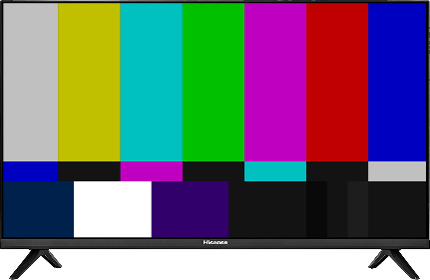

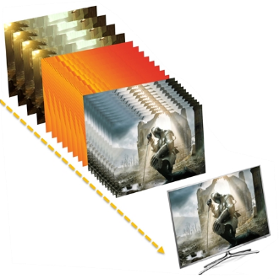


HDMI Features
All HDMI features are optional
Don’t assume if device supports a version of HDMI, it supports those features
SDR
HDR
Audio
Audio Return Channel (ARC)
High Dynamic Range (HDR)
Improvements
Enhanced Audio Return
Channel (eARC)
HDMI Ethernet Channel (HEC)
Dual view/4 audio channels
Variable Refresh Rate
Version 1.4
Version 2.0
Version 2.1
ITFreeTraining.com
© Copyright 2024
Notes:
06:36 Each version of HDMI introduces new features; however, it is important to understand that all HDMI features are optional. Thus, don’t assume if your device supports a particular version of HDMI, it supports all the features of that version. The manufacturer effectively chooses which features they will support. Manufacturers are forbidden from describing their devices using version numbers rather than features, but some still do this.
There are a lot of features, however, I will only look at the major ones between versions. To start with, I will look at version 1.4. Version 1.4 added Audio Return Channel otherwise known as ARC. HDMI is primarily designed to transmit a lot of video. In some cases, you may need to transmit audio in the reverse direction to the video. For example, if you have a TV connected to an antenna. The antenna will pick up television signal in the form of video and audio. If the TV plays back both, this is not a problem.
The problem occurs when you connect your surround sound system to the TV. In order for the surround system to play audio it needs to be transmitted from the TV. This is where the ARC channel comes into play. The ARC channel sends the audio signal in the opposite direction to your audio device. Things start getting more complicated when you have multiple devices such as game consoles and disk players. In these cases, you will often want to have all the devices use the one sound system since you probably paid a lot of money for it. The important point to remember is, ARC allows audio to be transferred in both directions. So, if all the devices in the chain are ARC compatible, they can re-direct the audio signal as required.
This sounds simple but can get complicated in the real world. If one device in the chain does not support ARC, the audio signal will stop at that device. Also, you need to ensure you use the correct cables. Later in the video I will look at the cabling you require. In some cases, you may need to try a few different things before it will work. If you can’t get it to work, you may need to run additional audio cables to get all your devices working. Hopefully you won’t need to.
Version 1.4 also added HDMI Ethernet Channel otherwise known as HEC. HEC never really took off, so it will be hard to find a device that supports it. Most of the time you will come across it is not with a device but when purchasing a cable, which I will look at later in the video.
Version 2 added a number of improvements to picture quality. Most of these were improvements to High Dynamic Range or HDR. HDR essentially increases the amount of data that can be used to represent pixels. This allows for more control over bright and dark areas on the screen. The end result is picture quality that looks brighter and more vibrant. Thus, you can see, even if you are using a low resolution, it may be worth using devices that support 2.0 or enabling it if it is disabled. Of course, you won’t get better results with version 2.0 alone, you also need a device that supports these features.
Version 2.0 also added dual view and increased the audio channels to four. Dual view allows two video streams to be displayed on the same device. This is useful for picture-in-picture, where essentially one video is displayed in a small box and the main view is displayed using the rest of the screen. It is also useful for devices like CCTV monitors where you want to display two video feeds on the same screen.
Version 2.0 increased the audio channels to four. It is important to understand these are audio channels which may contain multiple audio tracks. For example, if 5.1 surround sound is being used, this is effectively six audio tracks. Thus, each of these audio channels is capable of transmitting multiple audio tracks.
Version 2.1 adds support for Enhanced Audio Return Channel or eARC. This essentially increases the bandwidth of the channel and also allows it to use objects rather than audio tracks. Audio objects are used by Dolby Atmos and DTS:X. Basically, rather than using pre-mixed audio tracks, sound is transmitted as objects which are given a location where the sound is coming from. This means you can use any number of speakers and place them where you want to, and the sound system will work out how to play the sound object. This means you don’t get stuck with a surround sound system with a fixed number of speakers like 5.1, you can keep adding speakers and place them where you need them. The sound system will then adjust to the number and location of the speakers.
The last new feature I will look at is Variable Refresh Rate. Variable refresh rate allows the device to control the refresh rate of the monitor, thus allowing the device to speed up and slow down the refresh rate. This is important when playing computer games, because if the computer is doing a lot of processing it may increase the length of time it takes to render a frame. Without a mechanism like this, you can get what is called screen tearing. This is when the device has done half the rendering of the frame when it is updating, creating an image which is split between showing the new image and part of the old image. This is particularly noticeable if something is changing or moving quickly. Variable refresh rate allows the device to delay the next frame from being displayed until it has finished rendering it.
Now that we have had a look at versions and features, let’s next have a look at cables.

Slide 5
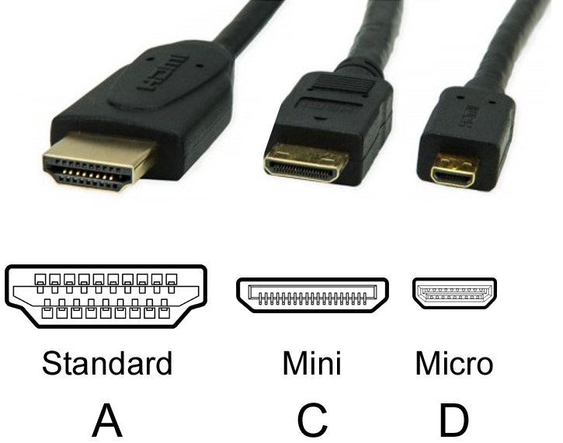





HDMI Cables
Not all cables are created equal
No cable differences between small revisions like 2.0a and 2.0b
Look for official logos
All have same pin count
When absent check for features/speeds
Or HDMI version numbers (Technically should not be used)
+ eARC
4.95 Gbps
10.2 Gbps
18 Gbps
48 Gbps
Category 1
Category 2
Category 3
Ver 1.4
Ver 2.0
Ver 2.1
* Cables are backward compatible
ITFreeTraining.com
© Copyright 2024
Notes:
12:02 When looking at HDMI cables, it is important to understand that not all HDMI cables are created equal. HDMI consumer cables use three different connectors. Although they are of different sizes, they have the same number of pins. The mini connector is essentially a smaller version of the standard connector. The micro connector has the same number of pins, but the pinout is different from the others, however, this does not affect the cable. They effectively do the same job; however, larger connectors are generally sturdier to withstand knocks than smaller connectors.
I have not looked at all the small HDMI revisions in this video, for example 2.0a, 2.0b, etc. The reason I have not done this is because these revisions often add minor features or fix bugs. Given that new features are optional, it is possible for a vendor to say their device supports a newer revision and not include any of the newer revision’s features. The main point you should take away from this is that there are no cable differences between small revisions like 2.0a and 2.0b.
To understand what a specific cable supports, look for official logos. Not all HDMI cables will have these, but if they do it will meet that HDMI standard. In some cases, the cable won’t have logos, particularly cheap cables. When this occurs, look for features and speeds listed on the cable to get an idea what it supports.
In the case of the logo shown, you can see the speeds that it supports. The speed will be higher than the speeds I listed earlier in the video because that was the data transmission speed. The packaging will often have the total speed which includes data plus the overhead of sending the data. With the absence of logos, have a look and see if the speed is listed on the packaging to give you an idea what it supports. These standards may also be listed as different categories. The HDMI forum has made a policy that cables should no longer be referred to by the HDMI version number. When purchasing a cable, it may have the version number on it, however, technically it should not be used.
If you find a cable with the version number listed, I have matched the version up with the official logo. This will give you an idea, if the cable only lists the version number, which one you should be purchasing. Keep in mind that when it comes to cables, in a lot of ways you get what you pay for. If the HDMI cable does not have any official logos on it, what you think you are paying for and what you get maybe different!
If you do purchase a cable, keep in mind that all cables are backwards compatible. Thus, if you want to future proof yourself, it may be worth purchasing an ultra-high-speed cable as it will support everything. However, they will cost more than the other types.
You will notice that two of the standards include ethernet, however, none of the standards mention ARC. This is because all the standards support ARC. eARC however is included with the Ultra High-Speed cable even though it is not mentioned on the logo. There are cables with the official logo that say they support ARC. Don’t worry too much about it, just know if you want to use ARC you can use any cable and for eARC you will need to use the ultra-high-speed cable. In a moment I will have a closer look at ARC and eARC to assist you purchasing the cable that meets your needs.

Slide 6
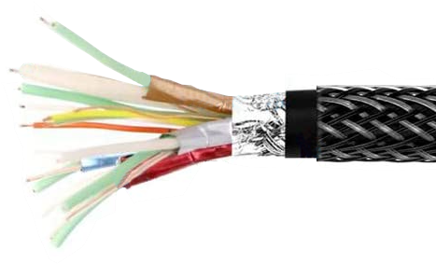



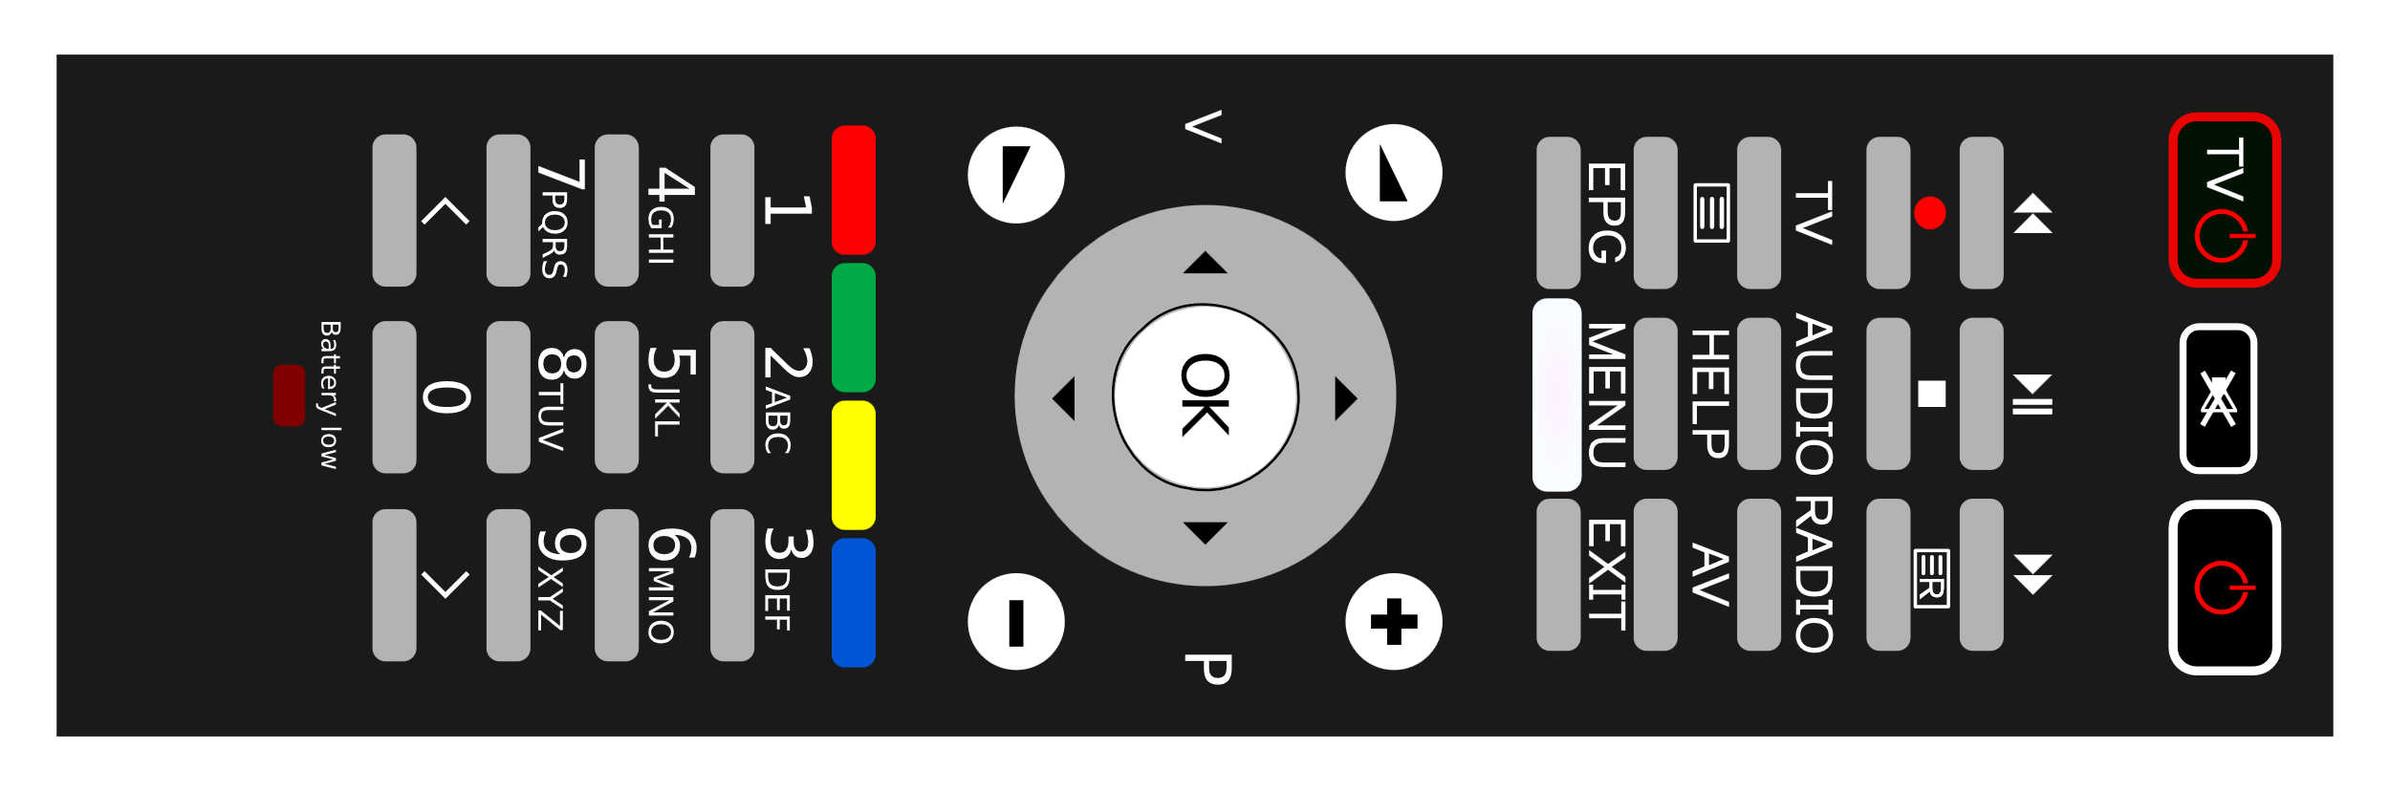
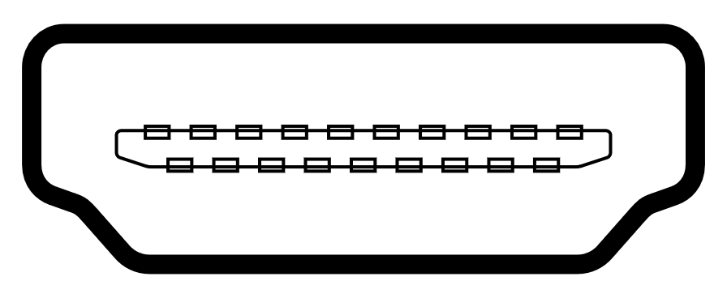





HDMI Ethernet and Audio Return Channel
TMDS
100 Mbit/s
Video and audio
HDMI Ethernet Channel
CEC
HDMI
HEC &
ARC
Contains extra twisted pair
Communication
Channels
HEC & ARC can run together
Consumer Electronics Control
DDC
eARC
1 Mbit/s
Audio Return Channel
Display Data Channel
Uses previously reserved wire
Cable required
ITFreeTraining.com
© Copyright 2024
Notes:
15:15 To understand how Ethernet and ARC work, I will first have a look at the other communication channels that are required for HDMI to operate. All HDMI cables must support three channels. Each channel has its own set of wires. The first being TMDS standing for Transition-Minimized Differential Signaling. This is a signaling standard that uses two wires running in parallel which allows a lot of data to be send through the wires at low voltage, which is resilient to interference. This channel sends video and audio data.
The next channel is Consumer Electronics Control or CEC. This channel is used to transmit control signals between devices. For example, if you press the power button on a remote control, the power on command could be sent to all the devices connected together using HDMI. In order to use this feature, all the devices need to support CEC and be compatible with each other. All HDMI cables need to have the wires for CEC, but this does not mean that any connected device needs to support that feature.
The last channel is Display Data Channel or DDC. Originally designed to communicate what resolution the device supports, it has been expanded in later versions to also include audio specifications. This channel needs to be implemented, so one device can communicate with another to determine what it supports.
These are the three channels that HDMI supports going back to the original specification. But you will notice that Ethernet and ARC are not included here.. In version 1.4, Ethernet and ARC were added. ARC adds a 1 Megabit per second channel but it only operates in one direction. Since video and audio can be transmitted through the TMDS channel, the ARC channel does not need to be bi-directional.
In order to add ARC to the original specification, ARC utilizes a reserved wire that was unused in the previous specification. Since the channel only operates at 1 Megabit per second, one wire is enough for this kind of data throughput, however, it is not enough for Ethernet.
In order to get Ethernet to work another wire is required. In order to get a second wire, it shares it with the hot-plug wire. The hot-plug wire is used to detect when the plug is connected or disconnected. Thus, it makes sense, you could run a signal over this wire since, if the plug is connected or disconnected you could detect the signal was being transmitted or stopped.
Ethernet runs at 100 Megabits per second which can cause problems with interference. To help prevent interference, these two wires are made in a twisted pair. A twisted pair is when the two wires are twisted together, which from an electrical perspective helps cancel out interference. You can start to see why a standard HDMI cable can’t be used for Ethernet.
Although Ethernet and ARC use the same wires, the good news is that they can run together. So, you don’t have to choose one or the other, if your devices support both, they can both be run at the same time.
To run Ethernet you will need a cable with the extra twisted pair which not all HDMI cables will have. In the case of ARC, a standard HDMI cable should support ARC unless it is of very bad quality. eARC increases the bandwidth of the channel from 1 Megabit per second to 37 Megabits per second. The increase in bandwidth means that not all cables will work with eARC.
In order to use eARC, you will need an HDMI cable that supports Ethernet or the ultra-high-speed cable. Since the ethernet channel can already support a 100 Mega bit per second signal, supporting the 37 Megabits per second eARC signal won’t be a problem.
There are a lot of different cables on the market, the question is how do you make sure that you purchase a cable that meets your needs?

Slide 7
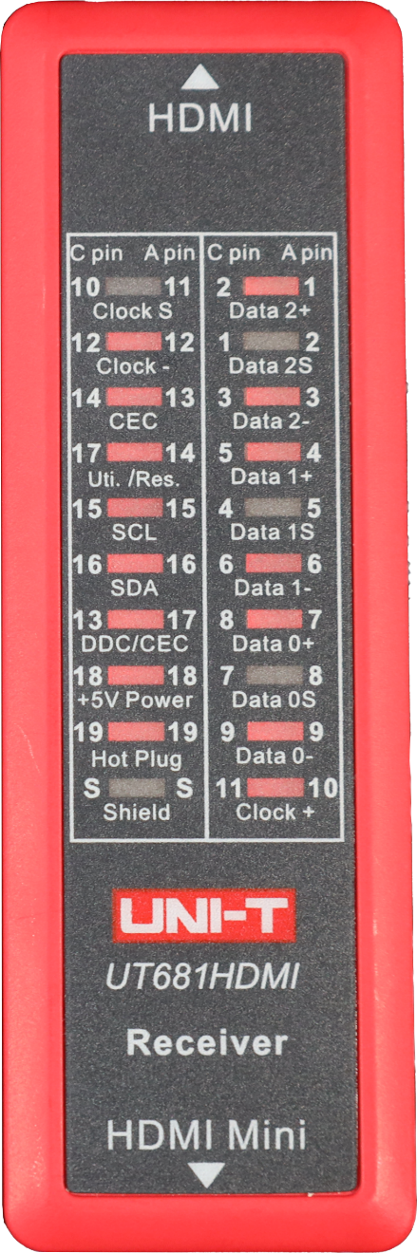
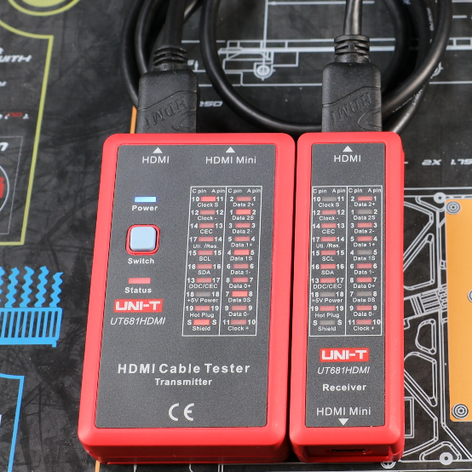
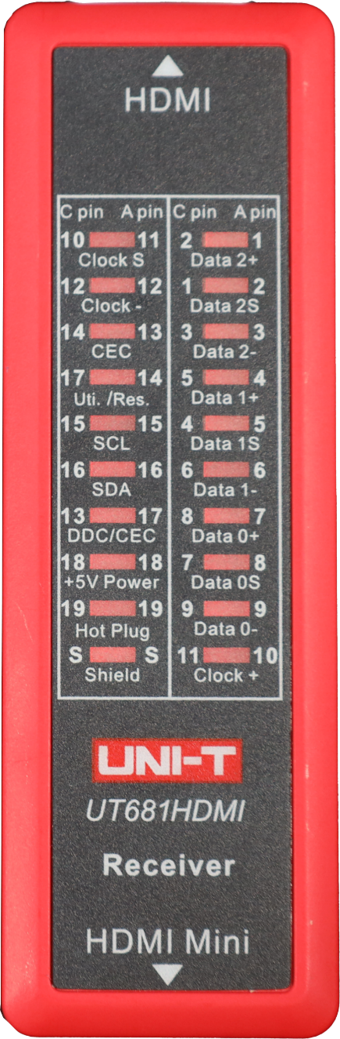
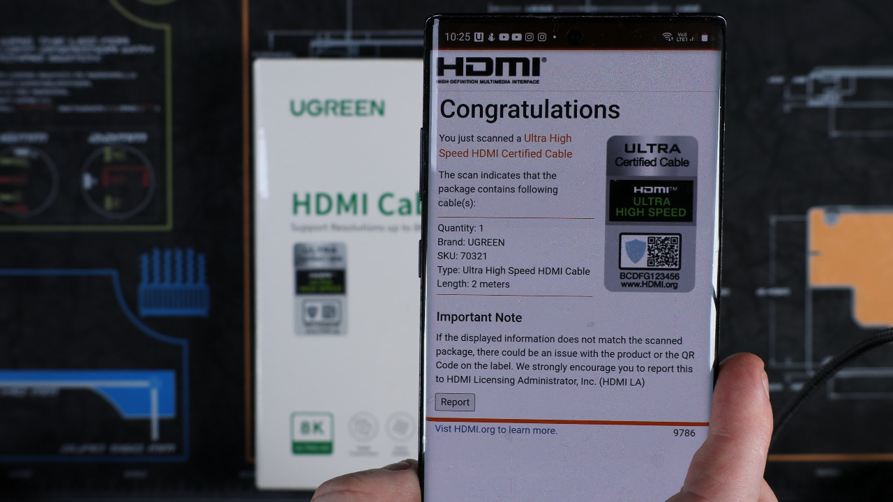
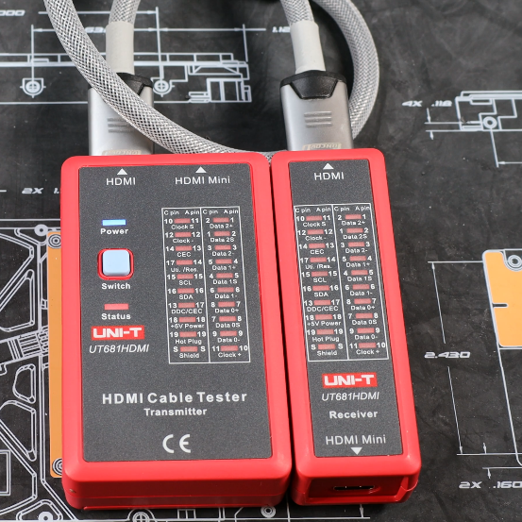
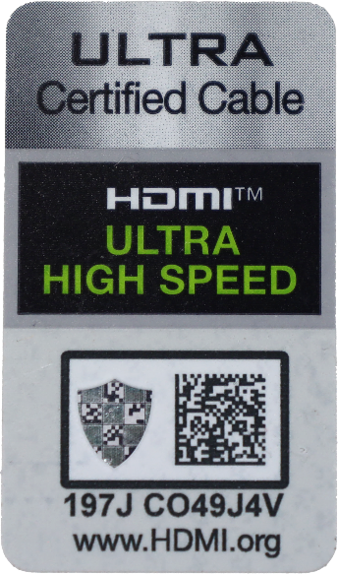
Cable Quality
Cable tester
HDMI certification
Tests connections of wires not quality
App authenticates HDMI products
No Shielding
Look for logo
Checks barcode online
Check matches product
Better quality
ITFreeTraining.com
© Copyright 2024
Notes:
19:00 I will look at two different ways to check the quality of your HDMI cables. The first being a cable tester; this device only tests the connectivity of the wires not the quality of the cable. Firstly, I will test a cheap HDMI cable. The tester is pretty simple to use, you plug the cable in and the LEDs will light up if the wire is connected.
For this cable, not all the lights have lit up. This can be an indication the cable is damaged, but in this particular case, the lights that are not lit up are the wires used for shielding. So effectively this cable will still work, however, due to the shielding being missing, the cable will only be able to transfer data at a low speed compared to other cables. The manufacturer has done this as it makes the cable cheaper to make. Quality cables unfortunately do cost more.
I will next have a look at a better-quality cable. This cable, unlike the first cable, has all the wires connected. Thus, when tested all the lights will light up. Tools like this can perform a quick test of your cable to make sure the wires are connected and there are no shorts, however, they do not test the quality of the cable.
In order to check the quality of the cable, the HDMI forum released HDMI certification. If an HDMI cable meets a certain quality, the manufacturer is allowed to put a logo on their product to indicate the product meets that quality standard. When you are purchasing a cable, it is a good idea to check the product has this logo.
The logo also has a barcode with a hologram on it. To check the cable is authentic, the barcode can be checked online. To make this process simple, there is an app available to check the barcode. To check the product, scan the barcode, pivoting the camera a bit so the app can scan the hologram and the app will check online for the barcode. The app will return information about the product such as the brand, the length and how many cables should be included. If the app can’t scan the barcode or the information is different to what the product says it is, you may have a counterfeit HDMI cable. If this is the case, I would not purchase the HDMI cable. If the product does not have this logo, it could still be a good cable, but you have no way of knowing for sure and there are a lot of low-quality HDMI cables on the market.
Now that we understand how quality can differ between cables, I will next have a look at some of the other problems that you may come across.

Slide 8
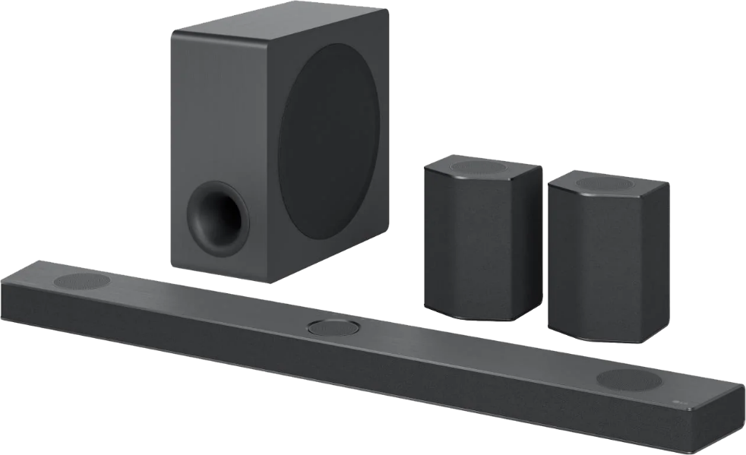

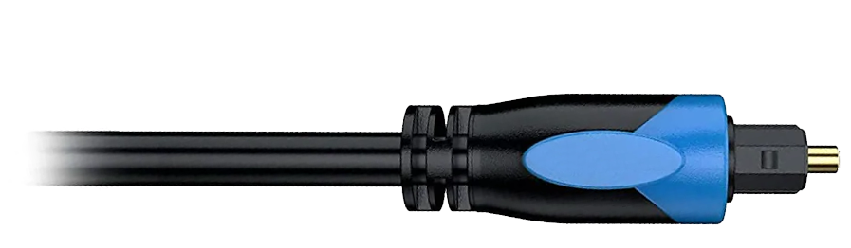



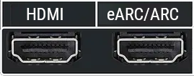
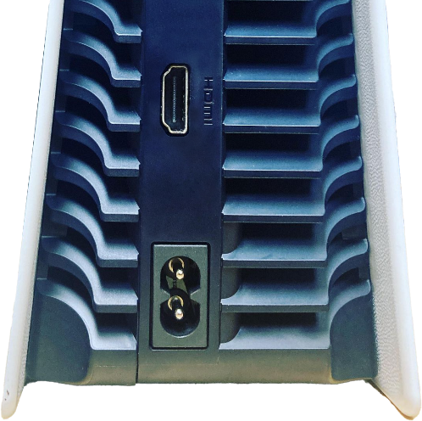

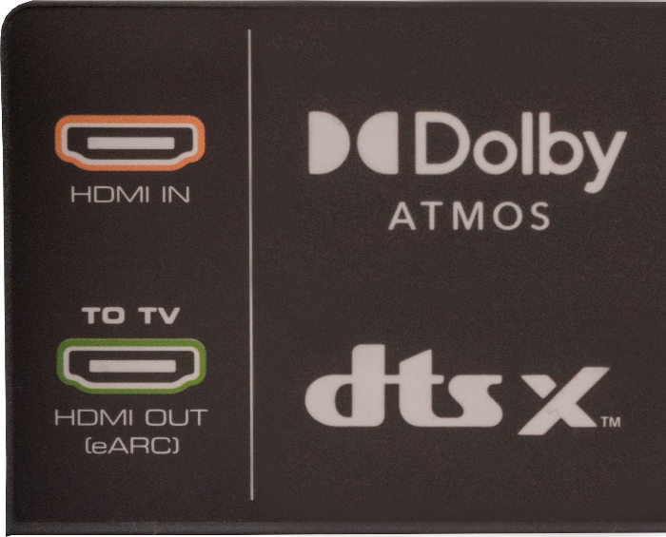
Compatibility
All devices in the chain need to support each other
May need to change order or use additional cables
Option 1
Option 2
ITFreeTraining.com
© Copyright 2024
Notes:
21:18 To understand how HDMI compatibility works, I will look at an example which explains the main concepts. In this example, we have a TV with a HDMI input and an ARC output. To start with, I will connect a Play Station 5 to the TV. The PlayStation 5 has a HDMI output on the back. I will use this to connect directly to the TV. In this example, I will use an ultra-high-speed certified cable. I could use a premium cable here, however, the premium cable only supports 4k up to 60Hz. PlayStation 5 supports up to 120Hz refresh rate so will support that output; however, most games on PlayStation 5 are 60Hz so a premium cable in the majority of cases will be fine. If you use a low-quality cable, you may find that some resolutions will not work or you may have video problems, for example, poor picture quality, distortion or the screen randomly going black.
This solution works well for basic examples like this. To make it more complicated, I will add a sound bar. This will give us better sound than the TV. On the back of the sound bar there are two HDMI plugs, an in and an out plug. The TV needs to send the audio signal to the sound bar. To do this, I will connect the two ARC ports together. In this case, the ARC port is the output port, but as we know, ARC travels in the opposite direction, thus it is fine to connect it to the output port.
Both the HDMI ports support eARC. For this reason, I will use the ultra-high-speed cable since it supports eARC. If you use a lower quality cable you may find that eARC will not work or is unreliable. A setup like this works well in most cases. The sound from the sound bar is better quality than that from the TV. We will call this Option 1.
The problem occurs when the PlayStation is used to play a movie. In this case, the movie uses Dolby Atmos for the sound. The sound bar supports Dolby Atmos, however, the sound is not getting transmitted as Dolby Atmos. The problem is that the TV does not support Dolby Atmos, thus the signal is not traveling through the TV to the sound bar. Since the TV does not support it, the sound is being transmitted using a lower standard.
You can start to understand that setting up HDMI is a bit more complicated than just plugging in the right cables. Now let’s consider another option that I will call Option 2 to solve this problem. In this case, I will use an ultra-high-speed cable to connect the PlayStation to the input port of the sound bar. The sound bar next needs to be connected to the TV. To do this, I will connect the TV to the sound bar as I did in Option 1. The sound bar will essentially pass the video signal through to the TV. Given that the output port is an ARC port, if you connect the TV to another device, the TV can still send audio signals back to the sound bar, assuming the device is not using Dolby Atmos.
This system will work well; however, if you are finding your games are a bit laggy, this may be because the output is traveling through the sound bar. Although this should not affect most people, if you are a competitive gamer this may be a concern. To get around this, you will probably want to connect the PlayStation directly to the TV, but when you do this, you will lose the Dolby Atmos sound.
One option is to upgrade the TV, another option you can do is connect an optical cable between the PlayStation and the sound bar. This means the sound can travel down the optical cable to the sound bar and the HDMI directly to the TV. This does mean that you need to run another cable, but sometimes you will find you need to do this to get the result that you want.
The main takeaway from this is, that when connecting a HDMI device, use a cable that supports what you need. Higher resolutions will need a better quality cable. eARC will require a quality cable or a cable that supports Ethernet.
When you connect multiple HDMI devices together, they all need to support the technology that you are using. If you are using technology such as Consumer Electronics Control which allows multiple devices to be controlled using the same remote, all the devices need to be compatible with each other. If you are having problems, try changing the order you connect your devices together or upgrading your cable. Hopefully this will fix the problem. Otherwise, you may need to replace or upgrade some of the devices.
In some cases, you may need to use HDMI with other technology, so let’s have a look how to do that.

Slide 9
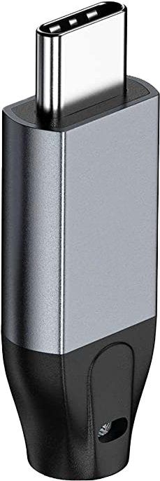

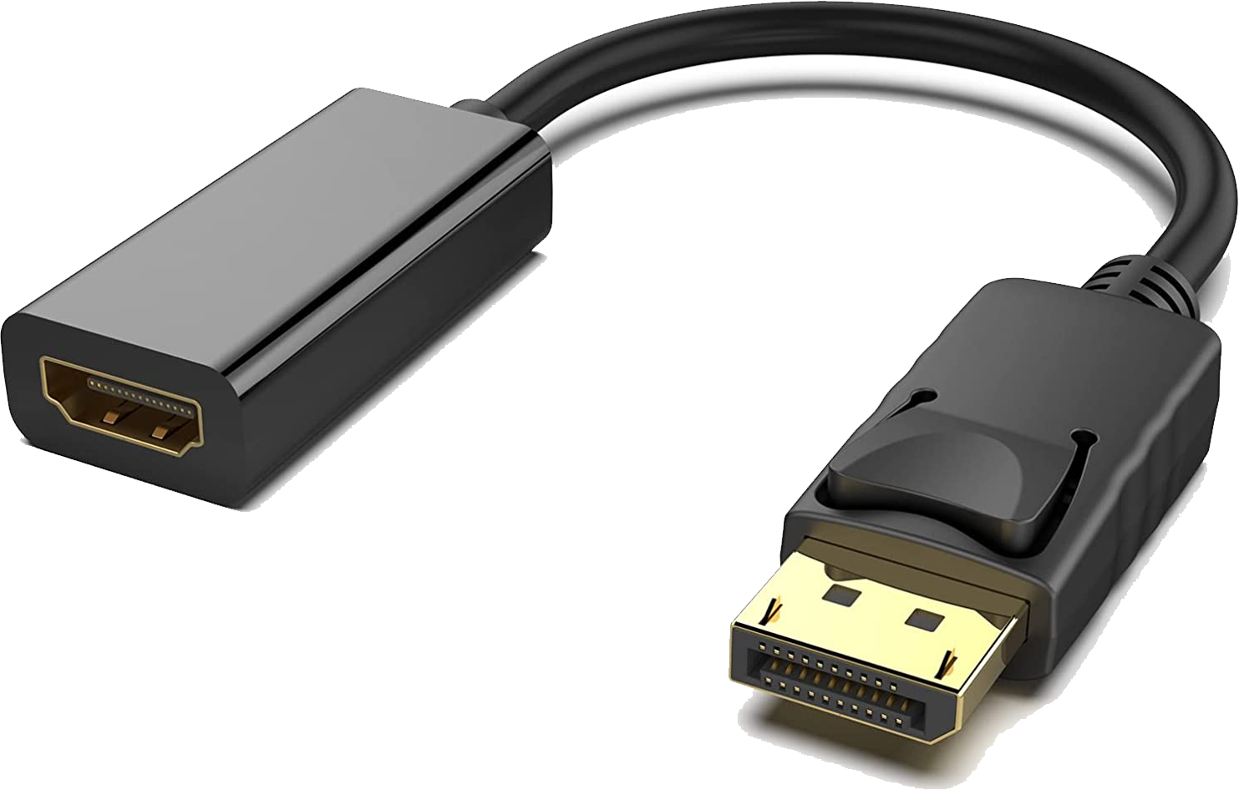


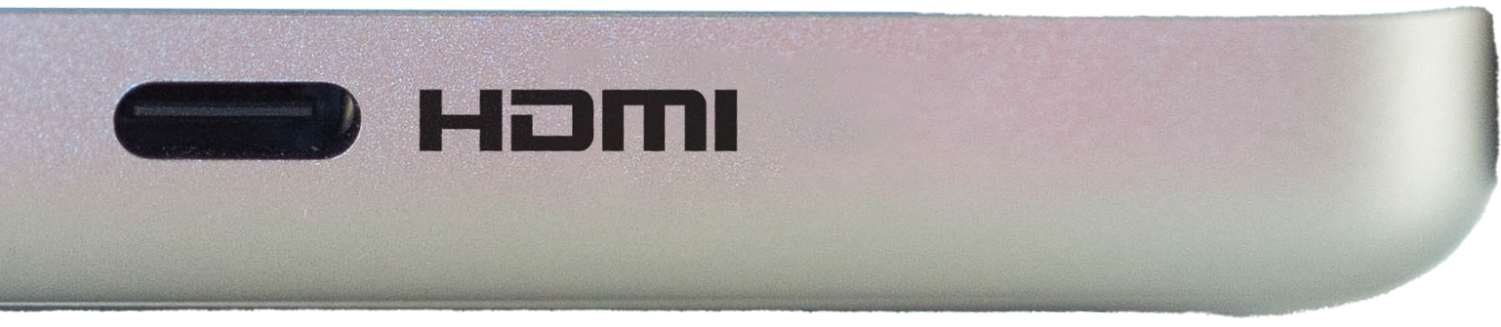
Compatibility With Other Technology
USB Type-C
DisplayPort
Alternate mode
Uses similar signaling
Allows wires to be remapped
Passive/Active adapter required
Allows support for non-USB data
Does not support ARC/eARC
ITFreeTraining.com
© Copyright 2024
Notes:
25:38 In some cases, you may need to use HDMI with other connector types. One connection that is becoming very common is the USB Type-C connection. With USB4, Type-C will be the preferred connection, so it is very likely this connection is not going away, well at least not for a very long time.
In order to support HDMI, Type-C uses what is called Alternate mode. Alternate mode essentially allows the wires to be remapped inside the cable. For example, wires that would normally be used for backwards compatibility with USB 2 can be remapped to be used with HDMI. This allows support for non-USB data.
Essentially what occurs is, the connection detects that HDMI is on the other side and sends a HDMI signal. This means that both sides need to support HDMI. What is basically happening is, the two devices are communicating with each other and agreeing what data to send over the cable. Although Alternate mode is primarily used for Type-C connections, essentially the cable used is irrelevant. If both sides support Alternate mode, both sides will communicate with each other and work out what signal to send. Thus, the cable could have a Type-C connection on both sides or a Type-C on one side and a HDMI connection on the other side. The main takeaway is, both sides need to support HDMI and support Alternate mode.
Alternate mode also supports other technologies like DisplayPort and Thunderbolt. In order to understand which technology your port supports, hopefully it will have a logo. Not all ports will have a logo next to them telling you what it supports. In some cases, the same port may support multiple technologies. If you are not sure, you can always give it a try, you won’t break anything by trying it, it simply may not work.
The next technology that is commonly supported with HDMI is DisplayPort. You will find cables and adapters on the market that have a HDMI connector on one side and DisplayPort on the other. DisplayPort and HDMI use similar signaling. Although the signaling is similar, the protocol and the voltages are different. This means a passive or active adapter is required.
A passive adapter essentially performs some voltage conversion and wire remapping. They are simple little chips that are hidden away in the cable. Since they don’t do any protocol conversion, the other side still needs to support HDMI. Essentially you are plugging in a HDMI signal into a DisplayPort. The DisplayPort then needs to recognize it is receiving HDMI and change itself to a HDMI port. You will find that some devices will support this and others not. Once again, you won’t break anything if you try it, it just may not work.
Active adapters have more electronics in them. They can perform more sophisticated signal conversion, however, don’t change the protocol. Active adapters will also strengthen or recreate the signal. This is useful if you are running the cable over a long distance. If you are purchasing a long cable, it is a good idea to get one with an active adapter in it as they are more reliable over longer distances.
At one stage, from a technology standard point, DisplayPort was ahead of HDMI, however, with revisions of HDMI both standards support pretty much the same features nowadays. The major difference between the two is that DisplayPort does not support ARC. If you need to use ARC, you will need to use HDMI. This is probably the main reason you see HDMI used mostly for home entertainment and DisplayPort more often used for computer equipment. You don’t really see DisplayPort used for home entertainment.

Slide 10

In The Real World
Not all cables are created equal
Premium
Supports 4k resolution
If supports Ethernet supports eARC
Ultra High Speed
Up to 8k
Adds eARC
All cables and versions are backward compatible
ITFreeTraining.com
© Copyright 2024
Notes:
29:05 There has been a lot covered in this video, so let’s have a look at the major points to assist you using HDMI technology. The first point to remember is, not all cables are created equal. With cables, a lot of the time you get what you pay for. If you are purchasing a cable, be aware, there are a lot of counterfeit cables on the market that claim to be high-quality but they are not. If you purchase one of these cables, it will probably work with low resolutions, but once you start increasing the data being transferred through the cable, don’t expect too much from it.
In order to assist the customer understand what they are purchasing, the HDMI forum came up with a certification program. The main two to look for nowadays are Premium and Ultra-High-Speed. There are other certifications that came before those which use different logos, however, these previous certifications did not include a hologram or barcode. Thus, there was no way to check what you were purchasing.
The premium cable supports 4k resolution at 60Hz, so for the current market it will support most people’s needs. Premium specification includes ARC support but not eARC. If the premium cable supports Ethernet, it also supports eARC. Technically all HDMI cables should support ARC, but if you purchase a very cheap HDMI cable, you may have problems.
Ultra-high-speed cables support more bandwidth than premium cables. Thus, they support up to 8k resolution. Ultra-high-speed also adds support for eARC. It does this by adding additional shielding. This is the same shielding required to run Ethernet. Thus by adding eARC, it also adds Ethernet support. It is, however, possible to have a premium cable that supports eARC. Let’s have a look.

Slide 11

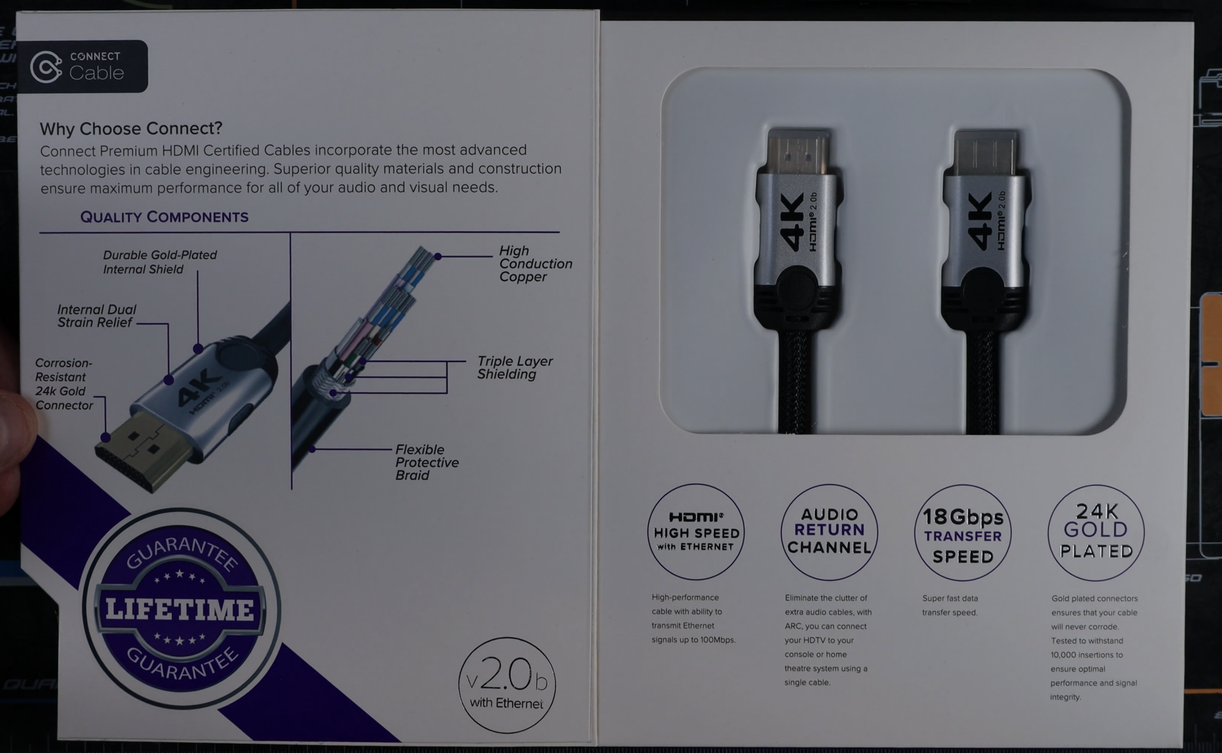
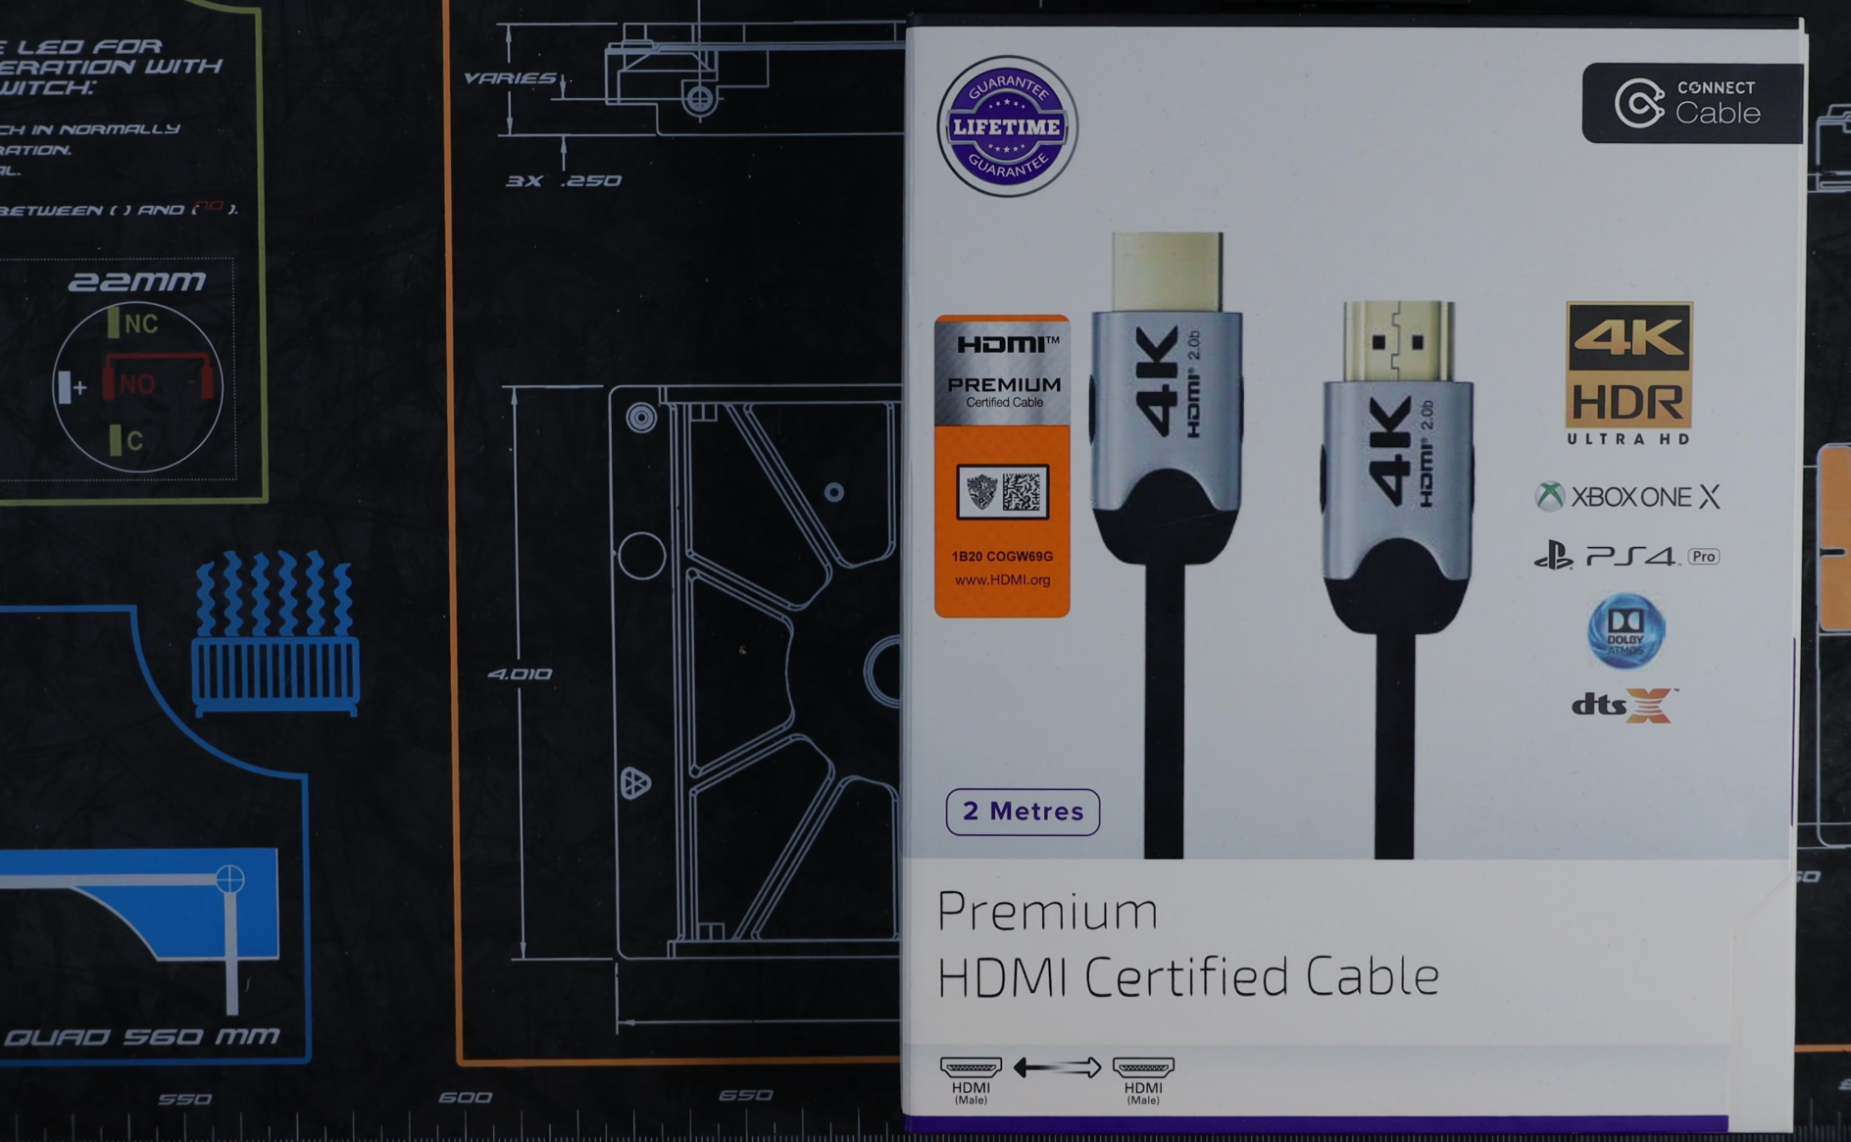
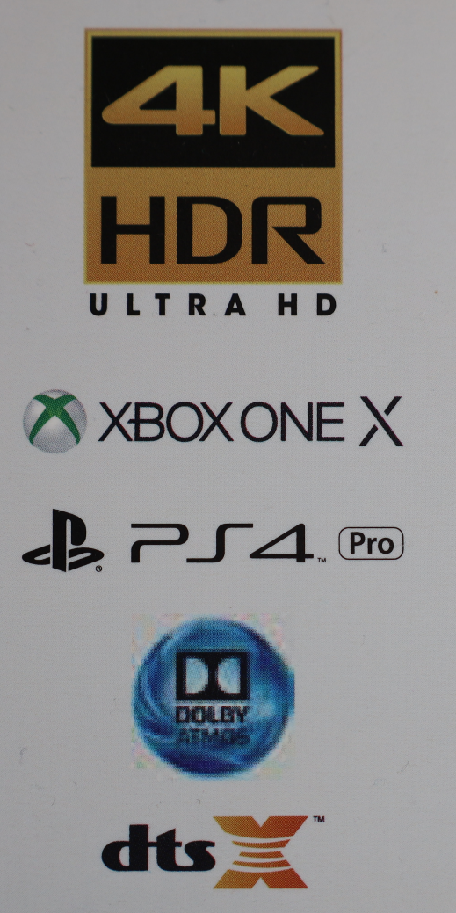




In The Real World
Sub-versions mean nothing
Audio Return Channel
Audio reverse direction
Buyer's guide
Ethernet support
4K support
Oxidation resistant
Thus, eARC supported
Excellent conductor
ITFreeTraining.com
© Copyright 2024
Notes:
30:46 This is an example of a certified premium cable. It has the Premium logo with barcode and hologram. Thus, it is unlikely to be a counterfeit product. On the front is some information to assist the buyer determine what the cable can be used for. Cables are not designed with a particular device in mind. Thus, this information is there to assist the buyer in purchasing the right one.
To get a better idea what sort of cable this is, inside the cover is additional information. Of interest is the version number the cable was designed to support. Keep in mind that the letters a, b, etc. mean nothing. Newer versions of HDMI support more features, however, this does not change anything about the design of the cable. Thus, when you see letters after the version number you can ignore them.
Notice that there is a logo for Audio Transfer Channel or ARC, essentially the channel that allows audio to travel in the reverse direction. Although all HDMI cables should support ARC, manufacturers like to put logos like this on their products to make them more appealing to the buyer. When the product does not say ARC is supported, the buyer may assume it is not supported and therefor buy a competitor’s product instead.
This cable supports Ethernet and thus has additional shielding in the cable. Since Ethernet and eARC use the same channel, this means this cable also supports eARC.
The speed of this cable is listed as 18 Gigabits per second. If you can’t find a lot of information about the cable itself, often the speed the cable supports will give you an idea of what it supports – 18 Gigabits per second is enough for basic 4K resolutions. For any more than that, you will need an ultra-high-speed cable supporting speeds of 42 Gigabits per second.
Lastly, the cable has gold plated connectors. These connectors are more oxidation resistant, meaning that they are more resistant to rusting. Gold is also an excellent conductor, so generally gives a better result than a different connector type like tin, however, gold connectors do cost more.

Slide 12
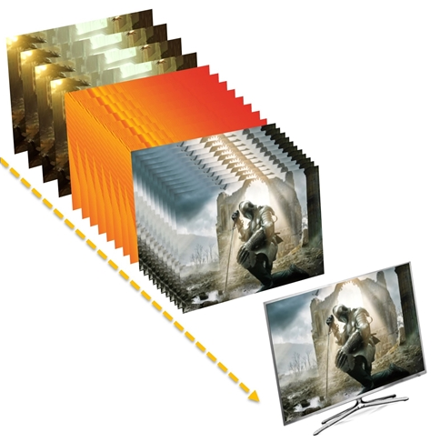


In The Real World
All HDMI features are optional
Don’t assume a device supports that feature
Check features before purchase and compatibility between devices
ITFreeTraining.com
© Copyright 2024
Notes:
32:45 The last point to consider is that all HDMI features are optional. Don’t assume that your device supports a particular feature just because it is designed with a particular version of HDMI in mind. Before you purchase a device, check it supports the features that you want and also that it is compatible with any other devices that you want to use it with.

Slide 13

Subscribe
Next video
Video content: https://ITFreeTraining.com/ap11/1a20
© Copyright 2024
Notes:
33:05 That concludes this video on HDMI from ITFreeTraining. I hope you have found the video informative. Until the next video from us, I would like to thank you for watching.
References
“The Official CompTIA A+ Core Study Guide (Exam 220-1101)” pages 21 to 22
“HDMI” https://en.wikipedia.org/wiki/HDMI
“Variable Refresh Rate” https://www.hdmi.org/spec21sub/variablerefreshrate
“HDMI” https://www.hdmi.org/blog/detail/129
“Picture: Film strip” https://pixabay.com/illustrations/fall-autumn-leaves-seasonal-movie-1673041/
“Picture: Audio equalizer” https://pixabay.com/vectors/equalizer-beat-music-sound-audio-153212/
“Picture: Speaker” https://pixabay.com/vectors/speaker-loudspeaker-audio-156844/
“Picture: Copyright theft” https://pixabay.com/illustrations/copyright-stealing-asset-bag-3197524/
“Picture: Copyright and chain” https://pixabay.com/vectors/lock-chain-copyright-protection-6806514/
“Picture: Remote Control” https://pixabay.com/vectors/electronics-infrared-ir-remote-2029563/
“Picture: Kitten” https://pixabay.com/photos/cat-flower-kitten-stone-pet-2536662/
“Picture: Chroma subsampling” https://en.wikipedia.org/wiki/Chroma_subsampling#/media/File:Colorcomp.jpg
“Video: Cat Video” https://pixabay.com/videos/cat-sleeping-rest-pet-kitten-2449/
“Video: Cat looking around” https://pixabay.com/videos/cat-head-game-black-eyes-close-up-4915/
“Video: Birds flying” https://www.pexels.com/video/a-flock-of-seagulls-flying-over-a-body-of-water-3324489/
“Picture: Headphones” https://www.pexels.com/photo/white-wireless-headphones-3394662/
“Picture: Car” https://www.pexels.com/photo/red-alfa-romeo-c4-on-road-near-trees-210019/
“Picture: HDMI connectors” https://upload.wikimedia.org/wikipedia/commons/4/42/HDMI_Connector_Types.png
“Picture: 4k Logo” https://commons.wikimedia.org/wiki/File:TVBS_4K_LOGO.jpg
“Picture: 1080p ready” https://commons.wikimedia.org/w/index.php?search=1080p&title=Special:MediaSearch&go=Go&type=image
“Picture: Question mark” https://www.pexels.com/photo/question-marks-on-paper-crafts-beside-coffee-drink-5428834/
“Video: PS5 Death Stranding Director Cut gameplay” https://www.youtube.com/watch?v=WnfTgS1dhC8
“Video: Army helicopter” https://pixabay.com/videos/soldiers-military-army-helicopter-446/
“Picture: Laptop” https://unsplash.com/photos/M_DMDRj0IuQ
Credits
Trainer: Austin Mason TFreeTraining.comVoice Talent: A Hellenberg https://www.freelancer.com/u/adriaansound http://I
Quality Assurance: Brett Batson http://www.pbb-proofreading.uk

