Slide 1
Notes:
Let’s have a look at how to pass the A+ exam.

Slide 2
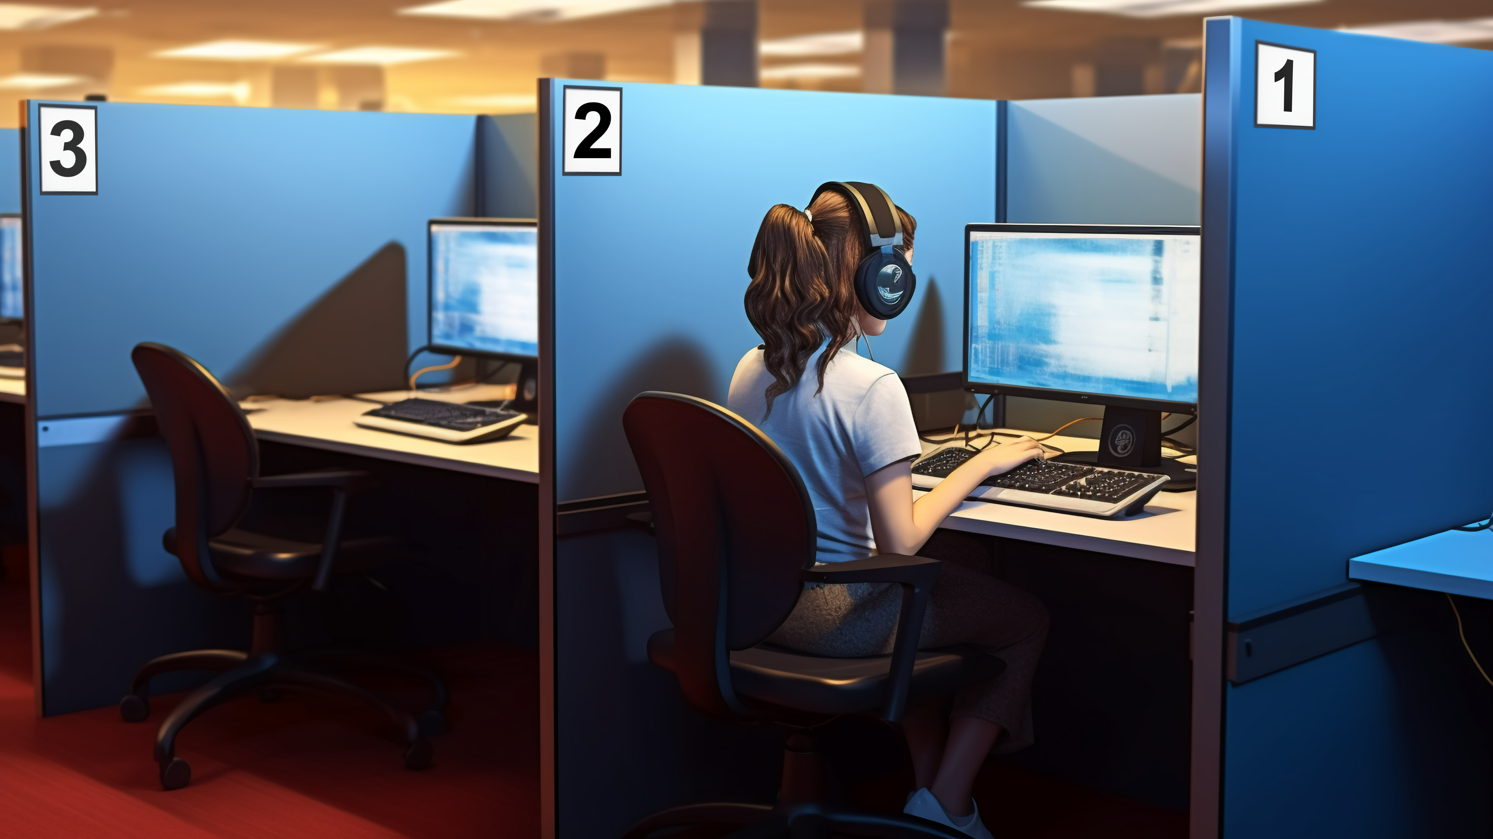
Exams
Pass two exams to get A+ certification
Can be passed in any order
Must be passed before retirement date
Retirement generally 3 years (Released date 20 April 2022)
220-1101 Core 1
Mobile Devices 15% Networking 20% Hardware 25% Virtualization and Cloud Computing 11% Hardware and Network Troubleshooting 29%
90 minutes. Maximum 90 questions 675 (on a scale of 100-900)
220-1102 Core 2
Operating Systems 31% Security 25% Software Troubleshooting 22% Operational Procedures 22%
90 minutes. Maximum 90 questions 700 (on a scale of 100-900)
ITFreeTraining.com
© Copyright 2024
Notes:
00:03 In order to get your A+ certification, you are required to pass two different exams. Previously, the exams were called “Hardware” and “Software”. The exams are now called “Core 1” and “Core 2”.
The first exam is 220-1101. You can see from the context that it is mostly hardware, but also covers topics like cloud and networking. This is probably why CompTIA dropped hardware from the title, as the exam context has become more diverse and goes beyond just covering hardware.
The second exam is 220-1102 or Core 2. This has more of a software focus but does also cover topics like operational procedures. Thus, you can understand that, although it focuses on software it covers more than just software.
You need to pass both exams, however, they can be passed in any order. There is no time limit between exams; however, you will need to pass both by the retirement date of the exam. At the time this video was created, the retirement date had not been set.
The CompTIA A+ certification is designed to validate your foundational knowledge and skills in IT. It is recommended for someone with 12 months of hands-on experience. It will be easier to pass if you have some knowledge of computers.
There is nothing stopping you from sitting the exam with no experience, in an attempt to get into the industry, but I would recommend that you set up a home lab to test out the topics in the course. This will give you a better understanding of how to support computers. Watching videos and reading books will unfortunately only get you so far.

Slide 3
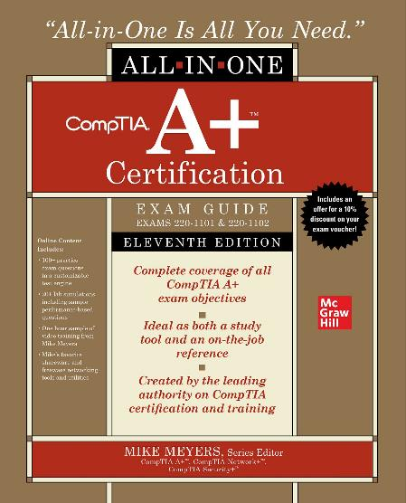
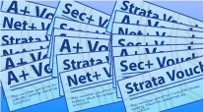
What you need
Course
ITFreeTraining
Available for free on YouTube
YouTube.com/ITFreeTraining
Reference
Mike Meyers
CompTIA A+ Certification All-in-One Exam Guide
Questions
Total Seminars
totalsem.com
ITFreeTraining.com
© Copyright 2024
Notes:
01:46 To get started, I would recommend a course like this one. There are other courses, both free and paid for, that you may also want to consider. We hope to get this course completed, but it all depends on funding.
Completing a course will give you a lot of information, but I would also get a good reference book. Once you think you are ready for the test, try some practice exam questions. This will give you an idea of how ready you are and if there are any topics that you need to work on more.

Slide 4
How long will it take?
Depends when you are ready to take the exams
Prior knowledge
Study commitment
ITFreeTraining.com
© Copyright 2024
Notes:
02:16 Many people ask how long it will take. This comes down to when you are ready to sit the exams and varies from person to person. The biggest two factors are prior knowledge and study commitment. If you have previously obtained your A+, and you’re just adding what is new to your knowledge, it should be a lot faster for you the second time around. How much time you spend studying and preparing will make a big difference. It is hard to find the time sometimes. Often, I will use dead time, such as traveling on public transport, to watch videos to increase my knowledge. The main thing is that once you start, keep consistently working on your preparation until you are ready to take the exam. If you start and stop all the time, in my opinion, it makes it harder.

Slide 5
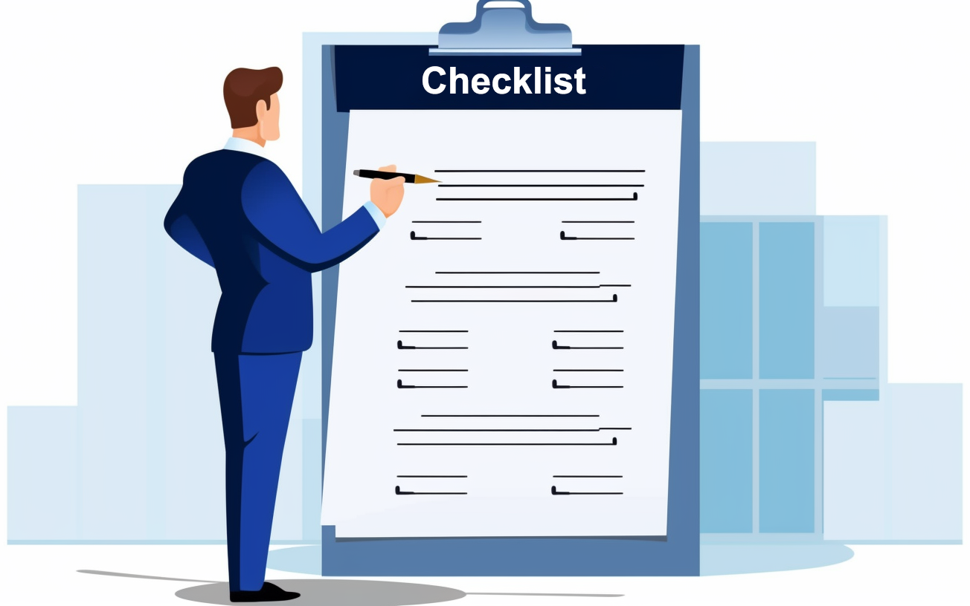
Download exam objectives
Available from CompTIA website
https://www.comptia.org/
Subject to change
Tick off what you know
ITFreeTraining.com
© Copyright 2024
Notes:
03:03 You should also consider downloading the exam objectives. These are available from the CompTIA website. The exam objectives are subject to change. Hopefully they won’t change, but it is possible for minor changes to occur. Have a look and make sure you have covered everything.
I personally go through the exam objectives and tick off the ones that I know. If I find that there are ones that I don’t know, I will study up on those exam objectives. This forms a good final check for me before sitting the exam to make sure I have covered everything.

Slide 6
Taking the exam
ITFreeTraining.com
© Copyright 2024
Notes:
03:36 When you are ready to take the exam, you will need to book it. To do this, go to the CompTIA web site, select “testing” and select “in-person” or “online” exam. In this case, I will select in-person. I will have a look at the online option in a moment.
There is a link to the testing policies on this page. It is not a bad idea to read through them. There are some accommodations if English is your second language, and the test is not available in your native language in your area.
Read through the other information on this page. CompTIA recommends that you arrive 15 minutes early for the test. The test center has some administration that needs to be completed before you can sit the test. This will give you enough time to complete it.
You are required to bring two forms of identification. Have a look at the ID policy to make sure that you have the right documents.
Also, you will not be able to bring any personal items into the testing room. This includes mobile phones and other devices. The test centers usually have some lockers, but not always. I have seen some testing centers that have pigeonholes for your items. So don’t take anything valuable with you if you don’t need to.
A photograph will also be taken when you check in for your examination. This photo will also be printed on your results when you complete the examination.
I will now go up to the top, and under testing, select the option “Online Exams”. Online exams were made available during Covid and it looks like they are staying around. If you prefer to do the test at home or can’t access the test center, this is an option.
There are a few things you need to know if you decide to use the online option. Firstly, you will need to perform a system test of your computer to make sure it meets the requirements. You can do this any time before the exam. I recommend you do it early on so you can fix any problems you may find.
The area where you do the exam will also need to be ready. This means removing any books and writing objects that are in arms reach. You can only have one monitor, so you will need to disconnect any additional ones.
Before you start the examination, they will ask you to spin the camera around so they can check the area around the computer. They also want to make sure you don’t have any text you can see, such as whiteboards or writing on the walls. When they first started online examinations, they had a requirement that you had to have a mirror behind you, but that does not seem to be required anymore.
The testing software also requires a minimum resolution and the scale should be set to 100%. When you run the test software, it will give you a test question so you can test your setup. It is important to get this right so you can easily read the questions. You don’t want to lose marks because you can’t see part of the question.
I will now select “system test” to test my system to see if the exam software will work on my computer. I first need to tick the box “I confirm that on my exam day I will be using this exam testing space, and internet connection”. Essentially, you are testing the computer and connection you are going to be using. If you change computers before the exam, you will need to run the connection test again.
You will notice the message about being behind a corporate firewall. If you do the exam at work, you may find your company’s firewall may block the connection. Also, virtual private networks or VPNs should be shut down before the test. This includes virtual machines. Before the test, you should close any other applications that are running. The exam software will scan for other software that is running; some software will be required to be shut down before the exam software is run.
You will notice there is an access code on the left-hand side. You will be required to enter this into the exam software. Next, download the software and run it. The next part can’t be recorded because it is test software and it blocks the recording, but I will have a look at what you need.

Slide 7
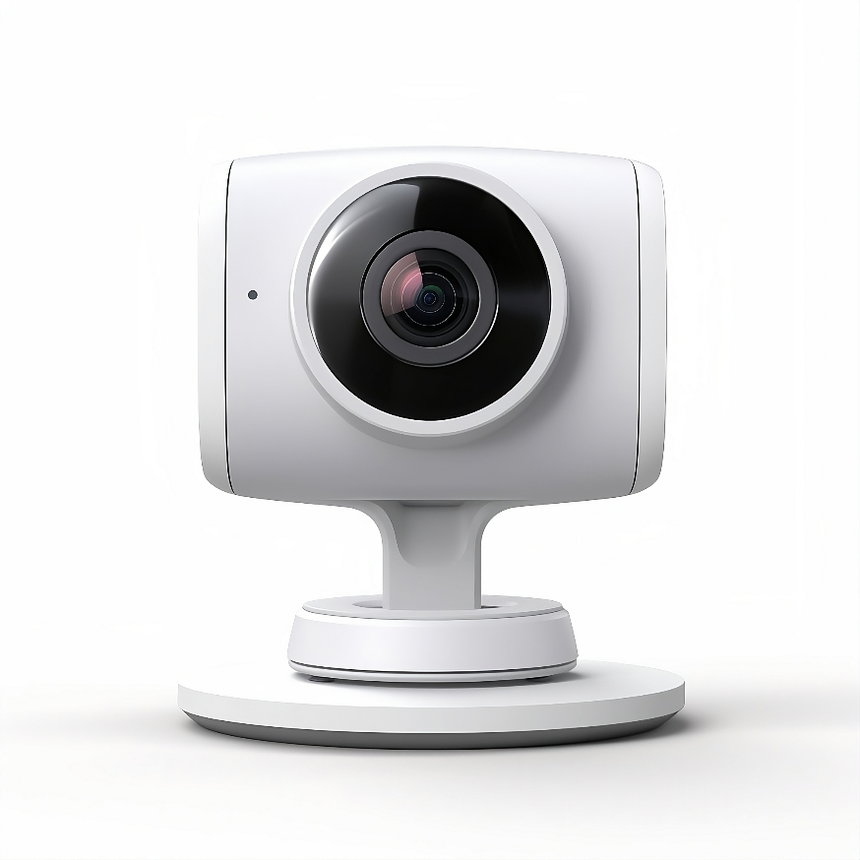
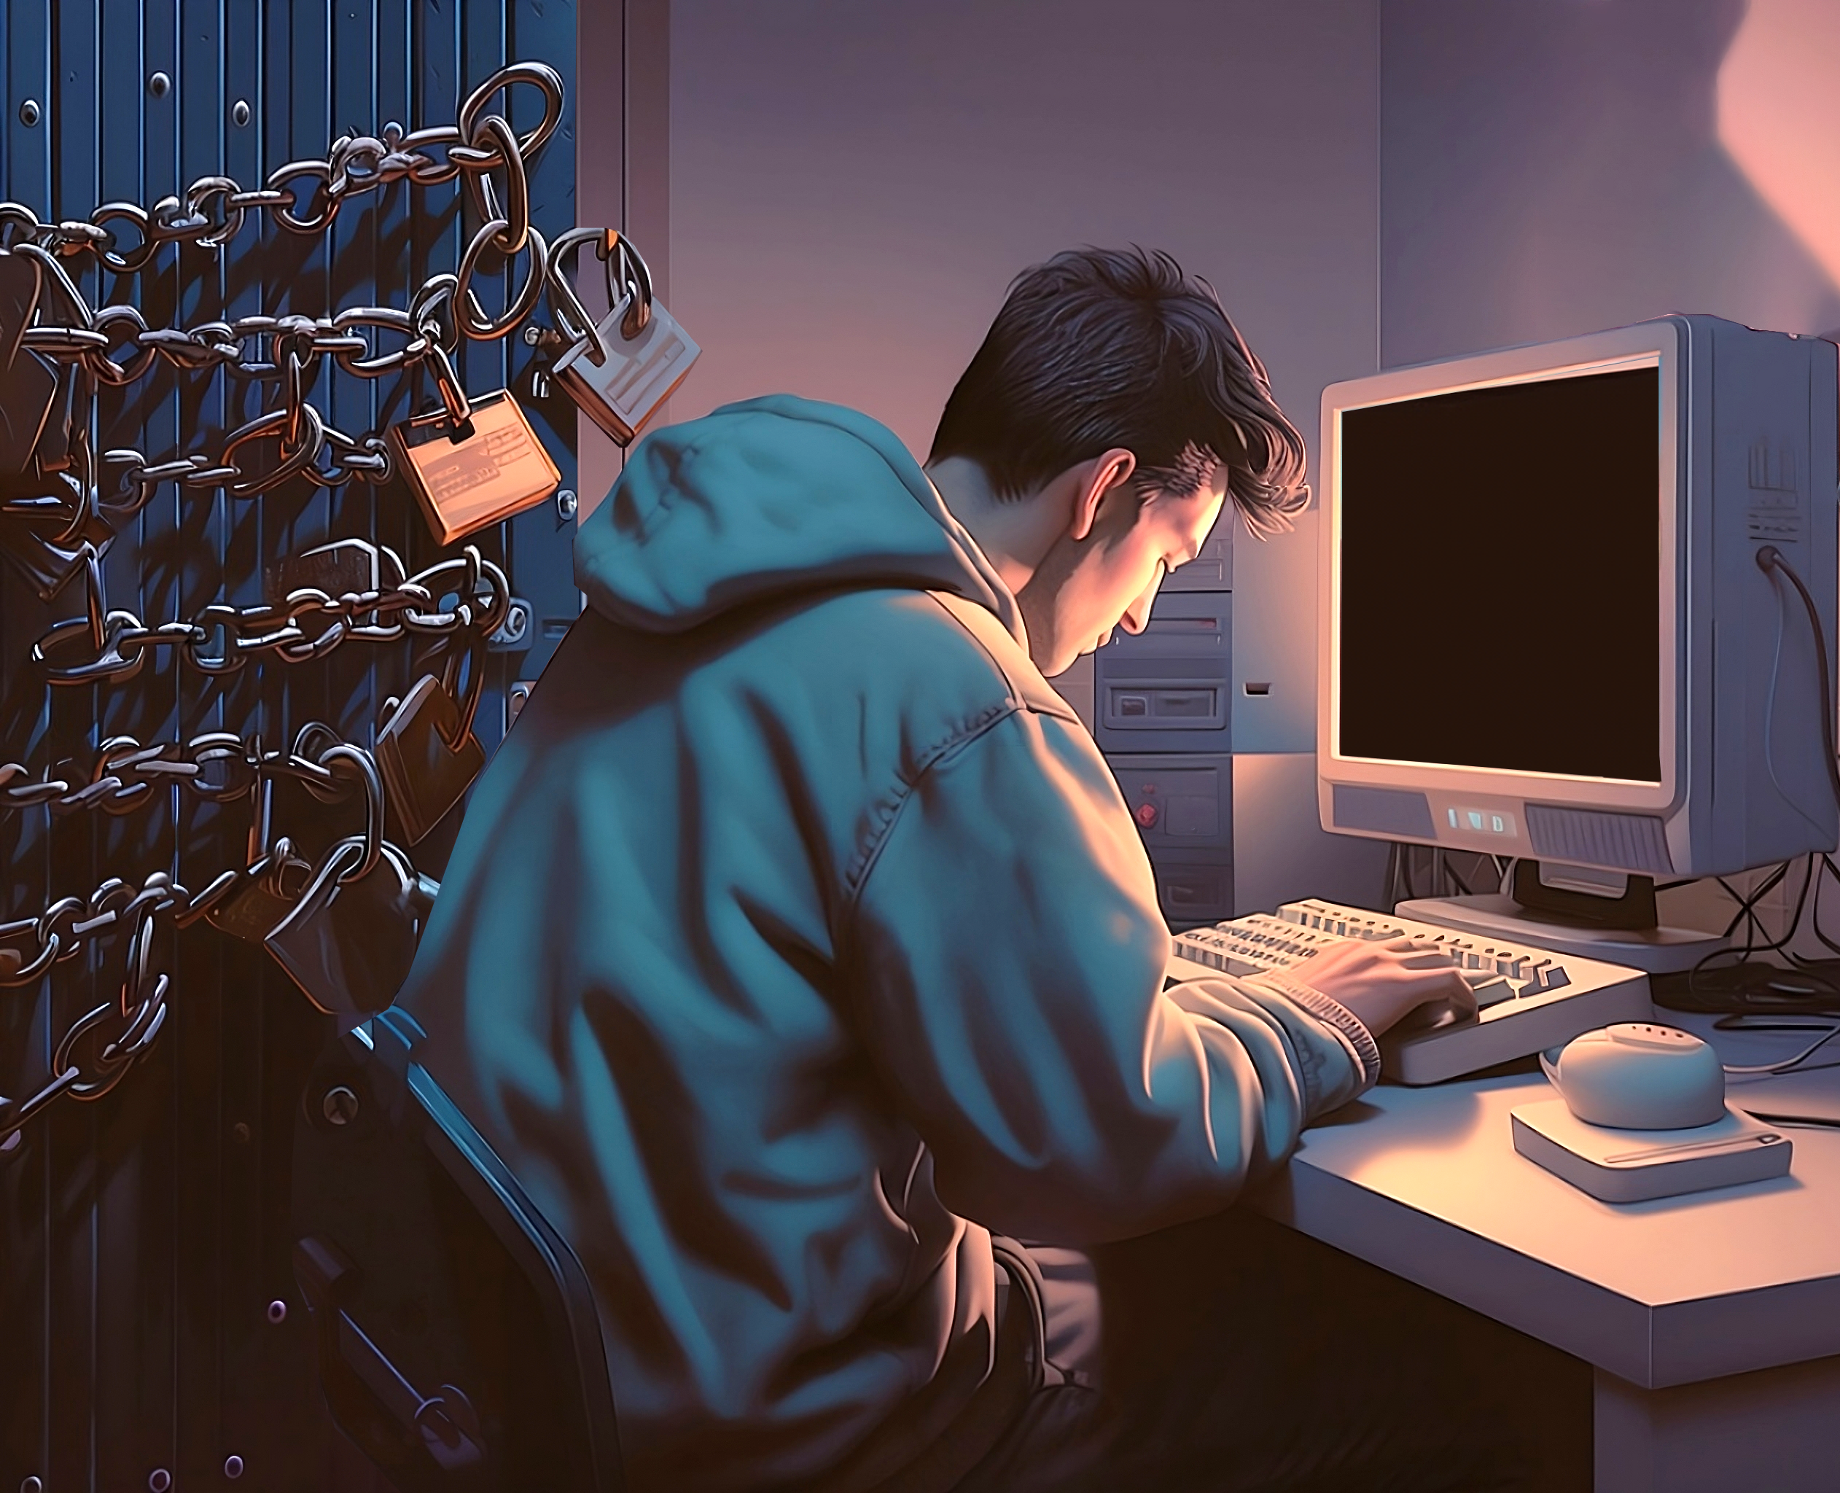
Online Exam
Microphone
Webcam
Quiet place
Reliable internet
Needs to be quiet. No visitors
No reading exam questions out loud
Can’t walk around, remain seated
Clean desk. No paper or books you can reach
ITFreeTraining.com
© Copyright 2024
Notes:
07:44 To do the online exam, you will need a microphone, web cam, a quiet place and reliable internet. The microphone will record audio during the exam. This is to make sure that you are not talking to someone and getting them to help you. The place you do the exam should be quiet and you should have no visitors while you are doing the exam. They monitor you using the microphone and webcam and if they see or hear something suspicious, they may not release your results. Best if you do the exam at home, tell everyone you live with, you are doing a test and then lock the door while you are doing it.
Since they are listening to the audio, don’t read the exam questions out loud. This is also to prevent people reading the question in an attempt to capture the exam question.
You will also need to remain seated during the exam. Don’t get up and start walking around. You will also need to clean your desk. You can’t have paper or books where you can reach them. When they first start the exam, they will get you to pan the camera around the room. So don’t think you can place anything off camera where they can’t see it. I will now look at some exam strategies to help you pass the exam.

Slide 8
Example exam question 1
What is the biggest reason to create a sandbox using a virtual machine?
A) To isolate internet applications so malware does not infect your computer
B) To isolate test software from yours and other computers
C) Better use of computer hardware
D) More efficient use of memory
Answer: B
Read the question carefully
Eliminate wrong answer
ITFreeTraining.com
© Copyright 2024
Notes:
08:57 I think the best way to understand exam strategies is to have a look at a few exam questions, which we will go through now and see how I would answer them. “What is the biggest reason to create a sandbox using a virtual machine?”
The first thing to do is read the question carefully. CompTIA is well known for making exam questions that are a little vague and easy to misunderstand what the question is asking. I will next go through the question and eliminate wrong answers. There are generally one or two answers that are clearly wrong.
To understand which answer to eliminate first, have a think about what the question is asking. In this case it is asking about sandboxing using virtual machines and the biggest reason to use virtual machines.
A sandbox refers to an isolated and controlled environment that allows you to run and test software, applications or processes without affecting the rest of the system. It is where you do your testing in an isolated environment, so it can’t break anything else on your computer or the network. A virtual machine is an emulation of a physical computer. They can be quick to create and can be configured to run isolated from your computer and the network.
Upon reviewing the answers, it's evident that option C is incorrect. The primary purpose of sandboxes is isolation; optimizing hardware usage is not a foremost consideration in this context. While virtual machines offer more efficient use of hardware, the focus here is on sandboxing as the main reason for employing virtual machines.
Answer D is also incorrect. Creating a virtual machine will consume more memory since each virtual machine requires its own memory. While one could say that running multiple virtual machines on a single computer is more memory-efficient than operating multiple physical computers, the question is about why you would create a sandbox in the first place. The primary reason for creating a sandbox is not efficient use of memory, it is about isolation.
By ruling out two options, we've narrowed down the possibilities to just two answers, giving us a 50% chance of selecting the correct one.
The final two answers include the concept of isolation, which is a key reason for creating a sandbox. Examining the first response, it suggests using a sandbox to isolate internet applications to prevent malware from infecting your computer. While this is a valid approach and one that I have utilized to test internet applications, there is a caveat: if malware infects the virtual machine, it could potentially spread to other computers on the network. Typically, when setting up a sandbox with internet access, it will be connected to its own internet connection and run on a separate computer, either physically on that computer or as a virtual machine on that computer, that is, it is not running on your computer. Running an internet application in a virtual machine that is connected to your computer defeats the reason for sandboxing the application in the first place. If this was the only answer left, I would select this answer since it mentions isolating and it is better than nothing, but there is a better answer. Remember, it is always the best answer you want. So, before you choose an answer, make sure there is not a better answer available.
The next answer isolates the software for testing, ensuring it doesn't impact your computer or others. The primary purpose of establishing a sandbox is indeed to achieve isolation. This response emphasizes that the sandbox is designed to prevent access to and have any interaction with other computers, thereby safeguarding them from any potential problems.
You could argue that answer A isolates to a certain degree, but when doing these questions think which is the best answer. The best answer here is answer B. Although answer A isolated the application
the fact it has an internet connection and is running on your computer means it is not the best answer. Malware could infect your computer and any other computer connected to the same network. Answer B it is.

Slide 9
Example exam question 2
In a computer system, which crucial element aids in the dynamic handling of data required for the system's ongoing operations?
A) Central Processing Unit (CPU)
B) Graphic Processing Unit (GPU)
C) Hard disk
D) Memory module
Answer: D
You can mark the question and come back if you need to
Mark
Marking allows you to revisit the question later
ITFreeTraining.com
© Copyright 2024
Notes:
13:09 You will get at least a few questions which just test if you know something. If you have done your study, hopefully it covers the topic. However, read the question carefully because sometimes an answer may look correct, but there is a better one.
The question here is, “In a computer system, which crucial element aids in the dynamic handling of data required for the system's ongoing operations?” I could select CPU as this is crucial to handling of data in the computer. But, read the question again – the question says aids. Since the CPU processes data, it is asking what aids the CPU.
Since GPUs can process data nowadays, you could argue it assists with data processing. Maybe there is a better answer.
A hard disk could also be used to supply data to the computer. When I read the question, I look for keywords. The keywords here are: crucial, dynamic and ongoing operations. You could run a computer without a hard disk so I would not call it crucial. Although you could use a hard disk for dynamic data access, it is not going to be very fast, so it is not really the best for ongoing operations. When I consider it against the keywords of the question, you can see it is not a good answer.
Answer D, memory modules, are designed to hold dynamic data. They are a crucial element of the computer since the computer won’t start without them. They assist with the dynamic handling of data for the computer and are used for ongoing operations. You can see answer D matches everything the question is asking, so the answer is D.
If you're unsure of an answer during the exam, you have the option to flag the question for review. The exam software provides a checkbox labeled "mark" for this purpose. By selecting this box, you can easily return to the question later. Personally, when I take exams, I use this feature to flag any question I'm uncertain about or don't know the answer to. After completing all the questions, I revisit and review the ones I've marked.
You don’t want to run out of time during the exam, as you won’t get marks for any questions you did not answer. Thus, I personally prefer to get through the exam first and whatever time I have left, I go over any questions that I marked. If you find that you are spending too long on one question, I would recommend marking it and coming back later.

Slide 10
Example exam question 3
You upgrade a number of components in a computer and find the PSU is no longer supplying enough power. What most likely caused this? (Select two)
A) Installing a card reader
B) Upgrading the graphics card
C) Replacing the network card
D) Upgrading a hard disk to solid state drive
E) Installing more RAM
F) Installing a water cooler
Answer: B and F
ITFreeTraining.com
© Copyright 2024
Notes:
15:45 The next question tests your knowledge but in an indirect way. The question says, “You upgrade a number of components in a computer and find the PSU is no longer supplying enough power. What most likely caused this?” You need to select two options out of six.
When I see a question like this, I ask myself what are they really asking? Since the power supply unit or PSU is no longer able to supply enough power, this tells me a component was added that is drawing a lot of power. So, the question is really asking, which of the answers listed is drawing the most power.
Let’s go through them one by one. A card reader does not use a lot of power, thus it won’t be that one.
Graphics cards tend to consume a significant amount of power. Upgrading the graphics card suggests an increase in power usage compared to the previous model. Therefore, this answer could be correct, unless a more suitable option is presented.
Replacing the network card would mean removing the old network card and putting in a new network card. Thus, the net power gain or loss would probably be very small if any at all. Thus, it won’t be this answer.
Upgrading the hard disk to a Solid-State Drive would mean less power as a Solid-State Drive uses less power than a hard disk. So, it is not this answer.
Installing more RAM will increase the power used by the computer, but memory modules don’t use a lot of power, so it is unlikely to be this option.
Now, installing a water cooler uses a lot of power. Since it does not say replace or upgrade, we can assume there was no water cooler in the computer before. Thus, the water cooler will use a lot of power since it has a radiator that is used to cool the water down. Water coolers use a lot more power than a fan does.
Thus, the most likely answers are upgrading the graphics card, answer B, and installing a water cooler, which is answer F. These answers use the most power, and so are most likely the components causing more draw on the power supply.

Slide 11
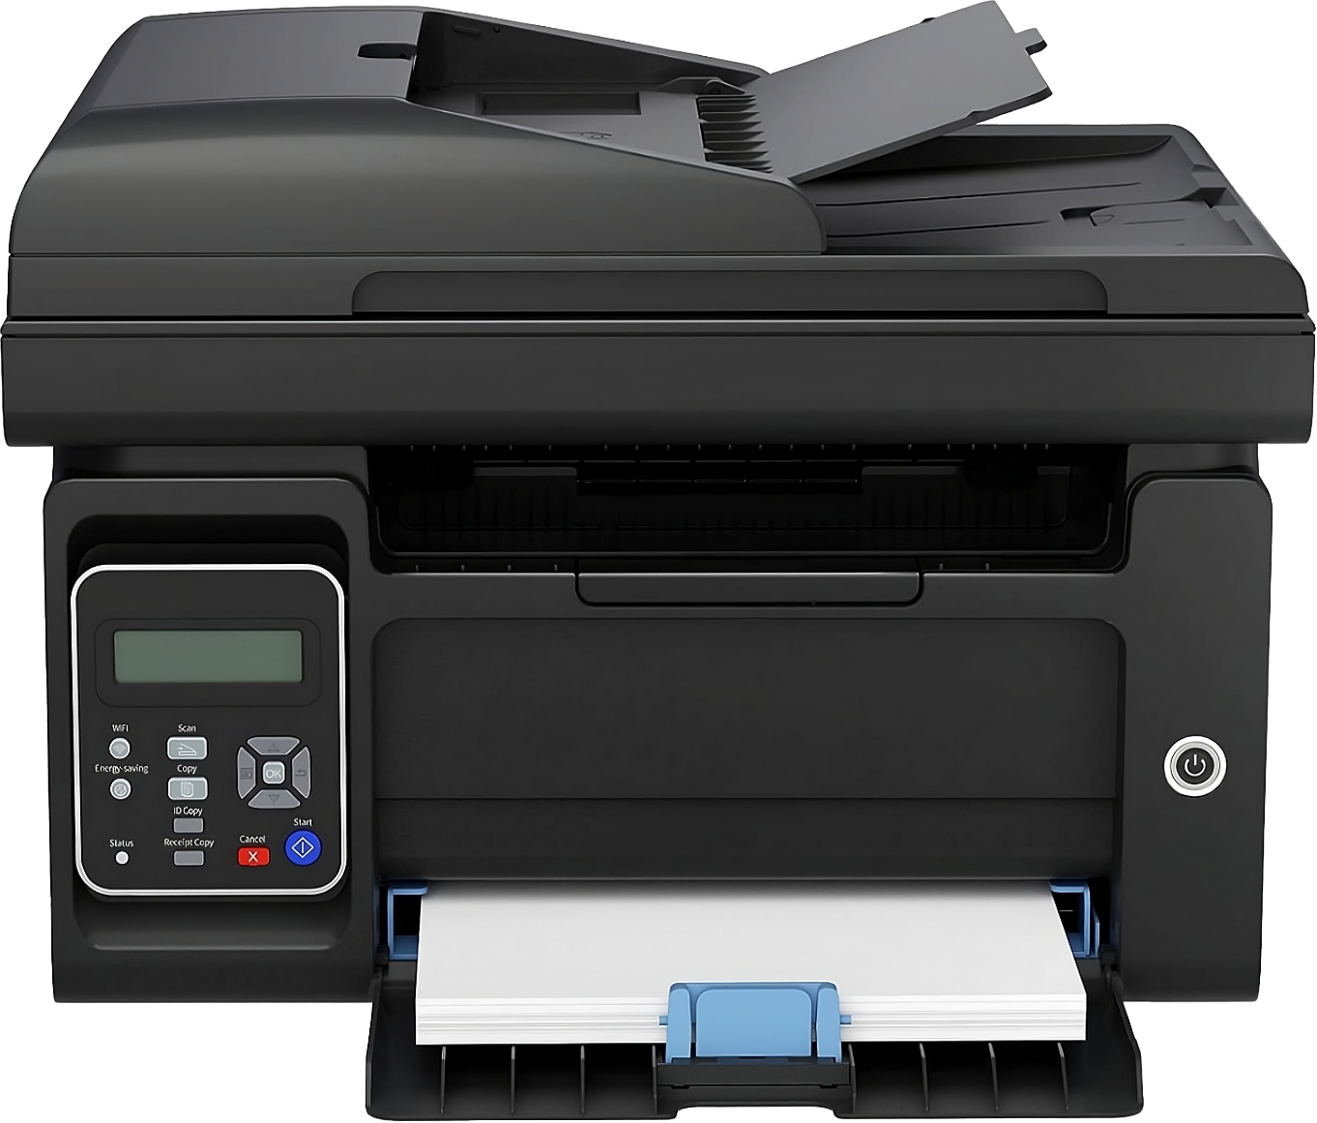
Simulation question
Maybe drag and drop or interactive
Generally, will have a reset option if you need to start again
Generally worth more marks
Duplexer
Drag & Drop
Tray
Ink
Duplexer
Toner
CPU
Tray
ITFreeTraining.com
© Copyright 2024
Notes:
17:48 The examination may have a few simulation questions. These are generally drag and drop or interactive. With drag and drop, you simply need to drag the answer to the correct location. The interactive questions may require you to enter information, for example, network information. In this case, the answer is duplexer and tray.
These questions might present more options than there are spaces to place them. Also, sometimes some options may be used more than once. It is important to read the question carefully and see what it is asking you to do.
The question will generally have a reset option, so if you need to start again, press it and it will reset the question. These questions are generally worth more marks than other questions. People utilize different strategies for these questions. Some will mark them and come back at the end of the exam using whatever time they have left. Some will complete these questions first, since they are worth more marks and therefore want to make sure they have time to do them.
I don’t think there is a right or wrong answer, the only recommendation I would make is, don’t spend too long on these questions. People have been known to spend far too long on these questions and have run out of time to complete the other questions in the exam.

Slide 12
Subscribe
Next video
Video content: https://ITFreeTraining.com/ap11/0015
© Copyright 2024
Notes:
19:05 That concludes this video. If this video helps you pass the A+ exam, let us know in the comments. Until the next video from us, I would like to thank you for watching.
References
None
Credits
Trainer: Austin Mason https://ITFreeTraining.com
Voice Talent: HP Lewis https://hplewis.com
Quality Assurance: Brett Batson https://www.pbb-proofreading.uk

