Slide 1
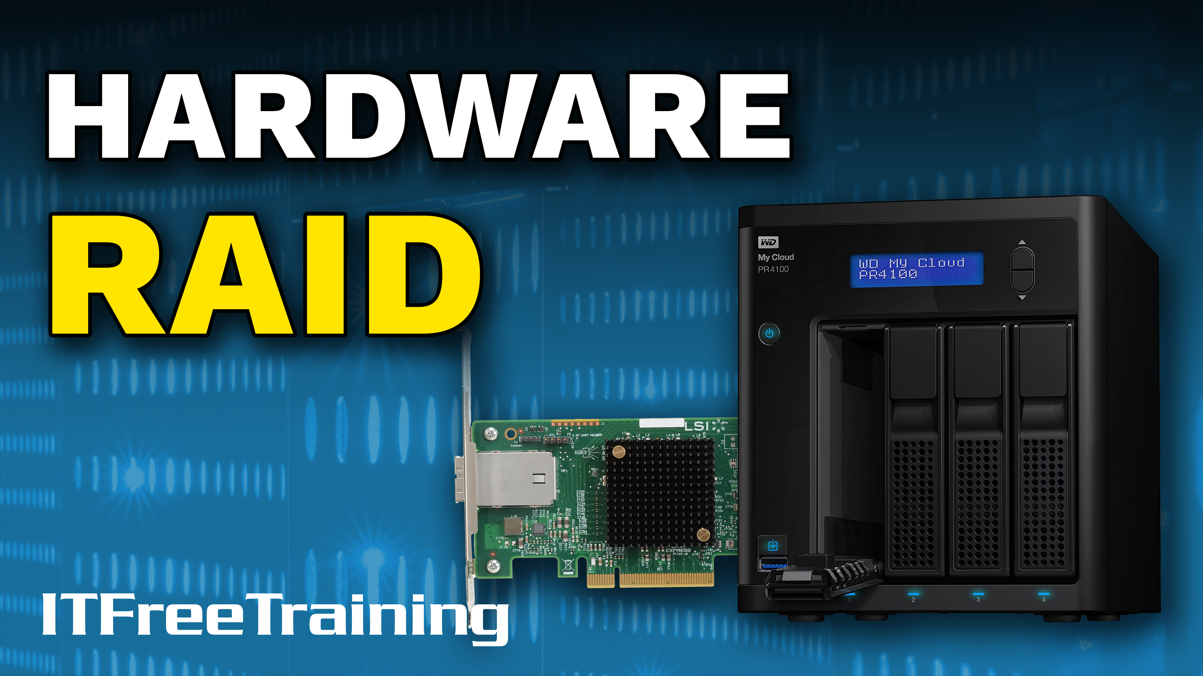
Notes:
In this video from ITFreeTraining I will have a look at how to setup hardware RAID. Hardware RAID allows you to combine multiple storage devices together, so the computer physically only sees the one storage device. RAID can give you better performance and add redundancy, so let’s have a look.

Slide 2
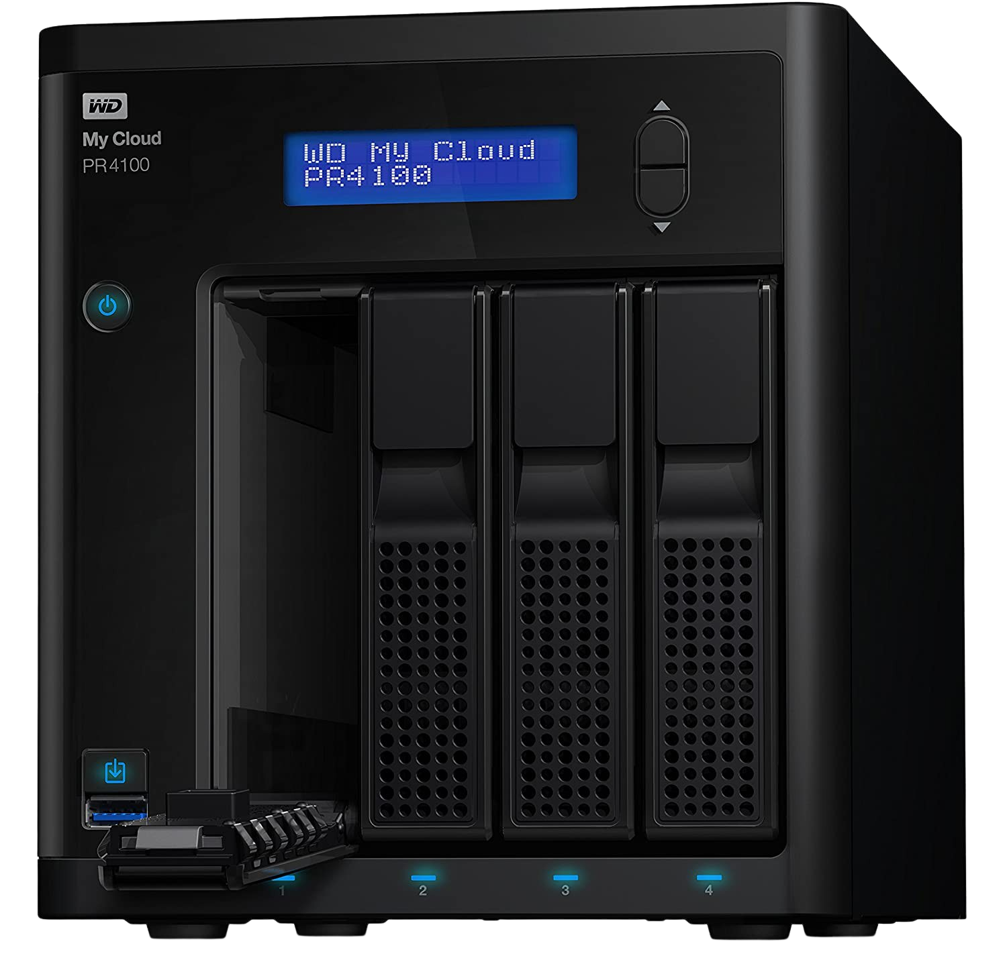
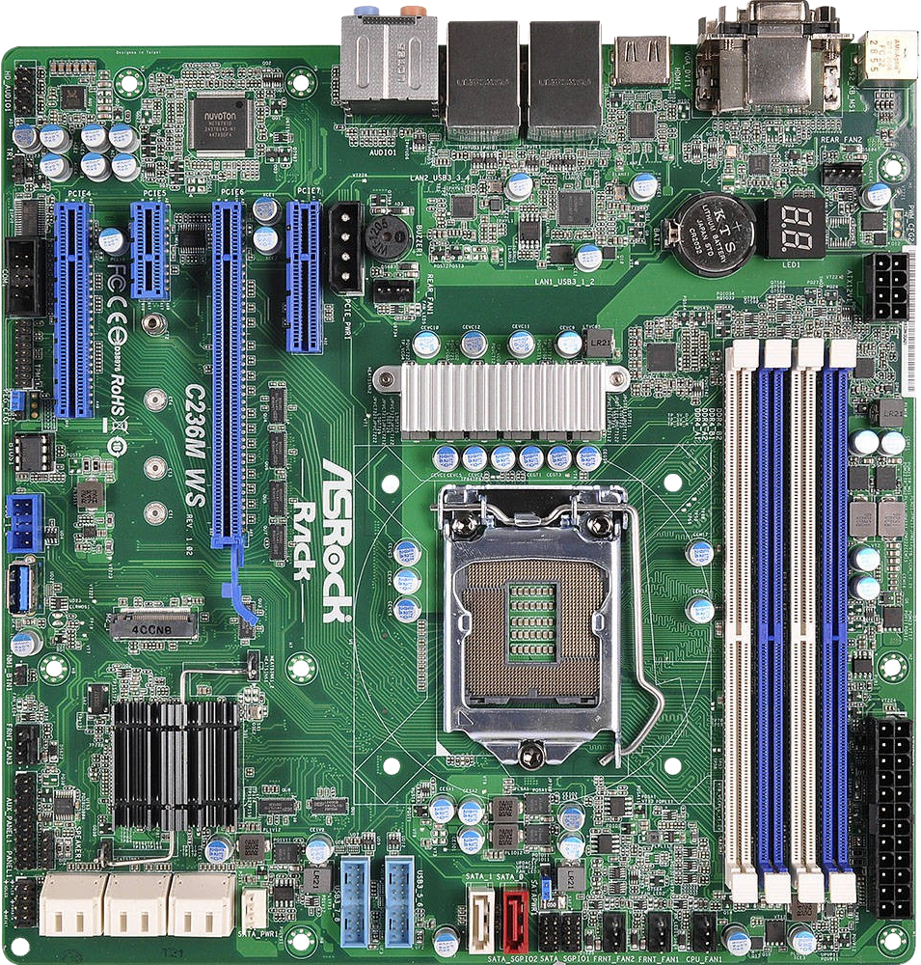
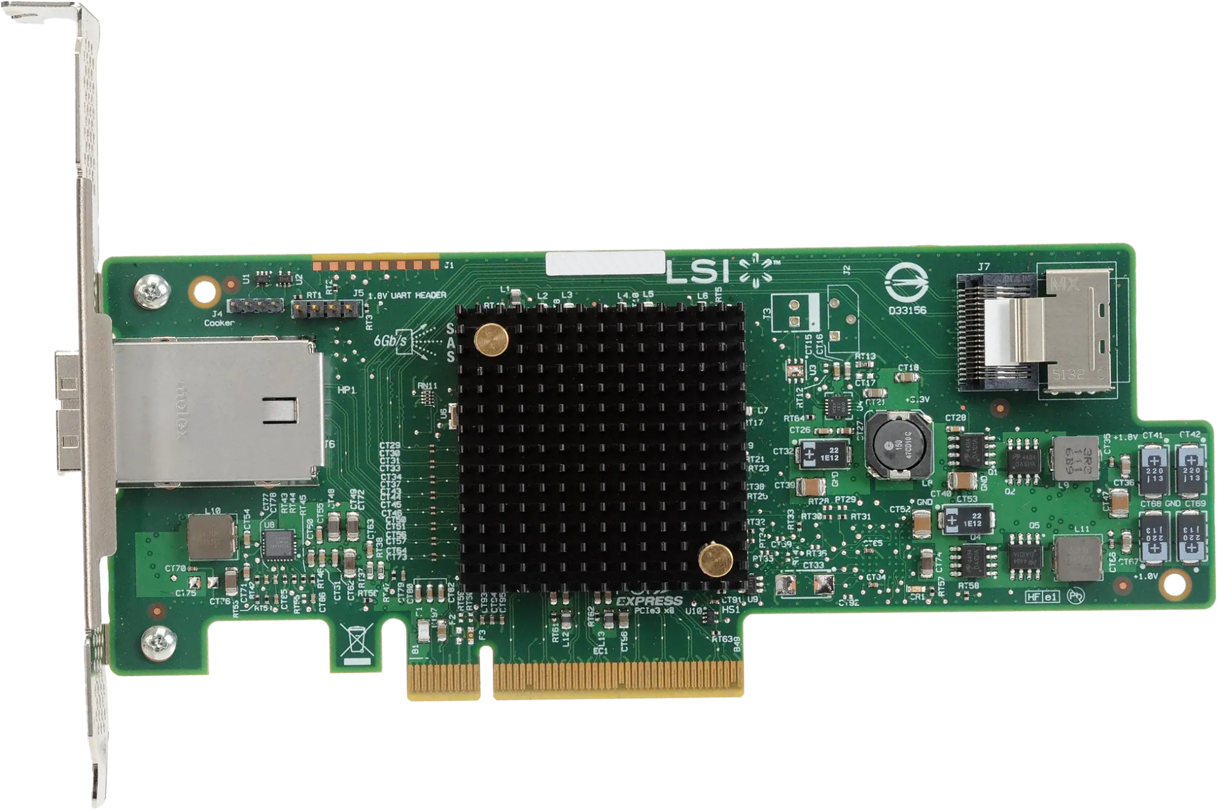
Hardware RAID Types
Expansion card
Motherboard
(May be software. Fake RAID)
Network Attached Storage
NAS
ITFreeTraining.com
© Copyright 2024
Notes:
00:18 RAID comes in a number of different forms. It is fairly common, nowadays, for motherboards to include RAID. The RAID included with a motherboard may not always be hardware RAID. It is not uncommon, particularly with the cheaper motherboards, for the RAID to be performed in software rather than hardware.
When the motherboard appears to have hardware RAID, but is in fact software RAID, some people refer to this as fake RAID. Essentially, before the operating system boots, the motherboard loads software to provide RAID functions. The operating system won’t know it is software RAID. Thus, the operating system will be able to boot from it just as with hardware RAID. The difference is the performance may not be the same as you would get from hardware RAID. For this reason, if you are considering using the RAID on the motherboard, I would have a look first at what you are getting. If it is software, you may not get the performance or reliability you are expecting.
RAID can also be added to the computer using an expansion card. The expansion card will have a storage connector to connect external storage devices. In the case of a Solid-State RAID expansion card, newer cards will use M.2 Solid-State Drives that are mounted directly to the expansion card.
Lastly, there is Network Attached Storage or NAS. These are generally an enclosure that contains a number of storage devices. The NAS performs the RAID functions. Often, the NAS will be accessible via a network hence the name network attached storage; however, it is also possible to access the storage through other means like USB. Which NAS you purchase will determine how to access it. Some NAS devices support fiber to access the device.
To start with, let’s have a look at how you would go about setting up RAID using a motherboard.

Slide 3
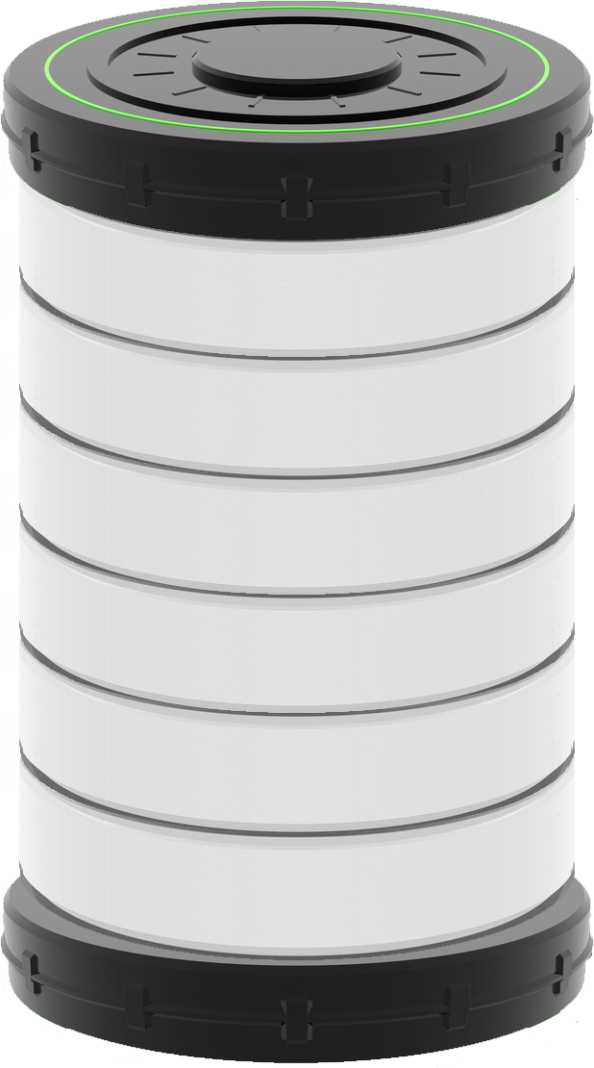



RAID Demonstration 1
Using Gigabyte GA-990FXA-D3 motherboard
File broken into 64k blocks
1
2
3
64k
64k
64k
RAID many read less than 64k block
ITFreeTraining.com
© Copyright 2024
Notes:
02:16 In this demonstration I will be using an older motherboard to demonstrate some of the RAID features. Later in the video I will look at a new motherboard to have a look at what features a new motherboard may have. Regardless of which motherboard you choose, RAID works much the same way.
For this demonstration, I have connected six 250 gigabyte SATA hard disks to the motherboard. They are all identical, which is ideally what you want for RAID.
To configure the RAID, I will start the computer up and press the delete key to go into the BIOS. You will notice the hard disks are detected when the computer starts up. Once I am in the BIOS, RAID support needs to be enabled. To do this, I will go into “Integrated Peripherals”.
For this computer’s setup, I will need to select “OnChip SATA Type”. Your BIOS may be different, but somewhere you should have a similar option. You will notice that there are three different options in here. In order to enable RAID support, I need to select “RAID”.
If you do change this option and you have Windows installed, there is a good chance changing this option will stop Windows booting. It may even corrupt the Windows install. Essentially, some changes need to be made to Windows in order for it to boot using the new setting. This makes it a chicken and egg kind of problem because, you need to boot into Windows to make the changes.
There are some workarounds for this that involve booting Windows into safe mode and then making the change. I can’t guarantee that these will work. It is recommended, that once Windows is installed not to change this setting. If you have to change this setting, back up your system first.
Also, have a look for other settings that may affect access to the hard disks. In this case, the next option down configures how SATA ports 4 and 5 will be configured. In this case they are set to SATA which is what it needs to be set to. If they were set to IDE, this would prevent access to two of the hard disks. Also have a look for settings that may disable SATA 3 or disconnect SATA ports.
I have made all the changes that I need to make, so I will press F10 to save the settings and exit the BIOS. You will notice that when the computer starts up a screen will be displayed with RAID information. What occurs with RAID controllers is they typically operate with a separate BIOS to the main BIOS. When the computer starts up, the BIOS will boot strap the RAID BIOS and you will get an additional screen like this.
Notice at the bottom, the message press ctrl-F to enter the RAID option utility. To make changes to the RAID you will need to use this utility. The key you need to press will change depending on which RAID you are using. In some cases, screens like these will appear before the BIOS screen and in other cases they will appear afterwards. If you have multiple BIOS add-ons they will appear one after the other and a lot of the time different keys need to be pressed to access the configuration software, but it is not guaranteed. It is just a matter of pressing the right key at the right time to access the configuration tool, in this case pressing ctrl-F.
I am now in the RAID configuration tool. When I go into the first option, this will show you all the hard disks that are currently available or being used by the RAID. The first four hard disks are shown, and when I press page down, this will show the last two hard disks.
I am happy that all six hard disks are accessible by the RAID, so I will press escape to go back to the main menu. Once in the main menu, the next step is to configure a RAID array. To do this, I will press 2 for the second option “LD view/define” – LD standing for logical disk. Essentially, creating a RAID is combining multiple hard disks together to form the one logical disk. The operating system will see this as the one logical unit.
On this screen you can configure the settings used to create the RAID. Notice that the “RAID mode” is currently set to RAID 0 which is striped. This does not have any redundancy, so if a hard disk fails you will lose all your data.
The next option down is the “Stripe Block Size” which is set to 64 kilobytes. Let’s have a closer look at this one. Let’s consider that there are three hard disks in a RAID 0 array. Now let’s also consider that we have a file that is 192k long. This file will be broken into three parts to be stored on the RAID.
If the operating system was attempting to read only 4K of the file, the RAID may read less than a 64k block.How the RAID is configured and the software it is using will determine how much it will read. To make things more complicated, the operating system will often, when it gets small reads, read ahead and store the data in cache just in case that data is requested later.
To summarize, the stripe block size is used to break up data across the hard disks. However, the physical block size the RAID uses to read the hard disk may be much smaller. Thus, the stripe size does not give you an indication of the physical block size used to access the data on the hard disks.
Just as with large allocation units, a large stripe size helps if you are storing a lot of big files. If you are storing small files, it will probably slow things down. If you are not sure, I would leave it on the defaults. If you have a server that you want to get the best performance out of, you may want to experiment with the settings until you get the best result.
You will notice for this RAID, the stripe block size can also be set to 128k and 256k. For RAID 0, to get the best performance, you want all the hard disks reading at once. If the stripe block size is 256k and you have four hard disks, this means the file would have to be over one megabyte to get the maximum benefit. In this case, I will set the block size back to 64k. This should give me good results on an average system.
The next option over is “Initialization”. By default, this is set to fast. This will write a small amount of information to the hard disks. Same sort of principal here as a fast format. You can also set this to “None” which will not write anything to the hard disks. You may want to do this if you had lost the RAID configuration and were trying to recover the data. Personally, if that happened, I would attempt using a recovery tool to get the data back rather than risking recreating the RAID and hoping for the best.
In this case, I will leave it on fast and move on. The next option is “Gigabyte Boundary”. This essentially rounds the RAID down to the nearest gigabyte when it is created. If switched off, all the space is used even if it does not line up with a gigabyte boundary.
The next option is the "Read Policy”. Setting this option also determines what the write policy will be. The default read ahead means that when a read is done, the RAID should read ahead anyway and store the data in the cache. The idea behind this is, if something is read, there is a good chance the following data will be read shortly afterwards. In the case of hard disks, it is more efficient to read large chunks of data at once.
Notice that the write policy is configured to “WriteBack”. Write back means that the data will be written to the cache rather than directly to the hard disks. The cache will later be written to the hard disks. It is more efficient to do it this way; however, if the RAID loses power while there is data in the cache this data will be lost. Some RAIDs will have the option of a battery backup, so data is not lost if there is a sudden loss of power.
Notice that when I change the read policy to “NA”, the write policy changes to “WriteThru”. This means that writes are written directly to the hard disks when they are received. For reliability this is the best option, but it will give you the worst performance. If reliability is your only concern, then this may be a good option, however, most people want to get some extra performance out of RAID as well.
The next option is “Read Cache”. This option will read the data and store it in the cache but won’t read more data than it is asked to. This is a good option if you have a lot of small files. Sometimes, it may be a bit of trial and error to work out what is best, but if you not sure, leave it on the defaults.
At the bottom is where I can assign drives to the RAID, and in this case I will add all the hard disks to the RAID. Once done, to create the RAID I will press ctrl-Y. I now have the option to assign a name by pressing ctrl-Y. In this case, I will assign the name “OS” to this RAID.
I will now get a prompt confirming that I want to create the RAID. Since fast initialization is being used, the Master Boot Record will be erased but all the data on the RAID won’t be. Once I press ctrl-Y, I will be asked if I want to use all the space or enter in the amount to use. For example, you could use only half the space for the RAID. You could also create a second RAID in the space not used. You could also, if you wanted to, mix different RAID types on the hard disks. Personally, I would not recommend doing this and I would use the whole space rather than dividing the hard disks into smaller parts. In this case, I will use all the space. It is easier to manage and also easier to understand what has occurred if you have a disk failure.
Now the RAID has been created, I can press enter to view it. You will notice at the top is the logical disk name. If you create multiple RAIDs, this name helps you keep track of which is which. At the bottom of the screen is a list of the hard disks in the RAID; also notice that the port number is included. If you have a hard disk fail, this will help you locate which hard disk failed.
So, now I will have a look at some of the other RAID types that can be created. I will go back to the main menu so I can delete the RAID I just created and free up the hard disks. From the main menu, I just need to select “3” to go into the delete menu.
To delete the RAID, all I need to do is hold ctrl and alt and press D. To confirm this is what I want to do, I will press ctrl-Y and the RAID will be deleted. I will now go back to the main menu and then go into the create menu to create a new RAID. For this RAID, I will select RAID 10.
Notice that when I select this, the option to perform a full initialization is available. If this is selected, all the data on all the hard disks will be erased. This is like doing a full format and, just like a full format, it takes a long time to complete. Because it takes so long, I will change it back to fast.
RAID 10 is a stripe of mirrors. That is, the data is mirrored and then the data is striped. In order to use it, you need an even number of drives, so for this example I will select all of the available hard disks.
Once selected, I will attempt to create the RAID. Notice that I will get an error message that a maximum of four drives can be selected. RAID 10 supports more than four drives, however this RAID implementation does not. Be careful about limitations like these. Not all RAID implementations support all the features and you may hit limitations like this.
You will notice that, if I attempt to create the RAID with three hard disks I will get an error saying the minimum number of disks is four. I will select another disk and create the RAID.
In this case, I won’t configure a logical disk name and I will create the RAID using all the available space. The RAID will now be created, and you will notice that if I now have a look at the details for the RAID in the top left, the name has been defaulted to “Logical Drive 1”. If you create multiple RAIDs, it will assign a number to them. If you have a few of them, it gets difficult to track which are which.
I will now go back to the main menu. As before, I will go into the delete menu and delete the RAID as I want to create some different RAIDs to have a look at their features. Once deleted, I will go back to the main menu and then go into the create menu. Once in the create menu, I will create a new RAID.
For the next RAID, I will create a JBOD or Just a Bunch of Disks. JBOD is not an official RAID standard. What JBOD does is, it takes all the hard disks you select and combines them together. The hard disks do not need to be of the same size or same type. If one of the hard disks was to fail, you risk losing all your data and JBOD does not support redundancy.
I will attempt to create a JBOD with just one disk. You will notice that I get an error message saying that at least two disks are required. I will select all the disks and then I will create the JBOD array.
You will notice the JBOD array was created without any problems. I will now go back to the main menu and will delete the JBOD array. Once deleted, I will go back to the main menu and then go back to the create menu and create a new RAID.
There are only two more RAID types to look at, and once created, I will keep them to see how to use them with Windows. The next RAID type I will select is RAID 1. This is a mirror, so essentially the data from one hard disk is duplicated to the other hard disk. Some RAID 1 solutions will allow you to select more than two hard disks. To test if this is the case with this RAID, I will select four hard disks.
You will notice that when I do this and attempt to create the RAID, I get an error message saying that a maximum of two disks is required. I will deselect two of the hard disks and attempt to create the RAID again.
I will give the RAID the name “OS” and accept the defaults to create the RAID using all the available space. The RAID has been created successfully. I still have four hard disks left, so I will go into the create screen and create another RAID.
For this RAID I will select RAID 5. RAID 5 uses one hard disk for parity. For this reason, it requires a minimum of three hard disks to operate. I will test this by selecting two hard disks and see what happens. You will notice that I get an error message saying that a minimum of three disks is required. I will now select another hard disk so that I have the three minimum hard disks required.
I will now create the RAID configuring it with the name “Data” and use all the capacity of the hard disks. Once this is complete, two RAIDs will have been created. One with a mirror and the other with RAID 5.
In the old days this was a common setup. The mirror or RAID 1 drive was used for the operating system. Once the computer has booted up, in a lot of cases there is not a lot of activity on the operating system drive, most of the activity is on the data drive. Thus, for the operating system redundancy is important, but performance is not so important.
For data, this will be stored on RAID 5; since RAID 5 provides redundancy, there is good read performance but not so good for write performance. You can see why this was a popular choice for file servers. Nowadays, RAID 5 is not as popular as it used to be.
I still have one hard disk left, so I will go back into the create screen to work out what to do with it. For the last hard disk, I will select “RAID READY”. RAID Ready allows the hard disk to be used with Windows software to back up the data from the mirror. This provides a third copy but it is done as a backup rather than in real time.
I will next go down and select the hard disk. I will be asked if I want to assign a name, so I will use the name “Stand By”. I will confirm as before, however I won’t be asked how much space I want to use since RAID Ready does not give you that option. In this case, if one of the other hard disks fails, I want to be able to remove this drive from RAID Ready and use it as a replacement hard disk.
You will find that in large storage environments there will be many standby disks to take over as soon as a hard disk fails. In this case the hard disk will have to actually fail, but in some environments the storage solution can detect the hard disk is starting to fail and will replace it before it fails. In large environments, the monitoring software may automatically request a replacement hard disk and have it automatically sent to the company before the IT staff even realize it has failed. This RAID solution has the ability to have a standby drive ready to take over if a drive fails; however, you can’t configure it here and need to use the RAID software to do this.
Since all the storage has now been created, I will go back to the main menu. In some cases, in the RAID utility, you will also need to set which RAID will be the bootable RAID. In this particular RAID utility this is not required and we will see why later.
Now that I have finished configuring the RAID I can exit the utility. Before I reboot the computer, I first need to download a device driver for Windows so it can use the RAID driver. To do this, I will go to the motherboard manufacturer’s website.
Windows does come with a lot of device drivers, but you will find for devices like RAID controllers often the device driver does not come with Windows. Also, since the device driver is needed to access the storage before Windows is installed, it is referred to as a preinstall device driver. For this reason, make sure you download the preinstall device driver as the regular device driver will not work.
In this case, I will scroll down and locate the Windows 8 RAID device driver. Make sure you are downloading the RAID device driver and not the SATA device driver. In some cases, the motherboard may have been released with a choice of different RAID controllers. When this occurs, there may be different device drivers. You will need to download the device driver for the specific RAID controller found on your motherboard. If you are not sure, you can always try downloading all the RAID device drivers and trying them. It won’t matter if you install the wrong device driver, it simply won’t work.
I am installing Windows 10, but there is no device driver for Windows 10. When this occurs, download the most recent operating system device driver you can find. In most cases, device drivers for Windows 7 and even Windows Vista will work on later operating systems, so Windows 8 should be fine.
You will notice the description of this device driver is preinstall driver, which is the one we want. You may notice that there may be references to pressing the F6 key. For example, it may be called the F6 device driver. Older installations of Windows were text based. At the start of the install there was a message saying that if you needed to install additional device drivers to press the F6 key. You had a limited amount of time to press the F6 key, if you missed it, the install would not prompt you again. The setup of Windows has changed a lot since then and there is no longer a requirement to press the F6 key at a certain time during the install, however, you may still see it referred to.
You will also notice the mention of a floppy disk. In old setups the extra drivers would need to be loaded from a floppy disk. The install software did not have an option to load them from anywhere else. So, before the install you needed to copy these device drivers to a floppy disk. Times have changed and you don’t need to use a floppy disk any more, however you may still see the device driver mention a floppy disk.
It is not mentioned here, but this device driver may also be referred to as “text mode setup”. This was because the old setup was text based and not graphics based. So, when looking for this device driver, look for preinstall driver, a reference to pressing F6, anything about a floppy disk or text mode setup. If you find any of these that should be your device driver. Keep in mind that, because the device driver was originally intended to fit on a floppy disk, the device driver should be quite small.
In some cases, the device driver will not be a separate device driver and will be included with other device drivers and even software. When this is the case, the preinstall device driver will be included in a sub-directory somewhere in the device driver package. To work out where it is, you can always refer to the readme file or search for it.
In this case, I downloaded this device driver. I have already copied the device driver to a USB flash drive containing a Windows 10 install. I will now put this Windows 10 USB flash drive into the computer so I can install Windows 10 onto the RAID.
Now that I have the computer ready to start the install, I will reboot. Before I start the install, I will first go in the BIOS and make sure the settings are correct.
Since I have configured the RAID settings previously, the setting I need to check is the boot order. To do this, I will go down to “Advanced BIOS Features”. Here, I will select the option “Hard Disk Boot Priority”. Once in hard disk boot priority, you will notice that this BIOS has picked up the RAIDs I created and also used the names I assigned them. If I wished, I could change the boot order here to attempt to boot off the second RAID I created. Although this BIOS does this, this will not always be the case. In some cases, you will only have an option to boot from an expansion card or something similar. When this happens, to change the boot order, you will need to be do it in the storage utility.
Since the BIOS is configured the way I need it to be, I will exit out of the BIOS and reboot the computer. Since the USB flash drive is in the computer with Windows 10 on it, the computer will boot into the Windows 10 setup.
The computer will attempt to boot off the RAID first, however, since there is no data there it will fail and then go down the boot order until it gets to the USB flash drive.
Once the setup starts, I will skip past the welcome screen and then select install. I will next be asked for the product key. Since I am just testing installing Windows 10 on the RAID, I will skip this step.
Next, I will need to select the operating system to install. Regardless of whether you are installing Windows client or server these steps are the same. In this case, I will select “Windows 10 Pro” and move on. For the next screen, I will accept the license and move on.
For the install type I will select custom; upgrade can only be run if you run setup from the Windows install you want to upgrade.
This screen will show the available storage you can install Windows on. You will see that the separate hard disks have appeared even though they are in the RAID. This is unusual and usually when a hard disk is put into a RAID it won’t appear in here. Make sure you don’t use these disks as it will corrupt the RAID.
In order to access the RAID, I need to load the device driver. To do this, select the option “Load driver”. For your information, if you press F6 this will also open this option. Once open, select browse and browse to the location containing the device driver.
Once I press O.K. the device driver will appear. In some cases, there may be multiple device drivers available. It is just a matter of choosing the one that meets your needs. Once I press next, Windows setup will load the device driver.
You will notice that when the device driver is finished loading, the hard disks seen earlier will disappear and be replaced by the RAID drives I created. These being, the RAID 1 mirror, the RAID 5 stripe with parity and the RAID Ready hard disk.
For this install, I will install Windows 10 on the first drive which is the RAID 1 array. Once I press next on the setup, Windows 10 will start installing. To see what the result is, I will pause the video and return once the install is complete.
The Windows 10 install is complete; to have a look at what hard disks were detected, I will open Windows Explorer, right click on “This PC” and then select “Manage” to open “Computer Management”. Once computer management is open, I will next select “Disk Management”.
You will notice that disk management has picked up the second and third RAID as initialized disks. So, the result so far is exactly the same as installing a new hard disk in the computer. I will cancel this screen. You will notice that the first hard disk to appear is the mirror drive that I created, followed by the RAID 5 and then the RAID Ready hard disk. As far as the operating system is concerned, the RAID drives are connected to the computer just like any physical hard disk would be.
To simulate a failed hard disk, I will physically unplug one of the hard disk’s data and power cables. Once this is done, I will go back to Windows and restart the computer. You will notice that Windows will reboot without issue even though a hard disk has been unplugged.
During the start up I have paused the RAID screen as it appears very quickly before disappearing. It appears so quickly, it is very easy to miss it. You will notice that the first RAID now as a status of critical. It is important when something like this happens to fix it as quickly as possible. It could be just a matter of plugging the hard disk back in. However, even doing this may still trigger a rebuild since the RAID controller won’t be able to determine if any data changed while the hard disk was offline.
The computer will still boot up as normal and I will be able to login as normal even though a hard disk has failed. Thus, you can understand why it is so important to know when a hard disk has failed, otherwise you could be finding out a hard disk has failed when a second hard disk fails and then you would lose all your data.
In order to manage the RAID better, I will need to download some software. This software is not available on the manufacturer’s website. Usually, the motherboard manufacturer provides all the software and device drivers, but sometimes you may need to get them from the company that created the hardware. Sometimes that company will also provide more up to date device drivers. This is common with video drivers.
The software I need is called RAIDxpert. To find it, I will use Google. Once I find the website containing the software, I need to scroll down until I find the right version. The one that I am after is the one for SATA only.
The software is a simple install where I accept the defaults, so I will speed the video up for it. When using RAID, it is important to see if the RAID has any management software. This software may provide additional information and provide you with important alerts such as a hard disk in the RAID has failed. Without this software, unless you see the message when the computer starts up, you may never know a hard disk has failed.
Once the software has installed, I will run it from the start menu. For this particular RAID software, the default username and password is admin.
It is worth taking a look around the RAID utility as there will be options in there that are not available using the BIOS utility I used earlier. On the left-hand side, I will select “Utility Configuration”. Under this option, notice that you can configure e-mail alerts. So, if there is a problem with the RAID the software can automatically send an e-mail to advise you. This is a useful feature if you have end-users who are using the computer and may not report RAID errors, but will report it when they lose their data and by then it is too late.
Notice that there is a section called Logical Drive View. This will show the three RAIDs that have been configured. Notice that the OS raid has an exclamation mark. When I select it, you can see the status of the RAID is critical. This is because I have disconnected one of the hard disks.
We want to replace the hard disk to get the RAID functional again. You will notice that the RAID Ready hard disk is functioning. I am not using it for backups or anything else, so I may as well use it to replace the failed hard disk. To use this hard disk, I first must delete the RAID. To do this, I will select “Logical Drive View” and then select the tab “Delete”. All I need to do then is select the RAID and press submit to delete it, thus freeing up the hard disk. I will be asked to confirm I want to delete the RAID and that all the data on the RAID will be erased.
The hard disk has now been freed up; notice that if I select OS, the RAID still has a status of critical and is not using the freed up hard disk.
The easiest way to replace the failed hard disk is to add the free hard disk as a spare. When a hard disk fails in the RAID, if a spare is available, the RAID will automatically start using it. To make this hard disk a spare, select the option “Spare Drive View”. From here I will select create and then select the free hard disk. You will notice that there is an option “Spare Drive Type”. Using this option, you can configure which RAID this hard disk will get used with. In this case, I will leave it on the default option of “Global Spare” so that any RAID can use it.
Once I press create, the hard disk will be added as a spare. You will notice that it does not appear in information as a spare hard disk. This is because the hard disk has already been used to replace the hard disk that I unplugged.
You will notice that, under OS the drive has activity listed as rebuild. The RAID is currently being rebuilt to utilize the spare hard disk. These hard disks are only 250 gigabytes in size, but it still took over an hour for the RAID to rebuild. Nowadays, a very large hard disk can take a whole day to be rebuilt. You can start to understand why RAID 5 is not as popular as it used to be. Consider if RAID 5 is being used for a large amount of storage. If a hard disk fails, you are at risk of losing all your data during the rebuild process. If it then takes a day to rebuild, that is a whole day you are crossing your fingers hoping that you don’t have another hard disk failure. You can see why RAID 5 has reduced in popularity with the increased use of larger hard disks.
For this demonstration I have the hard disks on a table, so let’s have a look at some better ways to organize them.

Slide 4
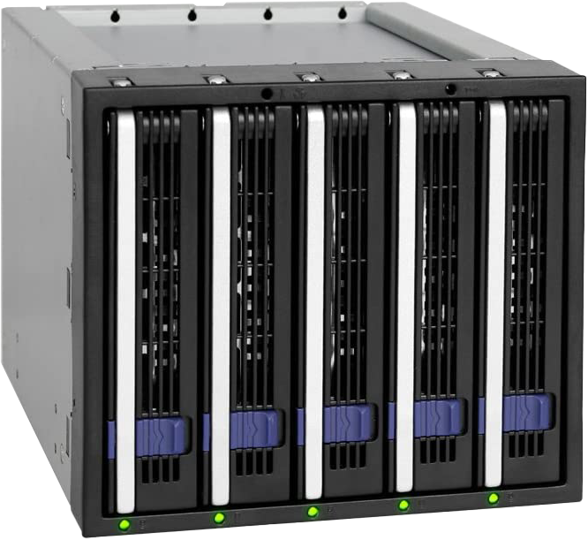
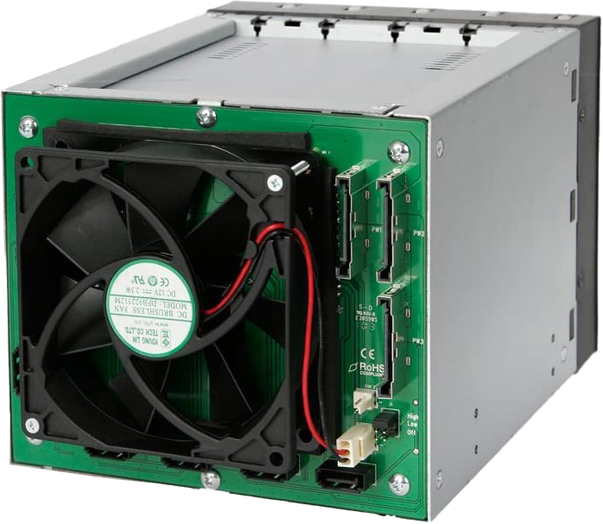
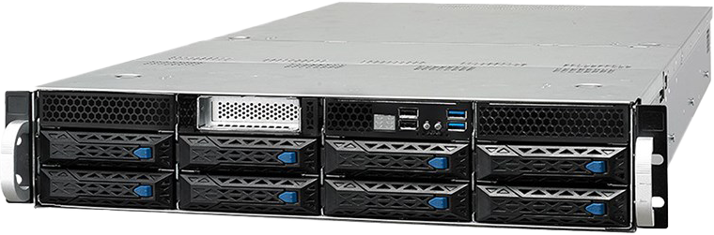
Hot-Swappable Enclosures
Adds removable storage
Plugs into 5 ¼ inch bay
Part of computer
ITFreeTraining.com
© Copyright 2024
Notes:
35:57 If you are planning on using RAID and your computer case does not have removable bay slots, you can always purchase a drive cage. These go into a five and a quarter inch drive bay. The data and power cables from the computer plug in the back. The front of the drive cage has drive trays so the hard disks can easily be pulled out of the computer. If a hard disk fails, this makes it easier to remove the failed hard disk. Some of these may also have lights on the front for the hard disk activity lights.
The other way you can get enclosures like this is when they are built into the computer. This allows the hard disks to be easily popped out and replaced. Generally, these also have the advantage that if a hard disk fails, they will have an indicator light so you can determine which hard disk has failed.
Nowadays, if you see these, they are generally part of a server setup. You used to see them sometimes with professional workstations, however with the increase in speed of Solid-State Drives and putting data on the network you don’t tend to see them used on professional workstations anymore.
Let’s have a look at how to use a RAID cage with a more modern motherboard.

Slide 5
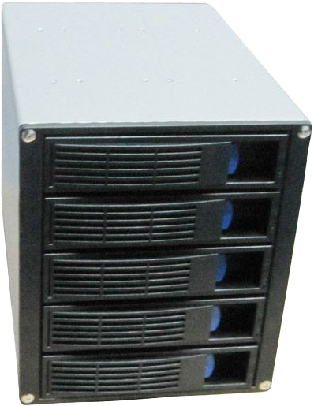
Raid Demonstration 2
RAID Cage Installation
ITFreeTraining.com
© Copyright 2024
Notes:
37:11 For this demonstration, I will use this RAID cage. You may also hear it referred to as a hard disk enclosure. The RAID cage makes it easier to install and remove hard disks. This particular RAID cage holds five separate hard disks. At the front are power and activity lights. If you purchase a system with a RAID cage built-in, it may also have a fault light to easily determine which hard disk has failed.
You will notice that I can easily pull out the RAID tray. The hard disk is screwed into the tray to hold it in place.
You will notice, if I have an empty tray, it is just a matter of placing a hard disk into the tray. Once in the tray, four screws need to be screwed in to hold the hard disk in place.
On the back of the RAID cage are five SATA ports. These ports plug directly into your motherboard. Next to the SATA ports there are two Molex power plugs. These provide power to all the five hard disks in the RAID cage.
The next step is to install the RAID cage. To do this, you need a computer case that will support it. In this case, this RAID cage requires three five and a quarter inch bays in order for it to be installed. In the old days it was easy to find one of these computer cases. Nowadays, with the decline of optical drives in the market, it is hard to find a computer with even one accessible five and a quarter inch drive bay.
In this example, this was the only computer case in the store that met this requirement. Having said that, I still needed to remove the front panel in order to get the RAID cage in. If you are considering using a RAID cage nowadays, you may have some difficulty getting a computer case that will support it. You may need to purchase a computer on special order, so I would consider this before purchasing.
The RAID cage is a simple install. First place the RAID cage in the computer. Once in, you would screw it in place like you would a hard disk drive. For this example, I won’t be using the computer cage in the computer, instead I will remove it so it will be easier to see what is going on.
If this RAID cage was installed in the computer case, the next step would be to plug the power and SATA cables into the back. In the case of this motherboard, there are six SATA ports, however the RAID cage only supports five hard disks. For this reason, I have only connected five SATA cables to the motherboard.
The first thing you need to do is work out which SATA cable is which. Generally, they are given numbers starting from either zero or one. You want, when possible, to keep the same number ordering since it will make it easier to work out which hard disk in the RAID enclosure goes to which port on the motherboard. The last thing you want to do when replacing a failed hard disk is pull out a working hard disk by mistake.
For this motherboard, the port numbering starts from zero, so purple is zero, black one, red two, blue three and green four.
Once you work out the order, it is just a matter of plugging them in the correct order in the RAID cage. I will start by plugging in the two Molex power cables. If possible, use different cables running to the power supply. This achieves two things. Firstly, if one of the cables were to fail, you would still be getting power from the other. Not putting all your eggs in one basket so to speak.
The second is that five hard disks will all be drawing power from the same cable. Although hard disks don’t use a huge amount of power and the biggest power drain will be during start up, you are still drawing power through the same cable. One cable should be able to handle five hard disks. Personally two cables is good, but if you can’t I would not be too worried about it. If you were connecting higher powered devices like modern graphics cards, I would not daisy chain them together as they draw large amounts of power.
I will next plug in each of the SATA cables, making sure that they are plugged in the correct order. Once all the SATA cables are plugged in, the next step is to switch the computer on.
Once the computer starts up, you will notice that Intel Rapid Storage BIOS will appear. For this RAID, this screen will not appear unless two hard disks are installed. So, if you are not seeing this screen and it is enabled in the BIOS, you may need to install additional storage first. Each of the hard disks that is in the RAID cage is detected. To enter the RAID BIOS I will press ctrl-I.
The setup for this RAID is very similar to the other RAID setups that I looked at previously, so I won’t spend too much time on it. To start with, I will select “Create RAID Volume”.
For the volume, I will enter the volume name “Data”. You can see that the RAID Levels are the same as we were offered in the previous RAID, that is, RAID 0, RAID 5 and RAID 10. You will also notice that there is a new option called “Recovery”.
If the recovery option is used, it can be the only RAID present. If you use any of the other RAID types, you can have multiple RAIDs and they can be different types if you wish. Recovery is very similar to RAID 1, but unlike RAID 1, you have the option to change the sync mode to continuous or on request. Recovery works by copying the data from a master drive to the recovery drive. The recovery drive can be mounted in Windows so it works like a backup for your data. Even in continuous mode, if the recovery drive is disconnected, it will sync up when it is reconnected. In the case of RAID 1, this would require a rebuild. Thus, if you just want a keep a backup copy of your system drive it may be a good choice.
For this example, I will select RAID 5. The next step is to select the hard disks that you want to use. In this case I will select hard disks 1, 2 and 3. I won’t select hard disk 0 because later on when I add an additional M.2 device, this hard disk will be disabled. Something to consider if you decide to use this kind of RAID and you are planning to upgrade later on.
Once I have selected the hard disks, as with the previous RAID I looked at, you can select the stripe size. There are a number of different stripe sets to choose from. You will find that when you look at different RAID solutions they all work much the same way and a lot of the time you will have the same options.
The next option gives you the choice to decide how much space to use. If you don’t use all the space, it is possible to create another RAID using the remaining space if you wish. In this case, I will use all the space on the hard disk and create the volume.
Now that the RAID volume is created, I will exit out of the RAID BIOS and let the computer boot into Windows. Like the previous RAID I looked at, it also comes with software that allows you to configure the RAID. If the operating system is not installed, the only choice you may have to create the RAID is using the RAID BIOS.
Once Windows has booted and I am logged in, I will next open Windows Explorer and then right click on “This PC” and select “Manage” to open “Computer Management”. Once open, I will select the option “Disk Management”. You will notice in disk management there are two new storage devices that were detected. In this case, I will deselect disk 0 and leave disk 3 selected and press O.K. I know that disk 3 is the RAID 5 I created earlier.
I will next scroll down, right click the RAID volume and select “New Simple volume”. For the wizard I will accept all the defaults and the drive will be formatted. You can see that Windows will treat this storage device just like a physically connected hard disk to the computer.
I have already installed the RAID management software, so I will close the open windows and next run the RAID management software. Once open, as before, you can access the same features as the RAID BIOS plus some additional ones. On the right-hand side, you can see what storage is connected, and notice the RAID 5 volume that I created earlier.
It is a good idea to have a look through the tools to see what options are available. For example, under preferences there are some options about how to manage alerts such as failed hard disks.
On the manage tab you can change some settings for the RAID. For example, under advanced you have options for write and read cache modes. I won’t spend any more time looking through the RAID tool, because essentially the software is very similar to the BIOS setup I looked at previously. Essentially, when you learn to setup one RAID every other RAID you set up will in some ways be similar.
This motherboard supports Optane, so I will shut down the computer and install it so we can see what effect Optane will have.
Optane comes in a number of different forms; in this particular case it is contained on a M.2 stick and is designed to cache read and write operations to storage devices. Just like an M.2 Solid-State Drive, to install one just give it a gentle push into the M.2 socket at an angle. Push the Optane down and screw in the retaining screw. Once this is done, the next step is to start the computer up.
As the computer starts up, hard disk 0 will appear to be missing. I will go into the BIOS and have a closer look at what has happened.
Once in the BIOS, you will notice that the hard disk connected to connection zero is no longer being detected. What has happened is, the connection that was going to this hard disk is now being used by Optane. Since there are a limited number of lanes going to the CPU and other devices in the computer, you will find that sometimes devices will share a lane. If you install two devices that share the same lane, you will need to choose which device will get that lane and the other device won’t be available.
To get Optane working, there are a few settings in the BIOS that need to be configured. In order to do this, I will press the F6 key to get into the advanced options. Once there, I will cursor across to the advanced tab.
Once on the advanced tab, I will cursor down to “Storage Configuration”. Once in storage configuration, there are a couple of changes that I need to make to allow Optane to work. The settings in your BIOS may be different.
In this BIOS, in order to access the settings, I first need to select the option “Use RST Legacy OROM” and disable it. This means that the setup in RAID BIOS on start up will no longer be available. In some BIOS’s it is possible to configure the RAID from the BIOS. This particular BIOS does not have that feature. In order to make changes to the RAID, I will need to use the RAID software in Windows.
The next setting is the one below that appears once the legacy ROM is disabled. This option is “RST Pcie Storage Remapping”. This option needs to be set to enabled. This option is required to re-direct PCI Express to the Optane device – if this is not enabled Optane will not work.
The next option down is “Teton Glacier Mode”. Teton Glacier was the previous name before they changed it to Optane. This option enables Optane, so I will select it.
That is all the changes required, so I will save the changes and exit the BIOS. The computer will now boot up and Optane should now be enabled. Once the computer has booted up I will login.
Once logged in, I will run the RAID software. In the RAID software, I will select the tab “Intel Optane Memory”. On the Optane tab, I will enable Optane by pressing the enable option.
The first pull down is fast drive, which is essentially asking which Optane module to use. There is only one Optane installed in this computer and thus it is already selected. Next, I need to select the data drive, for which there will also be only one option. This option is the Solid-State Drive that I am using to run Windows. Even though this is a Solid-State Drive, as Solid-State Drives go it is slow. Thus, it is a good candidate for Optane.
Optane essentially provides a high-speed cache. It is excellent for hard disk drives, but since Solid-State Drives are pretty fast they don’t benefit as much. As Solid-State Drives get faster there is an argument that Optane becomes less effective. You can also get Solid-State Drives that have Optane embedded in the storage device itself in order to cache data. In this example, Optane is a separate module in the computer rather than being on the Solid-State Drive.
Once I press yes, Optane will be configured. In the case of this computer, Optane does not take too long to configure. On your computer, it may take longer. Once complete the computer will require a restart.
So far, I have looked at two motherboards that have internal RAID and looked at how to configure them. I will next look at how to configure a computer using a hardware RAID card.

Slide 6
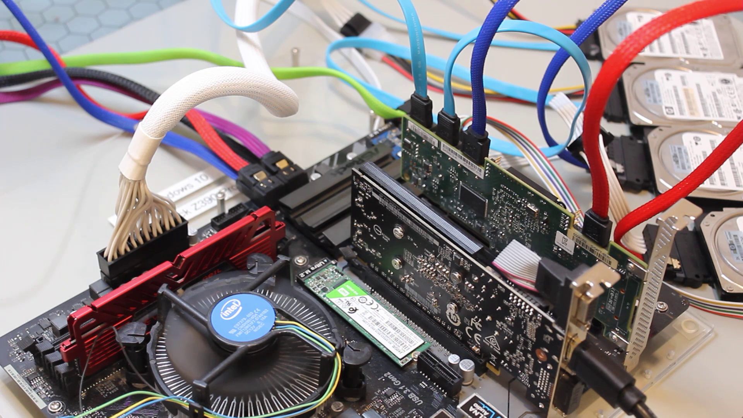
RAID Demonstration 3
ITFreeTraining.com
© Copyright 2024
Notes:
50:59 For this demonstration, I will be installing a SAS RAID card. SAS, or SCSI attached Storage, is a different type of hard disk interface. SAS uses the same data connection as SATA. If you plug a SATA drive into SAS hardware, the SAS hardware will support it. However, SATA won’t support SAS hard disks. To ensure a SAS hard disk is not plugged into a SATA connection, the connection on the back of SAS hard disks is slightly different.
Nowadays, you will only find SAS hard disks used in servers and large storage arrays. You don’t tend to find them used in workstations, even high-performance workstations. In this demonstration, I will install the SAS RAID card in a workstation to demonstrate how it works, but don’t expect to find SAS hardware in a workstation.
To install the RAID card, it is a simple matter of plugging it in to a spare expansion slot. Depending on your RAID card, you may have the option to install a battery backup, so if power is suddenly cut data is not lost.
For this demonstration, I have connected four SAS hard disks to the RAID card. Since SAS hard disks use a slightly different connection on the back of the hard disk, I need to use an adapter to connect a standard SATA data and power cable. Generally, when you use SAS in a server room, you will use a special SAS connection rather than using an adapter.
Two of the SAS hard disks that I am using have an adapter that include the power and data cables in the adapter. There are number of different adapters on the market depending on what your needs are.
You will notice that I have plugged the four hard disks into the RAID card. So, the RAID card is set up and ready to go. The procedure will be pretty much the same regardless of which RAID card you use. I decided to use a SAS RAID card to show you that you can use different hardware, however the process remains much the same.
Now that I have the RAID card installed, I will switch the computer on to look at how to set it up.
You will notice that when the computer starts up, as before, the RAID BIOS screen will appear. I will get the option to enter the configuration utility, but for the moment I will skip that.
You will notice that the hard disks that the RAID card detects will be listed. Notice that the first one is not the hard disk but the RAID card. SAS was designed for an older hard disk standard called SCSI. The SCSI standard will have the SCSI adapter or SCSI card appear as a device. Since SAS is designed off of the old SCSI standard, this is why the RAID controller card appears as a device.
Below this, you will notice that the four hard disks appear. So far everything is working as expected, but since I have missed the option to enter the configuration utility, I will restart the computer.
Once the computer has restarted, I will press ctrl-C to enter the configuration utility. Once you start using a few different configuration utilities you can pretty much use any configuration utility as they are all pretty similar. Since this hardware RAID card was designed to be used with storage solutions that may have a lot of different RAID cards in the same computer, the first screen will display all the RAID cards in the computer.
In this case, there is only one RAID card so only one will appear. If I had multiple RAID cards in the same computer, on this screen I could select the one that I wanted. I could also change the boot order to determine which RAID card will be used first to attempt to boot from. I will now select the first RAID card so that I can configure it.
Notice that on the first screen the option for boot support. It is set to “BIOS and OS” by default. In most cases, you would leave this as is. This means that RAID is available to the OS when the computer starts up.
The option of OS only is useful if you are not planning on using booting. Since the RAID does not require booting, it starts up a bit faster and saves a little bit of memory. If you are not sure, I would leave it on the default settings of BIOS and OS.
The option “BIOS Only” does not typically get used because this effectively makes the RAID available when the computer starts up but than hides it from the OS.
The next option “RAID Properties” is where you can configure the RAID. You will notice that the RAID card has three different types of RAID that it supports.
The option RAID 1E is just another name for RAID 10. RAID 10 is the name the industry uses, so I would not worry about remembering RAID 1E. On most RAID controllers they will use the standard RAID types, however, once in a while you may see a RAID controller that supports an unusual RAID type. When this occurs, it is just a matter of looking up that RAID type to see how it works.
For this example, I am going to select RAID 10. The next step is to select the hard disks that you want, and in this case I will select all four. Once selected, I will press C to create the volume.
On the next screen I will save the configuration and the RAID will be created. You can see the configuration works in much the same way as the previous one that I looked at. In a lot of ways, once you know how to configure one RAID you know them all. It is just a matter of learning any new features the RAID may support.
Since this is a SAS RAID card, there is one option that is present that you won’t see in SATA. That is the option “SAS Topology”. When I go into this option, you will notice that the controller and the RAID I just created are displayed. Expanding on Controller, you will notice that all the hard disks that are connected to this RAID card are shown.
This may not seem like much, but SAS has the ability to connect multiple devices together, kind of like network support for hard disks and storage devices. For example, it is possible with SAS to have multiple storage devices daisy chained to each other. It is also possible to use multipathing, which means that you can have a hard disk or storage device connected to multiple controllers. Thus, if one of the controllers was to fail the other controller could take over.
At the bottom, you have the option to expand the RAID which will give you information about which storage device is connected to the RAID. This is useful if your hard disks are on different RAID hardware, which is possible on very large storage implementations.
I will now exit out of here and then exit out of the main menu. I will be prompted to save the changes. Once I do this, I will be taken to the adapter list screen. I will exit out of here and reboot the computer.
The computer will start up. You will notice that on the RAID screen rather than the four hard disks the RAID volume appears. Some RAIDs may show the hard disks, some the volumes and some both.
I will now enter the BIOS to have a look at how to boot from the RAID. Once in the BIOS, I will press F6 to enter advanced mode. Once in advanced mode, I will select the tab “Boot”. You will notice in the BIOS, the volume I created will appear. If you want to boot off it, it is just a matter of selecting it.
There has been a lot covered in this video and a lot of it has given you an understanding of how to work with RAID in your environment. I will now have a look at the basics you need to know for the real world.

Slide 7

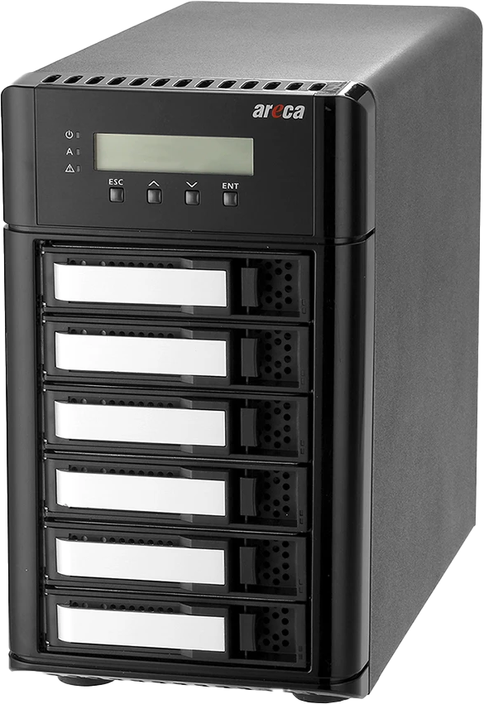
In The Real World
Hardware RAID better than software
Motherboard RAID may not be that good
May even be software RAID
Common RAID 0/1/5/10
Locked into solution
Built-in RAID more for
servers nowadays
External RAID enclosure
for workstations
ITFreeTraining.com
© Copyright 2024
Notes:
59:03 In the real world, hardware RAID is better than software. So, personally, I would use hardware RAID where I could rather than software. However, keep in mind that motherboard RAID may not be that good. Even on expensive motherboards RAID is an extra feature that the manufacturers don’t tend to put a lot of work into. In some cases, the motherboard RAID may be software RAID when you may think that you are getting hardware RAID.
The main RAID that you will need to know is RAID 0, RAID 1, RAID 5 and RAID 10. Although there are others that are used from time to time, these are the more common ones.
With the increased performance of Solid-State Drives you don’t see RAID used as much as it used to be. You will still see it used in servers and large storage implementations. You don’t tend to see it used in high-performance workstations as much nowadays. Solid-State Drives are much faster.
Although I did not cover it specifically in this video, I am sure that I have given you enough knowledge to be able to use one, and consider external RAID enclosures. Computer cases, nowadays, are not designed for RAID cages or other enclosures to be installed. External enclosures support high speeds through USB and Thunderbolt, so they are worth considering if you need to use RAID over traditional RAID cages.
Keep in mind that whatever RAID you choose, you are potentially locked into that solution. Different manufacturers have designed their RAID systems completely differently. The stripe sizes they use, how they store data on the disk and how parity is calculated. You most likely won’t be able to move your hard disks from one computer to another if the hardware for the RAID is different. Vendors are notorious for making their RAID different from others and thus not compatible with any other. Once you choose a RAID solution, it is not an easy task to migrate to a new one.

Slide 8
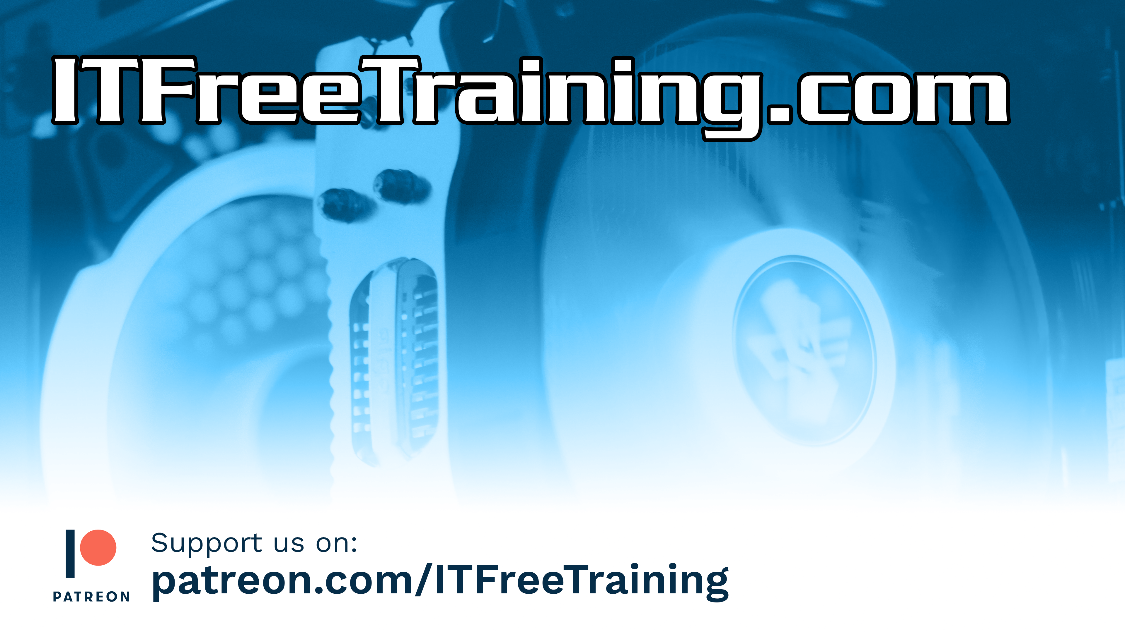
Subscribe
Next video
Video content: https://ITFreeTraining.com/ap/3d20
© Copyright 2024
Notes:
1:01:09 This has been quite a long video. If you have watched it all I hope we helped you understand hardware RAID a bit better. Until the next video from us, I would like to thank you for watching.
References
“The Official CompTIA A+ Core Study Guide (Exam 220-1001)” Section 6 Paragraph 276-286
“CompTIA A+ Certification exam guide. Tenth edition” Pages 309 – 311
“Optimal RAID Stripe Size and filesystem Readahead for RAID-10?” https://ioflood.com/blog/2021/02/04/optimal-raid-stripe-size-and-filesystem-readahead-for-raid-10/
Credits
Trainer: Austin Mason http://ITFreeTraining.com
Voice Talent: HP Lewis http://hplewis.com
Quality Assurance: Brett Batson http://www.pbb-proofreading.uk

