Slide 1
Notes:
In this video from ITFreeTraining I will look at removable flash memory devices. They contain no moving parts and can be easily transported from device to device. Over the years a lot of development has gone into these devices, so there are a lot on the market, and therefore it is important to understand their capabilities and what they can do.

Slide 2
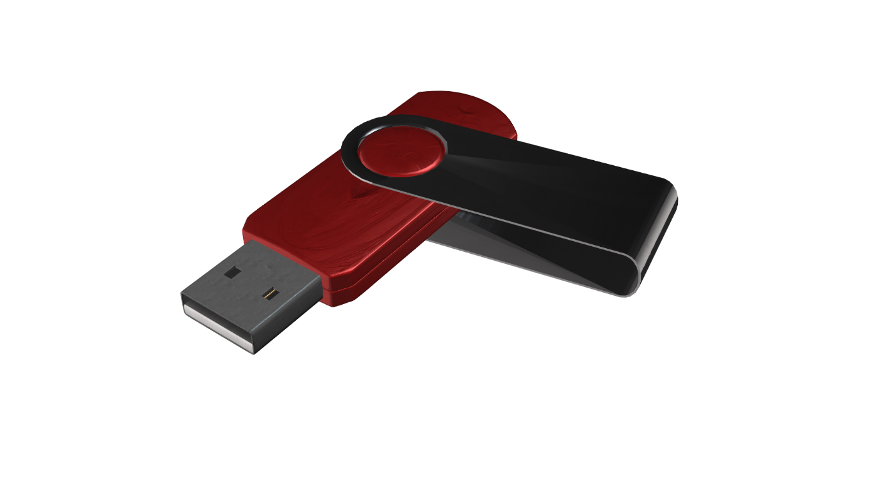
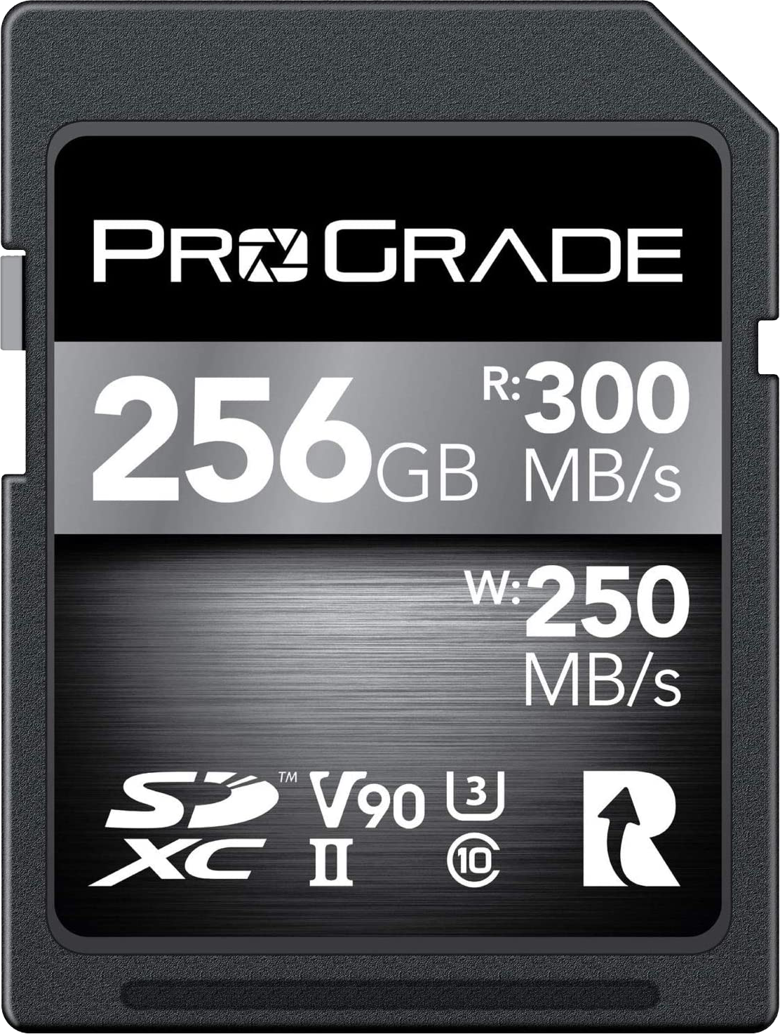
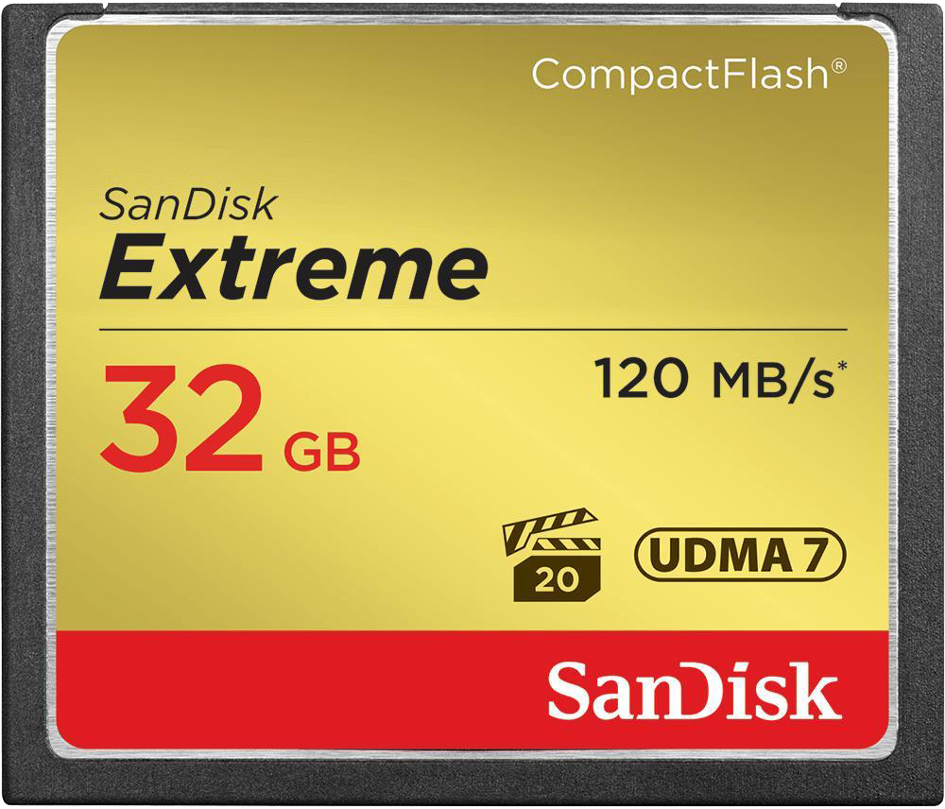
In This Video
USB Flash Drive
Compact Flash
SD Card
ITFreeTraining.com
© Copyright 2023
Notes:
00:24 In this video I will be looking at three different types of flash memory devices, these being USB flash drives, Compact Flash and SD cards. These storage devices have become commonplace, so it is important to understand how to use and support them. To start with, I will look at a USB flash drive.

Slide 3
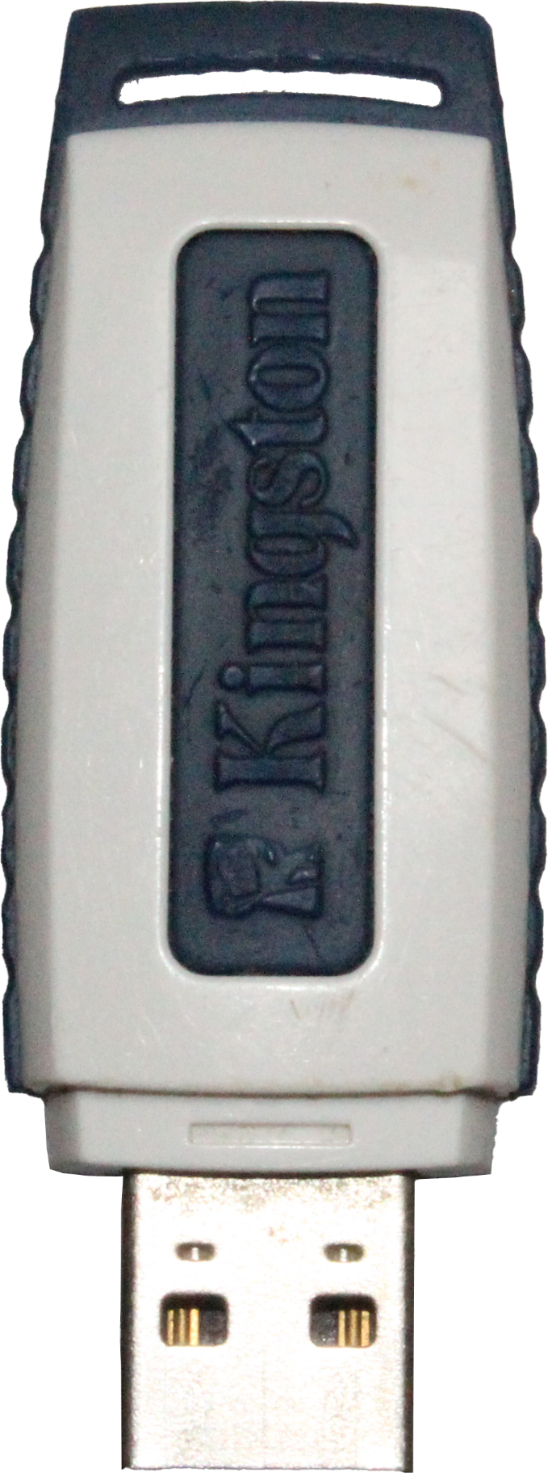
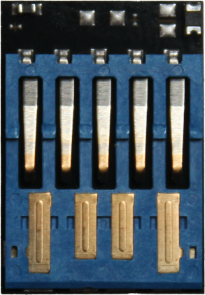
USB Flash Drive
Also known as Thumb/Jump/Flash Drives
Top
Back
ITFreeTraining.com
© Copyright 2023
Notes:
00:45 USB flash drives are also known as Thumb drives or Jump drives as well as flash drives. Since these storage devices are small and USB is well supported, they have become very popular. Here is an example of a USB flash drive.
This is an old USB flash drive that has 16 Gigabytes of flash memory. I will remove the plastic cover and have a look at what is inside. You can see at the top of the USB flash drive there are two chips and on the bottom is one chip. The two larger chips are the flash memory. The smaller chip is the controller chip.
There is no official standard on how data is stored using flash memory. Thus, manufacturers are free to implement their own algorithms on how to store data on flash memory. You will find that some USB flash drives will have extra features such as encrypting the contents of the flash memory. The vendor of the USB flash drive will provide additional software that is used to encrypt and decrypt the contents of the flash drive. However, you will find that there are alternatives to this like Windows BitLocker that you can use as well.
To get an understanding of how far flash memory has come, I have a brand new USB 3 128 Gigabyte flash drive to compare to my older 16 Gigabyte flash drive. They are about the same size, but notice how big it is when I remove the outer plastic. That’s it, the whole USB flash memory and controller plus the USB interface fit on this small piece of electronics. It really goes to show you how far the technology has come. Next, I will have a look at the performance of USB flash drives.

Slide 4
USB Flash Drive Performance
USB 2 max speed 60 MB/s
USB 3 max speed 575 MB/s (USB 3.1 625 MB/s)
100 MB/s read
40 MB/s write
420 MB/s read
380 MB/s write
ITFreeTraining.com
© Copyright 2023
Notes:
02:41 To understand USB performance a little bit better, consider that USB 2 max speed is 60 Megabytes per second while USB 3 max speed is 575 Megabytes per second. USB 3.1 max speed is 625 Megabytes per second. Flash memory is quite fast nowadays, so USB 2 speed limits the performance of modern flash memory. Thus, if performance is important, you may want to consider USB 3 devices.
I have selected two USB flash drives currently on the market. The first one has a read speed of 100 Megabytes per second and a write speed of 40 Megabytes per second. When purchasing a USB flash drive, the manufacturer, if they quote the speed, will often quote the read speed but not the write speed. The write speed is always slower than the read speed and thus probably the reason they are not always up front about what it is.
The second USB flash drive is a high-performance drive. The read speed of this USB flash drive is 420 Megabytes per second while the write speed is 380 Megabytes per second. Nowadays, I would only purchase USB 3 flash drives, as the performance of USB 2 is starting to show its age. If you are using a USB hub, you could have multiple devices all trying to share the same bandwidth making the speed even slower. Keep in mind that, just because it is USB 3 does not mean that the performance of the flash memory will be good, however generally it is a good indicator.
There is not too much to know about USB flash drives; in most cases you simply plug them in and they work. If you need a certain performance for the USB flash drive, you just need to have a look at the specifications for it and make sure that it meets or exceeds those requirements. There is one little catch that you should know when using USB flash drives. I will now change to my Windows 10 computer and have a look.

Slide 5
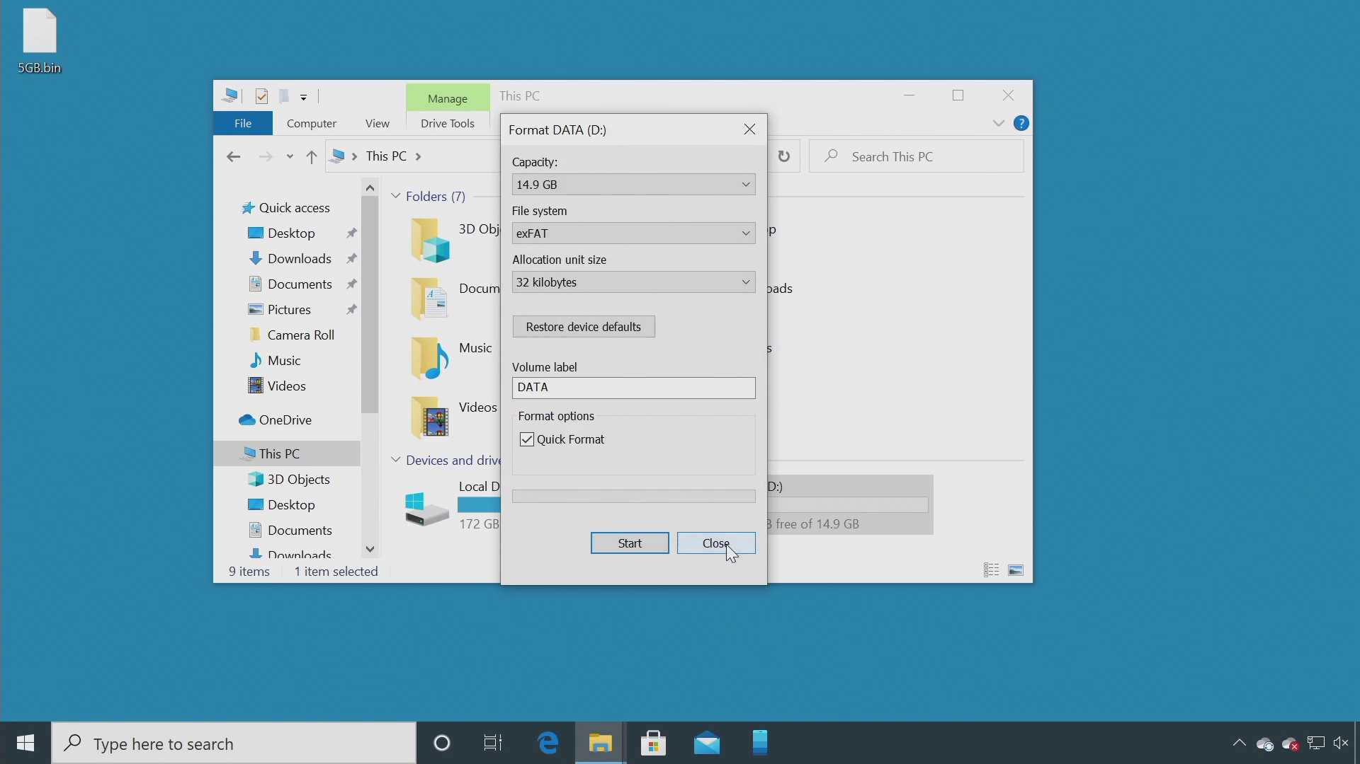
USB Flash Demonstration
For files over 4 gigabytes in size use exFat format
ITFreeTraining.com
© Copyright 2023
Notes:
04:57 On my Windows 10 computer, I will open Windows Explorer and select my USB flash drive. In this case, the USB flash drive is brand new and has not been used yet. I have a five gigabyte file on my desktop that I will attempt to copy onto the USB flash drive. Notice that I get an error message saying that the file is too large.
I will now go to the USB flash drive, right click on it and select “Properties”. Notice that the USB flash drive is formatted with FAT32. FAT32 has a limitation, in that it will not support any files over four gigabytes. FAT32 is however very compatible with older systems and thus many USB manufacturers will format the USB flash drive with FAT32, especially if they are small in terms of storage size.
To allow the USB flash drive to support larger files it will need to be reformatted. To do this, right click on the USB flash drive and select “Format”. In the format option, I will select “File system” and notice that I have three different options. These are NTFS, FAT32 and exFAT.
NTFS offers extra security features and also has journaling. Journaling is a feature in which writes are put into a transaction log before being committed. This gives better recoverability if a problem such as a power outage was to occur when the data was being written to the drive.
In the case of USB flash drives, the drive has a limited number of writes that can be performed before the USB flash drive starts wearing out. Features like journaling increase the number of writes on the USB flash drive and thus decrease its lifespan, and it also reduces the performance of the USB flash drive a little bit.
NTFS has security features such as permissions: however, since the USB flash drive is portable it is very easy to simply place the USB flash drive in another computer and bypass those permissions. Also, NTFS is not as well supported on non-Microsoft systems and generally you will want your USB flash drive to be portable between different systems. For these reasons, it is not recommended to use NTFS for USB flash drives since there is little benefit in doing so.
In this case, I will select exFAT and press the start button to format the USB flash drive. Windows will display a prompt asking me to confirm that I wish to proceed and erase all the data on the USB flash drive. Once I press O.K, the USB flash drive will be formatted with exFAT.
exFAT was first introduced in November 2006 so has pretty good hardware compatibility. In the future this should improve because in 2019 Microsoft officially released the specification of exFAT. With systems such as NTFS, Microsoft doesn’t release specifications explaining how everything works. Thus, when implementing systems like NTFS it comes down to guess work and Microsoft are free to change how it works at any time, so no one can be 100% sure they got it right. In the case of exFAT, the standard has been released so there is no guess work needed.
Now that the format is complete, I will close out of here and attempt to copy the five gigabyte file to the USB flash drive. Notice that this time the file copies across to the USB flash drive without any problems.
You can see there is not too much to know about USB flash drives, so now I will move on and have a look at Compact Flash.

Slide 6
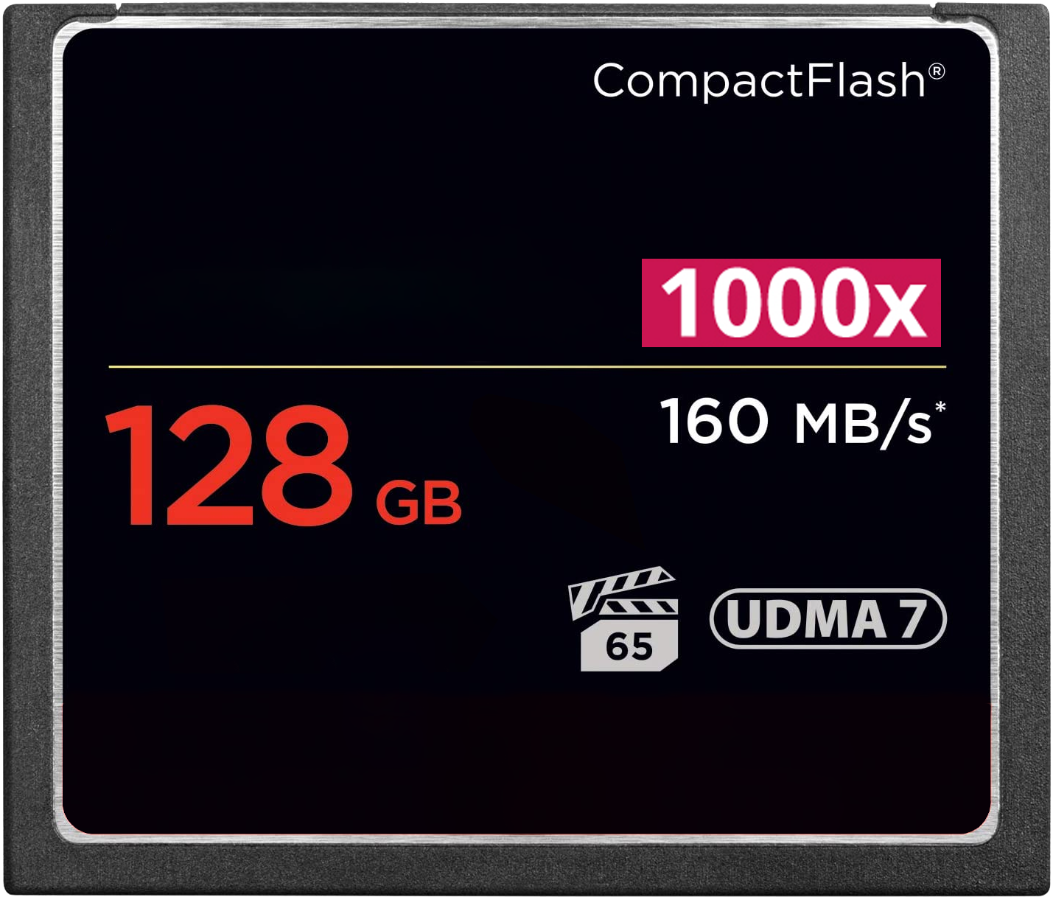
Compact Flash
Around since 1994
Larger and thus more durable than SD Cards
Lost market share to SD cards but still around
50-pin connector vs 9-pin SD Card (Generally faster)
Multiple of CD read speed (150 KB/s)
Capacity
Max read speed (MB/S)
Max bus read speed (UDMA 167 MB/s)
Minimum write speed in MB/s
ITFreeTraining.com
© Copyright 2023
Notes:
09:06 Compact Flash has been around since 1994. There were some other flash storage technologies before this, but Compact Flash replaces these and now those other technologies are obsolete. Compact Flash cards are larger than SD cards and thus more durable. Compact Flash lost a lot of market share to SD cards, but they are still used today. The main advantage to Compact Flash is it is more durable and generally faster than SD cards. Compact Flash has a 50-pin connector whereas an SD card has a 9-pin connector. Although having more pins does not always make something faster, in the case of Compact Flash it does.
Due to SD cards being smaller and getting faster, a lot of Compact Flash market share has been taken away by SD cards. You will find that, due to Compact Flash being more durable and generally faster some devices still support them. You will generally find that these devices are high-end devices where the data and speed is very important. For example, professional film equipment will often use Compact Flash. The equipment may also support SD cards, but you will find the serious professional using Compact Flash over SD cards.
When looking at Compact Flash there are a few things to look at to give you an idea of what you are buying. The simplest is the capacity, in this example 128 Gigabytes. Essentially, this is how much data can be stored on the Compact Flash.
In some cases, your Compact Flash may have a number followed by an X. This is an older standard and newer Compact Flash may not have it. This is a multiple of the minimum speed for a CD ROM. Since CD ROMs are so old nowadays and the speed of flash memory has improved so much, this figure does not have much meaning, so you can see why it is often left out.
The next figure is the maximum read speed. Keep in mind that this is essentially the maximum speed that the Compact Flash will operate at, and it is unlikely to be able to sustain that speed for a long period of time. Generally, speeds like these are burst speeds and the actual speed you get starts dropping pretty quickly.
The next specification is UDMA which stands for Ultra Direct Memory Access. This is basically a specification of how fast the bus from the device to the Compact Flash card is. In the case of UDMA7 this is 167 Megabytes per second. In my opinion, this specification does not help that much because it only gives bus speed, not an indication of how fast the flash memory is. If you have a really fast bus but the memory speed is slow, your performance will still be slow.
If you are purchasing Compact Flash for professional use, the most important specification is the number with the film clapper icon. This figure is the minimum write speed in megabytes. Essentially, this means that the Compact Flash card will never drop below this write speed. This is extremely important for digital cameras, particularly when recording video. If the Compact Flash card can’t keep up with the speed the device is transferring data, this will result in lost frames. If you are a professional, you can’t afford to have that happen, so make sure this figure matches or is higher than what your equipment requires.
Compact Flash also comes in two different types called Type I and Type II. The difference is Type II is thicker than Type I and won’t fit in a Type I slot. Type I will however go into a Type II slot. With the increase in the amount of data that can be stored in flash, Type I Compact Flash have become the most common. Most devices have dropped support for Type II, so you may not come across it.
Often when you purchase equipment the device will say what requirements it needs for Compact Flash memory. You just need to make sure that the Compact Flash meets or exceeds those requirements. Now that I have looked at Compact Flash, I will next have a look at SD cards.

Slide 7
Secure Digital (SD) Cards
Introduced in 1999
SD Card
miniSD
microSD
ITFreeTraining.com
© Copyright 2023
Notes:
13:28 Secure Digital cards or better known as SD cards were first introduced in 1999. They come in three different sizes. The largest known as SD cards, the next miniSD, followed by the smallest microSD. Given the increase in flash storage size, you don’t tend to see miniSD used any more. In a lot of cases, you will find that when microSD is sold, an adapter is supplied to achieve the larger SD card size.
When this video was made, it was possible to purchase a microSD card with two terabytes of storage. With this kind of storage available, you can understand why manufacturers are making microSDs that can be used in more devices and then supplying an adapter. It makes more sense since their cards can be used in more devices rather than fewer.
SD cards come in a number of different types, so let’s have a look.

Slide 8
SD Card Types
SD
SDHC
SDXC
SDUC
SD Card Type
Minimum Capacity
> 2 GB
>32 GB
>2 TB
Maximum
Capacity
2 GB
32 GB
2 TB
128 TB
FAT12 FAT16
FAT32
exFAT
exFAT
Suggested Format
ITFreeTraining.com
© Copyright 2023
Notes:
14:27 Currently there are four different SD card types on the market. When you purchase a device, it will support a particular type and be backwards compatible with the older types. Rather than try and remember the abbreviations, I find it easier just to look at the capacity. You can see there is no overlap on what capacity each type has.
If you purchase a device, for example a dash cam, it will generally have on the packaging the maximum capacity of the SD card it will support. It is just a matter of purchasing an SD card that is not larger than what the device supports. So, I don’t personally worry about the abbreviations, I just look at the maximum capacity of the device. There are however some other things that you need to consider before purchasing an SD card.

Slide 9
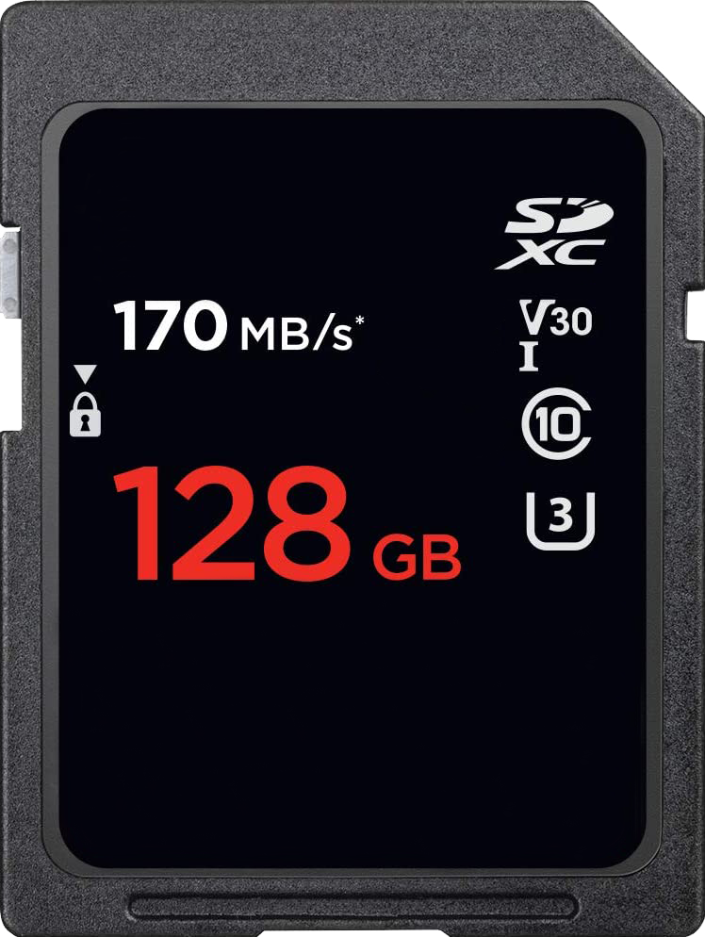
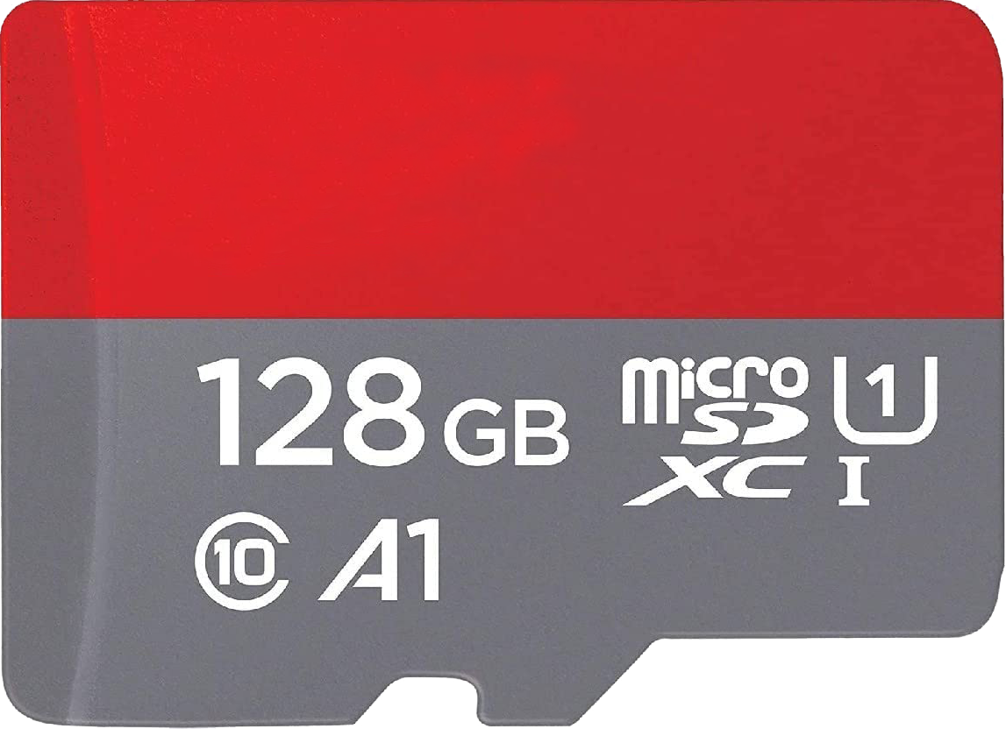
SD Card Ratings
Max read
speed
Standard
Min MB/s sequential writing
Capacity
Bus Interface UHS/I/II/III/Express
Speed Class
Highest 10 (MB/s)
UHS Class Speed
Write (MB/s)*10
Application Class
IOPS/write speed
ITFreeTraining.com
© Copyright 2023
Notes:
15:19 There are a lot of different ratings for SD cards. I have an example SD card and microSD card. The amount of information on them may seem confusing at first, but I think it makes it easier to understand if you consider that SD cards have gone through a number of different generations. New specifications were then added as the technology got better.
To start with, there may be a figure for the maximum read speed of the SD card. As with Compact Flash, this is a maximum speed and when the SD card is under load, it is unlikely to be able to maintain this speed for very long.
On the SD card there will also be a figure reporting how much data it can store, in the case of this SD card the amount is 128 Gigabytes. I will focus mostly on the SD card; however, you will notice that similar information is also printed on the microSD card.
On the SD card notice there is also a logo to indicate which standard the SD card was manufactured to. In this case the SD card has been manufactured to the SDXC standard. In most cases I will look at the maximum storage capacity the device will support, however if that is not listed, you can check the device to make sure it supports this standard.
In an attempt to make it easier for people to buy an SD card to meet their needs, there are specifications on the SD card that roughly fit into three different categories. I will start with the earliest standard before moving on to the newer ones.
The first standard was speed class. Speed class is pretty simple, it is essentially the minimum sequential write speed the SD card will support. In this case the class is 10 and thus the SD card will always, even under load, support at least 10 Megabytes per second. To make things a little more complicated the highest speed class is 10. When you purchase a device such as a digital camera, it may say it needs an SD card of a particular class, so you need to purchase a SD card of that class or higher.
If this specification only goes up to 10, a new specification was required for devices that are faster than class 10. The next specification is the video speed class that starts with a V. This once again gives a minimum sequential write speed; however, this is a multiple of 10. In this example the SD card will always perform a minimum of 30 Megabytes per second write speed, even under load.
The next specification is a number inside the U referred to as the UHS class speed. This is the minimum sequential write speed, and once again you need to multiply the number by 10. For this example, the minimum write speed would be 30 Megabytes per second.
The next specification appears on both cards; however, I will highlight it on the microSD card since it is getting a bit crowded on the SD card. This specification is the bus type. This will be I, II, III or Express. This is the bus from the device to the SD card. I personally look at the other figures because the bus speed does not give a real indication of how the SD card will perform.
There is also one other specification to look at. Keep in mind that these specifications are designed so a manufacturer can put this on the device box and the consumer will buy the right SD card. SD cards are now used in devices such as mobile devices, where the SD card is used to run applications rather than used to store pictures or videos as they were traditionally. Thus, another standard was needed if the SD card was going to be used for this purpose.
You will notice that this specification starts with the letter A followed by a number. This does not appear on the SD card, only the microSD card. My guess is, this is because you would want this specification if you are using it in a mobile device which nowadays all tend to use the microSD cards.
At the time of the making of this video there were only two application performance classes, these being A1 and A2. Both support a minimum sequential write speed of at least 10 Megabytes per second; however, what is different is the number of random IOPS it supports.
A1 supports a minimum of 1500 IOPS for reading and 500 IOPS for writing. A2 supports a minimum of 4000 IOPS for reading and 2000 IOPS for writing. A2 supports more IOPS than A1 does. In theory this should make the microSD work faster since it can process more instructions. In the real world, IOPS doesn’t mean anything unless the SD card is under load. The IOPS simply need to be high enough to support the number of instructions coming in. More is better, but you get to a point where more won’t increase performance. The IOPS just has to be high enough to support the load the storage is under.
In the case of mobile devices, applications are going to have more random reads and writes, thus generating more IOPS than tasks such as writing sequential video in a video camera. In this case, more IOPS makes sense. The IOPS specification can be a little misleading. IOPS are essentially like the tachometer in your car. The tachometer will show how many revolutions per minute the engine in your car is doing, but this does not mean anything until the car is put into gear and you get a true indication of how fast the car will go.
Putting all that aside, if I was to purchase a microSD for a mobile device, I would consider using an microSD with an A1 or A2 rating since this is designed for that purpose. SD cards without those ratings I would use for devices that write a lot of sequential data such as with video cameras or digital cameras.

Slide 10
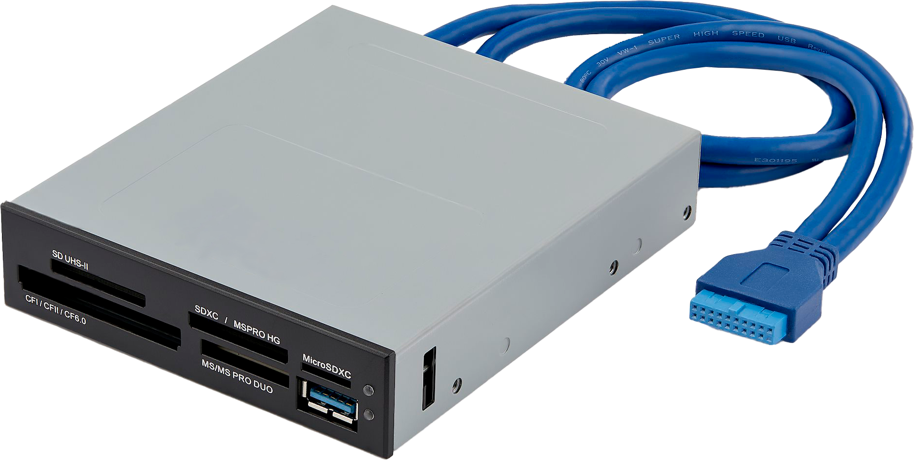
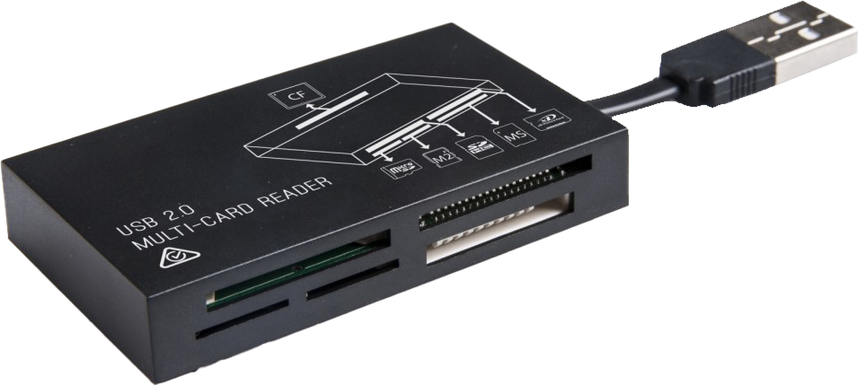
Memory Card Readers
Internal Card Reader
USB Card Reader
ITFreeTraining.com
© Copyright 2023
Notes:
21:44 The last topic I would like to cover in this video is memory card readers. Once you have put data on your SD card, you will need a way to transfer it to the computer. There are two types, and the first is an internal card reader.
Internal card readers are mounted in the computer case. Usually, they will plug into the motherboard using a USB plug. The other type is a USB Card Reader. These simply plug into a USB plug in your computer. If you do decide to purchase one of these, have a good look at what is available. Nowadays, you can purchase a USB hub with a card reader as well. Some of them also have other capabilities like video and audio. It may be worthwhile purchasing one of these
all-in-one units rather than buying a card reader and a separate USB hub.

Slide 11
Subscribe
Next video
Video content: https://ITFreeTraining.com/ap/3c50
© Copyright 2023
Notes:
22:38 That concludes this video from ITFreeTraining on removable flash memory devices. I hope this video helps you understand a little bit better about what storage devices to buy to meet your needs. Until the next video from us, I would like to thank you for watching.
References
“The Official CompTIA A+ Core Study Guide (Exam 220-1001)” Chapter 6 Paragraph 243-261
“CompTIA A+ Certification exam guide. Tenth edition” Pages 425 – 429
“CompactFlash” https://en.wikipedia.org/wiki/CompactFlash
“UDMA” https://en.wikipedia.org/wiki/UDMA
“Graphic: SD Cards” https://en.wikipedia.org/wiki/SD_card#/media/File:SD_Cards.svg
Credits
Trainer: Austin Mason http://ITFreeTraining.com
Voice Talent: Tomislav Krevzelj
Quality Assurance: Brett Batson http://www.pbb-proofreading.uk

