Slide 1
Notes:
In this video, I will look at Solid-State Drives. Solid-State Drives have become more popular than hard disks as they have better performance. In this video, I will have a look at how they work and what you can use them for.

Slide 2
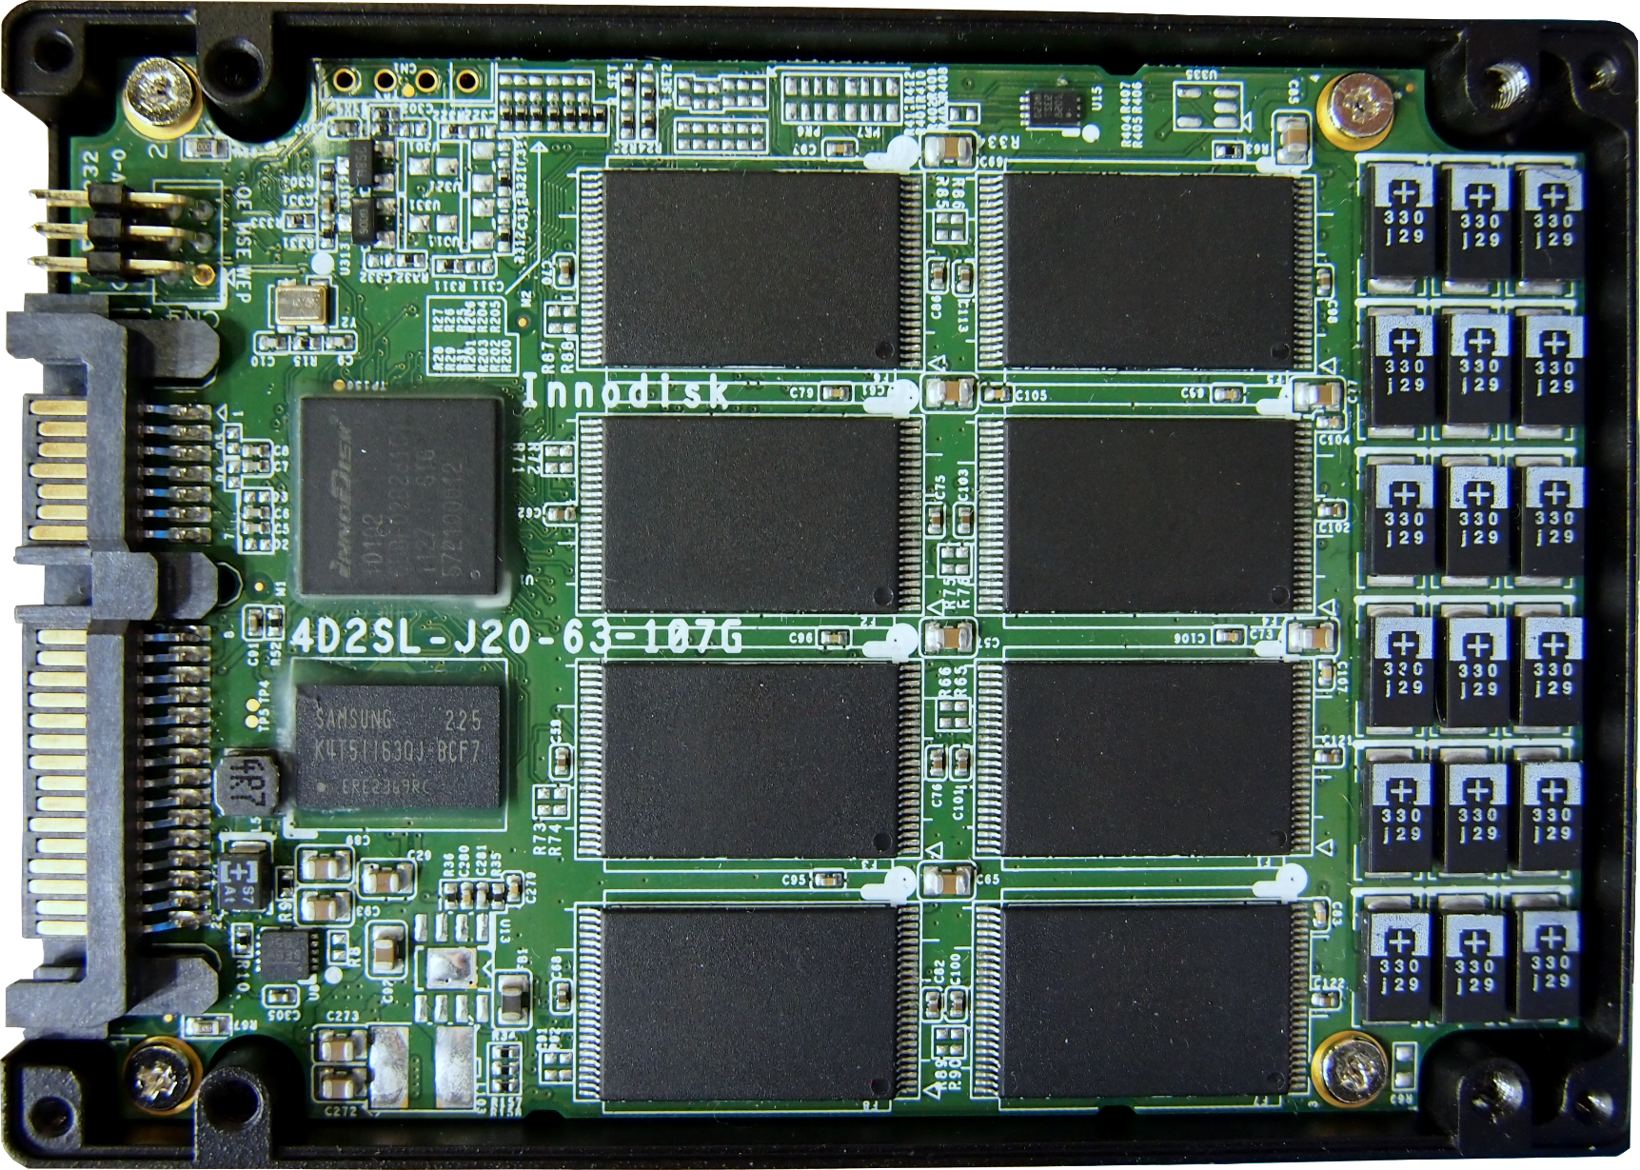
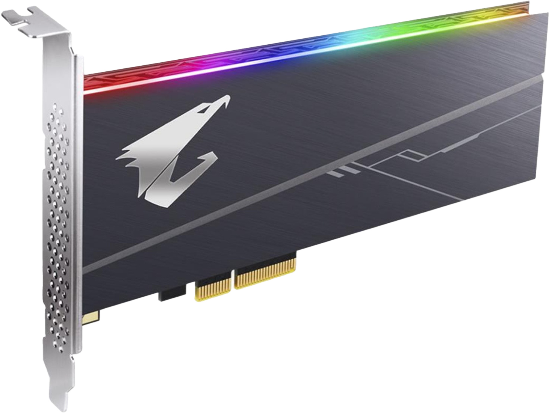
Solid-State Drive (SSD)
Uses integrated circuits to persistently store data
Commercially available in 1991
Solid State Drive
(In SATA case)
PCIe SSD
(PCI Express)
M.2
(NVMe/AHCI)
ITFreeTraining.com
© Copyright 2023
Notes:
00:15 Nowadays, Solid-State Drives or SSDs generally come in three different types. These are, Solid-State Drives, PCI Express and M.2. These all essentially use integrated circuits to persistently store data. This means once the data is written, it will still be available if the computer is switched off. Although they look different, they all use the same kind of chips to store data and, thus, are all considered to be Solid-State Drives.
Solid-State Drives became commercially available back in 1991. Back then, to be compatible with existing computers, they used the same connections as hard disks. Thus, the initial Solid-State Drives were functionally the same as hard disks; however, the technology used to store data was different.
Solid-State Drives can also plug into PCI Express slots. These are usually marketed as PCIe SSD. These were a bit more popular in the old days;, however, with the increased use of M.2 Solid-State Drives, they are becoming less popular. Nevertheless, they still get used in server systems, and later in this video I will look at when and why you would use them.
M.2 Solid-State Drives have become very popular. These storage devices use a small circuit board that can easily be installed onto a motherboard. They have become so popular that, in a lot of cases, they replace the other two types of Solid-State Drives.
Regardless of which Solid-State Drive you use, they all use flash storage in order to store data. Before I look at these storage devices in more detail, I will first look at how flash storage works in these devices.

Slide 3
Non-Volatile NAND
No charge or charge indicates zero or one
Gate
Gate
Source
Drain
Source
Drain
Electricity flows
Contains no charge
Contains charge
ITFreeTraining.com
© Copyright 2023
Notes:
02:00 Most Solid-State Drives use non-volatile NAND memory. To start with I will look at how a simple cell works. The cell essentially has three parts, the source, drain and gate. I won’t go into too much detail on how they work. Let’s consider the first example where there is no charge in the cell. When power is applied between the source and the drain, there is a gap between them. With no charge in the cell, the power will not be able to jump between the source and the drain.
The other state of the cell is when it contains a charge. When power is applied to the source and the drain, this time the power can jump between them with the added help of the charge in the cell.
No charge is logically equivalent to a zero value being stored in the cell; and a charge being equivalent to a one value stored in the cell. The drain is used to either remove the charge or add charge to the cell. You can start to understand why read and write speeds are different. Reading the cell is quite fast;, however, writing to the cell means either draining or filling the cell with charge which takes more time.
This is a basic design, so let’s look at how the basic design has been changed to allow more data to be stored.

Slide 4
SLC/MLC/TLC/QLC
SLC
MLC
TLC
QLC
Single-Level Cell
Multi-Level Cell
Triple-Level Cell
Quad-Level Cell
1
1 1
1 1 1
1 1 1 1
1 1 1 0
1 1 0
1 1 0 1
1 1 0 0
1 0
1 0 1
1 0 1 1
1 0 1 0
1 0 0
1 0 0 1
1 0 0 0
0
0 1
0 1 1
0 1 1 1
0 1 1 0
0 1 0
0 1 0 1
0 1 0 0
0 0
0 0 1
0 0 1 1
0 0 1 0
0 0 0
0 0 0 1
0 0 0 0
Cells wear out faster/Slower performance/Less reliable
Increased Storage
ITFreeTraining.com
© Copyright 2023
Notes:
03:16 The cell I have already looked at is called a Single-Level Cell or SLC. Cells like these can only hold two values, but there are also other cells that have been developed. A Multi-Level Cell or MLC is able to store four values. It does this by changing the amount of charge that is stored in each cell. Essentially, it is just a matter of reading how much charge is in the cell. This is not as easy as it sounds, the process takes longer to read data, write data and the cells wear out faster.
The next cell type is Triple-Level Cell or TLC followed by Quad-Level Cell or QLC. Having more data stored in the one cell means that it wears out faster. Essentially, storing different amounts of charge in the cell and reading the amount of charge in the cell is harder. In order to achieve this, it requires more accesses to the cell which reduces its lifespan. Having to perform multiple accesses also reduces the performance of the cell. There are also problems reading small differences in charge in the cell and thus the more data housed in a single cell, the less reliable that cell is.
The big advantage is that the amount of data that can be stored in a single cell is increased. Storing more data in a single cell costs more due to the added complexity of doing it;, however, as more flash memory gets manufactured, the price comes down.
Although each cell can hold multiple values, keep in mind that they are still only one layer. Thus, they are considered to be 2D cell. There is also another method that is used to store ever more data.

Slide 5
V-NAND/3D NAND
Allows for more storage
Allows stacking of SLC/MLC/TLC/QLC
3D
Shorter electrical paths mean faster performance
Difficult to manufacture
2D
ITFreeTraining.com
© Copyright 2023
Notes:
05:00 To increase the capacity of flash memory, manufacturers have started stacking memory cells on top of each other. If you consider a 2D cell, it will be made into one plane of cells. Each cell may be able to hold multiple values, but it is still only one layer. A 3D cell is multiple cells stacked on top of each other – this is called V-NAND or 3D NAND.
Stacking multiple cells like this allows for more storage. The manufacturer can essentially stack other cell types. For example, you can stack the single bit cells or cells that store more than one bit. Also consider that the cells are stacked very close to each other, which means shorter electrical paths which translates into faster performance. The downside is that they are difficult to manufacture.
Due to the extra difficulty in the manufacturing process, the chips are subject to more critical manufacturing problems. This is less of a problem with the 2D chips, because if a single chip fails you simply replace the whole chip. A single failure of a 3D chip would be equivalent of multiple 2D chips failing. Having said this, even with the extra problems, the increased storage means they can be sold at a higher price. Thus, we are starting to see more and more of this technology used with Solid-State Drives.
Now that we understand how the cells work, let’s have a closer look at how a Solid-State Drive works at a higher level.

Slide 6
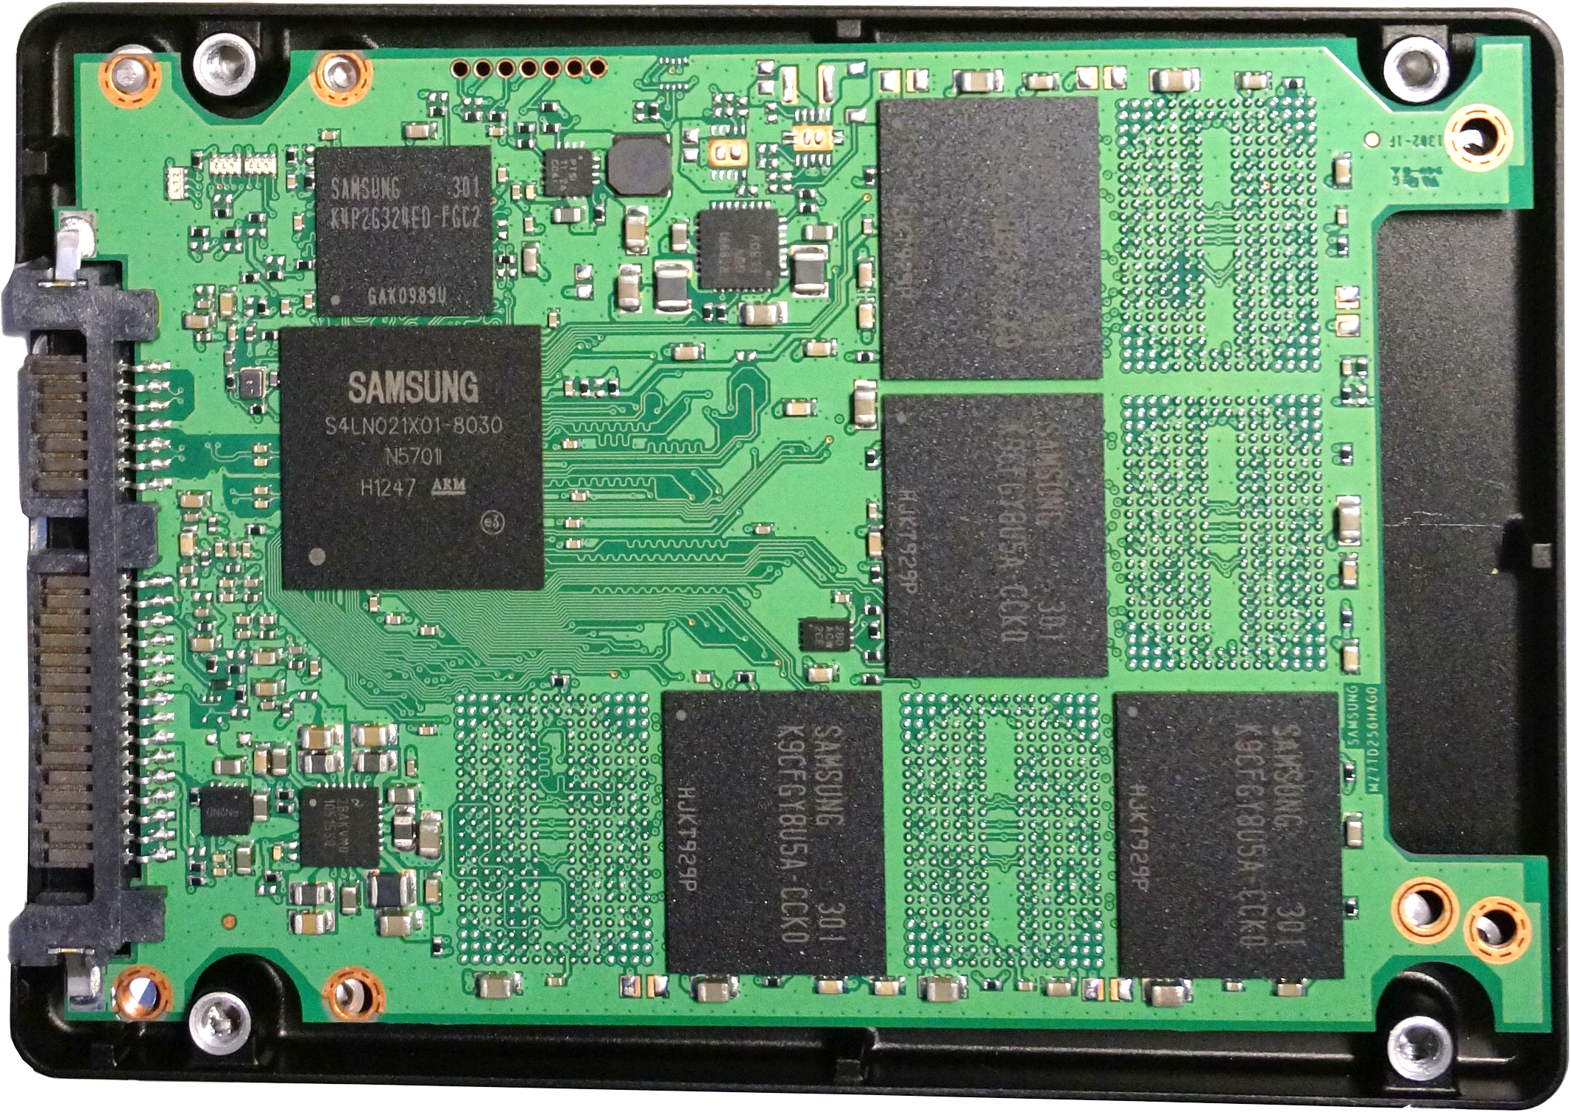
How They Work
DRAM/Cache
Controller Chip
Flash Chips
ITFreeTraining.com
© Copyright 2023
Notes:
06:35 To understand how Solid-State Drives work, let’s have a look inside one. There are a number of different chips inside a Solid-State Drive that make it work. Regardless of the interface or the design, the Solid-State Drive will work in a similar way.
The first chip I will look at is the controller chip. The controller chip, as the name suggests, controls the data flow between the other chips on the circuit board. It also takes the input from the computer and processes it.
Many Solid-State Drives will also contain a DRAM chip. The DRAM chip is used to cache data. This allows the Solid-State Drive to be more responsive when data is being written and also allows better scheduling of data transfer to and from the flash memory. This can make the Solid-State Drive perform better.
The controller on this Solid-State Drive supports eight channels. This means that one channel can access one memory chip. In this case, you will notice that there are four flash memory chips on the circuit board. However, there is space for eight memory chips. It is not uncommon for manufacturers to create one circuit board that can be used in many different configurations.
The main take away from this is that, unlike a hard disk drive where the head can only be in one place at a time, in the case of this Solid-State Drive, it can access four chips, all at the same time. This means it could be reading from one chip while writing to another chip. Using the buffer allows the Solid-State Drive to better schedule the reads and writes from these chips.
Let’s have a closer look at how a cache like this can affect performance of a Solid-State Drive.

Slide 7
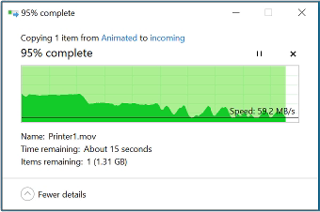
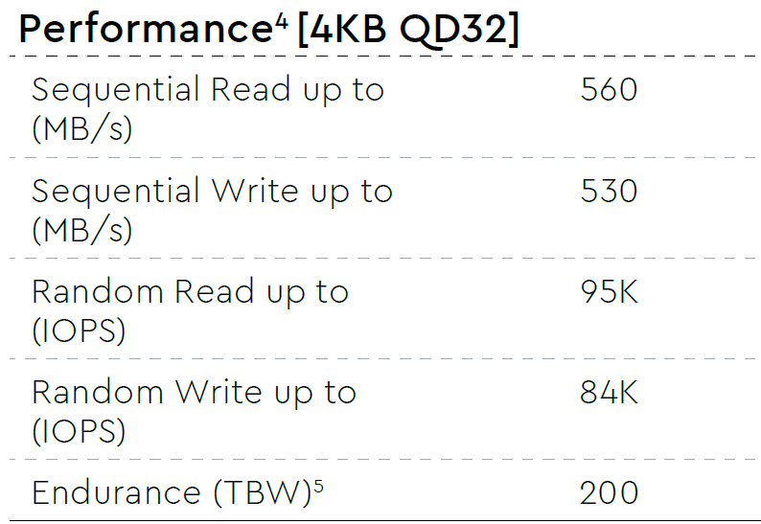
SSD Cache
Once cache is full performance will fall
ITFreeTraining.com
© Copyright 2023
Notes:
08:16 To understand better how the cache affects performance, I will copy a large file to a Solid-State Drive. You will notice that writing to the Solid-State Drive starts out at just under 400 Megabytes per second. As the cache starts getting full, performance drops to below 300 Megabytes per second. The estimated time to complete will also go up due to the drop in speed.
Remember also that the cached data is being transferred to the flash memory. So essentially, as the cache is filling up, the controller is attempting to remove data from the cache by transferring it to the flash memory. You will notice that eventually the controller will not be able to keep up and the cache will become completely full. When this occurs, you will notice the performance will reduce to under 100 Megabytes per second. Also notice that it will start to fluctuate. At the start, the write speed was pretty constant. As time passed, it dropped and started to fluctuate.
The cache thus performs two functions. It allows an initial burst in performance and smooths out the transfer rate. However, once the cache is full it can no longer do this. This is seen by the drop in performance and the fluctuating transfer rate. When purchasing a Solid-State Drive these are performance factors to consider. The specification of the Solid-State Drive may include performance specifications like the ones shown.
You will notice the maximum write speed for sequential writing is listed as 530 Megabytes per second. The best we achieved was 400 Megabytes per second. These maximum figures are always higher than what you will generally get in practice, because they are calculated under perfect conditions and using good hardware. For example, using different motherboards you may get different results. The point to take away is to read the specifications carefully. Often the manufacturer will release their specifications saying ‘up to’, which is essentially saying the best performance you can get under the best conditions. Also, as we have seen, this performance won’t last long.
Now that we understand how the cache works, let us next have a look at how memory is organized in a flash drive to give you an idea what can affect performance.

Slide 8
SSD Pages
Page is smallest unit that can be read/write to
Block
Page
Page
Page
Page
Page
Page
Page
Page
ITFreeTraining.com
© Copyright 2023
Notes:
10:39 Solid-State Drives are designed very differently from hard disk drives. If you are familiar with how hard disks store data, you may have heard the term sector being the smallest unit that you can read and write to. In the case of a Solid-State Drive, the smallest unit that can be read or written to is a page. Page sizes differ depending on the Solid-State Drive.

Slide 9
Write Data Example (Full SSD)
Data
Block
Used
Used
Used
Used
Data added to
existing page
Used
Used
Steps involved
Block
Block
Block
Used
Used
Used
Used
Used
Used
Used
Used
Used
Used
Used
Used
Used
Used
Used
Used
Data
Used
Used
Data
1) Read pages in block
2) Add data
3) Write pages to block
ITFreeTraining.com
© Copyright 2023
Notes:
11:02 To understand a bit more about Solid-State Drives, let us consider an example of writing data to the drive. For the sake of making the example simple to understand, let’s consider that the Solid-State Drive is close to full.
Let’s now look at the steps involved to write the new data to the Solid-State Drive. The first step is to read the blocks that are already in the page.
The next step is to add our new data to the existing data. This will need to be done in memory. Later in the video I will have a look at that process in more detail.
The last step is to write all the blocks back. So, you can see that, in this example, adding data to the Solid-State Drive involved three steps. In this process there was one read and one write. You can start to understand why a Solid-State Drive’s performance may start to reduce when writing data. If the Solid-State Drive needs to do a lot of reading in order to write data, two accesses will be required rather than one. Let’s look at a different example.

Slide 10
Write Data Example
Data
Data written directly to free block
Block
Block
Block
Used
Used
Used
Used
Data
Used
Used
ITFreeTraining.com
© Copyright 2023
Notes:
12:06 Let’s consider an example of a Solid-State Drive that has a lot of free space.
Since the Solid-State Drive has a lot of free space, there is some data on the drive but a lot of blocks that have no data.
The fastest way to write new data is to find a free block and simply add the data to this Block. Since we don’t have to add data to an existing block, this can be done in one write. You can see why performance of a Solid-State Drive will start reducing as it starts getting full. This is because more data rearrangement needs to be done in order to write the data. Rearranging the data means for every write, at least one read must occur which slows everything down. With a lot of free space, you don’t need to read anything or rearrange anything when you are writing.
Think of it like this, if you have a storeroom with a lot of free space, you don’t have to be careful about where you put anything. When the storeroom gets full, you may need to move some items around to make room for new items to be put in the storeroom.
Unlike hard disks, Solid-State Drive cells wear out over time. This needs to be managed.

Slide 11
Wearing
Cells wear out faster the more they are used
Wear levelling distributes wear across SSD
Cold data swapped around with hot data
Cold
data
Hot
data
Hot data
Hot data |  | Hot data
Hot data
Hot
data
ITFreeTraining.com
© Copyright 2023
Notes:
13:18 The next consideration with Solid-State Drives is wearing. Cells in a Solid-State Drive wear out faster the more they are used. This becomes a problem when you have files that are written to often. For example, the file allocation table on a drive will be updated every time a change on the drive is made.
Files on the drive that are updated often are referred to as hot data. Data that is not written to often is called cold data.
To even out the wear across the Solid-State Drive, a process called ‘wear leveling’ is done. This essentially distributes the wear across the drive. Cold data is moved to where there is a lot of wear of the drive. Now, when hot data is re-written, it is re-written to the location where the cold data was.
You can see that a system like this helps spread the wear out over the Solid-State Drive. Without a system like this, particular cells that are linked to highly used files will quickly wear out. This can cause the Solid-State Drive to fail sooner than it should.
As the drive is used more and more, the data on the drive gets fragmented and there is data on the drive that is no longer needed.

Slide 12
Garbage Collection
Remove old data. Move data. Creates empty blocks
Block
Block
Used
Stale
Used
Stale
Used
Used
Used
Used
Used
Stale
Used
Used
Used
Garbage collection
Block
Block
Used
Used
Stale
Stale
Used
Used
ITFreeTraining.com
© Copyright 2023
Notes:
14:31 In order to help address problems like these, Solid-State Drives use ‘garbage collection’. This is the process of removing old data and moving data around to create empty blocks. To understand how this process works, consider that you have two blocks.
Garbage collection is the process of removing all the stale data and combining the data from multiple blocks into one. You can see in this example, once garbage collection has completed,
the stale data has been removed
The more empty blocks there are, the faster writing to the Solid-State Drive will be in the future.
However, there are some problems with garbage collection. The main one being that garbage collection needs a way of telling what data is no longer required. This is where the next feature comes into play.

Slide 13
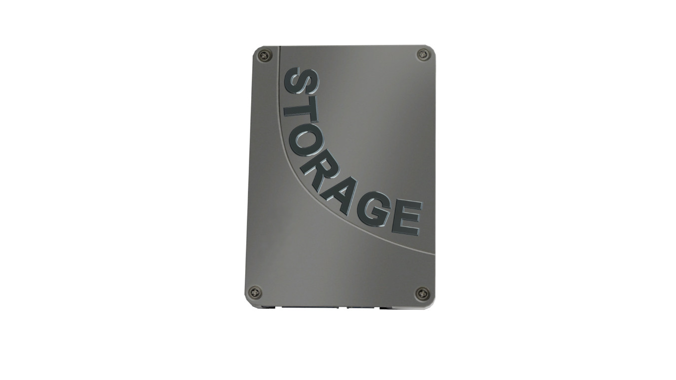
Trim
Inform the drive what data is no longer needed
File Allocation Table
C:\Pagefile.sys
C:\Bootmgr
C:\data\logs
C:\data\Wordfile
C:\data\Excelfile
C:\data\Accounts
C:\data\Clients
C:\data\Budget
C:\Pagefile.sys
C:\Bootmgr
C:\data\logs
C:\data\Wordfile
C:\data\Excelfile
C:\data\Accounts
C:\data\Clients
C:\data\Budget
C:\Pagefile.sys
C:\Bootmgr
C:\data\logs
C:\data\Wordfile
C:\data\Excelfile
C:\data\Accounts
C:\data\Clients
C:\data\Budget
Deleted
Deleted
Not needed
Deleted
Deleted
ITFreeTraining.com
© Copyright 2023
Notes:
15:19 To assist with garbage collection, the operating system can inform the Solid-State Drive what data is no longer required by using a feature called Trim. To understand better how Trim works, consider how a filesystem works. A file system will have a file allocation table or something similar. This keeps a record of where data is stored on a drive.
In this example, let’s consider a log file. The data for this file will be stored potentially in any location on the drive. The operating system keeps a record of where it is stored.
the filename is marked as deleted.
You will notice that the data on the drive is not deleted, and this is why you can use a recovery program to undelete deleted files. Essentially, the data is still there unless it is written over. The only thing that changes is that it is marked in the file allocation table as deleted.
When the operating system runs Trim, it tells the Solid-State Drive what data is no longer needed. Now when garbage collection is run, the Solid-State Drive has a better understanding of what data is required and what is not required.
With the way the operating system stores data, without Trim, the Solid-State Drive has no way of knowing which data is in use and which data is not. This means that during garbage collection, data may be moved around although it is no longer required. This will increase the number of writes on the Solid-State Drive and thus reduce its lifespan.
Assuming your OS and device support Trim, it will be run periodically by the OS. There is generally no need to run it manually as running it too often will actually increase the wear and tear of the SSD. I will now have a look at what you can do to increase the lifespan of your Solid-State Drive.

Slide 14
Reduce Wear
Reduce write amplification
Number of writes to the SSD
Use OS that supports Trim
Do not fill the SSD. (Keep below approx. 75%-80%)
Do not defragment
ITFreeTraining.com
© Copyright 2023
Notes:
17:10 In order to reduce wear on a Solid-State Drive, there are a few things you can do. By design, the drives are made to reduce write amplification. Write amplification is essentially about designing the Solid-State Drive to reduce the number of writes. This will be determined by the algorithm used by the manufacturer.
This is something you don’t have any control over. What you can control is using an operating system that supports Trim. Modern operating systems should support this. It will be on by default, so if you see the option don’t go switching it off. The only time you would consider switching off Trim is if you are attempting to recover lost data on the Solid-State Drive. In this case, you don’t want data you are trying to recover being deleted before you can recover it.
The next thing to consider is not filling the Solid-State Drive to capacity. There are a number of different recommended percentages that are given to keep the capacity below. It can vary a little depending on how often and what kind of data is stored on the Solid-State Drive, but around 75% to 80% is a good rule of thumb.
Once you start getting above this, writing new data to the drive will increase the chance that data will need to be rearranged to store the new data. This increases the number of reads and writes to the Solid-State Drive and thus reduces its lifespan.
The last thing to consider is not to defrag the drive. Defragmenting is the process of moving data on the drive so that it is laid out contiguously. Contiguous means in one place rather than scattered over the drive. In the case of hard disks this was important, as having the data scattered across the drive would mean the hard disk head would need to move multiple times in order to read the data. In Solid-State Drives random access is very fast. However, consider one other point. With processes like garbage collection operating, the data on the drive may be next to each other but reported by the operating system as not being. With Solid-State Drives there is no direct connection between where the operating system thinks that data is stored and where it is actually stored. In a hard disk, if data was stored on a particular sector on the hard disk, you could pinpoint the location on the hard disk. With Solid-State Drives the data could be anywhere.
Now that we have a good understanding of how Solid-State Drives work, I will next have a look at the different form factors that are available.

Slide 15
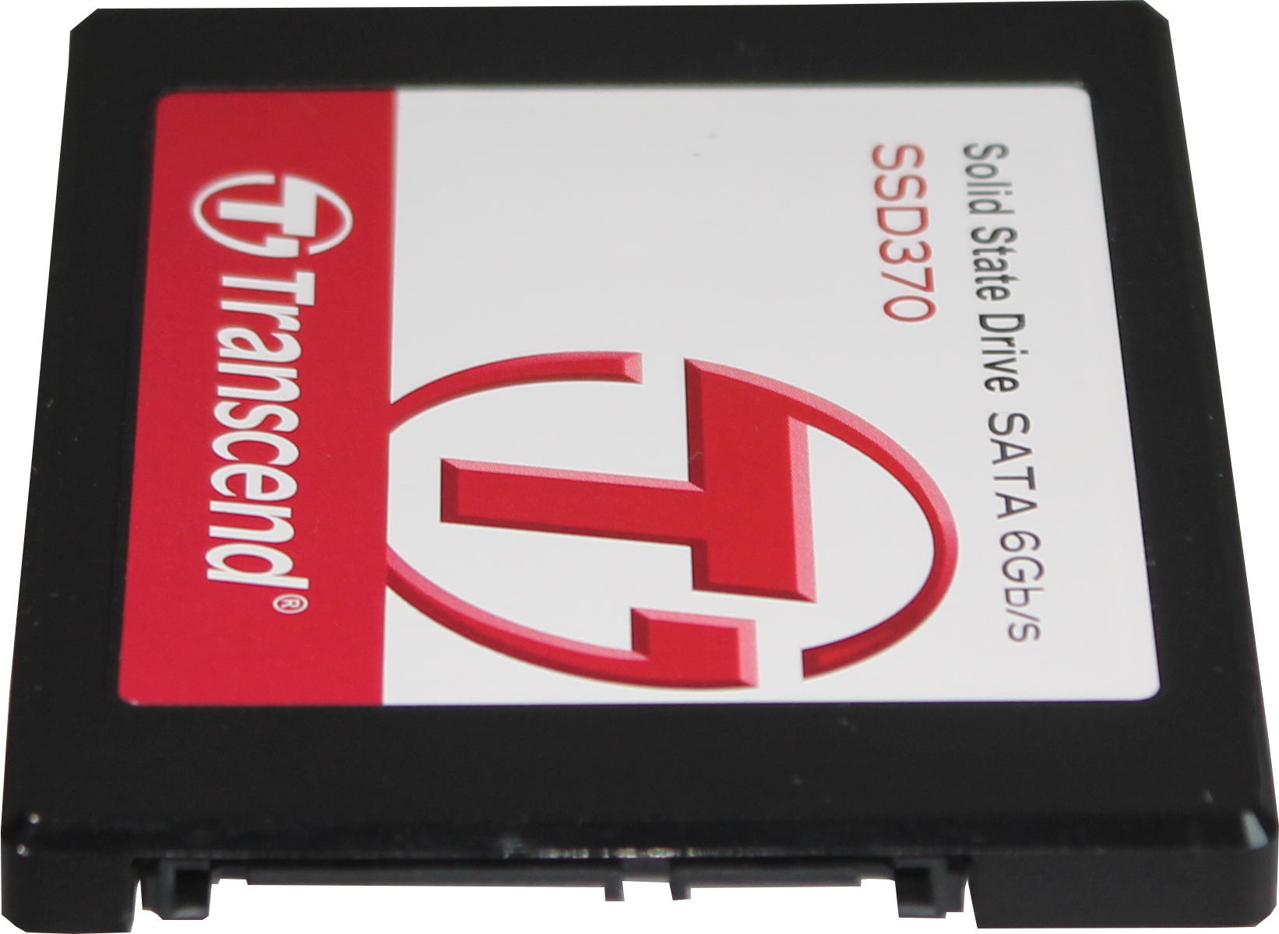
Solid-State Drive
First commercial Solid-State Drive
Thus, called Solid-State Drive
Compatible with older systems
Uses SATA interface
Limited to 600 Megabytes per second
Limited to AHCI protocol
Hot swappable
Requires hardware/software support
ITFreeTraining.com
© Copyright 2023
Notes:
19:45 The first form factor that I will look at is the Solid-State Drive. This was the first commercially available and thus is often called a Solid-State Drive. The other form factors that I will look at are also Solid-State Drives but are generally known by a different name in order to differentiate them from this one.
These Solid-State Drives use the standard HDD form factor, and thus are compatible with old systems. Therefore, they can be installed in a standard computer case. In some cases, you may need to use a mounting kit if you don’t have any 2.5-inch bays left, and you have to use a larger bay.
These storage drives also use the SATA interface. This provides backwards compatibility with older systems; however, it does present some problems. The first problem is it limits the interface to 600 Megabytes per second. This was not a problem when Solid-State Drives first were released, but nowadays high-performance Solid-State Drives can function faster than the SATA interface allows. As we have seen, even if the Solid-State Drive can’t maintain a high write rate to the storage, the DRAM can run very fast. Thus, you want a fast interface to support that initial burst of fast activity to best utilize the DRAM in the storage.
The next problem is that SATA uses the AHCI protocol. AHCI or Advanced Host Controller Interface was designed more with hard disks in mind rather than Solid-State Drives. For this reason, it is not as efficient for Solid-State Drives.
The big advantage with Solid-State Drives is that they are hot swappable. The next form factors that I will look at are not. Keep in mind that in order to use this feature, it requires hardware and software support. Hardware support will come in a computer’s BIOS or UEFI. Software support will be in the operating system. Even if the hardware used in the Solid-State Drive supports hot swapping, the rest of the computer also needs to support it.

Slide 16
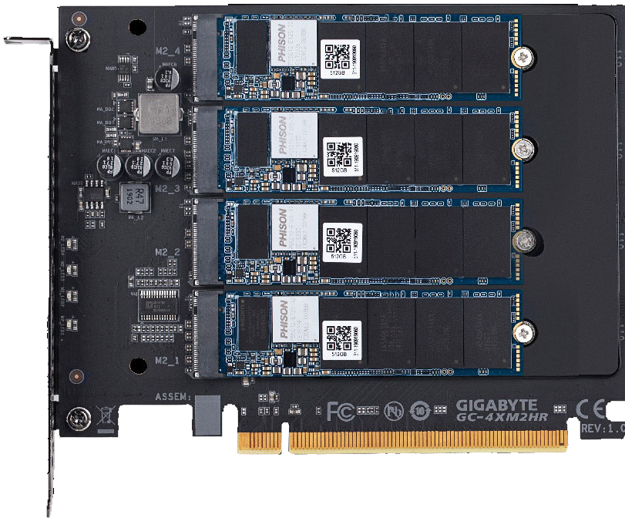
PCIe SSD
Up to 16 PCI Express lanes
Used in server/professional systems
M.2 nowadays more popular
Nowadays M.2 can use up to four PCIe lanes
May offer additional functions like RAID
1
Many PCIe SSD use M.2 SSD
2
3
BIOS needs to support PCIe booting
4
Otherwise, can be used as data drive
ITFreeTraining.com
© Copyright 2023
Notes:
21:56 I will next have a look at PCI Express SSD cards. These are cards that plug into a PCI Express slot in order to provide storage to the computer in the form of a Solid-State Drive. The advantage of using PCI Express is the card can use up to 16 PCI Express lanes. M.2 storage devices which I will look at next can use a maximum of four PCI Express lanes.
As we have seen, this extra bandwidth is useful if you have a lot of cache, as the computer can quickly transfer the data into the cache and write the data later on. However, as we have also seen, this is an initial burst and performance will drop off significantly if the computer keeps writing to the device.
These expansion cards potentially offer a fast interface, assuming they use more than four lanes, but due to the cost, are generally used in server or professional systems. Nowadays, M.2 has become very popular and offers good speed, so expansion cards like these are not used so much. M.2 can utilize up to four PCI Express lanes so can give good speed, thus reducing the benefit of expansion cards.
Expansion cards like this can offer additional functions;, for example, they may support RAID. In the old days, expansion cards were designed like the insides of the Solid-State Drive that I looked at the start of the video. That is, a circuit board with the controller and flash memory chips on it. Nowadays, you will often find that many PCI Express cards use M.2 storage.
In this example, you can see, inside the expansion card, there are four M.2 Solid-State Drives. I will cover M.2 shortly, but essentially, they are a Solid-State Drive on a circuit board that is about the size of a stick of gum. Nowadays, PCI Express expansion cards will either use M.2 Solid-State Drives or you will need to add them when you purchase the expansion card. It is becoming commonplace for the expansion cards to use M.2 Solid-State Drives. Given how popular they have become, it makes sense for the expansion card to use them.
Using an expansion card gives you the advantage that, if you do not have any available M.2 connectors, you can add a Solid-State Drive to your computer using the expansion card. Also, depending on the expansion card, you can add functions like RAID. RAID is the ability to have multiple storage devices working together as if they were one storage device. RAID can offer additional features like redundancy or increased performance.
PCI Express Solid-State Drives will require BIOS support in order to support booting. If your BIOS does not support PCI Express booting, the expansion card can still be used as a data drive. When you boot into your operating system you will then be able to access the storage as a data drive. Older computers will not support PCI Express booting; however, newer computers should.

Slide 17
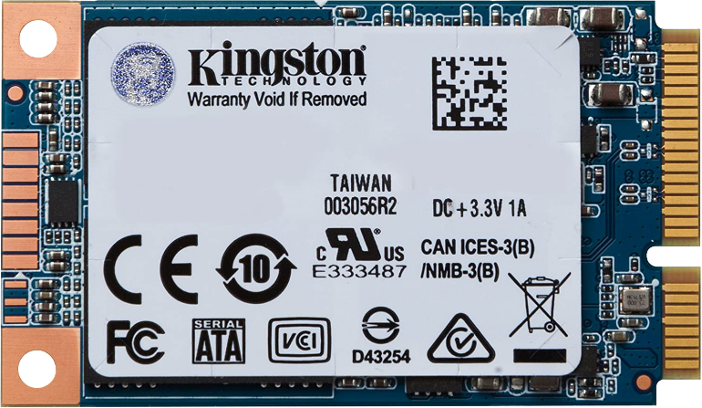
M.2 SSD
Next Generation Form Factor (NGFF)
Replaces mSATA standard
Internally mounted expansion card
M.2
mSATA
B + M-Key
M-Key
B notch
M notch
M notch
AHCI
NVMe
SATA
Up to four PCIe lanes
ITFreeTraining.com
© Copyright 2023
Notes:
25:03 The next Solid-State Drive that I will look at is the M.2 Solid-State Drive otherwise known as M.2 SSD or just M.2. The official name for M.2 is next generation form factor. This standard replaces the older mSATA standard. You can see in this example, this mSATA storage is shorter in width than the M.2 SSD. M.2 devices are always the same width; however, the length of them can vary. In the case of mSATA, they are limited to a smaller maximum size. mSATA was limited by the SATA interface and also had a limited area to put chips on. Essentially, M.2 offers a little more surface area than mSATA and, thus, allows for more storage on a single chip.
Regardless of which one you use, both are essentially an internally mounted expansion card. That is, it is a little board that is plugged into a connector on the motherboard. Later in the video I will look at how to install one.
M.2 keys nowadays are essentially sold in two different types. The first is B plus M-Key. M.2 used a notch system in order to determine which connectors the expansion card could be put into. In this example, you can see a notch at the top which is called the B notch.
The position of the notch from top to bottom is in alphabetical order. This will make sure that an M.2 expansion card can only be placed into a connection that supports it. In the case of B plus M- Key, this is designed to be able to be put into the B-Key and M-Key connections. To allow this, you will notice at the bottom of the expansion card is a second notch which is called the M notch.
Currently, Solid-State Drives on the market are B plus M-Key and M-Key. You can see the M-Key has a single notch. It would be possible to have a M.2 SSD drive that is B-Key only; however, it does not appear that you can currently purchase one on the market.
Most motherboards nowadays will use M-Key. So, either of these two can be used in this connection. The main difference between the two, other than the notches, is what interface they support. B plus M-Key supports Advanced Host Controller Interface or AHCI. This interface is used to support SATA devices. So essentially these M.2 SSDs are designed for backwards compatibility.
The AHCI protocol was designed with hard disks in mind and not Solid-State Drives. Thus, it does not handle things like multiple requests at the same time very well. Since hard disks have a head that moves across the drive and thus can only access one part of the hard disk at once, this is not a problem with AHCI. However, Solid-State Drives can have multiple chips which can all be accessed at the same time and, thus, you need a protocol that can support this.
In order to better support Solid-State Drives, Non-Volatile Memory Express or NVMe was created. This uses a protocol designed for Solid-State Drives. This gives you a performance boost. The next big advantage is that the SATA 3 interface is limited to 600 Megabytes per second. Also, in the case of M-Key, it is limited to four PCI Express lanes. The speed of these lanes is determined by the hardware in the computer.
The next thing to consider is which type is supported by your computer.

Slide 18
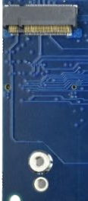
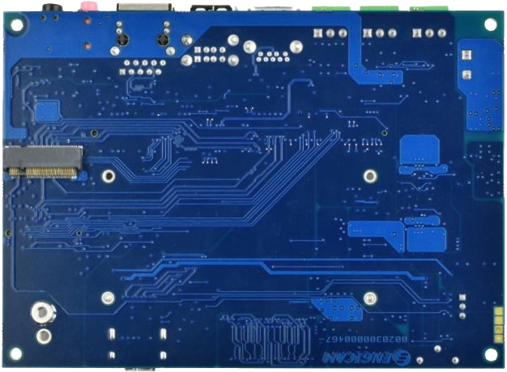
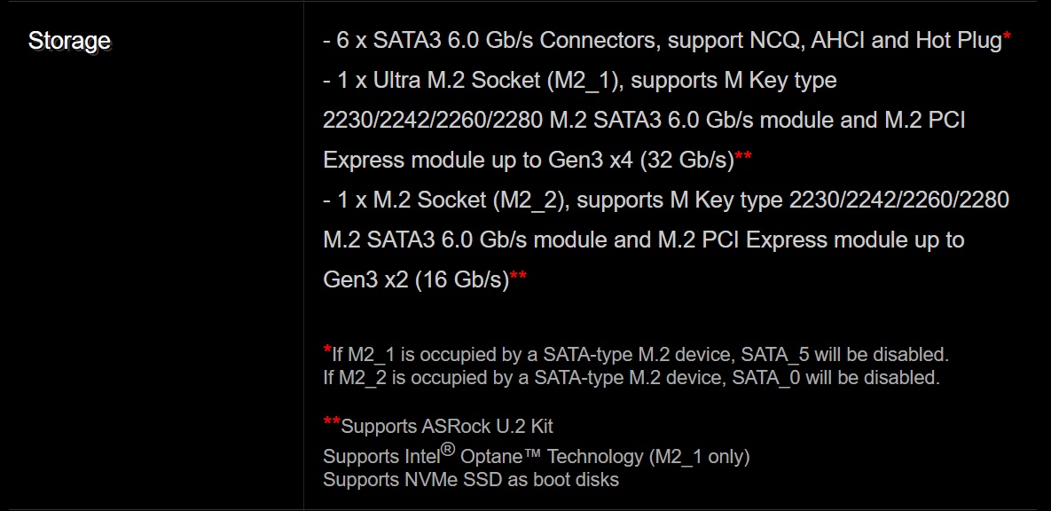
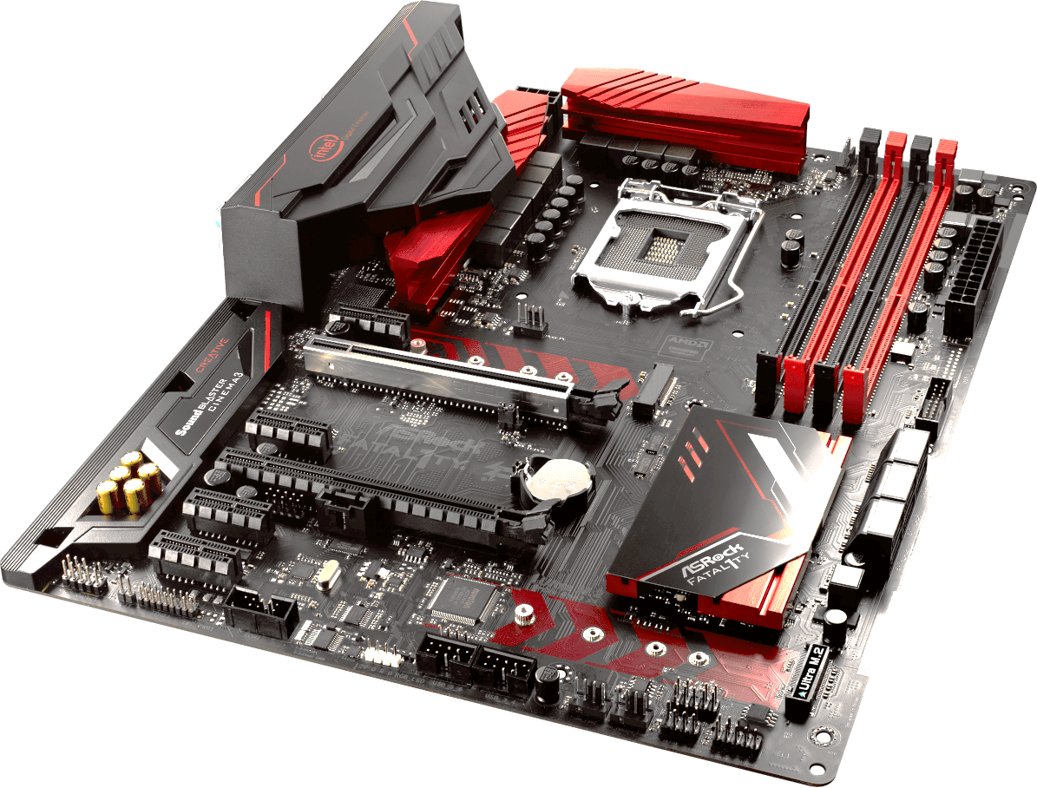
M.2 SSD Compatibility
Motherboards generally use M-Key
Some specialized/old boards may use B-key
B-Key Example
SATA3 (6.0Gb/s)
PCIe up to Gen3x4 (32 Gb/s)
SATA3 (6.0Gb/s)
PCIe Gen3x2 (16 Gb/s)
SATA port disabled if used
M-Key Example
ITFreeTraining.com
© Copyright 2023
Notes:
28:47 Generally, nowadays motherboards will use M-Key. You may, however, find that older computers, specialized motherboards and maybe some laptops use B-Key. In this example, you can see the B-Key connector is on the back of the circuit board.
To understand how compatibility works, I will have a look at an example motherboard. To understand what the motherboard supports, have a look at the specifications of the motherboard. On this particular motherboard there are two M.2 connections;, however, they are not both the same. It is important, if your motherboard has multiple M.2 connections, to use the one that meets your needs.
In this case, you can see the specification for the first M.2 connection. This connection firstly supports SATA3. So, you can use B plus M-Key M.2 SSDs on this motherboard. Notice also, that this connection supports up to four generation three PCI Express lanes. So essentially this connection supports B plus M-Key and M-Key. Notice the total speed supported is 32 Gigabits per second.
Next, consider the second connection. As with the previous connection, it supports SATA3 at 6 Gigabits per second. It also supports PCI Express; however, it supports only two generation three lanes. Thus, if an M.2 SSD was placed in this connection, it would be limited to 16 Gigabits per second. Thus, it is important when considering which connector to use, you don’t want to put your high-performance M.2 SSD in a connector that will underperform.
The next thing to consider is that on this motherboard, if a M.2 connector is used, an onboard SATA port will be disabled. Essentially, what is happening is the wiring for the SATA port is being re-routed to the M.2 connection rather than the SATA port on the motherboard. This motherboard has six SATA ports, so hopefully that is enough. However, it is important to know so you do not attempt to plug in a SATA cable into a SATA port that has been disabled. Also, if you plug in an M.2 SSD and a SATA drive stops working, you will know that you need to unplug the SATA drive and plug it into a different SATA port.
When you purchase an M.2 SSD, have a look at the specifications of the motherboard. This will help you work out which connection that you should put the M.2 SSD in. You don’t want to put your expensive M.2 SSD in a connection where it will underperform.
M.2 devices come in different sizes, so let’s have a look at some.

Slide 19
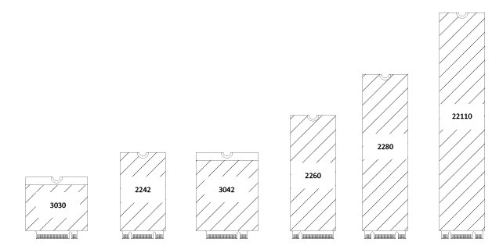
M.2 Form Factors
Width and Length (In millimetres)
22
E.g., 2280
22
22
110
22
30
16.5
22
30
80
60
42
42
30
30
30
ITFreeTraining.com
© Copyright 2023
Notes:
31:26 Shown here, you can see the common M.2 Form factors. The size of the form factor is given by its width and length in millimeters. For example, a common size is 2280. You will notice that most of the form factors are 22 millimeters in width. Wider and thinner form factors are used for other devices, for example Wi-Fi. Generally, M.2 Solid-State Drives will be 22 millimeters in width with a varying length.
Now that we have had a look at the different types of Solid-State Drives, I will next have a look at how to install and use them.

Slide 20
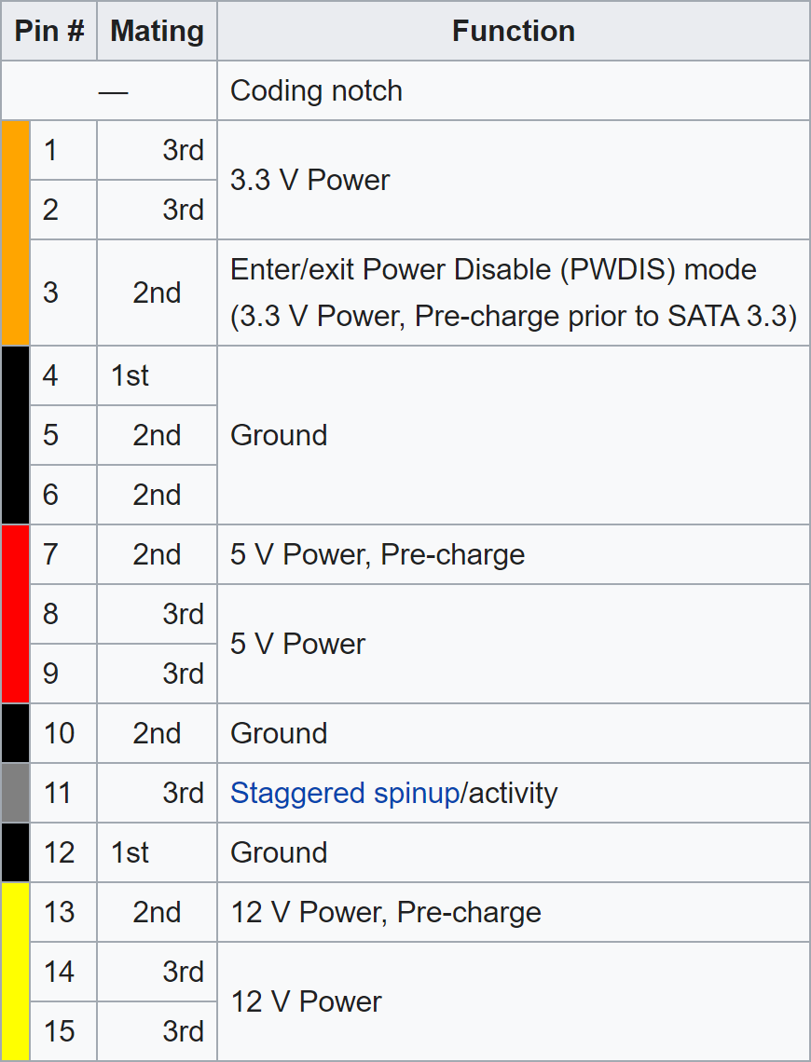
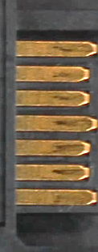
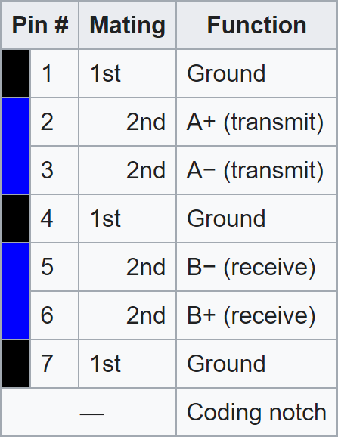
SSD Demonstration
ITFreeTraining.com
© Copyright 2023
Notes:
32:05 In this demonstration, I will install a Solid-State Drive which involves essentially plugging it in. In this case, it is a 2.5-inch Solid-State Drive. This was designed to be compatible with SATA hard disks, and thus uses the same connection. You will notice at the bottom of the drive, the SATA data connection and the power connection.
You can see that these connectors are L-shaped to prevent the connector being placed in the wrong way. The power connector supplies 3 volts, 5 volts and 12 volts of power. The pins are repeated; however, the pins themselves are of slightly longer lengths. This is done to support hot swapping. When the storage device is plugged in, the long pins will connect first allowing power to be drained from the connector to even out the power levels. This helps prevent a power surge damaging the device.
You will notice that the data connector has the same staggered pins to prevent a power surge damaging the device. SATA uses differential signaling to transmit data, so essentially two wires are used for sending and two wires for receiving. Using this method allows for less interference at higher speeds. This also, essentially, means that there is only the one bi-directional data channel. So effectively, this data connector only supports the equivalent of one data lane.
The next step is to plug the SATA data connector in. In the case of this motherboard, there are six different SATA ports. We will see shortly that different SATA ports may support different features. If you are not sure which ports support which, I would personally try the lower numbered SATA ports first. These generally have the most features. In some cases, the motherboard may have SATA 2 and SATA 3 connectors. If this is the case, make sure you don’t plug a SATA 3 drive into a SATA 2 port as it will underperform.
Once plugged into the motherboard, the next step is to plug the other end into the Solid-State Drive. Since the connector is L-shaped, it will only go in the one way. Don’t force the connector. If you find it does not go in, you probably have the connector upside down.
The next step is to plug in the power from the power supply. This is the same process as for the data connector. Like before it has an L-shaped connector and should just plug in. In this case, the motherboard is not in a computer case. Having the motherboard out of the computer case makes it easier to see some of the steps required. However, this does not show how to mount the Solid-State Drive in the case so it does not come loose.
To show how to mount the Solid-State Drive, I will mount it in this computer case that does not have anything installed in it as yet. Doing this gives us a clearer view of what is going on.
You will notice that when I have a closer look at the Solid-State Drive, there are screw holes on the sides and the bottom. Hopefully your computer case will have some places whereyou can mount the Solid-State Drive using these screw holes.
You will notice that, in this particular computer case, there is a place to mount a Solid-State Drive at the top and bottom. To use either, place the Solid-State Drive in your chosen position and then screw the drive into place.
It can be a little tricky but try to get one screw in first to hold the Solid-State Drive in place. The drives are not that heavy, so even one screw will be enough initially. Once you have it in place, put in the other screws. If you are having a lot of trouble, turn the computer case on its side to make it easier. In some computer cases, parts of the computer case may pull apart to make things easier.
In a lot of cases, it is a lot easier to plug the Solid-State Drive cables in first before mounting the drive in the computer case. This is assuming the cables are long enough. With some computer cases, the back panel of the computer case can be removed. For this computer case, the back panel can be removed by removing two screws from the back. You will notice that once the back panel is removed, it makes it a lot easier to get to the plugs at the back of the Solid-State Drive.
As before, the next step is to plug in the data cable. Once this is plugged in, next plug in the power cable. Depending on your computer case, there may be a number of places to mount a Solid-State Drive, it is just a matter of knowing where to look. Old computer cases won’t have as many options, whereas newer computer cases will have them in places you may not expect to see them.
In this computer case, you will notice that you could mount the Solid-State Drive at the bottom. Solid-State Drives are only two and a half inches wide. Before this, the bays in a computer case were five and a quarter and three and a half inches. Although 2.5-inch Solid-State Drives are becoming more common, computer case manufacturers like to give the purchaser some options so the computer case can be used for a lot of different purposes.
You will notice the large bays at the top, where a Solid-State Drive can also be mounted on its side. You will notice on this computer case, there are some notches to help hold the drive in place. Your instruction manual will list all the places that a drive can be mounted;, however, if you don’t have access to the manual, have a look around for little hints to where you can mount a drive.
In some cases, you may not have anywhere that you can mount the drive to. When this occurs, you can purchase an SSD tray. This is essentially a tray that allows the Solid-State Drive to be mounted into a 3 1/2 inch bay or a 5 1/4-inch bay.
Before installing, you will want to put the tray in the computer case to make sure it is oriented the correct way. Do things such as check the screw holes line up. If you install it in the wrong orientation, you won’t be able to get all the screws in or the drive won’t line up correctly. Also, make sure it is oriented so the data and power plugs are facing the right way.
Once you work out which way the tray needs to be installed, next work out which way the Solid-State Drive needs to be attached to the tray and screw in the Solid-State Drive to the tray. Like everything else on the computer, make sure each screw is finger tight.
Every computer case is different. Some computer cases are designed so you won’t require any screws but instead have special clips that attach to the drive in order for it to be installed. In this computer case, notice that on one side is a rail. Given the orientation of the bays, it would not be possible to have screws in the front, unless the front of the computer case could be removed to access the screws.
In order to use the rails, two screws need to be put in the tray, however these are not screwed in very far. The idea being the screws will go into the rail to support the tray. These screws have a flat top; if the screws were bulkier, they may stick out too far and prevent the tray going into the guide rail of the computer case. Try a few different options and see what works best.
Next slide the tray in. It should go in nice and easy. The last step is to screw the last two screws in place. You can get away with not putting all the screws in; however, the more you put in, the more secure the drive will be, keeping it secure if the computer gets moved. Also, putting all the screws in adds a little more professionalism. If you ever pull apart a computer and notice that everything is not plugged in correctly or there are screws missing, it does not look like a quality job. You don’t want that kind of feedback coming back to your employer that you did a second-rate job because you did not put all the screws in to hold the drive in place.
Now that I have had a look at how to mount a Solid-State Drive, I will go back to our Solid-State Drive that I plugged directly into the motherboard. In some cases, it is easier to look at the motherboard outside the computer case to get a better understanding of what is going on. I will now switch on the computer so I can have a look at the computer’s setup to work out how to configure the drive. In the case of this computer, to access the BIOS, I need to press the delete key when the computer first starts up.
This is an old computer, so the BIOS is limited in features. Later in the video I will look at some newer setups; however, it is good to know the older systems in case you need to support them. To start with I will select the menu option “Standard CMOS Features”.
This will show some of the basic settings of the computer. Notice that it shows four IDE channels;, however, no storage is shown. Some BIOS will show SATA drives here, some will not.
I will now exit back to the main menu and select the option “Integrated Peripherals”. This allows us to enable and disable components on the motherboard and perform some configuration.
At the top, notice the option “OnChip SATA Controller” is set to “Enabled”. I will change this option to “Disabled” which will effectively disable SATA and reset the option backs to its default. This is one of the first troubleshooting steps you should perform; if SATA has been disabled then you won’t be able to use your storage in the computer. The first step is to enable it by selecting “Enabled”.
The next step is to make sure SATA is configured correctly. The next option down “OnChip SATA Type” will determine what mode the SATA controller will operate in. Currently, because it has been reset when I disabled the SATA controller, it is set to “Native IDE”. In this mode, it is backwards compatible with older hard disks. If you are having compatibility problems you may need to configure this; however, this should only be a problem with very, very old hard disks. If you come across a hard disk that requires this, personally I would consider replacing it.
The next option is “RAID”. RAID is when multiple storage devices are used together for performance or redundancy reasons. In later videos I will have a look at this in more detail. The last option is “AHCI” – this option you generally want to use, particularly with Solid-State Drives. AHCI supports new features like Trim and thus your Solid-State Drive is going to perform better with it.
A word of warning here, if you change your system from “Native IDE” or “AHCI” or the other way around, operating systems like Windows will most likely not boot up anymore. You may need to do a re-install to get it to work. There are workarounds, for example, before changing the BIOS, change the boot up of Windows so that it uses safe boot with a minimal set of device drivers. This will hopefully allow you to make the change. Once the computer is booting with the new setting, switch it off to boot without safe boot and minimal device drivers. The process is still risky, so I would back up the computer first. The simplest way to get around this when setting up a new computer is make sure that it is always using AHCI mode.
The next option down “OnChip SATA Port 4/5 Type” is currently configured to “IDE”. IDE is an old standard, so unless you have a need to use it, I would switch this to “As SATA Type”. In the case of this motherboard, there are six SATA ports, so this will make sure that all six are running to support SATA. Otherwise, your SATA drive may not work or it may run at a lower speed.
Now that this is configured, I will go back to the main menu and select the option “Advanced BIOS Features”. In this menu, I will cursor down to the option “Hard Disk Boot Priority” and select it. I have not done this to change the boot order, but do notice that I can now see my Solid-State Drive. Unfortunately, since this is an old BIOS, there is no other way to see what SATA drives are installed other than going into this menu. With a newer BIOS, it should be easier to see what SATA drives are installed.
Since I have made changes, I will press F10 to save the changes and exit the BIOS. That’s it for Solid-State Drives. I will next have a look at PCI Express Solid-State Drives to see what you need to know in order to use them.

Slide 21
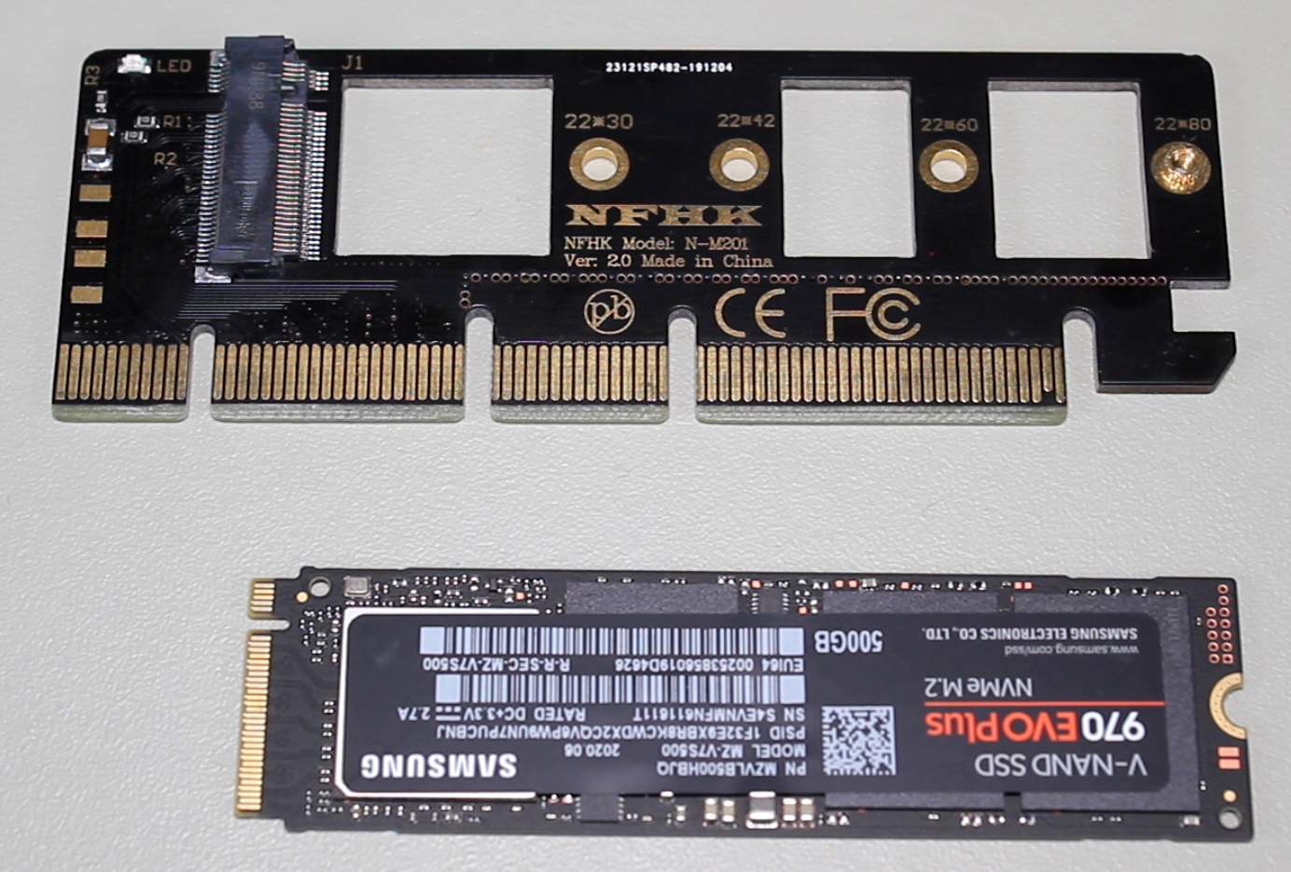
PCI Express Demonstration
M Notch
M Notch
ITFreeTraining.com
© Copyright 2023
Notes:
44:51 I will next look at Solid-State Drives that plug into PCI Express. Nowadays, if you purchase a PCI Express Solid-State Drive, it will most likely be a circuit board with an M.2 SSD inside. For this reason, I will look at a PCI Express adapter that an M.2 SSD can plug into. This board only supports the one M.2 SSD; however, larger ones support more and may support additional features such as RAID.
You can see at the end of the board is a stand-off. To the left of this are holes rather than stand-offs. When I take a closer look and compare it to the one next to it, you can see the one on the left has no stand-offs and the one on the right does. The one on the right being the 2280 form factor; 2280 is very popular, so you can understand why the stand-off has been put in this position by the manufacturer. If I had a smaller M.2 form factor, I would need to remove the stand-off and move it to the required position.
The next step is to install the M.2 SSD. In this example, I am going to use an NVMe M.2 SSD. Essentially this is an M.2 Solid-State Drive that supports PCI Express. You will notice that both have the M notch. This board is very simple in design. It basically connects power and PCI Express lanes directly to the M.2 device. Thus, if you plug an M.2 SSD in that does not support PCI Express, it will not work. Although it is possible for an M Type board to support PCI Express and SATA, generally they only support PCI Express. If I attempted to plug a B + M board in, it most likely would not work. The reason for this is these boards tend to only support SATA. This PCI adapter board only supports PCI Express M.2 devices.
Although possible for either to support both, due to the extra difficulty and cost of supporting both, you will generally find that B + M supports SATA and M supports PCI Express. Thus, make sure when you purchase an M.2 SSD, you purchase the one that is compatible with your computer.
The next step is to plug the M.2 SSD into the adapter. The process is the same if you were installing it on a motherboard. To install, insert the M.2 SSD into the connector at about a 30-degree angle. You may need to wiggle or push the board a little to get it to go into the connector. You should not have to apply too much force.
There is one screw that holds the board in place. In order to put the screw in place, push the board down so it is flat and then screw the screw into place. If everything went correctly, the board will be flat. Later in the video I will look at one of the cases where this may not occur.
Now that the M.2 SSD has been installed on the adapter, I will next plug the adapter into a spare PCI Express slot. It is important to make sure that you plug it into a PCI Express slot that will support the adapter. On this particular motherboard, this slot has four lanes and M.2 supports a maximum of four lanes, so this is enough. If you put the adapter in a slot with less lanes, its performance may be reduced or it may not work. If you are using an adapter that supports functions like RAID, it is possible that it may be able to utilize more than four lanes, so check the specifications before installing to ensure you get the best performance.
Now that the adapter is installed, I will switch the computer on and go into the BIOS. Notice that when I go into “Advanced BIOS Features” and select “Hard Disk Boot Priority” you will see that the Solid-State Drive does not appear. This is because this computer is too old to support booting from PCI Express. However, if I install the operating system to another drive, it will be able to use the SSD as a data drive. To get the best performance, you want your operating system to utilize a Solid-State Drive if possible. You could use a Solid-State Drive with a SATA interface like the one I looked at earlier, but there is also another solution if you want to use an M.2 SSD.

Slide 22
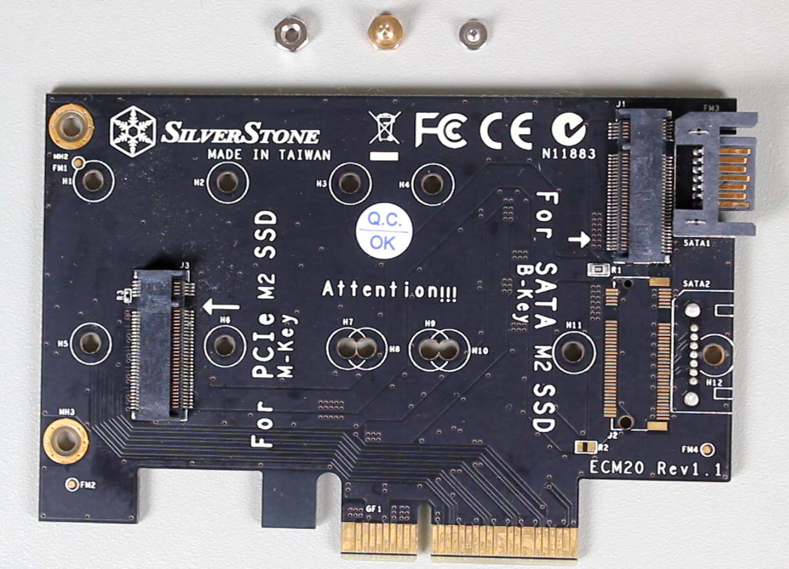
PCI Express SATA Adapter
B Notch
SATA
M Notch
ITFreeTraining.com
© Copyright 2023
Notes:
49:22 The next adapter card that I will look at supports both B-Key and M-Key. An M-Key connector is the same as the last adapter that I looked at; however, the B-Key has a SATA connector. This allows an M.2 SSD on this board to use one of the existing SATA interfaces on the motherboard. It requires the SATA data cable; however, does not require a SATA power cable since it gets its power from the PCI Express slot on the motherboard.
You will notice that the stand-offs on the board have not been installed. So, they will need to be put on the board before I can install an M.2 SSD. For this adapter, there is a bolt, stand-off and a screw that needs to be used to secure the M.2 SSD to the board. There is an M-Key and a B-Key; there are two sets since both connectors can be used at the same time. There are a number of screw holes, so you will only need to select the one that meets your needs. In most cases this will be the 2280 form factor since this is very common.
The first step is to place the stand-off in the board and then use the bolt to hold it in place. You will notice that the stand-off is essentially a metal screw with another screw hole in the top. Essentially it is used as a spacer to prevent the M.2 SSD touching the board.
To install the stand-off, I will place it in the 2280 hole on the adapter, flip it over and then attach the bolt. Once the first one is installed, I will install the second one since I will use both connectors. Even if you are not planning on using the connectors, I will generally install them on the board anyway, so they don’t get lost or I don’t have to find them when I need them. It is usually a lot less work to move the stand-off, if required, rather than having to search the storeroom to find the screws and bolts.
Now that the stand-off is installed, the next step is to install the M.2 SSD. I will first install my B plus M-Key M.2 SSD. You will notice this will go into the M-Key connector. Remember, this board only supports PCI Express so the M.2 will not work if I use this connector. Thus, I will remove it and place it in the other connector. As before, I will need to screw it into place.
Since this adapter has the second connector, I will also install a second M.2 SSD;, however, this one will be an M-Key, since it will need to support PCI Express. I will next plug the adapter into the motherboard. Like the previous adapter, it uses four lanes. So, I will put it in the slot that only uses four lanes, so no lanes are wasted.
The last step is to install the SATA data cable. One end will go into the motherboard and the other will plug into the adapter. Since this motherboard does not support PCI Express booting, this is a workaround to get it to work. You could of course purchase a Solid-State Drive, but using this method reduces the number of cables by one and makes it look a little tidier. This is also an option to use a M.2 Solid-State Drive with an older computer that does not have M.2 connections. Now that everything is installed, I will switch it on.
Once the computer has started up, I will enter into the BIOS as before, select “Advanced BIOS Features” and then select “Hard Disk Boot Priority”. Notice that the M.2 SSD connected by the SATA cable is now being displayed; however, the second M2. SSD is not showing.
To demonstrate what effects this has, I will pause the video and start the Windows install process. I will return once Windows setup is asking where to install Windows.
You will notice that both the Solid-State Drives have appeared in Windows. The first storage is fine to install Windows on. However, notice that when I select the second storage, I get an error message saying that Windows can’t be installed on this drive.
When I select the message, notice that it states that Windows can’t be installed on this drive because the hardware inside the computer does not support booting from this device. To install Windows, I will need to select the first drive and press next. Thus, Windows is being installed on an M.2 SSD;, however, it is using the one that supports the SATA interface. I will now pause the video and return once Windows is installed.
Now that Windows is installed, I will open Windows Explorer, right click “This PC” and select “Manage”. To have a look at what storage is installed, I will select “Disk Management”. Notice that when I select “Disk Management”, I will get a message that an uninitialized disk has been detected. When storage is added to Windows, Windows will write a unique signature to the storage. This allows Windows to detect when storage is moved between different interfaces or storage adapters. For example, if the SATA data cable was unplugged and plugged into a different connector.
Notice that Disk 0 is the storage that Windows was installed on. Disk 1 is the second M.2 SSD drive. It is accessible in Windows; however, we won’t be able to use it for booting Windows from since the hardware in the computer does not support it. If you find that you are supporting an old computer, there are other alternatives.

Slide 23
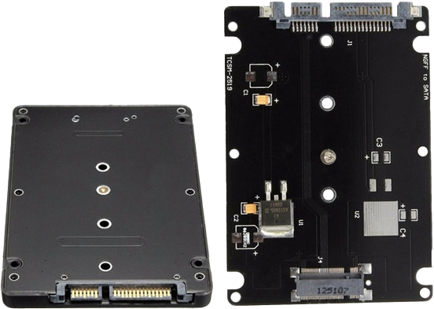
M.2 to SATA Adapter Case
Converts M.2 to SATA device
ITFreeTraining.com
© Copyright 2023
Notes:
55:06 One option is to purchase a case that converts an M.2 SSD into a Solid-State Drive that uses a SATA data and power connector. You will find that there are a lot of adapters on the market. If I were to take a guess of what was going to happen, I would say that M.2 SSD will become more popular and SATA Solid-State Drive less so. With the speed of Solid-State Drives currently limited to the SATA 3 protocol, unless that changes, you will get to a point that an M.2 SSD will easily outperform a SATA Solid-State Drive. When this occurs, you will probably see manufacturers put M.2 SSD in cases like these rather than make two different products. I could be wrong, the only way that we will know for sure is if we wait and see.
Now that I have had a bit of a look at M.2 SSD, I will now have a look at what can go wrong in the install of one.

Slide 24
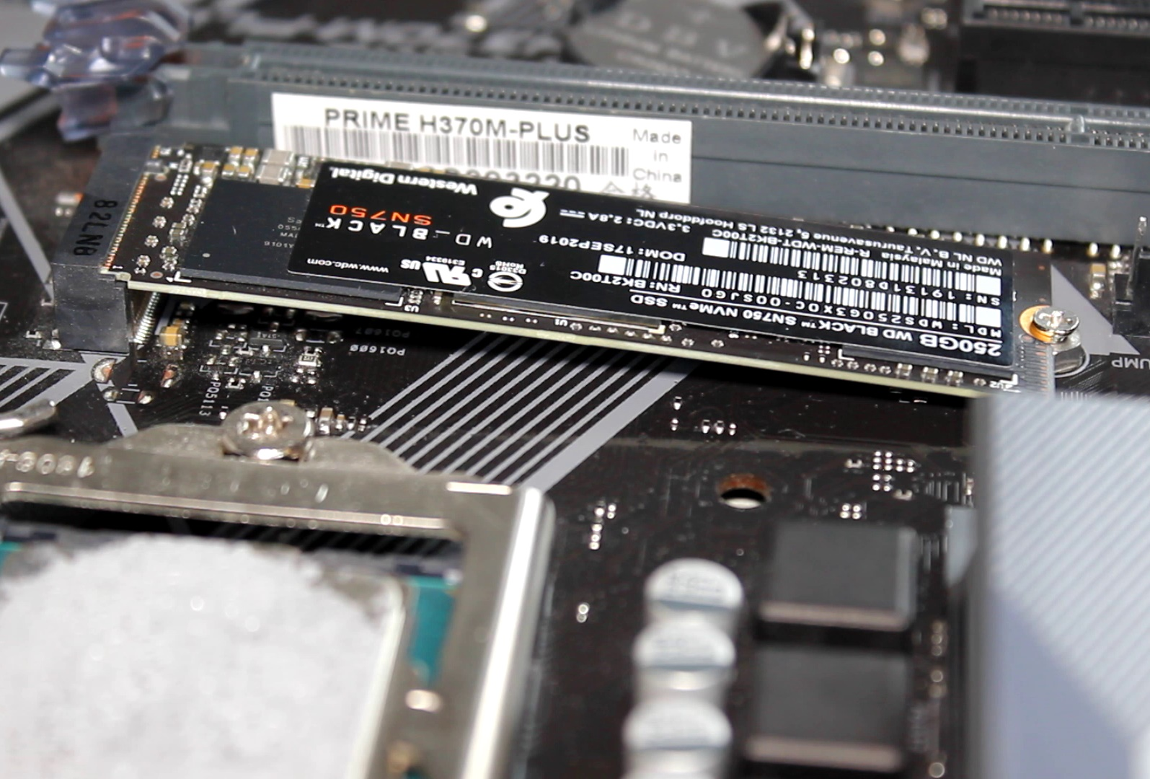
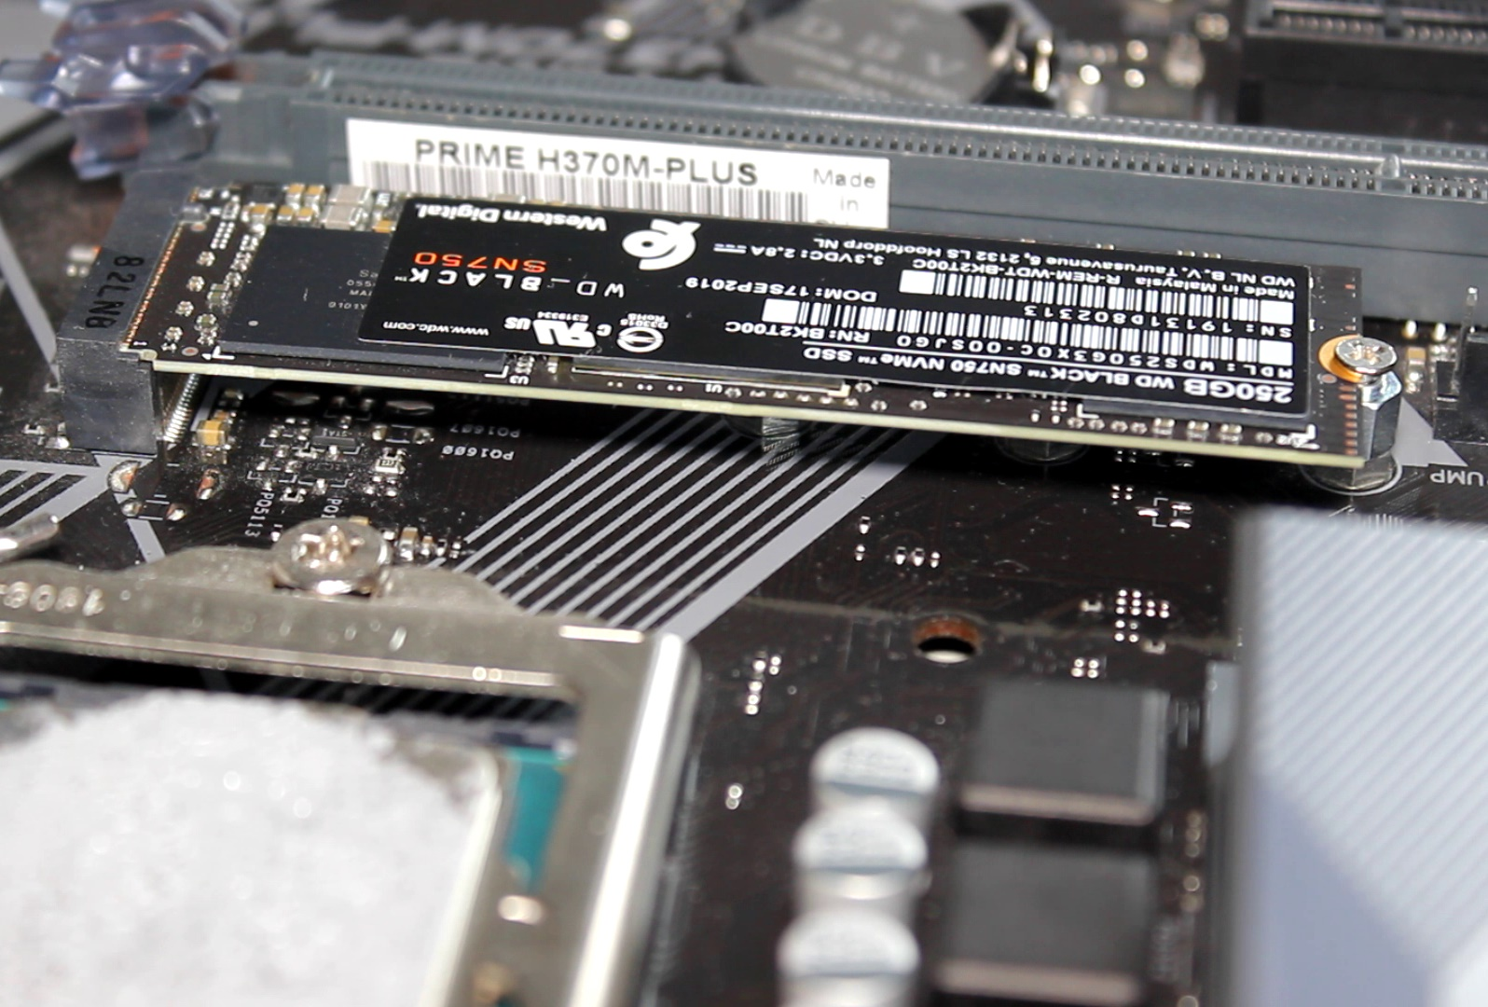
M.2 Demonstration Install
Incorrect
Correct
ITFreeTraining.com
© Copyright 2023
Notes:
56:08 On this motherboard, the M.2 SSD has been installed incorrectly. In this case, the board is at an angle rather than being parallel to the motherboard. It is a little difficult to see, but essentially it has been installed without using a stand-off. This is why it is at an angle down towards the motherboard rather than being parallel.
On this particular motherboard, a stand-off needs to be installed before the M.2 SSD is installed. These are similar to those used for the motherboard, but not exactly the same. If your motherboard uses them, they should be included in the box with the motherboard. Since the manufacturer of the motherboard is free to design their own, they may be difficult to get a replacement if lost. Not all motherboards will use stand-offs like these. Later in the video I will look at a motherboard that uses a different type.
Before I can install the stand-off, I will first have to remove the M.2 SSD. To do this, it is just a matter of first removing the screw that holds it in place. It helps if you have a magnetized screwdriver. Otherwise, you can use a three-prong part retriever like this one if you have it. Tweezers also work and if all else fails, you can try turning the computer upside down. The problem with this approach is the screw may get lost in a small recess inside the computer, so I would only do this as a last resort.
Once the screw is removed, it is just a matter of pulling the M.2 SSD out at a 30-degree angle. If all goes well, it should just pop out. Don’t lift it straight upwards as you risk damaging it.
On this motherboard, notice that it supports three different M.2 form factors, these being, 2280, 2260 and 2242. The stand-off needs to be installed for the form factor that you are using. In this case, the M.2 SSD was installed without the stand-off and thus appeared to be at an angle.
Before I install the M.2 SSD, I first need to install the stand-off in the 2280 position. It is just a simple matter to screw the stand-off in. If it is in a difficult to reach place, you may consider using a tool like a nut driver to get it into place, particularly if there are other components in the way such as video cards. In some cases, you may need to remove a few things in order to get to it. No one said working with computers is easy!
To re-install the M.2 SSD, push it into the connector on a 30-degree angle. It should click into place. As before, I just need to push the board down and screw in the screw to hold the M.2 SSD in place.
It is difficult to see the difference;, however, if I compare it to what it looks like now and what it looked like before, you can notice the difference. Not all motherboards will use stand-offs like these; however, if they do, make sure you use them, otherwise your M.2 SSD will be at an angle, putting additional stress on the connector.
On this motherboard, notice that there is room for an additional M.2 SSD. Your motherboard may have room for just the one or maybe a couple. They are starting to become more common on newer motherboards.
Consider how difficult it can be to get these stand-offs in. If I were building a new computer, I would put the stand-offs in before I installed the motherboard in the case. It is just easier to do it then, rather than trying to put them in when you have expansion cards, cables and limited room to work in.
The first thing I would do is locate the 2280 form factor position. If you are not sure, you can always look in the manual or use an existing M.2 SSD to measure it. Although it is possible to get M.2 SSD in other sizes, it seems the market for the moment has standardized on 2280. So, it is a pretty good bet that, when installing a new M.2 SSD, it will be that size.
As before, I will just screw the stand-off in. It can be a little tricky given that it is so close to an expansion slot, but like I said, it is a lot easier doing it before installing the motherboard than after. Also, since the stand-offs can be motherboard specific, it is best to keep them with the motherboard, so they don’t get lost.

Slide 25
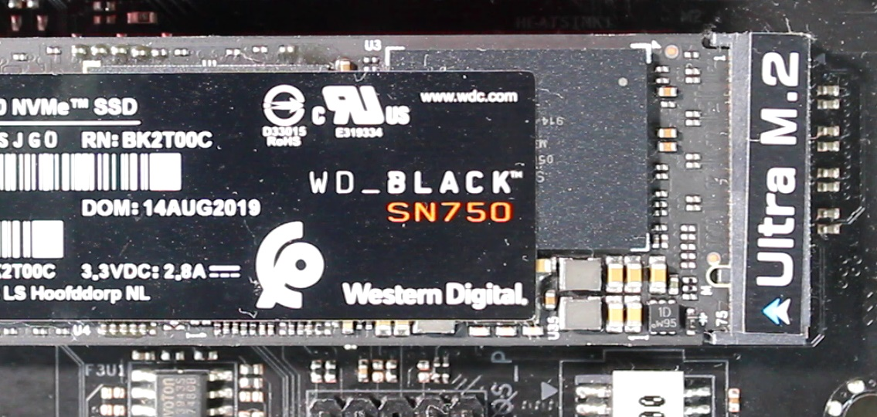
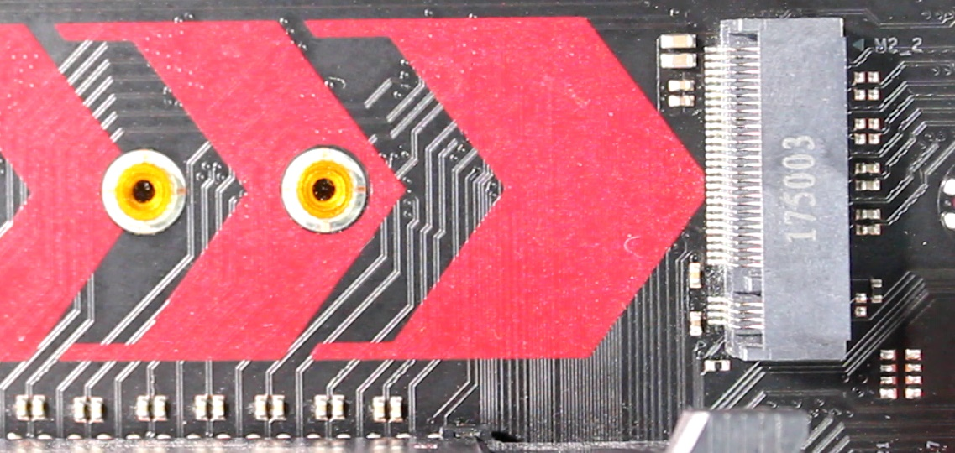
M.2 Interfaces Types
Fast Interface
Slower interface
ITFreeTraining.com
© Copyright 2023
Notes:
1:00:36 I will next have a look at a different motherboard. This will give you an idea how the stand-offs can change from one motherboard to another. On this motherboard, notice that the stand-off is pre-installed on the motherboard. There are holes for the other form factors;, however, the stand-off will need to be removed in order to utilize them.
You can see in this case, it is just a stand-off. There are no bolts or extra components holding it in. So, if you want to change the form factor, just remove the stand-off and screw it into the required location.
On this motherboard there are two M.2 connectors. Notice that one of them is marked as “Ultra”. This connector runs at a higher speed then the other one. If you have a high-speed M.2 SSD, you should put it in this connector rather than the other one to get the best performance. Depending on the motherboard, some connectors may be faster than others.
I will now start this computer up and enter the setup. This motherboard is a lot newer than the other motherboards that I looked at. Notice that in the “Storage Configuration” section, the SATA and M.2 drives are shown. The new motherboards will have better support and thus it is easier to see what storage is installed in the computer and also configure it. Since the computer supports the storage, you will also be able to install an operating system rather than just be limited to using the storage for data purposes.

Slide 26
Summary
SSD wear out. Use Trim. Keep below 75%-80% capacity
No Trim and high use increase wear for maintenance like garbage collection
PCI Express SSD
Most use M.2 SSD nowadays
Provide additional features. E.g., RAID
M.2 SSD
B + M-Key more compatible with older systems
M-Key gives better performance
ITFreeTraining.com
© Copyright 2023
Notes:
1:02:05 Before ending this video, I will do a quick summary of the major points. Solid-State Drives nowadays outperform hard disks. They fundamentally work very differently to hard disks. To get the most out of them and prevent wear, use an operating system that supports Trim and keep the data on the drive less than 75% to 80% of full capacity. Thus, when you purchase an SSD, purchase one with a bit more space than you need. Without Trim and the drive being near capacity, this increases the wear created by maintenance functions like garbage collection. If the data on the drive is not changing very often, this is not too much of a concern, but if you are writing to the drive often, this can significantly reduce the life of your Solid-State Drive.
PCI Express SSD was popular when it came out; however, Solid-State Drives with a SATA connection became more popular due to their backwards compatibility. With M.2 SSD becoming more popular, you will find that many PCI Express SSDs utilize M.2 SSD. The PCI Express SSD may come with some pre-installed, or you may have to install them yourself. The big advantage with PCI Express is they may provide additional features like RAID.
M.2 SSDs nowadays generally come in two types. These are B plus M-Key and M-Key. B plus M-Key use the SATA interface and thus is compatible with older systems. M-Key uses PCI Express and thus gives better performance; however, the computer will need to support it. Newer computers should support this.

Slide 27
Subscribe
Next video
Video content: https://ITFreeTraining.com/ap/3b25
© Copyright 2023
Notes:
1:03:48 I hope you have found this video on Solid-State Drives informative. Until the next video from us I would like to thank you for watching.
References
“The Official CompTIA A+ Core Study Guide (Exam 220-1001)” Chapter 6 Paragraph 125 - 139
“CompTIA A+ Certification exam guide. Tenth edition” Pages 292 - 294
“Solid-state drive” https://en.wikipedia.org/wiki/Solid-state_drive
“Coding for SSDs – Part 2: Architecture of an SSD and Benchmarking” http://codecapsule.com/2014/02/12/coding-for-ssds-part-2-architecture-of-an-ssd-and-benchmarking
“M.2” https://en.wikipedia.org/wiki/M.2
“Picture: Solid State Drive Inside” https://commons.wikimedia.org/wiki/File:Embedded_World_2014_SSD.jpg
“Picture: Inside SDD” https://upload.wikimedia.org/wikipedia/commons/f/f0/Samsung_SSD_840_120GB_MZ-7TD120--4_LID_REMOVED.JPG
“Picture: Grinder” https://pixabay.com/photos/angle-cutting-fire-grinder-heat-88524/
Credits
Trainer: Austin Mason http://ITFreeTraining.com
Voice Talent: HP Lewis http://hplewis.com
Quality Assurance: Brett Batson http://www.pbb-proofreading.uk

