Slide 1
Notes:
In this video from ITFreeTraining, I will be looking at storage adapters and the two main cables that you may come across when working with these devices. That is, SATA and SAS devices.

Slide 2
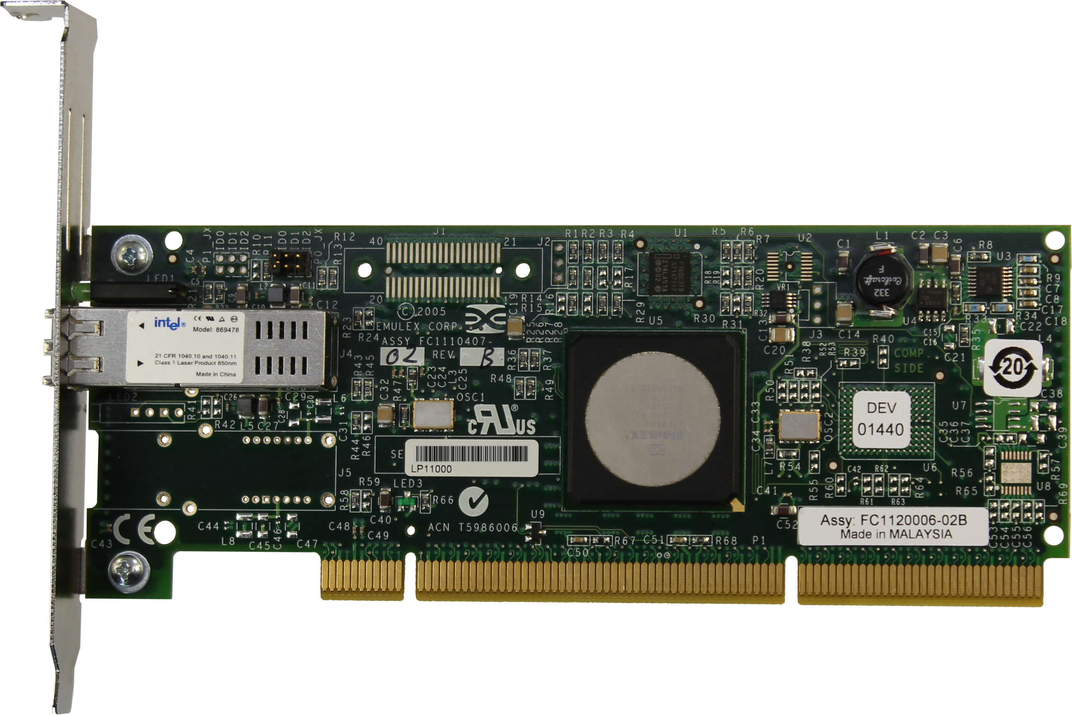
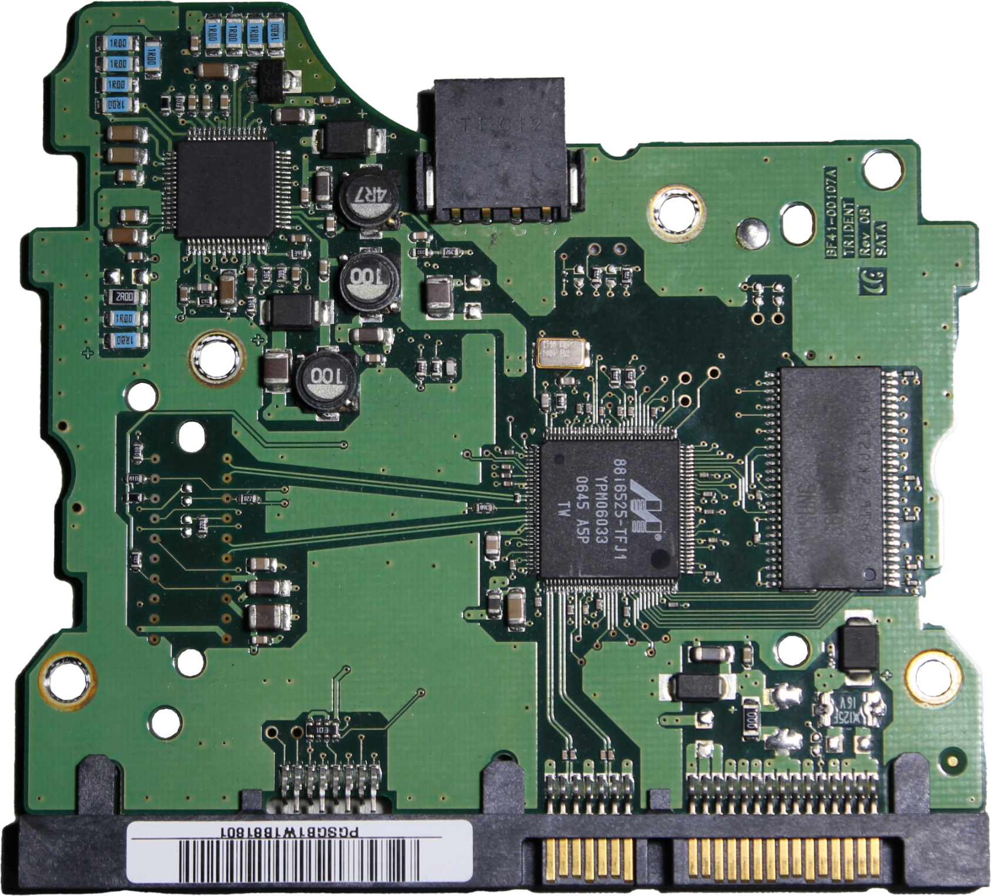
Definitions
Host Bus Adapters (HBA)
Drive Controllers
Circuits and bus
Circuitry only
ITFreeTraining.com
© Copyright 2023
Notes:
00:12 To start with, I will look at some definitions. The first one is Host Bus Adapter or HBA. An HBA is essentially the circuits and the bus that connects the device to the computer. In this case, the HBA is an expansion card. However, an HBA could also be an integrated circuit on a motherboard.
The HBA essentially contains the bus, processing and the connection to the device. The idea behind this is that it provides input/output processing between the host system and the connected device. HBAs have the added benefit that they relieve the host microprocessor of the tasks of accessing the device directly. This takes load off the microprocessor and other system components due to not having to worry about issuing low-level instructions to the device for things like buffering.
It is important not to confuse an HBA with a drive controller. A drive controller is essentially the circuit and other chips that control the device. This is different from an HBA in that this will connect to an adapter. For example, this circuit board is for a SATA drive. The cables will connect from the circuit board to the motherboard. On the motherboard will be a host adapter. This host adapter connects to the circuit board and provides the interface between the device and computer. So, this brings us to the next question: what is the difference between a Host Bus Adapter and a Host Adapter?

Slide 3
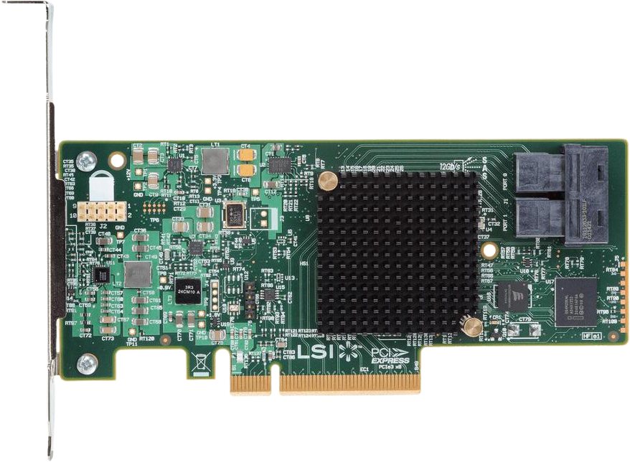
Host Bus Adapter and Host Adapter
Host Controller, Host Adapter, or Host Bus Adapter
Can be used interchangeably
ITFreeTraining.com
© Copyright 2023
Notes:
01:43 Shown here are two different expansion cards. The left one connects fiber devices and the right one connects SATA, SAS drives and also provides RAID services for those devices. Technically speaking, a Host Bus Adapter includes the circuits and the bus that connect it to the computer. However, there is always going to be a bus that connects the adapter, otherwise the data could not be transferred to or from the computer.
For this reason, these adapters will often be called Host Controllers, Host Adapters or Host Bus Adapters. So essentially, these terms can be used interchangeably. Therefore, don’t get too concerned which one is used, but understand that it is the hardware that controls data being transferred from the computer to the storage devices.
In order to connect a device to an adapter card like these, in most cases a cable will be required.

Slide 4
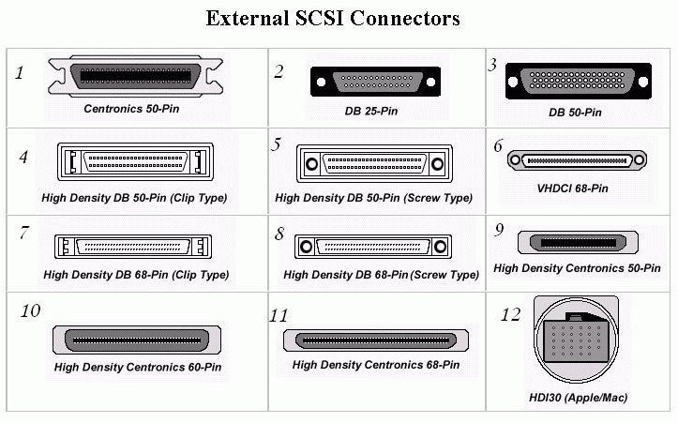
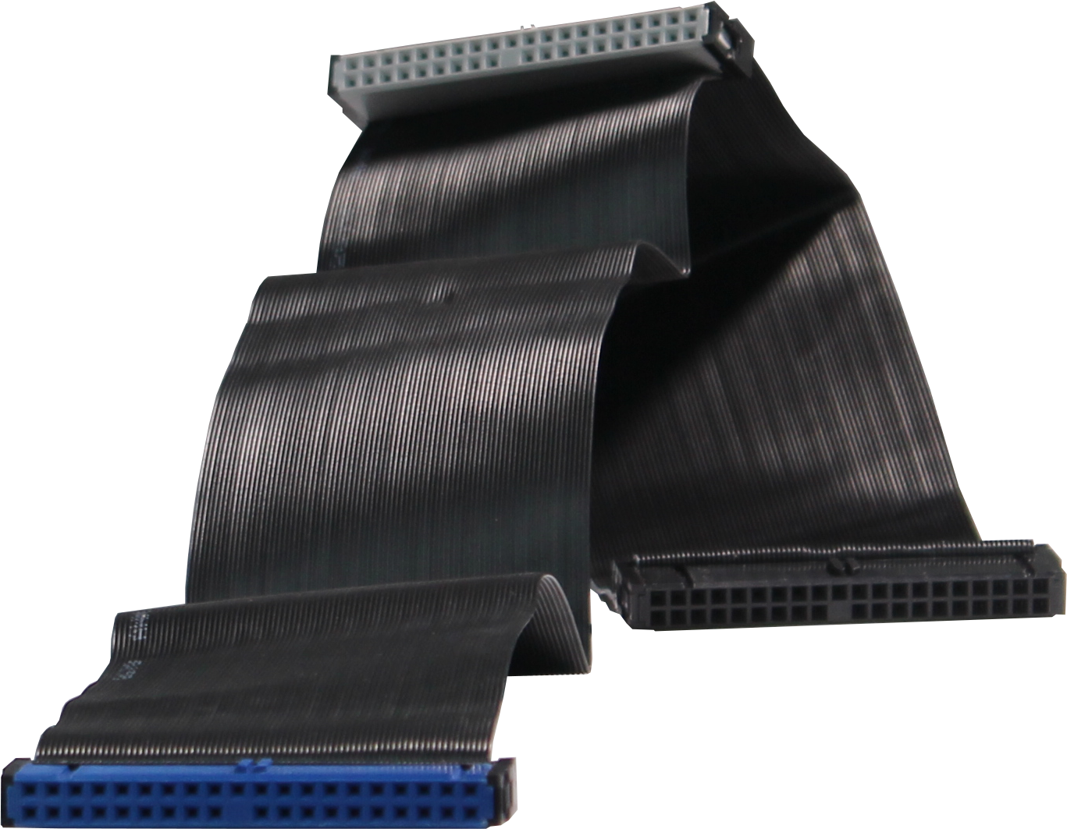
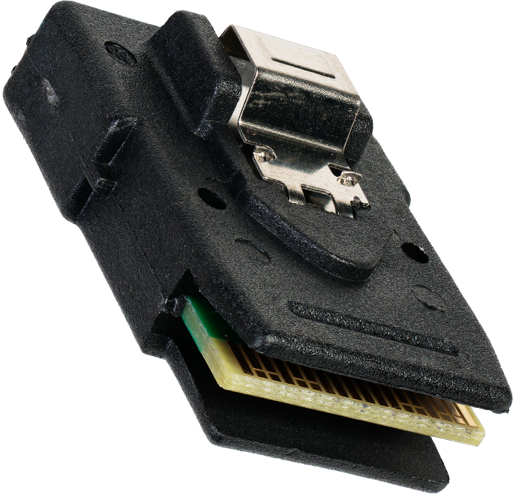
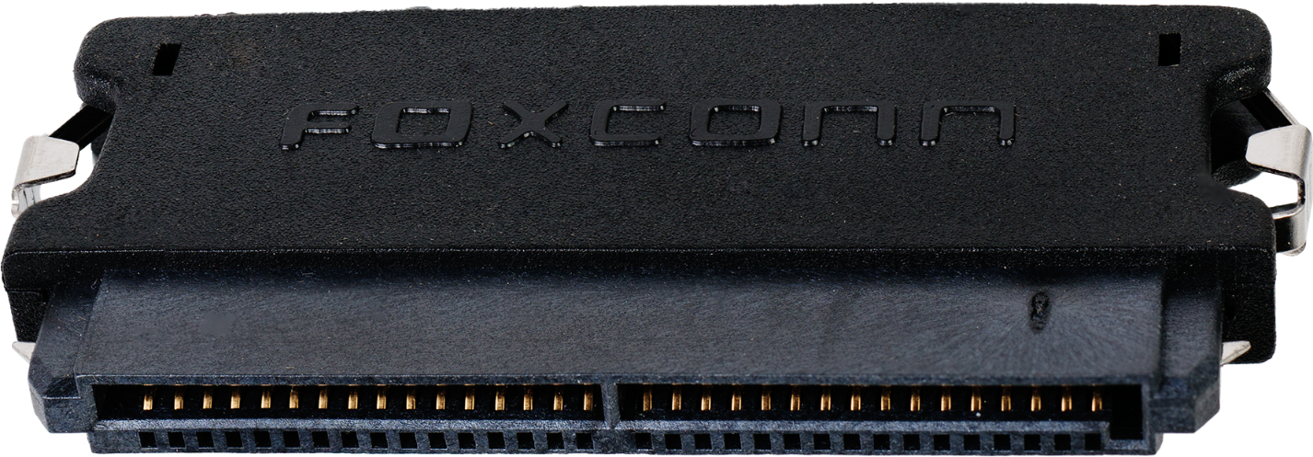
Cable Types
ATA/PATA/IDE (Obsolete)
SCSI (Obsolete)
SATA (Serial ATA)
SAS (Serial Attached SCSI)
* ATA stands for AT Attachment
ITFreeTraining.com
© Copyright 2023
Notes:
02:39 There are a lot of different cable types available, so I will only briefly cover some of the more commonly used ones. In other videos, I will go into more detail about these other cables. The first cable is the ATA, PATA or IDE cable. Hard disks essentially all use the same cable. There were different standards over the years, but they are backwards compatible. Hard disks with this interface stopped being manufactured just over ten years ago, so nowadays are obsolete. You will only come across it if you are working on an old system.
The interface was a parallel interface which provided high speeds at the time, but as data needs increased, it became harder to keep all the different data lines in a parallel interface in sync. As technology improved, it became possible to send more data using a signal data line, since you no longer had to worry about keeping multiple data lines in sync. To achieve higher levels of data transfer, the SATA interface was created.
SATA stands for Serial ATA. ATA refers to Attached AT and AT stands for Advanced Technology. This sounds confusing, but makes sense when you know what it is referring to. One of the first popular computers was known as AT or Advanced Technology.
The SATA interface is the most common interface that you will come across nowadays. Both of these interfaces were largely used by the home and low-end market. Nowadays you will also find that SATA is used in high-end servers and workstations, but not in all cases.
In the early days of computing, if you wanted better performance than the IDE interface could provide, your other choice was SCSI. There were many different versions of SCSI over the years, resulting in many different connection types. SCSI, back in the day, provided faster performance than IDE; however, it also cost more money. For this reason, you usually saw SCSI only being used in servers and high-end workstations.
SCSI also used multiple parallel data lines to transfer data, so ended up having the same data syncing problems that IDE had. For this reason, SCSI was changed to serial communication; SCSI over serial is called SAS.
Nowadays, you will find that SAS has replaced SCSI. SAS is generally used in enterprise environments. Unlike SCSI, you don’t generally find it in high-performance workstations; however, it is possible. Since SATA is still pretty good, you will generally find SATA will be used instead of SAS for high-performance desktops, while SAS is generally used to connect a large number of hard disks together, for example, in a RAID environment. SAS is also found in some dedicated servers.
With the exception of M.2 devices, nowadays you will generally find SATA and SAS will be used. I will now compare SAS and SATA.

Slide 5
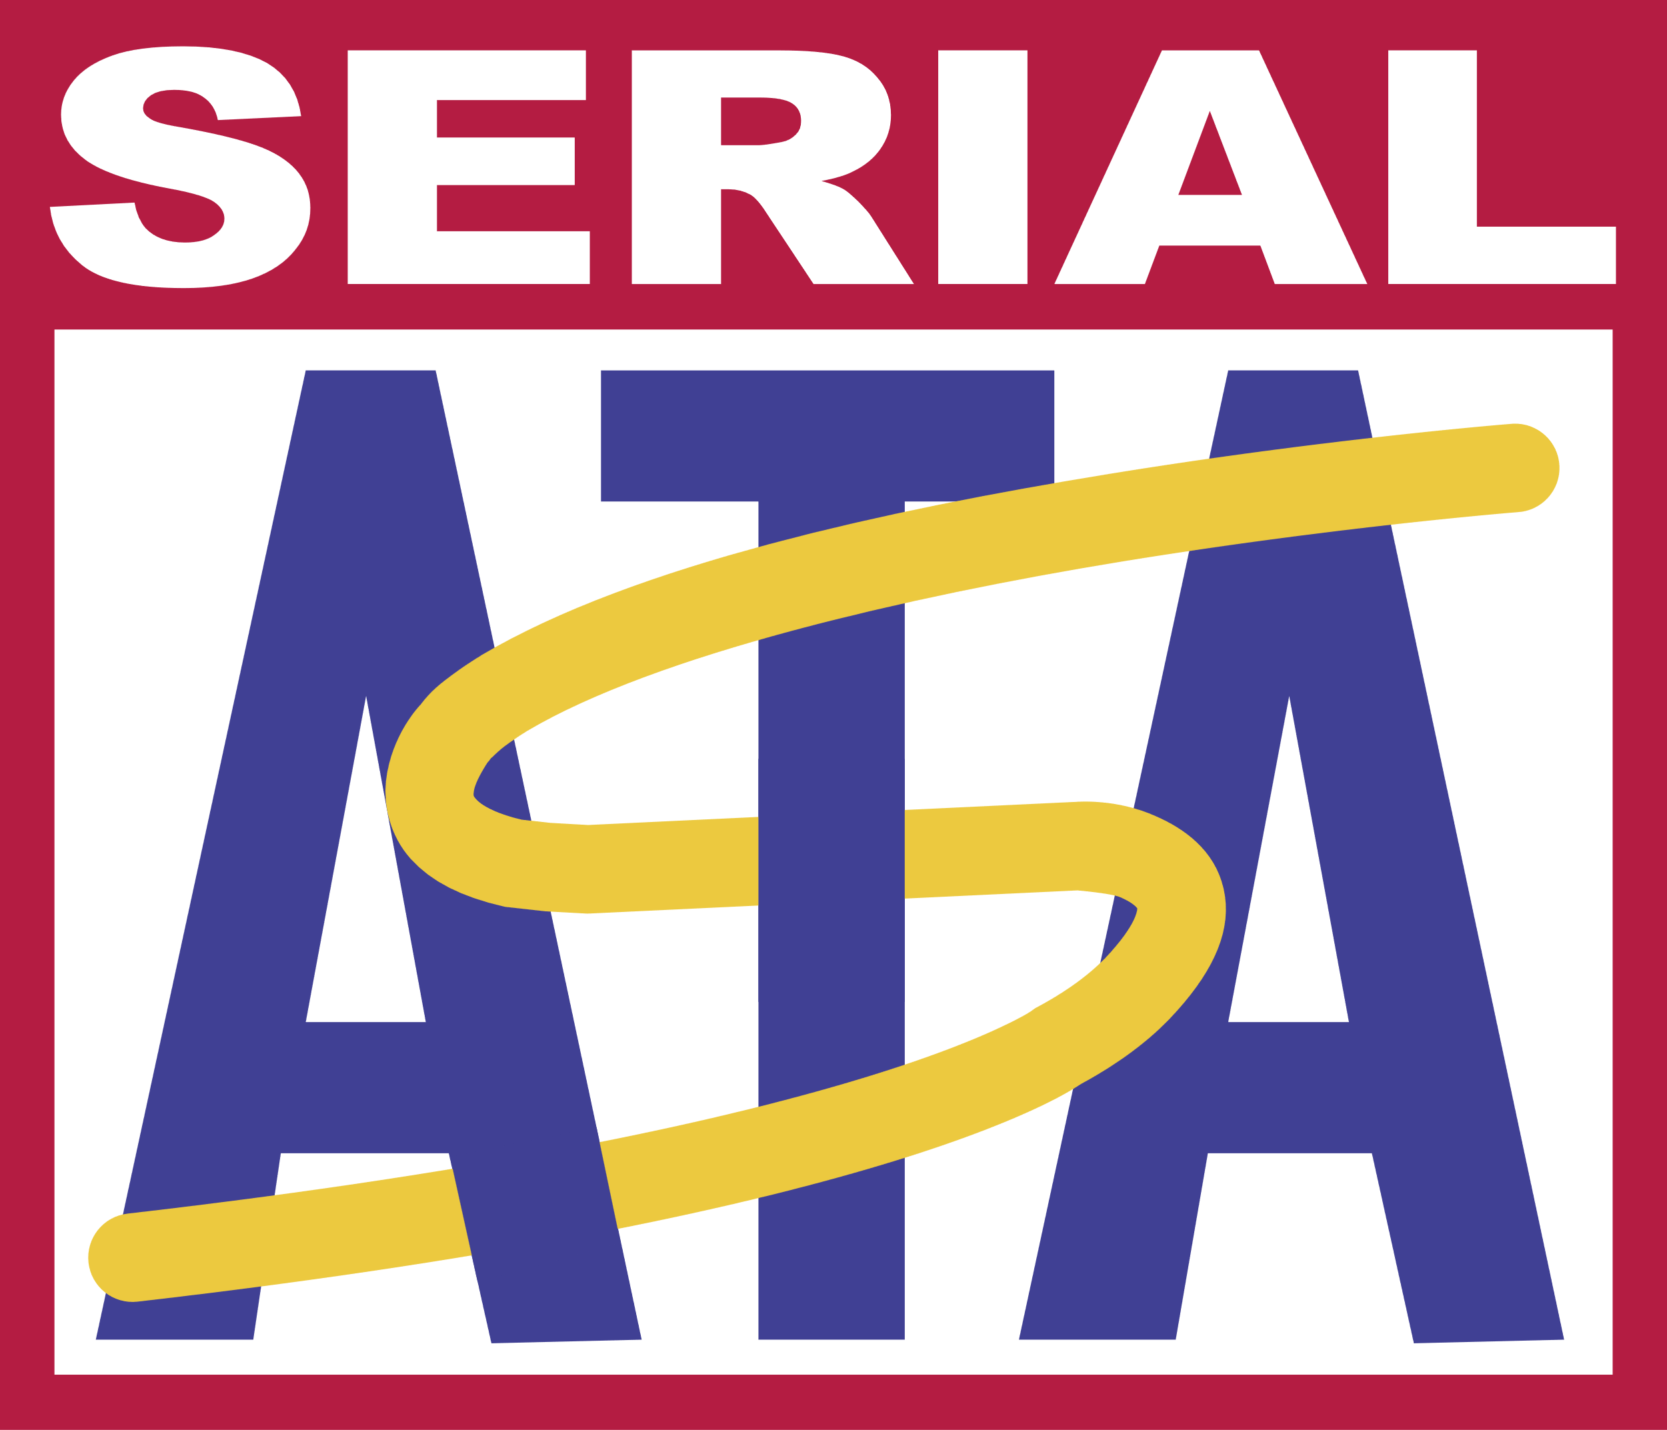
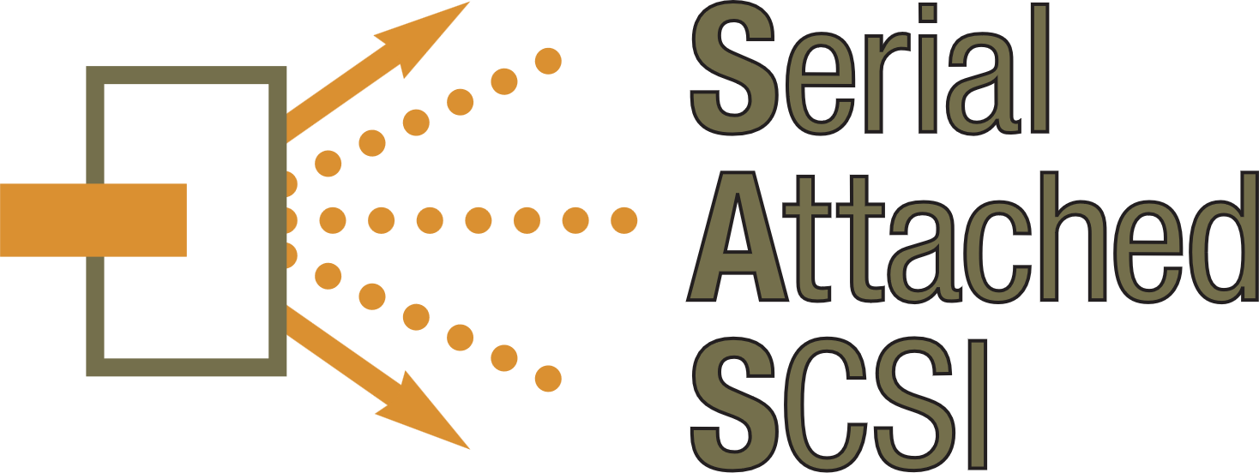
SATA vs SAS
Home/business use
Storage costs less
3.3ft (1m) cable length
One device per cable
Uses less power
No redundancy
Supports 6Gb/s
Enterprise/server
Better performance
33ft (10m) cable length
Up to 65,535 devices
Long lifespan
Multipath I/O
Supports 24Gb/s
VS
ITFreeTraining.com
© Copyright 2023
Notes:
05:41 SATA is designed more towards the home user and with the low-end business market in mind. SAS is designed more for high-end, server and cloud computing. For this reason, SATA storage generally costs less;, however, SAS generally offers better performance.
SATA supports cable lengths of 3.3 feet while SAS supports cable lengths of 33 feet. SATA has a limit of one device per cable; however, SAS (in theory) can support up to 65,535 devices on a single connection. You won’t find a device with that many connectors;, however, it is possible to connect multiple SAS controllers together to support more devices on a single connection. This is not uncommon in cloud computing where a single connection may connect tens if not hundreds of hard disks together.
SATA uses less power than SAS, but SAS generally has a longer lifespan. This means SAS drives are less likely to fail than SATA drives. SATA drives don’t support redundancy in the cabling. You have a single cable connection to each device and if that fails, the device will no longer work. By contrast, SAS supports multipath I/O. In a SAS configuration, it is possible to have multiple connections leading to a single device. If, for example, a device controller failed, it would be possible to switch to a backup controller.
Lastly, SATA supports speeds up to 6 Gigabits per second. Due to a lot of engineering and software related issues, we may never see another version of SATA, so this may be the fastest speed SATA achieves. Only time will tell. SAS currently supports up to 24 Gigabits per second. At the time this video was made, 45 Gigabits per second was under development.
Nowadays it is SATA and SAS devices that dominate the market, but you never know, you may come across something else in an old computer that uses a standard like SCSI.

Slide 6
Subscribe
Next video
Video content: https://ITFreeTraining.com/ap/3b20
© Copyright 2023
Notes:
07:47 That concludes this video on storage adapters and cables. I hope you have found this video useful and I would like to thank you for watching.
References
“The Official CompTIA A+ Core Study Guide (Exam 220-1001)” Chapter 6 Paragraph 109 - 125
“Host adapter” https://en.wikipedia.org/wiki/Host_adapter
“Picture: SATA logo” https://en.wikipedia.org/wiki/Serial_ATA#/media/File:Serial-ATA-Logo.svg
Credits
Trainer: Austin Mason http://ITFreeTraining.com
Voice Talent: HP Lewis http://hplewis.com
Quality Assurance: Brett Batson http://www.pbb-proofreading.uk

