Slide 1
Notes:
In this video from ITFreeTraining, I will look at hard disk performance factors. Looking at them will help you determine which hard disk you should buy and also how long you might expect it to last.

Slide 2
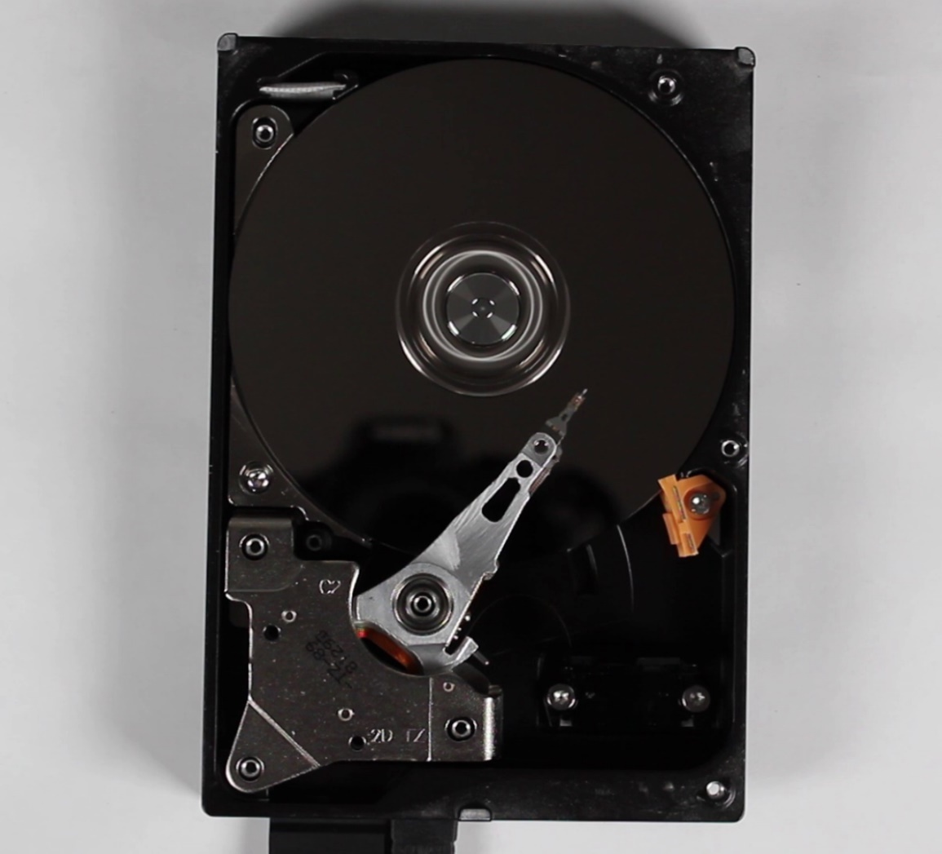
Seek Time
Average time to move from one place to another
Actuator move time
Rotation time
Average seek time about 9ms
RPM | Average latency [ms]
4,200 | 7.14
5,400 | 5.56
7,200 | 4.17
10,000 | 3.00
15,000 | 2.00
ITFreeTraining.com
© Copyright 2023
Notes:
00:12 The first performance factor I will look at is seek time. The seek time is the average time to move from one place on the disk to another. If I have a look at this hard disk, you will notice that the actuator moves quickly across the hard disk. Disassembling the hard disk like this has damaged it, so sometimes the head will go back to the parked position which is off the platter and try again. When the hard disk is running normally, you should see the actuator move the heads backwards and forwards across the platters and not returning to the parked position.
Seek time is made up of two factors, the first one being the actuator move time. This is measured as the average time the actuator takes to move from one place to another. The next factor is the rotation time. This is the time the head needs to wait until the platter spins around so the data that it is waiting for is under the head.
In theory, the seek time should be measured by looking at the average time it takes to move from all possible positions to all other possible positions on the hard disk. In practice, hard disk manufacturers use statistical measures to calculate this. Unlike some calculations that vary a great deal between manufacturers, seek time is one measure that I am happy to compare between manufacturers as the methods they use give similar results.
The rotation time will vary depending on what speed the hard disk spins at. Shown here are the latency times for hard disks of different speeds. Faster hard disks have lower rotation latency time due to having to wait less time for the platter containing the data to travel below the head. The manufacturer of the hard disk may give you this figure, but if they don’t, it should be close to the figure in the table.
Keep in mind that you need to add both these figures together to get a seek time. Nowadays, an average hard disk will have a seek time of about 9 milliseconds. The fastest high-end server drives have a seek time of about 4 milliseconds. Mobile devices have a seek time that is generally a little slow, around 12 milliseconds.
There is also a settle time which is essentially the time it takes for the head to settle after it has moved; this is the time it takes the head to stop vibrating so it does not read off track. This time is in microseconds, so hard disk manufacturers generally don’t give this figure and instead add it to the seek time.
Although off topic, solid-state drives have a seek time of around one tenth of a millisecond. So, you can understand why hard disk seek time can’t compete with that of solid-state drives.
Now that we have an idea how long it takes to get to the data, next I will have a look at how long it takes to read or write data.

Slide 3
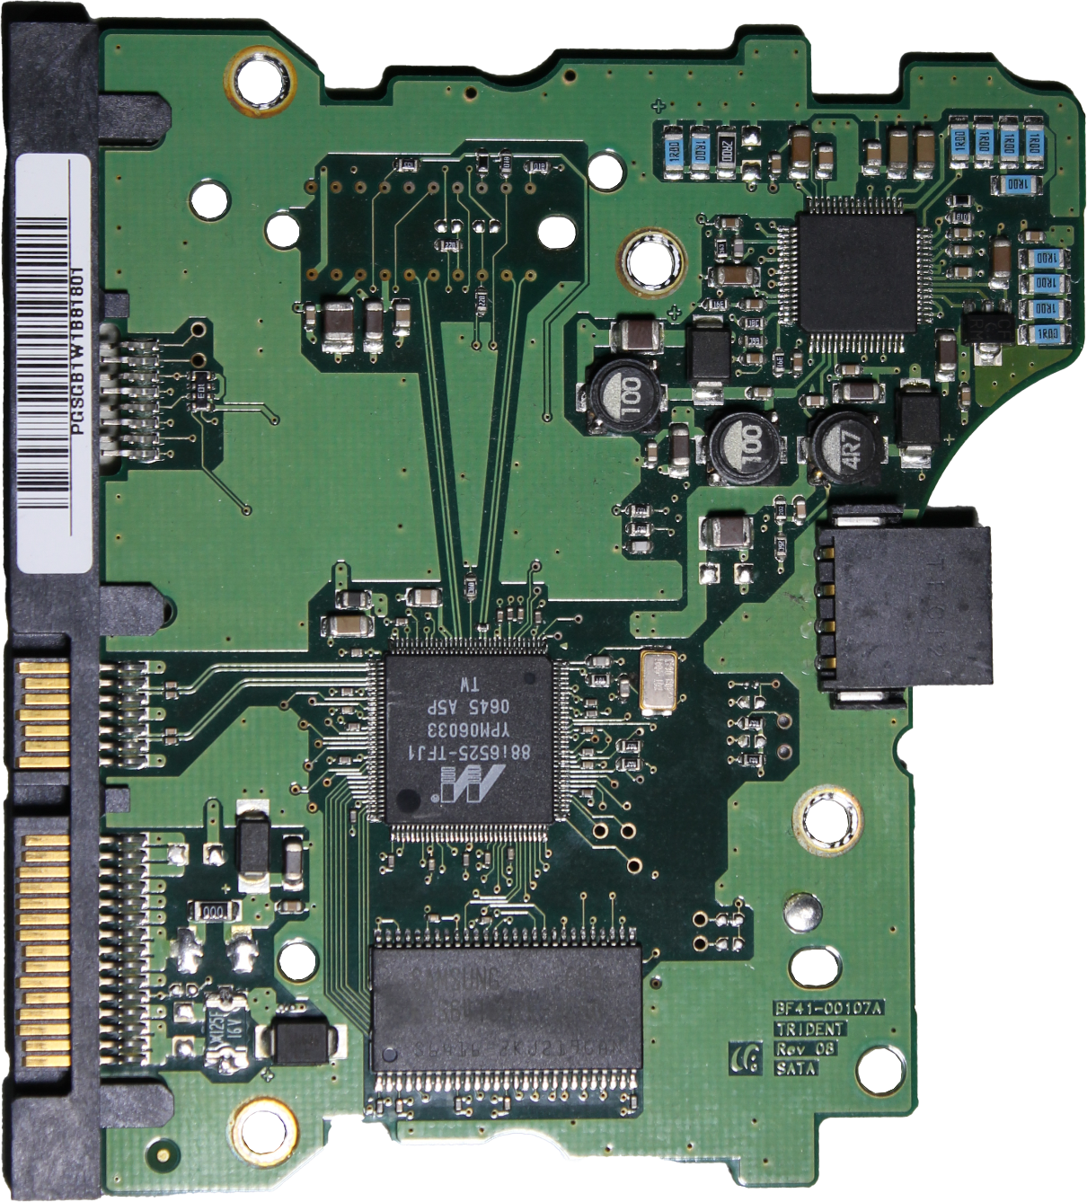
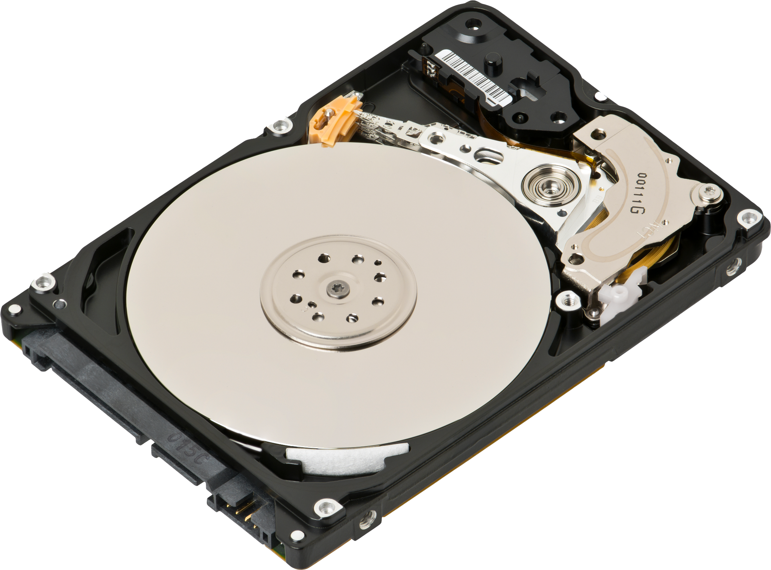
Internal Data Transfer Rate
Internal rate reading/writing data
Burst rate (High transfer rates while buffer’s filling)
Data transfer to/from platters
Circuit board will buffer
some data
ITFreeTraining.com
© Copyright 2023
Notes:
03:04 Hard disks will have an internal data transfer rate. The manufacturers don’t generally provide this figure, and I will explain later in the video why this is the case. This figure is essentially the internal rate the hard disk can read or write at.
This may sound simple, but this is made more complex as the circuit board on the hard disk contains a buffer. The data from this buffer is transferred to or from the hard disk as quickly as possible. If power is cut while there is data waiting in the buffer to be written to the hard disk, it may be lost, so you want to write it as fast as possible.
This is why, when you write something to a hard disk, you may see an initial burst in speed which will start leveling out. This is referred to as a burst rate. The initial high transfer rate occurs while the buffers are filling up. The hard disk itself still needs to move the head and locate the sectors before it can start writing. The buffer gives the hard disk a little bit of time to do this. If you are writing small amounts of data, this really helps, as the operating system is not waiting for the data to be written. However, if there is a lot of data waiting to be written, once the buffers are full, you will see the transfer rate start to level out.
All hard disks will have a buffer, and generally the more expensive hard disks will have larger buffers. Larger buffers help if you are writing to a lot of small files all over the disk. This is because the hard disk can write the data out of order. For example, rather than moving the head from the inside of the disk to the outside and then to the middle, it could move it from the inside to the middle and then the outside saving on seek time. Keep in mind, that if you are working with large files, for example video files, once the buffers become full, it becomes irrelevant. Generally, you see larger buffers on enterprise hard disks that have a lot of random writes all over the hard disk, and this is where you will see the most benefit.

Slide 4
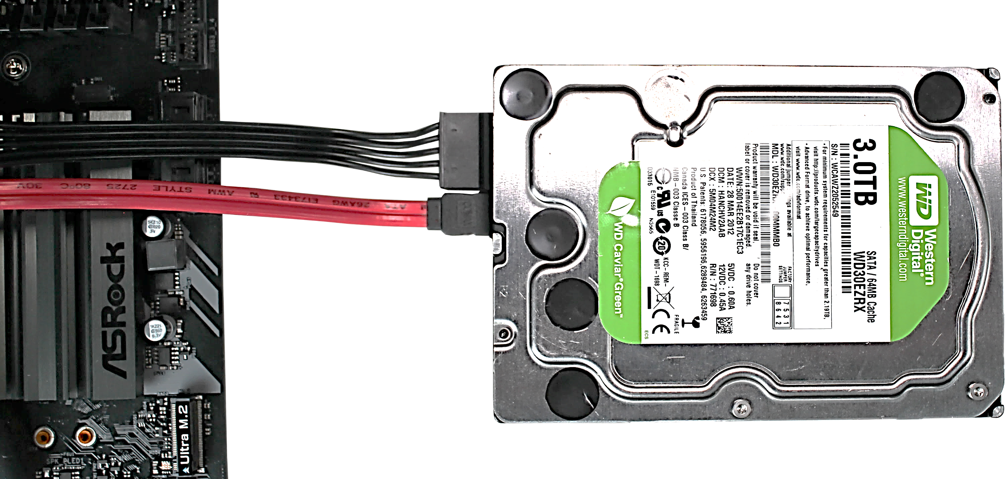
External Data Rate
Data rate between hard disk and storage controller
E.g., SATA 6Gb/s
ITFreeTraining.com
© Copyright 2023
Notes:
05:07 The next specification that I will look at is the external data rate. This is the data rate that can be transferred between the hard disk and the storage controller. The hard disk will support an upper speed. Keep in mind that if the storage controller does not support that speed, the hard disk will reduce its speed to match that of the storage controller.
The hard disk manufacturer will give you this specification; however, this will not give you an accurate estimate of how fast the hard disk will operate, as it may transfer data a lot slower than the external interface. So, let’s have a look at how you can determine how fast the hard disk will operate.

Slide 5
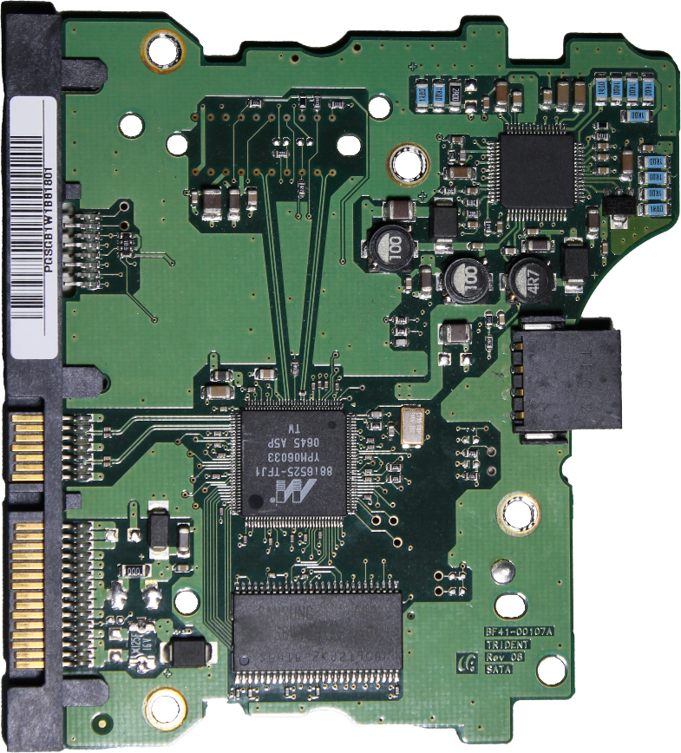
Data Transfer Rate
Sustained average transfer rate
Maximum transfer speed consistently expected
Internal data rate
External Data
Rate
Data rate storage controller will receive
ITFreeTraining.com
© Copyright 2023
Notes:
05:44 The hard disk manufacturer will have a specification for data transfer rate. It may be called slightly different things, but essentially it is the sustained average transfer rate. Or to put it another way, the maximum transfer speed you can consistently expect to receive. This gives you an understanding of how fast the hard disk may be performing. You may also see specifications that refer to the burst rate or a maximum possible transfer rate under ideal conditions. These transfer rates can’t be sustained over a long period. Take care when reading these specifications that you understand what they are referring to.
To get an understanding of how this rate is calculated, consider that you have the internal rate of the hard disk. This will be connected to an interface that provides an external data rate. The data transfer rate will be affected by both of these things. The transfer rate will be based on what the storage controller will receive.
Generally speaking, the external data rate will be higher than the internal rate. If you consider a hard disk manufacturer, what is the point of spending more money making a fast hard disk when the speed will be effectively capped by the external data rate. The external data rate will generally be a lot higher than the internal data rate, so it does not create a bottleneck. If you find the hard disk is not performing at the data transfer rate, the problem is, most likely, that the external data rate has been reduced. For example, a SATA 3 hard disk has been plugged into a SATA 2 port or perhaps the hard disk is running in a compatibility mode and the performance has been reduced.
So far, looking at the seek time and the data transfer rate will give you an idea how fast the hard disk may perform. Let’s have a look at some of the other specifications you may want to look at when purchasing a hard disk.

Slide 6
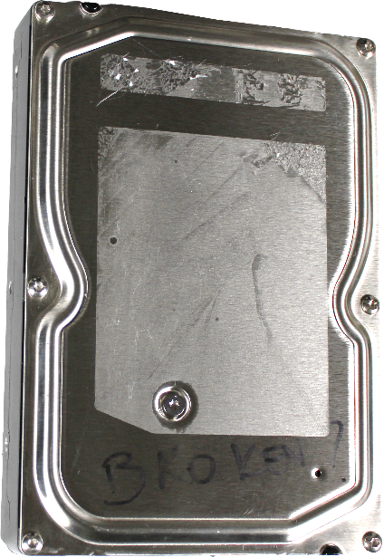
Reliability
Mean Time Between Failures (MTBF, hours)
AVERAGE
Time
Annual Failure Rating 24x7 (AFR)
Estimated probability that a device will fail per year
ITFreeTraining.com
© Copyright 2023
Notes:
07:38 The first measurement that I will look at is mean time between failures or MTBF. This is essentially an average taken between a number of hard disks and when they failed. For example, if you consider the time when three hard disks were put into service and when they were to fail, if you took an average of the fail times of those three hard disks, this would give you the mean time between failures.
The idea behind this is it would give you an indication of how long the hard disk may last. Remember it is an average, so a hard disk may fail sooner or it may fail later.
Some manufacturers may provide this specification while some may not. Another reliability figure is the annual failure rating. This is an estimate of the probability that a device will fail per year. This is measured as a percentage, for example 0.4%.
These figures assume the hard disk is used as per the manufacturer’s specifications. For example, used in a room under a certain temperature. If the hard disk is used in a location above this temperature, this will increase the failure rate of the hard disk.
These figures give you an indication of when a hard disk may fail. Certain hard disks will have a higher failure rating then others. For example, higher speed drives will generally fail sooner. If you are using them in a data center, having a look at the failure rate will give you an idea of how many failures you are likely to have. This will help give you an idea of what you may need to spend on replacement of hard disks, unless you have a support contract that covers hard disk replacements.

Slide 7
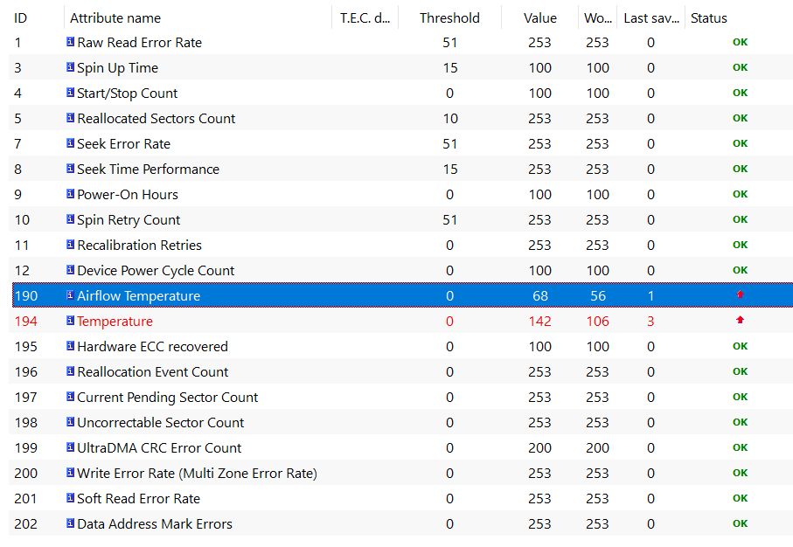
S.M.A.R.T
Self-Monitoring Analysis and Reporting Technology
Detects and reports indicators of drive reliability
ITFreeTraining.com
© Copyright 2023
Notes:
09:19 The last topic I will look at is S.M.A.R.T. S.M.A.R.T stands for Self-Monitoring Analysis and Reporting Technology. This technology essentially detects and reports indicators of drive reliability. Shown here is a report generated by S.M.A.R.T for a hard disk. You can see that the report has indicators and a threshold. Once the threshold has been reached it will report a problem. For this hard disk, the temperature of the hard disk is above what it should be. Problems like this are good to be aware of, as a hard disk running at a high temperature will have a reduced life span.
In the old days, only the more expensive and enterprise drives had S.M.A.R.T. Nowadays, a lot more drives have S.M.A.R.T support but not all; for Solid-State Drives, S.M.A.R.T is pretty common.

Slide 8
Subscribe
Next video
Video content: https://ITFreeTraining.com/ap/3b15
© Copyright 2023
Notes:
10:11 That concludes this video from ITFreeTraining on Hard Disk Performance Factors. I hope this video helps you decide which hard disk you want to purchase. Until the next video from us, I would like to thank you for watching.
References
“The Official CompTIA A+ Core Study Guide (Exam 220-1001)” Chapter 6 Position 102 – 109
“Hard disk drive performance characteristics” https://en.wikipedia.org/wiki/Hard_disk_drive_performance_characteristics
“Video: Fire works” https://pixabay.com/videos/explosion-fire-outbreak-smoke-8556/
Credits
Trainer: Austin Mason http://ITFreeTraining.com
Voice Talent: HP Lewis http://hplewis.com
Quality Assurance: Brett Batson http://www.pbb-proofreading.uk

