Slide 1
Notes:
In this video from ITFreeTraining, I will look at hard disk drives. Hard disks have been around since the early days of computing and are still used today even though solid-state drives have given them some competition. This video will look at how they work and when you would use one.

Slide 2
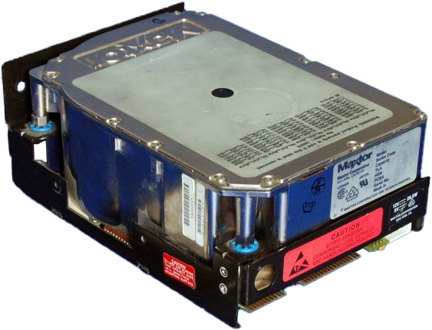
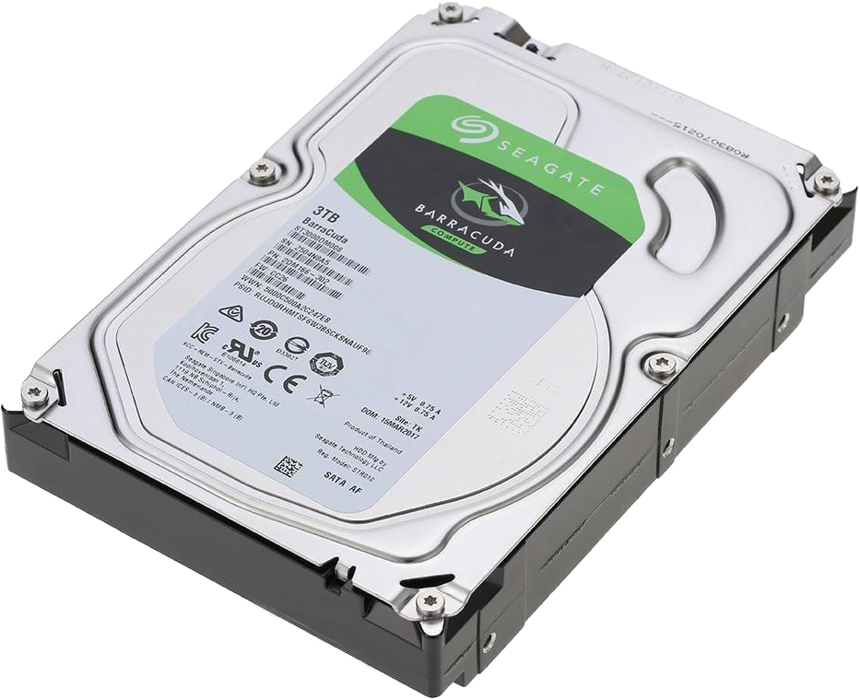
Hard Disk Drive
Used since the first computers were developed
Data stored on thin platters
ITFreeTraining.com
© Copyright 2023
Notes:
00:17 Hard disks have been used for storage since the first computers were developed. Essentially, a hard disk uses a number of thin platters to store data on.
The first hard disks were the size of refrigerators, but as time passed, they got smaller. There are a number of different sizes of hard disk on the market, but generally the largest hard disks sold today are three and a half inches wide. Later in the video I will have a look at the different sizes of hard disk available; however, for the moment I will concentrate on three and a half inch hard disks.
To start with, let’s have a look at what makes a hard disk work.

Slide 3
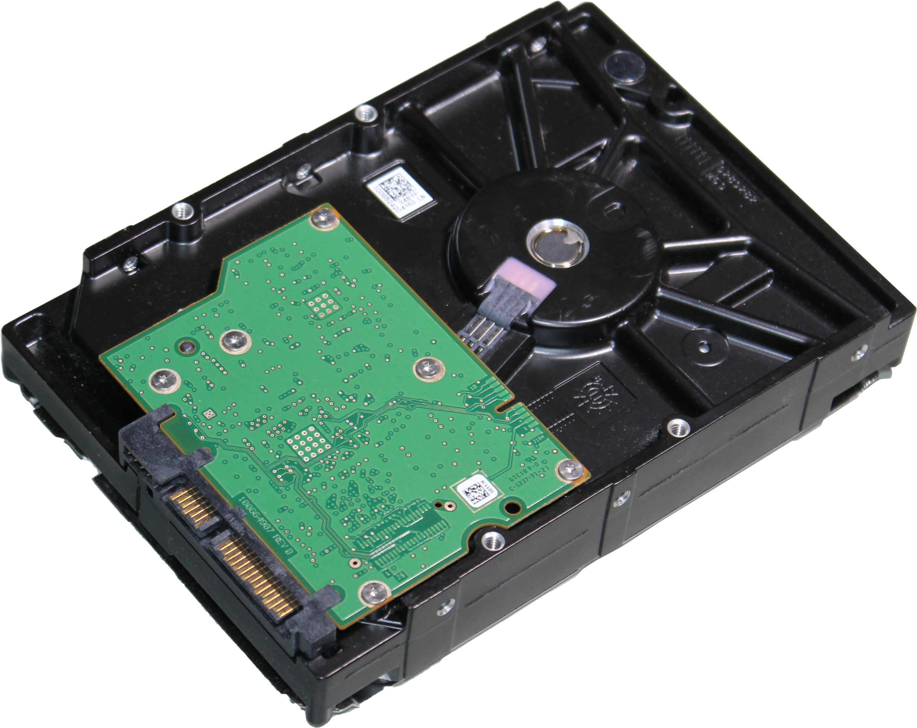
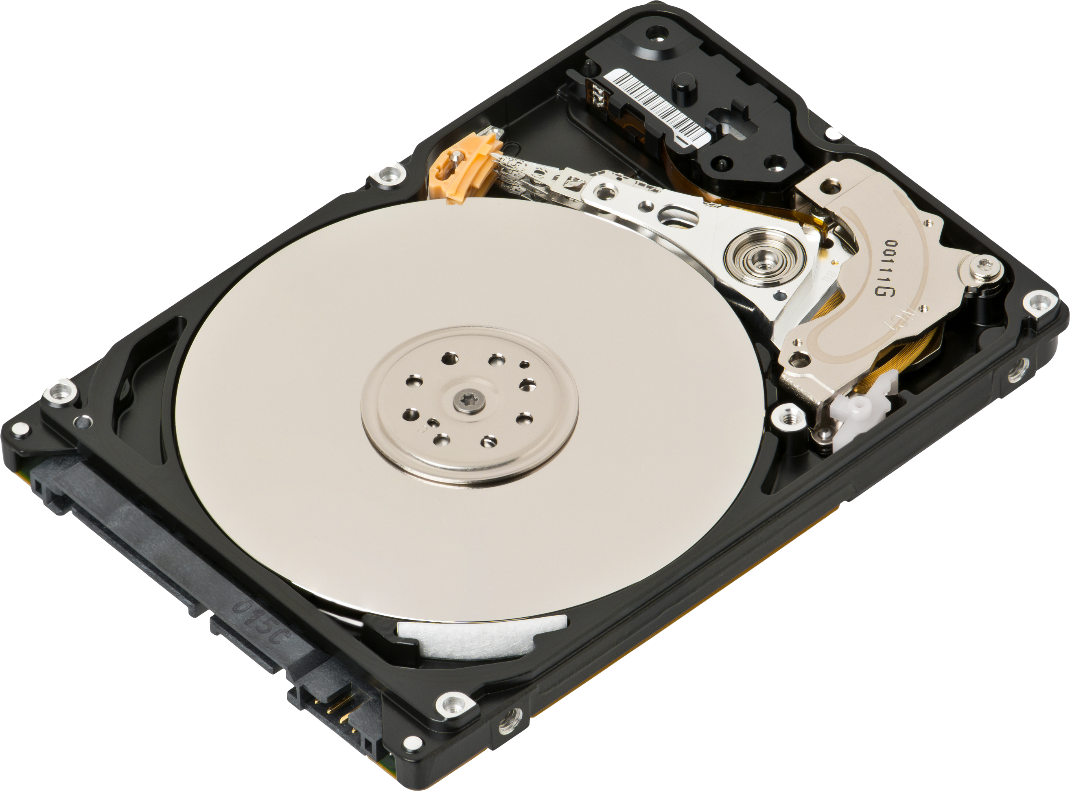
Inside a Hard Disk
Spindle
Read/Write heads
Circuit board
Actuator Arm
Platter
Actuator
Air filter
ITFreeTraining.com
© Copyright 2023
Notes:
00:53 Inside a hard disk there are a number of different parts that make them work. To start with, there is the platter. Many hard disks will have multiple platters to allow them to store more data. The platter itself can be made of many different materials. Generally, they are made of a non-magnetic material such as aluminum alloy, glass or ceramic. On this material is coated a thin layer of magnetic material. On top of the magnetic material is a layer of carbon to protect the surface. More on that later in the video.
In the middle of the hard disk is the spindle. The spindle is responsible for making sure the platters spin at a certain speed while the hard disk is operating. To read and write data on the hard disk, the hard disk has reading and writing heads. For each platter there is a read/write head.
To read or write data, the head moves across the platter. To move the head, it is connected to an arm. To control where this arm moves, there is an actuator that moves the arm back and forwards. Since the arm is connected to the actuator, it is called the actuator arm.
Hard disks are sealed to prevent dust getting in them. If dirt or dust gets into the hard disk, there is an air filter that hopefully will capture the material to prevent it getting onto the platters. If dust gets on the platters, it can damage the heads or the platters of the hard disk. This can potentially damage the hard disk and in the worst case make it unusable.
Under the hard disk there is a circuit board. This circuit board controls the hard disk. These are the basics of how a hard disk works, and I will now have a look at each component in more detail.

Slide 4
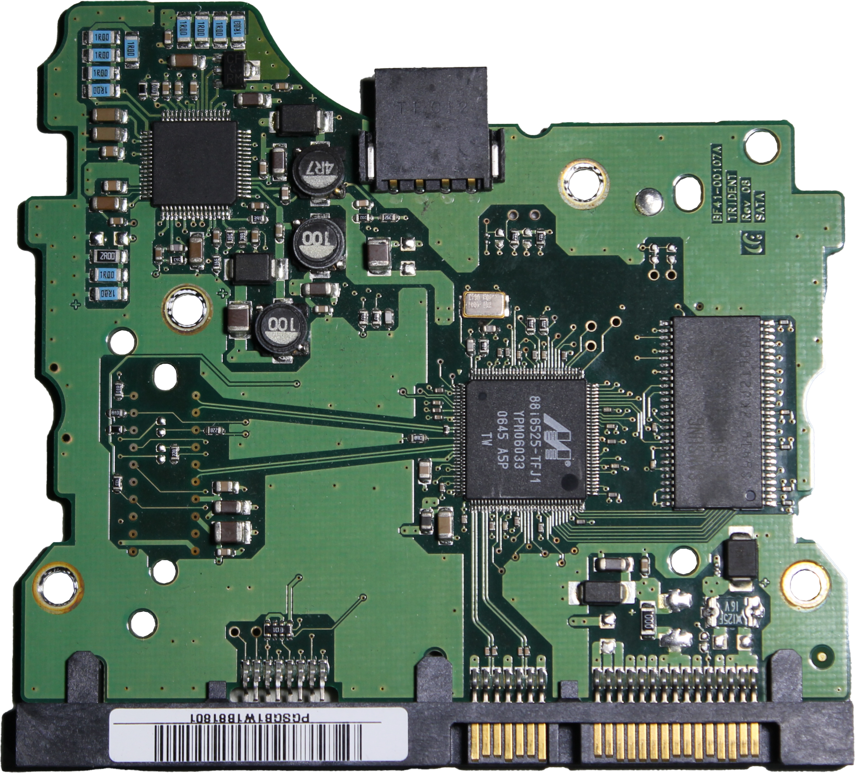
Hard Disk Circuit Board
Controls the actuator and rotation of platters
Transfers data to and from the hard disk
ITFreeTraining.com
© Copyright 2023
Notes:
02:37 The first component that I will look at is the hard disk circuit board. The circuit board is generally found underneath the hard disk; however, the manufacturer is free to put it where they like. The circuit board controls the actuator and rotations of the platters. It also controls transfer of data to and from the hard disk.
Sometimes, you get a hard disk failure due to the circuit board on the hard disk failing. In this case, you can see that the plastic around the SATA connector has been broken leaving only the pins. It is hard to see, but if I compare it with a hard disk that has not been damaged, you can see the plastic around the pins is missing.
If I now look at the SATA plugs themselves, you will notice that the missing plastic is inside the connector. What has occurred is these particular connectors have a clip on them which lock them in place. Someone has attempted to remove the SATA connector without unclipping it. If you attempt to remove a plug without unclipping it or unscrewing a hold screw, something has to give. In this case it was the plastic holding the connector in place. This is why it is important not to force things in computing. Sometimes you may need a little force, but if you use too much force you risk causing damage.
Most SATA connectors do not have a clip on them, so if you can’t reach them, giving the cable a little pull will generally unplug it. If you can’t see the other end of a connector because something is blocking it, don’t assume it does not have a clip holding it in place (some connectors won’t, some will, even the ones you don’t expect to). Pulling it too hard risks damaging a component or a connector, which is what has happened in this case.
To fix this, I could attempt to replace the connector. This is generally very difficult to do since the connector is often soldered, glued or somehow attached to the board. In this case, I have purchased a replacement board which has the required connector on it.
You will notice on the board there is a part number. To get the replacement, it was just a matter of finding someone who would sell me this board. eBay is a good place to look. If you have a number of dead hard disks of the same type, you may be able to get one working by swapping the board with another. When hard disks fail, it is generally a mechanical problem in the hard disks themselves, but it is not unheard of for a board to fail here and there.
Hopefully replacing the board will get the hard disk working again; however, it is not a guarantee it will work. Most hard disk circuit boards have a chip on them that contains unique data for that hard disk. This is written to the chip during the low-level formatting of the hard disk in the factory. Thus, swapping the circuit board may get the hard disk working again, but don’t expect to get the data back.
In order to remove the board from the hard disk, a special screwdriver is required. In this case, I have purchased a rachet screwdriver with a number of bits. It is just a matter of selecting the right bit. It is generally easier to buy a large number of bits for a rachet screwdriver rather than attempting to buy a screwdriver for every different screw you may come across.
It is just now just a simple matter to remove the four screws holding the board in place, remove the board, and replace it with the new board. Most hard disks will follow the same design. You may also find the same board is used for different hard disks, the only difference between the hard disks generally being the amount of data that they contain. Once the board is in place, the four screws are put back in.
If you take the hard disk to a data recovery company, they will either copy the data on the chip to the new circuit board or remove the chip from the old hard disk circuit board and transfer it to the new circuit board.
If you do swap the circuit board on a hard disk and get the hard disk working again, I personally would not trust it with your valuable data. Since the unique data created during the factory formatting is missing, you are hoping that the replacement circuit board data is close enough to the original circuit board.

Slide 5
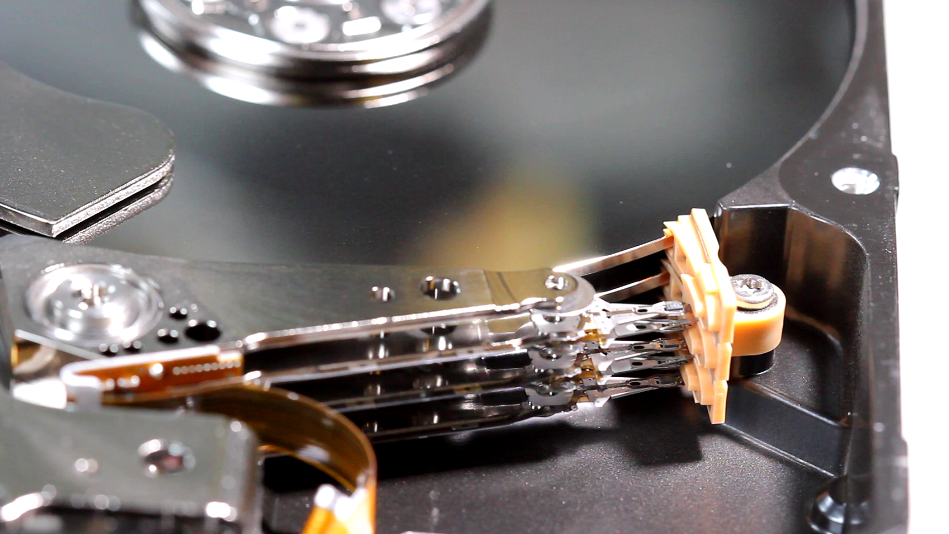
Actuator and Heads
Moves heads to different locations on platter
ITFreeTraining.com
© Copyright 2023
Notes:
06:50 The next part of that hard disk that I will look at is the actuator and the heads that are attached to it. The actuator essentially moves the read and write heads to different parts of the hard disk.
You can see in this hard disk the cover has been removed. If you ever remove a cover from a hard disk, it is safe to assume it will never work correctly, if at all, ever again. If this is done by a data recovery company, they will do this in a clean room as any dust that gets into the hard disk can damage it. Outside a clean room, it won’t take long at all for dust to get into it. The covers are generally sealed shut, so once the seal is damaged, more dust will get in if you then re-assemble the drive.
You will notice that when the hard disk is powered up, the platters will spin up and the actuator arm will move across the platters. This is an initial test the hard disk does to check it is working correctly. This hard disk is faulty, and this is why the test keeps getting repeated.
If I compare it to a different hard disk which has damage close to the edge of the platter, notice that the actuator arm keeps moving back and forward to where the damage is. It will do this a number of times before it gives up and spins the drive down. This is one of the tests you can perform on a hard disk to see what the problem may be. Simply turn it on and listen to what it is doing.
You will notice that with this working hard disk, once it is switched on, the actuator will move across the platter, essentially looking for damage or dust on the drive. Once it has completed a good pass over the platter it will go back to its resting position. If it can’t complete a good pass after multiple attempts the hard disk will spin down. Once the initial test is complete, Windows will start accessing data on the drive so the actuator will continue to move across the drive. Once Windows has finished accessing the drive, the actuator will stop moving.
If you find your hard disk is not working, check to make sure that it spins up and stays spun up. You should be able to hear the hard disk spinning; however, if you can’t, a lot of the time, if you put your hand on the hard disk case, not the circuit board, you can feel the vibrations of the hard disk spinning. Keep in mind that if power saving is running, the operating system may spin the hard disk down.

Slide 6
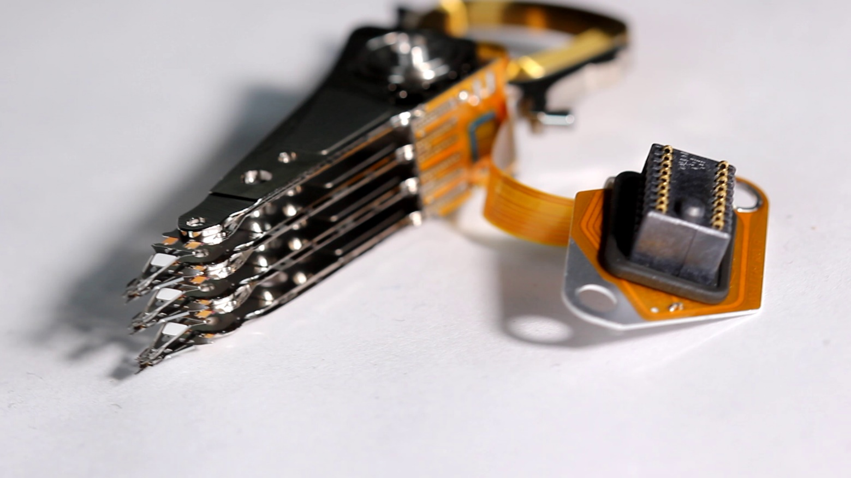
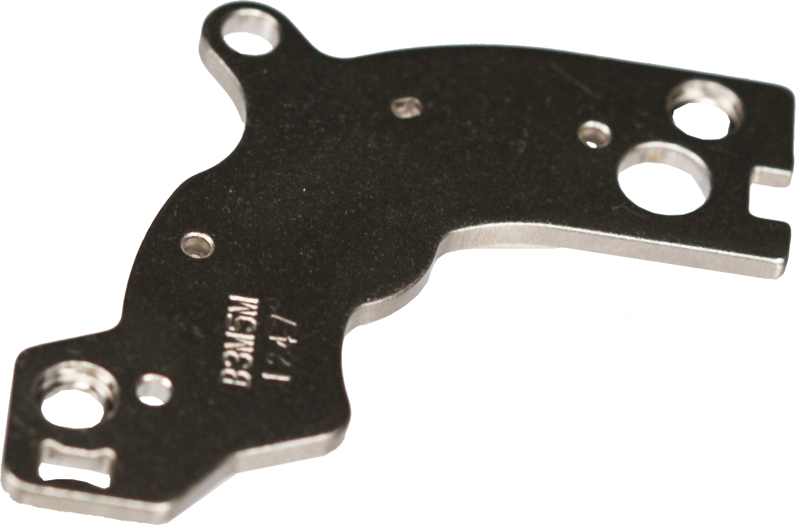
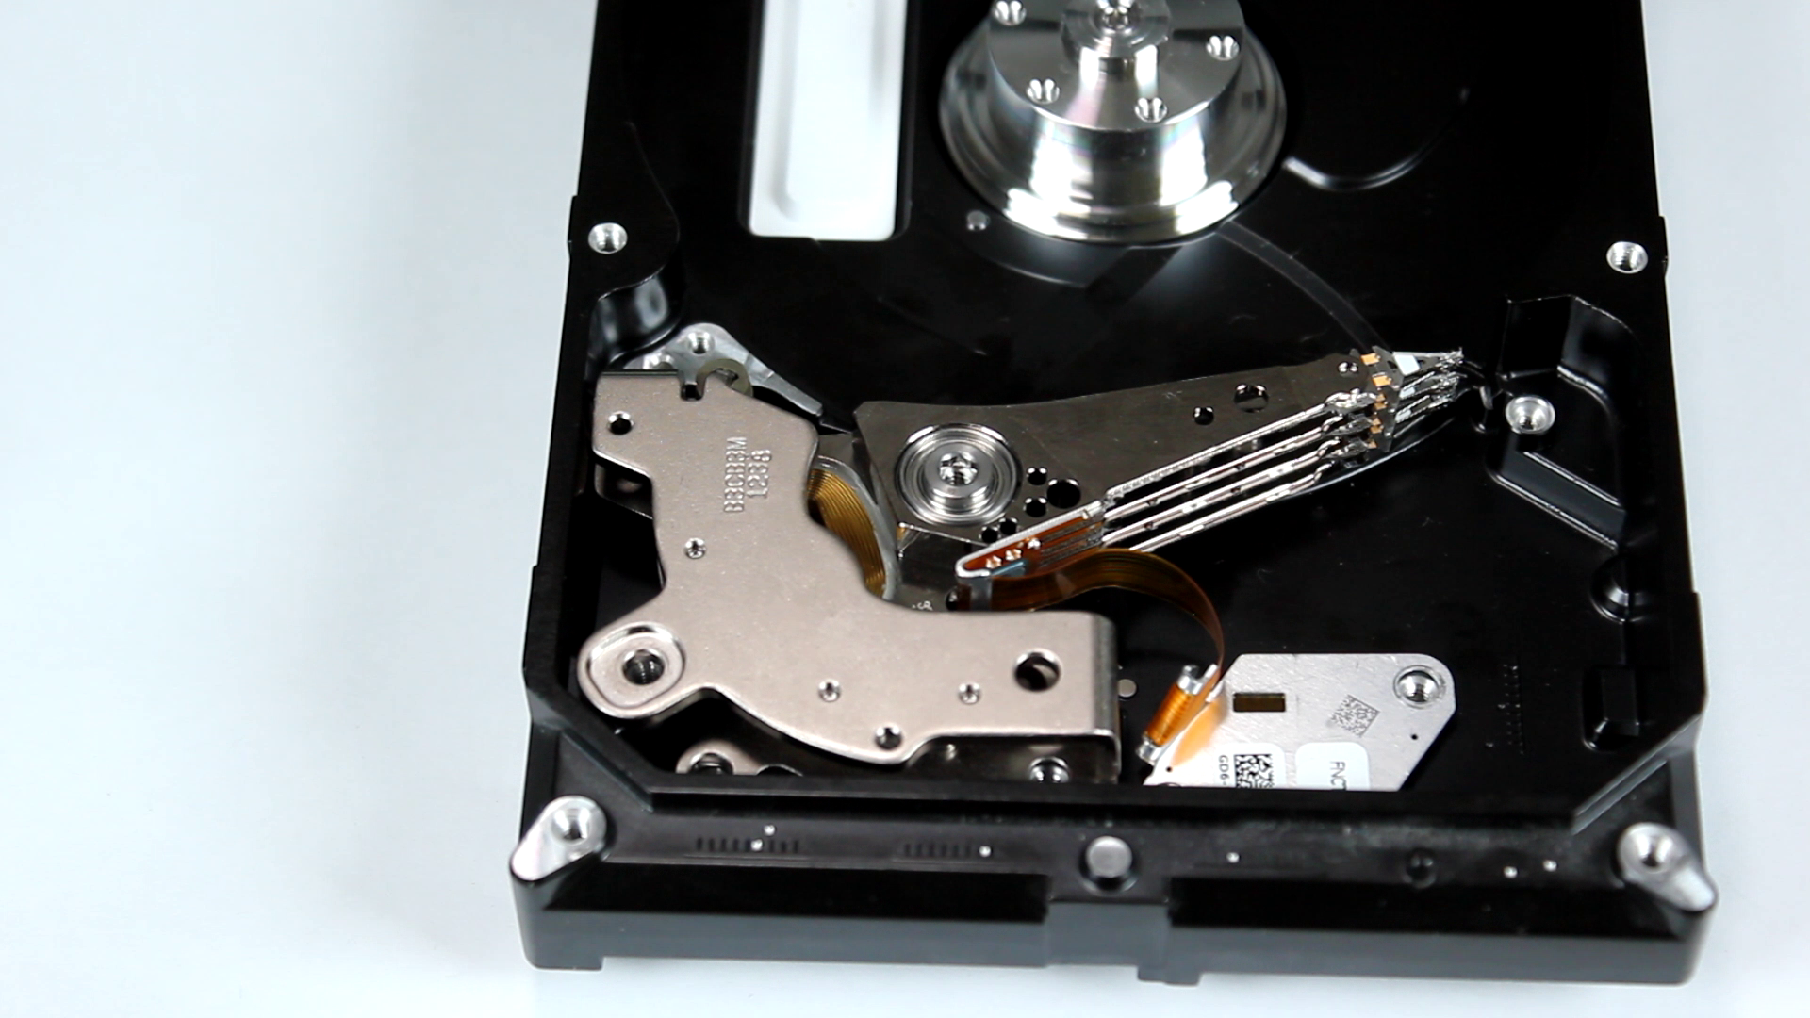
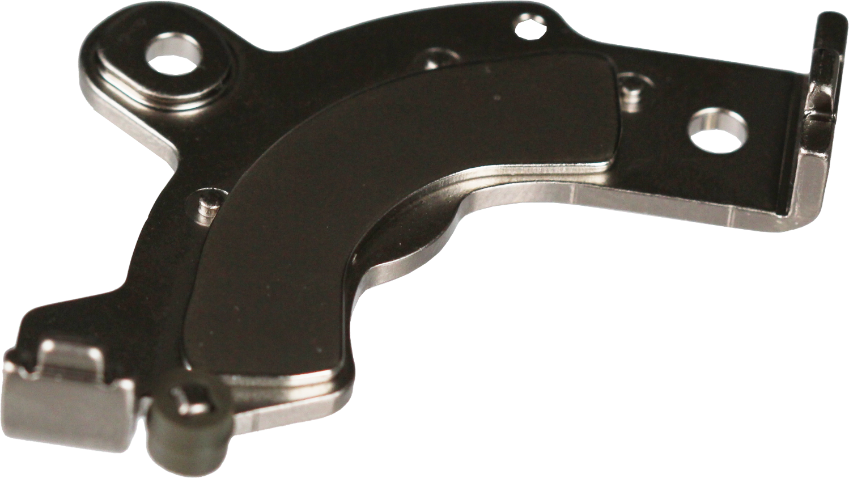
Actuator
Strong Magnet
Controls movement by using a
coil of wires in a magnetic field
Voice Coil
Strong Magnet
ITFreeTraining.com
© Copyright 2023
Notes:
09:17 In order to access the data on the drive, the actuator needs to be able to precisely move to different parts of the platter. To achieve this, there is a voice coil on the end of the actuator. A voice coil is essentially wire that is wrapped around and around – this is generally in a circle in the case of electric motors, but in the case of hard disks it is in the shape of a trapezoid.
Electricity passes through the wire which creates an electric field. The electric field needs something to react to, so on either side is a strong magnet. The magnets hold the actuator in place; once electricity passes through the voice coil, this changes the magnetic field which causes the actuator to move. Using a system like this is a lot more accurate than using an electric motor.
If you have a look at this hard disk case, you will notice the bottom magnet has been put in place with the actuator on top. If I gently push the actuator with a screwdriver, notice that the magnet will suddenly pull the actuator back to its start position.
I will now attempt to put the top magnet back into place; notice that it will jump out of my hand and will take some effort to get it into the correct place. The magnets used for the actuator are very strong. If you ever pull a hard disk apart, you will have trouble removing the magnet. Be careful. They are strong, and if your finger is in the way when a magnet is flying through the air towards another magnet or metal surface, you are going to get hurt. Keep this in mind if you decide to disassemble devices with strong magnets in them.

Slide 7
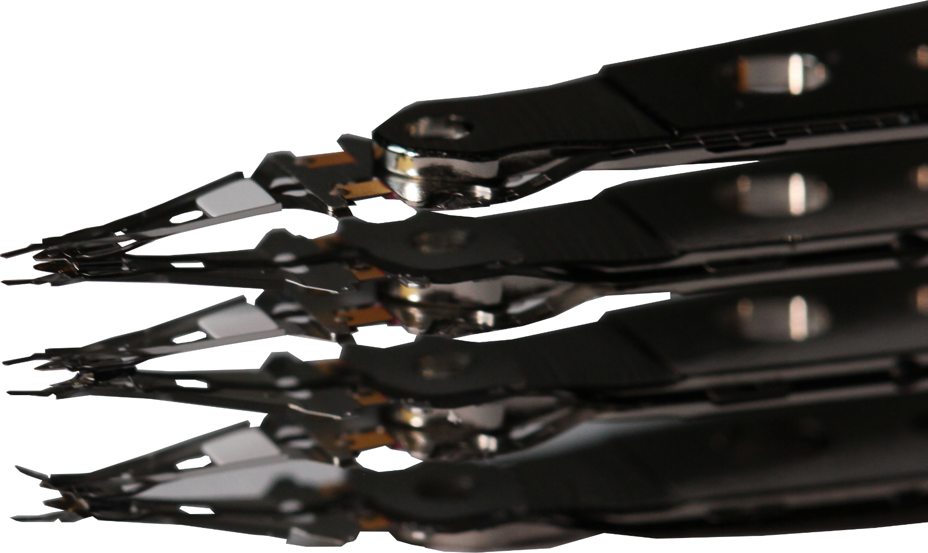
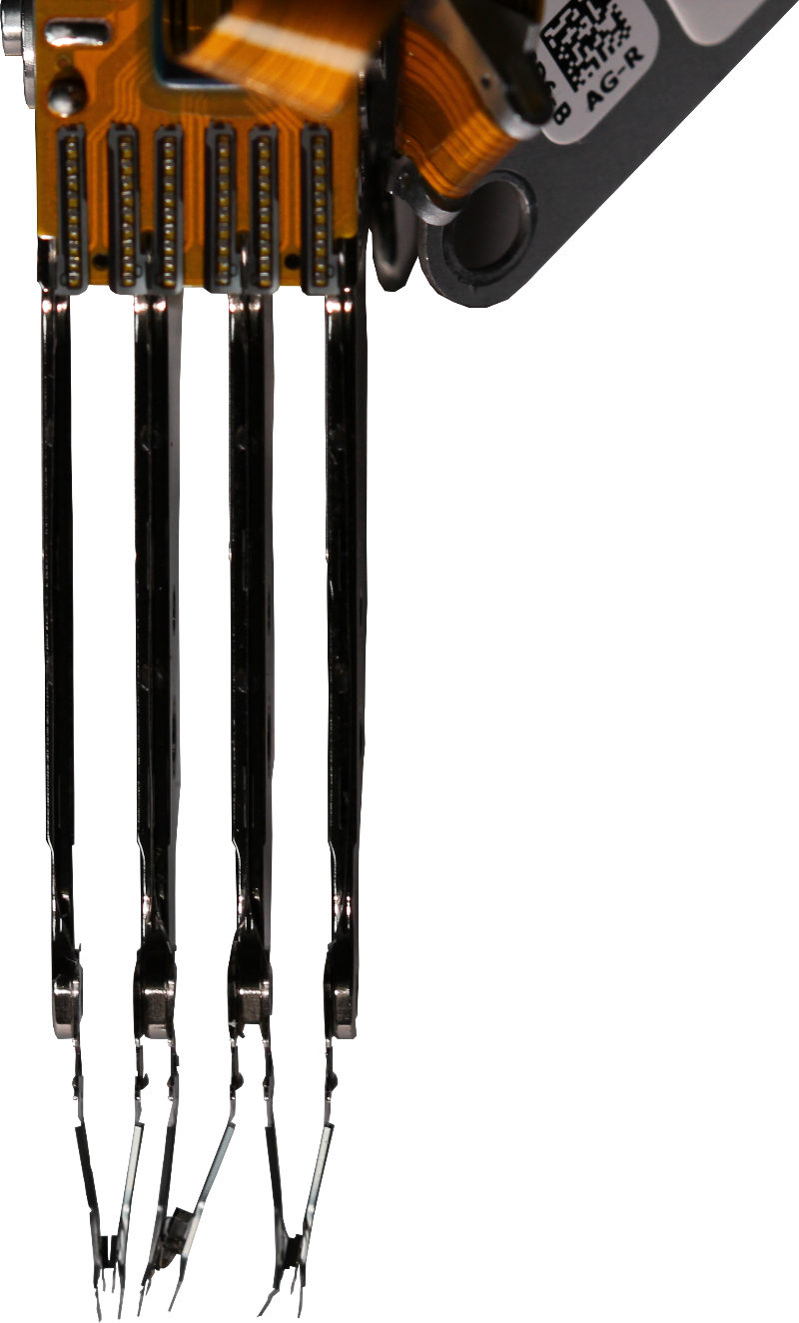
Hard Disk Heads
Head floats above platter
Air pushes head up
Suspension arm pushes head down
Constant height should be maintained
Suspension arm
Head
Slider
Air gap
Platter rotation
ITFreeTraining.com
© Copyright 2023
Notes:
11:01 The next part of the hard disk I will look at is the hard disk head. To understand how this works, consider that you have a hard disk platter that is spinning. The platter contains magnetic information. In order to read or write this information, you require a read or write head.
Generally, modern hard disks will have a read and write head on both sides of the platter so data can be stored on both sides.
Next to the head is what is called a slider. The slider helps direct the air as it goes through. Essentially, the air gap means the head floats above the platter. The air flow caused by the slider pushes the head up, and the suspension arm pushes the head down. The end result should be that a constant height above the platter is maintained.
The closer the head can get to the platter, the more information can be stored on the platter. With modern hard disks, the head may float above the platter as close as five micrometers. To give you an idea how small that gap is, a human hair is between about 17 and 189 micrometers. With that kind of clearance, you can understand why any dust, fingerprint or anything else on the platter can cause problems. Also remember that the platter is spinning very quickly and thus, anything big enough will strike the head with a lot of force and could potentially damage it. If the head is not damaged, the item may be pushed into the disk, damaging it. You can start to understand why these devices are so fragile if they are opened.
Now that we understand how data is accessed on the platter, let’s have a look at how it is stored.

Slide 8
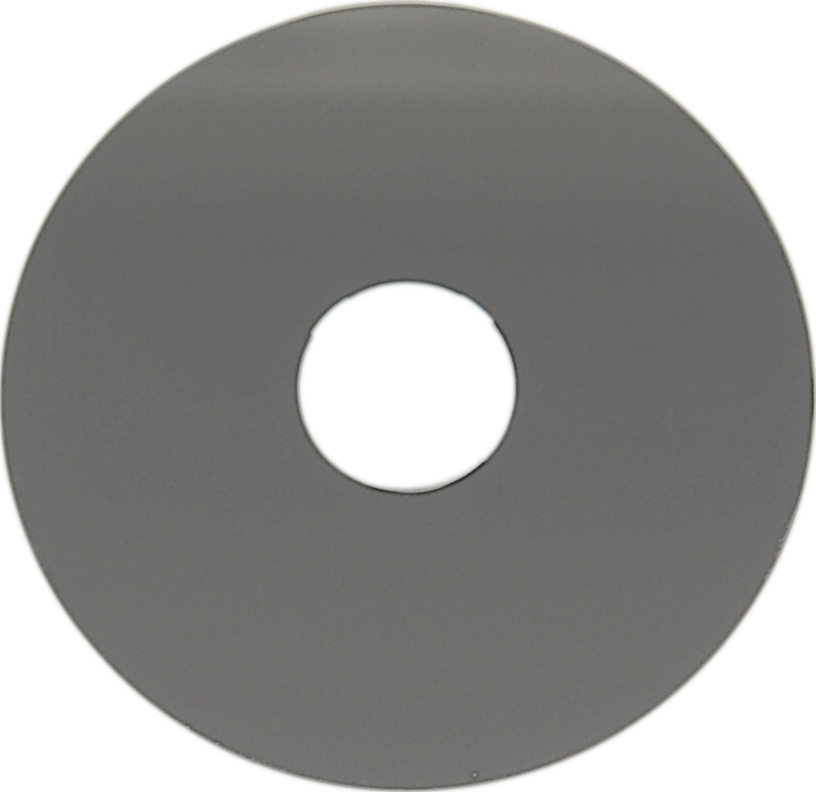
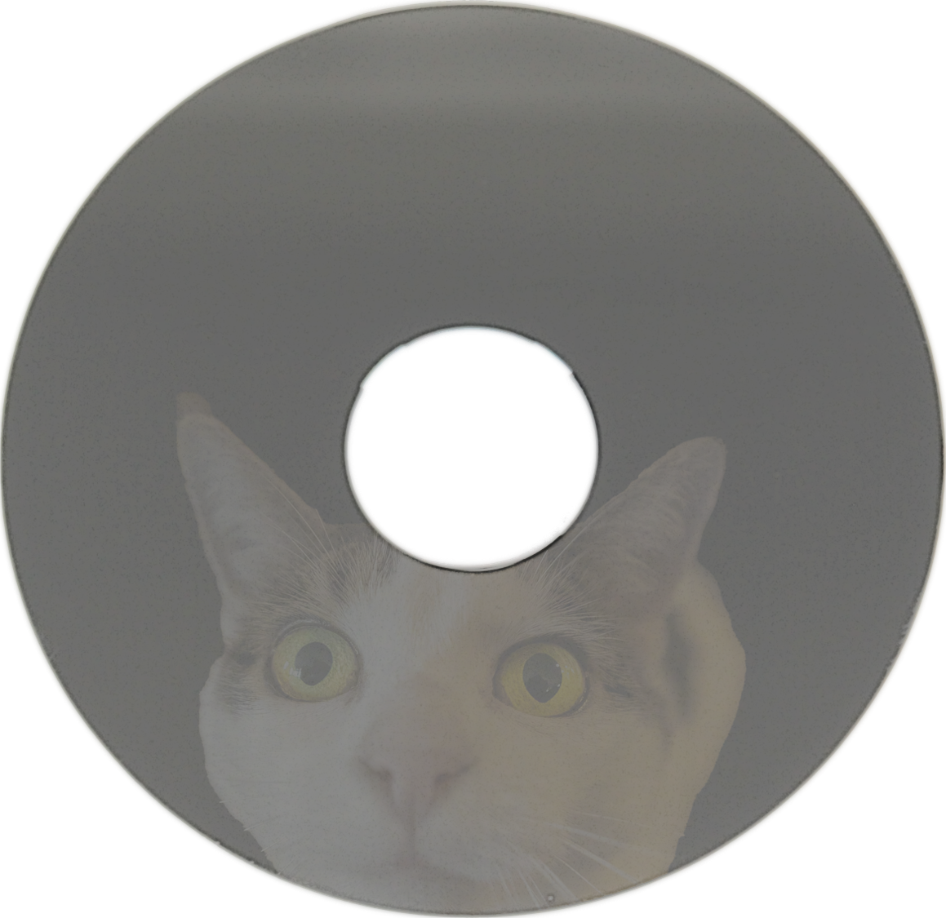
Platter
Circular disk to store magnetic data
Protective layer
Magnetic layer
Rigid layer
Magnetic layer
Protective layer
ITFreeTraining.com
© Copyright 2023
Notes:
12:44 The platter itself is a circular disk used to store magnetic data. These platters are very shiny like a mirror, so you will probably be able to see your face in it. The surface needs to be very smooth to prevent the head getting stuck or damaged as the platter spins around.
The platter itself is made of a number of different layers. The middle layer is a rigid layer. This rigid layer is pretty strong. You can see in the case of this platter I have attempted to break it; however, it has a strong metal layer in the middle. Some platters may be made of glass, so be careful if they break as you may get cut by glass fragments.
Due to the rigid middle of the disc, this is where the hard disk got its name. If you remember the old days of computing, you will recall the floppy disk. The material inside floppy disks could easily be bent and thus the name floppy disks. Hard disks could not bend like this, and therefore got the name hard disk.
In most cases the middle of the platter is a rigid layer and on top of this is a magnetic layer. This magnetic layer is what stores the data. Modern hard disks store data on both sides, thus the magnetic layer will be on both sides of the platter.
There are many different materials that are used for this layer. The layer itself may not be magnetic, but the important point is that it has the ability to change its structure when a magnetic field is applied to it. More on that in a moment.
On top of this layer is a protective layer. This layer protects the magnetic layer from wear and damage. In order to store the data, the head moves across the surface of the platter. If the head is reading, it simply needs to detect what magnetic field is in the platter. Modern hard disks will change the magnetic field in the material to facing either up or down to represent a one or zero. Old hard disks may change the field to left and right; however, as the amount of data on the platter increases, it becomes harder and harder to use this method to store data.
To make this even more complicated, as data increased on the platters, it was not possible to ensure that the area of the drive could be set to an up or a down field. Large capacity drives use a number of different tricks when reading the data to interpret what is read to work out if they are ones or zeros. Rest assured, the hard disk takes care of this for you, so you don’t need to worry about it. Next, I will have a look at how this data is laid out.

Slide 9
Sectors/Blocks
Old drives 512 bytes/Modern drives 4096 bytes
Modern drives support logical block addressing
Each sector given a block number
Sector (Header and data)
ITFreeTraining.com
© Copyright 2023
Notes:
15:17 The data on the platter is laid out in sectors. However, nowadays this is also often referred to as blocks. Both are technically correct, but there is one small difference I will talk about shortly. To understand how they work, consider a platter on the hard disk.
As the platter spins, the data is read or written on the platter. The data is laid out in what is referred to as a track. If you drew a circular line around the platter it would meet where it started. This track is divided into sectors. These sectors contain the base unit for data on the drive. In old hard disk drives, the sectors were 512 bytes; whereas in modern drives they are generally 4096 bytes or four kilobytes, commonly referred to as 4k.
The sector size is important because it is the smallest unit on the drive. So, if you attempted to save a file that was one byte in size on the hard disk, it would take up a whole sector. If you have a lot of small files, this can mean a lot of wasted space on the hard disk. Due to this previous hardware limitation, this is why the sector size was increased to 4096 bytes. The hardware limitation created a hard limit on certain specifications of the hard disk. Due to the hardware limit, having a smaller sector size limited the maximum size the hard disk could be. In order to increase the maximum space on the hard disk, the sector size had to increase because everything else had reached its limit.
You will be happy to know that nowadays we don’t need to worry about this. Modern hard drives support what is called logical block addressing. Essentially, each sector on the hard disk is given a number. The operating system simply requests the block with that number when it wants to read or write to it. Thus, you can see the difference between sectors and blocks. Sectors are the physical locations on the platter. A block is a number that is assigned to that sector. The advantage is, if the sector fails, the hard disk can allocate that block to a reserve sector. All hard disks will have a small number of reserve sectors to replace failed sectors on the platter. So, you can see the big differences between sectors and blocks is that sectors are physical and don’t change. Blocks are logical, referring to a sector on the hard disk and can thus change.
If you remember the old days of having clusters, cylinders and the like, don’t worry, you don’t need to worry about that anymore. Nowadays, data is accessed by using the block number and the operating system does not need to worry about how the data is laid out on the hard disk.
Each sector has header and data information. It is up to the manufacturer of the hard disk to decide what data is stored in the header. Generally, it will contain information that will allow the hard disk to determine which sector it is. It may also contain additional data, such as if the sector is bad and can’t be used. When this is the case, the sector may be marked as bad or it may have an address of an alternative sector that it can use.
You may be thinking, there is more surface area as we go out from the center, so does this mean there is more room for sectors? The answer is yes, there is. As we go further away from the center, more sectors can be fitted in, but we don’t need to worry about that. Why? Because logical block addressing takes care of that for us on modern drives. All we need to do is provide the block number and the drive will work out where it is.
You can see that in modern drives there is not much we need to worry about. Since blocks are essentially a number assigned to a sector, you may see the terms used interchangeably. You will generally find that newer software, unless accessing the physical sector, will refer to the data by blocks rather than sectors.

Slide 10
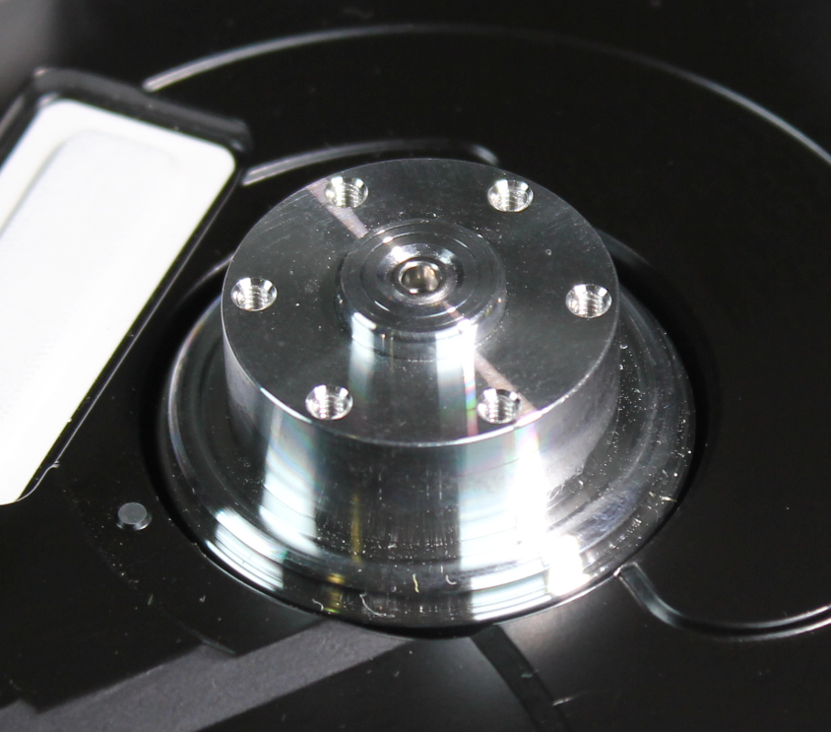
Spindle
Spins the platter at fixed speed
5400
RPM
5900
RPM
7200
RPM
10,000 (10k)
RPM
15,000 (15k)
RPM
Slower transfer speed
Faster transfer speed
Mobile/Desktop
Enterprise
Larger capacity/longer life
Less heat/quieter
Lower capacity/shorter life
More heat/noisy
ITFreeTraining.com
© Copyright 2023
Notes:
19:30 The next part of the hard disk that I will look at is the spindle. The spindle is essentially a motor in the hard disk that keeps the platters spinning at a fixed speed. In the case of devices such as optical drives it is possible for the spindle to increase or decrease its speed. For example, it may change it speed depending on if it is accessing the middle of the disk or the outside of the disk. In the case of hard disks this is not the case. The hard disk head moves very quickly across the platters as we have seen; it moves so fast it is not possible for the spindle to adjust its speed quick enough. For this reason, the speed is always constant.
Hard disks come in a number of different speeds, expressed as revolutions per minute or RPM. Nowadays, 7200 RPM are the more commonly sold hard disks on the market. There are some disadvantages and advantages to hard disks depending on their speed.
The advantage of faster hard disks is that they are, well faster. The faster the hard disk spins the quicker it can read the information on the drive and, thus, the faster it can transfer data. There are however some disadvantages.
Since the platters are spinning faster it means it requires more space on the platter to store a one or a zero. For this reason, slower spinning hard disks can have a larger capacity. A faster spinning drive also creates more heat and noise; for this reason, faster spinning drives have a shorter lifespan. It is estimated that a high-speed hard disk will fail two years sooner on average than a low-speed one.
You will generally find that slower speed hard disks will be used in mobile and desktop computers. The faster hard disks will be used in enterprise environments like server rooms. There were some consumer high-speed hard disks on the market years ago, but they don’t seem to be available nowadays. I would suspect that, with the increase in speed of solid-state drives, the home consumer is purchasing those rather than high-speed hard disks and thus there is no longer a market for the home user. However, they are still available for enterprise use. Due to the decreased capacity of high-speed drives, they are generally used in server rooms for applications that require a lot of data at high speed. For example, the log files used in a database server. The log files are written to constantly and get quite big, so they are good candidates for fast hard disks. The rest of the database is generally stored on slower hard disks to keep the price down.

Slide 11
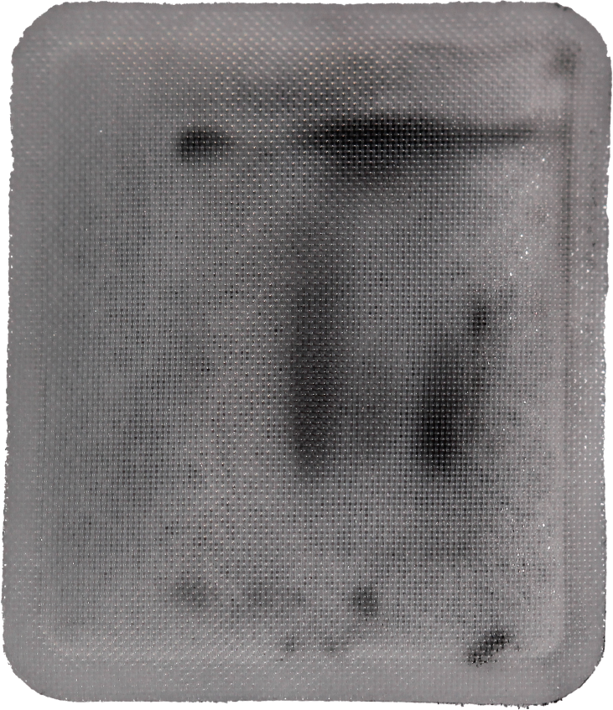
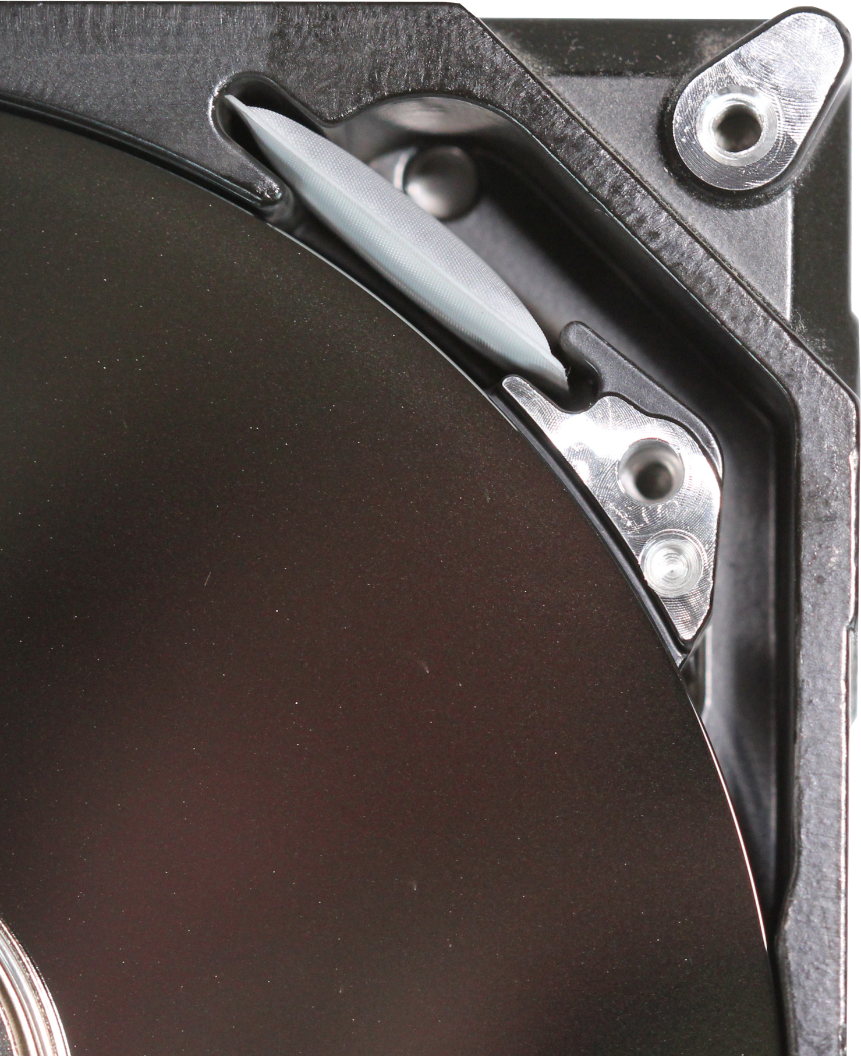
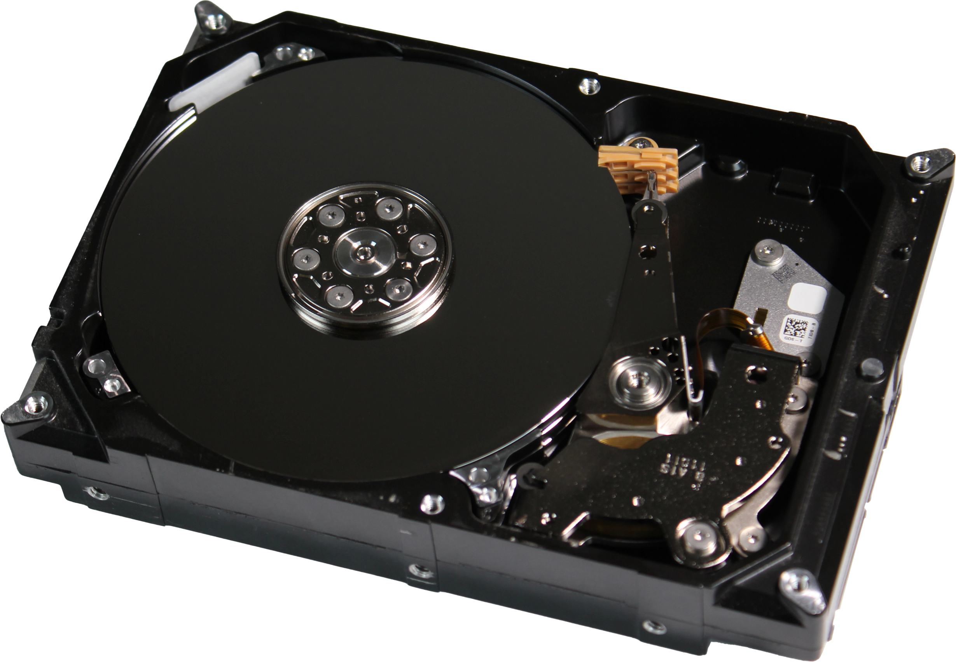
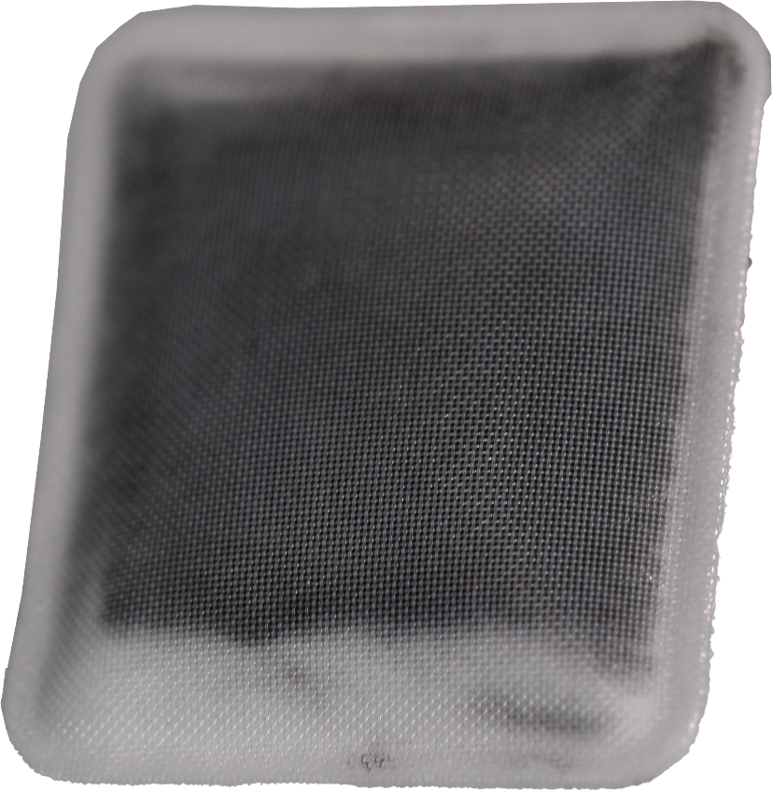
Air Filters
A filter that collects dust and dirt
Facing disk
Air flow
Facing away
ITFreeTraining.com
© Copyright 2023
Notes:
22:14 The next part of the hard disk I will look at is the air filt er. There is not too much to this. Simply put, it is a filter that collects dust and dirt. The air filter is located at the front of the drive. There will be a small duct near the platter that the air will flow through and then recirculate back to the platter. When the platters are spinning, this is enough to generate enough pressure to force the air through the duct and the filter.
This hard disk is pretty old, so you will notice that a lot of dirt has accumulated in the air filter. Even if the hard disk is old, do not attempt to replace the filter. Unless the hard disk is opened in a clean room, you will introduce more dust and dirt into the drive then if you left it unopened.
This completes our look at how the different parts of the hard disk work. The last specification that I will look at is the physical size of the hard disk.

Slide 12
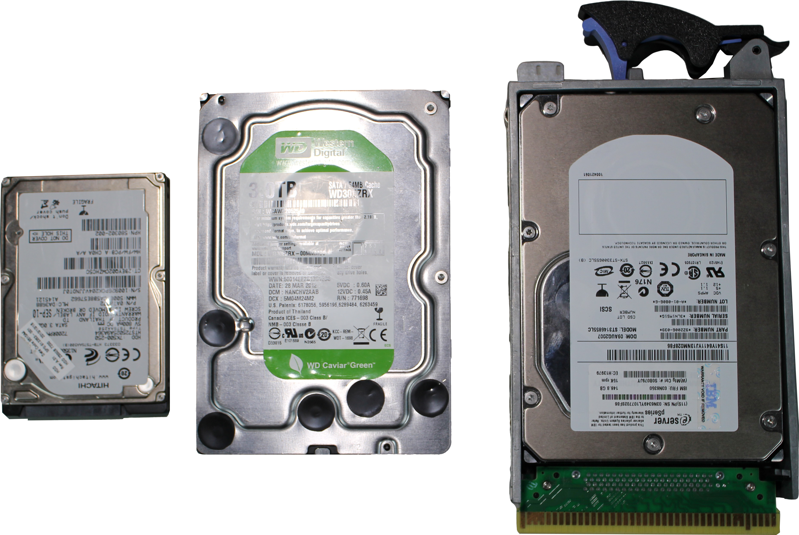
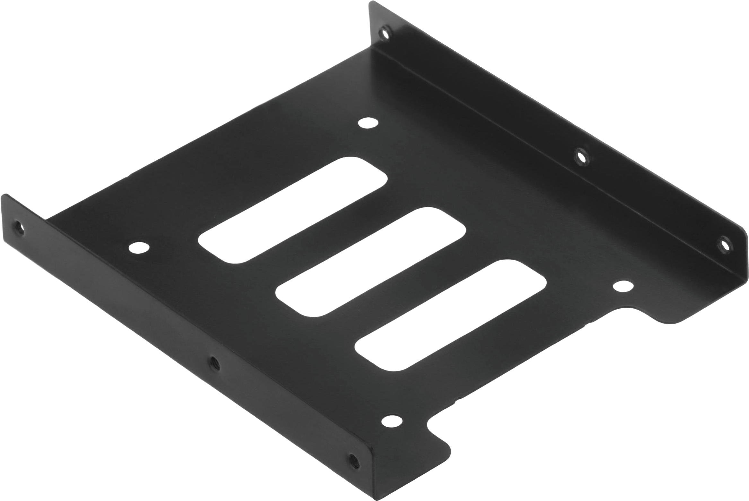
Hard Disk Form Factors
2.5/3.5-inch form factors most commonly used
2.5-inch
3.5-inch
2.5 to 3.5 adapter bracket
3.5-inch
drive in adapter
ITFreeTraining.com
© Copyright 2023
Notes:
23:14 Hard disks nowadays generally come in two form factors, the 2 and a ½ inch and 3 and a ½ inch form factors. It would be pretty hard to find one that did not. Here is an example of three different hard disks. The one on the left is a 2.5-inch hard disk. These are commonly found in laptops. Due to the reduced size, a lot of these hard disks run at 5400 RPM and capacity is not as high as the larger hard disks.
The next hard disk is the 3.5-inch hard disk. This one is generally the one that will be used in desktop computers. You will notice that the last hard disk looks bigger, however it is essentially a 3.5-inch hard disk in an adapter. Drives like these are generally used in servers and data centers. The adapter allows the hard disk to easily be pulled out and removed. When you see hard disks like these, remember they are probably 3.5-inch drives with just an adapter. Once you remove the adapter, they are the same size as other 3.5-inch drives.
In some cases, you may find that you will need to install a 2.5-inch hard disk but only have room to install a 3.5-inch hard disk. When this occurs, you can purchase a bracket. A bracket will allow you to mount a smaller 2.5-inch hard disk into the bracket. The bracket can then be installed in a 3.5-inch bay containing the 2.5-inch hard disk. Doing this ensures the drive is mounted correctly when you do not have any 2.5-inch bays left. Mounting the hard disk correctly ensures that it will not come loose or be damaged, particularly if the computer is moved.

Slide 13
Subscribe
Next video
Video content: https://ITFreeTraining.com/ap/3b10
© Copyright 2023
Notes:
25:00 That concludes this video on the basics of hard disk design and how they operate. I hope you have found this video useful and I look forward to seeing you in more videos from us. Until the next video, I would like to thank you for watching.
References
“The Official CompTIA A+ Core Study Guide (Exam 220-1001)” Chapter 6 Position 91 - 102
“CompTIA A+ Certification exam guide. Tenth edition” Pages 289 – 292
“Hard disk drive” https://en.wikipedia.org/wiki/Hard_disk_drive
“Hard disk drive platter” https://en.wikipedia.org/wiki/Hard_disk_drive_platter
“Picture: IBM Harddisk” https://commons.wikimedia.org/wiki/File:5.25_inch_MFM_hard_disk_drive.JPG
“Picture: Inside Hard disk” https://commons.wikimedia.org/wiki/File:Laptop-hard-drive-exposed.jpg
“Picture” https://unsplash.com/photos/9zbTchzxGqM
“Video: Cat looking around” https://pixabay.com/videos/cat-head-game-black-eyes-closeup-4915/
“Logical block addressing” https://en.wikipedia.org/wiki/Logical_block_addressing
“Hard disk drive performance characteristics” https://en.wikipedia.org/wiki/Hard_disk_drive_performance_characteristics
Credits
Trainer: Austin Mason http://ITFreeTraining.com
Voice Talent: HP Lewis http://hplewis.com
Quality Assurance: Brett Batson http://www.pbb-proofreading.uk

